Slide 1
Synthesis of the simulation and monitoring processes
for the data storage and big data processing development in physical experiments
Authors: Korenkov V., Nechaevskiy A., Ososkov G., Pryahina D., Trofimov V., Uzhinskiy A.
Joint Institute for Nuclear Research
Supported by RFBR
Dubna, 2014
Notes:
1

Slide 2
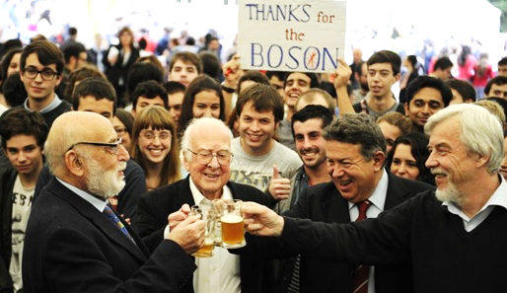
The LHC Computing Challenge
The Large Hadron Collider (LHC) delivered in Run 1 (2010-2012) billions of recorded collisions to the experiments
~ 100 PB of data stored at CERN on tape
The Worldwide LHC Computing Grid (WLCG) provides compute and storage resources for data processing, simulation and analysis in > 200 Tier1 and tier 2 centers
~ 300k cores, ~200 PB disk, ~200 PB tape
The computing challenge resulted in a great success
Unprecedented data volume analyzed in record time delivering great scientific results (e.g. Higgs boson discovery)
2

Slide 3
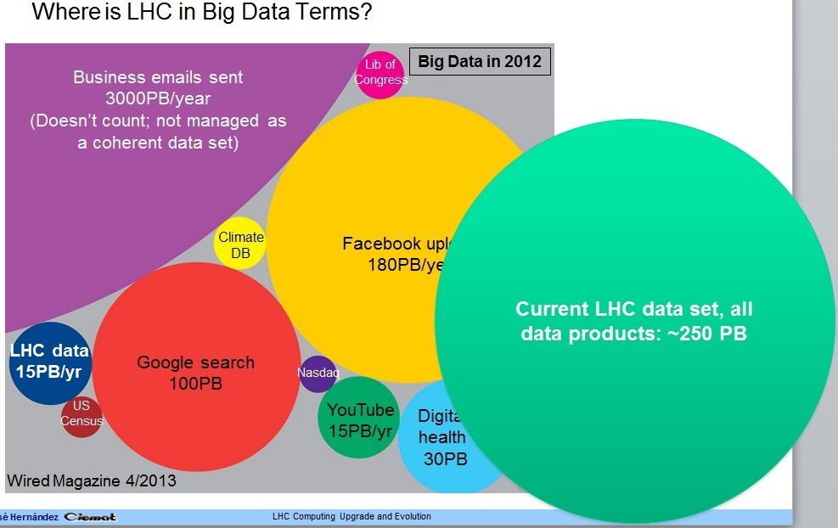
LHC computing challenges for Run2
Considerable LHC renovation is going on now to start Run 2 in 2015 when
the event reconstruction time will be doubled while the event rate to storage is expected to be 2.5 times faster.
We are coming
to the Big Data era!
It is needed for potentially new physics, but faces with great challenges in LHC computing:
large increase of CPU and WLCG resources;
combined grid and cloud access;
distributed parallel computing;
overhaul most of simulation and analysis software codes.
We are BIG!
Such a fast evolution of LHC distributed computing demands the careful dynamical simulations of all processes for data storage, transfer and analysis
3

Slide 4
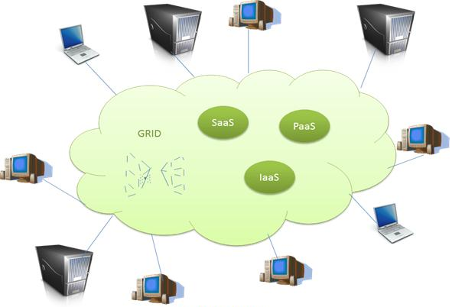
Grid and Cloud
(see N.Kutovsky PhD thesis)
Question:
How to predict the system behavior after some of modifications?
Solution:
Make continuous simulation process.
Use the statistics accumulated during operation as an additional input parameter to improve accuracy of results.
Notes:
4

Slide 5
What is simulation for?
Identification of system “weak points” (channels, queues, network capacity and other "bottlenecks");
Simulation of the different system configuration (grid infrastructure architecture, resources configuration, number of resource centers, etc);
Approbation of new algorithms of data access and replication strategies;
Simulation allows:
Optimize equipment needed for data
transfers and storage taking into account minimum cost and other project requirements;
Optimize resource distribution between
users groups;
Test the system functioning to define its "bottlenecks" and many other weak points.
etc .
Predict Grid system performance under various changes:
– Different workloads
– System configuration
– Different scheduling heuristics
Predict and prevent a number of unexpected situations;
Notes:
5

Slide 6
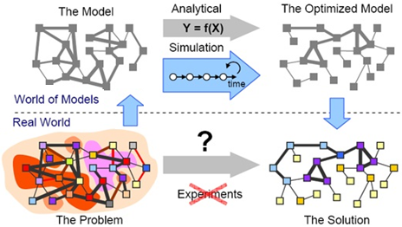
Analytical or imitative Simulations
Analytical approaches to grid and cloud systems simulation:
system is considered as a multi-channel queuing system with state controlled by
Markov process;
system is considered as a dynamic stochastic network, described by the system
of equations that allow to consider both routing and resource allocation in a network.
Both approaches give the simulation result in the form of asymptotic distributions,
and because of the limited theoretical assumptions can not be applied to specific
modeling of complex multi-tier architecture of computer networks with real
distributions of the input streams of tasks, difficult multipriority discipline their service and dynamic resource allocation.
We propse to use imitative simulations.
Notes:
6

Slide 7
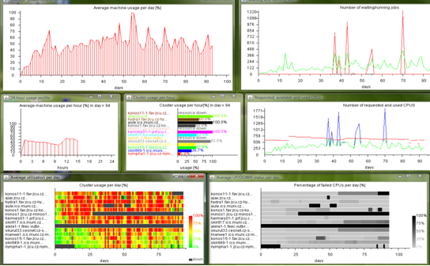
Simulation Toolkits
GridSim
Allows to simulate various classes of heterogeneous resources, users, applications and brokers
There are no restrictions on jobs number which can be sent on a resource;
System supports simulation of statistical and dynamic schedulers;
Statistics of all or the chosen
operations can be registered
Implemented in Java
Configuration files are used to set simulation’s parameters
Source code is available
Multilevel architecture allows to
add new components easily
Alea
Based on the latest GridSim
Visualization output
Include shedulers
Supports single CPU and multi CPU jobs
Intended for study of advanced scheduling techniques in Grid environment
It is a job scheduling simulator! It couldn't simulate data transfers!
Notes:
7

Slide 8
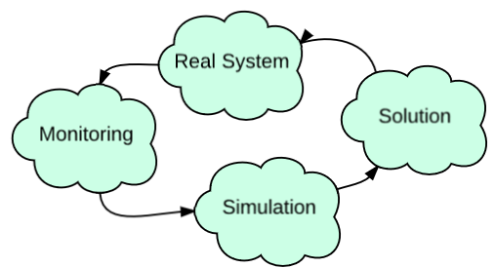
Challenge
Continuous development of Grid systems requires continuous adjustments of simulation parameters.
It is necessary to predict the behavior of the system with significant changes.
It’s possible to use exploitation system statistics obtained from the monitoring tools.
Tasks:
1. Providing matches the source data for the simulation with the real one;
2. Simulation validation - the simulation produced the correct results and does not differ from the behavior of the real system.
Approach:
Simulation of the existing computational systems:
input data is a system statistics from the monitoring and accounting tools (http://dashb-wlcg-transfers.cern.ch/ui/, http://dashb-atlas-task-prod.cern.ch/templates/task-prod, http://panda.cern.ch:25880/server/pandamon/query);
simulation results should match within the error limits with the results of monitoring for the same tasks.
2. Simulation of the new computational systems:
hypothesis about the input data flow parameters and procedures of it processing;
analysis of event time distribution that are generated by the input data flow processing;
distributions are compared with the results obtained from the monitoring of the existing system;
Notes:
Система мониторинга и учета ресурсов (СМУР) предназначена для отслеживания текущего состояния ресурсов, заданий и других объектов в грид-системе. Инструментарий СМУР должен предоставлять как статическую, так и динамическую информацию о функционировании грид-системы (примером динамической информации может служить состояние очередей на вычислительном кластере), а также результаты статистического анализа этой информации.
8

Slide 9
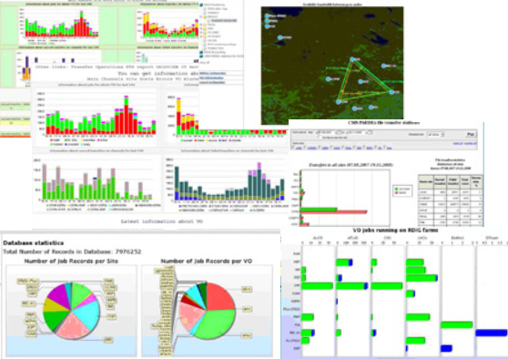
Monitoring system
Set of hardware and software for the analysis and control of a distributed computing system.
Monitoring main tasks:
Continuous monitoring of the grid services, both basic (common to the entire infrastructure) and related to individual resource centers;
Obtaining information about the computing resources (number of compute nodes to perform the tasks, the architecture of a computer system, installed software, specialized software packages available) and CPU consumption;
Data on access to the resources of virtual organizations and their use of quotas for computing resources;
Monitoring of the computational jobs and tasks implementation of and tasks (start, status changes, exit codes, etc.).
Monitoring parameters required for simulation:
1. number of tasks (simulation, analysis, reconstruction) coming into the system;
2. RAM is used;
3. CPU time used;
4. number of processed events;
5. Job execution time; 6. amount of data used.
Notes:
Система мониторинга и учета ресурсов (СМУР) предназначена для отслеживания текущего состояния ресурсов, заданий и других объектов в грид-системе. Инструментарий СМУР должен предоставлять как статическую, так и динамическую информацию о функционировании грид-системы (примером динамической информации может служить состояние очередей на вычислительном кластере), а также результаты статистического анализа этой информации.
9

Slide 10
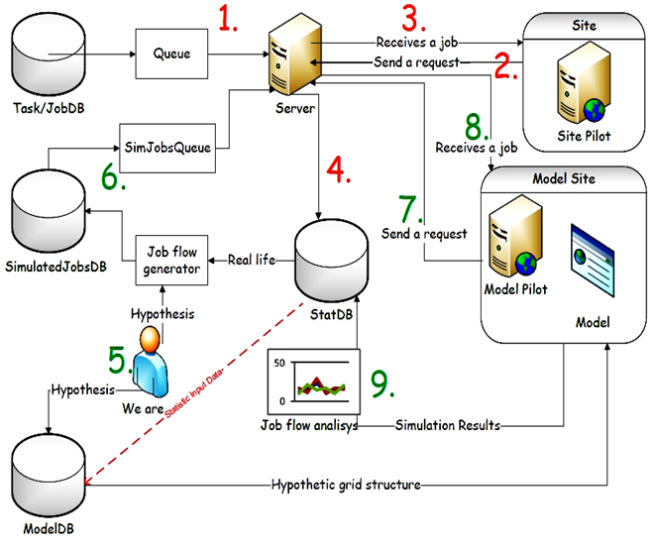
Synthesis of monitoring and simulation (SyMSim) scheme
Real Grid
1. Submit jobs to the server
2. Jobs request
3. Submit jobs for execution
4. Write statistic to DB
Simulation
5. Simulation based on
actual monitoring data,
generating input data for
the simulation
6. Jobs flow imitation
7. Jobs request
8. Submit jobs for execution
9. Simulation result analysis,
write statistic information.
Notes:
В настоящее время процессы моделирования и мониторинга рассматриваются, как две независимые задачи, не связанные между собой. Для успешного развития системы необходимо сделать процесс моделирования непрерывным, а чтобы повысить точность получаемых результатов, в качестве входных данных использовать статистику, накопленную во время работы.
В настоящее время методика создания систем интегрирующих две задачи – моделирование и мониторинг в рамках одного процесса не разработана. Инструментов, обеспечивающих такое объединение нет.
Таким образом, существует задача объединения процессов моделирования системы и ее оперативного мониторинга. Модель должна рассматриваться как неотъемлемая часть системы обработки данных, а данные мониторинга, как входные для моделирования. В результате работы модели будет получена информация о необходимых ресурсах для создания реальной системы, о параметрах процессов накопления, обработки и передачи данных. Также станет возможным спрогнозировать поведение системы в различных ситуациях при значительных изменениях. Для этого должна быть разработана методология и программные средства для синтеза процессов моделирования и мониторинга.
Данные мониторинга реальной грид-системы поступают в базу данных следующим образом: задание отправляется на сервер (1), далее сайт-пилот запрашивает задание на обработку (2), сервер отправляет задание на исполнение (3), информация о выполнении задания поступает в базу данных StatDB (4). На основе данных мониторинга пользователь задает входные параметра модели (5) и потока заданий (6), далее модель обрабатывает задания (7,8). Результаты работы модели доступны пользователю для дальнейшего анализа.
При разработке программы СиММод удалось расширить ее сферу применения на ставшие весьма актуальными в последнее время системы облачных вычислений.
10

Slide 11
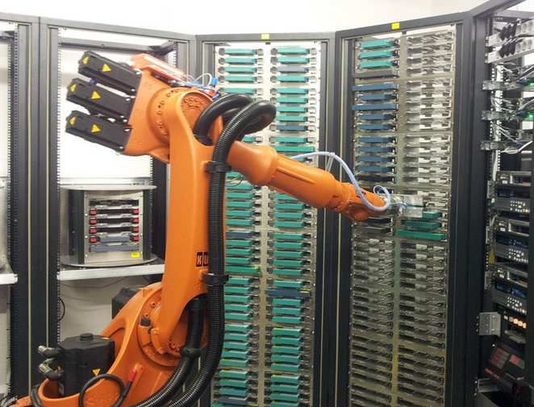
Problem statement
Baseline:
Under study structure composition:
tape robot,
Disk array,
CPU Cluster.
Cost:
1 drive - 5 conventional units,
1 CPU - 3 conventional units.
Outcome criteria:
Test flow of 99 jobs passage time.
Aim
Find the optimal ratio of the number of processors and the number of drives on a limited budget of 1000 units.

Slide 12
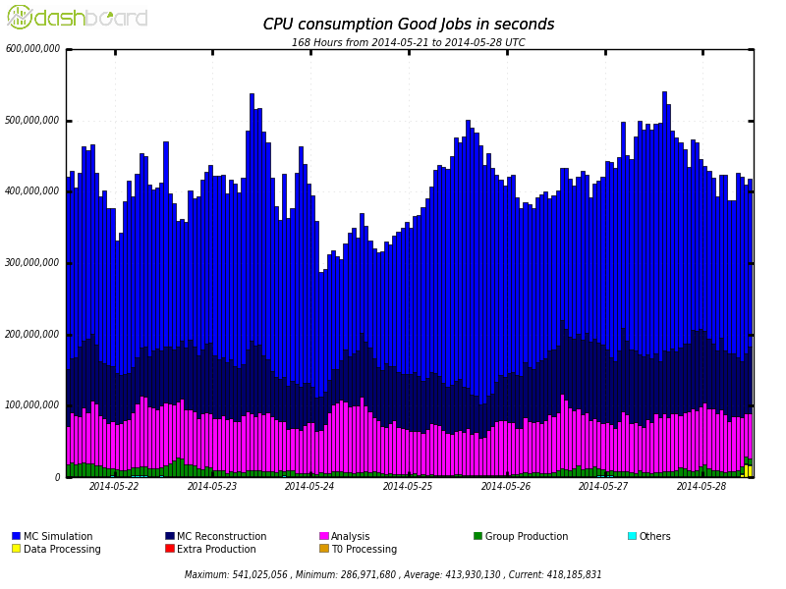
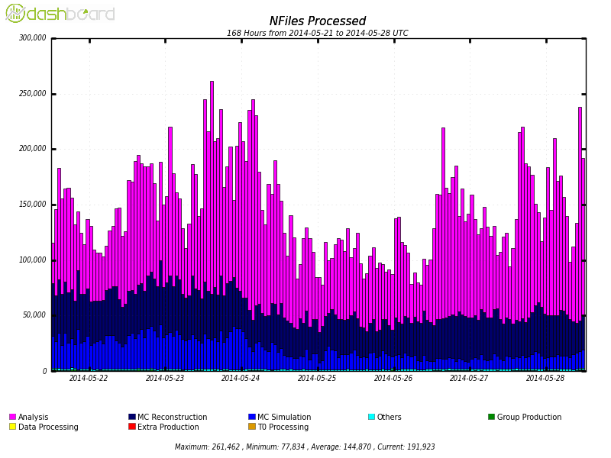
Jobs flow analysis (ATLAS)
а) Simulation (Intensive use of CPU)
b) Reconstruction (memory-intensive)
c) Analysis (intensive data replication, loading of communication channels).
Approximate ratio of different job types:
CPU consumption
Number of processed files
Our job flow generator produces 3 types of jobs with parameters (number of events,
CPU time, RAM, etc) closed to Atlas one.

Slide 13
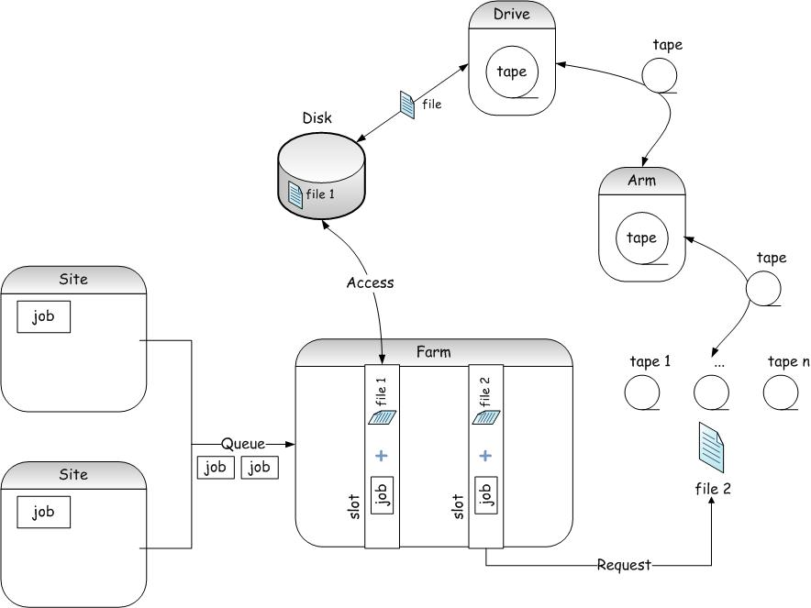
Jobs flow scheme
If slot and file are available Job is executed;
If file stored in tape library Job reserved slot but waiting for necessary file to the disk;
From tape to disk: tape cartridge move to the drive, cartridge's file system mounting to the drive, file is copied to the disk.
Notes:
13

Slide 14
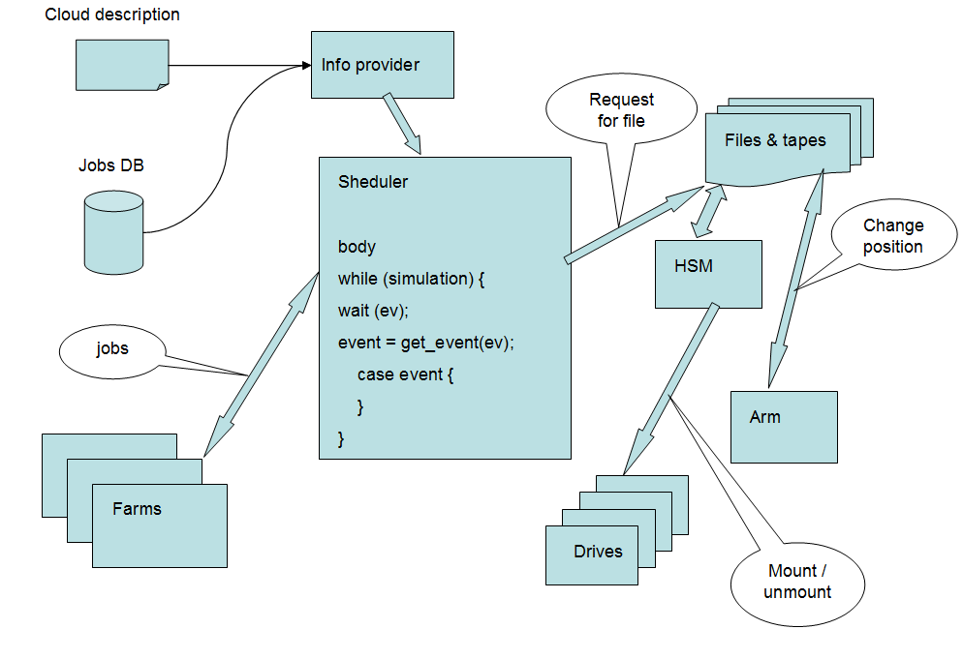
Interaction model components
JobFlow
Generator
A set of these classes allows one to simulate all the processes occurring with a file copy on tapes: load and unload of tape by manipulator, assembling on drive, search for a file on the tape and its reading/writing.
Notes:
14

Slide 15
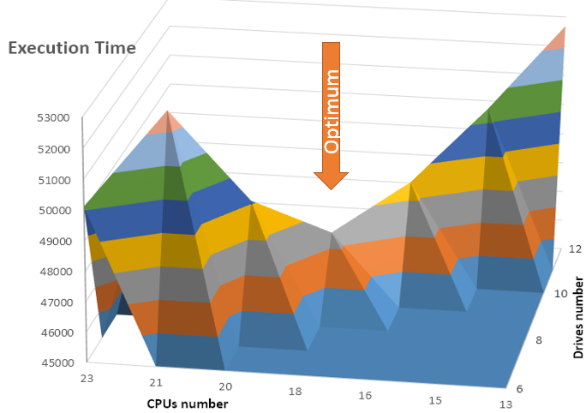
Simulation results
Set of tasks execution time depending on the CPU number and drives.
Configuration provides the minimum execution time: 18 CPUs, 9 drives

Slide 16
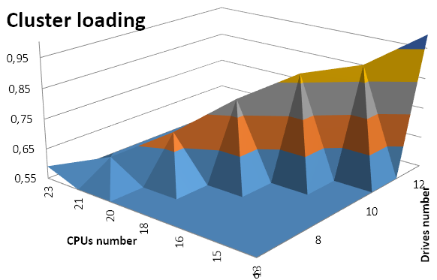
Result analysis
Determination of the cluster loading degree.
Cluster loading W = T100/Tа
T100 – CPU runtime package
Ta –astronomical
runtime package
Loading falls with a large number of CPUs. They idle waiting mount tapes with data on drives. Consequently, it is necessary to choose the optimal ratio of the number of processors and drives.

Slide 17
Conclusion
The proposed approach to simulation and analysis of computational structures is universal.
It can also be used to solve design problems and the subsequent development of data repositories, not limited to the physical experiments area.
Notes:
17

Slide 18
Thank you!
SyMSim@jinr.ru
Notes:
18

