Slide 1
Investigations of polystyrene-fullerene nanocomposite thin films by neutron and X-ray reflectometry
M.L. Karpets, T.V. Tropin, Ye. Kosiachkin,
Yu.E. Gorshkova, I.V. Gapon, M.V. Avdeev, L.A. Bulavin
Frank Laboratory of Neutron Physics, Joint Institute for Nuclear Research, Dubna, Russia
Physics Department, Taras Shevchenko National University of Kyiv,
Kyiv, Ukraine
20th September, JINR, Dubna, 2019

Slide 2

Composite materials
Addition of carbon black to rubber to reinforce automobile tires
Notes:
Nearly a hundred years ago

Slide 3
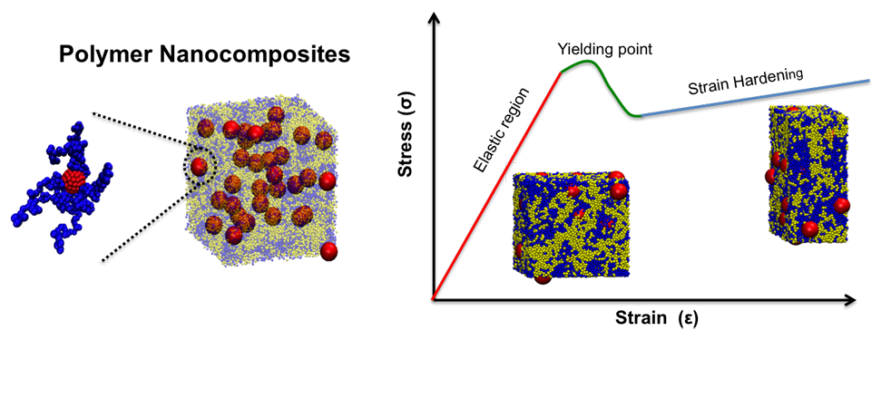
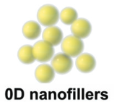
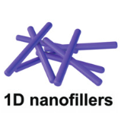
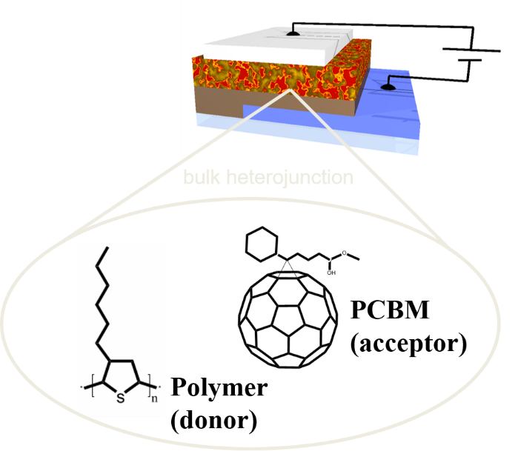
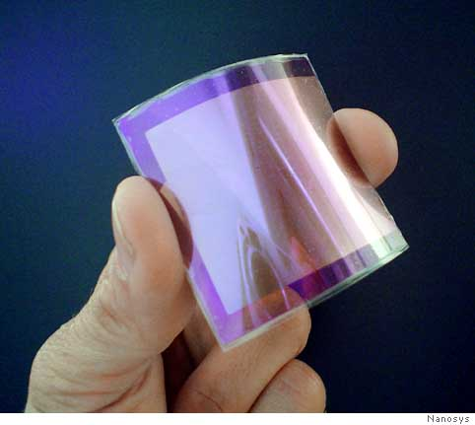

Polymer nanocomposites
Polymer nanocomposites
Particles added – in the nano range 1-100 nm!
High surface area!
Addition of nanoparticles is used to improve useful properties of the material!
Notes:
Low amount of nanoparticles added – substantial improvement of material properties.

Slide 4
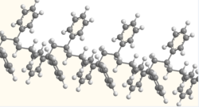
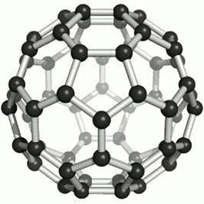
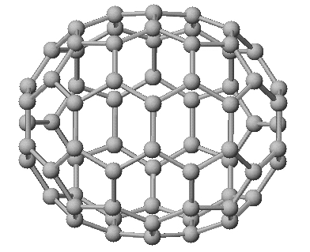
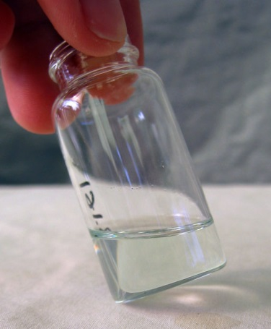
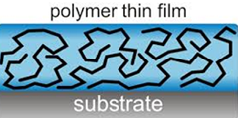
Fullerene/PS nanocomposite thin films
Polystyrene
Fullerene C₆₀
Fullerene C₇₀
7.1 Å
7.1 Å
7.1 Å
8.0 Å
A model system of polymer nanocomposites
1-100 nm
Addition of nanoparticles to polymer ﬁlms can retard and even eliminate dewetting!
Structural organization of nanoparticles in the film is important.
Yaklin, M.А., Duxbury, P. M., Mackay, M.E. // Soft Matter, 4(12), 2441 2008. https://doi.org/10.1039/b807565d
Notes:
In all cases, their ability to inhibit dewetting is dependent upon their location in the film as well as their interaction with the polymer.

Slide 5
Neutron and X-rays reflectometry measurements
investigation of structural properties
What is the structural organization of nanoparticles in polymer matrix?
Notes:
indispensible

Slide 6
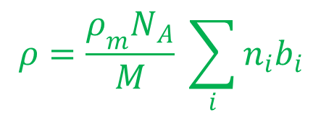
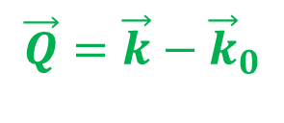
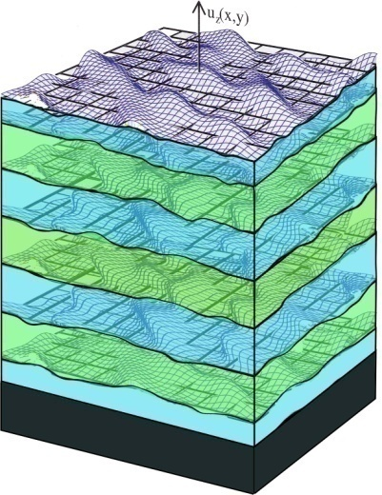
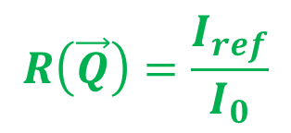
Neutron reflectometry
z
Scattering length density (SLD) for neutrons
x
q_{z}
y
k
reflected
beam
incident
beam
k₀
k₀
transmitted
beam
Notes:
Neutron reflectometry is a neutron diffraction technique for measuring the structure of thin films.
The technique involves shining a highly collimated beam of neutrons onto an extremely flat surface and measuring the intensity of reflected radiation as a function of angle or neutron wavelength. The exact shape of the reflectivity profile provides detailed information about the structure of the surface, including the thickness, density, and roughness of any thin films layered on the substrate.
The reflection is usually described in terms of a momentum transfer vector, denoted q_{z} , which describes the change in momentum of a neutron after reflecting from the material. Conventionally the z {\displaystyle z} direction is defined to be the direction normal to the surface, and for specular reflection, the scattering vector has only a z {\displaystyle z} -component.

Slide 7
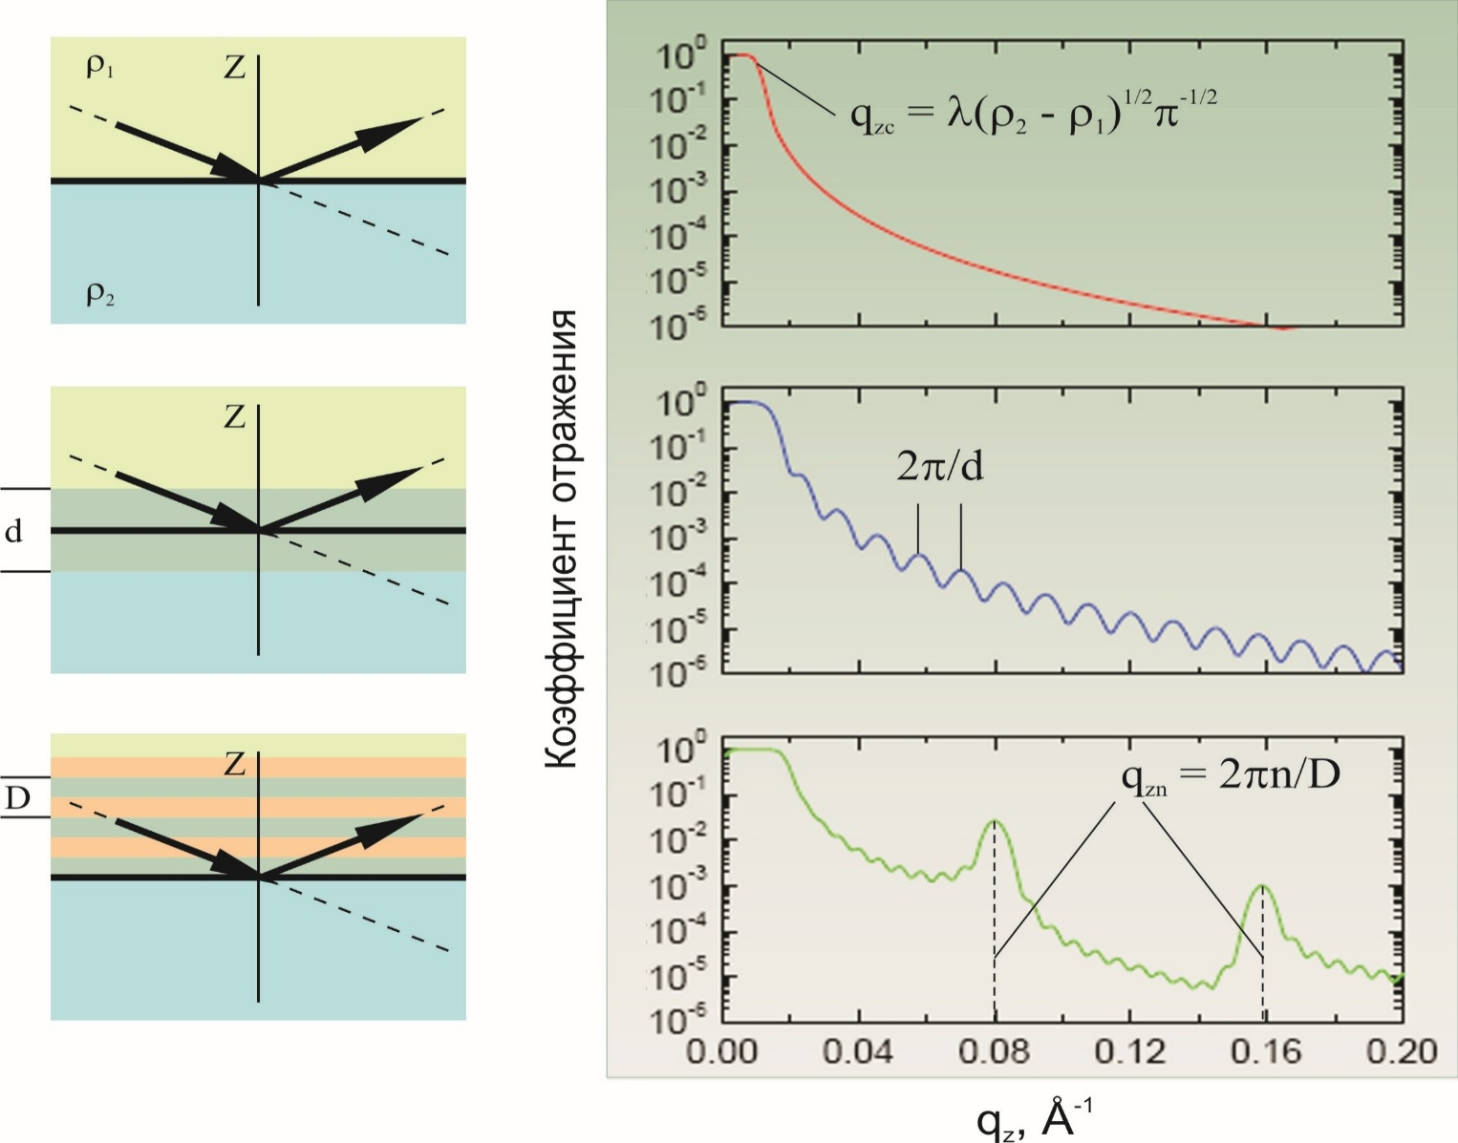
Specular reflection: obtained information
two semi-infinite mediums
Fresnel law
~q⁻⁴
Reflectivity
one layer
periodic multilayers
Reflected intensity -> Reflectivity -> depth scattering length density (SLD) profile
Notes:
Neutron reflectometry is a specular reflection technique, where the angle of the incident beam is equal to the angle of the reflected beam.

Slide 8
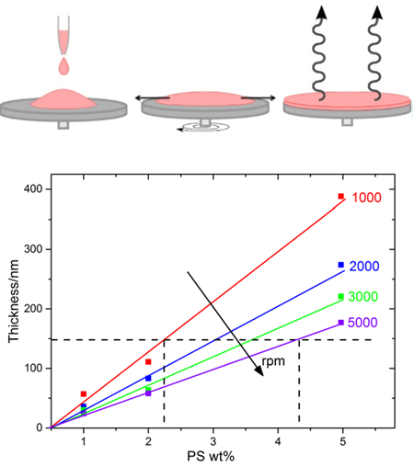





Samples preparation
Spin coating
Aggregation in solutions
Phase diagram

Slide 9
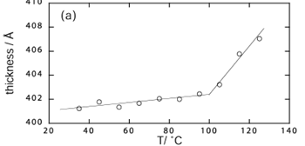
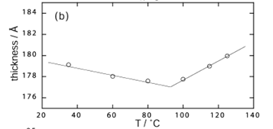
Pilot measurements @ GRAINS instrument
Measurements of PS film thickness for T=15-120°C.
Measurements at T=120⁰C
PS Sample preparation procedure tested;
First measurements in high temperature range.

Slide 10
Can we distinguish between different structures of low-concentrated C₇₀/PS nanocomposite thin films?

Slide 11
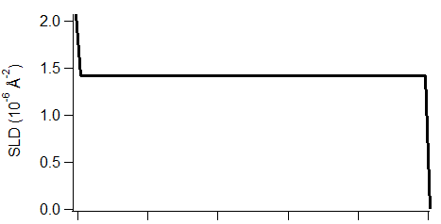

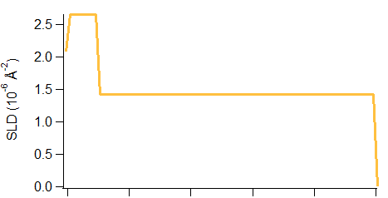
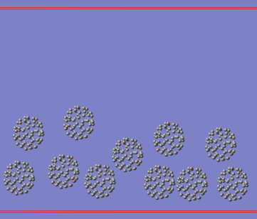
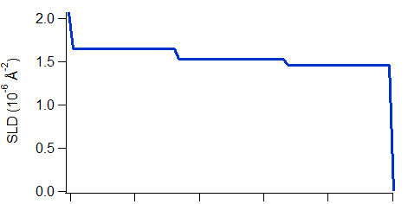
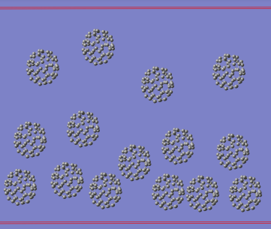
Models of structural organization
Pure PS
h
Substrate layer
h
Gradient from
substrate
h

Slide 12
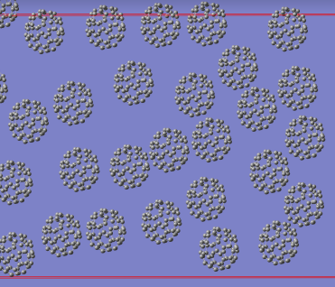
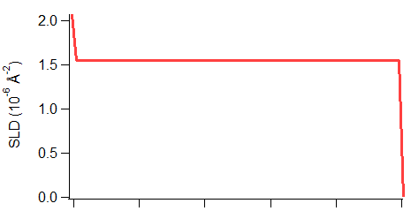
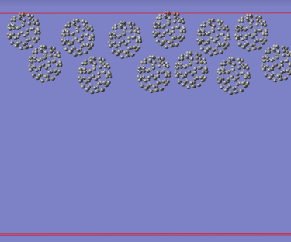
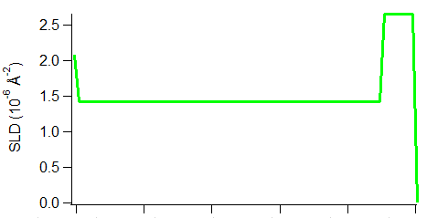
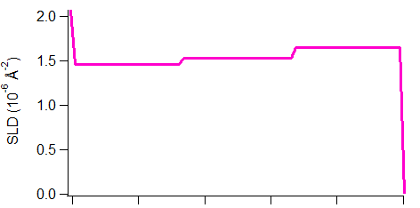
Models of structural organization
Homogeneous
dispersion
h
Air layer
h
Gradient
from air
h

Slide 13
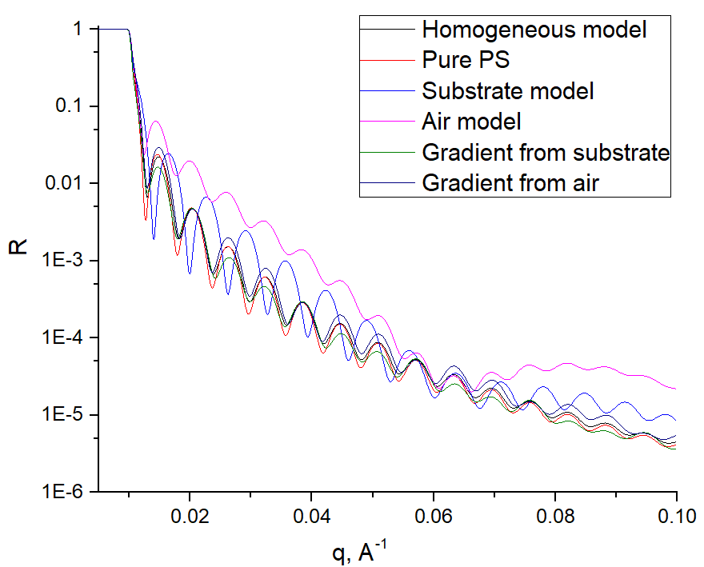
Modeling of NR scattering: different structures
Add experimental errors and try to fit the curves.
Karpets, M.L., Tropin, T.V., Bulavin, L. A., Schmelzer, J. W. P. // Nuclear Physics and Atomic Energy, 19(4), 376–382, 2018.

Slide 14
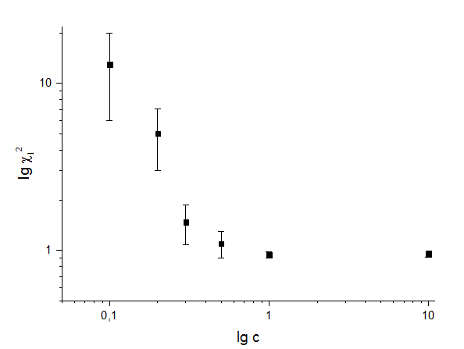
Modeling of NR scattering: different structures
Model | Layer | Thickness(Å) | SLD ( 10⁶ Å⁻¹) | Χ₁² | Χ₂²
10% wt C₇₀
Homogeneous | 1 | 1000 | 1.68 | 0.97 | 0.92
Substrate | 1 2 | 786 214 | 1.42 2.65 | 0.96 | 0.95
Air | 1 2 | 214 786 | 2.65 1.42 | 0.95 | 1.03
Gradient from substrate | 1 2 3 | 333 333 333 | 1.49 1.61 1.94 | 19 (0.94) | -
Gradient from air | 1 2 3 | 333 333 333 | 1.94 1.61 1.49 | 15 (0.95) | -
1% wt C₇₀
Homogeneous | 1 | 1000 | 1.44 | 0.98 | 0.92
Substrate | 1 2 | 979 21 | 1.42 2.65 | 0.94 | 0.92
Air | 1 2 | 21 979 | 2.65 1.42 | 0.94 | 1.01
0.3% wt C₇₀
Homogeneous | 1 | 1000 | 1.428 | 0.94 | 0.94
Substrate | 1 2 | 991 9 | 1.42 2.31 | 0.94 (0.97) | 0.83 (0.88)
Air | 1 2 | 9 991 | 2.31 1.42 | 9 (0.94) | 20 (1.34)
0.1% wt C₇₀
Homogeneous | 1 | 1000 | 1.423 | 0.94 | 1.18
Substrate | 1 2 | 991 9 | 1.42 1.71 | 7.7 (0.98) | -
Air | 1 2 | 9 991 | 1.71 1.42 | 1.48 (0.95) | -
1% relative mass content required for reflectometry measurements

Slide 15

X-rays reflectometry fullerene/PS PNCs
Fullerenes C₆₀
Fullerenes C₇₀
A set of thin films of similar thickness with different amounts of fullerene C₆₀/C₇₀ were prepared and measured.
Karpets, M.L., Tropin, T.V., Ye. Kosiachkin, V.L. Aksenov // Fullerenes, Nanotubes and Carbon Nanostructures, submitted, 2019.

Slide 16
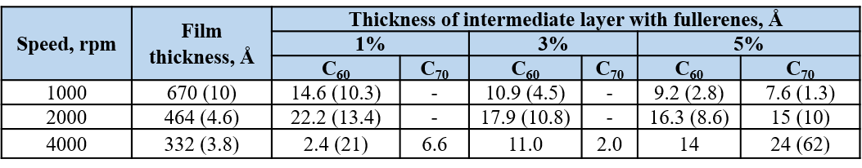
X-rays reflectometry fullerene/PS PNCs
Fit examples
Structural organization
Karpets, M.L., Tropin, T.V., Ye. Kosiachkin, V.L. Aksenov // Fullerenes, Nanotubes and Carbon Nanostructures, submitted, 2019.

Slide 17
Neutron reflectometry of C₆₀/PS PNCs
Similar samples prepared
In certain cases deuteration of PS used
Thickness h(T) dependencies measured at GRAINS, IBR-2, FLNP

Slide 18
NR measurements of C₆₀/PS thin films
~1 wt. % of C₆₀
~0.3 wt % of C₆₀
T_{g}~91°C
T_{g}~100°C
Fullerenes addition to polystyrene films affects glass transition temperature.
Decrease of T_{g} (effect of clusters) is measured.

Slide 19
NR measurements of C₇₀/PS film
Fits of NR curves at
T=15-150°C performed.

Slide 20
Conclusions
Thin films of polystyrene-fullerene C₆₀/C₇₀ nanocomposites for reflectometry investigations were prepared on Si substrates. Fullerenes content in the films varied from 1% to 5% by mass.
Neutron and X-ray reflectometry experiments show that fullerenes form nanolayers at the substrate-polymer film interface during the spin-coating process;
Temperature dependencies of structural organization reveal layer disturbance at high temperatures.
A decrease of T_{g}, probably due to aggregation effects observed.

Slide 21

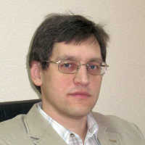
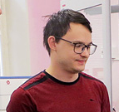

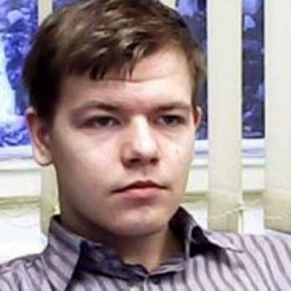

Research group
Maksym Karpets
(PhD student, Kosice, Slovakia)
Mikhail Avdeev
(Dr. Sc., Prof., FLNP JINR)
Yegor Kosiachkin
(PhD student, FLNP JINR,
KNU, Kyiv, Ukraine)
Yulia Gorshkova
(PhD, FLNP JINR)
Igor Gapon
(PhD, FLNP JINR,
KNU, Kyiv, Ukraine)
Leonid Bulavin
(Dr. Sc, Prof., KNU, Kyiv)

Slide 22
Thank you for your attention!

