Slide 1
Programme Advisory Committee
for Condensed Matter Physics
50th meeting (17 – 18 June 2019)
Dénes Lajos Nagy
126th session of the JINR Scientific Council, 19–20 September 2019, Dubna

Slide 2
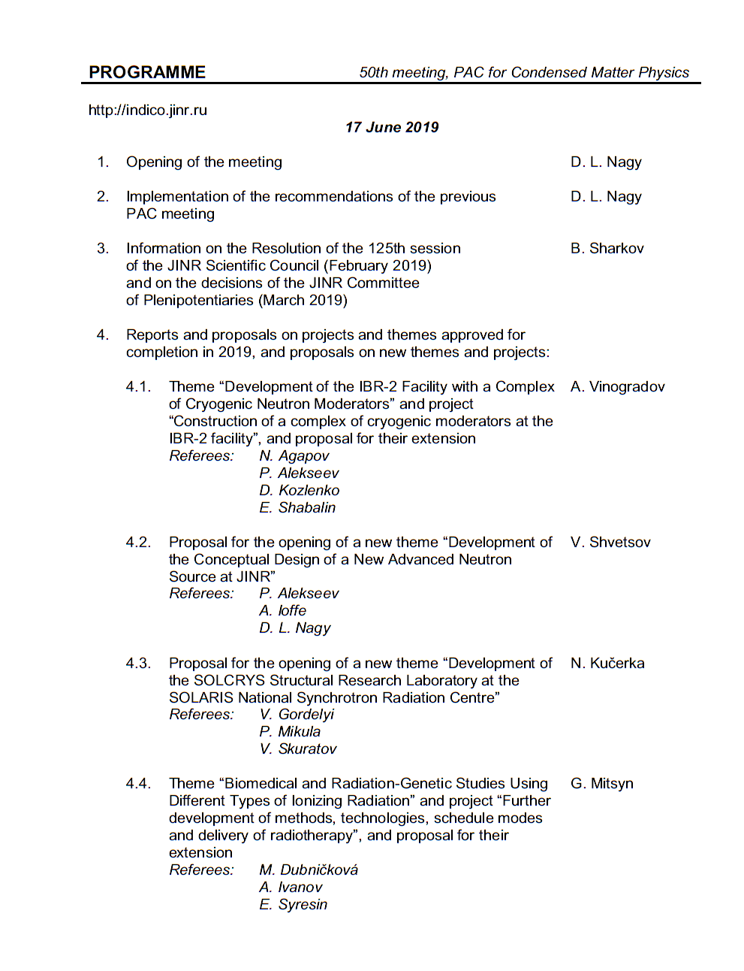
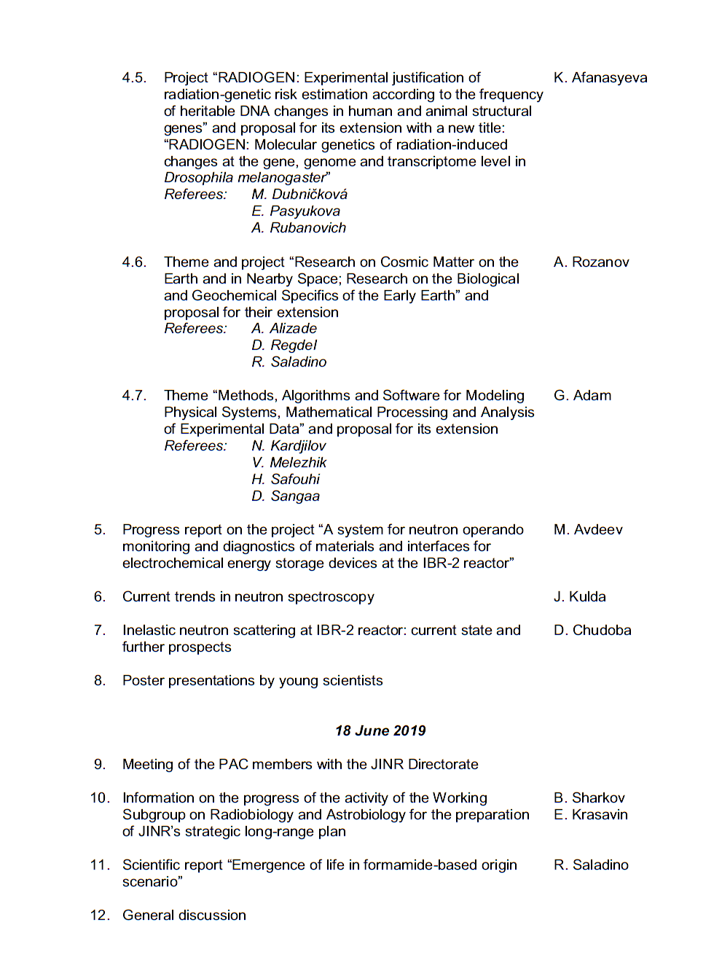
Agenda of the 50th PAC meeting
Highlights of the PAC-CMP meeting:
Reports and proposals on projects and themes approved for completion in 2019, and proposals on new themes and projects
Development of the Conceptual Design of a New Advanced Neutron Source at JINR
Development of the SOLCRYS Structural Research Laboratory at the SOLARIS National Synchrotron Radiation Centre
Inelastic neutron scattering at IBR-2 reactor: Current state and further prospects

Slide 3
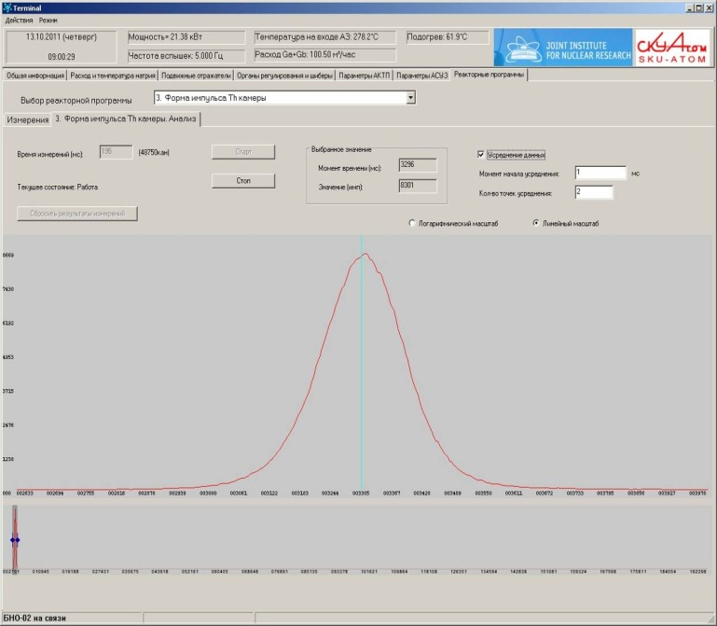
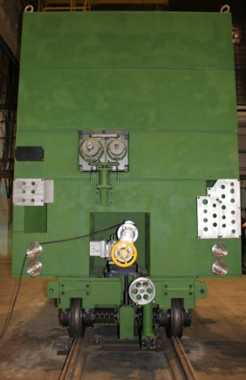
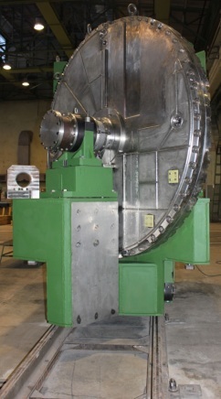
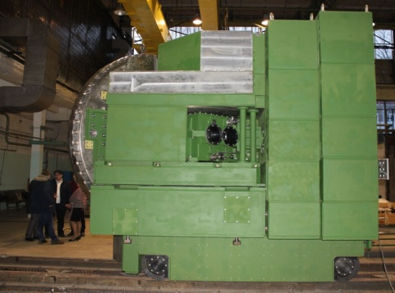
Reports and proposals on themes and projects
Report on the theme “Development of the IBR-2 Facility with a Complex of Cryogenic Neutron Moderators” and justification for its extension for 2020-2022
A. Vinogradov
1. Detailed statistics on reactor power and current status of IBR-2 beams at http://flnp.jinr.ru/ibr2
/current.html
2. Provision of physics research program on extracted neutron beams
 | Operation for physics experiments, hr. (plan - 2500 hr. per year) | Number of shutdowns
2017 | 2471 | 1
2018 | 1587 | 4
2019 | 1406 (as of May 01, 2019) | 1
Average power
2 MW
Peak power
1850 MW
200 μs
3. A new stationary radiation monitoring system has been put into regular operation. Dosimetric control and radiation monitoring meet the modern requirements of the safety rules and regulations
4. Manufacturing of a reserve reactivity modulator MR-3R

Slide 4
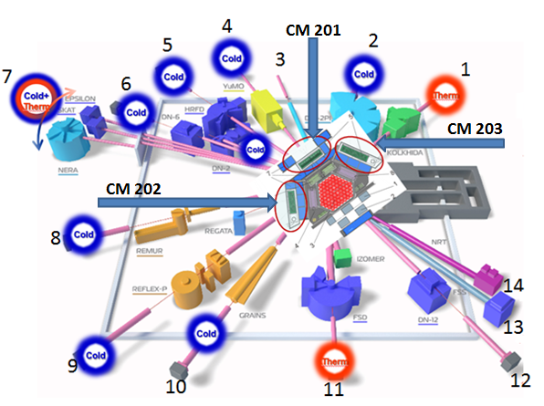
Report on the theme “Development of the IBR-2 Facility with a Complex of Cryogenic Neutron Moderators” and justification for its extension for 2020-2022
Project within the theme: “Construction of a Complex of Cryogenic moderators at the IBR-2 facility”
Complex of combined moderators
at IBR-2 reactor
N | Project | Status
1 | Development of a new mass flow rate meter | Completed
2 | Development of a device for mechanically removing pellets from the moderator chamber | In progress
3 | Project development, manufacturing and preliminary installation of CM-201 (beamlines 1, 4, 5, 6, 9) | Completed
4 | Development and construction of CM-203 (beamlines 2, 3) | Suspended
5 | Studies of additives to reduce viscosity | Completed
6 | Development and commissioning of a new cryogenic system | Completed
Recommendation. The PAC recommends extension of this theme and project for 2020–2022.

Slide 5
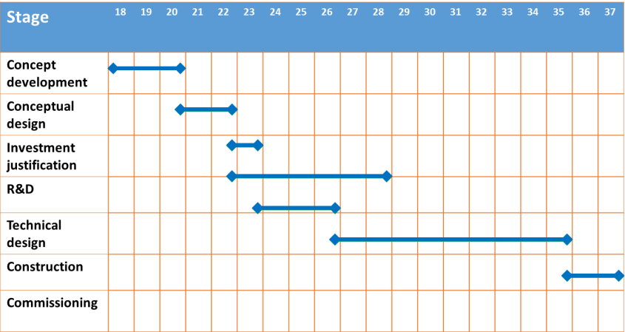
Proposal for the opening of a new theme “Development of the Conceptual Design of a New Advanced Neutron Source at JINR”
V. Shvetsov
The PAC notes the significant progress achieved by the FLNP team in developing a technical justification for the concept of the new source. At the same time, it would like to draw the attention of the project leaders and FLNP Directorate to the necessity of developing a rationale for the scientific programme for the new source.
Basic parameters of the reactor
Project roadmap (preliminary)
Parameter | Value
1 Average thermal power, MW | 15
2 Operational mode | pulsed
3 Repetition rate, Hz | 10
4 Fuel | NpN
5 Coolant | Na
6 Inlet temperature of the coolant, ⁰С | 290
7 Outlet temperature of the coolant, ⁰С | 391
8 Coolant flow through ½ of the core, kg/s | 58
9 Pressure drop across the core, Pa | 0,33·10⁵
10 Fast neutrons flux density on the reactor vessel, 10¹⁴ n/cm²·s¹ | 5,7
11 Fluence on the reactor vessel for 20 000 hours, n/cm² | 4,1·10²²
At present we have contract with NIKIET on feasibility study of the:
Pulsed reactor with mechanical modulation of reactivity, based on Np fuel
ADS with mechanical modulation of reactivity (super booster), based on PuO₂ fuel
Recommendation. The PAC supports this proposal and recommends the opening of this new theme for 2020–2022.
The PAC requests the theme leaders to define a management structure, clear deliverables, milestones, and a time schedule for this theme. The PAC expects progress reports from the FLNP Directorate and the Chairman of the Working Subgroup for Condensed Matter and Neutron Physics at each PAC meeting.

Slide 6
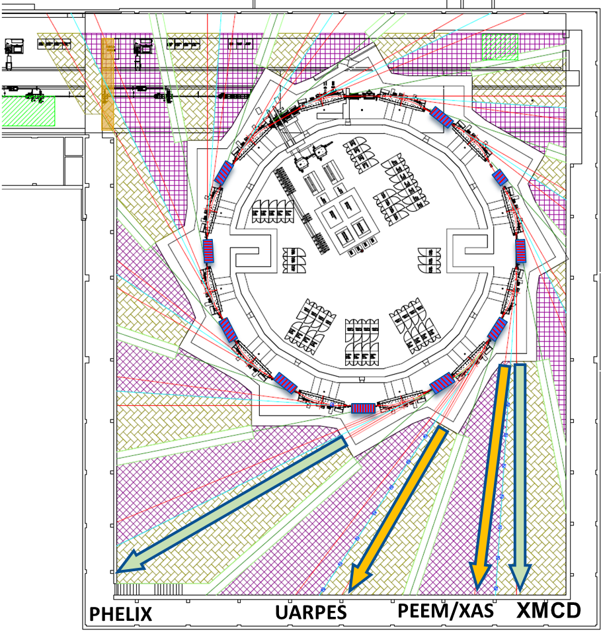
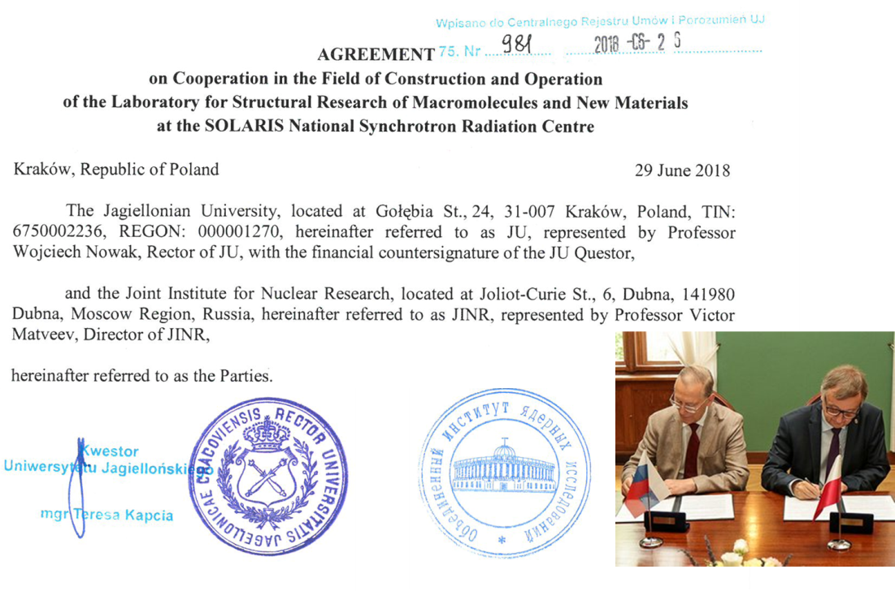
JINR–SOLARIS cooperation
The PAC heard the status and recent developments of the JINR–SOLARIS collaboration to develop the joint facility for structural research using synchrotron X-rays and a proposal for opening a new theme “Development of the SOLCRYS Structural Research Laboratory at the SOLARIS National Synchrotron Radiation Centre” presented by N. Kučerka.
The parameters of the existing facility and those for the new instruments proposed to be built allow one to estimate a potential for their future scientific use. An interest has been expressed by several organizations from JINR Member States.
SOLARIS beamlines
Beamlines at the delivery:
Ultra Angle-Resolved Photoelectron Spectroscopy
Photoemission Electron Microscopy X-ray Absorption Spectroscopy
Beamlines under construction:
angle integrated photoelectron spectroscopy
X-ray Magnetic Circular Dichroism
Materials science
structure of crystalline materials, semiconductors and new electronic materials, alloys and nanocomposites, polymers and fibers
Chemistry
catalysis, porous materials
Pharmacy
drug polymorphism, drug carriers, gels, lotions, creams
Structural biology
proteins and nucleic acids, biomacromolecular solutions
Beam line proposal for JINR
Name | Techinques | source | energy range [eV]
MX-BioSAXS-PD | MX – Macromolecular Crystallography diffraction of single crystals SAXS - Small Angle X-ray Scattering PD - Powder Diffraction in wide range of temperatures and pressures X-ray absorption spectroscopy | SC Wiggler | 6000-25000
Recommendation. The PAC recommends the opening of this new theme. The PAC expects the parameters of the three proposed stations and their connections with the scientific programme and the international synchrotron landscape to be reported at its next meeting.

Slide 7
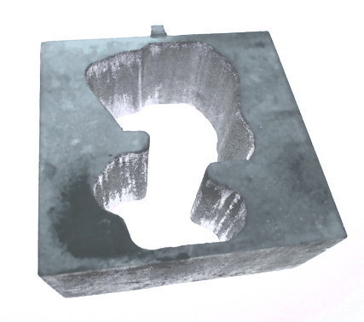
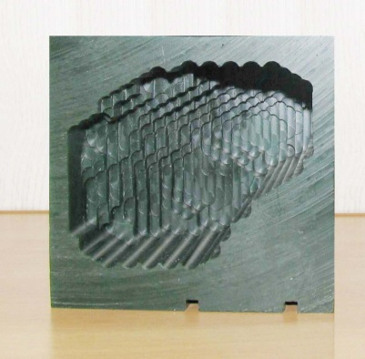
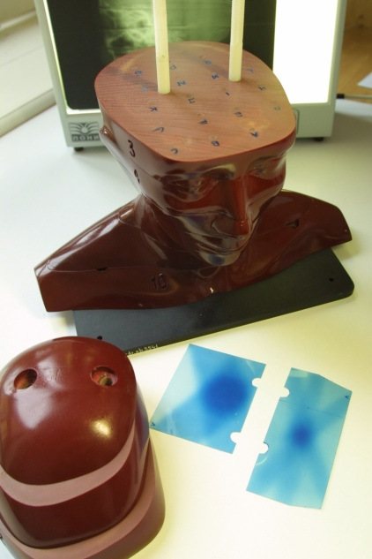
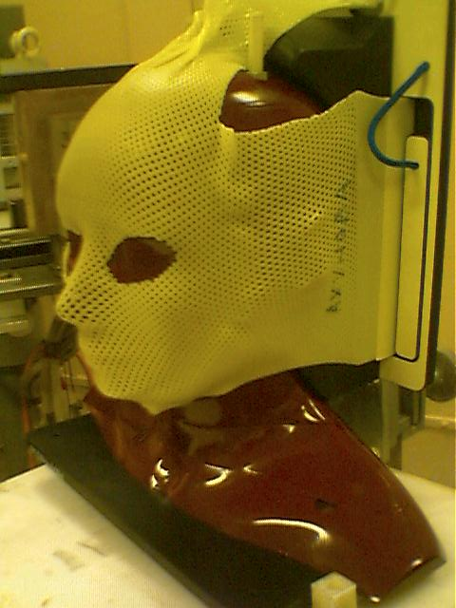
Theme “Biomedical and Radiation-Genetic Studies Using Different Types of Ionizing Radiation”
G. Mitsyn
Project “Further development of methods, technologies, schedule modes and delivery of radiotherapy”
The PAC emphasizes the high importance of the results achieved both in the field of clinical research on proton radiotherapy applications for the treatment of different diseases and in the field of radiobiology. Particularly, it should be stressed that the clinical research has entered a new phase, in which the statistical analysis of the treatment results becomes possible and the effectiveness of the proton radiotherapy techniques realized at JINR is seen.
Technologies to calculate and to produce individual collimators of Wood alloy and boluses (patient specific proton range moderators of irregular shape) of a special machinable wax using a digital computer controlled milling machine have been developed and realized
Using heterogenous “Alderson phantom” and radiochromic films a set of dosimetric experiments on verification of all the technological steps of treatment planning and realization of proton beam irradiation was carried out.
Patient set-up verification
Recommendation. The PAC recommends extension of this theme and project for 2020–2022. The PAC recommends strengthening the research underway in this field at JINR. It also requests information on the fundamental research in the field and on how the research will be transferred to the medical treatment.

Slide 8
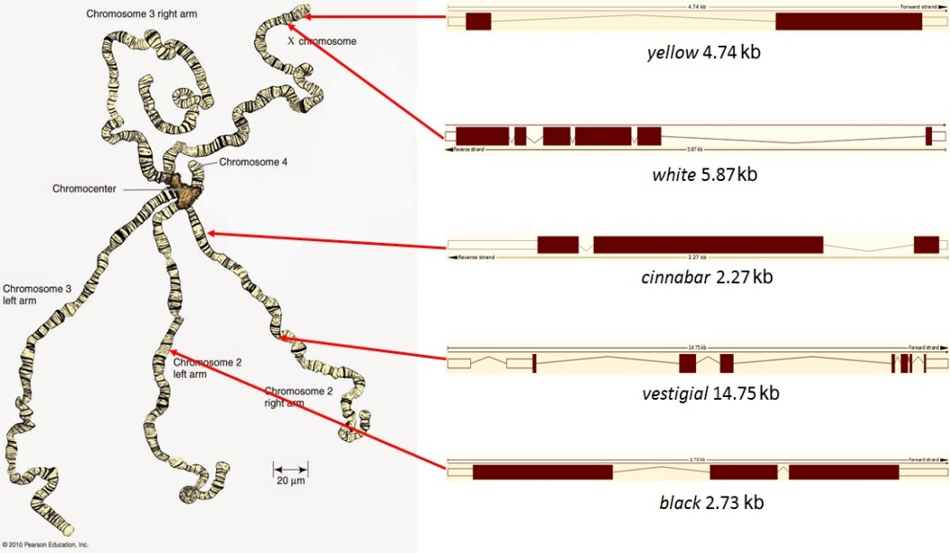
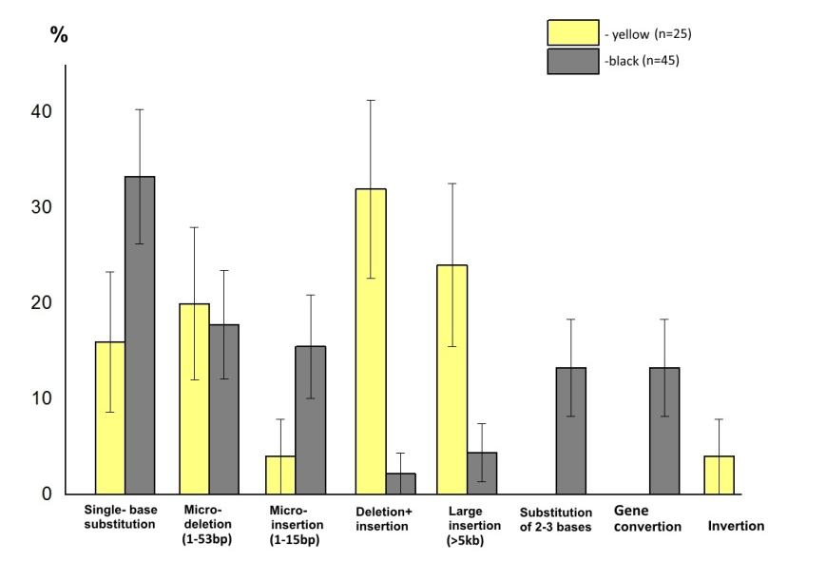
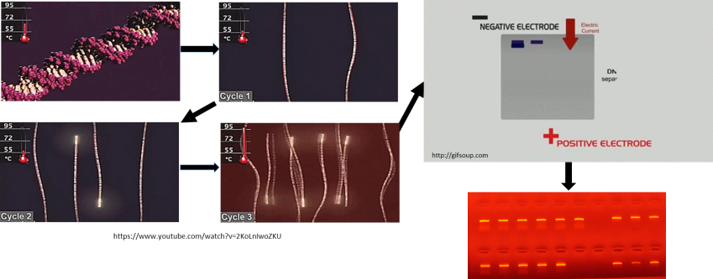
Theme “Biomedical and Radiation-Genetic Studies Using Different Types of Ionizing Radiation”
RADIOGENE project
K. Afanasyeva
The PAC notes the challenge of the situation in research that, although there is a vast amount of evidence for radiation-induced mutations in diverse biological systems, there is no exact evidence for radiation-induced germ cell mutations that could cause genetic disease in human population.
The PAC further notes that the concept of the project is based on results of hereditary diseases from mutations occurring in germ cells of Drosophila, and also on ionizing radiation capable of inducing similar changes in all experimental systems of the project. The PAC recognizes the significant progress in the development of this project and the new fundamental data in the nature of radiation genetics of living organisms and frequency of inherited changes in the DNA of gene mutations induced by γ-rays and fission neutrons in the Drosophila germ cells.
The PAC especially notes the high scientific and methodological level of the research based on advanced DNA technologies.
Spectra of γ-ray-induced DNA changes at the yellow and black genes of Drosophila melanogaster
Molecular methods: polymerase chain reaction (PCR)
Recommendation. The PAC recommends extension of this project with the new title “RADIOGENE: The molecular genetics of radiation-induced changes at the gene, genome and transcriptome level in Drosophila melanogaster” for 2020–2022.

Slide 9
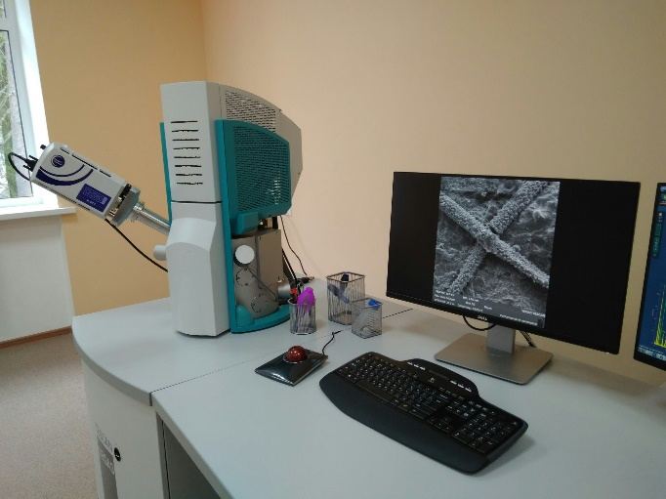
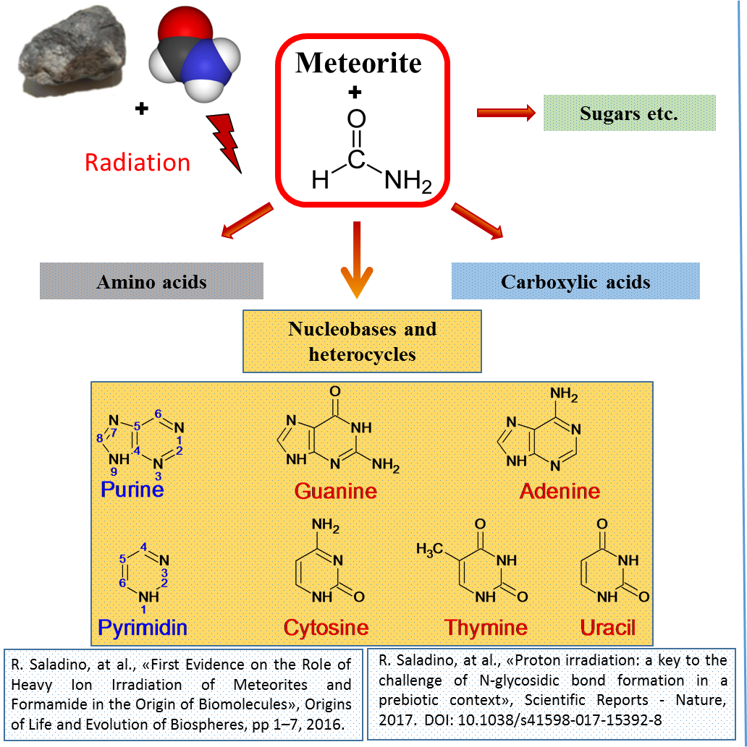
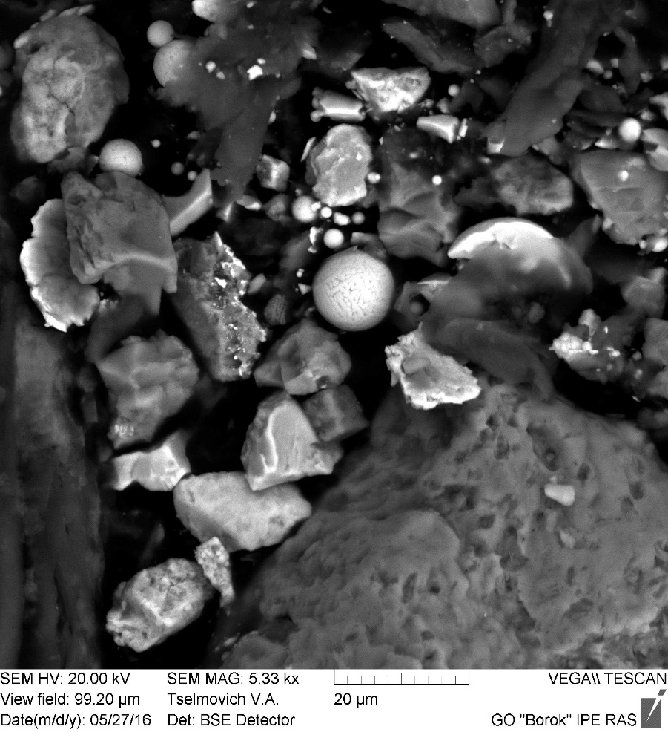
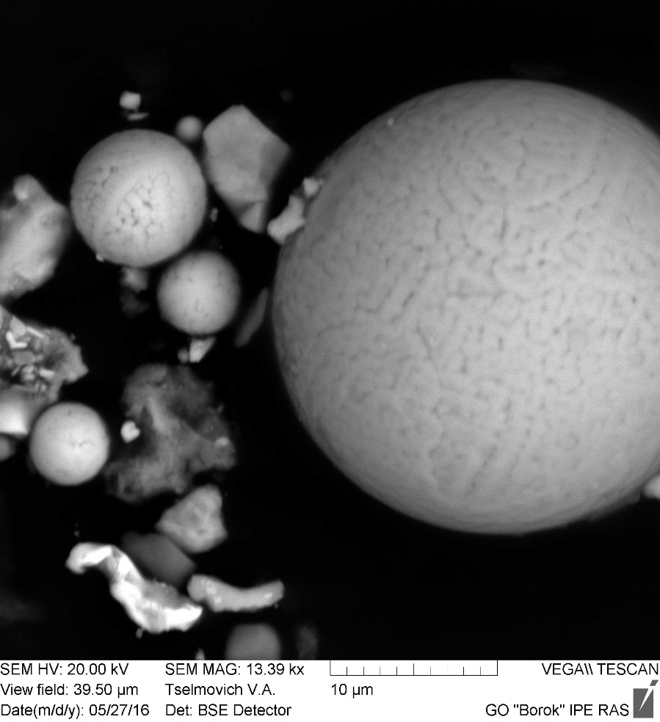
Theme and project “Research on Cosmic Matter on the Earth and in Space; Research on the Biological and Geochemical Specifics of the Early Earth”
A. Rozanov
The results achieved by the Astrobiology Sector of the Laboratory of Radiation Biology for the past three years indicate the high productivity of its research.
In addition to using JINR's facilities, in particular the Phasotron and the IBR-2 reactor, the Sector has acquired its own equipment. In 2017, a modern Tescan Vega 3 scanning electron microscope was put into operation, by which fossilized microorganisms in meteorites are searched for and studied.
Eukaryotic microorganisms have been found in the Orgueil meteorite; the results of this research have been published in the Paleontological Journal of the Russian Academy of Sciences.
Recommendation. The PAC believes that research in the fields specified by the proposal would make a remarkable contribution to the advancement of the interdisciplinary science of astrobiology and recommends extension of this theme and project for 2020–2022.

Slide 10
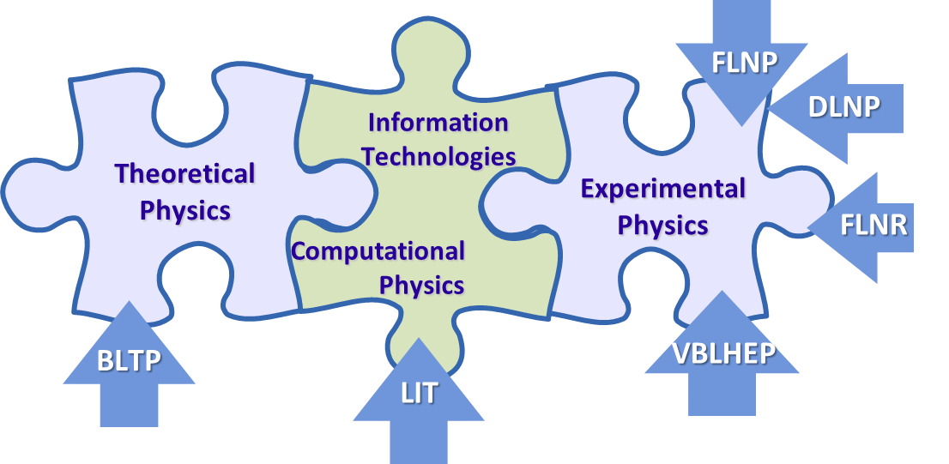
Theme “Methods, Algorithms and Software for Modeling Physical Systems,
Mathematical Processing and Analysis of Experimental Data”
Gh. Adam
The PAC highly appreciates the results obtained in the development of new mathematical methods, algorithms, and software packages intended to address topics of the outmost importance for the experimental and theoretical research conducted at JINR.
Issues of condensed matter physics address within the present theme are represented, on the one hand, through high-class computer support of the data acquisition and processing at IBR-2 spectrometers and, on the other hand, through important computer developments for the numerical solution of theoretical models describing either dynamic phenomena or structural properties of complex materials of interest in JINR laboratories.
The basis for future developments within this theme will be the maximum realization, for the benefit of the whole JINR scientific community, of the unique opportunities offered by the heterogeneous computing platform HybriLIT through its Govorun supercomputer and its education and testing site.
LIT involvement in JINR research: 53 projects of 28 topics of the 2019 JINR Topical Plan
Exceptional role of “GOVORUN” supercomputer
Summary
of recent achievements was presented
Big Data analytics and quantum computing
MMCP Conferences, 2011, 2015, 2017, 2019
Recommendation. The PAC considers the proposal to be well formulated and recommends extension of the theme for 2020–2023.

Slide 11
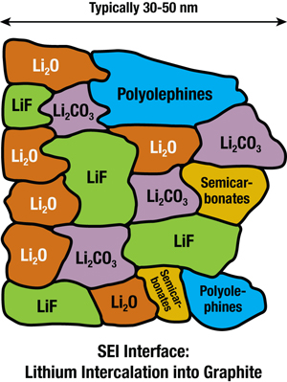
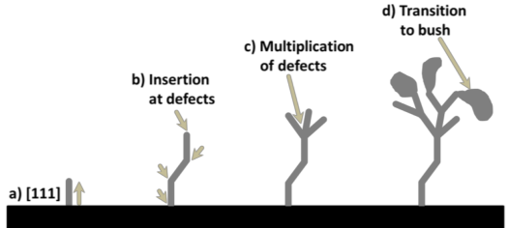
Status report by on the project “A system for neutron operando monitoring and diagnostics of materials and interfaces for electrochemical energy storage devices at the IBR-2 reactor”
M. Avdeev
Structural Research of Electrochemical Accumulators
Interface evolution
Formation of solid electrolyte interphase (SEI)
Project objectives
Development of common approaches to the effective use of neutron scattering methods (diffraction, reflectometry, small-angle scattering) in the analysis of the structural evolution of various types of electrodes and interfaces for electrochemical energy storage devices during operation (operando mode).
Design and development of specialized electrochemical cells and sample environment systems for operando research in neutron scattering experiments.
Electrode structure evolution
Negative
Electrode
Growth of dendrites
Lithium intercalation
Recommendation. The PAC is satisfied with the progress of this project and recommends its continuation.
Main objective
Study of operating electrodes and interfaces (operando mode)

Slide 12
General recommendation
The PAC recommends that speakers presenting reports on themes and projects change the manner of delivering information.
The presentation must clearly indicate the science and/or technology value of theme or project, the current stage of its implementation in connection with the whole timeline of suggested activities, the year-by-year plan of its implementation, the steps already completed and those to be completed, as well as relation of reported works to the corresponding part of the Seven-Year Plan for the Development of JINR.
The results obtained within the theme or project should be summarized briefly and reported in a concise manner.
For new proposals the expected results should be identified in the presentation.

Slide 13
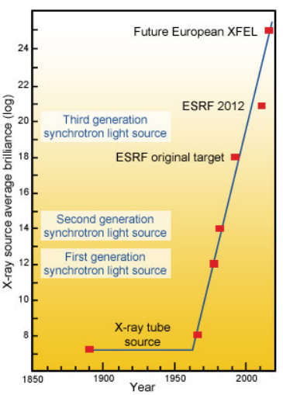
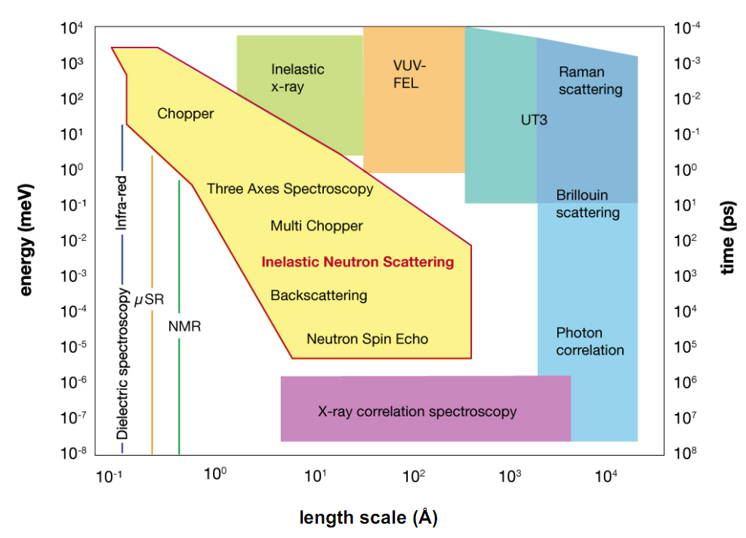
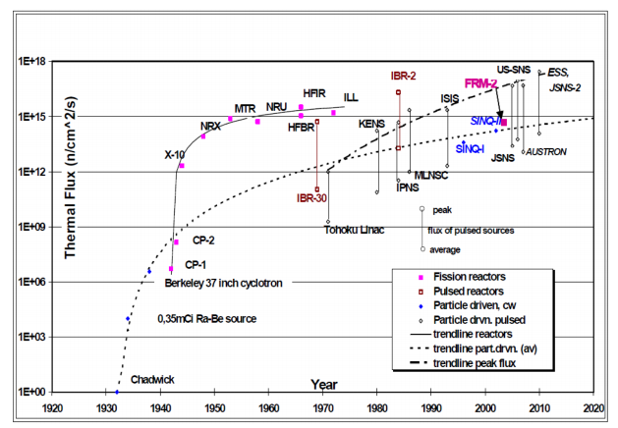
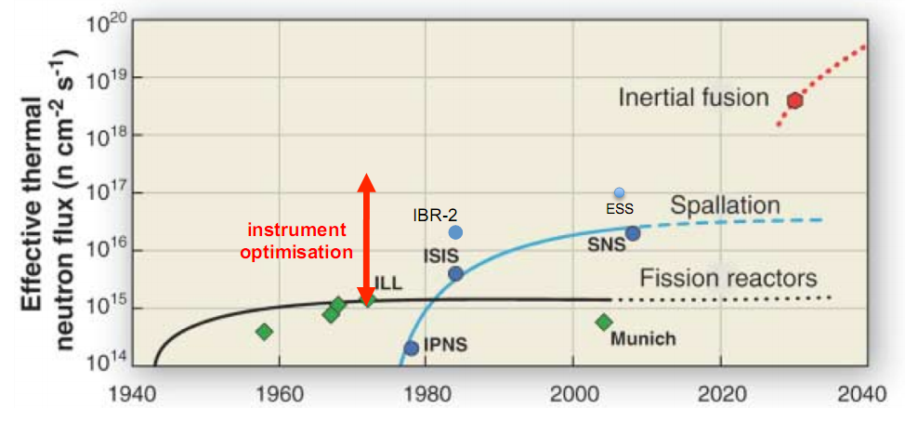
Inelastic neutron scattering at IBR-2
The PAC heard with interest an overview of the current trends in neutron spectroscopy worldwide presented by J. Kulda.
all known production reactions produce MeV neutrons
moderation to <1ev is a diffusive and incoherent process
Concluding remarks
instrument layout optimisation partly compensates stagnation of source brilliance
neutron spectroscopy studies driven by need of insight into material functions
topologic excitations and dynamics of frustrated spin systems are at the forefront in magnetism
most functional materials exhibit strong disorder/fluctuations
atomistic calculations (MD, AIMD) key to understanding of structure & dynamics of disordered systems
40+ years of instrument development & infrastructure optimisation
result in 2-3 orders of gain in experiment efficiency
• impact:
– typical experiment duration reduced by factor 2-3
– samples volumes reduced proportionately (eg. spectroscopy 10-50 mm3, proteins 0.1 mm3)
– new science (frustrated magnetism, chemical kinetics, protein crystallography, ...)

Slide 14
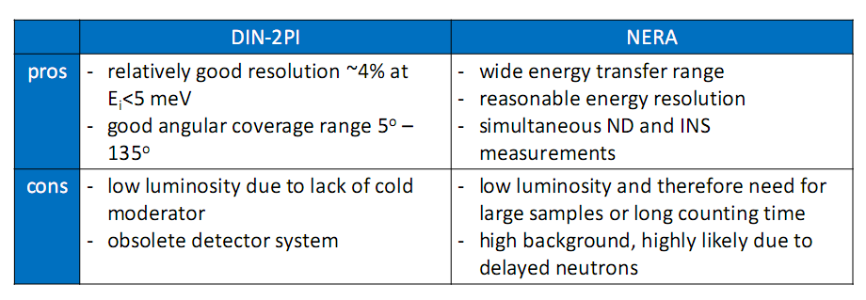
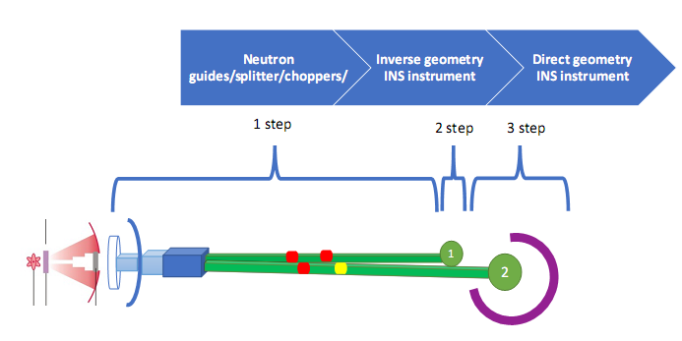
Inelastic neutron scattering at IBR-2
Summary
The PAC took note of the presentation by D. Chudoba on the current state of inelastic neutron scattering instruments operating at IBR-2.
The PAC notes that the two spectrometers mentioned in the report are the only inelastic neutron scattering instruments available at JINR.
The PAC was informed about FLNP plans to open a new project to further develop these spectrometers for 2021–2023.
Inverse geometry INS instrument
Recommendation. The PAC supports the development of new inelastic neutron scattering instruments and the preparation of a proposal for a new project for 2021–2023. The PAC expects a full-length proposal for this new project to be presented at its next meeting.

Slide 15
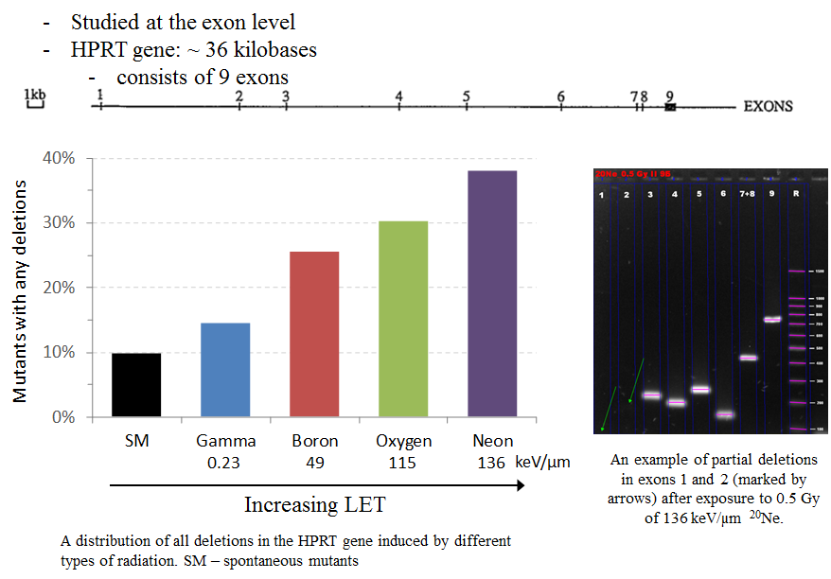
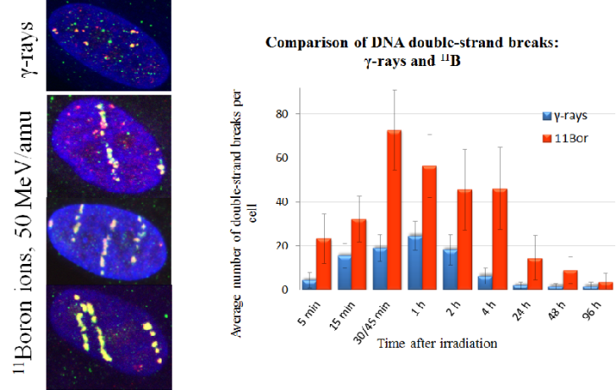
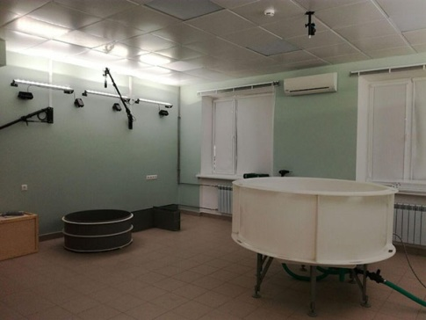
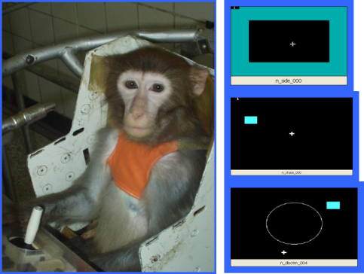
Preparation of JINR’s strategic long-range plan
The PAC took note of the information on the current activities of the Working Subgroup for Radiobiology and Astrobiology for the preparation of JINR’s strategic long-range plan presented by B. Sharkov and E. Krasavin.
Mission
SLRP is a forward look enabling JINR scientific community, in interaction with policy makers of JINR member States, to develop long-term views and analyses of future research developments with the aim of defining research agendas of JINR laboratories in national and international context.
Recommendation. The PAC endorses the efforts of the Working Subgroup for Radiation Biology and Astrobiology and of LRB towards finalizing the document on strategic development of radiation biology at JINR.
Strategic Goal
Strategic goal is to develop JINR as a world-class scientific center, which takes a leading position in the field of high energy physics, nuclear physics of low energy and heavy ion physics, neutrino physics, condensed matter physics, radiation biology, high performance computing and innovative technologies.

Slide 16
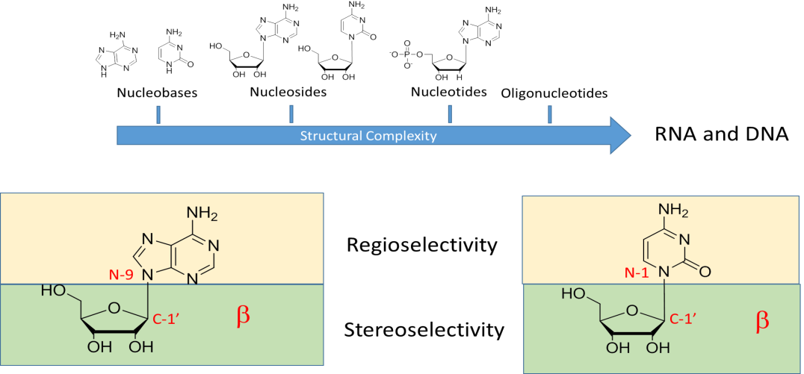
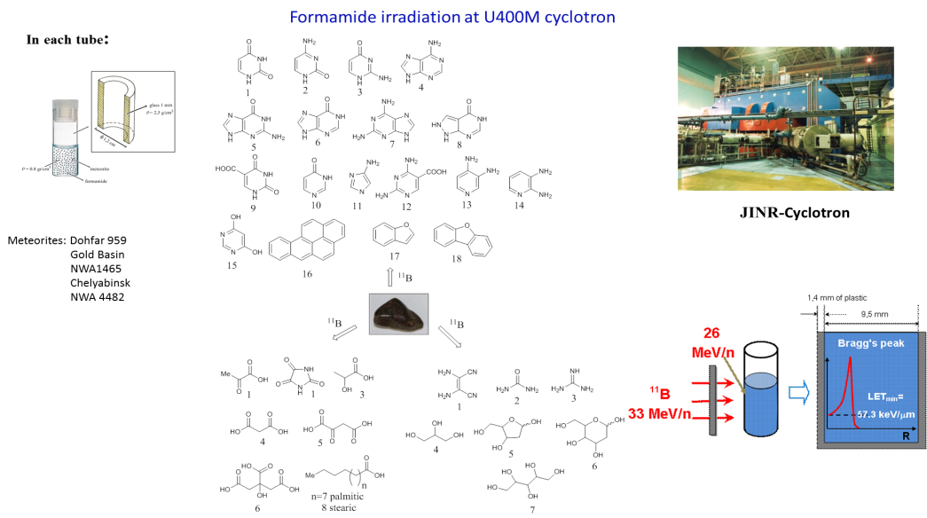
Scientific report
The PAC heard with interest the scientific report: “Emergence of life in formamide-based origin scenario” and thanks the speaker R. Saladino.

Slide 17
Poster presentations
The PAC reviewed poster presentations by young scientists in fields of information technology and condensed matter physics
The poster
“Investigations of polystyrene-fullerene nanocomposite thin films by neutron and X-ray reflectometry”
by M. Karpets*
was selected as the best poster at the session.
Recommendation. The PAC recommends this poster to be reported at the session of the Scientific Council in September 2019.
The PAC, however, is concerned about the low number of posters presented this time and recommends that the directorates of the Laboratories involved, on the one hand, encourage young scientists to participate more actively in poster sessions and, on the other hand, use poster sessions for presenting broader information on themes and projects reported at PAC meetings.
* At this session of the Scientific Council this poster will be reported by his co-author Dr. T. Tropin

Slide 18
Next meeting of the PAC
The next meeting of the PAC for Condensed Matter Physics will be held on 20–21 January 2020.
Its tentative agenda will include:
information by the PAC Chairman on the implementation of the recommendations of the current PAC meeting;
information by the JINR Directorate on the sessions of the Scientific Council (September 2019) and of the Committee of Plenipotentiaries (November 2019);
reports and recommendations on themes and projects to be completed in 2020;
progress of the development of a concept for JINR’s new neutron source;
status reports on upgrades of FLNP instruments;
discussion of a general scheme of evaluating themes and projects by the PAC;
information about scientific meetings;
scientific reports;
poster session.

Slide 19
Thank you for your attention

