Slide 1
Preparation of the Strategic plan for long-term development of JINR
NUCLEAR PHYSICS AT LOW AND INTERMEDIATE ENERGIES
Alexander Karpov
JINR Scientific Council meeting, September 19-20, 2019

Slide 2
Sub-group
Nuclear physics of low and intermediate energies including atomic physics, nuclear chemistry, and astrophysics
Synthesis and properties of superheavy elements
Study of exotic nuclei
Nuclear reactions induced by heavy ions
Local working group
Group of experts
 | Name | Institution
1. | Alexander Karpov | JINR
2. | Sergey Sidorchuk | JINR
3. | Sergey Dmitriev | JINR
4. | Vladimir Utyonkov | JINR
4. | Alexander Eremin | JINR
5. | Nikolay Aksenov | JINR
6. | Alexander Rodin | JINR
7. | Yuri Penionzhkevich | JINR
8. | Andrey Fomichev | JINR
9. | Leonid Grigirenko | JINR
10. | Vladimir Rachkov | JINR
 | Name | Institution
1. | Robert Eichler | PSI
2. | Emanuele Vardaci | INFN
3. | Gottfried Münzenberg | GSI
4. | Ephraim Eliav | School of Chem., Tel Aviv Uni.
5. | Mikhail Onegin | NRC KI, Petersburg
6. | James Roberto | ORNL
7. | Joseph Hamilton | Vanderbilt University
8. | Marek Pfützner | Warsaw University

Slide 3
Meetings on heavy and superheavy elements research
3rd International Symposium on Super-Heavy Elements
“Challenges in the studies of super-heavy nuclei and atoms” Kazimierz Dolny, Poland September 10-14, 2017
3 meetings
“Super-heavy atoms & chemistry of Super-heavy elements”, JINR, Dubna, Russia December 7-8, 2017, October 24-25, 2018, June 1, 2019
ECT* Workshop
“Spontaneous and induced fission of very heavy and super-heavy nuclei”,
Trento, Italy April 9-13, 2018
Meetings of the RAS Council on Heavy-Ion Physics
“Future of SHE research at Dubna”,
JINR, Dubna, Russia October 26-27, 2018
International Symposium “The present and the future of the Periodic table of chemical elements”
JINR, Dubna, Russia May 30-31, 2019
4th International Symposium “Super-Heavy Elements”
Hakone, Japan December 1-5, 2019

Slide 4
Meetings on light exotic nuclei research
Meetings of the RAS Council on Heavy-Ion Physics
“Future of RIBs research at Dubna”,
JINR, Dubna, Russia December 1-2, 2017
ECT* Workshop
“Probing exotic structure of short-lived nuclei by electron scattering” Trento, Italy July 16 – 20, 2018
ECPM 2018
“41st European Cyclotron Progress Meeting”, JINR, Dubna, Russia September 3 – 5, 2018
EXON 2018
“IX International Symposium on EXOtic Nuclei”,
Petrozavodsk, Russia September 10 – 14, 2018
Workshop in frames of “the 8th International Conference on New Frontiers in Physics”
Crete, Greece August 21-25, 2019

Slide 5
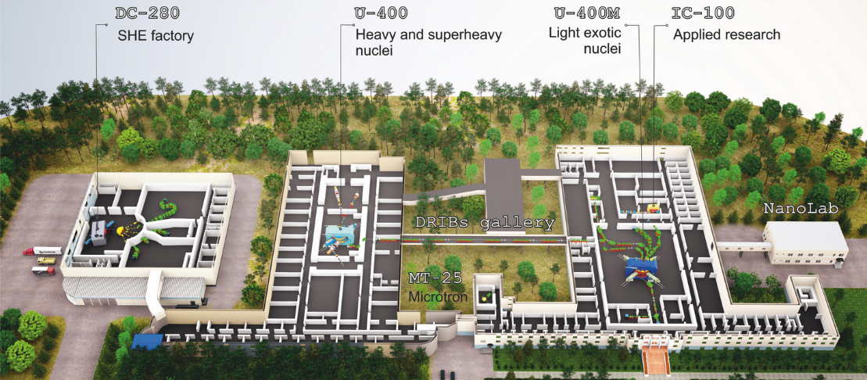
DRIBS-III ACCELERATOR COMPLEX
FLEROV LABORATORY OF NUCLEAR REACTIONS
FLNR’s basic directions of research:
Heavy and superheavy nuclei
Light exotic nuclei
Radiation effects and physical groundwork of nanotechnology
Accelerator technologies
Notes:
5
Beam intensity of Ca-48 up to 2.5 mkA
Ion energy variation on the target with factor 5
Cyclotron average magnetic field from 1.8 up to 0.8 T

Slide 6
FLNR main tasks for 2017–2023
Commissioning and development of "SHE Factory" based on DC280 cyclotron:
smoothly variable energy;
beam intensity ~10 pµA for nuclei with А~50;
new set-ups;
infrastructure for accommodation of user setups.
Modernization of the U400M cyclotron (2020-2021):
new main magnet coils, vacuum, diagnostics and radiation safety control systems;
increasing beam intensities and energies.
Reconstruction of the U400 to U400R cyclotron complex (2020-2023):
new experimental hall;
accelerated ions from helium to uranium;
smoothly variable energy within a wide range 0.8–25 MeV·A;
decrease the cyclotron power consumption.
Development of long-running experimental set-ups

Slide 7
Heavy and superheavy elements
basic facility: DC-280 @ SHE Factory

Slide 8
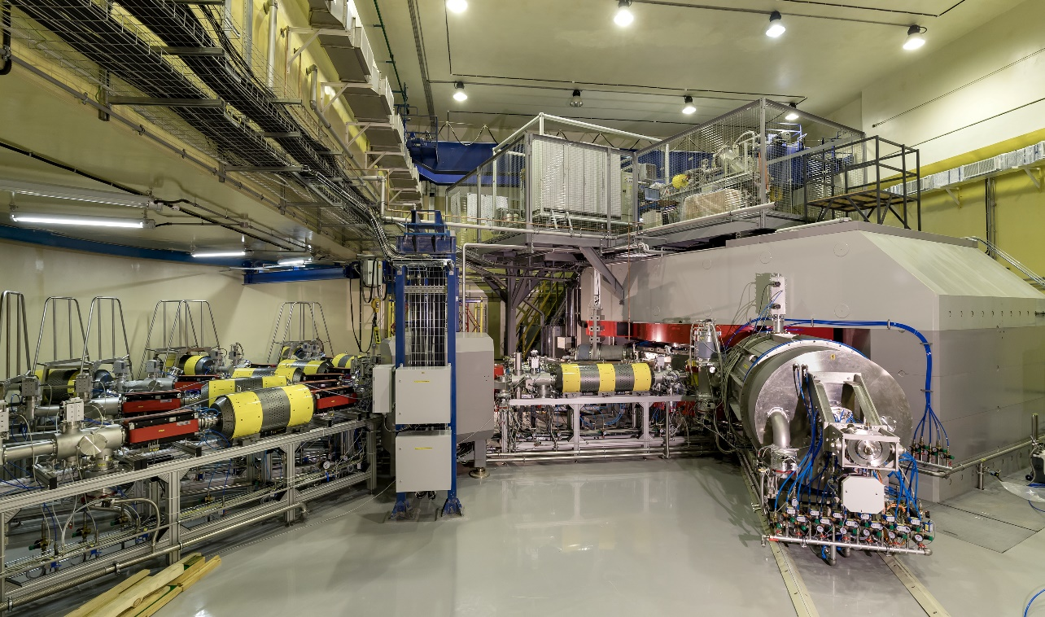
DC-280 ACCELERATOR COMPLEX
SUPERHEAVY ELEMENTS FACTORY
Beams (examples)
Ion | Ion energy [MeV/A] | Estimated output intensity [pps]
⁷Li | 4 | 1×10¹⁴
¹⁸O | 8 | 1×10¹⁴
⁴⁰Ar | 6 | 6×10¹³
⁴⁸Ca | 6 | (6-12)×10¹³
⁵⁴Cr | 6 | 2×10¹³
⁵⁸Fe | 6 | 1×10¹³
¹²⁴Sn | 6 | 2×10¹²
¹³⁶Xe | 6 | 1×10¹⁴
²³⁸U | 7 | 5×10¹⁰
Main parameters
Range of energies | 4÷8 MeV/A
K factor max. | 280
Pole diameter | 4 m
Magnet weight | 1000 t
Magnet power | 300 kW
Vacuum | 10⁻⁷ Torr
Commissioned: 2018-2019
Tasks:
Experiments at the extremely low (σ<100 fb) cross sections:
Synthesis of new SHE in reactions with ⁵⁰Ti, ⁵⁴Cr ...;
Synthesis of new isotopes of SHE;
Search for rare decay modes of SHE;
Study of excitation functions.
Experiments requiring high statistics:
Nuclear spectroscopy of SHE;
Precise mass measurements;
Study of chemical properties of SHE.
Main setups:
Gas-filled recoil separator (DGFRS-II);
Gas-filled recoil separator (DGFRS-III) for spectroscopy and chemical studies;
Mass Analyzer of SuperHeavy Atoms (MASHA) – from U-400M
Channels reserved for external users
Notes:
8
Beam intensity of Ca-48 up to 2.5 mkA
Ion energy variation on the target with factor 5
Cyclotron average magnetic field from 1.8 up to 0.8 T

Slide 9
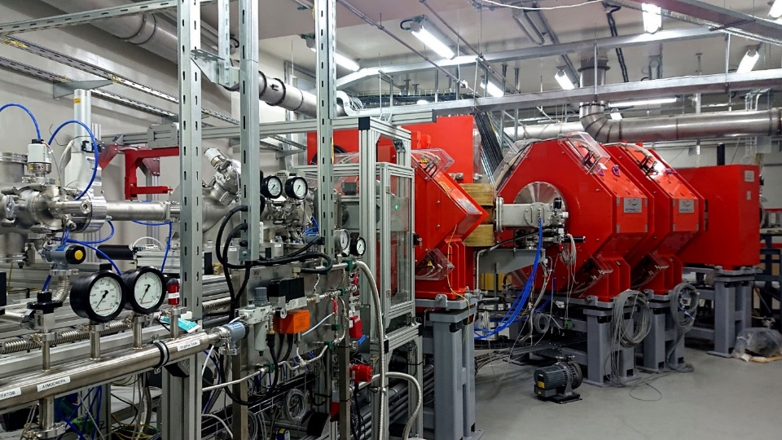
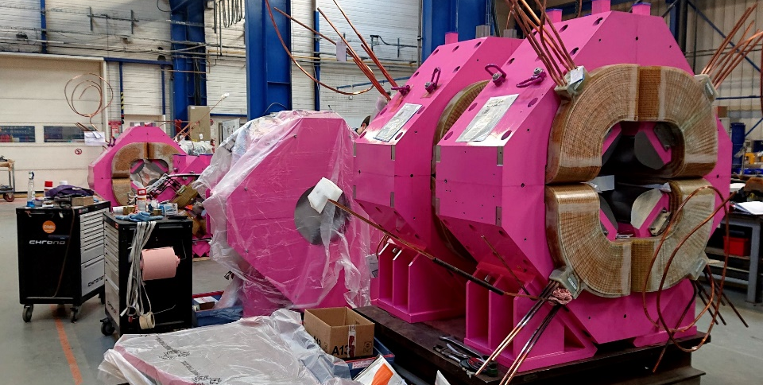
SuperHeavy Element Factory
GFRS-2
status: commissioned; tests and tuning are in progress purpose: synthesis of new SHE, new isotopes of SHE, decay modes, excitation functions, etc.
GFRS-3
status: manufactured, delivery to Dubna is expected by the end of 2019; assembling - 2020 purpose: decay spectroscopy; chemistry of SHE
Long-term plans:
Specialized radiochemical complex of the 1st class
ECR ion source on 28 GHz
Development of experimental set-ups

Slide 10
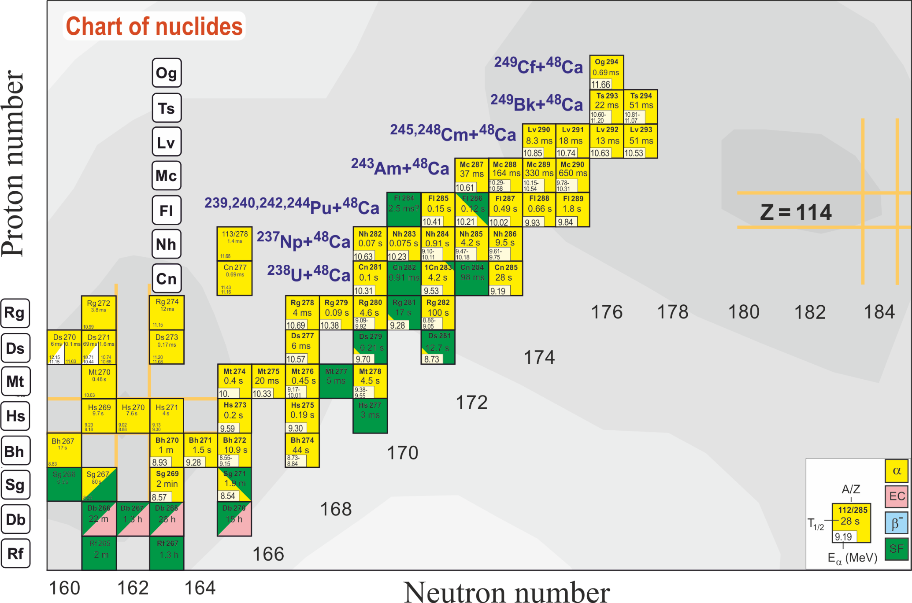
Fusion reactions: left, right or up?

Slide 11
Light exotic nuclei
basic facility: modernized U-400M

Slide 12
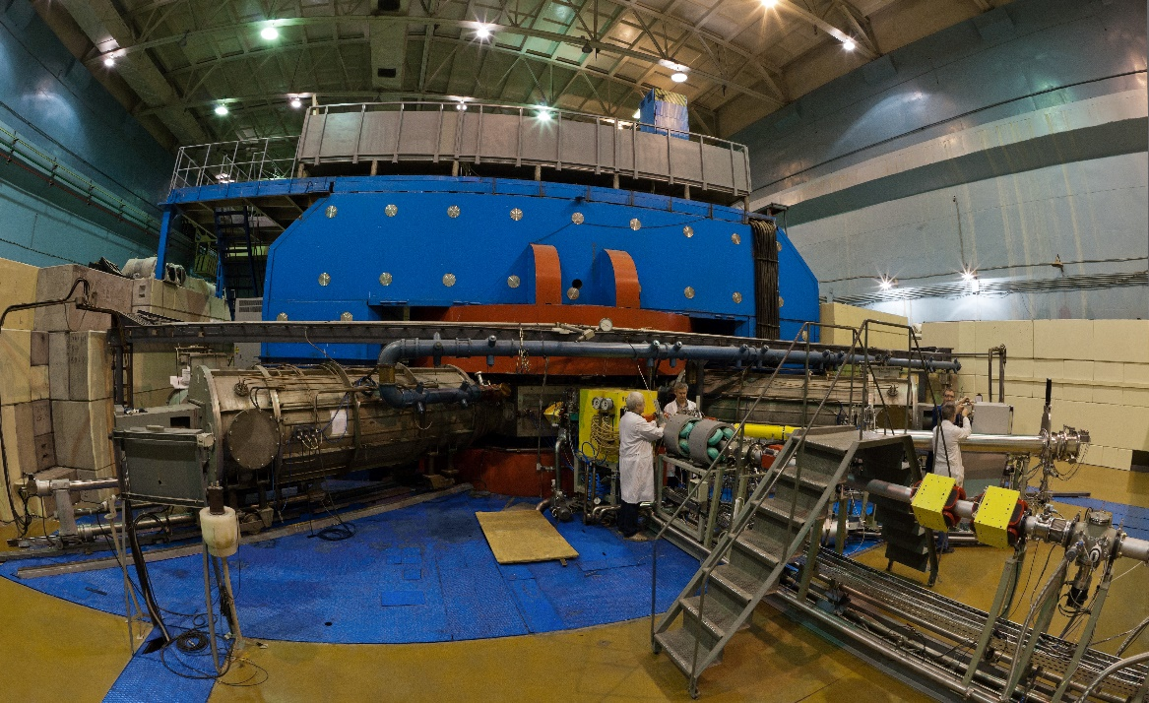
U-400M ACCELERATOR COMPLEX
EXPERIMENTS WITH RADIOACTIVE ION BEAMS
Beams (examples)
Ion | Ion energies [MeV/A] | Output intensity [pps]
⁶Li | 46 | 5×10¹³
⁷Li | 35 | 6×10¹³
¹¹В | 32 | 3×10¹³
¹²С | 47 | 2×10¹³
¹⁵N | 50 | 1×10¹³
¹⁸O | 33 | 1×10¹³
²⁰Ne | 53 | 2×10¹²
³²S | 53 | 1×10¹²
⁴⁰Ar | 40 | 1×10¹²
⁸⁴Kr | 27 | 2×10¹⁰
¹³²Xe | 25 | 1×10⁹
Main parameters
Energy range | 5÷10 & 25÷55 MeV/A
K factor max. | 550
Pole diameter | 4 m
Magnet weight | 2300 t
Magnet power | 1000 kW
Vacuum | 10⁻⁷ Torr
Commissioned: 1991
Modernized: 1996
Reconstruction: 2020-2021 (plan)
Tasks:
Stand-alone mode:
Properties and structure of light exotic nuclei
Reactions with exotic nuclei
Decay properties of nuclei at drip lines
Mass & laser spectroscopy of heavy nuclei
Applied research
Driving accelerator mode:
Production of beams of radioactive nuclei (U-400M → U-400)
Notes:
12
Beam intensity of Ca-48 up to 2.5 mkA
Ion energy variation on the target with factor 5
Cyclotron average magnetic field from 1.8 up to 0.8 T

Slide 13
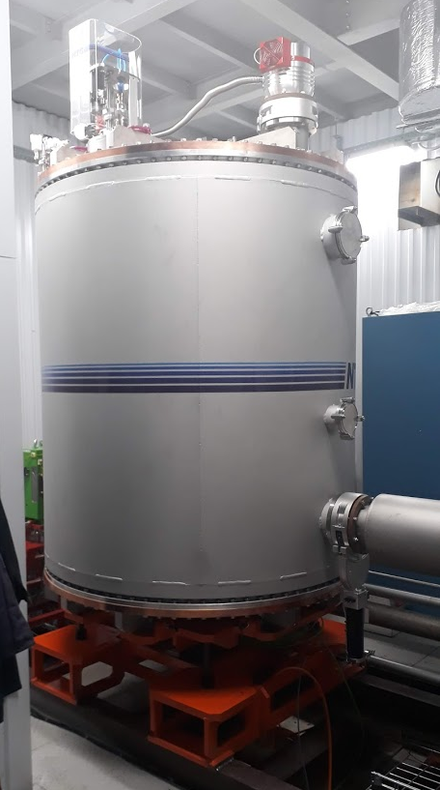
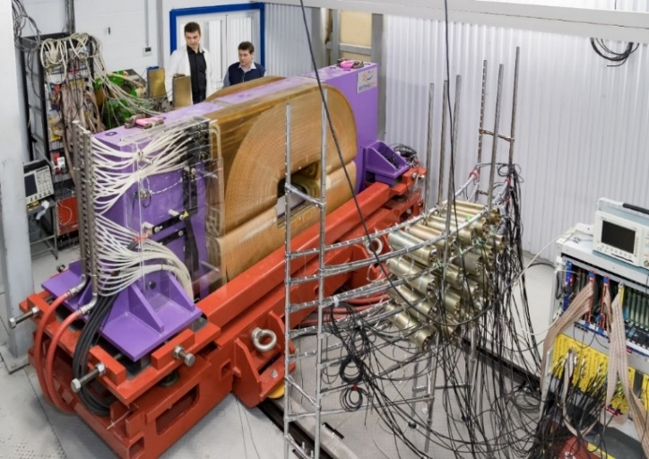
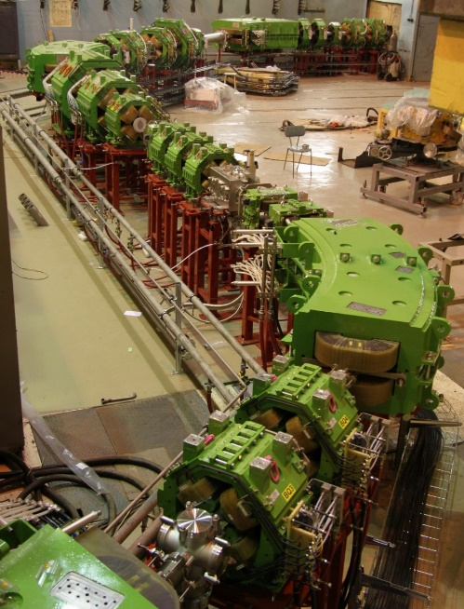
FRAGMENT SEPARATOR ACCULINNA-II
Experiments with radioactive beams
RIB* | Intensity, pps (at 1 pμA) | Energy, MeV/A
⁶He | 4x10⁷ | 22
⁶He | 1x10⁷ | 13
⁸He | 8x10⁴ | 23
¹¹Li | 7x10³ | 33
¹⁴Be | 2x10³ | 35
¹⁵B | 4x10⁵ | 32
¹⁶C | 2x10⁷ | 29
¹⁸C | 1x10⁴ | 25
²⁴O | 2x10³ | 23
⁸B | 2x10⁶ | 16
¹³O | 1x10⁶ | 24
¹⁷Ne | 2x10⁶ | 30
²⁴Si | 7x10³ | 12
²⁸S | 1x10³ | 38
2019: RF kicker
2021: Cryogenic target system (hydrogen, tritium, deuterium): under development (Sarov)
2021: Completion of modernization of the U-400M cyclotron
Continuously: Development of detectors for charged and neutral particles (optical TPC, neutron wall, scintillator arrays, Si-telescopes, active target, HPGe array)
http://aculina.jinr.ru/acc-2.php

Slide 14
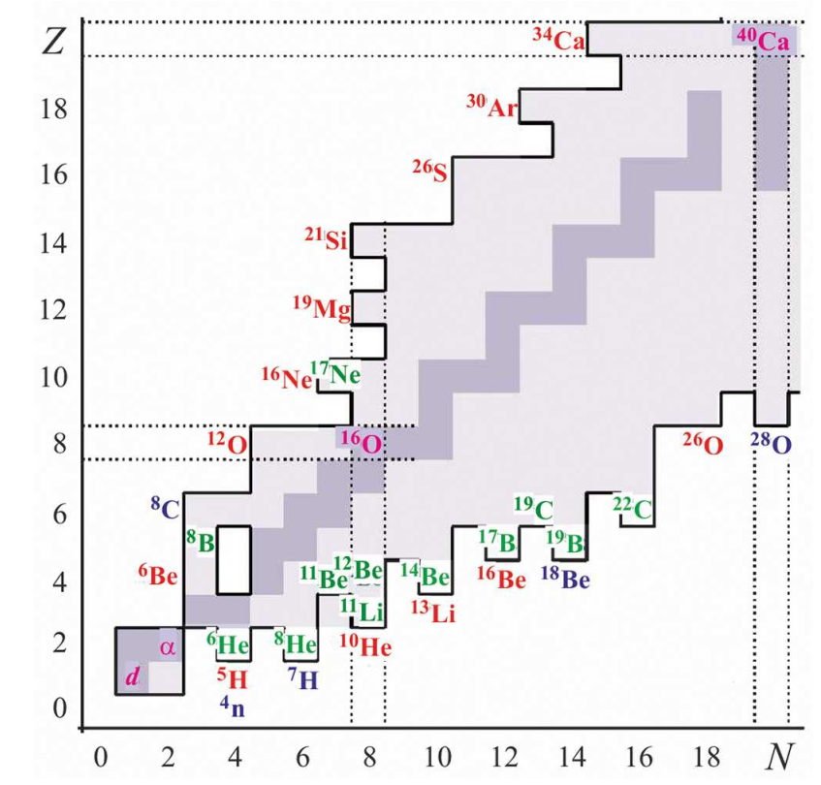
Experimental program with exotic nuclei (2019-2030)
Nucleon halo, neutron skin
Exotic decays: β-delayed, 2p, 2n radioactivity, etc.
Soft excitation mode
New magic numbers and intruder states
Spectroscopy of exotic nuclei
Cluster states
Reactions with RIBs
Astrophysical applications

Slide 15
Possible future of the RIBs research at FLNR
Substitution of the driving accelerator U-400M with a new one.
Superconducting LINAC-100 is under consideration. Goals:
Beams: up to Uranium
Energy: ~100 MeV/nucleon
Intensities: maximal possible
A new project entitled “Construction of a prototype of the initial section of the high-current heavy-ion linear accelerator for the production of intense radioactive ion beams for basic research” was proposed and considered by JINR PAC on Nuclear Physics.
The project is a supplement to the physical program of the project “Development of the FLNR accelerator complex and experimental setups (DRIBs-III)” (theme: 03-0-1129-2017/21).
The works within this project should demonstrate the feasibility of the LINAC-100 plus new fragment separator facility and prepare the basic technical documentation (TDR).

Slide 16
Nuclear reaction studies
basic facility: reconstructed U-400R

Slide 17
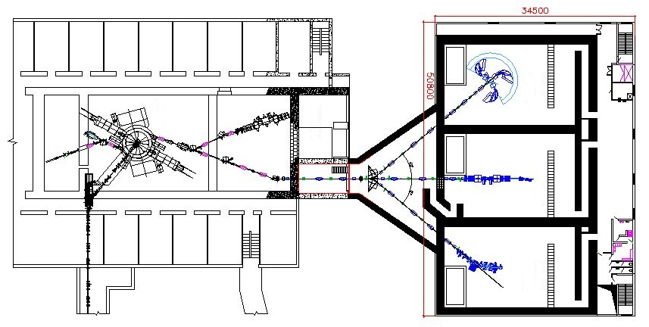
U400R: facility for nuclear reaction studies
new experimental hall
CORSET
U400R
MAVR
SHELS
STAR
GFS
GALS

Slide 18
Summary
HEAVY AND SUPERHEAVY ELEMENTS
Development of experimental set-ups @ the SHE Factory.
Realization of the experimental program in the area of SHE research.
Construction a specialized radiochemical complex of the 1st class.
Development of ECR ion source on 28 GHz for acceleration of ions up to Uranium.
Upgrade the U-400 (U-400R) accelerator, construction of the new experimental hall and equipping it with existing and new set-ups intended mainly for the study of nuclear reactions.

Slide 19
Summary
LIGHT EXOTIC NUCLEI
Continuation of experimental program on light exotic nuclei at the modernized U-400M cyclotron with the use of the ACCULINNA-2 fragment separator.
Consideration of a feasibility of construction of a new driving accelerator for the radioactive beam research.

Slide 20
Summary
Total available beam time of three FLNR’s cyclotrons (DC-280, U-400R, and U-400M) is expected to be of about 18 000 hours annually. This will allow us to formulate a user policy and open the FLNR facilities for external users.

Slide 21
Summary
Development of experimental set-ups @ the SHE Factory.
Realization of the experimental program in the area of SHE research.
Construction a specialized radiochemical complex of the 1st class.
Development of ECR ion source on 28 GHz for acceleration of ions up to Uranium.
Upgrade the U-400 (U-400R) accelerator, construction of the new experimental hall and equipping it with existing and new set-ups intended mainly for the study of nuclear reactions.
Continuation of experimental program on light exotic nuclei at the modernized U-400M cyclotron with the use of the ACCULINNA-2 fragment separator.
Consideration of a feasibility of construction of a new driving accelerator for the radioactive beam research.
The total available beam time of three FLNR’s cyclotrons (DC-280, U-400R, and U-400M) is expected to be of about 18 000 hours annually. This will allow us to formulate a user policy and open the FLNR facilities for external users.

