Slide 1
WSG-5 on Condensed matter and neutron physics
for the Strategic Long-Term Plan of JINR
DNS-IV: a New Advanced Neutron Source at JINR
Alexander Ioffe
(chairman of the WSG-5)
Jülich Center for Neutron Science at Heinz Maier-Leibnitz Zentrum (Munich, Germany)
and
Frank Laboratory of Neutron Physics (JINR, Dubna)
JINR Scientific Council Dubna 19.09.2019

Slide 2
Contribution on behalf of WSG-5 on condensed matter and neutron physics:
A. Ioffe (Germany) – Jülich Center for Neutron Science at Heinz Maier-Leibnitz Zentrum, München
Frank Laboratory of Neutron Physics JINR, Dubna (Chairman)
V.L. Aksenov (Russia) – National Research Center “Kurchatov Institute”, Moscow;
Frank Laboratory of Neutron Physics JINR, Dubna
J. Carpenter (USA) – Argonne National Laboratory, Chicago
A. Harrison (UK) – Diamond Light Source, Didcot, Member of JINR Scientific Council
N. Kucerka (Slovakia) – Frank Laboratory of Neutron Physics JINR, Dubna
T.V. Kulevoy (Russia) – National Research Center “Kurchatov Institute” – ITEP, Moscow
A.V. Lopatkin (Russia) – N.A. Dollezhal Research and Development Institute of Power Engineering (NIKIET), Moscow
F. Mezei (Sweden) – European Spallation Source, Lund
P. Mikula (Czech. Rep.) – Nuclear Physics Institute – Řež, Member of the JINR PAC on Condensed Matter Physics
D. Nagy (Hungary) – Wigner Research Centre for Physics, Budapest (Chairman of JINR PAC on Cond. Matter Physics)
V. Nesvizhevsky (France) – Institute Laue-Langevin, Grenoble, Member of JINR PAC on Nuclear Physics
L. Rosta (Hungary) – Budapest Neutron Center, Budapest
S.F. Sidorkin (Russia) – Institute for Nuclear Research of Russian Academy of Sciences, Troitsk Moscow Reg.
I.T. Tretyakov (Russia) – N.A. Dollezhal Research and Development Institute of Power Engineering (NIKIET), Moscow
D. Chudoba (Poland) – Frank Laboratory of Neutron Physics JINR, Dubna (scientific secretary)

Slide 3
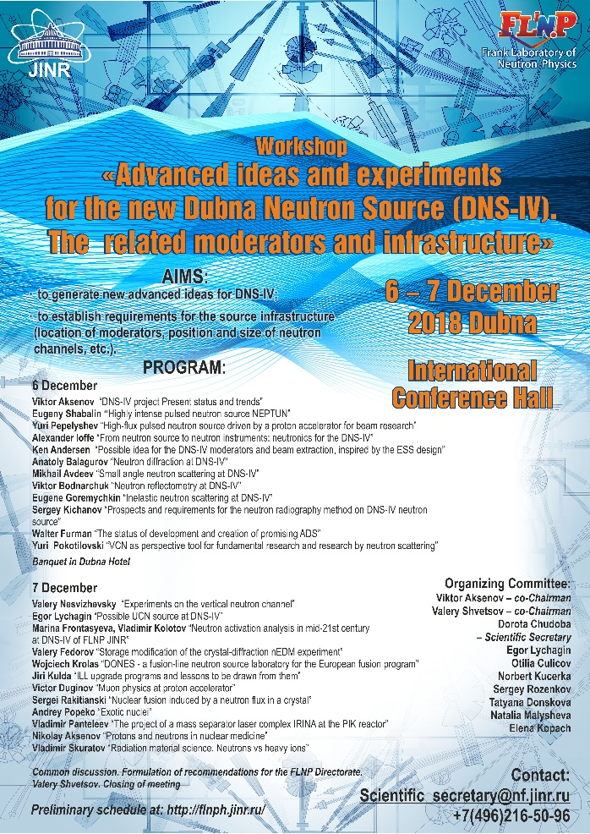
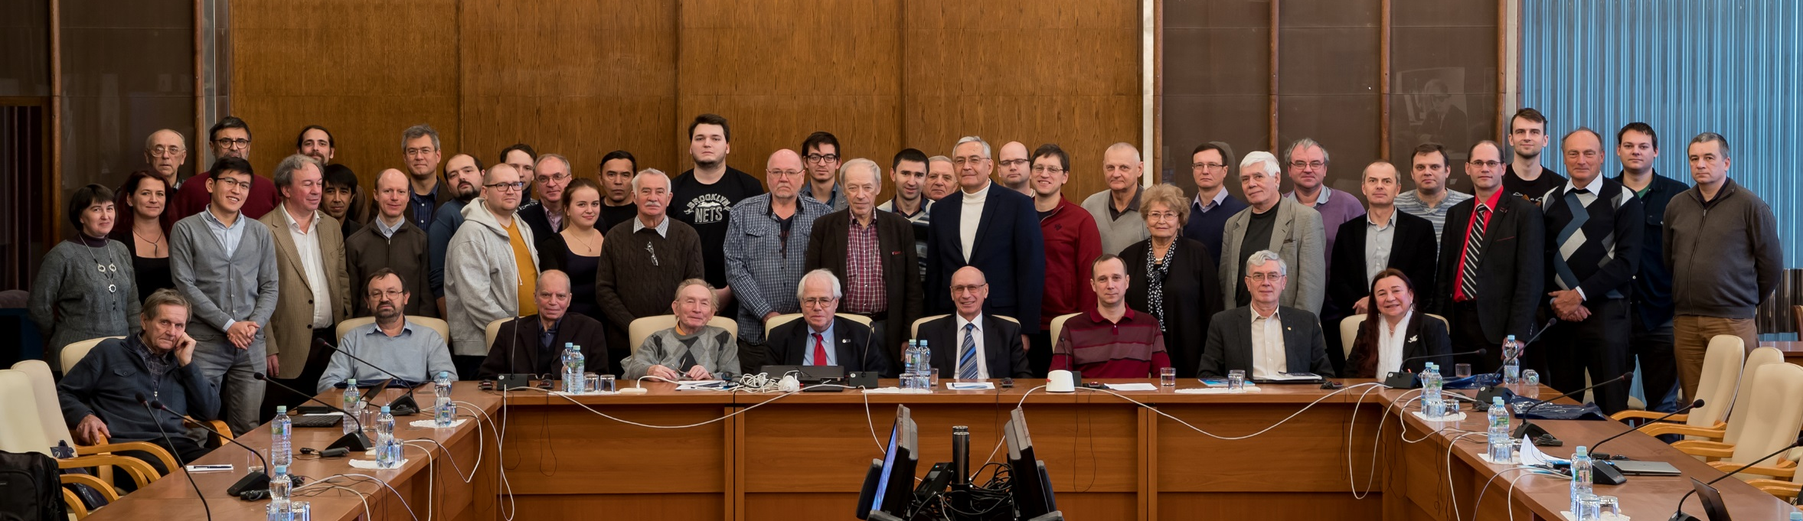
Meetings and workshop
Regular semiannual meetings of the WSG-5:
June 15, 2018; January 23,2019; June 18, 2019
International Workshop (December 6-7, 2018):
46 participants from Sweden, France, Germany, Hungary, Slovakia, Poland and Russia
leading European and Russian neutron centers were represented.

Slide 4
A New Advanced Neutron Source at JINR:
Dubna Neutron Source (DNS-IV)
A long-term strategy aiming:
to construct a world leading neutron source DNS-IV at JINR
to open unprecedented possibilities for scientists from JINR member states and worldwide for research in condensed matter physics, fundamental physics, chemistry, material and life science.
Project is extended over two strategic planning periods, till 2036.
Estimated construction costs (incl. instrumentation) - about 500M€

Slide 5
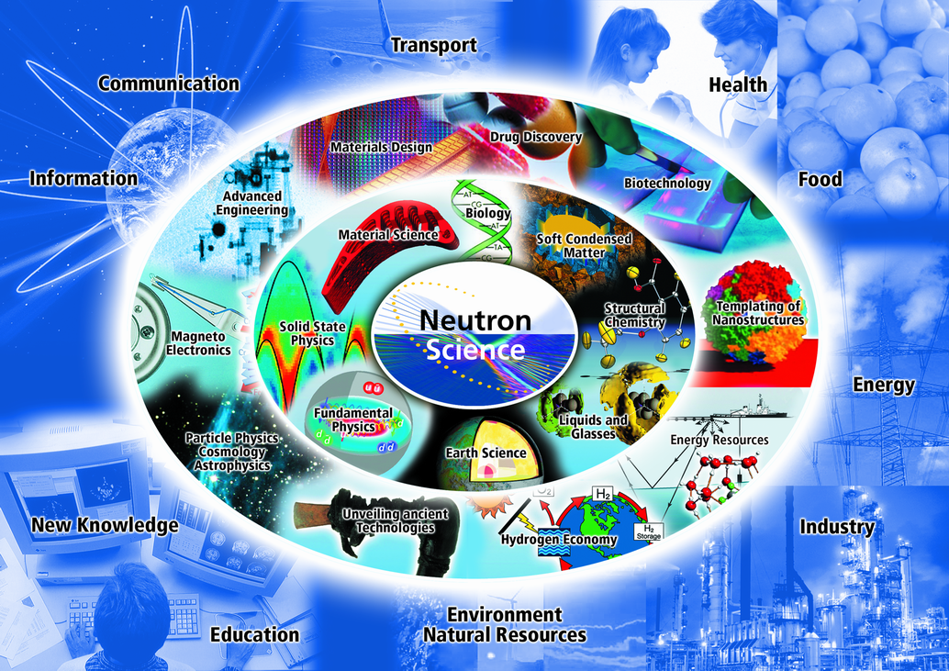
Neutron Science – critical applications in:
Condensed matter physics
(new materials, material design)
Information technologies (spintronics)
Fundamental physics
Life science: Biophysics, Pharmacology and Medicine – drug design and delivery
Engineering

Slide 6
Neutrons are enormously important for Condensed Matter Physics
It explores the fundamental properties of matter and their origins resulting from the interactions of a large number of atoms and electrons
It explains the material world around us
It is the broadest field of physics, interconnecting the physics with chemistry, biology, geology, and astronomy, as well as nearly all fields of engineering
Notes:
Condensed Matter Physics (CMP) explores the fundamental properties of matter and their origins resulting from the interactions of a large number of atoms and electrons. The intricate nature of these interactions results in properties and associated phenomena that often hint at a rich vein of underlying physics.
Condensed-matter and materials physics (CMMP) is the science of the material world around us. From the dawn of civilization, curiosity about the natural world has led to questions about the character of everyday substances such as water, snow, ice, and rocks, and how these respond to light, heat, and mechanical forces.
Materials and their behaviors are also key elements in other branches of science; as a result, CMMP is the broadest field of physics. Advances in CMMP have an impact that is immensely amplified by the intrinsic interconnectedness of CMMP with other fields of physics, chemistry, biology, geology, and astronomy, as well as nearly all fields of engineering.

Slide 7
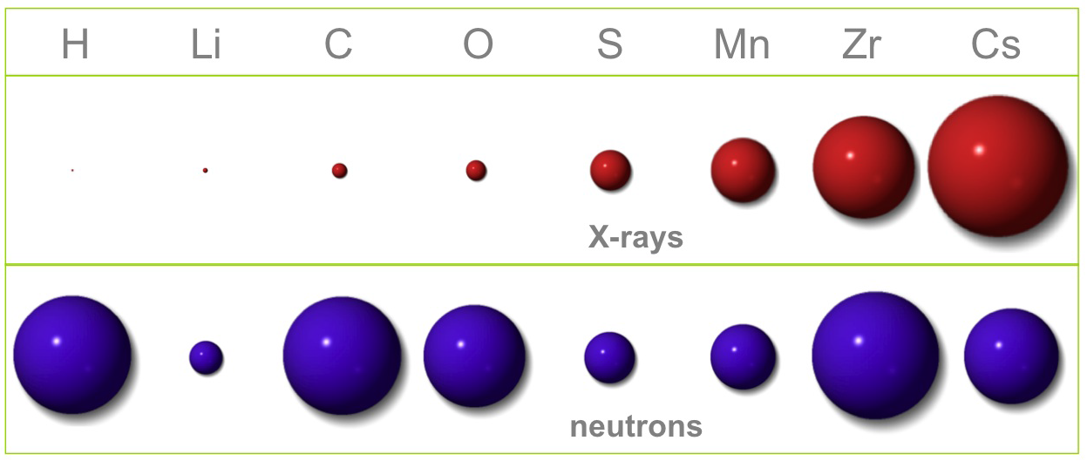
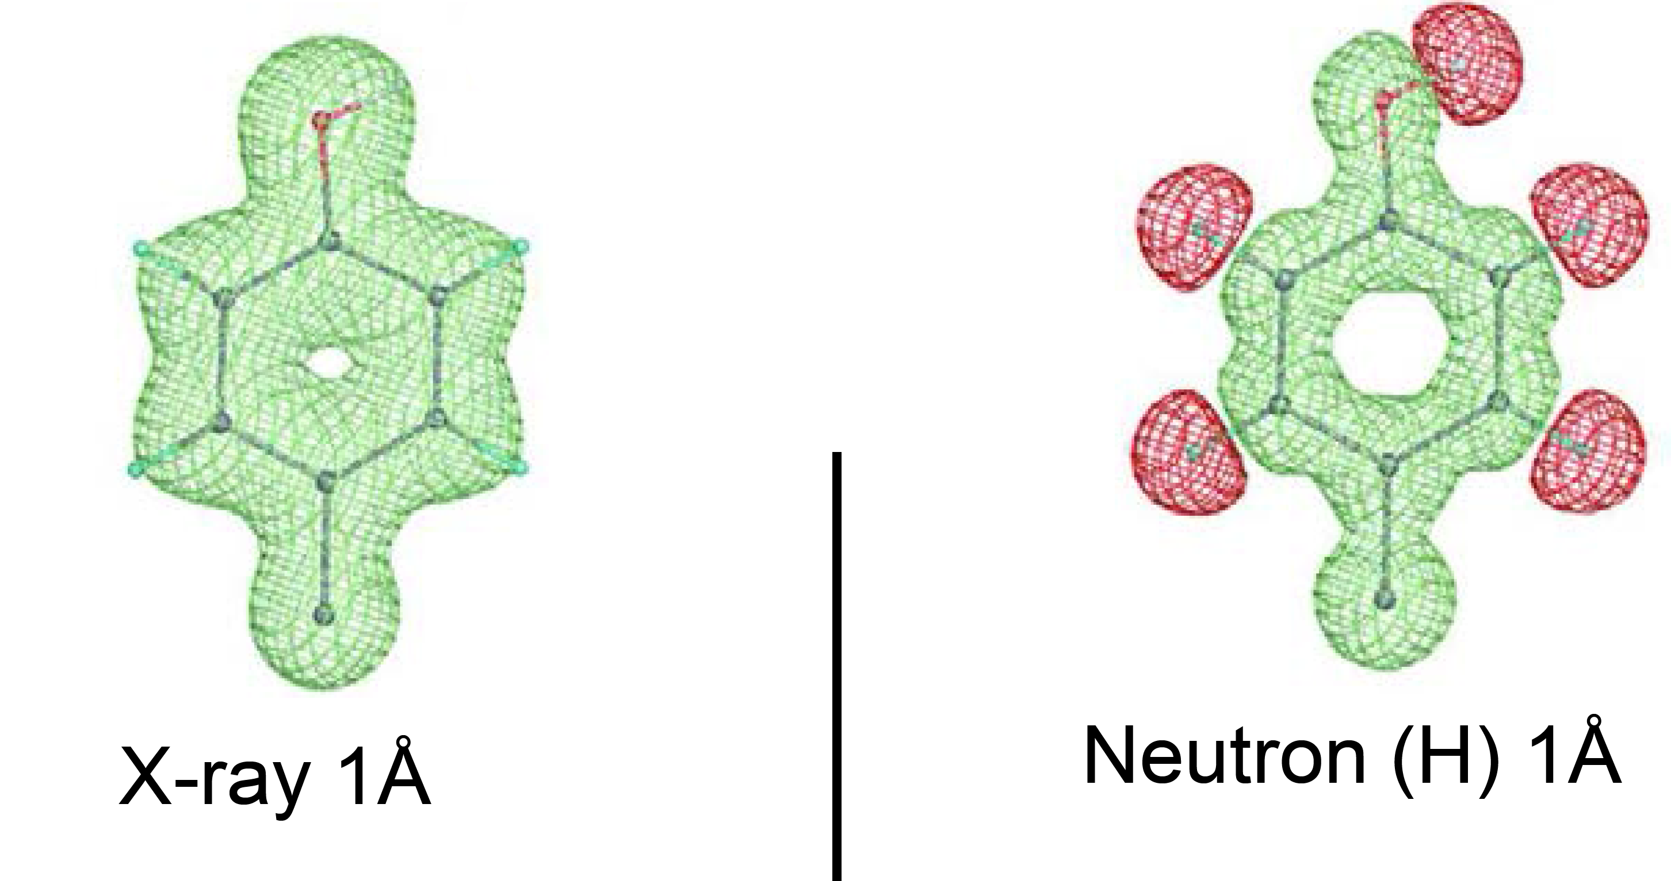
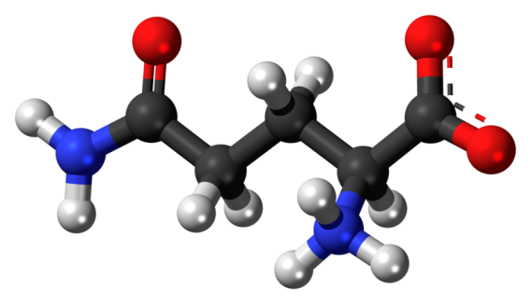
Neutrons vs. X-rays
Neutron scattering - no systematic A(Z) dependence => light elements are not masked by heavy ones
X-ray and neutron scattering power
X-rays: scattering ∼ Z
H⁺ is not visible for X-rays at the background of heavier atoms, but very well visible for neutrons!
Neutrons: irregular scattering
Neutron scattering clearly distinguish between neighboring atoms (for biology, particularly N, C and O)
Refining structure of proteins => drug design
Neutron energies: kT_{room}≈ 0.01eV (cf. 10-100 keV for X-rays)
=> non-disturbing and non-destructive probe;
=> much more sensitive to weak and slow atomic motions.
Neutrons: isotopic contrast! H/D difference – invaluable for biology

Slide 8
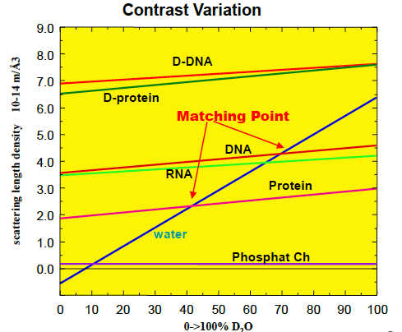
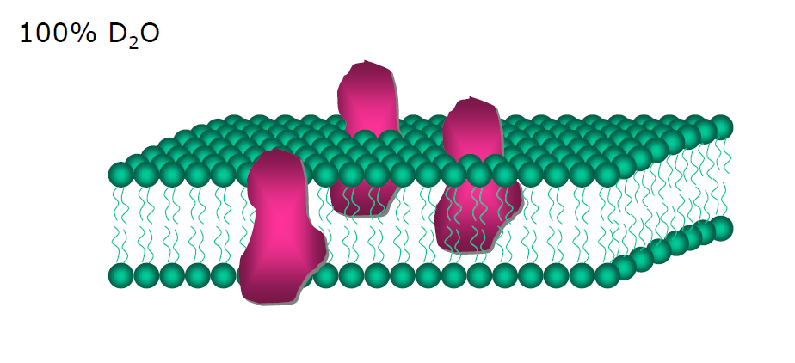
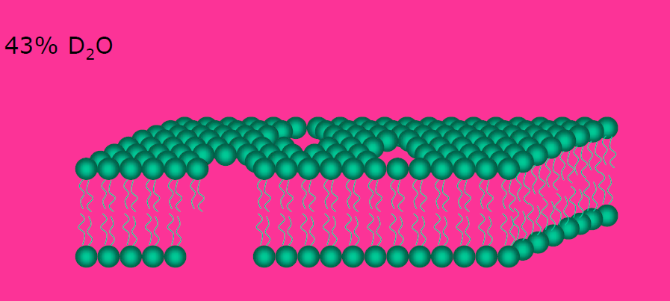
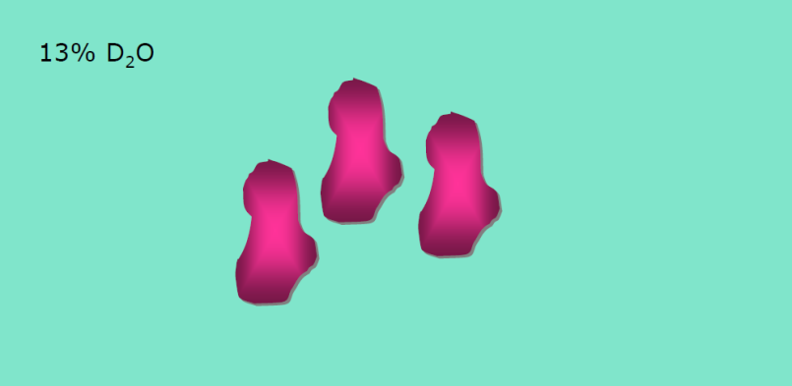
Neutrons vs. X-rays
H/D difference – isotopic contrast
Contrast variation
100% D₂O
D₂O
43% D₂O
H-protein contrast match
Scattering length density
13% D₂O
Phospolipid contrast match
H₂O
0 --> 100% D₂O
neutron anomalous magnetic moment => microspoic magnetic probe (polarized neutron scattering , polarimetry)
Zero charge => deep penetration (cm) without losses (cf. μm for X-rays)

Slide 9
Fundamental physics at DNS-IV
Very cold neutrons (VCN) - wavelengths 20Å to 100Å:
fundamental physics (search for neutron-antineutron oscillations; neutron lifetime measurements, search for extra-short-range interactions at neutron scattering, experiments with neutrons in a whispering gallery);
developing new techniques for condense/soft matter physics (high-resolution neutron spin-echo technique, reflectometry, high-resolution inelastic scattering, small angle scattering)
Ultra cold neutrons (UCN) - wavelengths > 600Å
traditional research with UCN (neutron lifetime measurement, neutron EDM search, precise measuring quantum states in gravitational field as tool for search new types of interaction, etc.);
new techniques for condense/soft matter and surface physics (high-resolution neutron microscopy, reflectometry);

Slide 10
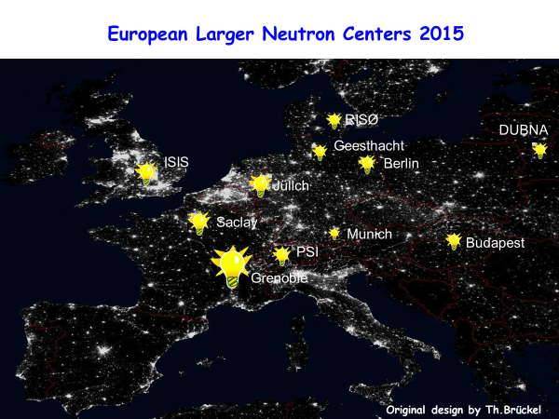
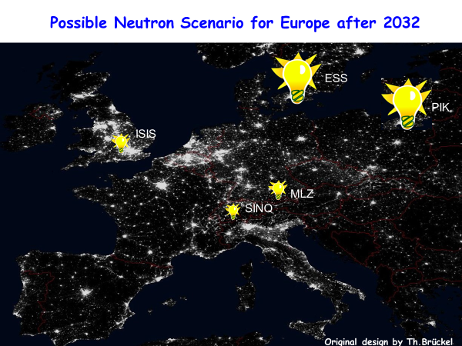


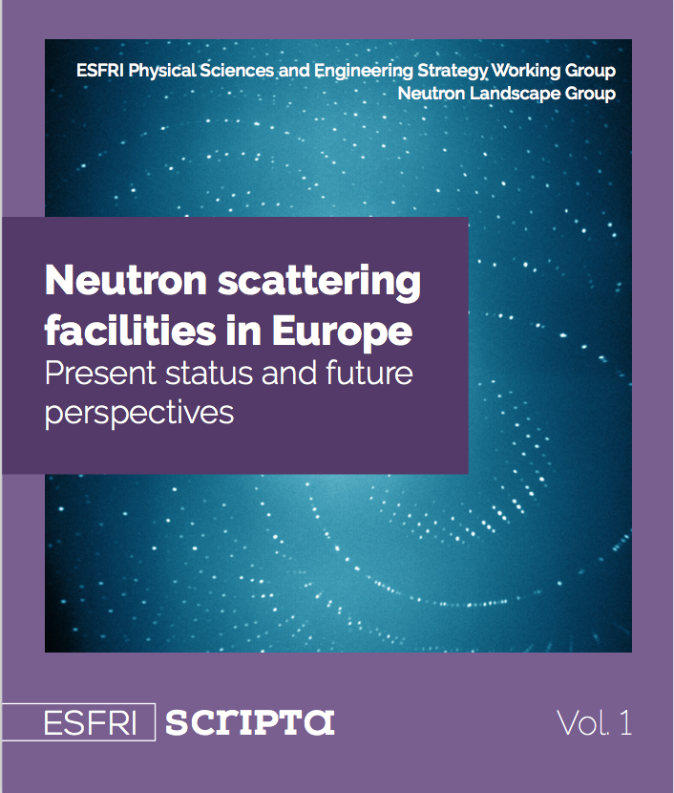
European neutron landscape
2016
2036
ЕSS
PIK
DUBNA
ISIS
DUBNA
FRM2
FRM2
ILL
Inevitable shortage of neutron access
Clear need in a new neutron source

Slide 11
World neutron landscape
2019
2036
ЕSS
PIK
DUBNA
ISIS
DUBNA
FRM2
FRM2
ILL
DNS-IV

Slide 12
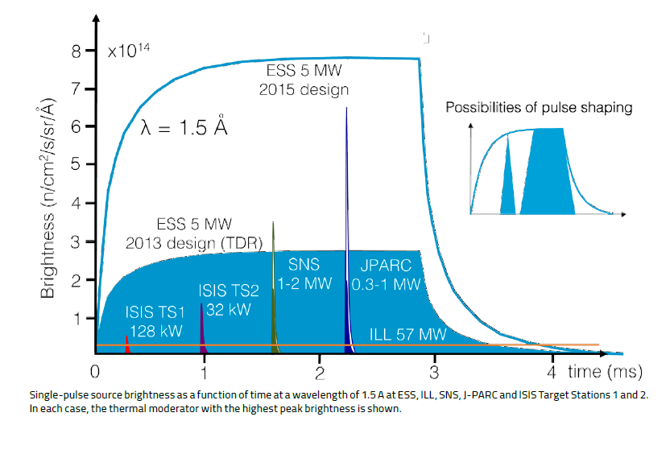
New Dubna neutron source
DNS-IV - not just another neutron source,
but one of the best in the world!
Pulsed neutron source: peak neutron flux instead of mean neutron flux.
significant gain in the instrument performance
All neutron sources built during last two decades are pulsed sources (ISIS-2 (UK), J-PARC (Japan), SNS (USA).
European Spallation Source (ESS) – the most advanced neutron source (to be operational in 2024)
Φ_{peak}
Pulsed source
Flux
τ
Reactor
source
Φ_{mean}
Neutron pulses at different facilities
T
t
IBR-2M
IBR-2M
ESS
Instruments at ESS will outperform
similar instruments at ILL by 20-100 times!
New Dubna source will be benchmarked against the ESS.
λ=1.5Å
Mean flux of ILL

Slide 13
New Dubna Neutron Source: DNS-IV
DNS-IV - not just another neutron source, but one of the best in the world!
Long pulse neutron source, however shorter pulse than at ESS (0.3ms vs. 3ms)
10 times higher magnitude
Pulse shaping
ESS long pulse is good for low resolution experiments
High resolution requires pulse shaping => intensity losses
DNS-IV: Φ_{peak}~10¹⁶
IBR-2M
x10
New Dubna source will provide shorter neutron pulses, however containing the same number of neutrons as at ESS.
=> it will be as good as ESS for low resolution experiments and better for high resolution experiments.
λ=1.5Å
Mean flux of ILL

Slide 14
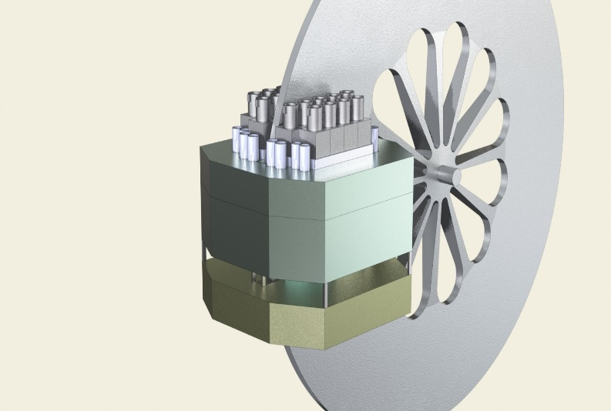
DNS-IV: two alternative concepts
1. Pulsed reactor IBR-3
Reactivity modulator
2. Accelerator-driven neutron source: spallation + multiplier
Core +reflector
E. Shabalin et al.
Core +reflector
Reactivity modulator
Proton beam
A. Vinogradov et al.

Slide 15
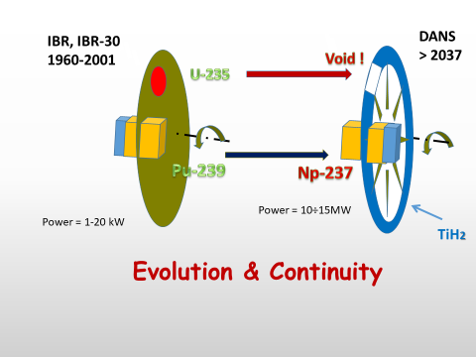
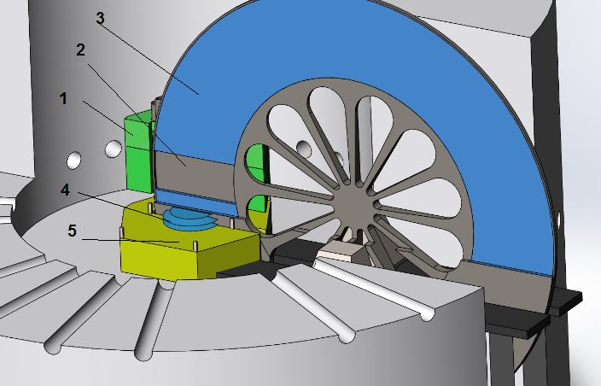
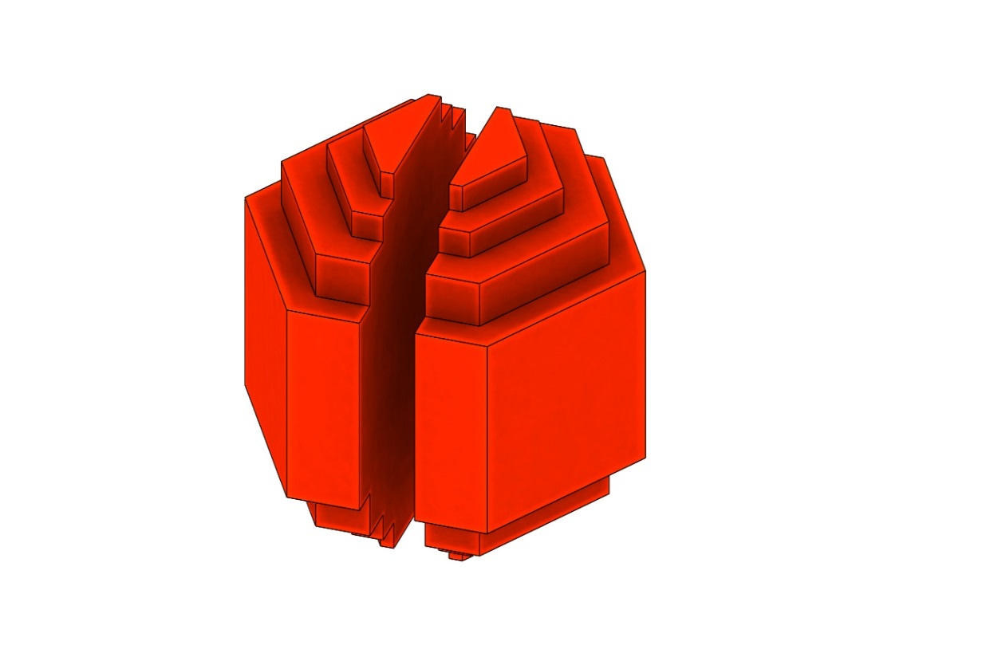
DNS-IV: two alternative concepts
1. Pulsed reactor IBR-3
E. Shabalin et al.
Reactivity modulator TiH₂
From IBR-2 to IBR-3
DNS-IV
> 2036
1- Np-237 reactor core, 2 - empty sector of reactivity modulator, 3 - reactivity modulator coated with TiH₂ , 4 - moderator, 5 – Be reflector.
thermal power of 10-12 MW
modified moderator placement geometry
=> neutron flux density 10¹⁴ n/cm²/s
Spherical core
to reduce the amount of Np-237.

Slide 16
DNS-IV: two alternative concepts
2. Accelerator-driven neutron source: spallation + multiplier
PuO₂ core operating in the deep under-critical mode
neutron multiplication factor of about 20-50
W target
Core + reflector
PuO₂
Proton beam
A. Vinogradov et al.
the same neutron flux as at ESS can be achieved by a 1.2GeV proton accelerator with the (20-50) times less beam power (0.1 MW vs. 5MW@ESS).
technical problems to be solved - the influence of instability of the accelerator’s operation on the stability of the operation of the booster.

Slide 17
Both options are under the feasibility study in N.A. Dollezhal Research and Development Institute of Power Engineering (NIKIET), Moscow
A positive feedback was already obtained for the IBR-3 project
Roadmap for design and construction of DNS-IV:
©NIKIET

Slide 18
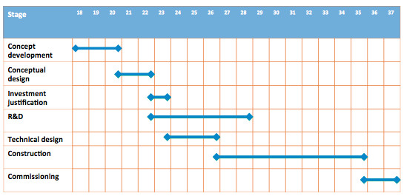
Both options are under the feasibility study in N.A. Dollezhal Research and Development Institute of Power Engineering (NIKIET), Moscow
A positive feedback was already obtained for the IBR-3 project
Roadmap for design and construction of DNS-IV:
©NIKIET

Slide 19
Highly efficient neutron source: maximal use of the emitted neutrons and neutrons delivered to instruments
Moderator
(spectra transformer)
Delivery system
(neutron guide)
Sample
Neutron Source
φ_{emitted}
φ_{delivered}
Expected gain vs. IBR-2:
Flux | 10
Moderators | 2-3
Delivery system | 5-7
Instruments | 3-5
Total | 300-1000
Neutron source will be built in combination with proper moderators, neutron delivery system and instruments.

Slide 20
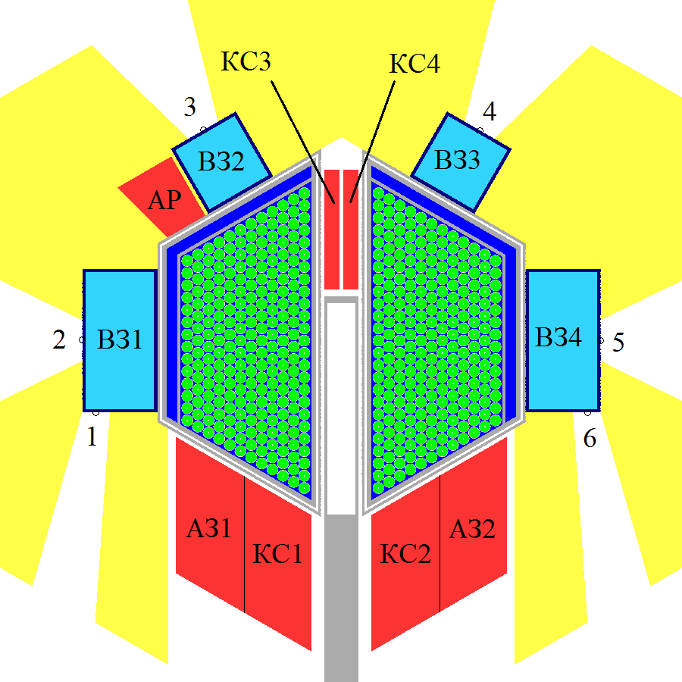
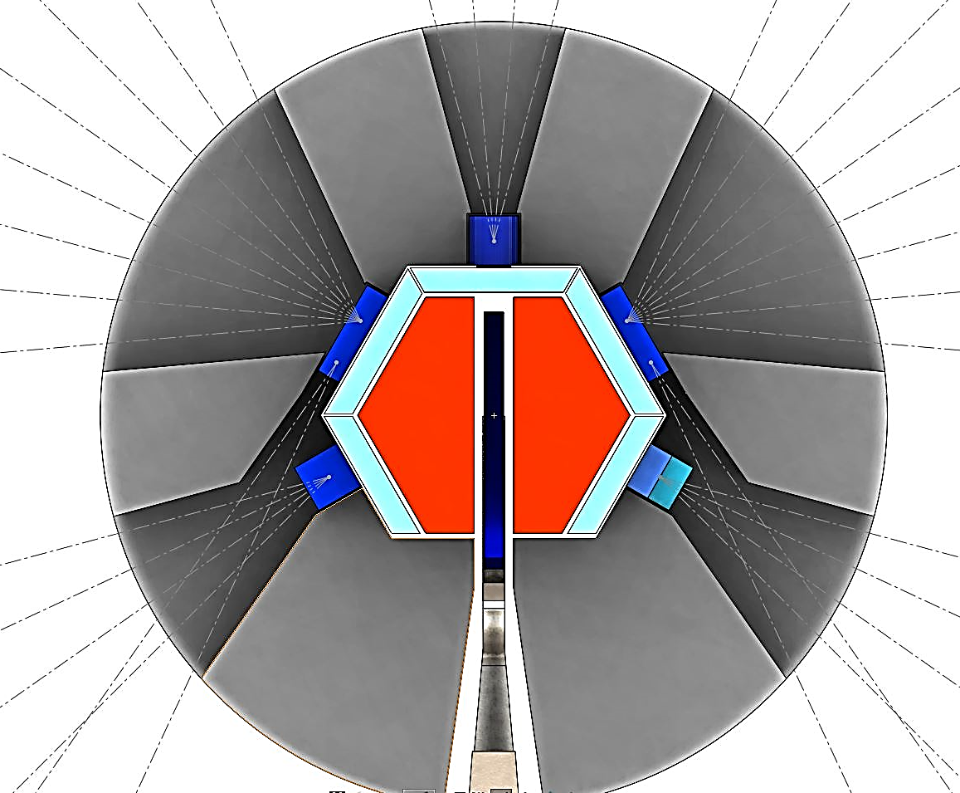
Plans for 2023-2030
1. Development of the final concept of modern thermal and cold moderators
Grooved moderators (high intensity)
Low-dimensional moderators (high brilliance)
30 K
(4 instr.)
30 K
(4 instr.)
32 beamports separated by 10°
CM-2
CM-3
30 K
(6 instr.)
80 K
(6 instr.)
CM-1
CM-4
Core
30 K
(2 instr.)
300 / 80 K
(2 instr.)
Converters for very cold neutrons (VCN/UCN factory)
time focusing of UCN at pulsed neutron beam.
construction of the VCN source prototype with directed extraction of neutron beam.
optimization of various moderators and UCN extraction systems for DNS-IV

Slide 21
2. Design of modern neutron instruments
Plans for 2023-2030
Monte-Carlo simulations and optimization of neutron delivery system – maximal use of the emitted neutrons.
Monte-Carlo simulations and optimization of neutron scattering instruments – maximal use of the delivered neutrons.
Development of dedicated Monte-Carlo simulation procedures
3. Design of the high-efficient neutron delivery system
Ballistic, elliptic and parabolic neutron guides
4. IBR-2 Instrumentation Development
Construction, installation and commissioning of two inelastic neutron scattering spectrometers in inverted and direct geometry at the beamline #2;
Upgrade of the all IBR-2 instruments;
Design of the instruments for DNS-IV, testing the key technologies prototypes at the IBR-2;

Slide 22
Conclusions
Systematic shortage of the neutron beamtime in Europe and worldwide raises demand in construction the new neutron sources;
We propose the new advanced neutron source at JINR (DNS-IV) (the combination with modern moderators, neutron guides and instruments), which promises to be one of the best in the world;
DNS-IV will open unprecedented possibilities for scientists from JINR member states and worldwide for research in condensed matter physics, fundamental physics, chemistry, material and life science;
FLNP possesses the high-level competence in construction and operation of pulsed neutron sources, cold and ultra-cold neutron sources and neutron instrumentation;
FLNP is also staffed by a large number of motivated young scientists and engineers eager to work on this new exciting project;
The planned start of the DNS-IV operation is 2036-2037;

Slide 23
Thank you for your attention!

