Slide 1
NICA Project Management
Information System
Morozov V.
Conference of Young Scientists and Specialists "Alushta 2016"

Slide 2
Аннотация
Цель данного доклада — описание использования современных методов планирования в системе управления проектом создания в ОИЯИ крупного коллайдерного комплекса NICA (Nuclotron based Ion Collider Facility). В докладе сформулированы гибкие и эффективные методы повышения уровня специализации управленческой деятельности с учетом специфики Объединенного института ядерных исследований как международной межправительственной научно-исследовательской организации, необходимые для успешной реализации проектов такого уровня, а также приведены результаты по расширению существующего функционала на основе информационной системы ADB2, такие как: система отчётов по ходу реализации проекта (интеграция с MS Project) и NICA EVM Costbook.

Slide 3
Plan:
Mega project NICA (history of development, goals and objectives, particularly the implementation);
Methods and tools of modern project management;
Project Management Information System NICA;
Expansion of an existing functional NICA EVM based on ADB2 (NICA EVM integration and MS Project, Costbook).

Slide 4
Megaproject NICA
Project NICA/MPD is a part of the JINR Roadmap for 2009-2016 is described in the JINR 7-years Program
Project NICA
One of the most important directions
Project NICA/MPD, a modern accelerator facility, will support world-leading programs in long base line relativistic nuclear physics and particle spin physics, radiobiology, applied research and education
Large and complex
> $ 500 million
Big amount of participants and stakeholders
Implemen-tation period > 5 years
The main goal of the project is a study of hot and dense strongly interacting matter in heavy ion (up to Au)

Slide 5
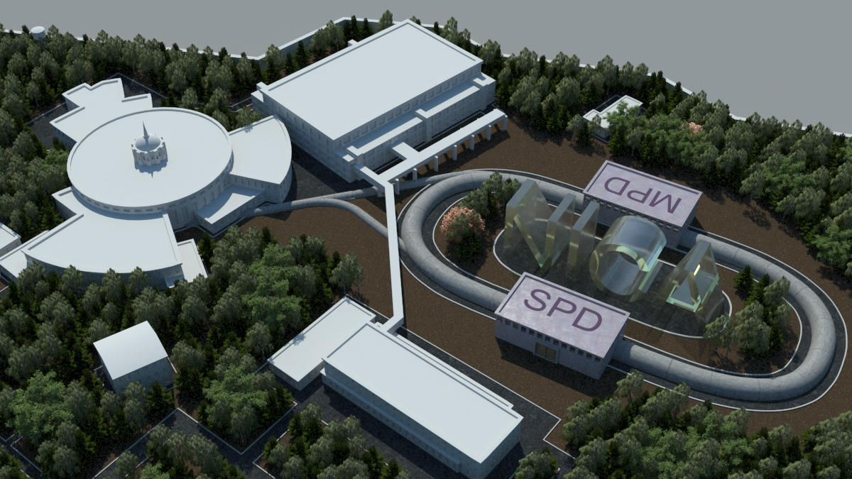
The NICA Complex
Accelertor complex LHEP
PS and
LU-20 (5MeV/u)
Experiments
with fixed targets
bld. 205
existing
60 000 m²
NUCLOTRON 0.6-4.5 GeV/u

Slide 6

The NICA Complex
KRION-6T+HILac (3MeV/u)
Accelertor complex LHEP
PS and
LU-20 (5MeV/u)
Experiments
with fixed targets
bld. 205
existing
BM@N
In preparation
SPD
Booster
(600 MeV/u)
Collider NICA
(1-4.5 GeV/u, C=503 m)
NUCLOTRON 0.6-4.5 GeV/u
MPD
MultiPurpose
Detector - MPD

Slide 7
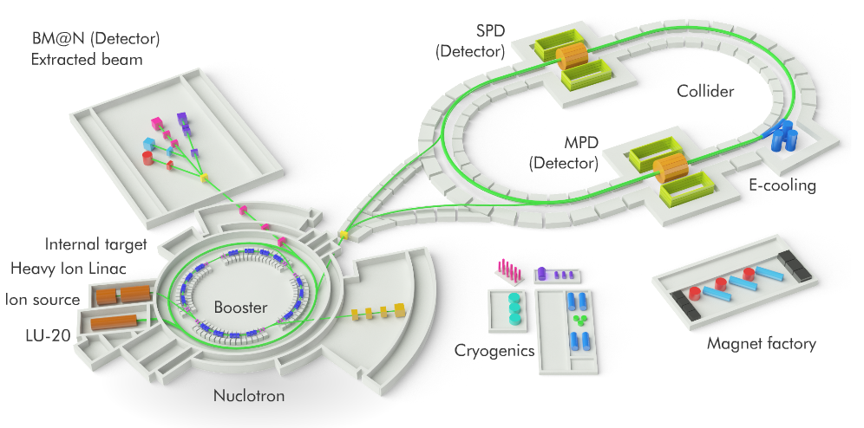
Мегапроект NICA
НИКА представляет собой кольцевой ускоритель (циклотрон), способный разгонять и сталкивать пучки протонов и тяжелых ионов вплоть до очень массивных ионов золота.
Планируемая кинетическая энергия ионов достигнет 4,5 ГэВ/нуклон, протонов — 12,6 ГэВ. Источником пучков для коллайдера станет модернизированный ускоритель «Нуклотрон» (построен в 1993 году). В двух точках столкновения встречных пучков разместят экспериментальные установки MPD и SPD.

Slide 8
International standards in project management
PMBOK®
(Project Management Body of Knowledge)
Project Management Institute
ICB
(International Competence Baseline)
International Project Management Association (IPMA)
PRINCE2
(PRojects IN Controlled Environments 2) Developed in the UK in the late 1990s
P2M
(A Guidebook of Project and Program Management for Enterprise Innovation) Project Management Association
of Japan (PMAJ)

Slide 9
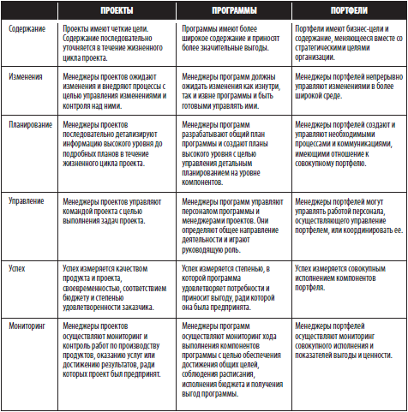
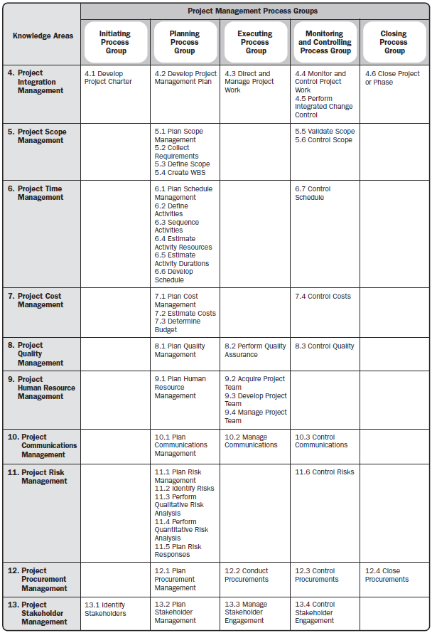
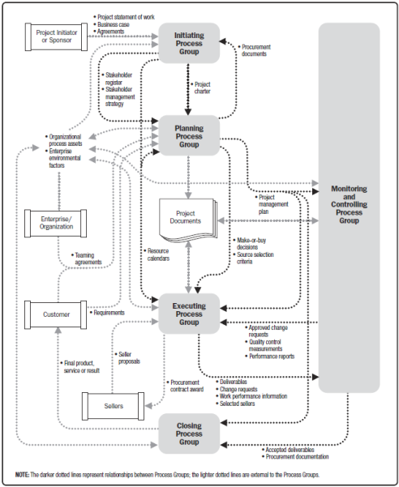
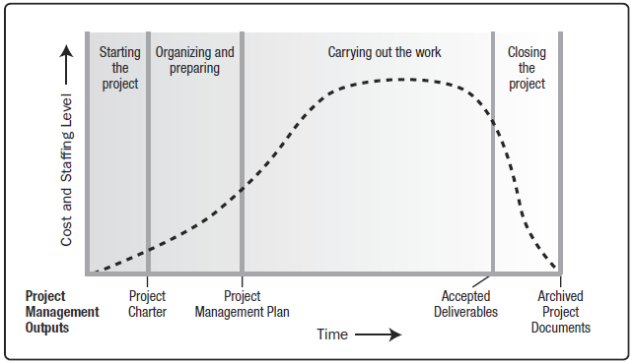
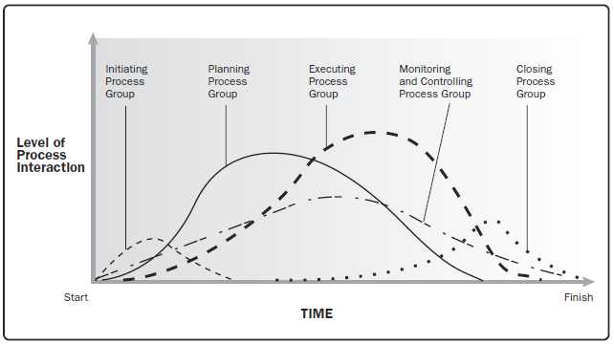
PMBOK®
42 processes of PM
5 process groups
9 knowledge areas

Slide 10
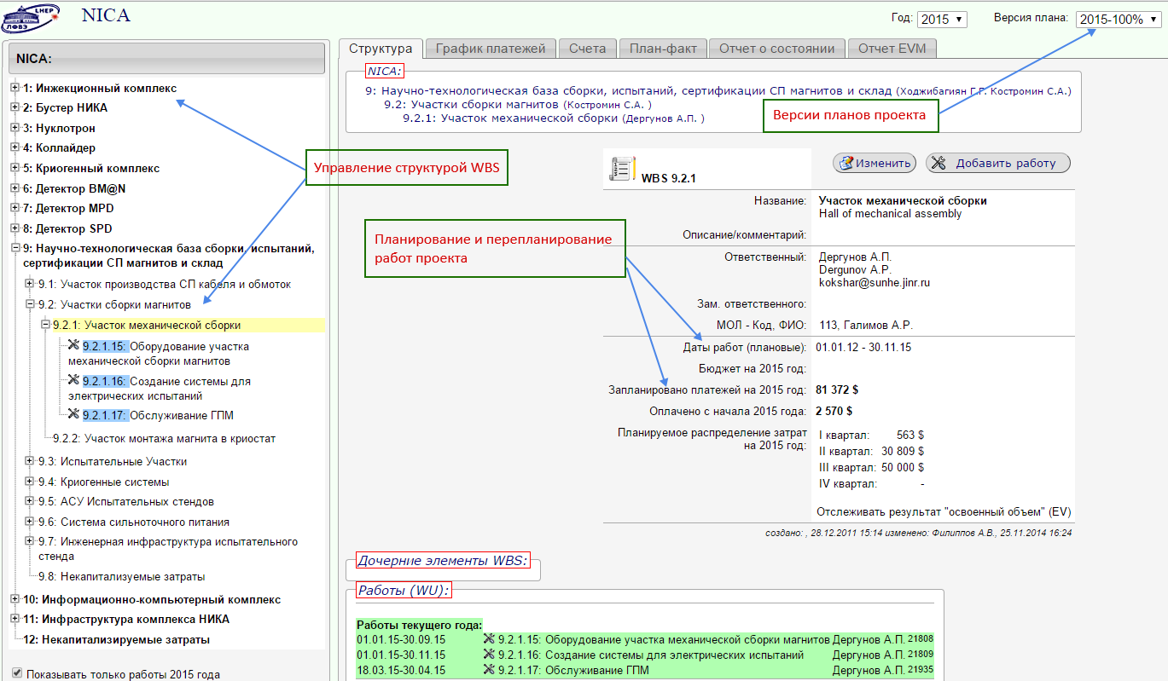
NICA Project Informational System
WBS structure management and WU binding to the responsible persons;
Project works planning and replanning;
Versions of project plans (baselines);

Slide 11
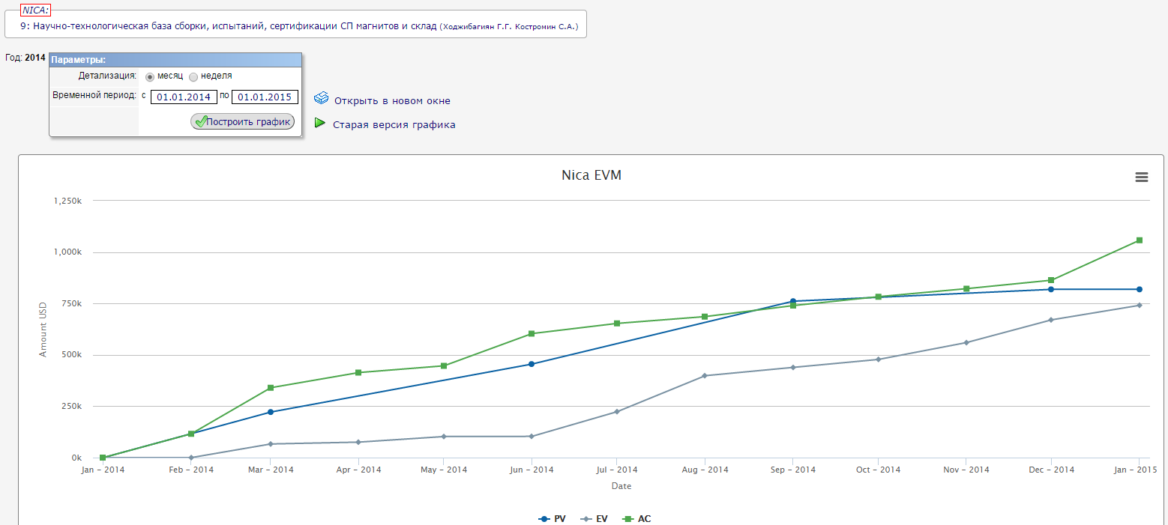
NICA Project Informational System
Work progress tracing in terms of AC (actual payments) and EV (earned value or % performance);
Notification system users by e-mail (for current progress report of the works);
Reports (some figures and etc.) according to the EVM procedure (PV, AC, EV);

Slide 12
The map of work in NICA EVM(JINR)
NICA EVM

Slide 13
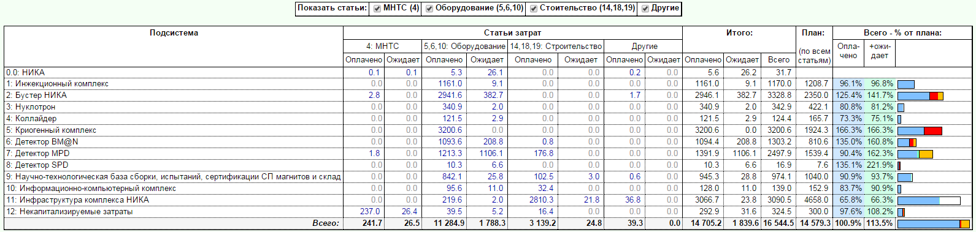
NICA Project Informational System
The project Financial Statements taking into account the "annual frame", the features of the JINR budget and payment schedules for project work;

Slide 14
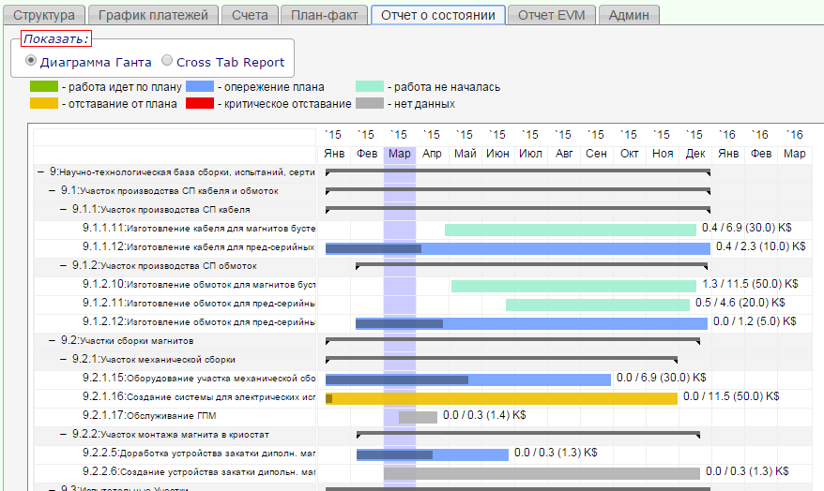
NICA Project Informational System
WEB interface

Slide 15
Accounting for capitalized objects
The hierarchical structure has been constructed and decomposed :
The first level WBS identifies eleven largest elements, which from the point of view of Russian accounting standards are capitalized objects;
Information about the actual costs incurred on capitalized objects collected in ADB2 system and transmitted to the system 1C accounting;
Service Commerce accounting system corresponds Russian standards and generates a value of fixed assets of the megaproject NICA (material costs).

Slide 16
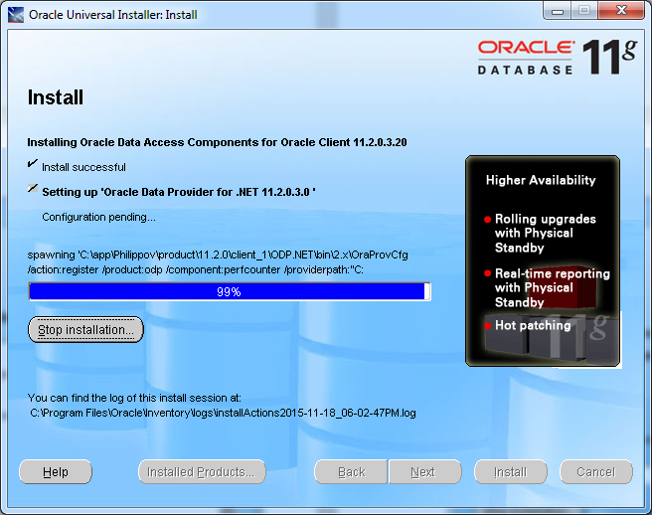
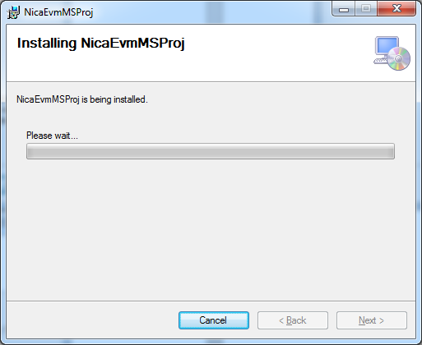
Integration ADB2 и MS Project
Installing client ORACLE and NicaEvmMSProj plug on PC

Slide 17
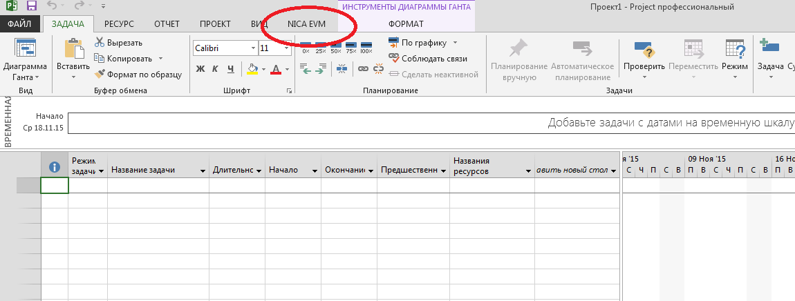
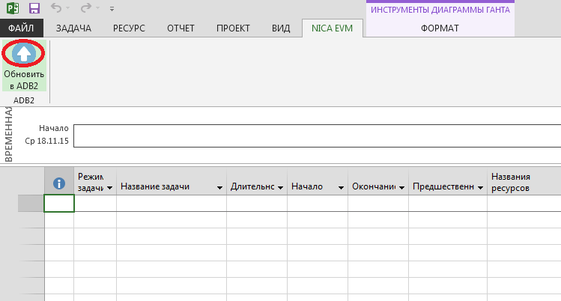
Integration ADB2 and MS Project
Functional NICA EVM is implemented in MS Project. Information from MS Project directly send the ADB2 system through the update ADB2 NicaEvmMSProj plugin. This plugin allows you to decompose the work at the lowest level, as well as monitor progress and set necessary to control or performance parameters and indicators (Milestone), available only in MS Project

Slide 18
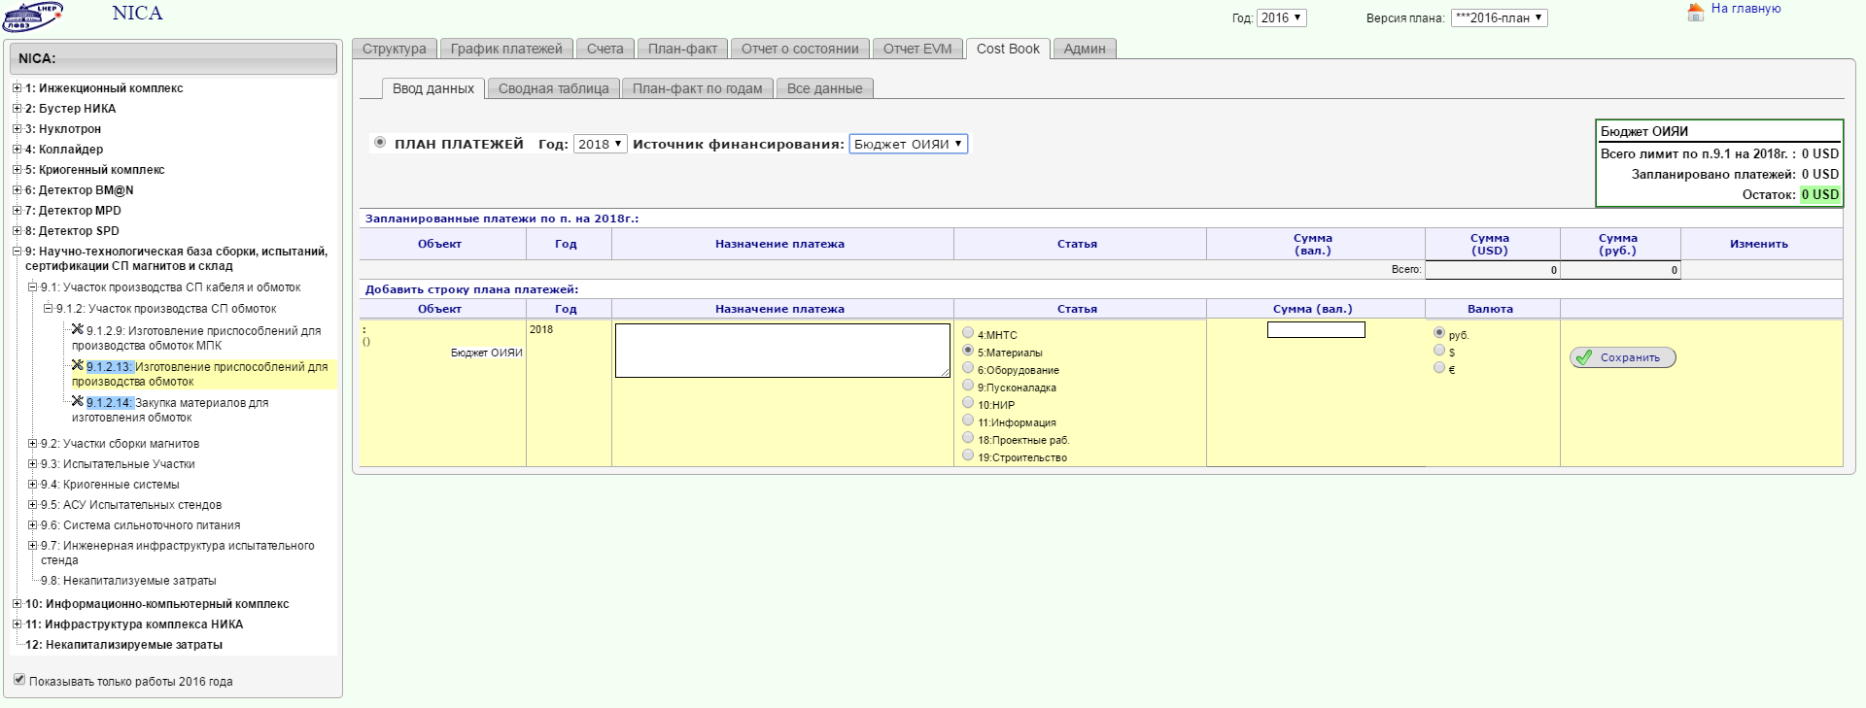
NICA EVM Costbook
The Costbook was created in ADB2 system as a tool to obtain complete information on the NICA project costs, as well as a detailed consolidation of all the costs of previous or future purchases for this megaproject from the budget of the JINR, the Russian Federation and other countries involved in the project NICA

Slide 19
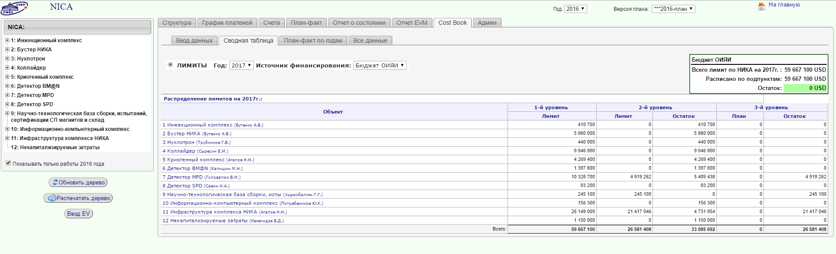
NICA EVM Costbook
Costbook structure is designed in a specificity of realization of the NICA megaproject at JINR and will be filled from the bottom up (the ideological principle of the project cost), and a method of filling the top down (the waterfall method) in a limitation of the JINR budget, the Russian Federation and others involved in the project countries for the next seven years.

Slide 20
Results
Operational control unit has extended functionality (through the integration of ADB2 and MS Project). This unit will allow the work to decompose the WBS NICA to the lowest level and provide a wide range of personalities for the control and execution of their own work with the help of various indicators and parameters. Project managers receive timely and full information on the conduct of various activities in each subsystem of the NICA project.
The structure of the Costbook megaproject NICA is designed to allow staff and project managers have a detailed plan(budget) of the project for the next 5-7 years into conditions the budgeting of the different sources of funding. Costbook provides a global understanding of the price of the project and have detailed plan for the upcoming year to be purchased by mega-project(have a legend and versioning plans of previous periods, can keep a complete financial history of the project)
Plans for 2016: new types of charts, including the forecast reflecting the progress of work on the current data(for operational monitoring of work progress) will be added to the NICA EVM system;

Slide 21
Thank you for your attention!
06/06/2016
vmorozov@jinr.ru

