Slide 1
Scientific Data Processing Portal and Heterogeneous Computing Resources at NRC “Kurchatov Institute”
V. Aulov, D. Drizhuk, A. Klimentov, R. Mashinistov, A. Novikov, A. Poyda,
E. Ryabinkin and I. Tertychnyy
NRC “Kurchatov Institute”

Slide 2
Project objective
Scientific data processing portal design, development and implementation to integrate large scale heterogeneous computing facilities as a common computing infrastructure.

Slide 3
“Kurchatov Institute” Computing Resources
The supercomputing facilities for Collective Usage includes high performance cluster with peak performance of 122.9 TFLOPS. It consists of 1280 nodes, with 2/8 cores CPUs per node (10240 cores total). Nodes operate under CentOS Linux and SLURM batch system.
One of the largest Russian Grid centers (WLCG Tier-1 center). The Tier-1 facility processes, simulates and stores up to 10% of total data for three LHC experiments (ALICE, ATLAS and LHCb).
OpenStack based Academic Cloud platform having performance 1.5 TFLOPS and providing 16 nodes, 256 cores, 512 Gb RAM and 60 Tb at storage system.

Slide 4
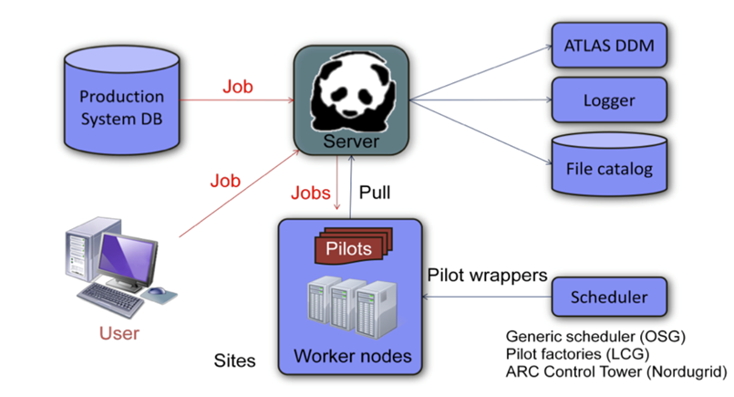
Method
Adopt the methods being used in the LHC High Energy Physics Experiments for BigData processing in other sciences.
The ATLAS Production and Distributed Analysis workload management system (PanDA) has been chosen as a base technology for the portal.
Basic PanDA scheme used in Kurchatov Institute

Slide 5
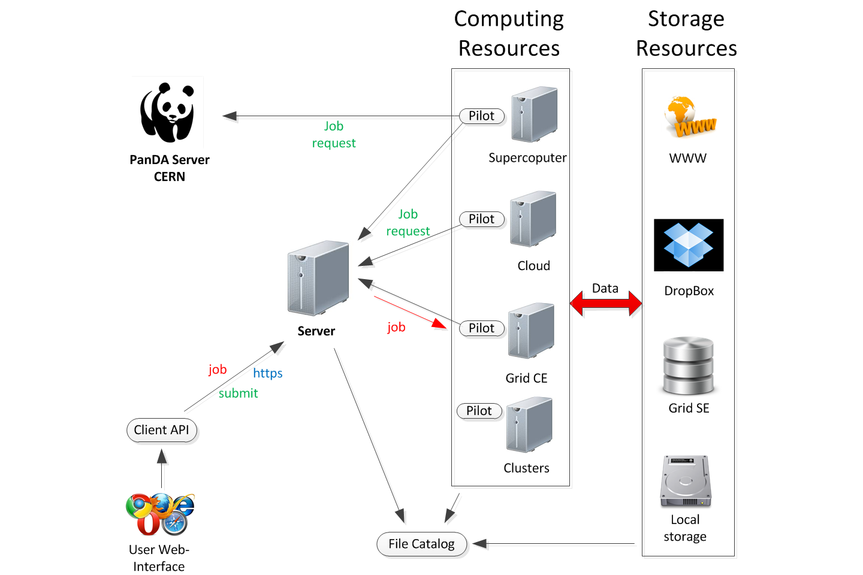
Computing portal at Kurchatov Institute
Web-user interface (python/FLASK)
File catalog & data transfer system (DDM)
Plugin based (ftp, http, grid and etc.)
Authorization OAuth 2.0
API for external applications
Token authentication
Upload/fetch files
Send a job
Get job status/statistics
Private FTP storage for each user

Slide 6
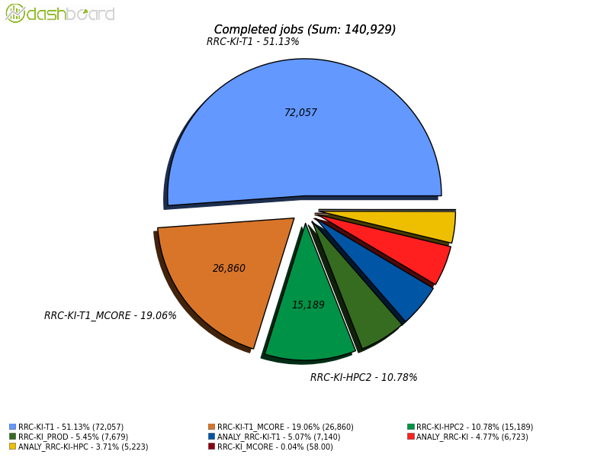
PanDA instance installation
PanDA@NRC KI
server, auto pilots factory, monitor and database server (MySQL)
After APF was installed in 2014 we immediately set up Analysis queue
Condor-SLURM connector
In 2015 we set up Production queue
15,5%
ATLAS MC Production and Analysis
Executed on SC@NRC-KI
It is transparent for Prodsys and Users

Slide 7
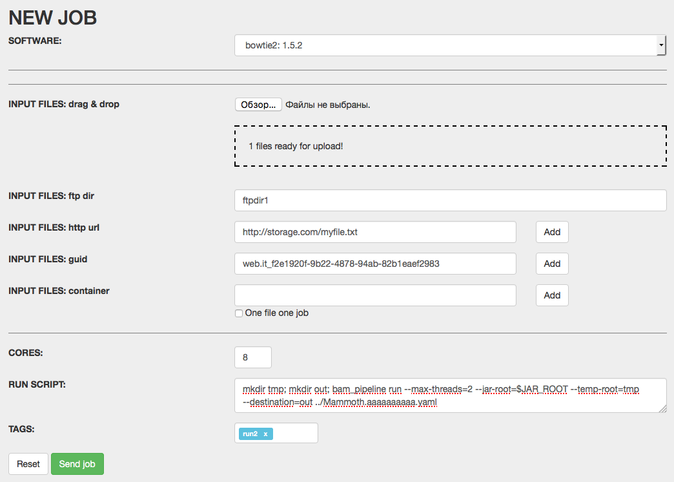
Web-user interface
Job setup interface
Easy setup distributive, input files, parameters and output file names
Local authentication (users don’t need a certificate)
Jobs monitor
After submitting a job you can monitor its status in the "Job list" tab. When the job finishes, you can get your results from the detailed info page
Links to the input/output files

Slide 8
Portal operation: Authorization, API, FTP Storage interaction
OAuth 2.0 authentication
API for external applications
Celery as async executor
WEB-based user interface
WWW
PanDA server
New job
External tools endpoint
API
WEBPANDA interface
files
Private ftp storage for user’s input files
FTP
VWN
VWN
VWN
WN
WN
WN
DDM
NFS
LUSTRE
Cloud
HPC

Slide 9
Typical portal jobs
The portal fits standard PanDA computational scheme and shows most efficiency for compute-intensive tasks that could be split into many sub-jobs to be computed in parallel. To hide execution complexity and manual routines from end-users we introduced and seamlessly integrated into the portal original pipelines control system, that automatically (and without user prompt) split input data, prepare and run sub-tasks as ordinary PanDA jobs and merge results.
prun
prun
init
prerun
split
prun
merge
postrun
finish
interface
runtime
interface
Time
Every pipeline contains several steps
Every step contains one or many standard PanDA jobs
Steps with many jobs can be executed in parallel
Pipeline workflow
Each step contains:
Server Python script
PanDA Jobs (if applicable)
This workflow allows to reduce total computational time by using multi-node parallelization

Slide 10
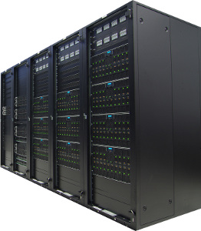
Approbation: biology application
Next Generation Genome Sequencing (NGS)
Analysis of ancient genomes sequencing data (Mammoths DNA) using popular software pipeline PALEOMIX can take a month even running it on the powerful computer resource. PALEOMIX includes typical set of software used to process NGS data
We adapted the PALEOMIX pipeline to run it on a distributed computing environment powered by PanDA.
To run pipeline we split input files into chunks which are run separately on different nodes as separate inputs for PALEOMIX and finally merge output file, it is very similar to what was done by ATLAS to process and to simulate data.
Using software tools developed initially for HEP and Grid can reduce payload execution time for Mammoths DNA samples from weeks to days.
~ 4-5 weeks
135
chunks
…
~ 2-4 days

Slide 11
Summary and Conclusion
PanDA instance has been installed at NRC KI, and it was adapted for the scientific needs of the Center’s users community and integrated with the computing resources at NRC KI.
We developed:
User’s interface to provide scientists with a single access point to the computing resources;
Data Management client to transfer data between disk storage and working node, as well as data stage-in/stage-out.
HTTP API for external applications
The portal has demonstrated its efficiency in running bioinformatical scientific applications, in particular for genome analysis.

