Slide 1
high performance computing with GPU
Anton Dzhoraev
Notes:
We’re at an important juncture in HPC, where the future is being defined today.
Two visions for the future of HPC, the path to Exascale. One vision is self-hosted CPU-only approach.
Other vision is accelerated computing, where CPU and accelerators work together to leverage Amdahl’s Law for performance.
They are two very different visions. We believe accelerated computing is the path forward and will explain why.

Slide 2
The real value of GPU for HPC
Deep Learning in HPC
HPC visualization
Agenda

Slide 3
Credentials built over time
# of Applications
287
300K
Majority of HPC Applications are
GPU-Accelerated, 410 and Growing
300K CUDA Developers,
4x Growth in 4 years
100% of Deep Learning Frameworks are Accelerated
Notes:
In those 10 years, we’ve built a platform that can’t be built over night, or by a single company. commitment, time, and community. After 10 years, accelerated computing is singularly the most important platform for HPC.
Apps: Majority of apps are now accelerated. Every HPC center can enjoy the benefits of GPUs.
Developers: Driven by the world’s largest ecosystem of HPC developers. 4x growth. Why? CUDA and OpenACC uniquely provide simple way to get performance for parallel arch’s.
DL: All frameworks optimized for GPUs

Slide 4
2 of 3 scientists without an essential tool
Data Center Throughput is the Most Important Thing for HPC
National Science Foundation (NSF XSEDE) Supercomputing Resources
Normalized Unit (Billions)
Source: NSF XSEDE Data: https://portal.xsede.org/#/gallery
NU = Normalized Computing Units are used to compare compute resources across supercomputers and are
based on the result of the High Performance LINPACK benchmark run on each system
Notes:
There is a major problem in HPC today, that no one seems to talk about.
2 out of 3 scientists aren’t getting the essential tool they need to do their science.
Computing is one of three pillars of science today, along with theory and experimentation
But there isn’t enough computing resources to meet all the demand of scientists.
NSF data shows >350B core hours were requested. But only 150B core hours are available.
Most of these systems are traditional CPU-only systems. TACC Stampede, SDSC Comet, LSU SuperMIC
Problem getting worse
Existing approach to HPC is just not keeping up.
Data center throughput is the most important thing for HPC today

Slide 5
Weak nodes
Strong Nodes
Lots of Nodes Interconnected with Vast Network Overhead
Few Lightning-Fast Nodes with Performance of Hundreds of Weak Nodes
Notes:
There’s always been two approaches to HPC: weak nodes and strong nodes. Weak nodes = CPU only. Strong nodes = accelerated.
Weak nodes = relatively low performance nodes interconnected with cables, networking switches, etc. To get high perf, need a lot of nodes.
Strong nodes = take as much performance into a single node. Reduce the overhead of cables, etnworking etc.

Slide 6
Two big inefficiencies with weak nodes
Typical Data Center Budget
Typical Strong-Scaling Performance
AMBER Benchmark
Rack, Cabling
Linear scaling
Compute Servers, 39%
Non-compute, 61%
ns/day
Infrastructure
Networking
0
60
80
20
40
100
# of CPUs
Most of budget spent on non-compute overhead
Network overhead causes performance inefficiencies
Sources: Microsoft Research on Datacenter Costs, Amber Simulations on SDSU Comet Supercomputer
Notes:
What it shows is the way HPC has been doing computing is simply not working. And it’s not working in two ways.
Not enough of the budget is spent on the thing that matters the most, on compute.
The pie chart on the left from Microsoft paper on datacenter costs, referenced in this slide it shows the breakup of datacenter costs. The blue slice is compute while the grey is non compute or in other words overheads. For every $ spent on compute, $1.50 is spent on overhead.
Other is that even for nodes that are deployed, users are not getting efficient use of their allocation.
The chart on the right represents a typical performance of any HPC app in this case it is Amber. The performance tapers off and adding more nodes does not give proportionate boost in performance. This leads to users asking for more compute resources just to cover the inefficiencies.

Slide 7
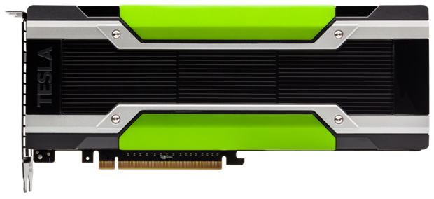
Tesla p100
Most Advanced data center gpu for mixed-app hpc
PASCAL
18.7 TF HP ∙ 9.3 TF SP ∙ 4.7 TF DP
New Deep Learning Instructions
More Registers & Cache per SM
CoWoS with HBM2
Up to 720 GB/Sec Bandwidth
Up to 16 GB Memory Capacity
ECC with Full Performance & Capacity
PAGE MIGRATION ENGINE
Simpler Parallel Programming
Virtually Unlimited Data Size Performance w/ data locality
Tesla P100 for PCIe-based Servers
Notes:
That’s why we’re introducing a new GPU. Tesla P100 for PCIe based servers.
It’s designed to boost data center throughput for HPC and to dramatically save money.
New NVIDIA Pascal Architecture which enables P100 to delivering 4.7 and 9.3 TeraFLOPS of double and single precision for HPC .
The chip on wafer on substrate HBM2 memory unifies data and compute into single package for up to 3X memory bandwidth over prior-generation solution
Page migration engine that simplifies parallel programming and enables datasets to go beyond the physical limits of GPU memory

Slide 8
Massive leap in performance
Speed-up vs Dual Socket Broadwell
CPU: Xeon E5-2697v4, 2.3 GHz, 3.6 GHz Turbo
Caffe Alexnet: batch size of 256 Images; VASP, NAMD, HOOMD-Blue, and AMBER average speedup across a basket of tests
Notes:
P100 is a massive performance jump across HPC and DL workloads, up to 27x performance compared to a CPU node. This chart compares the performance of various DL and HPC applications over a dual socket Broadwell CPU node
K80 was the previous flagship product for HPC, in some cases, such as VASP, AMBER P100 delivers 2x perf boost over K80’s. For DL, P100 delivers almost 3x boost over K80’s.
Remember that K80 has 2 discrete Kepler GPUs on the same board. And across the board, two P100 GPUs beat two K80 GPUs (or four discrete Kepler GPUs).
That’s tremendous value!

Slide 9
Extraordinary Strong scaling
One Strong Node Faster Than Lots of Weak Nodes
CAFFE ALEXNET PERFORMANCE
VASP PERFORMANCE
Single P100 NVLink-enabled Node vs Lots of Weak Nodes
Single P100 PCIe Node vs Lots of Weak Nodes
8x P100
8x P100
32 CPU Nodes
4x P100
64 CPU Nodes
Speed-up vs 1 CPU Server Node
Speed-up vs 1 CPU Server Node
4x P100
2x P100
2x P100
# of CPU Server Nodes
# of CPU Server Nodes
CPU: Dual Socket Intel E5-2680v3 12 cores, 128 GB DDR4 per node, FDR IB
VASP 5.4.1_05Feb16, Si-Huge Dataset. 16, 32 Nodes are estimated based on same scaling from 4 to 8 nodes
Caffe AlexNet scaling data: https://software.intel.com/en-us/articles/caffe-training-on-multi-node-distributed-memory-systems-based-on-intel-xeon-processor-e5
Notes:
We talking about the 2 inefficiencies with weak nodes lets look at how strong nodes address the scaling.
The charts show the performance of two key applications one a key DL app Alexnet and another a key HPC app.
Weak nodes approach: Get more performance by throwing more cpu nodes at the problem. Blue diamonds in the chart show the performance as you throw more CPU nodes at the problem. The performance never scales linearly. Too much overhead with communication.
Strong nodes approach: By adding more GPUs in a single node, performance goes up dramatically. No communication overhead. All sharing same memory space.
\

Slide 10
dramatically More for your money
EQUAL PERFORMANCE IN LESS RACKS
BUDGET: SMALLER, EFFICIENT
1 RACK
20CPUs + 80 P100s / 32 kW
Compute Servers, 85%
Non-Compute
15%
7 RACKS
VASP
960 CPUs / 260 kW
9 RACKS
CAFFE ALEXNET
1280 CPUs / 350 kW
2
(80kW)
4
(160kW)
6
(240kW)
8
(320kW)
10
(400 kW)
# of Racks
(Power Required)
Sources: Microsoft Research on Datacenter Costs
Notes:
Lets look at how strong nodes address the inefficiency of budgets being used towards overheads.
So let’s take the same two apps Vasp and caffe alexnet and compare the performance at datacenter level.
Green bar shows a single P100 Rack and blue bars show the # of racks of CPU-only nodes needed to match the performance.
For VASP 1 GPU rack gives performance equivalent to 7 CPU racks
For Alexnext 1 GPU rack gives performance equivalent to 9 CPU racks
When you deploy so many racks, most of the budget is spent on buying the infrastructure. But condense all that compute into a single rack, and 85% of the budget, which is 1/3 the size, is spent on compute.
550W for CPU node

Slide 11
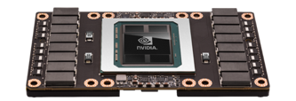
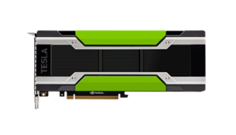
Tesla p100 accelerators
Tesla P100
for NVLink-enabled Servers
5.3 TF DP ∙ 10.6 TF SP ∙ 21 TF HP
720 GB/sec Memory Bandwidth, 16 GB
4.7 TF DP ∙ 9.3 TF SP ∙ 18.7 TF HP
Config 1: 16 GB, 720 GB/sec
Config 2: 12 GB, 540 GB/sec
Tesla P100
for PCIe-Based Servers
Notes:
This is the first time we will have the product with the same name available in two different form factors. So let me summarize this for you.
We have Tesla P100 in SXM2 form factor with NVLINK, This was launched at GTC. It is targeted at strong scaling applications
Then we have P100 for PCIe based servers available in board form factor that we are launching at ISC. This is targeted at mixed workload HPC, the same segment that we serve with K80.

Slide 12
Deep Learning for HPC

Slide 13
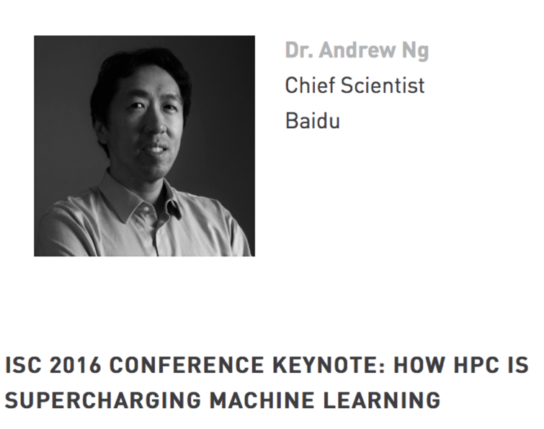
Isc keynote: hpc and AI
“Investments in computer systems — and I think the bleeding-edge of AI, and deep learning specifically, is shifting to HPC — can cut down the time to run an experiment, and therefore go around the circle, from a week to a day and sometimes even faster.”
— Andrew Ng, Baidu
“…deep learning and cognitively enabled applications are driving large-scale high-performance computing (HPC) projects that are heavier on GPUs. IDC expects major advances and potential large build-outs…”
— IDC
Notes:
Everyone in HPC is talking about AI. Customers are saying that # of compute jobs for AI is exploding, and want to learn more. This year’s keynote is about how HPC and AI are fueling each other. Prof. Ng.
HPC is starting to understand the impact that AI can have for science.
Now why does AI need HPC? It happens to be that GPUs and HPC makes first-class AI accessible to the masses.
In the past, companies solved their big data problem with approaches like Hadoop where compute is free but I/O is the bottleneck.
It’s an approach where you just throw lots of commodity servers at a problem, and build resiliency to make sure the problem finishes.
Google did this when they built a DL model that recognized cats. Used 2000 CPUs.
HPC is a different approach. SW is optimized to squeeze performance out of the compute resources, and either FLOPs or bandwidth bound.
When optimized for HW, Stanford was able to get same results as Google, but using 3 servers & 12 GPUs.

Slide 14
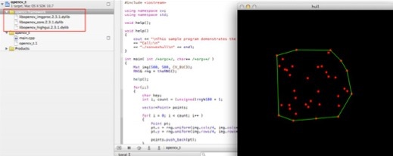

A new computing model
Something Big That Will Change the Landscape of HPC
ImageNet
Traditional CV
Deep Learning
Traditional Computer Vision
Experts + Time
Deep Learning Object Detection
DNN + Data + HPC
Deep Learning Achieves “Superhuman” Results
Notes:
Now. Why is it there so much energy around AI in HPC? For the same reason AI is changing how web services is done, we believe that AI will change the course of history for HPC.
And the reason why is because it’s a new computing model:
Handcrafted -> lots of data with HPC -> superhuman results

Slide 15

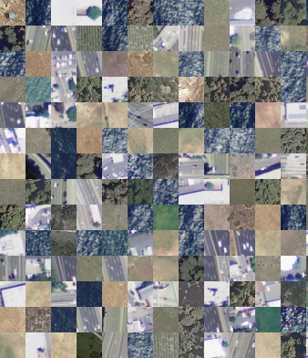
Deep learning fueling SCIENCE
NASA AMES
Classify Satellite Images for Carbon Monitoring
Determine Drug Treatments to Increase Child’s Chance of Survival
Analyze Obituaries on the Web for Cancer-related Discoveries
Notes:
Deep learning is already being used by scientific community to solve their large data problem.
NASA Carbon Monitoring System Program
PROBLEM:
Need to study satellite images to understand crop yield changes, vegetation, landscapes, and impact of carbon. But image classification is a challenging problem due to the high variability inherent in satellite data
SOLUTION:
DeepSat: Labeled datasets of satellite images + framework for the classification of images
Training: NVIDIA® DIGITS™ DevBox
Classification: Tesla-Accelerated NASA Pleiades Supercomputer (#13 LINPACK rating on TOP500 list)
IMPACT:
Classifying land cover from satellite images to understand crop yields, climate (emissions from forest), surface vegetation type, urban towns and landscapes
Oak Ridge
PROBLEM:
The World Wide Web has emerged as a powerful data source for epidemiological studies related to infectious disease surveillance. However, its potential for cancer-related epidemiological discoveries is largely unexplored. [Note: will get more info on “big dirty data”]
SOLUTION:
Theano deep learning framework
Tesla-Accelerated Titan Supercomputer at Oak Ridge National Laboratory
Using advanced web crawling and tailored information extraction procedures, the authors automatically collected and analyzed the text content of 79,394 online obituary articles published between 1998 and 2014.
With the derived information, the authors replicated a case control study design to investigate the association between parity (i.e., childbearing) and cancer risk
IMPACT:
Parity was found to be associated with a significantly reduced risk of breast cancer, pancreatic cancer, colon cancer, and ovarian cancer.
This large web-mining study on parity and cancer risk produced findings very similar to those reported with traditional observational studies. It may be used as a promising strategy to generate study hypotheses for guiding and prioritizing future epidemiological studies.
Children’s Hospital
Problem: Children arrive with complex, often chronic conditions, including respiratory illnesses, trauma, post-surgical care issues, sepsis and other infections. Many come as emergency cases. Need to find the best drug treatment for them
Solution: Learn from decades worth of health records, 13,000 records, from the pediatric ICU. Learn about interactions of treatments with patient’s vitals, heart rates, blood pressure. Predict survival rate.

Slide 16
Deep Learning Training Performance
Caffe AlexNet
Blistering pace
of innovation
for AI
Speed-up of Images/Sec vs K40 in 2013
2013
2014
2015
2016
AlexNet training throughput based on 20 iterations,
CPU: 1x E5-2680v3 12 Core 2.5GHz. 128GB System Memory, Ubuntu 14.04
M40 bar: 8x M40 GPUs in a node
P100: 8x P100 NVLink-enabled
Notes:
Lots of noise about AI at the show. Why GPUs for AI?
GPU makes deep learning practical because we bring massive performance of AI to the masses.
The pace at which we deliver innovation is astounding. 1x to 60x in 3 years. SW + HW.
Rate is super-Moore’s law. With Moore’s law, it would take us into 2020 or later to get this performance.

Slide 17
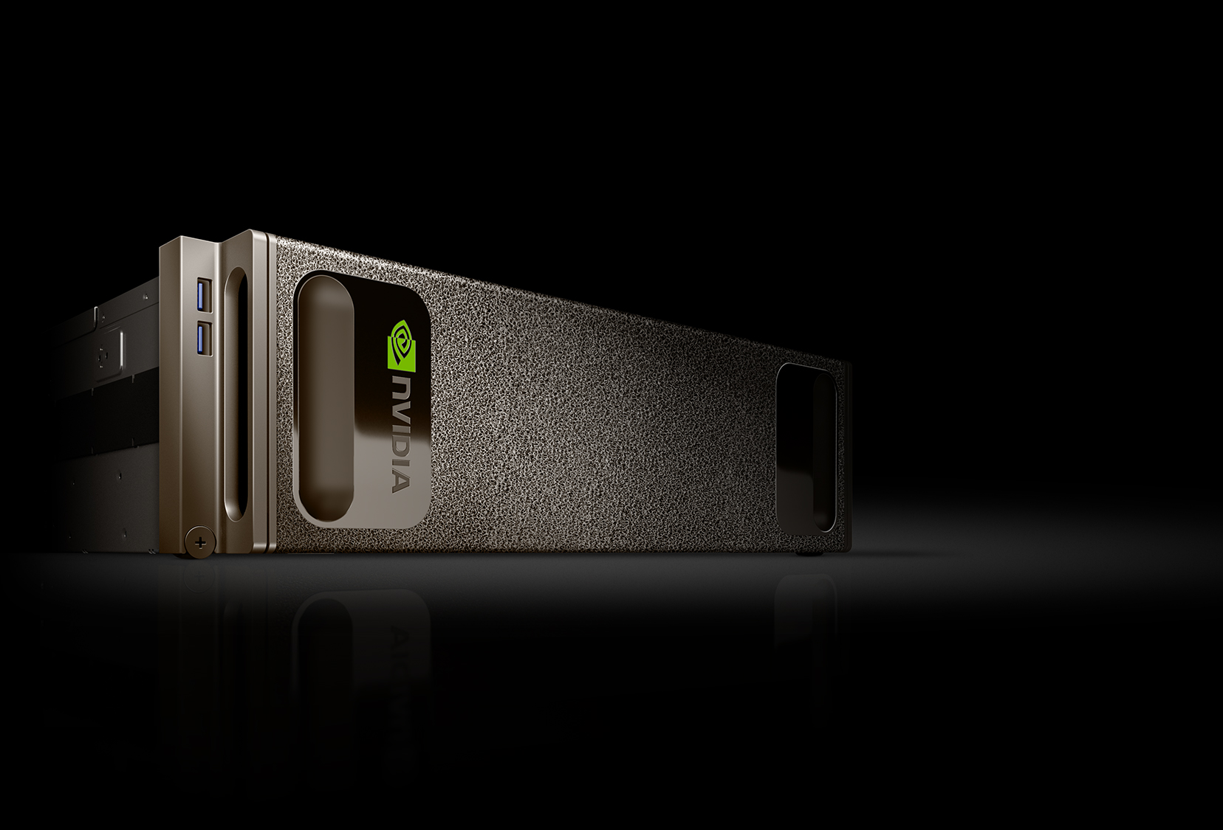
nvidia DGX-1
World’s First Deep Learning Supercomputer
Engineered for deep learning
170 TF FP16
8x Tesla P100 in hybrid cube mesh
Accelerates major AI frameworks

Slide 18
Hpc visualization

Slide 19
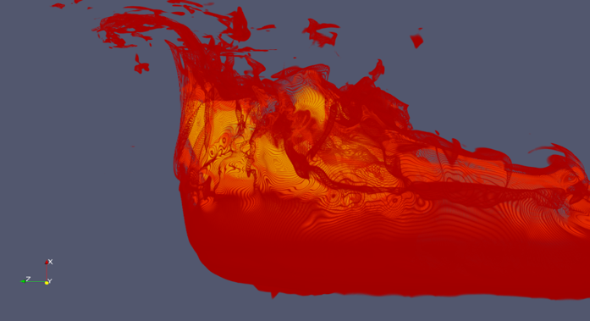
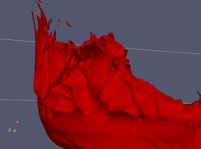
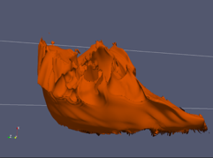
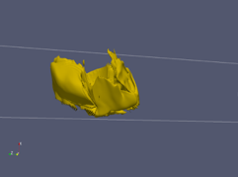
Interactivity enables Faster discoveries
Discovery Process Today with Existing Tools
Interactive Volume Rendering Experience
Iteration 1
Iteration 2
Iteration 3
Iterative and time consuming process
Faster insights with real-time analysis

Slide 20
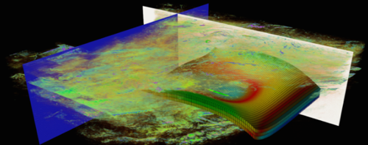
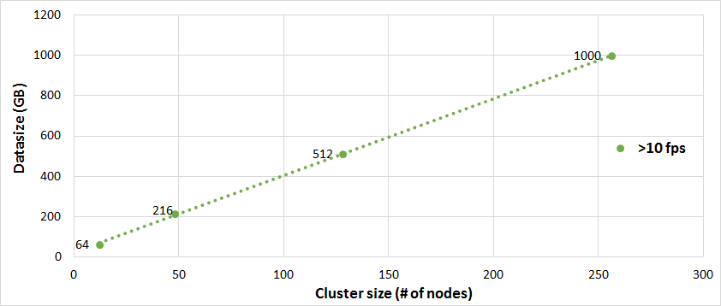
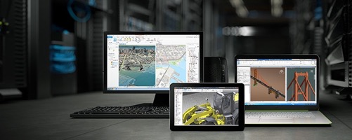
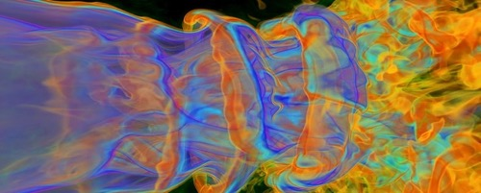



nvidia index
Leading HPC Tool to Analyze Large-Scale Data for Faster Discoveries
Interactive
Performance @ Scale
Visualize Anywhere
Built for Large-Scale Data
Remote Visualization
Notes:
IndeX enables scientists to analyze the entire data in real-time by enabling interactively visualize data of any size.
With the entire data in sight, scientists can quickly converge on the most interesting data for further analysis, resulting in faster time to discovery.
No volume visualization tool exists today that allows scientists to interact with data of any size in real-time.

Slide 21
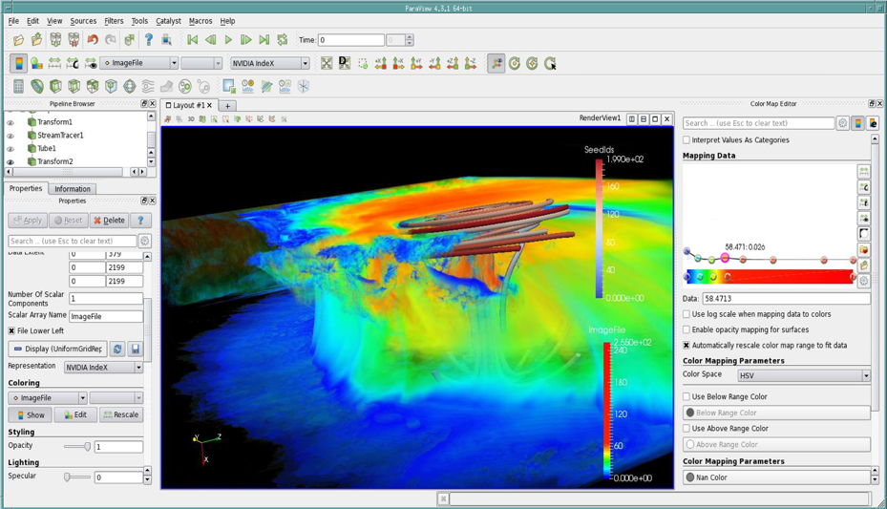
index for paraview now available
Thousands of ParaView Users Tap into Power of Interactivity at Any Scale
Multi-GPU per node support
Linear scaling in a cluster
High interactive frame rates
All ParaView formats supported
Integrates in current PV workflow
Workstation Edition: Free
Cluster Edition: For Scalable Performance
Learn more: www.nvidia.com/index

Slide 22
GPUs significantly increase throughput of DC, more jobs are being done at a time, more scientists can use SC for their research.
Deep Learning is a new driver for HPC and it also requires GPUs.
Visualization is a great tool for discovery acceleration in HPC and it is available with GPUs.
The outcomes

Slide 23
Anton Dzhoraev
adzhoraev@nvidia.com
Notes:
We’re at an important juncture in HPC, where the future is being defined today.
Two visions for the future of HPC, the path to Exascale. One vision is self-hosted CPU-only approach.
Other vision is accelerated computing, where CPU and accelerators work together to leverage Amdahl’s Law for performance.
They are two very different visions. We believe accelerated computing is the path forward and will explain why.

