Slide 1
Progress report on STAR’s Expansion to JINR via GRID
The 7th International Conference “Distributed Computing and Grid-technologies in Science and Education” (GRID 2016)
BNL STAR | JINR STAR | JINR LIT
Levente Hajdu | Yuri Panebrattsev | Vladimir Korenkov
Jerome Lauret | Geydar Agakishiev | Valery Mitsin
Lidia Didenko
Wayne J. Betts
1

Slide 2
Outline
About STAR
Key Physics Drivers
Motivations
Grid Architecture
Grid Production System
Previous successful productions
First impressions, findings and refinements at JINR
Efficiency Decomposed
Solutions and Perspective for a Path Forward
Proxy Solutions
PBS (input and output staging Solutions)
2

Slide 3
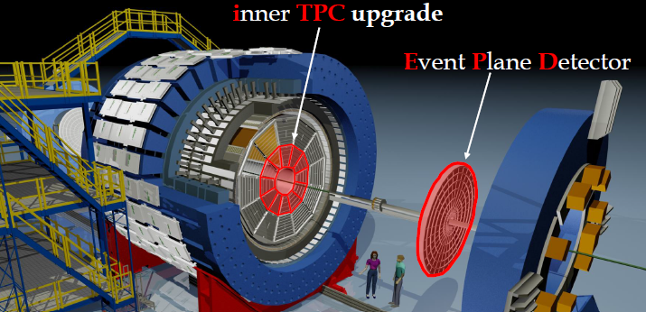
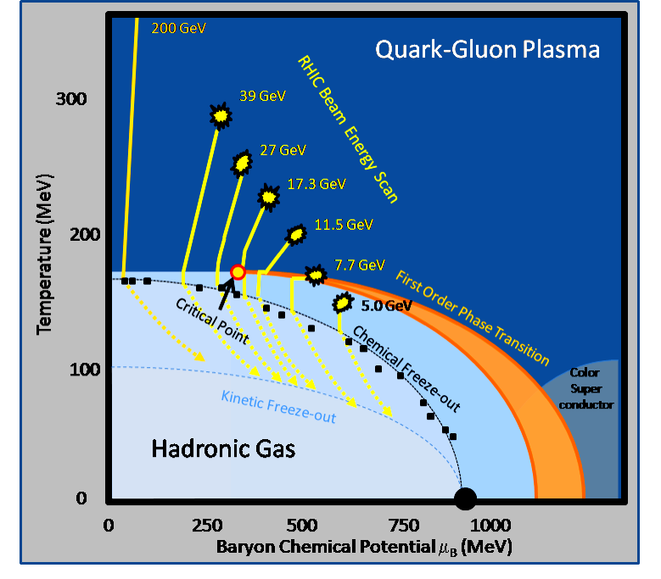
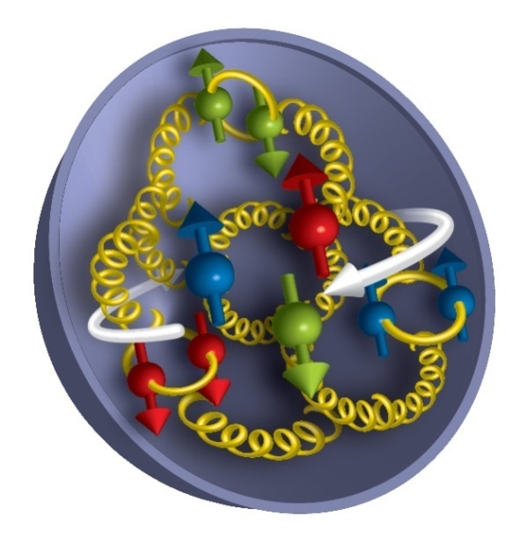
Key Physics Drivers
An experiment located @ RHIC in the USA/NY/LI, dedicated to Heavy Ion and Spin studies & properties of the QGP/QCD
Unique machine able to collide from Heavy Ions and polarized protons
Heavy-flavor and quarkonia measurement
Jet measurements
Chiral magnetic effect, chiral magnetic wave and chiral vortical effect
Phase structure of QCD matter – Beam Energy Scan
Understanding of the nature of the pomeron and potentially discovering the odderon
Single spin asymmetries in W+/-, Z, direct photon and Drell-Yan production
3

Slide 4
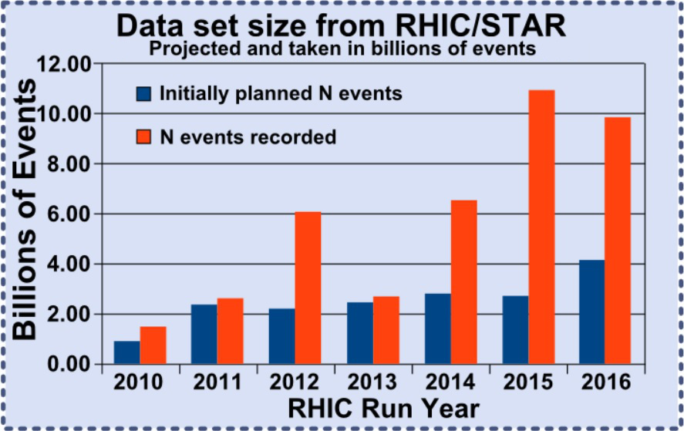
Motivation
Exciting versatile physics program
In our 16th year of data taking
Accumulated 25 petabytes of raw data
Projected to reach 40 petabytes
CPU needs to double by 2020
Huge dataset challenges - we seek additional resources to speed up scientific discoveries
13,500 slots are used for data production at BNL
This ONLY allows for 1.2-1.4 passes of data reconstruction
In contrast, typical HEP experiments have > 5 passes
Additional resources (+20% minimum) must be found to cover simulations and additional processing passes
This translates to ~ 118 Million CPU hours per year at the Tier-0 center and at least 24 Million CPU hours per year from other resources, such as JINR
4

Slide 5
Motivation…
Growth will unlikely come from the Tier-0 so there is an incentive to find resources “outside”
Data production success demonstrated at KISTI …
Expertise and software exists but all host sites have differences in:
Middleware Stack (grid software)
Bandwidth speeds
Batch system
Resource limits
Adjustments to our existing framework, adapting to the new facility “specifics” and tuning are expected to allow smoother, more efficient running.
5

Slide 6
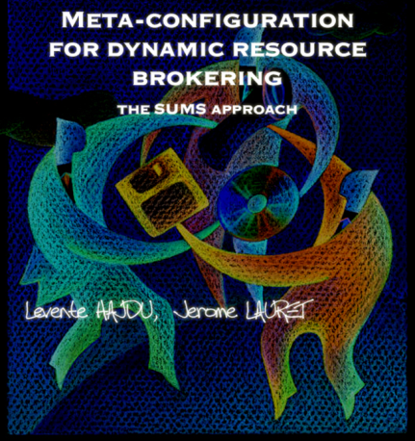
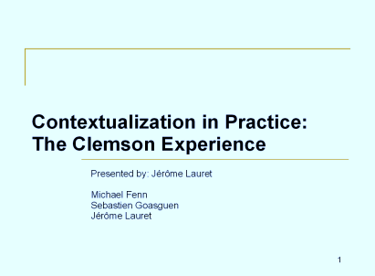
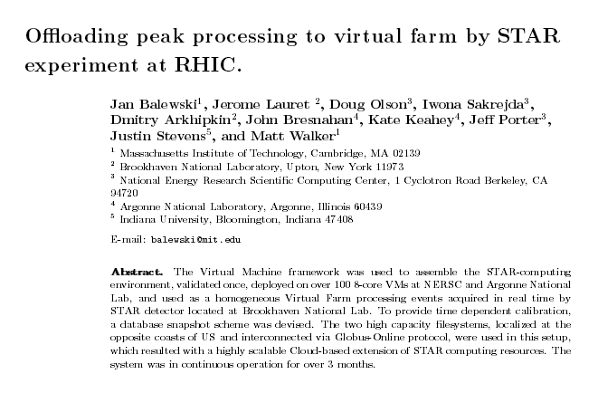
Working on Grids and Clouds for 16 Years
STAR has a long experience testing and offloading productions to a diversity of platforms (Cloud/Grid) and resources (Amazon, Universities, National Labs, ...) which has made us face different challenges and provided useful lessons learned.
“High Performance and Cloud Computing in Scientific Research and Education” Chapter 13, IGI Global, Levente Hajdu, Jérôme Lauret, Radomir A. Mihajlovic ISBN13: 9781466657847, ISBN10: 1466657847, EISBN13: 9781466657854.
“Offloading peak processing to virtual farm by STAR experiment at RHIC”, Proc. of the 14th International Workshop on Advanced Computing and Analysis Techniques in Physics Research (ACAT2011), Uxbridge, West London, United Kingdom, September 5-9, 2011, J. Phys. Conf. Ser. 368 (2012) 01211.
“When STAR meets the Clouds: Virtualization & Cloud computing experiences”, Proc. of the 18th International Conference on Computing n High Energy and Nuclear Physics (CHEP2010), Taipei, Taiwan, October 18-22, 2010, J. Phys. Conf. Ser. 331 (2011) 062016.
“Contextualization in practice: The Clemson experience”, Proc. of the 13th International Workshop on Advanced Computing and Analysis Techniques in Physics Research (ACAT2010), Jaipur, India, February 22-27, 2010, Pos ACAT2010 (2010) 027. “Integrating Xgrid into the HENP distributed computing model”, Proc. of the International Conference on Computing in High Energy and Nuclear Physics (CHEP07), Victoria, British Columbia, Canada, September 2-7, 2007, J. Phys. Conf. Ser. 119 (2008) 072018.
“Automated Finite State Workflow for Distributed Data Production”, ACAT 2016 conference proceedings, pending publication”.

Slide 7
Efficiency Defined
Farm Utilization Efficiency– The percentage of the farm utilized by successful jobs over all available slots integrated over all retry attempts
$${Efficiency}_{Farm} =\sum_{i=1 … n}{\frac{{\left(\frac{n successful jobs}{total slots}\right)}_{i}}{{try}_{i}}}$$
CPU Efficiency– The percentage of a CPU a job (a process) utilizes ${Efficiency}_{CPU}=\left(\frac{CPUTime}{RealTime}\right)$
CompoundEfficiency-
$=$$\sqrt{\left(\text{CPU} \text{Efficiency}\right)∗(\text{Farm} \text{Utilization} \text{Efficiency})}$
$$i=try$$
7
7

Slide 8
Previous Production Sites
STAR uses Grid resources at PDSF/NERSC (Berkeley) and in the past used clusters at Clemson University, Amazon Cloud, Fermilab, University of São Paulo, and others – most of those were used for simulation instead of data production (reconstruction of real data)
The first site STAR used to run data production on GRID was KISTI (The Korea Institute of Science and Technology Information)
STAR saturated 1026 job slots for 9 months processing 105,631 files, generating 213.7 TB of output and consuming 6,179,544 CPU hours
99% of jobs returned log and output files within 7 attempts
Farm Utilization Efficiency ${Efficiency}_{Farm}=$97(±2)%
Automated (Re-)Submission Attempt(s) Per Job at KIST
Number Of Jobs | Percent (%) | Job Submissions
102,043 | 96.6023 | 1
2,895 | 2.7406 | 2
493 | 0.4667 | 3
103 | 0.0975 | 4
83 | 0.0785 | 5
6 | 0.0056 | 6
3 | 0.0028 | 7
6 | 0.0056 | *Not Runnable
8

Slide 9
Components of the Grid Production System
HPSS = Tape silo system at BNL
Data Carousel = STAR tool for queueing and optimizing requests for the restoration of files from tape by minimizing mount and dismount cycles through reordering
SUMS (STAR Unified Meta Scheduler) = SUMS provides a unified interface for submitting jobs to sites and wrapping of the input file and user executable into a job. Feeding can also be turned on to limit the number of jobs submitted at one time.
HTCondor with Globus = provides authentication of users between sites and a mechanism to interface with the sites local batch system.
Production Database = Database for holding the state of each job
STAR File Catalog = includes PFN, LFN and MetaData
*.Daq Files = raw detector input files for reconstruction
*.MuDst Files = reconstruction output files
9

Slide 10
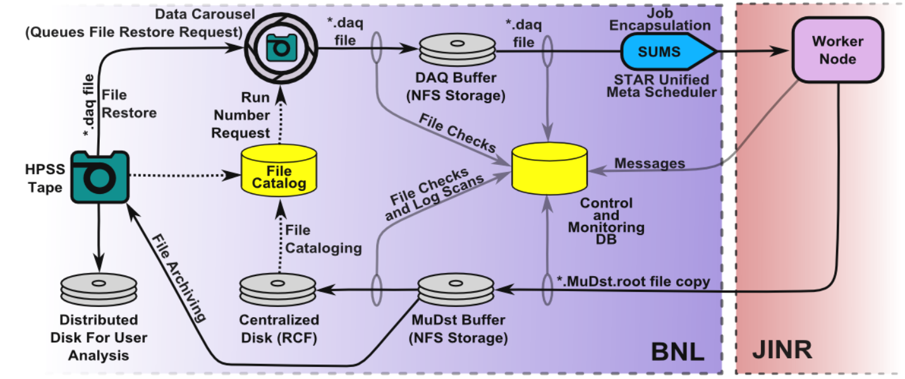
Current Grid Production Dataflow
10

Slide 11
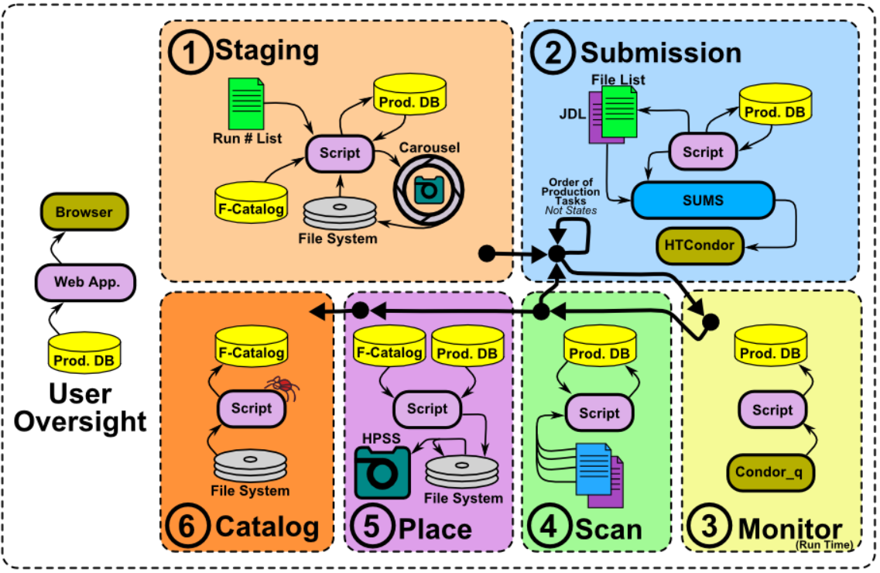
Detailed Stages of Production
11

Slide 12
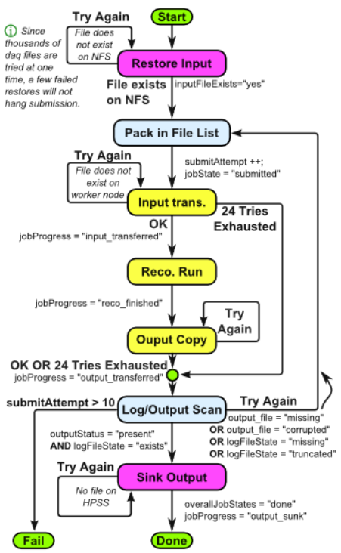
Grid Production Framework State Diagram
Finite state checking exists to verify each stage of the production
Central DB at BNL holds each job’s state
Each job is associated with:
One Input file
Batch System ID
Output file(s)
Event processing log
Batch System log
Produced Data File
System gathers information from:
File sizes are checked after each transfer
Batch system is polled every hour to get the current state of each job
Jobs send messages at each stage:
job start up (copy input starts), input transfer done (reconstruction starts), reconstruction done (output transfer starts), output transfer done
Log files (batch and reconstruction) are scanned for error states

Slide 13
Grid Software Stack Architecture
STAR Grid
Production
System
The chain is no stronger than its weakest link.
Где то́нко -- там и рвётся.
Data
Carousel
SUMS
STAR (BNL)
HTCondor
Dubna (JINR)
Berkeley (PDSF)
CREAM
OSG CE
PBS
VOMS
Proxy
Grid Proxy +
Grid Mapfile
SGE
13

Slide 14
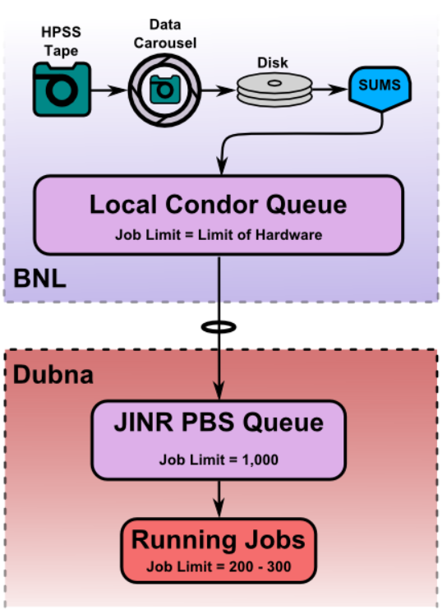
First Steps @ Dubna Initial Tuning
HTCondor submission to CREAM (Computing Resource Execution And Management) works to first order
Forwarding of renewed VOMS proxies is not robust
BNL VOMS proxies renewed from GRID proxies don’t seem to authenticate
BNL VOMS administrators agreed to change limit from 24 hours to 3 days increasing job run time
AFS allows connection to our software. CPU to wall-time ratio was low likely due to cache thrashing (𝐸𝑓𝑓𝑖𝑐𝑖𝑒𝑛𝑐𝑦_{𝐶𝑃𝑈}=52%)
AFS cache raised from 600 MB to 7 GB, improved CPU to wall-time ratio from 52% → >90%”
PBS running job limited to 58 wall hours, 24 CPU hours
Increased to one week
Queue limited to 500 queued jobs
Max number of queued jobs raised from 500 to 1k
Adjusted Condor configuration parameter to control the number of jobs pushed over at any one time.
Max Running jobs limited to 100
Running jobs raised from 100 max to 200-300 to test scalability
Thanks to Yuri Panebrattsev and Geydar Agakishiev for help from JINR.
Initial tuning on both sides (BNL + JINR) has achieved big improvements and proven viability.
14

Slide 15
Current Efficiency Decomposed
Efficiency in this context is defined as the number of jobs returning output and log files within one submission attempt
Proxy – All jobs running over 3 days are evicted because the new proxy on the submitting end is not forwarded
Affected by job runtime which is affected by the number of events in a file and their complexity
CREAM Infrastructure Errors – typically involves CREAM losing track of the job (“reason=-999”)
PBS – the batch system kills the job
Lack of CPU usage when the job is transferring input and output files
Aggravated by bottlenecking (many jobs starting at the same time) and network transients
Log Transfers – The batch system has lost track of where it was writing the output streams from the job’s processes
Resolution of the top two errors could push us to a comfortable ~95% efficiency
CREAM
15

Slide 16
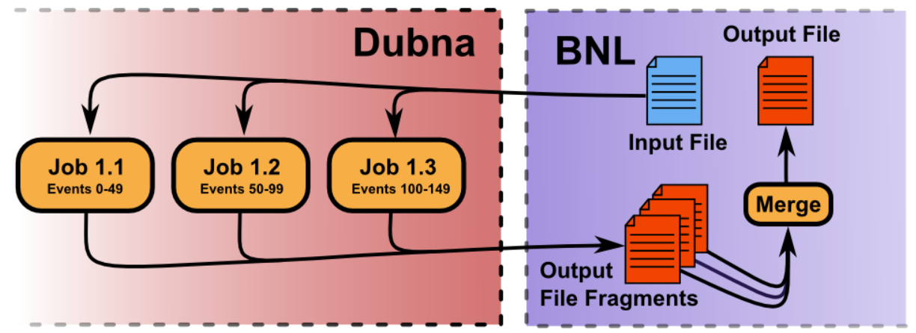
Possible Solution - Proxies
Test if the existing infrastructure will work with a grid proxy vs. a VOMS proxy
Install a GLOBUS gatekeeper that will work with a GRID mapfile instead of the CREAM infrastructure (this should also resolve the CREAM errors)
Explore MyProxy delegation as a possible solution, MyProxy claims to renew the VOMS proxy extension from GRID proxies
VOMS extensions automatically renewed from grid proxies have so far failed to authenticate
Reconstruct files at JINR with a limited number of events
Breakdown the input files into multiple jobs per input
16

Slide 17
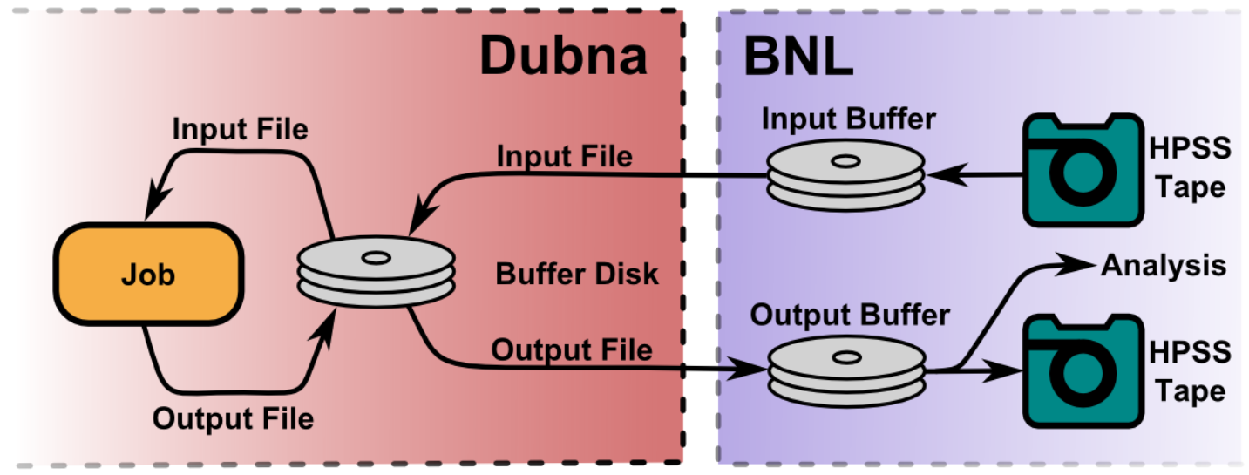
Possible Changes - I/O Handling
Do staging of input and output outside of the job’s runtime.
This solution would require a large (~50 TB (input + output)) local buffer on the host site
It can overflow if network interruptions occur
It requires changes to our production systems workflow
Investigate HTCondor’s delegated I/O staging
We have already mitigated jobs getting killed for failure to consume CPU during input copy by adding a 3 minute delay in between each job submission.
This reduced bottlenecking during the copy and the corresponding job deaths to 2%
17

Slide 18
Conclusions
Cooperative efforts in tackling initial problems & tuning rapidly brought us to a 74% workflow efficiency
Further tests showed remaining obstacles for which we are investigating solutions
Long live proxies + Hand-shake between OSG/CREAM , if resolved, would allow an additional +21% recovery
Would bring the production to a stunning 95% efficiency
Modulo finding solutions for the identified issues, Dubna resources seem to be a good candidate for STAR CPU demands
18
18

Slide 19
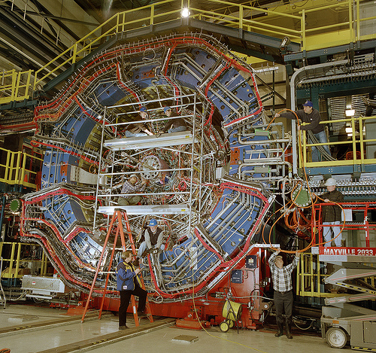
Questions ?
19

