Slide 1
DUBNA
Name
INSPUR High Performance Computing

Slide 2
1. INSPUR HPC Introductory
2. HPC Challenges & Trending
3. INSPUR @ Global
4. INSPUR GRID Solution
5. INSPUR HPC Solution

Slide 3
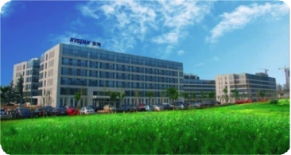
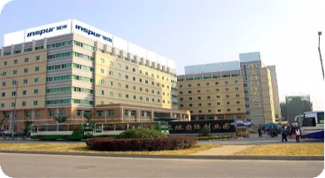
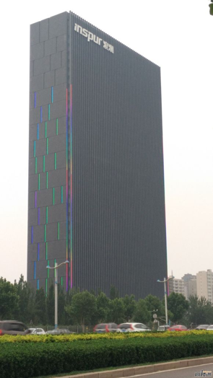
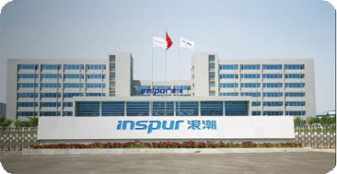

INSPUR
HPC
Market Leader
in China.
No.1 China Server Vendor
*Source: Gartner
No.5 WW Server Vendor
*Source: Gartner
3 Large Scale R&D centers WW
More Than 1500 Patents To Date
*Server Technology

Slide 4
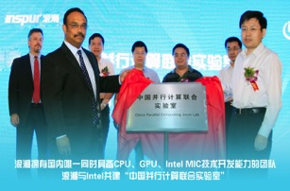
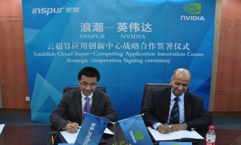
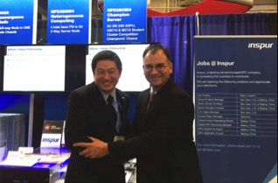
INSPUR HPC Innovation
Intel | INSPUR
GPGPU Innovation
HPC Blade System
Together with Intel co-develop HPC lab. (Intel XEON Phi)
The 1st Intel MIC monograph.
INSPUR | Nvidia startup an Innovation Lab in China.
Successfully improve 90x performance for Qihoo China.
INSPUR | Intel | Alter joined launch FPGA+DNN+OpenCL solution.
Overall HPC Cluster performance improved.
FPGA|CPU = 18.18x
FPGA|GPU = 3x

Slide 5
Top500 HPC System - Worldwide
2016.June, NUDT@33.86PFlops @No.2 in Top500.org
2013.June ~ 2016.June，NUDT@33.86PFlops @No.1 in Top500.org
2012.June，SUNWAY@1.1PFlops @No.14 in Top500.org
2011.Aug, Tsinghua University HPC center @ 107TFlops @No.97 in Top 500 CPU+GPU
2016.01, HPC center II @ 200TFlops

Slide 6
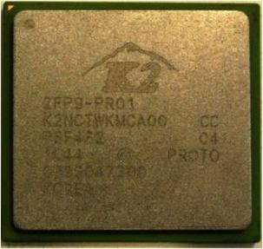
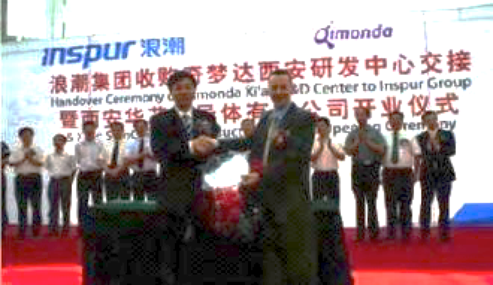
ASIC Chips Design
Core
CPU, HDD, DRAM
Chip
Chipset, SAS
Board
Motherboard, RAID, HBA
Auxiliary Module
Structural
Integration
Backplane, Power Supply, Adaptor, Fans
Chassis, Cabinet, Cables, Package
Parts assembly
INSPUR acquired No. 3 world largest memory chip manufacture Qimonda in 2009
End-To-End Design & Production.
Military standard Chipset & processor.
Open-Power Chip (IBM)

Slide 7






















































China Customer
Inspur is the leader in Internet Industry (with >50% market share) in China for CDN, portal sites, video sites, online gaming, e-commerce… providing quality solutions and strong support for Internet enterprises such as the BATQ.
Others Public Cloud Videos Tools Portals CDN E-Commerce Games

Slide 8












































INSPUR Global Enterprise Customer

Slide 9
1. INSPUR HPC Introductory
2. HPC Challenges & Trending
3. INSPUR @ Global
4. INSPUR GRID Solution
5. INSPUR HPC Solution

Slide 10
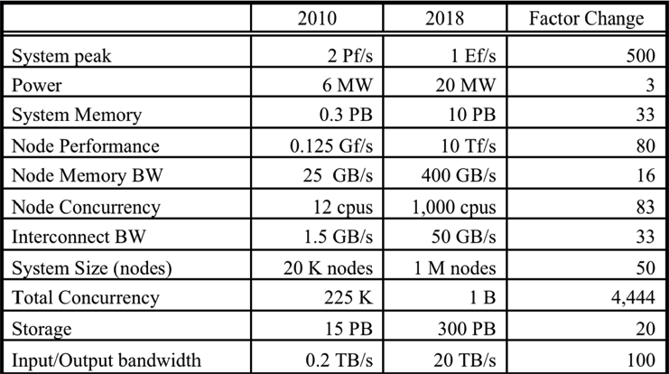


HPC Growth & Challenges
PetaScale to ExaScale
Exascale = PetaScale x 1000?
Director, Dr. Lucy Nowell
Computer Scientist and Program Manager
Office of Advanced Scientific Computing Research (ASCR)
DOE – Department Of Energy
1. Energy Consumption
2. Memory bandwidth & Capacity
3. I/O Throughput

Slide 11

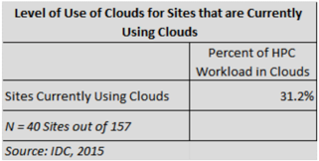
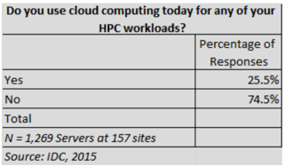
HPC Market & Technology Trending
HPC On Cloud
HPC on Cloud demand is gaining momentum.
Overall growth still remain at low side.
40 out of 157 sites are using HPC within Cloud. (* Data Size: IDC Data Center Event, 1000 participants)
Demand, Challenges & Game Changing
HPC Storage Market.
  Data size growth rate is higher than forecast.
  Data monitoring & migration became bigger headache for entire industry.
Technology breakthrough.
  HPC vendor looking for breakthrough of Power, Performance & IO bandwidth.
Management System.
  Overall system management & monitoring with report generating capability.
None x86 technologies.
  ARM, GPUs, FPGAs products is getting famous.

Slide 12
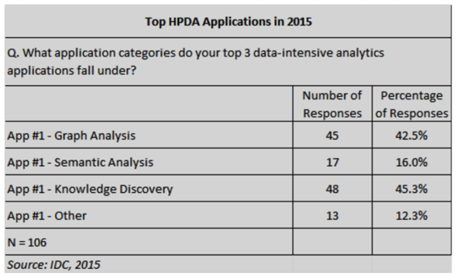
HPC Market & Technology Trending
HPC HPDA – High Performance Data Analyst
HPDA demand is growing.
Especially on Graph Analysis & Knowledge Discovery. (a.k.a. Deep Learning)
Deep Learning became one of the key element within current data rich society.
High demand in Data Analytics, mainly in search, pattern discover
Big Data Technology on HPC.

Slide 13
1. INSPUR HPC Introductory
2. HPC Challenges & Trending
3. INSPUR @ Global
4. INSPUR GRID Solution
5. INSPUR HPC Solution

Slide 14

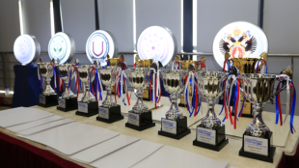

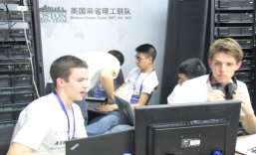

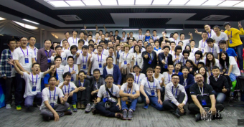
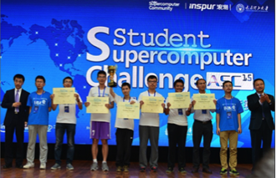


ASC – WW Student SuperComputer Challenge
Asia SuperComputer Community
Global recognize event, held since 2012.
Organise by INSPUR HPC Team together with International SuperComputing Conference as well as HPC Advisory Council.
>170 University globally participated.
Organiser &
Committee

Slide 15

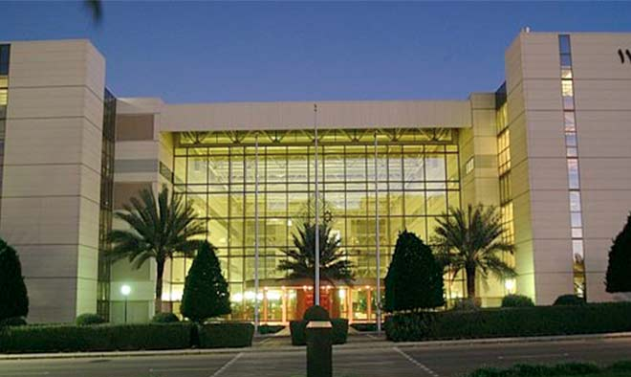

Kingdom Of Saudi Arabia
KACST – King Abdulaziz City for Science and Technology
Date Palm genome processing
The first research program to finish the whole sequencing map of Date Palm
Work with 34 scientists, 1277 days non-stop.

Slide 16
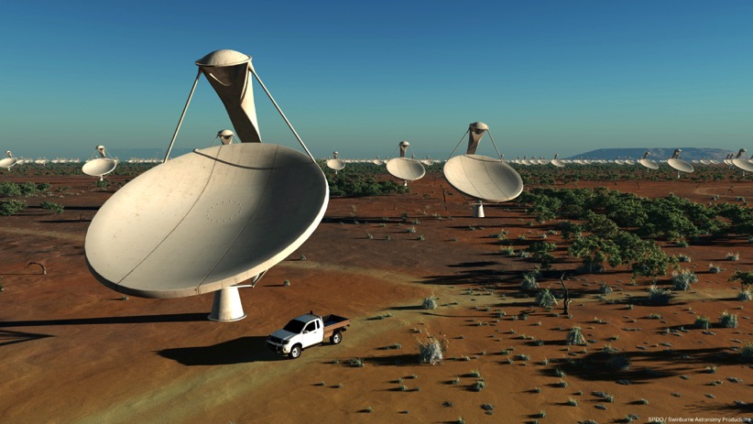
University Of Cambridge, London, England
International Astronomical Research – SKA (Square Kilometer Array)
Inspur is responsible for the data processing and computational platform.
Server & Storage
Scheduler, Cluster Software & Resource Management.
Astronomical Research Application.

Slide 17

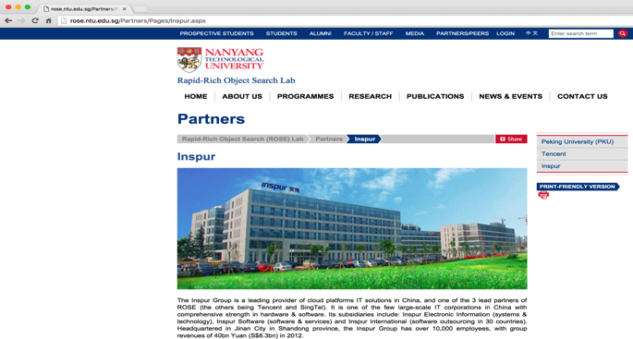
Singapore – NTU (Rapid-Rich Object Search Lab)
Research Collaboration Agreement (March 2014)
URL: http://rose.ntu.edu.sg/Partners/Pages/Inspur.aspx
The Inspur Group is a leading provider of cloud platforms IT solutions in China, and one of the 3 lead partners of ROSE (the others being Tencent and SingTel). It is one of the few large-scale IT corporations in China with comprehensive strength in hardware & software. Its subsidiaries include: Inspur Electronic Information (systems & technology), Inspur Software (software & services) and Inspur International (software outsourcing in 30 countries). Headquartered in Jinan City in Shandong province, the Inspur Group has over 10,000 employees, with group revenues of 40bn Yuan (S$8.3bn) in 2012.
The ROSE Lab’s collaboration with Inspur involves the formation of a joint research team at NTU to focus on innovations in the following areas:
Media Cloud Platform: To jointly develop a prototype media cloud platform, catering for media content storage, computation, search, and streaming. This includes the development of cloud-based media processing functions like media coding, image clustering & matching, and adaptive bit rate streaming.
  Scalable Media Sensing & Search Applications: To jointly develop high performance software for media sensing and object search services. This includes:
    Search in image-based Big Data applications
    Automatic indexing & recognition for Human Faces
    Automatic indexing & retrieval of Catalogued Products
    Automatic search & recognition of Logos & Trademarks
  Support for Media Distribution Services: To provide consulting services to support Inspur’s Media Streaming Server development

Slide 18


China Earth Simulation Research Lab
TsingHua University, FIT Lab
TsingHua University
Both Hardware/Software, design & integrated by INSPUR.
Nvidia GPU + Intel MIC Technology
The highest performance supercomputer in the domestic public systems (No.97@Top500 2011.6)
Peak Performance: 172TFlops
1,480 six-core processors with 8,880 cores
CPU Peak: 104.07TFlops
GPU Peak: 68TFlops
Network: 40Gbps IB
Storage system: 1PB

Slide 19




Shanghai JiaoTong University SuperComputer
One of the China Top University in Southern China
No.1 supercomputer among all the universities @260TFlops
830 Intel Sandy Bridge E5-2670
100 Nvidia Kepler K20 GPU
10 Intel Xeon Phi 5110
Mellanox FRD 56Gbps
720TB INSPUR parallel storage system
CPU
GPU
MIC

Slide 20
1. INSPUR HPC Introductory
2. HPC Challenges & Trending
3. INSPUR @ Global
4. INSPUR GRID Solution
5. INSPUR HPC Solution

Slide 21

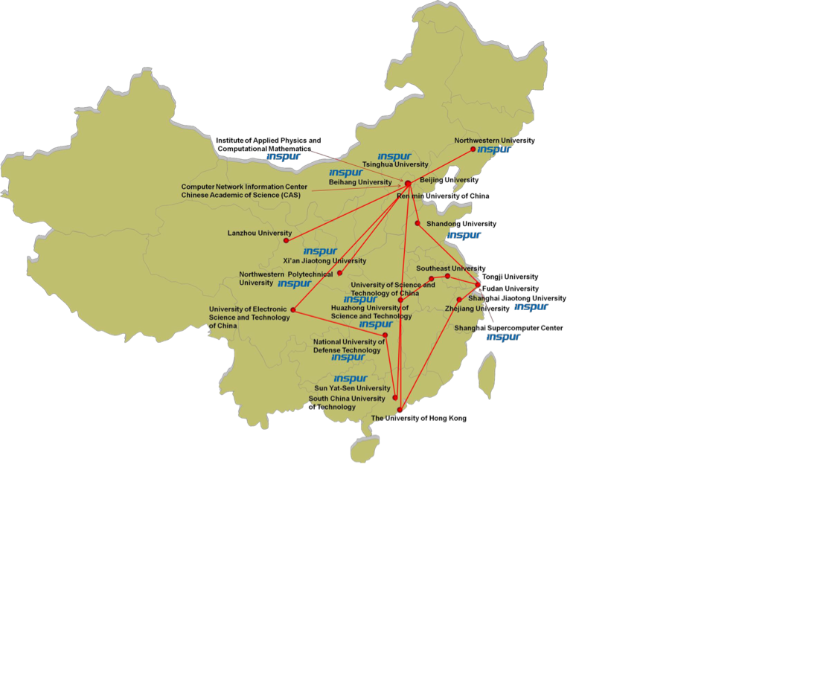
INSPUR Education GRID
The China Grid enables universities across the country to collaborate on research, scientific and education projects. This is one of the world's largest implementations of Grid computing -- which takes untapped application, data and computing resources from different computing systems and makes them available where and when they're needed, resulting in a single, virtual system.
Phase I: 2003~2006, Phase II: 2008~2012
43 universities were involved in this grid
To build 6 high performance computing center To develop 13 key discipline grids, including:
Application research grid such as material, energy, bioinformatics, computational fluid dynamic, media, atmosphere & environment, law Dedicate grid such as online course, large scale information processing, network monitoring, image processing.
1

Slide 22
ChinaGRID Platform
Portal: Grid entry for submitting & monitoring job, querying resources’ info, user management and accounting etc.
Grid Developing Environment: a set of toolkits including portal development tools, resource encapsulation tools, programming tools and job generation tools etc.
Information Center: the manager of resource & service information
Uniform Management: a set of managers including job manager, data center, domain manager and service container
Security: Identity authentication and mapping, service and resource authorization, secure transferring etc.

Slide 23
ChinaGRID Platform – In Detail
Portal
GRID Developing Environment
Portal
Development Tools
Resource
Encapsulation Tools
Programming Tools
(GRID RPC/GRID PPI)
Job Generation Tools
Management Tools
Installation Tools
Information Center
Domain Manager
Service Management
Resource Management
Fault Tolerance Mechanism
Domain Info
Management
User
Management
Identity
Mapping
Service Matching
Topology Management
Quality Of Service
Management
Metadata
Description
Status Monitor
Negotiation Policy
Job Manager
Data Manager
Security
Job Submission
Job Monitoring
Job Remote Deploy
Uniform Access Entry
Certification Authentication
Work Flow Management
Job Scheduling
Service Support
Identity Certification
MetaData Manager
Proxy Management
Service Container
Storage Resource Manager
Remote / Hot Deploy
Service Monitor
Single Sign in
Node Resource Monitor
Batch Job Service
Replication Catalog
Security Management
Life Cycle Management
Service Group
Storage Manager
Resource Access Control
Base Fault
Notification
Resource Property

Slide 24


ChinaGRID – Network Linkage
CERNET – China Education and Research Network
  The first & largest national academic Internet backbone
    Supported by the Chinese government and directly managed by the Ministry of Education.
    Infrastructure mainly serves the universities, institutes, colleges and schools all over the China.
  The end users are professors, researchers and students.
CSRNET – China Science & Technology Network
  The first & earliest formal direct global connected Internet link
    Serves scientific and technical communities, relevant government departments and hi-tech enterprises
    Provide services like network access, host trusteeship, virtual host and domain name registration etc.
  Became one of the top large-scale networks in China and is one of the key roles in the development of China Internet Industry.

Slide 25
1. INSPUR HPC Introductory
2. HPC Challenges & Trending
3. INSPUR @ Global
4. INSPUR GRID Solution
5. INSPUR HPC Solution

Slide 26
INSPUR Comprehensive End-To-End HPC Solution
Apps
CAE/CAD,CFD, Life Science，Weather，Animation，Graph Analyst … etc
Storage
Full Scale Storage Solution, DAS, NAS, SAN … etc
Entry to High End
Cluster Management
Technology
INSPUR Cluster Engine
T-eye
MPI, SMP ….
INSPUR
Services
Operating System
Windows, Linux, x86, x64, Unix
Interconnect
Infiniband, High Speed Ethernet
Node
Full Scale Server Solution & Technology, x86, Mission Critical … etc
Entry to High End
INSPUR
Technology Partners

Slide 27







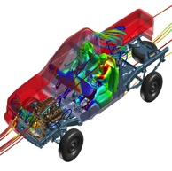
China Leading HPC Vendor in Multiple Industry
Oil & Gas
Military
Academic
Extensive Knowledge And Expertise Across The Industry
Earth
Simulator
CAE

Slide 28
INSPUR Product Portfolio
Data Center
High Performance Computing
Storage
Security & Services
SmartRack
Smart Cloud Solution
Virtualization
In-Cloud OS
TS 800 Series
K1-900 Series
HPC Appliance
Commercial computing cluster
On-line centralized storage
Data protect storage
Business integration storage
Mass data storage
software
IT Operational Services
Security Solution
Network Management Software
Storage Server
High-density server
x86 Blade
x86 Rack
x86 Tower
Industrial Server
Big Data
INSPUR provides Integrated software & hardware solutions for different industries and applications.

Slide 29

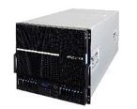




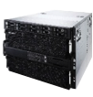




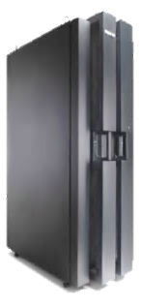



Enterprise Computing – Complete Server Portfolio
NEW
NEW
NX8840
8-way Server
NX5440M4
TS860
NF8480M3
NF5280M4
4-way Server
NF8460M4
2-way Server
NF5280M3
P8000
STAR
TS850
Tower Server
NF5270M4
Mission Critical
SmartRack
NF8460M3
NP5540M3
NF5270M3
NF5180M4
STAR
NF8420M3
TSK1
NF5170M4
NP3020M3
INSPUR can provide a Complete server portfolio to meet end-user demands
Notes:
除了上述明星产品外，浪潮还有完整的通用服务器产品线，涵盖中高低端，完全满足中小企业和大型企业的应用需求

Slide 30


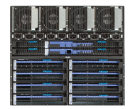


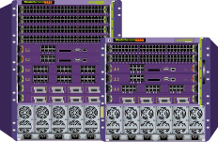


High Performance Computing Product Portfolio
Blade compute system
High speed storage system
Compute Network
INSPUR i Series & NX Series
INSPUR AS500/1000 Series
Fat compute server
Massive storage system
Infiniband Connectivity
Management Network
INSPUR TS800 Series
INSPUR AS8000/10000 Series
Management & landing server
Backup tape library system
INSPUR NF5000 Series
INSPUR TL Series
Ethernet Connectivity

Slide 31
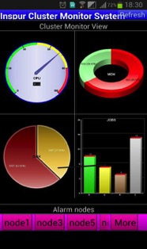
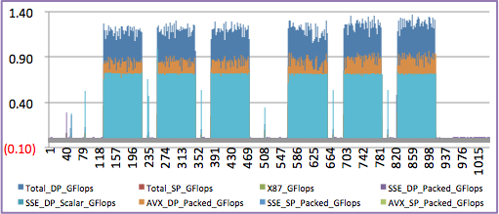
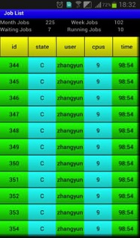
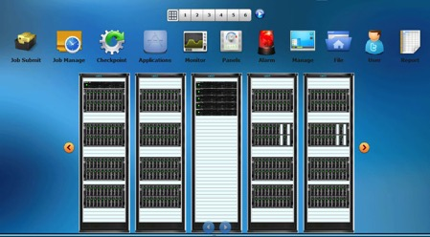
INSPUR HPC Resource Management / ClusterEngine
INSPUR T-eye 2.0
Server & Cluster Utilization Report
Application
Analyzing & Optimization
System Health Check
Status Report Output

Slide 32
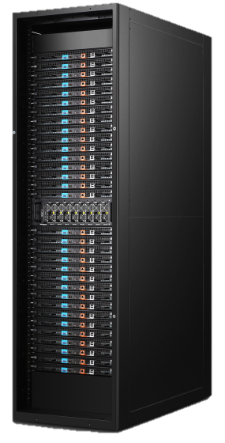






INSPUR HPC SmartRack
A customized product for Internet, the unique server conform to Scorpio 2.0 Open Data Centre standard
New ERA of Smart Architecture
Accounted for 50% China Rack Solution Market
48 x 2P nodes
32 x 2P nodes
Compute nodes
Improved by
50%
Acceleration node
4 x GPU
Storage nodes
Hot-Swap
Recommended Environment:
Internet, HPC, Cloud computing, Big Data, Enterprise Web

Slide 33

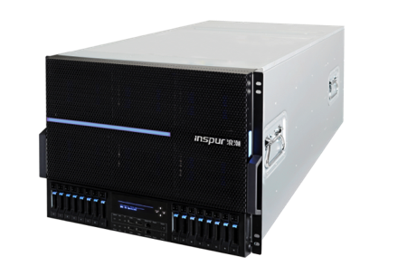

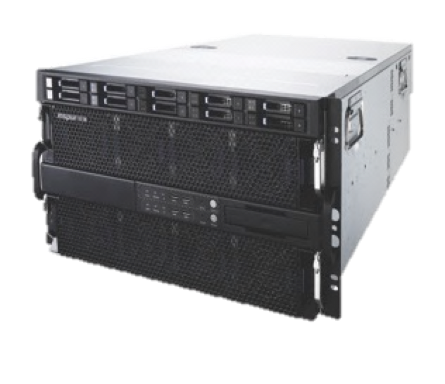






INSPUR TS800 Series – Mission Critical
Boxboro-EX
Brickland-EX
Intel® Xeon®
7500
(NHM-EX)
Intel® Xeon®
E7 -8800
(WSM-EX)
Intel® Xeon®
E7-8800 v2
(IVB-EX)
Intel® Xeon®
E7-8800 v3
(HSW-EX)
Future Xeon® E7
Certified Operating System
Price
Inspur TS850
Inspur TS860
Performance
Performance

Slide 34

Thank you !
Overseas Headquarters, Inspur Group Co ., Ltd.
Mail：Eddie.Hing@inspur.com

Slide 35


INSPUR HPC Appliance Solution
Key Features
Performance Acceleration
  Support both MPI parallel and GPU accelerating.
Unified installation package
  Integrated Caffe, CUDA and run-time libraries.
Mainstream parallel file system supported
  Support Lustre, and high performance I/O
Unified system management
  Integrated with INSPUR ClusterEngine, support cluster management, license management, job scheduling etc.
Deep Learning Appliance
MPI optimized Caffe frame, developed by INSPUR.
Colloborate with Nvidia Gen 6 GPU technology.

Slide 36

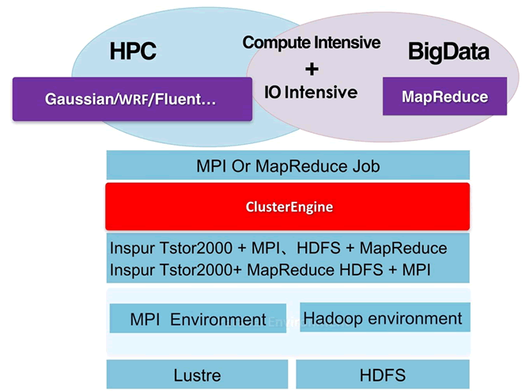
INSPUR HPC Appliance Solution
Key Enhanced Features
Unify operation interface
  HPC & Hadoop unified interface
  Job management, Dynamic scheduling, Provisioning, Unified resource charging system
Unify System Management
  Resource monitoring
  Support Dynamic switching between HPC/Hadoop nodes
Unified storage system, data copy free
  IEEL files system Hadoop connector
  Support Data Copy between HDFS & Lustre
  Hadoop tools integrated:
    Mahaout, Hive & PIG are available.
Big Data Appliance On HPC

Slide 37

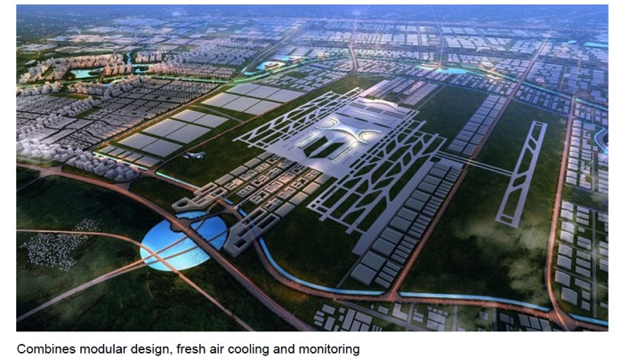
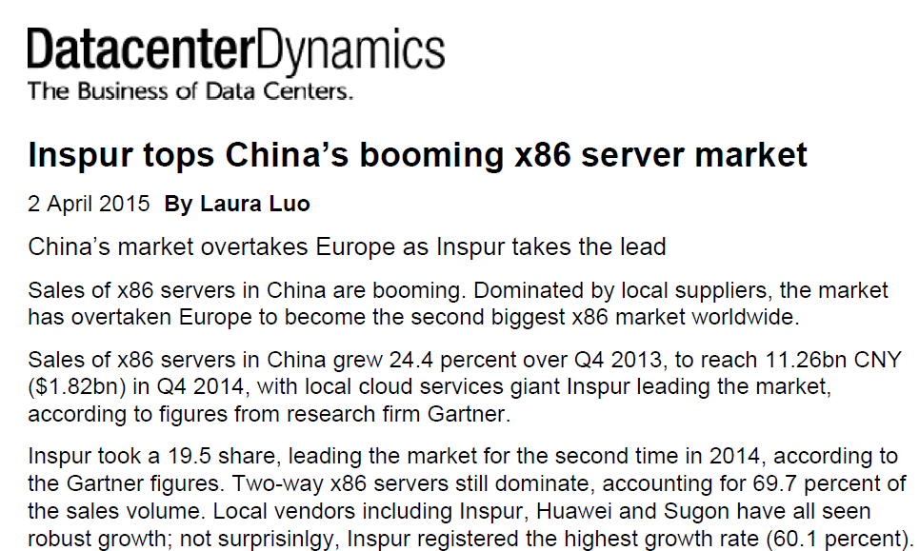
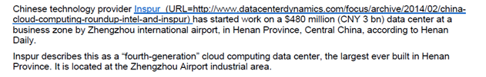
Published News / Reference / Wins

