Slide 1
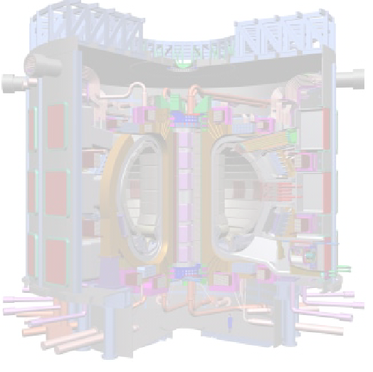
Online processing of large volume OF experimental data in strong electromagnetic and radiation fields in ITER
I.Semenov¹, A.Khilchenko ², V.Vorobiev¹, S.Portone ¹, E.Mironova ¹, D.Nikolaeva ¹
1 -“Project Center ITER”, Russia, Moscow, sq. Academic Kurchatov, 1 b.3
2 - BINP, Russia, Novosibirsk, prosp. Academic Lavrentiev 11
E-mail: i.semenov@iterrf.ru, A.D.Khilchenko@inp.nsk.su, s.portone@iterrf.ru, e.mironova@iterrf.ru, D.Nikolaeva@iterrf.ru

Slide 2
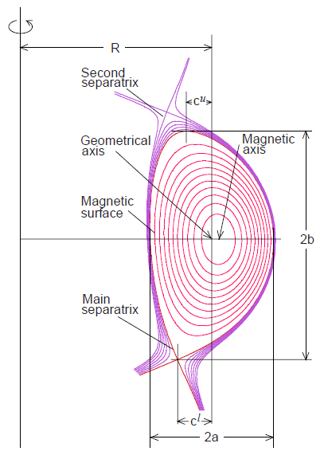
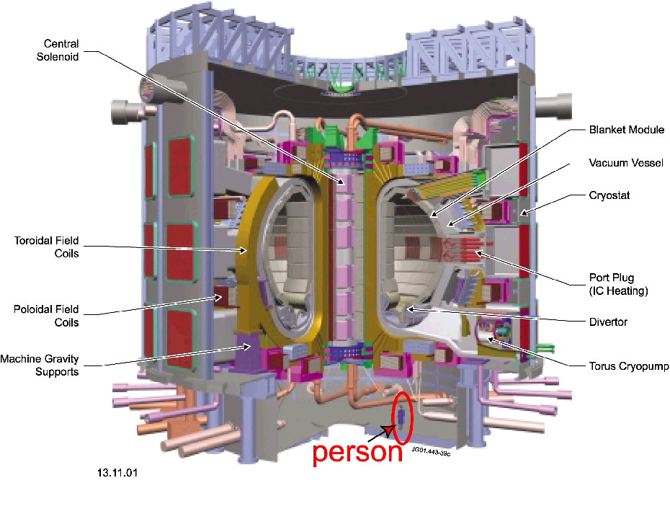

International Thermonuclear Experimental Reactor (ITER)
First plasma – 2026 (2028)
Fusion power 500 MW
Plasma temperature – 15 keV
Working gas – D-T
Plasma density (Line averaged) – 10¹⁹ m³
Plasma current – 15 MA
Toroidal field – 5.3 T
Plasma pulse duration ~ 3000 sec
Auxiliary heating – 40-90 MW
Plasma major radius (R) – 6.2 m
Plasma minor radius (a) – 2.0 m
Plasma volume – 830 m³
1.5 х 10²⁰ neutrons/sec

Slide 3
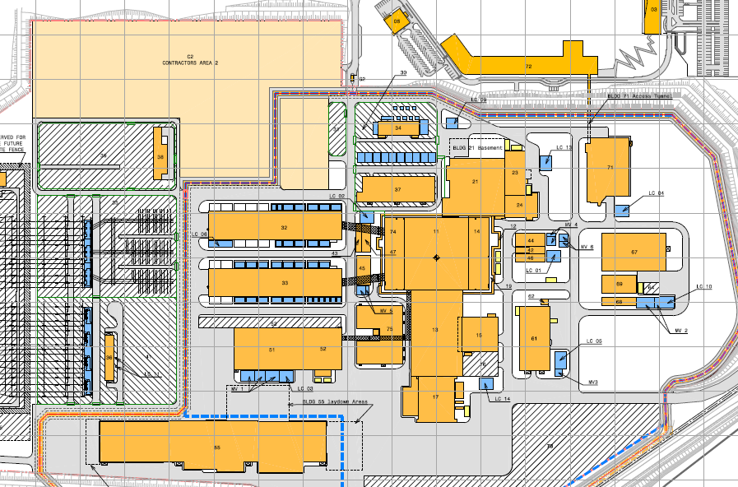
ITER SITE
IT server room in B-72
TOKAMAK Building B-11
Hot Cell Facility Building-21
CODAC Server Room B-73
ITER Control Room B-73
Diagnostic B-74
Tritium B-14
ECE B-15

Slide 4
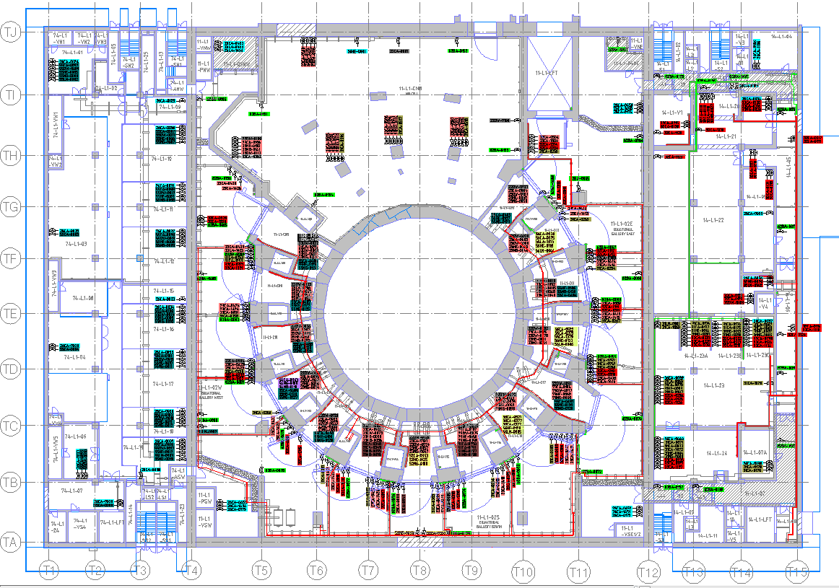
TOKAMAK Building
Building №74
Building №11
Токамак
Building №14
Bio Shield
Port Сells
Port Сells Wall
Tokamak
Tokamak Building
Wall
Interspace

Slide 5
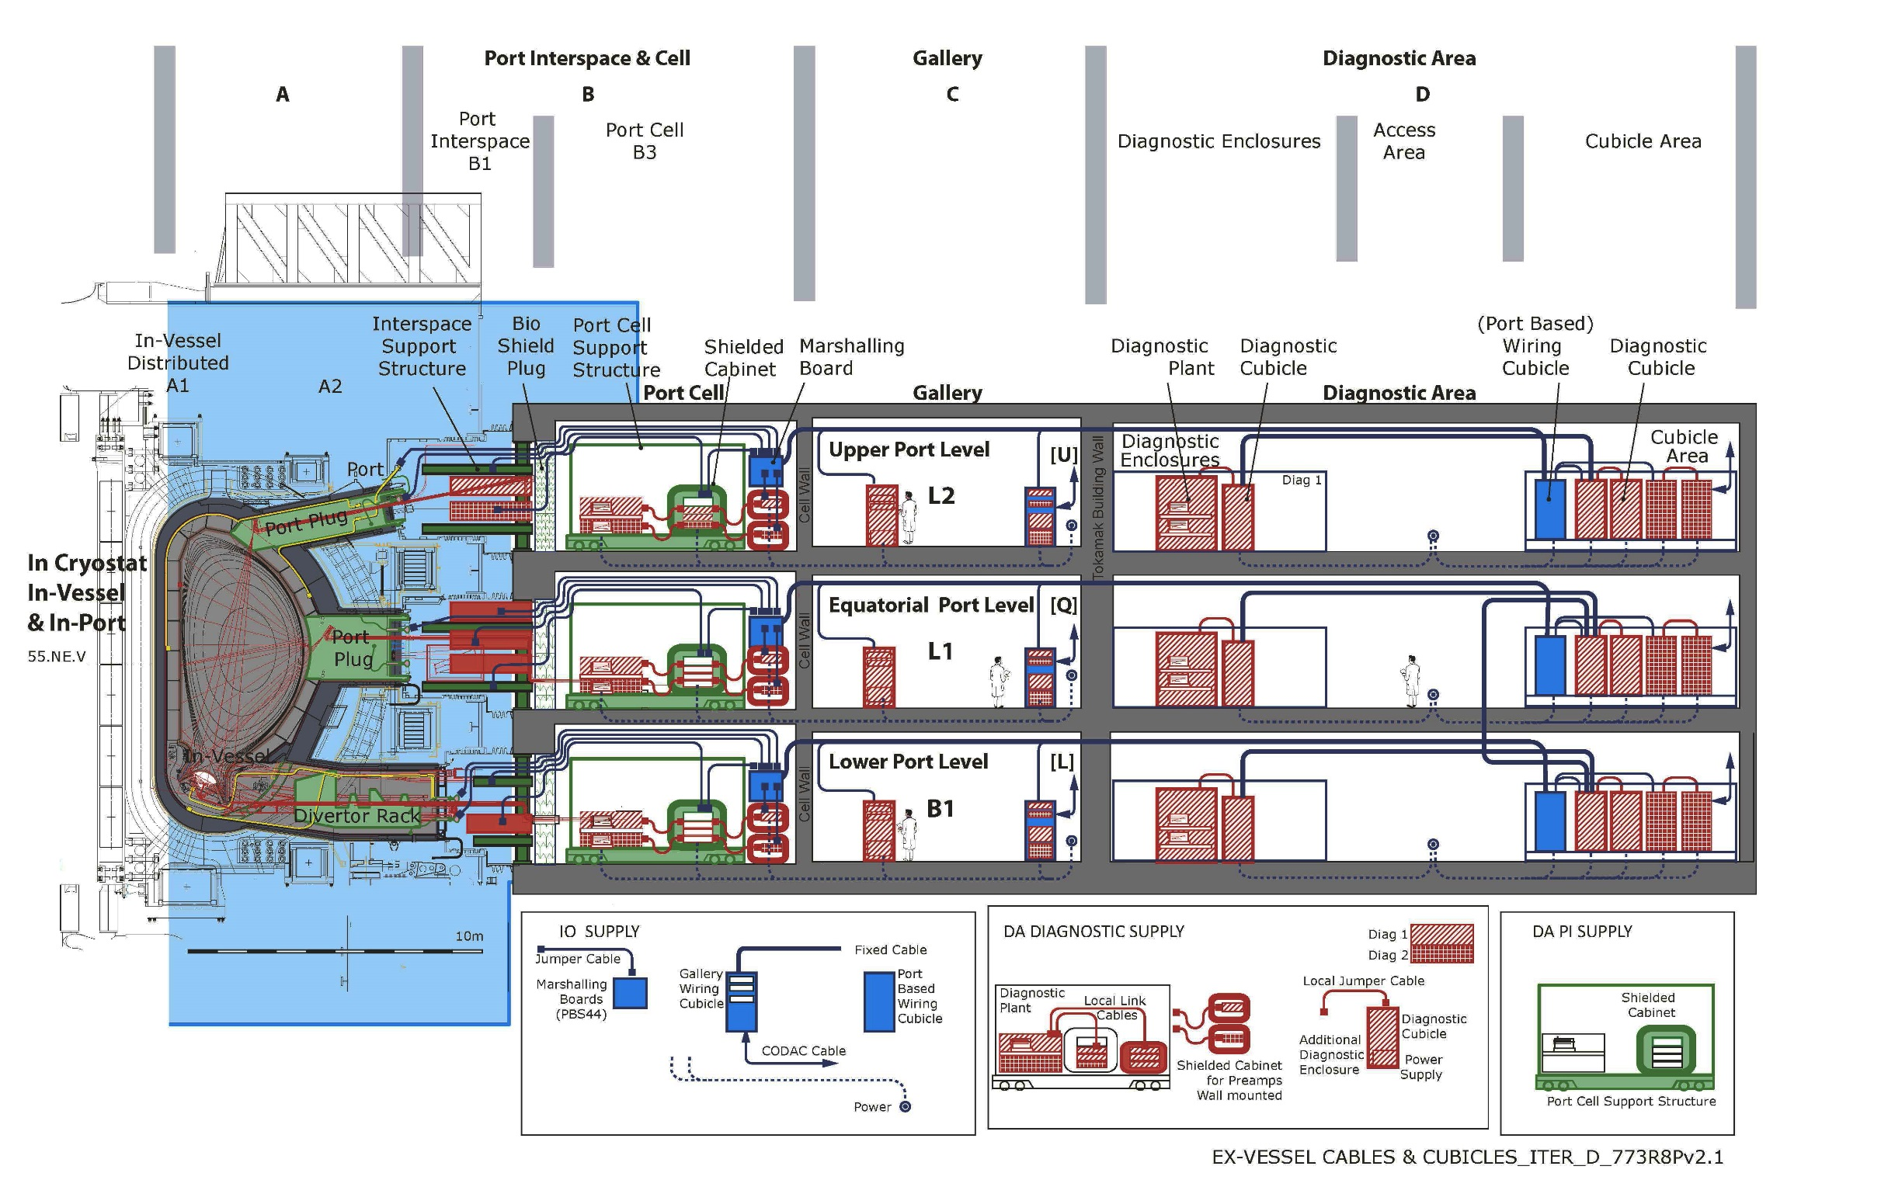
Tokamak operation zone

Slide 6
Main Challenges in Tokamak Operation Zone
Equpment Location. Some front-end electronics cannot be relocated outside operation zone of installation because of long cables induce noise on experimental signals.
Aggressive Environment. Sensors and front-end electronics located near ITER installation (Port Cells, Galleries) works in strong magnetic (~0.2 Теsla), neutron (~ 10⁷ n.cm⁻².s⁻¹), and Hard X-ray fields. In addition, this equipment must have good electromagnetic shielding (EMC) because located near megawatt radiofrequency oscillators (up to 170 GHz).
Radiation protection of electronic parts. In ITER the number of different electronics parts in radiation zone is very large ~500, compared with about 20 different parts in ATLAS detector. Development of special radiation-hard electronics parts for ITER is very expensive and not appropriate for the project.
Networks restrictions. Some multi channel diagnostics generate huge amount of experimental data (~ 100-500 GB/sec) which have to be transmitted in to CCS in real time. Estimations show the required data transmission velocity is more than 10 times accedes the channel capacity of existing ETHERNET and computer buses (~10 Gb/sec). Also, it is necessary to take into account not only data transmission velocity but also latency and packets collision between plant system and supervisor and between plant systems.

Slide 7
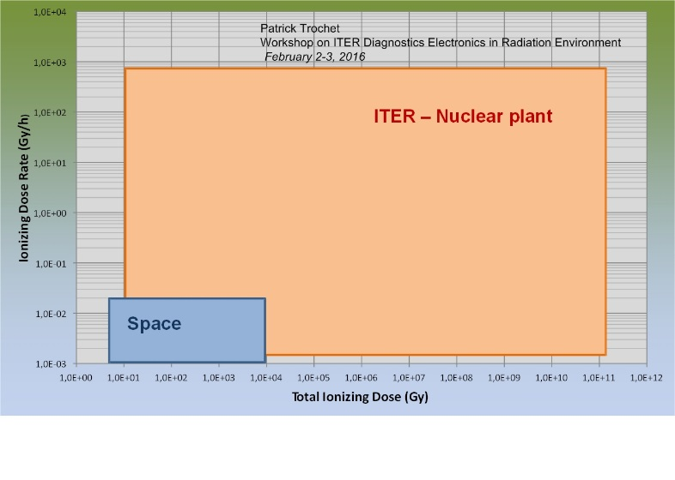
Radiation and Magnetic
Shielding Requirements (Port cell)
(Vincent Martin, Work performed in the frame work of the F4E-FPA-407 contract)
Non critical equipment
Radiation type | Radiation level at B11/L1/PC | Threshold for electronics from ITER policy* | Needed Attenuation factor
Total Integrated Dose (Gy) | 10³ | 10¹ | 100
Neutron Flux (n/cm²/s) | 10⁵ | 10² | 1000
Static Magnetic Field (mT) | 150 | 5 | 30
Radiation is MAIN HEADACH !!!
*IO IDM RAKTPP, values for non-critical electronics (QC>2)

Slide 8
Local Shielding Design (Shielded cabinet)
(Vincent Martin, Work performed in the frame work of the F4E-FPA-407 contract)
Local shielding against neutrons: moderator for fast neutrons (e.g. polyethylene or concrete) and absorber for thermal neutrons (e.g. Cadmium).
Attenuation of gamma dose rate: 7.5 cm of Tungsten for a factor 100.
Shielding against magnetic field: pure iron
Non critical equipment
Layer # (from outside) | Cabinet Side | Composition | Thickness (cm) | Role
1 | left, right and back | Concrete | 5 | Fast neutrons (14 MeV) moderator
 | plasma side |  | 30
2 | All sides | Cadmium | 0.5 | Absorber of thermalized neutrons
3 | All sides | Tungsten | 7.5 | Attenuation of gamma dose
4 | All sides | Pure Iron | 2 | EM shielding

Slide 9
Magnetic loops exclusion requirements
LEZ: Loop exclusion Zone
CBN: Common bonding network

Slide 10
Loop Exclusion Requirements
(PCDH)
Low transfer capacitance
LPF
Power

Slide 11
Electro Magnetic Compatibility Requirements
Designed as Faraday casing
DC/DC
convertors
Low transfer capacitance
Actuator
AC/DC
convertor
.
DAS
F
POWER
Plasma
P
L
Detector
n
o
i
UPS
t
a
z
i
n
o
k
r
c
Data
h
o
c
l
n
C
y
S
One grounding point
Optical lines

Slide 12
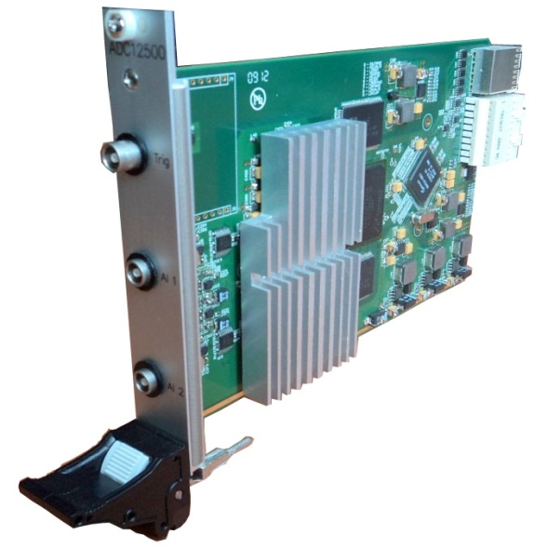
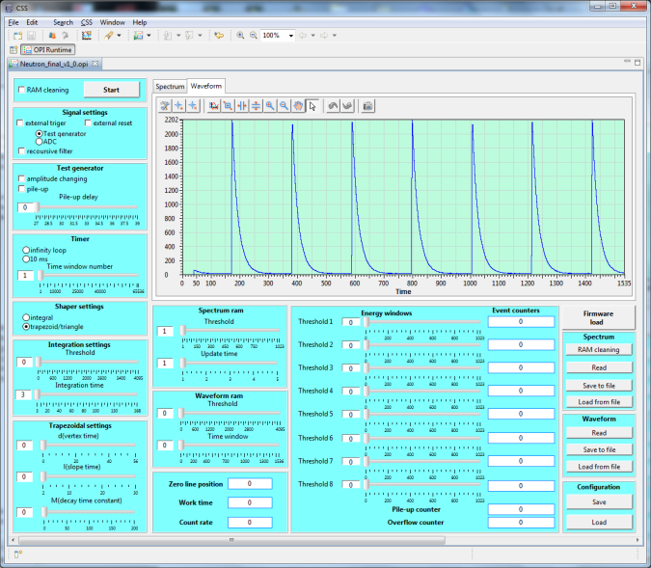
ADC12500 PXIe was taken as a basis
Form factor: 3U PXI Express;
Simultaneously sampling channels number: 2;
ADCs: 12 bit 500Ms/s;
Input amplifiers:
  frequency band: 0 – 250MHz;
  programmable (PGA & DAC):
    gain range: 0 – 50;
    zero line position shift
  RMS noise: less than 1.5 low-orders ADC bit;
  Input: DC/AC differential, differential resistance 110 Ohm;
  common voltage range: -2.5V - +2.5V;
Sampling frequency: programmable - 500MHz, 250Mhz, 125MHz and etc. (divide by 2 until the frequency more than 1MHz);
ADC sampling synchrosignal jitter: <1ps;
ENOB in full input signal frequency band: > 10.5 bits;
Memory size: 3MSamples/channel (32MS/channel and DDR2/3 RAM base are possible in future);
Power consumption: < 20 W (preliminary);
FPGA: Ciclone-3 series EP3C40F780C6 780 pin FBGA;
X4 Lane PCI Express Bridge: GN4124 from GENNUM (compliant with PCI Express Base Specification 1.1., support the FPGA reconfiguration through PCI Express).

Slide 13
Bus and Network Restrictions
On board
On line calculations

Slide 14
Network and Radiation Restrictions
On board
On line calculations

Slide 15
RF_DA Multi channel real time registration system
(for non-critical electronics (QC>2)
~50-100 GB/s
~10 GB/s
~1 GB/s

Slide 16


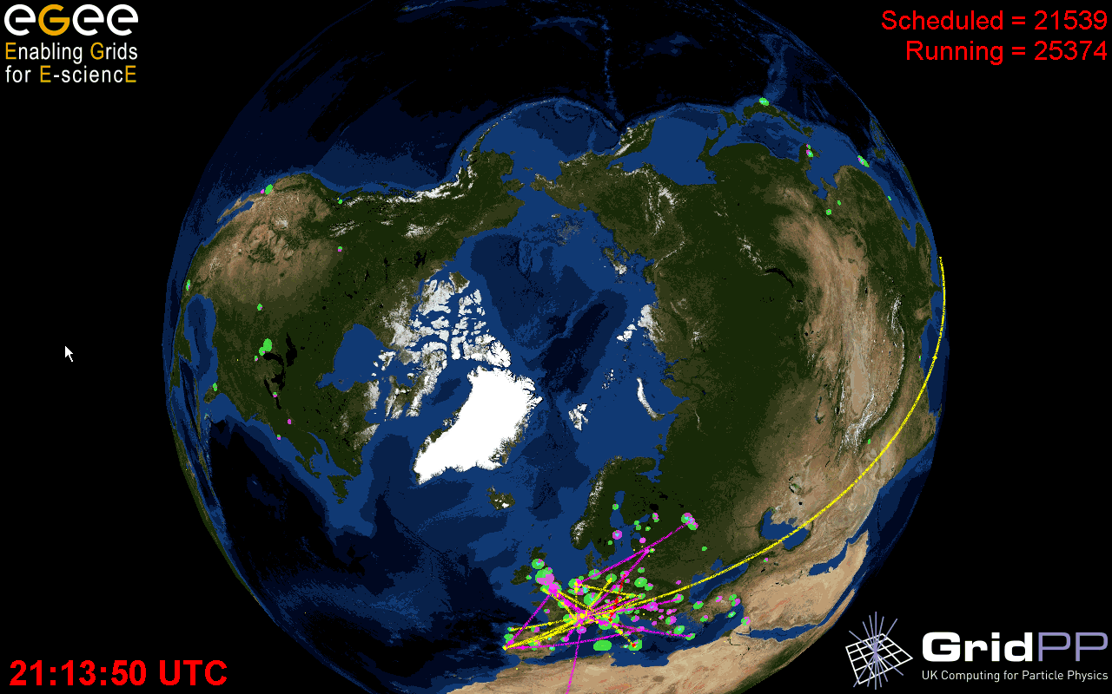
LHC
THANK YOU

