Slide 1
Pragmatic appliance of GPGPU technology
St.Petersburg State University
Dmitry Khmel
Andrei Ivashchenko
Magdalyne Kamande
Amissi Cubahiro
Dubna 2016

Slide 2
Introduction
Modern GPGPU eventually turn into a very powerful computing devices.
More and more applications are starting to support GPGPU.
Graphics processor passed the stage of development from the vector-like graphics accelerator to computing units.

Slide 3
Vector processors
In the 1980s in the field of scientific computing vector processor has got a dominative position.
The main advantage is the appliance of SIMD computing principles.
The disadvantage is that this type of processor is an integral part of supercomputers. It makes vector processors inaccessible and not widely spread.

Slide 4
The history of the development of GPGPU
In 1996, 3dfx Interactive launched the first graphic accelerator Voodoo Graphics.
In the early 2000s GPU technology became particularly popular.
In 2007, the company Nvidia releases the first API for working with general purpose tasks for its new line of graphics processors (CUDA). From this point we introduce the concept of GPGPU.

Slide 5
The history of the development of GPGPU
In 1996, 3dfx Interactive launches the first graphic accelerator Voodoo Graphics, the processor which has a frequency of 50 MHz and 4 MB of RAM.
The earliest accelerators used API Glide
In Voodoo graphics cards for the first time really acceptable performed 3D-games, with the result that Glide is widespread.
In the future development of Microsoft's Direct3D and OpenGL implementation specifications replaced Glide.

Slide 6
The history of the development of GPGPU
In the early 2000s GPU technology is particularly popular.
It develops as a GPU itself and the API to work with them (OpenGL, DirectX).
In 2007, the company Nvidia releases the first API for working with general purpose tasks for its new line of graphics processors (CUDA). From this point we introduce the concept of GPGPU.

Slide 7
The development of CPU and GPGPU in the 2000s

Slide 8
The development of CPU and GPGPU in the 2010s

Slide 9
The history of the development of GPGPU
With the change of generations, GPGPU improved by introducing new technology:
Dynamic parallelism
Hyper-Q
Grid Management Unit
Nvidia GPUDirect

Slide 10
GPGPU LINPACK benchmark

Slide 12
I-Ray Server

Slide 13
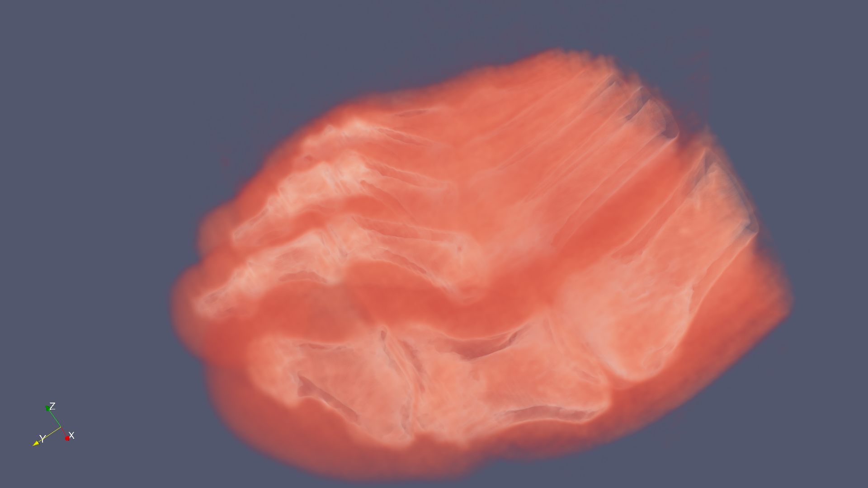
Appliance of ParaView package

Slide 14
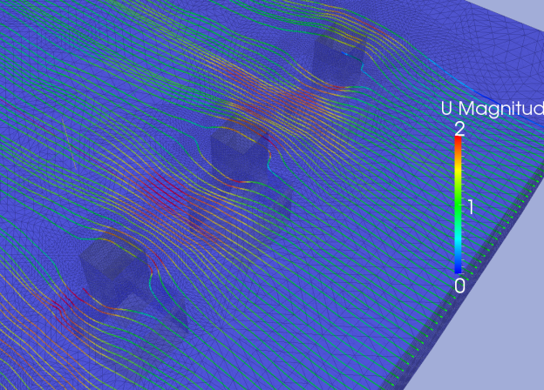
Turbulent water flow over bridge’s pillars

Slide 15
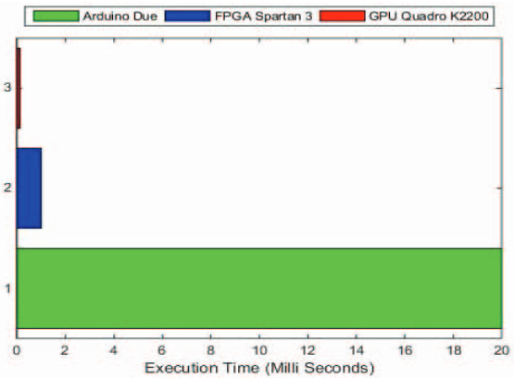
The motion control systems implemented for GPGPU

Slide 16
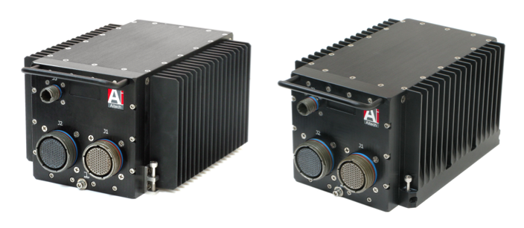
Aitech A191 GPGPU System
Military-grade embeddable solution
Sealed Faraday Cage
EMI/RFI filter
Based on GTX 770M
Sensor and crypto
purposes

Slide 17
Conclusion
GPGPU is still not self-sufficient, but tends to achieve it
The latest improvements made in that direction:
Vector-like data transmitting
3-layered memory organization
Most effective on a tasks based on simple logic and ops

Slide 18
Thank you for attention

