Slide 1
JINR Tier-1 service monitoring system: Ideas and Design
LIT
Igor Pelevanyuk, Ivan Kadochnikov
@GRID2016

Slide 2
Introduction
1
Why it is important and complicated

Slide 3
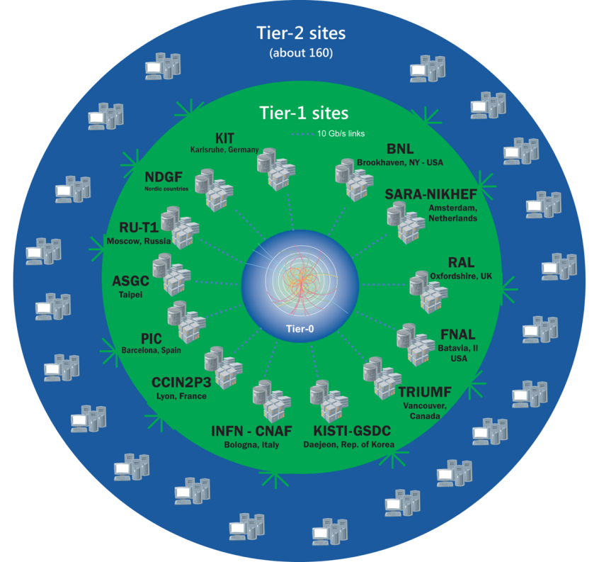
WLCG
World LHC Computing Grid
Tier-0: 20% of compute capacity.
Tier-1: Highly reliable. Serve T2 centers.
Tier-2: 160 centers. Serve users’ tasks.
Tier-3: Centers serving specific groups.

Slide 4
Purpose
Store
Process
Deliver
Other T1s
T2s
T3s
For
To
Data coming from Large Hadron Collider

Slide 5
Services
Process
Store
Transfer
Other

Slide 6
Hierarchy
Services
OS/Software
Hardware
Network
Infrastructure
Icons are Designed by Freepik

Slide 7
Task
Deploy a system
to show status of services
on a single page
with ability to investigate reasons of problems.

Slide 8
Work done
2
What we have already achieved

Slide 9
Sources
Local
Parsing
Fast
Fast
Slow
Controllable
Controllable
Security
Parsing
Security
Uncontrollable
Security
Parsing
Important data

Slide 10
Web-security
Local network
ProxyAgent
HTTP request
<HTML>
Monitoring host
<HTML>
HTTPS request

Slide 11
SSH-security
Monitoring host
Monitored host
ssh monitor@monitored test1
stdout, stderr
Monitored host configured to run ProxyCommand.sh on particular ssh key
ProxyCommand.sh contains list with allowed commands. Passing test1 as parameter could lead to executing /opt/adm/qsub -q

Slide 12
First iteration
Collection
Visualization
Executors
JSONs
Retrievers
HTTP Requests
HTML response
HTTP Request

Slide 13
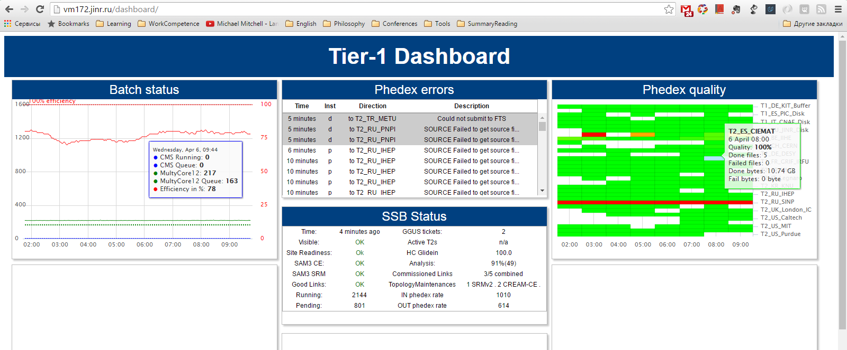
Dashboard

Slide 14
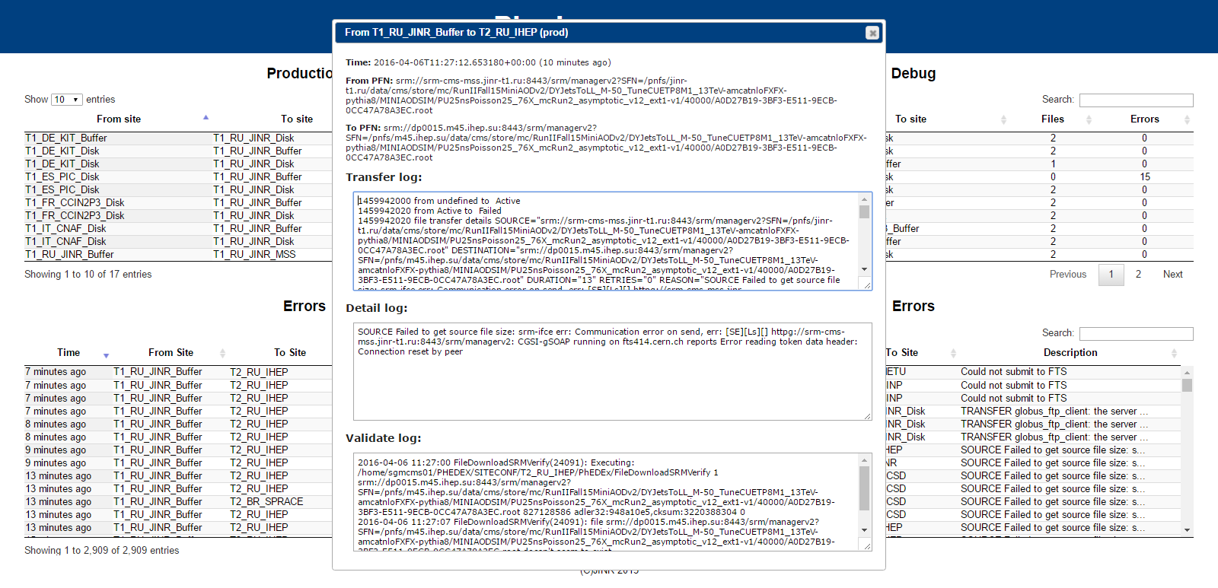
Transfer Service - Phedex

Slide 15
Phedex - Quality

Slide 16
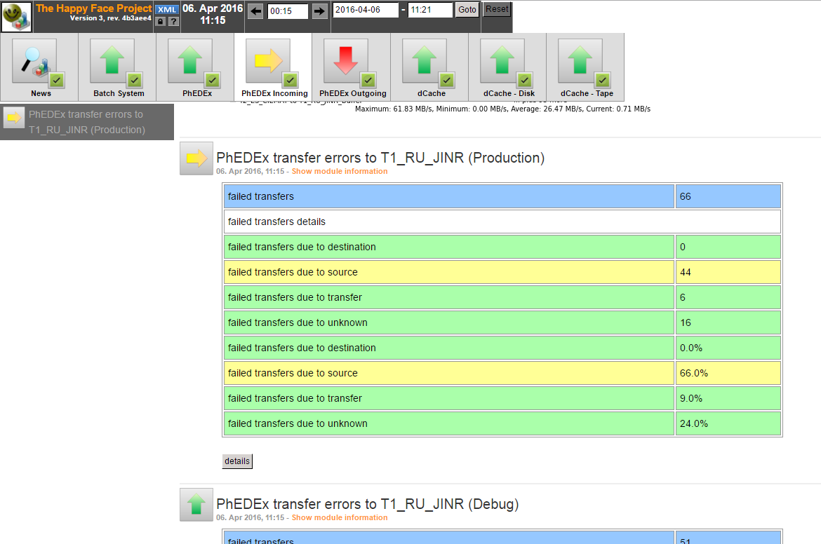
HappyFace
Simple
Aggregation
Alarms
Detalisation

Slide 17
Task2.0
Deploy a system
to show status of services
on different scales
with ability to react automatically
on occurring events,
and alow forecast based on past data.

Slide 18
Next Steps
3
To the Future

Slide 19
Architecture
Module
REST
Collect
DB
HTML,
CSS,
JS
Analyze
Forecast
React

Slide 20
JavaScript

Slide 21
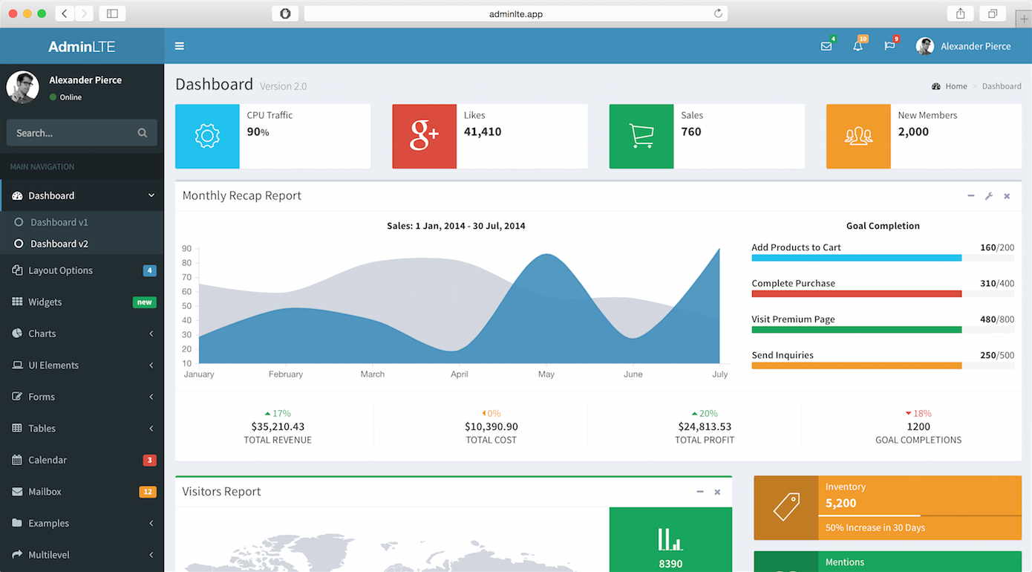
Want big impact?

Slide 22
New Techs
https://github.com/tier-one-monitoring
Landscape.io – Coding style check
Travis CI – Continuous Integration
Installation, Regressive, Compatibility, Functionality, …
Covetalls.io – Code coverage

Slide 23
Concusion
4
Wrap up!

Slide 24
Conclusion
Alarm system required
Model of service interaction
Complex Event Processing techniques
More, more, and even more modules

Slide 25
THANKS!
Any questions?
You can write me to Pelevanyuk (at) jinr.ru

