Slide 1
Design of the front-end electronics based on multichannel IDEAS ASICs for Silicon and GEM detectors
Yu. Ivanova, S. Khabarov, Yu. Kovalev
JINR VBLHEP

Slide 2
Using of IDEAS ASICs for BM@N facility
Current FEE BM@N configuration (March 2018) is based on ASICs provided by commercially company (IDEAS) for next detectors:
Forward Silicon Detector;
GEMs (Gas Electron Multiplier);
CSC (Cathode Strip Chamber).
According to upgrade plans for BM@N FEE for new detectors also will be based on the IDEAS ASICs:
Si beam tracker;
Si beam profilometer;
Forward Silicon Tracking Detectors.
[http://bmn.jinr.ru/about/]

Slide 3
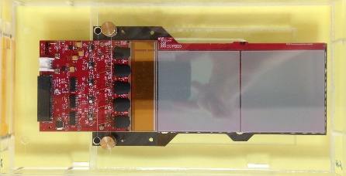
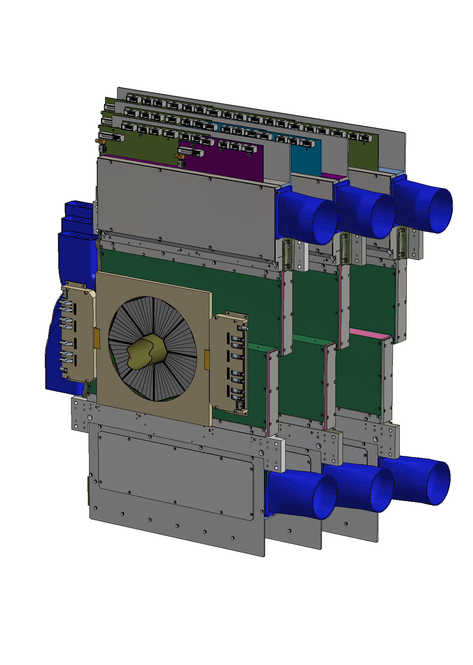
Number of Forward Silicon Tracking Detector channels for BM@N experiment
Forward Silicon Tracking Detectors
Three coordinate planes
10 detector modules;
Detector module
Double-sided Silicon Strip Detectors;
3 coordinate planes
14 detector modules;
18 detector modules.
10 VATAGP7.1 IDEAS ASICs;
128 ch/chip.
1280 channels:
Total detector modules: 42.
The total number of measuring channels: 53760.
N. Zamyatin
Detector council BM&N meeting, 09.04.191

Slide 4
Number of GEM Tracking System channels for BM@N experiment
GEM Tracking System
GEM plane
7 GEM planes
4 VA163 IDEAS ASICs;
32 ch/chip.
6400 channels:
50 FEE boards;
The total number of measuring channels: 89600.

Slide 5
Front-end electronics block diagram
Detector
IDEAS ASICs
ADC
Control Unit
Silicon
GEM
VATAGP7.1
VA163 / VA162
FPGA
Multichannel
> 50 MSPS
CSC
DAQ System
VATA64HDR16.2
Front–end electronics

Slide 6
IDEAS ASIC’s features
 | VATAGP7.1 | VATA64HDR16.2 | VA32HDR11 | VA163 | VA162
Number of channels | 128 | 64 | 32 | 32 | 32
Input charges | -30fC ÷ +30fC | -20pC ÷ +55pC | -35pC ÷ +25pC | -750fC ÷ +750fC | -1.5pC ÷ +1.5pC
Shaping time | 500ns | 50/100/150/300ns | 0.9μs | 500ns | 2 ÷ 2.5μs
Noise | 70e⁻ ENC + 12e⁻/pF | 1fC | 13000e⁻ ENC | 1797e⁻ ENC at 120pF load | 2000e⁻ ENC at 50pF load
Gain | 20μA/fC | 2-gain settings | 36 μA/pC | 0.88μA/fC | 0.5μA/fC
1 analogue multiplexed output | ✓ | ✓ | ✓ | ✓ | ✓
Time-to-amplitude converter |  | ✓
Self-trigger | on-chip |  | with IDEAS TA32cg2
Application | are used for Forward Silicon Detector | will be used for Si beam tracker | will be used for Si beam profilometer | are used for GEMs, CSC | were used for GEMs, CSC

Slide 7
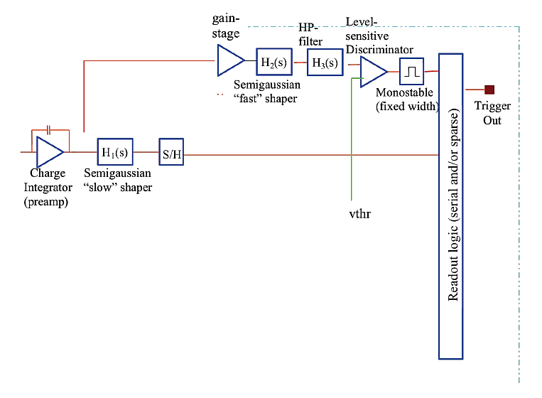
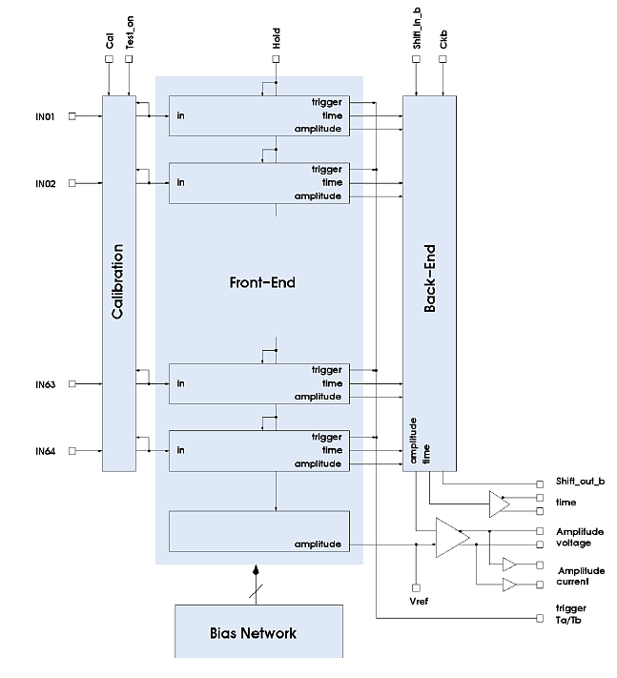
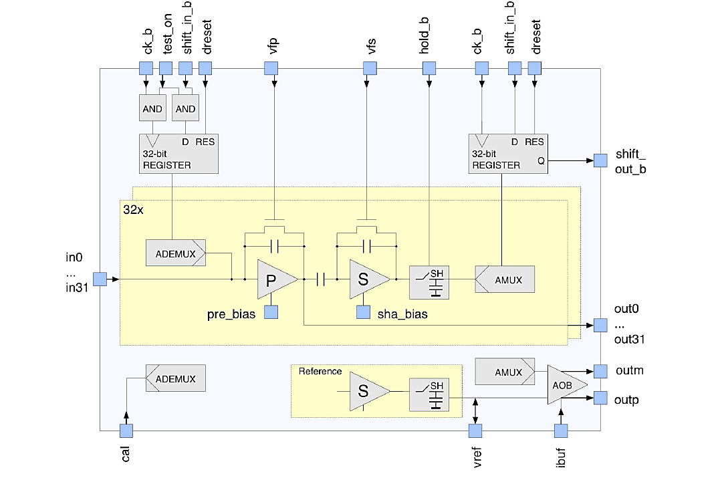
IDEAS ASIC’s functional description
VATAGP7.1 | VATA64HDR16.2 | VA162
[VATAGP7.1
IDEAS DATASHEET:
128 Channel Silicon Detector Readout with Trigger]
[VA162 IDEAS DATASHEET:
32 CSAs with Pre-amplifier Outputs,
Sample-and-‐Hold and Multiplexer Output]
[VATA64HDR16.2 IDEAS DATASHEET]

Slide 8
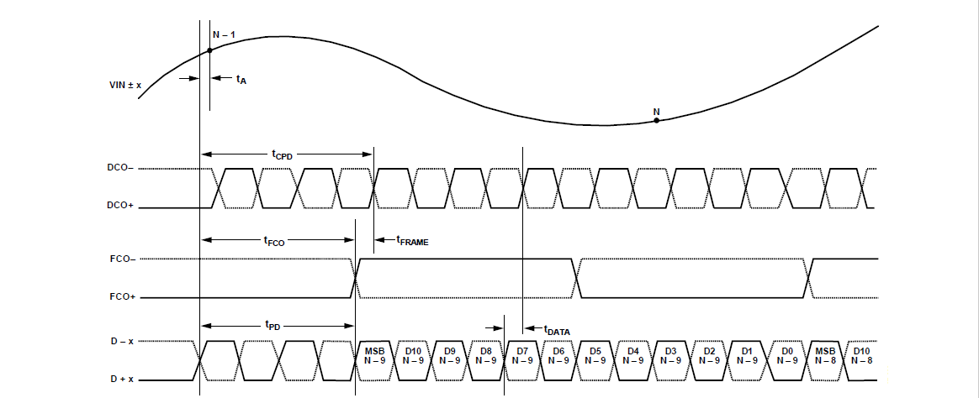
FPGA Design

Slide 9
Event readout
From Si Strip Detector to VA162
Inside VA162
From FPGA to VA162
From VA162 to ADC

Slide 10
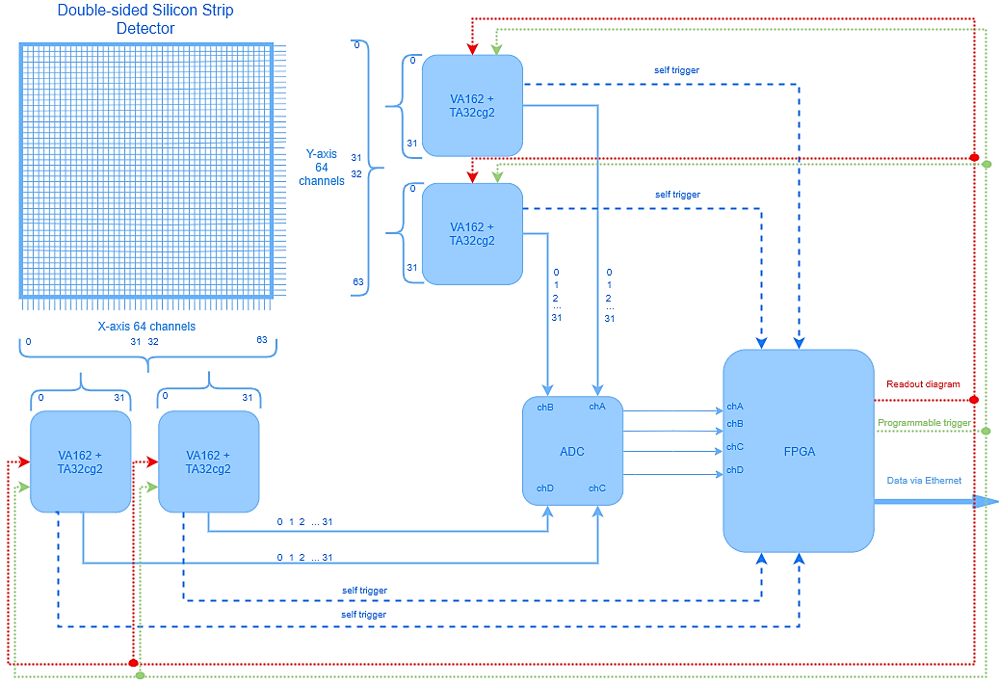
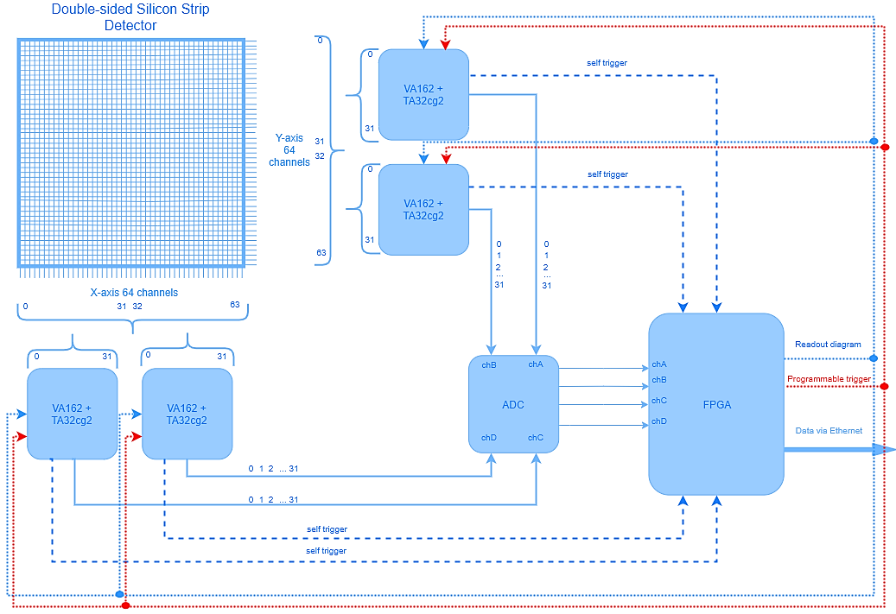
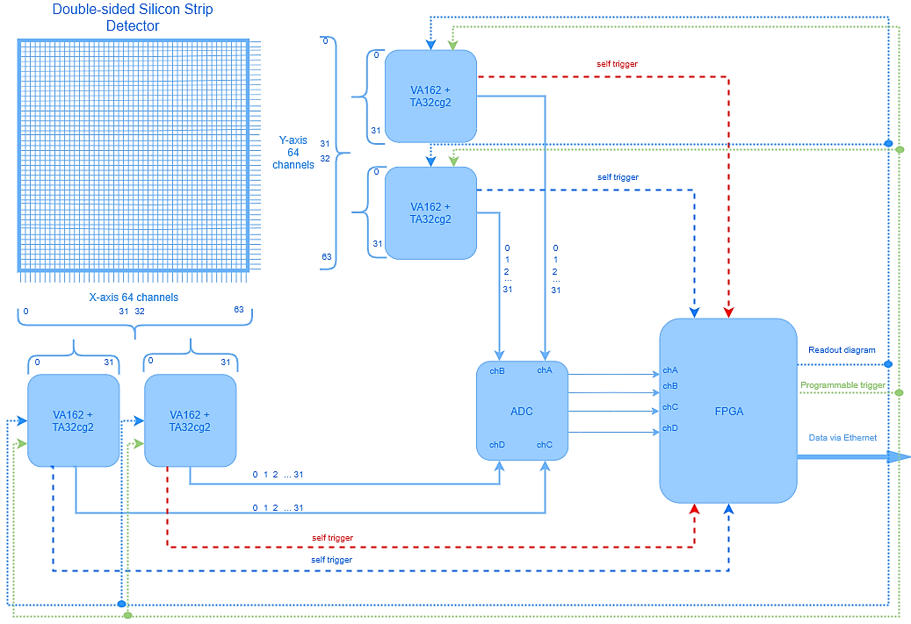
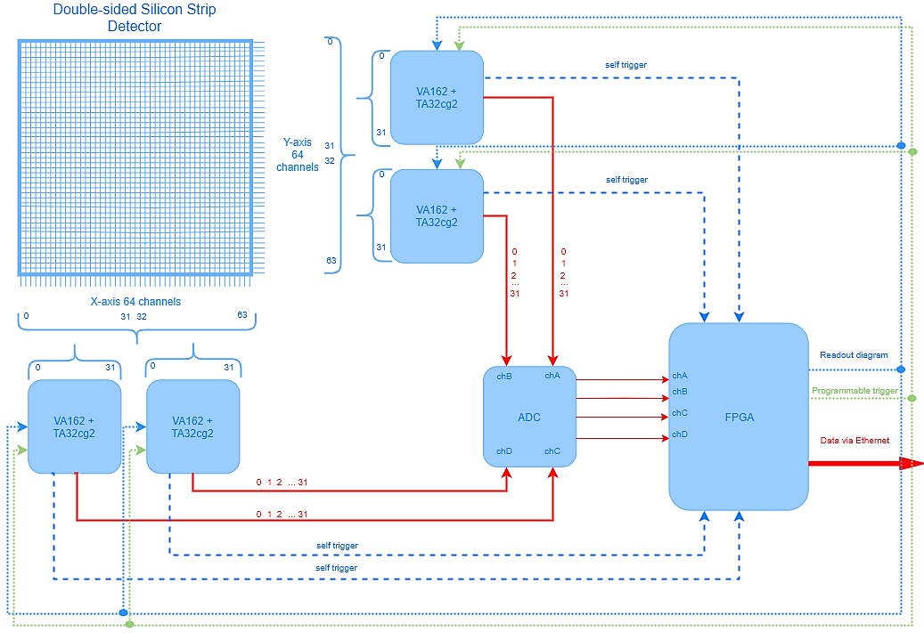
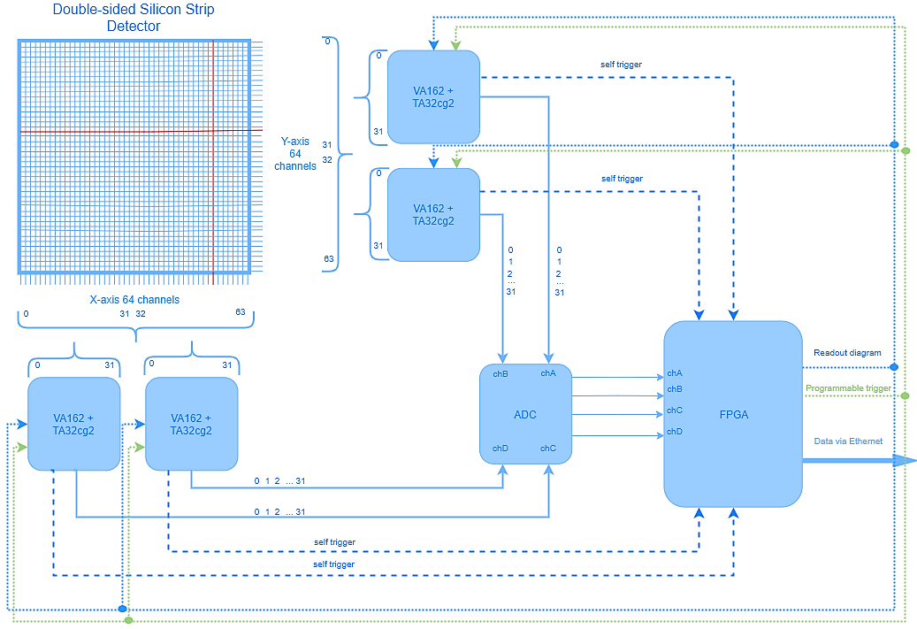
Design of the Si beam profilometer
Configuration TA32cg2
registers:
pre-amplifier gain;
pre-amplifier input
potential;
trigger disable
for each 64 channels;
trigger threshold;
test channel.

Slide 11
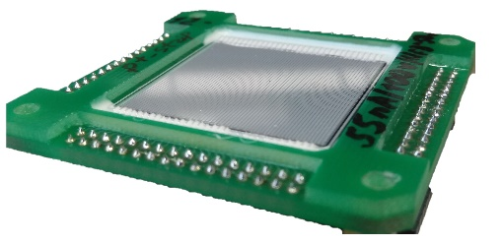
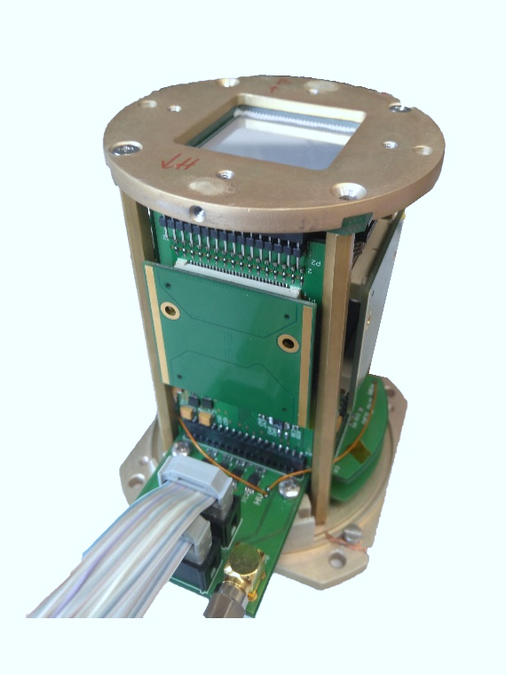
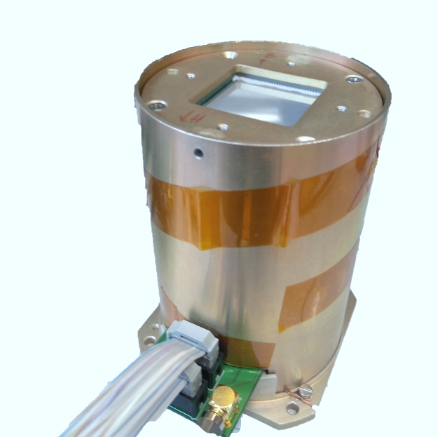
Si beam profilometer prototype
Double-sided
Silicon Strip Detector
A mezzanine card with one or two (VA+TA) of the IDEAS ASICs might be plugged into another front-end electronics board.

Slide 12
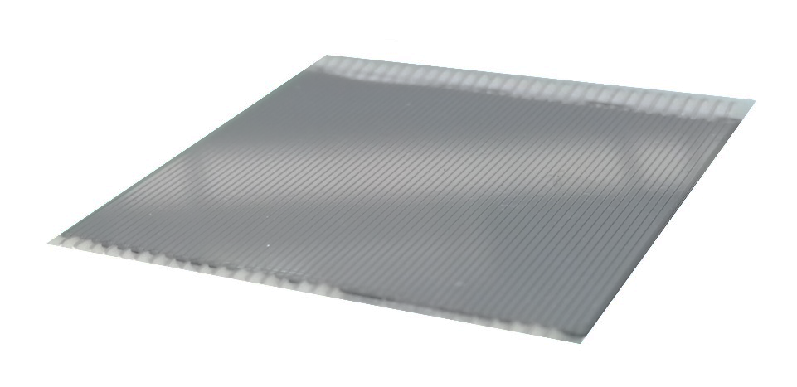
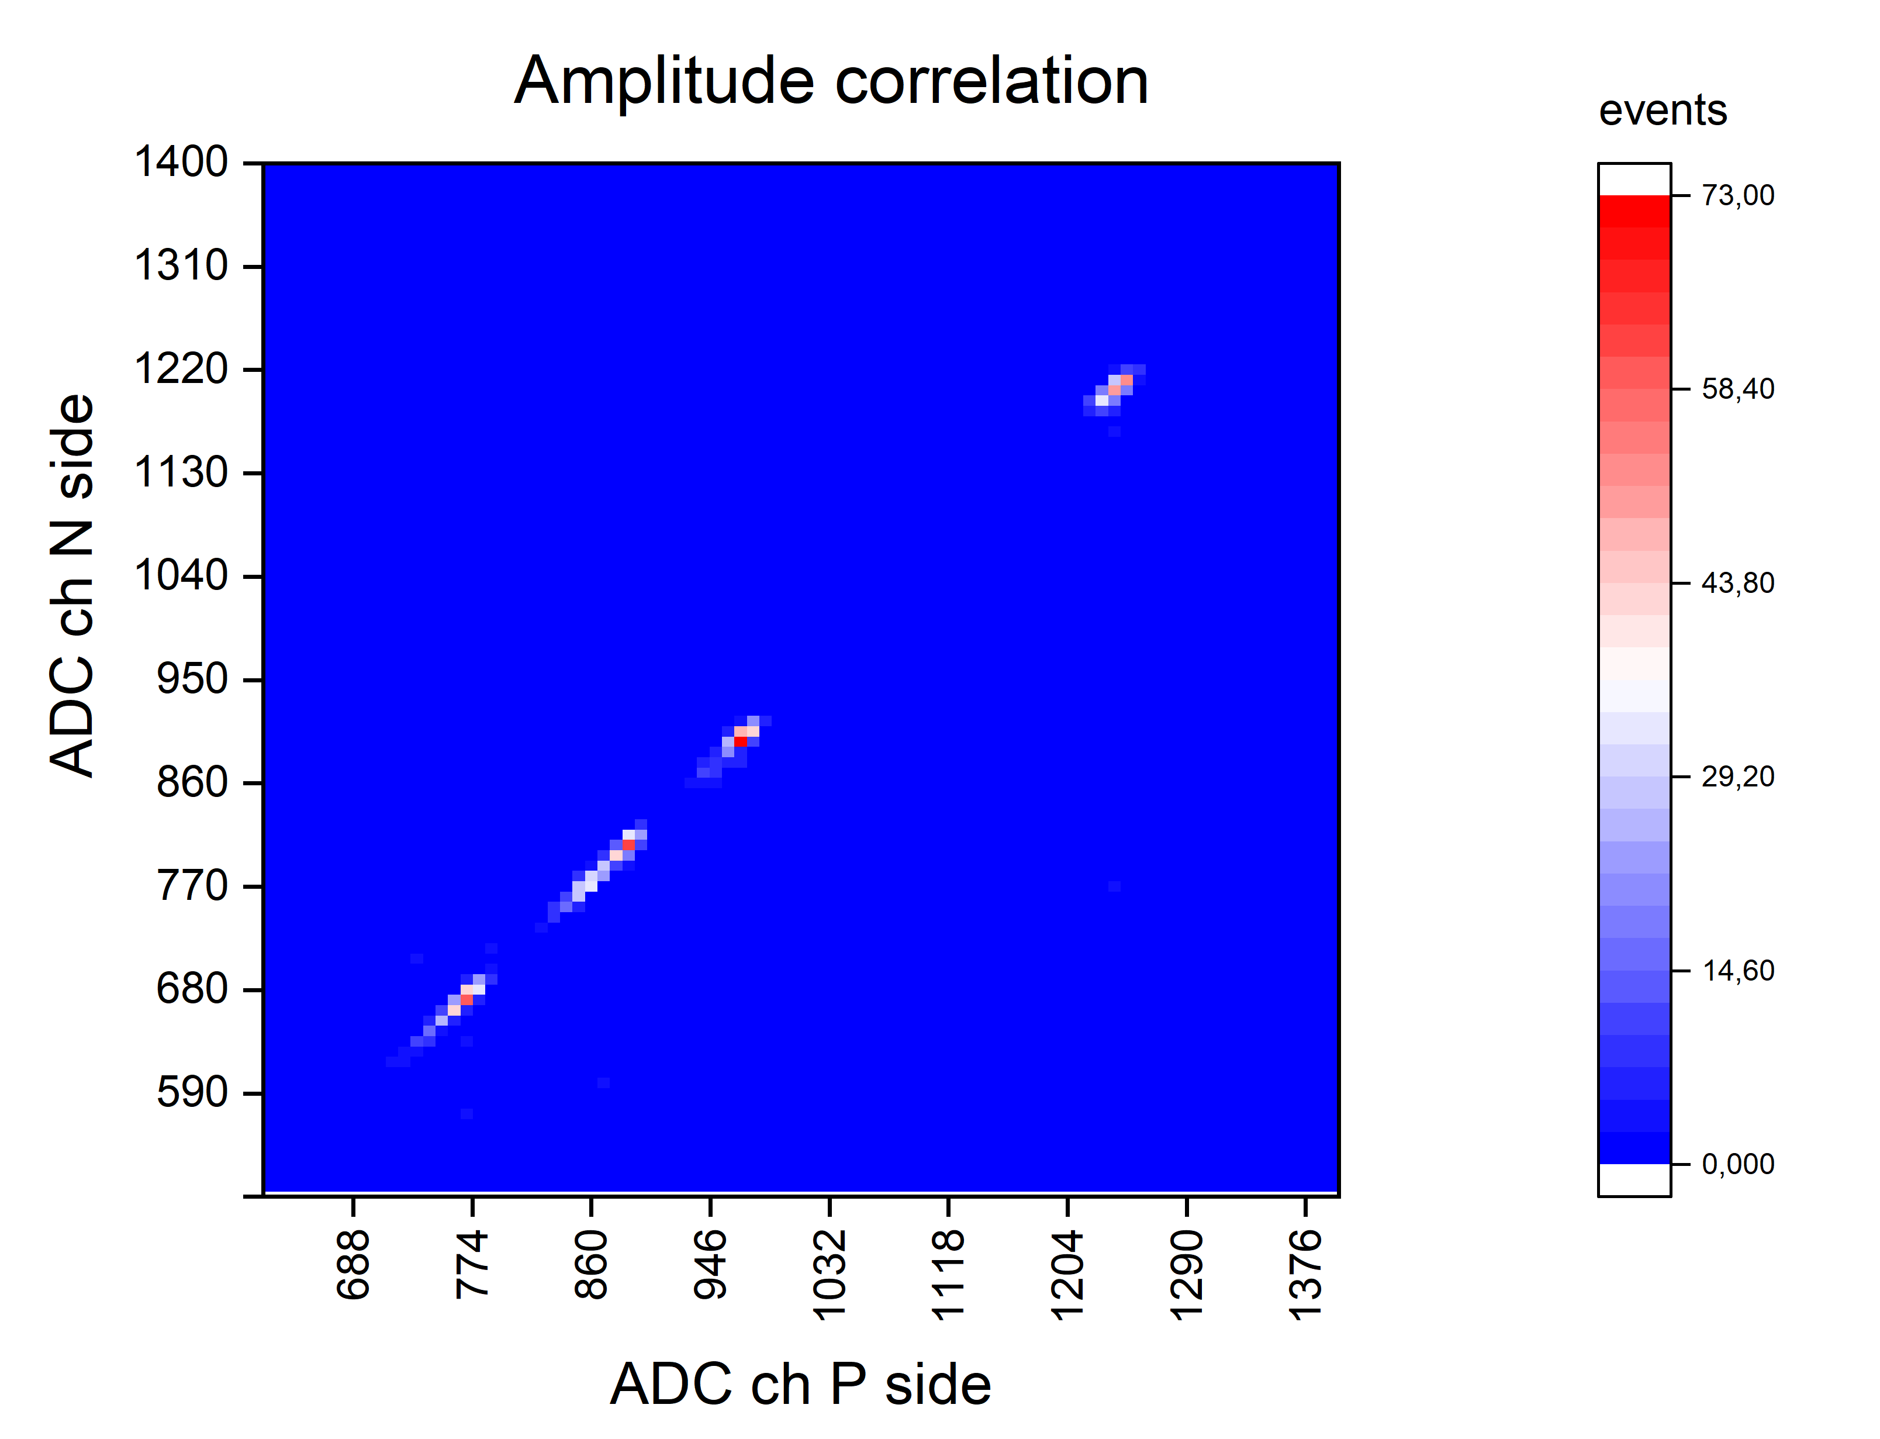
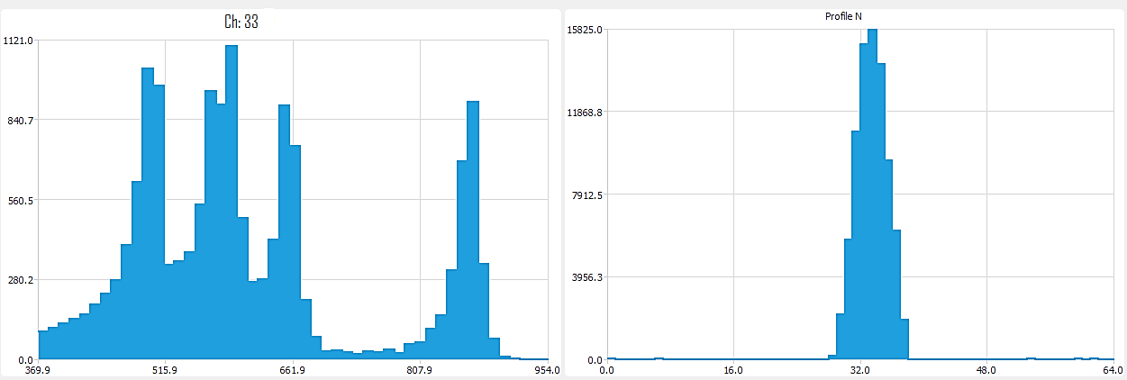
Experimental setup (no vacuum)
Test with collimated ²²⁶Ra (VA162)
²²⁶Ra
1mm Pb as a collimator
Kapton layer
for electrical insulation strips
5,5 MeV
Double-sided
Silicon Strip Detector
(64x64 strips; size 35x35mm)
4,8 MeV
5,3 MeV
6 MeV
7,6 MeV
Profile P
Profile N

Slide 13
Conclusions
IDEAS (Norway) produces multichannel (32, 64, 128), commercially available ICs with wide input charge range for front-end readout of ionizing radiation detectors;
FEE based on IDEAS ASICs for Silicon Detector, GEMs, CSC were successfully run for BM@N experiment in March 2018;
The Si beam profilometer prototype (FEE based on IDEAS VA162 and FPGA readout) has been designed and tested with ²²⁶Ra.
Plans
Front-end readout electronics are being designed for upgraded BM@N experiment for:
Forward Silicon Tracking Detector (3 coordinate planes);
3 Silicon beam trackers;
2 Silicon beam profilometers;
GEMs.

Slide 14
Acknowledgments
I would like to show gratitude to Nikolay Zamyatin for result discussions and tests, and to Evgeniy Zubarev for design and manufacture of structures.

Slide 15
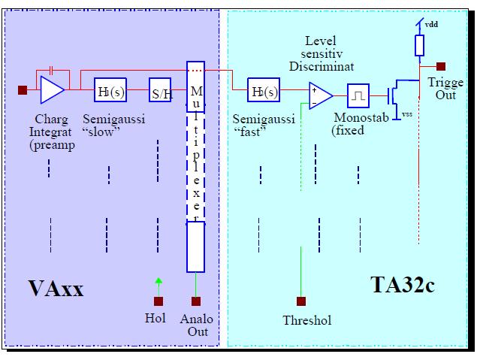
TA32cg2 & TA32cg3
 | TA32cg2 | TA32cg3
Number of channels | 32
Peaking time | 75-150 ns | 75-100 ns
Threshold DACs | 3 x 32bit DAC-mask
Gain | Programmable
Polarity | Negative or positive

