Slide 1
Calculation of efficiency of cylindrical thermal neutron counter assemblies
A. Kurilkin^{*1}, A.Churakov¹, A.Glazkov²
1 – Joint Institute for Nuclear Research, Dubna, Russia
2 - V. N. Karazin Kharkiv National University, Kharkiv, Ukraine
Email: akurilkin@jinr.ru

Slide 2
Outline
Introduction
Experimental setup
Simulation
Results
Conclusion

Slide 3
Introduction
The neutron scattering techniques are widely used in the modern science at studying:
atomic and magnetic structure
dynamics of simple crystals
nanostructures
complex chemical reactions
catalytic processes
complex liquids
self-organizing systems
exotic electronic states
One of the main tools to measure thermal neutron fluxes is the gaseous detector.
Particularly, cylindrical proportional counters are widely used on many spectrometers.
Advantages of cylindrical counters:
detectors with large counting area can be constructed
well known work stability

Slide 4
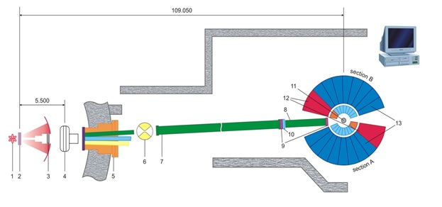
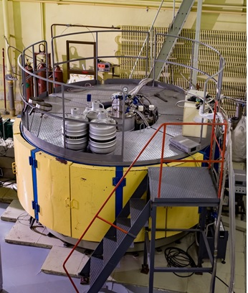
Multi-purpose inverse geometry spectrometer NERA
1 – IBR-2 reactor core
2 – thermal and cold moderators of radial horizontal beamlines 7-11 and tangential beamlines 1-9
3 – beam shutter
4 – fast neutron background chopper
5 – common vacuum splitter of three neutron beams by Ni-mirror neutron guides
6 – I-chopper of beamline 7b
7 – vacuum Ni-mirror guide tube of neutron beamline 7b
8 – vacuum sections of beamline 7b
9-10 – monitor and diaphragms of incident beam 7b, respectively
11 – sample position
12 – NPD sections
13 – INS and QENS sections of the NERA spectrometer
NERA spectrometer is designated predominantly for the study of molecular dynamics.
Main research fields:
Dynamics and structure of the condensed matter, particularly, of the substances exhibiting phase polymorphism.
Investigation of substances in which phase transitions are accompanied by changes in the structure, lattice dynamics or in the character of stochastic motion of molecules or molecular groups.

Slide 5
Multi-purpose inverse geometry spectrometer NERA
Task:
To upgrade the spectrometer by new detectors with characteristics better than the old one.
Restrictions:
The sensitive area of detector must be equal in geometrical size to the old boxes.

Slide 6
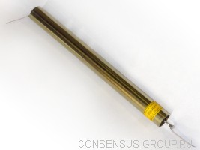
Thermal neutron counters Helium-18/200-8.0/L
Advantages:
1 - well known
2 - stability of work
3 - efficiency ~70% at En=0.025eV
Work reaction : n+³He → p + ³H + 764keV

Slide 7
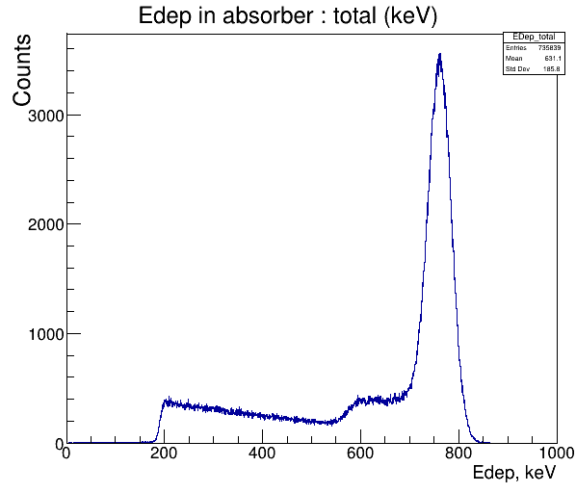
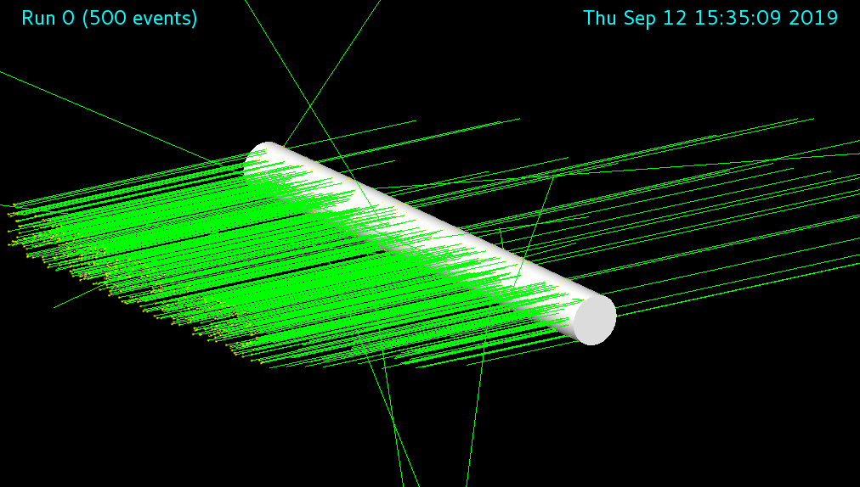
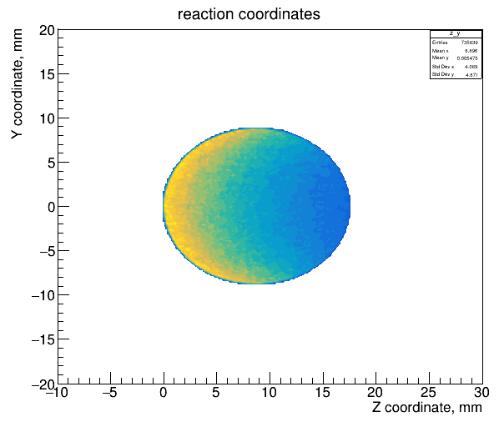
Geant4 simulation of thermal neutron counters assemblies
Geant4 is a toolkit for the simulation of the passage
of particles through matter.
Physics : QGSP_BERT_HP hadronic model.
(uses the data driven high precision neutron package (NeutronHP)
to transport neutrons below 20 MeV down to thermal energies.)
It allows to estimate efficiency of the detector and track lengths of ³H and proton.
Work reaction : n+³He → p + ³H + 764keV

Slide 8
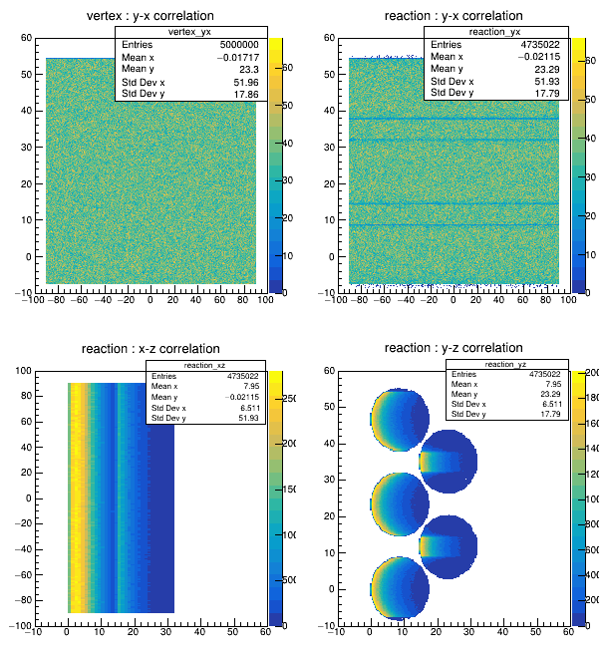
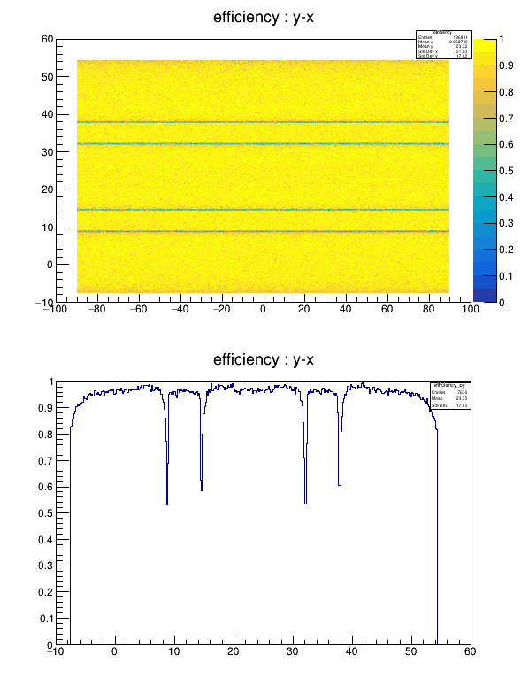
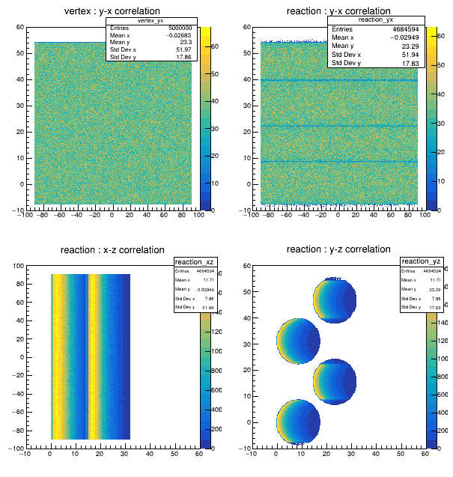
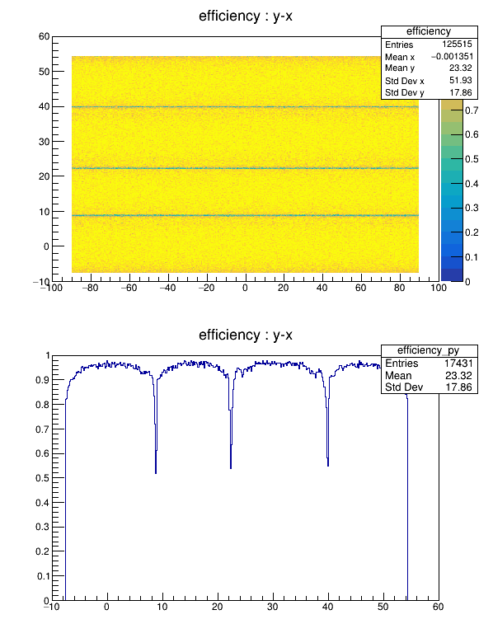
Simulation of thermal neutron counters assemblies (Geant4)
Assembly from 5-th tubes
Assembly from 4-th tubes
Efficiency of assemblies for the neutron beam with vertex from the point source :
Energy of beam | 5-th tubes assemblies | 4-th tubes assemblies
0.025 эВ | 82.5 % | 76.7 %
0.00465 эВ | 94.0 % | 92.1 %
Efficiency of assemblies for the neutron beam with uniformly distributed vertex:
Energy of beam | 5-th tubes assemblies | 4-th tubes assemblies
0.025 эВ | 83.6 % | 78.3 %
0.00465 эВ | 94.7 % | 93.7 %

Slide 9
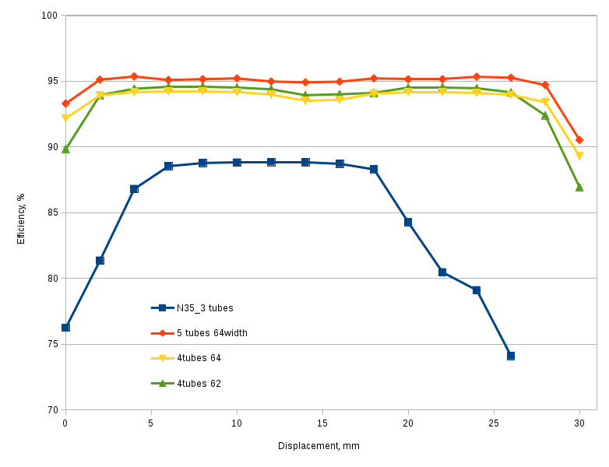
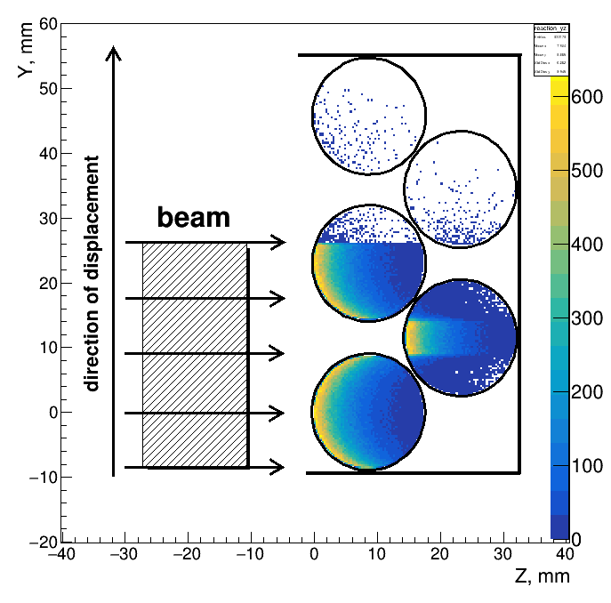
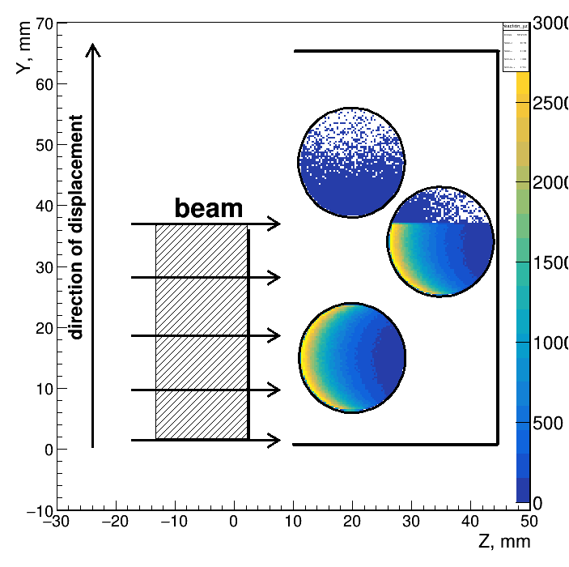
Dependence of efficiency from beam displacement value
displacement, mm
Energy of beam : 0.00465 эВ
The goal is to compare the efficiency of assemblies if the beam has a width of 35mm and hits in the different areas of the detector.

Slide 10
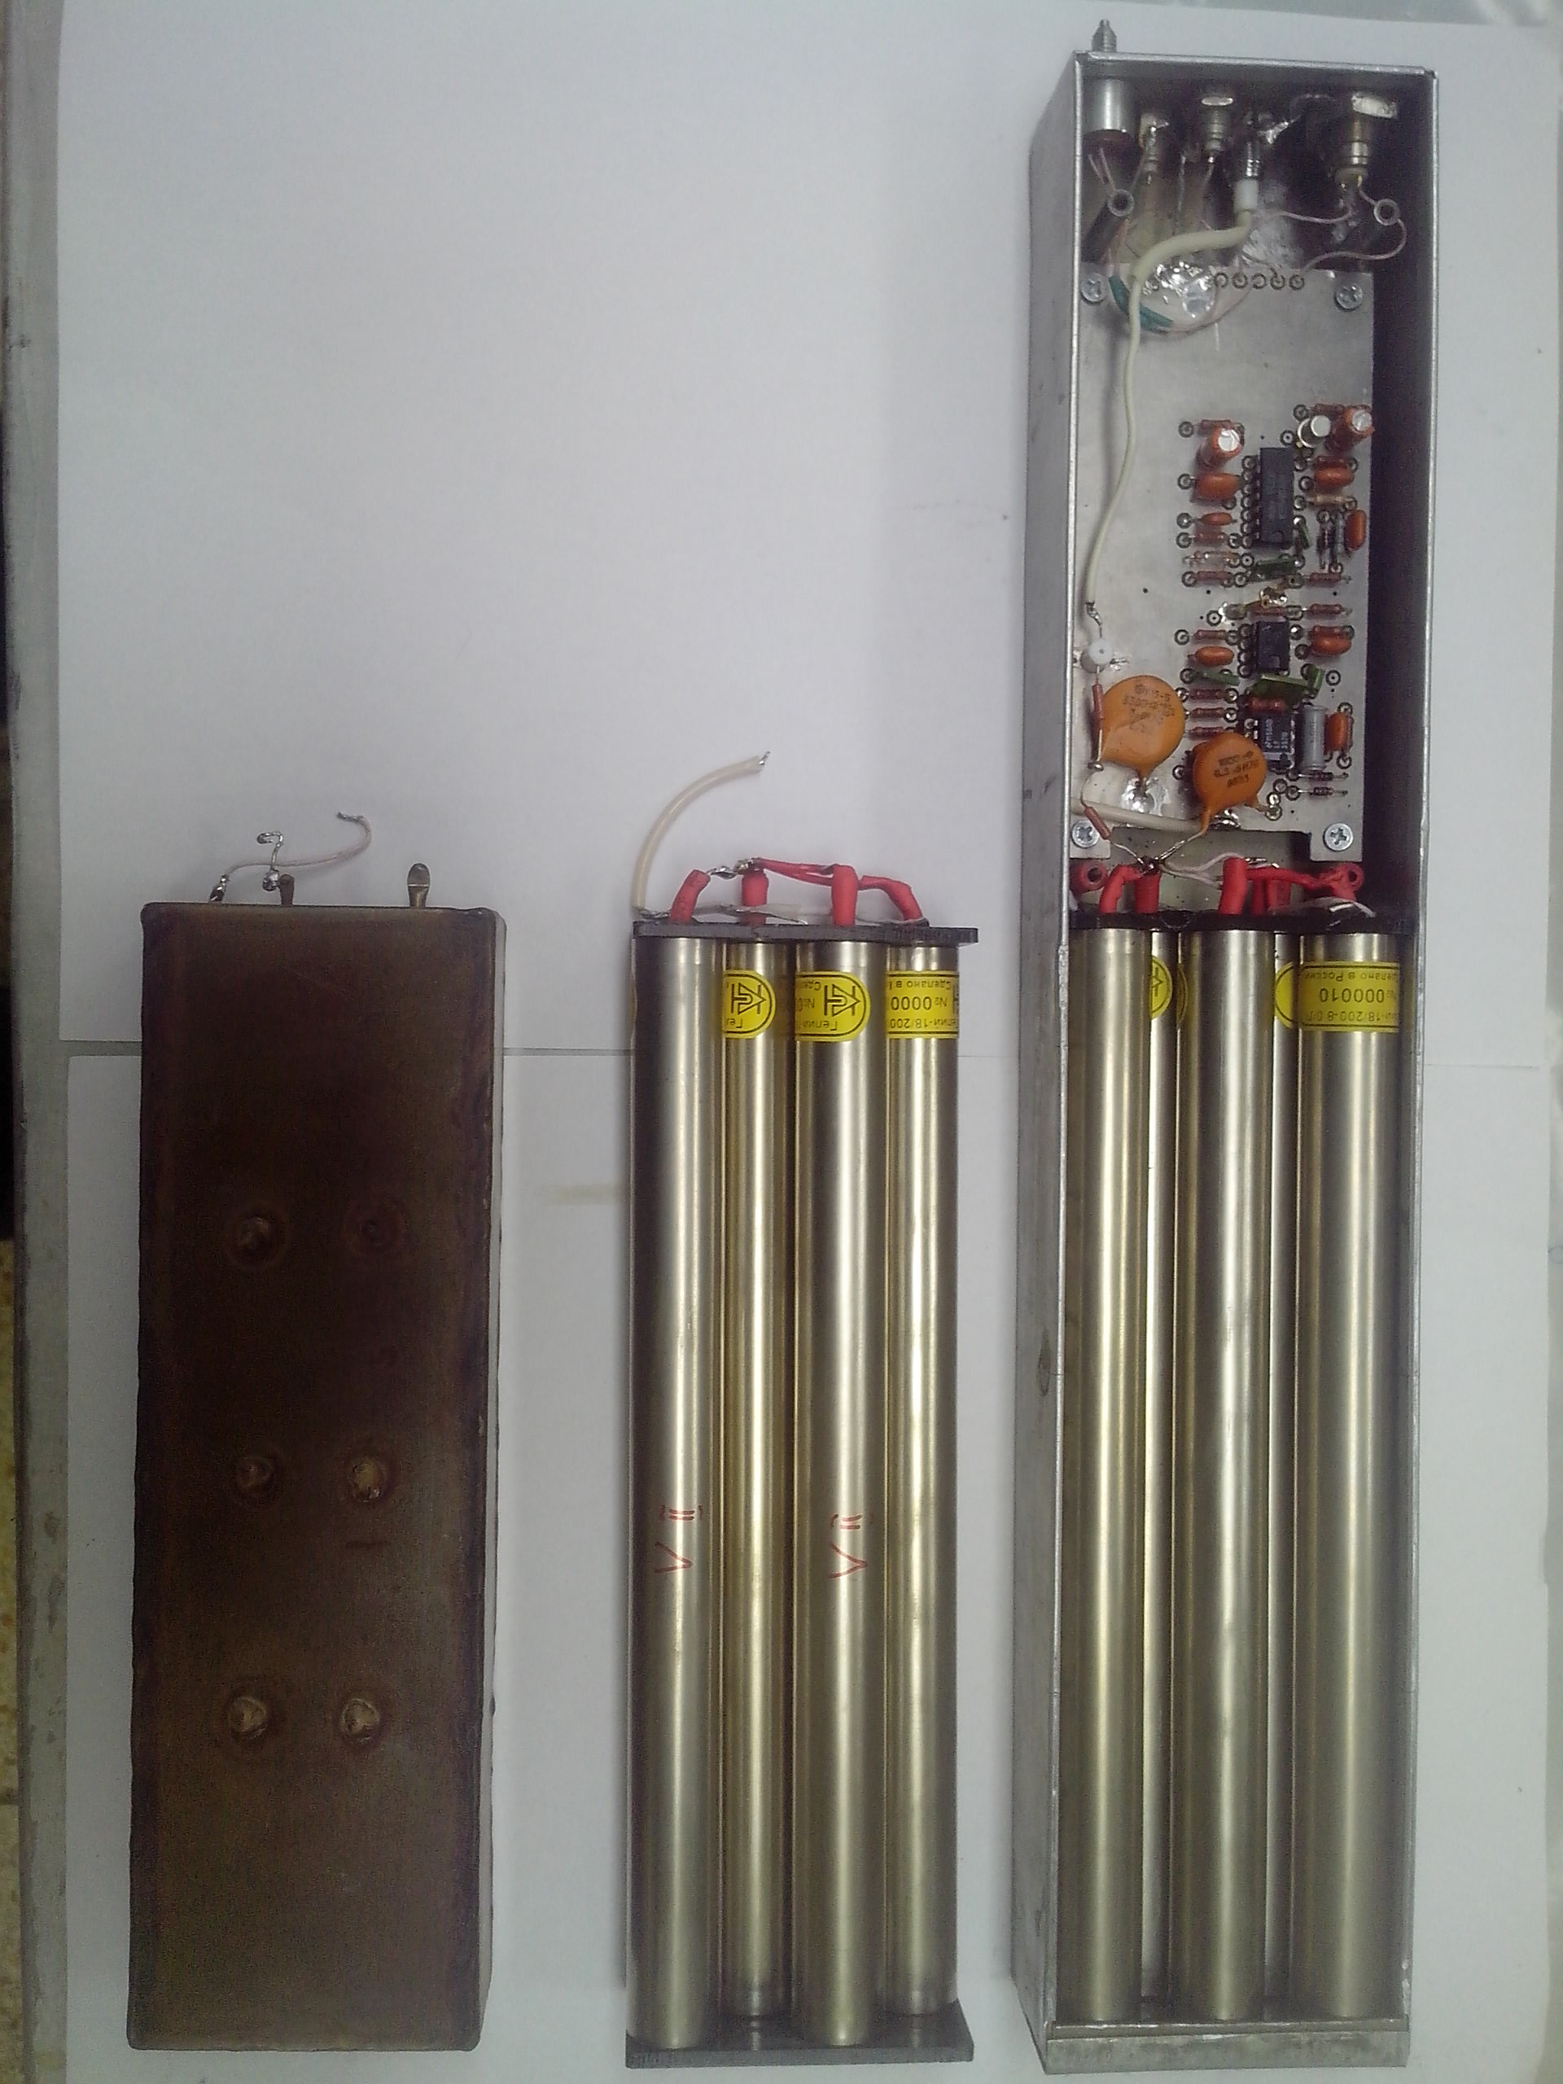
Experimental results
Assemblies from 5 (N35), 4 (N25, N33) and 3(N28) tubes have been constructed.
Width of sensitive region: 64mm – N35, N25, old; 62mm – N33, ~50mm - N28
Ratio of number of counts normalized by time:
N35/old = 1.454
N25/old = 1.21
N33/old = 1.08
N28/old = 1.14 – 3 tubes (more counts than assemblies N33)
Possible reasons of disagreement with simulation :
width of the reflected beam, its falling angle on the sensitive surface of the detector and the intensity distribution in space.

Slide 11
Conclusion
NERA spectrometer:
The assembly from the 5-th standard counters covers maximum possible area with low sensitivity to the width of the beam and neutron falling angle. This construction has been chosen to upgrade the spectrometer.
Simulation:
The simulation results using Geant4 show that it is possible to choose the geometrical placement of tubes that the difference in efficiency between 5 and 4 counter assemblies covered the same area are very small at thermal energies.
This fact shows clearly that is possible to decrease the cost of detection part of spectrometers using less number of standard counters. It is very important in the construction of detector with a large counting area.

Slide 12
Thank you for attention!

Slide 13
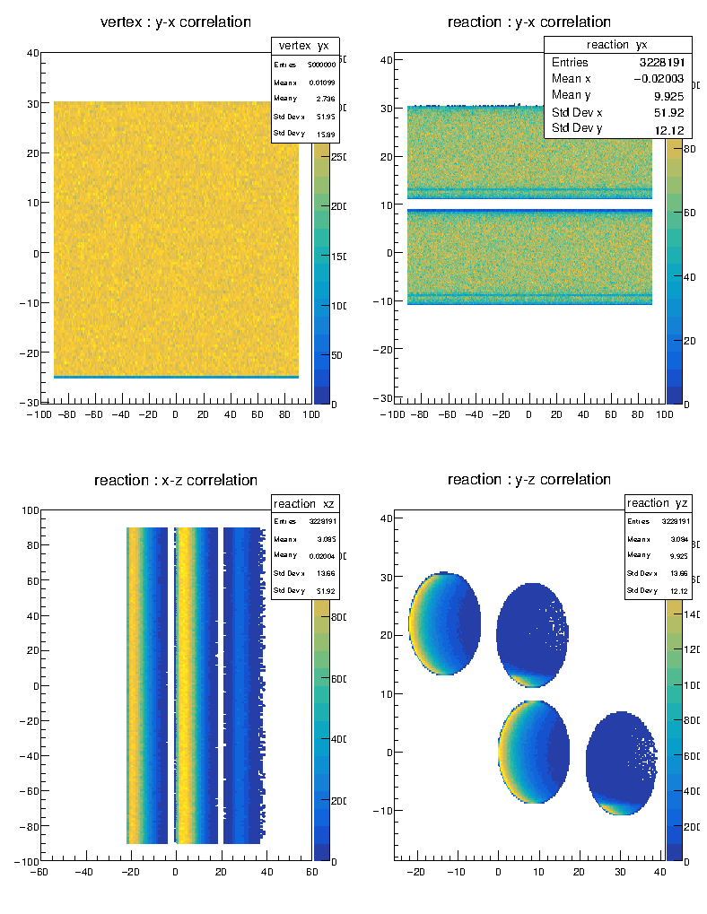
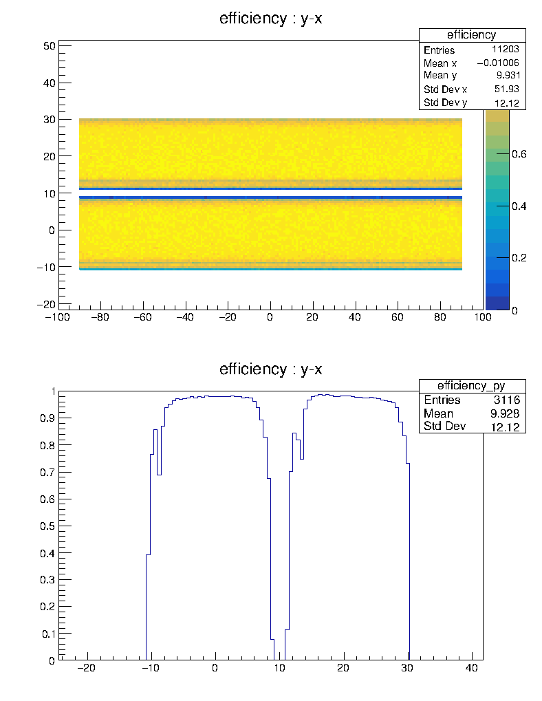
Simulation results: beam angle 45 deg
Efficiency of 4 tubes assemble decreases from 93.7% to 64.5%
Efficiency of 5 tubes assemble decreases from 94.7% to 87.4%
Ratio 5t/4t = 1.353 ~ Exp – 1.343

Slide 14
Experimental results
Ratio of number of counts normalized by time:
N35/old = 1.45 – 5 tubes
N25/old = 1.21 – 4 tubes
N33/old = 1.08 – 4 tubes
N28/old = 1.14 – 3 tubes (more counts than assemblies N33)

