Slide 1

GRID @ JINR
Tatiana STRIZH
on behalf of JINR Grid team

Slide 2

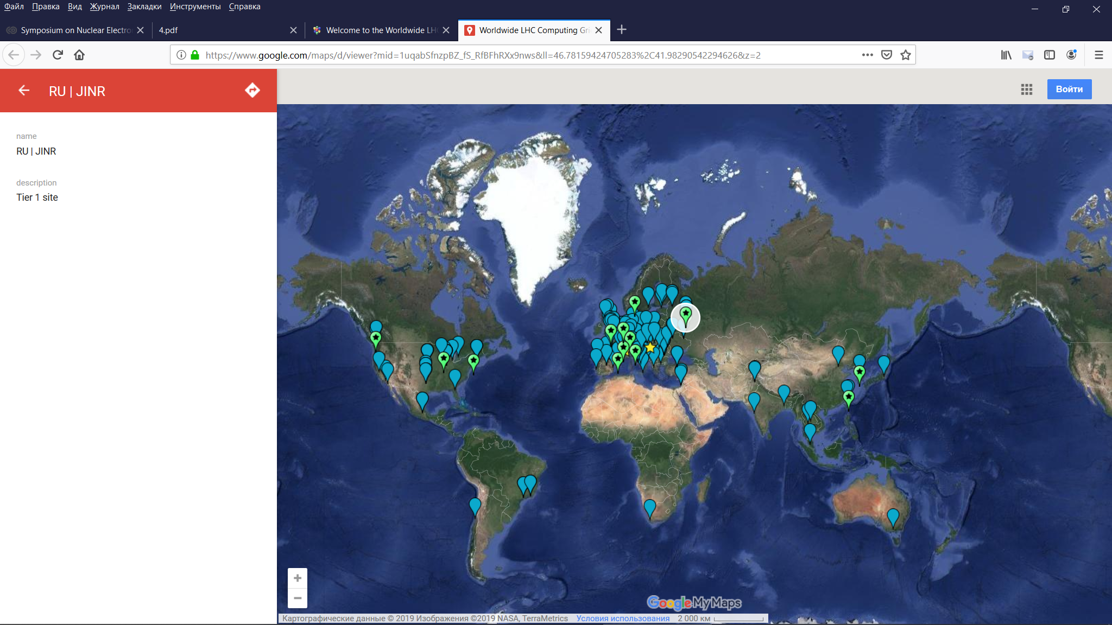
Global collaboration
42 countries
170 computing centres
Over 2 million tasks run every day
1 million computer cores
1 exabyte of storage

Slide 3
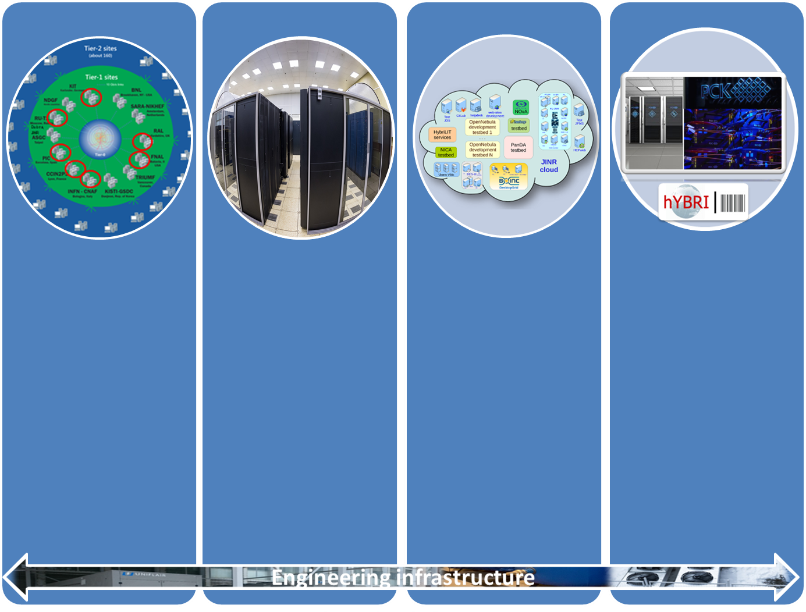

Multifunctional Information and Computing Complex
Main components
Grid-Tier1:
10688 cores
10.4 PB disk
11 PB tape
Grid-Tier2
CICC:
4128 cores
2.7 PB disk
Cloud:
1572 CPU
8.142 TB RAM
1.1 PВ disk
HPC Govorun
Peak ~0.5 Pflops
HybriLIT:
~ 70 Tflops
LIT IT-infrastructure is the one of JINR basic facilities

Slide 4
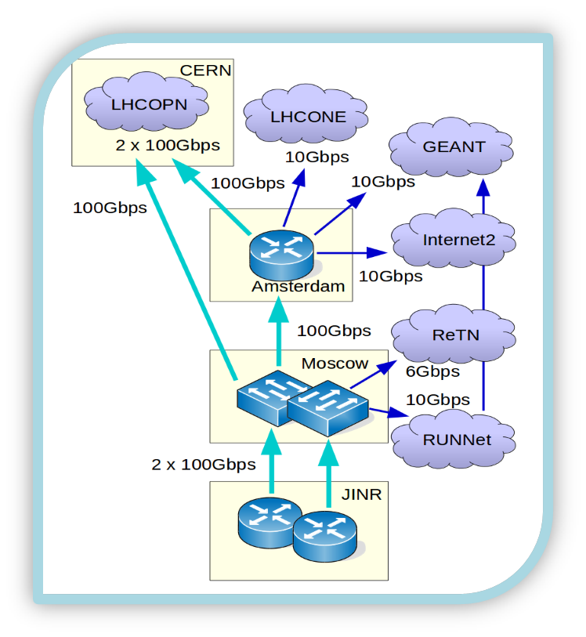
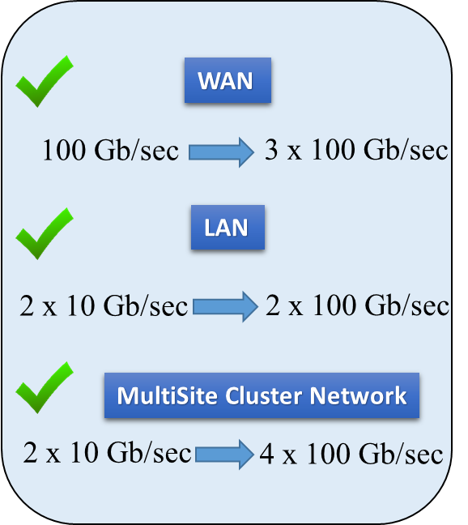
NETWORK INFRASTRUCTURE

Slide 5
JINR Tier1 for CMS
Resources
JINR Tier2 and CCIC
Resources
Computing Elements (CE)
Worker Node (WN)
Typically SuperMicro Blade
400 64-bit machines: 2 x CPU, 10-16 core/CPU
Total: 10688 core/slots
Storage Elements(SE)
Storage System: dCache
Typically Supermicro and DELL
1st - Disk Only: 9.3 PB
2nd - support Mass Storage System:1.1PB.
1 tape robot: IBM TS3500, 3440xLTO-6 data cartridges; 12xLTO-6 tape drives FC8, 11 PB
Software
OS: Scientific Linux release 6 x86_64.
BATCH : Torque 4.2.10 (home made)
Maui 3.3.2 (home made)
CMS Phedex
dCache-5.2
Enstore 4.2.2 for tape robot.
Computing Elements (CE)
Worker Node (WN)
Typically SuperMicro Blade, SuperMicroTwin2,
Dell FX
240 machines: 2 x CPU Xeon, 4-14/ CPU
Total: 4128 core/slots
Storage Elements(SE)
Storage System: dCache
Typically Supermicro and DELL
1st - Disk for ATLAS & CMS 2070ТB
2nd – Disk for ALICE, EOS 712ТB
3-rd Disk for some EGI VОs & local users 147TB
Software
OS: Scientific Linux release 6 x86_64
BATCH: Torque 4.2.10 (home made)
Maui 3.3.2 (home made)
CMS Phedex
ALICE Vobox
dCache-5.2
EOS aquamarine

Slide 6
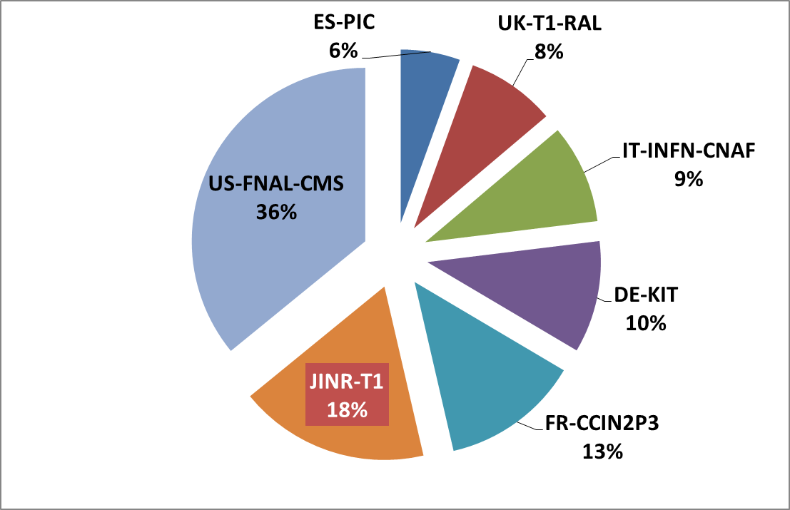
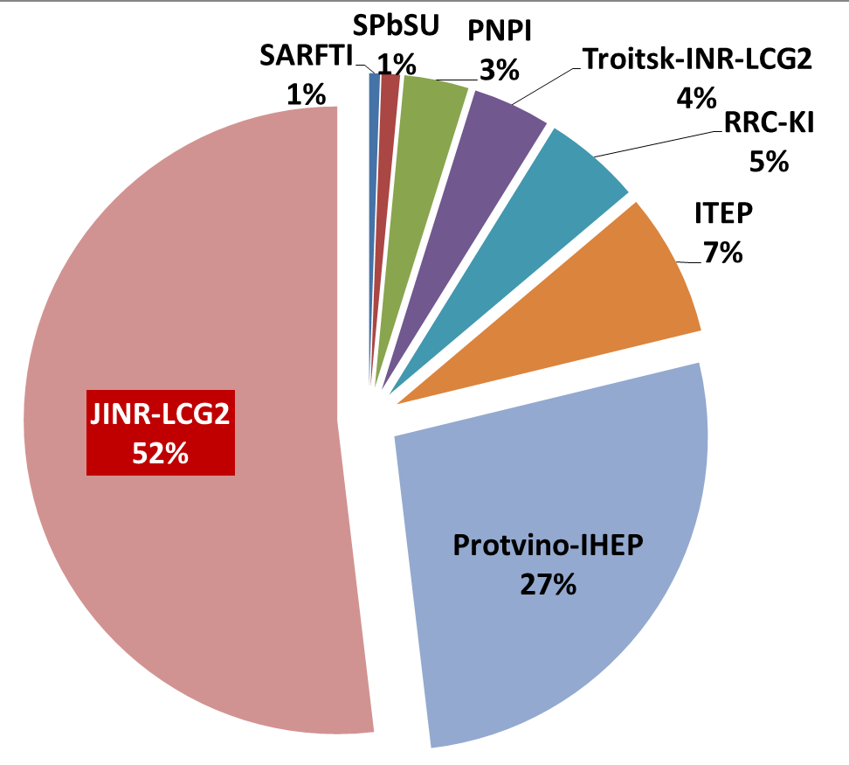
Grid @ JINR
Tier1 for CMS experiment and Tier2
Tier1 for CMS: permanent storage, re-processing, analysis
WLCG Tier1 for CMS in JINR site is ranked second among world Tier1 for CMS.
Tier2 for all four experiments at LHC (Alice, ATLAS, CMS, LHCb) and other virtual organizations BES, BIOMED, СOMPASS, MPD, NOvA, STAR, ILC: simulation, processing, end-user analysis
WLCG Tier2 site in JINR is the most productive in the Russian Data-Intensive Grid (RDIG)
World Tier1 for CMS — Sum CPU Work (HS06 hours) by Tier 1 Node and Year 2019
Federation RU-RDIG — Sum CPU Work (HS06 hours) by Site and Year 2019 (LHC VOs)
Notes:
The MICC grid components are the Tier1 for the CMS at LHC and the Tier2 center for Alice, ATLAS, CMS, LHCb, BES, BIOMED, СOMPASS, MPD, NOvA, STAR, ILC etc.
Tier1 (JINR-T1) took a second place among other Tier1 centers for CMS providing 18 % of the total CPU work for CMS.
JINR Tier2 site is the best one in Russian Data Intensive Grid (RDIG) federation and provides 52% of the total CPU work of RDIG
The Tier2 also provides carrying out computations outside the grid for experiments and the local users of the JINR Laboratories. More than 3 millions jobs were processed in 2019.
Грид компонента многофункционального информационно-вычислительного центра в ЛИТ включает Tier1 центр для эксперимента CMS на LHC и Tier2 для Alice, ATLAS, CMS, LHCb, BES, BIOMED, COMPASS, MPD, NOvA, STAR, ILC и т. д.
Tier1 (JINR-T1) занял второе место среди других центров Tier1 для CMS, что составляет 18% от общего процессорного времени для эксперимента CMS.
Сайт Tier2 ОИЯИ является лучшим в Российском гриде для интенсивных операций с данными Russian Data Intensive Grid (RDIG) и обеспечивает 52% общего процессорного времени RDIG
Tier2 также обеспечивает проведение вычислений для экспериментов и локальных пользователей из лабораторий ОИЯИ. Которые не пользуются грид сервисами. В 2019 году было выполнено более 3 миллионов заданий.

Slide 7
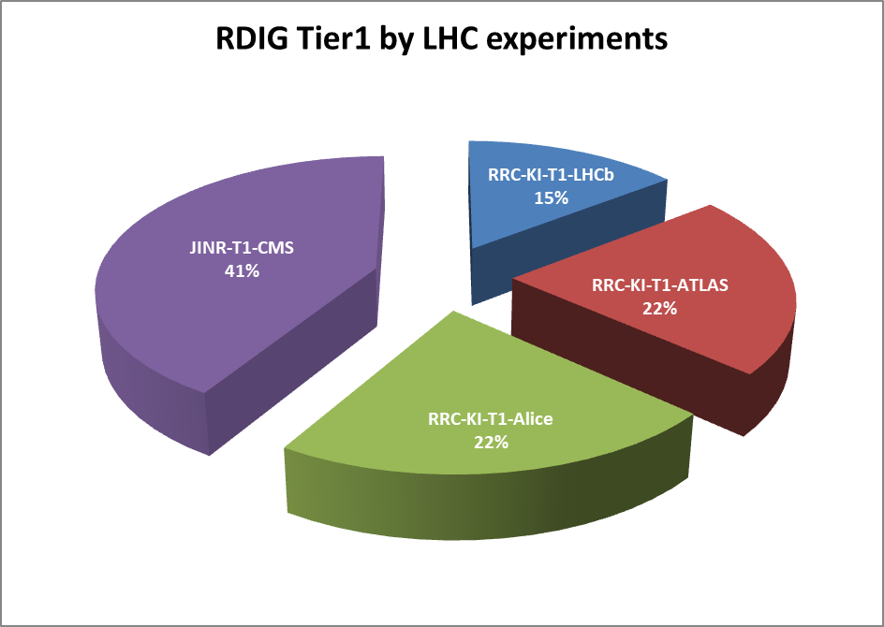
Sum CPU Work (HS06 hours) by RDIG Sites from Sep.2017 to Sep. 2019

Slide 8
Sum CPU Work (HS06 hours) by RDIG Sites from Sep.2017 to Sep. 2019

Slide 9
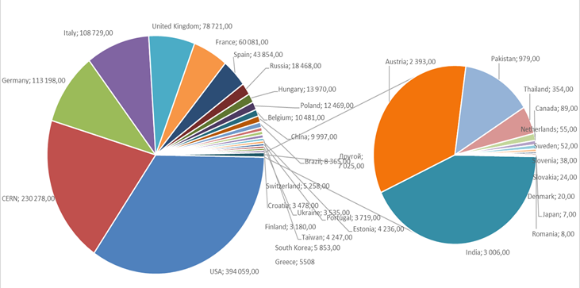
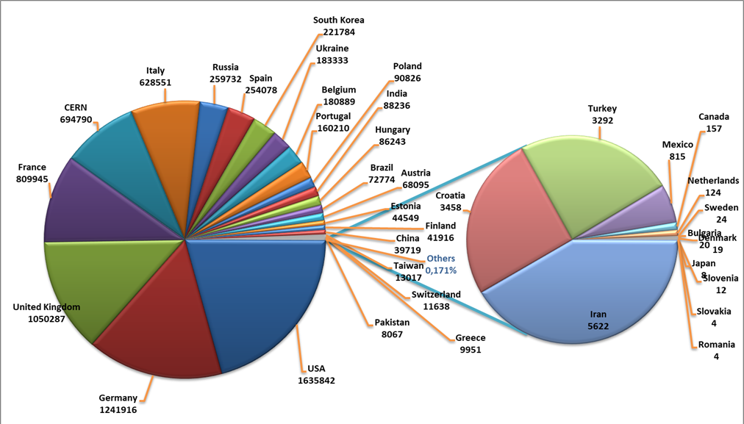
JINR Tier1 CMS data exchange
In 2019 loaded was 16.8 PB to Т1 Disk, 0.969 PB to T1 Tape
Buffer and TAPE usage:
157 sites worldwide transfer data FROM us;
140 sites transfer data TO us;
Leaders are CERN, KIT(Germany), RAL (UK).
Storage Element Disk only usage:
316 sites worldwide transfer data FROM us;
150 sites transfer data TO us.
In 2019 36.4PB was downloaded from T1 Disk, 3.5PB from T1 Tape

Slide 10
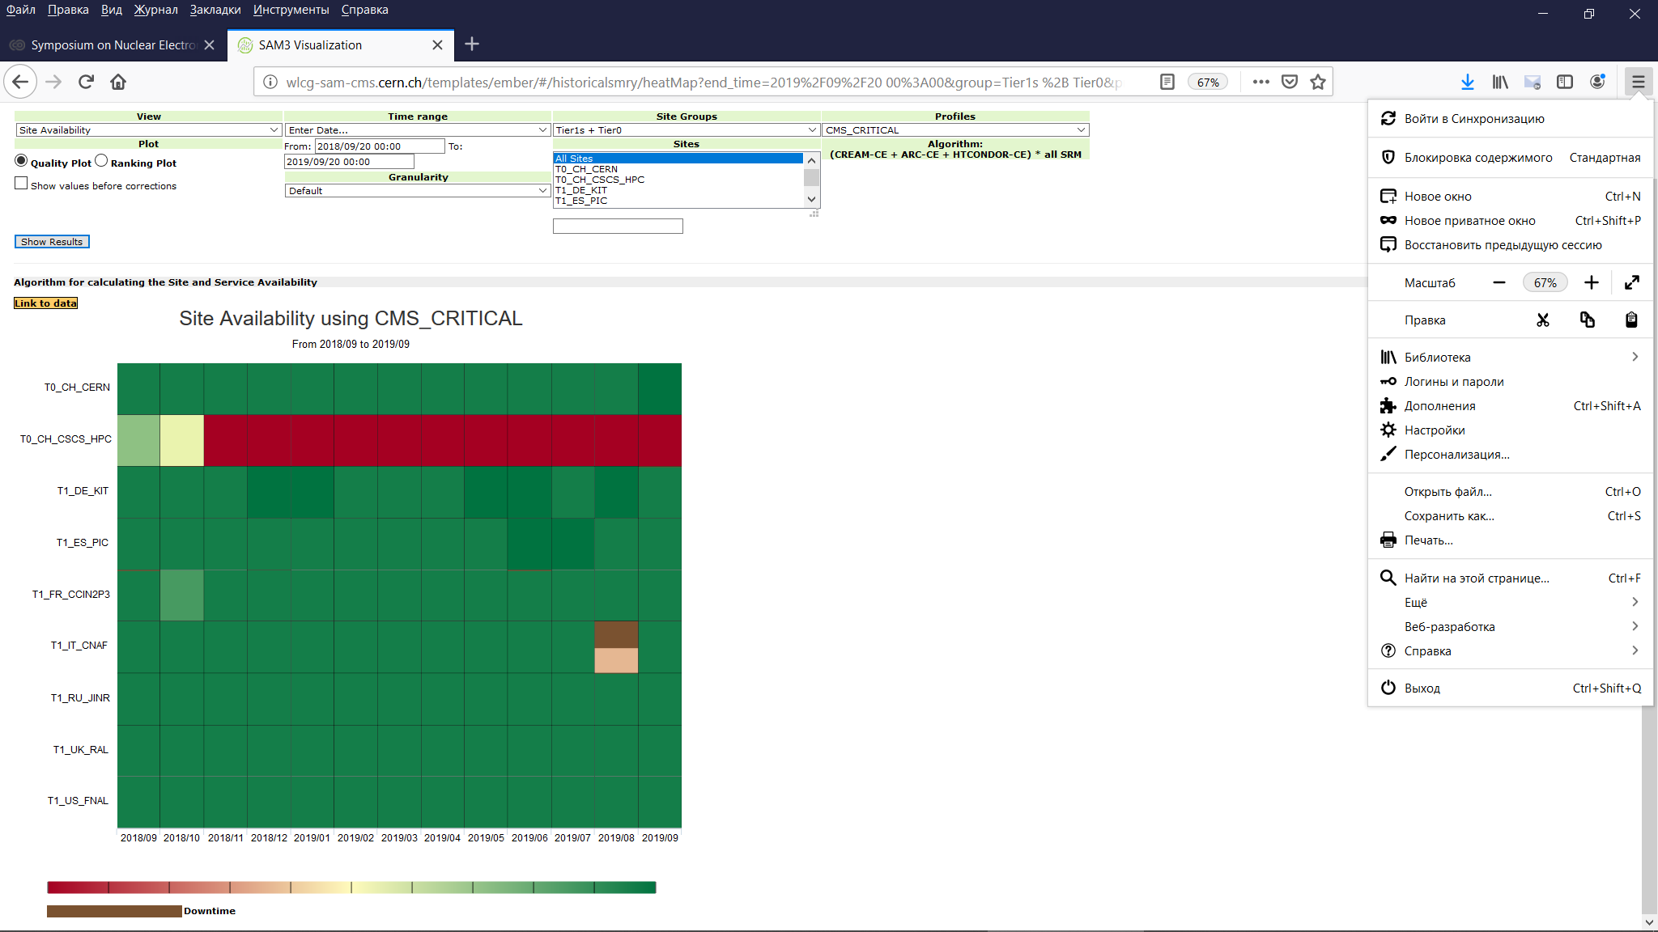
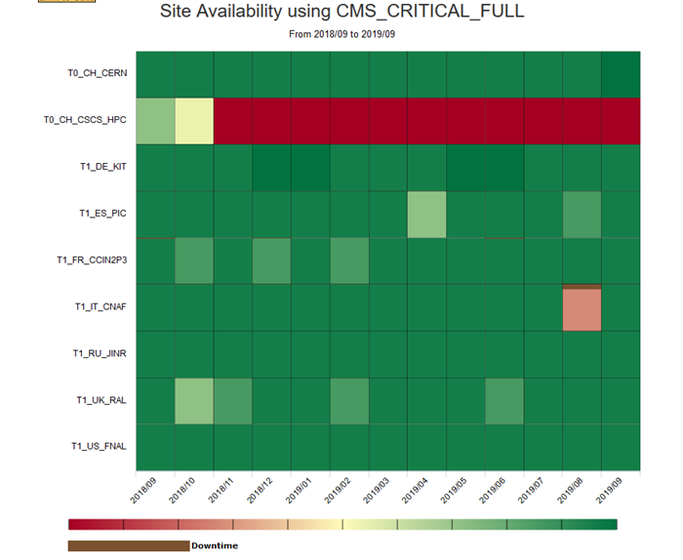
JINR Tier1 CMS Availability

Slide 11
Availability of WLCG Tier0+Tier1 Sites for CMS Feb.2019- Jul.2019

Slide 12
JINR Tier1 CMS Reliability

Slide 13

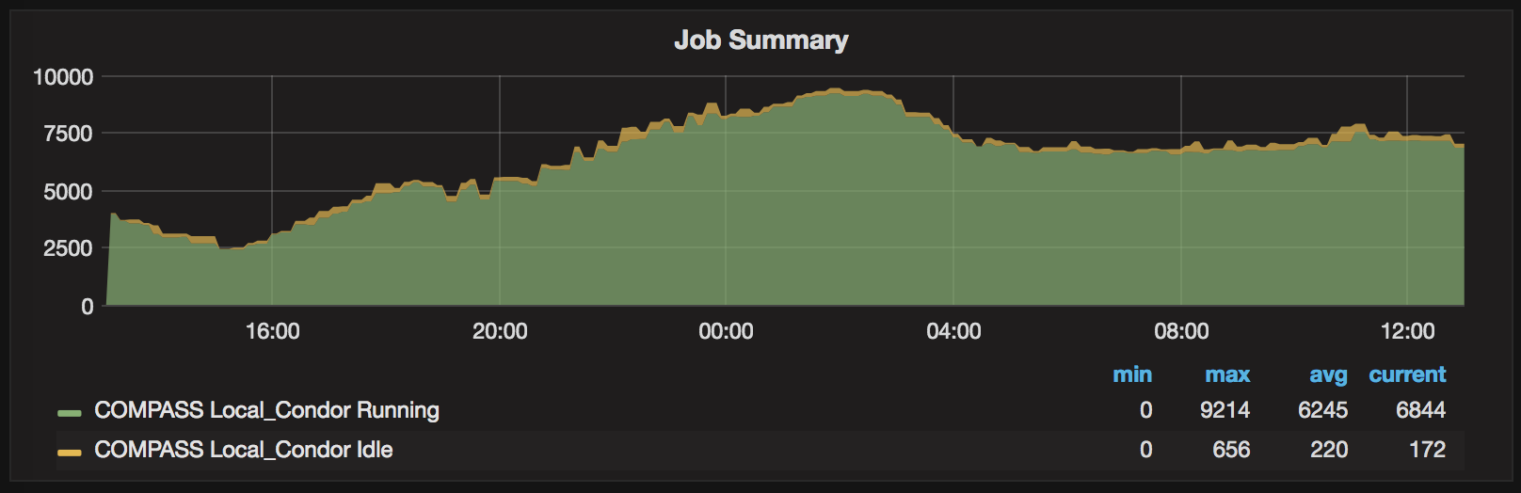
COMPASS ProdSys
Key features:
Production management via Web UI, allows one to define a task, send, follow and manage it during lifecycle.
Via PanDA job execution layer jobs are being sent to any available type of computing resource: Condor, LSF, PBS, etc.
Computing sites: CERN Tier1, JINR Tier2, HPC
Storage: EOS and CASTOR at CERN
All management services deployed at
JINR Cloud Service
Since August 2017
~5 000 000 chunks of raw data processed
~100 000 000 of events processed
~700TB of merged data produced
and migrated to Castor
~9 000 000 jobs processed: mc gen,
mc reco, data reco, ddd filtering
Tasks requests layer: Web UI
Task definition layer: ProdSys
Job definition layer: ProdSys
Job execution layer: PanDA
Artem Petrosyan report “Distributed data processing of COMPASS experiment” today after coffee

Slide 14



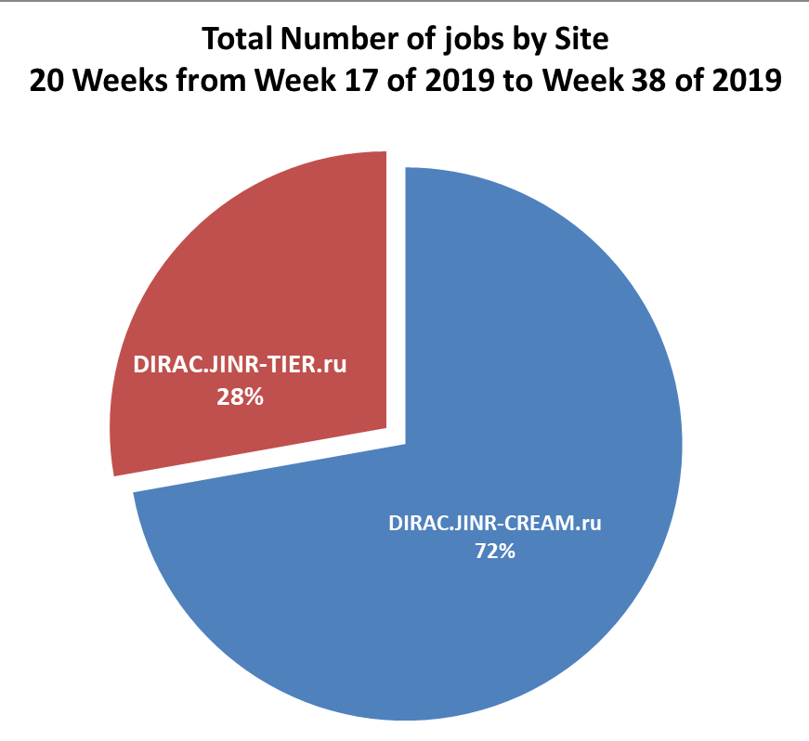
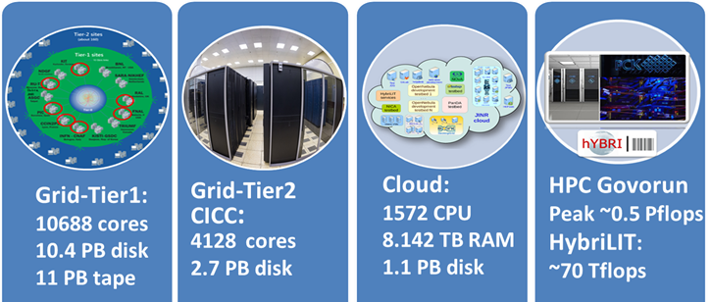
Integration of distributed resources
The DIRAC Interware provides various interfaces for the integration of distributed heterogeneous computing and storage resources.
More than 50000 of NICA MPD experiment Monte-Carlo simulation jobs were done at JINR Tier1 and Tier2 MICC using DIRAC.
Igor Pelevanyuk report “Cloud integration within DIRAC Interware ” today after coffee

Slide 15
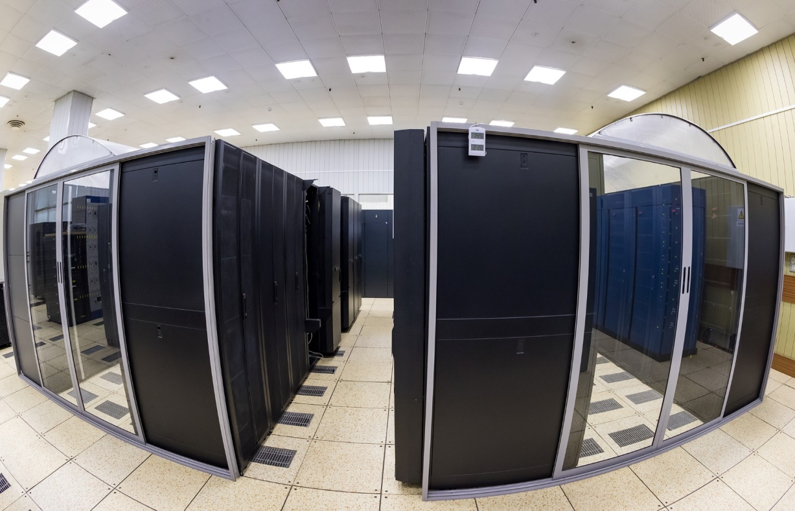
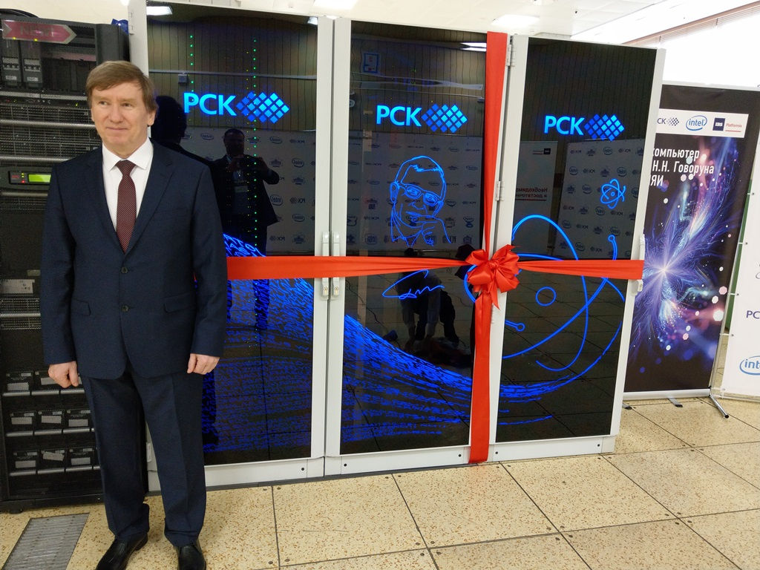
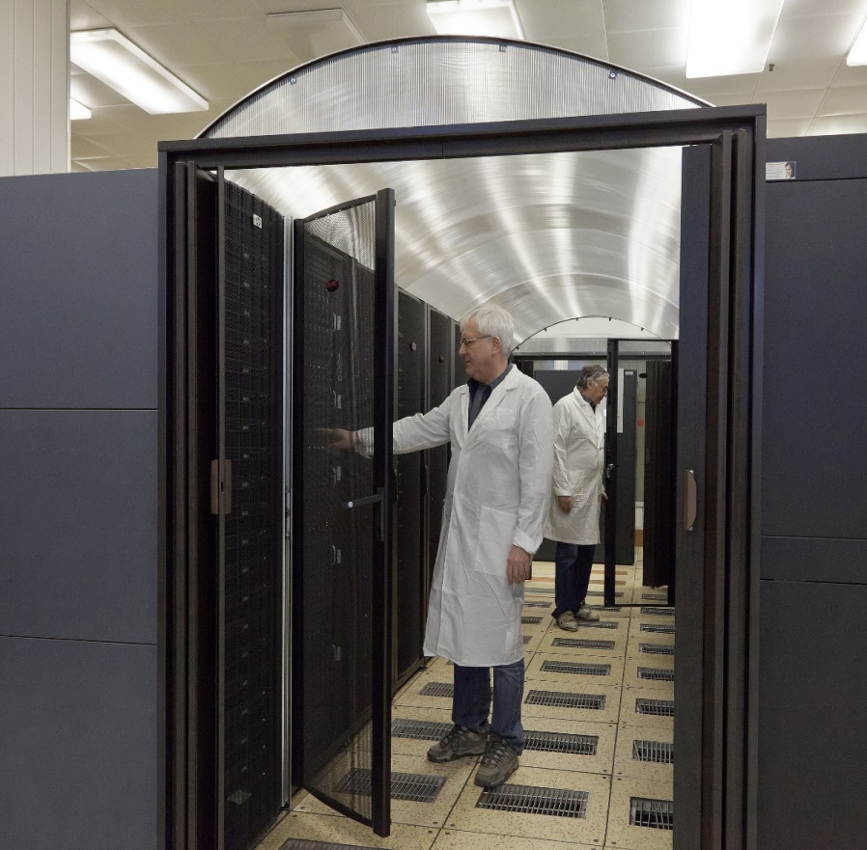
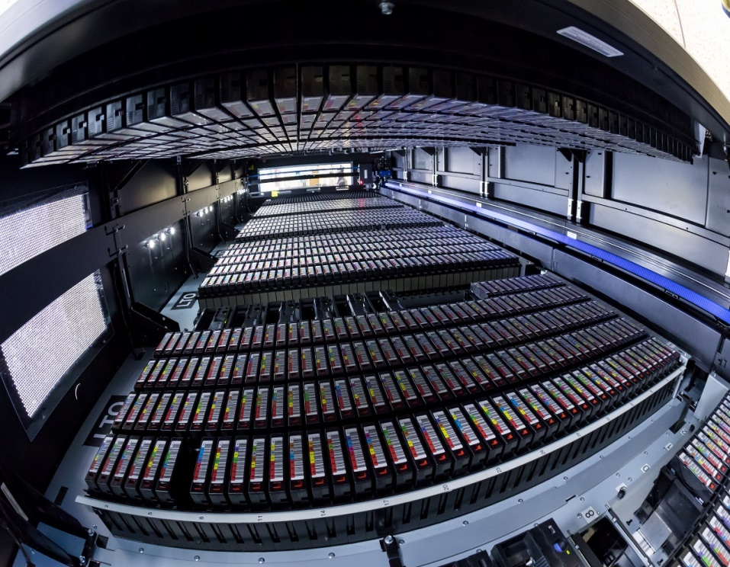
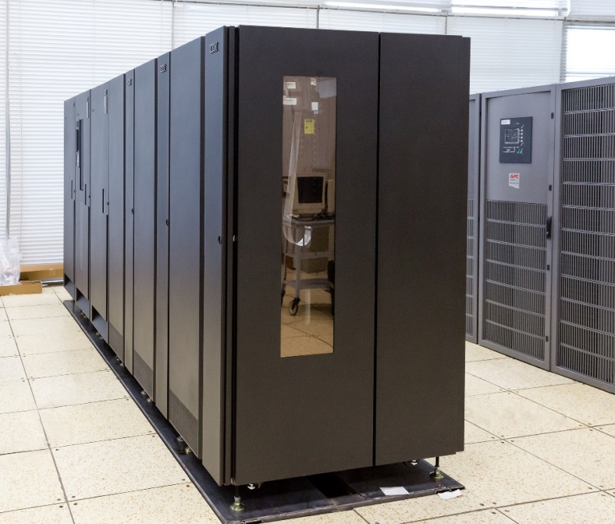
Development of resources of Tier1 CMS and Tier2
Increase in computing resources of Tier1 CMS up to 350 kHS06
Increase in computing resources of Tier2 up to 170 kHS06
Expansion of the storage system of Tier1 CMS on disks up to 16 PB
Expansion of the storage system of Tier1 CMS on tapes up to 42 PB
Expansion of the MICC storage system on EOS up to 60 PB

Slide 16
Thank you for your attention!

