Slide 1

JINR Multifunctional Information and Computing Complex (MICC)
Tatiana Strizh on behalf of MICC team

Slide 2

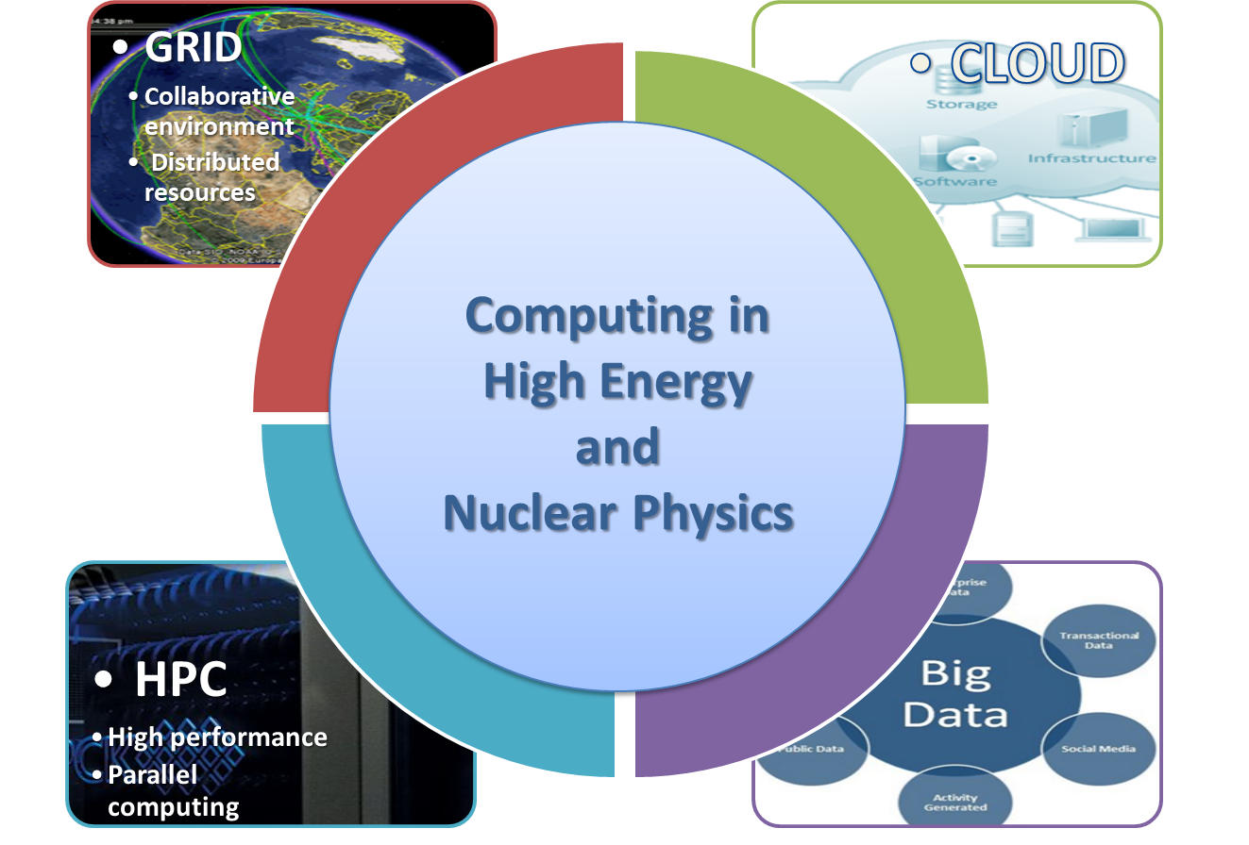
Computing in High Energy and Nuclear Physics
Big variety of
  architectures,
  platforms,
  operational systems,
  network protocols,
  software products.
The interface of the uniform environment should provide a way for organization of collective development, solution of problems of various complexity and subject matter, management and processing of data of various volumes and structures, training and organization of scientific and research processes.

Slide 3
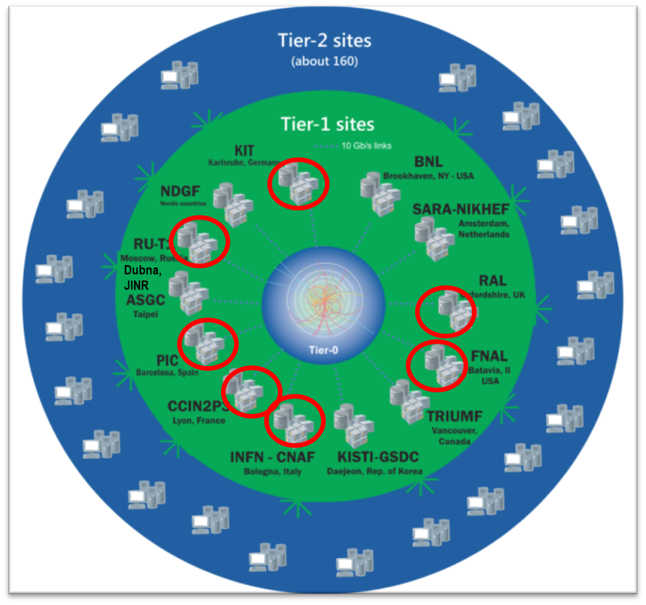
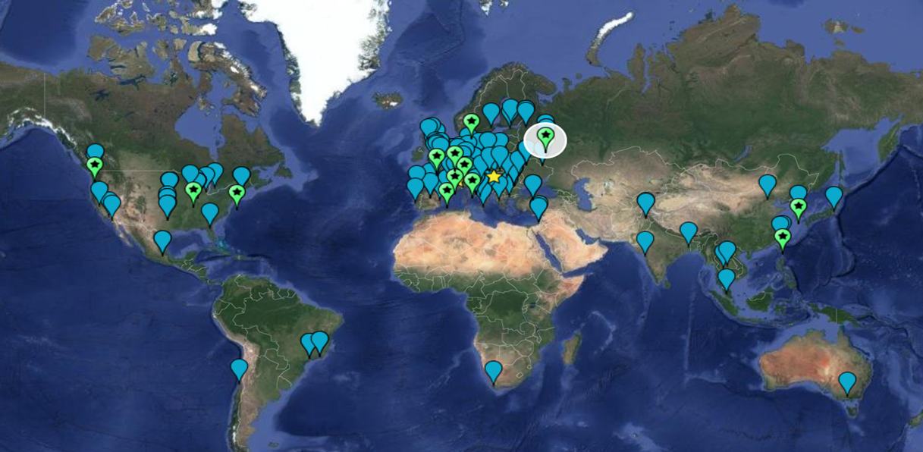
The Worldwide LHC Computing Grid
WLCG:
An International collaboration to distribute and analyse LHC data Integrates computer centres worldwide that provide computing and storage resource into a single infrastructure accessible by all LHC physicists
The mission of the WLCG project is to provide global computing resources to store, distribute and analyse the ~50-70 Petabytes of data expected every year of operations from the Large Hadron Collider.
WLCG computing enabled physicists to announce the discovery of the Higgs Boson on 4 July 2012.
nearly 170 sites,
42 countries
1 000 000 cores
1 EB of storage
> 3 million jobs/day
10-100 Gb links
Tier-0 (CERN): data recording, reconstruction and distribution | Tier-1: permanent storage, re-processing, analysis | Tier-2: Simulation, end-user analysis
Worldwide LHC Computing Grid - 2019

Slide 4
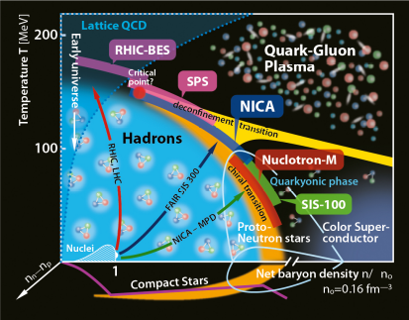
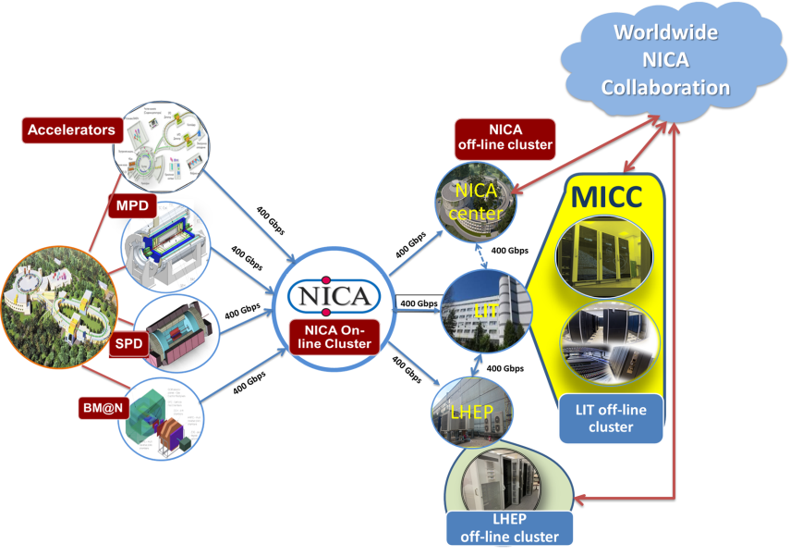
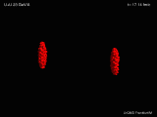
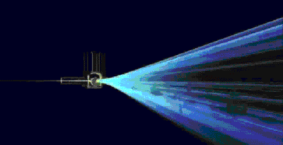
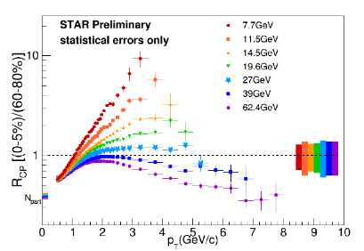
NICA computing concept
& challenges
QCD phase diagram
Simulations
Event reconstruction
4
Physics analysis
Notes:
есть несколько экспериментов, есть несколько типов ферм-кластеров для обработки и есть сеть между всеми центрами . Сегодня сделано 400 гбитсек сеть для этого и сегодня активно используем свободные ядра на суперкомпьютере говорун для моделирования и отладки программ обработки/
At present, the Govorun supercomputer is used for both theoretical studies and event simulation for the MPD experiment of the NICA megaproject. To generate simulated data of the MPD experiment, CPU computing components of the Govorun supercomputer, i.e. Skylake (2880 cores) and KNL (6048 cores), are used; data are stored on the ultrafast data storage system (UDSS) under the management of the Lustre file system with a subsequent transfer to cold storages controlled by the EOS and ZFS file systems. UDSS currently has five storage servers with 12 SSD disks using the NVMe connection technology and a total capacity of 120 TB, which ensures low time of access to data and a data acquisition/output rate of 30 TB per second.
The DIRAC software is used for managing jobs and the process of reading out/recording/processing data from various types of storages and file systems

Slide 5
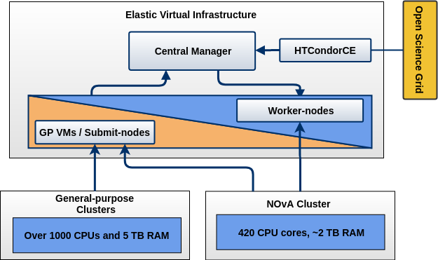
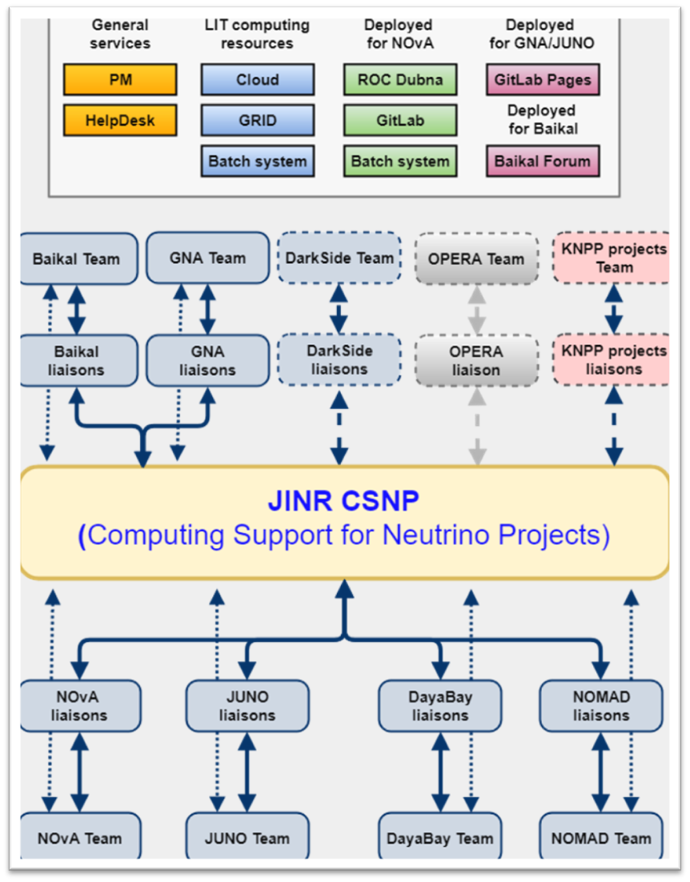







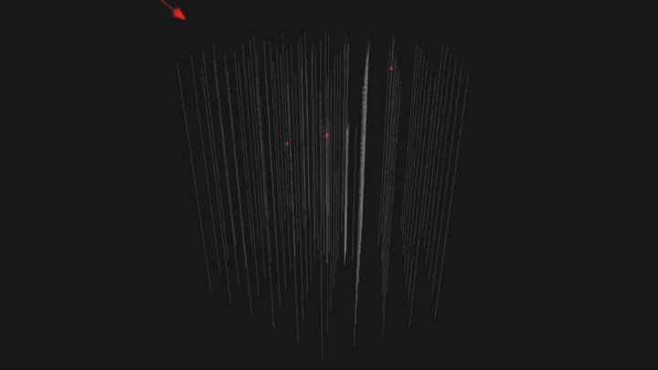




JINR Neutrino computing platform
LIT and DLNP agreed to establish a joint working group on writing a proposal about the dedicated project for developing computing facilities at JINR for neutrino experiments the Institute participates in.
LIT contribution: engineering infrastructure (electricity, UPS, cooling, network, racks, manpower) | DLNP contribution: computing and storage resources (CPUs/GPUs&disks)
HTCondor - production and analysis, job processing;
JupyterHub – development tool;
Personal virtual machines - traditional interactive applications;
GitLab CI - automated software testing and deployment.
5
Notes:
LIT provides support for IT services, computing infrastructures, trainings, etc. for the JINR neutrino program. The NOvA experiment team was the first to actively use the LIT cloud resources, these resources are also used by the Baikal experiments - GVD and JUNO. This slide shows the ratio of the neutrino experiments in the consumption of cloud resources.
In order to effectively use resources of the information and computing environment of neutrino experiments, in which JINR employees participate, a decision on the creation of a unified neutrino
information and computing platform (environment) based on the MICC resources was made by the directorate of LIT and DLNP.
All hardware resources for neutrino experiments are planned to be purchased due to the budgets of the experiments. The infrastructure support (racks, power supply and cooling)
is provided by the Laboratory of Information Technologies.
Для нейтринной программы ОИЯИ ЛИТ обеспечивает поддержку общих IT – сервисов, вычислительных инфраструктур, проводит тренинги, развертывает и поддерживает дополнительные IT – сервисов по требованию и многое другое. Эксперимент NOvA первым начал активно использовать облачные ресурсы ЛИТ, и теперь обладает наибольшим количеством выделенных ресурсов, за ним следуют эксперименты Baikal -GVD и JUNO. За счет нейтринной программы ЛЯП количество вычислительных ядер в облачной инфраструктуре возросло в 2 раза. На слайде представлено соотношение долей нейтринных экспериментов в потреблении облачных ресурсов.
Для эффективного использования ресурсов информационно-вычислительной среды нейтринных экспериментов, в которых принимают участие сотрудники ОИЯИ, руководствами ЛИТ и ЛЯП было принято решение о создании единой нейтринной информационно-вычислительной платформы (среды) на базе ресурсов МИВК.
Все аппаратные ресурсы для нейтринных экспериментов планируется приобретать за счёт средств самих экспериментов. Инфраструктурное обеспечение (стойки, питание и охлаждение) предоставляется Лабораторией информационных технологий.
5

Slide 6
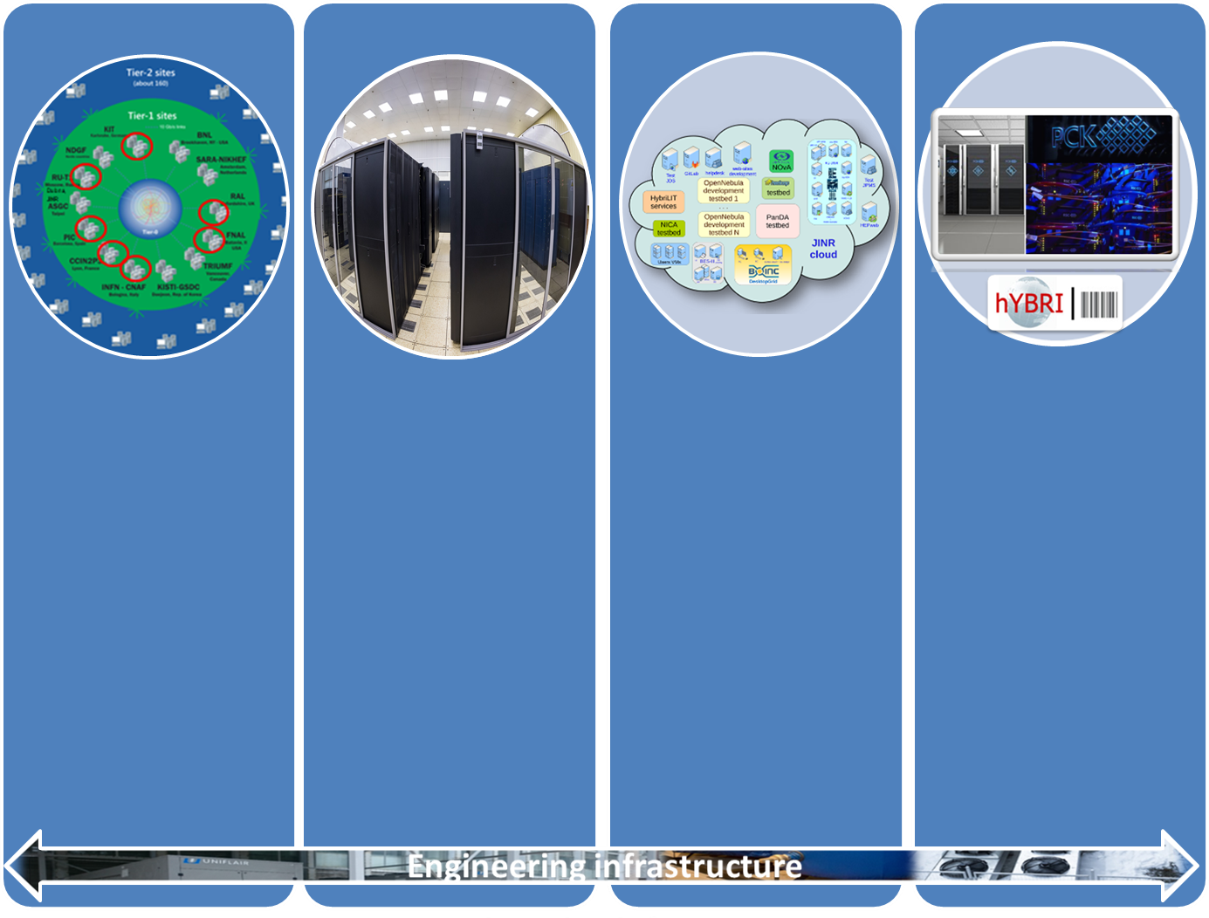

Multifunctional Information and Computing Complex
Increase of total computational nodes by ~4 times
Increase of disk file system by ~3 times
Tape robot capacity increase by 2 times
Supercomputer GOVORUN with total pear performance 1Pflops (single precision) or 0.5 Pflops (double precision) was put in operation
Grid-Tier1:
10688 cores
10.4 PB disk
11 PB tape
Grid-Tier2
CICC:
4128 cores
2.7 PB disk
Cloud:
1572 CPU
8.142 TB RAM
1.1 PВ disk
HPC Govorun
Peak ~0.5 Pflops
HybriLIT:
~ 70 Tflops
LIT IT-infrastructure is the one of JINR basic facilities

Slide 7
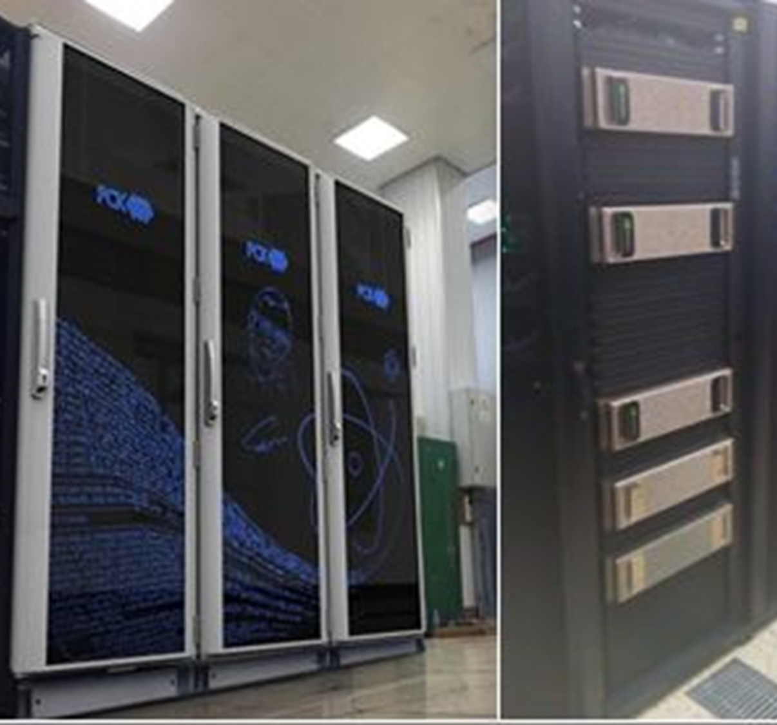
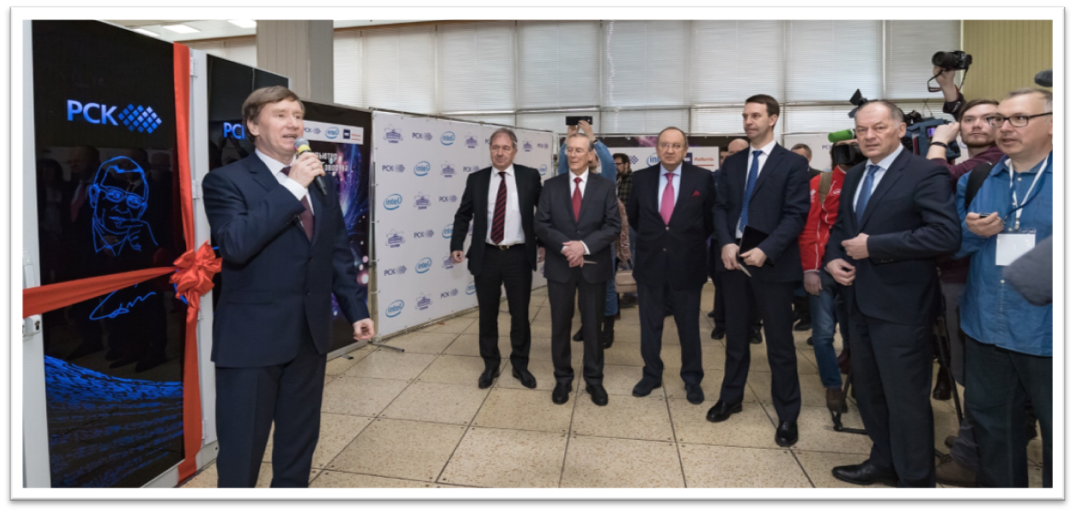


Main achievements last years:
“GOVORUN” HPC
MICC NEW Component
“GOVORUN” supercomputer (a natural development of the heterogeneous cluster HybriLIT) was put into operation
it was the result of requests from scientific groups of JINR Laboratories, primarily BLTP, with the aim of cardinally accelerating complex theoretical and experimental studies in nuclear physics and condensed matter physics underway at the Institute as well as for the development of computing for the NICA megaproject
supported by JINR Directors Grant
inaugurated was on 27 March 2018

Slide 8
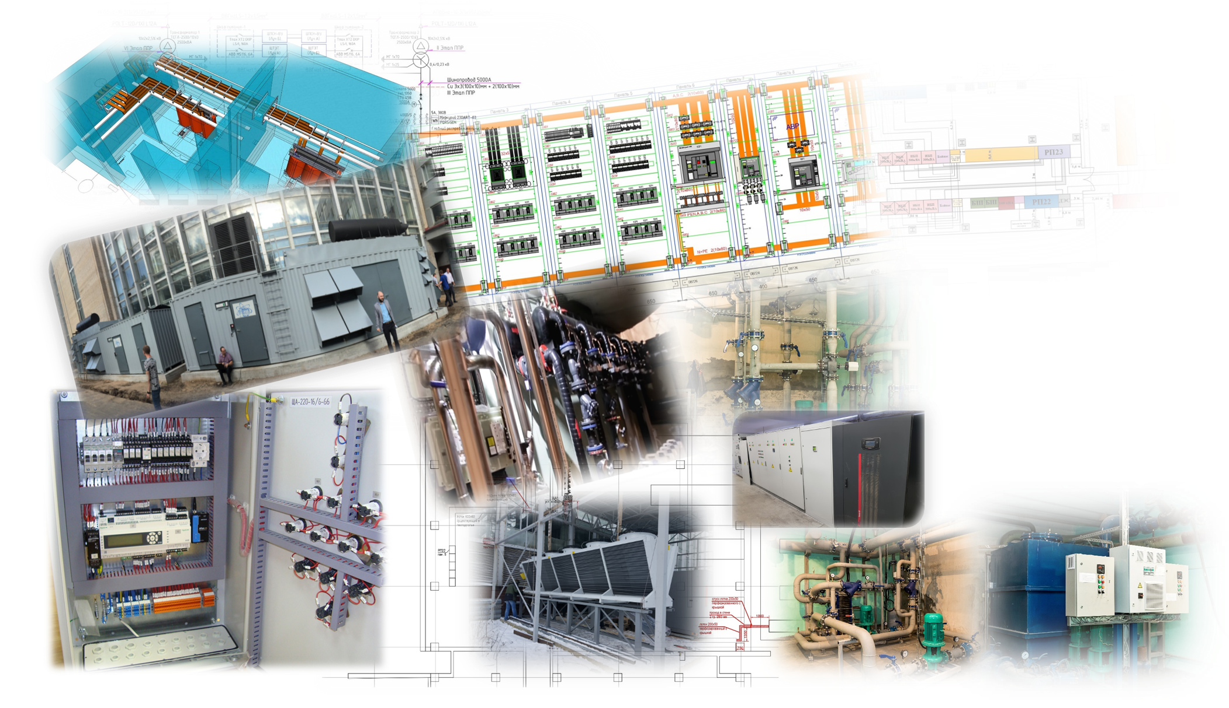

MICC engineering infrastructure
Power supply expansion
0.5 mVA
1.6 mVA
New 100% water cooling of the GOVORUN
100 kVA
300 kVA
Providing the guaranteed power supply
0.4 mVA
1.2 mVA

Slide 9
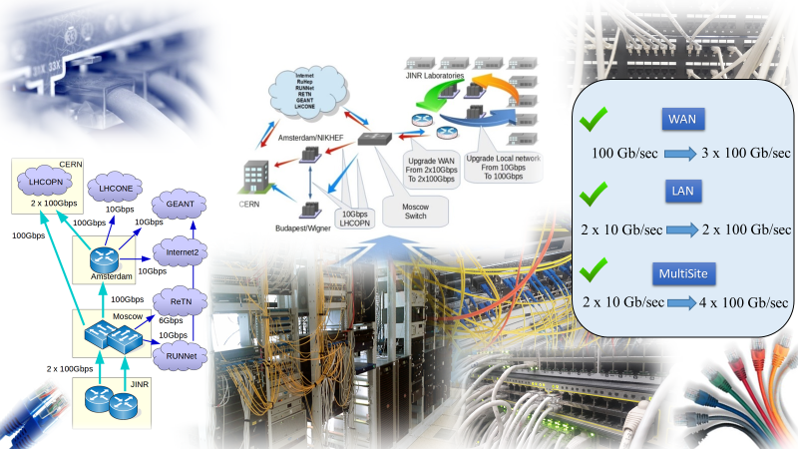
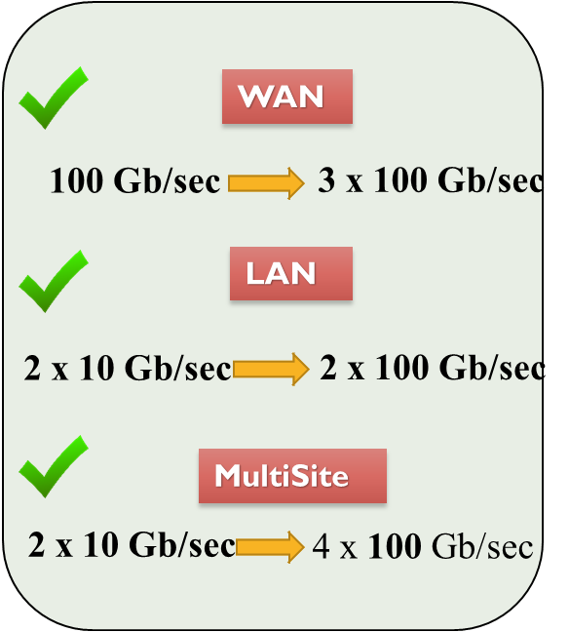
JINR Network and telecommunication
Comprises 8008 computers & nodes, Users – 7715, IP – 14154, Remote VPN and EDUROAM users – 396,
E-library- 1505, mail.jinr.ru-2677, AFS -369, VOIP – 131

Slide 10
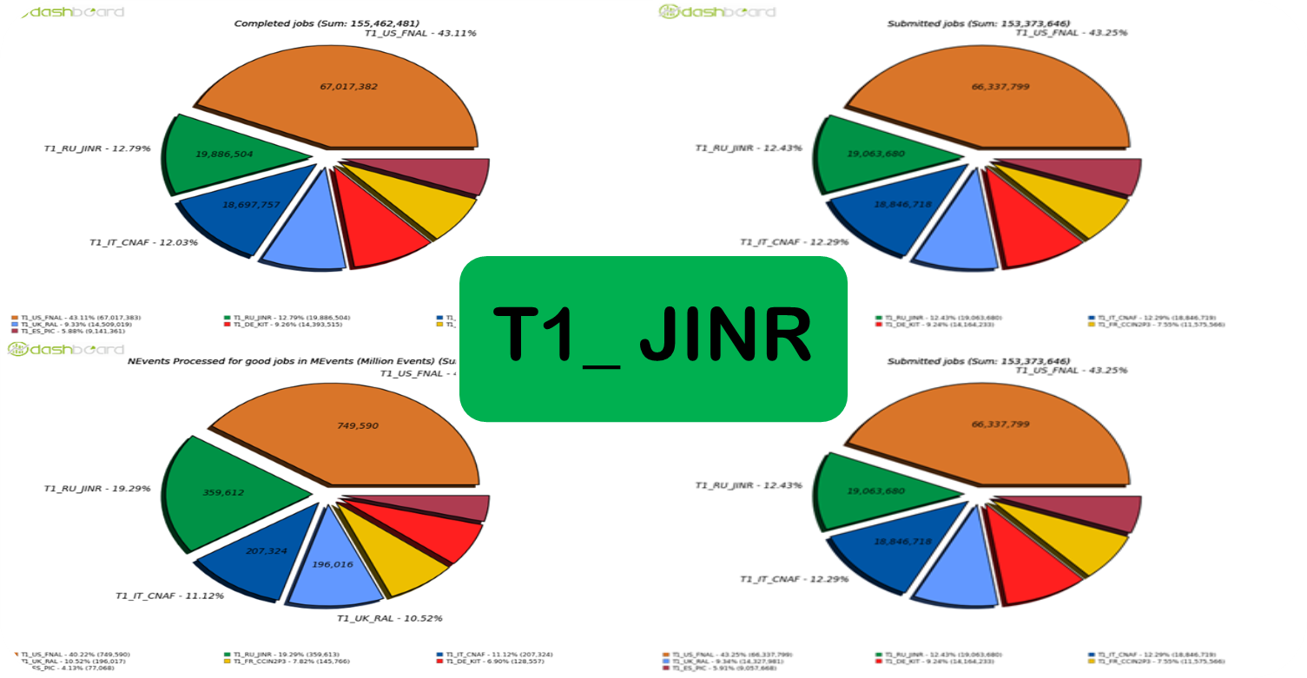
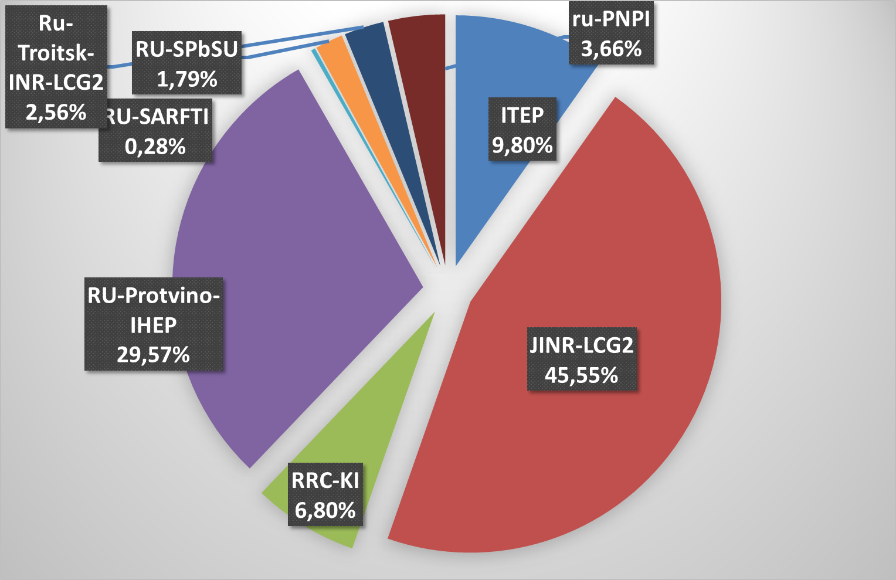
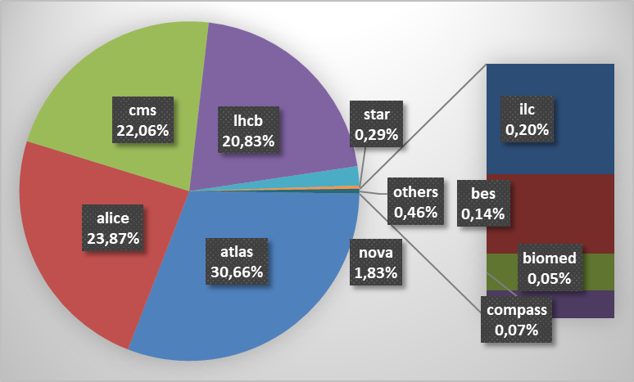
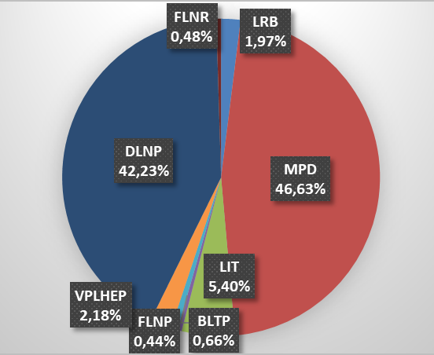
Grid resource usage 2017-2019
The MICC grid components are the Tier1 for the CMS at LHC and the Tier2 center for Alice, ATLAS, CMS, LHCb, BES, BIOMED, СOMPASS, MPD, NOvA, STAR, ILC etc. Tier1 ( T1_JINR) took a second place among other Tier1 centers for CMS by completing over 19.9 million jobs and over 359 billion processed events, which is 19.3% of the total number of CMS events.
The Tier2 provides carrying out computations outside the grid for experiments and the local users of the JINR Laboratories. More than 11.9 millions jobs were processed.
Tier2 and CICC

Slide 11
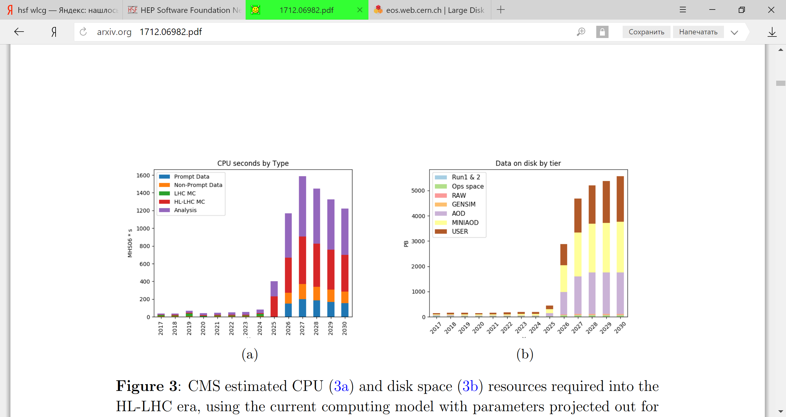
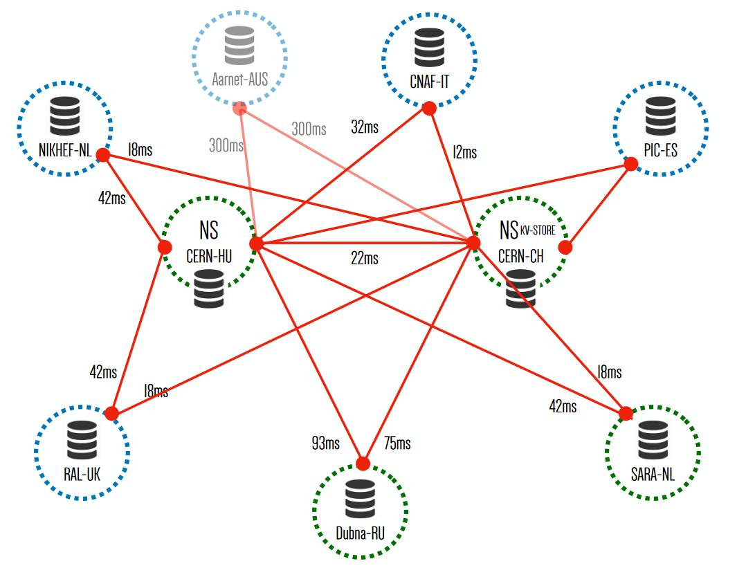
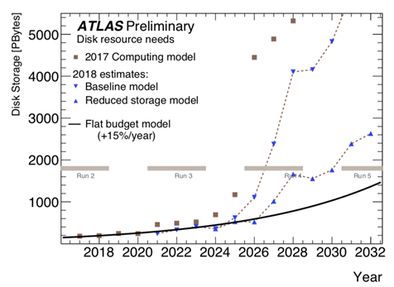
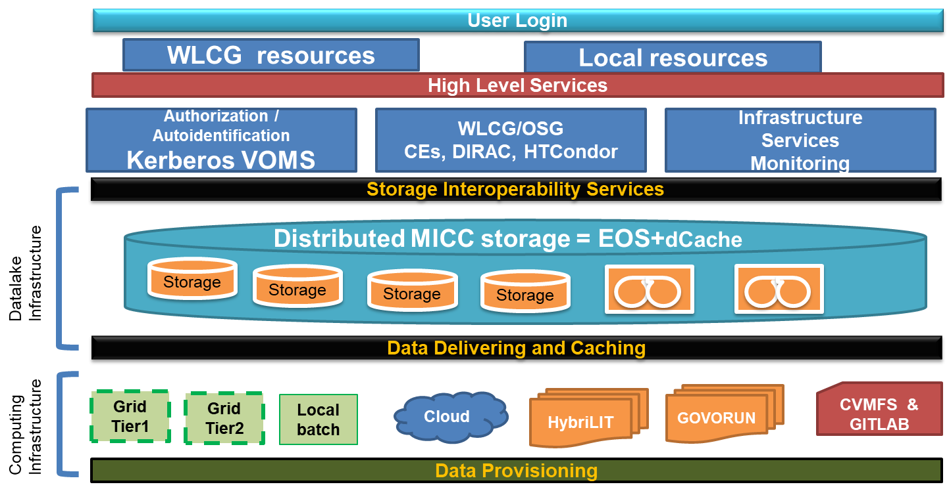
EU DataLake
JINR DataLake
CMS estimation
The JINR DataLake prototype was built as a distributed EOS storage system.
EOS was successfully integrated into the MICC structure.
EOS is used for storing and accessing big arrays of information.
It can be applied for collective data simulation, storage of raw data gathered from experimental setups, data processing and analysis.

Slide 12
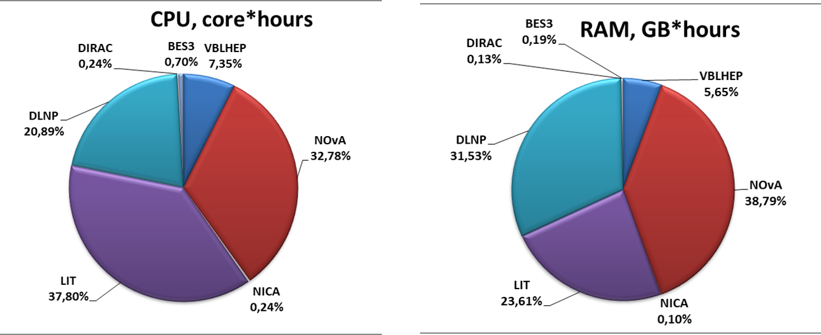
Cloud infrastructure
One of the key components of the JINR cloud infrastructure is a software-defined storage (SDS) based on Ceph.
New fault-tolerant cloud architecture was designed to optimize the architecture of the cloud storage based on ceph
Smart cloud scheduler was developed
Transformation the JINR cloud from IaaS into the Software-as-a-Service (SaaS) platform – the JINR service for scientific and engineering computations
Total CPU cores: 1572: LIT — 972, DLNP: NOvA — 420, JUNO — 96, Baikal-GVD — 84
Total RAM: 8142: LIT: 5020, DLNP: NOvA — 1864, JUNO — 502, Baikal-GVD — 756
Total Ceph-based software defined storage — 1.1PB,
effective capacity: ~360 TB due to 3x replication

Slide 13



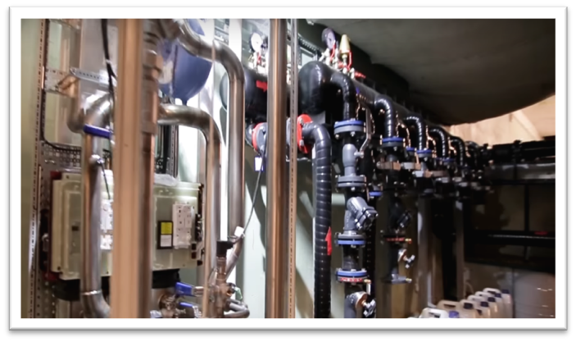
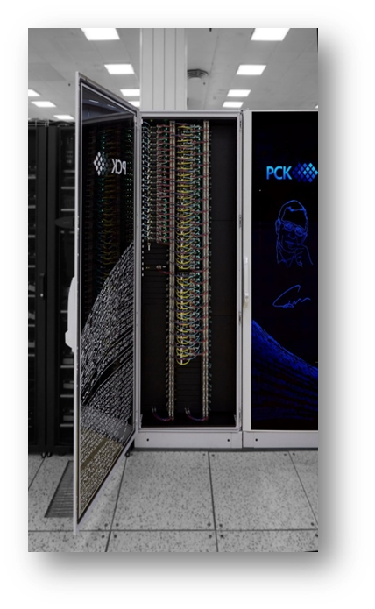
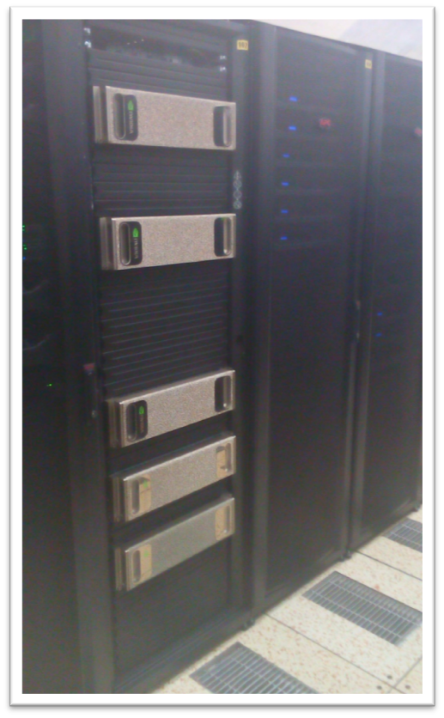
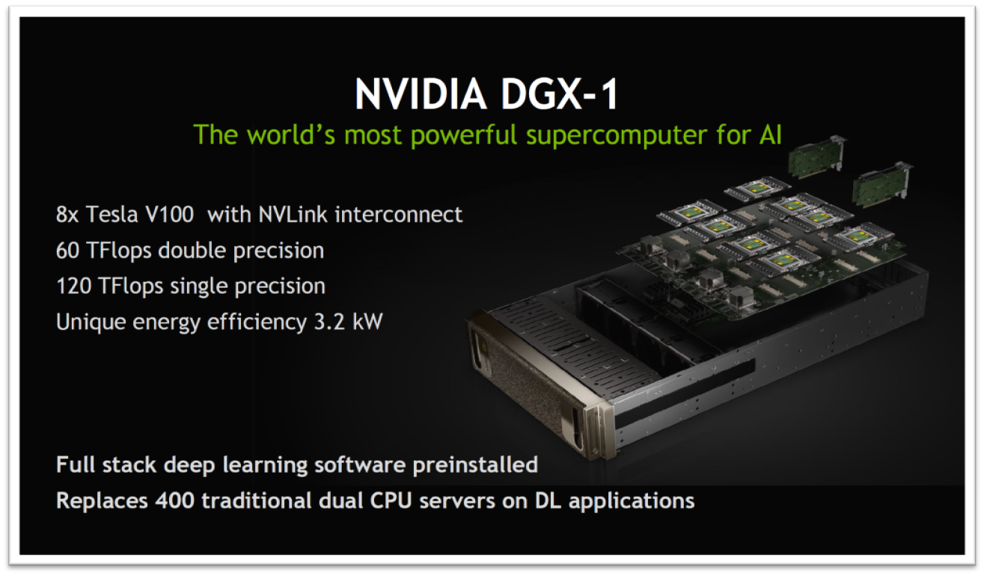
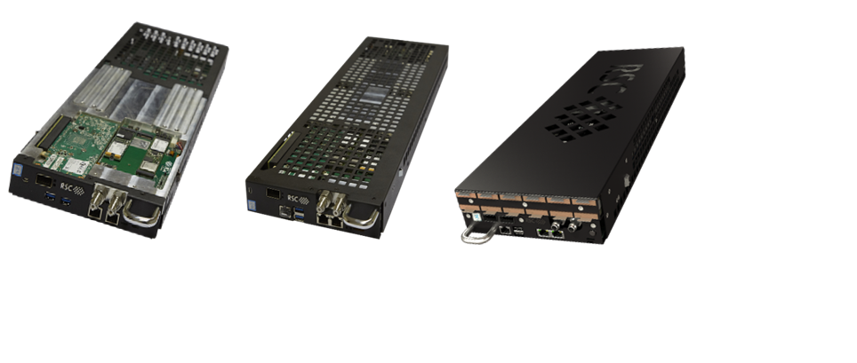
Supercomputer “GOVORUN”
It named after Nikolai Nikolaevich Govorun, with whom the development of information technologies
at JINR has been connected since 1966
Unique heterogeneous and hyper-converged system
Multipurpose high-performance system with direct hot liquid cooling of all system components
The most energy-efficient system in Russia (PUE = 1,06)
First 100% hot liquid cooling of Intel® Omni-Path interconnect
Record power density – up to 100 kW per 42U cabinet
100% liquid cooling in ’hot water’ mode engineering infrastructure for ultra high dense scalable and energy efficient cluster solution. Equipment racks, additional redundancy, automated monitoring and control system
CPU-component based on the newest Intel architectures (Intel Xeon Phi and Intel Skylake processors)
GPU-component based
on NVIDIA DGX-1 Volta.

Slide 14
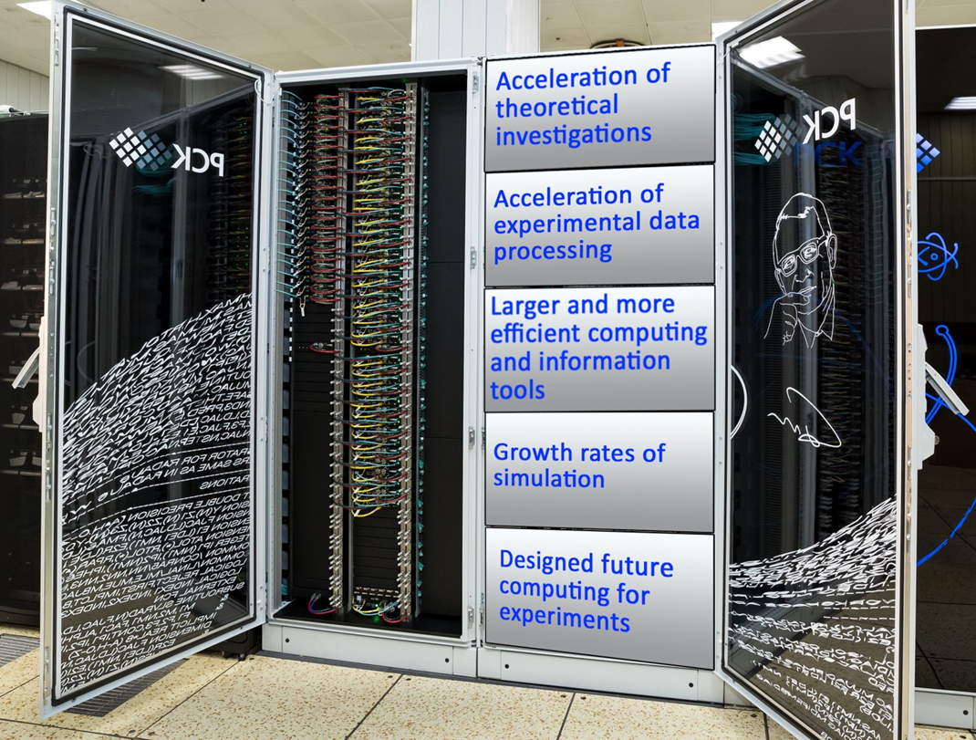
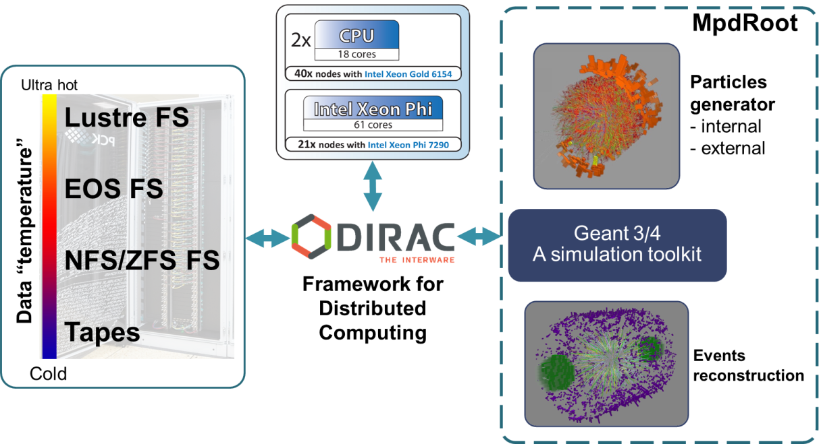
Supercomputer GOVORUN for the NICA
At present, the GOVORUN supercomputer is used for both theoretical studies and event simulation for the MPD experiment of the NICA megaproject. To generate simulated data of the MPD experiment, the CPU computing components of the GOROVUN supercomputer, i.e. Skylake (2880 cores) and KNL (6048 cores), are used; data are stored on the ultrafast data storage system (UDSS) under the management of the Lustre file system with a subsequent transfer to cold storages controlled by the EOS and ZFS file systems. UDSS currently has five storage servers with 12 SSD disks using the NVMe connection technology and a total capacity of 120 TB, which ensures low time of access to data and a data acquisition/output rate of 30 TB per second.
The DIRAC software is used for managing jobs and the process of reading out/recording/processing data from various types of storages and file systems.

Slide 15
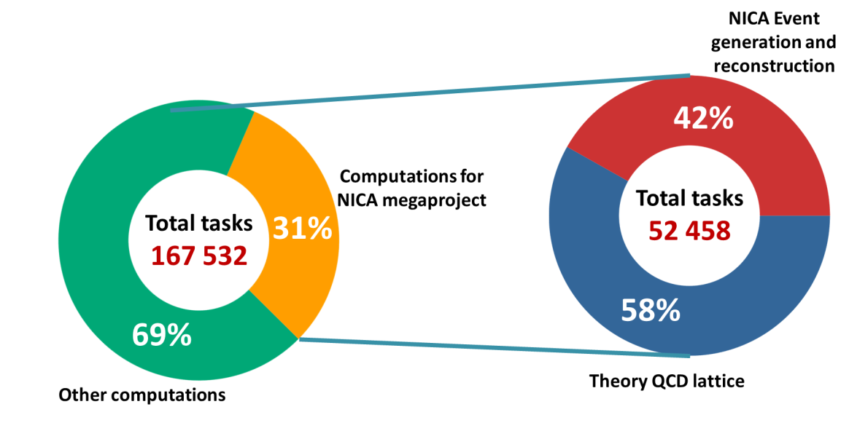
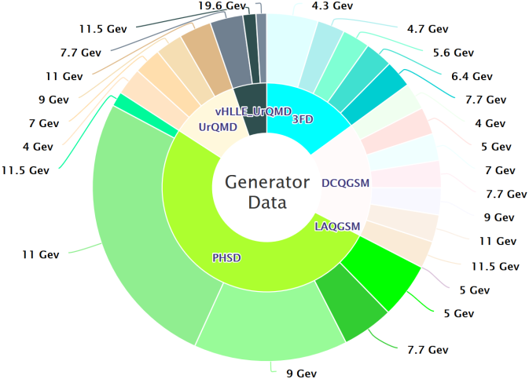
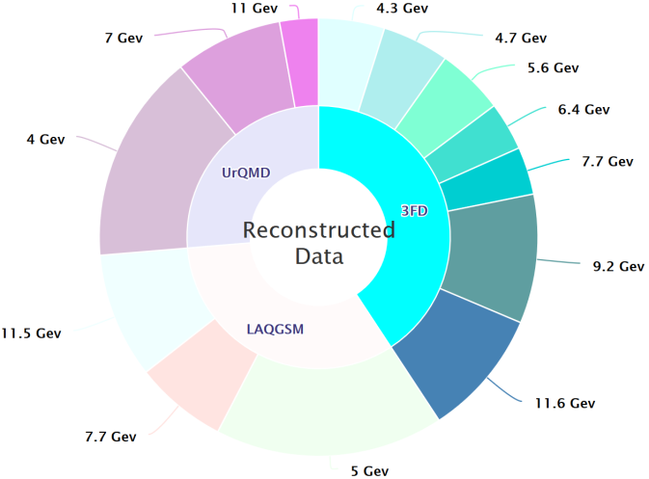
Statistics of using the supercomputer for the NICA
Since commissioning, more than 164,000 tasks were performed on the GOVORUN supercomputer. One third of them refer to computing for the NICA megaproject. Moreover, more than half are theoretical calculations carried out on all computing components of the supercomputer. More than 40% directly relate to the event generation and reconstruction for the MPD experiment.
By June 2019 over 75 million events for the MPD experiment have already been generated using the UrQMD generator. At the present time reconstructed almost 6.5 million events. The CPU component and the UDSS are used for the solution of these problems.

Slide 16
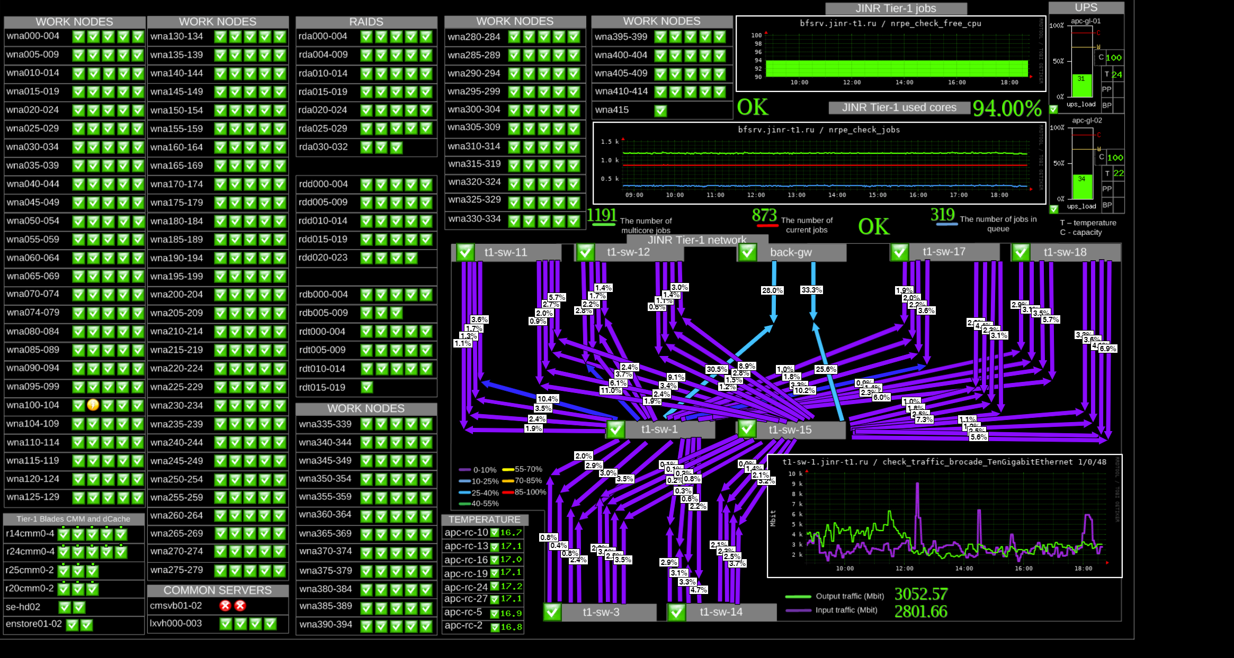
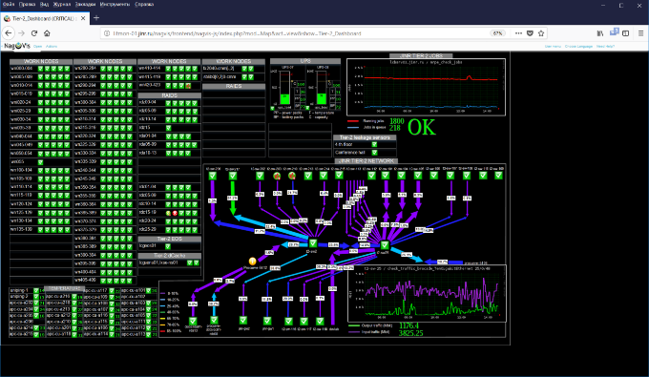
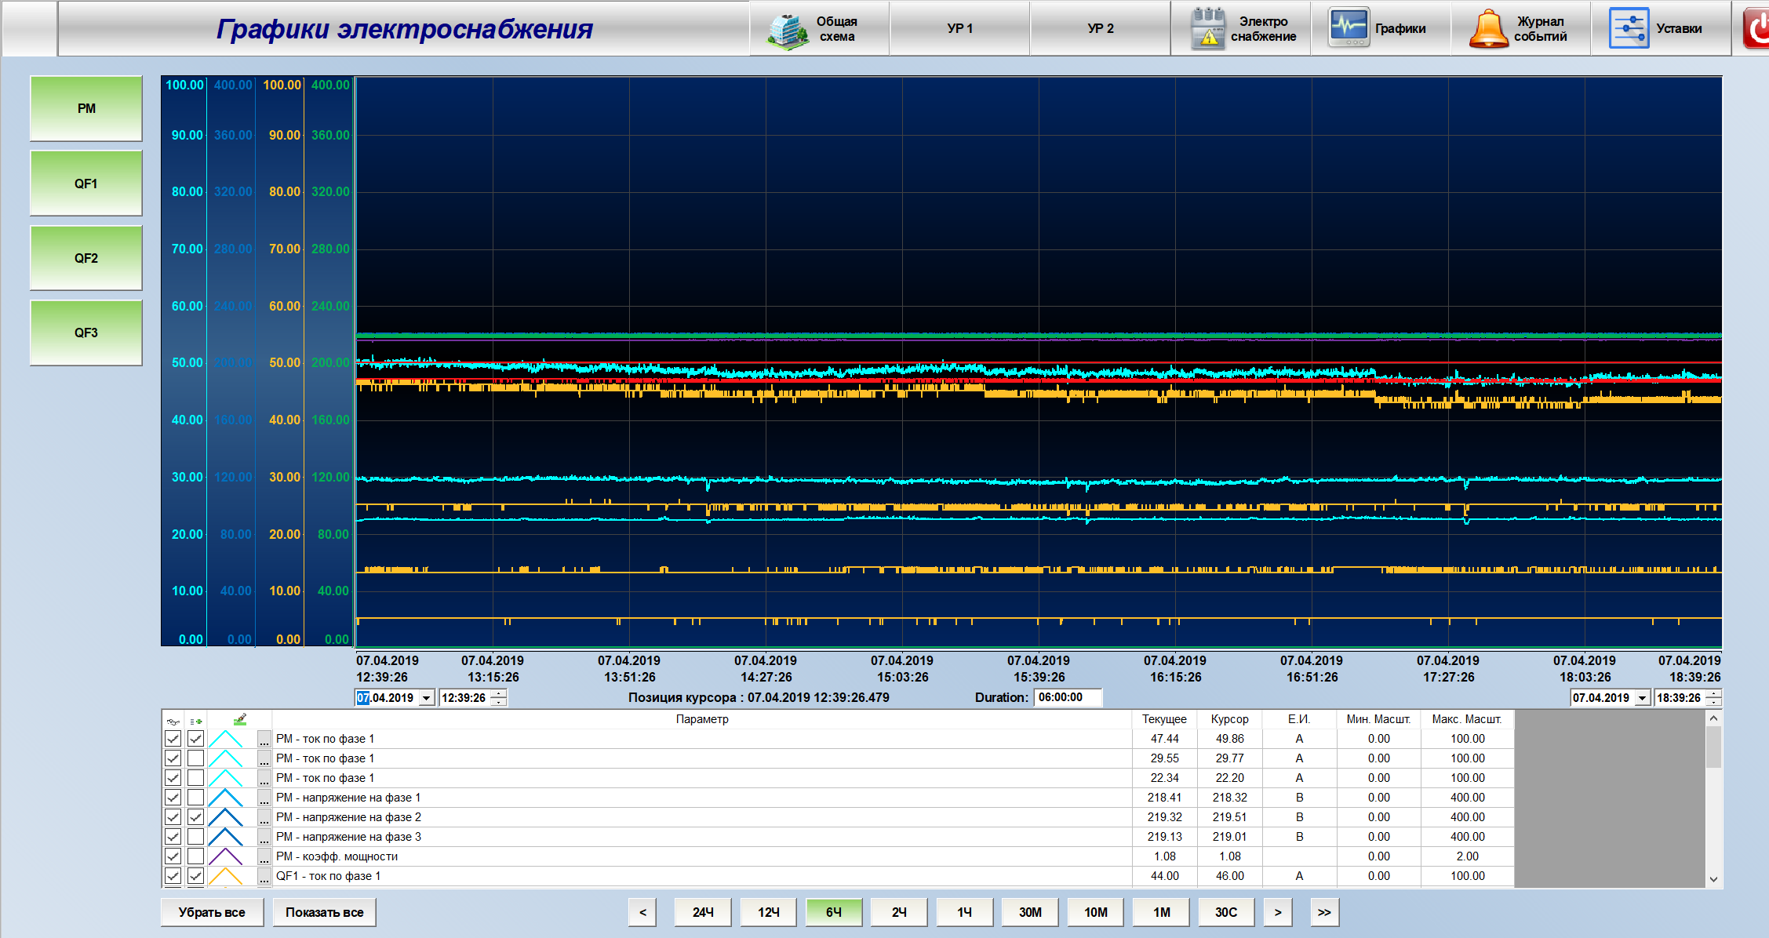
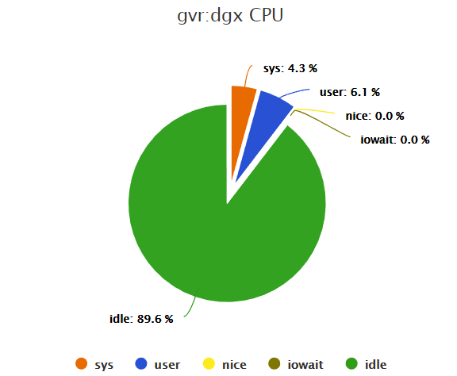
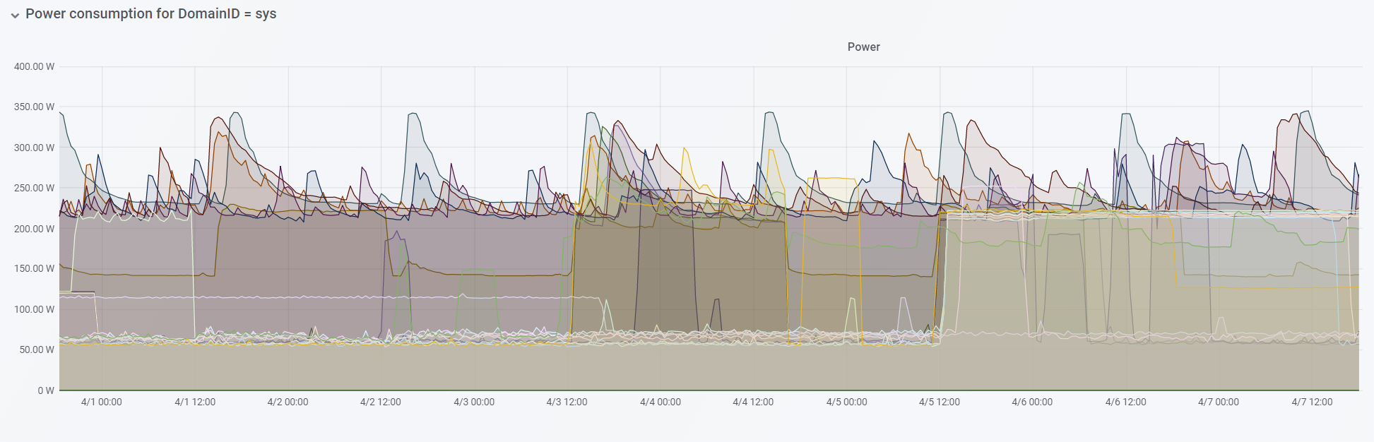
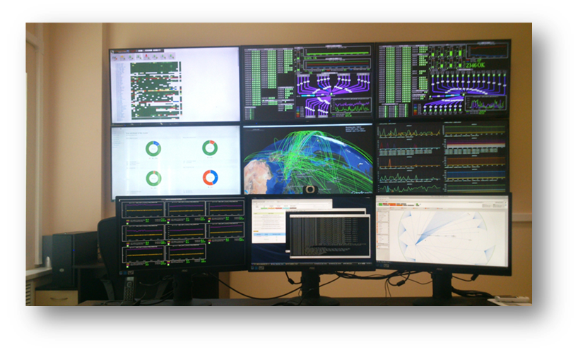
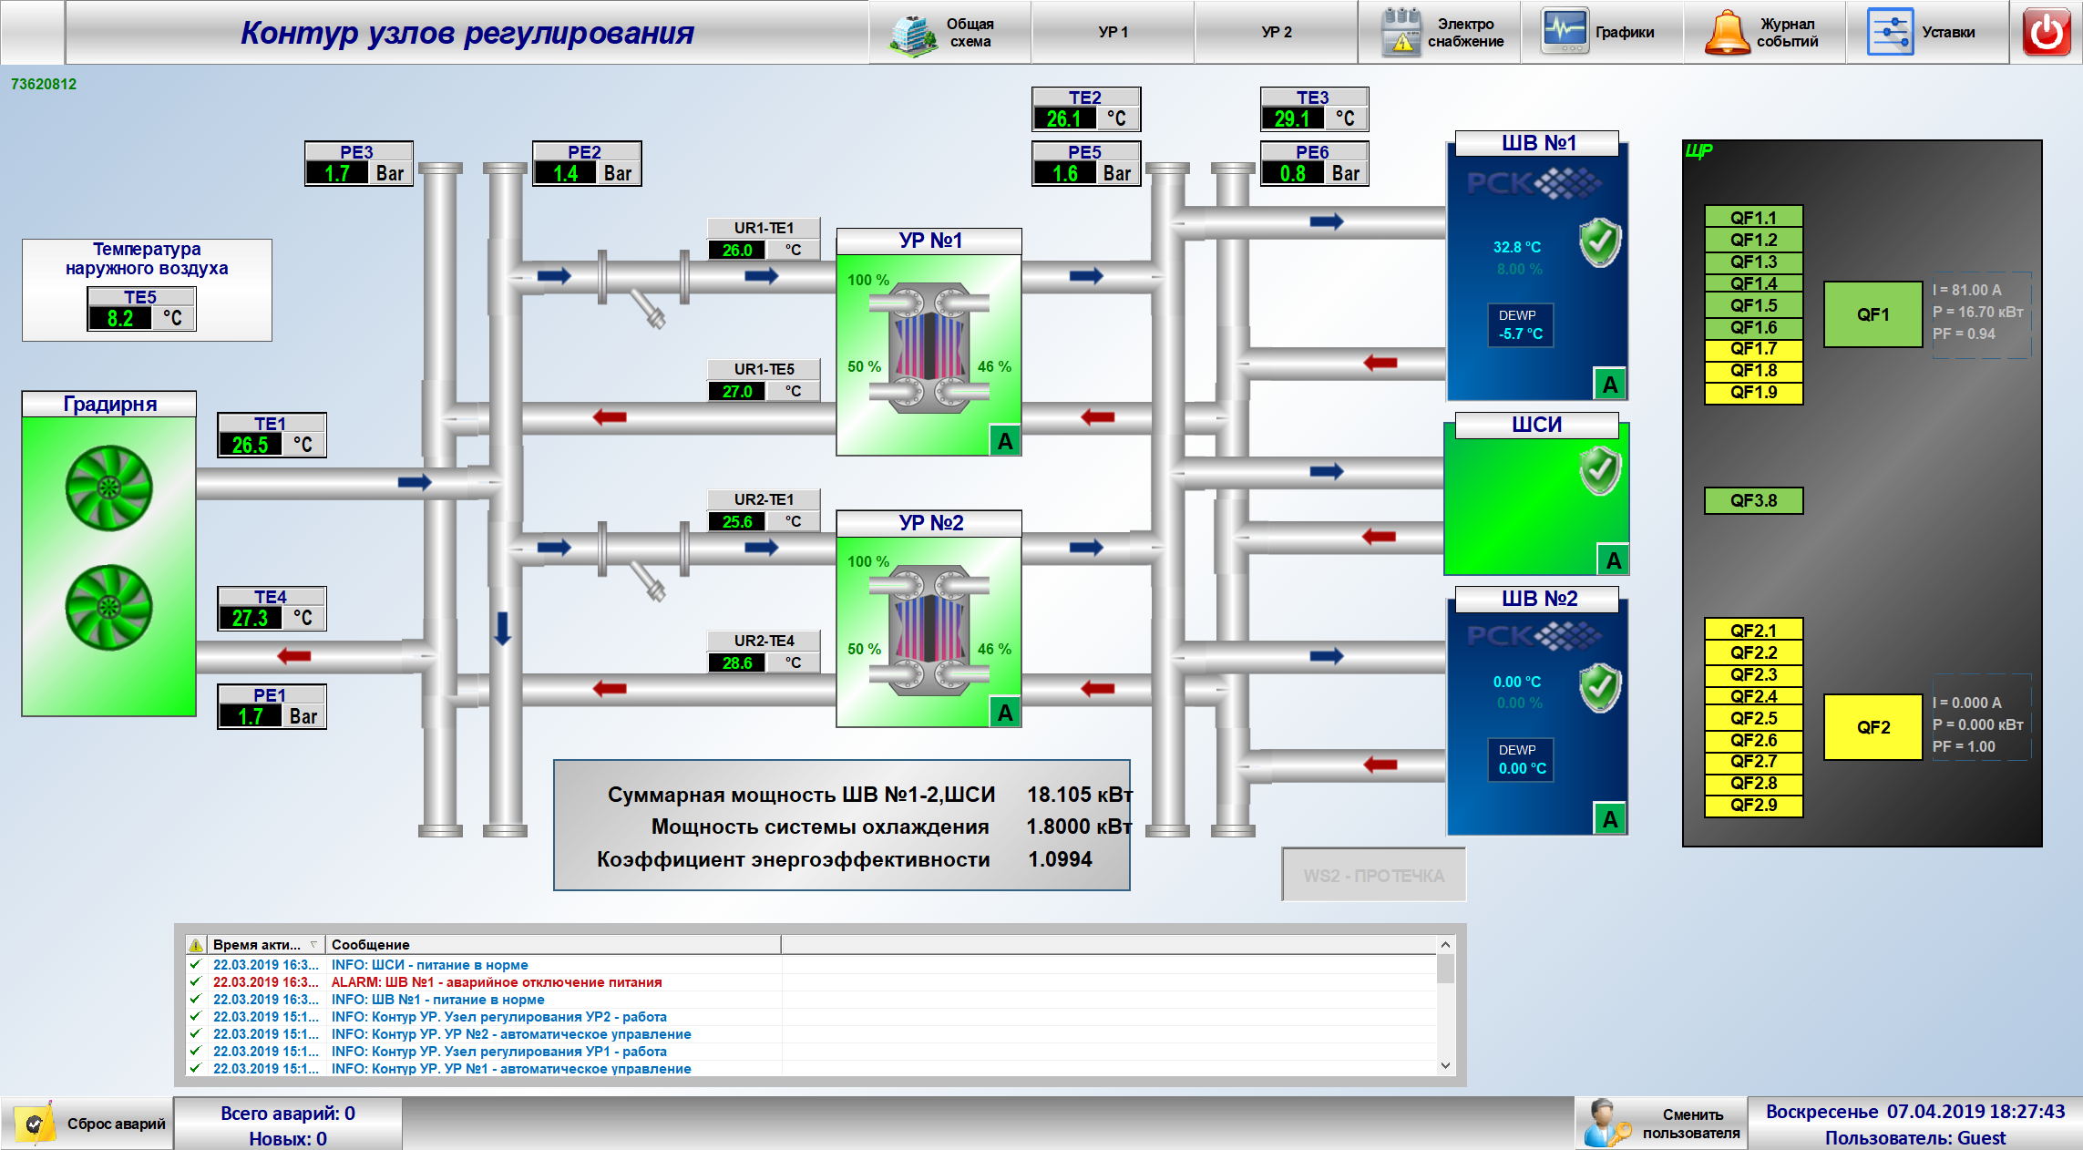
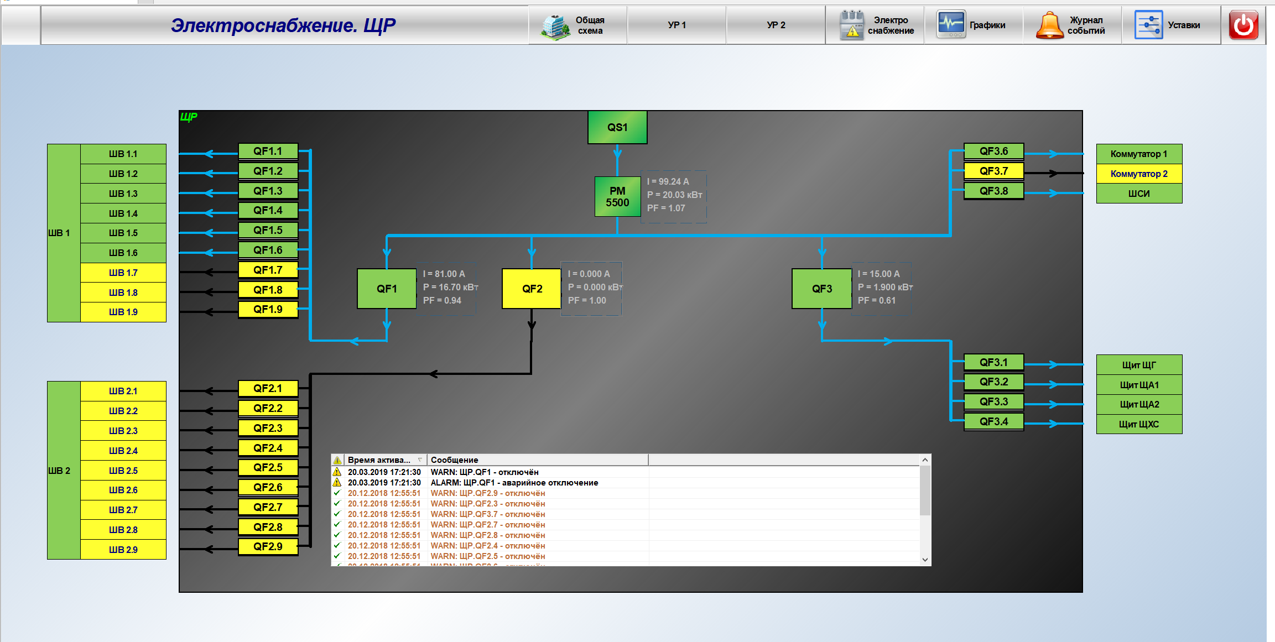
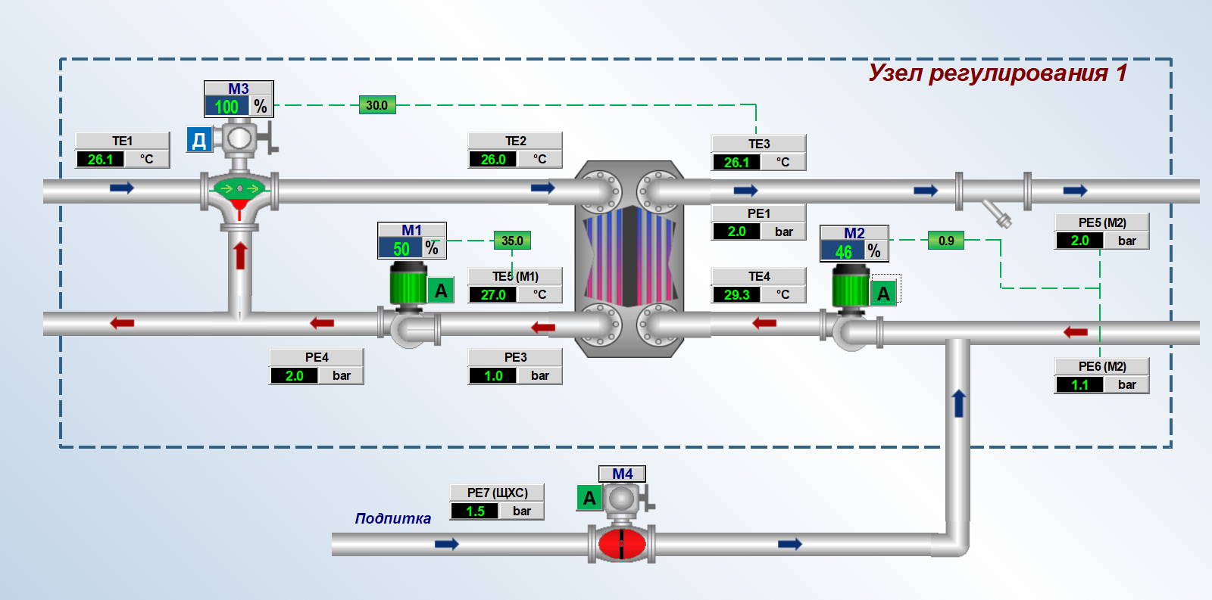
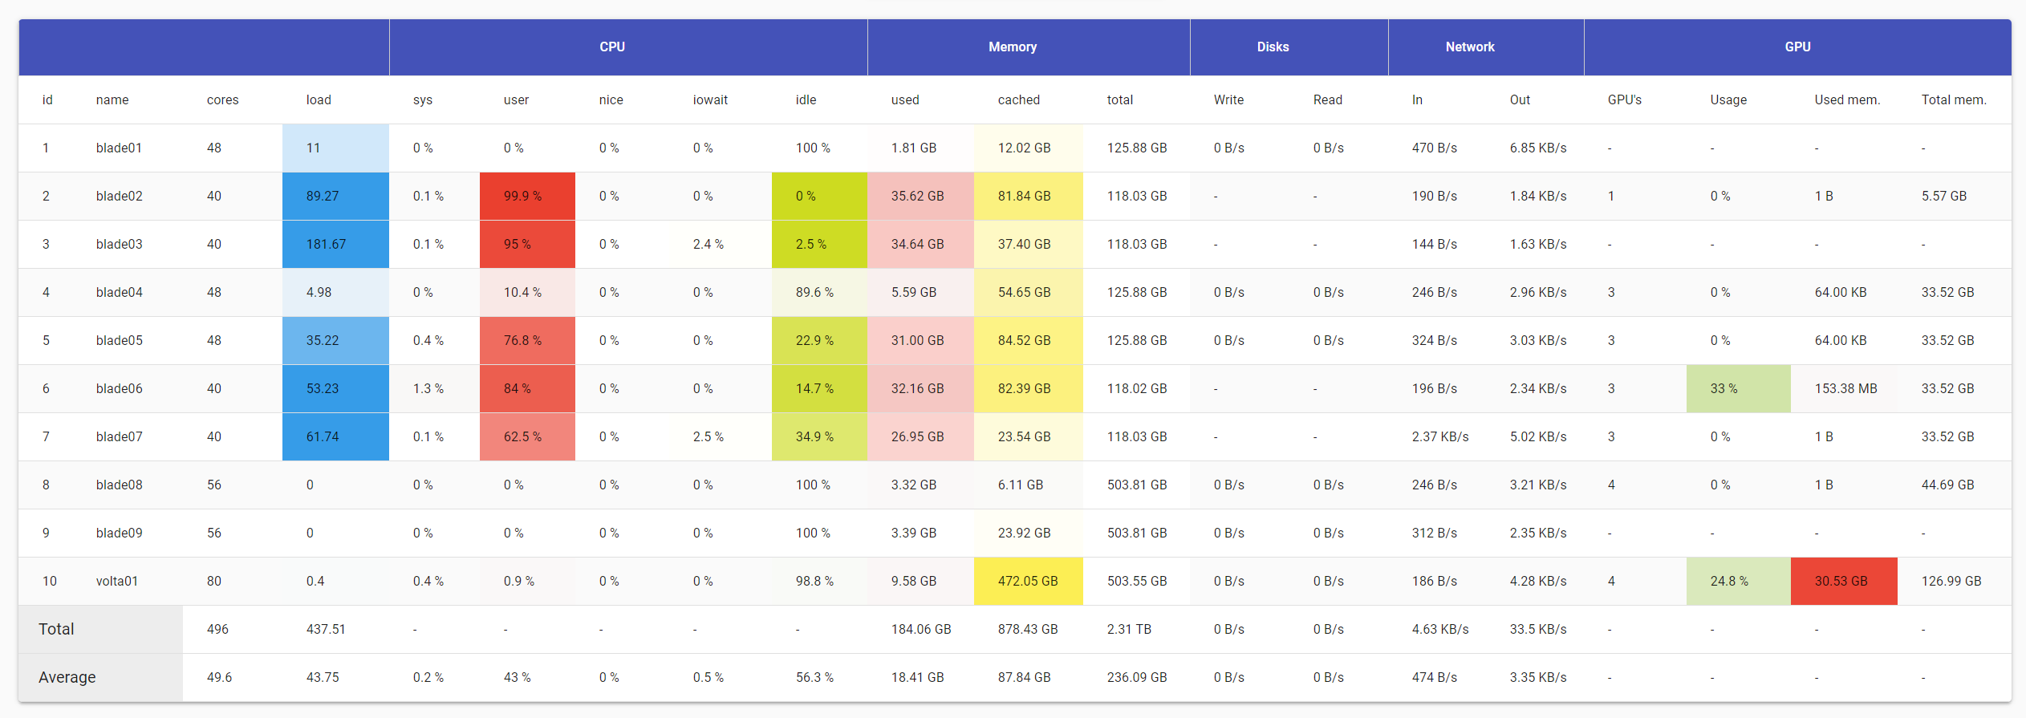
JINR MICC monitoring
1. Monitoring the states of all MICC nodes and services- from the supply system to the robotized tape library
2. Global real time survey of the state of the whole computing complex
3. In case of emergency, alerts are sent to habilitated persons via e-mail, SMS, etc.
4. 1250 hosts are under observation
5. 10 295 services controlled in real time

Slide 17
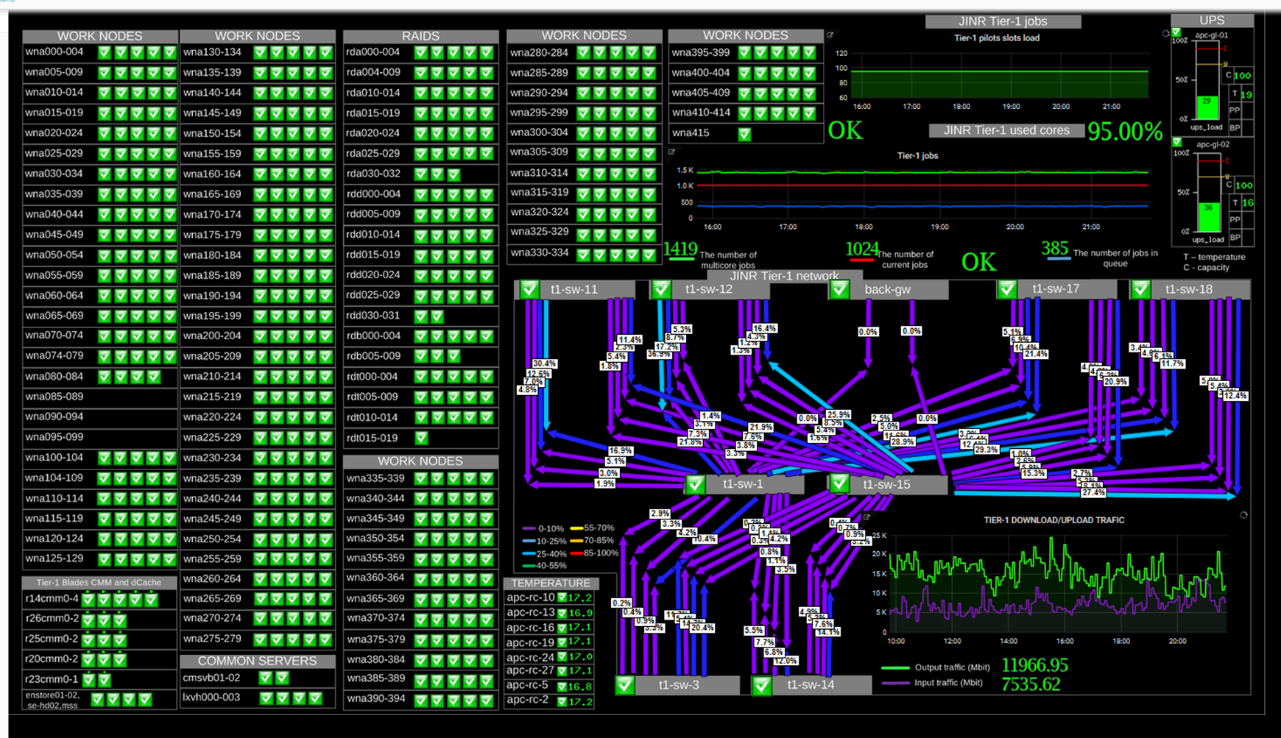
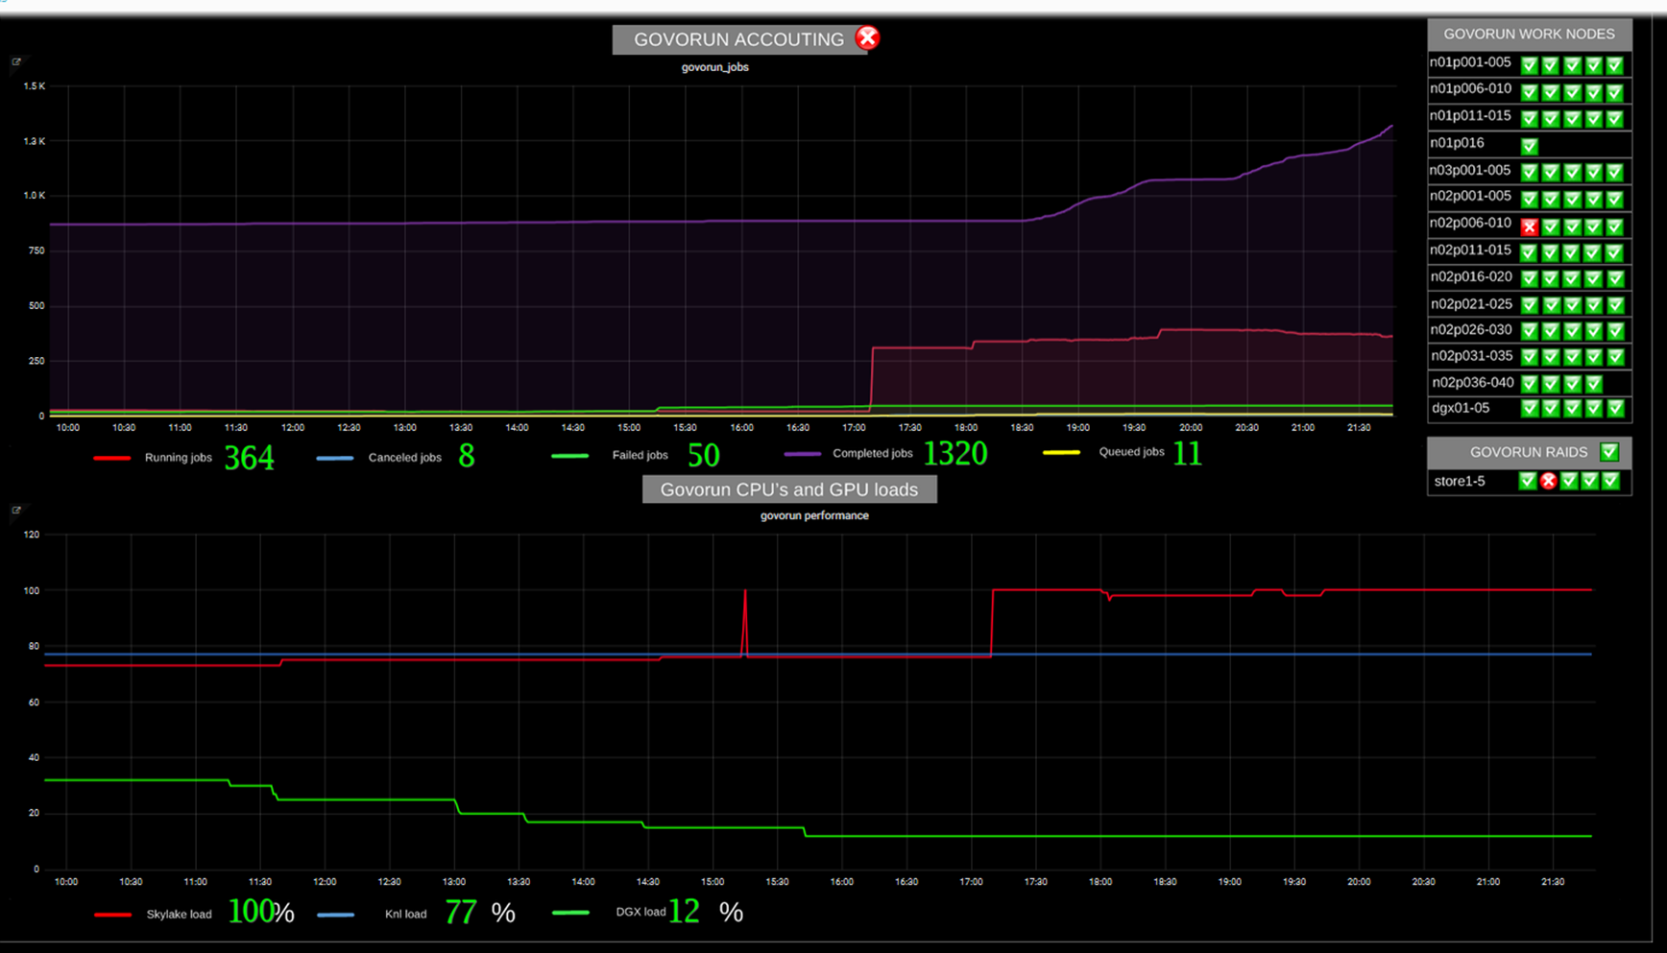
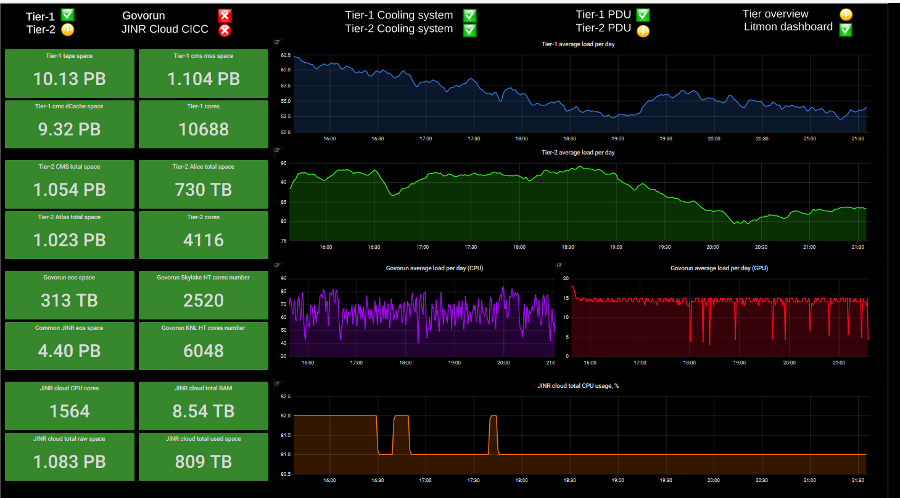
JINR MICC monitoring

Slide 18
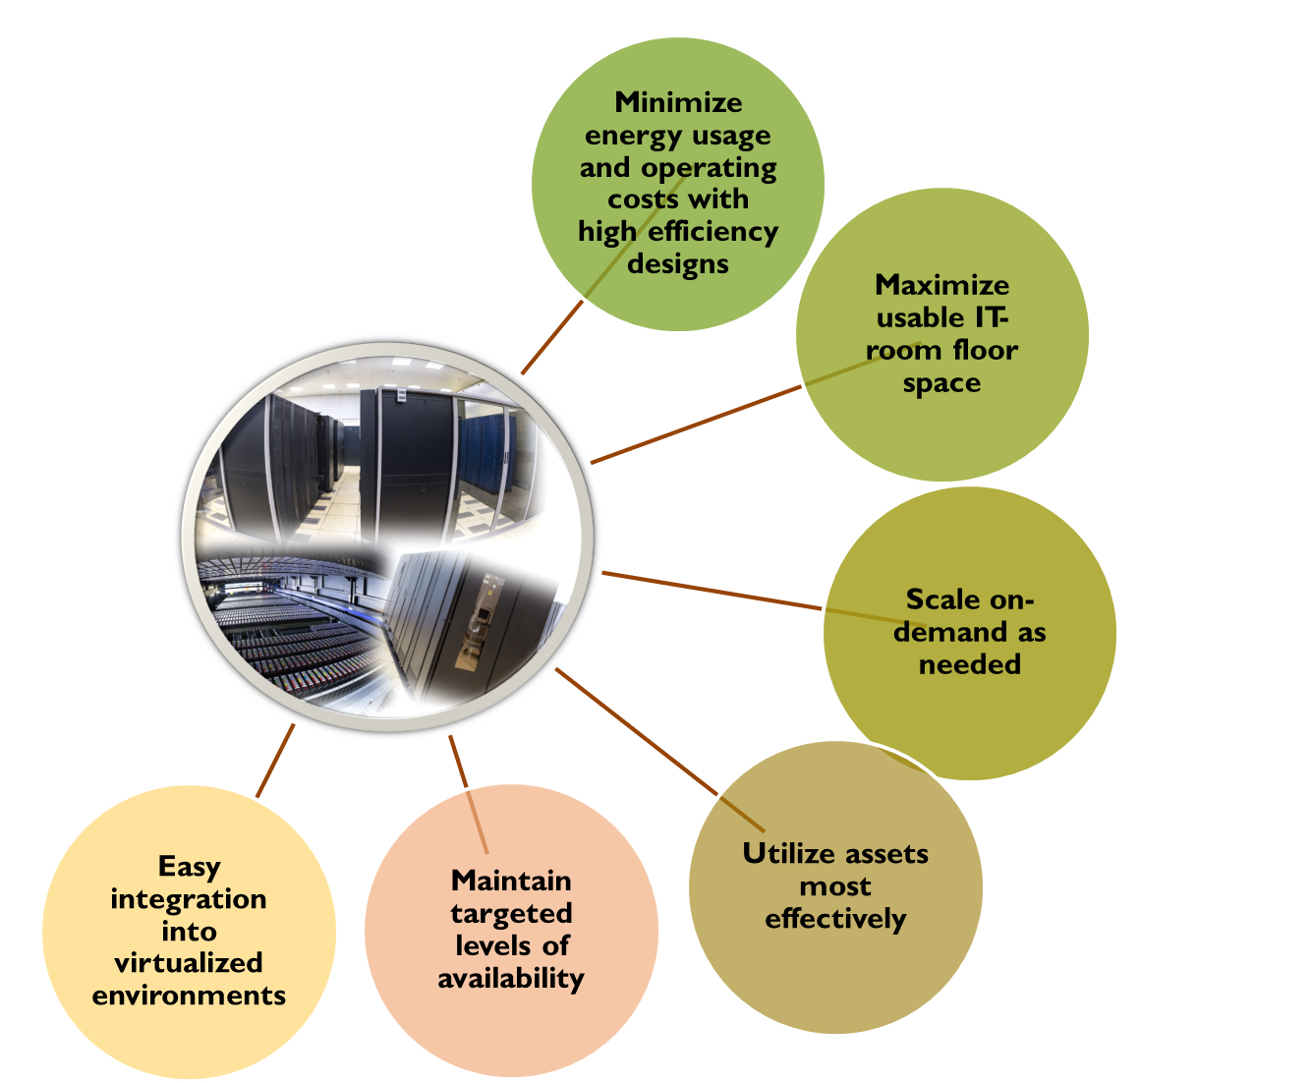
The built up Multifunctional Information and Computing Complex (MICC)
is a fault-tolerant infrastructure with electrical power storage and distribution facilities with expected availability of 99.995%
supports and uses a large variety of architectures, platforms, operating systems, network protocols and software products
provides means for organization of collective development
supports solution of problems of various complexity and subject matter
enables management and processing of data of very large volumes and structures (Big Data)

Slide 19





CHALLENGE: R&D of software to acquire, manage, process, and analyse the big amounts of data to be recorded
Data Analysis and Interpretation
Data Organisation, Management and Access
Data-Flow Processing Framework
Conditions Data
Visualisation
Software Development, Deployment, Validation and Verification
Data and Software Preservation
Physics Generators
Detector Simulation
Software Trigger and Event Reconstruction
Machine Learning
Facilities and Distributed Computing
Security
CMS estimation
CMS estimation

Slide 20












Big Data + HPC (HPDA - High Performance Data Analysis)
Annual data production follows to exponential law.
In 2020
> 40 ZB data
will be
created
High Energy Physics
Biology
Nanotechnology
Science
CERN Large Hadron Collider
> 20 Pb/Year, > 200 Pb stored
Astrophysics
Climate
Square Kilometer Array radio telescope (SKA) > 20 Pb/Day (estimation)
An International radiotelescope
for the 21st century
...et cetera
Large Synoptic Survey Telescope (LSST) > 10 Pb/Year (estimation)

Slide 21

MICC unified resource and data flow management system
The main objectives of a unified resource management system are:
to provide the ability to process large amounts of data;
to provide the possibility to organize massive computing tasks;
to optimize the efficiency of the use of computing and storage resources;
to effectively monitor the resource loading;
to consolidate the accounting for the use of resources;
to provide a unified interface of access to resources.
The data flow management system should provide:
an interface for the formation of jobs, chains and groups of jobs;
a database for storing job definitions;
a job generation system based on certain parameters;
the preparation of input data through the data management system of the MICC unified resource management system; the selection of suitable computing resources;
sending jobs to the load management system of the MICC unified resource management system;
control over their implementation.
For experiments the system should provide:
the ability to ensure an isolated interface for each experiment;
the possibility to form a chain of data processing in accordance with the experiment computing model;
processing on available computing resources.

Slide 22





Development of resources of MICC
Increase in computing resources of Tier1 CMS up to 350 kHS06
Increase in computing resources of Tier2 up to 170 kHS06
Expansion of the storage system of Tier1 CMS on disks up to 16 PB
Expansion of the storage system of Tier1 CMS on tapes up to 42 PB
Expansion of the MICC storage system on EOS up to 60 PB
Increase in CLOUD total recourses up to 11000 cores, ~7PB storage, ~7 TB RAM
Increase “Govorun” performance by 90 TFlops for double-precision operations per year
Se

Slide 23



















Educational program on the HybriLIT platform
Training courses, tutorials and lectures
HybriLIT group
leading scientists from JINR and its Member States
Leading manufacturers of modern computing architectures and software
Parallel programming technologies
Tools for debugging and
profiling of parallel
applications
Frameworks and tools for ML/DL tasks
Work with packages of applied software
Regular training courses
Courses within conferences and schools

Slide 24
Thank you for your attention !

