Slide 1
Modernization of the management and control system of the cryogenic neutron moderator of the fast pulsed reactor.
Authors: A.V. Altynov, М.V. Bulavin, S.А. Kulikov, Т.B. Petukhova, А.P. Sirotin.
NEC’2019 Montenegro, Budva, Becici

Slide 2
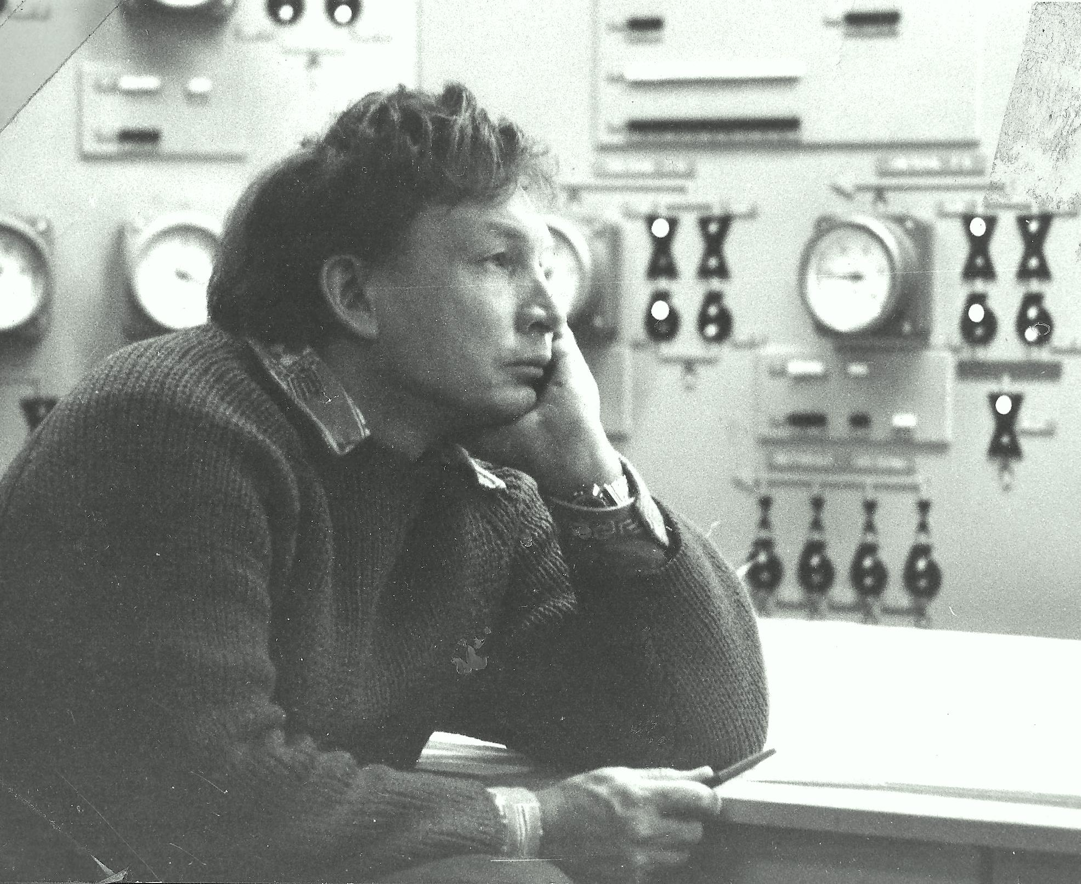
History
In the 80s of the last century, the idea of the ​​bulk neutron moderator with ice and methane was first proposed. But it couldn’t be realized.
At the end of the last century the idea of creating a neutron moderator with the use of mesitylene appeared in helium environment.
In 2005 the development of the pelletized moderator was started and was completed in 2011.
In 2012 the moderator was firstly launched and in 2013 it was put into operation.

Slide 3
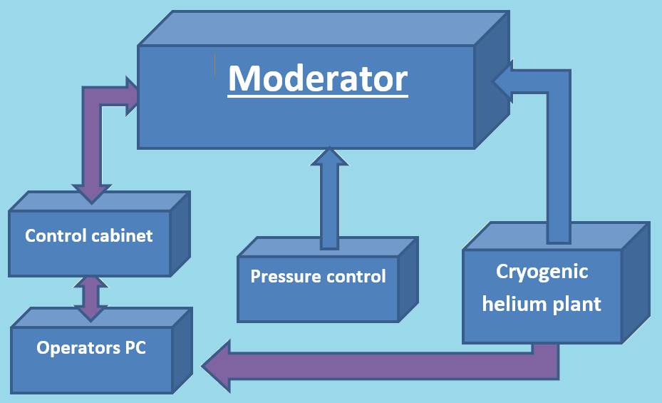
Control system
The control system of cold neutron moderators includes:
monitoring and management of the pellets loading;
temperature monitoring of
individual units;
pressure control in circuit moderator.
The main directions of modernization of the moderator control system are:
• Improving the reliability of the control system;
• Increasing the level of automation of the control system;
• Integration of new elements into the control system.

Slide 4
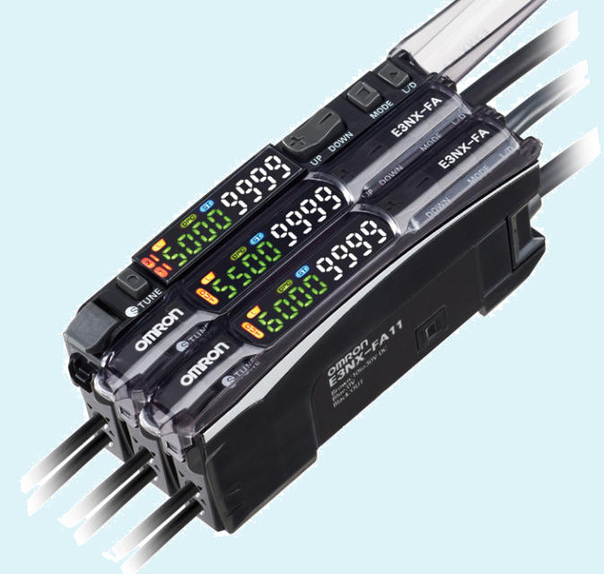
Monitoring and management of the pellets loading.
The control system of flying balls is based on the pressure difference between two points on the pipeline during the flight of the ball. The measurement of the pressure difference before and after the ball is carried out by the differential pressure sensor DXLdp. This allows to register the ball, to determine the speed of its movement.
Differential pressure sensors, in the process of modernization, are replaced by optical span sensors Smart Fiber Amplifier Unit E3NX-FA11 allowing to record the passage of balls at high speed.

Slide 5
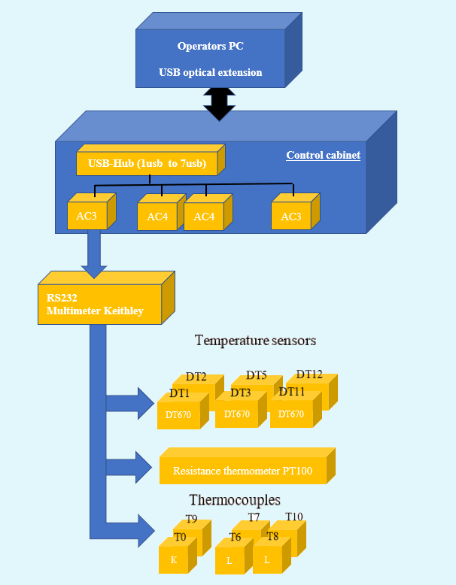
Temperature monitoring of individual units.
The complex system of sensors includes 6 thermocouples of the K type, platinum resistance thermometer to measure the temperature of the cold junction and silicon diode for high-precision measurement of cryogenic temperatures.
The measurements are performed using the highly precise multimetr Keithley 2000 from twenty-channel scanning card.
During operation, we had to abandon the previously used multi-channel interface converter MOXA Uport due to regular problems with the numbering of COM ports on the operator’s PC. Instead, a multi-channel USB hub is used.

Slide 6
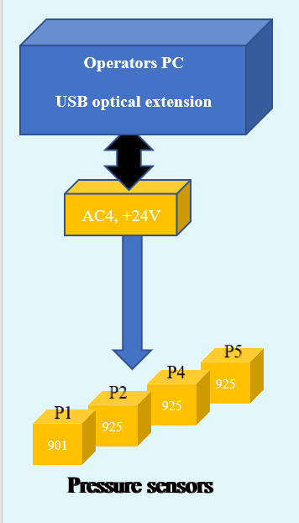
Pressure control in circuit moderator
The control system of the vacuum circuit moderator includes eight pressure sensors MKS925 and one sensor MKS901.
The vacuum sensors MKS925 and MKS901 are designed for measuring pressure in the range from 1×${10}^{−9}$ to 3000 Torr., at normal atmospheric pressure.
During operation and modernization, the MKS925 sensors were replaced with sensors of the same type of the later series with an improved electronic base and an enlarged display, which reduced the number of failures.

Slide 7
Pressure control in circuit moderator (continue)
Also, during modernization of the moderator, 16 valves of the vacuum system were changed from manual to electromagnetic. The valve solenoid is controlled via the 24 V line through the OWEN relay block from the operator's PC. When the moderator is operating, the system pressure is controlled programmatically and a ban is issued on changes in the state of the sensors, which can lead to an emergency.

Slide 8
Main user interfaces: CM_Viewer
SCP includes two main user interfaces:
• BMC to control the loading and movement of mesitylene balls and gas flow;
• CM_Viewer to obtain information on operation of systems of the cryogenic moderator.
The software is designed to automate the control of the main parameters of the moderator, graphically display them, collect data on physical parameters and sound alarms in case of emergency. The software is regularly updated to increase the speed of the program, facilitate the work of the operator and increase the information content of the program windows.

Slide 9
Results
According to the results of the modernization, it is planned to reduce the number of hardware failures in the operation of the moderator by 50%, and software failures by 80%.
At present, work is underway to integrate the FANUC six-axis robot repackler and a video surveillance system for its manipulations into the control system. The operator only needs to click on the program button on the robot control tab and watch.
The main promising area of modernization of the cold moderator control system is the rejection of using a PC as a means of control by Programmable Logic Controllers (PLC). The operator’s PC will carry out only the function of an external user interface and server for remote control of moderator parameters. This will increase the reliability of the system and its security against unauthorized interference and exposure.

Slide 10
THANKS FOR YOUR ATTENTION!
sorry my English

