Slide 1



DijetGAN: A Generative-Adversarial Network approach for the Generation and Simulation of QCD Dijet Events at the LHC
Riccardo di Sipio, Michele Faucci Giannelli, Sana Ketabchi Haghighat, Serena Palazzo
3 October 2019

Slide 2
Introduction
The LHC experiments use Monte Carlo (MC) simulation to perform measurement and searches
The production and simulation of MC event requires large computing resources which are, in many ways, constraining the reach of LHC measurements
Our work describes how GANs could be used to produce the required amount of events in a fraction of time

Slide 3
Monte Carlo in LHC experiments
Several problems of the current model
  Simulation takes most of the GRID resource but these resources will not scale with the luminosity increase of LHC
  New (more accurate but slow) MC generators are being developed that require more of CPU time
    For example, in the ATLAS top group, the best generators cannot be used to produce the billions of events required by the experiment
Yesterday I showed how we are tackling the simulation in ATLAS
In our paper we show that a GAN can be used for both stages (generation and simulation) of the MC production
  We are aware that the simulation will always be handled with specialised tools by each experiment but we show that it possible to use GAN to simulate complex events, instead of the low level approach shown yesterday

Slide 4
Di-jet physics
jet 1
jet 2
The system is described by the two jets 4-vectors
However there are symmetries that can and have to be exploited

Slide 5
Monte Carlo training sample
Generation
2 million events were produced with MadGraph and showered using Pythia8
Detector simulation
Delphes3 was used with an ATLAS geometry
  A pile-up compatible with Run2 conditions was used
Object reconstruction
Leptons, jets and missing energy were reconstructed in Delphes3
  We used the ATLAS definition of large-R jets by setting R=1.0

Slide 6
Object level definition
The object reconstruction was performed twice, before and after the detector simulation
The object reconstructed using only the generator information define what is commonly known as the particle level
  The GAN trained on these objects aims at reproducing only the generator
The object reconstructed after the simulation step are defined as reconstruction level (or detector level)
  By training on these events we evaluate the ability of a GAN to reproduce the full chain

Slide 7
Object selection
Our study focuses on boosted objects
We apply a cut on the scalar sum of the p_{T} of the two jets (H_{T} >500 GeV) was used to select events with high p_{T} jets:
  1.5M events selected at particle level
  800k events selected at reco level

Slide 8
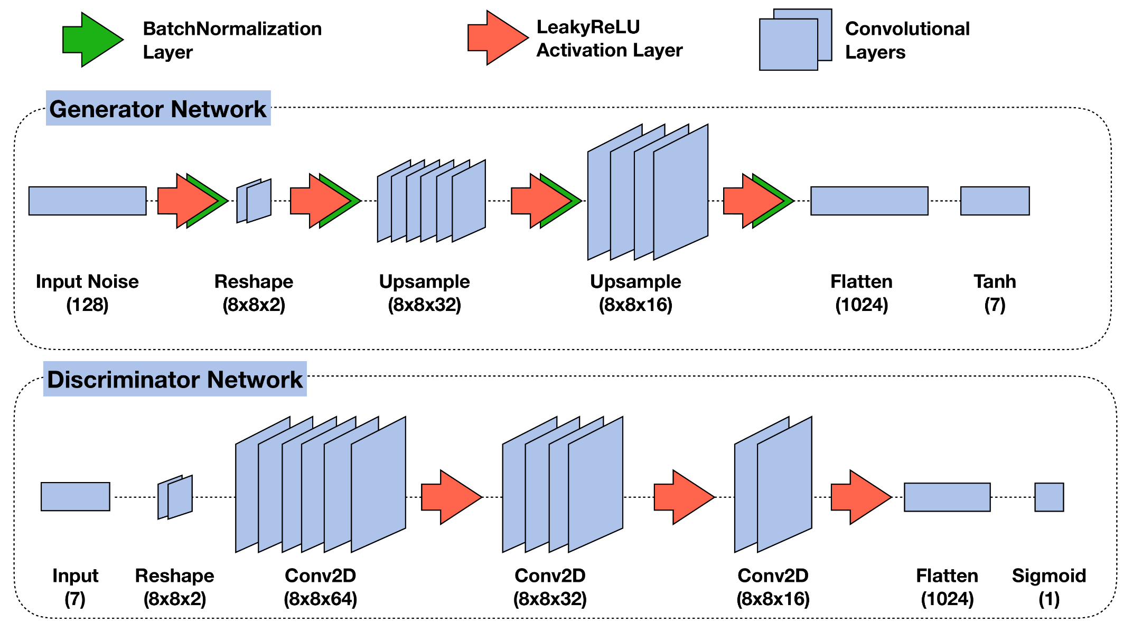
The GAN

Slide 9




Implementation
Keras v2.2.4
Tensorflow v1.12
Inputs scaled in the [-1,1] range and pre-processed using Scikit-learn and Pandas libraries

Slide 10
The training
The Generator transform a vector or 128 random numbers into 7 physics quantities:
  p_{T}, η and m of the leading jet
  p_{T}, η, m and φ of the sub-leading jet
The Discriminator compares the generator with the MC events
The loss functions are:
  G: Mean square error
  D: Binary cross-entropy
Both G and D use Adam optimiser with a learning rate λ=10⁻⁵
We train for 100k iterations with batches of 32 events
1 hour for training on a GPU NVIDIA Quadro P6000

Slide 11
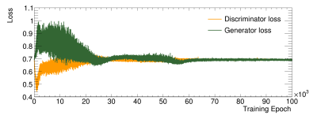
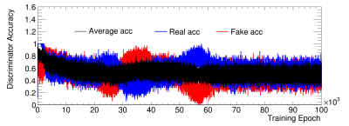
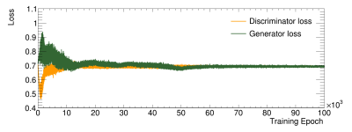
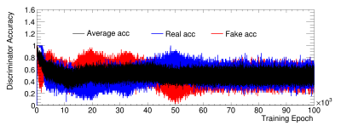
Loss and accuracy vs epochs
Reco level
Particle level
Nash equilibrium reached after 10k iterations
  this does not provide any information on the performances
  Accuracy getting more stable after 60k iteration also not an indication of better performances

Slide 12
Simulation
The GAN can simulate 1M events in 80s
The values outputted by the GAN are manipulated to revert the exploited symmetries
The 4-vectors of the simulated jets are used to build physics observables which we compare to the MC sample
This is done every few thousands epochs

Slide 13
Going beyond other GANs
All images looks like humans
But are the features preserved from the training sample?
  Distance between eyes
  Length and width of nose
  Mouth width
  Forehead height
Not just the average but also the distribution
  Are faces too rounded?
Image by NVIDIA

Slide 14
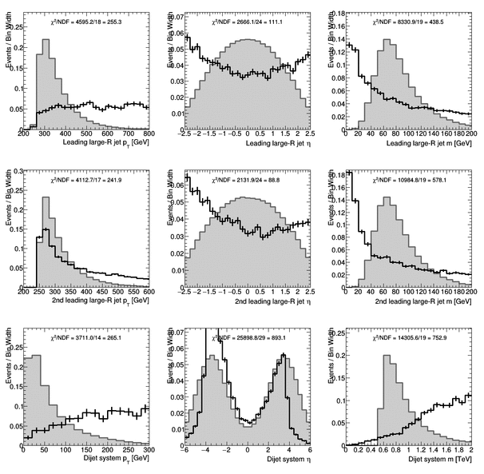
Training of the GAN
p_{T}
η
Mass
Leading jet
Sub-Leading jet
di-jet system

Slide 15
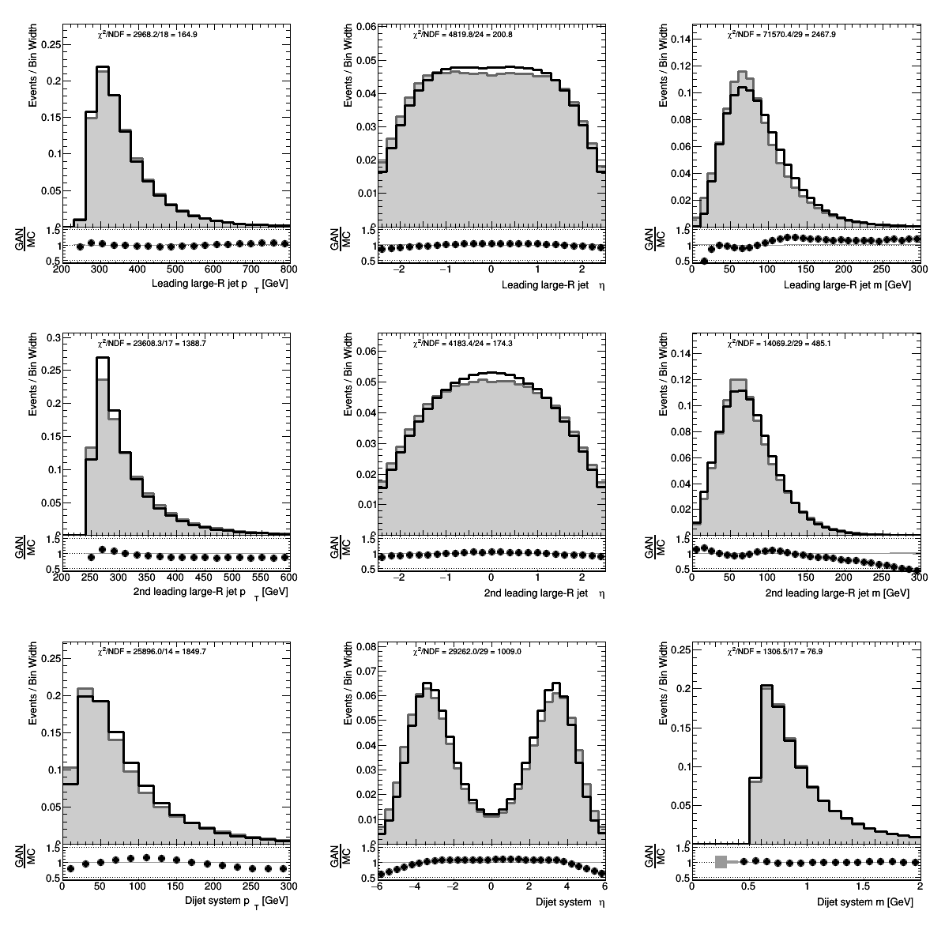
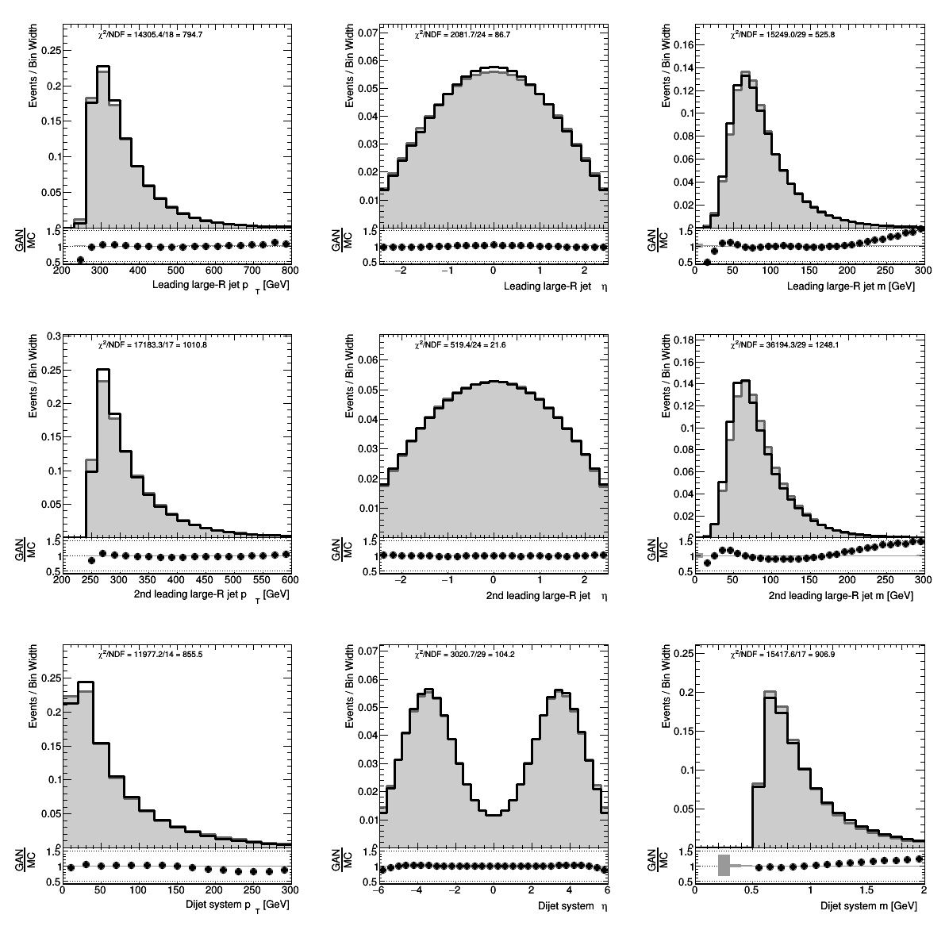
Results
Reco level
Particle level
Although not perfect, the GAN can reproduce the shapes of all variables

Slide 16
Boosted top events
The same GAN was trained on all-hadronic top pair boosted events
  p_{T} > 350 GeV
  M < 500 GeV
Expected double peak in the mass distribution
  At the top mass (172.5 GeV)
  At the W mass, for events in which the b-jets is not contained in the large-R jet (80 GeV)

Slide 17
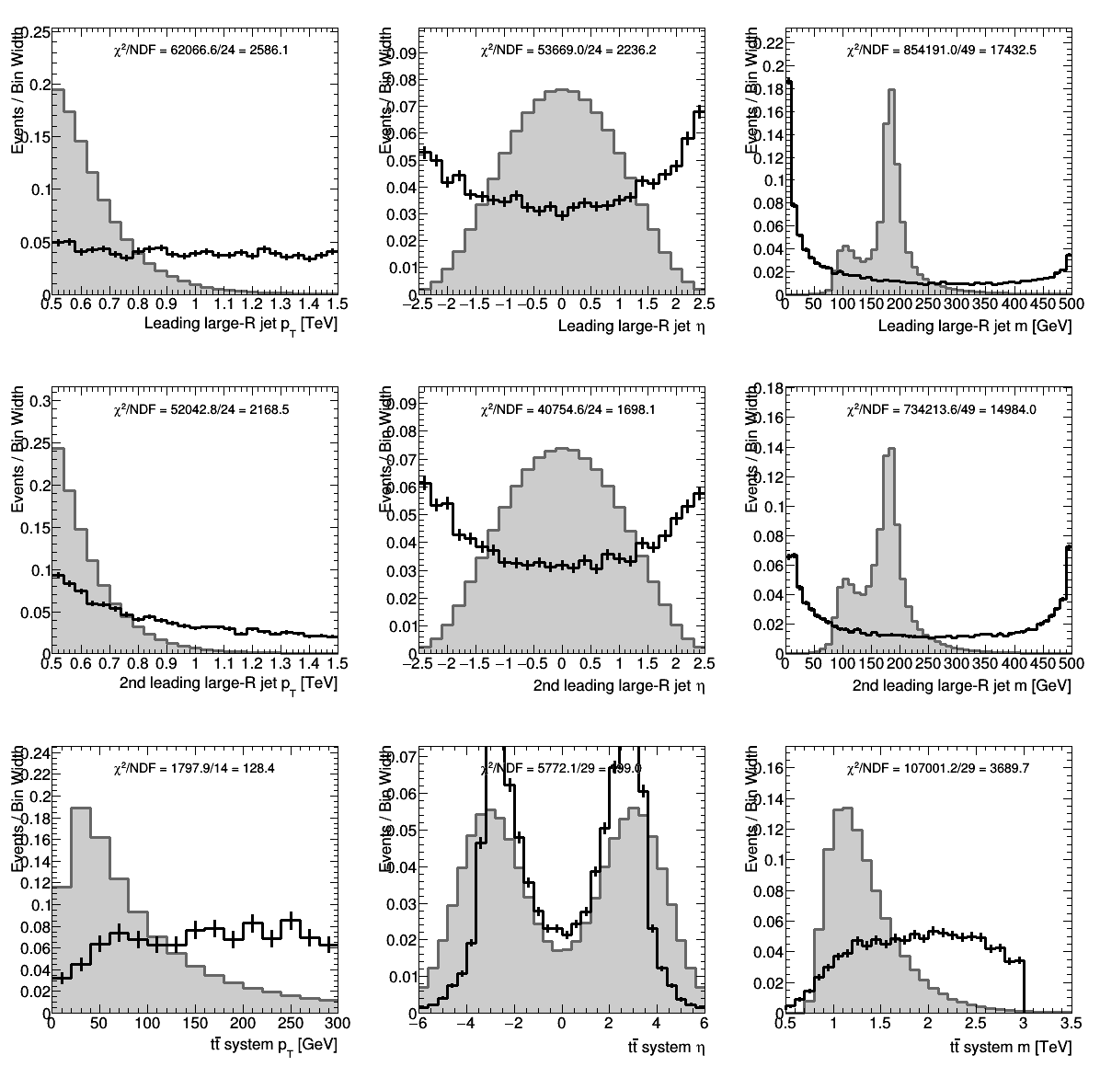
Top events

Slide 18
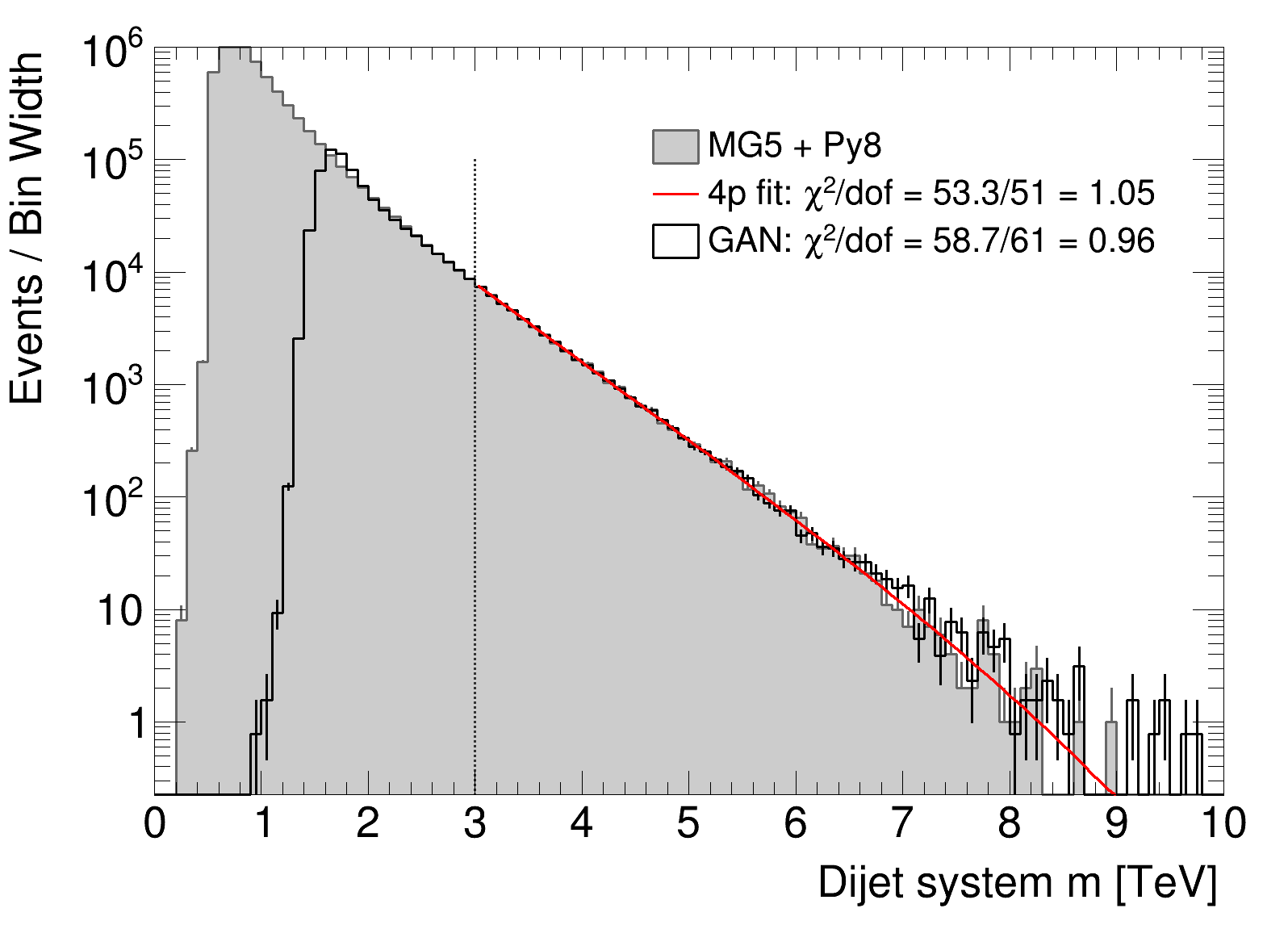
Extrapolation at high M_{jj}
Restricting to a small phase space at high M_{jj} which is a region for BSM searches
MC fitted with 4p analytic function
40k events used for training (M_{jj}>1.5TeV)
Fitting between 3 and 10 TeV we have a
χ² /NDF=1.04
The GAN as
χ² /NDF=1.29

Slide 19
Possible developments
The GAN hyper-parameters could be further improved
WGAN-GP are considered better architectures for a large variety of problems,
  we tried it without observing any significant improvements but other changes may be required too
Conditioning on some variables would make the training dataset more homogeneous making it easier for the GAN to learn features
Test in a real analysis

Slide 20
Conclusion
We demonstrated that GANs can be used to produce di-jet and top events learning many features from the training MC sample
This work can open the door to the use of high accuracy MC samples in the LHC experiments, thus improving the predictions which are crucial for many searches and high-priority SM measurements
The paper was published in JHEP
Our code is available on GitLab

Slide 21
Backup

Slide 22
What I learnt from this project
AKA, pointer for your ML project
Understanding the input data is more important than optimising the network
If you have a symmetry, exploit it and do not have the GAN try to learn it
  In many cases it cannot learn it
  If it can, it will learn other features with lower precision
GPU are overrated
  Most of the time we are limited by I/O not CPU
GAN are NOT a minimisation problem
  They do not naturally converge and picking the best iteration is not trivial

Slide 23
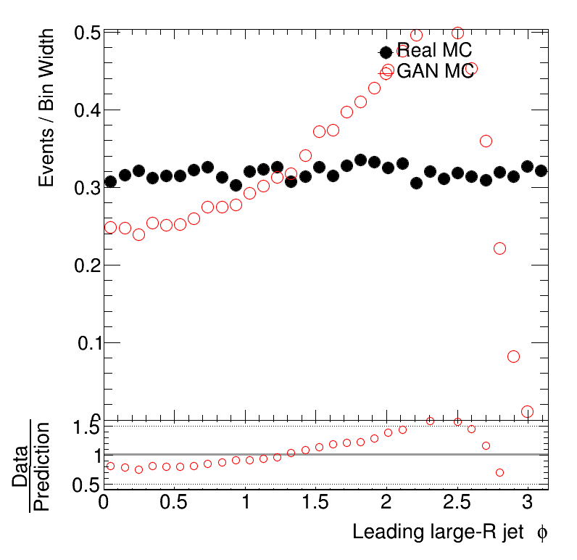
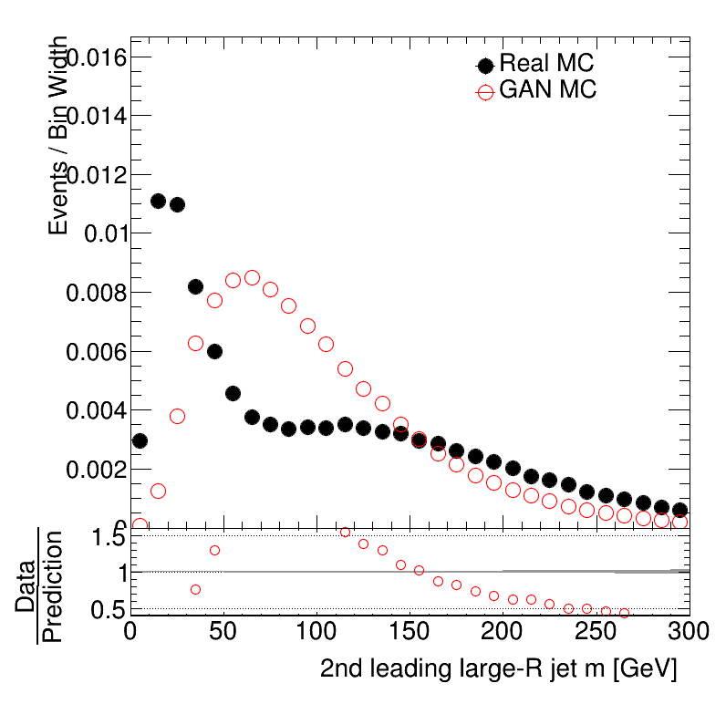
Data manipulation
A GAN cannot learn about two jets going in any direction

Slide 24
First improvement
Di-jet production is φ invariant
We fix the leading jet φ = 0 (equivalent to a rotation)
The sub-leading jet φ = Δ(φ₁ – φ₂ )
The symmetry is reverted when simulating events by randomising the value of the leading jet φ and rotating the sub-leading jet accordingly

Slide 25
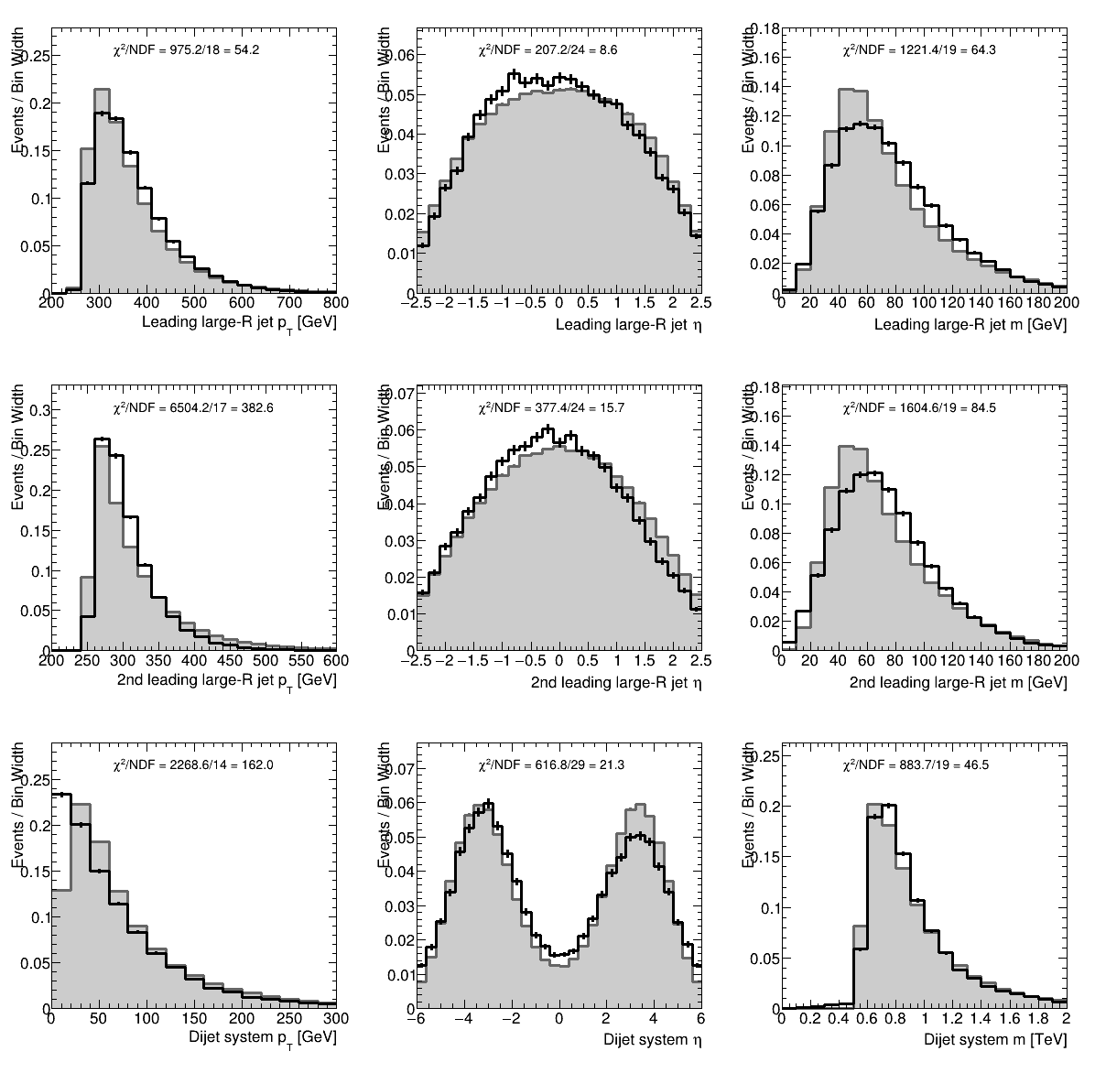
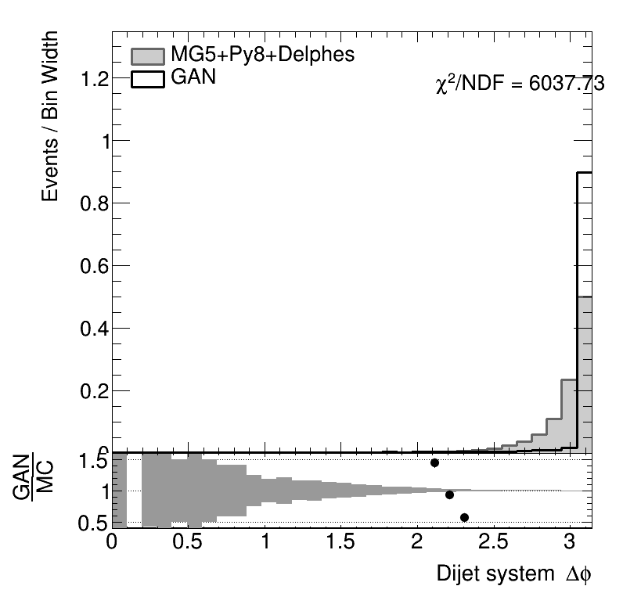
Result

Slide 26
Further symmetry exploitation
After fixing the φ of the leading jet, the system has another left-right symmetry
Fixed by setting the sub-leading jet to
φ = |Δ(φ₁ – φ₂ )|
The symmetry is reverted when simulating events by randomising the sign of the sub-leading jet φ

Slide 27
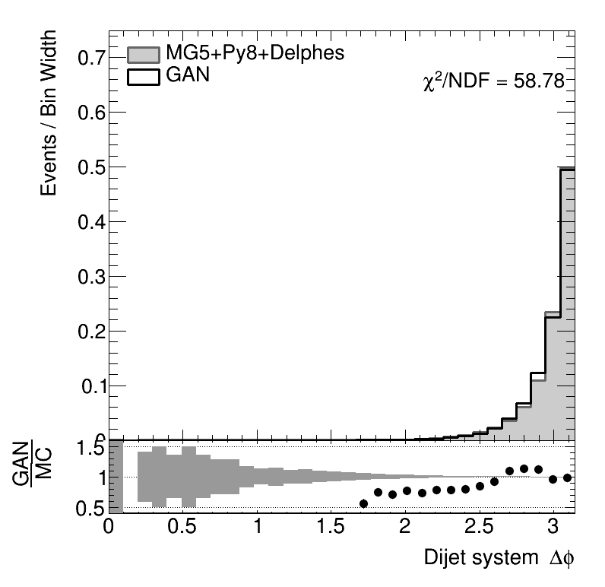
Effect of the fix

Slide 28
GPU vs CPU
GPU in principle should perform significantly better than CPU but we observe similar training time for CPU and GPU
The problem is caused by the significant amount og I/O required to train a GAN which causes a bottleneck as the CPU does not run at 100%
This problem was seen also in GANs developed by us and other groups for fast simulation in ATLAS
  Probably not a general problem of GANs, just reporting what we observe

Slide 29
Not a minimisation
GAN do not converge like fits, there is no minimisation as there is no metric to minimise
This is an issue as there is no natural way to evaluate the performance for choosing the best epoch
The first GANs were simply used to reproduce faces that could pass as humans
  There was no control on average distributions
In HEP we need high accuracy on a large number of observables which are correlated
  No simple solution, we simply took the epoch with the smallest sum of χ²

Slide 30
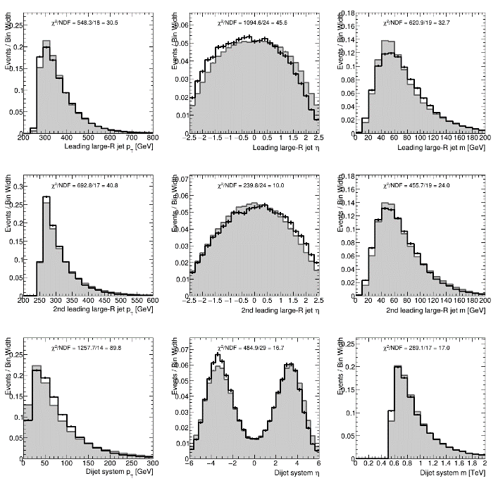

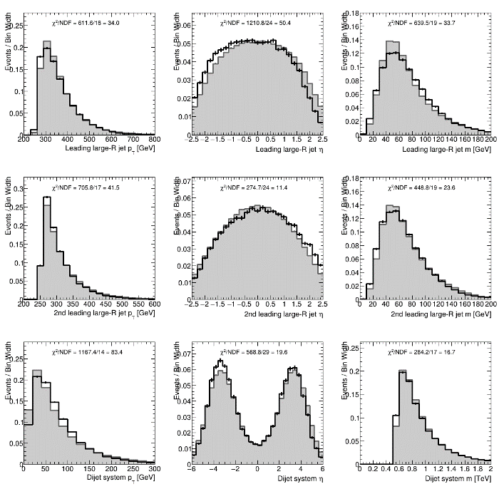


Small variation on consecutive epochs
Epochs 55k±2

Slide 31
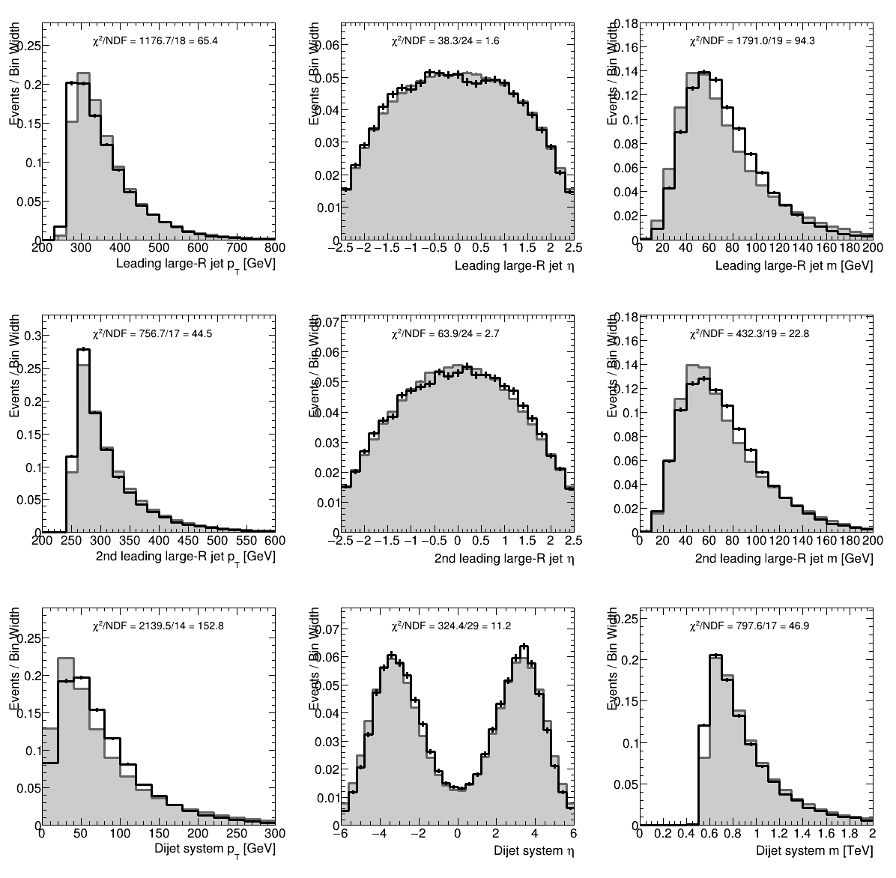
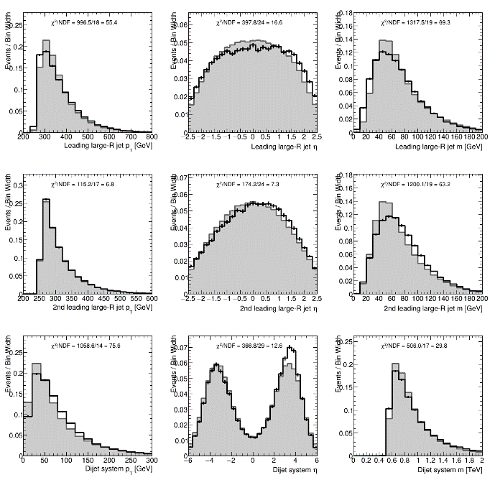
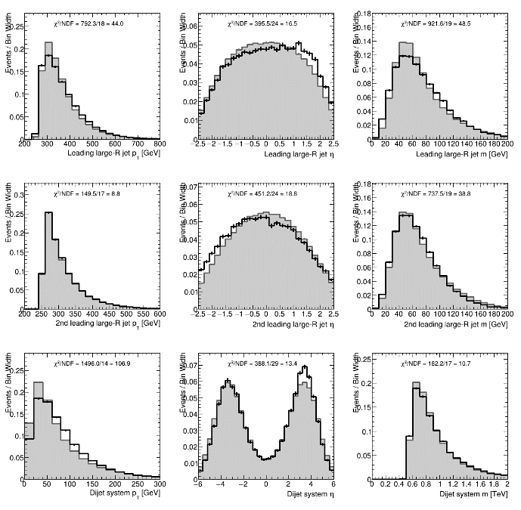
On a larger scale
50k
60k
70k
The agreement of the GAN with the MC for the eta distributions degrades at higher epochs but the sub-leading jet p_{T} and mass distributions improve
p_{T} of the system is best modelled at 60k

