Slide 1
ELECTRONICS OF THE FISSION FRAGMENTS SPECTROMETER "COMETA-F"
Oleg Strekalovsky^{1,3}, Dmitry Kamanin¹, Yury Pyatkov^{1,2}, Alexandr Strekalovsky¹ Vladimir Juchko¹
¹Joint Institute for Nuclear Research
²National Nuclear Research University “MEPHI”
³ University “Dubna”
Notes:
At present, we cannot say that we understand the nuclear fission process

Slide 2
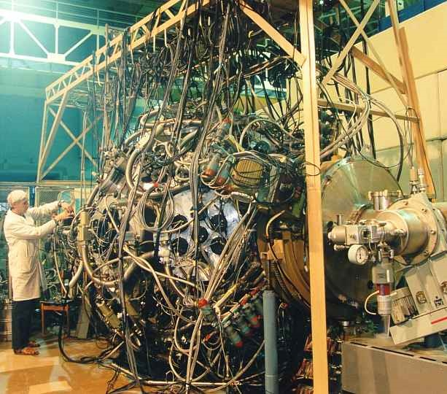
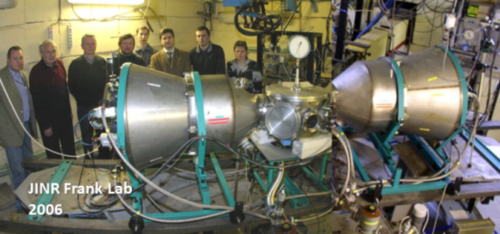
FOBOS
>1990y
FLNR / Sector №5: dynamics of heavy nuclei interaction, fission of heavy and superheavy nuclei / Group №1: of fission of weakly excited nuclei
mini-FOBOS
Rare processes: multibody decays and their “fine structures”.
Eur. Phys. J. A 45, 29-37 (2010)
Notes:
In our group of the Flerov LNR we study nuclear decay. At first at Fobos spectrometer installed on U400 accelerator
Then at minifobos two arms spectrometer with neutron belt and now
at the Pin diods spectrometer
One unusual effect was found at fobos experiments, which was called collinear cluster tri-partition (three-particle,?) decay

Slide 3
Summary of the previous results on CCT
D.V. Kamanin, Yu. V. Pyatkov
"Clusters in Nuclei - Vol.3"
ed. by C. Beck,
Lecture Notes in Physics 875,
pp. 183-246 (2013)
Notes:
certainly, the results were published in European physical journal

Slide 4
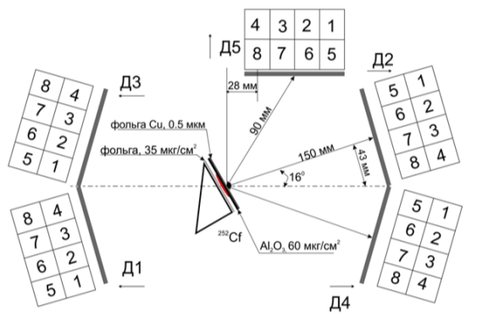
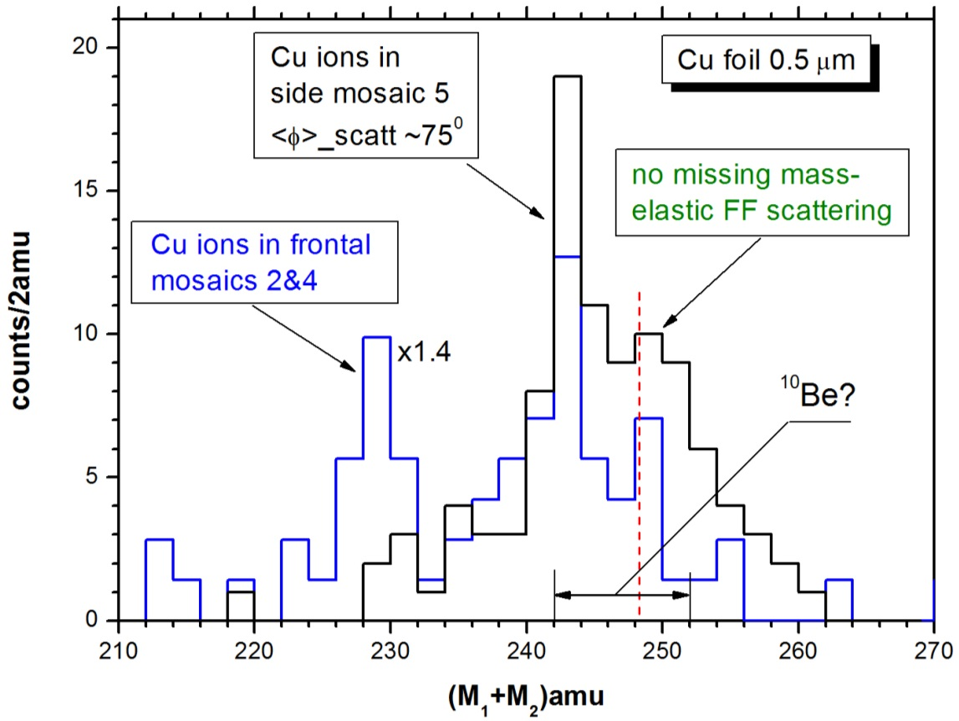
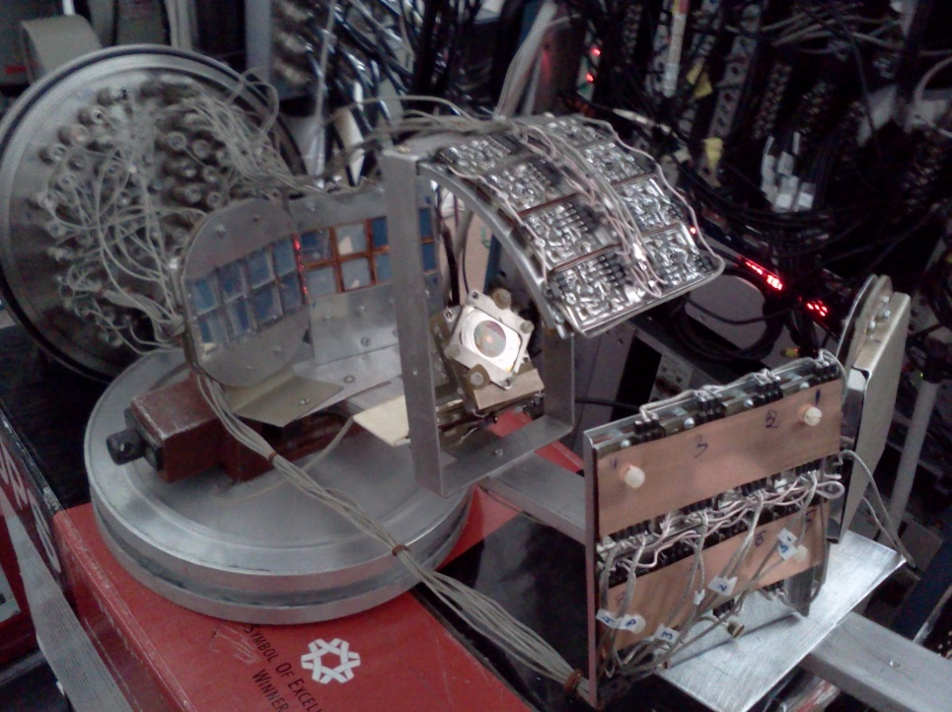
Angular dependence of the break-up yield
At the large angles of scattering of the knocked–out ions from the foil
conventional elastic Rutherford
scattering takes place.
Notes:
At first effect was found using ordinary for millenium analogue electronic and set of coordinate-sensitive avalanche counters, Bragg ionization cameras, phosvich detectors. Now we used absolutey different digital electronics, detectors and saw the same effect.
Two arme spectrometer Cometa consist of start detector and a few matrix of PIN diodes

Slide 5
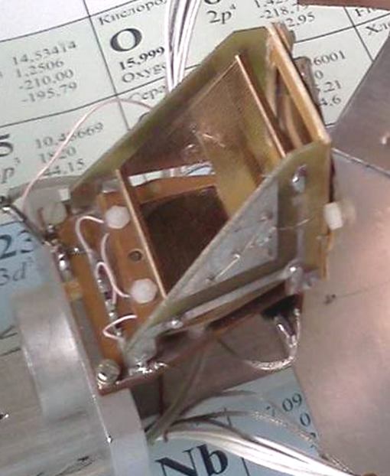
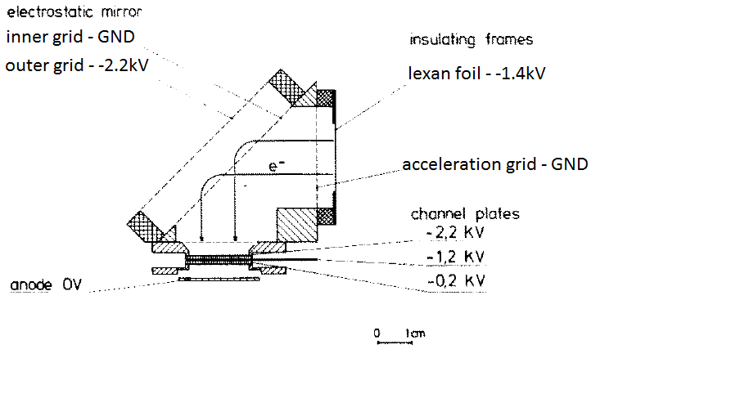
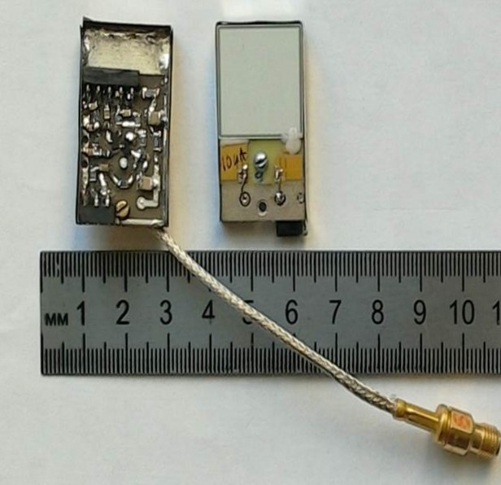
18x18mm
Notes:
Start signal for time interval measurement is taken from start detector, which consists of Au foil and shevron of two multi channel plates. Pin diode is used for simultaneous energy
and stop-time of ion registration. We used home made fast transistor amplifiers, placed very close to detector and which worked in vacuum.

Slide 6
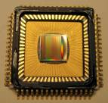
SWITCH CAPACITY ARRAY DT5742, V1742
DRS4
PLL-regulated
Sampling Speed
DT5742
V1742
Notes:
In the three-particle fission model, two fragments are expected to move in one direction and one fragment in the opposite. The flight time is tens of ns. We need a registration system with good energy and time resolution. The registration of the waveform eliminates pile-ups and noise and allows the use of different mathematical methods for analysis.
Fast ADCs with more than 12 bits are expensive
The solution was the use of multi-channel recorders based on the DRS4 chip

Slide 7
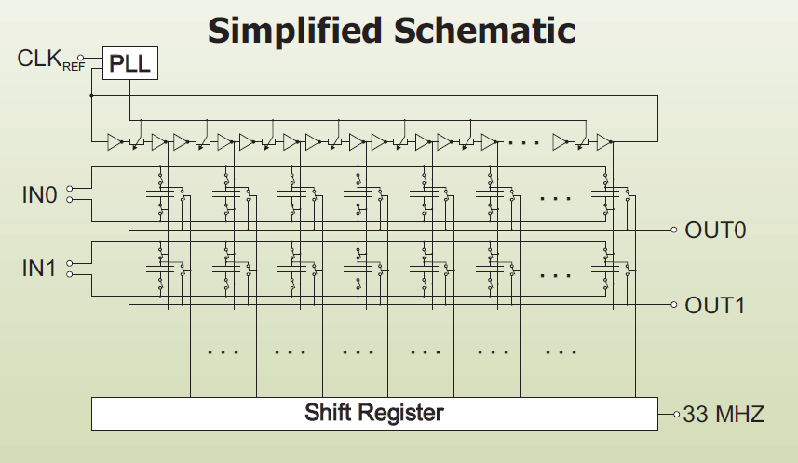
Notes:
7
chip was developed at the Paul Scherrer institute. Switch capacity array consists of 1024 capacitors.

Slide 8
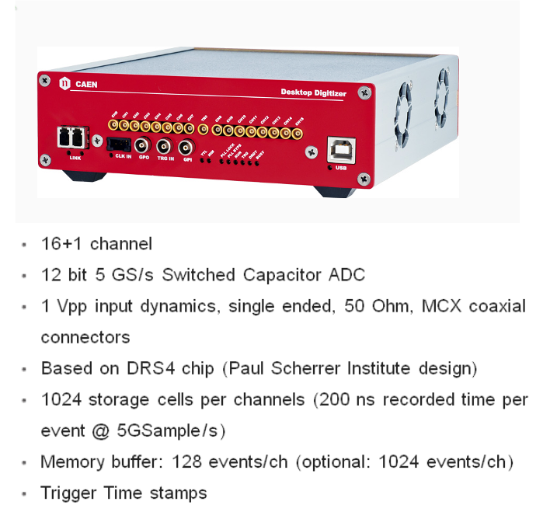
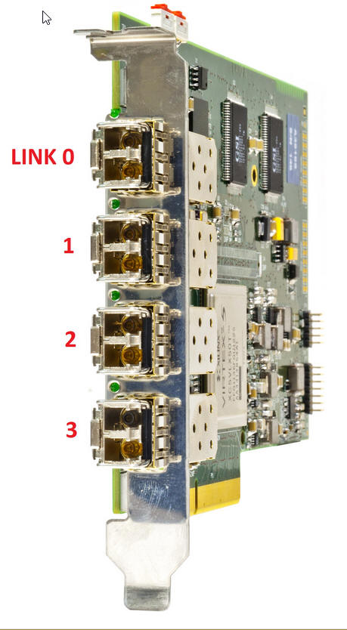
SONET-2
Notes:
A fiber optic network is used for the connection to the PC.

Slide 9
Notes:
Each of registered events looks like this one.

Slide 10
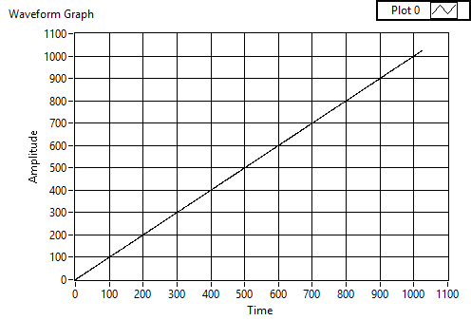
Notes:
if the correction procedure is applied to the ramp voltage recorded in the recorder memory (on the left), then the obtained values will have the following form (on the right).
Data correction procedure takes a lot of time, and now we do it offline.

Slide 11
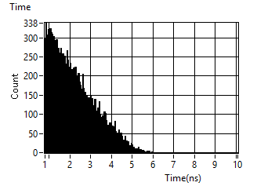
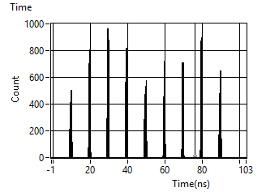
Измерения временных интервалов несколькими регистраторами
Схема подключения временного калибратора ORTEC 462 к оцифраторам DT5742
Распределение времени, полученное при измерении временных интервалов от калибратора при подаче сигналов на входы разных микросхем DRS4 после учета поправки положения сигналов в соответствии с положением соответствующих триггерных сигналов
Распределение временных интервалов при подаче сигнала Старт на вход одного
регистратора, а сигнала Стоп на вход другого
регистратора
Notes:
The ortec time calibrator generates test signals with a duration increasing by 10 ns for each next pulse.
The time distribution for one dc4 circuit looks like this. If the start signal is taken from one circuit, and the stop comes to another, then the resolution becomes very poor. But if we take into account the time shift between the recorded trigger signals, then this correction allow adequately restore the correct distribution.

Slide 12
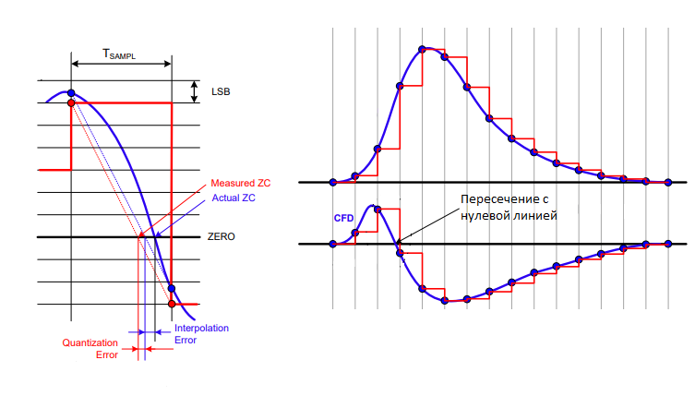
Разрешение = Tsample/√12 Tsample = 200 пс
Интерполяция позволяет улучшить временное разрешение
Зависимость от времени нарастания и амплитуды импульса
CFD, LED, другие привязки?
Notes:
when measuring time, the blue line is the real signal. The error of the moment of determining the zero line intersection is associated with an error due to the ADC bit depth and the interpolation error

Slide 14
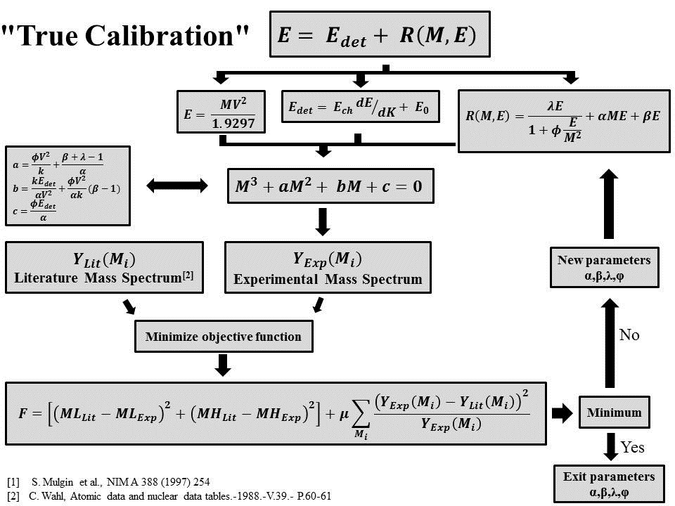
Notes:
when restoring the mass of fragments, we use the well-known distribution of spontaneous fission of Cf. This allows one to take into account the effect of pulse height deficit and plasma delay.

Slide 15
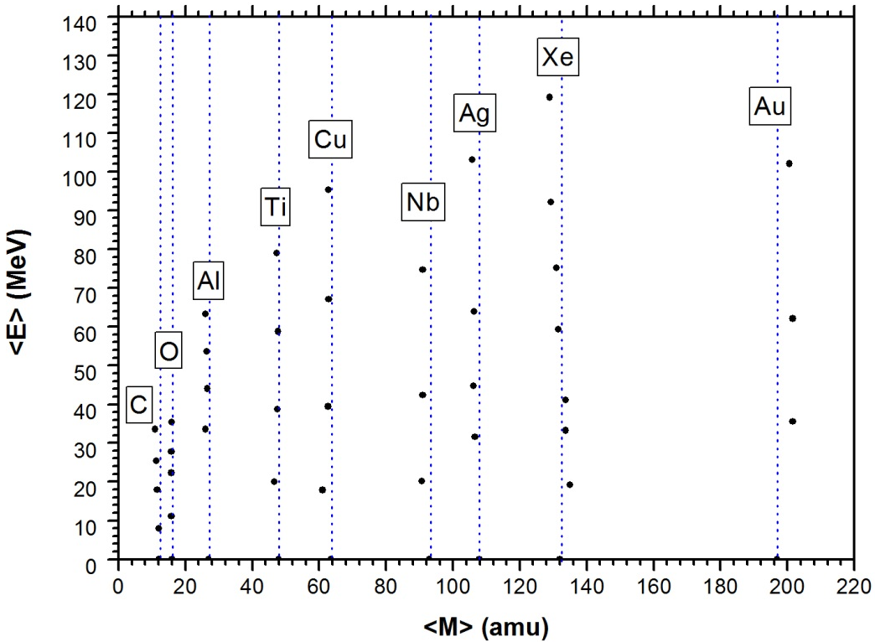
HI mass reconstruction at different energies
Time-of-flight mass-spectrometry of heavy ions in a wide range of masses and energies using PIN diodes.
Kamanin D.V.¹, Pyatkov Yu.V.^{2,1}, Zhuchko V.E.¹ , Strekalovsky A.O.¹ , Strekalovsky O.V.¹, S. Heinz ³, Ilić S. ^{4,1} , Alexandrov A.A.¹, Alexandrova I.A.¹, Jacobs N.⁵, Kuznetsova E.A.¹, Malaza V⁵. (submitted to NIM A in November 2015)
The developed mass recovery procedure allows determining mass in a wide range of masses and energies (ions from 12С to 132Хе in the energy range ~ (10-100) MeV).
Experimental setup
at IC-100 beam line
Notes:
the correctness of the reconstruction method was verified experimentally at the cyclotron in FLNR.

Slide 16
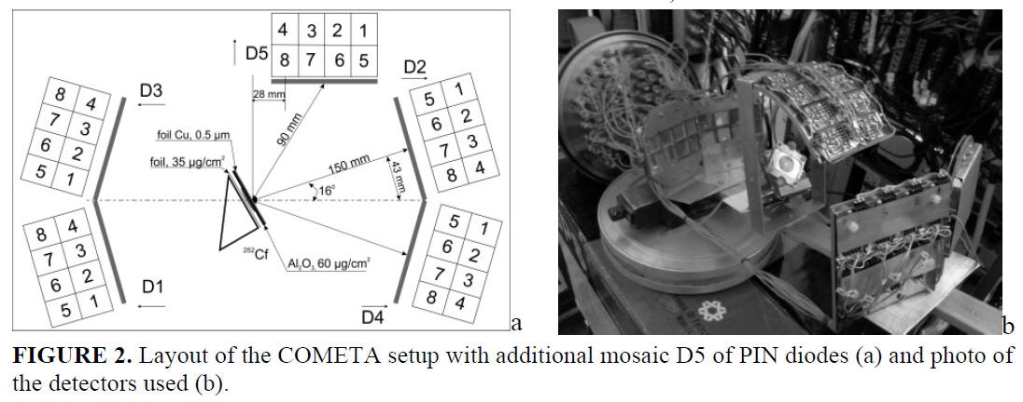
COMETA - F

Slide 17
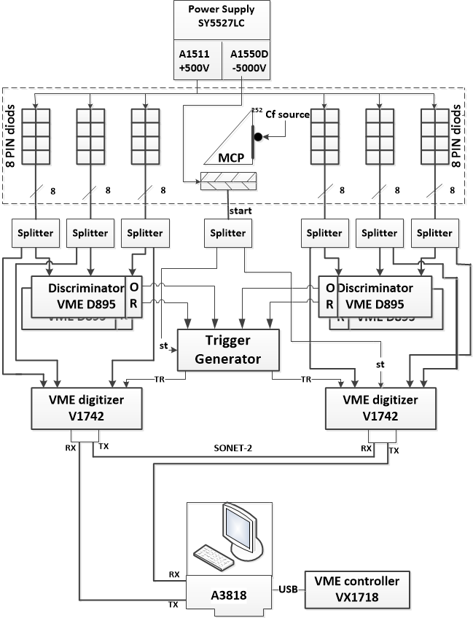
Notes:
The basis of the data collection system are 32-channel digitizers. The B895 discriminators, together with the trigger unit, allow you to generate a data acquisition trigger. The data recorded in the buffer over the fiber-optic network is transmitted to a PC and then to 120 TB of the SInology storage.

Slide 18
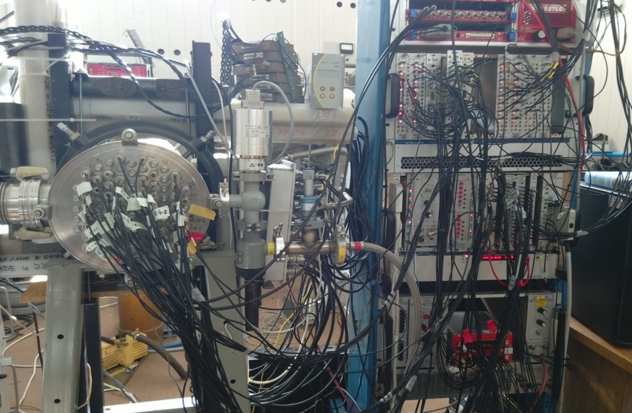
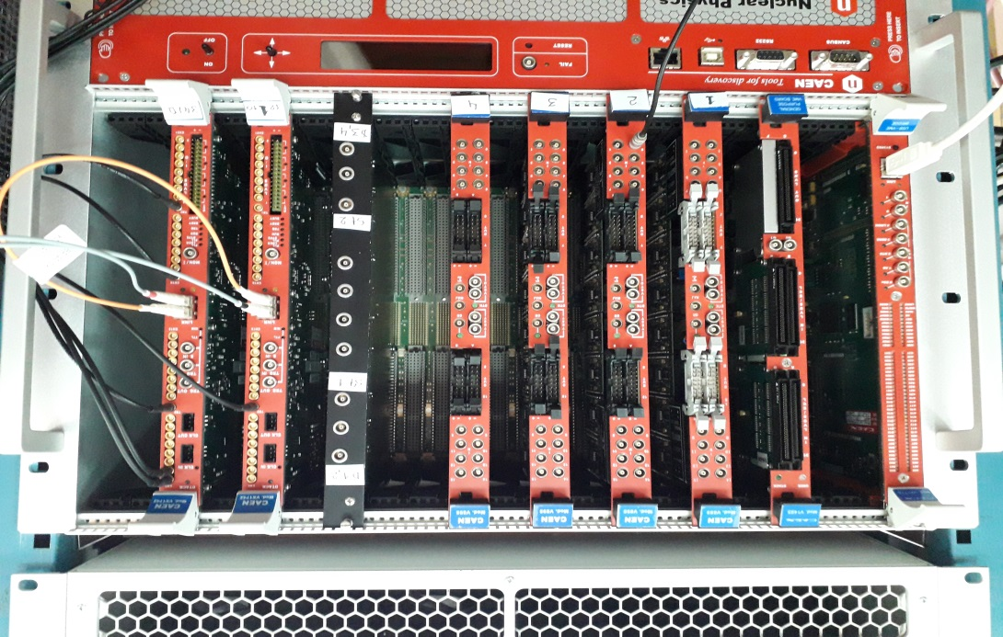
Установка Комета
Общий вид спектрометра Комета
Notes:
all spectrometer electronics installed in one VME crate

Slide 19
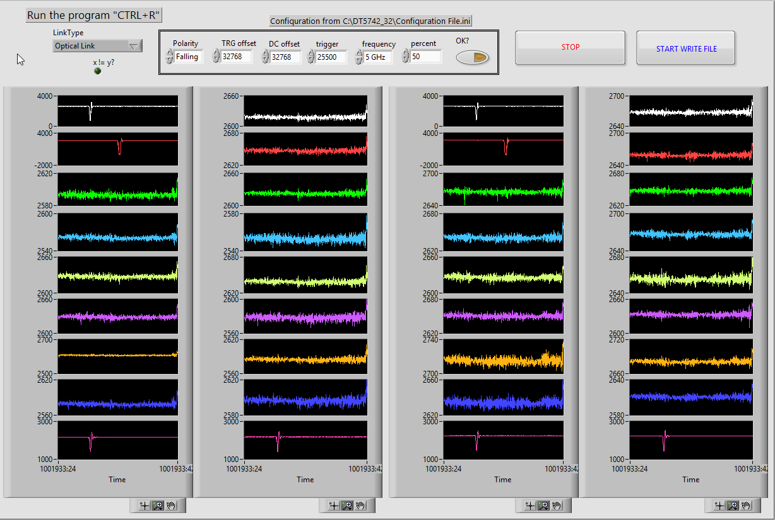
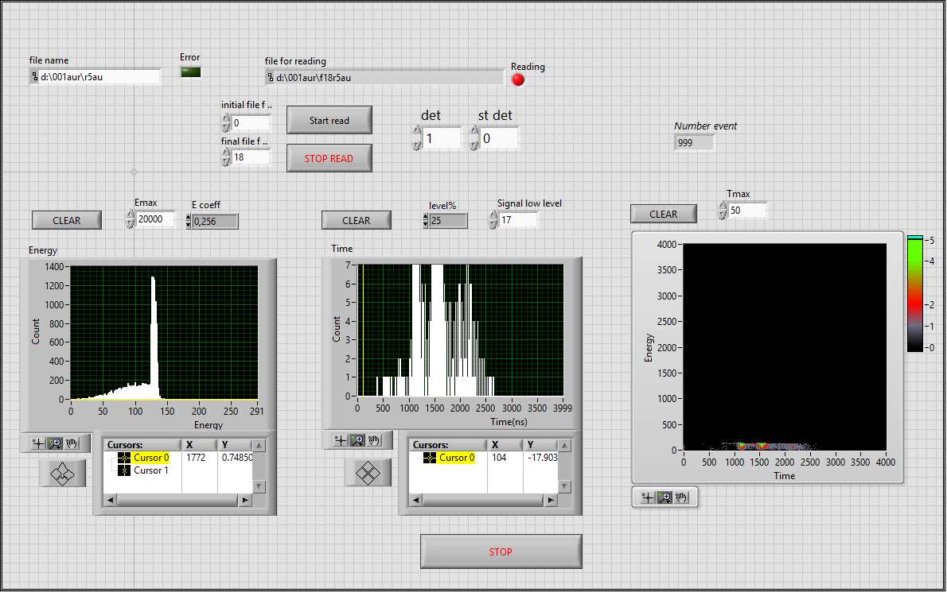
Notes:
software for data collection system developed in LV environment.

Slide 20
Thank you for your attention

