Slide 1
Data streams processing
in metadata integration system for HENP experiments
Anastasiia Kaida¹, Marina Golosova², Maria Grigorieva³, Vasilii Aulov²
on behalf of ATLAS Collaboration
¹ National Research Tomsk Polytechnic University
²National Research Center “Kurchatov Institute”
³ Lomonosov Moscow State University
Symposium on Nuclear Electronics and Computing - NEC'2019
30.09.2019 – 04.09.2019 Budva, Montenegro

Slide 2
Outline
Data Knowledge Base (DKB) metadata integration
Architecture of metadata integration system
PoC: usage in DKB prototype
2/10

Slide 3
Data Knowledge Base
DKB is a system aimed at knowledge acquisition and providing fast response for a variety of analytical queries in the context of complicated information infrastructure, such as infrastructure of HENP experiments.
PoC prototype system is being developed for the ATLAS experiment at LHC.
Metadata integration system is a part of DKB responsible for metadata gathering from various external systems.
?
Links reconstruction (semantic integration) and metadata preparation for further usage, according to a set of predefined rules
Chicago ES
DKB@CERN
S1
Access point
accepts requests in (predefined) user-friendly form
ES
Supports a wide range of analytical requests
ProdSys2
?
task
S2
AMI
Rucio
?
?
output_ds
Metadata integration system
Integrated analytical storage
?
output_ds
S3
output_ds
Custom analytical request
S*
User Interface
?
M.Golosova, “Data Knowledge Base: metadata integration system for HENP experiments”, NEC’2019 ©
3/10

Slide 4
Data Extraction, Transformation, and Load (ETL)
The metadata integration process can be presented as a set of logically independent operations. To simplify the development process and reduce re-implementation of common logical operations that may be useful for different integration processes, each operation was treated as an essentially separate unit – integration module. This concept allows building and modernization the integration process on the logical level.
Pipeline – processing chain combined of integration modules. Pipeline arranges data flow from data sources to the main DKB storage.
Integration modules (E/T/L) – combinable logically independent components, each of which implements one logical unit of ETL-process carrying out only one operation: metadata extraction, transformation or uploading.
Chicago ES
DKB@CERN
ProdSys2
E
T
T
T
L
ES
AMI
Rucio
4/10

Slide 5
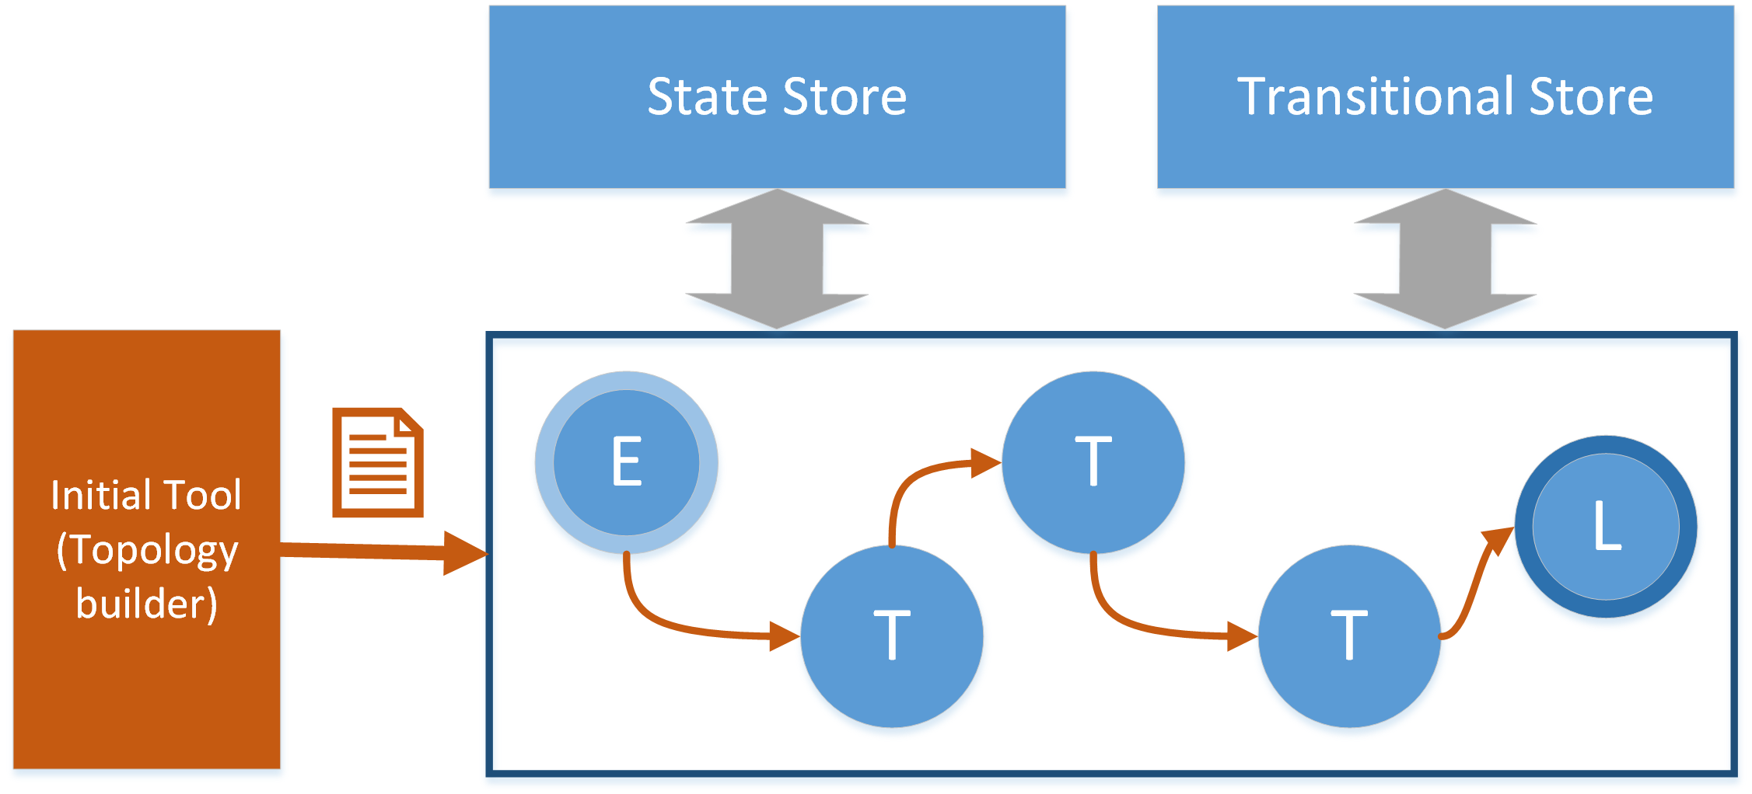
Topologies building
The integration system must run the integration process according to the human defined description and keep it alive.
Topology is a description of integration process as a directed acyclic graph in terms of modules and links between them. Physically, this description can exist as a configuration file.
Topology builder an integration system component that runs modules sequence according to a topology. Once all modules are initiated, data stream starts running from source (E-module) to sink (L-module).
The data transfer between linked modules can be implemented using message-oriented middleware (MOM).
Data stream – metadata flow generated by extraction module (E-module). It goes through all the transformation modules (T-modules) and sinks through the upload module (L-module) to the final storage. The operational unit in data stream is a message.
5/10

Slide 6
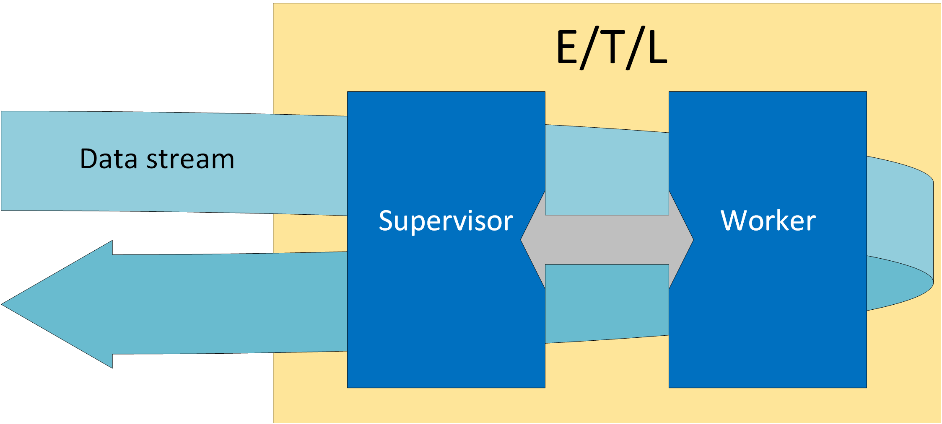
Integration module components
Each ETL module consists of two following processes:
Worker – executes one of ETL operations after process initialization with each message in the data stream: generating new messages or processing input messages with medata. Worker processes are aimed to carry out case-specific tasks. Any executable that supports supervisor/worker communication procedures (transfer of data stream messages via standard I/O), can be used as a worker for integration module.
Supervisor – addresses the common objectives for all ETL-modules of a particular type (E/T/L). Supervisor provides metadata transfer between ETL-modules and communicates with a worker.
6/10

Slide 7
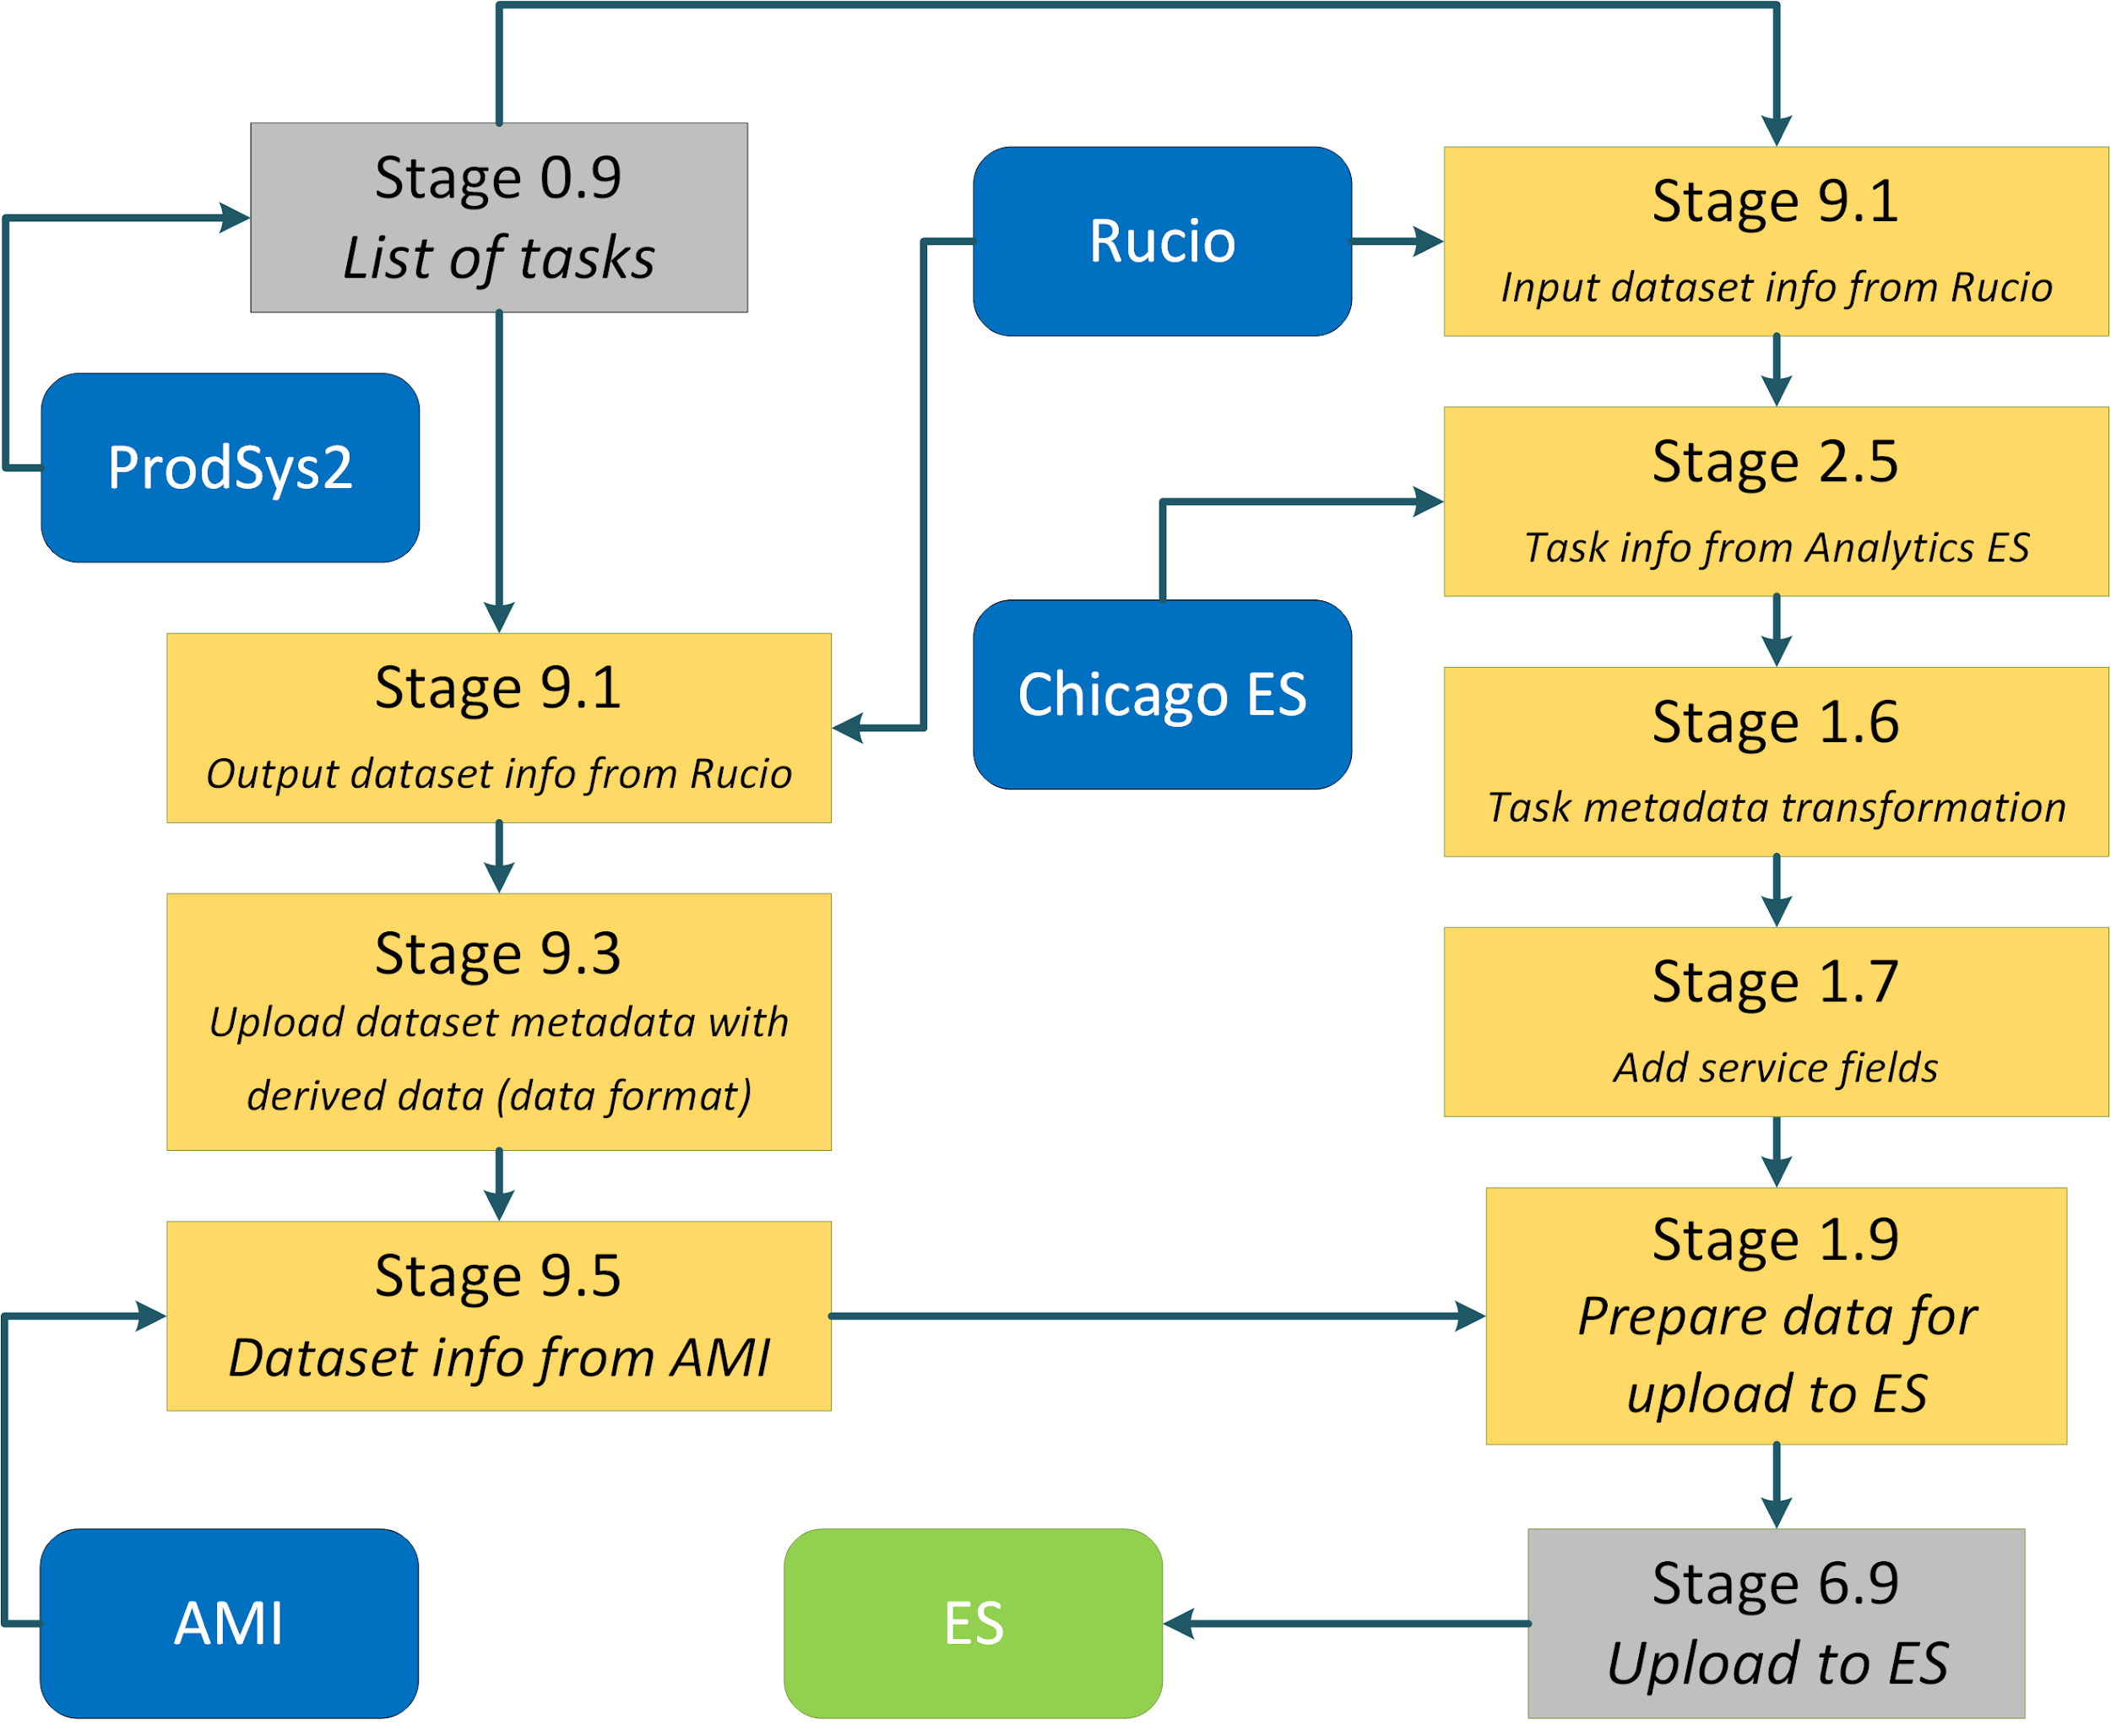
Metadata processing pipelines
The pipeline implementation for the DKB prototype gathers metadata from four external systems: AMI, Chicago ES, Rucio, ProdSys2).
An external system may act as a starting point for a processing pipeline (here: ProdSys2) or an extra source of additional data at transformation stage (AMI, Rucio, Chicago ES).
Each transformation stage executes only one operation (e.g. metadata transformation and adding new fields should be executed separately). This approach allows for avoiding unnecessary interference in the code.
7/10

Slide 8
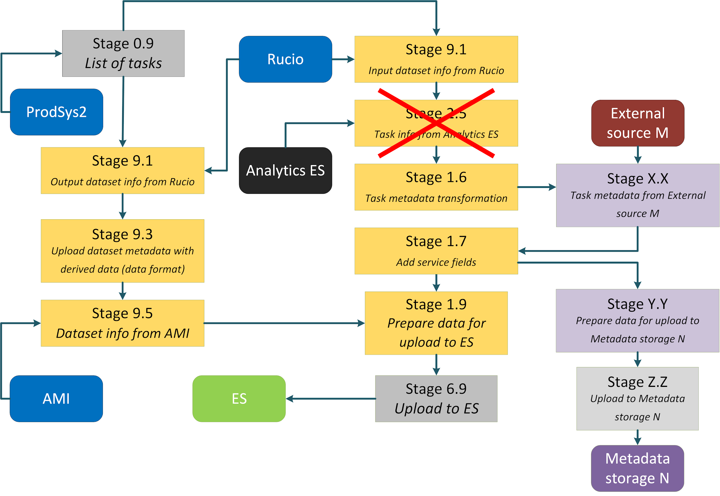
Metadata processing pipelines (2)
The architecture of the metadata integration system was designed to build an arbitrary structure for data streams processing.
The variety of data sources and final storages may change during the DKB project lifetime, so the architecture allows the following changes:
Change an existed pipeline structure
Add/remove an external source
Add/remove a DKB final storage
Build a new pipeline and plug it to an existing pipeline (Y.Y -> Z.Z -> N)
8/10

Slide 9
Conclusion
The proposed architecture allows automation and simplifies management of metadata gathering processes
The concept of plug-in modules provides possibility for flexible redesign of integration processes
PoC: the metadata integration process was implemented according to the proposed solution in the context of DKB prototype
The implemented solution allowed the execution of an initial load of metadata to the final storage and setting up the process of metadata updating
Some of the developed modules for the storage filling and metadata updating were reused for the task of metadata consistency check between the DKB final storage and original external sources
9/10

Slide 10
Acknowledgements
This work is supported by Russian Foundation for Basic Research
№18-37-20003.
Special thanks to:
Alexei Klimentov
Brookhaven National Laboratory
Alexei Saveliev
National Research Tomsk Polytechnic University
Dmitry Golubkov
National Research Center “Kurchatov Institute”
10/10

Slide 11
Backups

Slide 12
Glossary
AMI – ATLAS Metadata Interface (https://ami.in2p3.fr)
ProdSys2 (ATLAS Production System 2) – top level workflow management system
Rucio – Distributed Data Management system (https://rucio.cern.ch)
12/10

Slide 13
13/10

Slide 14
Thank you for your attention!

