Slide 1
Benchmarking WLCG resources using HEP experiment workloads
Andrea Valassi (CERN IT-DI)
On behalf of the HEPiX CPU Benchmarking WG
NEC Symposium, 2 October 2019 – Budva, Montenegro
https://indico.jinr.ru/event/738

Slide 2
Outline
Overview: CPU benchmarking in WLCG (Worldwide LHC Computing Grid)
Why benchmarking compute resources in WLCG
Benchmarking past, present, future: HEP-SPEC06 and its limitations
Benchmarking compute resources using HEP experiment workloads (WL’s)
Overview and technical implementation details
Status and outlook: HEP score for CPU resources
Applicability to HPCs (supercomputers) and GPUs
Conclusions

Slide 4
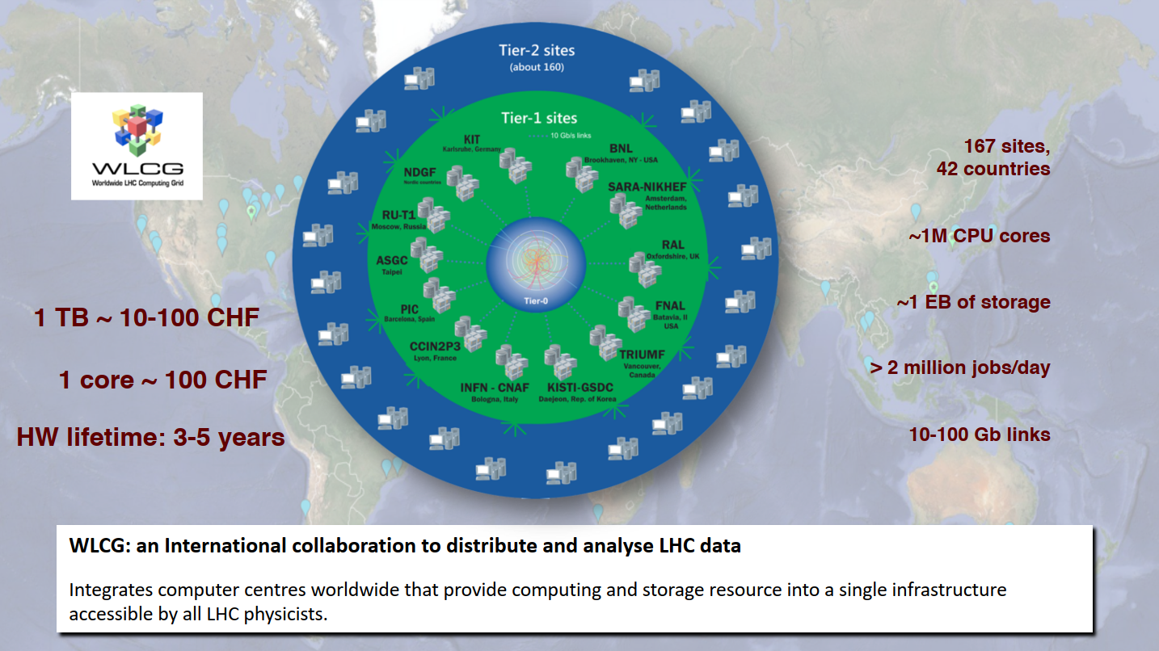
WLCG – a varied computing landscape
S. Campana, ESPP, Grenada, May 2019
“CPU cores” are not all equivalent to one another (sites are managed independently):
Some CPU cores are able to do more “work” than others per unit time (throughput)
Some CPU cores are more expensive than others

Slide 5
Why benchmarking CPU resources in WLCG?
Two main use cases for WLCG:
Accounting
Experiments need and request “X” CPU resources to do their computing for one year
Funding agencies and computing sites provide “X” CPU resources to the experiments
Resource review boards compare the “X” actually used to the “X” which was requested
Procurement
Computing sites buy the CPU resources providing the best “X” per CHF/EUR/…
In addition:
Scheduling
I have a 1hr slot on a node with “X” CPU: how many events can I send for processing?
Software optimizations
By tuning my software, how much “faster” can I go on this CPU of benchmark “X”?

Slide 6
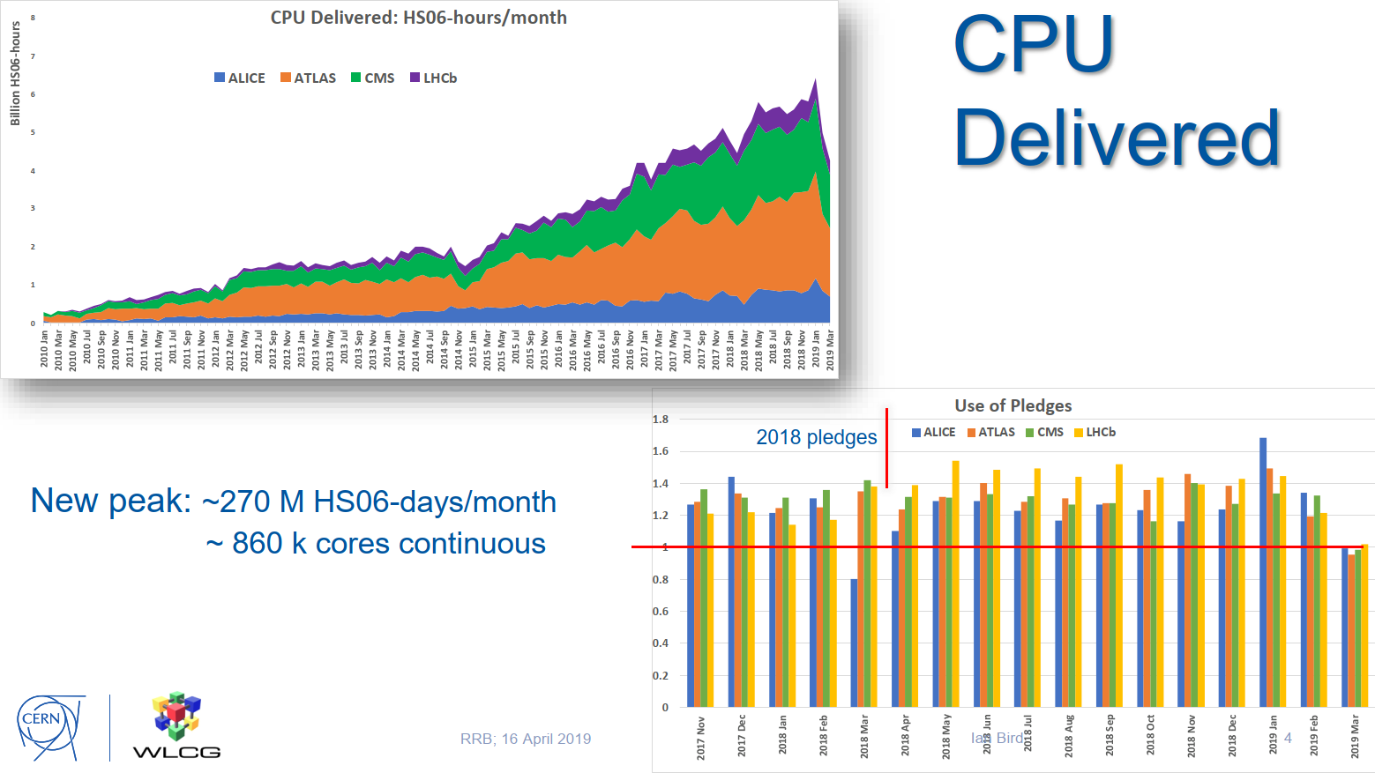
WLCG accounting: current benchmark is HEP-SPEC06 (HS06)
Ian Bird, April 2019,
Computing Resources
Review Board
9M HS06 is ~0.9M cores → very approximate rule of thumb: 10 HS06 per core

Slide 7
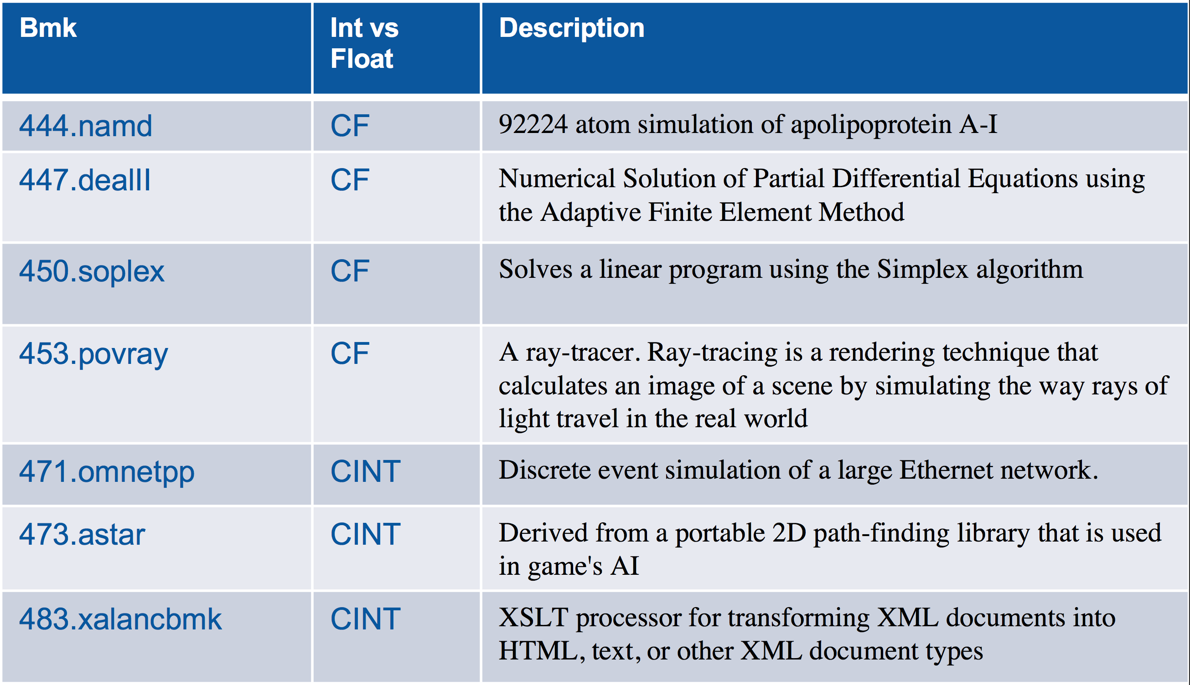
A reminder about HS06 (1)
Derived from SPEC CPU2006®: industry-standard, CPU-intensive, benchmark suite
Standard Performance Evaluation Corporation was founded in 1988 by a few vendors
Not a kernel or a synthetic benchmark: real applications (but not from the HEP domain)
HS06 is derived from “all_cpp” CPU2006 suite of 7 C++ benchmarks (4 FP, 3 INT)
Tuned for HEP: recompiled with gcc optimizer switches of LHC experiment 32-bit software
Execution time of the full HS06 suite: O(4h)
The overall HS06 score is the geometric mean of the 7 individual benchmark scores
4 FP benchmarks
3 INT benchmarks

Slide 8
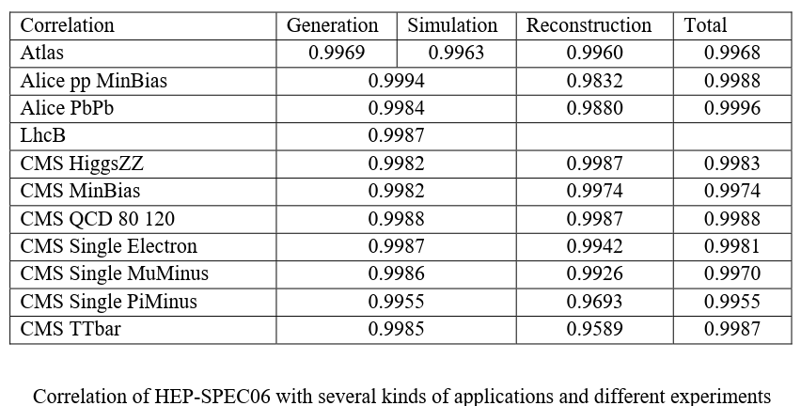
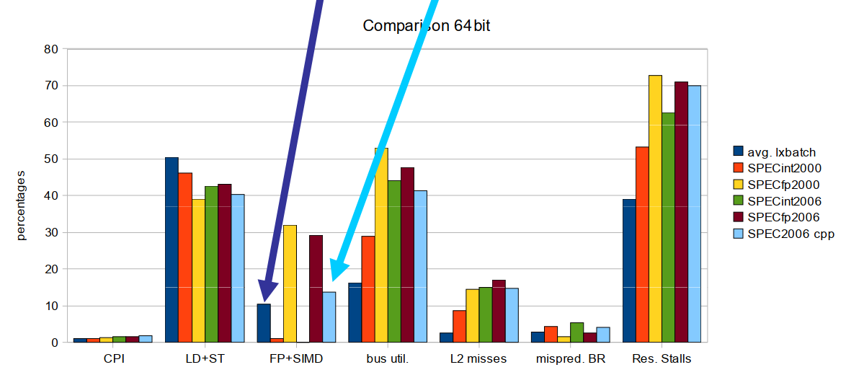
A reminder about HS06 (2)
HS06 was chosen because (in 2009) it seemed representative of HEP workloads
High correlation with the throughput (events per second) of experiment workloads
Matched usage pattern on LHC compute nodes as seen from hardware counters (perfmon)
Fractions of FP+SIMD, Loads and Stores, Mispredicted Branches…
FLOATING POINT fraction is ok (~10%) for “all_cpp”
(lower for SPEC INT, higher for SPEC FP)
M. Michelotto et al. (2010)
J. Phys. Conf. Ser. 219 052009

Slide 9
HEP software and computing evolves… so do HEP CPU benchmarks!
1980’s
MIPS (M Instr Per Sec)
VUPS (VAX units)
CERN units
1990’s – 2000’s
SI2k (SPEC INT 2000)
INTEGER benchmarks
200 MB footprint
2009
HS06 (SPEC CPU 2006 all_cpp)
INTEGER + FP benchmarks
1 GB footprint
32-bit
x86 servers
single-threaded/process on multi-core
2019
2 GB footprint (or more)
64-bit
multi-threaded, multi-process
multi-core, many-core
vectorization (SSE, … AVX512)
x86 servers, HPCs
ARM, Power9, GPUs…?
As time goes by, WLCG computing is becoming more and more heterogeneous
One of the challenges is how to summarize performance using a single number
Unfortunately, this is needed at least for accounting purposes

Slide 10
After 10 years, HS06 shows some limitations (1)
Poor correlation of HS06 score with throughput of HEP workloads
ALICE and LHCb: HS06 no longer scales with their applications
Somewhat better agreement for ATLAS and CMS
Use of 32-bit benchmark for 64-bit applications explains part of the discrepancy
Plot by M. Alef
D. Giordano, CHEP2018, Sofia, July 2018

Slide 11
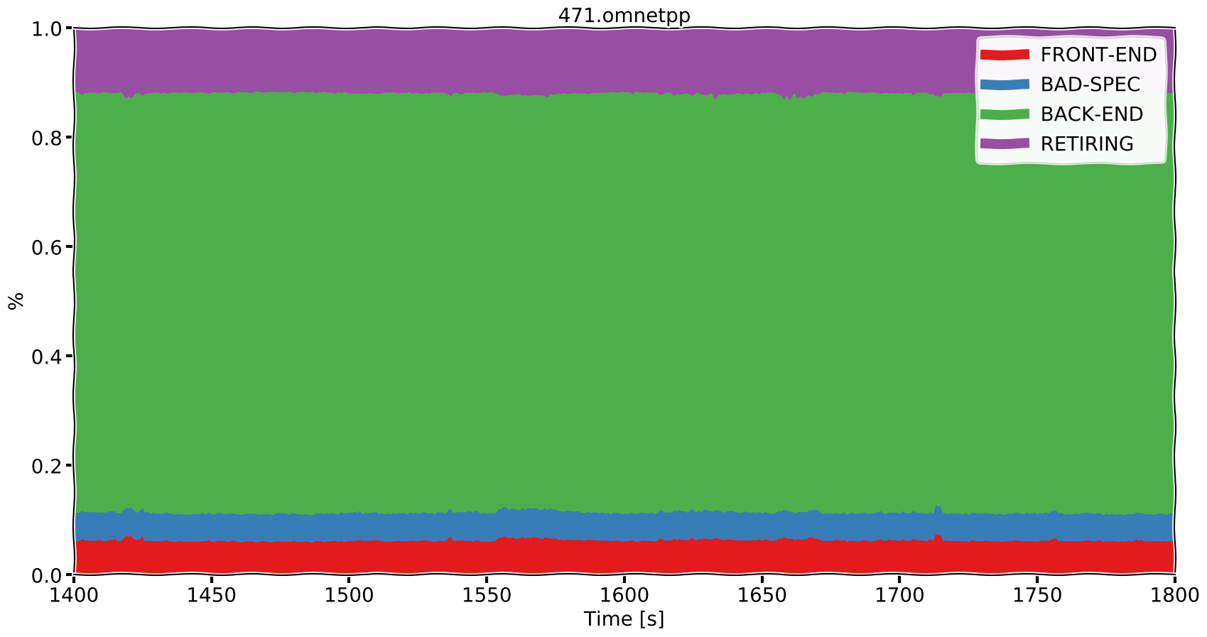
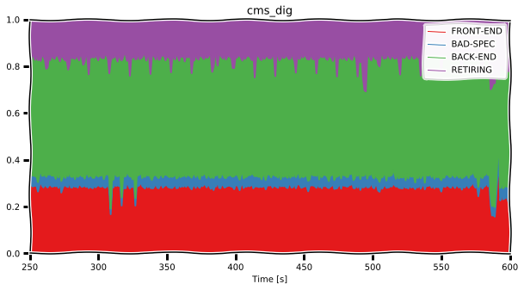
After 10 years, HS06 shows some limitations (2)
Discrepancy between HS06 and HEP workloads on CPU usage patterns
Analysis of hardware performance counters using the Trident toolkit
Similar to that done with perfmon in the past
Characterization in terms of:
Front-end
Fetch and decode program code
Back-end
Monitoring and execution of uOP
Retiring
Completion of uOP
Bad speculation
Cancelled uOP (branch misprediction)
HEP-SPEC06 workload
D. Giordano, WLCG GDB, May 2019
HEP workload (CMS DIGI)

Slide 12
SPEC2017 has been evaluated, but it would not solve the issue (1)
SPEC2017 score is highly correlated to HS06 score
Hence it is also poorly correlated to HEP workload throughputs
SC17 score/core
D. Giordano, WLCG GDB, May 2019
Correlation 0.975
HS06 (64-bits) score/core

Slide 13
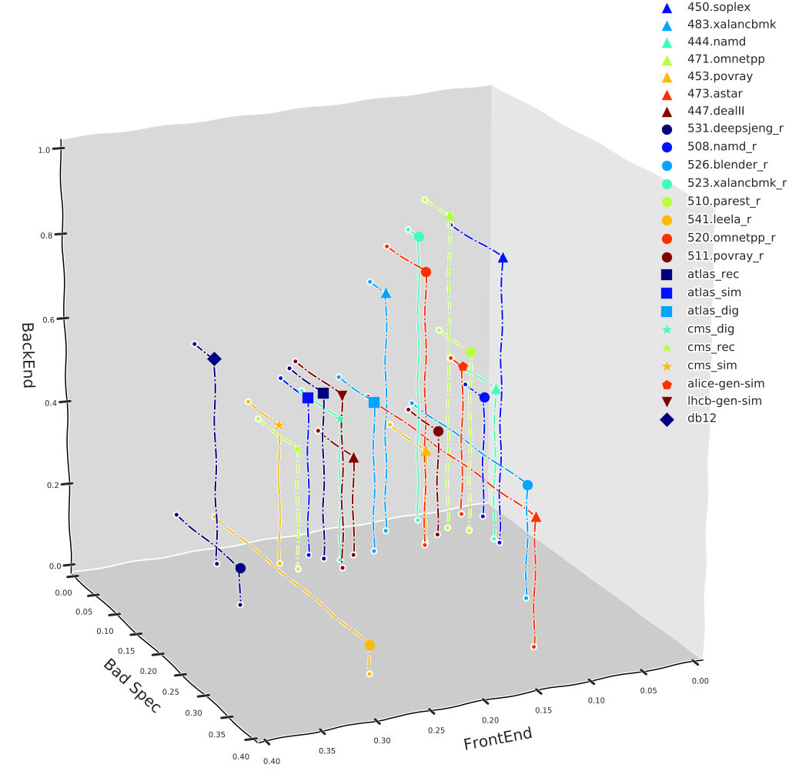
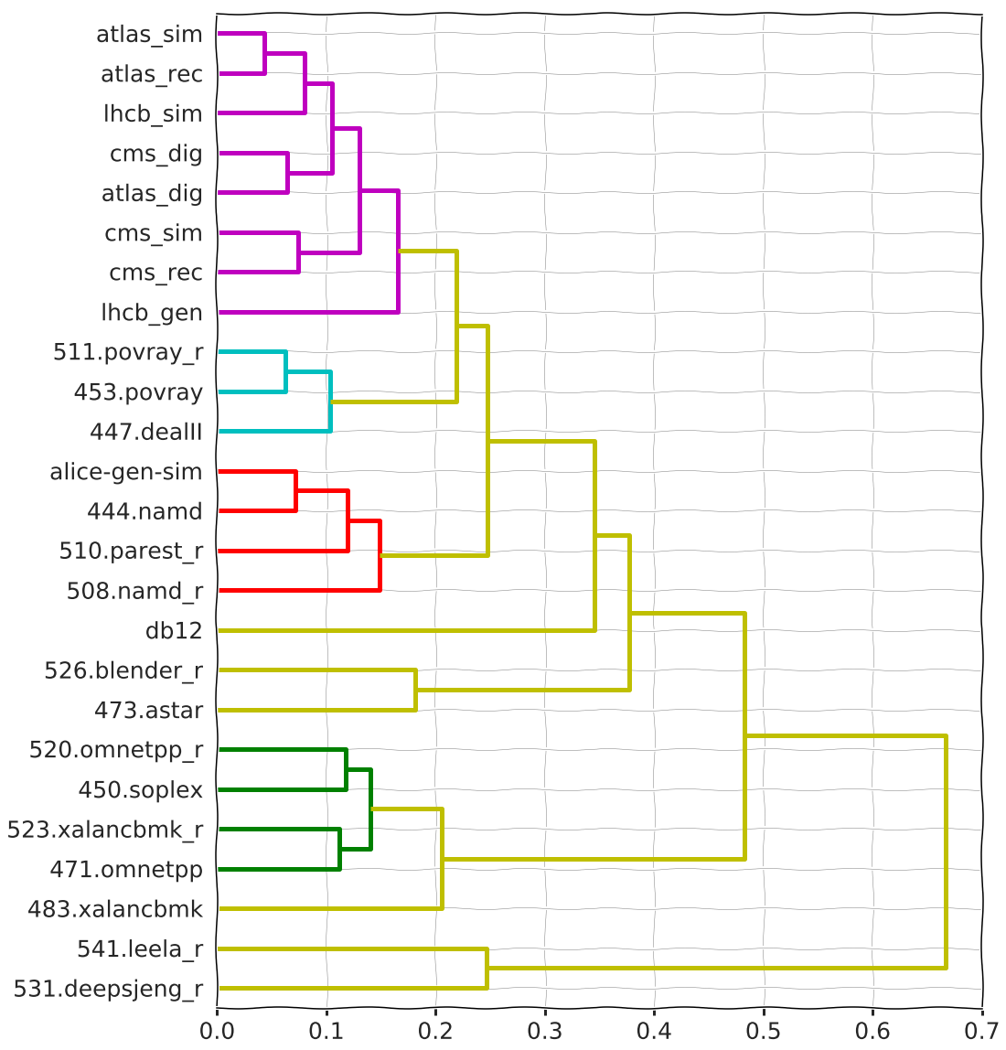
SPEC2017 has been evaluated, but it would not solve the issue (2)
SPEC2017 and HS06 benchmarks have similar CPU usage patterns
And they both differ from those of HEP experiment workloads
HEP workloads
Back-end
SPEC2017
SPEC2006
Bad-spec
Front-end
Dendrogram of workload similarity

Slide 14
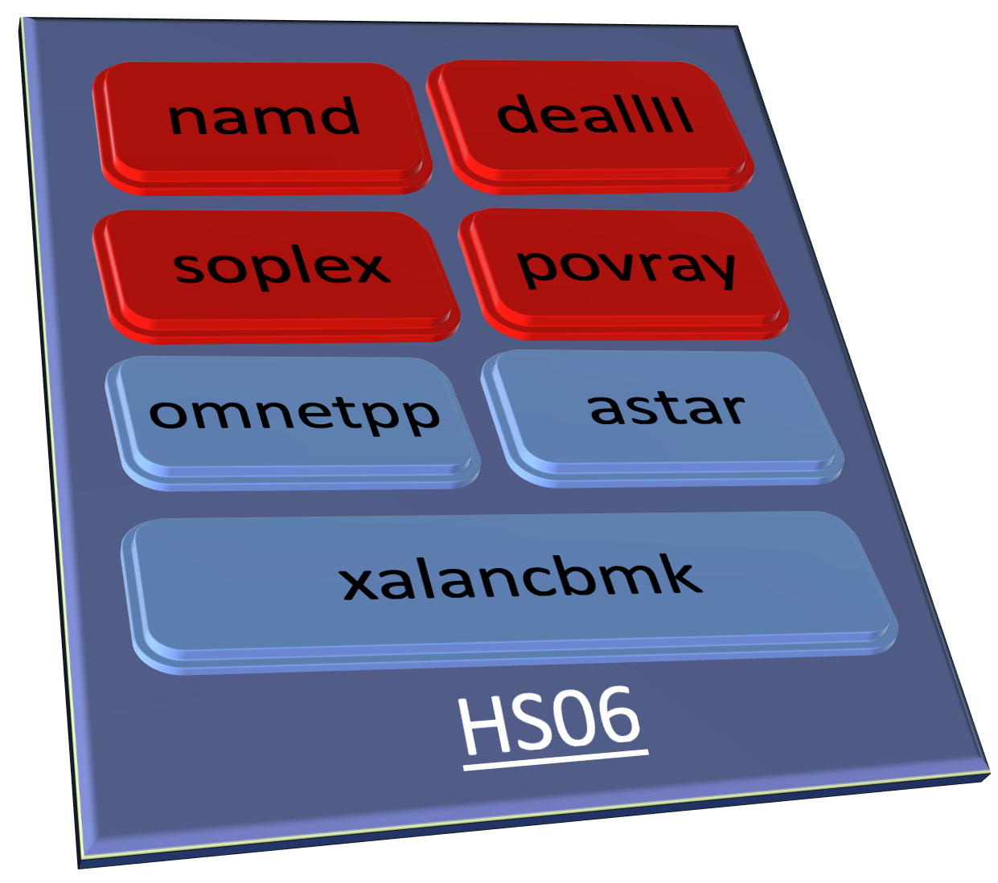
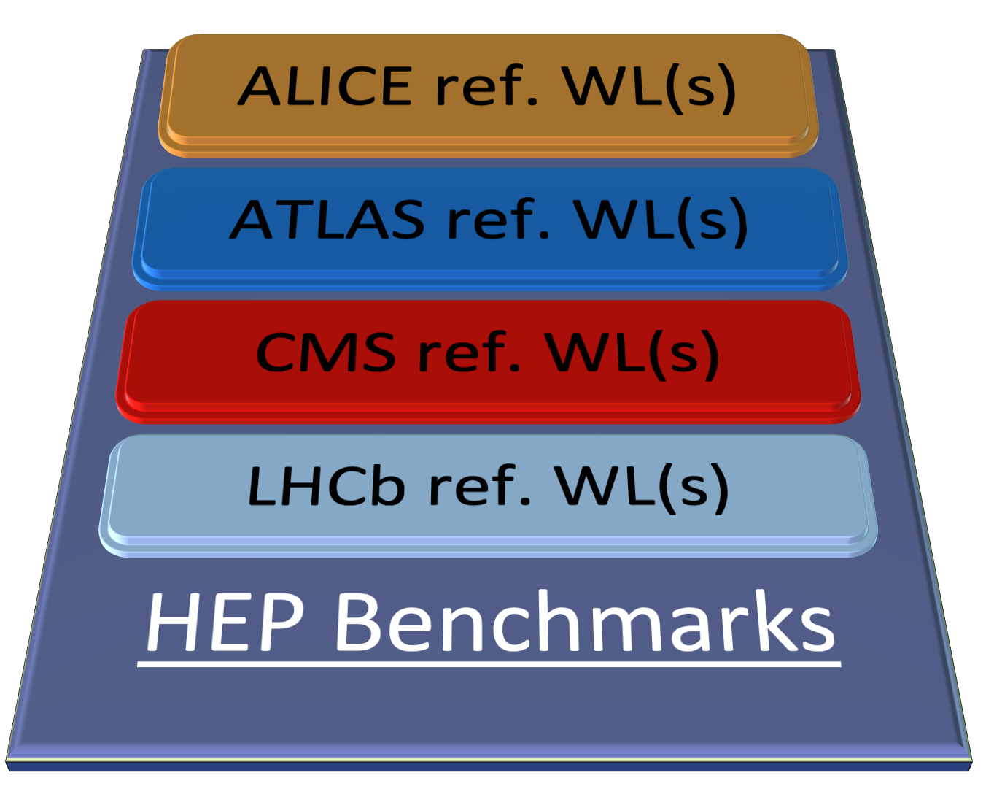
We are developing an alternative solution: benchmarking CPUs using HEP workloads
For comparison, how did we converge on HEP-SPEC06 in the past?
We analysed several subsets of the SPEC benchmark suite
We chose one with high correlation and similar patterns as HEP WLs
By construction, using HEP workloads directly is guaranteed to give
A score with high correlation to the throughput of HEP workloads
A CPU usage pattern that is similar to that of HEP workloads
For event generation, detector simulation, digitization, reconstruction….
What enables doing this now is the availability of container technology!

Slide 15
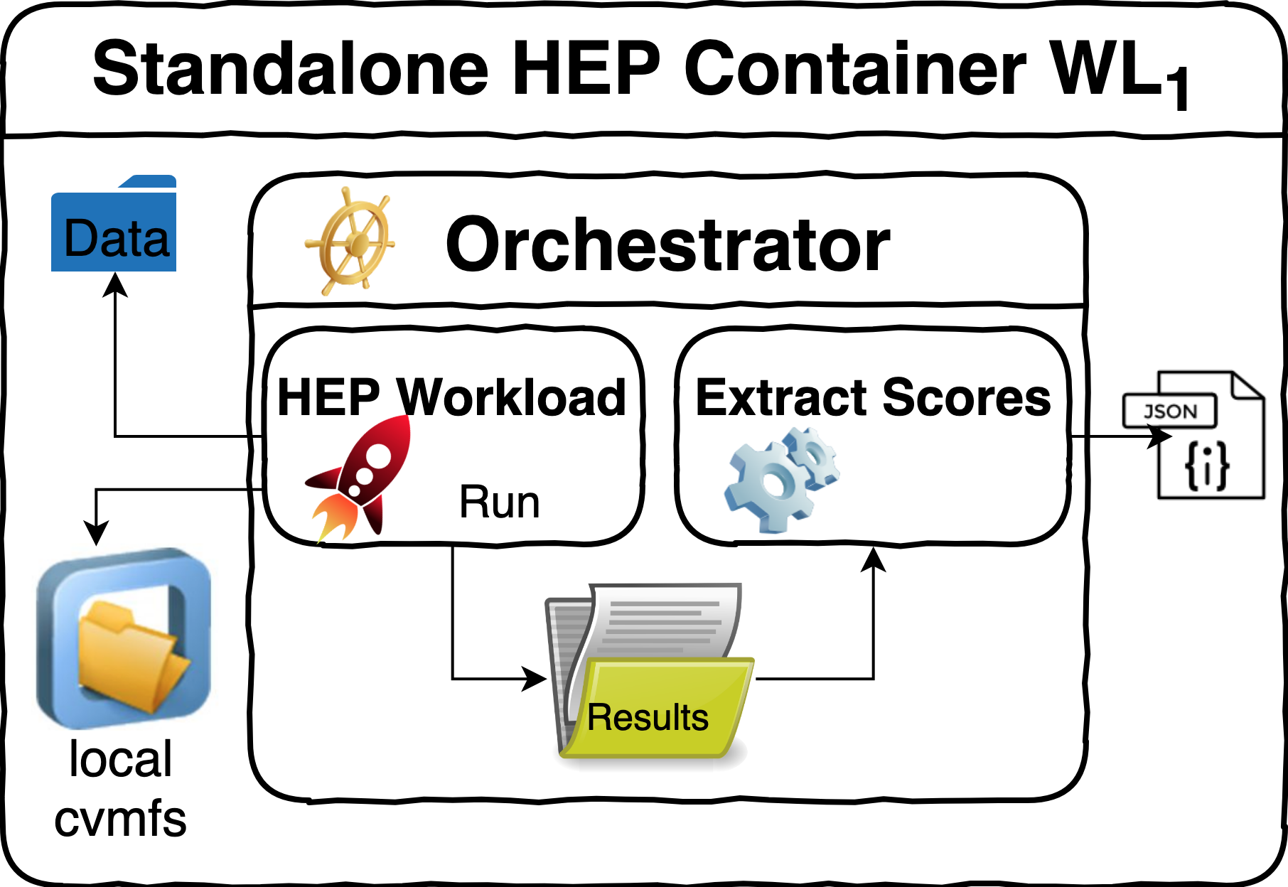
From HEP reference workloads to benchmark containers
Requirements (see J. Gray, The Benchmark Handbook for Database and Transaction Systems, 1993)
Reproducible results (relevant to describe HEP workloads)
Portable and self-contained (no need for network connectivity)
Simple and understandable, easy to use, execution not too slow, storage not too large
Long term support, scalable and extensible
Approach: for each HEP workload, build a standalone container encapsulating all and only the dependencies needed to run the workload as a benchmark
Components of each HEP WL container
Software repository (O/S and /cvmfs)
Input data (event and conditions data)
An orchestrator script (benchmark driver)
Sets the environment
Runs (many copies of) the application
Each copy may be multi-process or multi-threaded
Parses the output to generate scores (json)
Combine many WLs into a single “HEP score”

Slide 16
Project organization
Current contributors
M. Alef, J. M. Barbet, J. Castro, O. Datskova, D. Giordano, C. Grigoras, C.’Hollowell, M. Javurkova-Pagacova, V. Khristenko, D. Lange, S. Mete, M. Michelotto,, L. Rinaldi, E. Santorinaiou, A. Sciabà, A. Valassi
Core team for common infrastructure development and overall testing
Experiment contacts for experiment-specific software, workloads, metrics
Three repositories under https://gitlab.cern.ch/hep-benchmarks:
hep-workloads (the common infrastructure and individual workloads)
hep-score (single-number benchmark aggregator from several WLs)
hep-benchmark-suite (automate execution, collect results in a database)
Track work progress via Jira Project and Twiki

Slide 17
The hep-workloads CI and registry
Individual HEP workload container images are built and distributed via gitlab
The gitlab CI (continuous integration) builds and tests new images on commit
If the build is successful, the CI pushes these (versioned) images to the gitlab registry
The images are built as Docker containers
But they can be executed both via Docker and Singularity
$ docker run -v /my_host_path:/results $IMAGE $ singularity run -B /my_host_path:/results docker://$IMAGE
A json summary and detailed logs are then found in /my_host_path on the host system

Slide 18
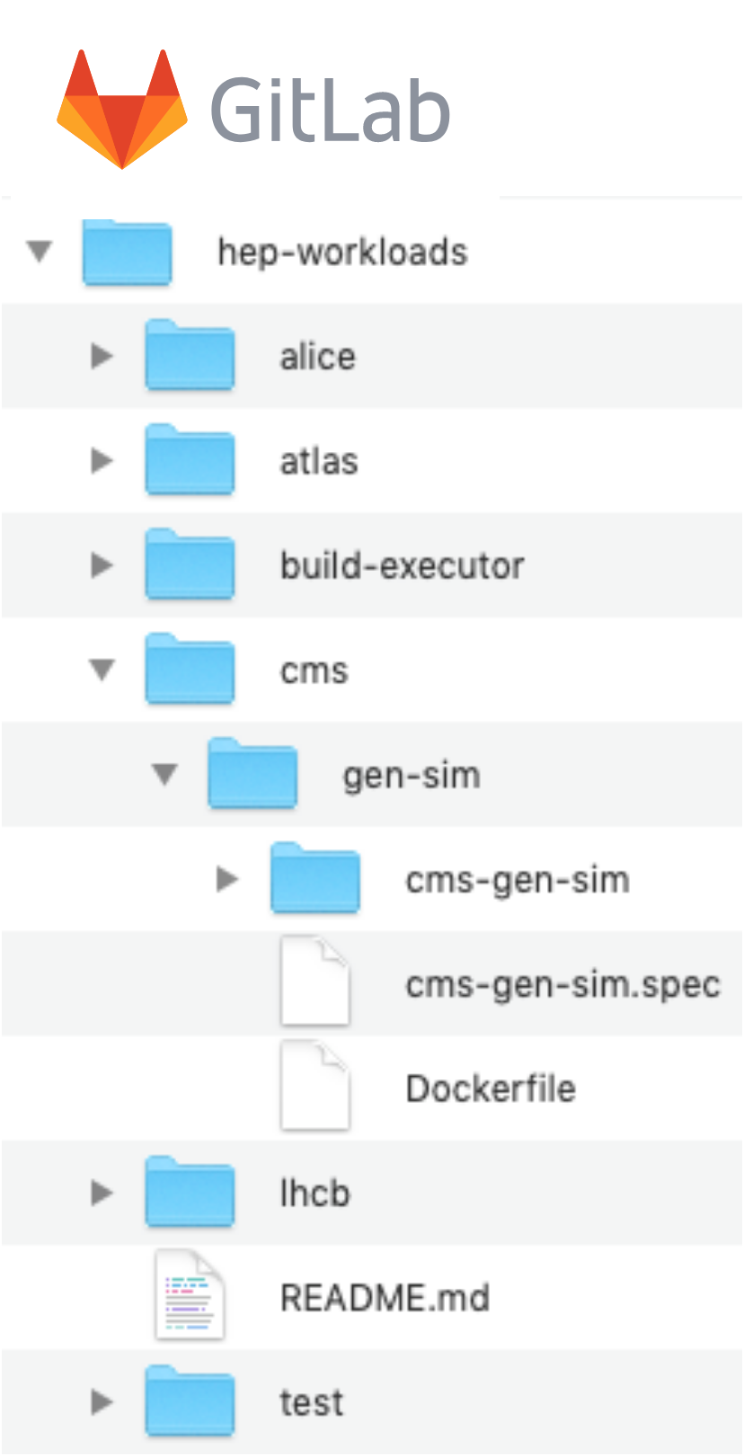
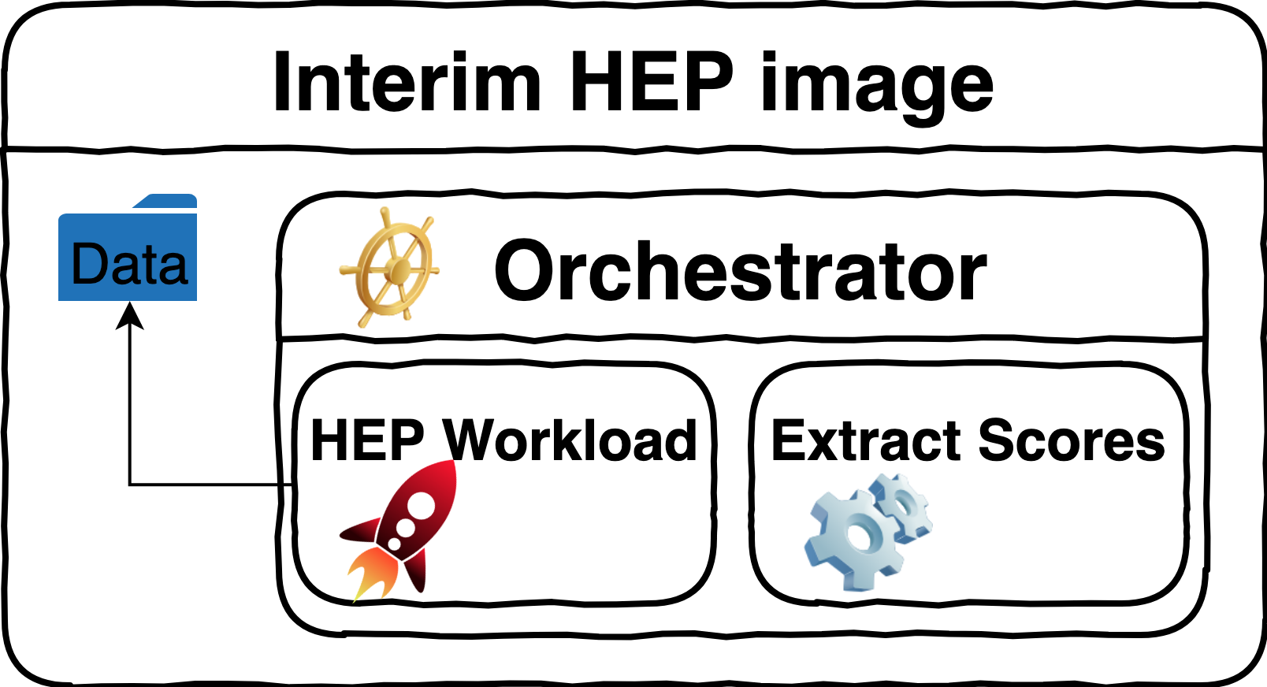
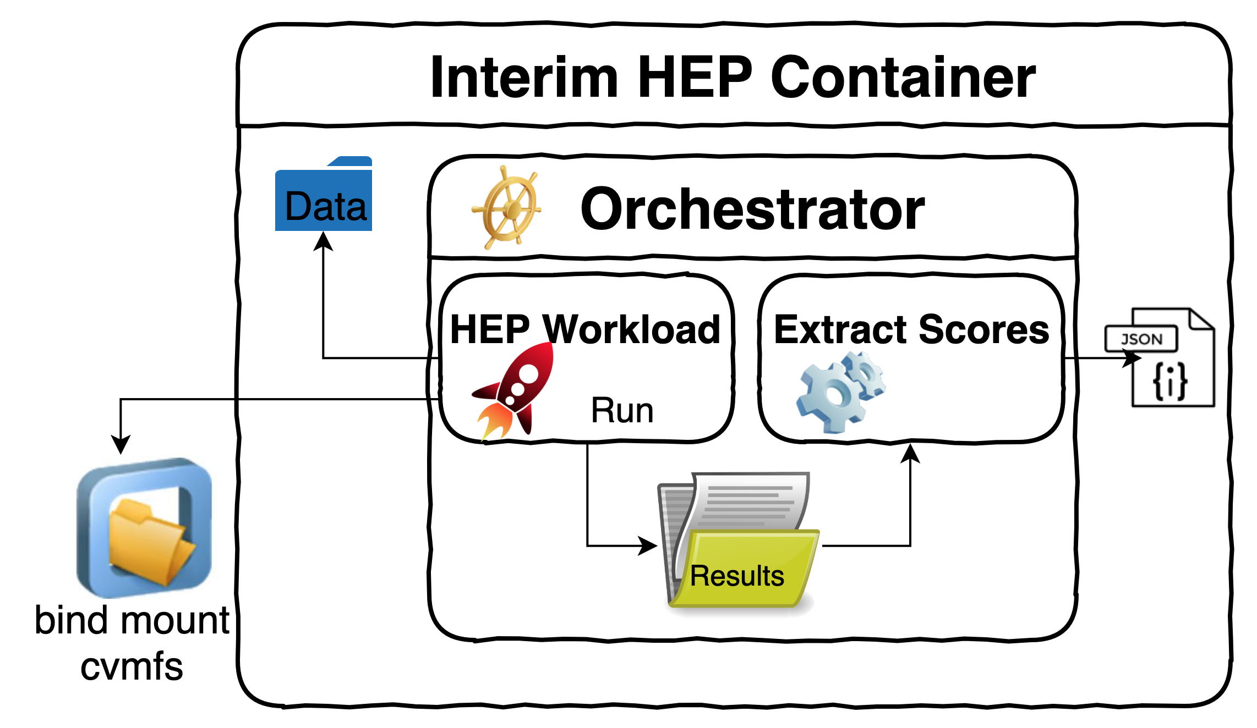
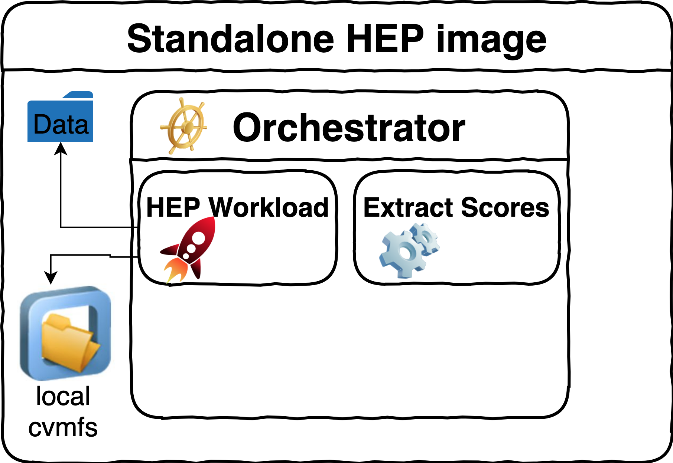
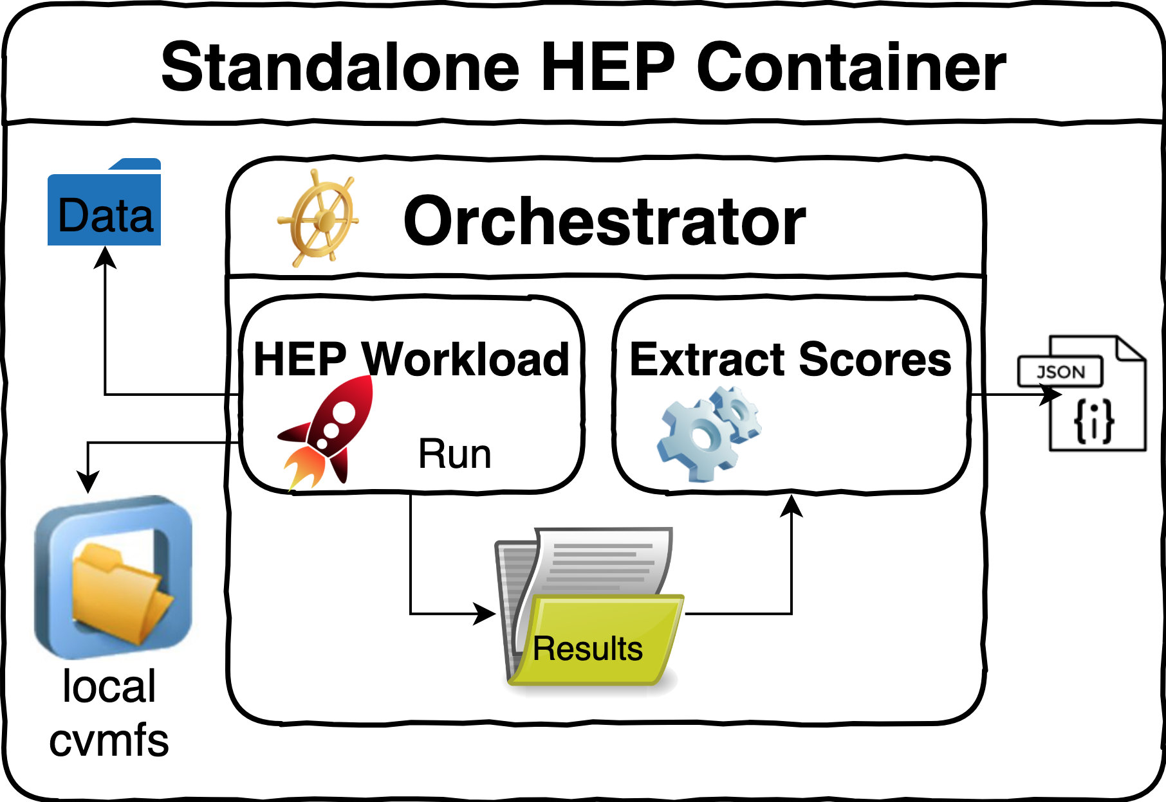
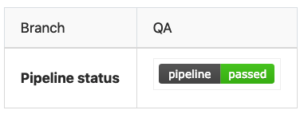
Build procedure in the hep-workloads CI
Main idea: experiment software is on /cvmfs, discover what is needed in a dry run
Enabling technology: cvmfs tracing mechanism
Starting from a gitlab repo containing only the CI and WL orchestrator scripts:
Build an interim image, where /cvmfs is the standard network-connected service
Run the WL from that image, generating cvmfs traces listing which files were accessed
Build the final standalone image, where /cvmfs is a local folder, copying all relevant files
Test the WL from that image (both in Docker and Singularity), push it to the gitlab registry
1
2
3
4

Slide 19
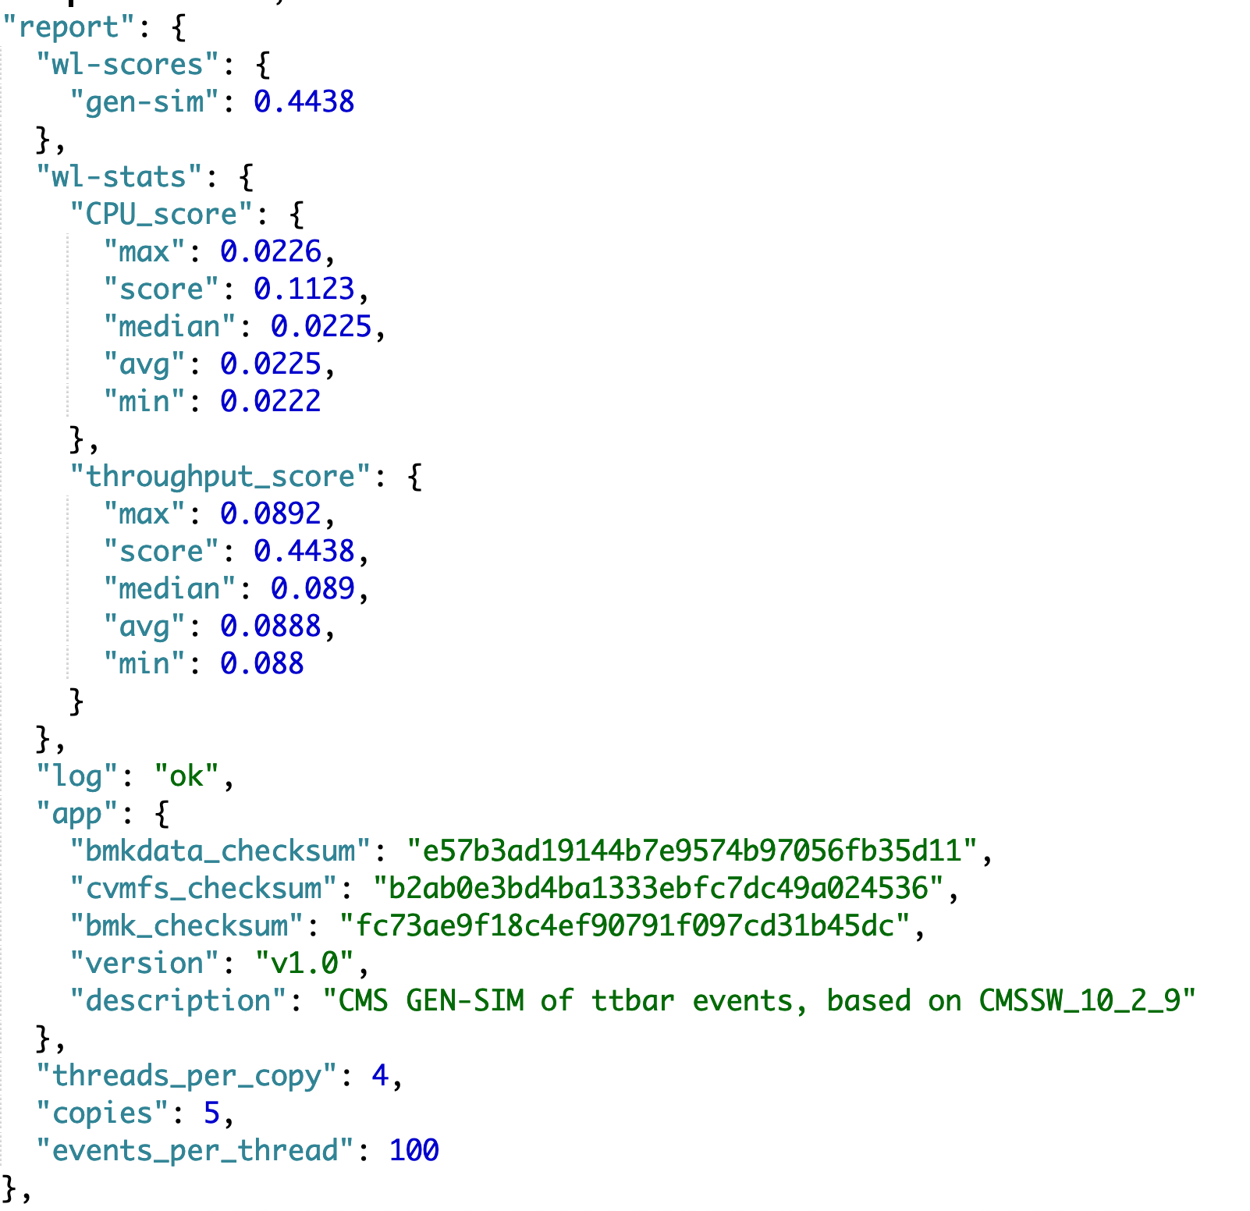
The hep-workloads output report
JSON document with the essential information
Configuration parameters
#copies, #threads, #events, status
Benchmark score: total node throughput
Events per wall second (sum over all copies)
Or events per CPU second in some cases
Details for each application copy
Statistics: mean, median, max, min…
Additional metrics for performance studies:
Memory and CPU utilization
Workload metadata
Description, version, checksum

Slide 20
The hep-workloads containers: available images and work in progress
GEN and SIM workloads are available for all four LHC experiments
DIGI and RECO workloads are available for CMS, work in progress for ATLAS
Download the container images from the gitlab registry:
gitlab-registry.cern.ch/hep-benchmarks/hep-workloads/alice-gen-sim-bmk:latest
gitlab-registry.cern.ch/hep-benchmarks/hep-workloads/atlas-gen-bmk:latest
gitlab-registry.cern.ch/hep-benchmarks/hep-workloads/atlas-sim-bmk:latest
gitlab-registry.cern.ch/hep-benchmarks/hep-workloads/cms-gen-sim-bmk:latest
gitlab-registry.cern.ch/hep-benchmarks/hep-workloads/cms-digi-bmk:latest
gitlab-registry.cern.ch/hep-benchmarks/hep-workloads/cms-reco-bmk:latest
gitlab-registry.cern.ch/hep-benchmarks/hep-workloads/lhcb-gen-sim-bmk:latest

Slide 21
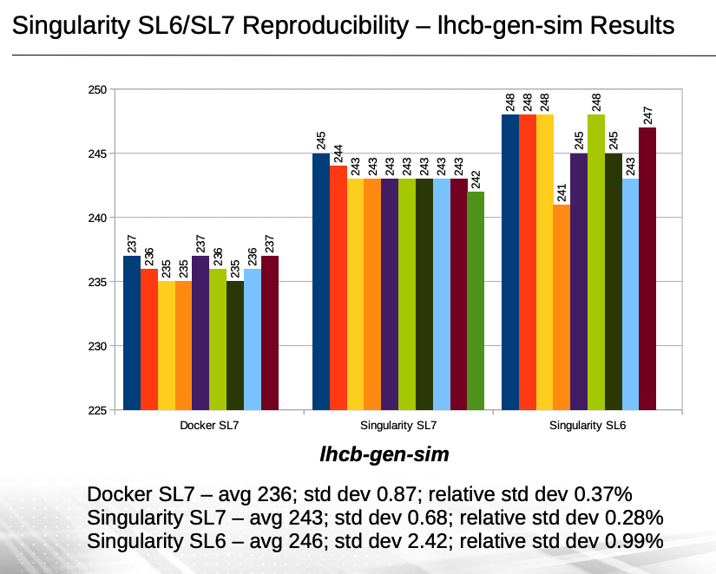
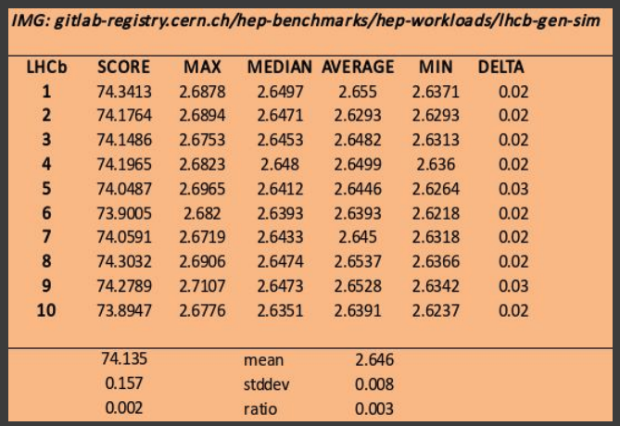
Validation studies for hep-workloads
Work in progress
Careful analysis of robustness and accuracy of individual HEP benchmarks
Are the results of multiple measures reproducible?
How do results change as a function of input parameters (#events, #threads, #copies)
Are the results obtained with singularity and docker containers compatible?
Use the most stable and best understood workloads for the first hep-score prototype!

Slide 22
The hep-score benchmark: many degrees of freedom, one number
“A computer system’s performance cannot be characterized by a single number or a single benchmark. […] Many users (decision makers), however, are looking for a single-number performance characterization. […] There are no simple answers. Both the press and the customer, however, must be informed about the danger and the folly of relying on either a single performance number or a single benchmark.”
Kaivalya M. Dixit, Overview of the SPEC Benchmarks,
in J. Gray (Ed.), The Benchmark Handbook for Database and Transaction Systems, 1993.
Each HEP workload stresses different components of a computer system
Some are I/O intensive, others not; some are vectorized, others not…
Presently, HEP score is the geometric mean of a small subset of WL’s
Eventually, more complex averages may be necessary
In any case, our infrastructure will make it possible to separately measure and record several different WL benchmarks independently
Work in progress

Slide 23
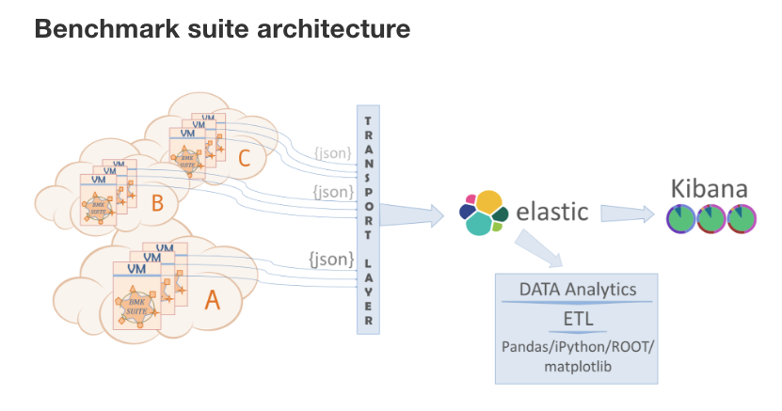
The hep-benchmark-suite toolkit
Work in progress
A single toolkit to coordinate execution and result collection for several benchmarks
Example: execute HS06, SPEC2017 and HEP-SCORE on a set of reference machines
Collect results of all benchmarks in a global JSON document and upload it to a database
Next steps:
Identify a set of reference machines (like the “lxbench” cluster used for HS06 studies)
Systematically study the correlation of individual HEP WL’s to one another and to HS06

Slide 24
Outlook on heterogeneous resources (HPCs, GPUs…)
All of the work on hep-workloads described so far refers to x86 architectures
WLCG computing is expected to go well beyond x86 in the medium term future
Non-x86 HPC supercomputers (ARM, Power9, GPUs…) will probably play a large role
By and large, the software of the experiments is not yet production-ready for this
Porting and validating it (and having the people to do that) is one of the first priorities
But our new benchmarks must be ready in time to do the accounting for these resources!
Specifically: work is in progress on a HEP workload container involving GPUs
CMS event reconstruction, with optional GPU offload of pixel tracking (Patatrack)
IMO, this is likely to be the first LHC experiment software deployable on a GPU-enabled Grid
The container build approach described earlier applies also in this case
Work in progress

Slide 25
Conclusions
After 10 years, HEP-SPEC06 no longer describes well enough HEP workloads
Our solution: build a new benchmark directly from HEP workload throughputs
Enabling technologies: Docker containers and cvmfs tracing mechanism
Status: individual containers exist for GEN-SIM workloads of all four experiments
And for the DIGI and RECO of CMS (and soon for ATLAS too)
WIP: a first HEP-SCORE prototype built from a subset of those workloads exist
It presently defines the new overall benchmark as the geometric mean of individual scores
WIP: the basic infrastructure to run the WLs on a set of reference machines exists
We will then systematically collect the data to compare WL’s to one another and to HS06
Outlook: can extend the idea and implementation to HPCs and non-x86 resources
A container for a workload with optional GPU offload (CMS Patatrack) is being prepared

Slide 26
Backup slides

Slide 27
Docker layers in hep-workloads images
Docker container images are always made up of layers
Translating Docker images to Singularity also keeps this layer structure unchanged
From the bottom up, these layers can be cached until the first difference is found
The hep-workloads CI builds these layers to make them as cacheable as possible
The bottom layers contain what is expected to change least often
The top layers may change more frequently (across different workloads or versions)
Advantage in the CI: faster builds/tests, save storage space (both Docker and Singularity)
Advantage for users: faster tests, save storage space (if Docker and Singularity caches are set up)
Changes more often: caching less likely
Common and WL scripts: /bmk
Experiment WL software: /cvmfs
Experiment WL data files: /data
O/S add-ons via yum install
O/S: Scientific Linux CERN 6
Changes less often: caching more likely

Slide 28
Redistribution: software and data licensing
Work in progress
The software stacks of the four LHC experiments are all Open-Sourced
With slightly different licenses and copyright clauses
Data-intensive experiment workload benchmarks (e.g. digi-reco) use Open Data
Approved by the relevant experiments
We are in the process of clarifying the details of how to Open-Source our benchmark suite, while allowing its use by all interested parties

Slide 29
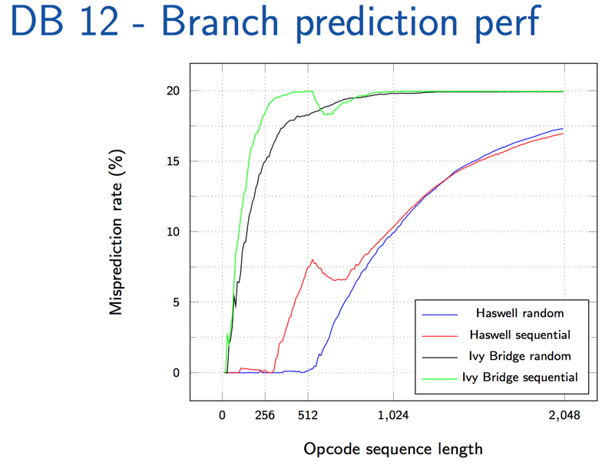
Fast benchmarks
Two fast benchmarks have been found useful by the LHC experiments
ATLAS KV (KitValidation)
Essentially GEANT4 detector simulation (default: 100 single muon events)
Agreement with ATLAS and CMS simulation (M. Alef et al, Proc. CHEP2016)
DIRAC Benchmark 2012 (DB12)
Agreement with ALICE and LHCb (when DB12 runs at job time)
Not robust enough to replace long-running benchmarks
DB12 dominated by the front-end call and branch prediction unit
SMT is not beneficial at all for DB12 when loading all CPU threads
KV shortness and event simplicity affected by systematics
Found in the performance studies of Meltdown/Spectre patches
Can be improved extending the test duration and event complexity
M. Guerri, CERN ITTF, April 2017
D. Giordano, CHEP2018, Sofia, July 2018

