Slide 1
Digital Lab Platform implementation for processing and analysis heterogeneous neurobiological data of the Kurchatov Institute Resource Center "Cognimed"
Irina M. Enyagina, Andrey N. Polyakov.
NRC «Kurchatov Institute», Department of Neurocognitive Sciences
2019

Slide 2
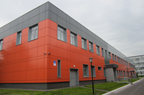
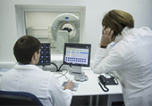
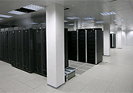
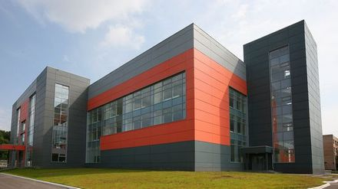
TOPIC OF REPORT
This report presented the project of Digital Lab Platform implementation to organize storage, processing and analysis of heterogeneous neurobiological data (MRI, fMRI, EEG), obtained at Kurchatov Institute Resource Center of Nuclear Physical Research Methods "Cognimed". To this goal was created a new Digital Lab module - System "Neuroimaging".
System "Neuroimaging“ allows to organize the interaction between the Resource Center «Cognimed», the Computer Center Complex for Simulation and Data Processing and the scientists at the Kurchatov Institute (Moscow).

Slide 3
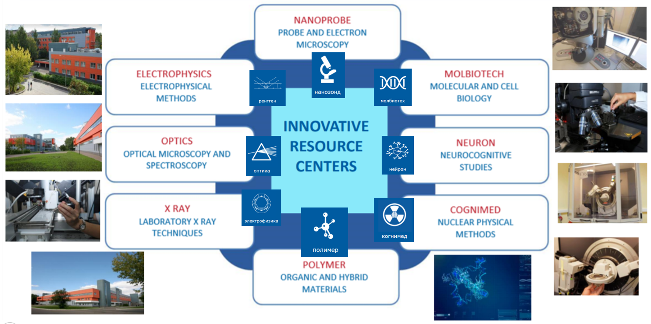
INTRODUCTION
Integration and analysis of heterogeneous (obtained at disparate equipment) experimental data is very actual question today, because it allows to get of higher-level scientific results.
Kurchatov Institute Resource Centers have more than 400 units of modern experimental devices and installations, what allows to obtain a various kind of scientific data.
Supercomputing clusters – 5 generations
HPC 1 – 34 Tflops (2007) | INTEL Xeon
HPC 2 & HPC 3 – 300 Tflops (2009 & 2013) | INTEL Xeon Nvidia
HPC 4 – 500 Tflops (2015) | INTEL Xeon Haswell
HPC 5 – 600 Tflops (2015) | NVidia Tesla K80 Kepler
Kurchatov Institute Computing Center includes a Complex for Simulation and Data Processing for Mega-science Facilities providing of high-performance computing for Big Scientific Data analytics.

Slide 4
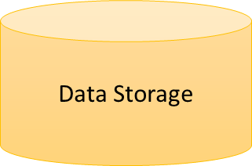
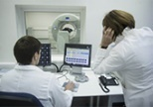
THE MAIN TASKS
There is a general task is to organize of better collaboration between the KI Computing Center and KI Resources Centers for improving of processing and analysis experimental scientific data.
Another important task is to integration of heterogeneous (obtained on various equipment) experimental data for getting of higher level scientific results.
The third task is are creating of a centralized unified data storage, which will allows use heterogeneous experimental data many times for various scientific studies.
KI
RECOURCES CENTERS
KI COMPUTING CENTER
DIGITAL LAB PLATFORM
PROPOSED SOLUTION
Web-portal
To solve these tasks we are propose apply the Digital Lab Platform, which allows to organize the interaction between the Resource Centers, Computing Center and scientists at the Kurchatov Institute (Moscow) .
The pilot module on this direction is the System "Neuroimaging“.
KI
SCIENTISTS

Slide 5
WHAT IS DIGITAL LAB PLATFORM?
Digital Lab Platform is an information system for intensive work with metadata in heterogeneous data store with a function of the dynamic modification by user of both the data and the metadata models. Digital Lab Platform performs a role of data flows manager for organizing the conversion and transfer of data between separate elements of System for data processing and analysis. Based on the Digital Lab Platform it is possible to create as a simple modules for processing and analysis homogeneous data, and a complex modules for processing and analysis heterogeneous data.
Key functions
design of new data and metadata models with function of their dynamical modification;
registration of input data with extraction of initial metadata;
multi-criteria search on metadata attributes;
easy integration of external applications and services by users;
ingesting, restructuring and data processing jobs and workflows;
data share and access permissions to the toolkit resources;
collaborative work for multiple users.

Slide 6
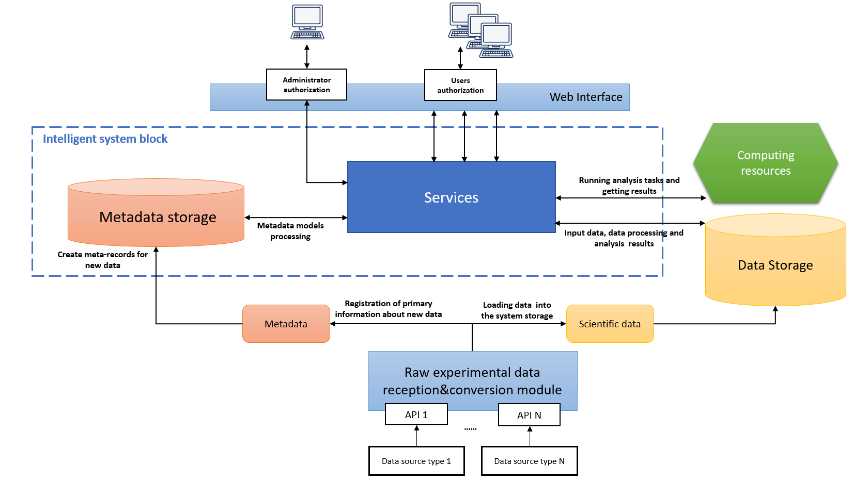
DIGITAL LAB ARCHITECTURE
Key component is Metadata Storage, main elements of this storage are data and metadata models. Interface to these models have standardized format and will be provided by services.
Services are at of three groups system, application and user’s. One of the basic functions for system services are extracting initial set of metadata from input data as well creation of further metadata during the user work. System services are provide also the job loading on computing resources, processing inquires to the storage (file) system etc.

Slide 7
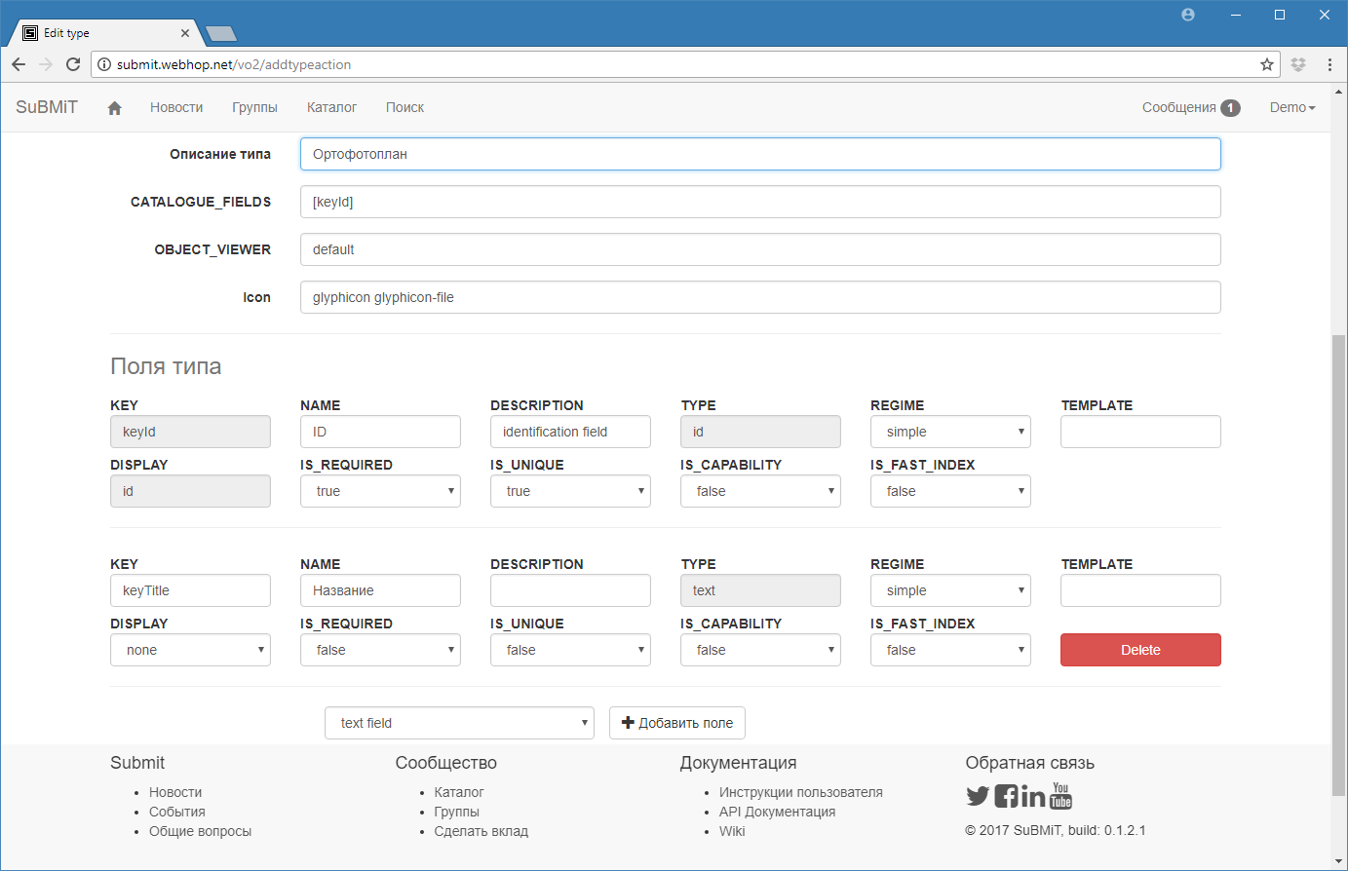
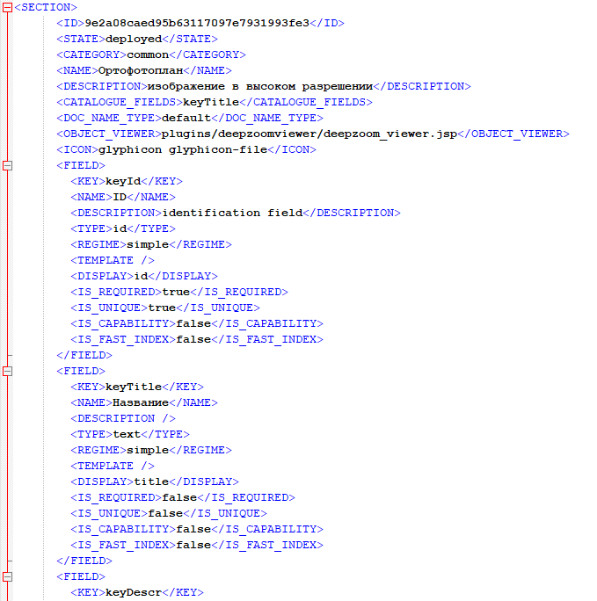
DIGITAL LAB PLATFORM
Metadata model design and XML representation
The scheme includes different types of the fields: text, number, reference etc. There has been created special service to make syntactic analysis of the model (written on XML) and to transmit his model to the corresponding SQL requirements by use of the rules defined for object-relational mapping.

Slide 8
DIGITAL LAB PLATFORM
software requirements
Java 8 (programming language)
Tomcat 7 (application deployment and access)
MySQL 5.1 (metadata register)
Java 2 Enterprise Edition (architecture)
Apache Struts 2.0 (application logic)
Application server (Apache TomCat 8.5)
EJB 2.0, Servlets 2.3, JSP 1.2. specifications (interface)
XML is used for the data/metadata models storing

Slide 9
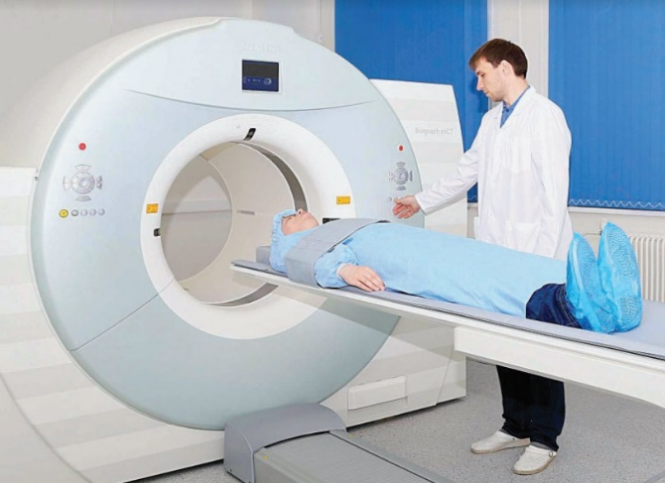
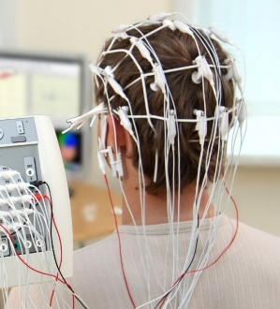
SYSTEM «NEUROIMAGING»
Digital Lab Platform module for processing and analysis heterogeneous neurobiological data
Understanding of the human brain architecture and its neuronal functional connectivity is an important neuroscience goal. There are two areas of research: anatomical structure (MRI) and functional connectivity (fMRI, EEG). Results of these researchers are used in machine intelligence and bioinformatics scientific studies (brain-computer interface, thought recognition, polygraph, etc.), and in clinical practice (neuropsychology, neurology, neuroradiology, neurosurgery, psychiatry, rehabilitation).
There is growing interest in combining EEG, MRI and fMRI experimental data for study of human brain functional connectivity. To implement this methodology was developed the new module of Digital Lab Platform - System «Neuroimaging» for automatic processing, analysis and storage of heterogeneous neurobiological data (MRI, fMRI, EEG) of the Kurchatov Institute Resource Center of Nuclear Physical Research Methods "Cognimed".
At this time the System are using at the Kurchatov Institute for the integration and analysis of MRI and fMRI data, obtained on a Siemens Verio Magnetom 3T Tomograph of the Kurchatov Institute Resource Center "Cognimed".

Slide 10
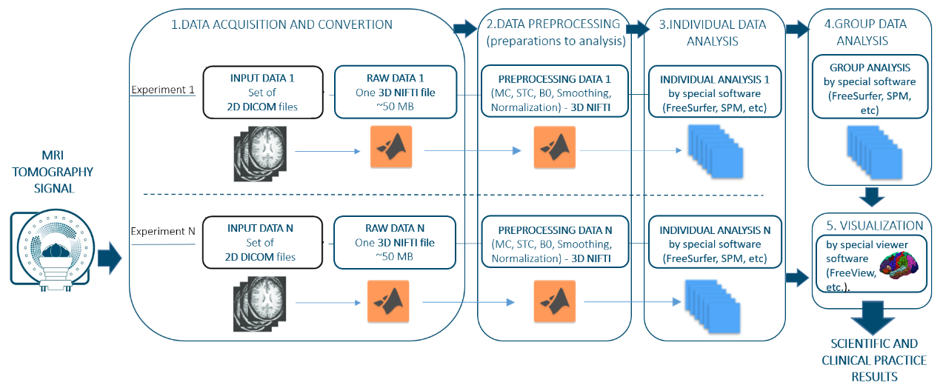
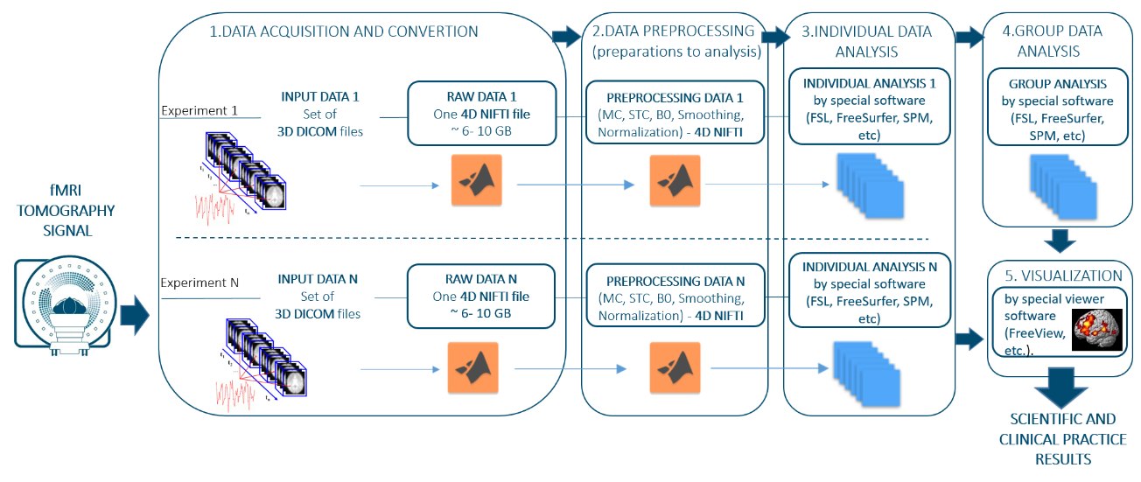
MRI/fMRI experiments data work flows
MRI/fMRI tomography experiment signal converted on Tomograph operator’s PC to a set of DICOM files (2D DICOM files for MRI, 3D DICOM for fMRI). One set DICOM files is one MRI/fMRI experiment, and this is «Input Data» for our System.
Then the set of DICOM files converts to one NIFTI file (3D NIFTI ~ 50 MB `for MRI, 4D NIFTI ~ 6-10 GB for fMRI), and this NIFTI file is «Raw Data» for our System.
Then "Data Preprocessing" stage is start: «Raw Data» are prepare for analysis. This stage start and finish with NIFTI file.
After then the main stage of working with data begins – «Data Analysis». Part one of this stage - «Individual Data Analysis» (for one experiment). And the second part (if necessary) is «Group Data Analysis» (some number of experiments, usually for groups from 20 to 200 patients). This stage start with NIFTI file, but at finish we have a data in a different format, which depends on the specialized software, which was chose for analysis: it is can be single file or a directories of files.
It is possible to neurovisualization results of data analysis by special visualizing editors (FreeView, for example).
The results of data analysis then used in scientists research (usually, results of group analysis) and in clinical practice (usually, results of individual analysis).

Slide 11
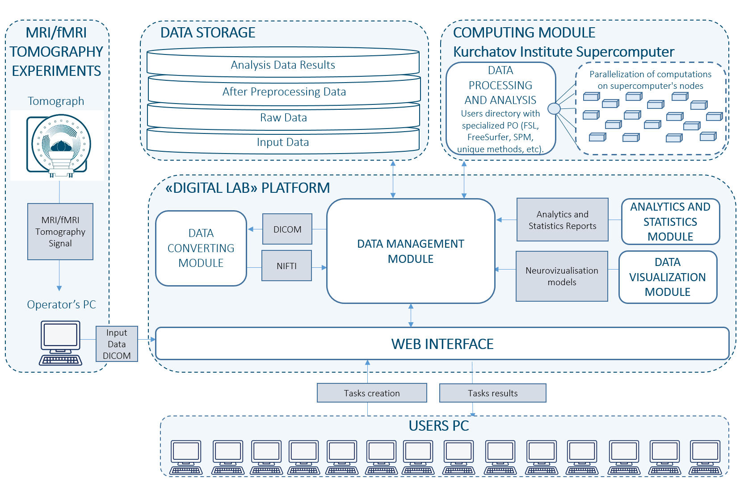
System «Neuroimaging» Architecture
The System «NEUROIMAGING» has the following structure:
1. Data Storage: Uniﬁed storage of data and results of their processing and analysis.
2. Computing Module: Data processing and analysis using specialized software (standard tools (FreeSurfer, FSL, SPM, etc.) and own developed by Kurchatov Institute researchers tools (unique methods for rest-fMRI, etc.). Parallelization of calculations on supercomputer’s nodes.
3. Analytics and Statistic Module: Data group’s formation by set of parameters; analytics and statistic reports generated.
4. Data Visualization Module: Creating the models of data neuroimaging with Viewer Editors (FreeView, etc).
5. Data Management Module: Organizes the exchange of data between Web Portal, Data Storage, Computing Module and other modules of System.
6. Web interface: Organization of System interaction with external devices (Tomograph operator's PC, User’s PC of medical and scientific organizations, etc.).

Slide 12
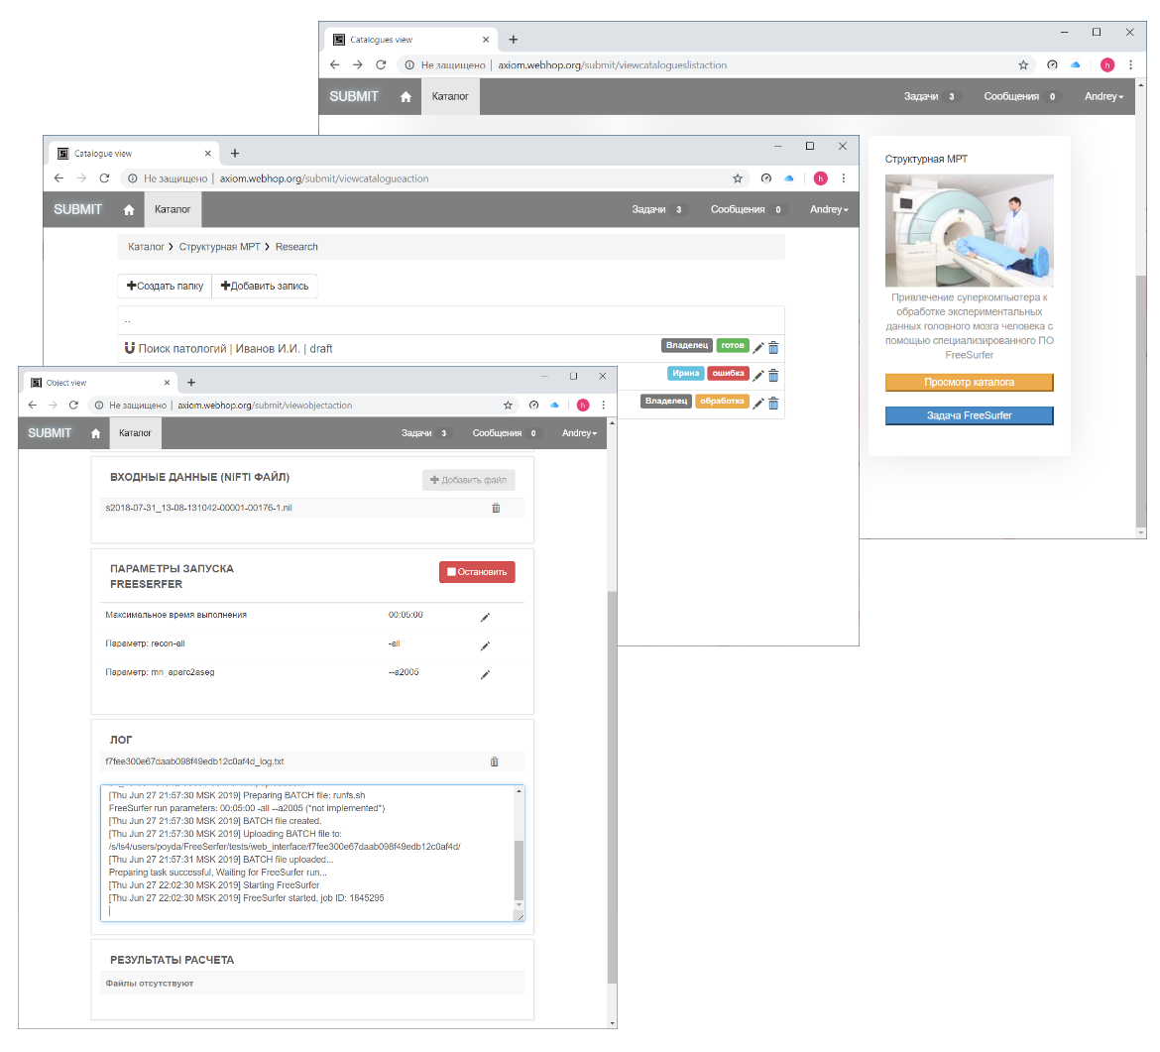
System «Neuroimaging» implementation Example 1: Module «FreeSurfer»
Algorithm for users
Step 1 Log in to the portal
Step 2 Create new patient record
Step 3 Attach MRI/fMRI data (DICOM files or NIFTI file).
Step 4 Start task by pressing «Start» button
Step 5 Waiting of results
(interactive log is provided for job status monitoring)
Step 6 Download .rar file with results

Slide 13
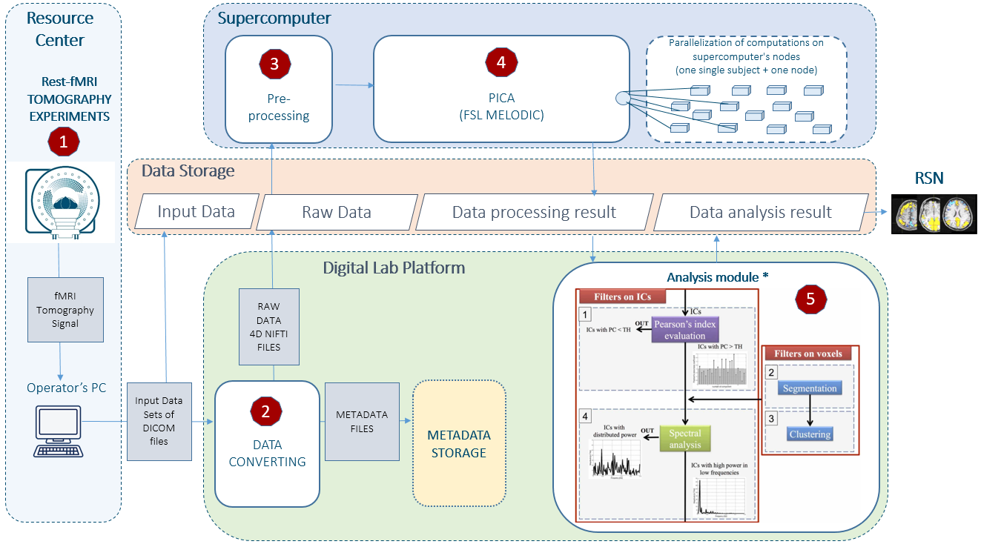
System «Neuroimaging» implementation Example 2: Module «PCA-based algorithm for RSN automatically select»
PICA-based algorithm for automatically select resting-state functional networks on Digital Lab Platform, including data processing on the Kurchatov Institute Supercomputer and Data Analysis Module, which can used to detect neural networks and reduce subjectivity in ICA component assessment.

Slide 14
Benefits of System «Neuroimaging» implementation
Many times speed up of processing and analysis MRI and fMRI data due to parallelization of computations on supercomputer nodes.
Wide choice of tools for processing and analyzing data due to the installation of a set of modern specialized software packages on a supercomputer.
Centralized data storage, with the possibility of searching on a set of parameters, what make possible in the future to reuse this data for various scientiﬁc studies.
Unique mathematical methods implementation.
Work with data at any time from any place using web-portal.

Slide 15
Acknowledgement
These works were performed as a part of the Kurchatov Institute research activities on the project “Creation of a distributed modular research and development platform "Digital laboratory”” (No. 1359).
As computational recourse are using the Kurchatov Institute Supercomputer, Cluster HPC 4.
The MRI and fMRI data obtained on a Siemens Verio Magnetom 3T tomograph of the Kurchatov Institute Resource Center.

Slide 16
THANKS!

