Slide 1
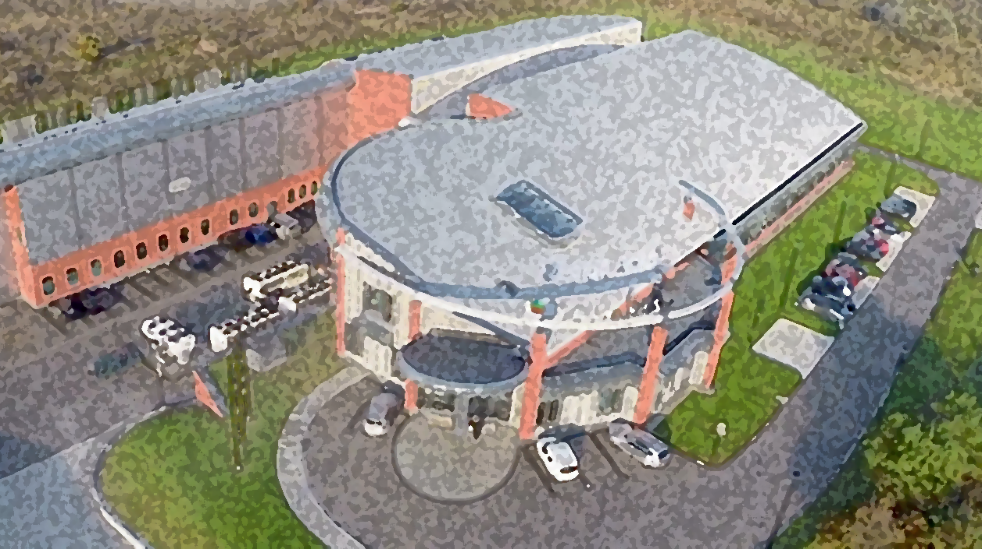
Status of the establishment of the SOLCRYS Laboratory at the SOLARIS center of the Jagiellonian University in Kraków (Poland)
V.Shvetsov

Slide 2

SOLARIS
Project settings and boundary conditions
National Project, executed by Jagiellonian University
Timetable
Conceptual design 2009
Project approved 2010
Project completed: December 2015
Budget
50 M€ - European Union Regional Development Fund,
Innovative Economy Operational Program
Deliverables
Building
Machine (linac + synchrotron)
2 experimental beamlines
TEAM
Courtesy of M.Stankiewicz

Slide 3

SOLARIS - Project settings and boundary conditions
Replica of MAX-IV 1.5 GeV ring – but:
  Different building
    Different storage ring tunnel
    Different building infrastructure
  Different injection – linac but not full energy
  Ramping
Uniqueness (first such facility in PL)
  There are no commercially available synchrotrons
  Tailored made design
  Tailored made equipment
Funds: 50 M€ - source:
Courtesy of M.Stankiewicz

Slide 4
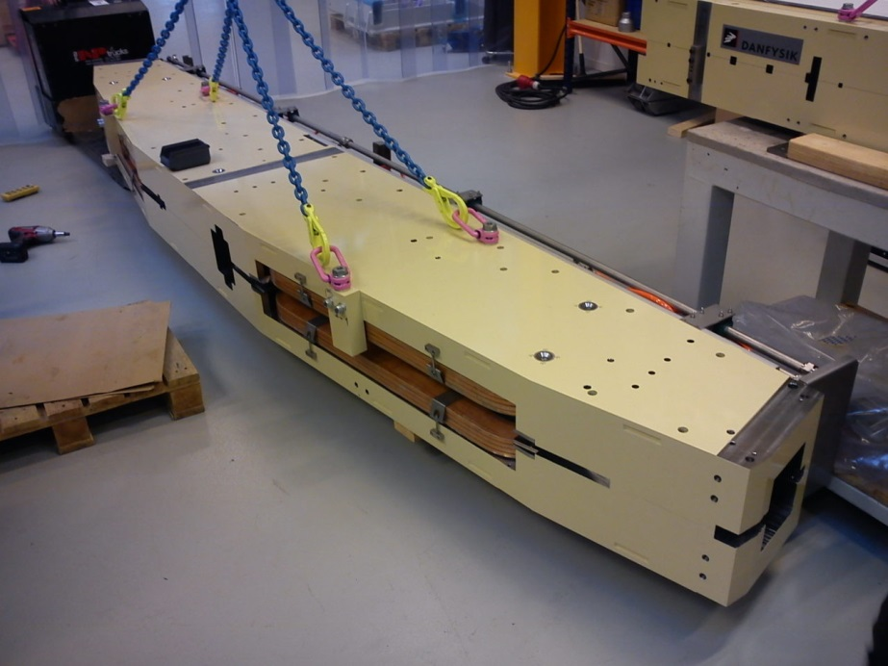
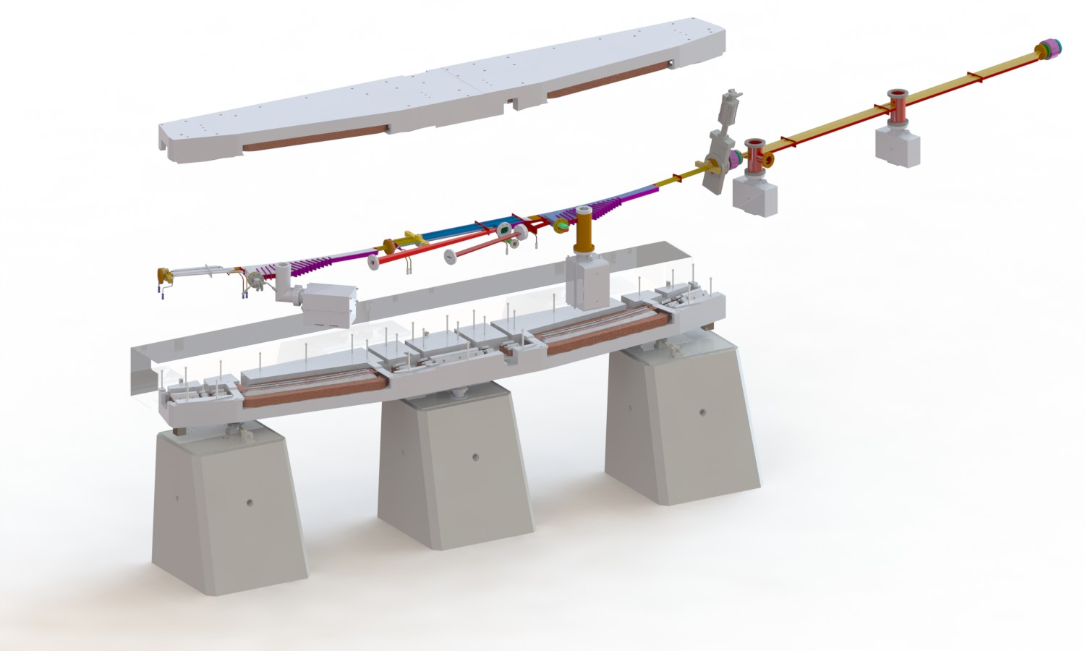
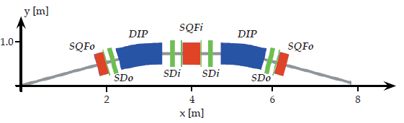
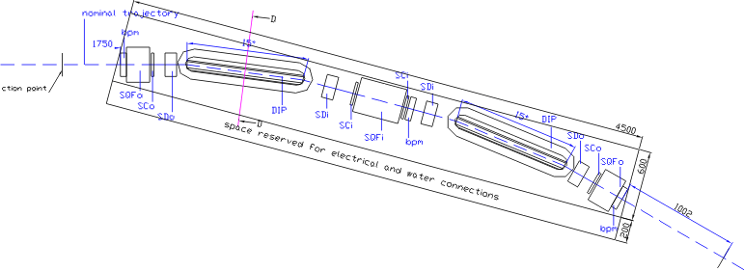

SOLARIS 1.5 GeV ring design - MAX-lab accelerator team - Mikael Eriksson
SOLARIS – unique design
of the storage ring
Ring circumference | 96 m
Electrons’ energy | 1.5 GeV
Injection energy | 0.4-0.7 GeV, upgrade to 1.5 GeV
Current | 500 mA
Bends | 12
Straight section length | 3.48 m
H beam size: 184 um
V beam size:13 um
Emmitance: 5.6 nm rad
Unique, revolutionary design:
single yoke magnetic cells (double bend achromats)
Courtesy of M.Stankiewicz

Slide 5
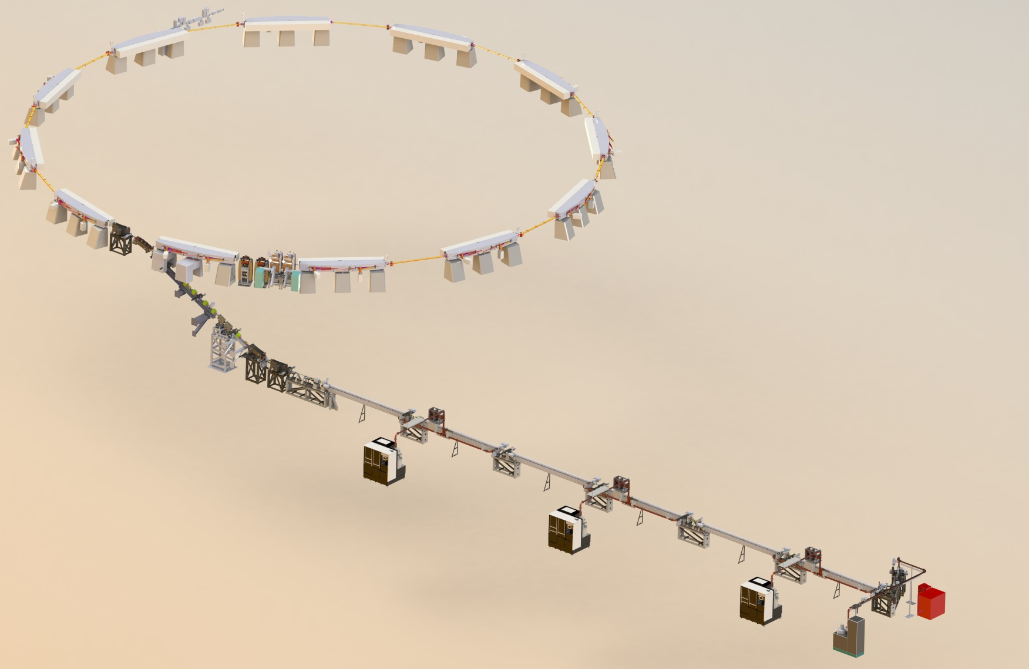
Machine
1.5GeV Storage ring
12 DBA Cells – 96 m circ.
Space for ID’s (10 sections) ~ 3.5 m
10 straight sections for Ids
100 MHz RF system
300 MHz Landau Cavities
Injection dipole kicker
Ramping
Current: 500mA
Emmitance (bare Lattice): 6nmrad
600 MeV Linac
RF Thermionic Gun
6 accelerating structures (in 3 units)
Accelerating gradient 20 MeV/m
S-band – 2998.5 MHz
3 RF Units :
- ScandiNova K2 modulators
Toshiba klystrons
SLED cavities
Courtesy of M.Stankiewicz

Slide 6

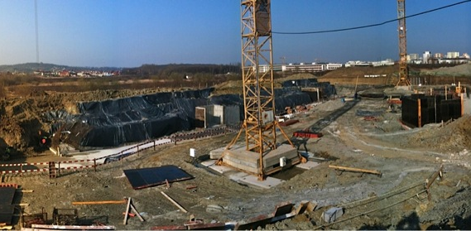
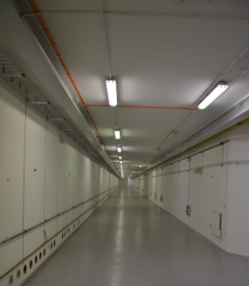
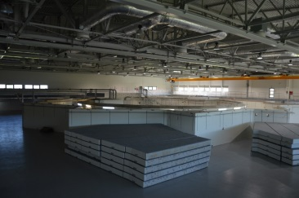
Time schedule
April 2010 – project start
January 2012 – start of the building construction
May 2014 – building handover
June 2014 machine installation
Courtesy of M.Stankiewicz

Slide 7
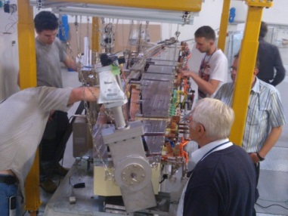
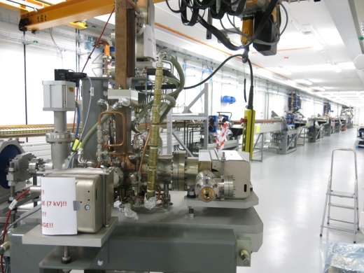
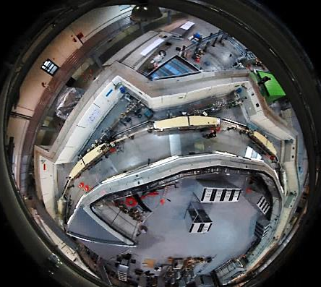
Time schedule
November 2014 linac conditioning start
April 2015 Storage ring installation done
May 2015 Solaris commissioning start
December 2015 end of the project
Courtesy of M.Stankiewicz

Slide 8
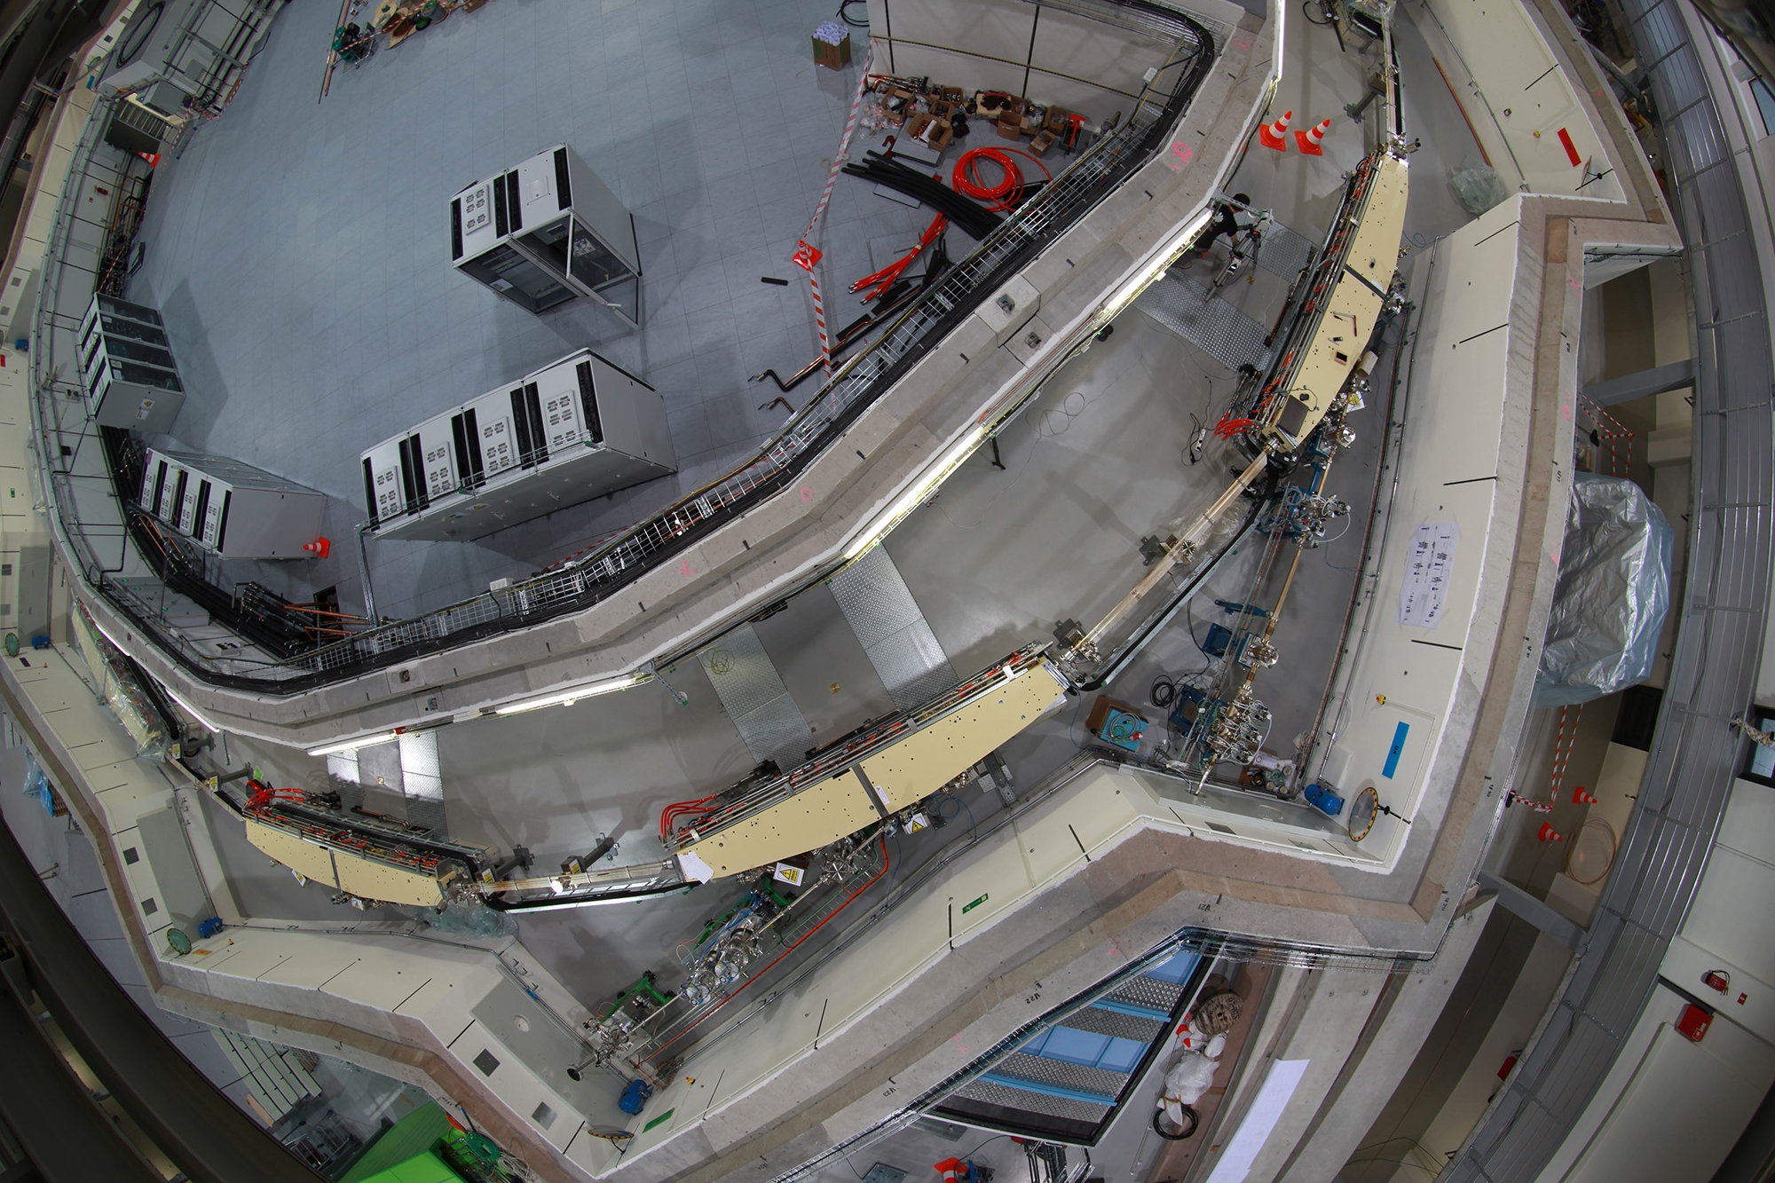
Courtesy of M.Stankiewicz

Slide 9
Brief History
First discussions in 2017, draft of the Agreement;
Report “Synchrotron Radiation in Modern Sciences” (N. Kučerka) at FC meeting, November 21, 2017;
Report “Cooperation between JINR and the National Synchrotron Radiation Centre SOLARIS (Kraków, Poland)” (V.Shvetsov) at the 47th meeting of the PAC for Condensed Matter Physics on January 22 2018;
Two reports at the 123rd session of the Scientific Council on February 22 2018
  SOLCRYS — new laboratory for structural research at the Polish synchrotron SOLARIS: proposed concept (M. Stankiewicz);
  Complementarity between neutron and synchrotron X-ray scattering, the potential of the synergy between IBR-2 and SOLARIS (V.Shvetsov);
Report “SOLCRYS — JINR's new laboratory for structural research at the National Synchrotron Radiation Centre SOLARIS of the Jagiellonian University in Kraków” (N. Kučerka) at the 48th meeting of the PAC for Condensed Matter Physics on June 14 2018;
And finally, Agreement between JINR and JU signed on June 28 2018;

Slide 10
Workgroup
JINR SOLARIS
Norbert Kučerka Marek Stankiewicz
Alexander I. Kuklin Maciej Kozak
Evgeniy V. Lukin Jacek Szade
Dorota Chudoba Michał Młynarczyk
and
Denis P. Kozlenko, Mikhail V. Avdeev, Andrey V. Rogachev, Pavel Yu. Apel
Courtesy of N. Kučerka

Slide 11
SOLCRYS – beamlines proposed
MX
- Macromolecular X-ray Crystallography
BioSAXS
- Small-Angle X-ray Scattering of Bio-macromolecular solutions
PD
- Powder Diffraction in a wide range of temperature & pressure
Cryo TEM
- Cryo Transmission Electron Microscopy

Slide 12
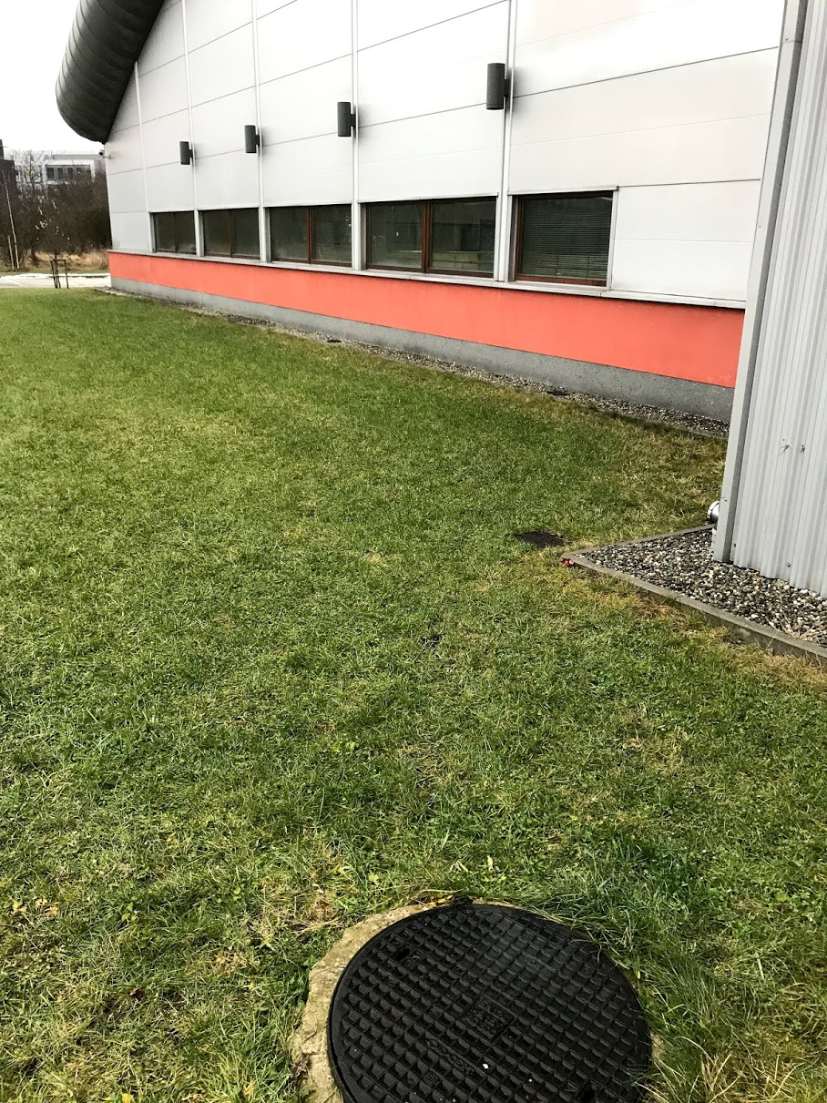
SOLCRYS – laboratory for structural research
Materials science
- structure of crystalline materials
- semiconductors and new electronic materials
- alloys and nanocomposites
- polymers and fibers
Chemistry
- catalysis
- porous materials
Pharmacy
- drug polymorphism
- drug carriers
- gels, lotions, creams
Structural biology
- proteins and nucleic acids
- biomacromolecular solutions
Dec 22 2018
Courtesy of N. Kučerka
Notes:
The research directions are aligned well with the JINR’s scientific program in condensed matter physics. Some of the research will benefit from the complementarity of neutron and X-ray based measurements, some will achieve opportunity for further expansion, and others will help to create new competencies.

Slide 13
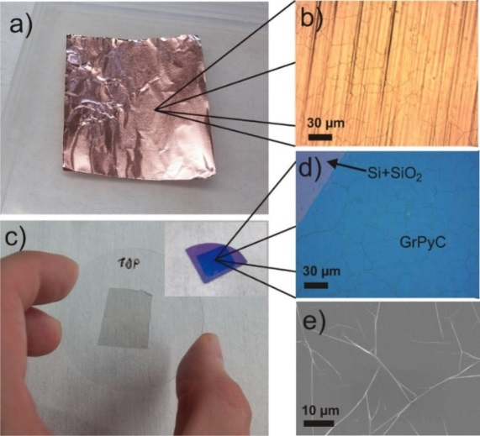
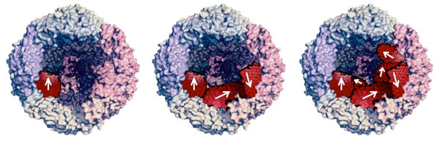
SOLCRYS – objectives
electronic structure of different materials
using X-ray absorption spectroscopy
(topological insulators)
heavy atom diffraction of single crystals and powders
diffraction at high pressure
macromolecular crystallography
structure of bio-macromolecular assemblies
courtesy of P.Kuzhir from BSU, Minsk
Magnetoferritin
P.Kopčanský, V.I.Petrenko, et al.
Courtesy of N. Kučerka

Slide 14
SOLCRYS – desires
SuperConducting Wiggler providing
X-rays at the energy up to 20keV (0.6 Å)
Front end infrastructure
Endstations:
  SAXS/WAXS
  Macromolecular crystallography
  Powder diffraction with a high pressure option
Courtesy of N. Kučerka

Slide 15
SOLCRYS – desires
High pressure diffraction (ALS, Berkeley and/or NSLS, Brookhaven)
Energy > 17keV & ΔE/E~2x10⁻⁴
Focusing down to 20μm
Parameter | focus | Divergence in the focus | Flux in the focus | Energy resolution | Energy
Value | <20x20 μm | < 1 mrad | ~10¹¹ photon/sec (>10¹⁰) | 2x10⁻⁴ | >17 keV
Courtesy of N. Kučerka

Slide 16
Present status of the SOLCRYS development
Start of the tendering, first round of SOLCRYS technical dialogue
  February 4th-5th 2019 FMB Oxford Limited (UK);
  February 12th 2019 – IRELEC (France);
  February 13th to 14th 2019 – AXILON (Germany);
  February 22nd 2019 – ARINAX (France);
Negotiations with Budker Institute of Nuclear Physics on SC wiggler;
Visit of the JINR financial specialists to Krakow in December 2018;

Slide 17
Thank you for your attention!

