Slide 1
UPGRADE OF THE GERDA EXPERIMENT
N. Rumyantseva

Slide 2
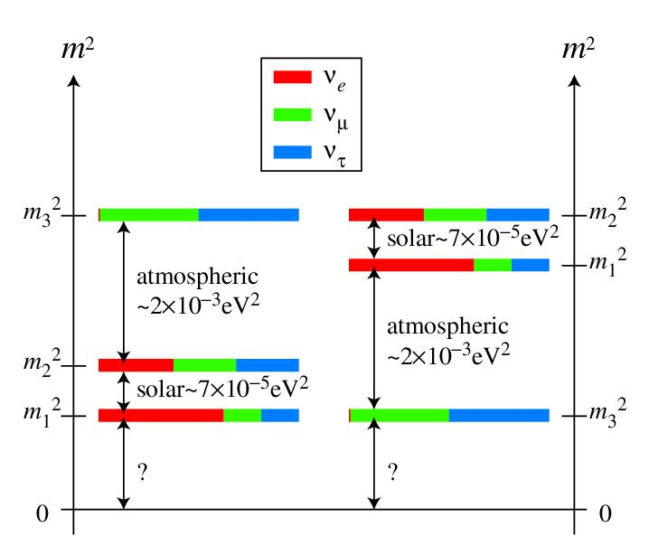
Neutrinoless double beta decay
Searching for 0νββ helps to understand:
Nature of ν (Dirac or Majorana)
Neutrino mass scale
Neutrino hierarchy
Isotope | $$G^{0ν}$$ $$\left({10}^{−14}\text{yr}\right)$$ | $$Q\left(\text{keV}\right)$$ | Nat. ab. (%)
⁴⁸Ca | 6.3 | 4273.7 | 0.187
⁷⁶Ge | 0.63 | 2039.1 | 7.8
⁸²Se | 2.7 | 2995.5 | 9.2
¹⁰⁰Mo | 4.4 | 3035.0 | 9.6
¹³⁰Te | 4.1 | 2530.3 | 34.5
¹³⁶Xe | 4.3 | 2461.9 | 8.9
¹⁵⁰Nd | 19.2 | 3367.3 | 5.6
Experimental sensitivity:
Zero background:
$$T_{1/2}^{0ν}∝M t$$
Non-zero background:
$$T_{1/2}^{0ν}∝\sqrt{\frac{M t}{∆E BI}}$$
$$M t$$
exposure (kg yr)
energy resolution (keV)
background index (counts/keV kg yr)
$$∆E$$
$$BI$$
Target mass and detector efficiency as high as possible
“Zero-background” to have linear increase of sensitivity vs exposure
Notes:
Neutrinoless double beta decay is a hypothetical lepton number violating process, where two neutrons convert into two protons and two electrons. If we observe this process, it would mean that the neutrino
is its own anti-particle (Majorana particle). It will provide access to the absolute mass scale of neutrinos, and support extensions of the Standard Model.
There are 35 isotopes for which the double beta decay (both 2 neutrino and neutrinoless) is energetically allowed, however its probability strongly depends on the decay energy. So only a few isotopes with the decay energies more than 2 MeV are under consideration now.
The sensitivity of 0νββ search is proportional to the exposure. That is why any 0νββ experiment should use pretty big mass of isotope and keep the efficiency as high as possible. Another critical point is a
background in the region of interest, since only in the case of “zero” background, sensitivity is linearly increase with exposure.

Slide 3
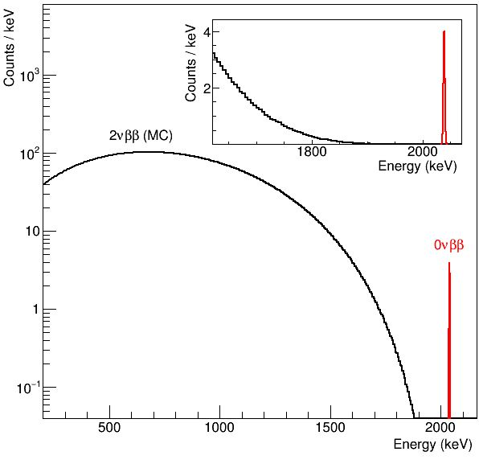
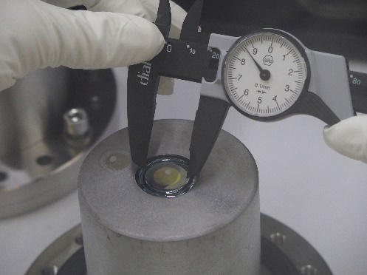
Neutrinoless double beta decay search with ⁷⁶Ge
The GERDA experiment is an ultra-low background experiment aimed to search for 0νββ decay of ⁷⁶Ge.
⁷⁶Ge → ⁷⁶Se + 2e⁻ + 2ν_{e}
Ge detector
Q = 2039 keV
● ⁷⁶Ge → ⁷⁶Se + 2e- with Q_{ββ} = 2039 keV
● Source and detector are the same
→ high detection efficiency
● Isotope enrichment up to 88% for
detector material
● Intrinsically pure material
→ low background
● Excellent energy resolution
→ 2νββ background suppressed
● High density material → ββ point-like
→ backgrounds can be discriminated and rejected
Notes:
In the GERDA (GERmanium Detector Array) experiment, bare germanium detectors are operated in liquid argon (LAr). The detectors are made from germanium with the fraction of the ⁷⁶Ge isotope enriched to about 88%. Since the source and the detector of 0νββ decay are identical (in this calorimetric approach), the detection efficiency is high.
Germanium detector is a pure material – so it helps to reach very low background level.
The experimental signature of 0νββ decay is a sharp peak at the end of continuous 2νββ spectrum – so the energy resolution is essential. This gives a serious advantage to Ge projects thanks to the excellent energy resolution of semiconductor detectors.

Slide 4
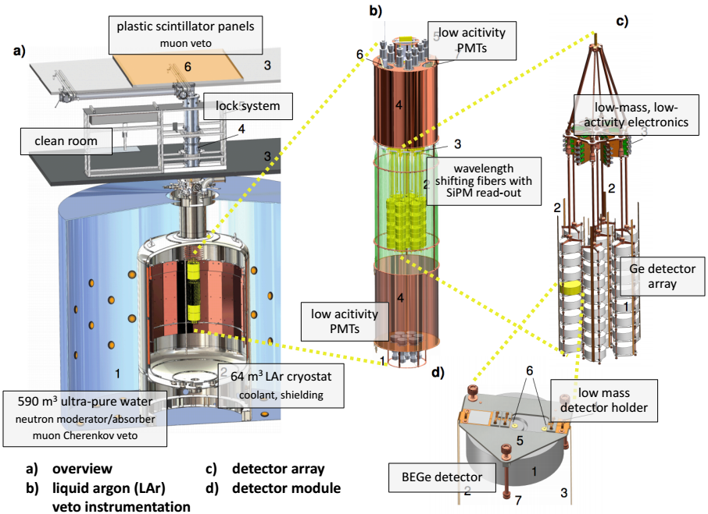
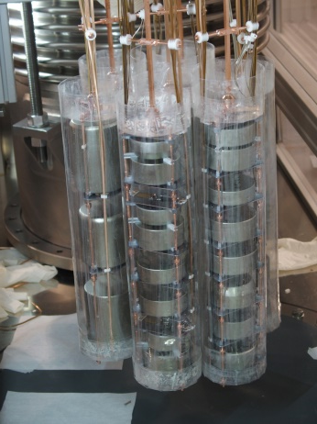
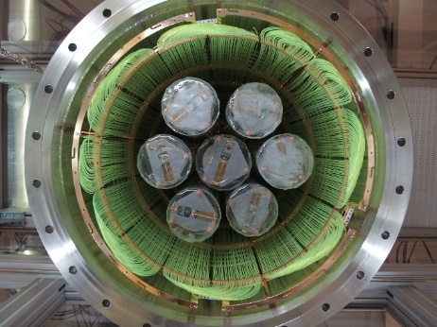
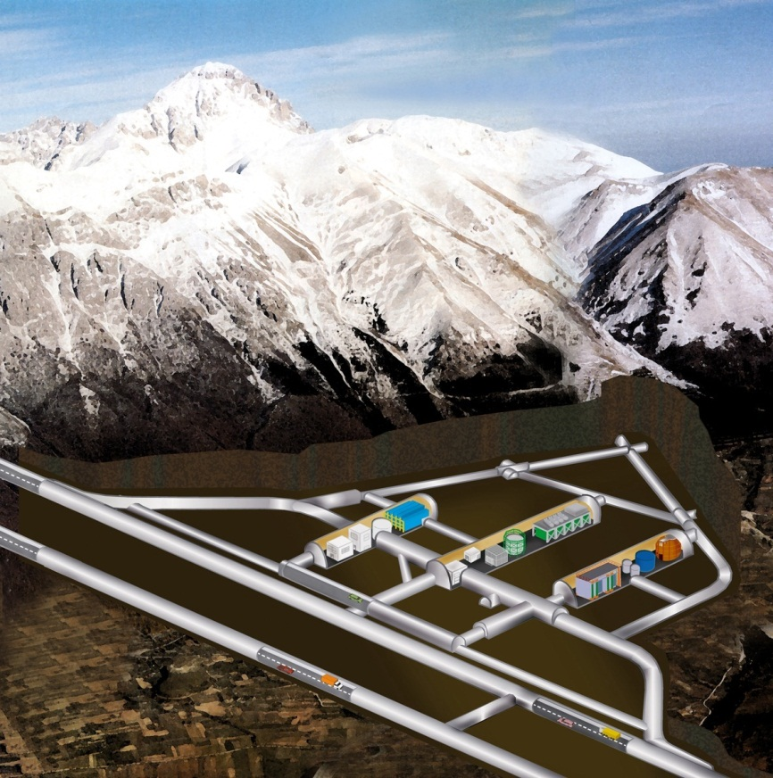
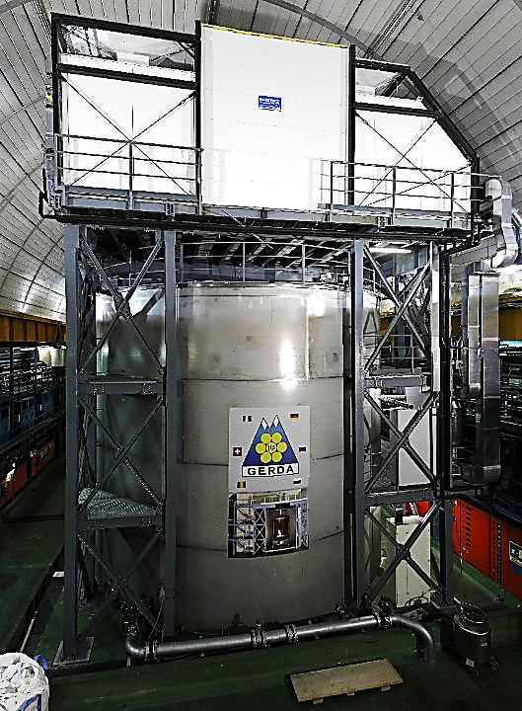
GERDA Phase II: design
3500 m.w.e
1.25 µ / (m² h)
Features:
Low-A shield, no Pb
Bare Ge-diodes array in liquid argon (LAr)
LAr is used as veto system
Good pulse shape discrimination capability of Ge detectors
GERDA will collect data until the end of 2019
Notes:
The GERDA experiment is located at the Laboratori Nazionali del Gran Sasso in Italy. A rock overburden of about 3,500 m water equivalent removes the hadronic components of cosmic ray showers and reduces the muon flux to 1.25 muons m⁻² h⁻¹.
GERDA uses enriched germanium detectors arranged in strings within a cryostat filled with liquid argon. The liquid argon acts both as cooling and active shielding medium. The cryostat is enclosed by a large tank with ultra-pure water with PMTs. These PMTs detect Cherenkov light from muons passing through the setup. A clean room on top of the cryostat and water tank houses a glove box and the lock for assembling of Ge detectors.
Close to the detector array we have LAr veto system, which allows to readout the scintillation light from Ar and, thus, to additionally reduce the background.
Another important feature of the GERDA is a possibility to reach better background index by pulse shape discrimination in Ge detectors.

Slide 5
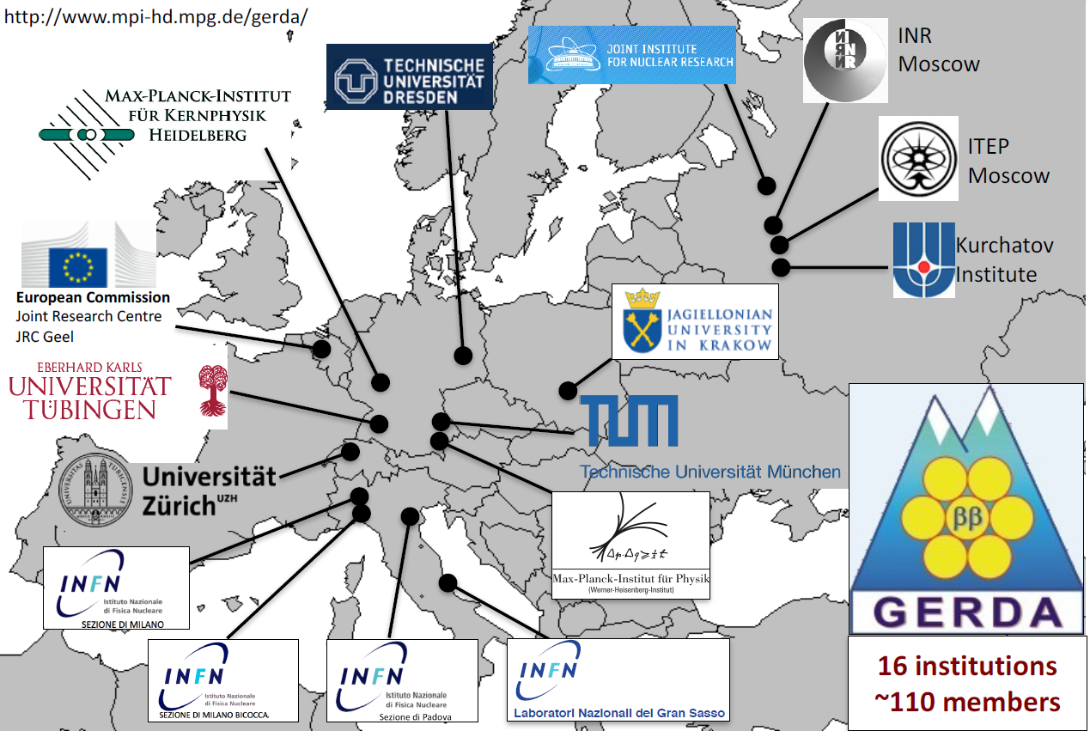
GERDA collaboration
GERDA members from JINR:
V. Brudanin, D. Borowicz, V. Egorov, M. Fomina, K. Gusev, A. Klimenko, O. Kochetov, A. Lubashevskiy, I. Nemchenok, S.Nepochatich, N. Rumyantseva, V. Sandukovsky, E. Shevchik, M. Shirchenko, A. Smolnikov, I. Zhitnikov, D. Zinatulina (Total FTE = 7.5)
Notes:
The GERDA collaboration includes ~ 110 members from 16 institutions and 6 countries. The JINR group in GERDA consists of 17 people and plays important role in all parts of the experiment: operations with germanium detectors, production and integration of active veto systems (that is plastic muon veto, liquid argon veto, nylon mini-shrouds) and data analysis.

Slide 6
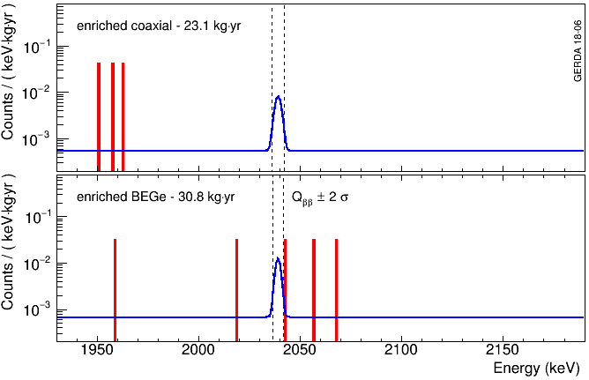
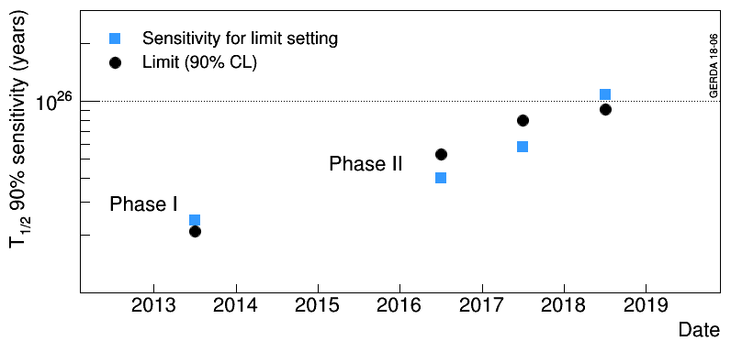
GERDA: results 2018
60 kg yr of data collected in Phase II by April 2018
82.4 kg yr in total (Phase I + II)
Unique background indices achieved:
Coax: ${5.7}_{−2.6}^{+4.1}×{10}^{−4}$ cts/(keV∙kg∙yr)
BEGe: ${5.6}_{−2.4}^{+3.4}×{10}^{−4}$ cts/(keV∙kg∙yr)
New 2018 limits:
Median sensitivity for limit setting:
$1.1×{10}^{26} \text{yr}$ (world best!)
Best fit → no signal
Probability to have stronger limit 63%
best in the field when normalized to FWHM!
after all cuts
$T_{1/2}^{0ν}>{0.9×10}^{26}\text{yr}$
$$T_{1/2}^{0ν}>{0.9×10}^{26} \text{yr} \text{(90\% }\text{CL}\text{)}$$
$m_{ββ}^{}>{112−228 meV}^{}$
Preliminary
GERDA reached important milestone for 0νββ search!
Notes:
GERDA Phase II is taking data since December 2015. 60 kg yr of data were collected in Phase II by April 2018. Together with Phase I we have more than 80 kg yr. The background index is improved by almost two times compared to the previous release and stays the best among all double beta decay experiments.
The unprecedented median sensitivity of more than 10²⁶ yr was reached first time ever. This is very important milestone for 0νββ search.

Slide 7
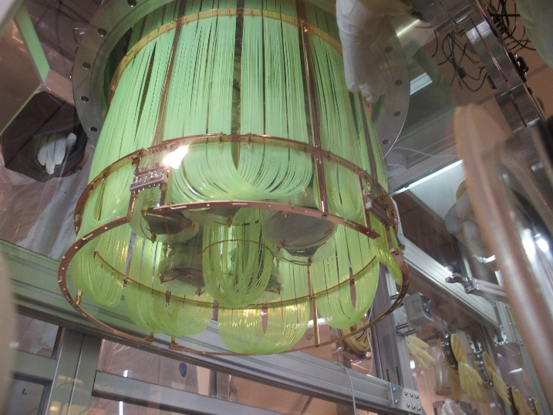
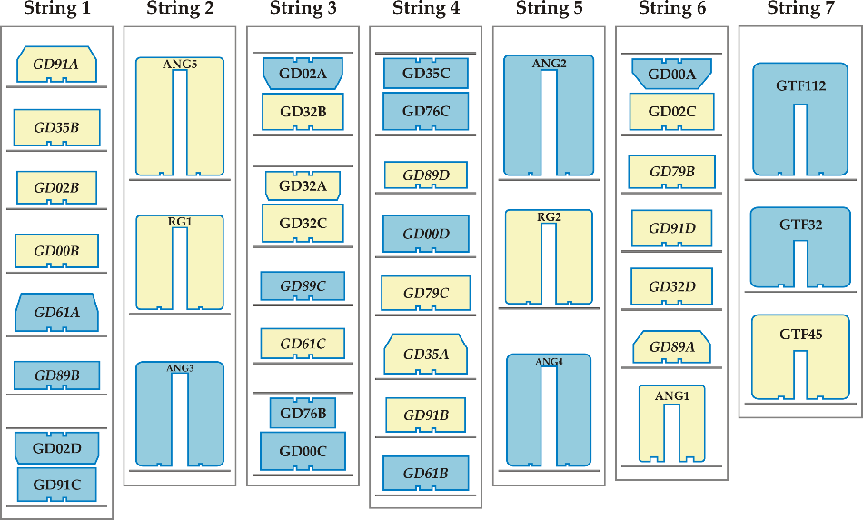
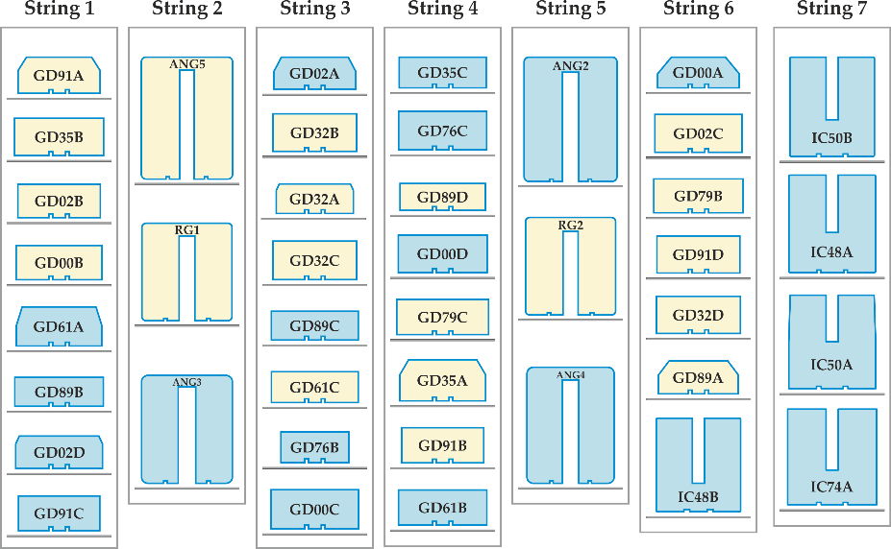
GERDA: upgrade 2018
Upgrade of the GERDA experiment aimed to:
Test the novel detectors + increase the mass of ⁷⁶Ge
Total increase of ⁷⁶Ge mass ~ 6 kg!
Show the possibility to improve the background index
Exchange all cables by new ones with better radiopurity
Replace old LAr veto by improved version
Repair broken JFETs and electronic channels
Prove the robustness and reproducibility of the GERDA approach (very important for the next generation Ge project)
Notes:
In 2018 the GERDA collaboration performed the upgrade aimed to test the novel Ge detectors and increase the mass of ⁷⁶Ge.
Another goal was to show the possibility to improve the background index and to prove the robustness and reproducibility of the GERDA approach, which is very important for the future Ge experiments.

Slide 8
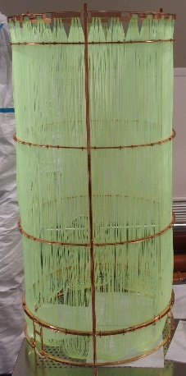
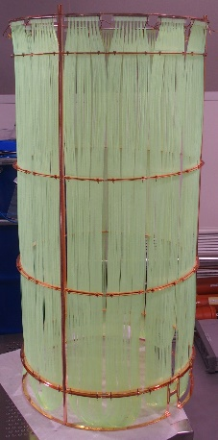
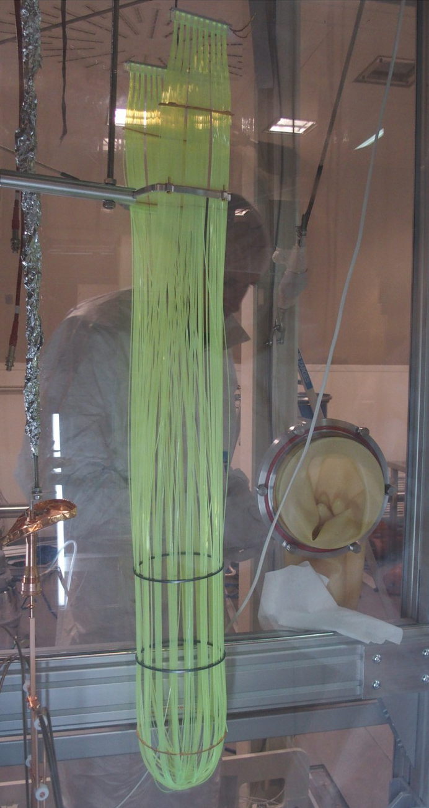
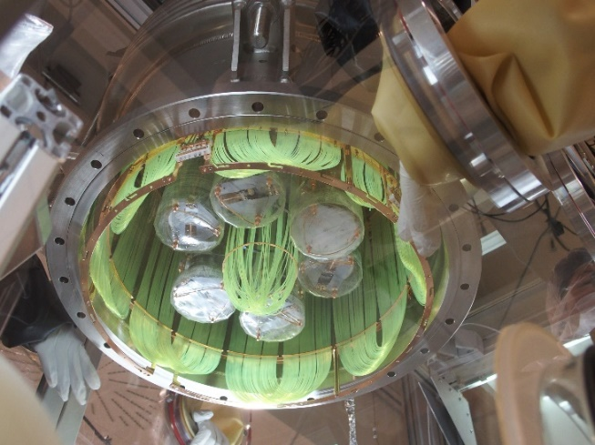
GERDA: successful upgrade 2018
New LAr veto:
new fiber curtain (improved light collection) + central module to read out hidden Ar volume
Old curtain
New curtain
New readout
1215 fiber ends, 135 SiPMs
810 fiber ends, 90 SiPMs
9 SiPMs mounted on fused
synthetic quartz substrate
Central module
²²⁸Th spectra before and after upgrade
Produced
Designed
Installed
Designed, produced and installed by common TUM & JINR team
Notes:
The new liquid argon veto system includes new fiber shroud with improved light collection and central module needed to view hidden LAr volume.
The new liquid argon veto system has been produced, tested and installed in GERDA by common TUM and JINR group.

Slide 9
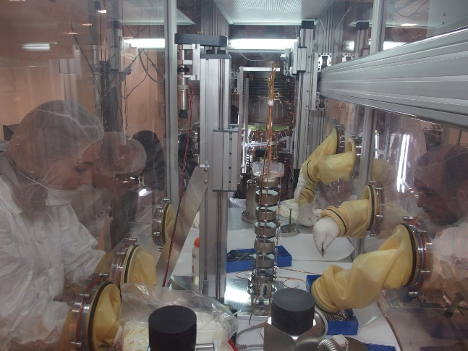
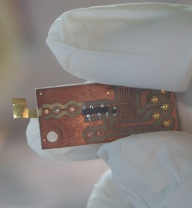
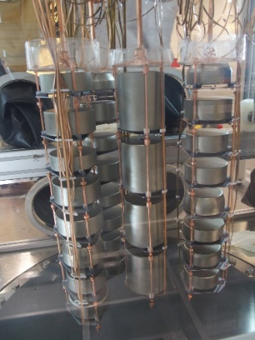
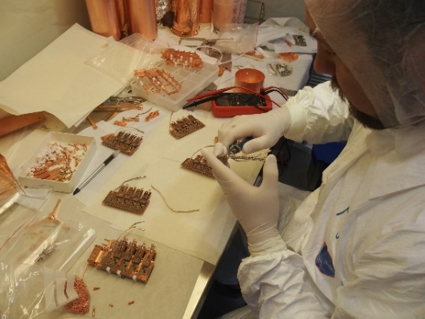
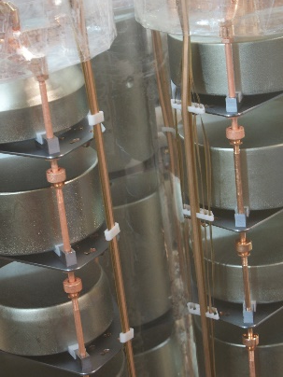
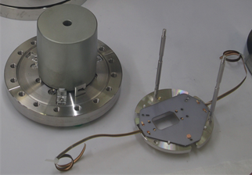
GERDA: successful upgrade 2018
All detectors were dismounted from the strings and holders, bonded with new cables and mounted back
Broken electronic channels repaired and protective diodes installed
New signal cable routing to reduce the cross-talk and improve resolution
 | Pyralux 3 mil TECNOMEC | Cuflon HV Haefele | Cuflon signal Haefele
²²⁶Ra | < 3.8 mBq/kg x 0.5 g → < 2 μBq | (8 ± 2) mBq/kg x 2.7 g → (22 ± 5) μBq | (50 ± 10) mBq/kg x 0.5 g → (25 ± 5) μBq
²²⁸Th | < 5.5 mBq/kg x 0.5 g → < 3 μBq | < 8.3 mBq/kg x 2.7 g → < 22 μBq | < 21 mBq/kg x 0.5 g → < 11 μBq
⁴⁰K | (0.11 ± 0.03) Bq/kg x 0.5 g → (55 ± 15) μBq | (0.11 ± 0.03) Bq/kg x 2.7 g → (300 ± 80) μBq | (0.2 ± 0.1) mBq/kg x 0.5 g → (100 ± 50) μBq
⁶⁰Co | < 0.77 mBq/kg x 0.5 g → < 0.4 μBq | < 2.3 mBq/kg x 2.7 g → < 6.2 μBq | < 17 mBq/kg x 0.5 g → < 8.5 μBq
²³⁷Cs | < 1.2 mBq/kg x 0.5 g → < 0.6 μBq | < 2.4 mBq/kg x 2.7 g → < 6.5 μBq | < 10 mBq/kg x 0.5 g → < 5.0 μBq
after upgrade
before upgrade
New cables
Old cables
Notes:
All detector cables were exchanged by new ones with better radiopurity. To do this we had to dismount all 40 detectors from strings and holders, rebond them with new cables and mount everything back.
We have also repaired all broken electronic channels. In addition, the routine of signal cables has been changed. That helped to improve the energy resolutions for most of detectors.

Slide 10
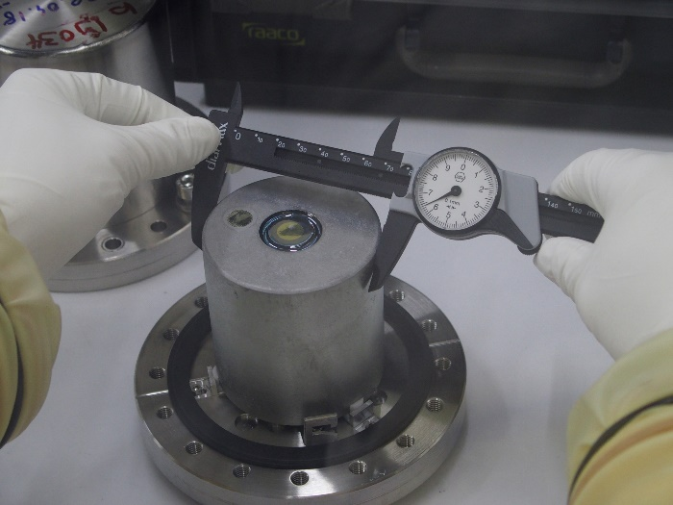
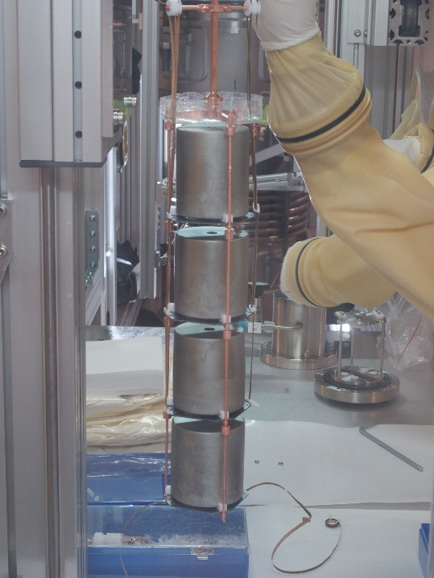
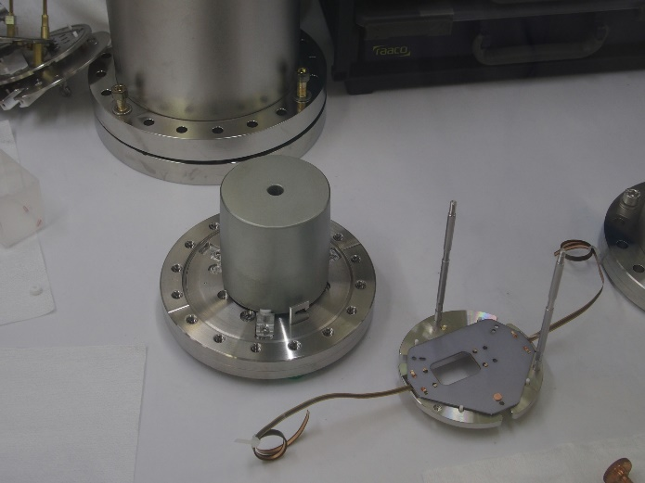
GERDA: successful upgrade 2018
5 inverted coaxial detectors made from ⁷⁶Ge have been produced, characterized and mounted in the GERDA setup to replace the detectors made from natural Ge
Results of upgrade 2018:
Entire upgrade operation lasted ~5 weeks in April/May + 1 week in July
Performed by JINR + MPIK + TUM + INFN team
All electronic channels are functioning
No deterioration of detectors leakage current after upgrade
New fiber shroud and central fiber module are working
Energy resolutions improved
Novel ⁷⁶Ge detectors installed
Only enriched detectors in GERDA now!
GERDA will collect data until the end of 2019 then…
Notes:
5 novel inverted coaxial detectors, which are good candidates for tonne-scale Ge project, were produced, characterized and installed. ⁷⁶Ge mass is increased by about 6 kg!
The upgrade operation was successfully performed in Spring and Summer 2018. It took less than 2 months (note, that all detectors had to be fully disassembled and assembled again). It performed with the leading role of JINR specialists and brought the very useful experience for the next generation germanium project LEGEND.

Slide 11
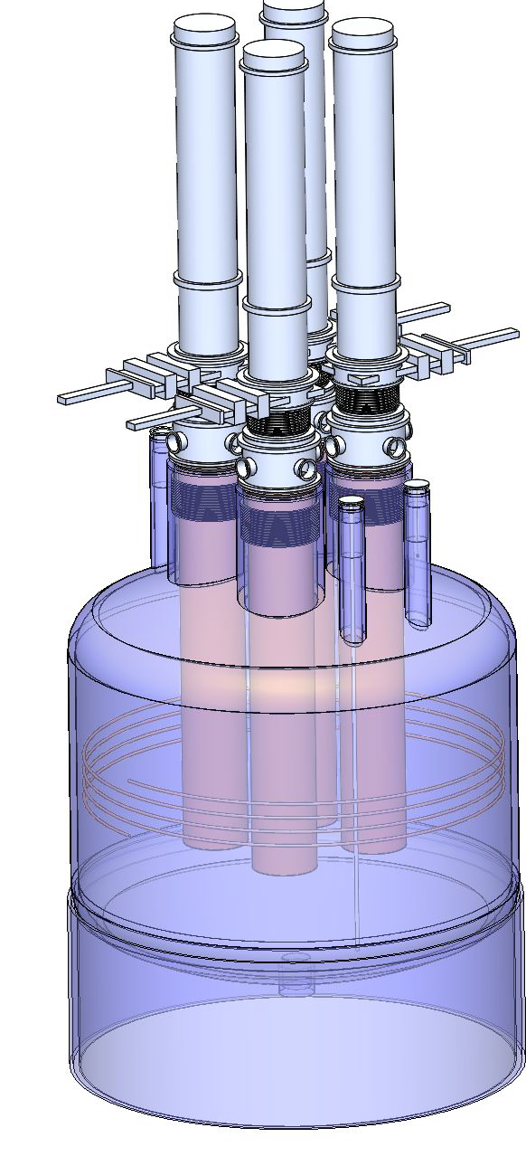
LEGEND: the best from GERDA and MJD
Large Enriched Germanium Experiment for Neutrinoless ββ Decay
First stage (L200):
(up to) 200 kg in modified GERDA infrastructure at LNGS
bkg reduction by factor 3-5 w.r.t GERDA
Sensitivity 10²⁷ yr
Plan to start data taking in 2021
Subsequent stages:
1000 kg (staged)
timeline connected to DOE down select process
bkg factor 30 w.r.t GERDA
Location tbd
Sensitivity 10²⁸ yr
Notes:
The GERDA will take data until the exposure of 100 kg yr will be reached (at the end of 2019). At that time the sensitivity should be well above 10²⁶ yr. However, this sensitivity will not allow getting an information about neutrino mass hierarchy.
To answer this question the new generation experiment LEGEND is being built. It is foreseen at least two phases of the project. The first phase (LEGEND-200) will operate with ~ 200 kg of enriched isotope and the expected sensitivity will be 10²⁷ years. The second phase (LEGEND-1000) will use 1000 kg and would be reach 10²⁸ years.
It should be noted, that a germanium experiment has good discovery potential of because the excellent energy resolution of Ge detectors. LEGEND-200 will be carried out in the modified GERDA infrastructure at LNGS. The goal is to start data taking in the first phase of LEGEND in 2021.

Slide 12
Thank you for attention

Slide 14
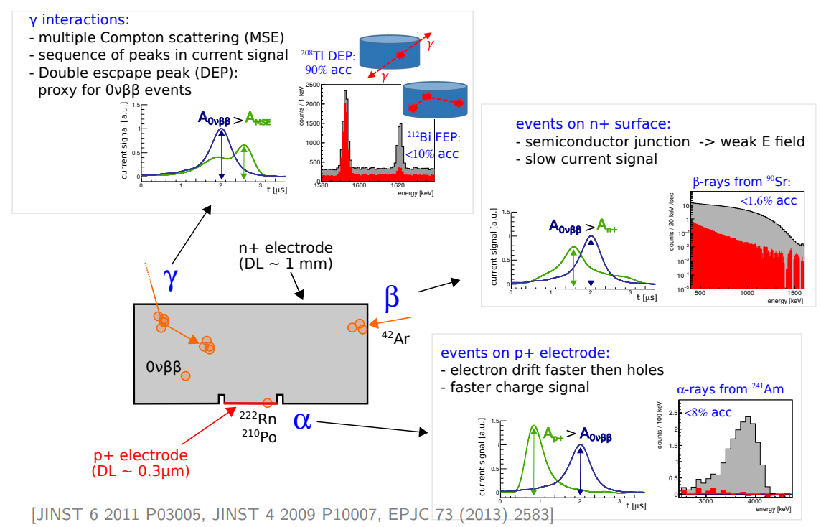
Pulse Shape Discrimination for BEGe detector

Slide 15
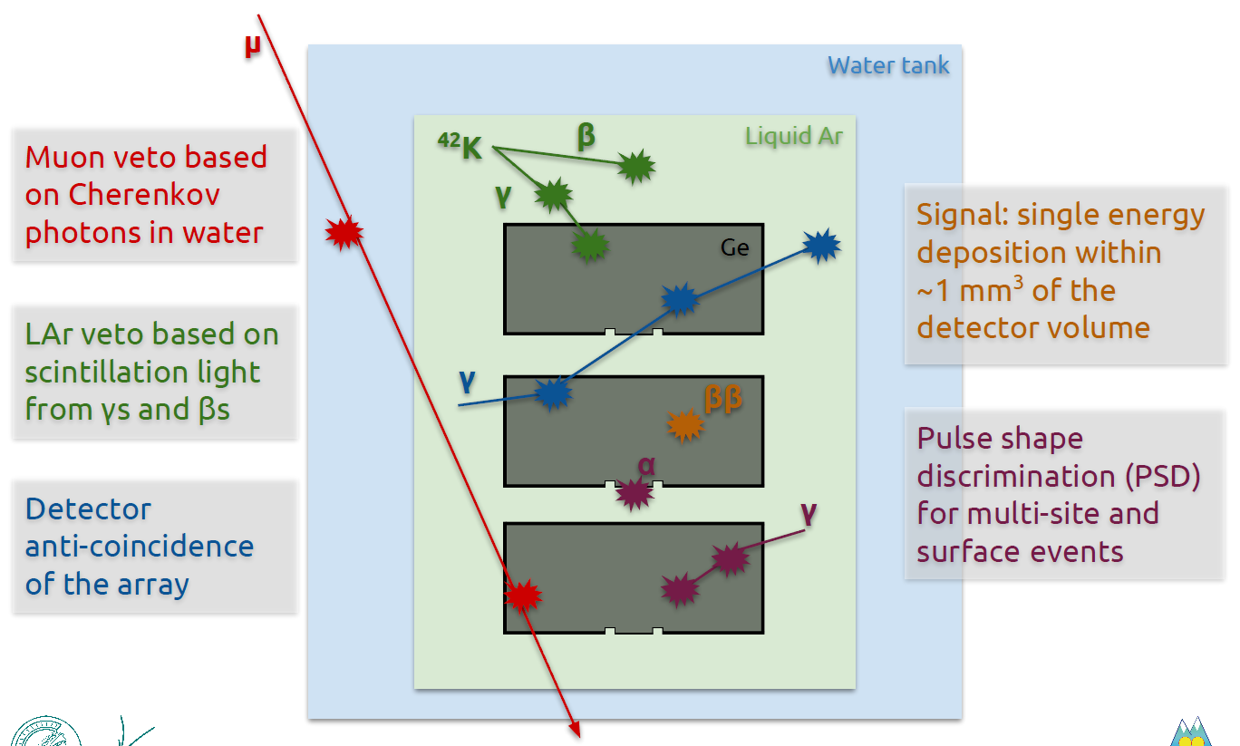
Background reduction concept
Source: AJ Zsigmond’s talk at Neutrino 2018

Slide 16
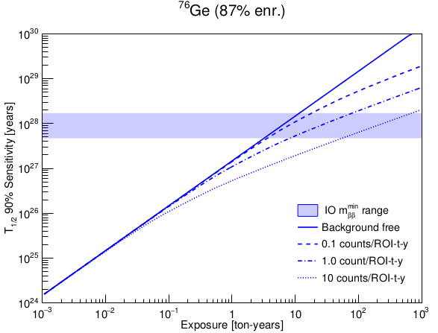
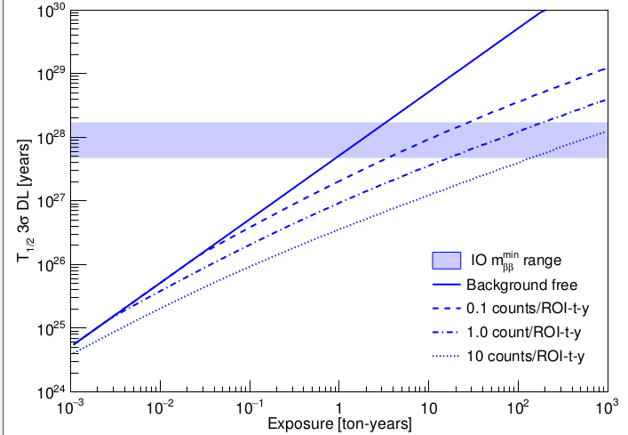
LEGEND: sensitivity
T_{1/2} limit (90% C.L.)
Discovery (50% chance for a 3σ signal)
LEGEND 1000kg
LEGEND 1000kg
18 meV, different NME
LEGEND 200kg
LEGEND 200kg
GERDA-II / MJD
GERDA-II / MJD
T_{1/2} unknown, BSM → 'around corner‘
background reduction in steps → phased approach
inputs: 60% efficiency (GERDA number)
Background: GERDA/MJD ~ 3 cts/(FWHM t yr)
200 kg ~ 0.6 cts/(FWHM t yr)
1000 kg ~ 0.1 cts/(FWHM t yr)
N.B.: background-free operation
is a prerequisite for a discovery

Slide 17
$$\frac{1}{T_{1/2}^{0ν}}=G^{0ν}{\left|M^{0ν}\right|}^{2}\frac{{\left\langle m_{ββ}\right\rangle }^{2}}{m_{e}^{2}}$$
$$G^{0ν}$$
= phase space factor
$$M^{0ν}$$
= nuclear matrix element
$$m_{e}$$
= electron mass

