Slide 1
UNECE Convention on Long-Range Transboundary Air Pollution (LRTAP) - Update
Krzysztof Olendrzynski on behalf of the CLRTAP secretariat
29th Task Force meeting of ICP Vegetation, Dubna, Russian Federation, 1-2 March 2016
Notes:
Adopted in 1979; 51 Parties in Europe, North America, the Caucasus and Central Asia

Slide 2
Outline
Convention and its Protocols, policy – science links
Update on science (EMEP, Working Group on Effects)
Draft 2016 Assessment Report – a major science report of the Convention
Update on policy (34th session of Executive Body, 18 Dec 2015, WGSR)
Update on capacity building activities
Update on outreach and communications

Slide 3
Convention on Long-range Transboundary Air Pollution
Established in 1979; 51 Parties: Europe, North America, Central Asia
Protocols that cover key air pollutants:
  The 1999 Protocol to Abate Acidification, Eutrophication and Ground-level Ozone (Gothenburg Protocol); amended in 2012 (PM2.5 and black carbon added)
  The 1998 Protocol on Persistent Organic Pollutants; amended in 2009
  The 1998 Protocol on Heavy Metals; amended in 2012
  The 1994 Protocol on Further Reduction of Sulphur Emissions;
  The 1991 Protocol concerning the Control of Emissions of Volatile Organic Compounds or their Transboundary Fluxes;
  The 1988 Protocol concerning the Control of Nitrogen Oxides or their Transboundary Fluxes;
  The 1985 Protocol on the Reduction of Sulphur Emissions or their Transboundary Fluxes by at least 30 per cent;
  The 1984 Protocol on Long-term Financing of the Cooperative Programme for Monitoring and Evaluation of the Long-range Transmission of Air Pollutants in Europe (EMEP).

Slide 4
Effects-based approach in design and functioning of the Convention’s Protocols
Actions driven by observed effects of air pollution on human health, vegetation, crops, waters, forests, materials …
Science supported policy making
Multi effect, multi pollutant approach - Gothenburg Protocol
Agreed actions:
National emission ceilings, emission limit values for various source categories (installations), obligation to apply best available techniques, obligations on reporting (also policies and measures)

Slide 5
Update from the EMEP Steering Body and the Working Group on Effects
1st joint session of EMEP Steering Body and WGE; joint highlights and recommendations for policy
EMEP trend assessment report (emissions, concentrations/depositions, atmospheric and integrated assessment modeling)
WGE trend assessment report (health impacts, impacts on ecosystems, crop and material damage)
Both assessments complemented each other and provided key input to the 2016 Assessment report (scientific report)
Joint work of EMEP/WGE and AMAP of the Arctic Council
Information sharing with WHO, Stockholm and Minamata Conventions
Notes:
Highlights from the 1st joint session of the two bodies – mid September 2015
Both trend assessments provided input to the assessment report and both to be completed in 2016

Slide 6
Monitoring programme within EMEP:
Level 1
Main ions in precipitation and in air
heavy metals in precipitations
ozone
gas particle nitrogen ratios (low cost)
PM₁₀ and PM_{2.5} mass
meteorology
at ca 125 sites
Level 2, supersites (joint EMEP/Global Atmosphere Watch)
PM composition (EC/OC, mineral dust)
Aerosol physical and optical properties
CH₄
Tracers (CO and halocarbons)
POPs
Heavy metals in air and aerosols
VOC
+ all level 1 activities
20-30 sites
Both levels are mandatory for all Parties

Slide 7
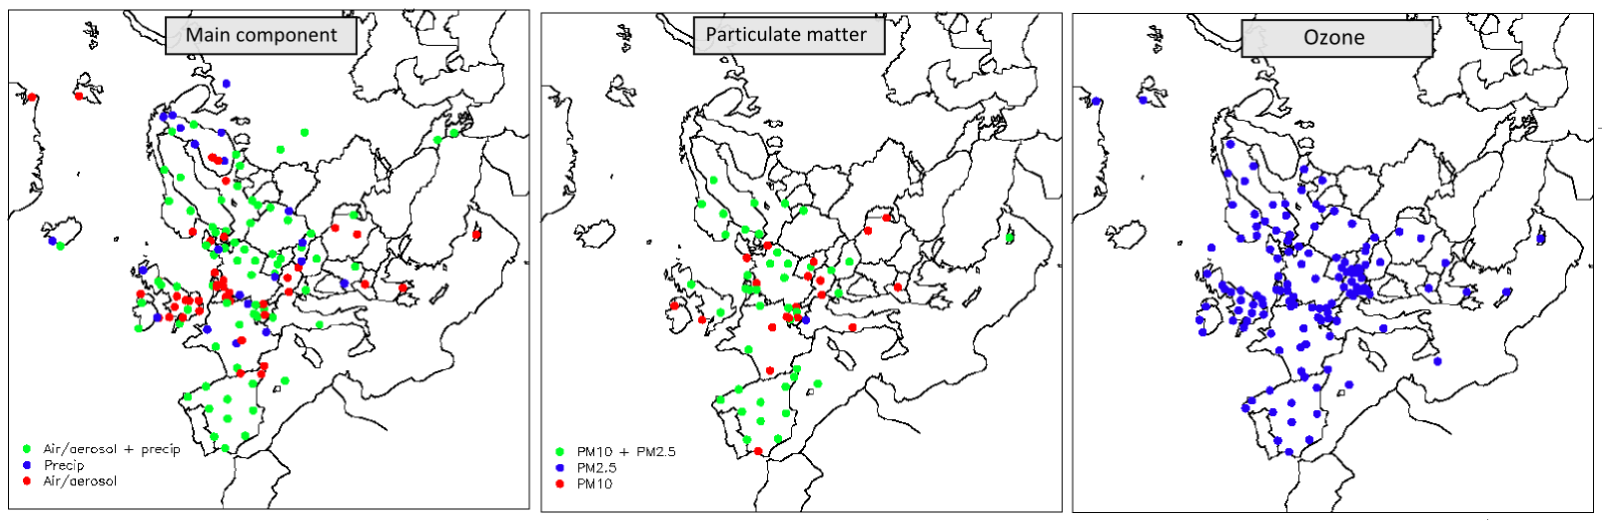
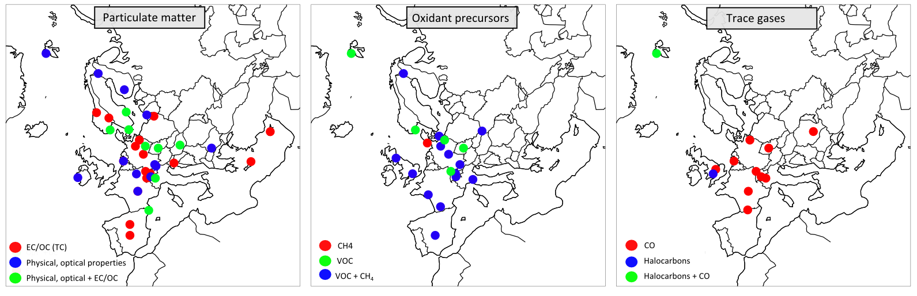

EMEP sites in 2013
Level 1: Relatively good coverage except towards East, though challenges with sampling frequency
Level 2: Large improvements in density and quality in aerosol network, a need for similar improvements for VOC and trace gases

Slide 8
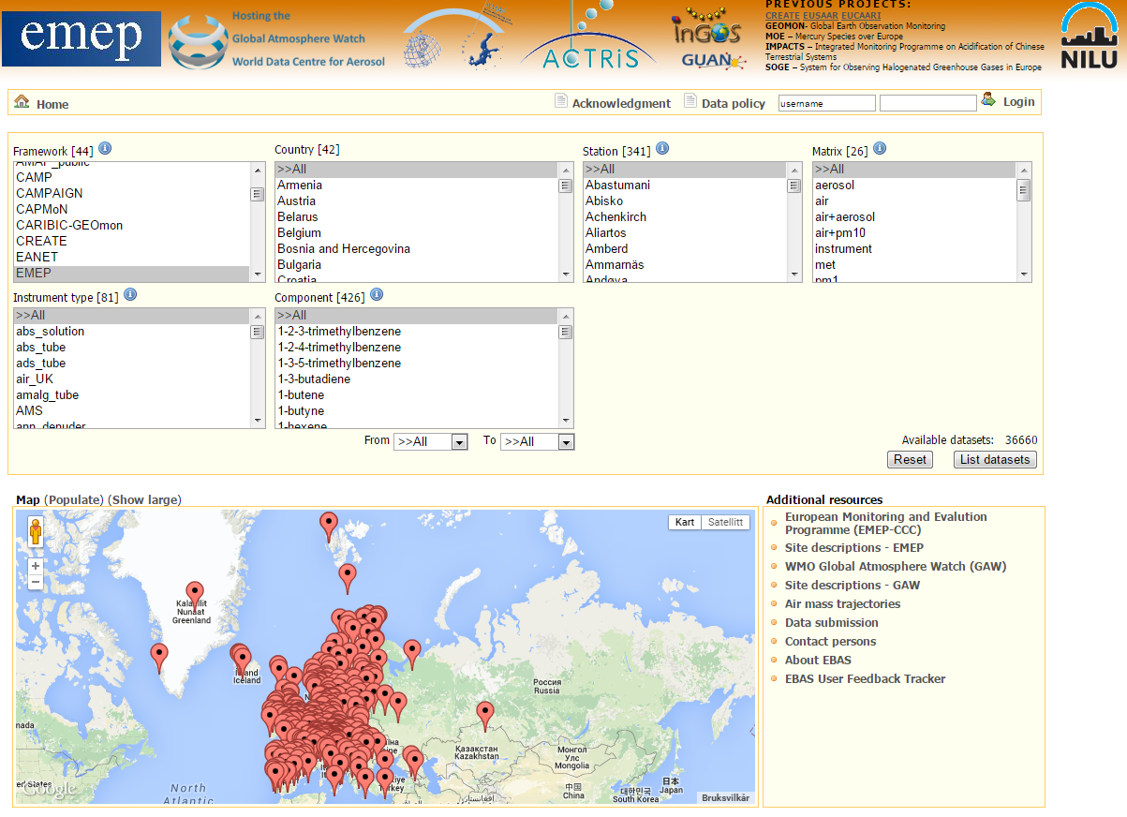
Free access to EMEP data: http://ebas.nilu.no/

Slide 9
Draft 2016 Assessment Report
Key messages:
Significant achievements: recovery from acidification, major reductions of sulphur, nitrogen oxides and lead emissions and related impacts
Challenges remain: impacts on health and ecosystems; PM2.5, ground level ozone; excess nitrogen and related biodiversity loss
95% of population exposed to excess concentrations (PM2.5, O3), ~600,000 premature deaths annually (UNECE region); up to 15 % damage to wood and crop production; significant loss of GDP
High background concentrations levels throughout Europe; emission reduction efforts needed at all spatial scales from urban to regional
Costs of control generally far less than damage costs; for industry costs of absence from work higher than abatement costs
Links with climate policies (black carbon, methane); challenges: biomass burning and biofuels, incentives for diesel vehicles!
Air pollution controls linked to several Sustainable Development Goals (SDGs)

Slide 10

Success of Convention in reducing emissions of air pollutants
Notes:
Emissions of major pollutants were reduced from 40 to 80% since 1990

Slide 11
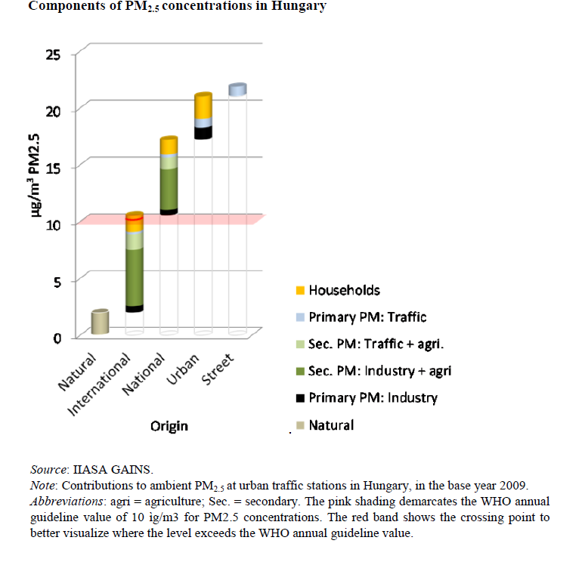
Why transboundary cooperation is on air pollution mitigation is essential?

Slide 12
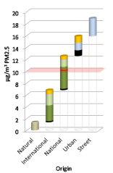
Netherlands Germany Poland
In several countries local PM2.5 levels are strongly influenced by secondary particles (ammonium sulphate and ammonium nitrate) from transboundary sources (IIASA, TSAP12, 2014)

Slide 13
Updates from the Working Group on Strategies and Review
Task Force on Reactive Nitrogen (TFRN)
UNECE Framework Code for Good Agricultural Practice for Reducing Ammonia Emissions published
Increasing evidence of contribution of ammonia to PM2.5 formation
UNECE joined a multi-partner initiative Towards the Establishment of the International Nitrogen Management System (GEF funded project)
TFRN to continue to work on the relationship between human diets and the impact of the nitrogen cycle on the environment (in cooperation with WHO) through its Expert Panel on Nitrogen and Health

Slide 14
Updates from the Working Group on Strategies and Review
Task Force on Techno-economic Issues (TFTEI)
Guidance document on emissions from mobile sources under the Gothenburg Protocol – latest technical information on emission control techniques for vehicles – to be adopted by 35th Executive Body
Guidance Document for estimation and measurement of emissions of Volatile Organic Compounds – to be adopted at 35th EB
Methodological support to countries on best available techniques (BATs) through elaboration of tools and dedicated workshops
53rd WGSR session – Geneva,15-17 December 2015
Exchange of experience on national policies, strategies and measures

Slide 15
Guidance documents to support implementation
Guidance document on control techniques for emissions of sulphur, nitrogen oxides, volatile organic compounds and particulate matter (including PM10, PM2.5 and black carbon) from stationary sources
Guidance document on economic instruments to reduce emissions of regional air pollutants
Guidance document on national nitrogen budgets
Guidance document on preventing and abating ammonia emissions from agricultural sources
Guidance document on health and environmental improvements using new knowledge, methods and data
Ammonia Framework Code for Reducing Emissions in Agriculture
Guidance document on mobile sources
Support for governments: guidance documents, emission limit values, information sharing on good practices

Slide 16
UNECE led capacity building activities on air pollution in 2013-2015
Contributions by the European Union, Norway, Switzerland and the Netherlands; a needs driven programme
Air pollutant emission inventories (development and reporting) - consultancy support and a series of workshops organized in Azerbaijan, Armenia, Georgia, Kazakhstan, Republic of Moldova, Uzbekistan, Ukraine.
2015: analysis of the national air quality assessment and management policies and legislation in Uzbekistan, identifying gaps and providing recommendations on further steps towards ratification
Support to participation of delegates and experts from Eastern Europe, the Caucasus and Central Asia in the regular meetings of the subsidiary bodies and meetings of task forces aimed at improving their capacities;
Awareness-raising among decision-makers
New contribution by the Russian Federation

Slide 17
8th Environment for Europe Ministerial Conference in Batumi, Georgia, June 2016
At its 20th meeting, UNECE’s Committee on Environmental Policy (CEP) decided on two themes for the Conference:
  Greening the economy in the pan-European region
  Improving air quality for a better environment and human health
Conference as an opportunity to provide major inputs through a number of avenues:
  Shaping the ministerial discussions (background paper)
  Action for Cleaner Air Initiative
  Presentation of the 2016 Assessment Report
  Communications and outreach

Slide 18
Outreach within and beyond UNECE region
Important component of the Convention’s Long-term strategy
Cooperation and information sharing with the following processes:
East Asia Acid Deposition Network (EANET)
UNESCAP NEASPEC project on regional air pollution
Regular contacts between scientific communities and academia on monitoring and modelling, including through the Task Force on Hemispheric Transport of Air Pollution (TFHTAP)
Tightening of cooperation between CLRTAP and the Arctic Council
Notes:
NEASPEC – North-East Asia Subregional Programme for Environmental Cooperation, www.neaspec.org
UNESCAP – United Nations Economic and Social Commission for Asia and the Pacific
Participation of EANET experts in EB meeting, design of monitoring programme based on EMEP experience
Strong cooperation under the NEASPEC project
Transport – diesel exhaust
Agricultural ammonia emissions as an important source of PM2.5

Slide 19
WHO: air pollution - world’s largest single environmental health risk (2014)
Due to increasing number of evidence of air pollution effects, especially on human health, and due to links with climate change mitigation, air quality is high on the agenda
United Nations Environment Assembly resolution 1/7 (2014)
World Health Assembly resolution 68.8 on addressing health impacts of air pollution (2015)
Air quality embedded under targets 3.9, 11.6, 12.4 of Sustainable Development Goals (healthy lives, sustainable settlements, sustainable consumption and production)
COP-21: UNECE and WHO to co-organized a side event and exhibition booth on health aspects including air pollution; other side events on air pollution (with EU); also UNEP/CCAC events
Notes:
Goal 3. Ensure healthy lives and promote well-being for all at all ages
Target 3.9 By 2030, substantially reduce the number of deaths and illnesses from hazardous chemicals and air, water and soil pollution and contamination
Goal 11. Make cities and human settlements inclusive, safe, resilient and sustainable
11.6 By 2030, reduce the adverse per capita environmental impact of cities, including by paying special attention to air quality and municipal and other waste management
Goal 12. Ensure sustainable consumption and production patterns
12.4 By 2020, achieve the environmentally sound management of chemicals and all wastes throughout their life cycle, in accordance with agreed international frameworks, and significantly reduce their release to air, water and soil in order to minimize their adverse impacts on human health and the environment

Slide 20
UNECE/WHO/UNEP interagency cooperation on air pollution
Interagency meetings in February and October 2015 (next meeting: 3 March 2016) at the initiative of UNECE’s Executive Secretary Organizations have strong, mutually supportive mandates on air quality
  Joining efforts to complement and strengthen each other’s work
  Providing strong joint messages to Governments with a bigger impact
  First steps to increase the existing cooperation have been taken; milestones for 2015-2017 have been identified
  Future interagency meetings and growing cooperation to be expected

Slide 21
Other initiatives
Climate and Clean Air Coalition (CCAC)
  UNECE joined CCAC as a non-state partner (Sept 2015)
  Contributions to a number of initiatives to be expected (e.g. Heavy Duty Diesel Vehicles, Household Cooking and Domestic Heating, Regional Assessments of SLCPs, Urban Health)
Tightening of cooperation between CLRTAP and the Arctic Council (technical meetings in Potsdam on 16-17 Feb 2016 (focus on black carbon, Hg and POPs)
Launching 2016 Assessment Report – 31 May 2016 in Brussels

Slide 22
Thank you very much for your attention
http://www.unece.org/env/lrtap/welcome.html
krzysztof.olendrzynski@unece.org

