Slide 1
Reduction of the number of sampling sites in Switzerland for the survey 2015
Lotti Thöni
FUB – Research Group for Environmental Monitoring
Rapperswil, Switzerland
The 29th Task Force Meeting of the UNECE ICP Vegetation
Dubna, Russian Federation

Slide 2
Number of sampling sites, surveys Switzerland
Switzerland has participated in the European moss monitoring surveys since 1990
Year | Number
1990 | 235
1995 | 201
2000 / 2005 / 2010 | 142
2015 | ca. 70
Notes:
Switzerland has participated in the European moss monitoring surveys since 1990.
We started with 235 sites reduced later to 142 till the last survey 2010 mostly due to less funding resources. Now we had to reduce again, to about the half, for the 2015 survey. This was necessary to get funds for measuring POPs.

Slide 3
Reduction of number of sites
Statistical aided reduction?
Various conditions and factors made it difficult
E.g. broad variety of geographically different regions
Notes:
How to reduce the number of sites such that the data are still representative?
I started with thinking about statistical aided reduction but then I noticed that there are various conditions and factors that made it difficult.
For instance because of a broad variety of geographical regions

Slide 4
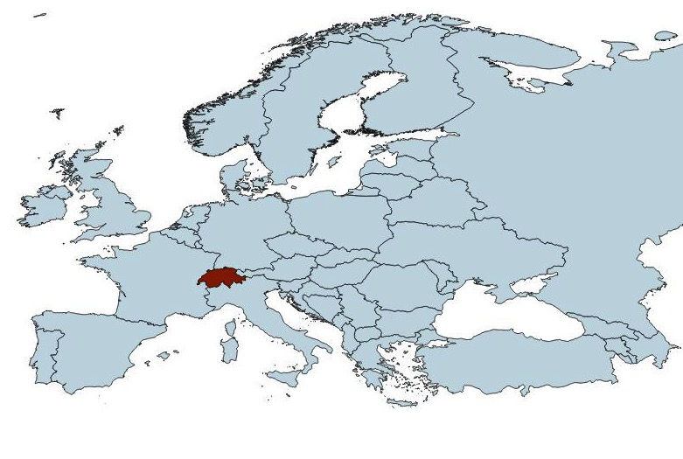
Geographical situation of Switzerland
Notes:
But First to the geographical Situation. Switzerland is a small country in the middle of Western Europe.

Slide 5
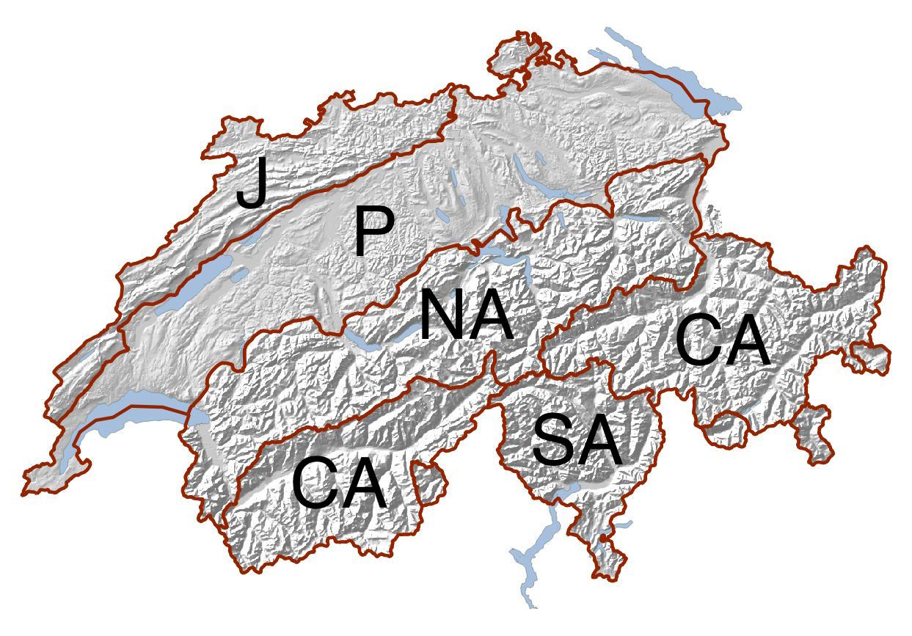
Switzerland and
Geographical regions
8 Mio inhabitants
Area 41’000km²
Jura 12%
Plateau 23%
Alps 65%
Altitude 193-4618m a.s.l.
J = Jura
P = Plateau
NA = Northern Alps
CA = Central Alps
SA = Southern Alps
Notes:
But it has a as already said a variety of landscapes
But first some facts about CH has about 8 mio inhab., mostly living in the P region. The area of CH is about 41’000 squarekm, covering an altitude of 193-4618 m a.s.l. 2/3 of area are situated in the Alps and these are divided in N, C and S alps. Mountains and ridges have a important influence especially on population density and on weather conditions and therefore also on the pollution deposition.

Slide 6
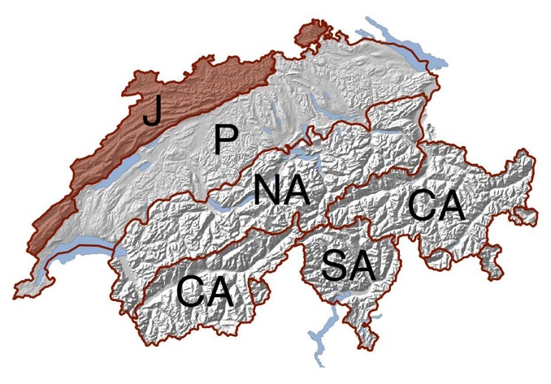
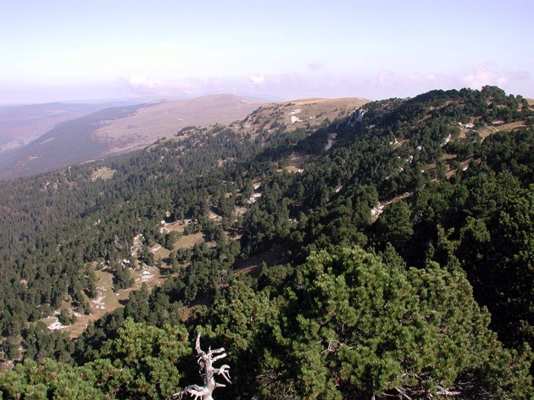
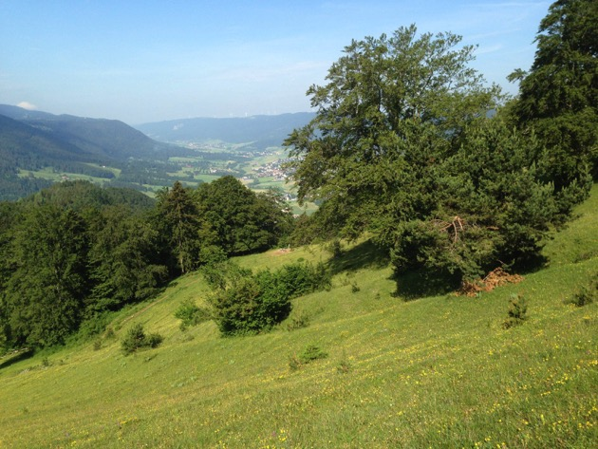
Geographical regions of Switzerland: Jura (J)
Low populated
Ridges
relatively high amount of precipitation
Notes:
Here some information about these regions. Jura is a low populated hilly landscape with ridges, and the precipitations are rel. high as the ridges are the “first” hills, leading to the orographic lift for frequent weather fronts with rain from the West.
Crête de la neige, Aargauer Jura

Slide 7
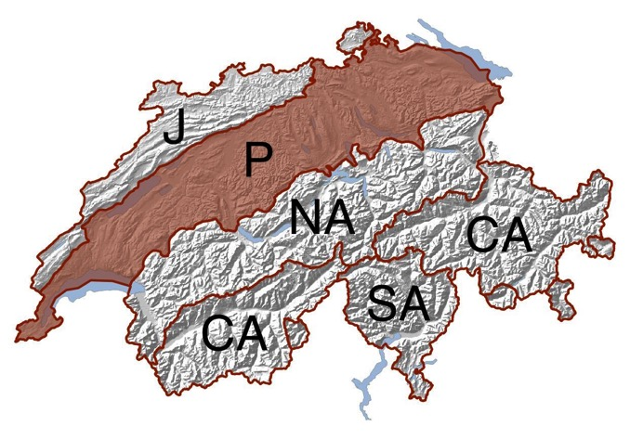
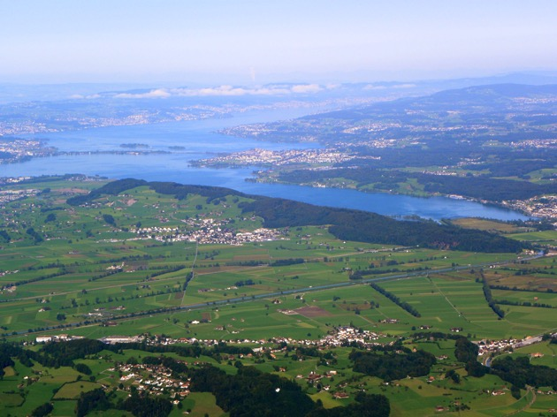
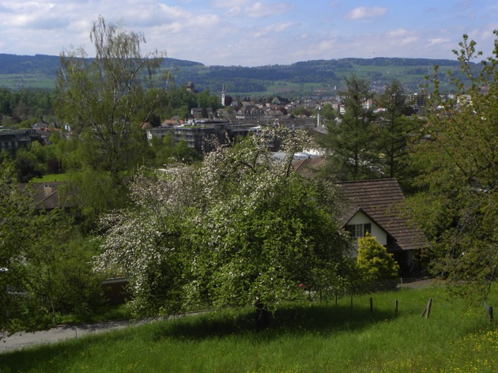
Geographical regions of Switzerland: Plateau (P)
Rel. highly populated
Small hills,
relatively low amount of precipitation
Notes:
Most people of Switzerland live on the hilly Plateau. Here are the “big” cities (at least big for Switzerland) St. Gall, Zürich, Bern the capital, Lausanne, Geneva. There is rel. low amount of precip. because it is sheltered by the J ridges in the West and by the Alps in the South
This is Lake Zurich and the town in Rapperswil, where I live and where we have also our company. Many of you were there 5 years ago.
Uster

Slide 8
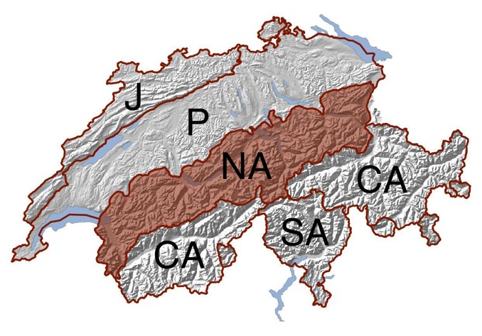
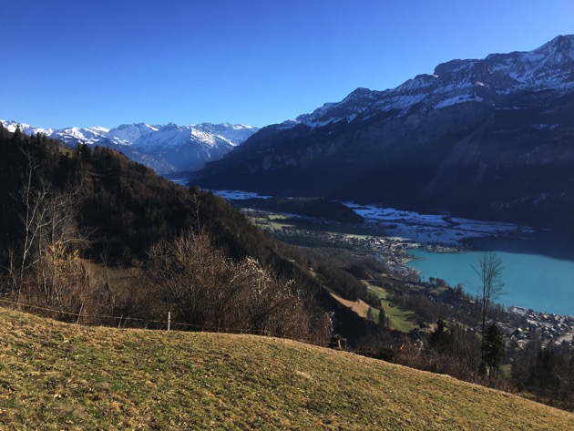
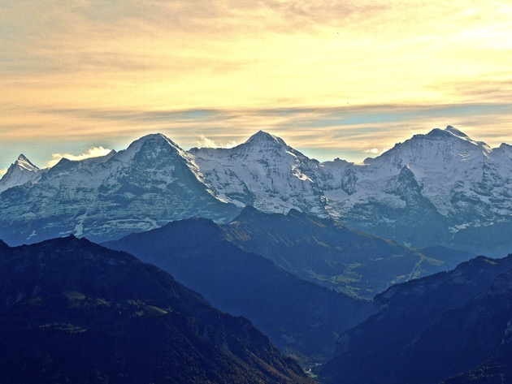
Geographical regions of Switzerland: Northern Alps (NA)
Rel. low populated
High mountains in SE,
relatively high amount of precipitation
(orographic lift)
Notes:
To the Northern Alps. These are rel. low populated due to not many places where you can live. The highest peaks are in the South with more than 4000 m. There is a lot of rain because of the much stronger orographic lift of the weather fronts from West than in Jura .
.
On this picture is Lake Brienz and in the town of Brienz I grew up. On this picture you see the high peaks of Eiger, Mönch und Jungfrau in the Bernese Oberland.

Slide 9
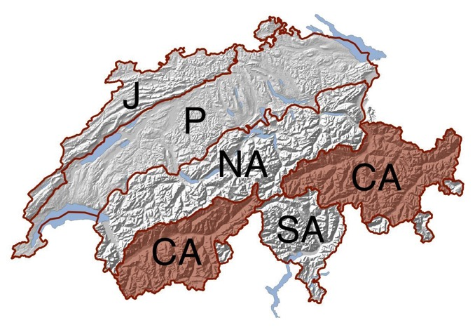
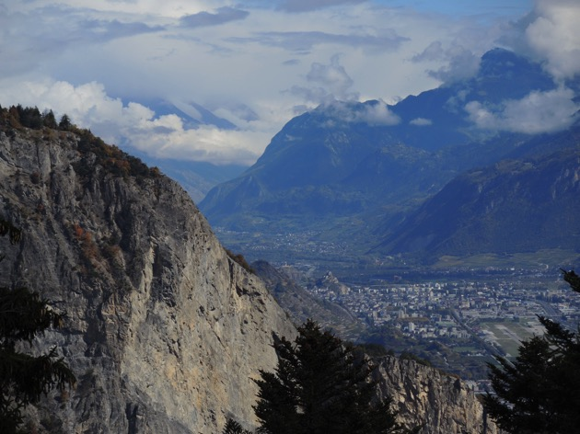
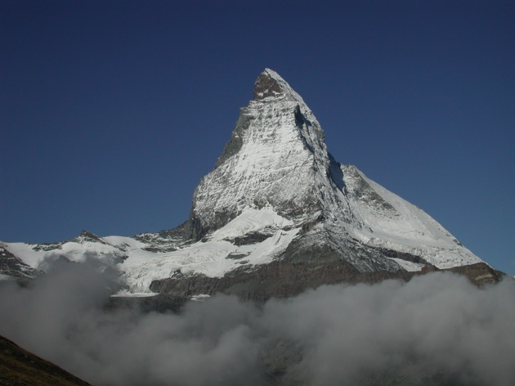
Geographical regions of Switzerland: Central Alps (CA)
Rel. low populated
High mountains on both sides
Low amount of precipitation
Notes:
Central Alp. This is again a rel. low populated regio. There are high mountains in the North and in the South which shelter from the rain fronts. That is why there is a low amount of precipitation in these CA
On the photo we see Sion the main town of Wallis, a great valley surrounded by steep mountains. On the right side we see the Matterhorn the Swiss landmark.

Slide 10
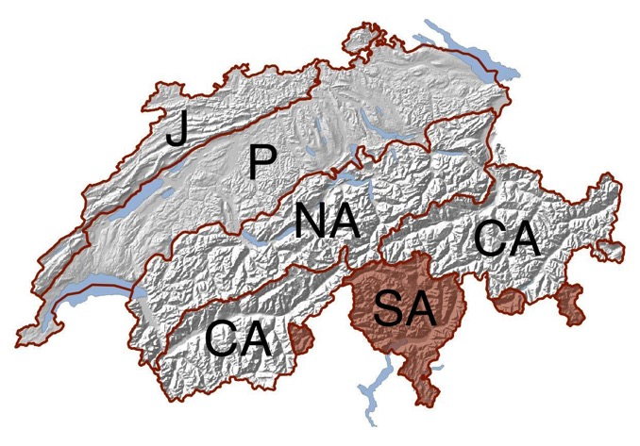
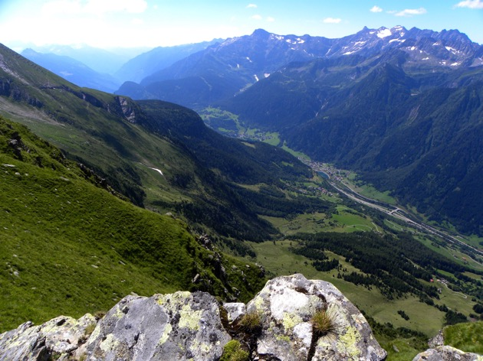
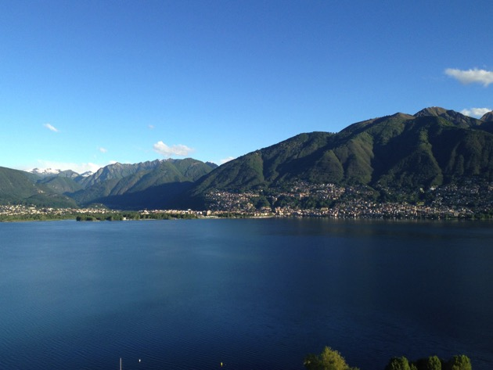
Geographical regions of Switzerland: SA Southern Alps
Rel. low populated
High mountains on the north side
High amount of precipitation
Notes:
Now to the SA: again low populated. High mountains in the north, and therefore high precip. because of the orographic lift of weather fronts from the south.
Leventina with the high mountains and here Lago Maggiore with Locarno

Slide 11
Geographical regions of Switzerland:
The big differences of these 5 regions made it necessary to split the results.
Notes:
As you have seen the variety is big it was nec. to split the results

Slide 12
Procedure for reducing the site number
Pragmatic approach
„site quality“:
20 of 142 sites were not ideal anymore → excluded
122 possible sites left
Notes:
What criteria did we use for reducing the site. As already said we used a pragmatic way.
At first we had to judge the site quality.
During the 20 years from 1990 till 2010 at some of the sites the condition had changed substantially. E.g. there are new buildings or streets nearby, or no open spaces for gathering the mosses anymore.

Slide 13
Pragmatic approach
Out of the remaining 122 sites:
Sites at same location or very close in 1990-2010
Notes:
….. We choose first those where the sampling could be done at the same location or very close. In the Alp regions it was in general possible to sample at the same location every period. But especially on the Plateau we often sampled in clear-cuttings that overgrew between the sampling periods. Often we could find another clear-cutting in the neighbourhood, keeping the location similar within 1990 – 2010. And hopefully in 2015.

Slide 14
Pragmatic approach
Out of the remaining 122 sites:
Sites at same location or very close in 1990-2010
Same moss species in the 5 surveys
Notes:
At some sites there were not taken the same moos species in every survey, sometimes Pleurozium schreiberi sometimes Hypnum cupressiforme. We preferred those sites with the same moss species in all periods.

Slide 15
Pragmatic approach
Out of the remaining 122 sites:
Sites at same location or very close in 1990-2010
Same moss species in the 5 surveys
Sites with other monitoring studies: N, POP, soil, air
Notes:
We preferred also those sites where we have studied also N or POP or where there are sites run by National soil or air monitoring programmes - for comparisons.

Slide 16
Pragmatic approach
Out of the remaining 122 sites:
Sites at same location or very close in 1990-2010
Same moss species in the 5 surveys
Sites with other monitoring studies: N, POP, soil, air
Geographical distribution evenly
Notes:
Then we tried to distribute the sites evenly.

Slide 17
Pragmatic approach
Out of the remaining 122 sites:
Sites at same location or very close in 1990-2010
Same moss species in the 5 surveys
Sites with other monitoring studies: N, POP, soil, air
Geographical distribution evenly
At least 12 sites at the 5 geographical regions
J, P, NA, CA, SA
Notes:
For result analysing reasons we wanted at least 12 sites per the geogr. regions previously mentioned.

Slide 18
Pragmatic approach
Out of the remaining 122 sites:
Sites at same location or very close in 1990-2010
Same moss species in the 5 surveys
Sites with other monitoring studies: N, POP, soil, air
Geographical distribution evenly
At least 12 sites at the 5 geographical regions
J, P, NA, CA, SA
→ 73 sites were chosen
Notes:
These criteria led to 73 sites.

Slide 19
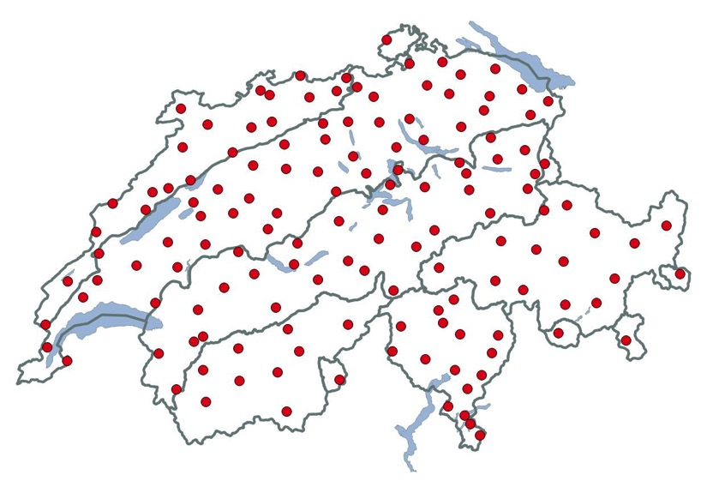
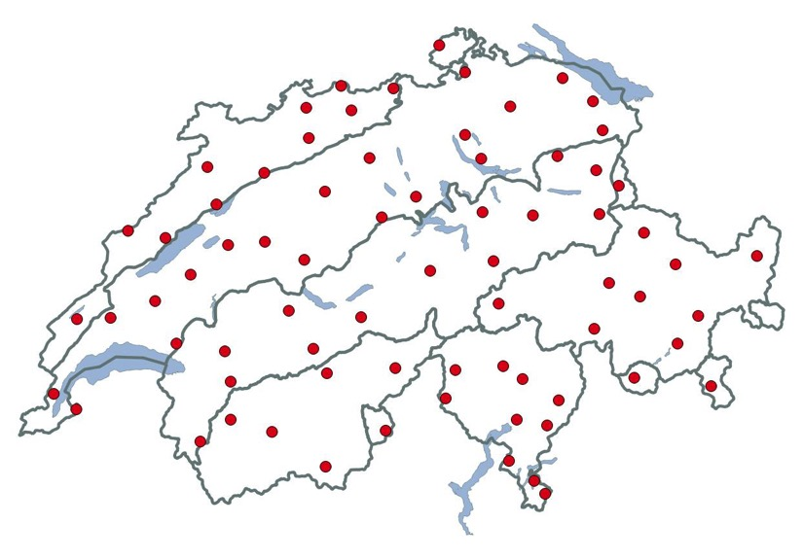
Distribution of sampling sites
142 sites
73 sites
1.7 sites/1000km²
Notes:
Here the distribution of the former studies with 142 sites and that of 73 sites for the survey 2015. This corresponds to 1.7 sites/1000km2. These are still more than the 1.5 sites/1000km2 asked for in the manual.

Slide 20
Comparison 142 vs. 73 sites
Still ± the same information?
Median
Boxplots
Notes:
To find out if we have more or less the same information with 73 sites than 142, we compared Medians and Boxplots.

Slide 21
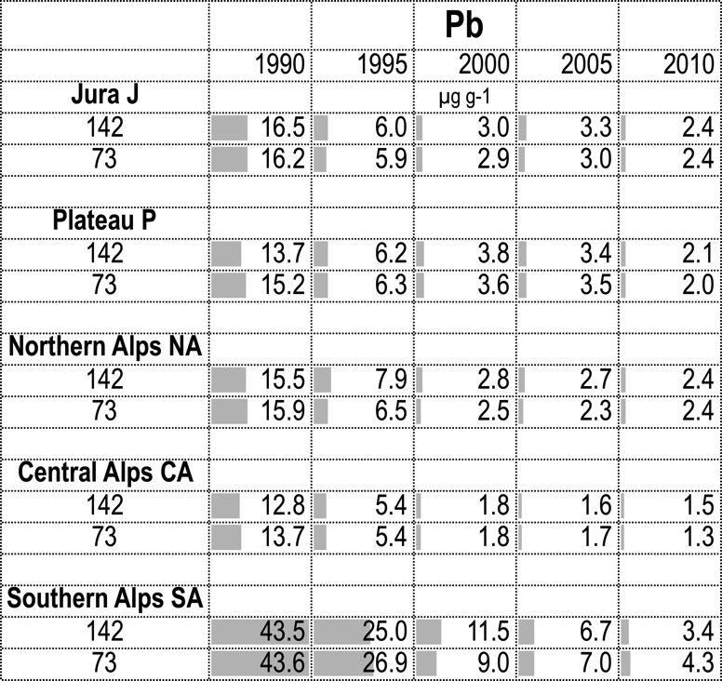
Median Pb
Notes:
As example Pb. We have here the 1990 …2010 surveys, split in the 5 regions and analysing the results of 142 and 73 sites. The Medians are illustrated by grey bars and they indicate the relative concentrations. The reduced 73 sites have mostly a similar median as the 142 sites. There is a good agreement. (showing some ex.)

Slide 22
Pb
J
P
NA
CA
SA
142 sites
1990
1995
2000
2005
2010
11
J
P
NA
CA
SA
73 sites
1990
1995
2000
2005
2010
11
Notes:
The results as Boxplots. We have here J 1990 … to 2010, the same for P…
Above for 142 sites, below reduced to 73 sites
The images are very similar.

Slide 23
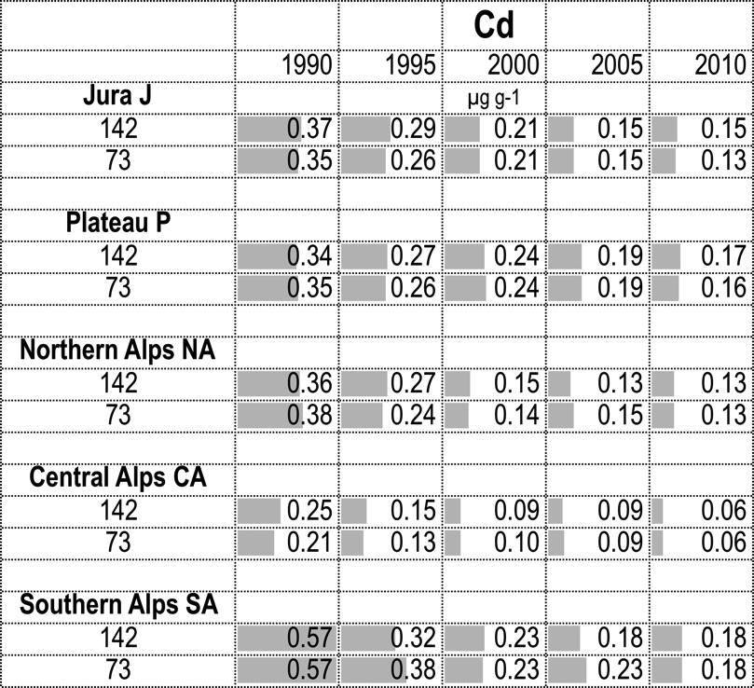
Median Cd
Notes:
Another example, Cd: also here the agreement is good

Slide 24
Cd
J
P
NA
CA
SA
142 sites
1990
1995
2000
2005
2010
11
J
P
NA
CA
SA
73 sites
1990
1995
2000
2005
2010
11
Notes:
Also the Boxplot picture is very similar

Slide 25
V
J
P
NA
CA
SA
142 sites
1990
1995
2000
2005
2010
11
J
P
NA
CA
SA
73 sites
1990
1995
2000
2005
2010
11
Notes:
Here another example, V that is again similar for 142 and 73 sites.
Also the other elements are mostly in a good agreement.

Slide 26
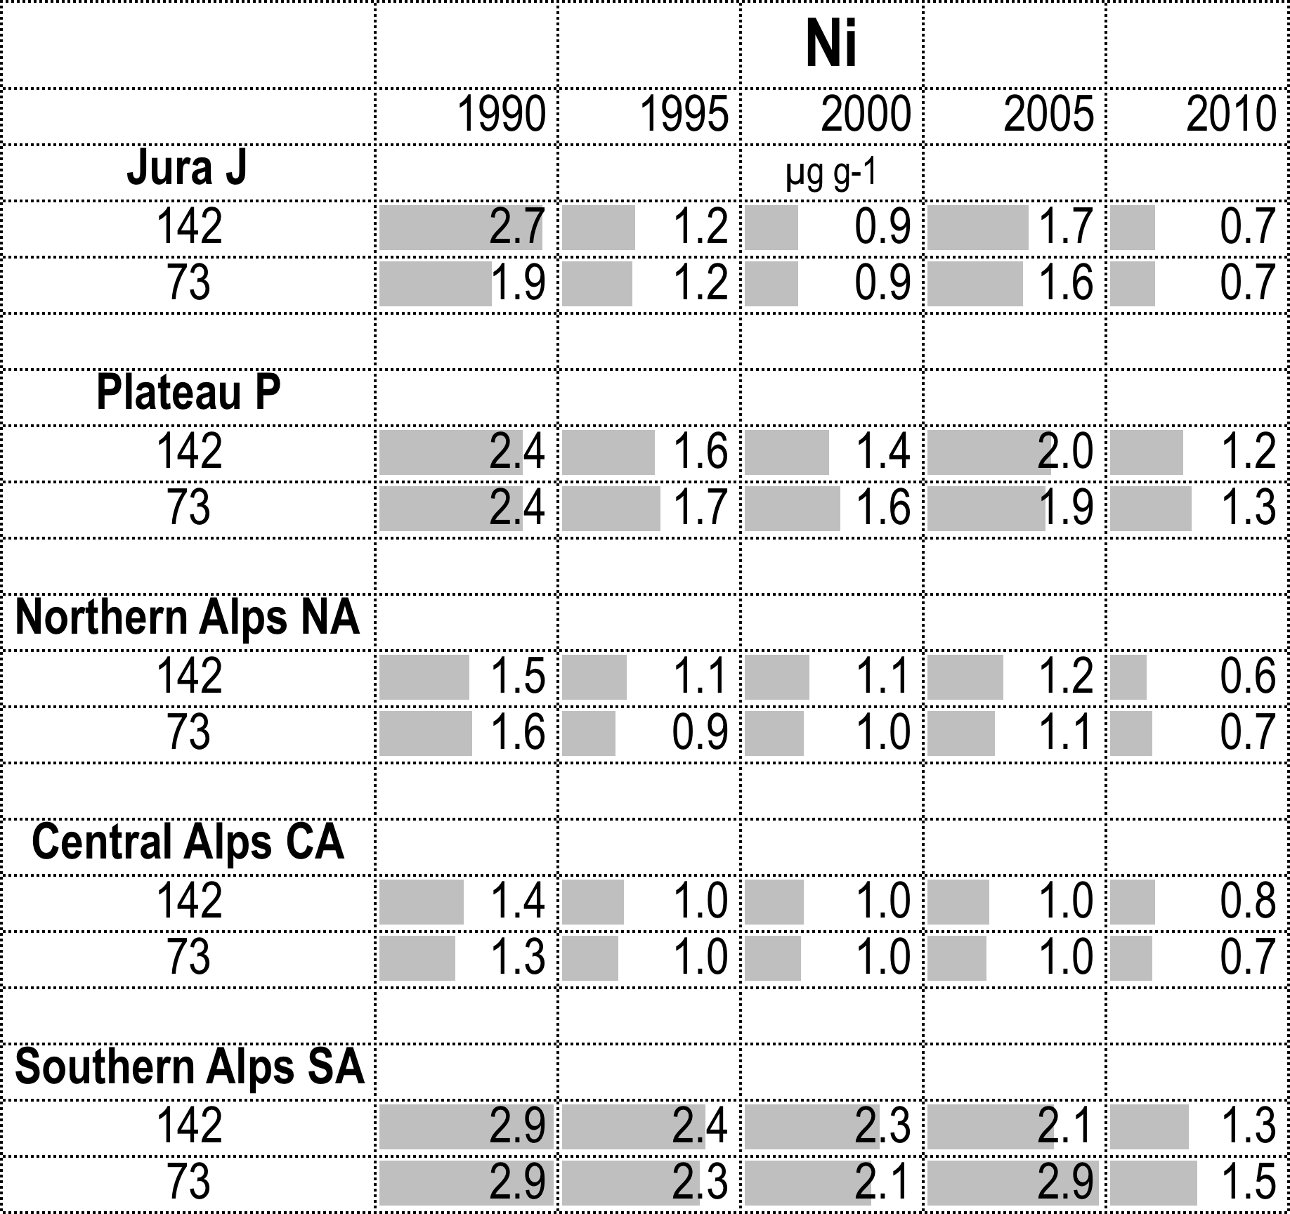
Median Ni
Notes:
An exception is (the agreemen)t in Ni, here the comparison of the median. Especially J 1990 and SA 2005 are not similar.

Slide 27
Ni
J
P
NA
CA
SA
142 sites
1990
1995
2000
2005
2010
11
J
P
NA
CA
SA
73 sites
1990
1995
2000
2005
2010
11
Notes:
But even Ni that had the biggest differences between 142 and reduced number of sites the image is not so different.

Slide 28
Conclusion
The number of sites can be reduced in Switzerland to the half of the earlier surveys (73 sites) without loosing too much of information.
This still represents a coverage of more than the required 1.5 sites/1000km²
Notes:
So we are optimistic that the .......

Slide 29
Thanks
To the Federal Office for the Environment FOEN, Switzerland for funding the studies
To the many people who were involved in this project with coordination, sampling, preparing, analysing etc. in Switzerland
And to the European coordinaters:
UNECE-ICP Vegetation

Slide 30
As
142 sites
73 sites

Slide 31
Co
142 sites
73 sites

Slide 32
Cr
142 sites
73 sites

Slide 33
Cu
142 sites
73 sites

Slide 34
Fe
142 sites
73 sites

Slide 35
Hg
142 sites
73 sites

Slide 36
Zn
142 sites
73 sites

