Slide 1
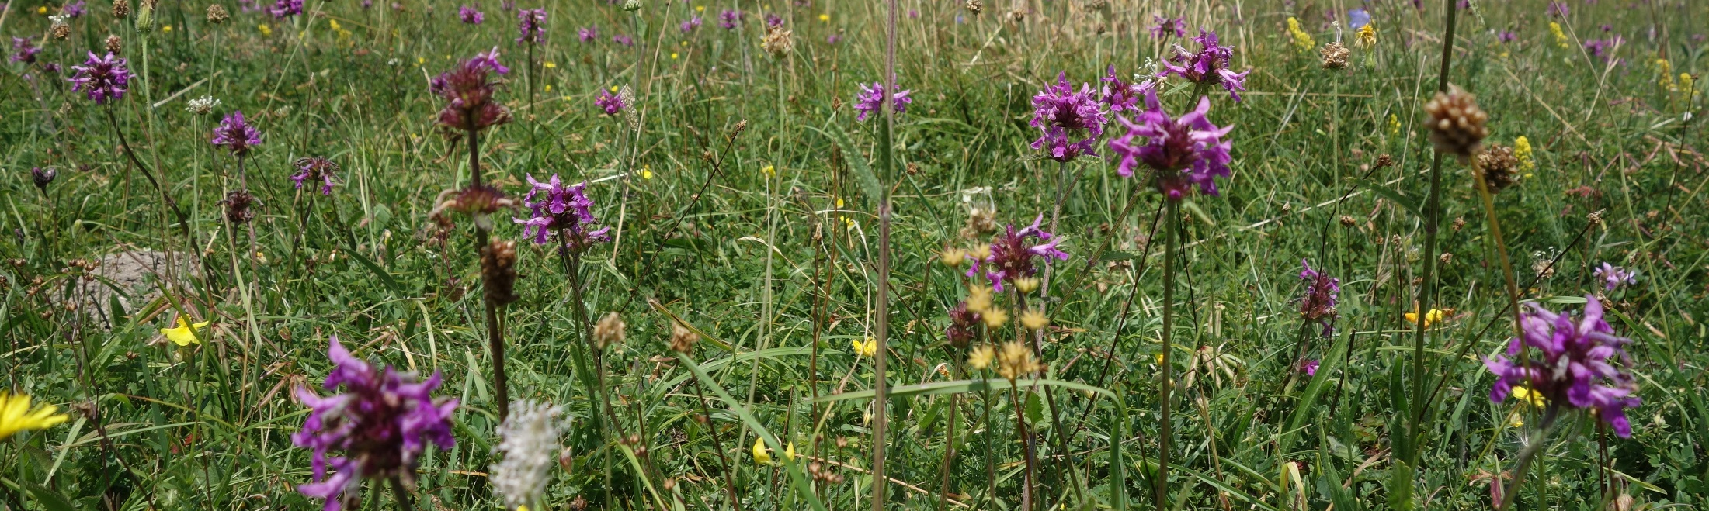
Achievements of ICP Vegetation* in 2015
and future workplan (2016-18)
Harry Harmens, Gina Mills, Felicity Hayes, Katrina Sharps
(CEH Bangor, UK),
and the participants of the ICP Vegetation
* Supported by Defra (UK), NERC (UK) & UNECE
29th ICP Vegetation TFM, 1 – 3 March. 2016, Dubna

Slide 2
EECCA
WGE
SCIENCE
EMEP
WGSR
POLICY
ICP Vegetation

Slide 3
Outline
Report on evidence of impacts of ozone on vegetation (update from 2007 report)
(brochure)
Ozone dose response relationships and critical levels (Modelling and Mapping Manual); first global flux-based maps of ozone on wheat yield
Report on impacts of ozone on biodiversity (brochure)
Progress European moss survey 2015/16
Common workplan items WGE/EMEP
  WGE trends report
  Assessment report LRTAP Convention
  Improvement data access - common portal WGE
Medium-term workplan (2016 – 2018)
Collaboration and outreach
Notes:
Contribution to WGE report on impacts of air pollution on biodiversity and ecosystem services

Slide 4
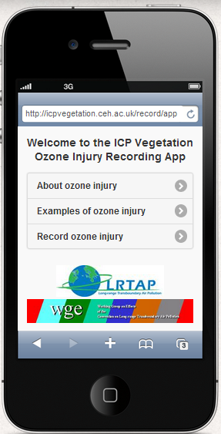
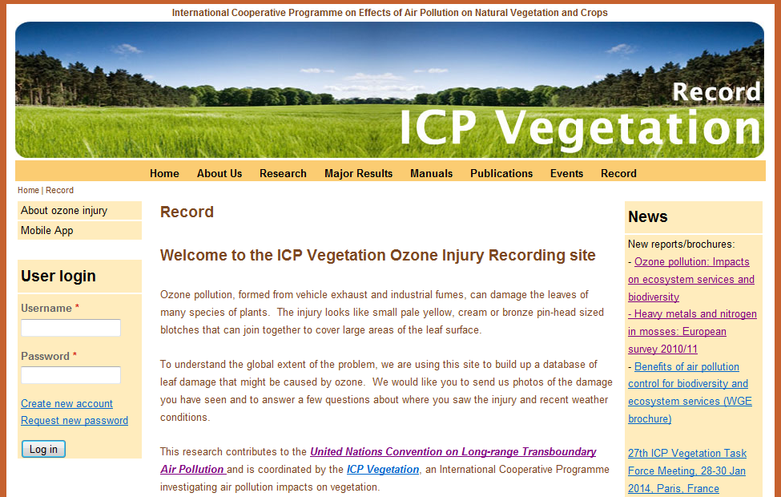
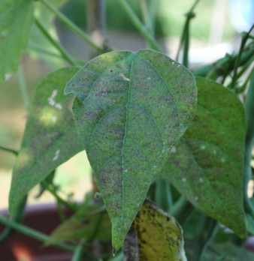
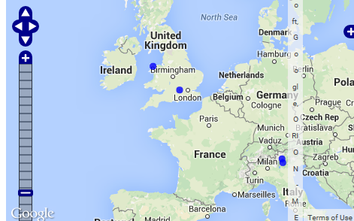
Smart phone App and ozone gardens (http://icpvegetation.ceh.ac.uk)
Recording incidences of leaf ozone injury
Submit photographs of ozone injury
Location on interactive map
Purpose:
(1) Quantify extent of damage in changing profile
(2) Validate risk maps
Protocols were developed

Slide 5
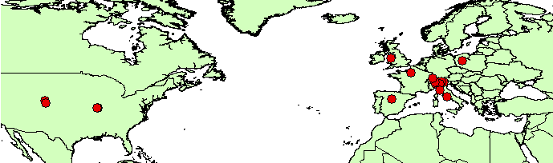
Registration and data submission
2014: 36 people (primarily in ozone community); 20 records received
2015: 33 further registrations in 2015; 38 records received
2015
USA: ozone gardens (Boulder and St Louis), Rocky Mountains.
Europe: UK (Bangor), Italy (Milan, Bergamo, Trento, Rome, Pisa), Switzerland (Locarno, Zurich), Poland (Poznan), France (nr. Paris), Spain (nr. Madrid)
Uptake of activity lower than expected:
- Form too labour intensive
- Less surveyors out in the field, so less regular monitoring (‘incidental’)
- Less ozone injury in recent years, also due to climate
Notes:
You have a few options to try if your phone can’t use its GPS while you are indoors.
1) Send the record while outside and online
2) Fill out the form while outside (with internet switched off). If you have downloaded the App you should be able to access it either via an icon on your home screen or just by typing the url into your browser. Your phone will record the location using GPS while you fill out the form. As you are offline, the form will then be saved (you’ll get a message telling you this after you click submit) and then you should see a ‘Saved forms’ option on the main menu of the App. Then when you are indoors and online, you can click on the saved forms, and submit.
3) Try sending the form while indoors and online but close to a window or even with your phone out of the window!
The way that this App has been designed is different from the usual App that you would download from itunes. It is basically a website that functions like an App. When you click on the ‘Record’, ‘Mobile App’ option, you should see a screen with a green clover background and an enter button. You should then proceed through the recording form, answering the questions, and then submit the form. While you are doing this, the App will be downloading in the background. This means that the next time you visit the site online, it should not have to download again. It also means that if you are offline and you enter the app’s URL (http://icpvegetation.ceh.ac.uk/record/app) into your browser, you should still be able to fill in the form and then save it to be submitted when you are back online.
If you wish to save the App to your home screen, (see the iphone picture in my instructions, which will lead to a clickable clover icon on your home screen), you should then be able to click this icon instead of having to go to the website to use the App. This should work both online and offline.
It’s just set up differently than the Apps that you will be used to. This means that the App can be used on a wide variety of phones without having to write code for each phone and won’t require frequent updates.

Slide 6
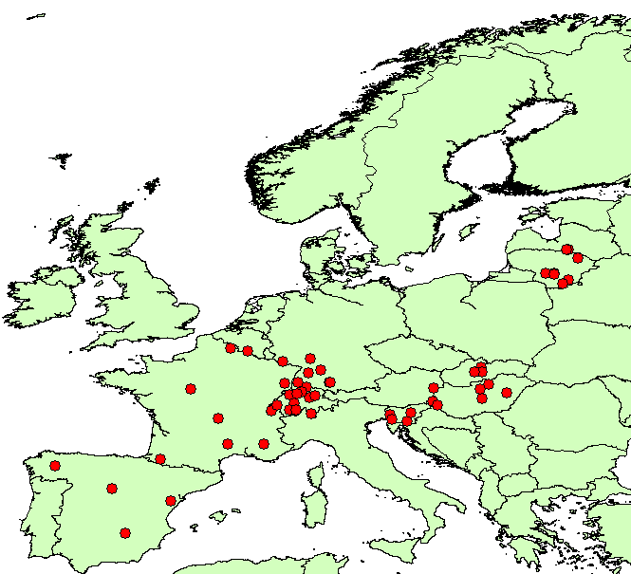
Ozone leaf injury (2002 – 2014) at ICP Forests sites
Provisional map
Source: ICP Forests PCC Collaborative Database
29th ICP Vegetation TFM, 1 – 3 March. 2016, Dubna

Slide 7
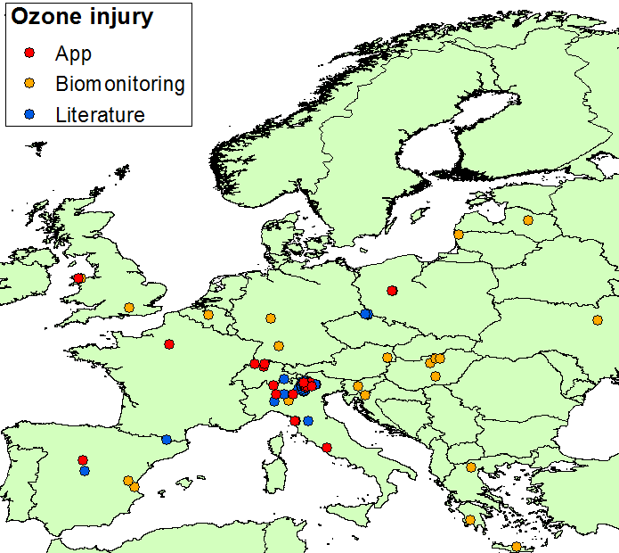
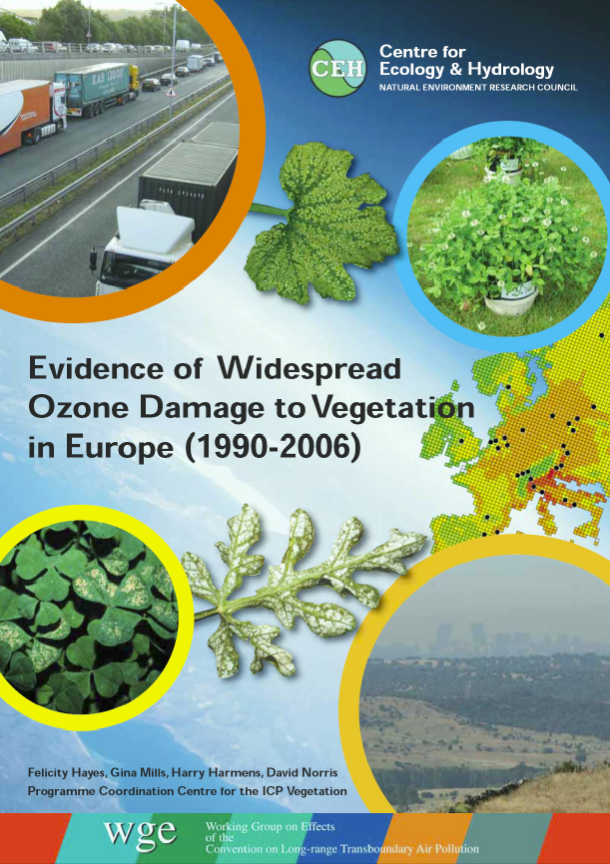
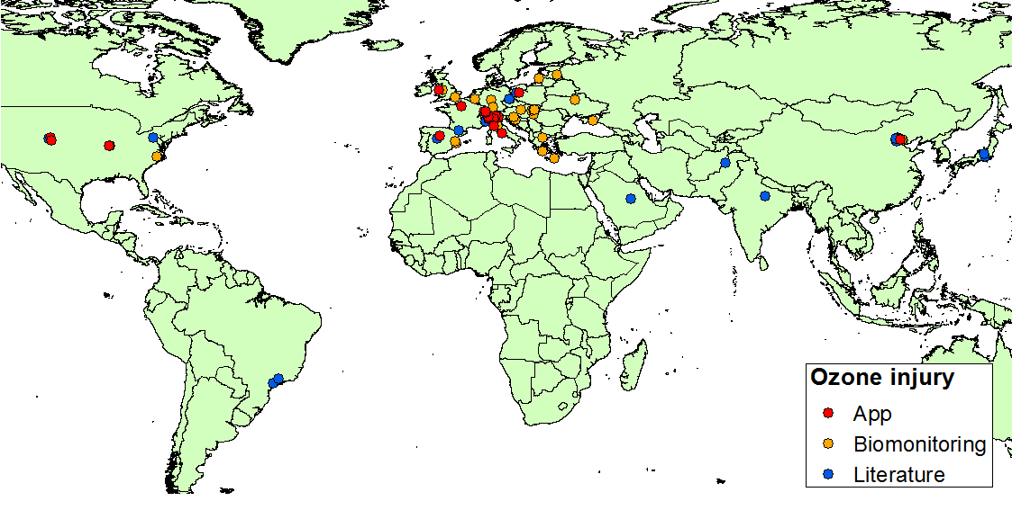
Further field-based evidence ozone impacts
Data from 2007 onwards
‘Evidence report 2007’
8 page brochure (March 2016):
Air filtration experiments
Observations in ambient air
Epidemiology studies

Slide 8
Ozone critical levels - Chapter 3 Mapping Manual
Updates 28th TFM adopted by WGE
23 – 25 November, 2015: Epidemiology and
Critical Levels Methodology Workshops,
Hindås (nr. Gothenburg), Sweden, 30 experts
7 – 9 June 2016: Preparatory Critical Levels
Methodology Workshop, Bangor, UK (invited
experts). Financial support from Switzerland.
Autumn 2016: UNECE Ozone Critical Levels
Workshop, Madrid, Spain. Open invitation.
2017: Report on revised ozone risk
assessment methods for vegetation
2017: Revision of Chapter 3 Mapping Manual
http://icpvegetation.ceh.ac.uk
29th ICP Vegetation TFM, 1 – 3 March. 2016, Dubna

Slide 9
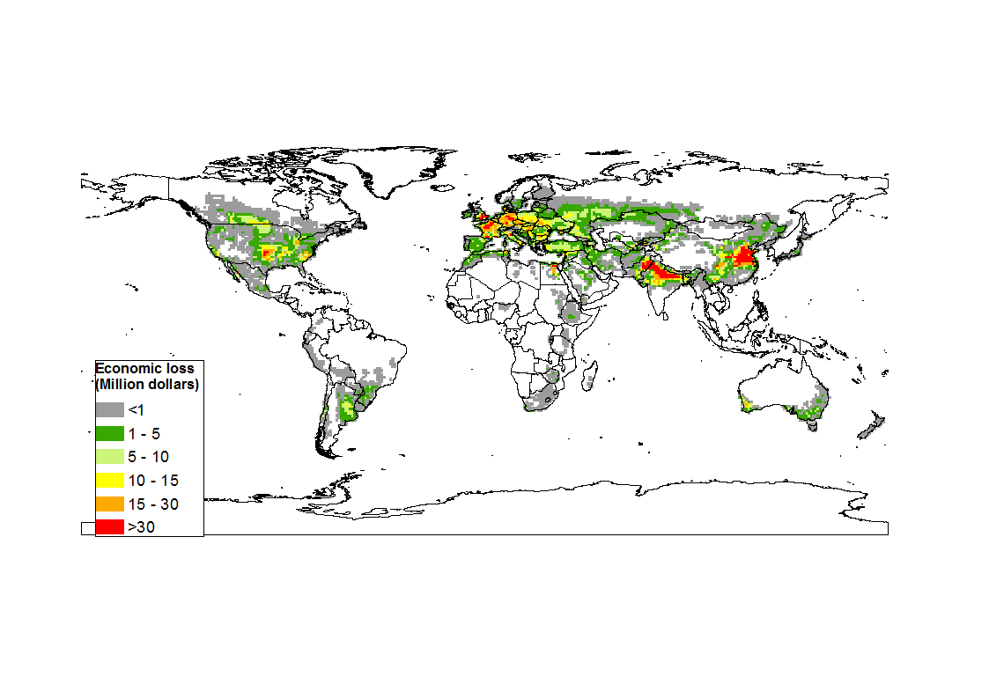
First ozone flux-based global assessment
Economic losses, wheat
(million dollars per 1° square)
Global economic losses due to ozone effects on wheat yield (9.4% loss) are estimated at $24.3 billion
Data averaged for 2010, 2011, 2012, weighted per grid square by proportion irrigated (based on production) .
Gina Mills, Katrina Sharps
FPVII ECLAIRE, CEH NC Air quality impacts

Slide 10
Habitats at risk from ozone
Field-based evidence of ozone impacts on biodiversity is scarce. Mainly data for individual species exposed to ozone in experimental conditions.
Following approach Mills et al., 2007, EUNIS habitats most sensitive to ozone were identified. However, now based on response individual species to 24hr mean ozone.
Drawback: Northern European bias using UK NVC communities.
EUNIS habitat | Abbreviated name | Mean no. of spp. in habitat | Mean % of species tested for O₃ sensitivity | No. of O₃-responsive species* | % of O₃-responsive species* | No. of NVC communi-ties
D2 | Valley and transition mires | 25.0 | 20.0 | 3.0 | 60.0 | 1
I1 | Arable and market gardens | 57.3 | 23.8 | 7.5 | 56.4 | 6
I2 | Cultivated gardens, parks | 31.0 | 29.0 | 5.0 | 55.6 | 1
E5 | Woodland fringes | 58.9 | 22.8 | 6.8 | 51.1 | 9
E4 | (Sub)alpine grasslands | 70.0 | 21.4 | 7.0 | 46.7 | 1
E3 | Seasonally wet grasslands | 63.0 | 25.1 | 6.6 | 43.4 | 7
B1 | Coastal dunes, sandy shores | 49.0 | 25.5 | 5.0 | 42.8 | 8
E1 | Dry grasslands | 86.9 | 26.5 | 10.1 | 41.9 | 9
E2 | Mesic grasslands | 71.7 | 35.9 | 10.3 | 41.4 | 6
B3 | Rock cliffs and shores | 47.3 | 25.7 | 5.0 | 40.1 | 6
F3 | Montane scrub | 61.5 | 23.9 | 6.0 | 38.7 | 2
D5 | Sedge and reed beds | 40.0 | 22.5 | 3.0 | 33.3 | 1
F4 | Temperate shrub heathland | 65.0 | 22.1 | 4.0 | 27.2 | 2
* Species for which above-ground biomass was either reduced or stimulated.

Slide 11
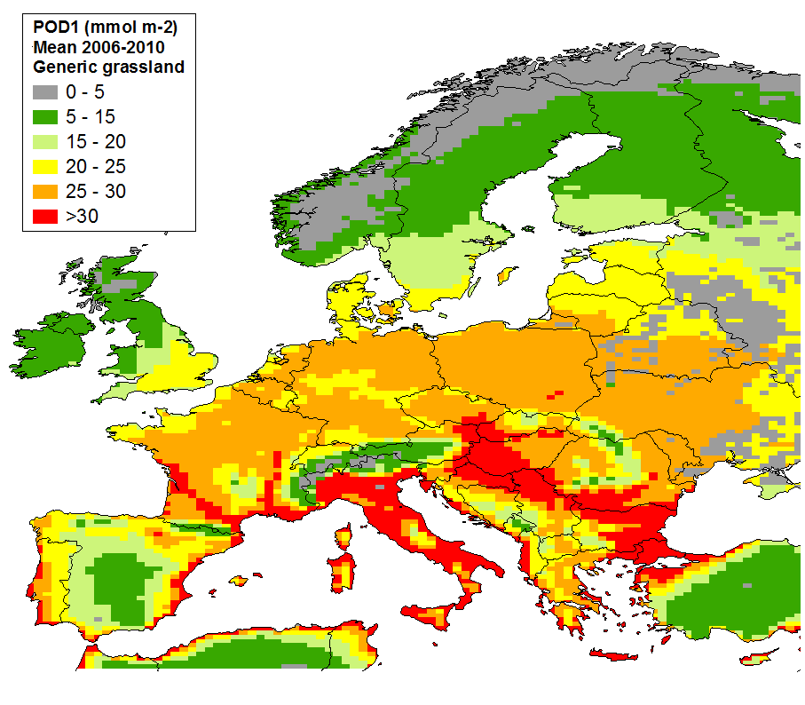
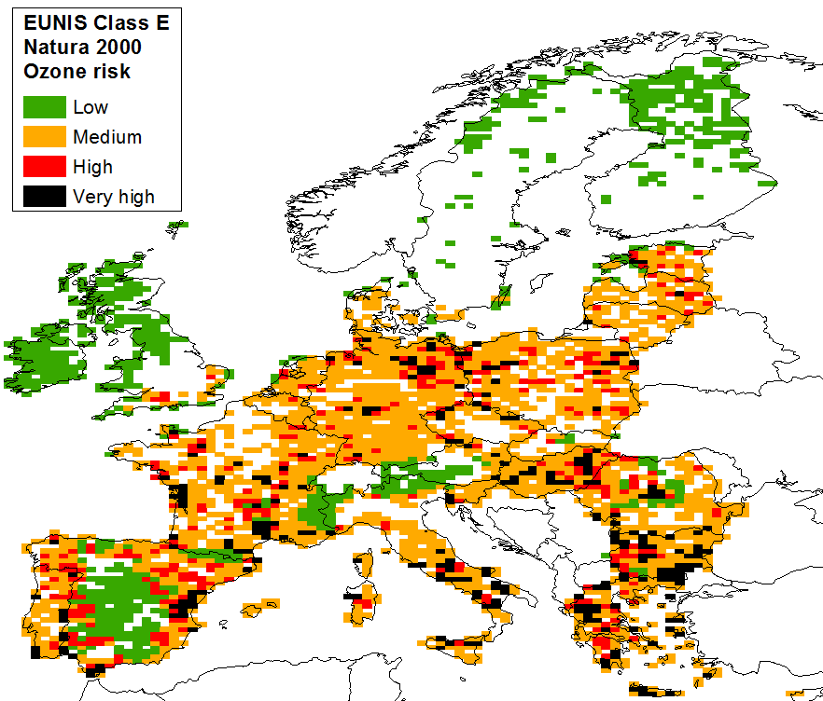
Natura 2000 grassland habitats at risk
Grassland area in grid cell (%) | Mires, bogs, fen area in grid cell (%) | POD₁ grass (mmol m⁻²)* | <5 | 5 - 15 | 15 - 20 | 20 - 25 | 25 - 30 | >30
 |  | RISK | 1 | 2 | 3 | 4 | 5 | 6
0.5 – 5 | <1 | 1 | 1 | 2 | 3 | 4 | 5 | 6
5 - 10 | 1-5 | 2 | 2 | 4 | 6 | 8 | 10 | 12
>10 | >5 | 3 | 3 | 6 | 9 | 12 | 15 | 18
Grassland POD₁ (April – September) Grassland area Natura 2000 sites from CCE (Simpson et al., 2012) (0.50º x 0.25º)

Slide 12
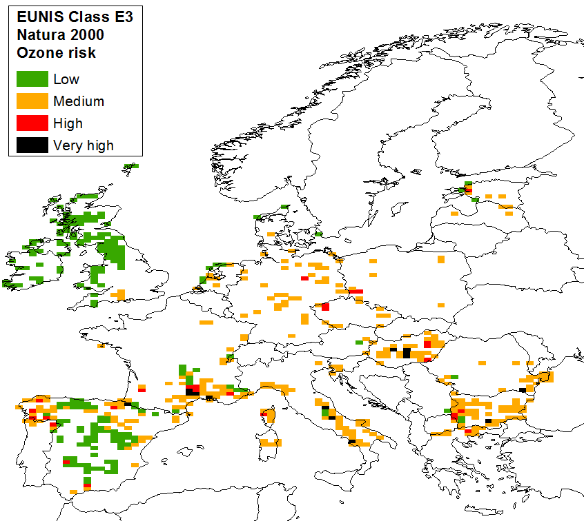
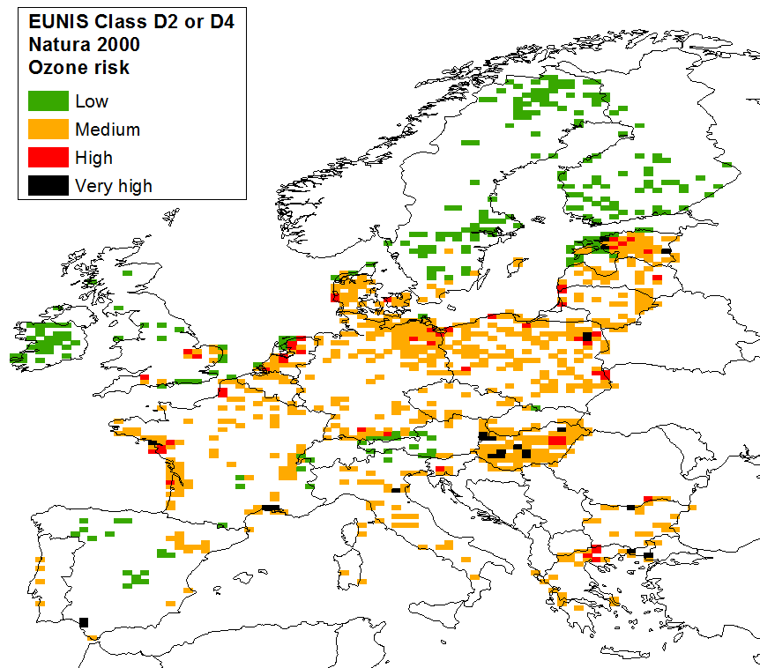
Natura 2000 areas at risk
Wet grassland (E3) Mires and fens (D2 or D4)
Natura 2000 areas at highest risk from ozone impact in parts of Central and Southern Europe, where climate conditions are conducive to high phytotoxic ozone dose in areas with medium to high ozone concentrations and habitat area is high.
29th ICP Vegetation TFM, 1 – 3 March. 2016, Dubna

Slide 13
Umwelt Bundesamt (Germany) report
Elke Bergmann, Jürgen Bender, Hans-Joachim Weigel Thünen-Institut für Biodiversität, Braunschweig
http://www.umweltbundesamt.de/en/publikationen/assessment-of-the-impacts-of-ozone-on-biodiversity
Quantitative estimations and any kind of dose-response functions are still lacking for other endpoints than growth and transpiration and receptors other than crops, forest trees or some pasture plants.
To estimate the risk to ecosystems and to establish critical levels for ozone to protect the integrity of natural ecosystems key species and key parameters within a model system have to be selected which are able to indicate a dysfunction of an ecosystem.

Slide 14
Update moss survey 2015/16 (1)
Notes:
Some EECCA and many SEE countries

Slide 15
Update moss survey 2015/16 (2)
29th ICP Vegetation TFM, 1 – 3 March. 2016, Dubna
Notes:
Some EECCA and many SEE countries

Slide 16
WGE Trends Report (1990 – ca. 2010)
Decline exceedance S critical loads to 9 and 5% in aquatic and terrestrial ecosystems respectively
Area with exceedance N critical loads has declined from 72 to 60%
No clear trends in risk of ozone impacts on vegetation (1999 – 2010) or in risk of population exposure to ozone (2000 – 2010). Inter-annual variability ozone due to climate conditions.
Ozone pollution in future dependant on regional emission changes and global transport of ozone precursors such as methane.
Particulate matter (PM) monitoring only started after 2000 (PM10) or 2005 (PM2.5). Decrease PM10 but no change PM2.5 exposure.
Decline metal concentrations in mosses similar to decline in modelled deposition: ca. 77% (Pb), 51% (Cd) and <20% (Hg). However, accumulation ongoing in deeper soil layers. Decline area critical load exceedance Pb from 67 to 20% (1990 – 2010), no exceedance for Cd, Hg decline area of exceedance from 69 to 56%.
POPs: largest decline (80 – 90%) in deposition of PCBs and HCB, with decline levelling off in 2005. Lowest decline for PAHs (30%).
De Wit, H., Hettelingh, J.P., Harmens, H. (Eds)
Challenges: Ozone, mercury and some POPs require collaboration at Northern Hemispherical scale to achieve (further) reductions.
Systematic long-term monitoring and impacts of air pollution required

Slide 17
LRTAP Convention Assessment Report 2016
O₃ conc.
(ppb)
Content
Main points
Summary for policymakers
A. Where are we?
A1. Health impacts of particulate matter
A2. Biodiversity and eutrophication
A3. Acidification of lakes and forest soils
A4. Ozone trends and impacts on health and ecosystems
A5. Persistent pollutants (HM and POPs)
B. What are key challenges and opportunities?
B1. Air pollution measures could improve the economy
B2. Transboundary and multisectoral approaches
B3. Air pollution at a wider scale
B4. Air quality and climate change: two sides of the same coin
B5. Institutional arrangements
1990 2001 2012
Year
Summary to be presented at 8th Environment for Europe
Ministerial Conference, Batumi, Georgia,
8 – 10 June, 2016
29th ICP Vegetation TFM, 1 – 3 March. 2016, Dubna

Slide 18
Outreach activities
First Asian Air Pollution Workshop, 31 October – 2 November 2015,
University of Tokyo. Harry Harmens gave keynote lecture.
  38 participants: 31 from Asia (China, Japan), 7 from Europe
  Lack of integrated structure for air pollution research in Asia, such as
  LRTAP Convention, where scientists and policy makers meet and discuss
  2nd workshop: 22 – 23 October, 2016, Beijing, China.
  ICP Vegetation contributes to Tropospheric Ozone Assessment Report (TOAR): Global metrics for climate change, human health and crop/ecosystem research’ www.igacproject.org/TOAR
    Gina Mills is lead author for chapter on ozone metrics for vegetation; several other ICP Vegetation participants contribute too
    Gina Mills attended HTAP Workshop, 17 – 19 February, 2016, Potsdam, Germany: ‘Assessing the impacts of future global air pollution scenarios’
    Moss survey activities and ozone research
29th ICP Vegetation TFM, 1 – 3 March. 2016, Dubna

Slide 19
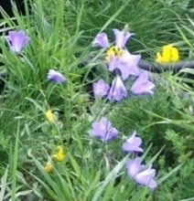
Medium-term workplan (2016 – 2018)
Ongoing annual activities – report on:
Supporting evidence for ozone impacts on vegetation
Progress with the moss survey 2015/16
Contribute to common workplan items WGE:
Assessment Report 2016; Monitoring priorities; Web-based
data access; Effective organisation work carried out by ICPs
Specific activities – Report on:
2016: - Updated report on field-based evidence of ozone impacts on vegetation
- Ozone impacts on biodiversity
- Ozone critical levels workshop (autumn), Spain
- Ozone injuries of forests trees and plant species at forest edges
2017: - Revised ozone risk assessment methodologies
- Revision Chapter 3 of Modelling and Mapping Manual
2018: - Report European moss survey 2015/16
- Any to add after this meeting??
Notes:
EECCA = Eastern Europe, Caucasus and Central Asia, SEE = Southern-Eastern Europe

Slide 20
Parties at 29th ICP Vegetation TFM, Dubna
Rest of Europe | SEE | EECCA | Rest of world
Czech Republic | Albania | Azerbaijan | Cuba
France | Bulgaria | Belarus | Egypt
Germany | Greece | Georgia | Guatamala
Hungary | Macedonia | Kazakhstan | India
Italy | Romania | Russian Federation | Japan
Norway | Serbia | Ukraine | Mongolia
Poland | Slovenia |  | USA
Slovakia | Turkey |  | Vietnam
Spain
Switzerland
UK
Total: 33 countries (91 delegates)
SEE: South-Eastern Europe
EECCA: Eastern Europe, Caucasus
and Central Asia

Slide 21
Reports, brochures and papers
Harmens et al., 2015. Annali di Botanica 5: 47-59 (‘History of ICP Vegetation’)
Harmens et al., 2015. Environmental Pollution 200: 93-104 (‘Moss survey 2010’)
Harmens et al., 2015. Science of the Total Environment 538: 1024 – 1026 (‘Comment on moss monitoring paper Fernández et al.’)
Mills et al., 2016. Environmental Pollution 208: 898-908 (‘Ozone impacts in N enriched world and changing climate’)
Büker et al., 2015. Environmental Pollution 206: 164-173 (‘Forest ozone flux paper’)
Schröder et al., in press. Environmental Science and Pollution Research (‘Spatial analysis moss survey data 2010’)
29th ICP Vegetation TFM, 1 – 3 March. 2016, Dubna

Slide 22
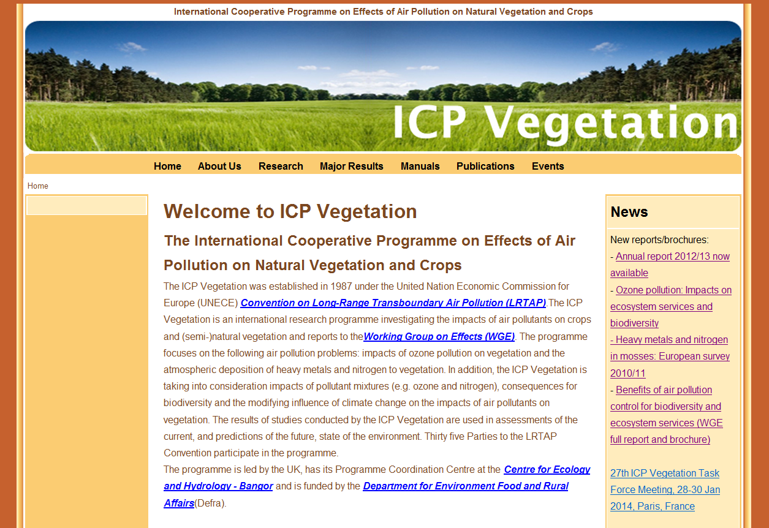
Thank you for your input over the years!
http://icpvegetation.ceh.ac.uk
Thank you Marina Frontasyeva
and colleagues for organising this
meeting and JINR for supporting
this meeting and the ICP
Vegetation work
30th ICP Vegetation Task Force
meeting: Poznan, Poland?
Thank you very much for your attention
and your contributions!
29th ICP Vegetation TFM, 1 – 3 March. 2016, Dubna

