Slide 1
Programme Advisory Committee
for Condensed Matter Physics
48th meeting (14 – 15 June 2018)
Dénes Lajos Nagy
124th session of the JINR Scientific Council, Dubna, 20–21 September 2018

Slide 2
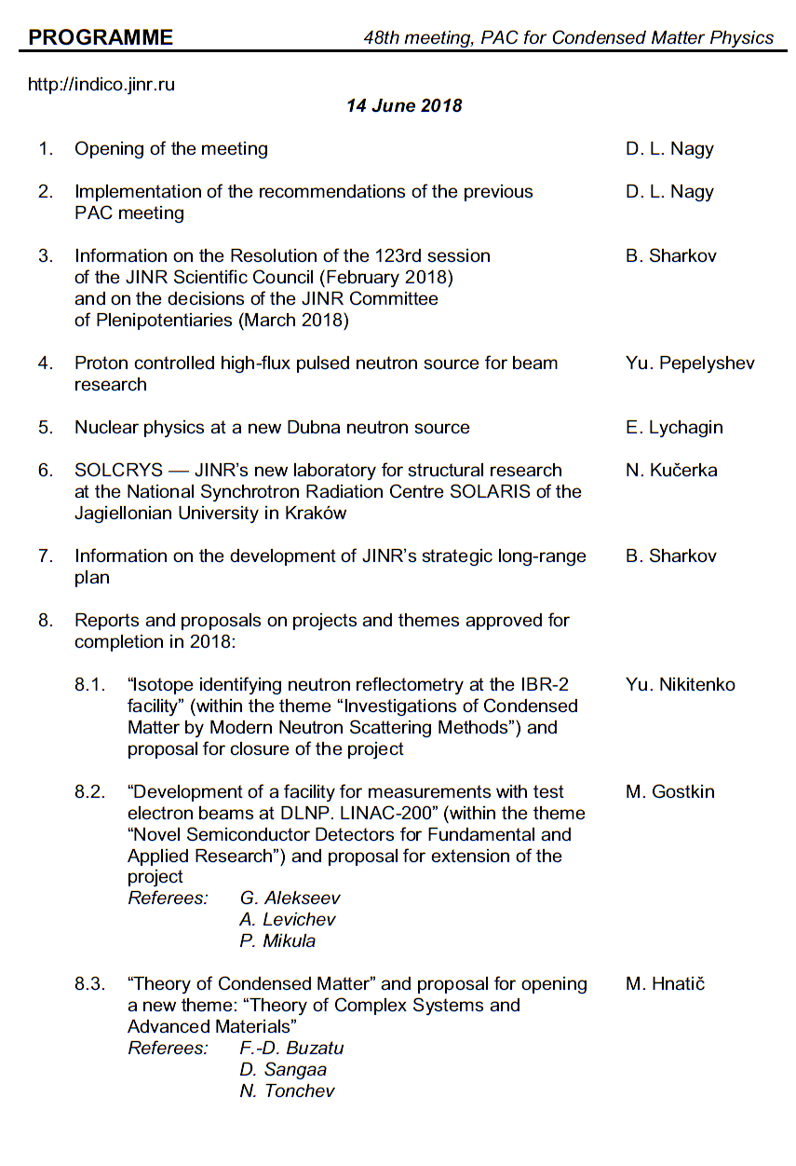
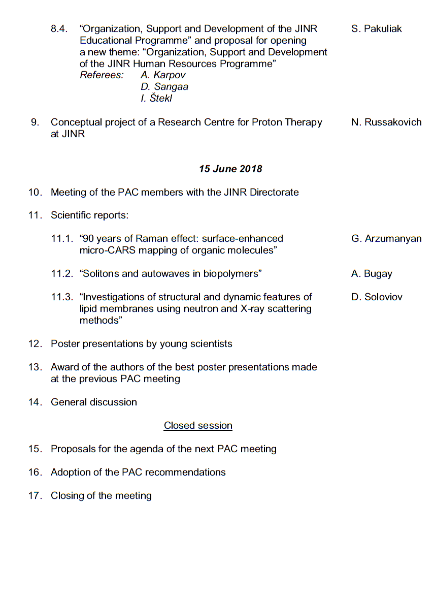
Agenda of the 48th PAC meeting
Highlights of the PAC-CMP meeting:
Alternative option of a new source of neutron at JINR
The scientific case for JINR’s new neutron source
Cooperation between JINR and the National Synchrotron Radiation Centre SOLARIS
Reports and proposals on themes and projects

Slide 3
A new source of neutron at JINR: Suggested timeline
The suggested timeline of the preparatory phase of JINR’s new neutron source with estimated deadlines includes:
establishing an international working group (IWG) in 2018;
organizing international workshops by FLNP and scientifically coordinated by the IWG from 2018 until the conceptual design report will be concluded;
publishing a short (up to 50 pages) kick-off document elaborated by the IWG on the idea of the new facility until mid-2019;
elaborating and publishing a detailed scientific case until early 2020;
elaborating a detailed conceptual design report until the end of 2020;
elaborating the administrative and financial model for the construction, commissioning, operation and decommissioning phases until 2021;
taking decision on the construction of the new facility until 2023.

Slide 4
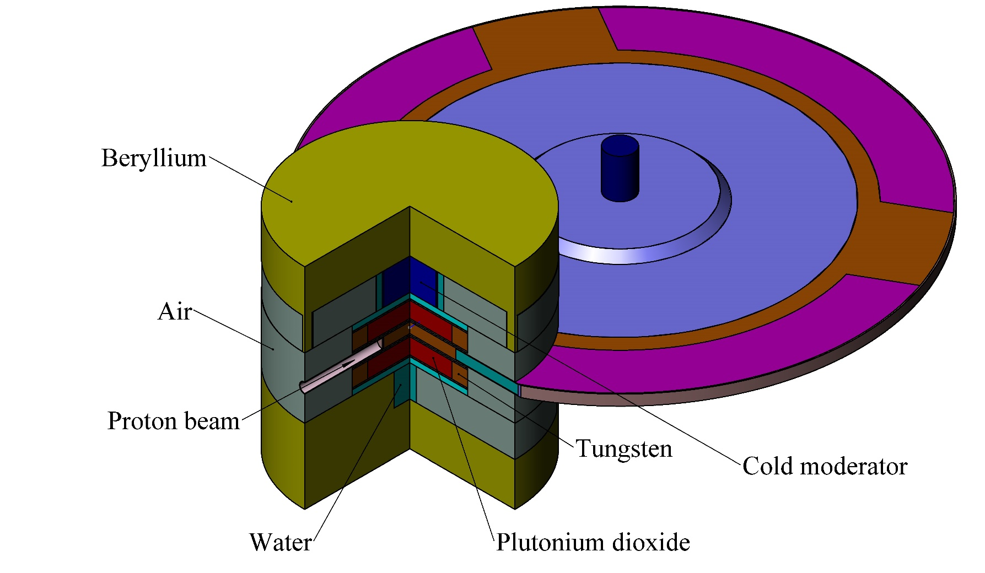
Alternative option of a new source of neutron at JINR
The PAC heard with interest the report on an alternative option for the development of a new source of neutrons at JINR, presented by Yu. Pepelyshev. The physical scheme of the source is based on a subcritical booster with a plutonium dioxide core giving a criticality level of no more than 0.98 and a non-multiplying tungsten target.
Optimal variant of the source
Recommendation. The PAC recommends that the work on the development of the general concept of a new neutron source on the basis of the presented physical models be continued.
Evaluation model of a booster with a rotating tungsten target and plutonium dioxide core.

Slide 5
Development of the scientific case for JINR’s new neutron source
The PAC took note of the report on a scientific programme in nuclear physics being proposed for a new JINR’s neutron source as presented by E. Lychagin.
The PAC notes that very cold and ultracold neutrons are of great interest for fundamental physics research. At the same time, the scientific case for use of these neutrons for condensed matter studies should be elaborated. In this regard, the PAC considers it necessary to continue discussions about ultracold and very cold moderators for a new neutron facility.
Reasons to discuss NUCLEAR PHYSICS PROGRAM at the PAC for CONDENSED MATTER PHYSICS:
The new source has been discussed here several times.
To show that the nuclear researchers will need several neutron beams at a new source.
We hope that we are all interested in a very cold neutron source and we have to unite our efforts.
Recommendation. The PAC recommends starting the development of a scientific case for the moderators of ultracold and very cold neutrons at a new JINR neutron source.

Slide 6
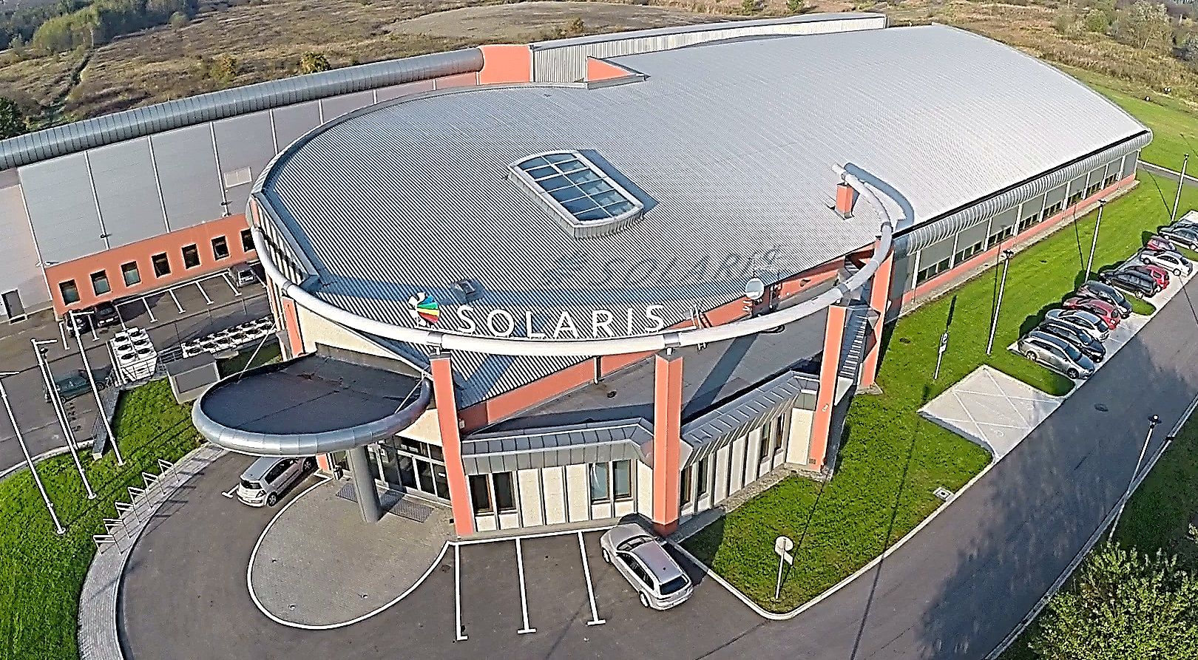
SOLCRYS — JINR's new laboratory for structural research at the National Synchrotron Radiation Centre SOLARIS of the Jagiellonian University in Kraków
Materials science
- structure of crystalline materials
- semiconductors and new electronic materials
- alloys and nanocomposites
- polymers and fibers
Chemistry
- catalysis
- porous materials
Pharmacy
- drug polymorphism
- drug carriers
- gels, lotions, creams
Structural biology
- proteins and nucleic acids
- biomacromolecular solutions
The PAC took note of the activities of the team coordinated by the FLNP Directorate concerning the development of the concept for a new laboratory for structural research of macromolecules and new materials at the National Synchrotron Radiation Centre SOLARIS, presented by N. Kučerka. The PAC acknowledges that the new capability to be provided by the new laboratory will become a part of the JINR research tools, especially in terms of complementarity between existing neutron-based techniques and future X-ray methods. At the same time the PAC recommends continuing the analysis of the feasibility of the technical design and parameters required by future experiments.

Slide 7
Information on the development of JINR’s strategic long-range plan
The PAC was informed by Vice-Director B. Sharkov about the progress of the development of JINR’s strategic long-range plan up to 2030 and beyond. The PAC endorses the steps towards formation of the memberships of the subgroups for condensed matter physics and neutron physics, as well as for radiobiology and astrobiology and the work plans for 2018–2019.
Recommendation. The PAC recommends that the subgroups provide regular information on their work at its future meetings.

Slide 8
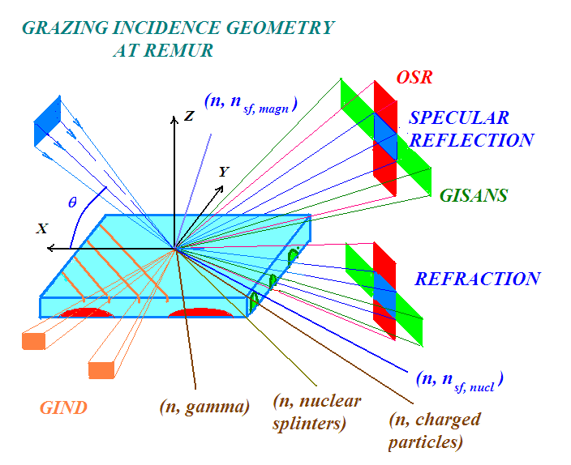
Reports and proposals on themes and projects
The PAC took note of the report presented by Yu. Nikitenko on the concluding project “Isotope identifying reflectometry at IBR-2 reactor” within the theme “Investigations of Condensed Matter by Modern Neutron Scattering Methods”. The PAC is pleased to note that Isotope Identifying Reflectometry (IIR), a principally new method designed to study diffuse processes in layered nanostructures, has been successfully implemented at the IBR-2 reactor. The performance of the reflectometer which realizes this method corresponds to the one planned before. IIR is an important step in the modernization of the IBR-2 instruments.
Recommendation. Given the successful completion of the project “Isotope identifying reflectometry at the IBR-2 reactor”, the PAC recommends its closure.

Slide 9
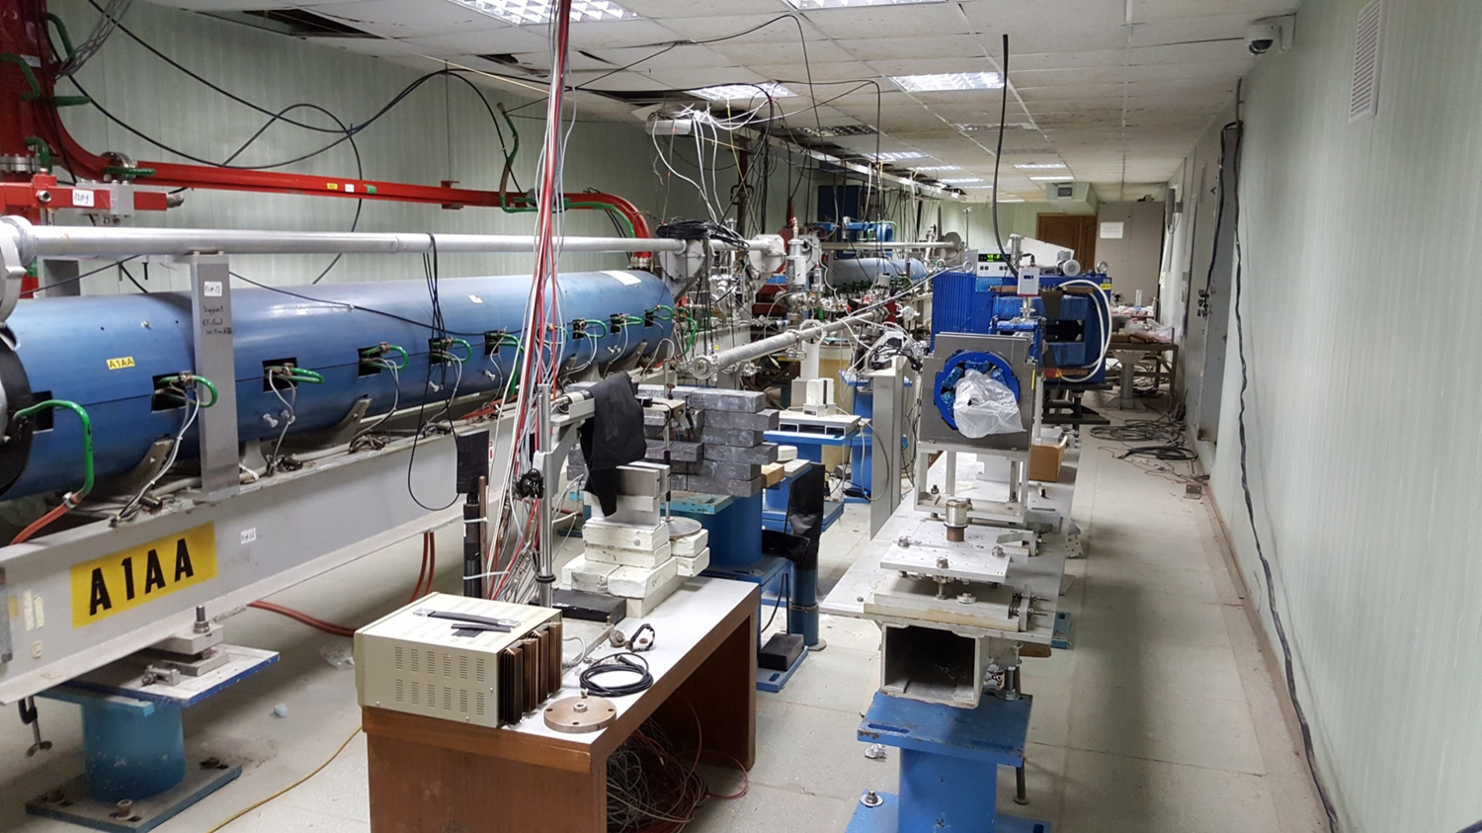
Reports and proposals on themes and projects
The PAC considered a proposal for opening a new project “Development of a facility for measurements with test electron beams at DLNP. LINAC-200”, presented by M. Gostkin. The PAC appreciates DLNP's efforts in developing new types of elementary particle detectors capable of operating under conditions of high rates and at the same time providing the performance, precision, and reliability of registration required for experiments at future accelerators. Nevertheless, it misses a scientific case of the project within the competency of this PAC and feels that, on the basis of the presented information, no support to the initiative can be granted at this stage.
LINAC-200
Recommendation. The PAC encourages the authors of the proposal “Development of a facility for measurements with test electron beams at DLNP. LINAC-200” to elaborate a detailed scientific case within the scope of the PAC for Condensed Matter Physics or, alternatively, to consider submitting their proposal to another PAC.

Slide 10
Reports and proposals on themes and projects
The PAC took note of the report on the concluding theme “Theory of Condensed Matter” and considered a proposal for the opening of a new theme “Theory of Complex Systems and Advanced Materials” presented by M. Hnatič.
The PAC highly appreciates the results obtained in the main research directions: complex materials and nanostructures, contemporary problems of statistical physics. It also appreciates the interrelation between the ongoing theoretical studies and the JINR experimental programmes.
The PAC supports continuation of this research under a new theme that should incorporate the development of new theoretical methods and approaches for describing and predicting the properties of new materials and identification of universal laws of behaviour of equilibrium and non-equilibrium statistical systems which are of current interest in modern condensed matter physics. The PAC welcomes the deepening, within a new theme, of cooperation with the experimental groups of JINR and its Member States in order to raise it to a higher level. The PAC considers the requested funding reasonable.
Recommendation. The PAC recommends closure of the theme “Theory of Condensed Matter” and opening a new theme “Theory of Complex Systems and Advanced Materials” for the period 2019–2023.

Slide 11
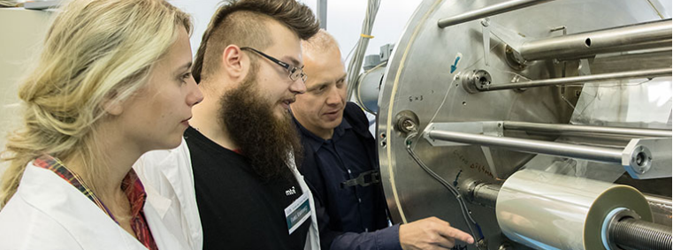
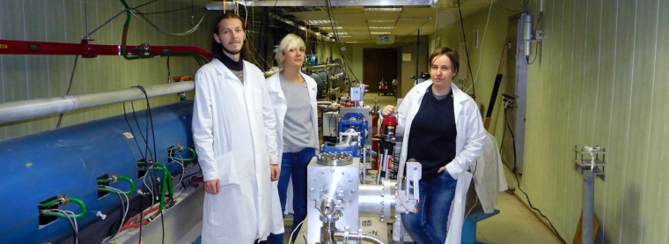
Reports and proposals on themes and projects
The PAC took note of the report on the concluding theme “Organization, Support, and Development of JINR Educational Programmes” and considered a proposal for opening a new theme “Organization, Support and Development of the JINR Human Resources Programme”, presented by S. Pakuliak.
The PAC notes that the University Centre (UC) has been performing the overall coordination and support of the educational and human resource development programmes at JINR within the current theme. As part of the theme, one of the main issues and functions of JINR is being implemented –– attracting talented young people and partner scientific research organizations of the Member States to the Institute. In order to accomplish this, certain conditions are being created at JINR to assign Bachelor, Master, and PhD students from Member-State universities to work on their theses. Together with JINR Laboratories, the UC organizes and runs student programmes of various levels, which allow attracting talented young people and ensuring the continuity of JINR’s scientific schools. It is of utmost importance to continue the current activities within the framework of the proposed new theme, enhancing the cooperation with the leading universities of the Member States to attract young people to work on the JINR flagship projects.
Recommendation. The PAC recommends closure of the theme “Organization, Support, and Development of JINR Educational Programmes” and opening a new theme “Organization, Support and Development of the JINR Human Resources Programme” for the period 2019–2023.

Slide 12
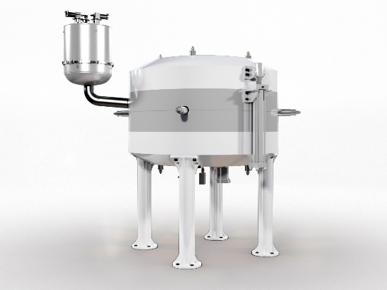
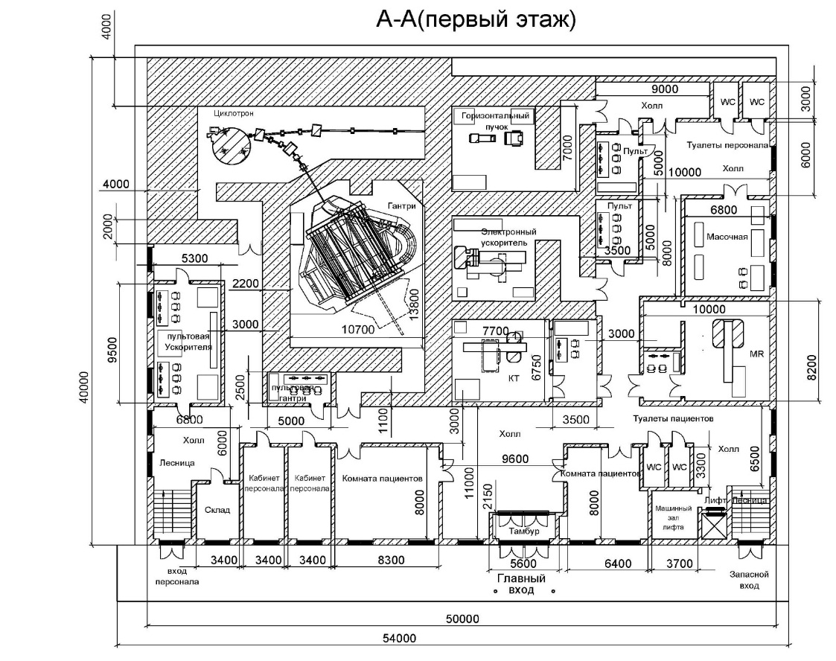
Reports and proposals on themes and projects
The PAC took note of the conceptual project of a Research Centre for Proton Therapy at JINR presented by N. Russakovich. The PAC recognizes the importance of further development of instruments and methods for proton therapy at JINR and fully supports the idea of playing a leading role in disseminating the culture of proton therapy in JINR Member States.
Recommendation. Taking into account the real state of the Phasotron and the ongoing work on the construction, together with Chinese colleagues, of the SC202 therapeutic cyclotron, the PAC invites the JINR Directorate to elaborate the project of a new, compact research infrastructure for therapy with proton beams which could serve also as a pilot facility for future use in JINR Member States as well as an educational tool for training specialists in proton therapy.
Superconducting cyclotron SC202

Slide 13
Scientific reports
The PAC heard with interest the scientific reports:
“90 years of Raman effect: surface-enhanced micro-CARS mapping of organic molecules” (G. Arzumanyan)
“Solitons and autowaves in biopolymers” (A. Bugay)
“Investigations of structural and dynamic features of lipid membranes using neutron and X-ray scattering methods” (D. Soloviov)

Slide 14
Poster presentations
The PAC reviewed 18 poster presentations by young scientists in fields of condensed matter physics.
The poster “Analysis of the working ability of a planar graphene tunnel field-effect transistor in the presence of edge vacancies” by A. Glebov was selected as the best poster at the session.
The PAC also noted two other high-quality posters:
“Recrystallization role in ion track formation in dielectrics” (R. Rymzhanov)
“Studies of Wigner quasiprobability distributions” (V. Abgaryan)
Recommendation. The PAC recommends the poster “Analysis of the working ability of a planar graphene tunnel field-effect transistor in the presence of edge vacancies” to be reported at the session of the Scientific Council in September 2018.

Slide 15
Next meeting of the PAC
The next meeting of the PAC for Condensed Matter Physics will be held on 24–25 January 2019.
Its tentative agenda will include:
information by the PAC Chairman on the implementation of the recommendations of the current PAC meeting;
information by the JINR Directorate on the sessions of the Scientific Council (September 2018) and of the Committee of Plenipotentiaries (November 2018);
reports and recommendations on themes and projects to be completed in 2019;
discussion of the progress of the scientific case for JINR’s new neutron source;
progress in implementing the FLNP User Programme;
status reports on the upgrades of FLNP instruments in the context of the JINR Seven-year plan;
information about scientific meetings;
scientific reports;
poster session.

Slide 16
Thank you for your attention

