Slide 1
Programme Advisory Committee for Nuclear Physics
48-th meeting
20–21 June 2018
Marek Lewitowicz

Slide 2
Programme
1. Opening of the meeting M. Lewitowicz
2. Implementation of the recommendations of the previous PAC meeting M. Lewitowicz
3. Information on the Resolution of the 123rd session of the JINR Scientific Council (February 2018) M. Itkis
and on the decisions of the JINR Committee of Plenipotentiaries (March 2018)
4. Report on the concluding theme “Improvement of the JINR Phasotron and Design of Cyclotrons for Fundamental and G. Karamysheva
Applied Research” and proposal for its extension
5. Information on the concluding theme “Organization, Support and Development of the JINR Educational Programme” S. Pakuliak
and on the opening of a new theme: “Organization, Support and Development of the JINR Human Resources Programme”
6. Status of the Factory of Superheavy Elements and the quality control system for construction of the DC-280 cyclotron I. Kalagin
7. Commissioning and first results of the ACCULINNA-2 fragment separator А. Fomichev
8. Status of the MAVR high-resolution magnetic analyser S. Lukyanov
9. Supercomputer “Govorun” –– new prospects for heterogeneous computations in nuclear physics D. Podgainy
10. Scientific reports:
10.1. “State-of-the-art and future prospects of neutron activation analysis at the IBR-2 reactor” М. Frontasyeva
10.2. “Investigation of subsurface layers of solids with the help of charged particle beams accelerated at the EG-5 А. Kobsev
electrostatic generator”
10.3. "Appearance of quasifission in reactions of heavy-ion collisions “ А. Nasirov
11. General discussion
12. Meeting of the PAC members with the JINR Directorate (closed discussion)
13. Poster presentations by young scientists
14. General conclusion on the poster presentations
15. Proposals for the agenda of the next PAC meeting (closed discussion)
16. PAC recommendations
17. Closing of the meeting

Slide 3
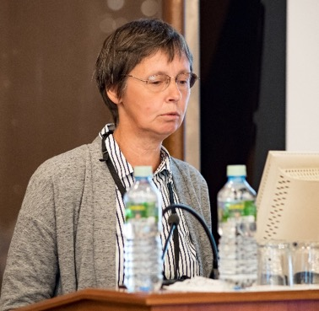
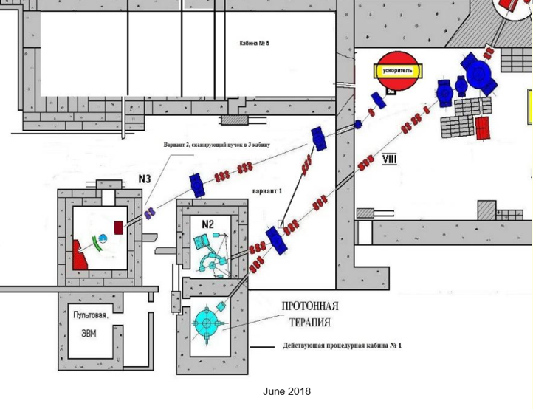
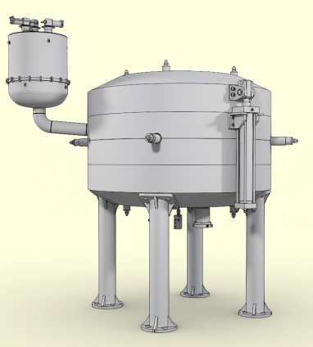
Report on the concluding theme
“Improvement of the JINR Phasotron and Design of Cyclotrons for Fundamental and Applied Research” and proposal for its extension
The theme is focused on the development and improvement of accelerators for hadron therapy applications.
The Phasotron still operates mainly for medical research, but should be phased out and replaced within a few years.
G.A. Karamysheva
The plan is to replace Phasotron by a superconducting isochronous cyclotron SC202 which has been jointly developed by JINR and the Institute of Plasma Physics of the Chinese Academy of Sciences in Hefei.
Notes:
The cyclotron will provide acceleration of protons up to 200 MeV with maximum beam current of 1 μA. We plan to manufacture in China two cyclotrons: one will operate in Hefei cyclotron medical center the other will replace Phasotron in Medico-technical Center JINR Dubna and will be used for further research and development of cancer therapy by protons. Figure 15 shows possible positon of SC202 in the building No1.

Slide 4
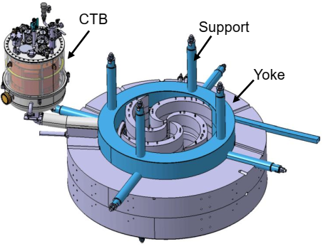
Report on the concluding theme
“Improvement of the JINR Phasotron and Design of Cyclotrons for Fundamental and Applied Research” and proposal for its extension
Main parameters of SC202 200MeV proton cyclotron:
Mass | 55 Tonn
RF Freq | 91.5 MHz
Coil current | 720 kA
Ion source | PIG
Sector azimuthal length | 20-35 deg
Vertical gap between sectors | 38->9 mm
Valley depth | 250mm
Recommendations:
The PAC is worried about the progress in realization of the new SC202 cyclotrons which is a new task for the Hefei Institute. It recommends an even closer collaboration, e.g. by establishing a permanent presence at Hefei.
JINR should insure that enough resources are also allocated locally for all further tests and installations.
The PAC recommends extension of the theme “Improvement of the JINR Phasotron and Design of Cyclotrons for Fundamental and Applied Research” until the end of 2019 with first priority. It expects a new complete project to be ready next year, focused on the timely realization of the SC202 compact cyclotron.

Slide 5

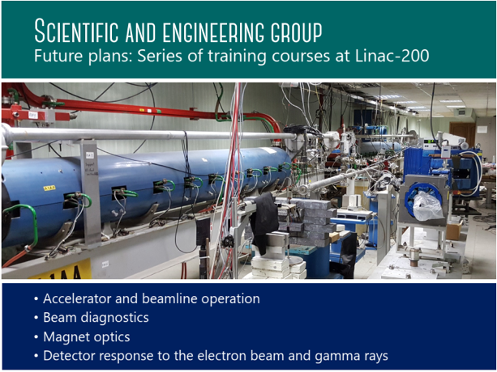

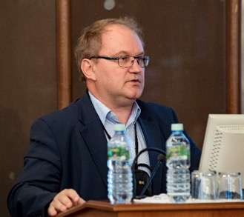

Information on the concluding theme “Organization, Support and Development of the JINR Educational Programme” and on the opening of a new theme: “Organization, Support and Development of the JINR Human Resources Programme”
S. Pakuliak
The PAC supports the recommendations of the 48th meeting of the PAC for Condensed Matter Physics (14–15 June 2018) on the opening of the new theme by the UC. The PAC suggests extending the UC’s international cooperation, especially towards common “double degree” programmes with JINR Member and Associate States.

Slide 6
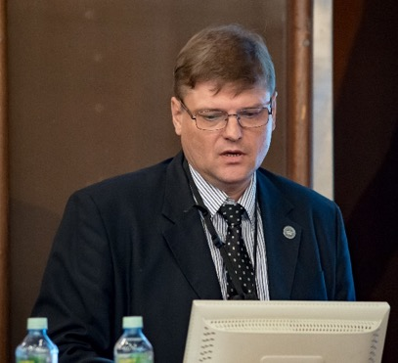
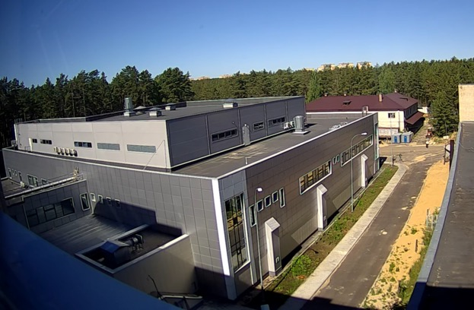
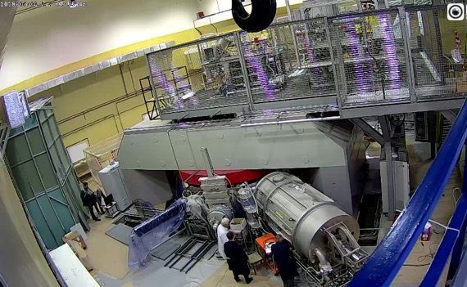
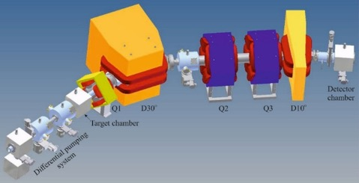
Status of the Factory of Superheavy Elements and the quality control system for construction of the DC-280 cyclotron
Superheavy Elements (SHE) Factory – the Goals
Experiments at the extremely low (σ<100 fb) cross sections:
Synthesis of new SHE in reactions with ⁵⁰Ti, ⁵⁴Cr ...;
Synthesis of new isotopes of SHE;
Study of decay properties of SHE;
Experiments requiring high statistics:
Nuclear spectroscopy of SHE;
Study of chemical properties of SHE.
I. Kalagin
SHE Factory Building
New facilities:
New gas-filled separator
Pre-separator
SHELS
Etc.
High-current cyclotron DC-280

Slide 7
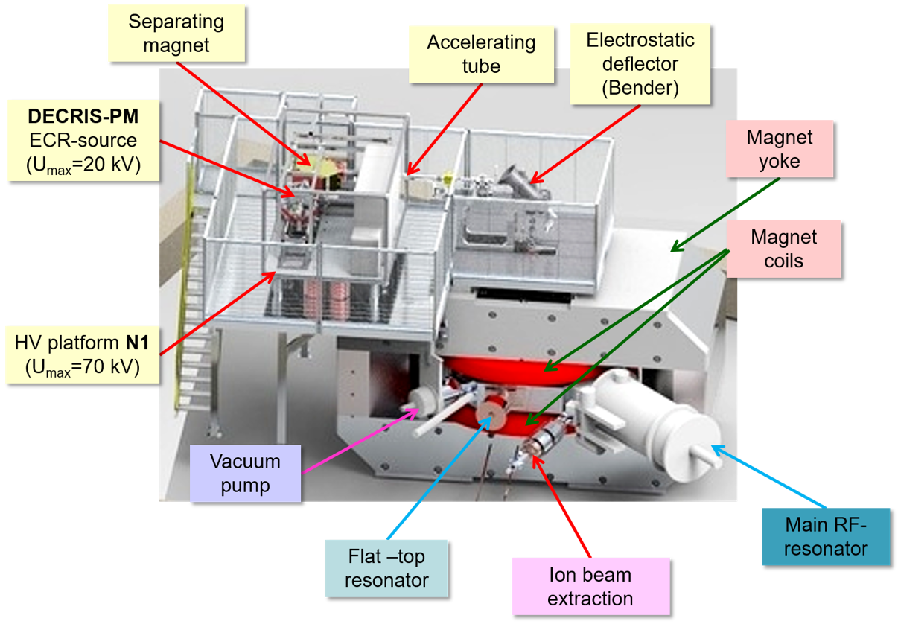
Status of the Factory of Superheavy Elements and the quality control system for construction of the DC-280 cyclotron
DC-280
Main Parameters
Ion sources | DECRIS-PM - 14 GHz Superconducting ECR (developing stage)
Injection energy | Up to 80 keV/Z
A/Z range | 4÷7
Energy | 4÷8 MeV/n
Magnetic field level | 0.6÷1.3 T
K factor | 280
Gap between plugs | 400 mm
Valley/hill gap | 500/208 mm/mm
Magnet weight | 1000 t
Magnet power | 300 kW
Dee voltage | 2x130 kV
RF power consumption | 2x30 kW
Flat-top dee voltage | 2x14 kV

Slide 8
Status of the Factory of Superheavy Elements and the quality control system for construction of the DC-280 cyclotron
Quality control system for construction of the DC-280 cyclotron:
Results:
Autonomous Launching and Tuning Works (LTWs) LTWs of all the DC-280 cyclotron systems are being carried out. The GFS-2 separator is being assembled. Documents for obtaining the Federal Medical and Biological Agency of Russia (FMBA) permission on Complex LTWs with acceleration of testing ions are being prepared.
All products and systems for the SHE Factory were designed and manufactured in compliance with the Quality Assurance System.
The DC-280 cyclotron was constructed in compliance with the Quality Assurance System under standard GOST R ISO 9001
The Quality Assurance System defines:
Project structure management
Types of official documents, procedures for their preparation, processing, storage, and classification
Stages of the DC-280 project implementation
Recommendations:
The PAC recommends that the JINR and FLNR Directorates put all necessary efforts to allow for the timely completion of the construction, licensing, and commissioning of the SHE Factory in 2018. The PAC recommends that the quality assurance system devised at FLNR be used during launching and tuning work and the commissioning of the main systems of the SHE Factory. The PAC recommends that thorough monitoring be provided during the commissioning of all the above-mentioned systems and set-ups of the SHE Factory in order to guarantee a reliable performance of the facility with design parameters. The PAC also recommends that the FLNR Directorate focus on the preparation of Day-1 experiments and make a presentation on the planned scientific programme at the next PAC meeting.

Slide 9
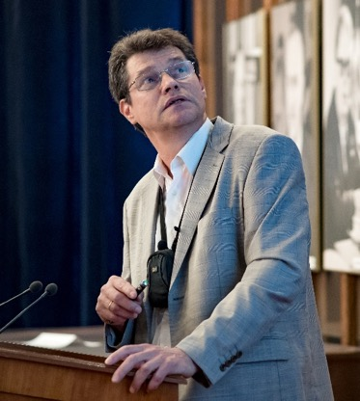
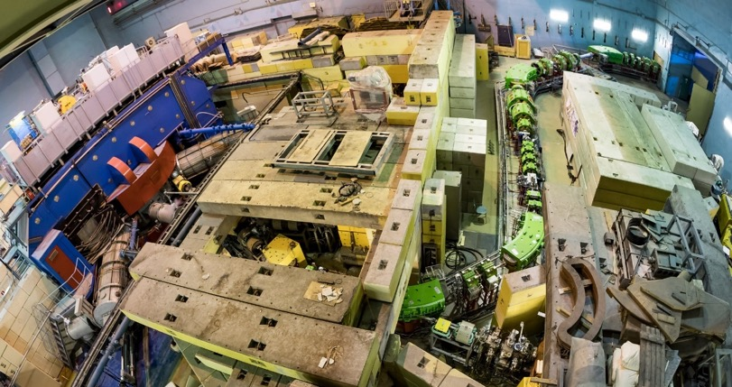
Commissioning and first results of the ACCULINNA-2 fragment separator
ACCULINNA-2 fragment separator commissioned in 2017 is now ready for day-one experiments.
In 2018 experimental program with RIBs has been focused on beta-delayed exotic decays of ¹¹Be, ⁶He+d scattering and d(⁶He,³He)⁵H reaction study.
Method to study low-lying states of ¹⁰Li populated in the reaction d(⁹Li,p)¹⁰Li → n+⁹Li was tested too. (registration of protons, emitted backward in laboratory system, in coincidence with neutrons moving in forward direction)
The study of the ⁷H and its 4n-decay in the reaction d(⁸He,³He)⁷H is proposed for the fall 2018.
A. Fomichev
Recommendation.
The PAC endorses the first experiment on the ACCULINNA-2 fragment separator aimed at studying the properties of ⁷H in the ⁸He(d, ³He)⁷H reaction and the requested beam time at the U-400M accelerator for its implementation.

Slide 10
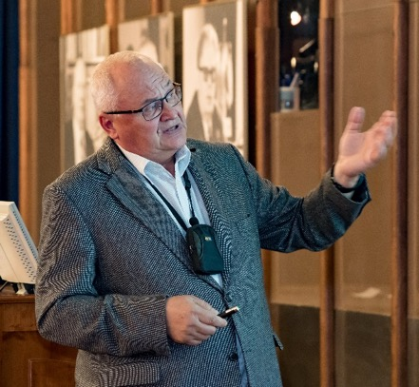
Status of the MAVR high-resolution magnetic analyser
Design specifications:
The MAVR spectrometer will be used both for primary and secondary beams for the accelerator facility U400 and U400R. It will be used for the secondary beam production as well as an energy monochromator.
A new magnetic optical system is based on dipole magnet MSP-144 and two quadrupoles.
This modification improves the value of the solid angle of the spectrometer 30 msr
(by factor of 10).
S. Lukyanov
Focal plane length 2 m.
The large acceptance dp/p=10%, momentum resolution
and dispersion the value 10⁻⁴ and 1.9 cm/% respectively
The detector system aiming to measure Q, Z and A of products
with absolute accuracy by:
  trajectory reconstruction of the detected products using
  a drift-chamber
  time of flight (TOF),
  energies losses (ΔE) and
  total kinetic energies (TKE).

Slide 11
Status of the MAVR high-resolution magnetic analyser
Motivation
Planned experiments:
Stable beams:
Multi-Nucleon Transfer Reactions as a TOOL to study n-rich nuclei
Study of multi-nucleon transfer reactions produced by ¹⁸O and ²²Ne projectiles on Ta target is planned December 2018
Secondary Beams:
”Search for cluster states in light nuclei (⁸B, ¹⁰C)”
”Total reaction cross section”
MAVR is an universal device for studies at energy domain near Coulomb barrier
Expected larger value of cross section both for production and reaction with exotic nuclei at E~10 - 15 MeV/A
Comparative to TISOL method but cheaper and in-flight method -> access to refractory elements
Universal device for missing mass method for spectroscopy and other experiments
Recommendations.
The PAC appreciates the scientific goals and the current progress of the MAVR analyser, recommends completing integration of all its mechanical and electrical systems and suggests performing the in-beam commissioning experiment as soon as possible as to verify whether the projected performance is achieved.

Slide 12

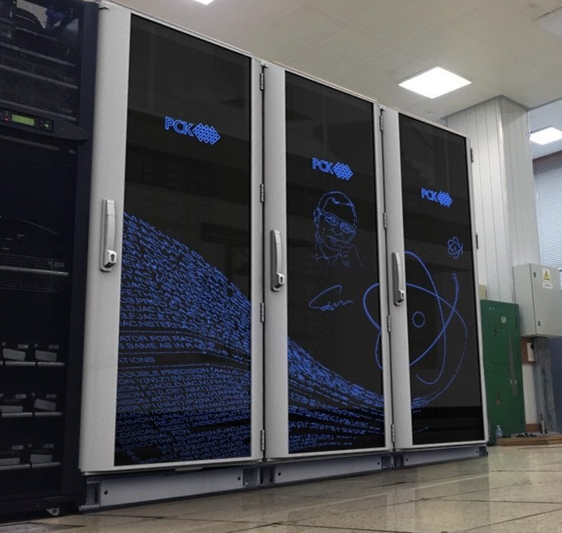
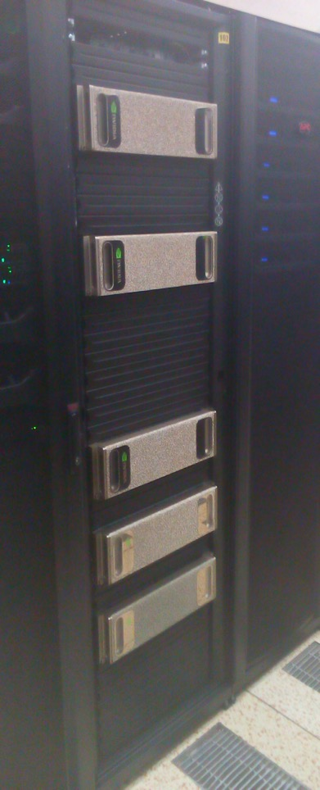




Supercomputer “Govorun” –– new prospects for heterogeneous computations in nuclear physics
D. Podgainy
The PAC heard with interest the report “Supercomputer “Govorun” –– new prospects for heterogeneous computations in nuclear physics”, presented by D. Podgainy and notes the substantial progress in developing the high-performance computing component of the multifunctional centre for storage, processing and analysis of data at JINR.
The PAC supports the efforts of LIT to develop the supercomputer “Govorun” as one of the essential tools for a further fast development of experimental and theoretical physics at JINR and its Member States.

Slide 13
Scientific reports
The PAC heard the excellent report “State-of-the-art and future prospects of neutron activation analysis at the IBR-2 reactor” presented by M. Frontasyeva.
The PAC heard the report “Investigation of subsurface layers of solids with the help of charged particle beams accelerated at the EG-5 electrostatic generator”, presented by А. Kobzev.
The PAC heard the report “Appearance of quasi-fission in reactions of heavy-ion collisions” presented by A. Nasirov.

Slide 14
Poster session
The PAC appreciated the high quality of presentations of new results and proposals by young scientists in the field of nuclear physics research.
The best posters selected are:
  “The fusion-fission and quasi-fission in the near barrier reaction of ³²S + ¹⁹⁷Au” presented by I. Harca
  “Spectroscopy of the isotopes of transfermium elements in Dubna: present status and perspectives” presented by A. Kuznetsova
  “Orientation of statically deformed heavy nuclei in multinucleon transfer reactions” presented by V. Saiko
The PAC recommended the poster
“The fusion-fission and quasi-fission in the near barrier reaction of ³²S + ¹⁹⁷Au”
for presentation at the session of the Scientific Council in September 2018.

Slide 15
Next meeting of the PAC
The next meeting of the PAC for Nuclear Physics will be held on
22 – 23 January 2019.
Its tentative agenda will include:
reports and recommendations on themes and projects to be completed in 2019;
status of the Factory of Superheavy Elements and its scientific programme;
Status of the scientific programme at ACCULLINA-2;
evaluation of projects of neutrino physics and dark matter research jointly with the PAC for Particle Physics (program, date and scope of the joint session are under discussion);
operation of the existing experimental set-ups with beams of the FLNR cyclotrons and the obtained scientific results;
consideration of new projects;
scientific reports;
poster presentations of new results and proposals by young scientists in the field of nuclear physics research.

Slide 16


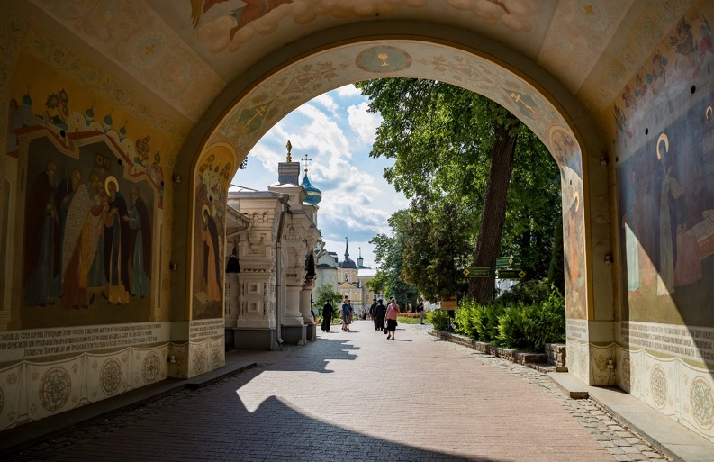
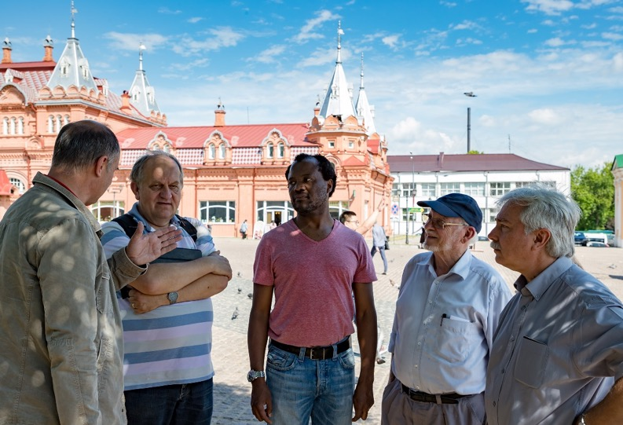
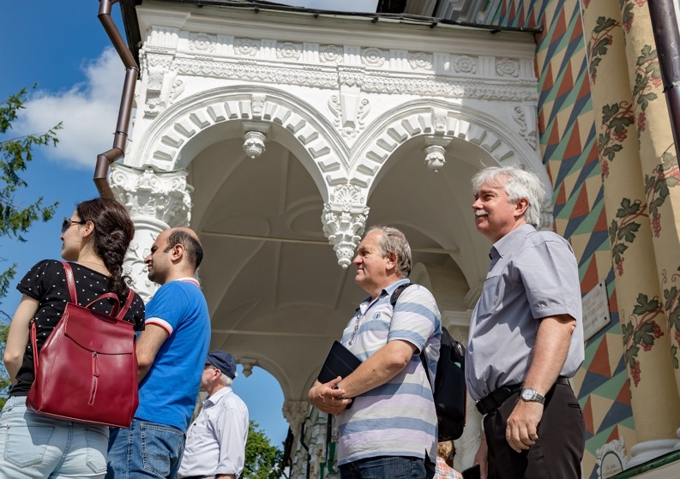
Visit to Sergiyev Posad

Slide 17
THANKS FOR YOUR ATTENTION!

