Slide 1
DEVELOPMENT OF THE
ENGINEERING INFRASTRUCTURE
FOR JINR SCIENTIFIC PROGRAM
B. Gikal, JINR Chief Engineer
------- JINR Scientific Council, ------ September, 20018

Slide 2
ENGINEERING INFRASTRUCTURE
JINR engineering infrastructure is a multi-component structure, which should provide:
operability and development of the JINR basic facilities;
supply of energy resources;
communication service;
safe operation of the Institute's facilities and equipment

Slide 3


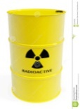








Institute infrastructure
ENGINEERING
INFRASTRUCTURE
SAFETY ENSURING DEPARTMENTS
Radiation and
nuclear safety
Storage and registration of radioactive materials
Electric power supply
Heat supply
Industrial safety
Water supply
Labour protection
Genereal security
Communication
Fire safety
Infrastructure of Laboratories
Cooling systems
Cryogenic systems
Notes:
First of all, what is included in the concept of JINR infrastructure. The structure consists of two main blocks
Infrastructure includes

Slide 4
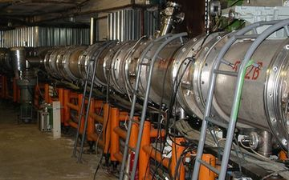
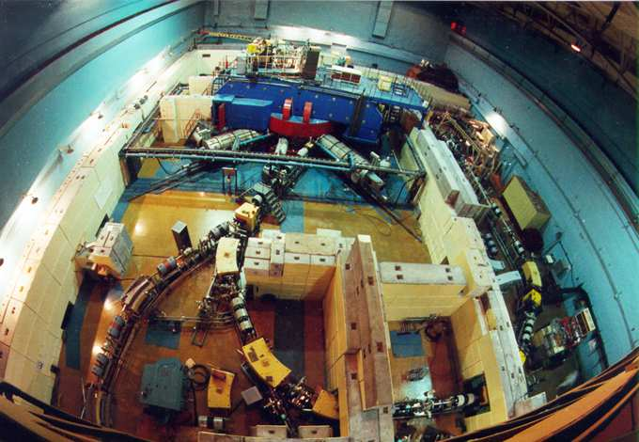
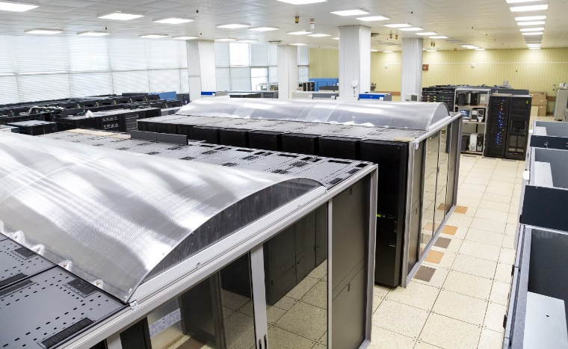
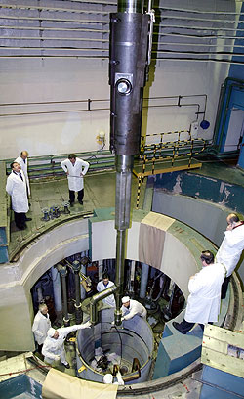
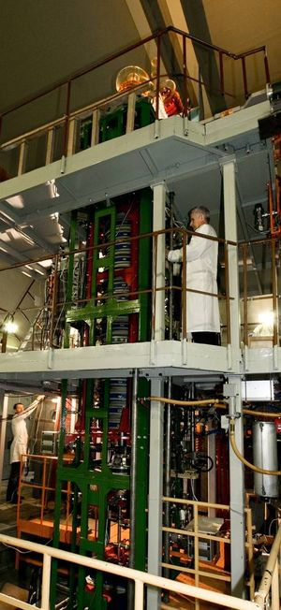
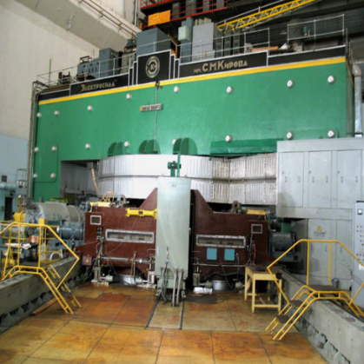
BASIC FACILITIES
JINR engineering infrastructure should ensure the operation of existing Institute facilities and the implementation of new projects
Operating facilities of the Institute, which consume the main bulk of JINR infrastructure resources
Accelerator complex of VBLHEP
DRIBs complex of FLNR
Nuclotron
U-400 U-400M
DC-280
IC-100
MT-25
Phasotron and complex facilities for physical and applied research of DLNP
Computing Complex of LIT
Base facilities of FLNP
IBR-2M
IREN

Slide 5
PROGRAMME
OF DEVELOPMENT OF THE
JINR ENGINEERING
INFRASTRUCTURE
The JINR infrastructure should provide for the planned creation of new projects and facilities
New JINR projects
Creation of new Facilities

Slide 6


Veksler and Baldin Laboratory of High Energy Physics
The development of laboratory infrastructure is mainly aimed at the implementation of the NIСA project
Infrastructure of the laboratory
New cooling system on the basis of fan cooling towers
Cryogenic complex - liquid helium and nitrogen plants
Infrastructure of the Institute
Modernization of power supply systems
Modernization of heating systems
Reconstruction of heat and water supply networks
Notes:
Development of laboratory Infrastructure includes creation of new cooling system and construction of new cryogenic complex. In the frame of development institute infrastructure it is necessary to make modernization ……………..

Slide 7
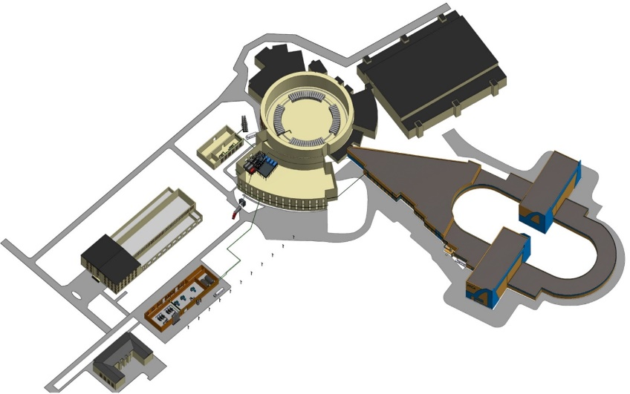
NICA complex
NICA project requires an additional resource:
- an increase in electrical capacity of 22 MW and
- an additional capacity for hot water supply for new buildings.
The substation existing power - 22.4 MW is almost completely used.
The required power increase for the NICA project:
Booster - 1.6 MW
Collider - 9.0 MW
Cryogenic compressor station - 9.0 MW
Computer cluster - 1.05 MW
Total additional power 21.65 MW
The heat load of the new buildings will be 11.7 Gcal/hr, it means, the total heat energy consumption at VBLHEP will be doubled versus the existing value.

Slide 8
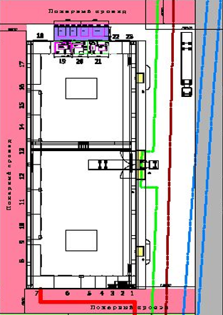
Flerov Laboratory of Nuclear Reactions
- Now the electric power consumed by existing installations is 4 MW.
In 2023 it will be 6.4 MW.
- A small additional heating power for new buildings will be required.
New experimental hall of U-400 cyclotron
DC-280
Mounting hall of FLNR
(new building)

Slide 9


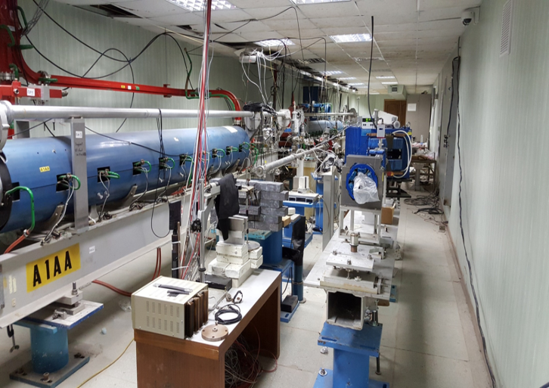
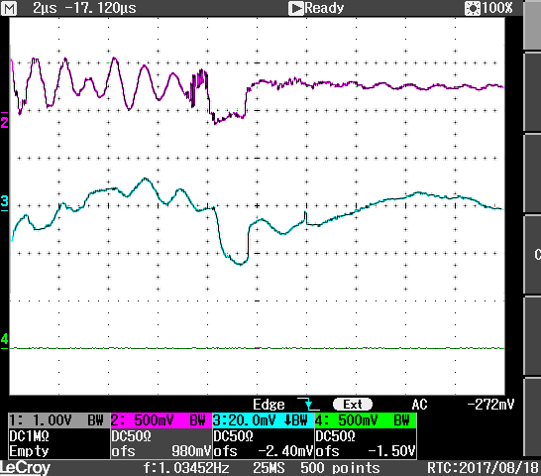
Dzhelepov Laboratory of Nuclear Problems
The laboratory plans to complete the creation of a research complex based on the LINAC- 200 linear accelerator.
9
Principal goals:
Provide electron testbeams for R&D detector
Provide base for training (together with the
University Centre)
August 2017:
Physical start-up at 200 MeV
Design parameters
Beam energy up to 200 MeV
Pulse current up to 60 mA
Pulse length of 0.1-3 μs
Pulse frequency up to 100 Hz
The energy spread < 1%
Current status
Commissioning is under way
Gun and four accelerator stations are fully operational
First beam of 200 MeV electrons is obtained
Test beam infrastructure is being developed
Notes:
Laboratory has

Slide 10

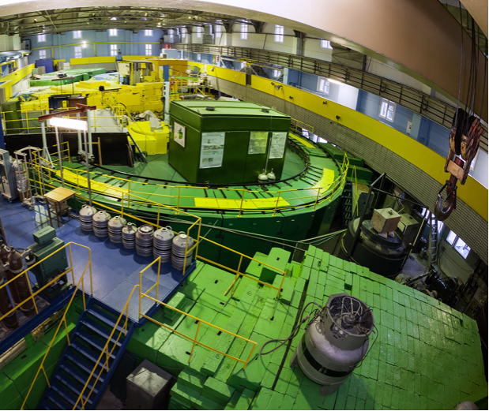
Frank Laboratory of Neutron Physics
Dzhelepov Laboratory of Nuclear Problems
The plan:
Decommissioning of the Phasotron by 2023.
Creation of a proton therapy complex based on a superconducting cyclotron.
Commissioning of the linear electron accelerator LINAC- 200.
These installations do not require additional power supply from the Institute infrastructure.
Frank Laboratory of Neutron Physics
- Programme of development of the IBR-2 and complex of physical facilities.
Elaboration of new n-source concept.
These programmes of development do not require additional power supply from the Institute infrastructure.
Notes:
In the plan of laboratory

Slide 11
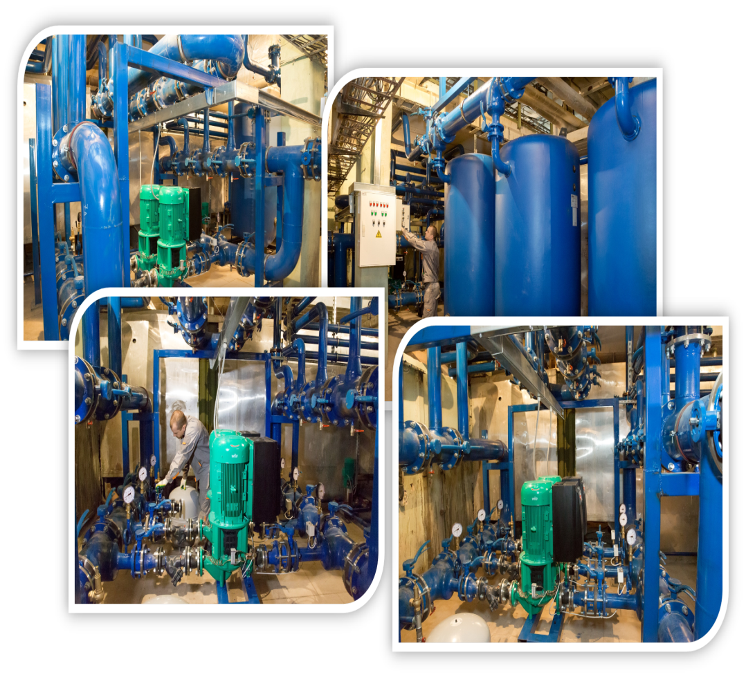
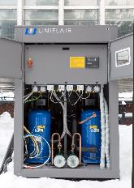
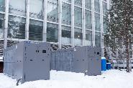
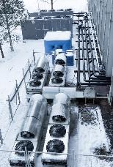

Laboratory of Information Technologies
Infrastructure of the laboratory
The upgrade of the laboratory infrastructure is aimed at improving the reliability of the computer system operation:
- Modern water cooling systems using chillers.
- Hot and cold air systems for ventilation.
- Uninterruptible power supply systems
Infrastructure of the Institute
Total electrical power consumption:
- Now the computer complex consumes 450 kW and the building consumes 320 kW.
By 2023 the planned increase in power consumption
is about 2.5 MW.
The Institute's infrastructure should provide an increase
in the power supply.
Notes:
. The Institute's infrastructure should provide an increase in the power supply.

Slide 12
JINR ENGINEERING SYSTEMS

Slide 13
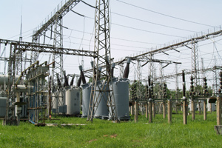
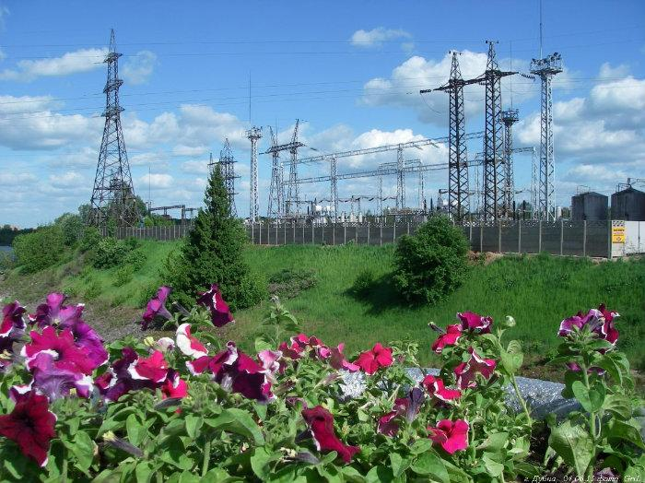


Existing electrical supply scheme of JINR
“Tempy” Electrical Substation
Hydroelectric Power Plant оf 30 MW
The main supply of the Institute is provided by the “Tempy” Electrical Substation
Maximum power 52 MW
Two independent supply lines with a length of 5 km
Maximum power 4 MW
Two independent supply lines of 110 kV with a
length of 20 km
LNP
The line can be used for the substation as a reserve line
JINR Substation-1
“GPP-1” 22.4MW
The station is located on the site of LHEF
JINR Substation-2
“GPP-2” 29.6 MW
The station is located on the site of LNP
14 MW – JINR
10 MW – JINR
28 MW are used by city power consumers
Notes:
The main supply of the Institute is provided from the “Tempy” Electrical Substation

Slide 14
Distribution of electric power among consumers of substation 1 (GPP-1) and substation 2 (GPP-2)
JINR power supply
Presently (before reconstruction)
After reconstruction
Substation 1 power (GPP-1) - 22 396 kW
consumers:
  JINR – 13 866 kW
  City consumers - 8 530 kW
Substation 2 power 2 (GPP-2) - 29 584 kW
consumers:
  JINR– 10 000 kW
  City consumers - 19 584 kW
Substation 1 power (GPP-1) – 40 800 kW
consumers:
  JINR– 32 270 kW
  City consumers - 8 530 кВт
Substation 2 power (GPP-2) – 39 180 kW
consumers:
  JINR– 19 596 kW
  City consumers - 19 584 kW
Total power increase for JINR - 28 MW
Project status
- the project has received a positive opinion of the expert organization.
substation 1: 2 transformers with a capacity of 20 MW each will be replaced
by 2 transformers with a capacity of 40 MW each.
substation 2: 3 old transformers with a capacity of 16 MW each will be replaced
by 4 new transformers with a capacity of 16 MW each.
- start of purchase of equipment and preparation for installation - 2019.
- completion of the reconstruction – in 2020
- The total cost of the project is about 1 billion rubles.

Slide 15
Heating supply scheme for the Institute and the Сity
Central boiler-house
Power
102.6 Gcal/hour
“East” boiler-house
Power
166.0 Gcal/hour
Total heating power
268.6 Gcal/hour
Total heat power consumption - 70 Gcal/hour
LNP site
LHEP site
City consumers
Current upgrading of Boiler-houses and heat network:
Automation of boiler-houses.
Planned repair of the steam-boiler in the “East” boiler-house.
Reconstruction and maintenance of the heat network.
The program of accounting of heat energy resources is implemented in JINR laboratories.
The heat-supply networks of the Central and “East” boiler houses are combined.
The capacity of one boiler-house is enough for emergency heat supply of the Institute and the city.
There is a sufficient capacity reserve for the further development of the Institute and the city.

Slide 16
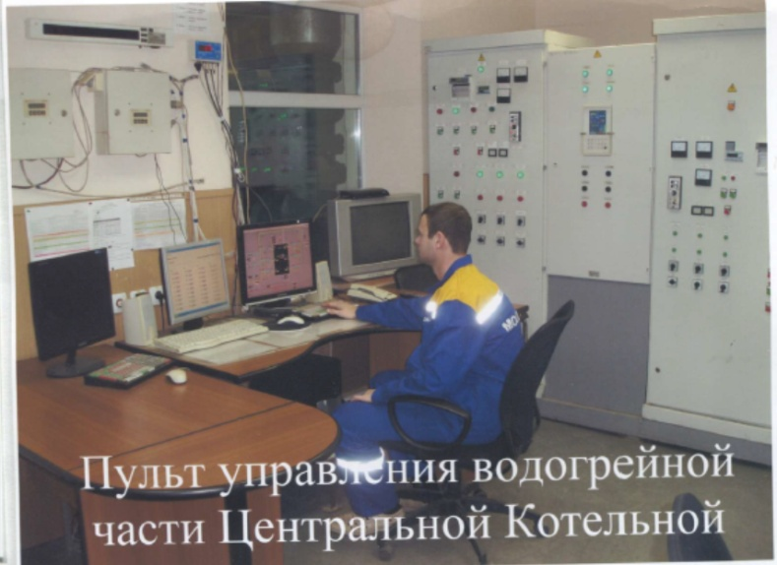
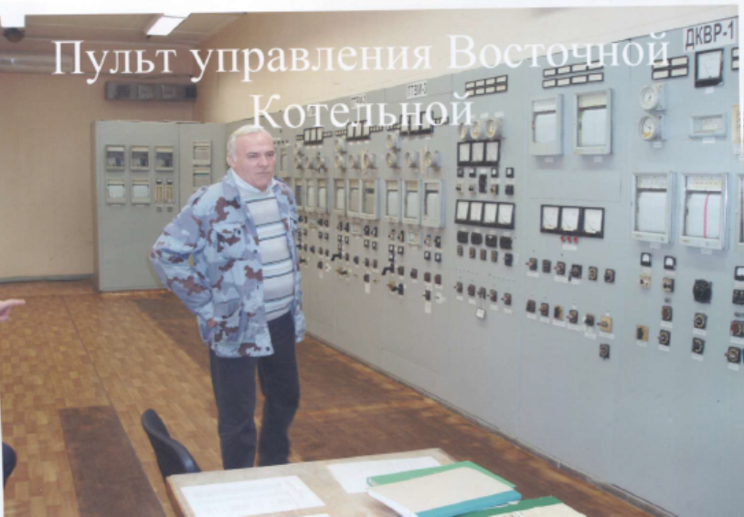
Heat supply
According to the plan:
:
New control room of Central boiler-house
Automation of the Central boiler-house
is completed.
The total cost of the project is 95 million rubles.
Reconstruction of boilers of the “East”
and Central boiler-houses is carried out.
Plans for the heat supply system for the next few years
- to perform full automation of “East” boiler-house
The total project cost is about 100 million rubles.
to replace most of the pipes of water supply
networks at the LNP site.
- to create a single dispatching center of
heat accounting for the main consumers.
Old control room of “East” boiler-house

Slide 17

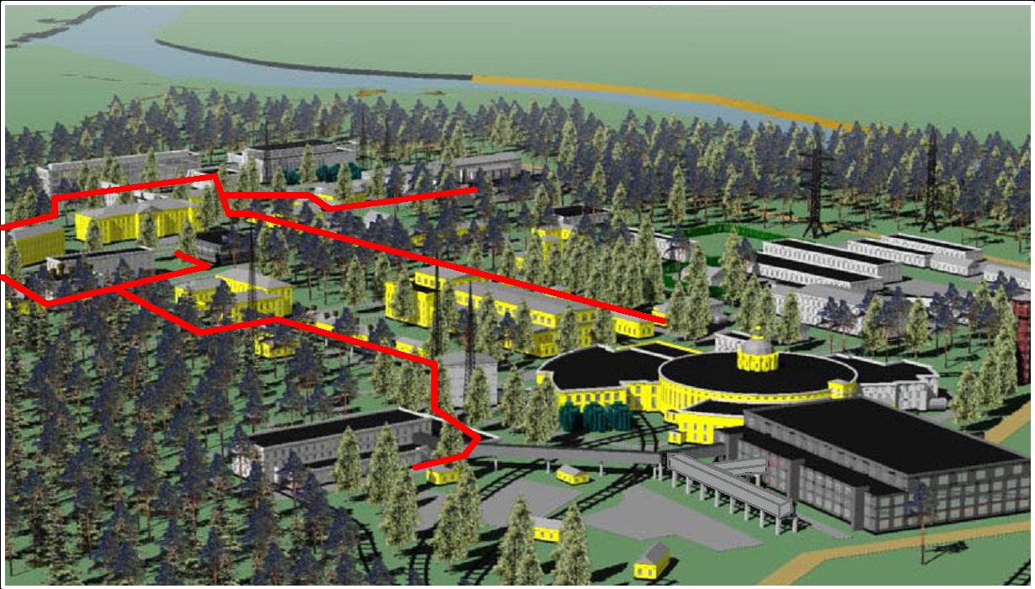
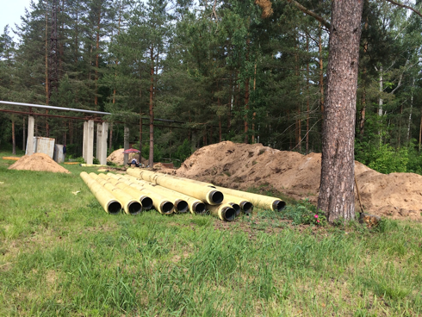
New main heating pipelines on the LHEF site
During the last few years, more than
2 km of the main heating pipelines have been reconstructed on the LHEF site.
Pipelines are ringed, this guarantees reliable heating of all the existing lab’s buildings.

Slide 18
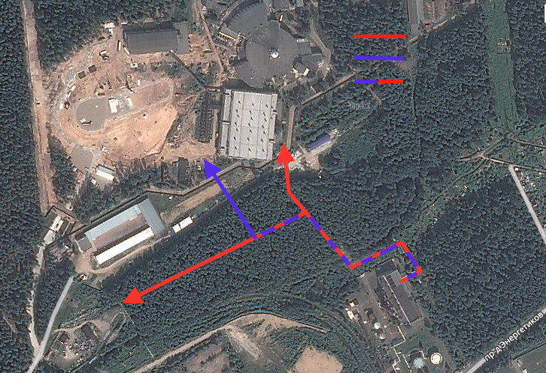
Modernization of heating facilities
Existing lines
New lines
Modernization needed
D500>D600mm pipeline
B
“East” Boiler House
A
The heating load of the new buildings of the NICA complex will be 11.7 Gcal/hr, i.e. the total load at VBLHEP will be doubled versus the existing value.
In the frame of the modernization of heat networks, it is necessary to lay a new line with an increased diameter pipes of up to 500 mm or more.

Slide 19
Water supply system of the Institute and the city
Water preparation station.
(pumping-filtering station)
River VOLGA
Substation 3
Proposal for future development.
performance
420 m3 / hour
Substation 1
performance
420 m³ / hour
Substation 2
performance
420 m³ / hour
Pumping station
Full performance of water station 840 m³ / hour
Water consumption by the city and JINR 500-550 m³ / hour
City consumers
JINR
Current activity
Project of reconstruction
of the pumping-filtering station.
Automation of the drinking water
preparation.
Reconstruction and replacement
of the water pipes.
Development of the automatic system of water accounting
- The station reserve is 300 m³ / hour. This is enough for the next 5 years.
- For further development the construction of substation 3 is required . (The option of co-financing from the Administration of city or the Moscow region is considered.)

Slide 20
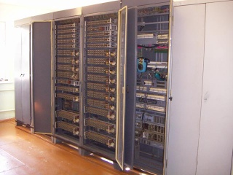
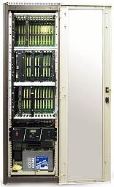
TELEPHONY (phone station)
Before modernization :
Analog station built in 1975-1985
5500 users (~3800 at JINR)
Old network
No additional services
(IP-telephony, etc.)
Space requirement ~950 m²
Presently :
Digital electronic station
Scalability
Optical connection
Low cost of long distance calls
Modern services
Floor space and electricity saving
The analog station has been replaced with a new digital one.
Increased level of service,
increased reliability of communication in an emergency,
reduced cost of the station operation .
Approx. cost: ~ 0.5 M$

Slide 21

RADIATION AND NUCLEAR SAFETY
Objectives:
Purchasing of devices and equipment
for the radiation control.
Purchasing of a mobile radiological laboratory.
(*) Reconstruction and development of new
systems of the radiation control
(e.g. IBR-2M, NICA, IREN).
(*) Disposal of the used radioactive sources.
Handling of radioactive wastes.
Metrological maintenance of the radiation control.
Accreditation of the radiation control laboratory.
The existing radiation safety system corresponds to the current norms and rules.
The current modernization of equipment is carried out according to the plan.

Slide 22
LABOUR PROTECTION AND INDUSTRIAL SAFETY
Main Goals:
Providing safe and healthy working conditions for personnel.
Ensuring prescribed benefits and compensation for appropriate
categories of workers .
Realization of preventive actions to avoid traumatism and also emergency situations.
Activities to be continued:
Certification of workplaces with regard to working conditions, in particular,
available benefits and compensation for work in harmful and/or dangerous working
conditions.
Scheduled replacement of morally and physically outdated equipment and technical
devices.
Re-equipment of the JINR Industrial and Sanitary Lab with modern instrumentation
to take more precise measurements and online processing of parameters and
levels of the harmful and dangerous production factors.
Technical upgrade of workplaces of the specialists on labour protection in the JINR
departments.
Advanced training in the fields of labour and industrial safety for the JINR experts
and department heads. The JINR University Center can be involved in this activity.
Notes:
In the Institute labour protection and industrial safety system works well

Slide 23
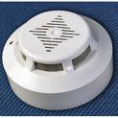
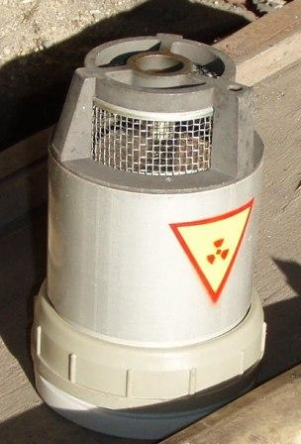
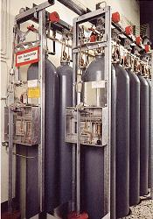
FIRE SAFETY
FIRE STATION
control panel
The Institute has created a single dispatching center to control the fire safety system of the all Institute. The system includes 15000 sensors and 7 fire-fighting stations
JINR
GOALS:
Re-equipment of the fire
station with fire engineering.
Modern control panel (GSM,
large covering area, etc.).
Gradual replacement of
the RID-1 annunciators
Ongoing activities to
maintain the JINR infrastructure
in accordance with the fire
safety requirements.
15000 annunciators
including ~3500 RID-1
which have to be replaced
7 automatic gas
fire-fighting systems

Slide 24
Thank you for attention

