Slide 1
The unified database for the fixed target experiment BM@N
NEC’2015 XXV Symposium on Nuclear Electronics and Computing
Gertsenberger K. V.
Laboratory of High Energy Physics, JINR
for BM@N collaboration
30 September 2015

Slide 2
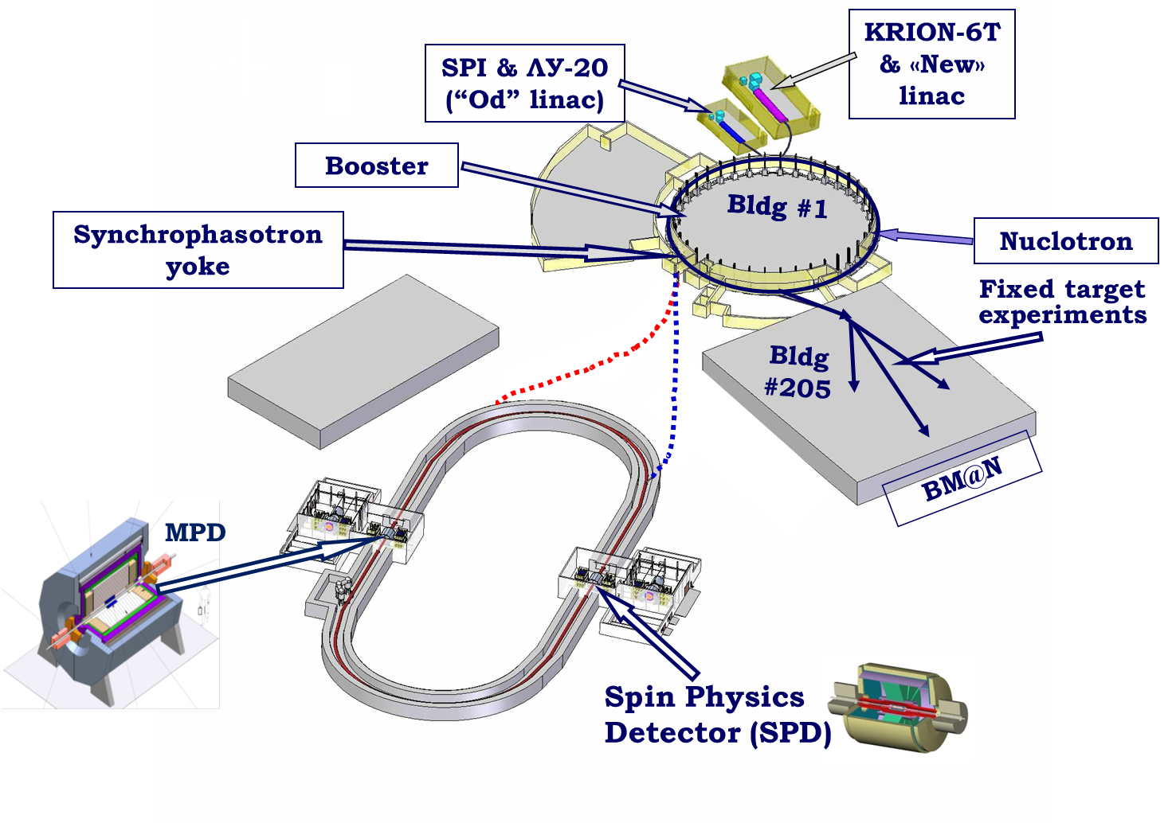
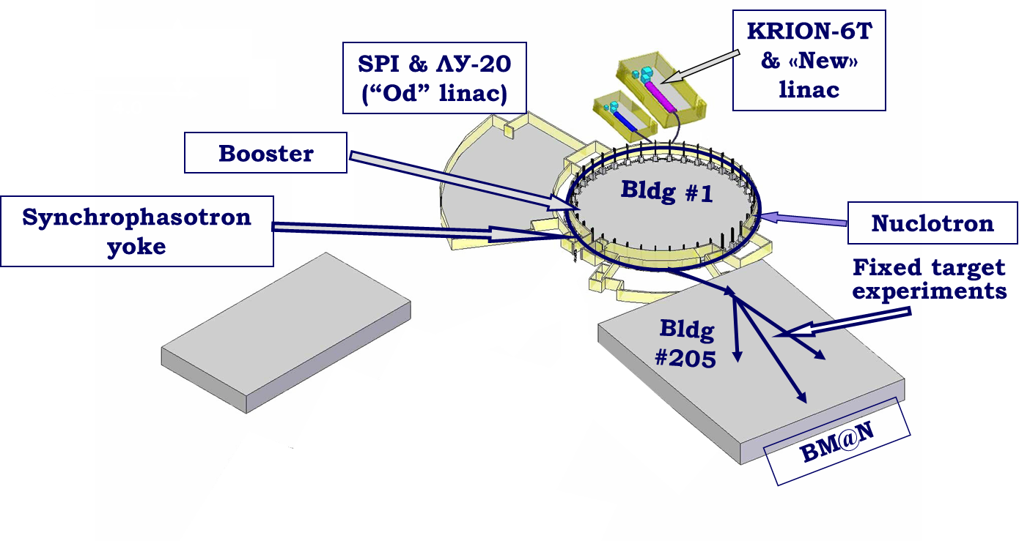
BM@N experiment
Baryonic Matter at Nuclotron (BM@N) at extracted Nuclotron beam
Gertsenberger K.V.

Slide 3
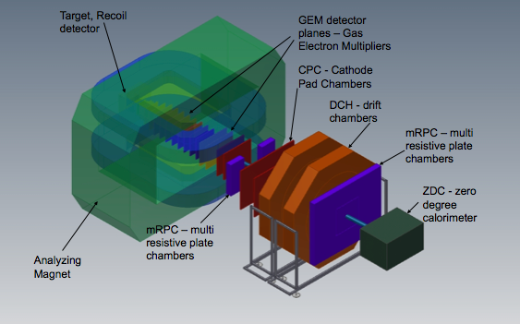
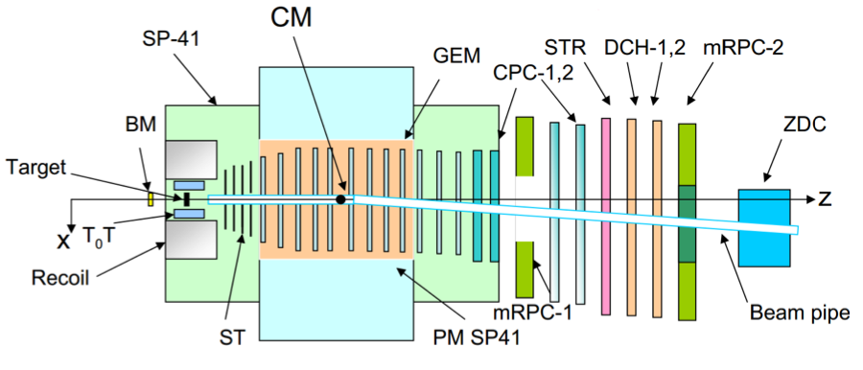
BM@N setup
The physics program:
study of elementary reactions and ‚cold‘ nuclear matter
study of the properties of dense nuclear matter with strangeness, in-medium effects
hypermatter production
hadron femtoscopy
Gertsenberger K.V.

Slide 4
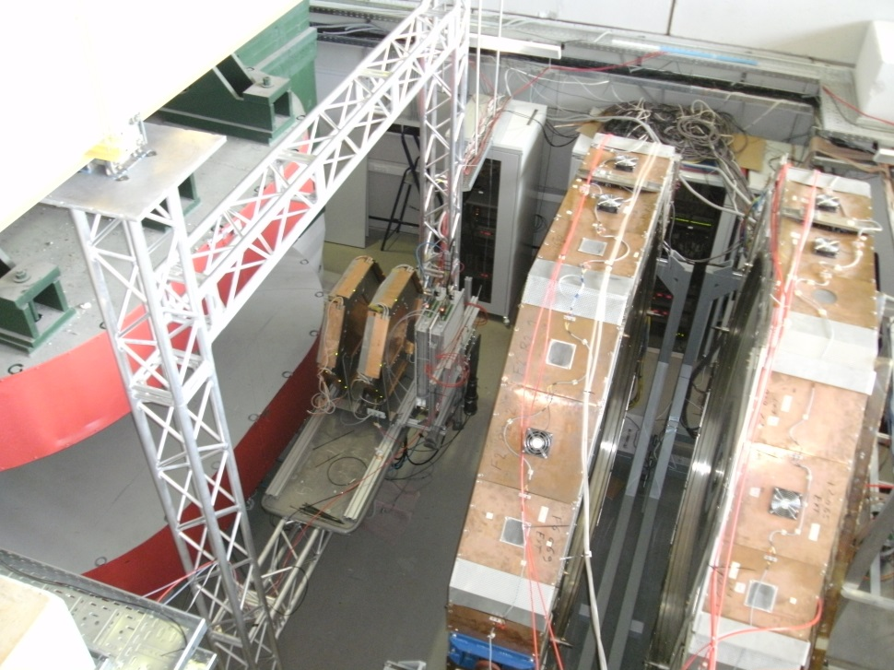
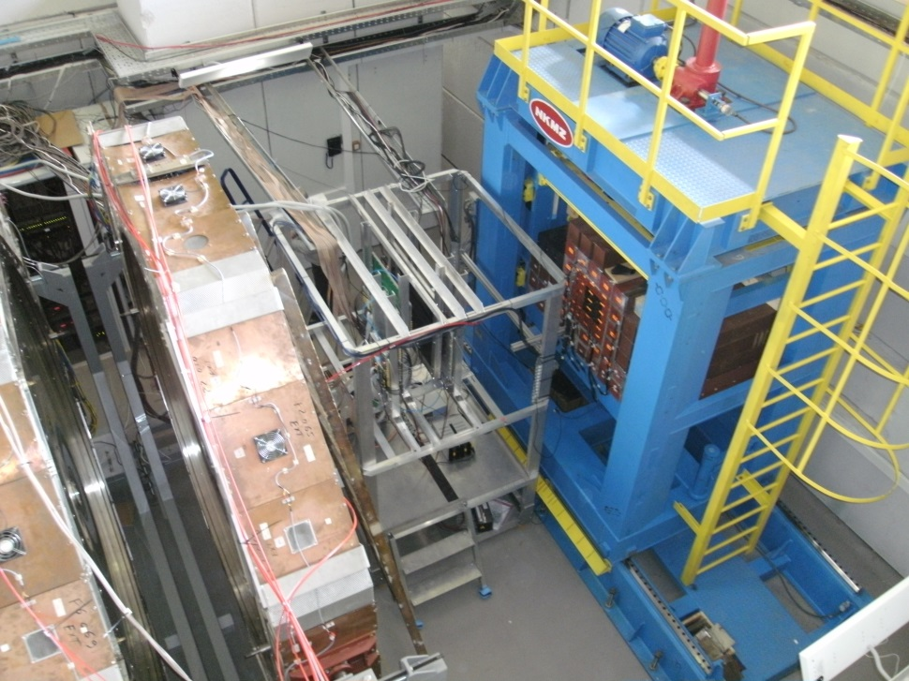
BM@N facility (technical runs: 22 Feb-15 Mar 2015)
DCH-1,2
ZDC
ToF-700
ToF-400
DCH-1,2
Beams: deuteron (Run 1 and Run 2), carbon (Run 3)
Energy: 3.5 GeV/nucleon
Targets: carbon, copper, none
Detectors: DCH 1, DCH 2, 3 MWPC-MPD, T0+Tr(BC1+BC2+CD+BC3), ToF-400, ToF-700, ZDC, ECAL
Gertsenberger K.V.

Slide 5
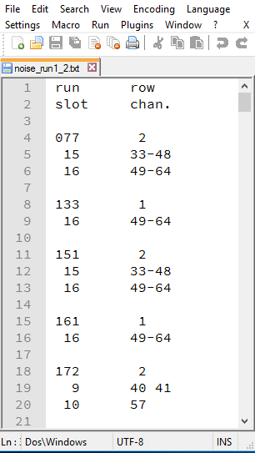
Multiple data of the BM@N experiment
676 raw data files, *.root files, parameter data
noise channels
HTML
Excel
Text
Gertsenberger K.V.

Slide 6
The main problems of data storing
the data of the experiment is distributed between many subdivisions – it’s difficult to find necessary absent information for the other subdivisions
required information is stored in a lot of files of different types (binary, html, excel, txt and other)
detector mapping (text files) can be corrected but you won’t know about changes and will continue to work with old data
BM@N geometry scheme is hand-drawn and can be varied from run to run
Gertsenberger K.V.

Slide 7
Why should a database system be used?
The lacks of the file storing approach:
the usage of multiple files and arbitrary formats (imposed by author), duplication of information in different files lead to data isolation, redundancy and inconsistency
sequential, non-indexed access and search (not efficient)
no mechanism exists for relating data between these files
it’s difficult to access and manipulate the data: one needs some dedicated programs
uncontrolled concurrent access by multiple users often leads to inconsistencies
Gertsenberger K.V.

Slide 8
The purposes of the unified database for BM@N
central data storage of the BM@N experiment
unified access and data management for all BM@N members
correct multi-user data processing
ensuring the actuality of the information being accessed (run parameters, detector geometry and position, technical and calibration data, etc.), data consistency and integrity
excluding the multiple duplication and use of outdated data
automatic backup of the stored data
merging the existing databases to simplify access and administration
Gertsenberger K.V.

Slide 9
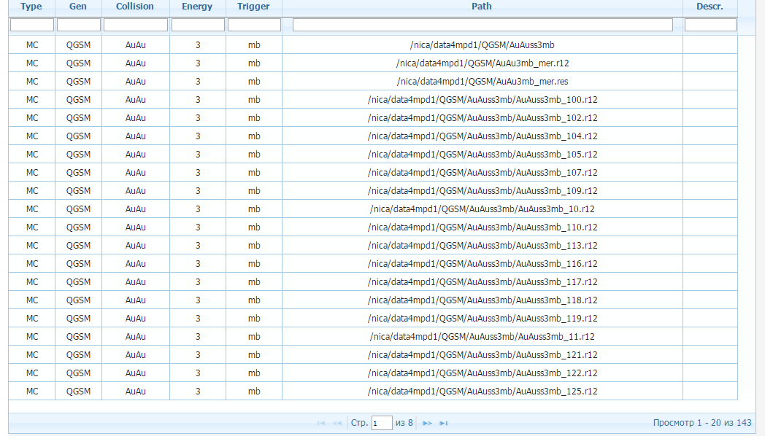
The Simulation database (MySQL)
Event generator: UrQMD, QGSM …
File location: NICA cluster
Web interface by Ivan Slepov
Gertsenberger K.V.

Slide 10
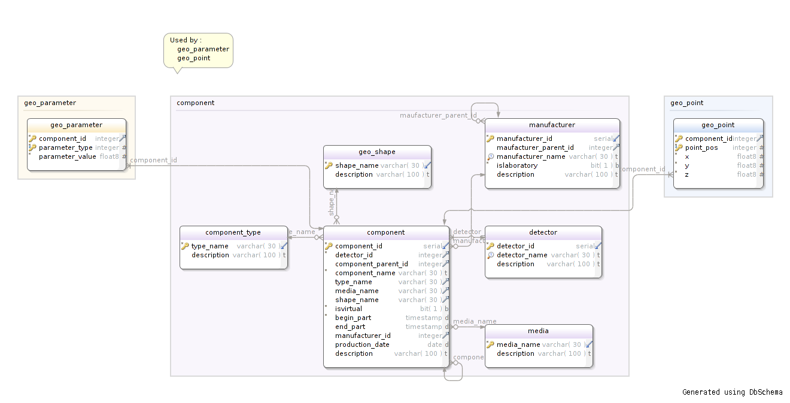
The Geometry database (PostgreSQL)
The database worked in testing mode with manual data insertion
Gertsenberger K.V.

Slide 11
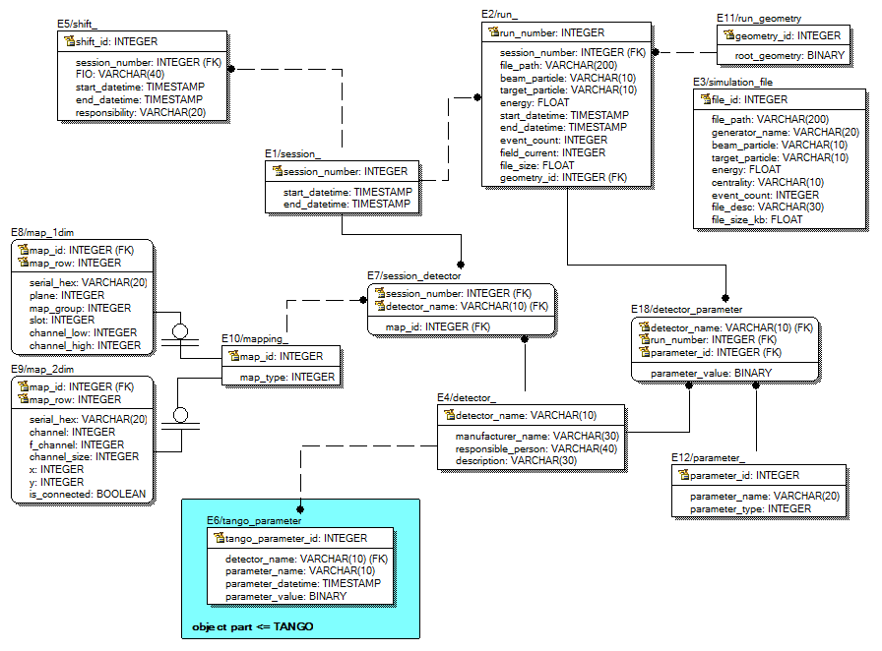
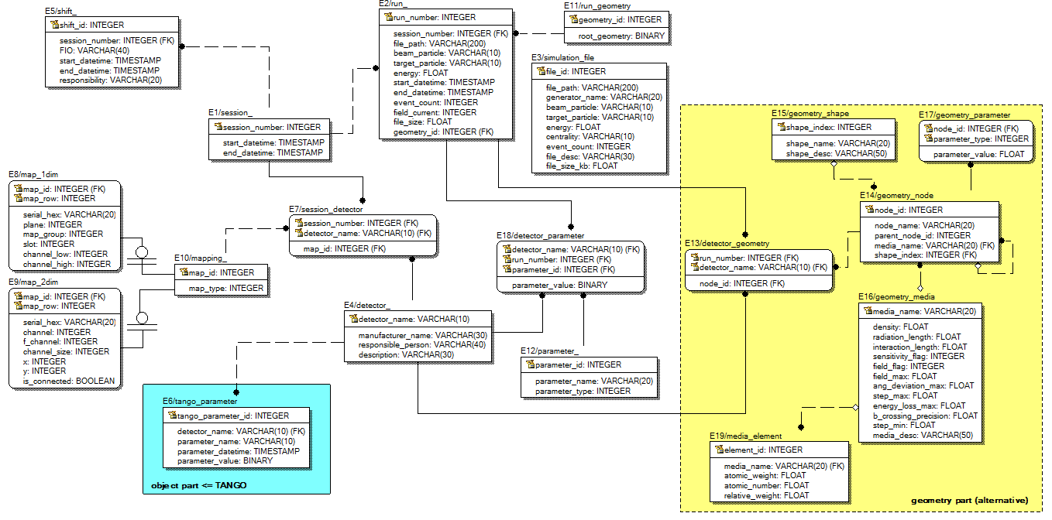
Unified database ER-diagram
PostgreSQL implementation
Gertsenberger K.V.

Slide 12
The data being stored in the database
Configuration data is concerned with detector running mode, i.e. voltage settings as well as some programmable parameters for frontends electronics.
Calibration data describes the calibration and the alignment of the different subdetectors. Usually quantities are evaluated by running dedicated offline algorithms.
Parameter data presents the state of detector subsystems. They include a variety of detector settings including the geometry and material definitions.
Algorithm data is used to control the way an algorithm operates. It includes, for example, cuts for selection and production files’ paths.
Gertsenberger K.V.

Slide 13
BMNRoot software
developed for the event simulation, reconstruction and physical analysis of particle collisions with a fixed target registered by the BM@N facility
implemented in the programming language C++ based on ROOT and FairRoot environments
has a runtime parameter manager which writes and initializes parameters to (from) ASCII or ROOT files:
ASCII file mode is intended for an easy and convenient access to parameters
ROOT file mode is a convenient way to have local copies of the parameter data using the binary object streaming mechanism automatically provided by the ROOT
converts the facility geometry from *.geo and *.root subdetector files to result ROOT file used to visualize BM@N on the screen
Gertsenberger K.V.

Slide 14
C++ class database interface (BMNRoot)
Class wrappers for all database tables with many specific functions allow to access and manage the data without SQL statements in the BMNRoot software
DbSession – describes sessions (a set of BM@N runs)
DbShift – contains information about session’s shifts
DbRun – run parameters (number, date&time, energy, beam, target, magnet field, file path, etc.)
DbDetector – detector dictionary
DbMapping, DbMap1dim, DbMap2dim – store detector mapping data
DbSessionDetector – the list of detectors in session with link to the mapping
DbParameter – parameter dictionary (presented on the previous slide)
DbDetectorParameter – values of detector parameters for experiment runs
DbRunGeometry – contains BM@N geometry as ROOT files in binary format
DbSimulationFile – describes a set of generated simulation files
The main functions:
static: Create[Entity], Get[Entity], Delete[Entity], PrintAll.
non-static: Getters and Setters functions, Print.
Gertsenberger K.V.

Slide 15
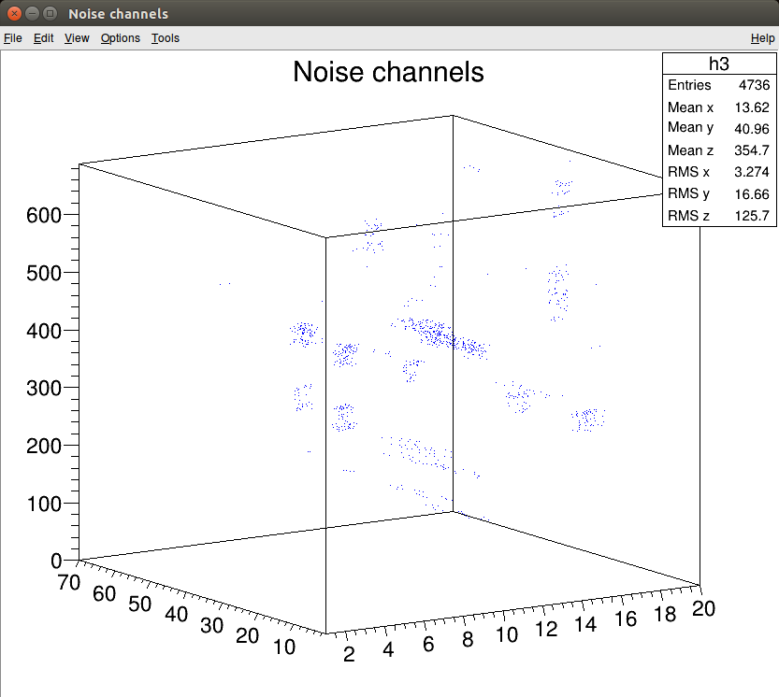
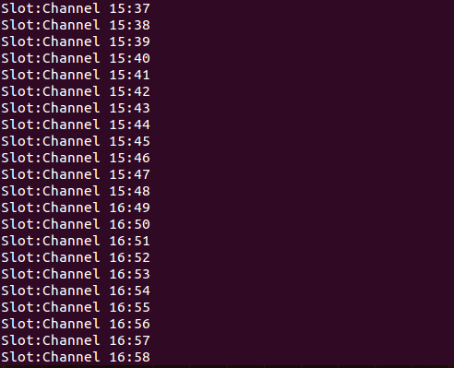
“Noise channels” parameter (example)
IIStructure* pValues = new IIStructure[32];
AssignIIStructure(pValues, 0, 15, 33, 48); // slot:15, channel:33-48
AssignIIStructure(pValues, 16, 16, 49, 64); // slot:16, channel:49-64
DbDetectorParameter::CreateDetectorParameter(run_number, "DCH", "noise", pValues, 32);
DbDetectorParameter* pDetectorParameter = DbDetectorParameter::GetDetectorParameter(run_number, "DCH1", "noise");
if (pDetectorParameter != NULL)
{
IIStructure* pValues; int element_count = 0;
pDetectorParameter->GetIIArray(pValues, element_count);
// e.g. print values (slot:channel)
for (int i = 0; i < element_count; i++)
cout<<pValues[i].int_1<<":"<<pValues[i].int_2<<endl;
}
run
channel
slot
Gertsenberger K.V.

Slide 16
Additional classes of the database interface
DbConnection serves to open and close connections to the BM@N database
DbGenerateClasses generates skeleton classes for all tables of the database
DbParser parses existing data of the BM@N experiment from HTML, Excel and text files, and writes it to the unified database
DbGeoConverter converts ROOT files with BM@N geometry to the alternative database view
DbTangoData gets hardware data from the “slow” control system (Tango) for selected time range (run number), detector and parameter defined by name
It includes the following directories:
macro/* - ROOT macros for executing the tasks presented by the classes above
examples/* - numerous examples of using the class wrappers to work with the BM@N database
docs/* - database interface documentation
Gertsenberger K.V.

Slide 17
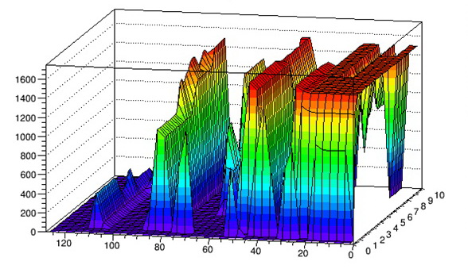
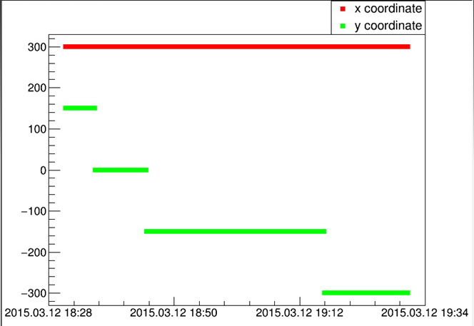
Using Tango (hardware) data
DbTangoData class gets hardware data from the Tango control system based on MySQL DBMS
Main functions of the class:
Tango_Data* GetTangoParameter(char* detector_name, char* parameter_name, char* date_start, char* date_end);
void PrintData(Tango_Data* parameter, bool isGraphicPresentation = false);
GetTangoParameter
(“ZDC”, “Vset”, “2015.03.13 23:40”, “2015.03.13 24:00”);
(“ZDC”, “PosY”, “2015.03.12 18:20”, “2015.03.12 19:40”);
coordinate
voltage
time counter
ZDC tower number
time
Gertsenberger K.V.

Slide 18
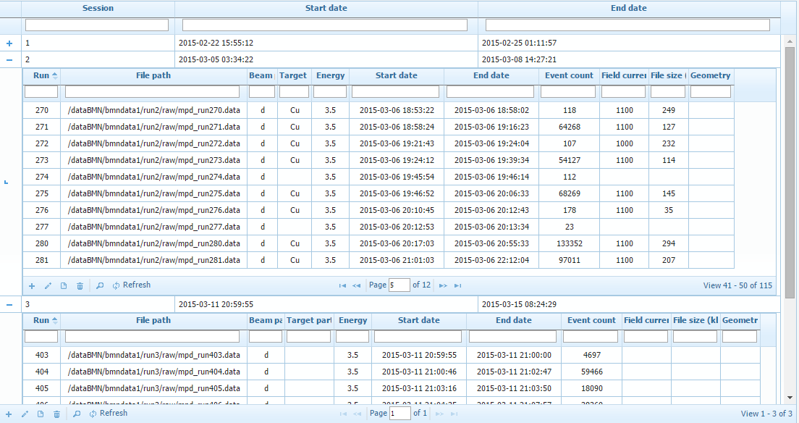
Web interface of the developed database
Web interface by Ivan Slepov
Gertsenberger K.V.

Slide 19
The unified BM@N database
raw data processing
event reconstruction
physical analysis
reading and changing data
BMNRoot
users
C++ database interface
(connect, SQL I/O)
TSQLServer
central
database
PHP
Web interface
DbTangoData class
Postgres, SQL
automatic backup
Tango
simulation database
existing configuration, calibration, parameter and algorithm data (HTML, Excel, TXT)
geometry database
slow control system
Gertsenberger K.V.

Slide 20
Conclusions
The BM@N database was developed based on Postgres DBMS and deployed on the NICA cluster.
The unified database merged the existing databases and included existing data of the first BM@N runs from multiple files (HTML, Excel, text).
C++ database interface was implemented as a part of the BMNRoot environment to use it for raw data processing, event reconstruction and physical analysis tasks. It provides the classes and tools to store and access data without SQL statements.
DbTangoData class was developed to get hardware data from the BM@N control system – Tango.
Web interface of the BM@N database was implemented to simplify reading and changing the data by users.
The developed database is the central data storage of the BM@N experiment allowing unified access and data management for all BM@N members and correct multi-user data processing, ensuring the actuality, data consistency and integrity of the information, and excluding the multiple duplication.
A future version of the unified database will be used for MPD/NICA experiment
Gertsenberger K.V.

Slide 21
NEC’2015 XXV Symposium on Nuclear Electronics and Computing
Thank you for attention!

