Slide 1
TANGO Standard Software for Nuclotron Beam Slow Extraction Control
XXV Symposium on Nuclear Electronics and Computing, Montenegro, 2015
V. Andreev, V. Volkov, E. Gorbachev, V. Isadov, A. Kirichenko, S. Romanov, G. Sedykh
JINR, Dubna, Russia

Slide 2
Vasily Andreev et al. “TANGO Standard Software for Nuclotron Beam Slow Extraction Control”
Introduction
TANGO Controls to be basis of the NICA Control System
Nuclotron control subsystems must conform to the paradigm of TANGO
Software of the existing Nuclotron subsystem should be rebuild to match TANGO

Slide 3
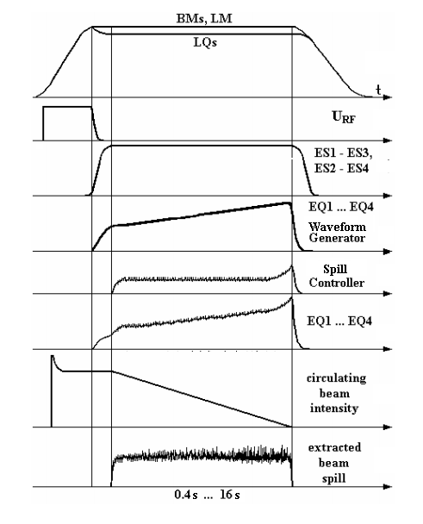
Vasily Andreev et al. “TANGO Standard Software for Nuclotron Beam Slow Extraction Control”
Beam slow extraction process from the Nuclotron
The beam extraction process is realized by excitation of the radial betatron oscillation resonance.
The sextupole nonlinearity is excited by two pairs of extraction sextupole lenses (ES).
Four extraction quadrupole (EQ) lenses perform the coherent tune shift ∆Qx within the resonance band.

Slide 4
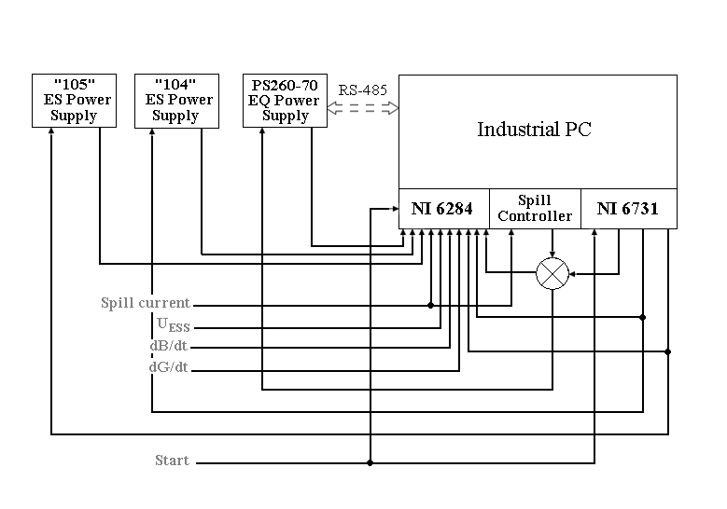
Vasily Andreev et al. “TANGO Standard Software for Nuclotron Beam Slow Extraction Control”
Hardware structure of the Nuclotron Beam Slow Extraction Control

Slide 5
Vasily Andreev et al. “TANGO Standard Software for Nuclotron Beam Slow Extraction Control”
TANGO Device concept
The “Device” is the core concept of TANGO.
A Device can represent:
An equipment,
A set of equipments ,
A set of software functions ,
A group of devices representing a subsystem
A Device has an interface composed of commands and attributes, which provides the service of the device.
Device Server is a process in which Device is created and managed.

Slide 6
Vasily Andreev et al. “TANGO Standard Software for Nuclotron Beam Slow Extraction Control”
Slow Extraction Device Server
DAQmxAI
Device Server
DAQmxAO
Device Server
PSMbus
Device Server
SEFeedBack
Device Server
Serial
Device Server
NI-6284
NI-6731
PS260-70
Spill Controller
Diagram of the Slow Extraction Device Server

Slide 7
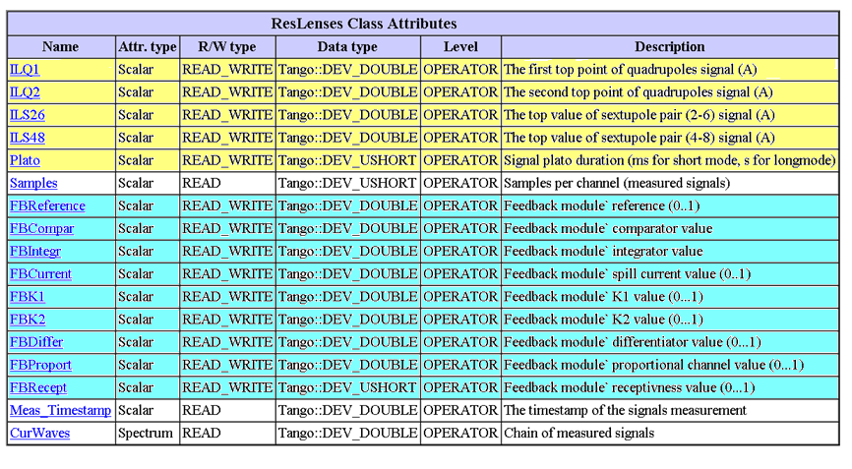
Vasily Andreev et al. “TANGO Standard Software for Nuclotron Beam Slow Extraction Control”
Attributes of the Slow Extraction Device Server

Slide 8
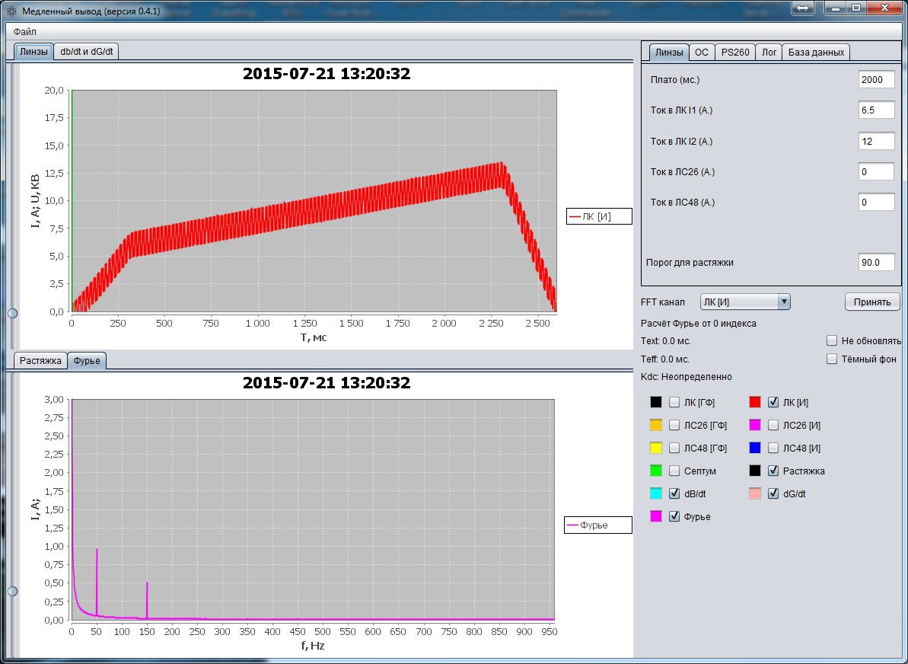
Vasily Andreev et al. “TANGO Standard Software for Nuclotron Beam Slow Extraction Control”
GUI of the Slow Extraction Control Client

Slide 9
Vasily Andreev et al. “TANGO Standard Software for Nuclotron Beam Slow Extraction Control”
Slow Extraction Control Client
Slow Extraction Device Server
PSMBus Device Server
DBStorageDS Device Server
Diagram of the Slow Extraction Control Client

Slide 10
Vasily Andreev et al. “TANGO Standard Software for Nuclotron Beam Slow Extraction Control”
Slow Extraction Web-client
WebSocketDS
Device Server
Nuclotron
web server
Slow Extraction Device Server
Diagram of the Slow Extraction Web-client

Slide 11
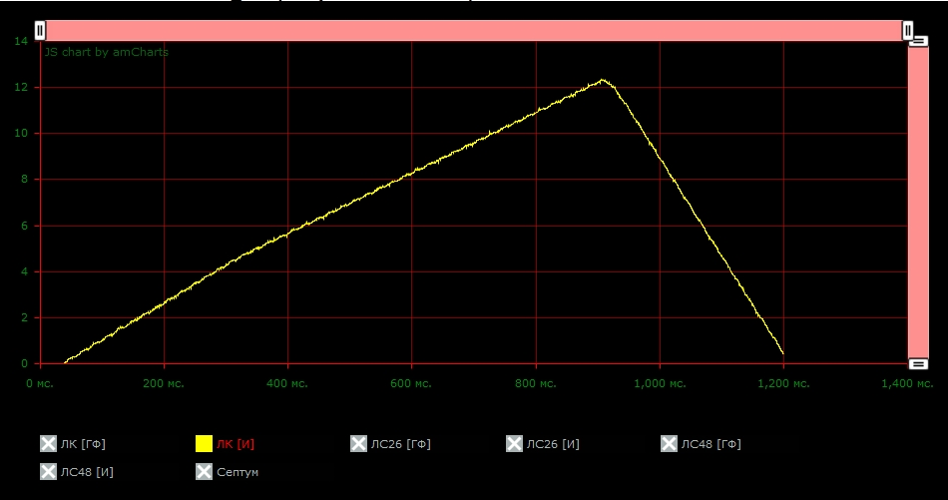
Vasily Andreev et al. “TANGO Standard Software for Nuclotron Beam Slow Extraction Control”
Screenshot of the Slow Extraction web-client

Slide 12
Vasily Andreev et al. “TANGO Standard Software for Nuclotron Beam Slow Extraction Control”
Conclusion
Slow Extraction Control Subsystem of the Nuclotron has a TANGO interface now
The software was tested during the last Nuclotron run and thereafter
All the detected bugs have been fixed
The software is ready to be put into commissioning at the next run of the accelerator

Slide 13
Thank you for your attention!

