Slide 2



The dCache.org collaboration
HTW
Berlin
(University)
Cheap labor injector
About 11 developers and support people in total

Slide 3
Usage

Slide 4
To proceed we need to learn a bit about dCache

Slide 5





Features needed for this presentation
Access via variety of Credentials
Can be all mapped to the same individual
Kerberos
Username
Password
dCache
X509

Slide 6


Features needed for this presentation
Access via a variety of Protocols
All to the same file
http/WebDAV
NFS/pNFS
dCache
GridFTP
GRID

Slide 7
Consequence
We support a typical scientific data life cycle

Slide 8

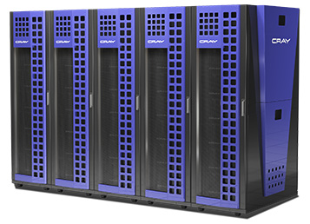

Scientific Data Cloud
High Speed
Data Ingest
Fast Analysis
NFS 4.1/pNFS
Wide Area Transfers
(Globus Online, FTS)
by GridFTP

Slide 9
Except, something is missing !
The final scientist needs to :
Sync with his/her devices
Share data with colleagues

Slide 10

Scientific Data Cloud
High Speed
Data Ingest
Fast Analysis
NFS 4.1/pNFS
Wide Area Transfers
(Globus Online, FTS)
by GridFTP
Sync’ing and Sharing

Slide 11


Why not using ownCloud
We are not running OwnCloud storage
BUT
We are using OwnCloud to provide a particular VIEW into your storage space.
GridFTP
Unlimited hierarchical
Storage Space
Globus Online
NFS 4.1 / pNFS
HPC, HTC

Slide 12

How to scale out !
Web Load Balancer
Own Cloud
Own Cloud
Own Cloud
Own Cloud
NFS 4.1 / pNFS
Pool Node
Pool Node
Pool Node
Pool Node
Pool Node
Pool Node

Slide 13
DESY Production Instance
Fully integrated into DESY infrastructure
  Monitoring
  Kerberos
  LDAP
Groups are added one by one to check scalability.
Currently
  650 Users
  7 Tbytes (2 replicas)
  Some power users up to 200 Gbytes / each
Idea: Unlimited space (XXL)
  Subset via ownCloud
NFS (4.1)
GridFTP
WebDAV
ownCloud

Slide 14
But ownCloud is not the only and possibly not the best solution.

Slide 15
Cube PAD
We are investigating further
dCache collaborates with DCORE
DCORE provides CubePAD
Besides other advantages: focus on strong privacy plus sharing
Tighter integration with dCache
Final goal : dCache namespace holds CubePAD metadata.

Slide 16
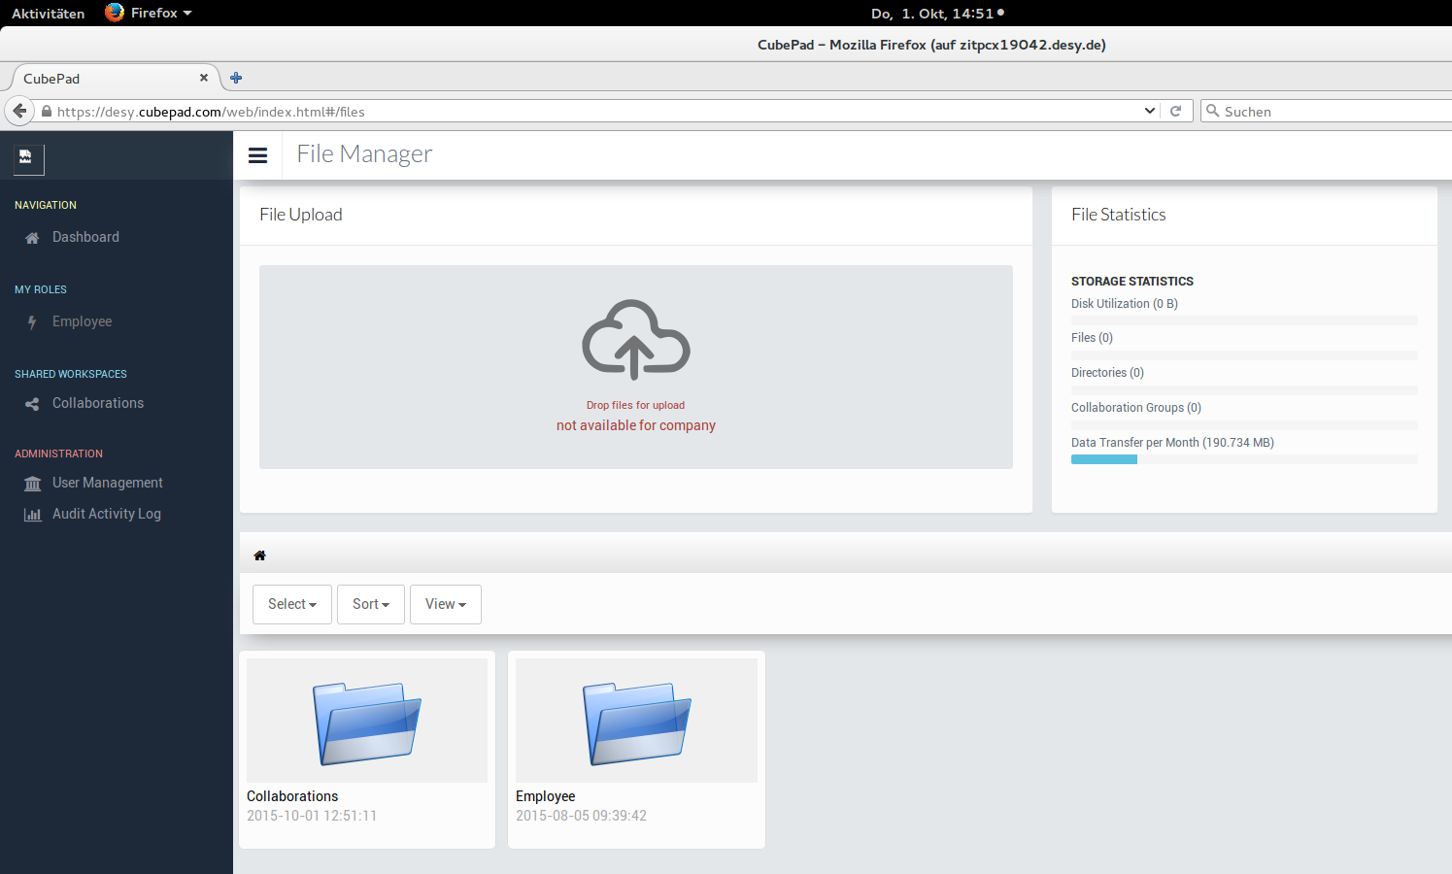
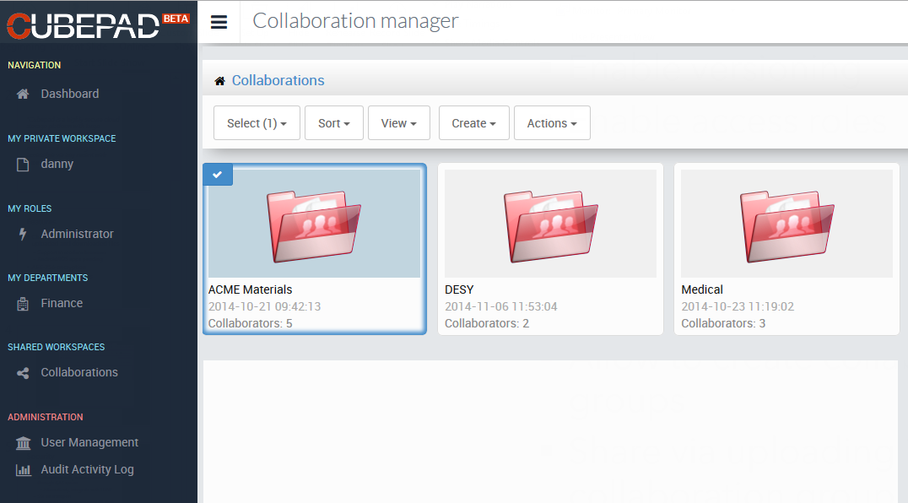
Cube Pad File Manager
DESY
Instance

Slide 17

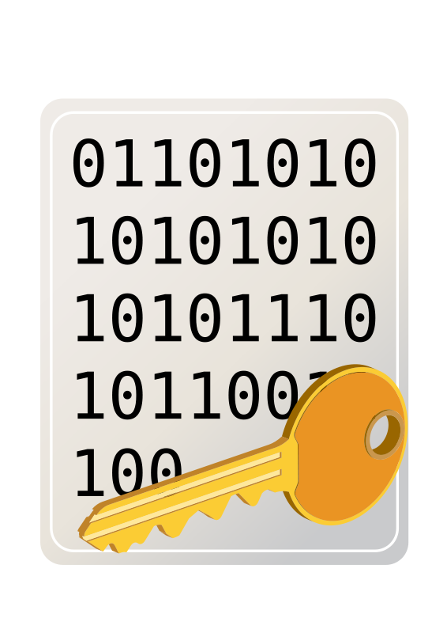



Encrypting and sharing
dCache
WebDAV door
Shamir Schema
(based on Hydra)
AAAA BBBB CCCC
CCCC
BBBB
AAAA

Slide 18
Encrypting and sharing, cont
File is encrypted within the browser on the fly to the server (dCache WebDAV).
Each file gets its own secret symmetric key.
Symmetric key is split into ‘n’ pieces and stored at ‘n’ different geographical and political Locations. (Shamir Schema).
One needs to break into ‘m’ < ‘n’ servers to get the entire key.
Sharing works by sharing the keys.

Slide 19
Now we have :
Scalable storage
Access via scientific mechanisms concerning
  credentials and
  protocols
Sync’n Share for easy access from
  Laptop
  Mobile devices
  Browser

Slide 20
Still bits and pieces missing :
Selection of Quality of Service for your storage.
QoS : SSD, Tape, Spinning disk, # of copies
Or in other words :
  Access latency : low <-> high
  Probability of data loss : low <-> high
Considerations :
  High Quality of Storage is expensive
  Not all data is equally important
So the user or experiment framework should be enabled to pick the right compromise based on his/her
  Requirements
  Size of your wallet

Slide 21
Storage Quality
Amazon
  S3 : online
  Glacier : nearline
Google
  Standard
  Durable Reduces Availability (DRA)
  Nearline
IBM (HPSS, GPFS)
  Storage classes (user defined)
dCache
  Storage groups (user defined)
  Tape
  Disk (spinning or SSD)
  Resilient Management (‘n’ copies)

Slide 22


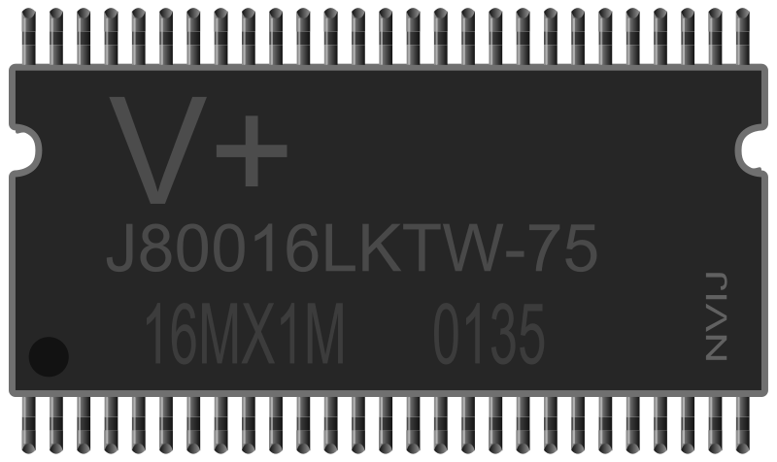
Another useful dCache feature
Multi Tier / Quality of Service
Removable Media
(Tape)
Spinning Disks
dCache
SSD’s

Slide 23
In order to get this sorted out consistently, dCache is following two strategies.
Providing API and GUI for customers to specify personal QoS setup.
Agreeing on standard vocabulary to enable PaaS to consistently describe QoS
  Trying this with RDA and OGF
  Hope is to agree on a http/REST based protocol to negotiate QoS with arbitrary endpoints. (CDMI good candidate)
  dCache is part of this activity within INDIGO DataCloud

Slide 24
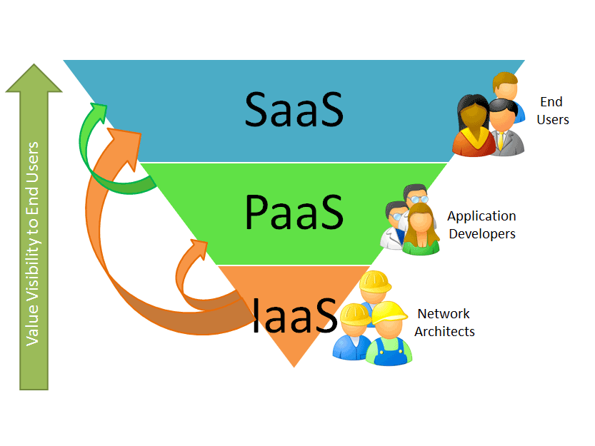
INDIGO Data Cloud Cheat Sheet
11 ++ Million Euros
30 months duration
26 partners
The project aims for an Open Source Data and Computing platform targeted at scientific communities, deployable on multiple hardware, and provisioned over private and public e-infrastructures.
About 800.000 Euro for dCache.
~ 2 more FTEs
Major objectives for dCache is :
“Data LifeCycle Support” and
“Software Defined Storage”

Slide 25
Summary
dCache extends its multi protocol, multi credential Mantra by typical Cloud Access Mechanisms.
Successfully production system with ownCloud but evaluating other systems (CubePad) especially for ‘high privacy’ mechanism.
Making already established QoS mechanisms in dCache available
  via GUI for individuals and
  trying to agree on a standard vocabulary and management protocol with European and International standardization organizations to support the use of QoS by platform services (experiment frameworks)

Slide 26
The END further reading www.dCache.org

