Slide 1

Dynamic Federation
of
Grid and Cloud Storage
Fabrizio Furano, Oliver Keeble, Laurence Field
Speaker: Fabrizio Furano

Slide 2
Grid+Cloud storage
We report on work about seamless integration of Cloud storage resources in HTTP-enabled workflows
I.e. How to use Cloud resources together with existing Grid and HEP distributed storage
  Limit effort needed (possibly next to zero)
  Agility in adding/removing storage
  Make usage/management seamless
  Promote scalability, performance and sw quality
  Preserve sites’ admin autonomy
  Allow “opportunism” in resource management
Very simple tech requirements, easy to share with other communities

Slide 3
Why HTTP/DAV?
Interesting technical features
  Multitalented, covers most existing use cases, while allowing new stuff
  Applications just access the data, wherever they are (very different from distributed FSs)
  Supports WAN direct access
  Performance can be very high for applications using it efficiently
It’s there, whatever platform we consider
  HTTP is moving much more data than HEP worldwide, although in different ways
We like browsers, they give a feeling of simplicity
Goes towards convergence
  One technology can accommodate multiple use cases, also interactive
  Users can use their preferred devices and apps to access their data
  Sophisticated custom applications are allowed
  Can more easily be connected to commercial systems and apps
Attractive for a professional to be formed in these systems
Greater chances to be understood when you mention it

Slide 4
The Grid DM problem
The reality of a production-grade distributed model is challenging
Just locating a resource in a huge index can be a challenge for scalability and speed
With 10s or 100s sites the normality is that they come and go
With 1000s disks the normality is that quite a few break
Cloud storage is not immune, as it can be added, removed without notice, or have downtimes
How to track “Where is file X now” ?
  This is different from “Where is file X supposed to be ?”
How to reduce the data mgmt cost for finding it ?

Slide 5
Where is file X … check now
An idea pioneered since years 2000s with the Xrootd framework
  http://www.computer.org/csdl/proceedings/iat/2005/2416/00/24160698-abs.html
Where is file X ? Spread the load by asking the working endpoints
  Pays just a network round trip
  Even through WAN, most of the times it’s quicker than a loaded DBMS
  By construction it’s correct in that moment, naturally models data losses
  Locations can be cached for some time
    If a file is accessed now, then it likely will be again shortly (temporal locality principle)
We can then have a frontend system that is able to locate files by asking the endpoints “Do you have file X in this moment” ?
If properly done, this mechanism can be extended to file listings, VERY useful to administrators

Slide 6
Dynamic Storage Federations

Slide 7
Dynamic Federations: Dynafed
Project started in 2011 in EMI as an exploration on storage federations with open protocols. Collaboration with dCache team.
Now the core is a stable protocol-agnostic component
Relies only on standard services in sites/endpoints
Our interest is in scalable performance, HTTP, WebDAV, S3 and friendly tools
Various projects are using or evaluating it, in HEP and outside HEP
Its features with S3-based cloud storage are particularly interesting
Interplays well with FTS, as a file movement workhorse

Slide 8

What’s Dynafed
Dynafed is a browser-friendly realtime scalable aggregator of HTTP/WebDAV/S3 metadata sources.
Aggregates/caches/presents metadata, redirects clients to resources for reading or writing. Geography-aware redirections
Realtime detection of site up-ness, no need of installing anything special at the sites
Presentation is usually through WebDAV and HTML
Low latency realtime behavior, can be used in LAN and WAN, or both
With S3 it keeps keys secret, natively exploiting the S3 delegation scheme
Supports folders on S3 with no overhead
Supports Rucio file semantics (plugin)
Can talk to external DBs or services. Can just be seen by them as a large WebDAV site
Applies uniform Apache-based authentication
Applies uniform authorization rules: Apache modules, libgridsite or its own rules

Slide 9

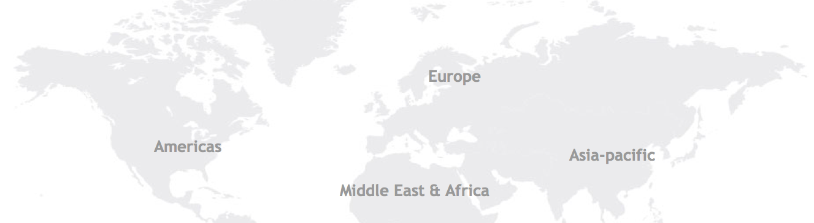

On the fly friendly visualization
Full WebDAV access
Redirection-based
Robust against failures
Fully scalable
With 2 replicas
/dir1
/dir1/file1
/dir1/file2
/dir1/file3
DESY Prototype:
14/15 LHCb sites
60 ATLAS sites
Geography-based
Client-aware redirections
Flexible authentication/authorization, friendly with identity federations
Realtime detection of sites’ up-ness
Makes S3 storage
easy to use, scales it up and applies uniform security
Site A
(HTTP/S3)
Site B
(HTTP/S3)
.../dir1/file1
.../dir1/file2
.../dir1/file2
.../dir1/file3

Slide 10
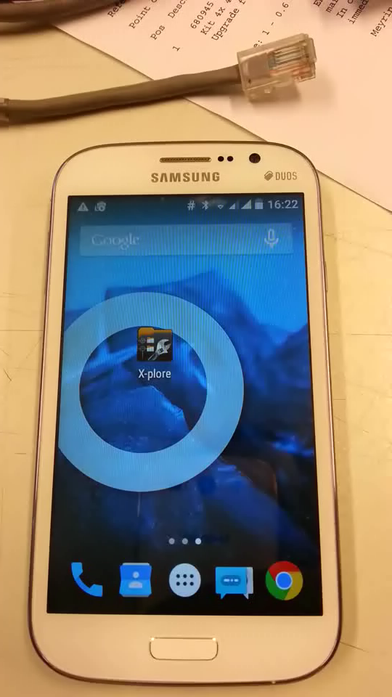
Easy access
Main Dynafed testbed with dozens of Grid endpoints and several demos
The file being accessed is hosted in an XrdHTTP instance… somewhere
Data discovery is dynamic, no static indexing involved
The HTTP ecosystem can give unprecedented flexibility to Grid data access, fully supporting the Grid workflows

Slide 11
S3 support in the HTTP ecosystem
S3 is a sort of very smart HTTP dialect
Scalability-oriented on the server side, somehow makes non-scalable usage difficult
Simple and very fast access delegation mechanism
Supports hierarchical content ( directories! ) in buckets in a way that a vanilla client can’t easily exploit
  No concept of directory, just path prefix ☺
  It defines a tree in the opposite direction with respect to a regular file system
We wrote a simple DynaFed C++ plugin that exploits all these in a friendly way

Slide 12
S3 support in the HTTP ecosystem
Dynafed can federate any number of remote S3 buckets together with other non S3 storages
This S3 fed will work as a unique read/write WebDAV storage, totally seamless, extremely fast and scalable.
This S3 fed will avoid having to distribute S3 keys to the clients, works with short-term delegations
  Users/jobs do not need to bother with S3 mechanics, just use a clean URL
Tested with Amazon and Ceph S3 implementations
This S3 fed can apply a uniform authorization/authentication schema
  Can be X509, login/pwd, in principle whatever mechanism that works as an Apache module
We used this mechanism in …

Slide 13
The Data Bridge
The Data Bridge is a component that bridges authentication domains for storage access
Context: volunteer computing (BOINC) and Grid environment
Built on Apache plus the Dynafed technology with S3 buckets as backends
  Dynafed exploit that, plus giving scalability, easy data presentation, uniform authorization and flexibility
  Apache can also host other ‘standard’ authentication plugins
It’s a generic idea to harmonize Cloud storage and multiple authentication domains, including Grid/X509/VOMS
BOINC users (user/pwd) need to receive the Job desc AND write the output
Grid agents (FTS, X509) need to read what the BOINC user wrote

Slide 14
The Data Bridge
Workload
Manager
PUT/GET
Apache
PUT/GET
BOINC
User
HTTPS redirect & sign
HTTPS redirect & sign
X509
mysql
Multiple
S3 buckets
anywhere
DynaFed
PUT/GET
PUT/GET
FTS
Grid

Slide 15
Initiatives with Data Bridge
CMS@Home
  Pioneered the adoption of the data-bridge
Test4Theory
  Pre-production mode, running a fraction of the prod jobs through the Data Bridge
BNL
  Evaluation of ATLAS workflows involving Amazon S3, dCache, Grid clients and FTS3. Good feedbacks
Human Brain Project and EGI
  Under evaluation for accessing/sharing large repos of brain scans from browser-based 3D apps

Slide 16
Dynafed project status
The project is in a stable, low dev overhead state, actively maintained, getting increased exposure
Ideas for the next development cycles:
  Redirection monitoring, to allow the logging of federator behavior for real-time monitoring and subsequent analytics
  Metadata integration, beginning with the incorporation of space usage information, allowing the federator to expose grid-wide storage metrics
  An HTTP-based endpoint realtime status/management subsystem
  Semantic enhancements to the embedded rule-based authZ implementation. Or maybe pluggable authZ
  Study other similar Cloud storages, e.g. MS Azure
  Deployment tests with other Apache security plugins, to support natively Identity Federations on Cloud storage
    Big potential and unprecedented flexibility could be the prize. Anyone willing to try and let us know ?

Slide 17
For more info
Dynafed homepage: http://lcgdm.web.cern.ch/dynamic-federations
Full Dynafed documentation: https://svnweb.cern.ch/world/wsvn/lcgdm/ugr/trunk/doc/whitepaper/Doc_DynaFeds.pdf
Demo testbed:http://federation.desy.de
Web FTS homepage: https://webfts.cern.ch/
DAVIX (powerful HTTP/WebDAV/S3 client) : http://dmc.web.cern.ch/projects/davix/home

Slide 18
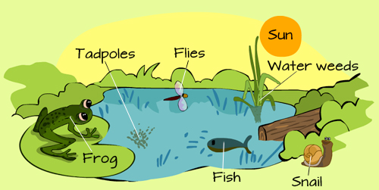
Conclusion
We can seamlessly federate Grid and Cloud storage, in a very flexible and “opportunistic” way
Among us we tend to name all this “HTTP ecosystem”, referring to an ensemble of components that sustain each other’s usage and are very open to usage by “normal” professionals
  Easier to share services to other communities
  Easier to develop new services
  Easier to use Grid services for interactivity, outreach and others
  Easier to be understood by non-HEP professionals
Focus on usability, flexibility, performance, scalability
Everything available as high-quality RPMs, mostly in EPEL
Dynafed is a generic component, we foresee other applications (e.g. clustering remote or local caches)
We encourage collaborations and new ideas

Slide 19
Backup hardcore slides

Slide 20


Where is file X ?
The cache
remembers
what happened
The next metadata interactions
will very likely be fed by the cache
The 2nd level cache can be shared
among federators
(memcached)
Frontend (Apache2+DMLite)
Metadata
cache
Federator
Plugin
Plugin
Plugin
Plugin
SE
SE
SE
SE

Slide 21
Dynafed: Simple assumptions
Each site’s content is accessible via HTTP/DAV to the other sites
Same path/name means same file
  Modulo a site prefix, e.g.
    /<pfx of site A>/data/prod01/myimage.jpg
    /<pfx of site B>/data/prod01/myimage.jpg
    http://lxfsra04a04.cern.ch/dpm/cern.ch/home/dteam/dynafeds_demo/everywhere/file_1000.txt
    http://sligo.desy.de:2880/pnfs/desy.de/data/dteam/dynafeds_demo/everywhere/file_1000.txt
    Federated as: http://federation.desy.de/fed/dynafeds_demo/everywhere/file_1000.txt
  More complex forms of translation are possible. Simpler is better.
An identity recognized by the federator has to be recognized by the sites too
  In some cases the federator can apply a form of delegation
All participating sites allow the federator to read file metadata (HEAD and PROPFIND)

Slide 22
Dynafed Focus: performance
Performance and scalability have primary importance
  Otherwise it’s useless...
Fully C++ , designed for parallelism
  No limit to the number of outstanding clients/tasks
  No global locks/serializations!
  The endpoints are treated in a completely independent way
  Thread pools, prod/consumer queues used extensively (e.g. to stat N items in M endpoints while X clients wait for some items)
Aggressive metadata caching
  A relaxed, hash-based, in-memory partial name space
  Juggles info in order to always contain what’s needed
Spurred a high performance DAV client implementation (DAVIX)
  Wraps DAV calls into a POSIX-like API, saves from the difficulty of composing requests/responses
  Loaded by the core as a “location” plugin
  http://dmc.web.cern.ch/projects/davix/home
  Available in ROOT 5 and 6 as TDavixFile

Slide 23
Dynafed system design
A system that only works is not sufficient
To be usable, it must privilege speed, parallelism, scalability
The core component is a plugin-based component called originally “Uniform Generic Redirector” (Ugr)
  Can plug into an Apache server thanks to the DMLITE and DAV-DMLITE modules (by IT-GT)
  Composes on the fly the aggregated metadata views by managing parallel tasks of information location
    Never stacks up latencies!
  Makes browsable a sparse collection of file/directory metadata
  Able to redirect clients to hosts known to be working in that moment
  Built on the concept of partial, volatile namespace made of objects
  Objects are kept in LRU → a fast 1st level namespace cache
    Peak performance is ~500K->1M hits/second per core

Slide 24
Dynafed: Name translations
A sophisticated scheme of name translation is a key to be able to federate almost any source of metadata
UGR implements algorithmic translations and can accommodate non algorithmic ones as well.
  Algorithmic is technically a way better choice
A plugin could also ask to an external service (e.g. an LFC or a private DB)
The metadata caching keeps the performance high, especially in the case of external translators

Slide 25
Clients come and are distributed through:
different machines (DNS alias)
different processes (Apache config)
Clients are served by the UGR. They can browse/stat or be redirected for action.
The architecture is multi/manycore friendly and uses a fast parallel caching scheme

