Slide 2

Large-scale data services for science: present and future challenges
Massimo Lamanna
CERN IT dept
Data & Storage Services (DSS)
28 September – 02 October, 2015, Montenegro (Budva)

Slide 3
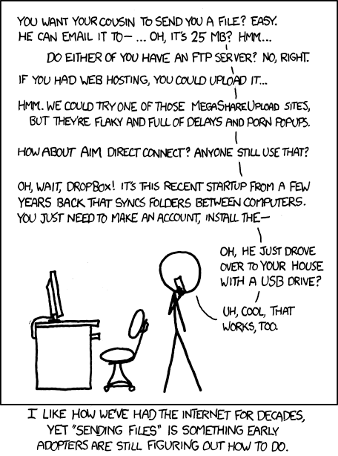
Content
Special emphasis on Tier0
Special emphasis on Data Management
Some new trends for innovation
What/How?
Should we continue to do it the same way?
  (R)evolution or adiabatic changes?

Slide 4
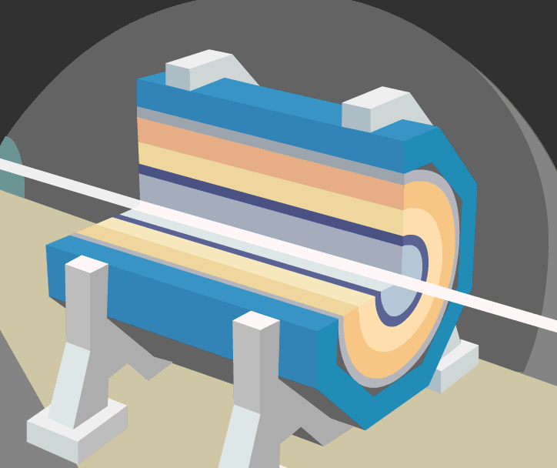
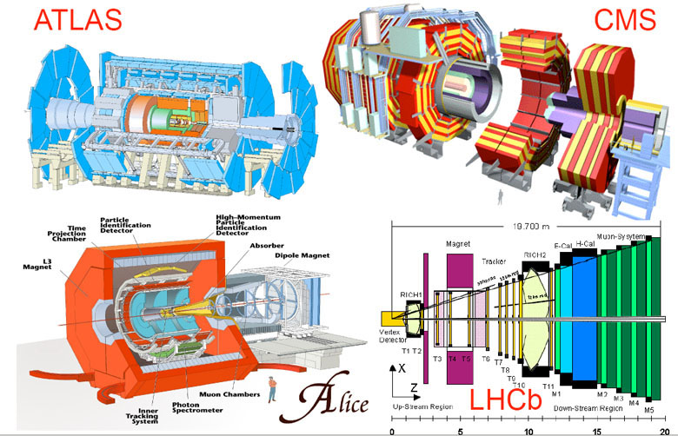
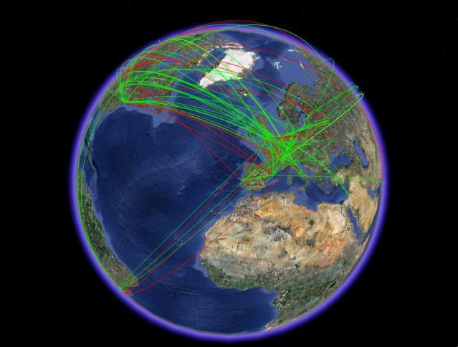
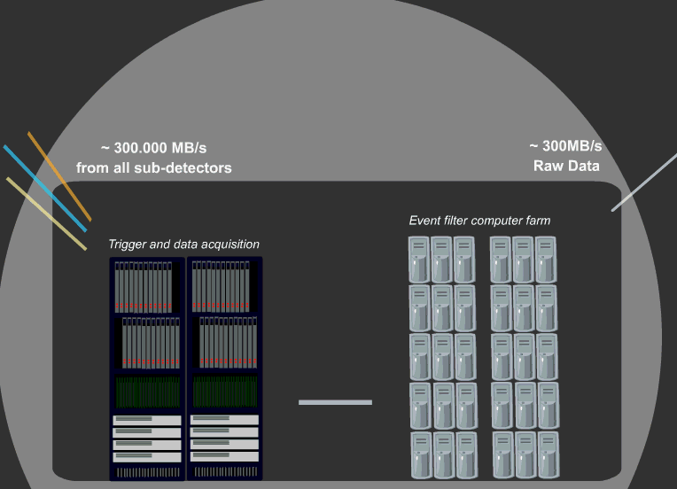
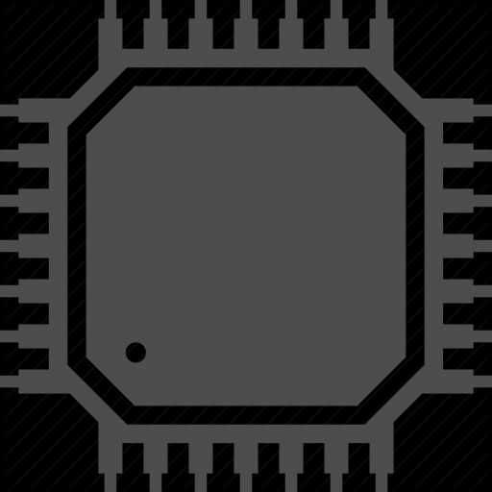
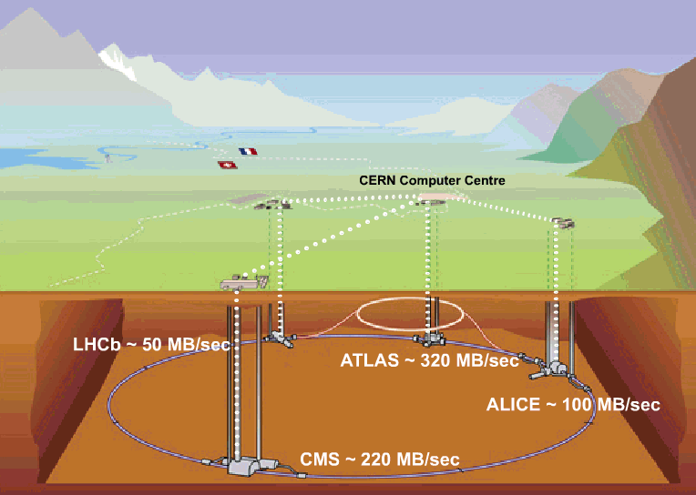
WLCG computing (Tier0)
Reconstruction use case
  Goals: data quality and immediate access for analysis
  Organised activity dominated by heavy processing and replication
Analysis use case
  Goals: extract physics quantities (discovery)
  Individual activities dominated by event selection and sharing
WLCG
FTS
CASTOR/EOS (Disk)
CASTOR (Tape)
CERN Batch (CPU)

Slide 5
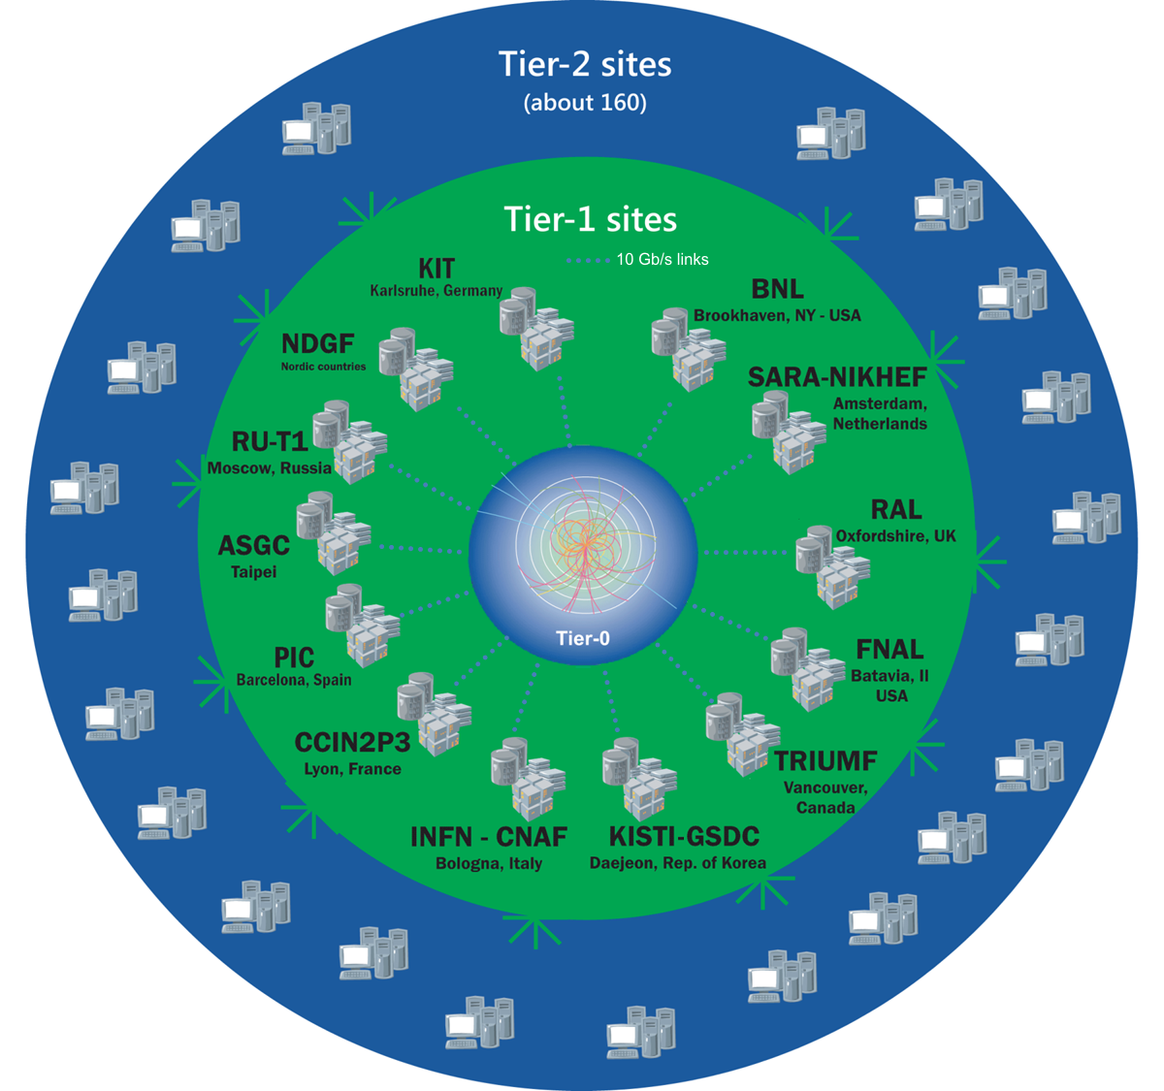


WLCG computing (analysis)
Reconstruction use case
  Goals: data quality and immediate access for analysis
  Organised activity dominated by heavy processing and replication
Analysis use case
  Goals: extract physics quantities (discovery)
  Individual activities dominated by event selection and sharing
WLCG

Slide 6

Personal considerations
Complex visionary software stack
  Developed along many years, by several projects and experiments
  Complete -somewhat rigid- set of tools, libraries, OS, etc…
Compute:
  Mainly batch model (federation of batch farms)
Data:
  Monarc model (hierarchy – data pre-placement)
  Experience (pre-placement – data locality)
  Catalogue / download

Slide 7
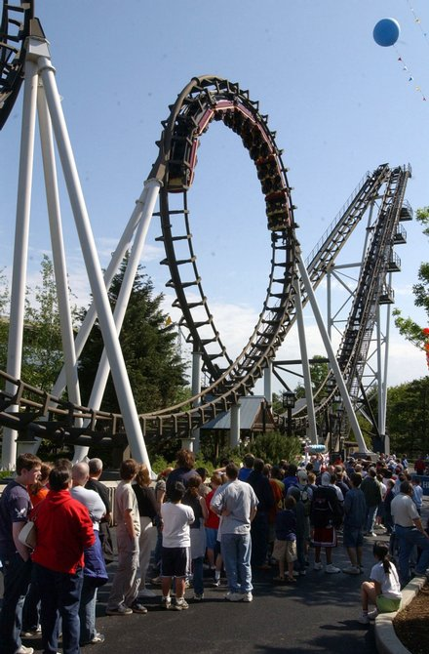
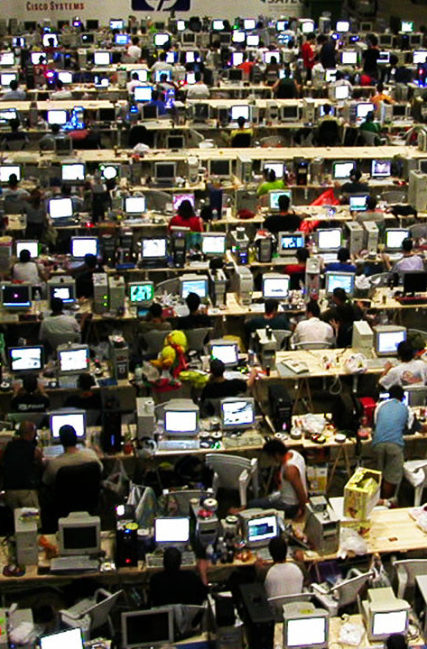


Reconstruction & analysis in the next years
Growing size (complexity). HW and
operational costs
Growing size (new ways to work) and
integration with modern technologies

Slide 8
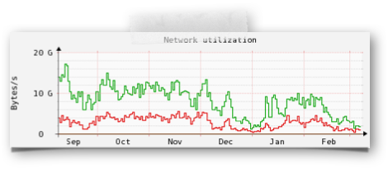
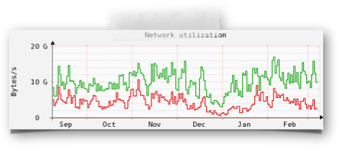
LHC activity in Run 1 (end 2012 – beginning 2013)
CASTOR
Data taking
pp 2012
pA 2013
EOS
User analysis

Slide 9
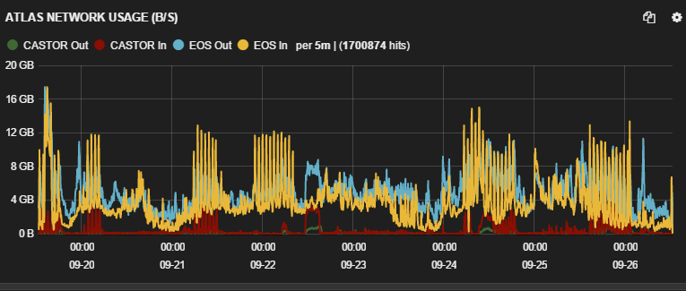
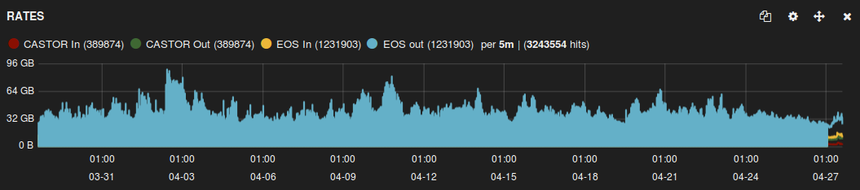
User load and LHC Run2
(GB/s) Breakdown (ATLAS experiment)
September 2015
(GB/s) Analysis only (all experiment before Run2)
All experiments
April 2015

Slide 10
Reconstruction

Slide 11


Storage for the CERN OpenStack infrastructure
The problem: provision the OpenStack infrastructure with disk (virtual block storage)
We selected Ceph:
Early adopters
Contributions/partnership
One of the largest Ceph instances worldwide
OK but, can it scale even higher?
30 PB tests
RAW Size | RAW Avail | RAW Used
3618 TB | 3098 TB | 519 TB
Pool | Used | Objects
volumes | 147 TB | 39177068
images | 17560 GB | 2253954
cinder-critical | 4184 GB | 1071402
.rgw.buckets | 3936 GB | 42467495
Volumes: 535 TB quota, 147 TB used
So that’s 441 TB Ceph space consumed to hand out 535 TB of triple redundancy virtual disks.

Slide 12

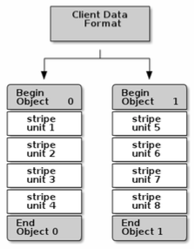

Ceph as backend (reco)
Built on top of Ceph RADOS
One step further than HW standardisation (we have the same HW from AFS to EOS)
Two main goals:
  Simplify operations (diskservers maintenance)
  Decouple single-stream performance from single box/disk availability
  and congestions
Single tape stream performance (up to 500 MB/s: tape server speed need ~ 300 MB/s
Released in CASTOR v15 but deployment targeted after LHC RUN2
Diskserver
Diskserver
Proxy
Diskserver
Proxy
Diskserver
Ceph Cluster

Slide 13
Analysis

Slide 14
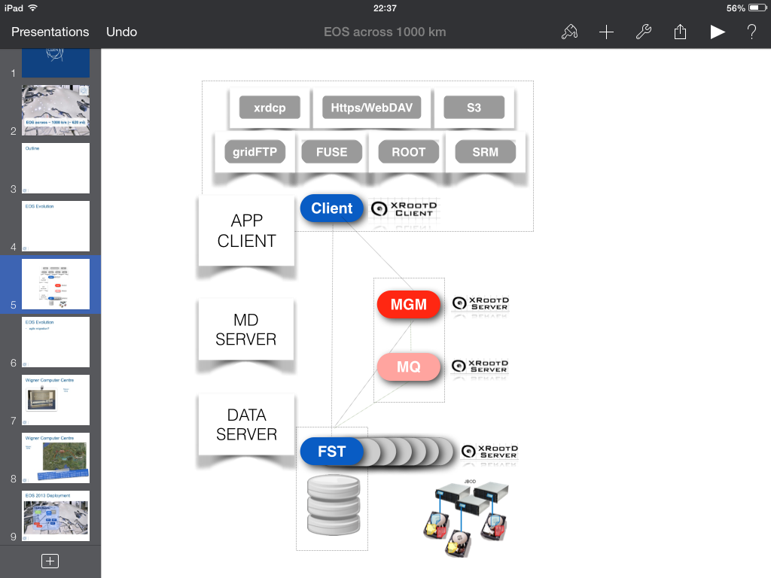

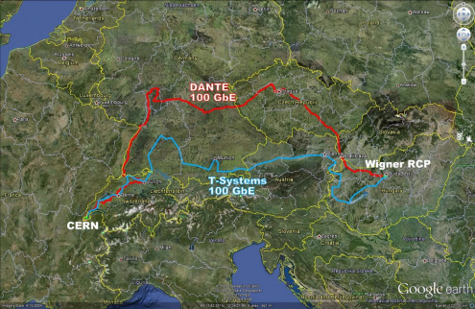
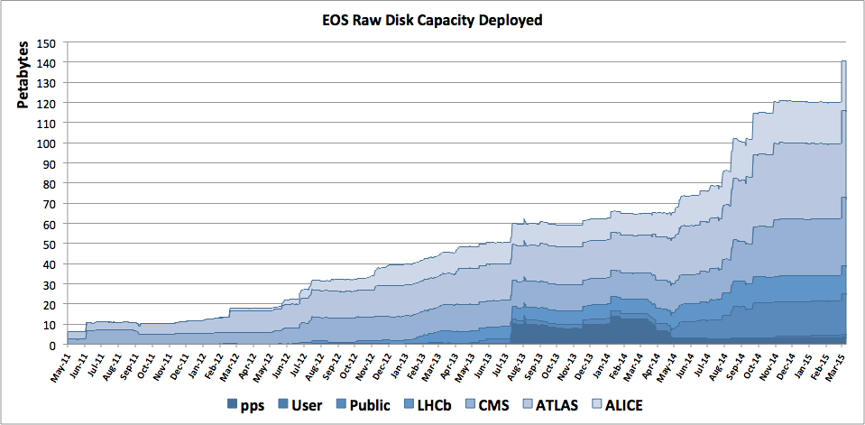
More on
EOS: Large disk farms for physics and beyond
  Currently ~70 PB quota
Developed in CERN/IT (DSS)
Original goal
  Large scale (PBs for 100s/1000s independent scientists) analysis of LHC data
  Arbitrary level of data durability via cross-node file replication or RAIN using commodity hardware
Status
  Multisite
  Large number of protocols available
    Native for performance
    Special gateways
    Standard protocols more and more used
  More client platform
    Red Hat Linux + OSX
    More Linux + Windows

Slide 15

Redundant replicas vs durability
FST
FST
FST
FST
EOS FSTs
10 Gb NIC
48 HDD
4 TB each
~ 200 TB in a box
Disk_{a}
Disk_{b}
Failure precursors (SMART errors)
  All available copies can be used
  Drain “out” all files
    $Na\left(t\right)$ → 0
    Conservative estimate
  Not dominated by HDD/NIC
  No primary-copy concept
Failed disk
  Remaining n-1 replicas
  No impact
Double failure (n=2 case)?
  Disk_{a}$∩$Disk_{b} $∙$ p²
  Disk_{a} ~ $\int_{\text{t}\text{a}\text{ − }Δ}^{\text{t}\text{b} }{Na\text{(}\text{t}\text{) }\text{dt} }$
Annual Failure Rate ~ 0.25%
O(10⁴) disks
Measured file loss
Better schemas?
  Erasure code
    RAID6 like
  Ready but not deployed
  Less space overhead (cfr. RAID1 and RAID6)
  A-priori also faster
    Fragments go to clients from multiple nodes

Slide 16




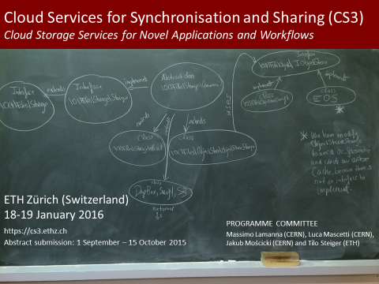
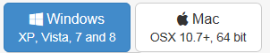
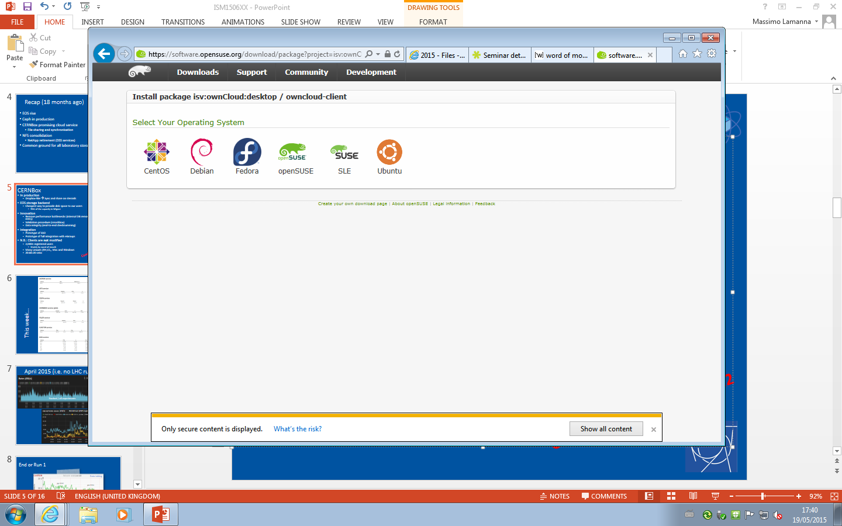
CERNBox/EOS
EOS
  Mature storage at 100 PB scale
  Protocol independent (notably Fuse and WebDav)
  Multisite (performance, business continuity, ...)
CERNBox
  Sync (offline access, multi device access, available on all OS of relevance)
  Sharing (users, egroups, external collaborators,
  readonly / rw / time-limited leases)
  Entry point to “connect” applications and data (web portal)
  Built on ownCloud
  EOS backend

Slide 17






CERNBox / EOS
Where Cloud Storage meets with LHC storage
fs
webdav
xroot
sync
share
mobile
web
EOS
ACLs
Namespace
Physical Storage

Slide 18
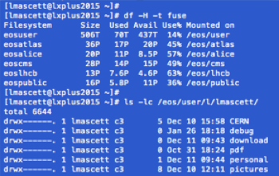

fs
webdav
xroot
sync
share
mobile
web
EOS
ACLs
Namespace
Physical Storage

Slide 19
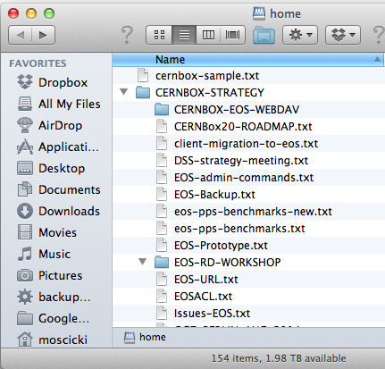
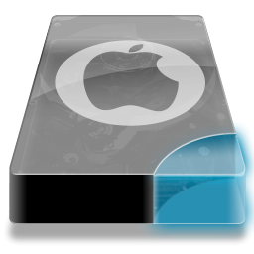
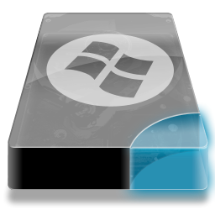
fs
webdav
xroot
sync
share
mobile
web
EOS
ACLs
Namespace
Physical Storage

Slide 20
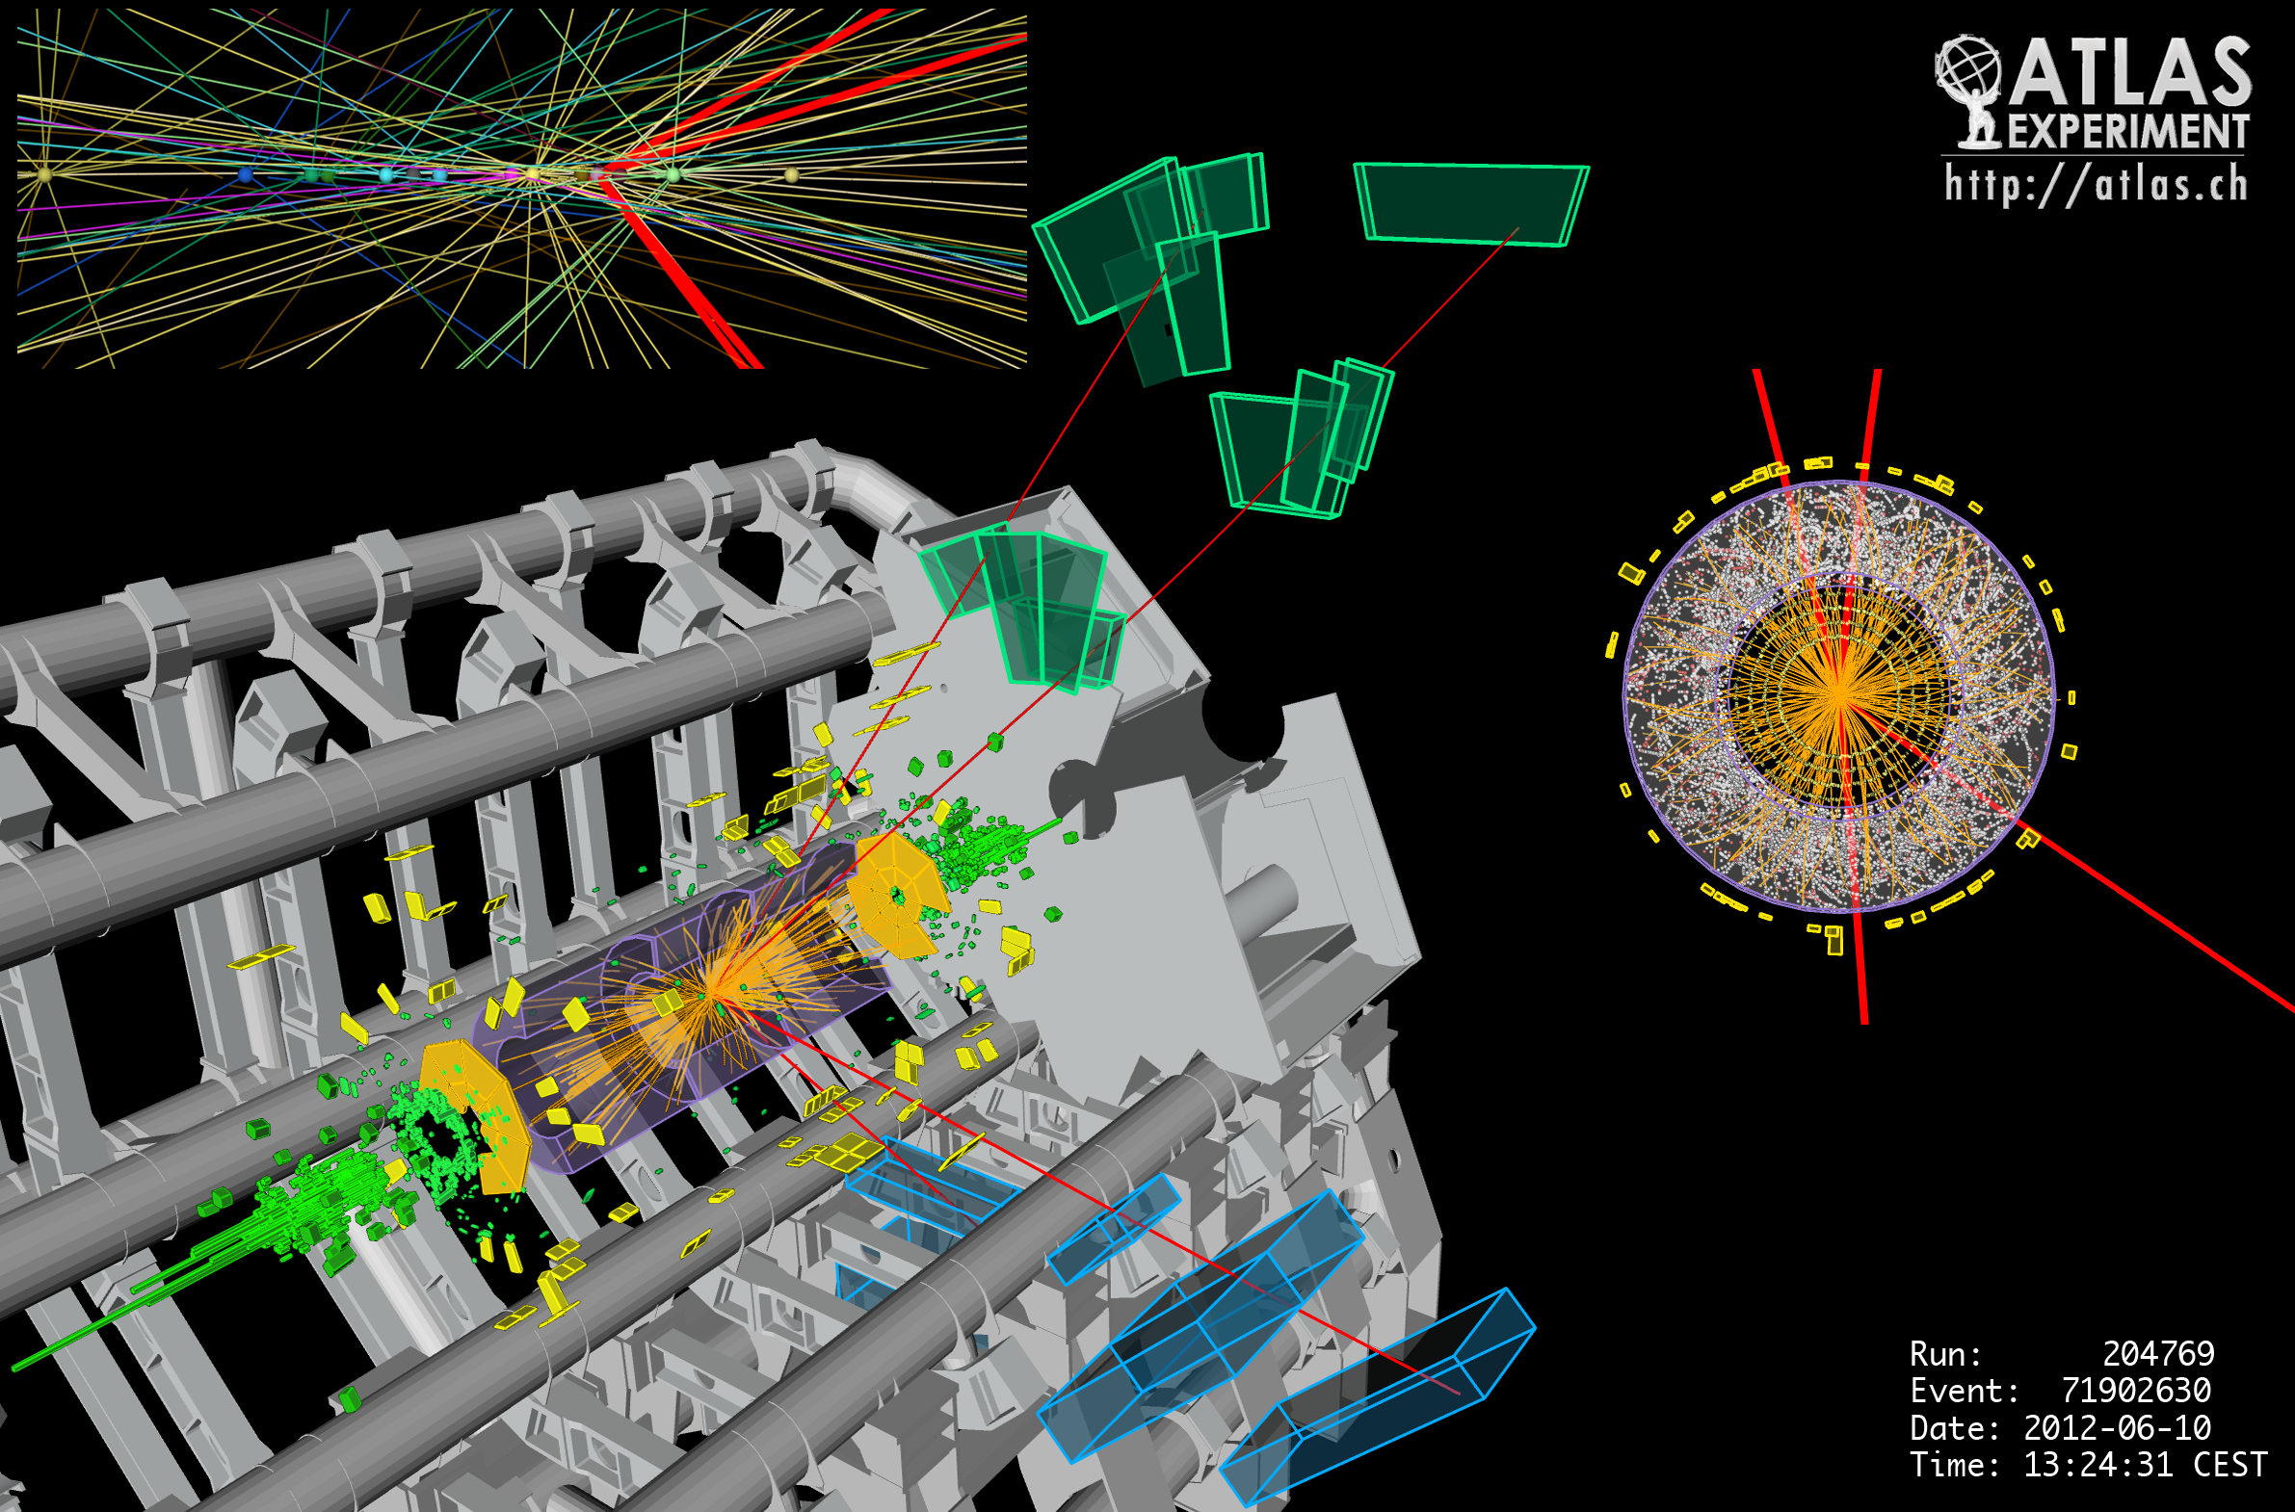

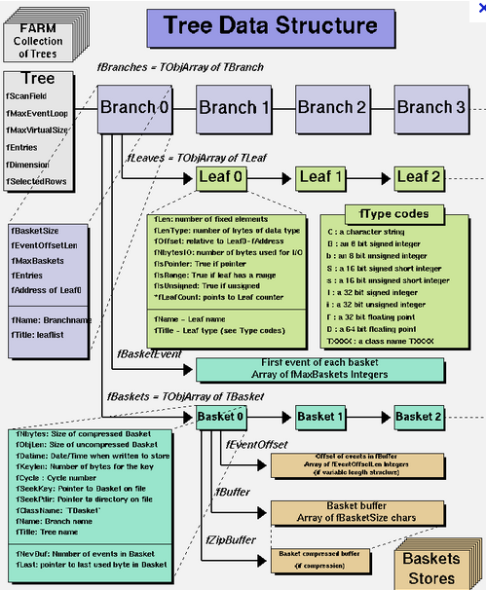
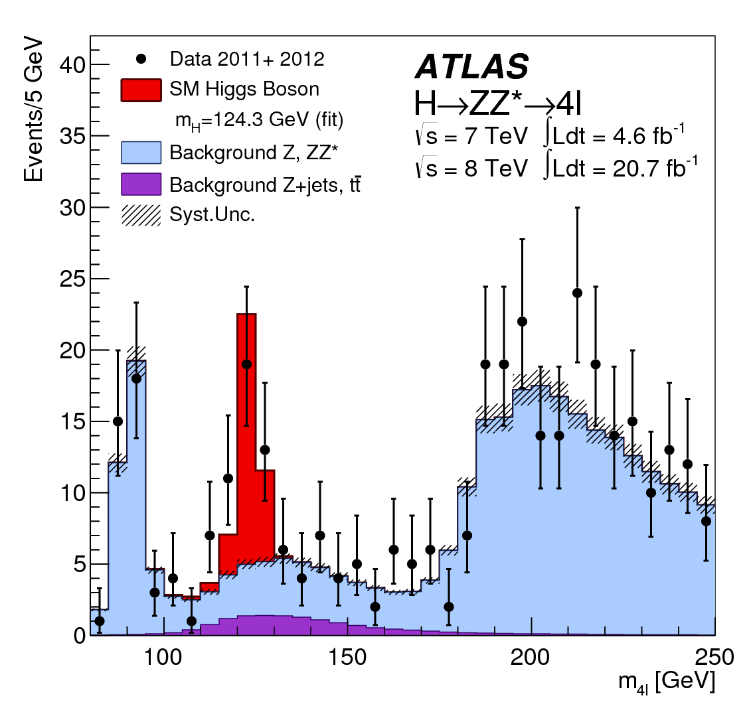
fs
webdav
xroot
sync
share
mobile
web
EOS
ACLs
Namespace
Physical Storage

Slide 21
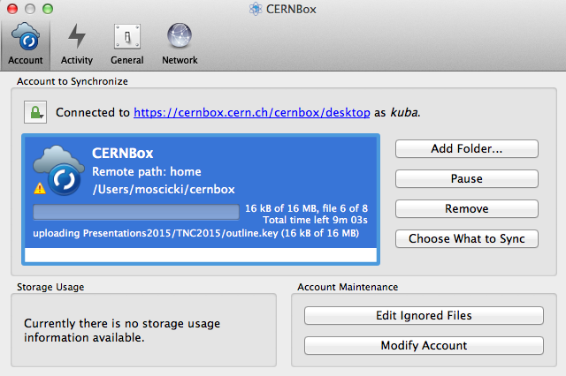


fs
webdav
xroot
sync
share
mobile
web
EOS
ACLs
Namespace
Physical Storage

Slide 22
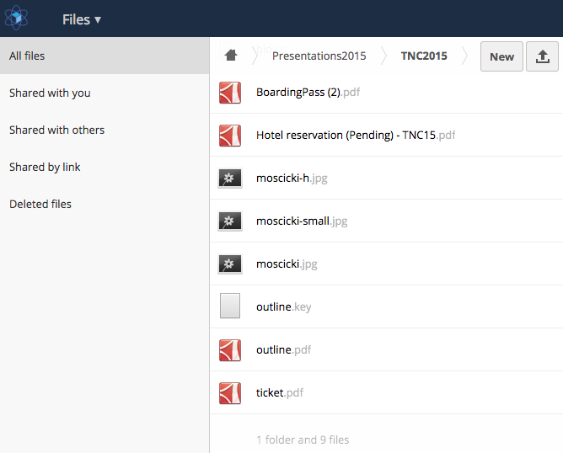
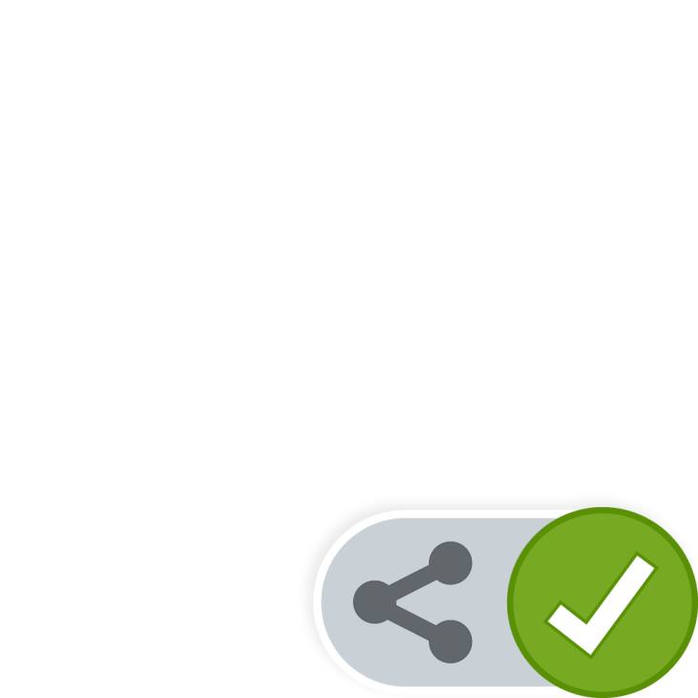


fs
webdav
xroot
sync
share
mobile
web
EOS
ACLs
Namespace
Physical Storage

Slide 23
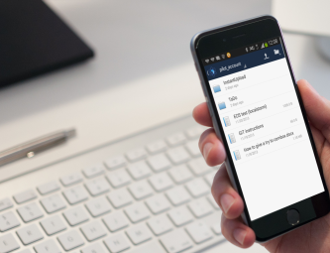
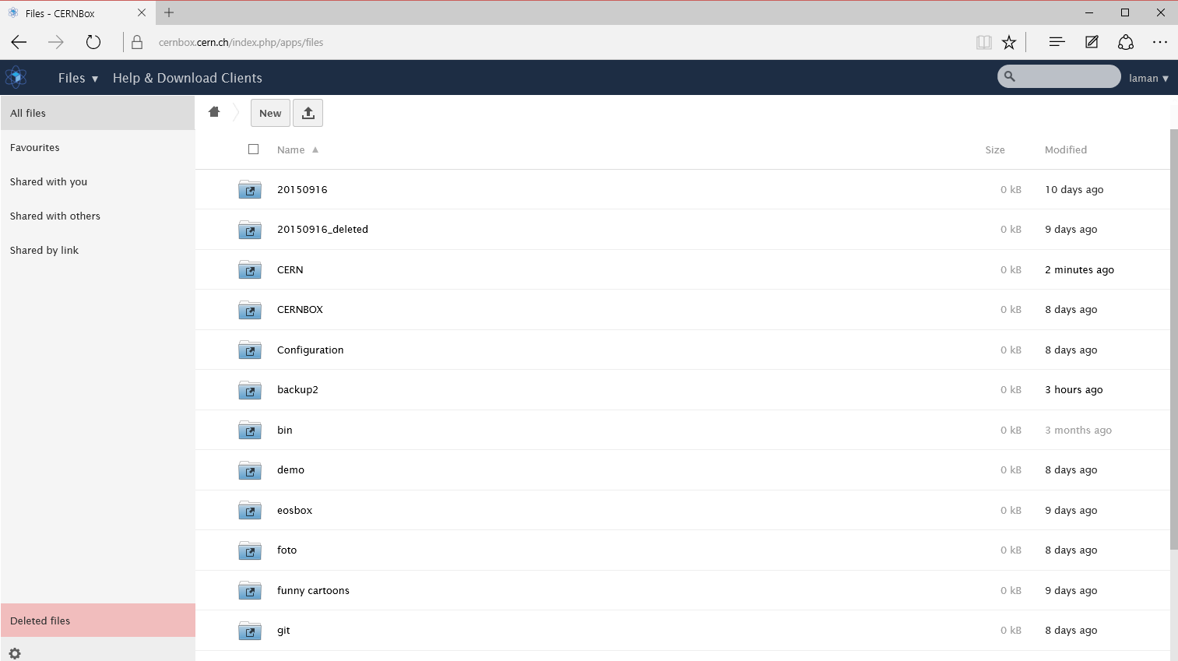






fs
webdav
xroot
sync
share
mobile
web
EOS
ACLs
Namespace
Physical Storage

Slide 24
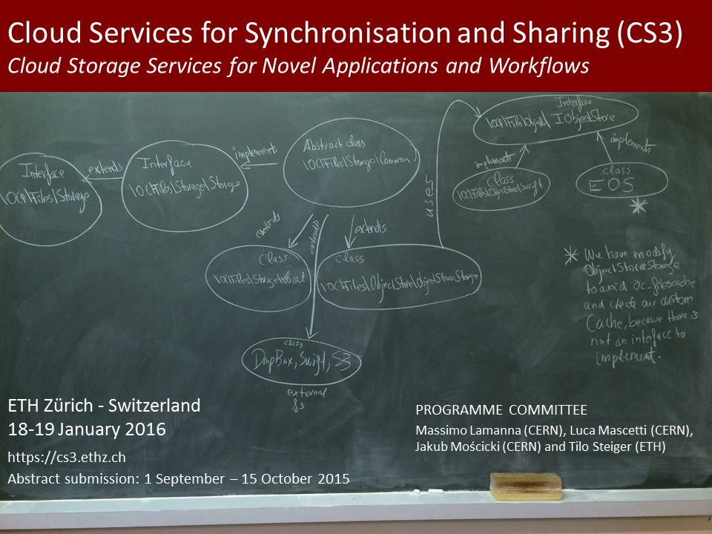
See you there :)

Slide 25
Demo
CERNBox

Slide 26
New stuff
Highlights on recent developments

Slide 27
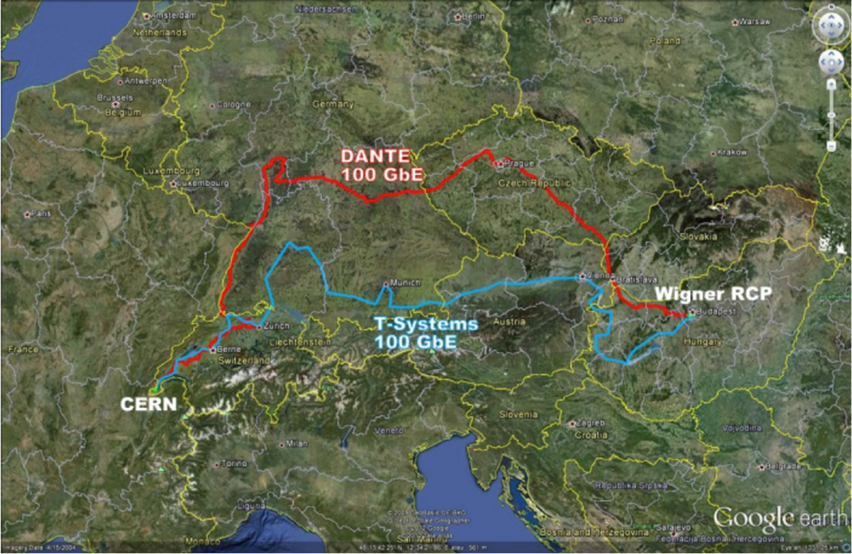
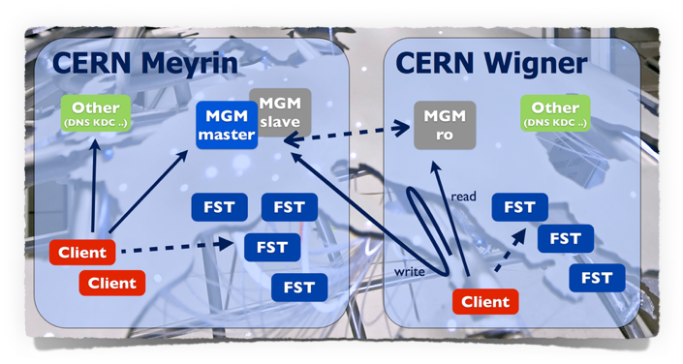
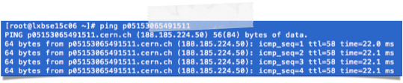
Wigner
EOS distributed deployment
2 independent 100Gb/s links
About 22 ms latency
22ms rtt

Slide 28
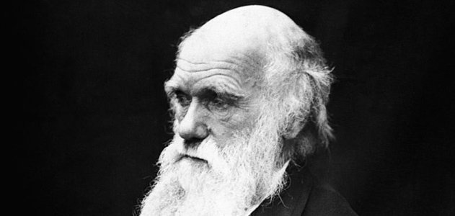
MGM
MGM
FST
Meyrin and other original deployments
MGM
MGM
FST
MGM
FST
Meyrin + Wigner
dependability, durability, performance
MGM
MGM
FST
MGM
FST
MGM
F
S
T
Support other
deployments
MGM
MGM
MGM
FST
MGM
FST
MGM
MGM
F
S
T
More differentiation
Ecosystem for a variety of species
MGM
MGM
FST
MGM
FST
MGM
MGM
F
S
T
MGM
MGM
FST
MGM
F
S
T
FST

Slide 29
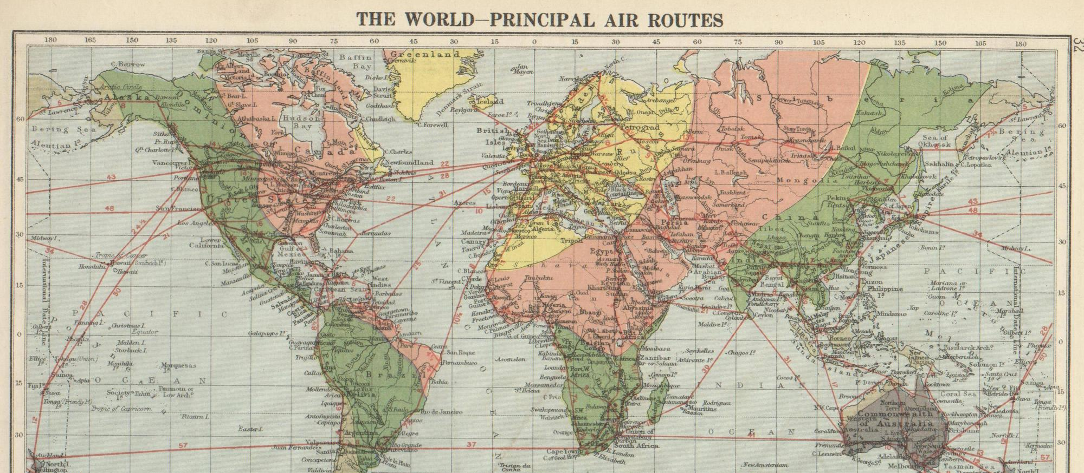





300 ms
300 ms
20 ms
320 ms

Slide 30
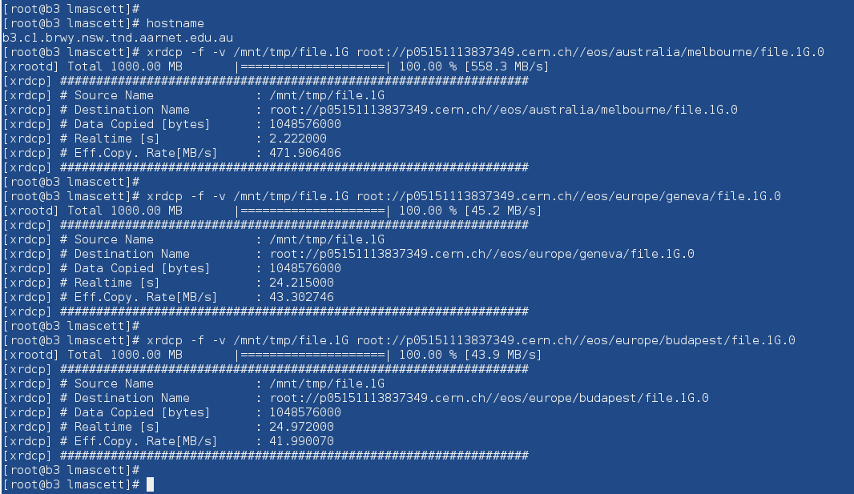

Slide 31
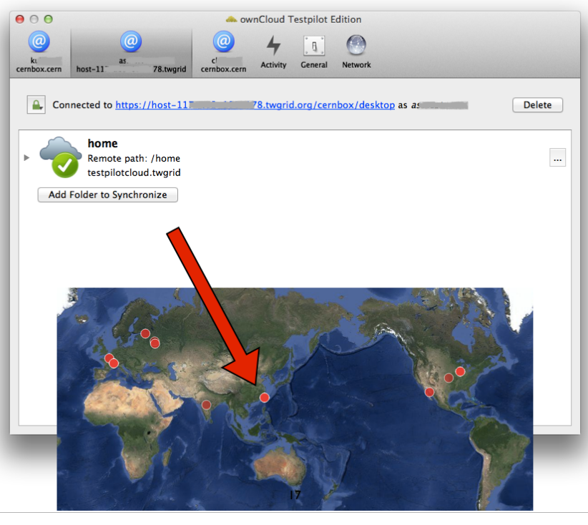


Slide 32
What’s next?
Highlights on recent ideas

Slide 33
Seamless integration?

Slide 34
Data only (synch and share)

Slide 35
What about data processing?

Slide 36
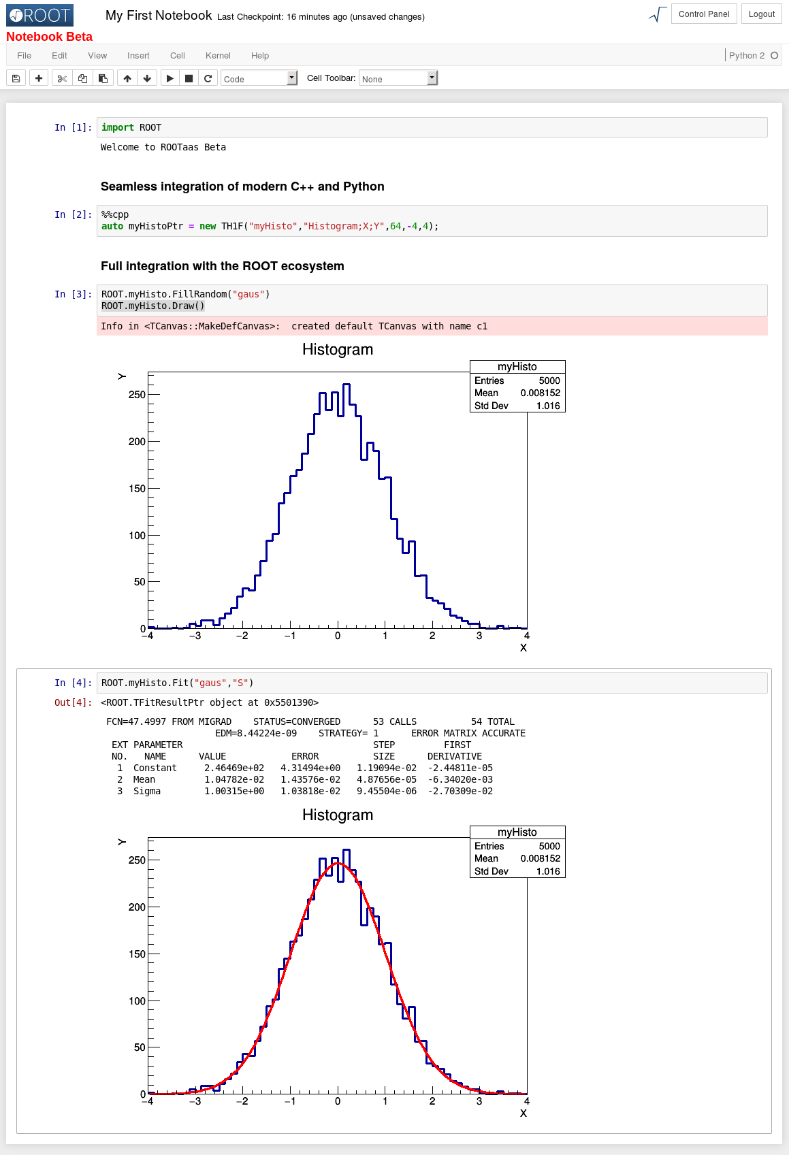
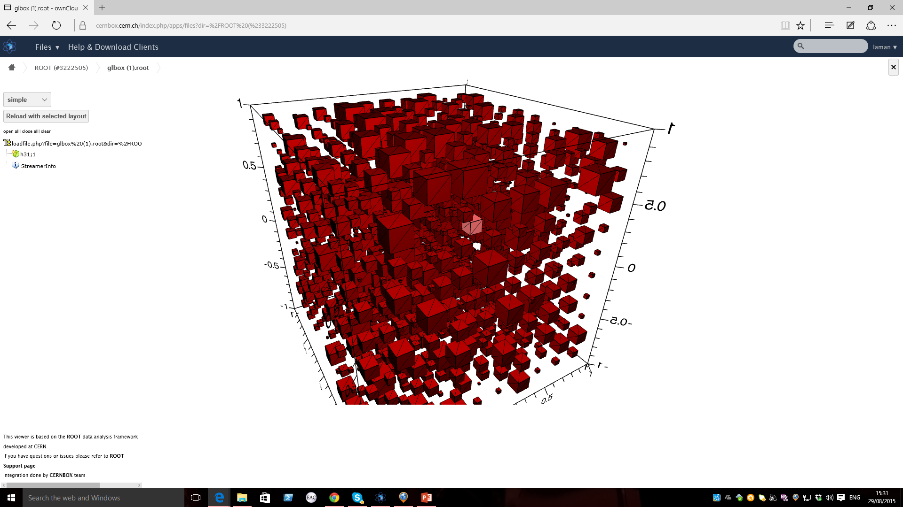
More information in D. Piparo et al. (CERN PH SFT)
@ROOT Workshop (http://indico.cern.ch/event/349459/)

Slide 37
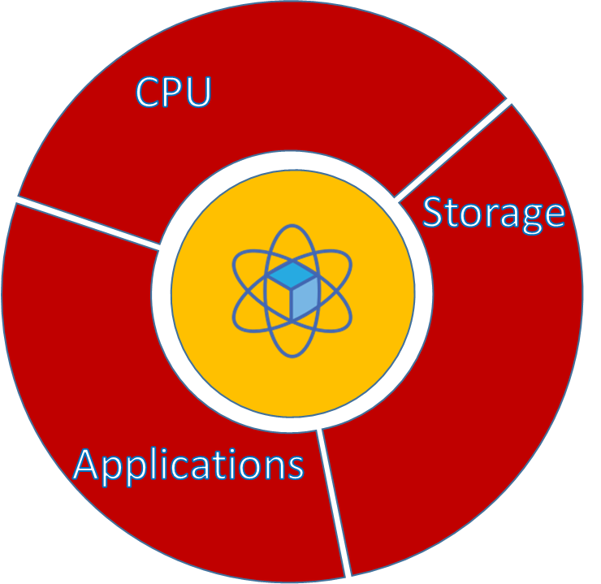
Vision
Data services → Services for data analysis
How to there?
  Development and service preparation
  Build on existing technologies (ROOT, CERNBox, EOS, CVMFS, …)
  Build on existing infrastructures (WLCG)
Innovative and coherent
  Break the traditional divides:
    batch vs interactive
    compute vs storage
    local vs remote
Attractive new functionality
  For HEP…
  … and beyond

Slide 38
Credits
Special thanks to entire CERN IT DSS group

Slide 40
Spare foils
Miscellanea

Slide 41
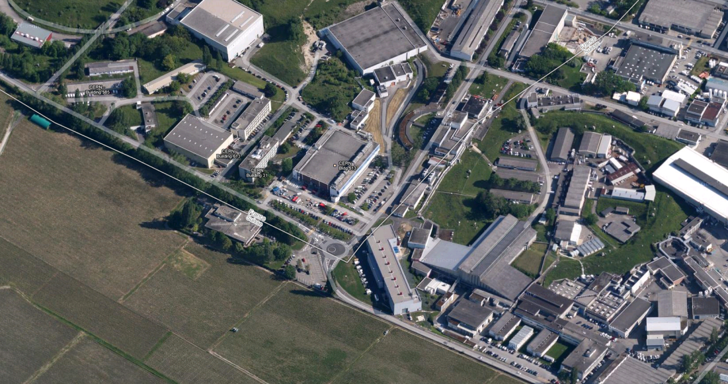
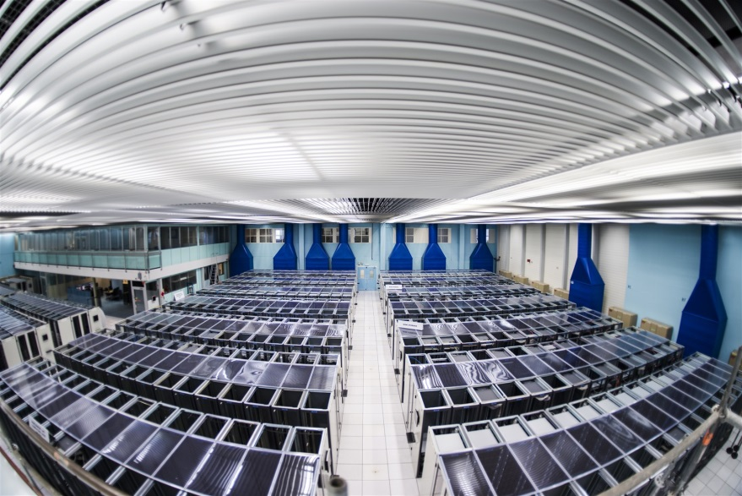
CERN Computer Centre
CERN computer centre:
Built in the 70s on the CERN site (Meyrin-Geneva)
~3000 m² (4 main machine rooms)
3.5 MW for equipment
Estimated Power Usage Efficiency (PUE) ~ 1.6
New extension:
Located at Wigner (Budapest)
~1000 m²
2.7 MW for equipment
2x100Gb links (21 and 24 ms RTT)
CERN CC (Prep. for 2015 LHC – Run2)
Number of 10GB NICs | 4,919
Number of 1GB NICs | 21,335
Number of cores | 115,664
Number of disks | 78,764
Number of memory modules | 77,244
Number of processors | 20,816
Number of servers | 11,961
Total disk space (TiB) | 143,163
Total memory capacity (TiB) | 430.42

Slide 42
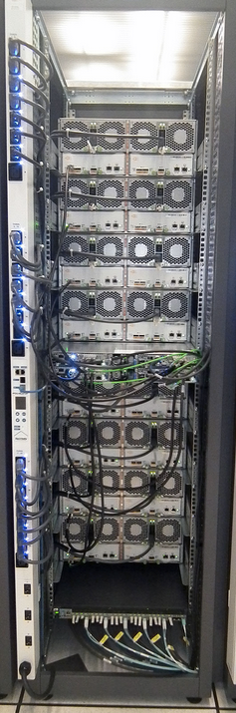
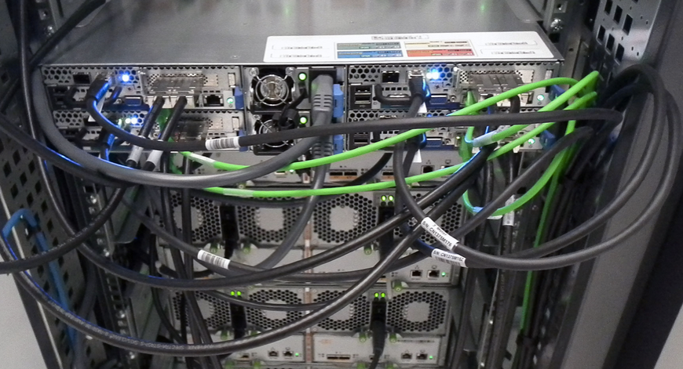
Commodity / Uniformity
Uniform across services
  Same building blocks for AFS, CASTOR, Ceph and EOS
  AFS:CASTOR:EOS 1:10:70 ratio
  Heterogeneity essentially from technology evolution
    Yearly cycle; new models with best “price per GB”
Main building block
  ¼ of quad system (1 node with dual CPU,
  64 GB RAM, 10Gbit/s NIC)
    OpenStack hypervisor use the
    same hardware
  2 24-disk trays per node
  24 4-TB disks per tray (6 TB in
  the next delivery)
  → 200 TB building block

Slide 43

Ceph as back-end
Ceph virtual volumes (RBD) for AFS & NFS backend
  Expose storage volume via VM gateways
  Exploit ZFS features for snapshots and backups
  Disaster recovery server in Wigner
Prototype
Virtualised
AFS Server
Virtualised NFS Server
Virtualised NFS Server
VM
Gateway
VM
Gateway
VM
Gateway
AFS Volume
ZFS
ZFS
ZFS Send
libRBD
libRBD
libRBD
Ceph Cluster (Meyrin)
Ceph Cluster (Wigner)

Slide 44
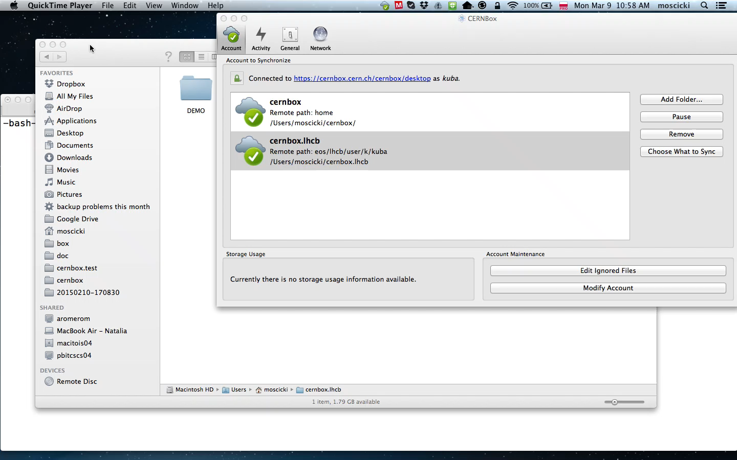
CERNBox

Slide 45
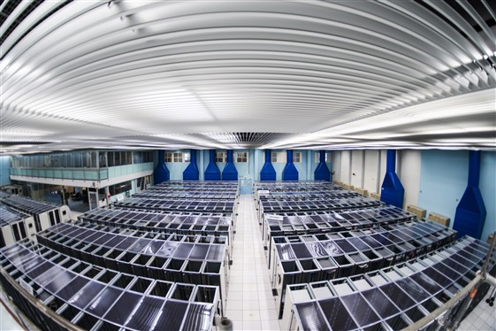





CERNBox
Currently 70 PB deployed!
File-system access for users to /eos/user/u/user directory
  Full access when connected
Partial sharing (my laptop and /eos/user/u/user)
  Offline access from multiple devices
Two-way sharing with other users or group areas
  Offline access
Lazy sync via sync client
Central-services view (batch)
User view (laptop)
User 1
Group 1
User 2
sharing
sharing
MyAnalysis
MyAnalysis
Full AOD
Develop
Full-sample analysis
Test data
Test data
outputs
outputs
Lazy sync
Typically 0.1/1 TB available
on your laptop…

