Slide 1
Drift Chamber detectors in the first BM@N experiment prototype Nikolay Voytishin, Vladimir Palichik LIT
Alushta, Crimea
July 11, 2015

Slide 2
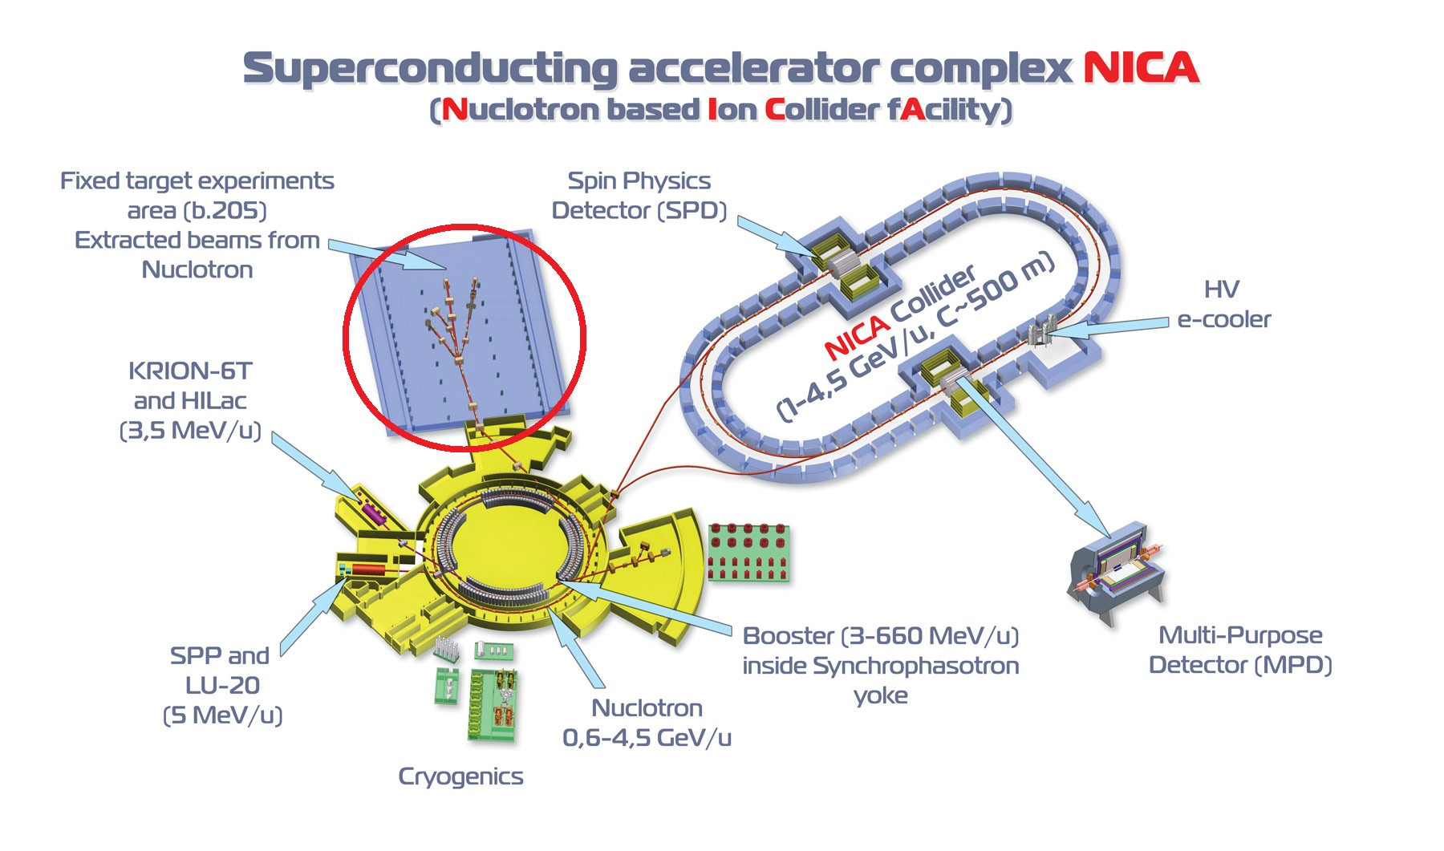
BM@N experiment
BM@N

Slide 3
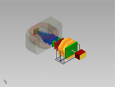
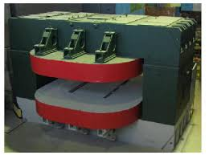
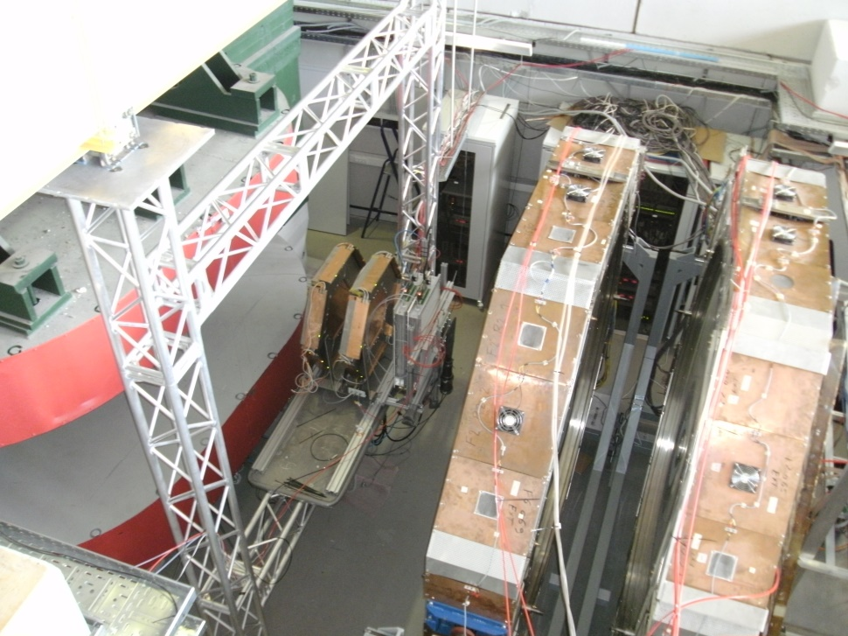
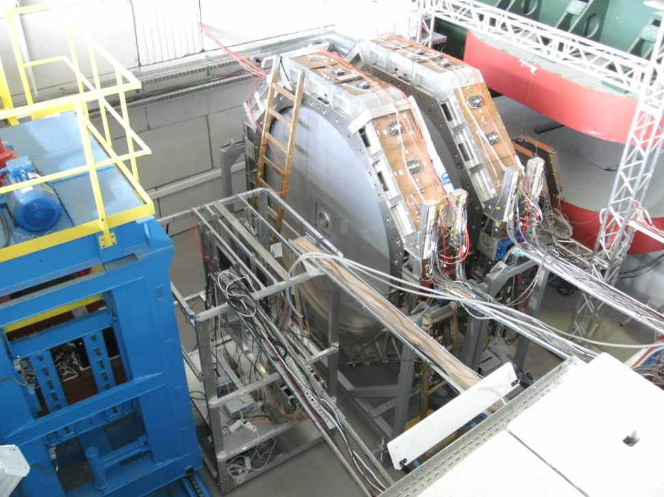
BM@N experiment
MWPC
Dipole Magnet00
DC-1,2
ToF-400
magnet
DC-1,2
ZDC
ToF-700
Detectors’ placement0

Slide 4
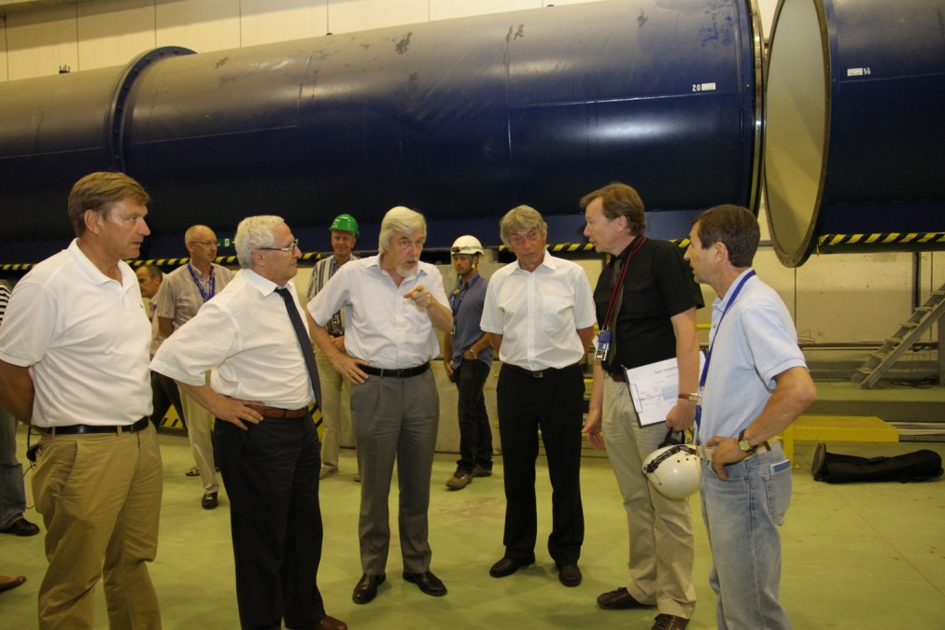
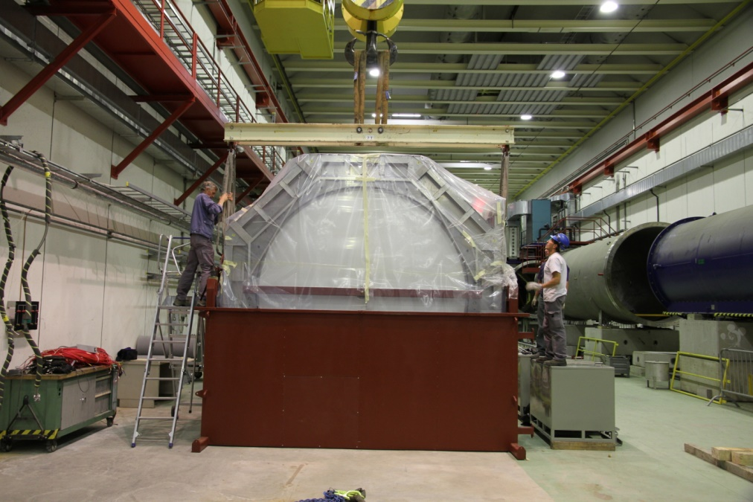
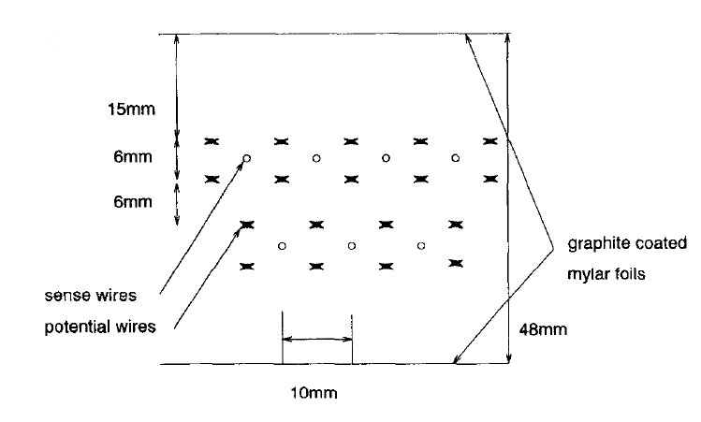
Drift Chamber detector
4 double coordinate planes: wire angles 0,90,±45°, wire pitch 10 mm,
Yout ± 1.35 m, Xout ± 1.35 m, Rmin = 10 cm, 2048 wires per chamber
one DC-plane schematic representation

Slide 5
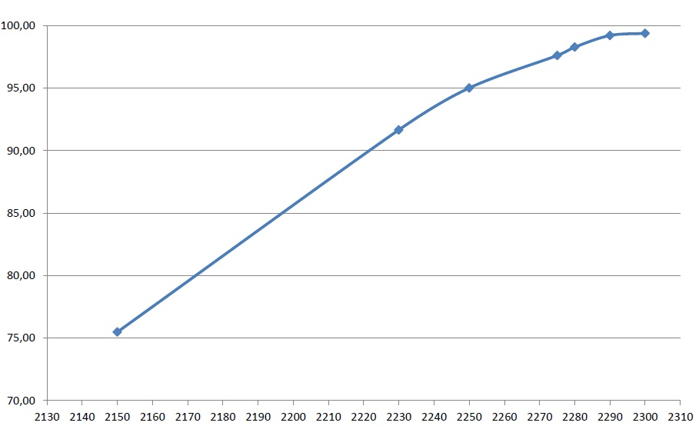
Optimal HV value search
Efficiency, (%)
High Voltage, (V)
DC efficiency

Slide 6
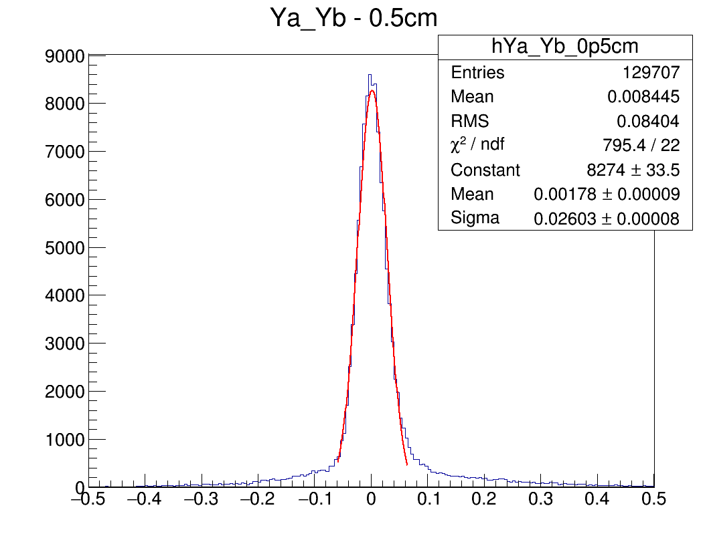
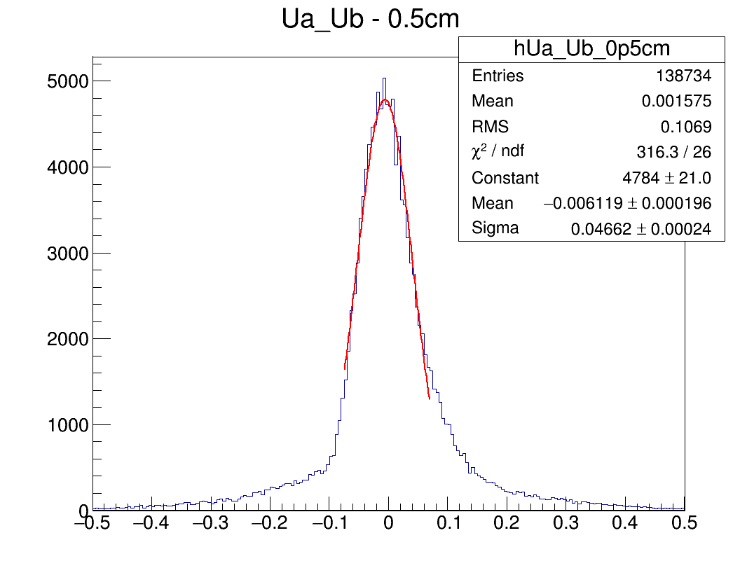
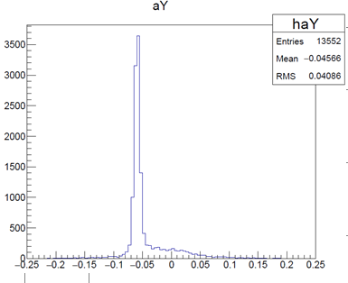
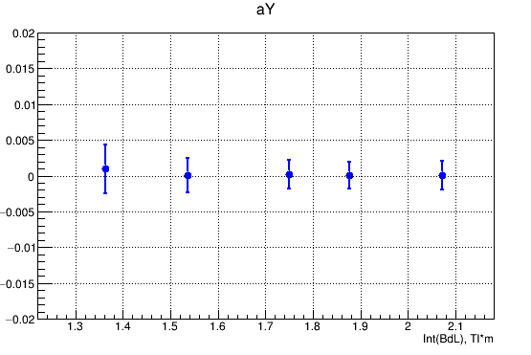
Detector resolution and alignment
184 µm
330 µm

Slide 7
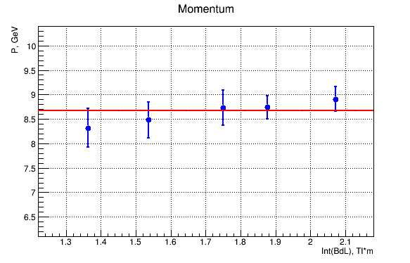
Deuteron momentum measurement
$$\sin\left(α_{out}−α_{in}\right)=0.3∗\frac{Int(BydL)}{p}$$
+2.6%
-4.3%
Momentum value 8.68 Gev/s with systematical error .

Slide 8
Summary
The work is still in progress;
The Drift Chamber‘s segment builder needs further improvement and sophistication;
The Drift Cambers are one of the main detectors in the current BM@N experimental setup;
Some mistakes and uncertainties were omitted during the first runs;
The optimal HV value was chosen;
The chambers were aligned perpendicular to the beam;
The received resolution of the chamber varies for different planes, with the best value of 184 µm;
The deuteron momentum was measured as 8.68 GeV/s .
+2.6%
-4.3%

Slide 9
Thank you for your attention!

