Slide 1
Issadykov Aidos (JINR Dubna & ENU Astana)
Impact of scalar mesons on the rare B-decays
*Phys.Rev.D 91 074007

Slide 2
outline:
В→K*₀(800) and В→K*(892)
Scalar mesons: f₀(500), K*₀(800), a₀(980), f₀(980)
Covariant quark model
Form factors of B-S transition
Branching fractions

Slide 3
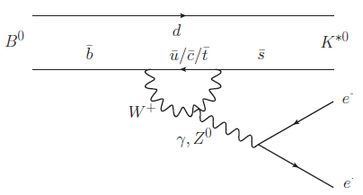
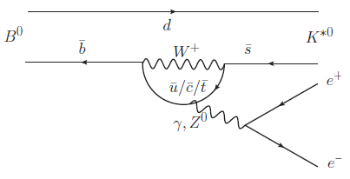
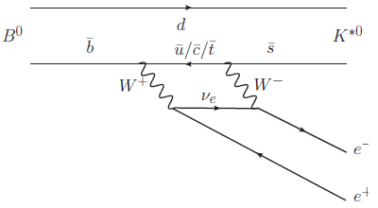
В→K*₀ℓ⁺ℓ⁻ and В→K*ℓ⁺ℓ⁻
*

Slide 4
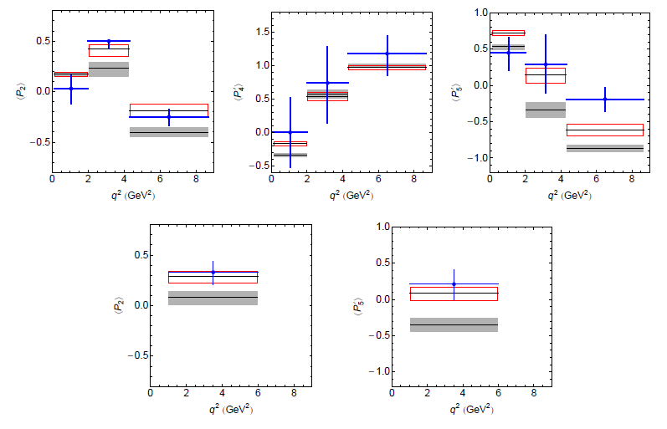
В→K*(892)
*

Slide 5
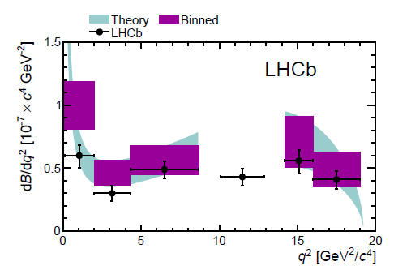
Br(В→K*(K𝜋) 𝜇⁺𝜇⁻ )
В→K*(K𝜋)𝜇⁺𝜇⁻
Exp/SM = 3.7σ
New Physics ??
*

Slide 6
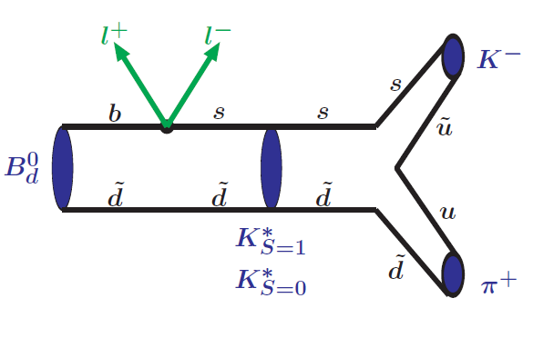
В→K*(→ K𝜋) + ℓ⁺ℓ⁻

Slide 7
Scalar mesons
*PDG14’

Slide 8
b → s ℓ⁺ ℓ⁻

Slide 9
B-S transition in covariant quark model

Slide 10
Compositeness condition in covariant quark model

Slide 11
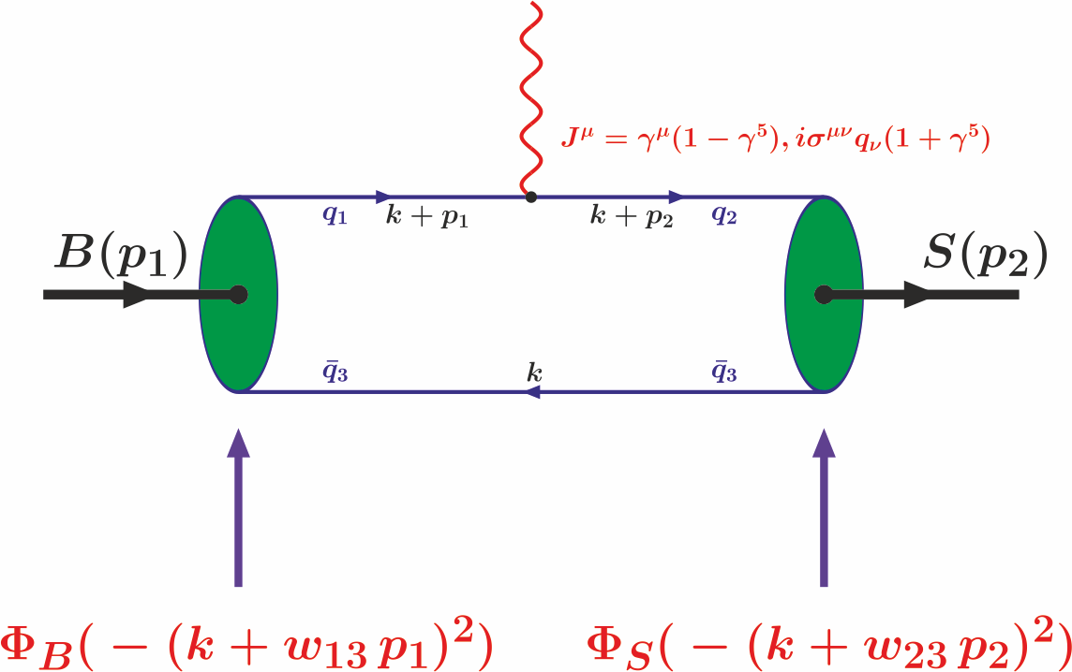
B-S transition diagram

Slide 12
Model parameters
The fitted values of the size parameter Λ in GeV

Slide 13
B-S transition matrix elements

Slide 14
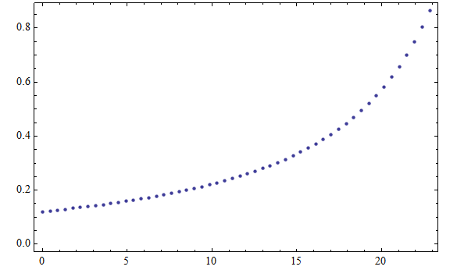
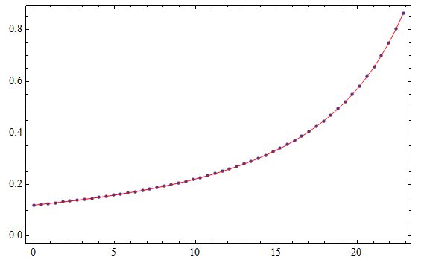
Form factors of B-S transition

Slide 15
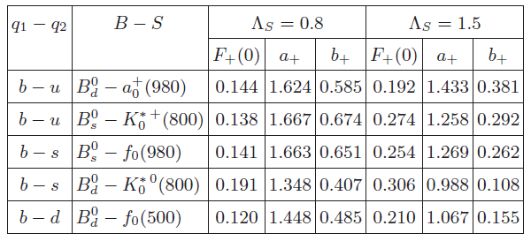
Form factors of B-S transition

Slide 16
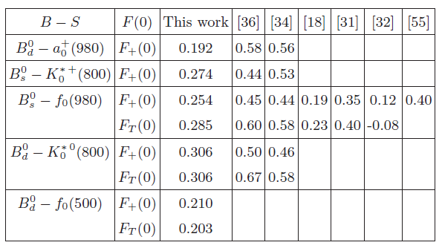
Form factors of B-S transition

Slide 17
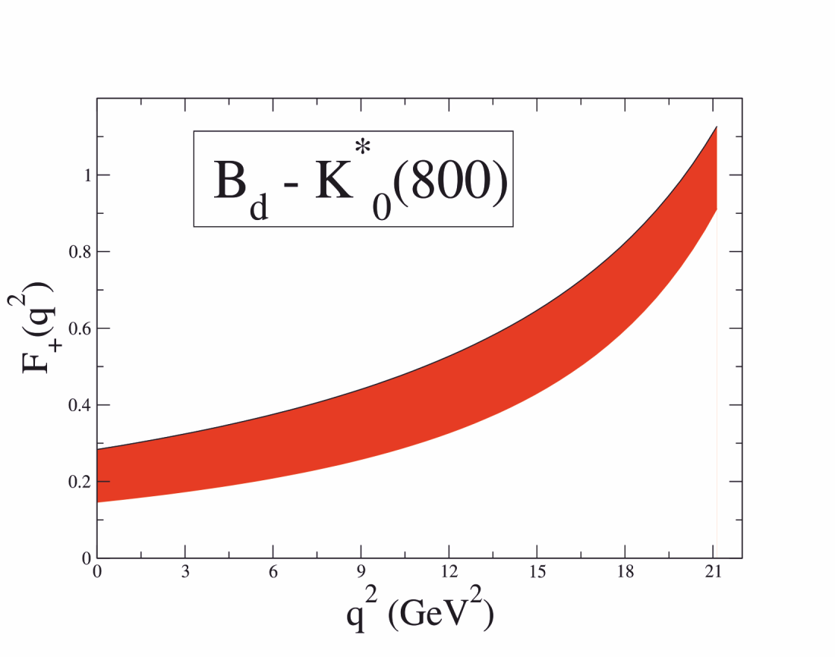
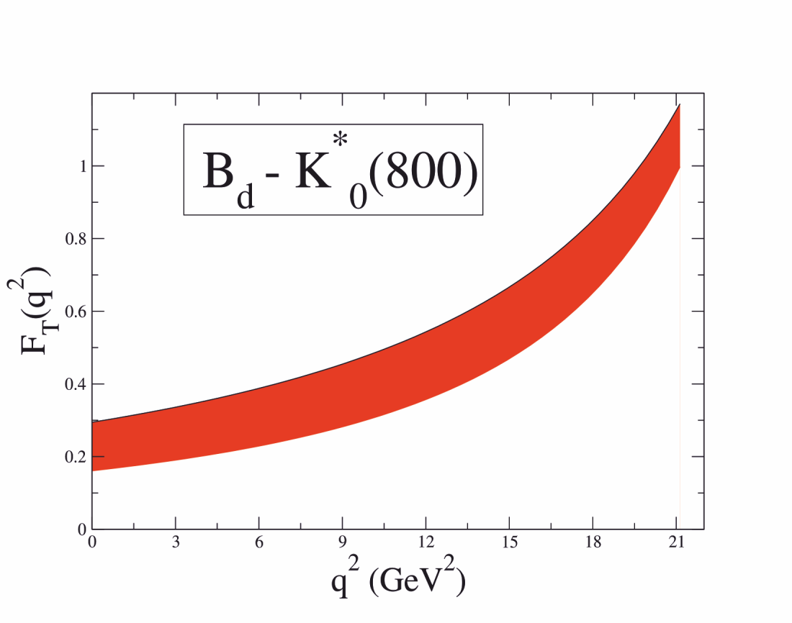

Slide 18
Branching fractions

Slide 19
S-wave and P-wave contributions in the narrow width-limit
*

Slide 20
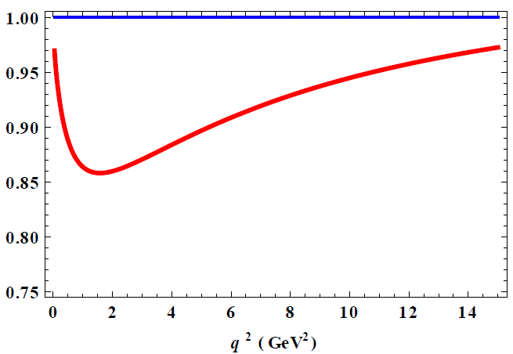
The ratio of the differential decay rate

Slide 21
Conclusions
We calculated:
The B - S transition form factors in the full kinematical region within the covariant quark model
The branching ratios for different decays
The impact of scalar mesons on the rare B-decays

Slide 22
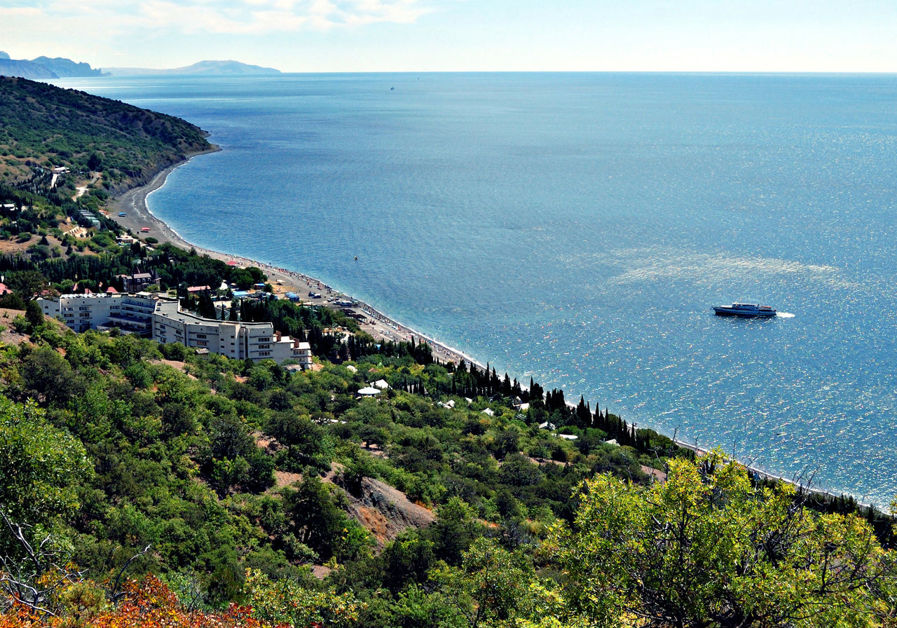
Thank you !

