Slide 1


Decays of B_{c} meson
Issadykov Aidos
in collaboration with:
Mikhail A. Ivanov, S. Dubnicka, A.Z. Dubnickova, A. Liptaj
XXIV Baldin Seminar on High Energy Physics Problems,
JINR, Dubna
19.09.2018

Slide 2
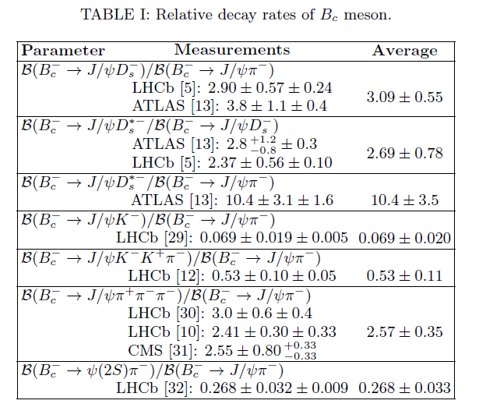
Experimental data

Slide 3



Covariant quark model
* G.V. Efimov and M.A. Ivanov, Int. J. Mod. Phys. A 4 (1989) 2031.

Slide 4

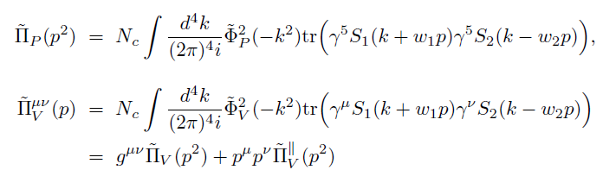
Compositeness condition in covariant quark model
* S. Weinberg, Phys. Rev. 130 (1963) 776.
* A. Salam, Nuovo Cim. 25 (1962) 224.

Slide 5
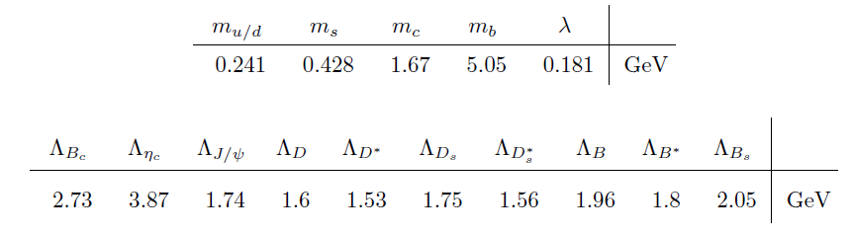

Model parameters
The fitted values of the size parameter Λ in GeV
*C. Patrignani et al. [Particle Data Group], Chin. Phys. C 40 (2016) no.10, 100001.

Slide 6
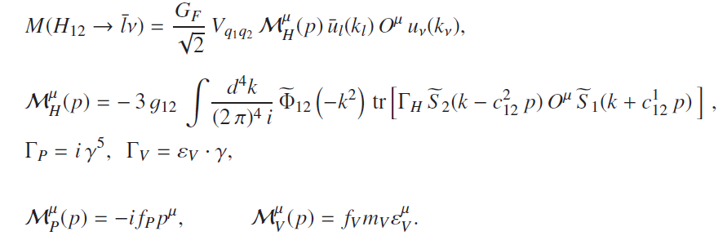
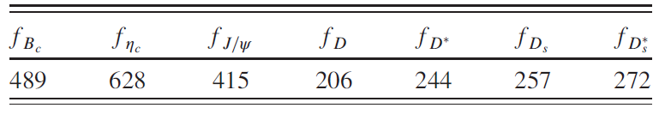
Leptonic decay constants
* Dubnicka, Dubnickova, Issadykov, Ivanov, Liptaj, Phys.Rev. D96 (2017) no.7, 076017

Slide 7
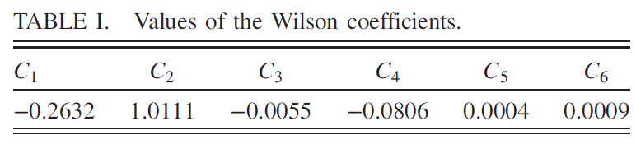
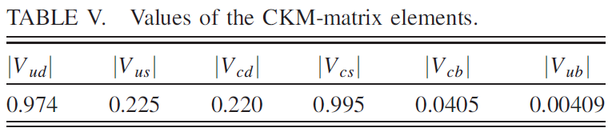
Parameters
*S. Descotes-Genon, T. Hurth, J. Matias, and J. Virto, J. High Energy Phys. 05 (2013) 137.
*C. Patrignani et al. [Particle Data Group], Chin. Phys. C 40 (2016) no.10, 100001.

Slide 8
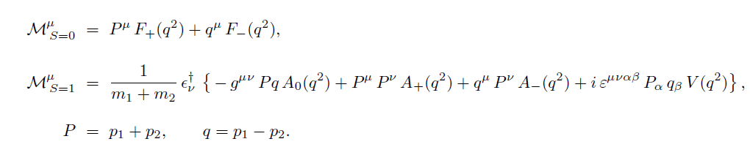
The Invariant Form factors definition

Slide 9
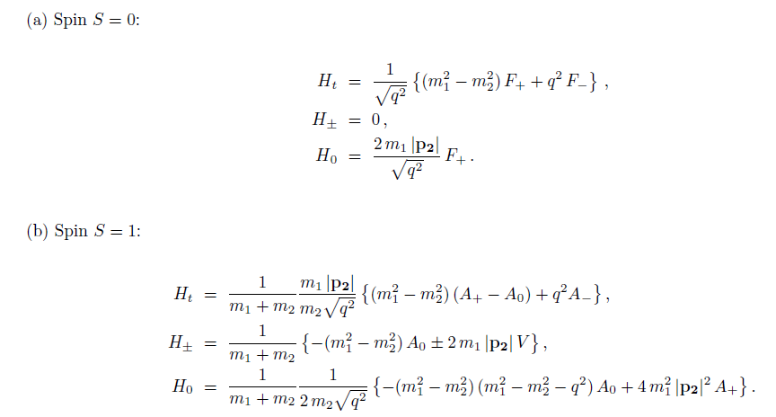
Definition of the Helicity Form factors

Slide 10
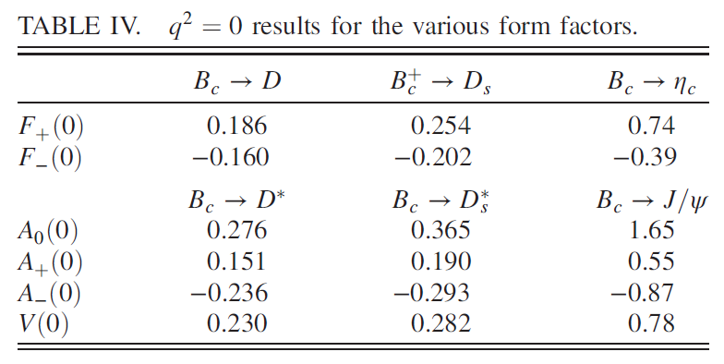
Form factors $B_{c}$ decays
* Dubnicka, Dubnickova, Issadykov, Ivanov, Liptaj, Phys.Rev. D96 (2017) no.7, 076017

Slide 11
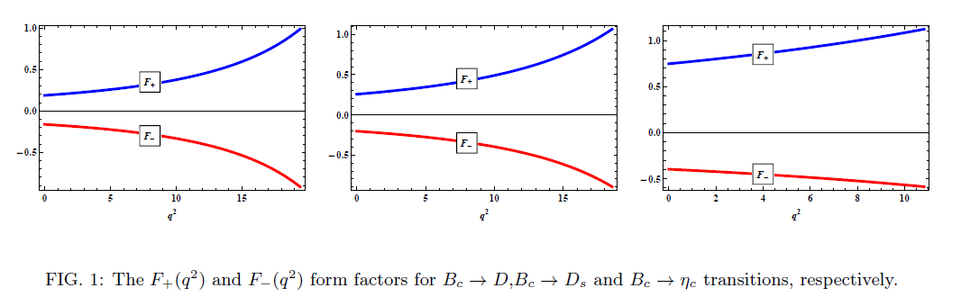
Form factors $B_{c}$ decays
* Dubnicka, Dubnickova, Issadykov, Ivanov, Liptaj, Phys.Rev. D96 (2017) no.7, 076017

Slide 12
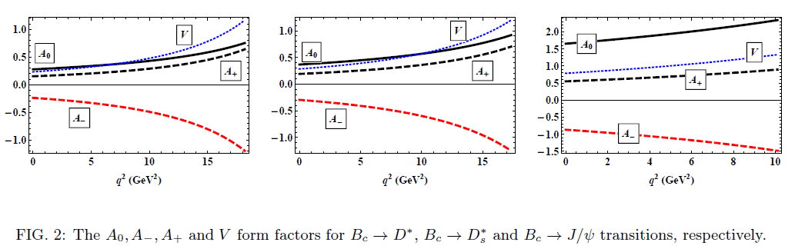
Form factors $B_{c}$ decays
* Dubnicka, Dubnickova, Issadykov, Ivanov, Liptaj, Phys.Rev. D96 (2017) no.7, 076017

Slide 13
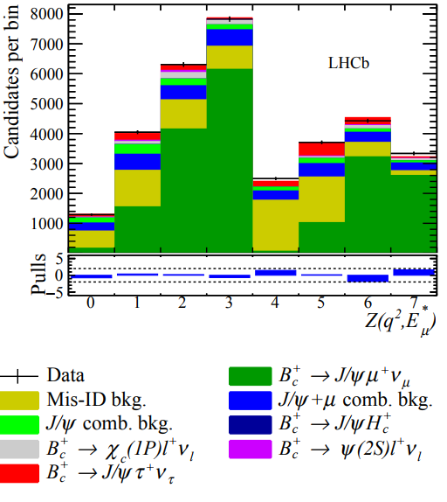


Semileptonic decays of B_{c} meson
*arXiv:1711.05623

Slide 14
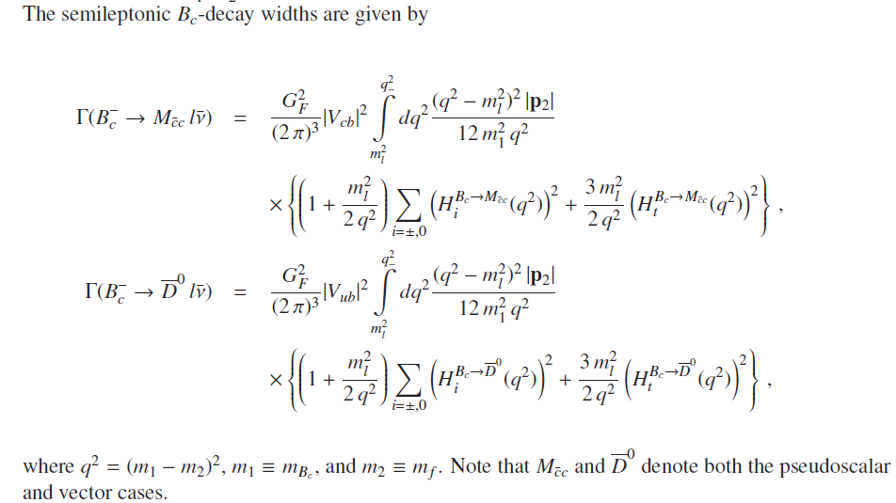

Widths of semileptonic decays of $B_{c}$ meson in terms of helicity amplitudes

Slide 15
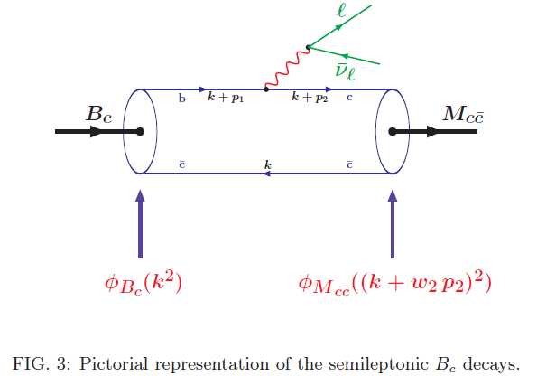
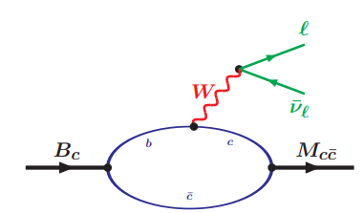
Semileptonic decays of B_{c} meson

Slide 16
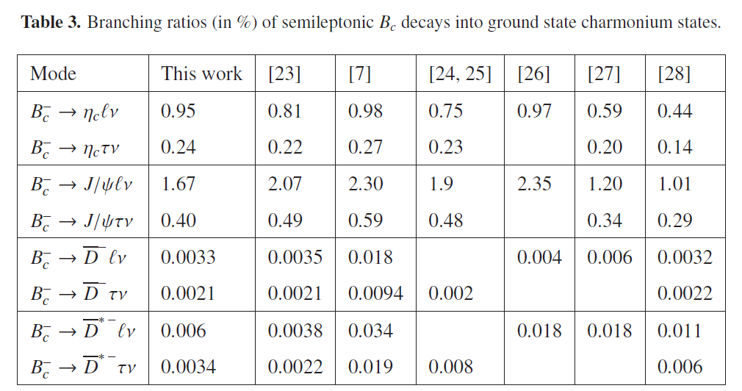
Branching ratios of semileptonic $B_{c}$ decays
*Issadykov, Ivanov, Nurbakova, EPJ Web Conf. 158 (2017) 03002

Slide 17
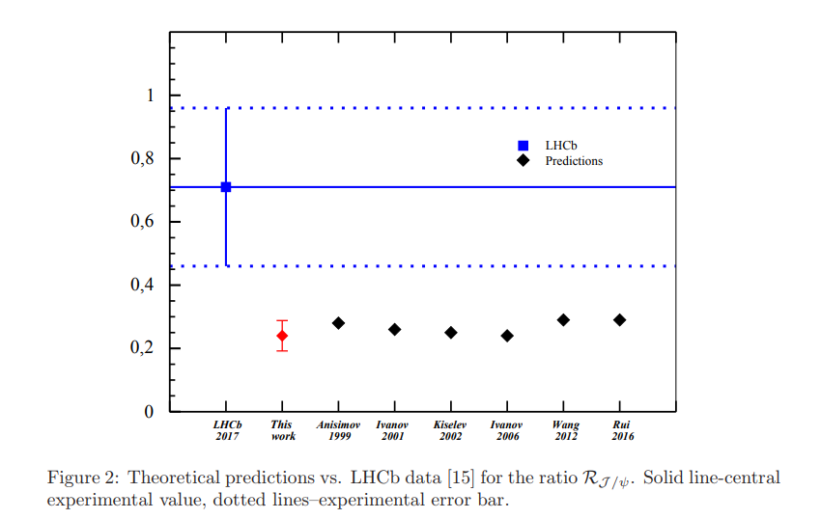
Branching ratios of semileptonic $B_{c}$ decays
*Aidos Issadykov, Mikhail A. Ivanov, Phys.Lett. B783 (2018) 178-182

Slide 18
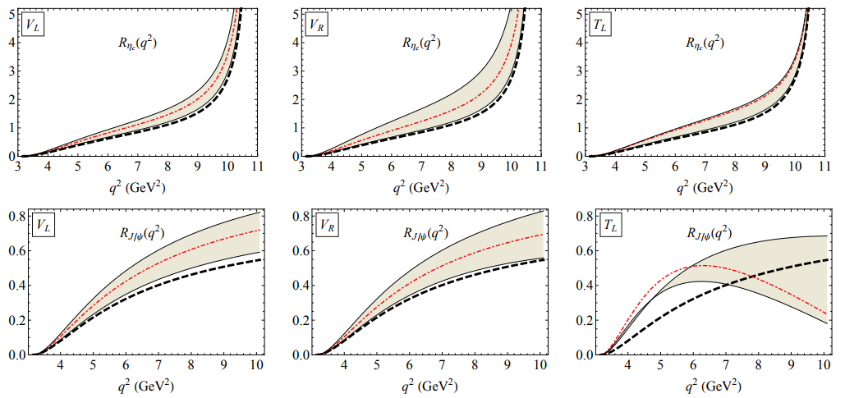
New Physics effects in semileptonic $B_{c}$ decays
*Tran, Ivanov, Körner, Santorelli. arXiv:1801.06927

Slide 19

Nonleptonic decays of B_{c} meson
LHCb collaboration:
*R. Aaij et al. [LHCb Collaboration], Phys. Rev. D 90 (2014) no.3, 032009

Slide 20
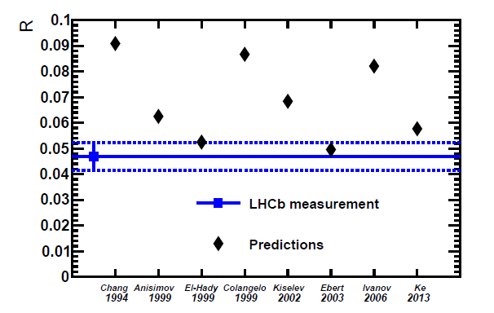
LHCb data 2014
*R. Aaij et al. [LHCb Collaboration], Phys. Rev. D 90 (2014) no.3, 032009

Slide 21



Nonleptonic decays of B_{c} meson
LHCb collaboration(nonleptonic):
*R. Aaij et al. [LHCb Collaboration], JHEP 1309 (2013) 075
*R. Aaij et al. [LHCb Collaboration], JHEP 1609 (2016) 153

Slide 22
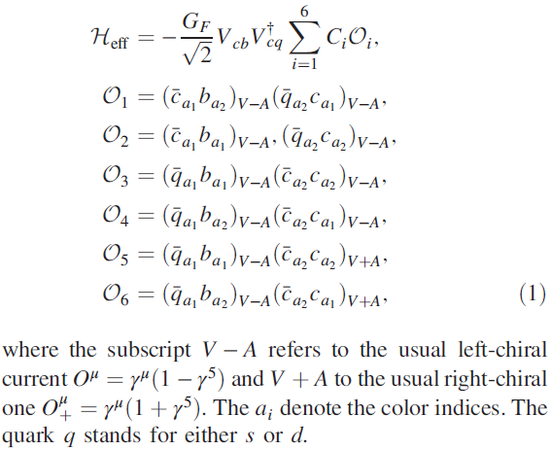
Effective Hamiltonian
Fierz transformation

Slide 23
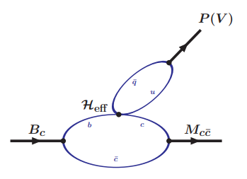
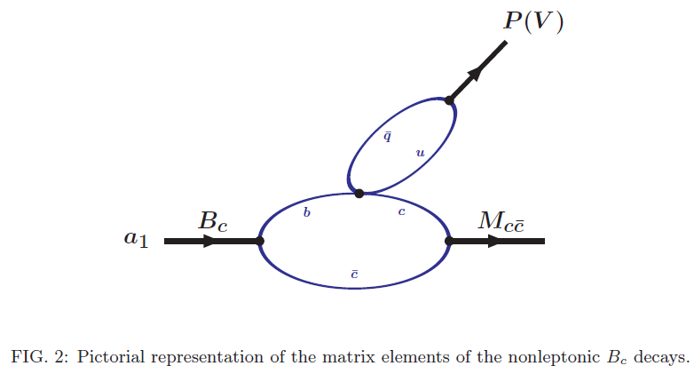
Nonleptonic decays of B_{c} meson

Slide 24
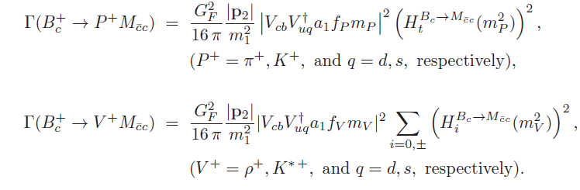
Nonleptonic decays of B_{c} meson

Slide 25
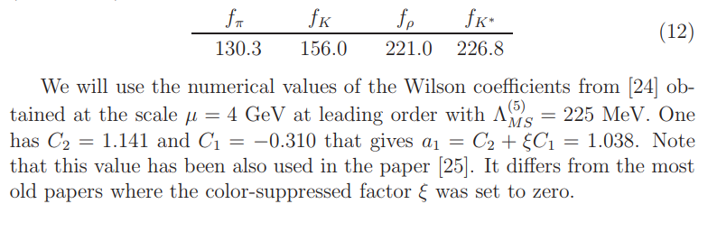
Model parameters
g

Slide 26
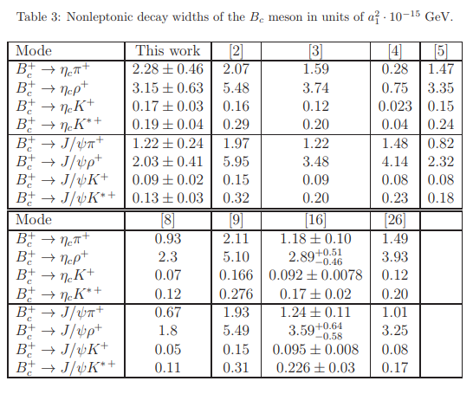

Nonleptonic decays of B_{c} meson

Slide 27
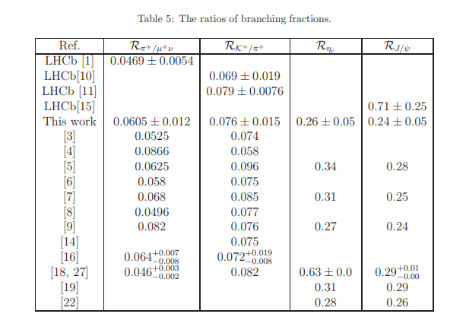
Nonleptonic decays of B_{c} meson

Slide 28
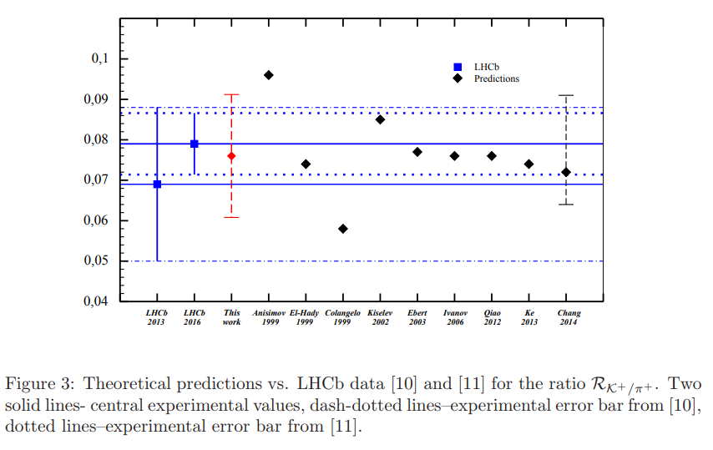
Ratios of branching fractions

Slide 29
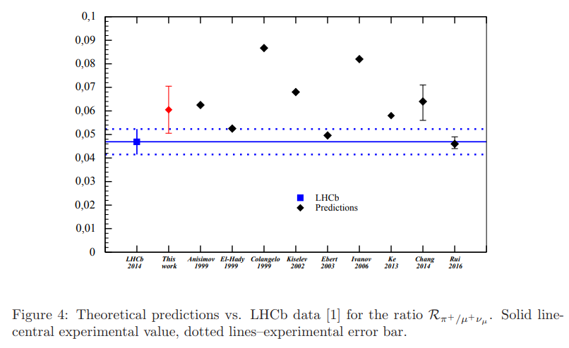
Ratios of branching fractions

Slide 30
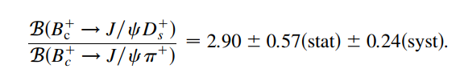

Nonleptonic decays of B_{c} meson
*R. Aaij et al. (LHCb Collaboration), Phys. Rev. D 87, 112012 (2013); 89, 019901(E) (2014).

Slide 31






Nonleptonic decays of B_{c} meson
*G. Aad et al. (ATLAS Collaboration), Eur. Phys. J. C 76, 4 (2016).

Slide 32
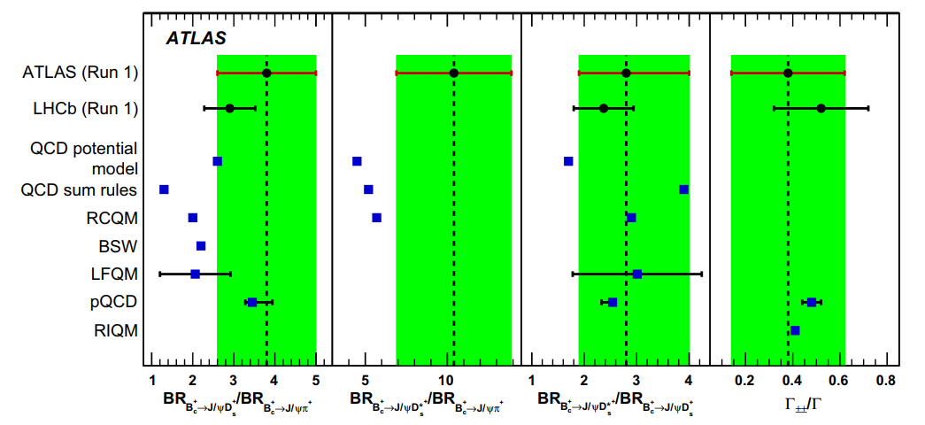
Nonleptonic decays of B_{c} meson
*G. Aad et al. (ATLAS Collaboration), Eur. Phys. J. C 76, 4 (2016).

Slide 33
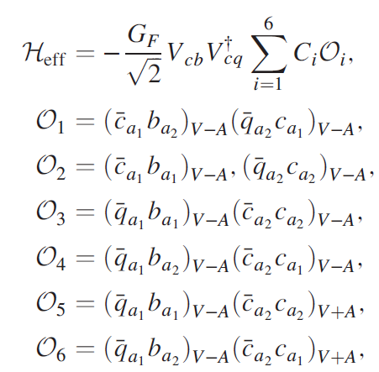
Effective Hamiltonian

Slide 34
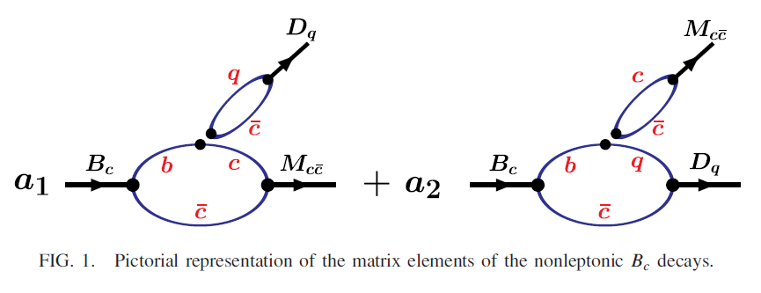
Nonleptonic decays of B_{c} meson
a₁ = C₂+C₄ = 0.93 and a₂ = C₁+C₃ = -0.27

Slide 35
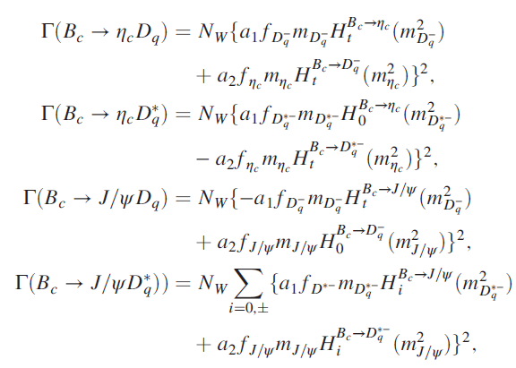

Nonleptonic decays of B_{c} meson

Slide 36
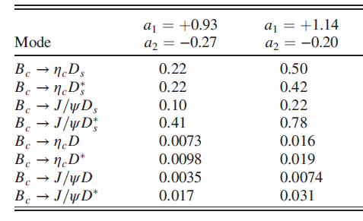


Nonleptonic decays of B_{c} meson
* Dubnicka, Dubnickova, Issadykov, Ivanov, Liptaj, Phys.Rev. D96 (2017) no.7, 076017

Slide 37
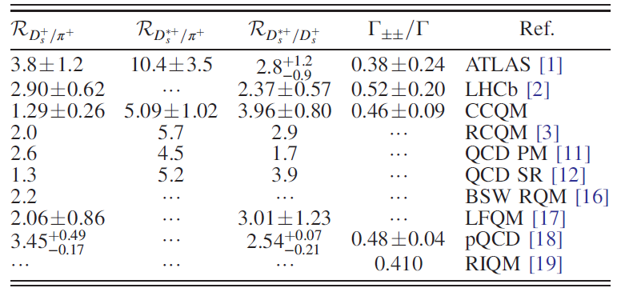
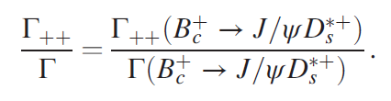
Ratios of branching fractions
* Dubnicka, Dubnickova, Issadykov, Ivanov, Liptaj, Phys.Rev. D96 (2017) no.7, 076017

Slide 38
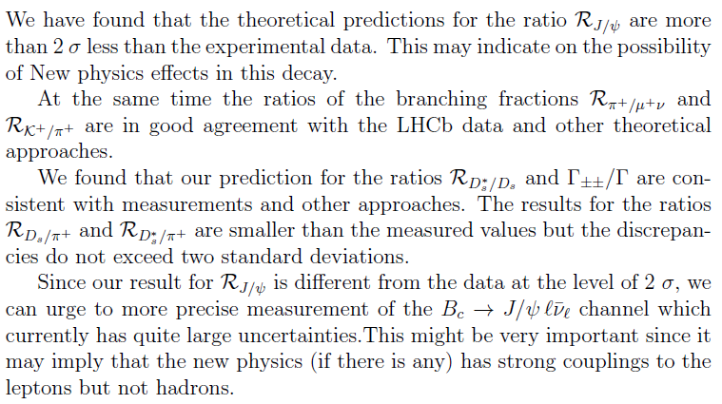
Conclusion

Slide 39
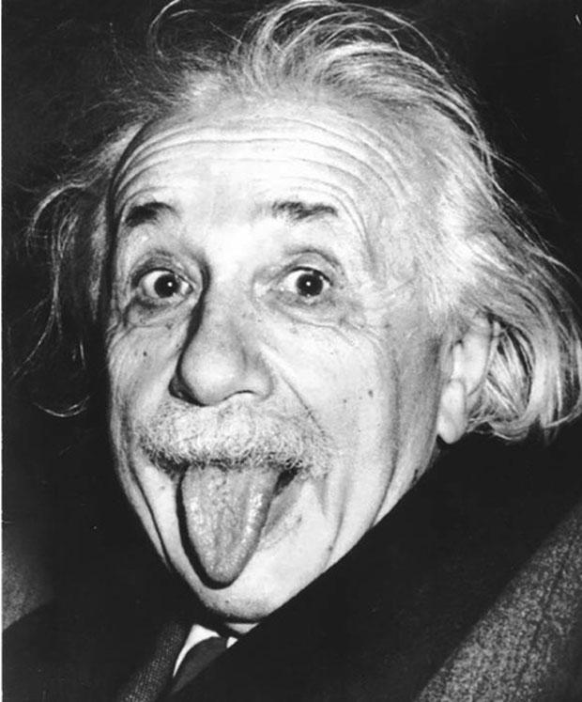
Thank you!
*A. Einstein

