Slide 1
First experiments on deep ionization of Ir, Ce and Xe atoms
in local ion trap at JINR
V. P. Ovsyannikov, E. D. Donets, E. E. Donets, D. E. Donets, S. I. Tytynnikov, V. I. Stegailov,
A. Yu. Ramsdorf, A. Yu. Boytsov, D. N. Rassadov
Joint Institute for Nuclear Research, Dubna, Russia
A. V. Nefiodov
Petersburg Nuclear Physics Institute, St. Petersburg, Russia
A. A. Levin
MaMFIS Group, Hochschulstr. 13, D-01069 Dresden, Germany

Slide 2
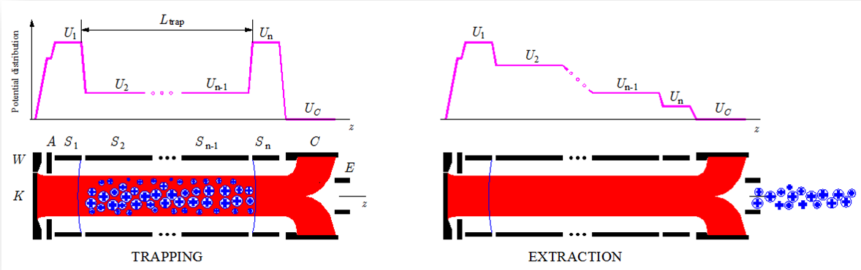
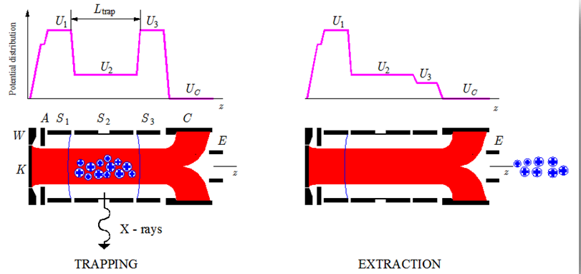
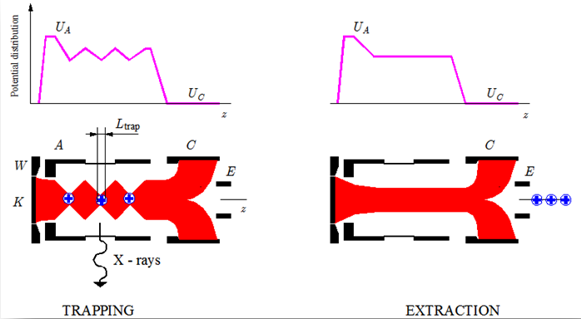
Production of highly charged ions in electron beams (history)
Electron Beam Ion Source (EBIS),
E. D. Donets, Dubna, 1967
Electron Beam Ion Trap (EBIT),
M. Levine, R. Marrs, LLNL, 1986
L_{trap}= 2 cm,
j_{e} ~ 2 kA/cm²
L_{trap}= 0.7 – 1.5 m, j_{e} ~ 500 A/cm²
K, cathode
W, focusing (Wehnelt) electrode
A, anode
S₁, S₂,…, S_{n}, sections of drift tube
C, collector
E, extractor
z, axis of electron beam
j_{e} , effective electron current density
L_{trap} , trap length
Main Magnetic Focus Ion Source
(MaMFIS)
L_{trap}= 1 mm
j_{e} > 10 kA/cm²

Slide 3
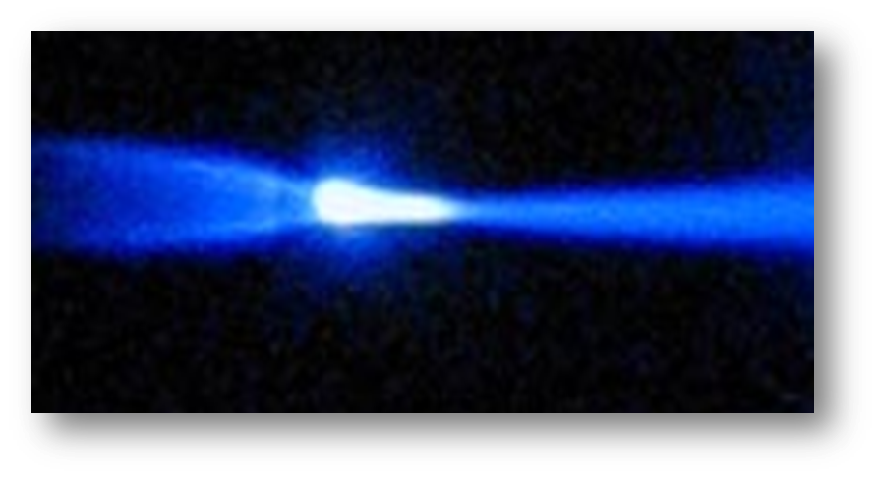
Main Magnetic Focus Ion Source (MaMFIS)
Electron current density j_{e} is the key quantity, because it determines
the rate for production of highly charged ions

Slide 4
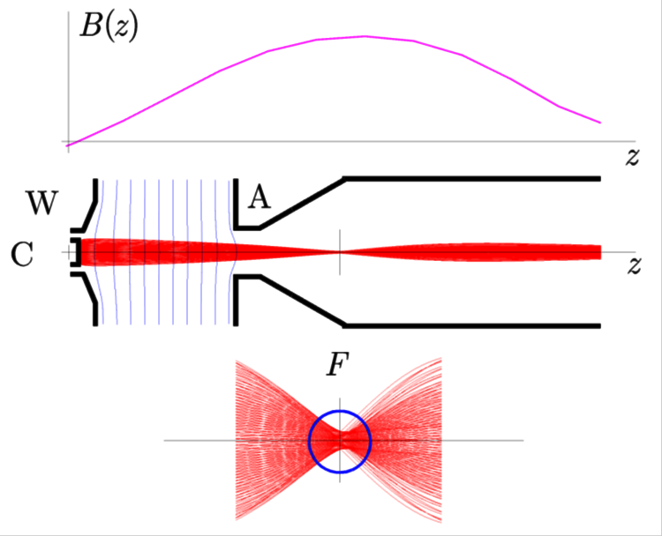
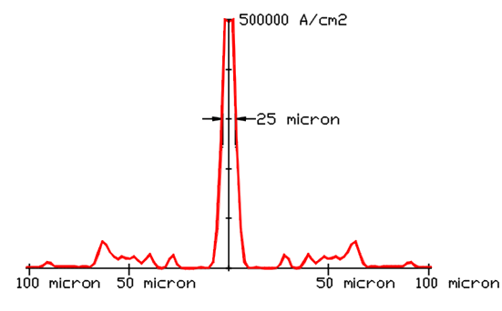
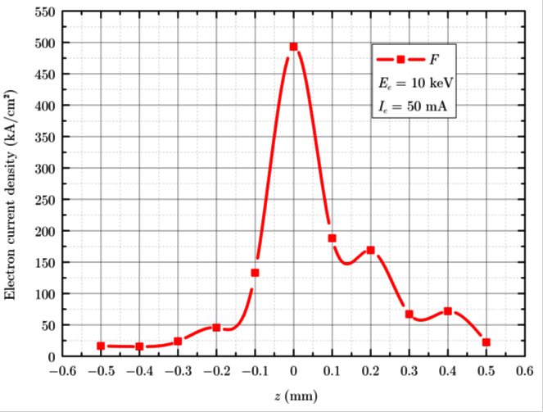
Operation principle of MaMFIS (Single Focus)
C, cathode
W, focusing (Wehnelt) electrode
A, anode
z, axis of electron beam
B(z), magnetic field distribution
F, magnetic focuses (local ion traps)
Electron beam trajectories for
single-focus electron optics (theoretical estimation)
Radial (left fig.) and axial (right fig.) distributions of electron current density j_{e} near focus point F
The electron current density in a single focus can be extremely high!

Slide 5
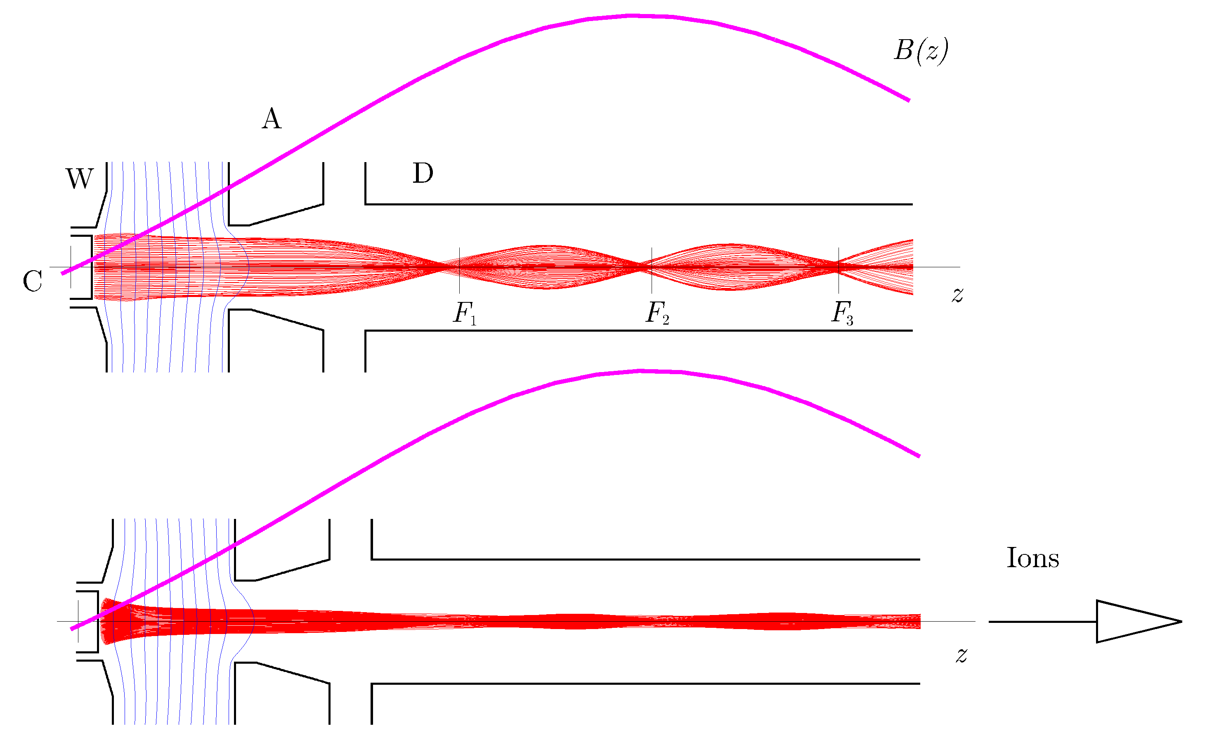
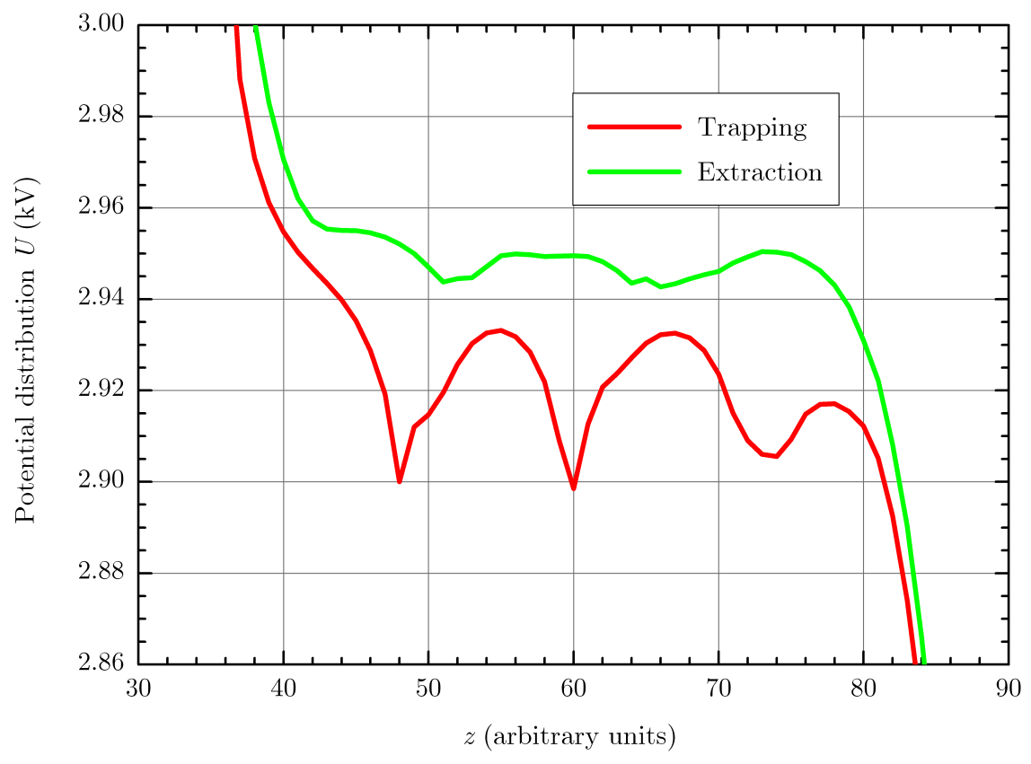
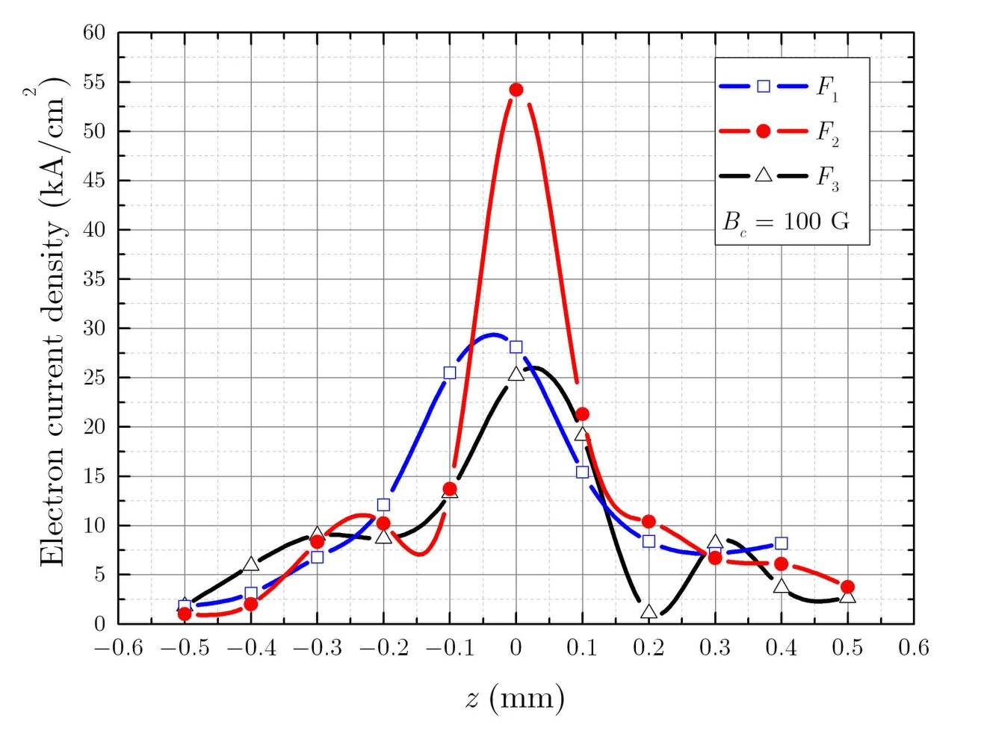
Operation principle of MaMFIS (Three Focuses)
C, cathode
W, focusing (Wehnelt) electrode
A, anode
D, drift tube
z, axis of electron beam
B(z), magnetic field distribution
F₁, F₂, F₃, magnetic focuses (local ion traps)
Effective electron current density j_{e} ~ 20 kA/cm²
Axial distribution of
electron current density
on the length of 1 mm
near focuses
Local ion traps in
a rippled electron beam

Slide 6
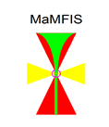
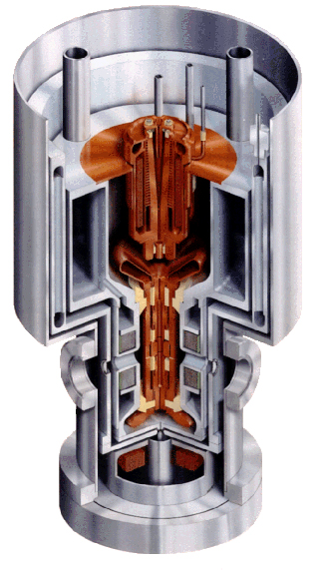
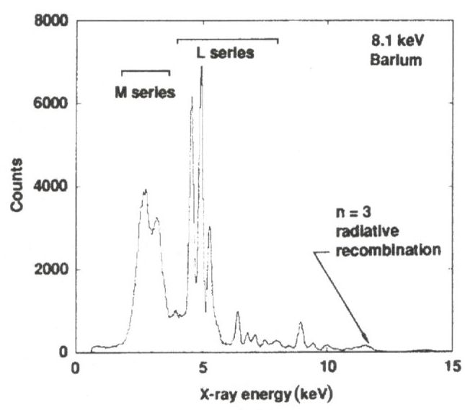
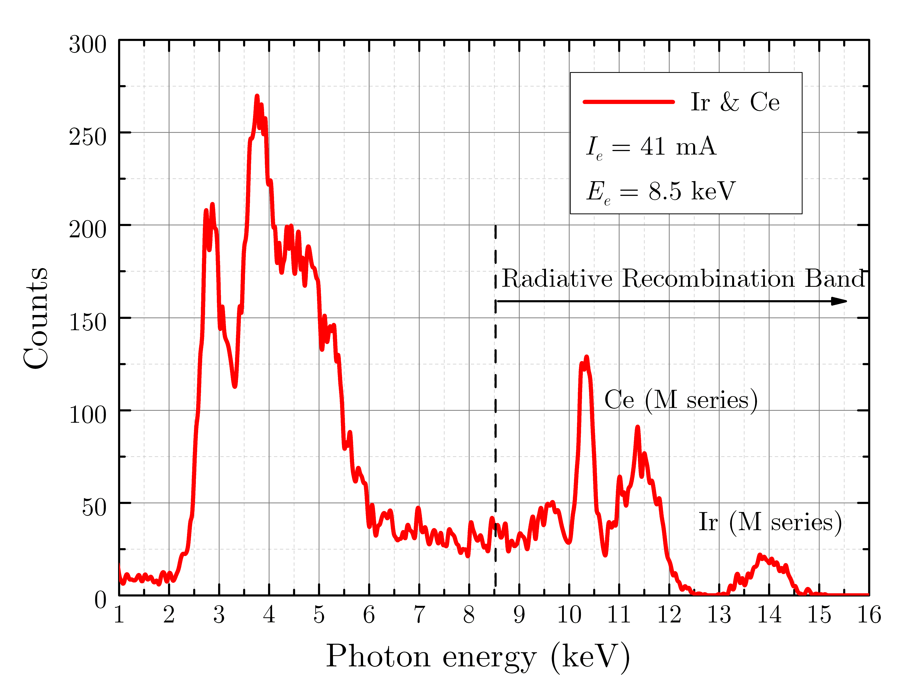
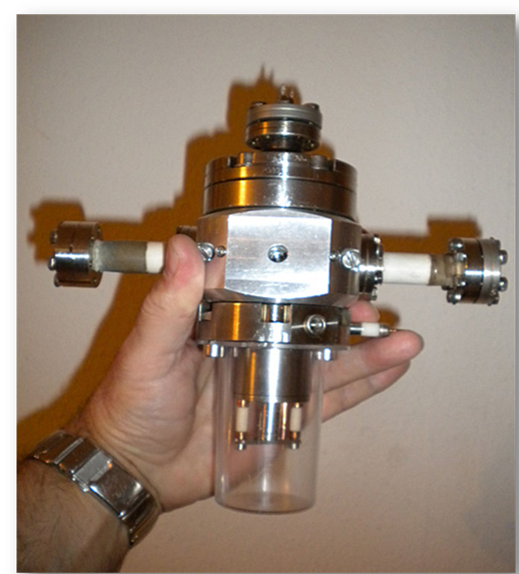
MaMFIS-10 versus LLNL superconducting EBIT
X-ray spectra from cathode materials
M.A. Levine, R.E. Marrs,
J.R. Henderson, D.A. Knapp
and M.B. Schneider,
Phys. Scripta T22, 157 (1988)
V.P. Ovsyannikov and A.V. Nefiodov,
Nucl. Instr. Meth. B 370, 32 (2016)
MaMFIS-10
E_{e} b 10 keV
I_{e} = 50 mA
LLNL EBIT
First run: Justus-Liebig-University Giessen, 2013

Slide 7
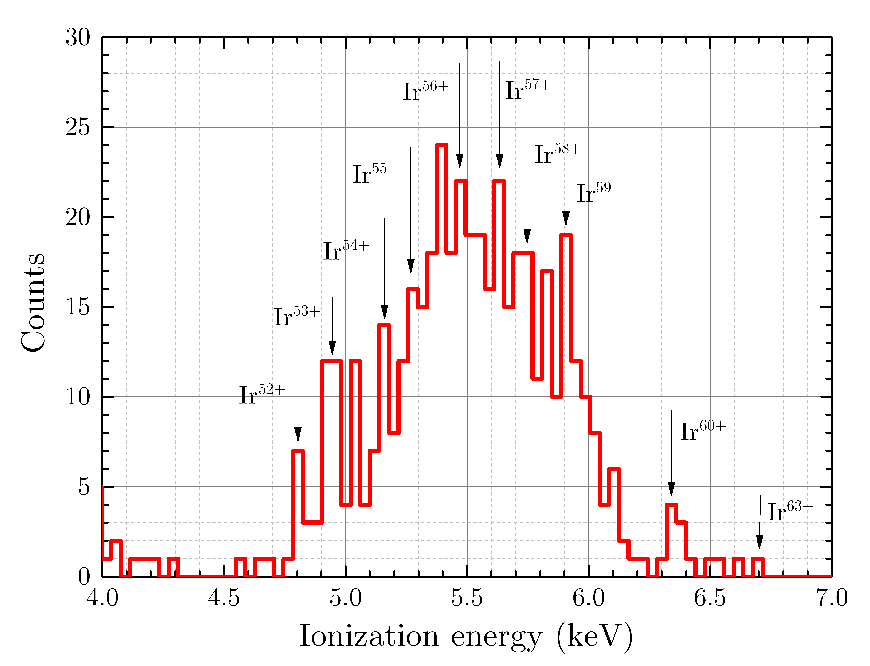
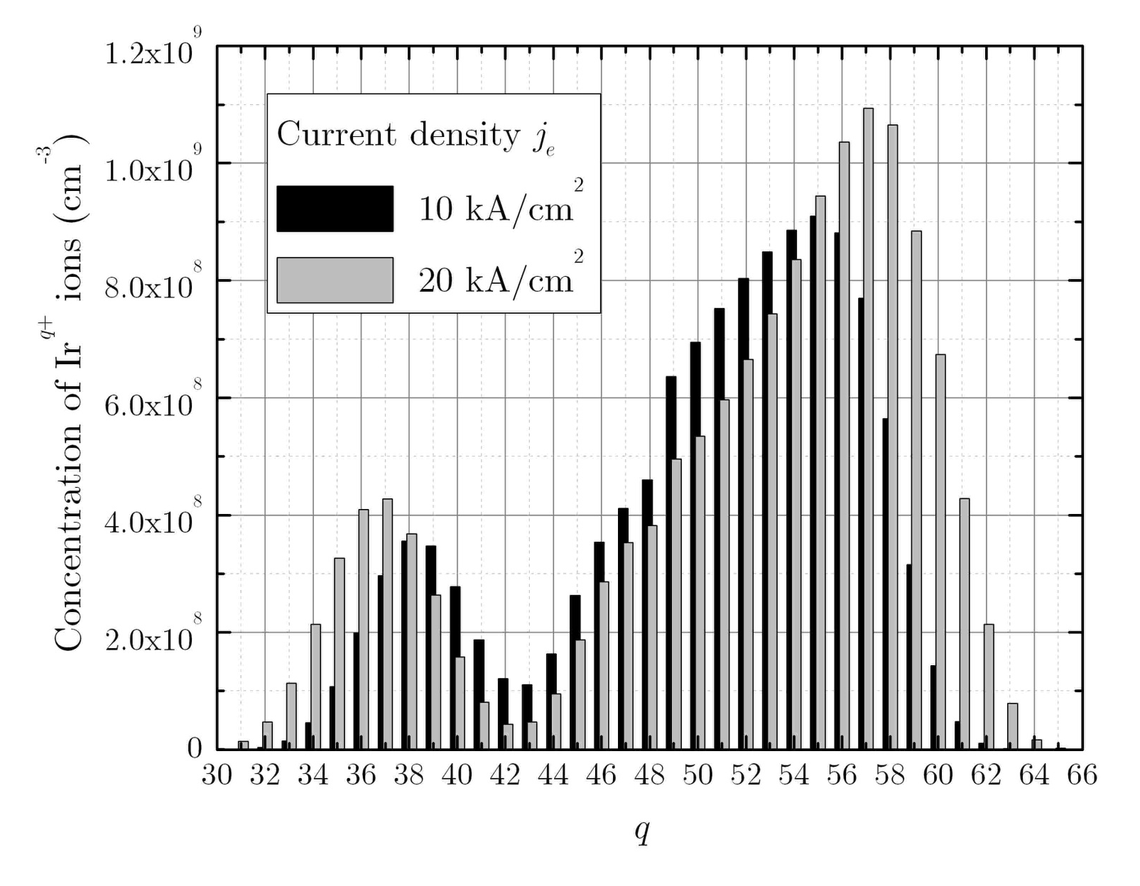
MaMFIS-10: Estimation of electron current density
X-ray emission due to radiative recombination into the M-shell of Ir ions (experiment)
Charge-state distributions of Ir ions for different electron current density (computer simulation)
Electron current density is estimated to be j_{e} ~ (10 – 20) kA/cm²

Slide 8
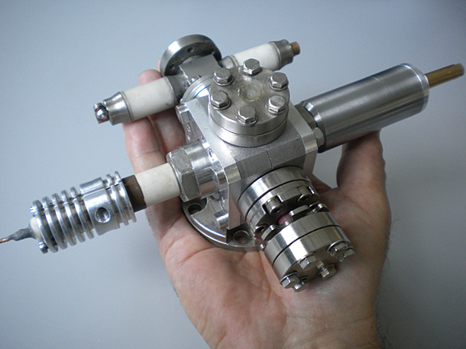
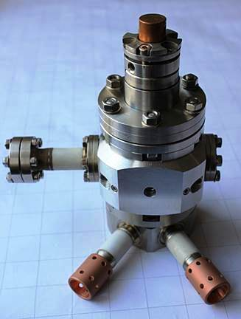
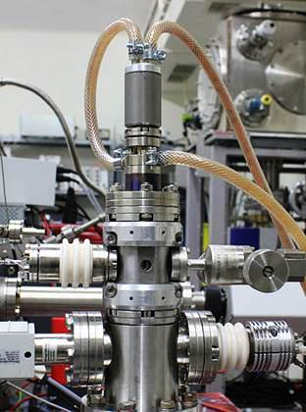
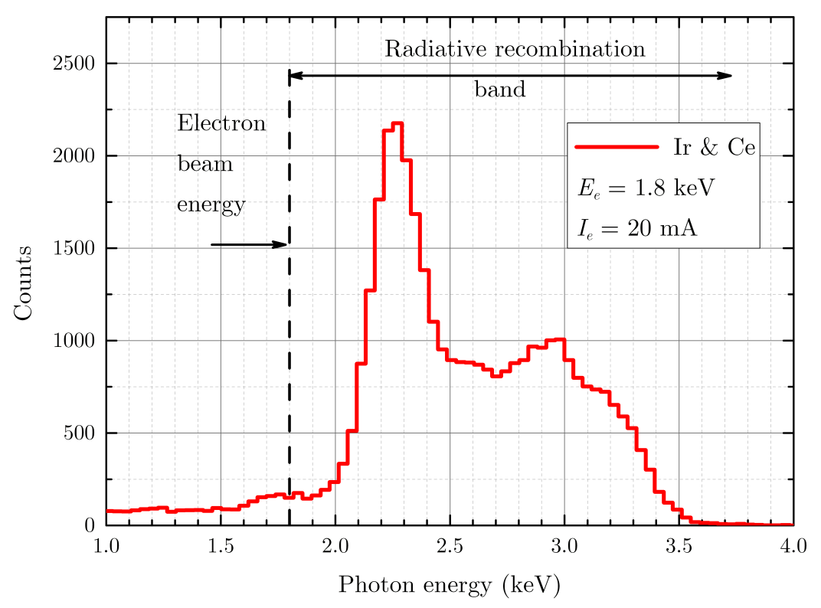
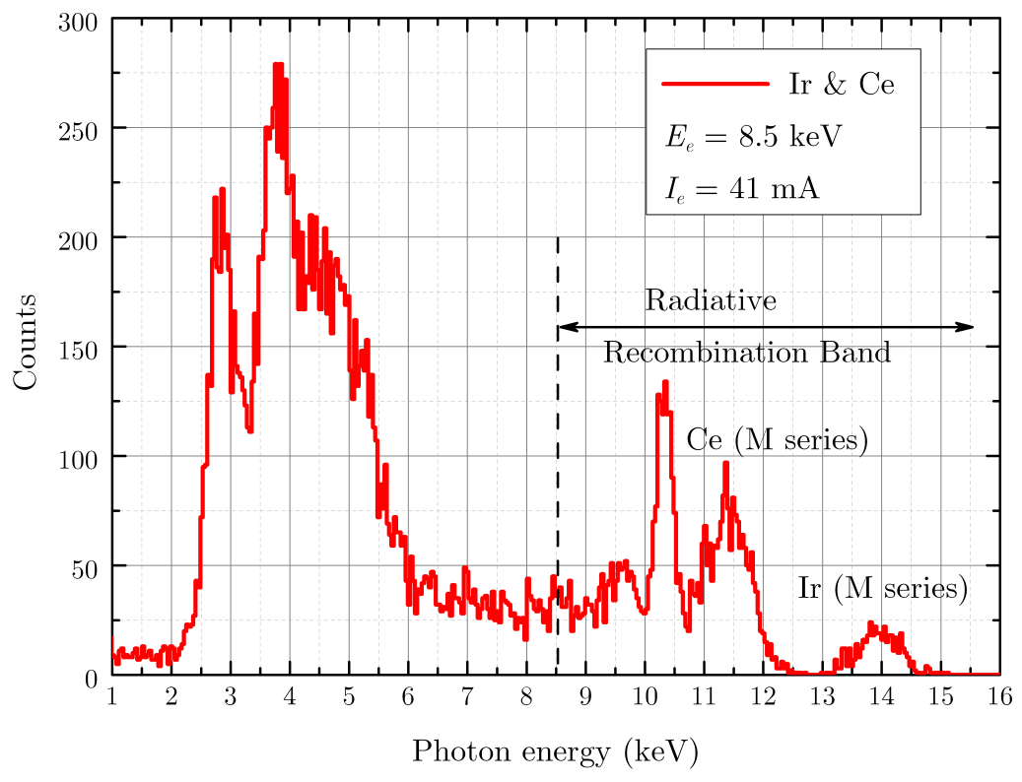
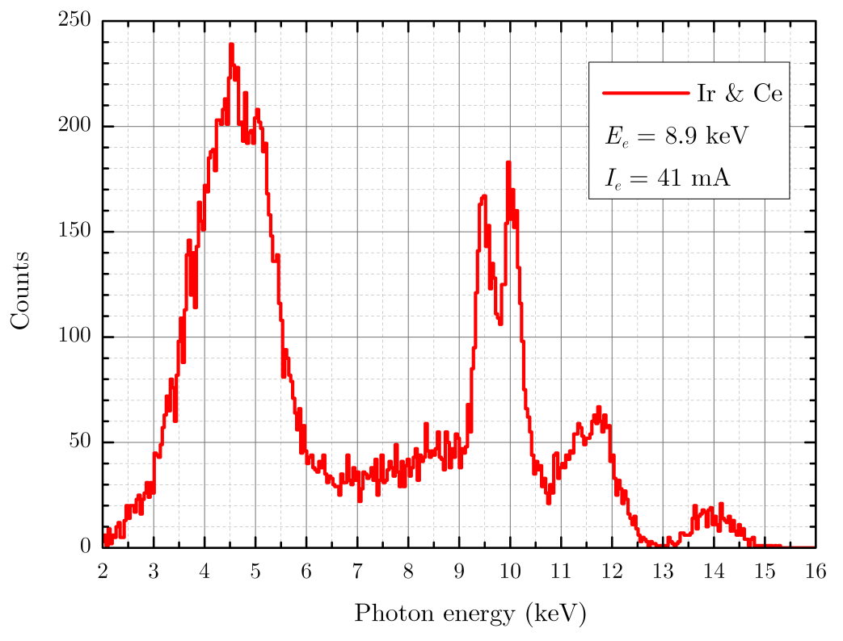
MaMFIS family developed until now
Not yet tested
MaMFIS-4
E_{e} b 4 keV
MaMFIS-8
E_{e} b 8 keV
MaMFIS-10
E_{e} b 10 keV
MaMFIS-30
E_{e} b 30 keV

Slide 9
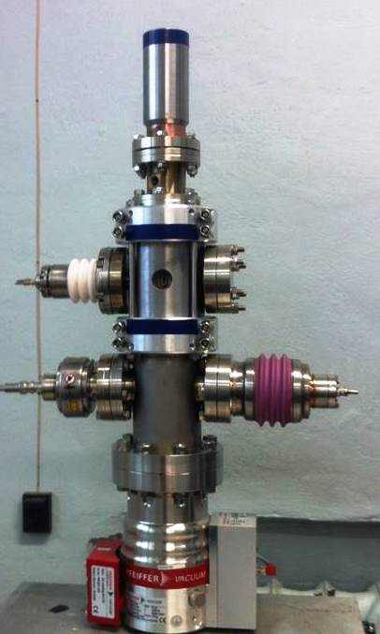
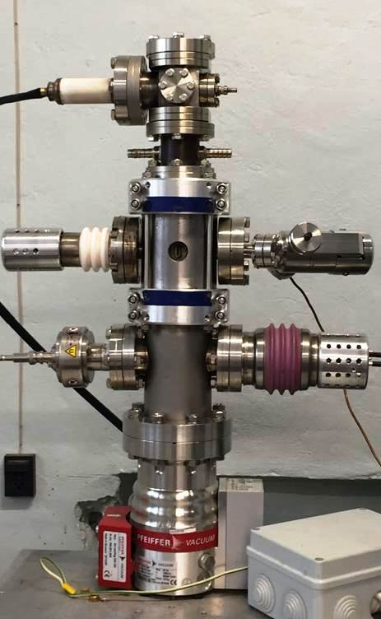
MaMFIS-40 at JINR in Dubna
Project parameters:
Electron energy E_{e} b 35 keV
Electron current density j_{e} b 20 kA/cm²
Electron current I_{e} b 50 mA (DC-mode)
Realized parameters:
E_{e} b 40 keV
j_{e} b 20 kA/cm²
I_{e} b 50 mA
Aim of project:
Development of MaMFIS technology for production of highly charged ions of
heavy elements
First assembling of MaMFIS-40D
Assembling for extraction mode

Slide 10
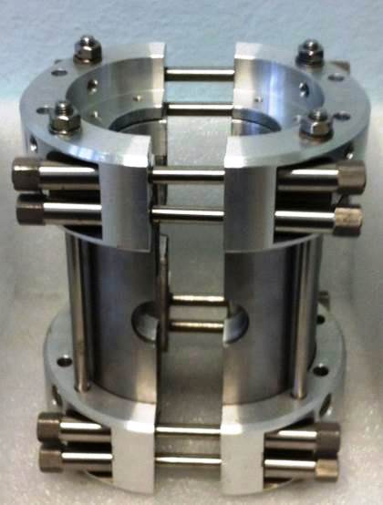
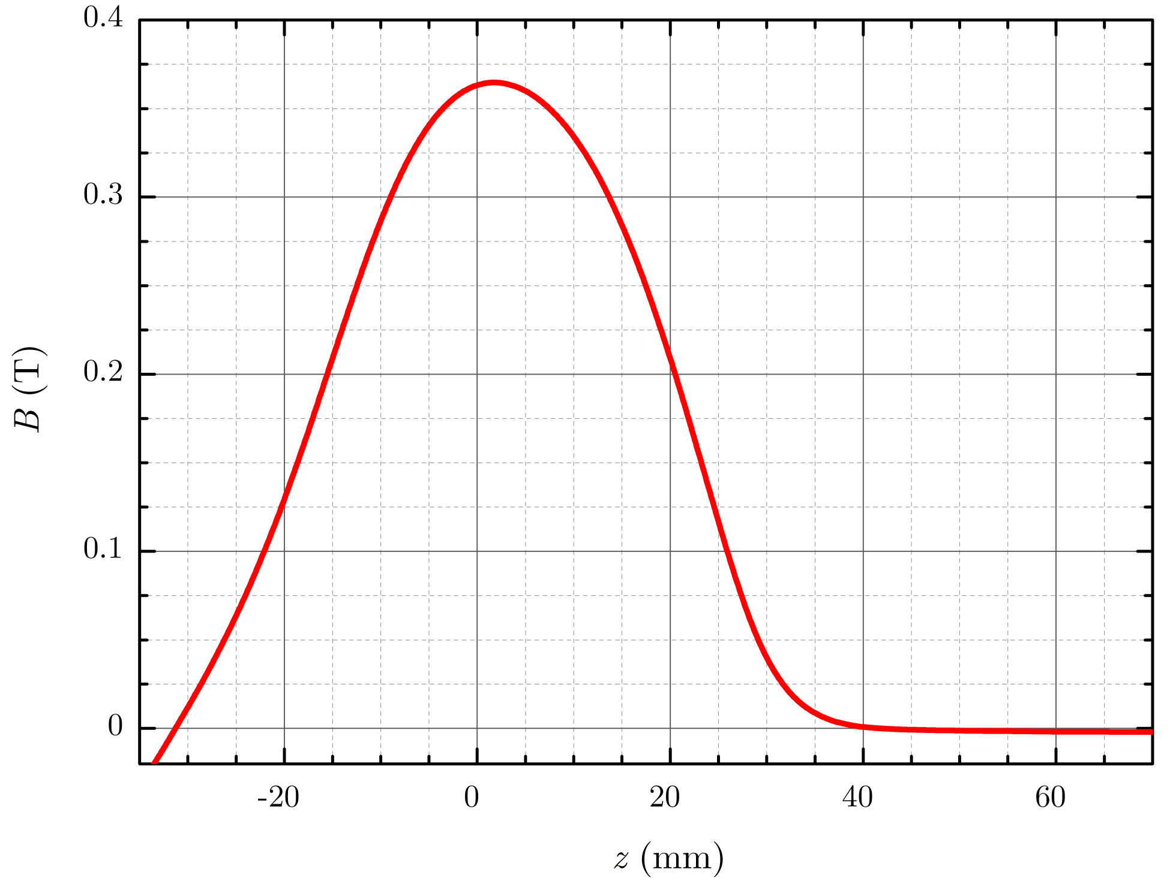
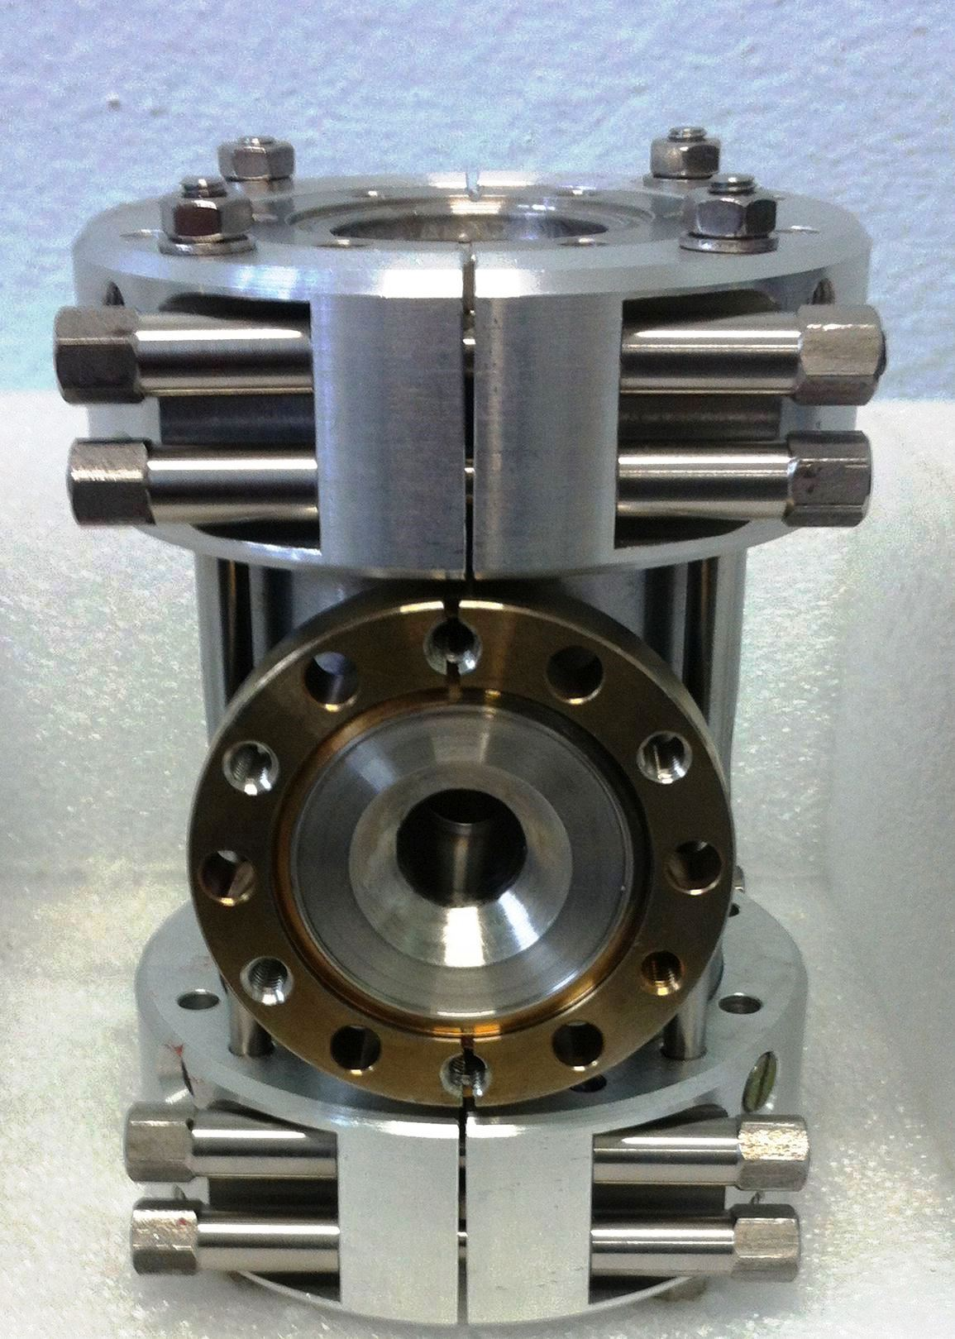
Permanent magnet focusing system
Focusing permanent magnets on ionization chamber
Focusing permanent magnets
Magnetic field distribution

Slide 11
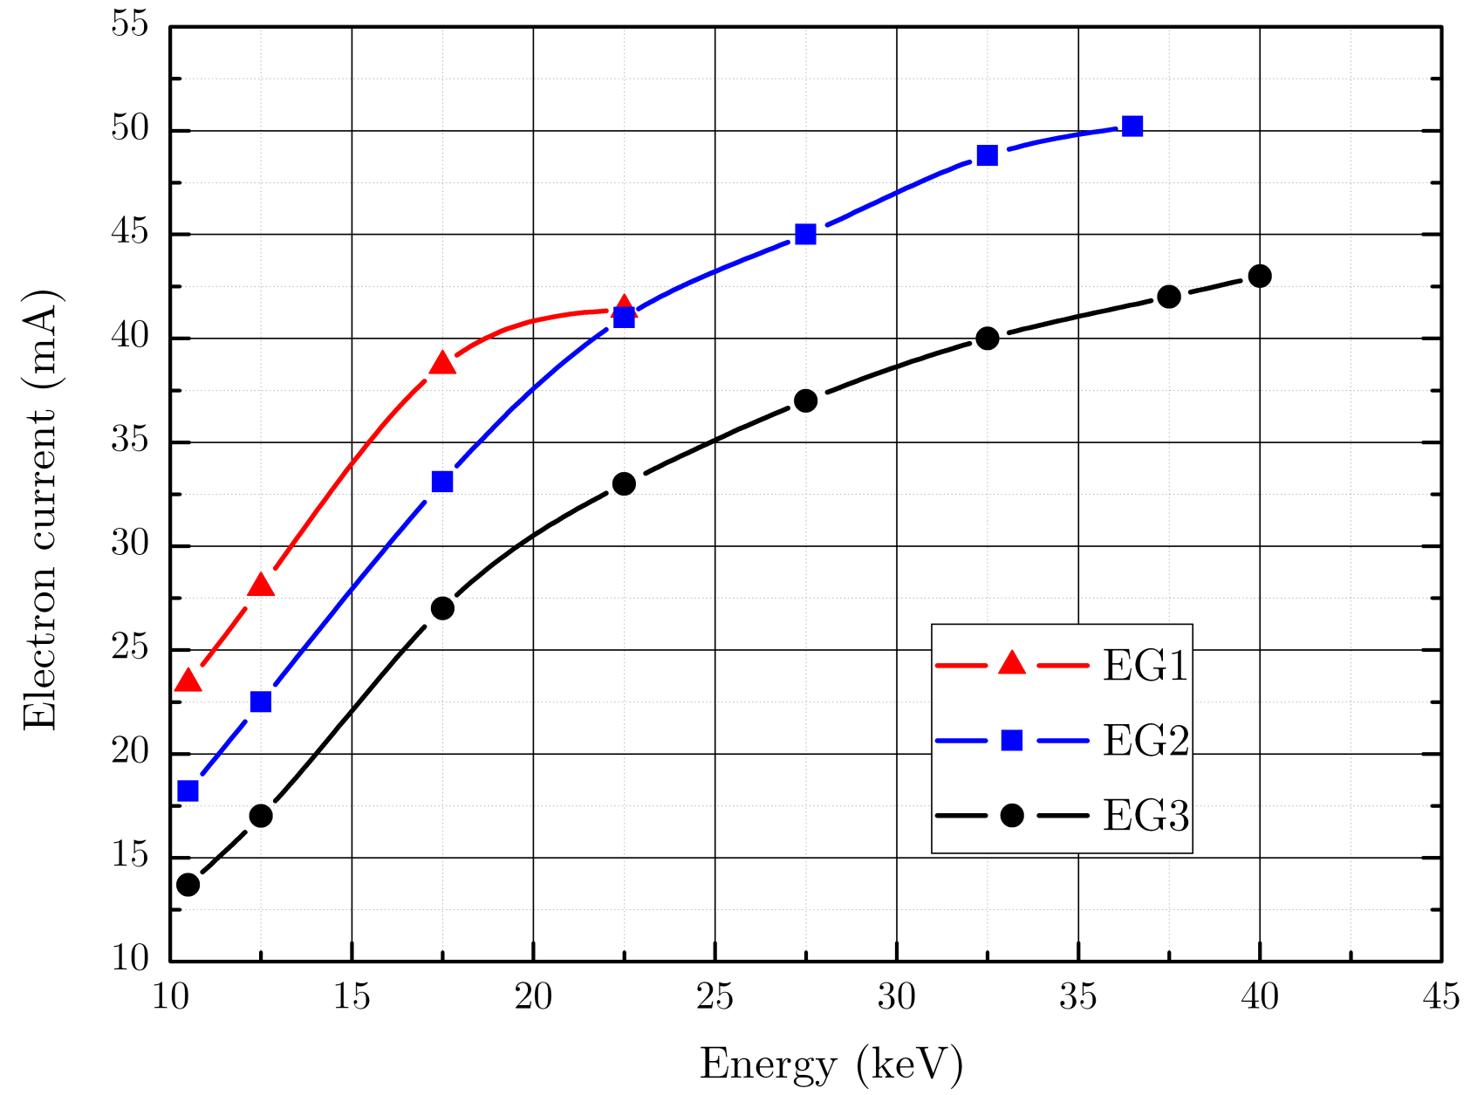
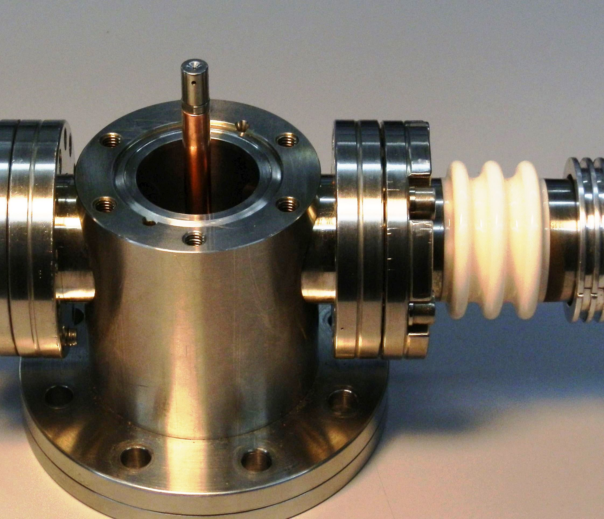
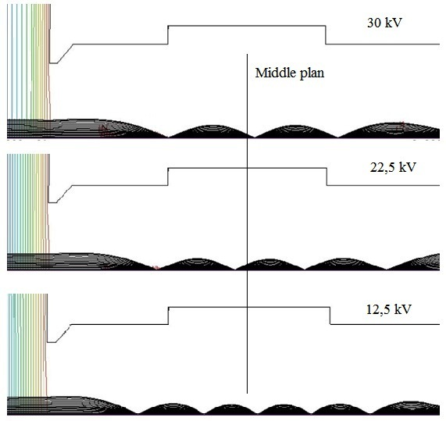
Electron gun and its characteristics
Volt-Ampere characteristics of electron guns (EG)
Electron beam trajectories
vs. Electron energy E_{e}
Cathode assembly of electron gun

Slide 12
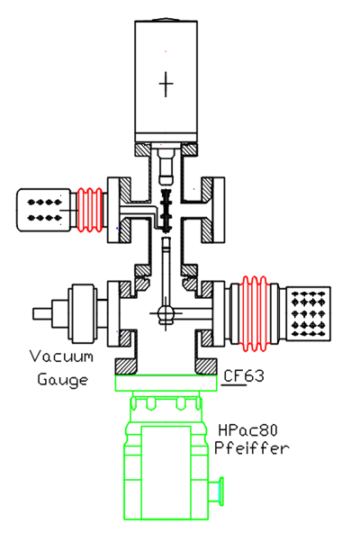
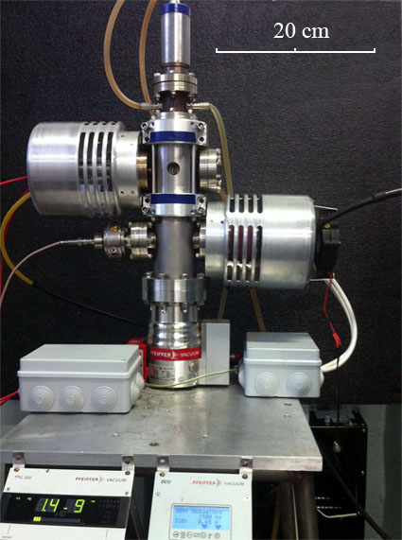
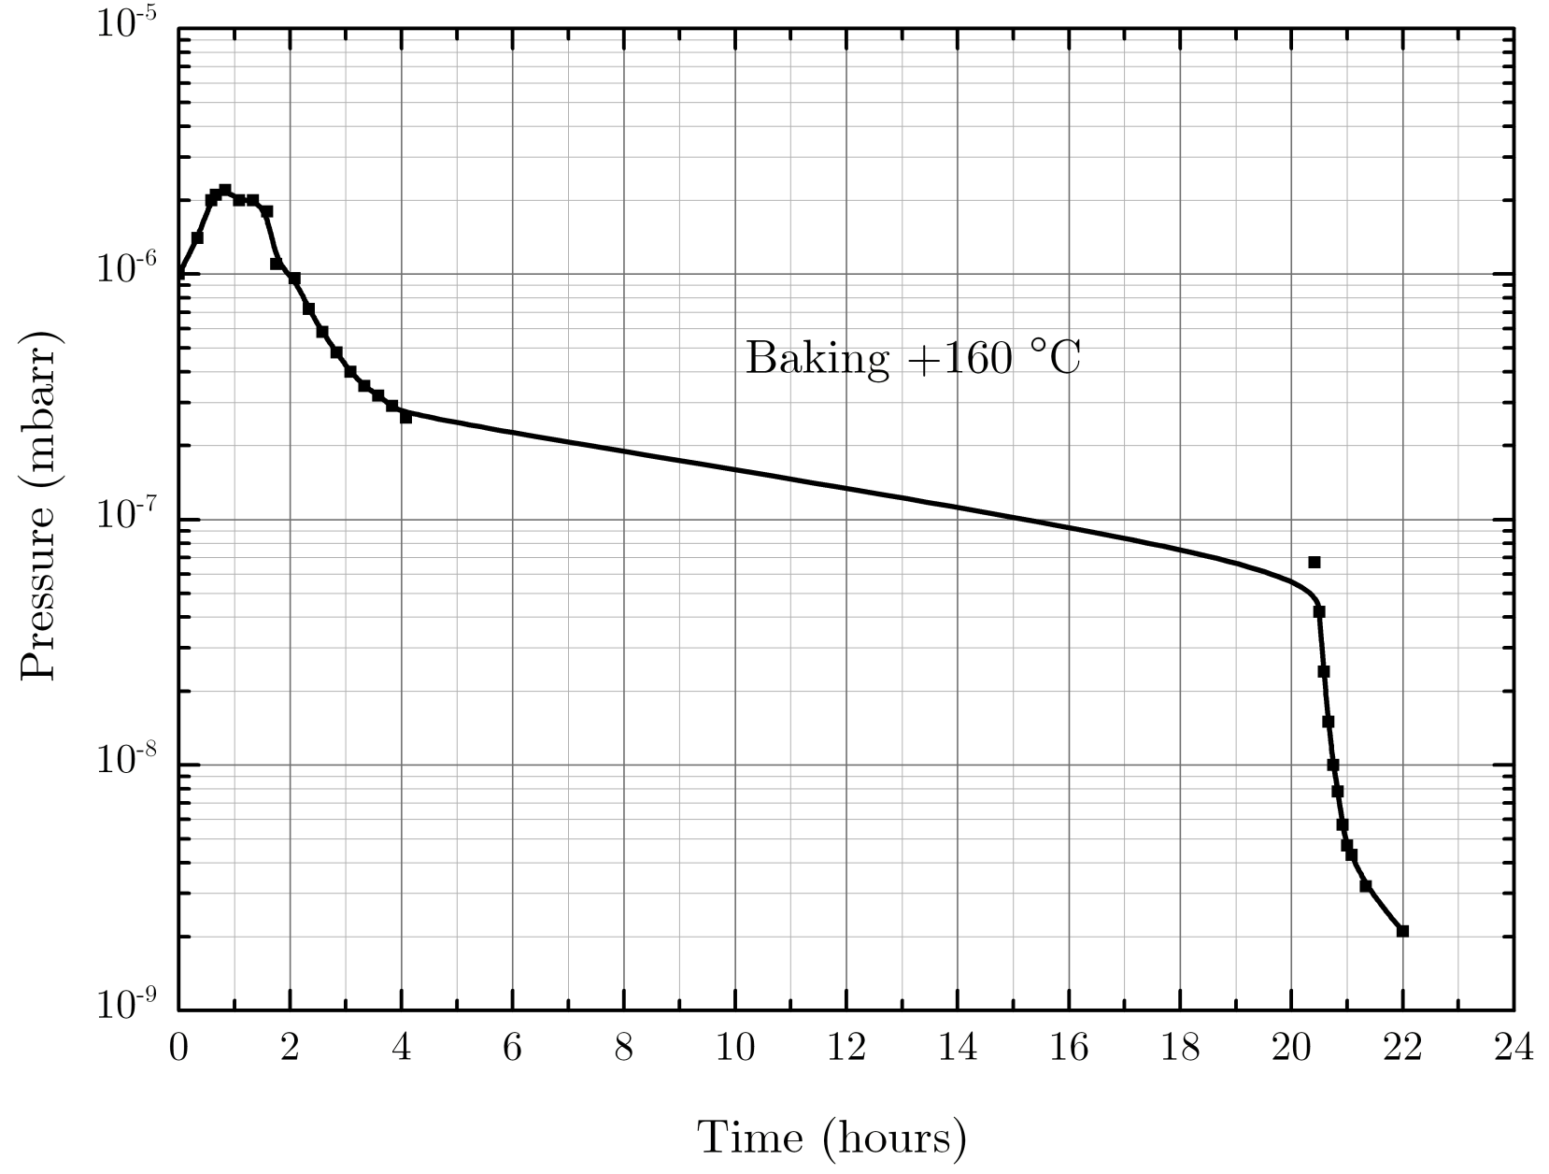
Vacuum
During operation vacuum ranges
from 10⁻⁹ to 5×10⁻⁸ mbar
Vacuum volume < 1 litre
Baking procedure

Slide 13
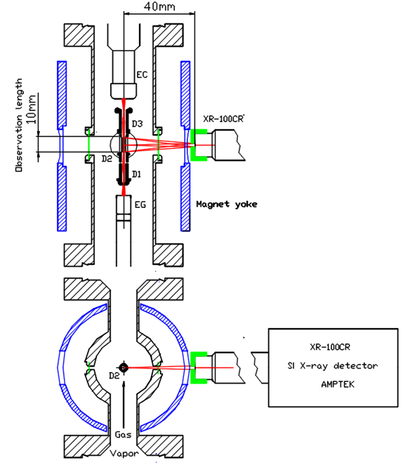
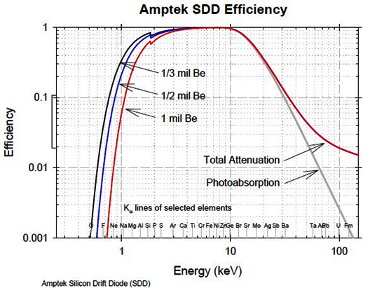
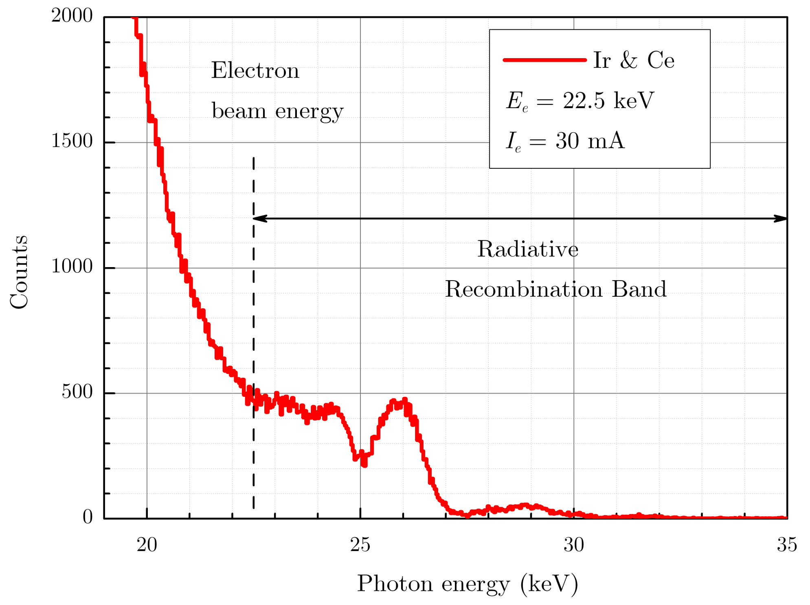
X-ray spectroscopy
Efficiency of registration
Experimental scheme
Radiation spectrum of cathode materials

Slide 14
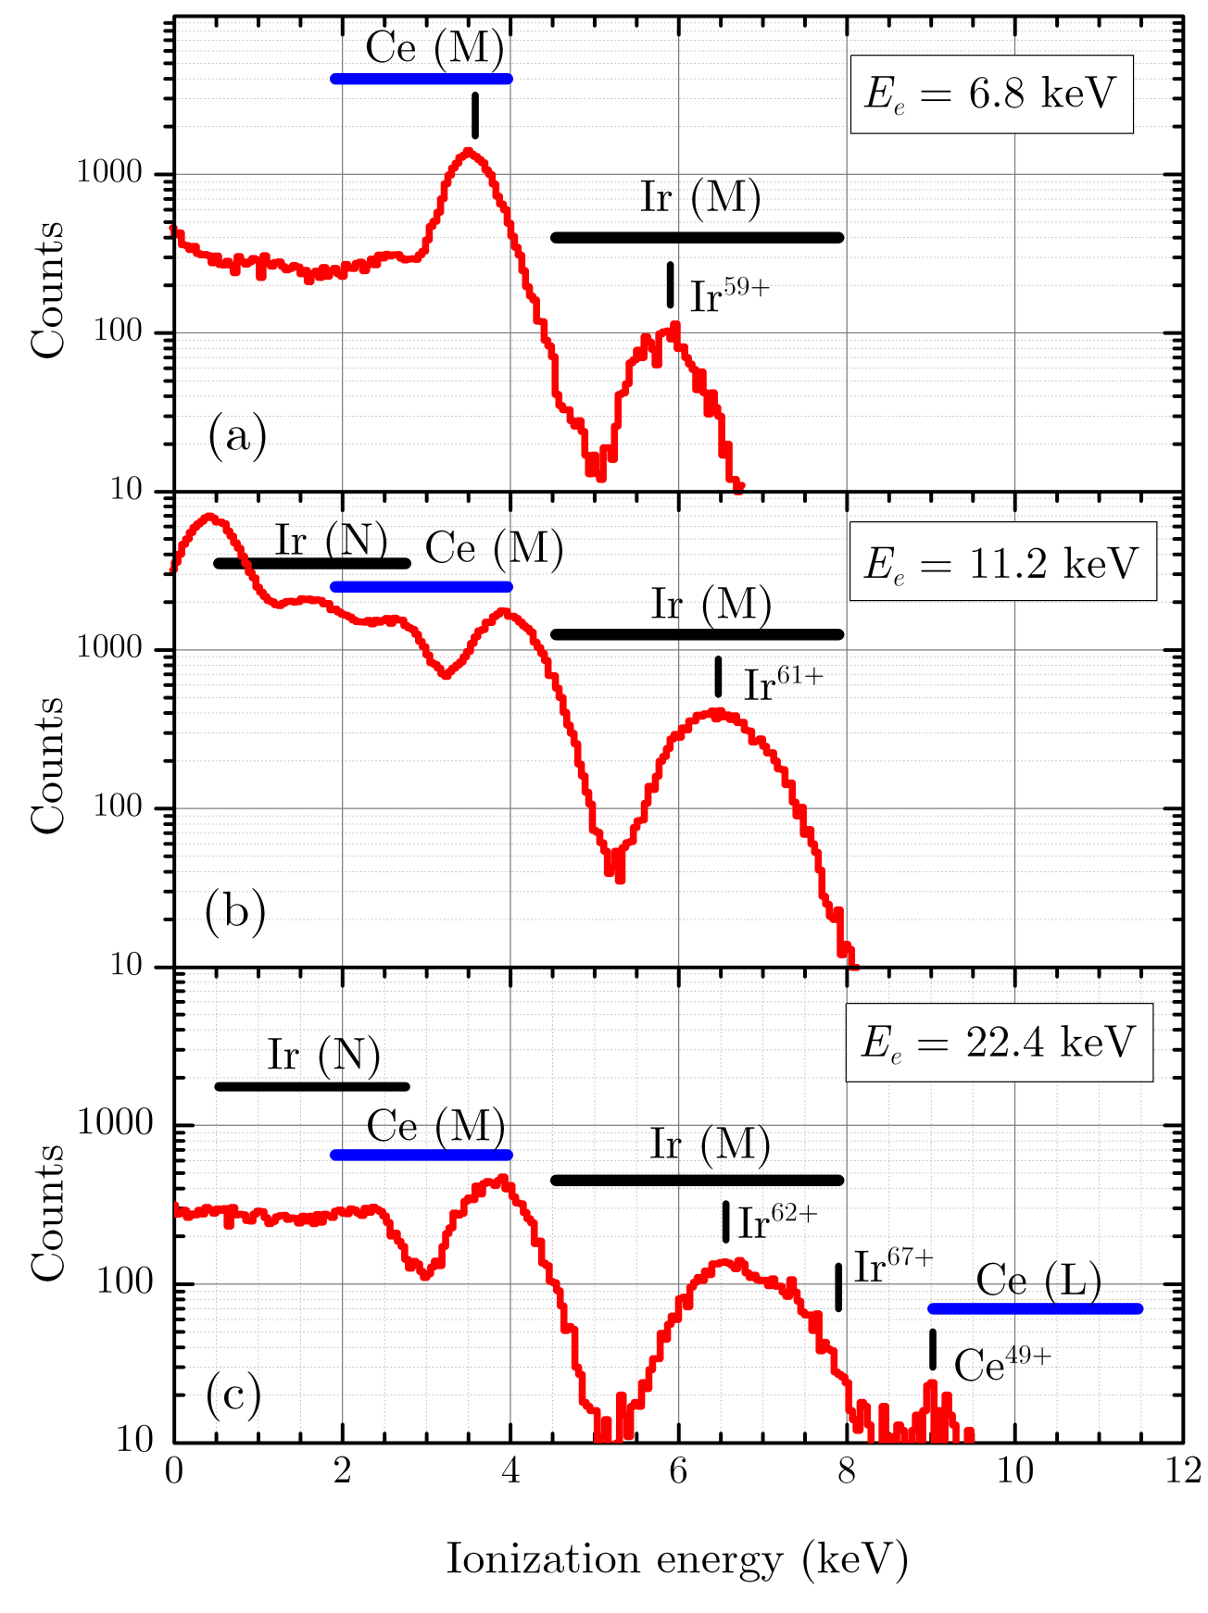
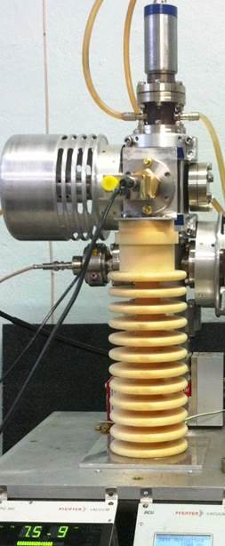
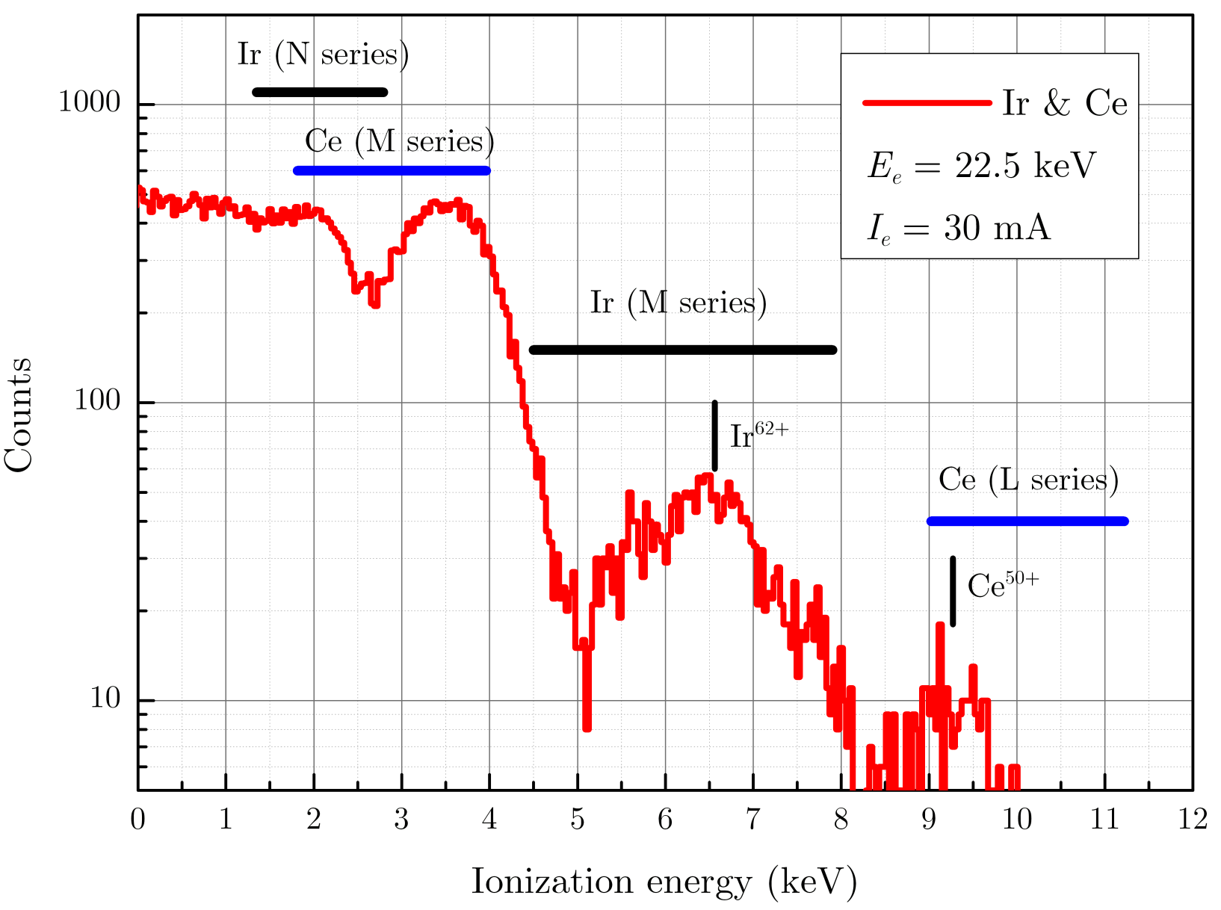
Radiative recombination continuum
Cathode materials (Ir & Ce)
RR spectrum for E_{e}= 22.5 keV
RR spectrum for different E_{e}

Slide 15
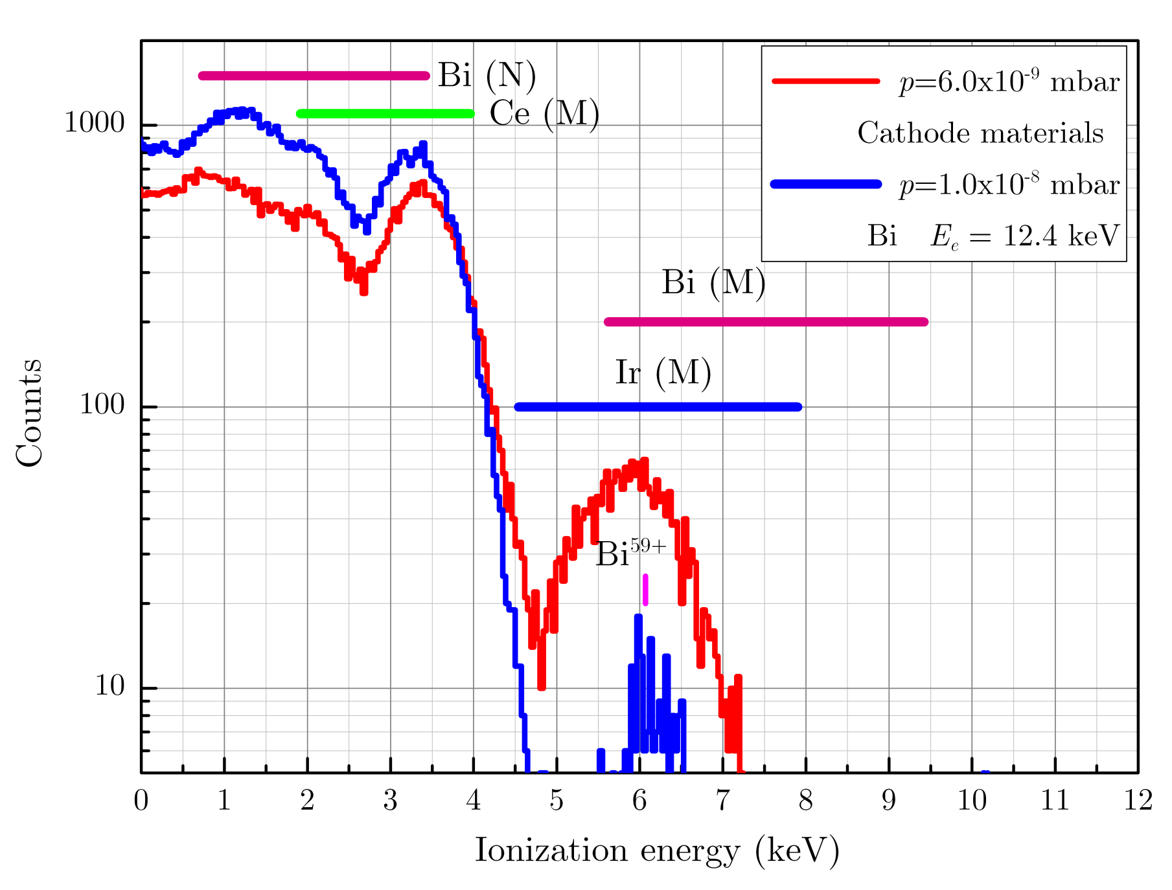
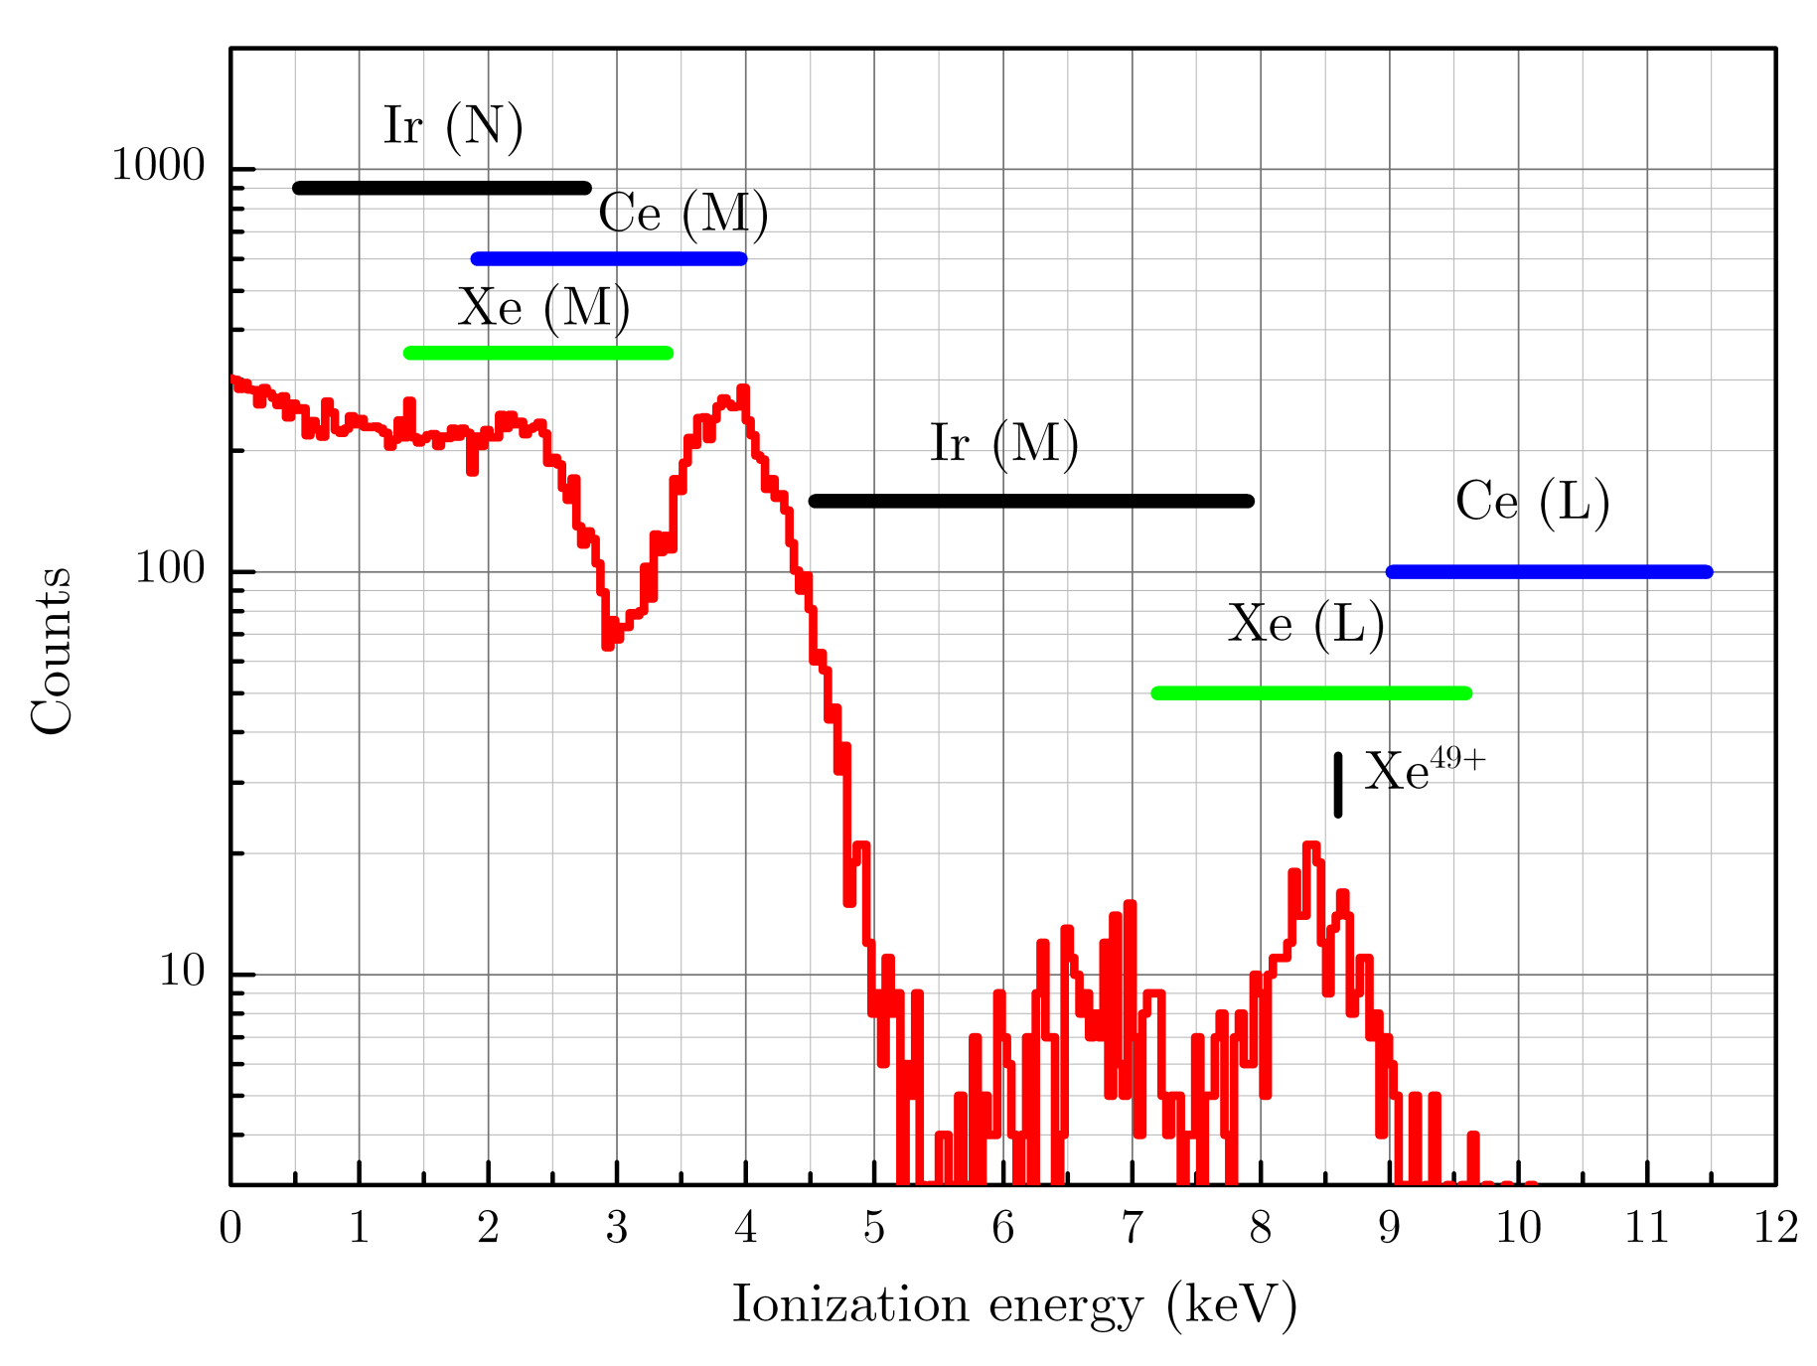
Radiative recombination continuum
Injected materials (Bi & Xe)
RR spectrum of bismuth (blue curve) compared to that of cathode materials (red curve)
RR spectrum of xenon

Slide 16
Features and applications of MaMFIS
Advantages:
Highest ionization factor among the ion sources
available around the world
Minimum confinement time
High-frequency operation
Disadvantage:
low intensity in pulse
Applications
Atomic physics (X-ray spectroscopy and ion-atom collisions)
X-ray astrophysics and solar physics
Plasma physics (magnetic fusion diagnostics)
Interaction of highly charged ions with surface (secondary electron and ion emission)
Secondary ion mass spectrometry
Nanostructuring

Slide 17
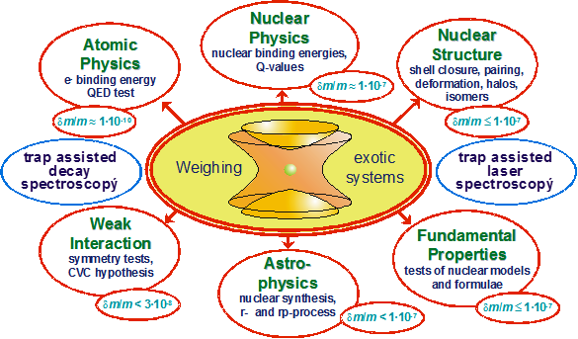
Penning Trap experiments
Future Penning Trap Experiments
at GSI / FAIR – The HITRAP and MATS Projects
MaMFIS as ion source for high-precision mass measurements
K. Blaum^{1,2} and F. Herfurth¹ for the HITRAP and MATS Collaboration
¹GSI Darmstadt, ²Johannes Gutenberg-University Mainz
$$\frac{m}{\text{D}m }\sim \frac{qB}{m}$$
Resolution:
Intensity of ions > 1 ion/s
MaMFIS technology perfectly fulfills the requirements
MaMFIS is a very efficient Charge Breeder
with trap capacity of 10⁵ – 10⁶ charges, in particular, for short half-life radionuclides
“The radioactive beam intensity spans … from a few to over 10¹⁰ ions/s.”
F. Wenander, Charge breeding of radioactive ions with EBIS and EBIT,
Int. Symposium on Electron Beam Ion Sources and Traps,
April 7th-10th 2010, Stockholm, Sweden

Slide 18
High-density microplasma research
MaMFIS:
E_{e} ~ 10 keV E_{e} ~ 40 keV
j_{e} ~ 20 kA/cm² j_{e} ~ 200 kA/cm²
n_{e} ~ 2×10¹³ cm⁻³ n_{e} ~ 10¹⁴ cm⁻³
Joel Clementson, LLNL

Slide 19
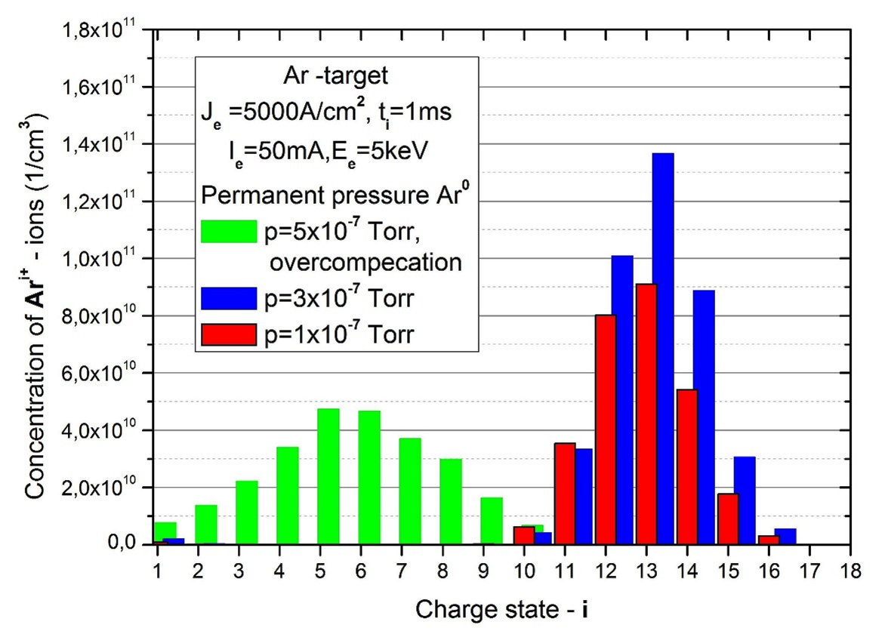
High-frequency accelerators
Accelerated ion | ¹⁶O⁵⁺ | ²⁰Ne^{6+,7+} | ⁴⁰Ar^{12+,13+} | ⁵⁶Fe^{17+,18+} | ⁸⁴Kr^{25+,26+} | ¹³²Xe^{36+ ÷ 39+} | ¹⁸⁴W^{42+ ÷ 46+ *} | ²⁰⁹Bi^{48+ ÷ 53+}
A/Z | 3.2 | 3.67, 2.86 | 3.33, 3.08 | 3.29, 3.11 | 3.36, 3.23 | 3.38 ÷ 3.67 | 4 ÷ 4.38 | 3.94 ÷ 4.45
Yield, ions/s | 7⋅10⁷ | 8⋅10⁷ | 9⋅10⁷ | 10⁸ | 3⋅10⁸ | 4⋅10⁸ | 4⋅10⁸ | 4⋅10⁸
Low-intensity, high-charge state ion beams
for special applications
Ion source of MaMFIS-10 type:
expected yield of Kr²⁵⁺ ~ 10⁸ ions per second

Slide 20
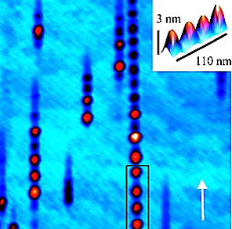
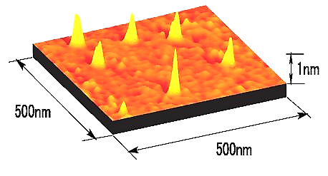
Nanostructuring
Basic idea – R. Schmieder, 1991
Basic research – University of California, Berkeley
Livermore EBIT was moved to Berkeley in 2001
Prof. Dr. Marika Schleberger
University Duisburg-Essen
(Dresden EBIT)
http://yebisu.ils.uec.ac.jp/surface.html

Slide 21
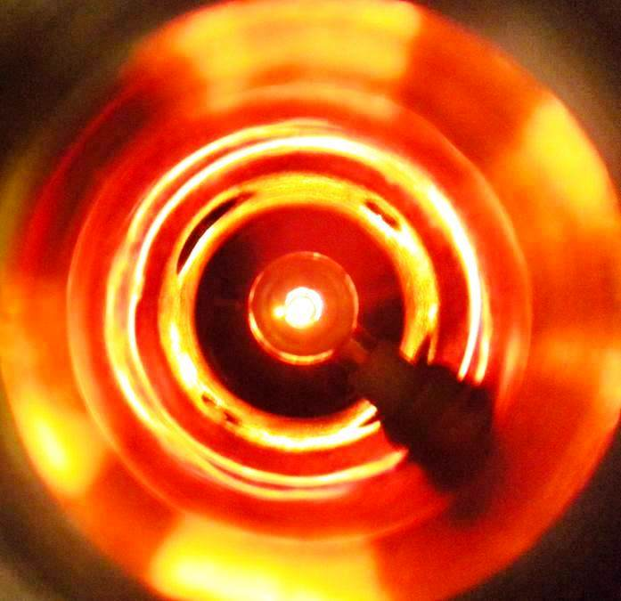
Summary
Novel method for production of highly charged ions in a rippled electron beam is developed and confirmed experimentally at electron energies E_{e} b 22.5 keV
Electron current density of about 20 kA/cm² is achieved
X-ray radiation from highly charged ions of Ir⁶⁷⁺ and Xe⁵⁰⁺ is detected
Method allows one to produce any ions of arbitrary elements of the periodic table up to U⁹²⁺ ions in simple compact devices
X-ray spectroscopy of all elements of the periodic table is feasible

Slide 22
Acknowledgements
The authors express deep gratitude to
A. A. Smirnov and A. A. Karpukhin for help in the x-ray spectroscopic measurements,
Mueller for giving opportunity to test the first MaMFIS in Institute for Atomic and Molecular Physics
at Justus-Liebig-University Giessen,
O. K. Kultashev for his contribution to creation of electron optics,
All members of Krion Group of Joint Institute for Nuclear Research in Dubna, who help in experiments
THANK YOU FOR YOUR ATTENTION !

