Slide 1
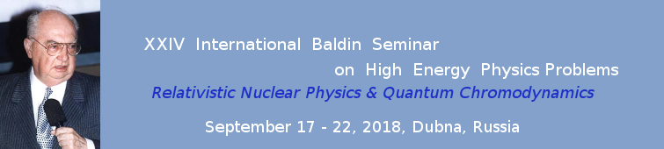


UPDATE ON THE SEARCH OF TWO PHOTON EXCHANGE IN ELECTRON PROTON ELASTIC SCATTERING
Egle Tomasi-Gustafsson
CEA, IRFU, Saclay, France
Vladimir V. Bytev
JINR, BLTP, Dubna, Russia

Slide 2
EM proton form factors
Unpolarized cross section
Rosenbluth method
Polarization Method
A.I. Akhiezer, M.P. Rekalo, 1967
2γ exchange ?
A.J.R. Puckett et al, PRL (2010) , PRC (2012), PRC (2017)

Slide 3
Two photon exchange
1γ-2γ interference is of the order of α=e²/4p=1/137
In the 70’s it was shown [J. Gunion and L. Stodolsky, V. Franco, F.M. Lev, V.N. Boitsov, L. Kondratyuk and V.B. Kopeliovich, R. Blankenbecker…] that, at large momentum transfer, the sharp decrease of the FFs, if the if the momentum is shared between the two photons, may compensate α
                The calculation of the box amplitude requires the description of intermediate nucleon excitation and of their FFs at any Q^{2...}
                Different calculations give quantitatively different results .
Theory not enough constrained!

Slide 4
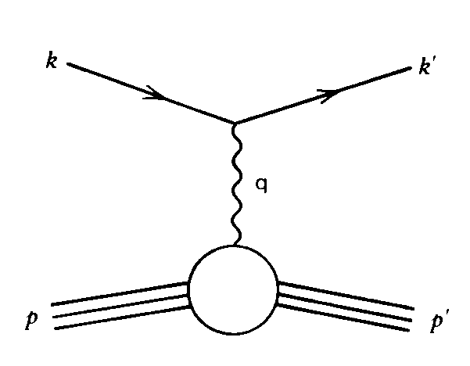
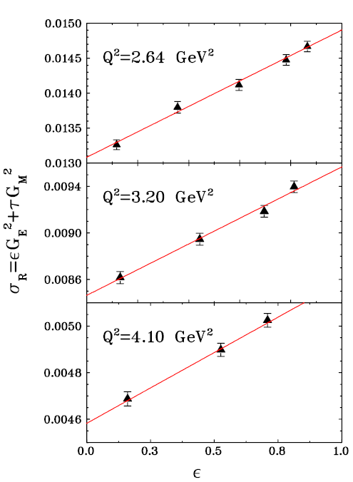
The Rosenbluth separation
Q² fixed
Linearity of the reduced cross section
ε
        tan²θ_{e} dependence
Holds for 1γ exchange only
PRL 94, 142301 (2005)

Slide 5
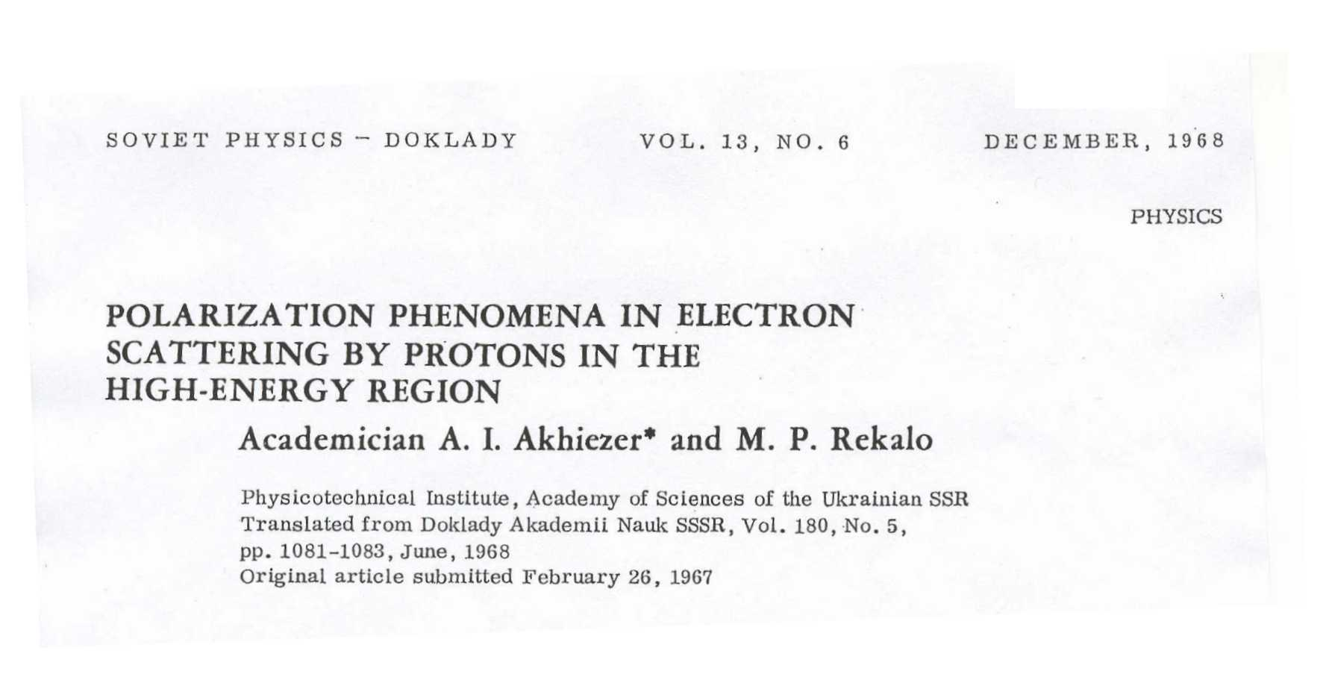
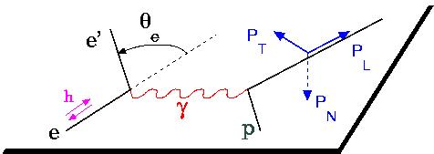
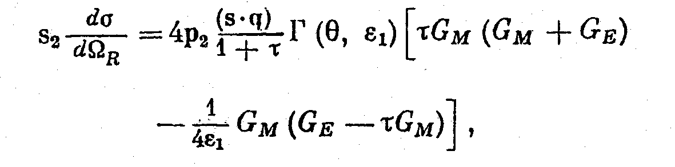
The polarization method (theory:1967)
The polarization induces a term in the cross section proportional to G_{E} G_{M}
Polarized beam and target or
polarized beam and recoil proton polarization

Slide 6
Polarization Experiments
A.I. Akhiezer and M.P. Rekalo, 1967
  Jlab-GEp collaboration
  "standard" dipole function for the nucleon magnetic FFs GMp and GMn
  2) linear deviation from the dipole function for the electric proton FF GEp
  3) QCD scaling not reached
  3) Zero crossing of GEp?
  4) contradiction between polarized and unpolarized measurements
A.J.R. Puckett et al, PRL (2010) , PRC (2012), PRC (2017)

Slide 7
Model independent statements
    A sizable 2γ contribution would invalidate the FFs extraction as well as all experimental results based on the Born approximation.
One-photon exchange:
    Two (real) EM form factors
    Functions of one variable (t)
Two-photon exchange:
    Three (complex) amplitudes
    Functions of two variables (s,t)
Breaks the linearity of the Rosenbluth plot
Induces:
  charge-odd observables (asymmetry in e± p cross section)
  P-odd polarizations (Py)
The expansion parameter is (Zα), α = e²/4π = 1/137.
  It is expected to increase
    When Z increases
    At small angles

Slide 8






Check of linearity of the Rosenbluth plot
Simple parametrization:
1γ 2γ interference is charge-odd!
E. T.-G., G. Gakh, Phys. Rev. C72,015209 (2005)

Slide 9
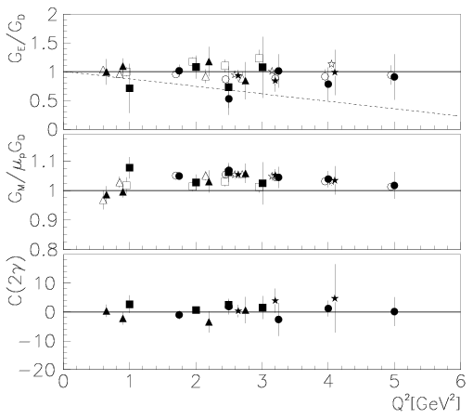
Check of linearity of the Rosenbluth plot
From the data:
<C> = 0.5 ± 0.6
deviation from linearity
<< 1%!
E. T.-G., G. Gakh, Phys. Rev. C72,015209 (2005)

Slide 10
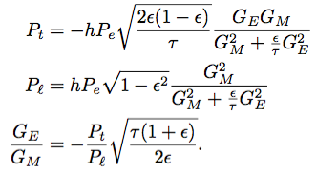
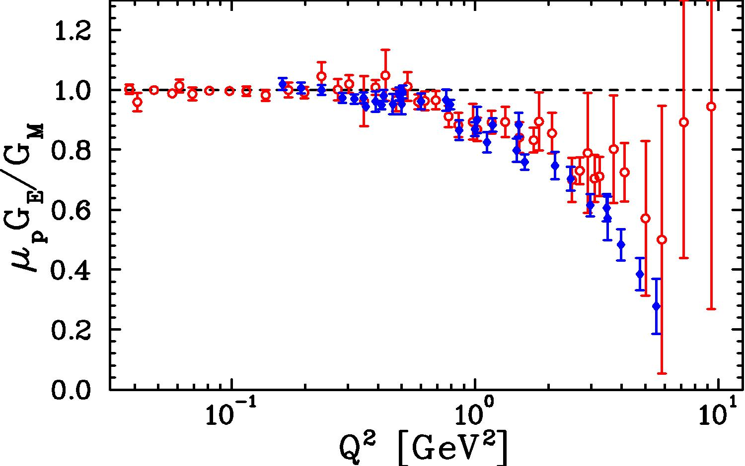
Check of ε-independence of G_{E} /G_{M}
A.I. Akhiezer and M.P. Rekalo, 1967
M. Meziane, GEp2 collaboration.
PRL 106 (2011) 132501
Y. Bystritskiy, E.A.Kuraev, E.T.-G, PRC.75, 015207 (2007)
P. Blunden et al., PRC 72,034612 (2005) (mainly GM)
A. Afanasev et al., PR.D 72,013008 (2005) (mainly GE)
N.Kivel and M.Vanderhaeghen, P.R.L.103:092004 (2009)
J.Arrington, W Melnitchouk, J.A. Tjon,
P.R. C76, 035205 (2007)

Slide 11
Polarization Experiments
A.J.R. Puckett et al, PRC (2017)
A.I. Akhiezer and M.P. Rekalo, 1967
Q²=1 GeV²
Q²=3 GeV²
Q²=5 GeV²
Yu.M. Bystritskiy E.A. Kuraev,, E. T-G., PRC75 (2007) 015207

Slide 12
Word data on e⁻/e⁺ scattering

Slide 13
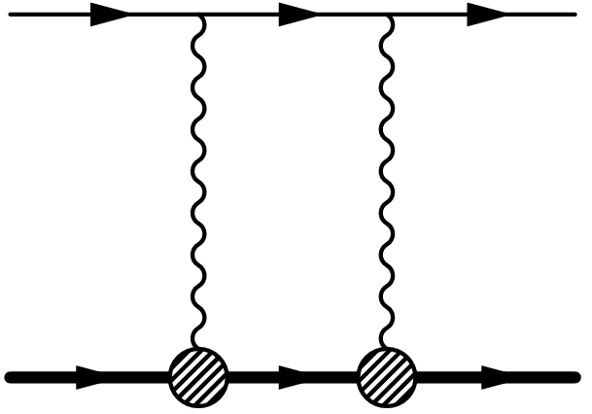
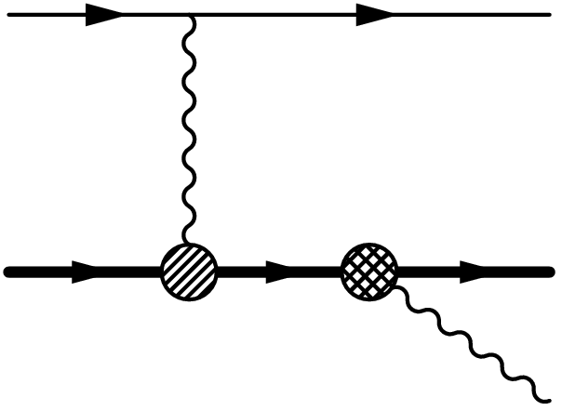
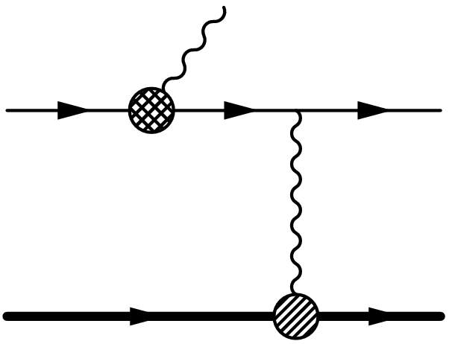
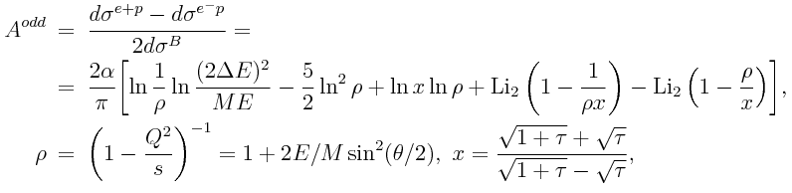
Electron/Positron scattering
C-odd asymmetry in e⁻/e⁺ scattering
E.A. Kuraev, V.V. Bytev, S.Bakmaev and E.T-G, PRC 78, 015295 (2008).
C=0.97,0.99
ε=0.4
Q²=3 GeV²
Soft photon emission
2γ exchange

Slide 14
CLAS, VEPP-3, OLYMPUS….
VEPP-3 @ Novosibirsk: E_{beam} = 1.6, 1.0 (and 0.6) GeV
CLAS @ JLAB : E_{beam} = 0.5 – 4.0 GeV continuous
OLYMPUS @ DESY: E_{beam} = 2.0 GeV
_{M. Kohl}
Low Q², large ε range
Overlapping kinematics
Claimed precision
around 1%

Slide 15

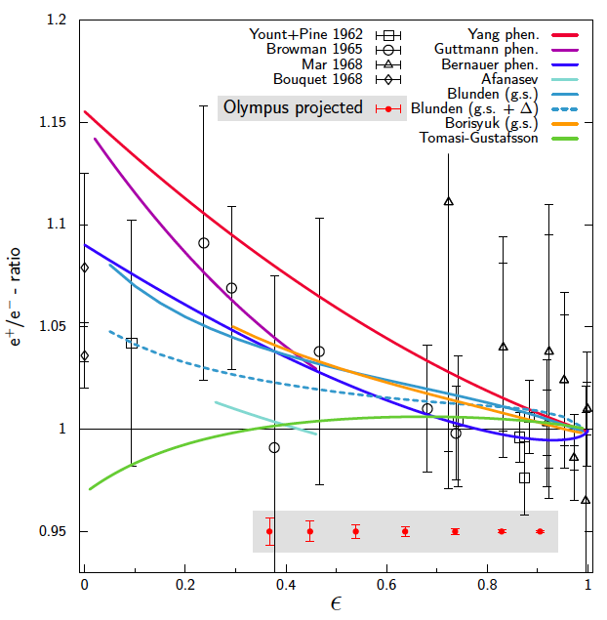
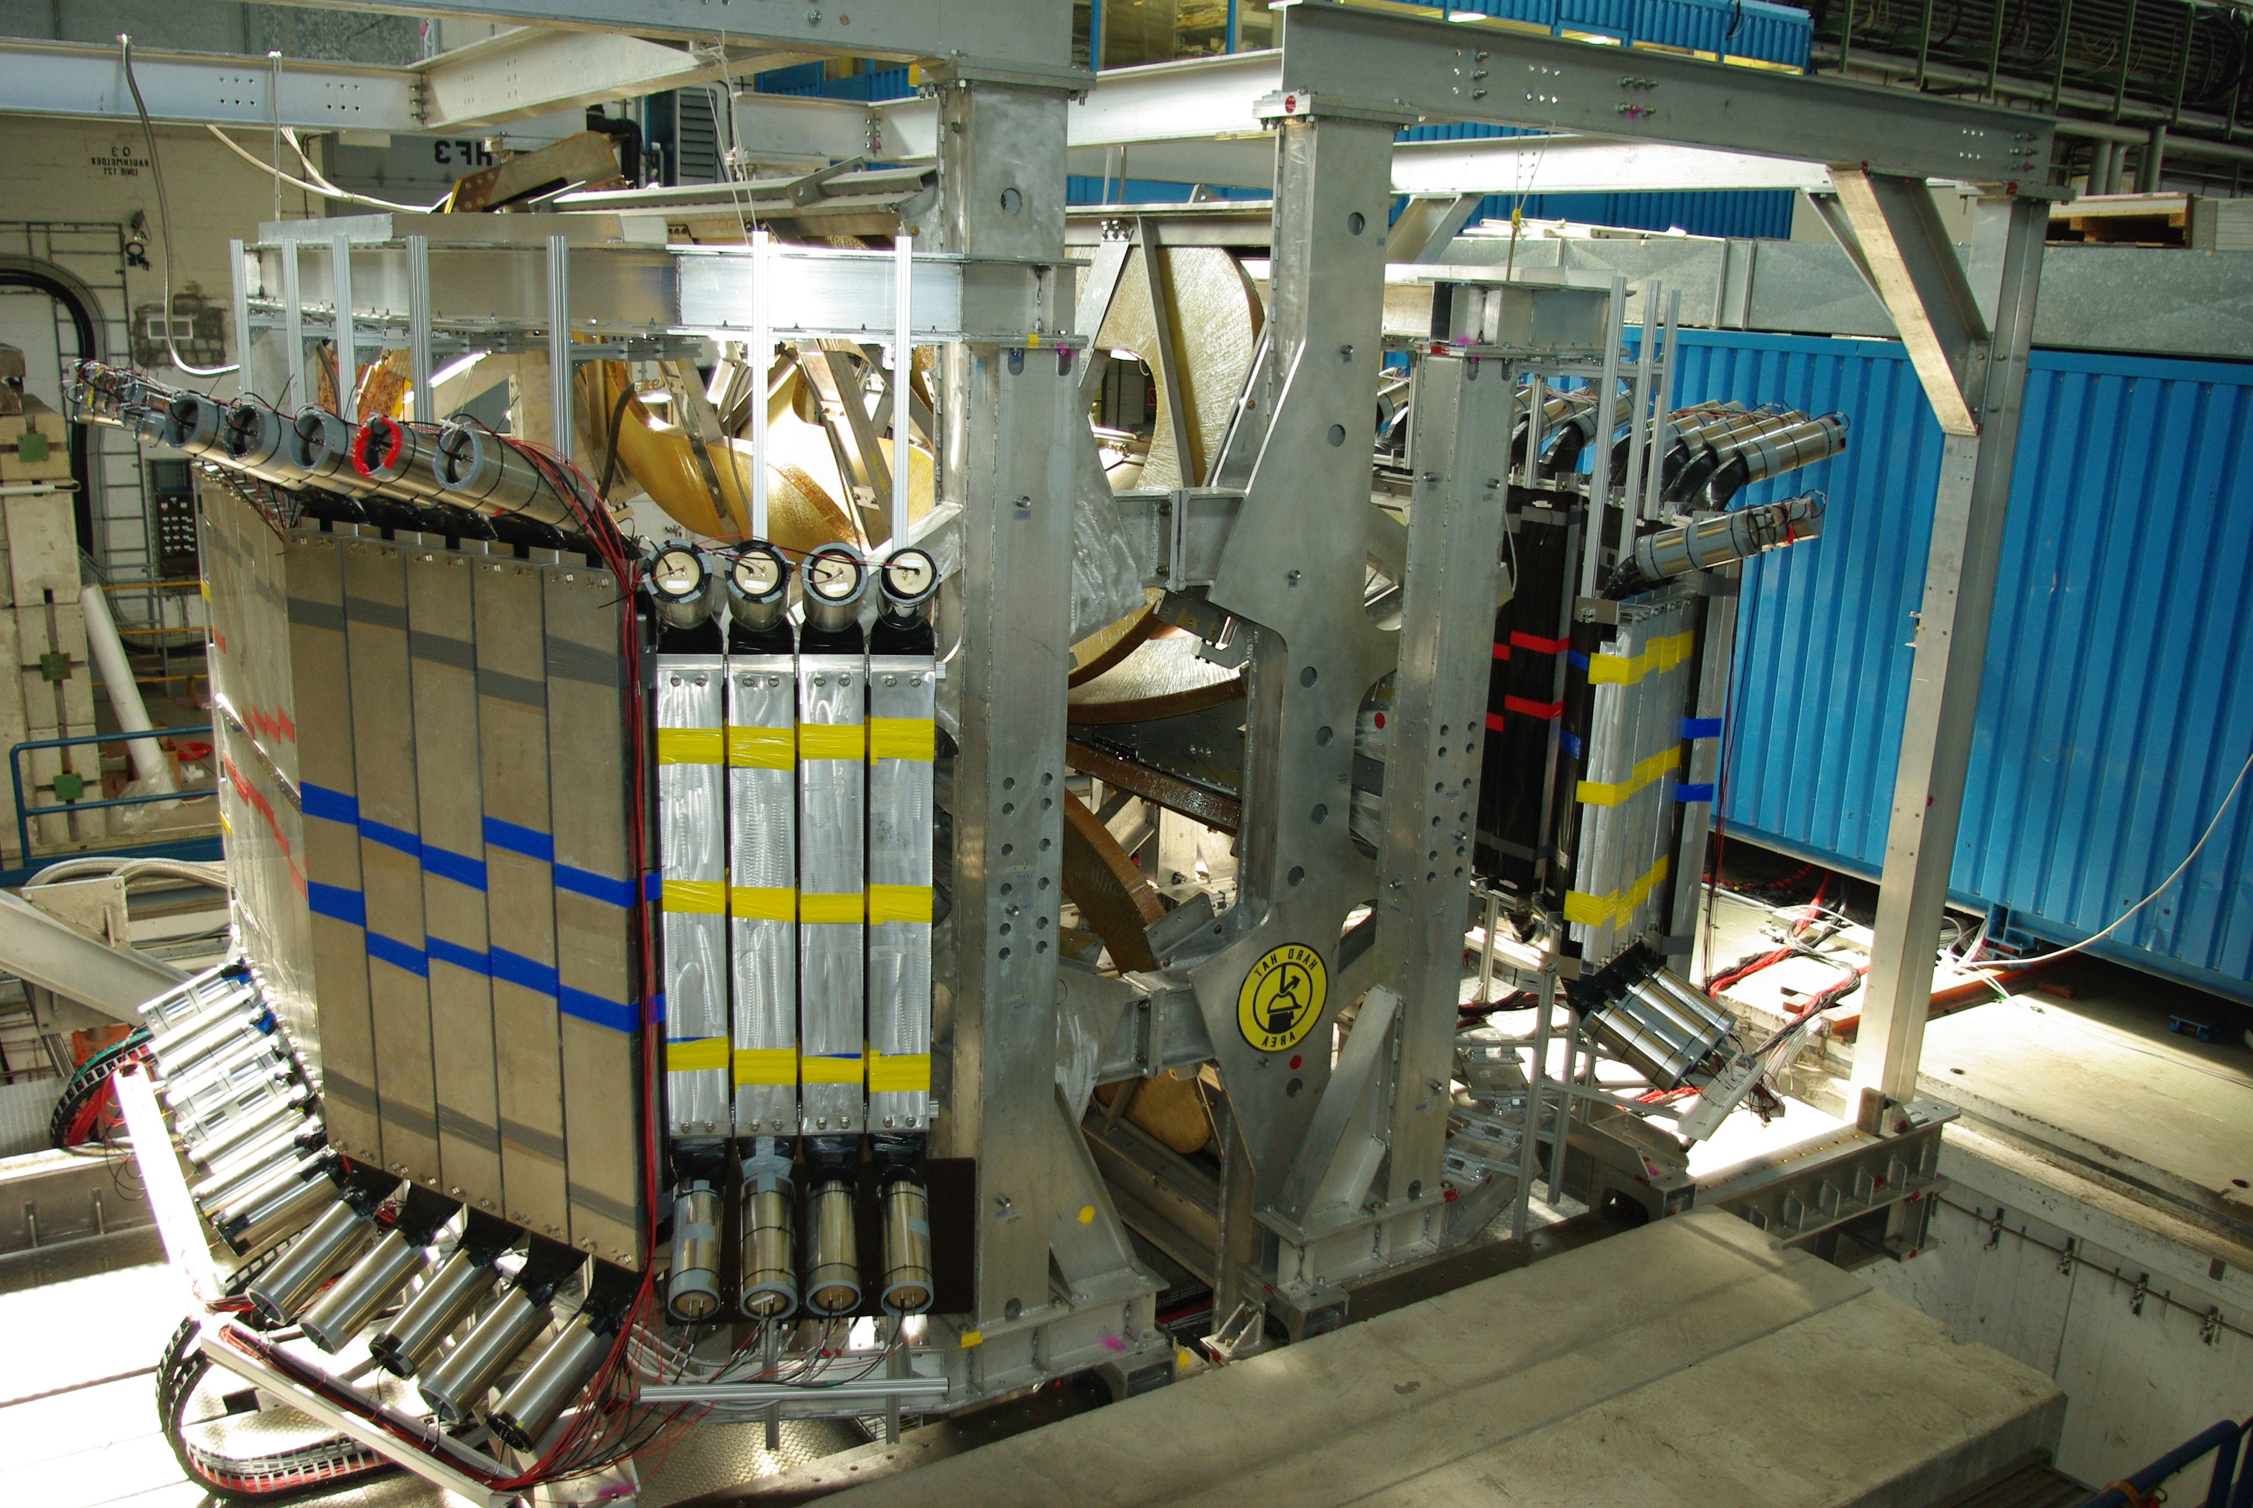
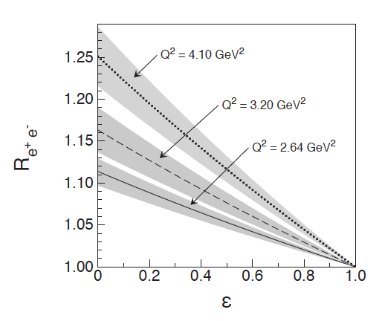
OLYMPUS @ DESY
Measure ratio of e±-p cross to 1% total error
unpolarized 2 GeV e± beams available at DORIS, DESY
detector BLAST from MIT-Bates
_{M. Kohl}
July 2011
Expected ~6% effect at ε=0.4, Q²=3.2 GeV²
J. Guttmann, N. Kivel, M. Meziane, and M. Vanderhaeghen,
EPJA 47, 77 (2011)
ε_{min}

Slide 16
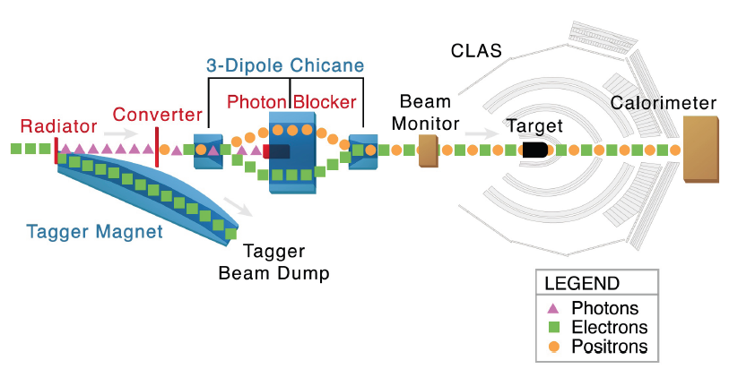
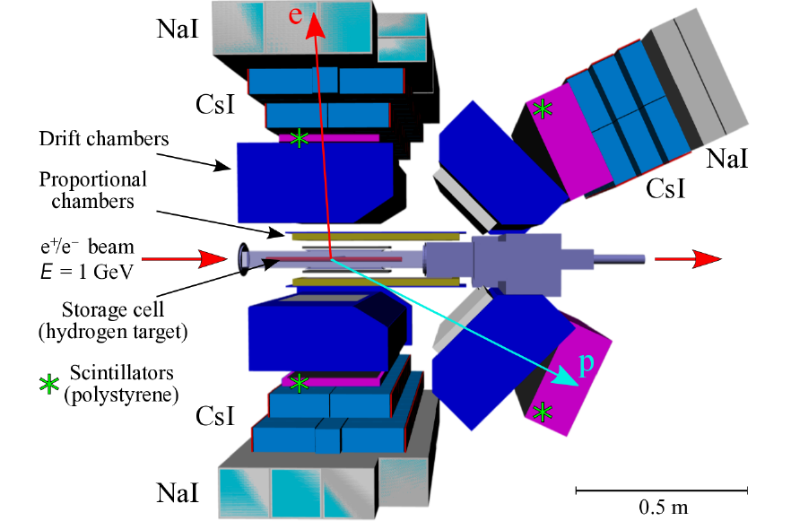
CLAS @ JLab
VEPP-3 @ Novosibirsk
E=1 and 1.6 GeV
Dedicated ESEPP generator
(A. Gramolin, V. Nikolenko,
V. Fadin, R.E. Gerasimov…)
I.A. Rachek et al., PRL 114, 062005 (2015)

Slide 17
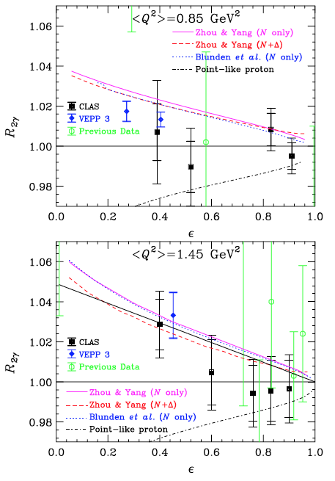
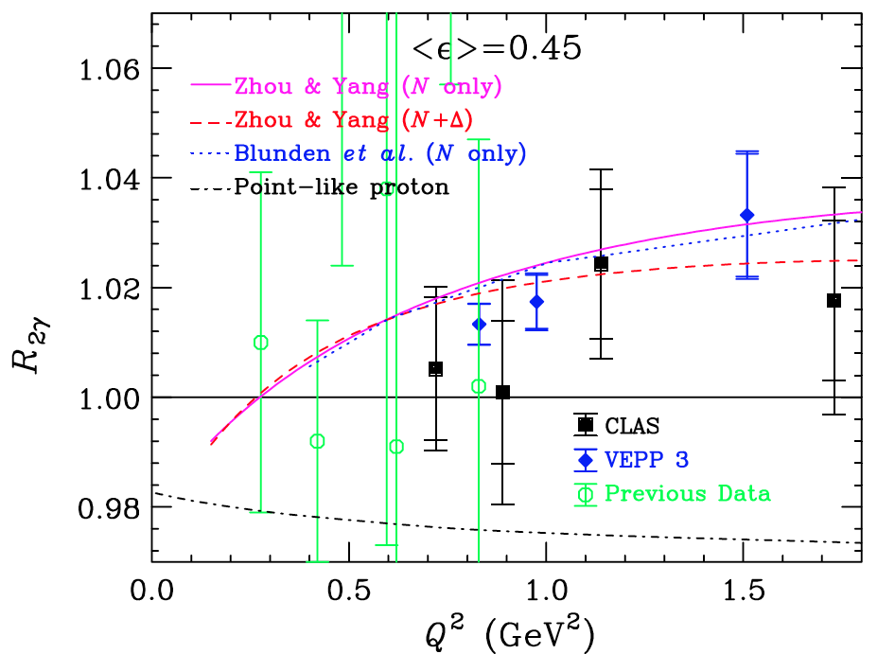
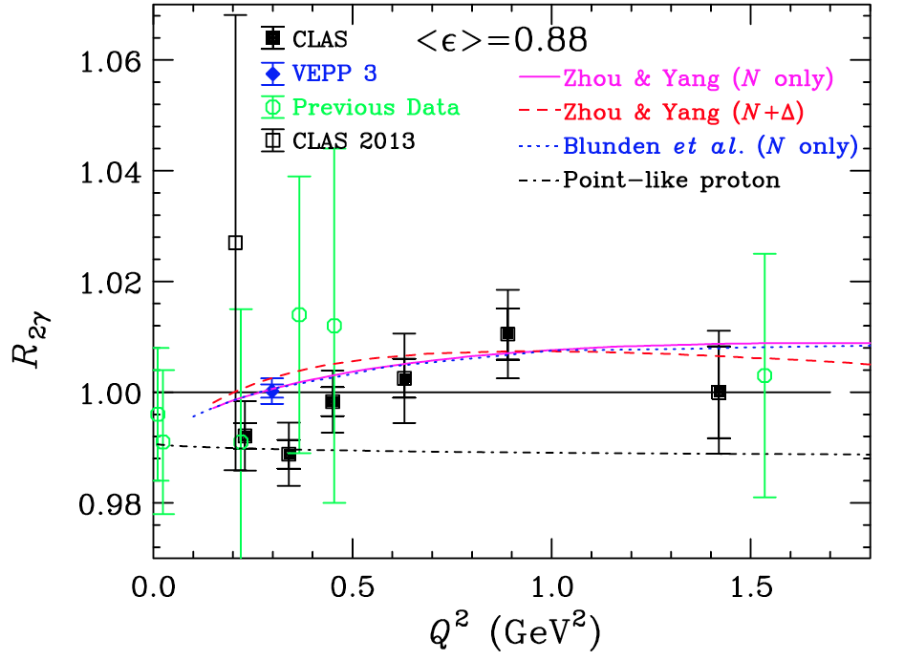
CLAS
V. Rimal, PRC95, 065201 (2017)
Q²<2 GeV2
Effect < 2%
No evident increase
with Q²

Slide 18
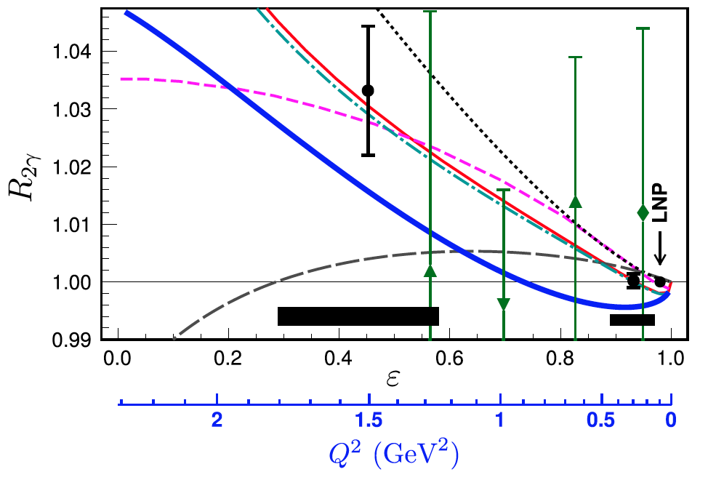
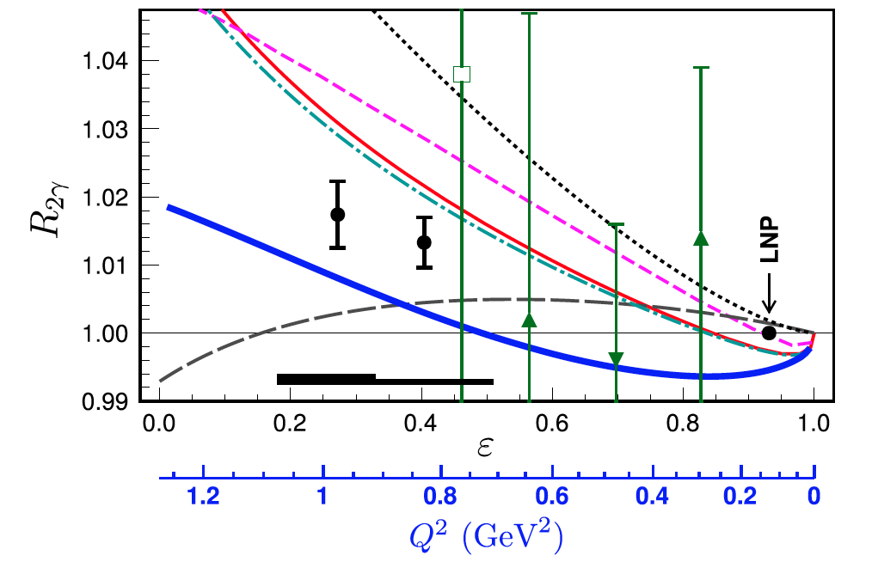
VEPP
I.A. Rachek et al., PRL 114, 062005 (2015)
Large asymmetry in the raw data
Big effort on radiative calculations
Run I, E=1.6 GeV
Run II, E=1.0 GeV

Slide 19
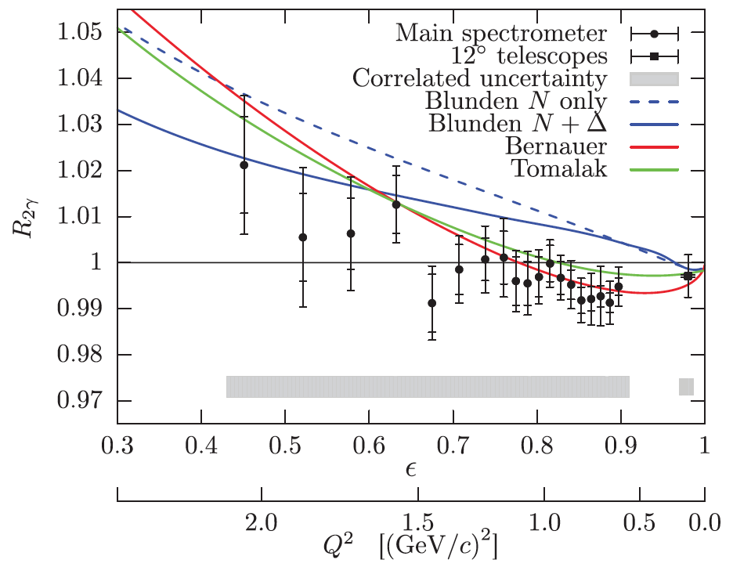
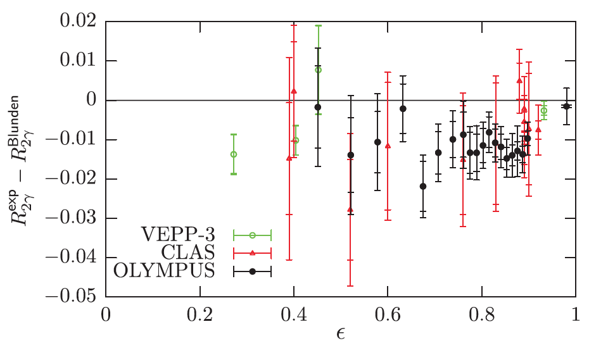
OLYMPUS
B.S. Henderson et al., PRL 118, 092501 (2017)

Slide 20
All Data
                Compatible with unity?

Slide 21
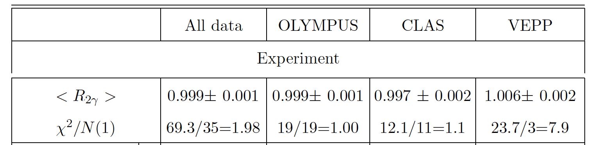
All Data

Slide 22



From Experiment to Theory
                C-odd asymmetry.
                Measured Ratio:.
                Published ‘Hard contribution’
                To be compared with theory:.

Slide 23
Radiative corrections
                1st order radiative corrections usually applied to the data
C=0.99
Q²=3 GeV²

Slide 24
Radiative corrections: VEPP
<Q²>=1 GeV²
<ε>=1 GeV²

Slide 25
Radiative corrections (CLAS)
<Q²>=1 GeV²
<ε>=1 GeV²

Slide 26
Radiative corrections (OLYMPUS)
<Q²>=1 GeV²
<ε>=0.7 GeV²

Slide 27
Difference Exp-Theory
Difference Maximon-Tjon
Difference
< 2%
No evident increase
with ε, Q²
Difference Mo-Tsai

Slide 28
Radiative Corrections (e⁻p)
Andivahis et al., PRD50, 5491 (1994)
Q²=1.75 GeV²
May change
the slope of σ_{R}
(and even the sign !!!)
Q²=5 GeV²
Q²=3.75 GeV²
RC to the cross section:
− large (may reach 40%)
ε and Q² dependent
− calculated at first order
E. T.-G., G. Gakh, PRC 72, 015209 (2005)

Slide 29
Radiative Corrections (SF method)
Andivahis et al., PRD50, 5491 (1994)
SLAC data
SLAC data
corrected by SF
Jlab Polarization
data
  Yu. Bystricky, E.A.Kuraev, E. T.-G, Phys. Rev. C 75, 015207 (2007)

Slide 30
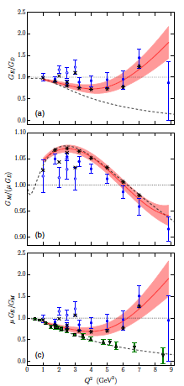
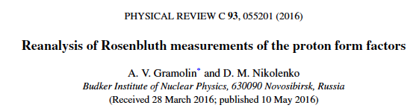
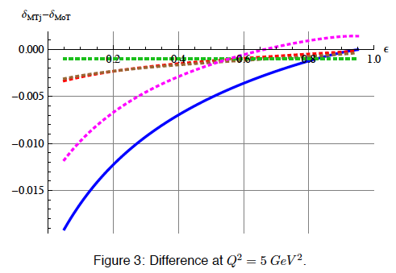
V. Fadin ,R.E.Gerasimov

Slide 31
Other issues in data
G_{E}² versus G_{M}²
- Correlations
Q² < 2 GeV²
RC(ε)
Q² > 2 GeV²
  E.T-G, Phys. Part. Nucl. Lett. 4, 281 (2007)
- Normalizations
- of different sets of data
- within a set of data

Slide 32
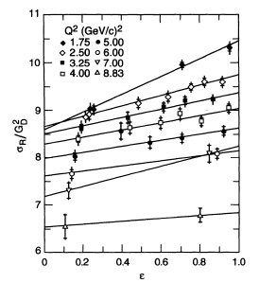
Normalization
Andivahis et al., PRD50, 5491 (1994)
Two spectrometers
(8 and 1.6 GeV)
2 points at low ε
Fixed renormalization
for the lowest ε point
c=0.956
(acceptance correction)
Increases the slope!
G_{E} ≈ G_{D}

Slide 33

Direct extraction of the Ratio
Andivahis et al., PRD50, 5491 (1994)
S. Pacetti and E.T-G., P.R.C. 94 (2016) 055202

Slide 34




Conclusion - Discussion
Experimental results DO NOT favor a large 2γ effect
Other explanations are likely
  Radiative corrections
  Normalization, correlations in experimental data
Models should be developed in all Q2 range
  Large effort in Space- and Time – like regions is ongoing to measure form factors more precisely in a wider kinematical range
Jefferson Lab
VEPP-3 Novosibirsk
IHEP

Slide 35
Different Data Sets
R²
G²_{M}

Slide 36

Electric contribution to ep cross section
G_{E} ≈ G_{D}
G_{E} < G_{D}

Slide 37
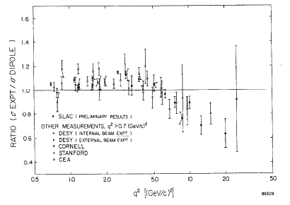

Nucleon FFs above 6 GeV
σ/σ_{D}
1
2
5
10
20
(Q)² [GeV²]
…which makes evident any disagreement
with the dipole prediction
R. Taylor
(Q)² [GeV²]

Slide 38
Nucleon FFs above 6 GeV
σ/σ_{D}
1
2
5
10
20
(Q)² [GeV²]
…which makes evident any disagreement
with the dipole prediction
R. Taylor
(Q)² [GeV²]

Slide 39

electron/positron scattering
Two photon exchange:
Born approximation
2γ exchange:
Asymmetry
The effect is enhanced in the ratio

