Slide 1



Alexander Karpov
FLNR, JINR
Superheavy elements research at Dubna: achievements and perspectives

Slide 2
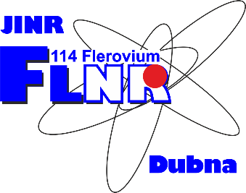
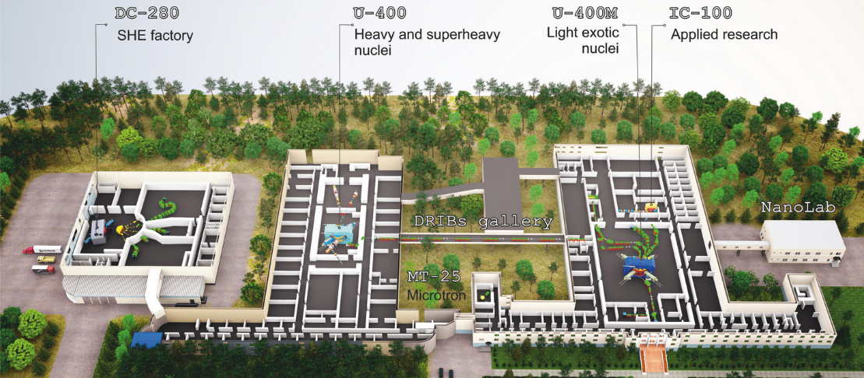
DRIBS-III ACCELERATOR COMPLEX
FLEROV LABORATORY OF NUCLEAR REACTIONS
FLNR’s basic directions of research:
Heavy and superheavy nuclei
Light exotic nuclei
Radiation effects and physical groundwork of nanotechnology
Accelerator technologies
Notes:
2
Beam intensity of Ca-48 up to 2.5 mkA
Ion energy variation on the target with factor 5
Cyclotron average magnetic field from 1.8 up to 0.8 T

Slide 3
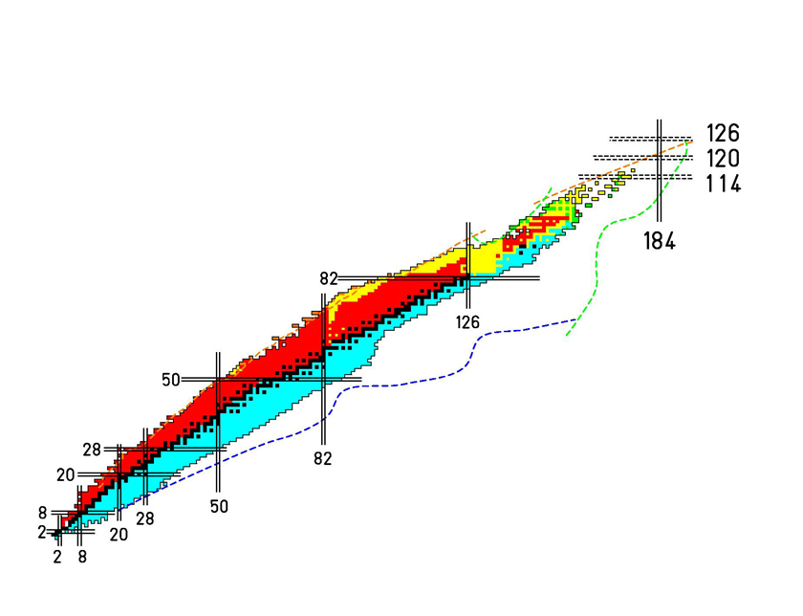
Chart of nuclei
stable
alpha decay (α)
beta-minus (β⁻)
spontaneous fission
beta-plus (β⁺)
N=Z
number of protons
number of neutrons

Slide 4
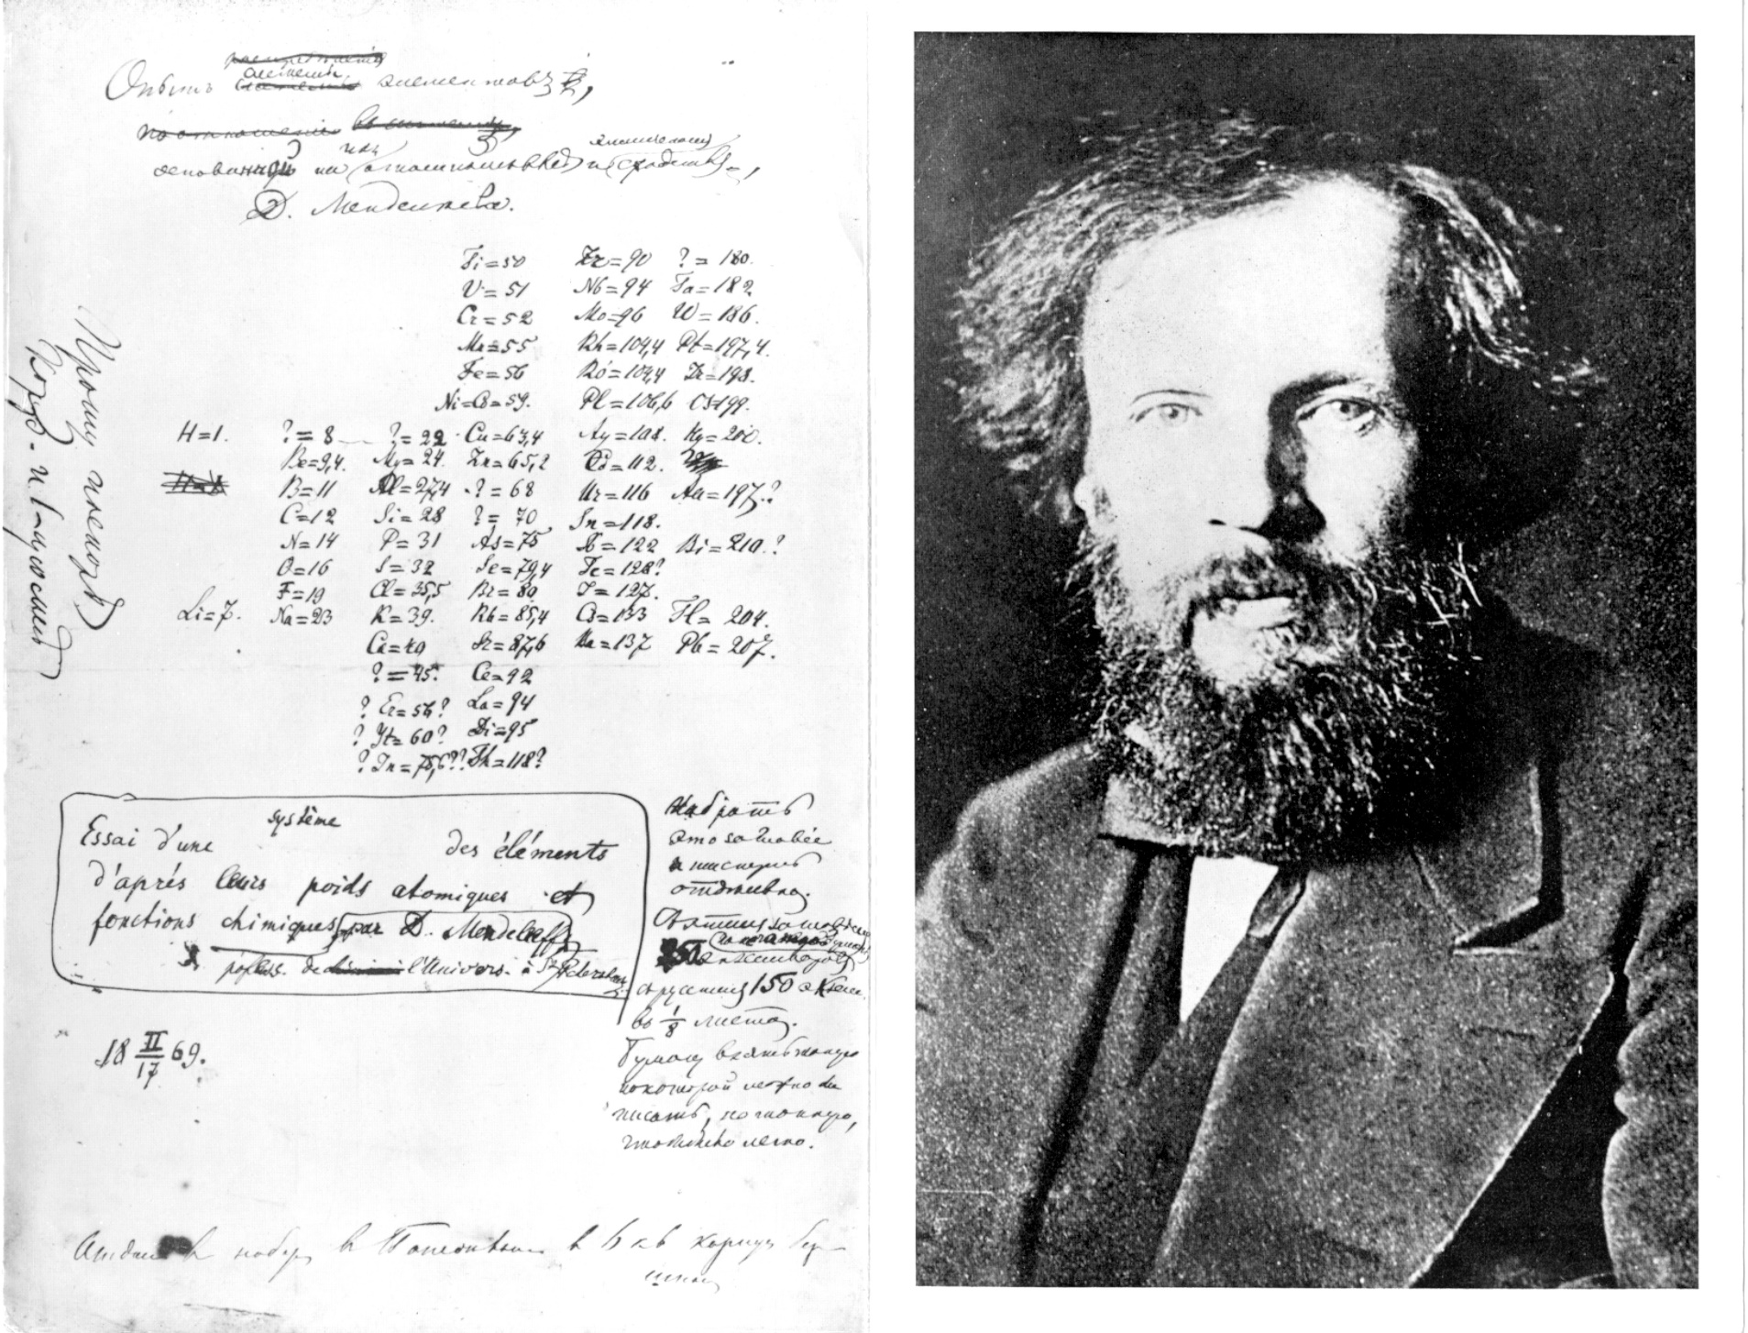
Mendeleev’s Table (1869)

Slide 5
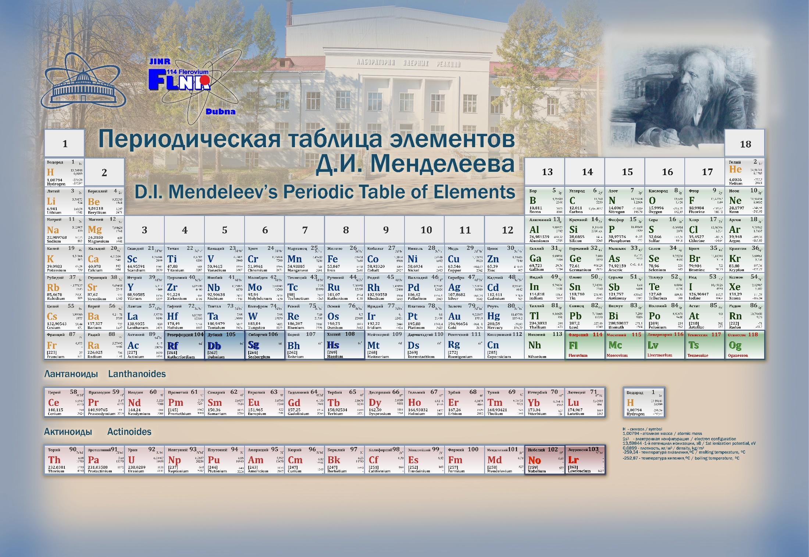
Mendeleev’s Table Today

Slide 6
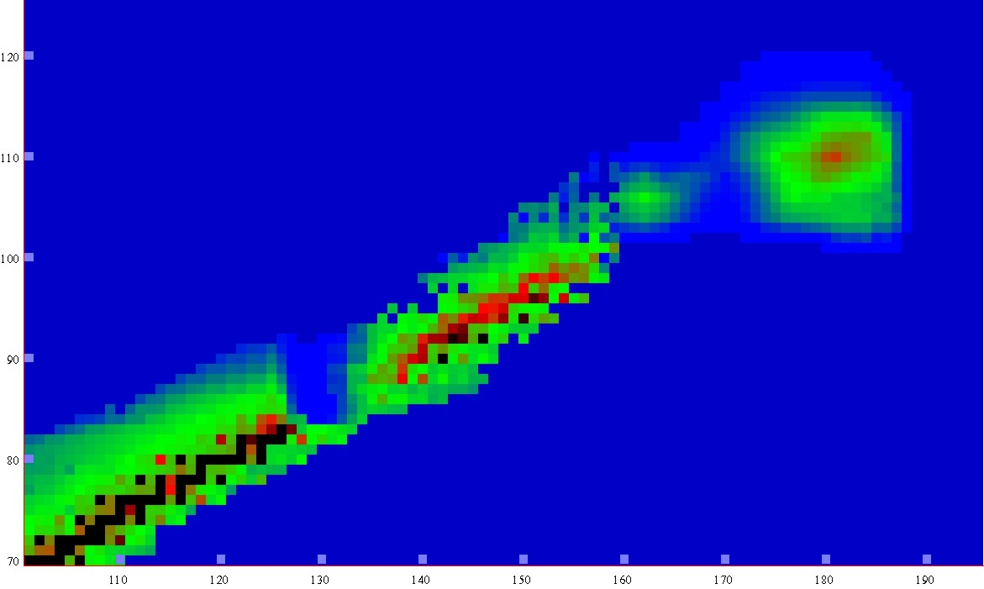
Chart of Nuclei
120
Proton number
110
Th, U
Pb
100
Island of stability
Predicted in 1966
Dubna, Frankfurt
90
80
70
110 120 130 140 150 160 170 180 190
Neutron number
Notes:
6

Slide 7
Synthesis of SHE with accelerators
1971; Orce, France:
²³²Th + ⁸²Kr → ³¹⁰126 + 4n; σ_{4n} < 0.5 mb !!!
1971; Dubna: ²⁰⁸Pb + ⁷⁰Zn → ²⁷⁶112 + 2n; σ_{2n} < 0.1 mb !!! (1996, GSI, Germany);
1971-1975; Dubna: ⁷⁶Ge, ¹³⁶Xe + ²³⁸U;
1975; Dubna: ⁴⁸Ca + Actinides:
Los Alamos (USA)
Berkeley (USA)
Dubna (JINR)
Oak Ridge (USA)
Mainz (Germany)
Darmstadt (Germany)
Orsay (France)
Würenlingen (Switzerland)
Tokyo (Japan) some later

Slide 8
U-400 ACCELERATOR COMPLEX
NUCLEAR SPECTROSCOPY AND REACTION MECHANISMS
Ion | Ion energies [MeV/A] | Output intensity [pps]
¹⁶O²⁺ | 5.7; 7.9 | 3×10¹³
¹⁸O³⁺ | 7.8; 10.5; 15.8 | 2.6×10¹³
⁴⁰Ar⁴⁺ | 3.8; 5.1 | 1×10¹³
⁴⁸Ca⁵⁺ | 3.7; 5.3 | 7.2×10¹²
⁴⁸Ca⁹⁺ | 8.9; 11; 17.7 | 6×10¹²
⁵⁰Ti⁵⁺ | 3.6; 5.1 | 2.4×10¹²
⁵⁸Fe⁶⁺ | 3.8; 5.4 | 4.2×10¹²
⁸⁴Kr⁸⁺ | 3.1; 4.4 | 1.8×10¹²
¹³⁶Xe¹⁴⁺ | 3.3; 4.6; 6.9 | 4.8×10¹¹
¹⁶⁰Gd¹⁹⁺ | 5.5 | 6×10¹⁰
²⁰⁹Bi¹⁹⁺ | 3.4 | 6×10¹⁰
Main parameters
Energy range | 3÷21 MeV/A
K factor max. | 650
Pole diameter | 4 m
Magnet weight | 2100 t
Magnet power | 850 kW
Vacuum | 10⁻⁷ Torr
Commissioned: 1978
Modernized: 1996
Reconstruction: 2020-2023 (plan)
Tasks:
Stand-alone mode:
Synthesis of superheavy elements (SHE)
Chemistry of SHE
Nuclear & laser spectroscopy
Nuclear reactions: fusion, fusion-fission &
quasi-fission, multi-nucleon transfer reactions
Applied research
Post-accelerator mode:
Reactions with exotic nuclei
Structure of light exotic nuclei
Experimental setups:
Gas-Filled Recoil Separator (DGFRS-I)
Separator for Heavy Elements Spectroscopy (SHELS)
Radio-chemical setups
Double-arm time-of-flight spectrometer (CORSET)
Magnetic Analyzer of High Resolution (MAVR)
Notes:
8
Beam intensity of Ca-48 up to 2.5 mkA
Ion energy variation on the target with factor 5
Cyclotron average magnetic field from 1.8 up to 0.8 T

Slide 9
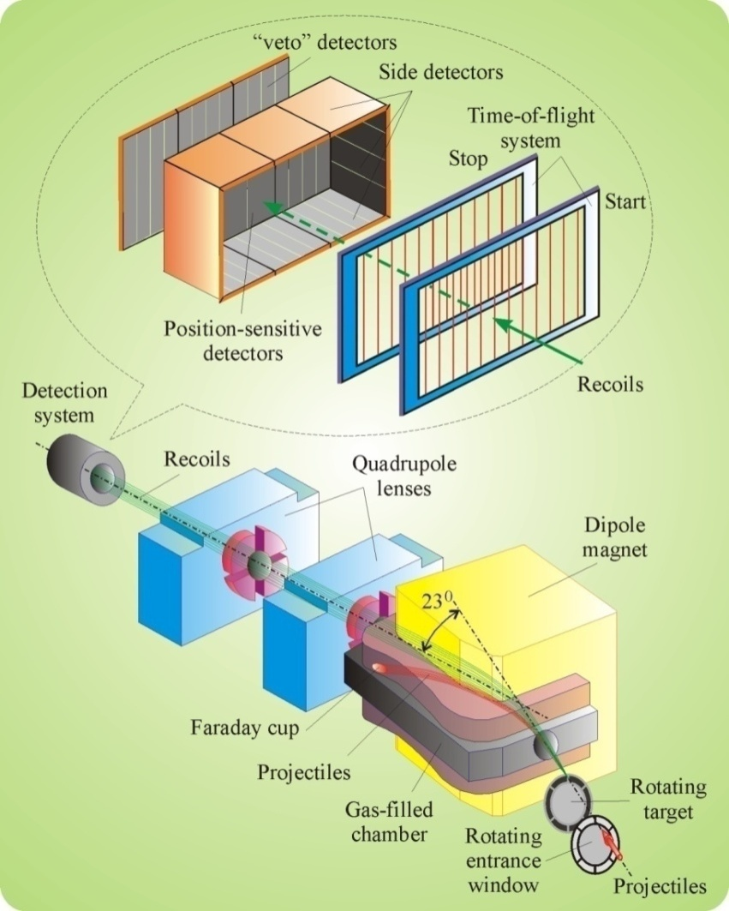
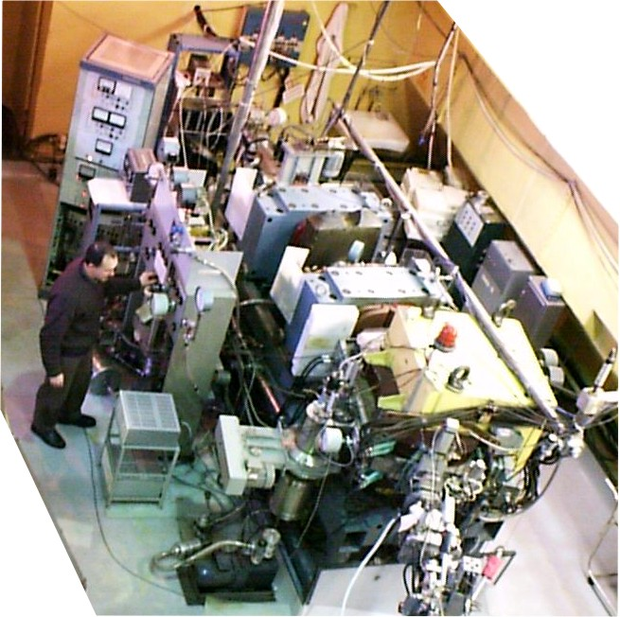
Dubna gas-filled recoil separator

Slide 10
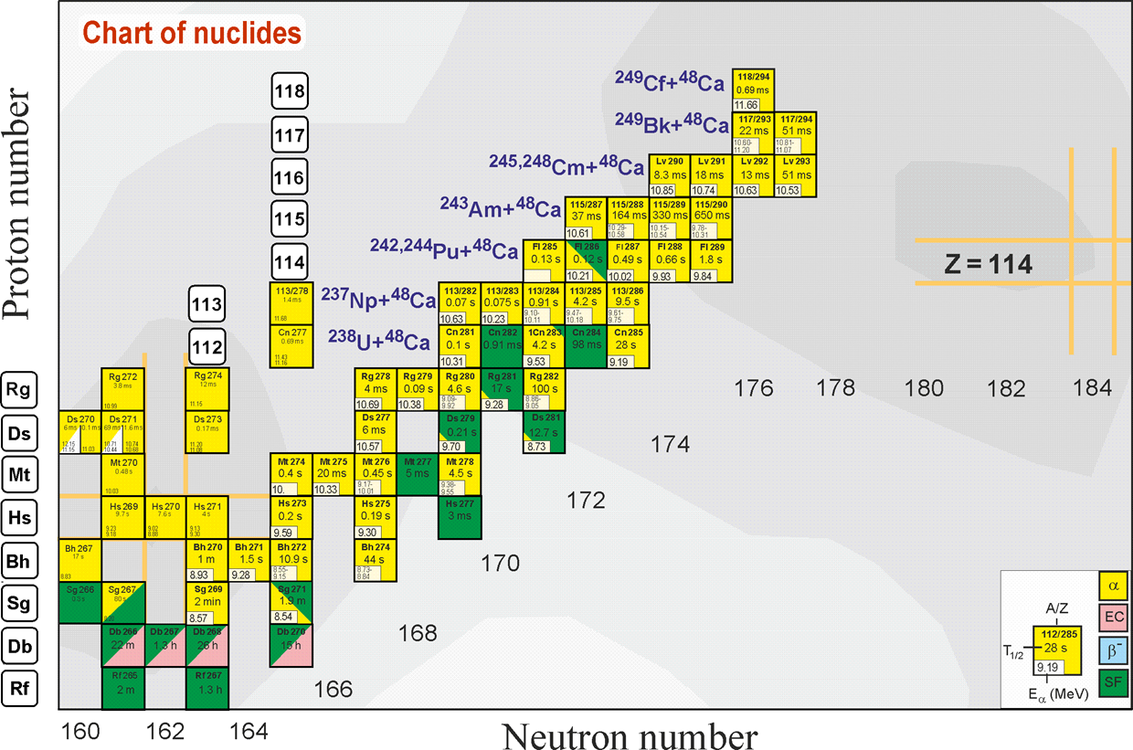
Region of superheavy nuclei.
Recent achievements: 6 new elements and > 50 new isotopes of SHE

Slide 11
Confirmations
(2007-2014)
A, Z | Setup | Laboratory | Published
²⁸³112 | SHIP | GSI Darmstadt | Eur. Phys. J. A 32, 251 (2007)
²⁸³112 | COLD | PSI-FLNR (JINR) | NATURE 447, 72 (2007)
^{286, 287}114 | BGS | LRNL (Berkeley) | P.R. Lett. 103, 132502 (2009)
^{288, 289}114 | TASCA | GSI – Mainz | P.R. Lett. 104, 252701 (2010)
^{292, 293}116 | SHIP | GSI Darmstadt | Eur. Phys. J. A 48: 62 (2012)
^{287, 288}115 | TASCA | GSI – Mainz | P.R. Lett. 111, 112502 (2013)
²⁹⁴117 | TASCA | GSI-Mainz | P.R. Lett. 112, 172501 (2014)

Slide 12
Mendeleev’s Table Today (since Nov. 28, 2016)
10 of 18 elements discovered during last 60 years
were first synthesized in Dubna

Slide 13


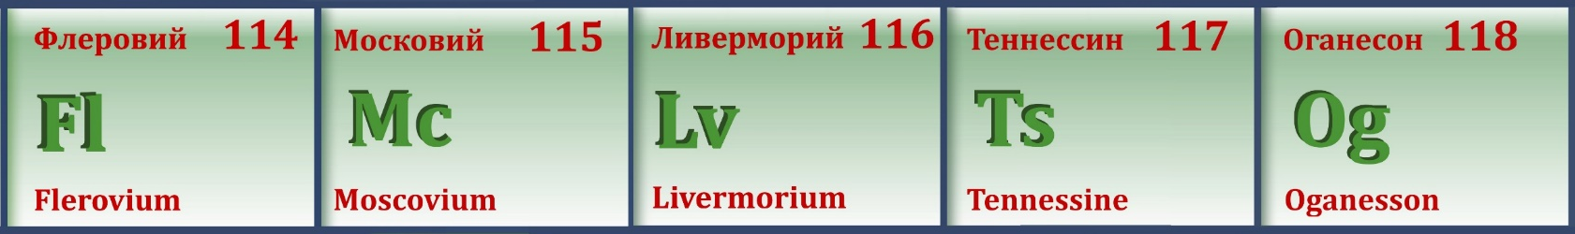
May 2012:
Official approval of the name Flerovium for element 114
and the name Livermorium for element 116
30th December 2015:
Approval of the discovery of new elements 113, 115, 117, and 118
International Union of Pure
and Applied Chemistry
element 113: RIKEN (Japan)
elements 115 and 117: JINR (Dubna) - LLNL (USA) – ORNL (USA) collaboration
element 118: JINR (Dubna) – LLNL collaboration.
28th November 2016:
IUPAC formally approved names and symbols of new elements:
  Nihonium (Nh) for element 113,
  Moscovium (Mc) for element 115,
  Tennessine (Ts) for element 117, and
  Oganesson (Og) for element 118.
All these elements were synthesized for the first time at the U-400
accelerator complex of the Flerov Laboratory of Nuclear Reactions of JINR.

Slide 14
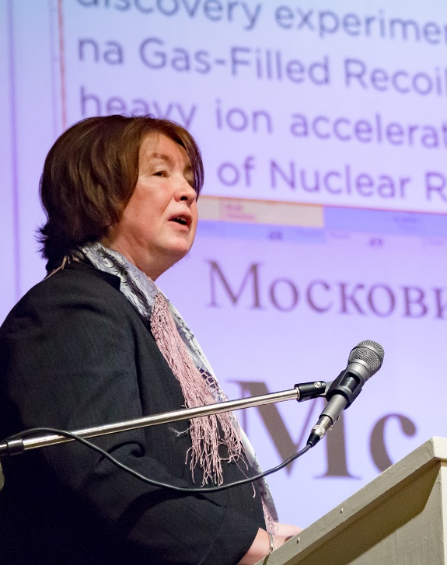
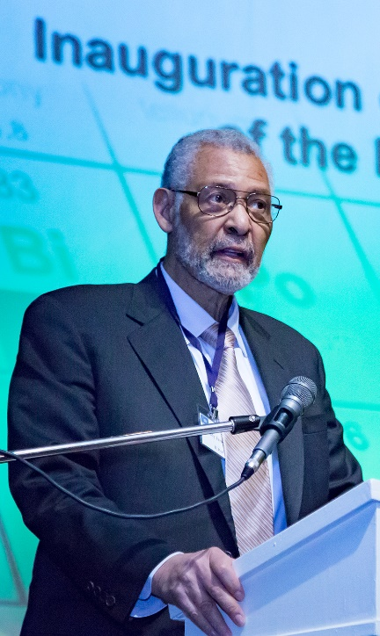
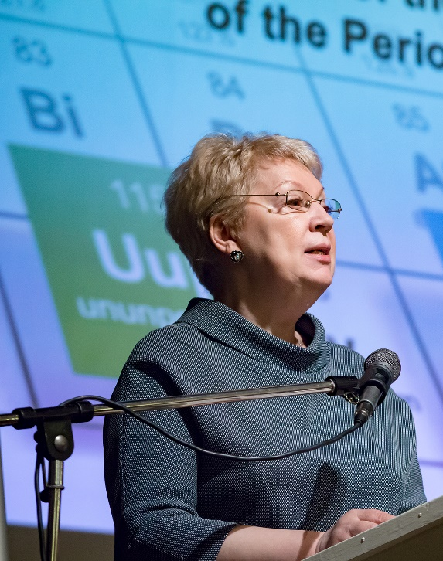
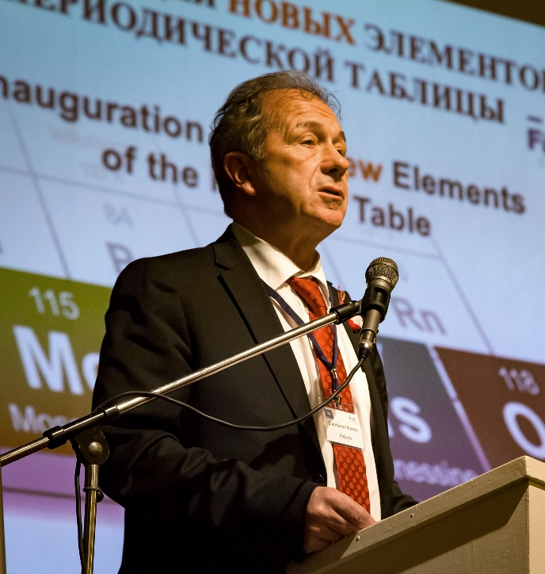
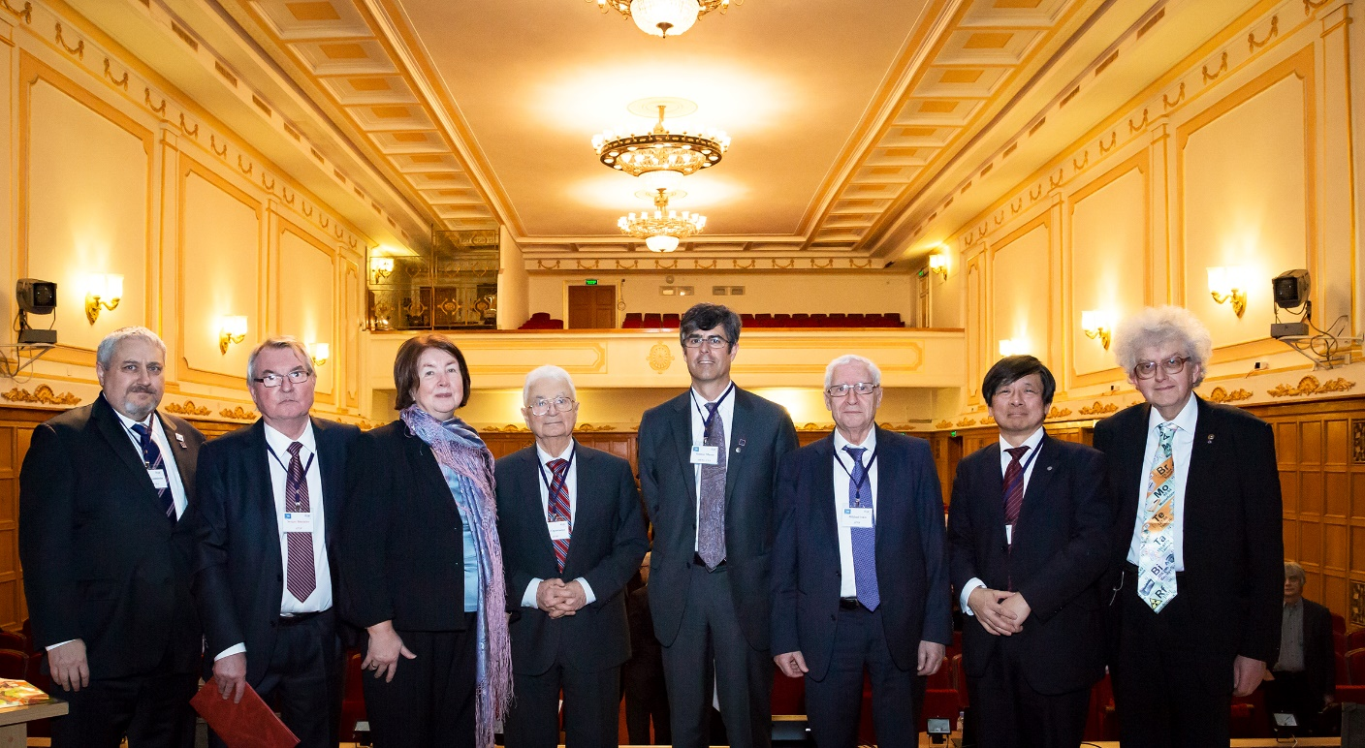
Inauguration of elements 115 (Moscovium), 117 (Tennessine), 118 (Oganesson)
Prof. N. Tarasova
IUPAC
Dr. K. Reed
IUPAP
Prof. O. Vasilieva
Minister of S&E, Russia
Prof. L. Kostov
CPP of JINR Member States
Moscow
Central House of Scientists
of RAS
March 2, 2017
Notes:
A ceremony of inauguration of elements 115 (Moscovium), 117 (Tennessine), and 118 (Oganesson) was held on March 2, 2017 in Moscow in the Central House of Scientists of RAS. The participants of the colloquium were over 200 delegates from 12 countries, among them, representative delegations of JINR (Dubna, Russia), ORNL (USA), LLNL (USA), Vanderbilt University (USA), RIKEN (Japan), GSI (Germany), PSI (Switzerland), GANIL (France), IUPAC and IUPAP, Russian official authorities, Russian Academy of Sciences, as well as the leading scientists who made significant contributions to this field of nuclear physics.

Slide 15
Superheavy Elements (SHE) Factory – the Goals
Experiments at the extremely low (σ<100 fb) cross sections:
Synthesis of new SHE in reactions with ⁵⁰Ti, ⁵⁴Cr ...(119, 120);
Shaping of the region of SHE (synthesis of new isotopes of SHE);
Study of decay properties of SHE;
Study of excitation functions.
Experiments requiring high statistics:
Nuclear spectroscopy of SHE;
Precise mass measurements;
Study of chemical properties of SHE.

Slide 16
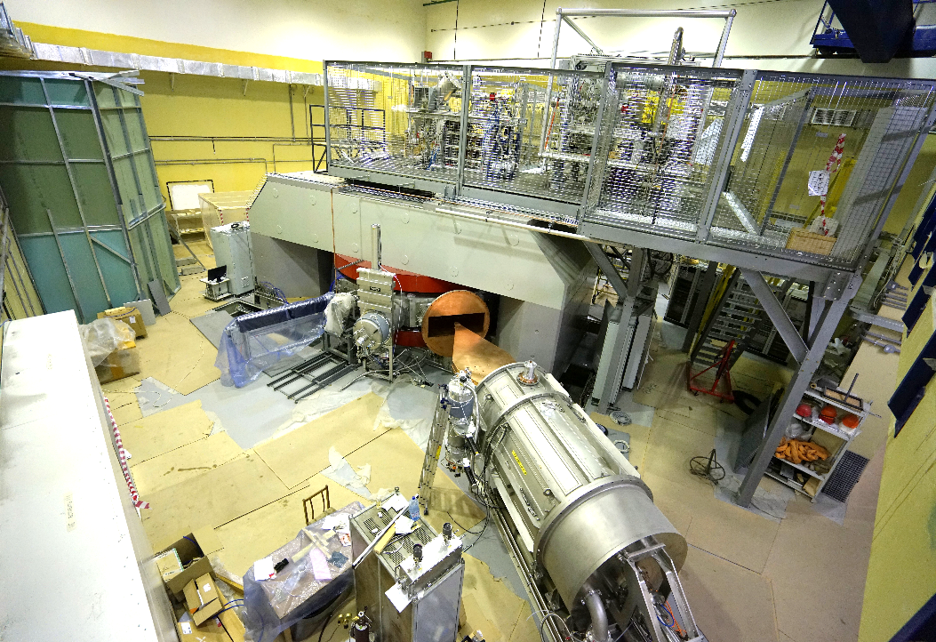
DC-280 ACCELERATOR COMPLEX
SUPERHEAVY ELEMENTS FACTORY
Beams (examples)
Ion | Ion energy [MeV/A] | Estimated output intensity [pps]
⁷Li | 4 | 1×10¹⁴
¹⁸O | 8 | 1×10¹⁴
⁴⁰Ar | 6 | 6×10¹³
⁴⁸Ca | 6 | (6-12)×10¹³
⁵⁴Cr | 6 | 2×10¹³
⁵⁸Fe | 6 | 1×10¹³
¹²⁴Sn | 6 | 2×10¹²
¹³⁶Xe | 6 | 1×10¹⁴
²³⁸U | 7 | 5×10¹⁰
Main parameters
Range of energies | 4÷8 MeV/A
K factor max. | 280
Pole diameter | 4 m
Magnet weight | 1000 t
Magnet power | 300 kW
Vacuum | 10⁻⁷ Torr
Commissioning: 2018 (plan)
Tasks:
Experiments at the extremely low (σ<100 fb) cross sections:
Synthesis of new SHE in reactions with ⁵⁰Ti, ⁵⁴Cr ...;
Synthesis of new isotopes of SHE;
Study of decay properties of SHE;
Study of excitation functions.
Experiments requiring high statistics:
Nuclear spectroscopy of SHE;
Precise mass measurements;
Study of chemical properties of SHE.
Main setups:
Gas-filled recoil separator (DGFRS-II);
Preseparator for chemical investigations;
Separator for Heavy Element Spectroscopy: velocity filter SHELS – from U-400;
Mass Analyzer of SuperHeavy Atoms (MASHA) – from U-400M
Channels reserved for external users
Notes:
16
Beam intensity of Ca-48 up to 2.5 mkA
Ion energy variation on the target with factor 5
Cyclotron average magnetic field from 1.8 up to 0.8 T

Slide 17
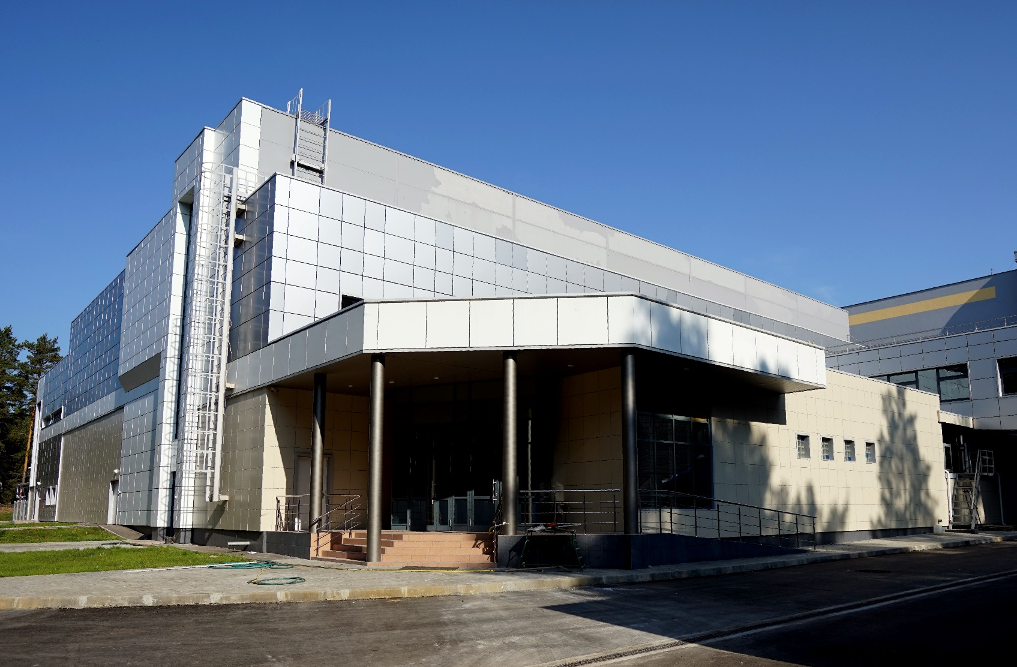
Superheavy Elements Factory

Slide 18
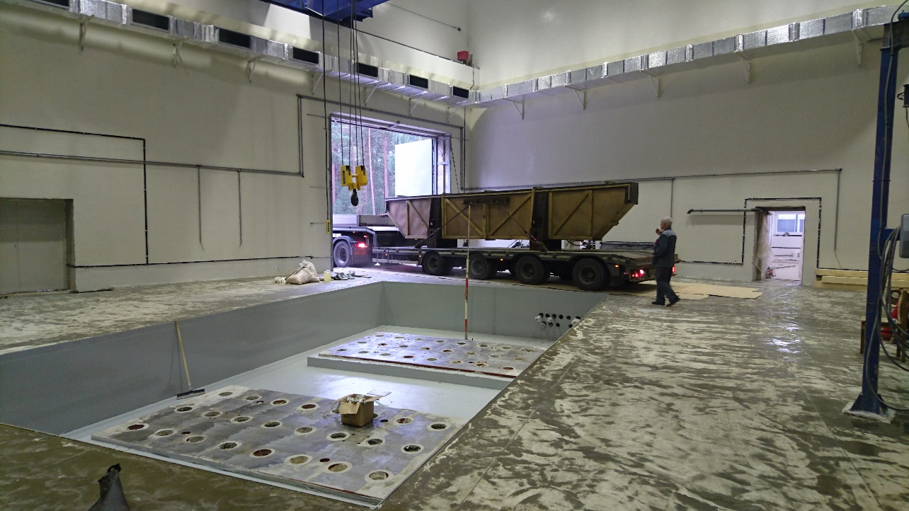
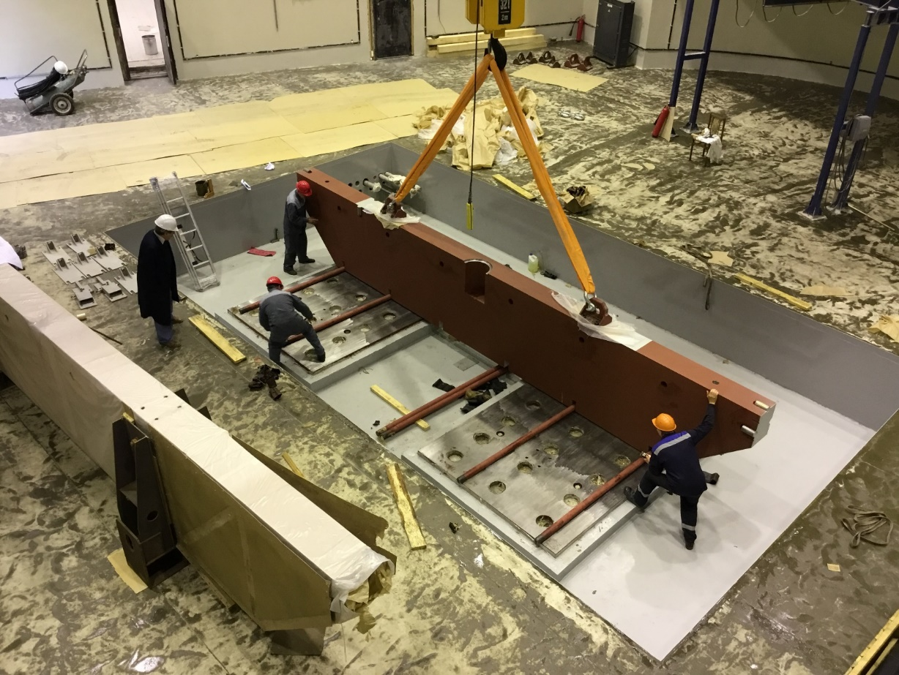
Assembling of the DC-280 main magnet
15/09/2016, 9:00
Same day, 14:35

Slide 19
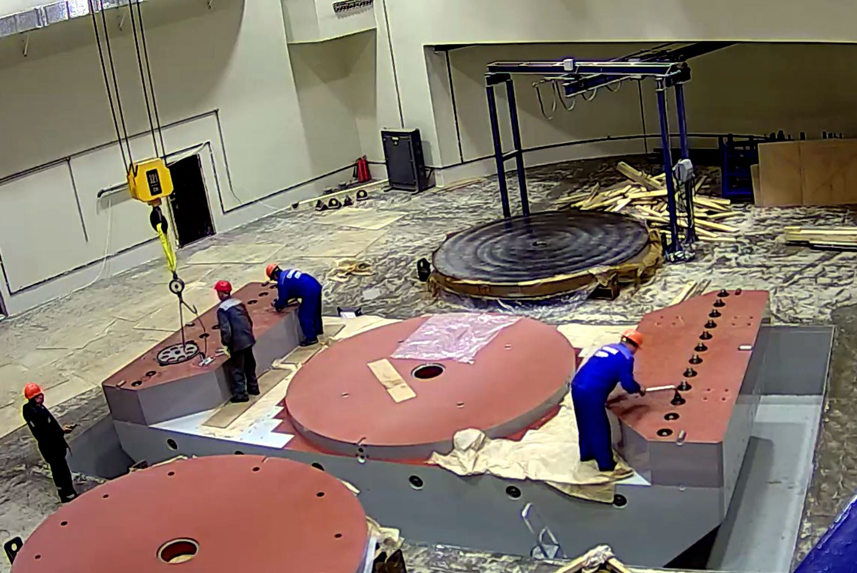
Assembling of DC-280 magnet
28 Sep 2016, 08:53

Slide 20
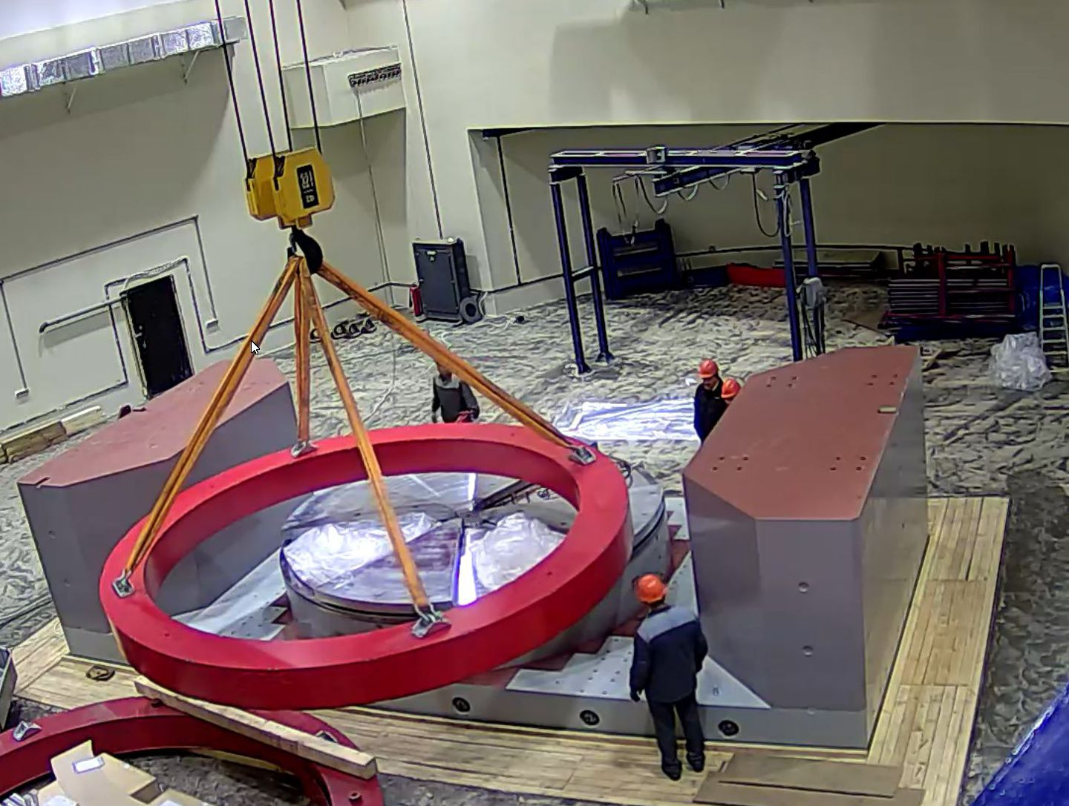
Assembling of DC-280 magnet
18 Oct 2016, 11:02

Slide 21
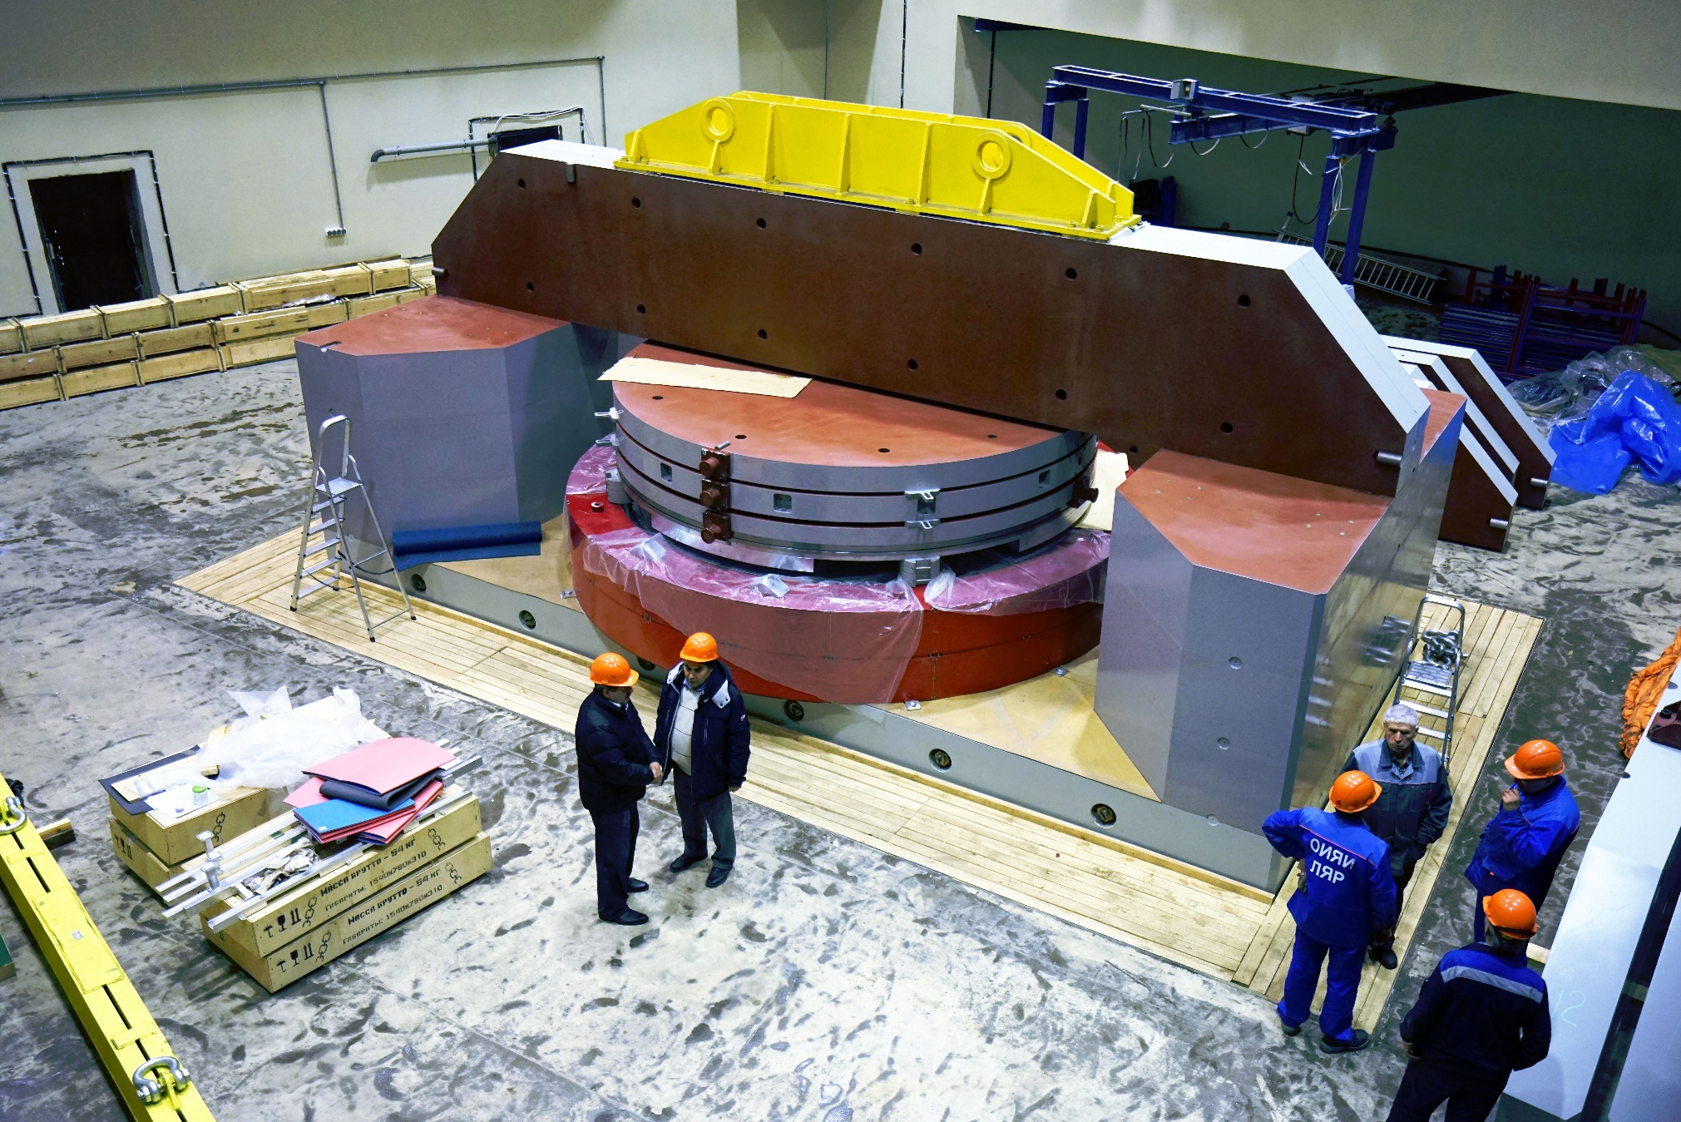
Assembling of DC-280 magnet
31 Oct 2016, 15:52

Slide 22
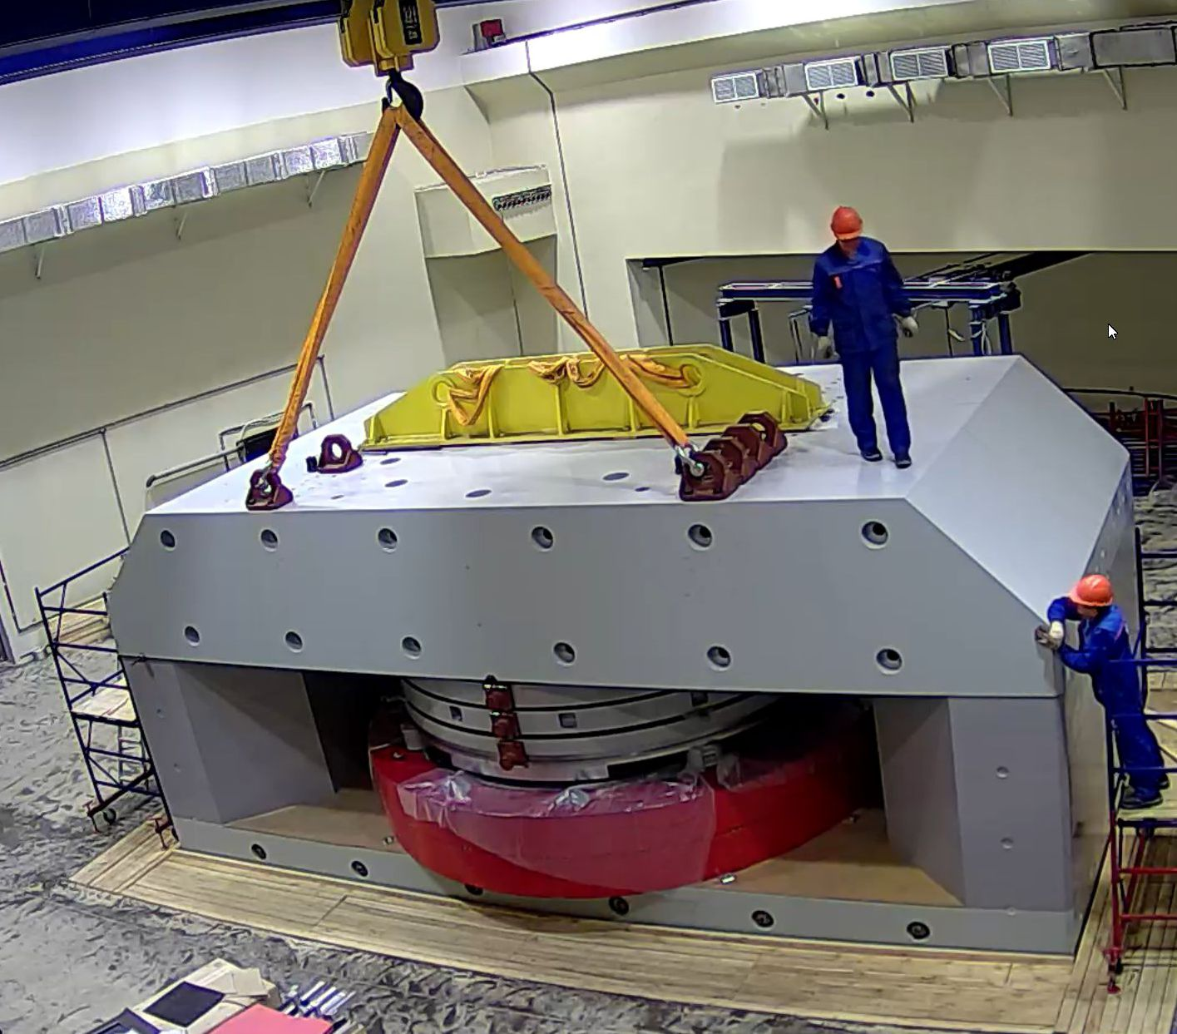
Assembling of DC-280 magnet
03 Nov 2016, 10:00

Slide 23
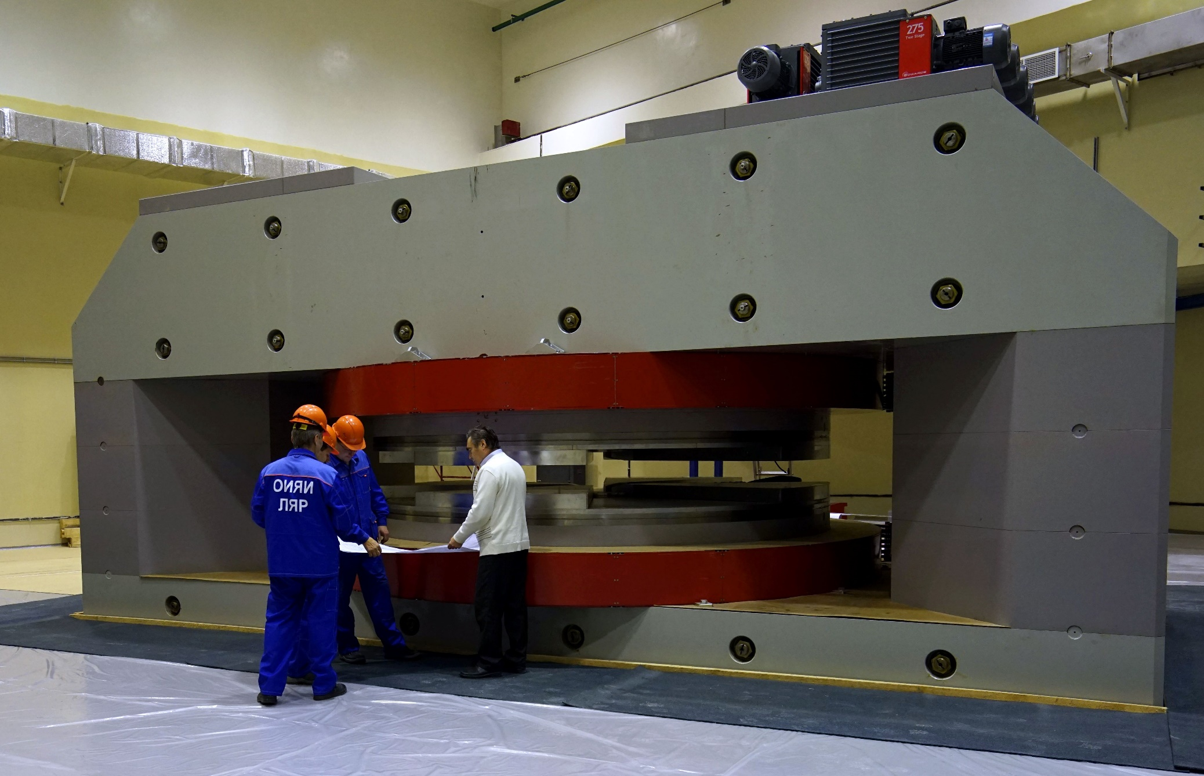
Magnet of DC-280 cyclotron – ready for testing
18.01.2017 http://lideo.ru/embed/4655

Slide 24
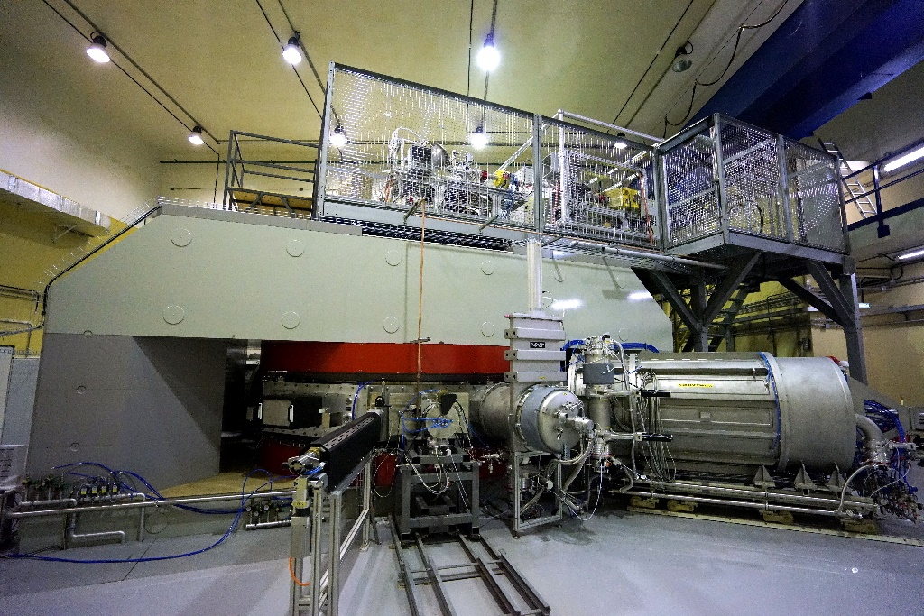
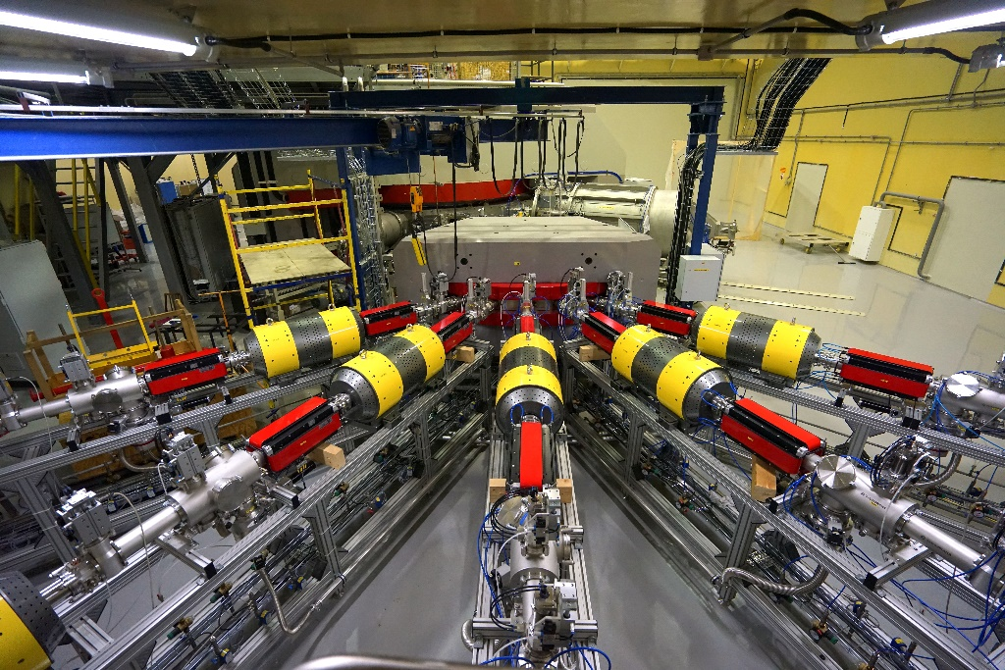
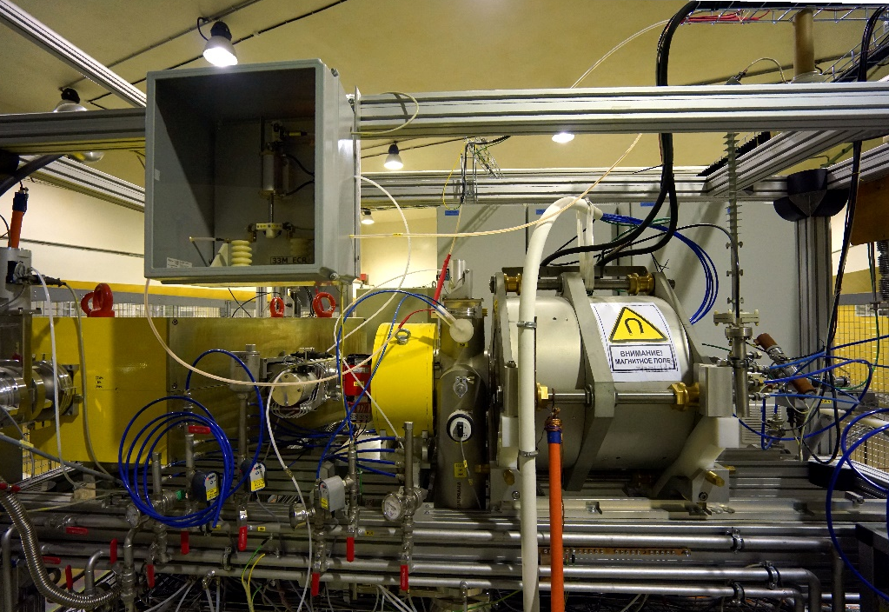
Specialized high-current cyclotron DC-280
DC-280 (expected) E=4÷8 MeV/A
⁷Li | 4 | 1×10¹⁴
¹⁸O | 8 | 1×10¹⁴
⁴⁰Ar | 5 | 6×10¹³
⁴⁸Ca | 5 | 1×10¹⁴
⁵⁴Cr | 5 | 2×10¹³
¹³⁶Xe | 5 | 1×10¹⁴
²³⁸U | 7 | 5×10¹⁰

Slide 25

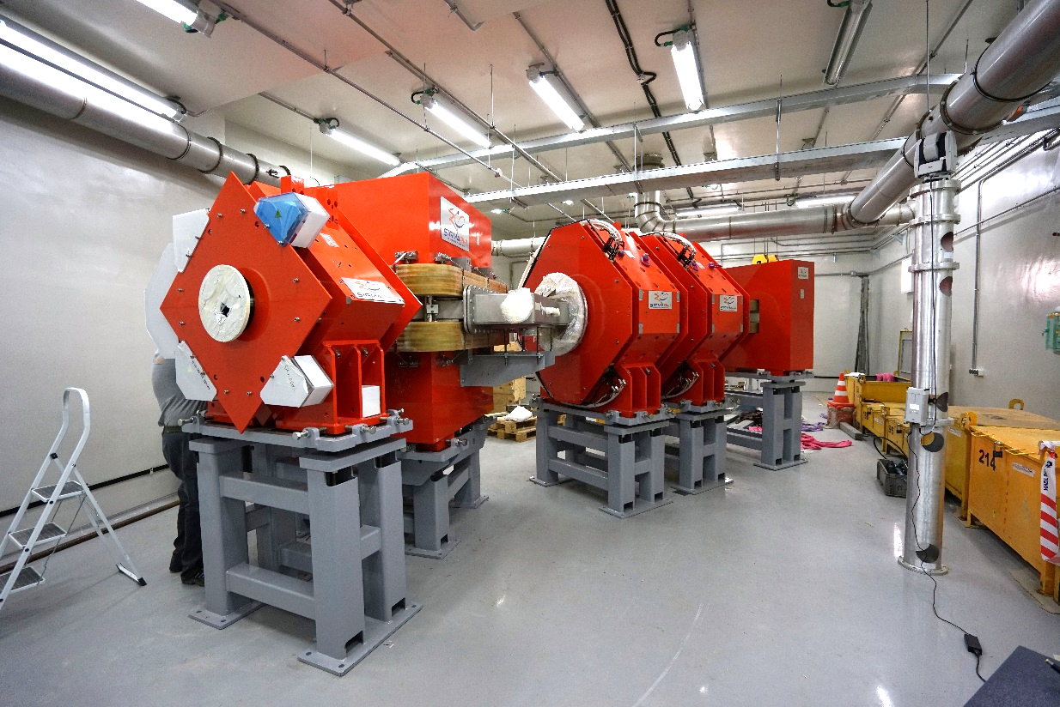
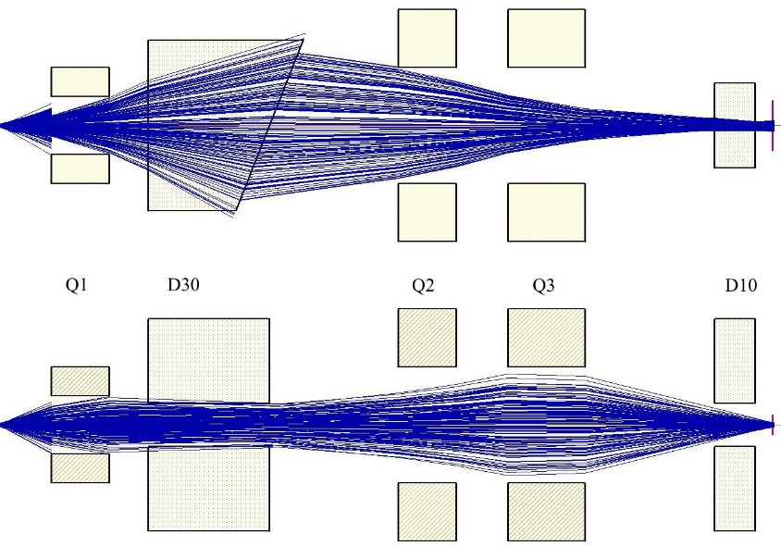
New gas-filled separator
Reaction | Transmission
²⁴⁴Pu(⁴⁸Ca,3n)²⁸⁹114 | 60 %
²⁴⁴Pu(⁵⁸Fe,4n)²⁹⁸120 | 75 %

Slide 26
Reactions of Synthesis
Act. + ⁴⁸Ca
Target
materials
Producer
Isotope
enrichment (%)
²³⁷Np IAR 99.3
²³⁹Pu RFNC ---
²⁴⁰Pu IAR/ORNL 99.98
²⁴²Pu RFNC/ORNL 99.98
²⁴⁴Pu ORNL 98.6
²⁴³Am IAR / ORNL 99.9
²⁴⁵Cm IAR 98.7
²⁴⁸Cm IAR /ORNL 97.4
²⁴⁹Bk ORNL ≥ 95
²⁴⁹Cf IAR/ORNL 97.3
^{249,250,251}Cf ORNL (50+14+36)%
0,35-0,40 mg /cm2 - ≈ 12 mg
Projectiles ⁴⁸Ca produced by
Heavy Ion Accelerator U-400;
Energy: 235-250 MeV
(v ≈ 0.1 c);
Intensity: 1.0-1.5 pμA
(n×10¹² ÷ 10¹³ 1/s);
Consumption: 0.5-0.8 mg/h
Beam dose: (0.3-3.0)∙10¹⁹
Notes:
26

Slide 27
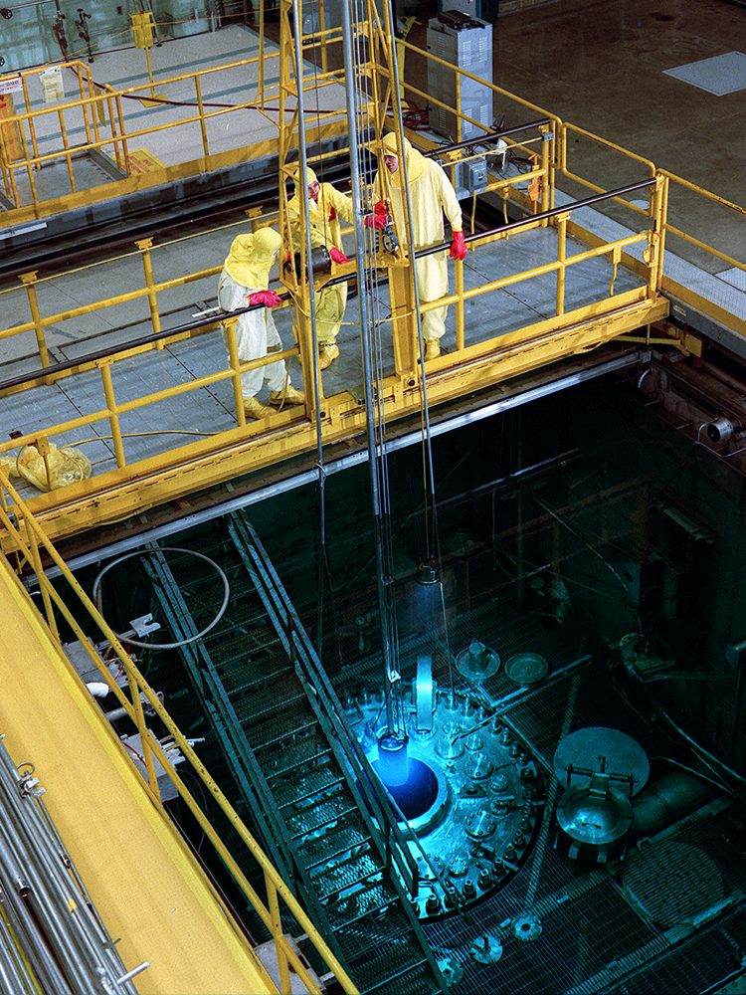
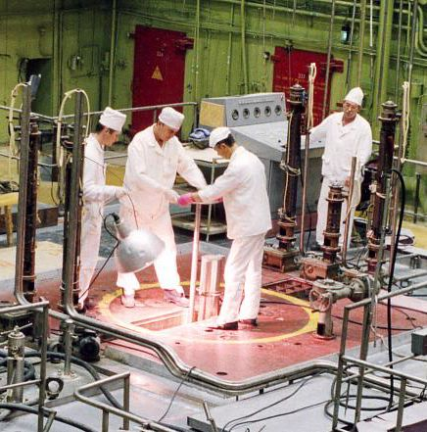
Isotope reactors
HFIR, ORNL, Oak Ridge, USA, 85 MW
CM-3, IAR, Dimitrovgrad, RF, 100 MW
Notes:
27
27

Slide 28
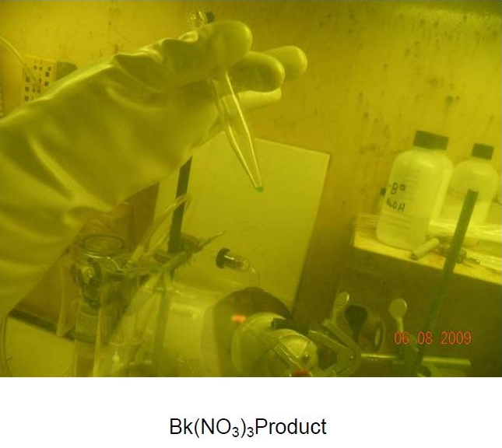
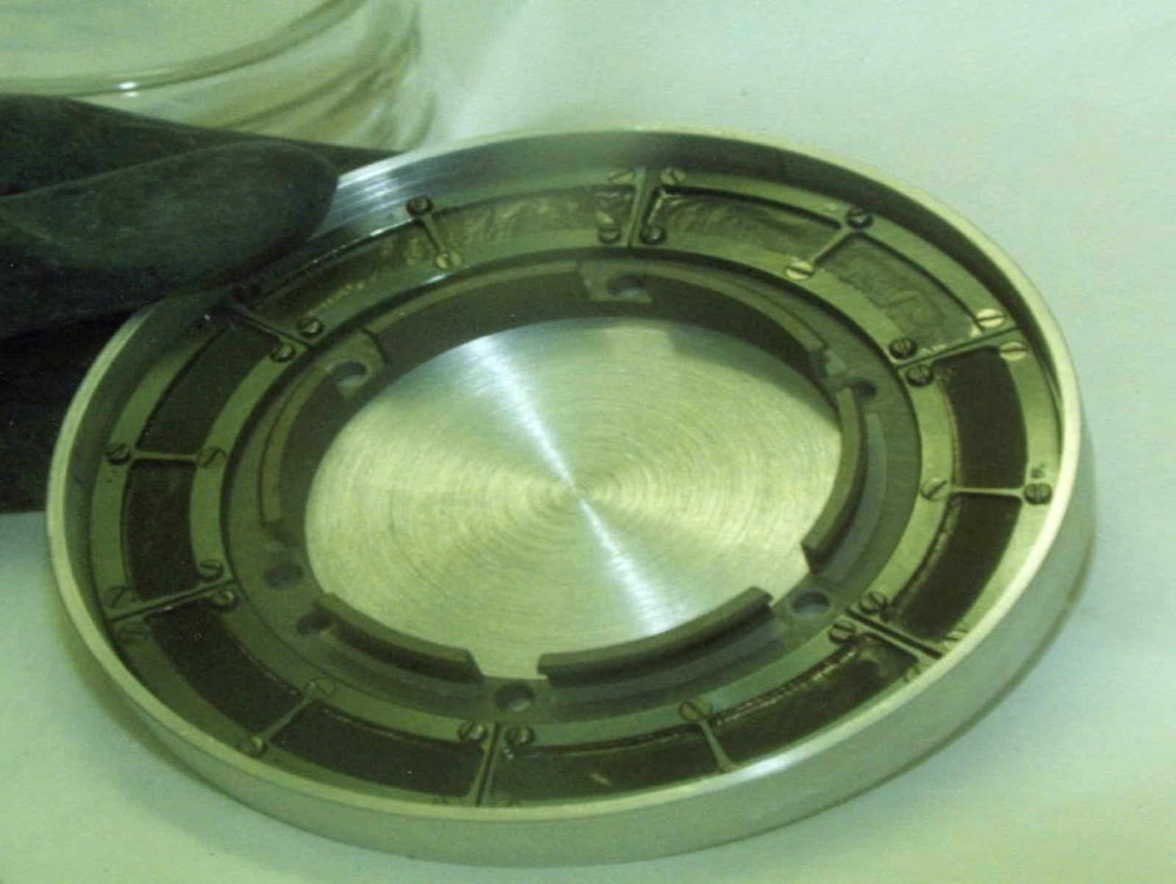
22 mg of ²⁴⁹Bk
have been produced in HIFR ORNL
Prices per 1 mg
¹⁹⁷Au ≈ 0.045 US$
^{nat}U₃O₈ ≈ 0.03 US$
²³⁹Pu ≈ 4 US$
²⁴⁹Cf ≈ 60 000 US$
Target wheel
Notes:
28

Slide 29


Slide 30
Future Isotopes for Use in Physics and Chemistry
Isotopes with high isotopic purity required for continued production of superheavy elements and exploration of the island of stability include: ^{233,235}U, ²³⁷Np, ^{239,240,242,244}Pu, ²⁴³Am, ^{245,248}Cm, ²⁴⁹Bk, and ^{249,251}Cf. Note that with new accelerator facilities with higher beam intensities coming on-line (such as the Super Heavy Element Factory in Dubna, Russia), demand for these isotopes will increase because thicker and larger targets will be required; current targets require ~20 mg whereas future targets are envisioned to require > 100 mg. Note also that high isotopic purity may necessitate usage of an isotope separator capable of separating radioactive material. Isotopes with high isotopic purity required for chemical study include: ²⁴⁸ Cm, ²⁴⁹Bk, ^{249,251}Cf, ^{252,254}Es, and ²⁵⁷Fm. The Isotope Program is working with this community to develop a strategic plan for the materials needed for further studies in this area and then to implement it.
Mixed and mass separated actinides for chemical and physical studies of transuranium and trans-neptunium isotopes namely ²³⁷Np; ²⁴²Pu, ²⁴⁴Pu, ²⁴³Am, ²⁴⁸Cm, ²⁴⁹ Cf, ²⁴⁹Bk, ²⁵¹Cf, ^{253/254}Es, and ²⁵⁷Fm. ²⁴⁸Cm is the only readily available isotope of curium that can be used in standard radiochemical facility. The world-wide supply of ²⁴⁸ Cm is constrained, and the available ²⁴⁹Bk is currently primarily used as target for synthesis of superheavy elements. ²⁴⁹Bk decays to ²⁴⁹Cf and, similar to Cm, ²⁴⁹Cf is the only Cf isotope readily available that can be used in radiochemical laboratory. Specific metallic and/or chemical forms of these isotopes would be most interesting.

Slide 31
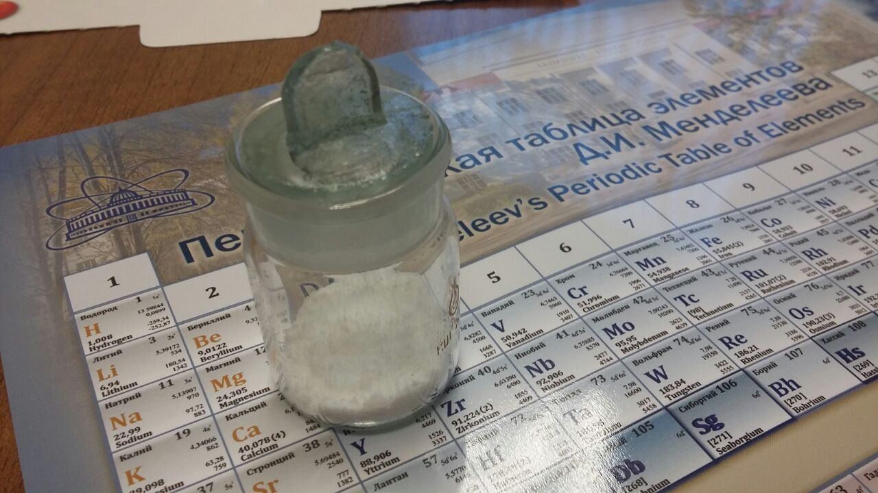
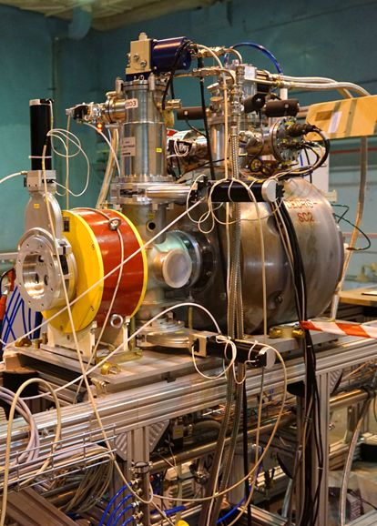
Superconducting 18 GHz ECR ion sources
~2 grams of ⁴⁸Ca
Ion source DECRIS-SC2
Consumption: 0.5-0.8 mg/h
Prices per 1 mg
¹⁹⁷Au ≈ 0.045 US$
^{nat}U₃O₈ ≈ 0.03 US$
²³⁹Pu ≈ 4 US$
⁴⁸Ca ≈ 250 US$
31
Notes:
31

Slide 32
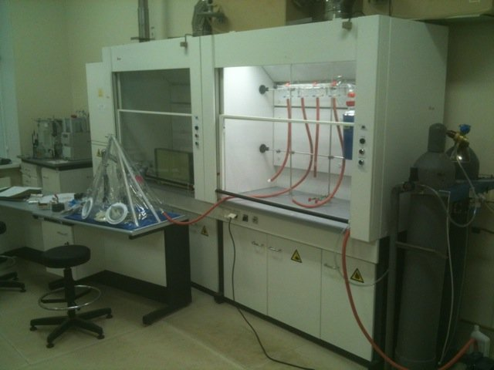
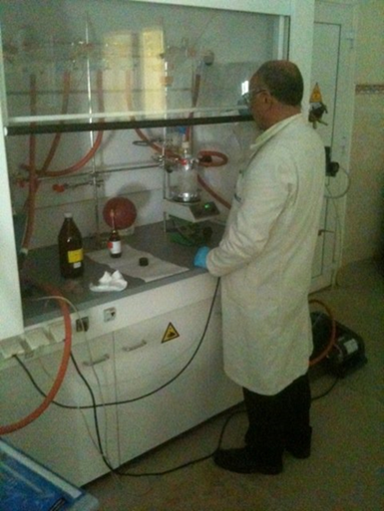
Development of ⁵⁰Ti beam using MIVOC method
Synthesis of (trimethyl)pentamethyl-cyclopentadienyl titanium
TiCl₄ + (CH₃)₅C₅Si(CH₃)₃ Cp*TiCl₃ + 3CH₃Li Cp*Ti(CH₃)₃
where Cp* - (CH₃)₅C₅
Starting material: ⁵⁰TiCl₄ enrichment ˃ 90% - available from Trace Sciences International Inc.
The first step of synthesis was performed at IPHC, the final step at FLNR.
The efficiency of synthesis is more than 90%.
Chemistry laboratory

Slide 33
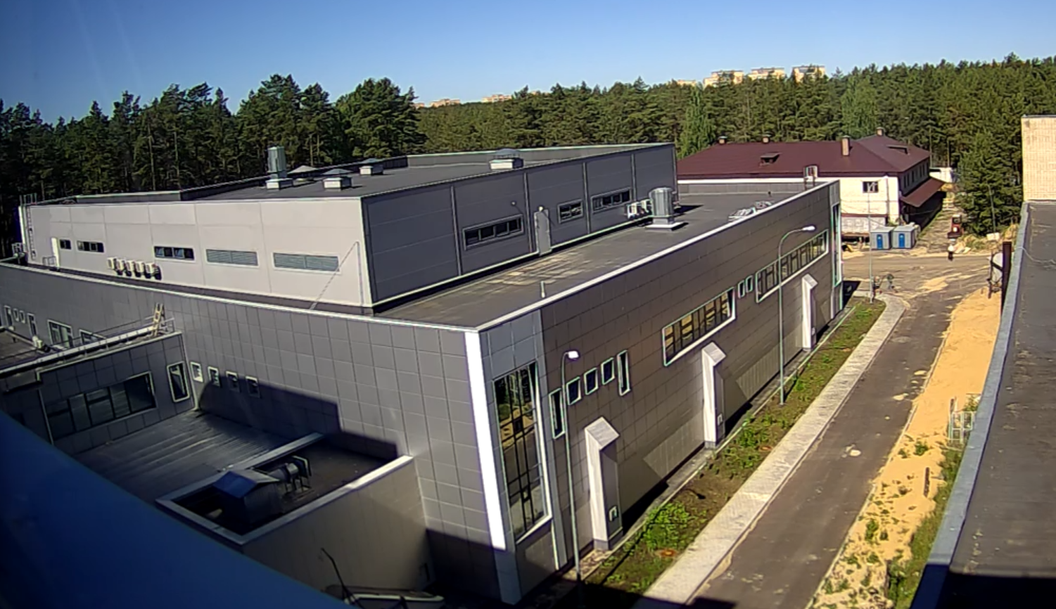
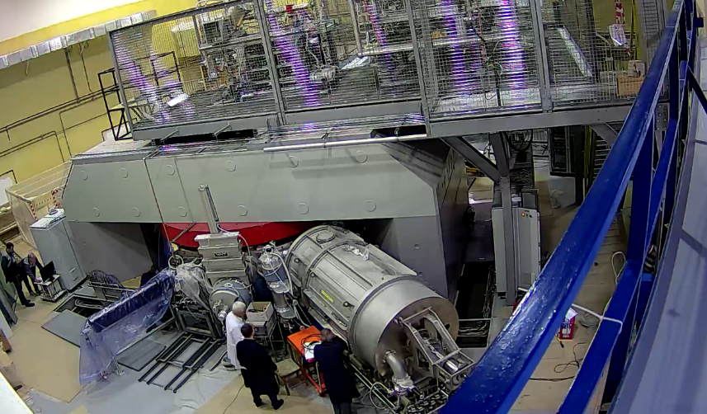
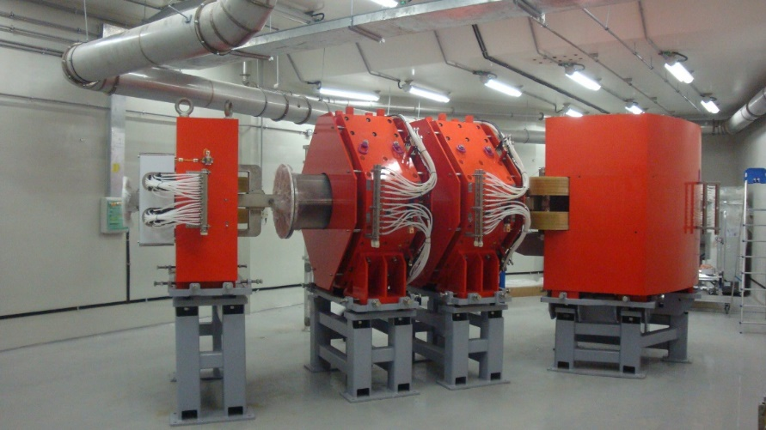
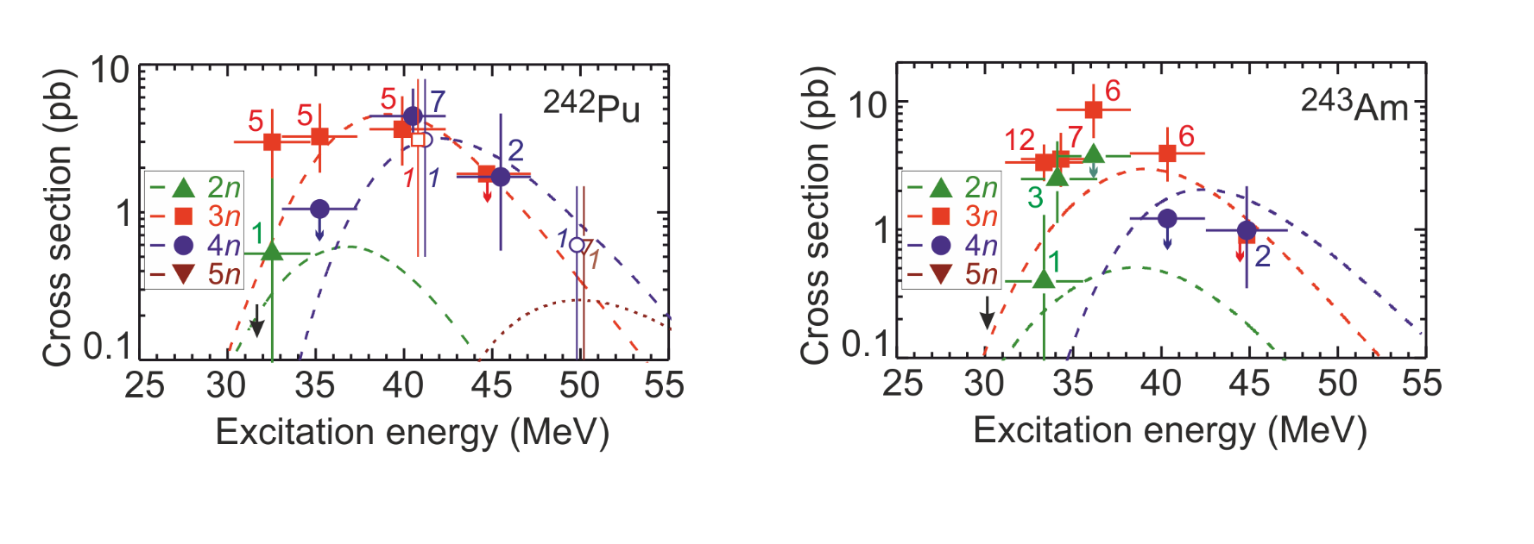
Superheavy Elements Factory
DC-280
DC-280 cyclotron:
autonomous launching and
tuning works
gas-filled recoil separator (GFRS-2):
assembled
existing data for ⁴⁸Ca+²⁴³Am
the most critical tasks for
the end of 2018 – beginning of 2019:
certifying;
full commissioning;
preparing and conducting day-first test experiments (⁴⁸Ca+²⁴³Am);
2nd half of 2019:
preparing and conducting experiment on synthesis of element 119 in the ⁵⁰Ti+²⁴⁹Bk reaction;

Slide 34
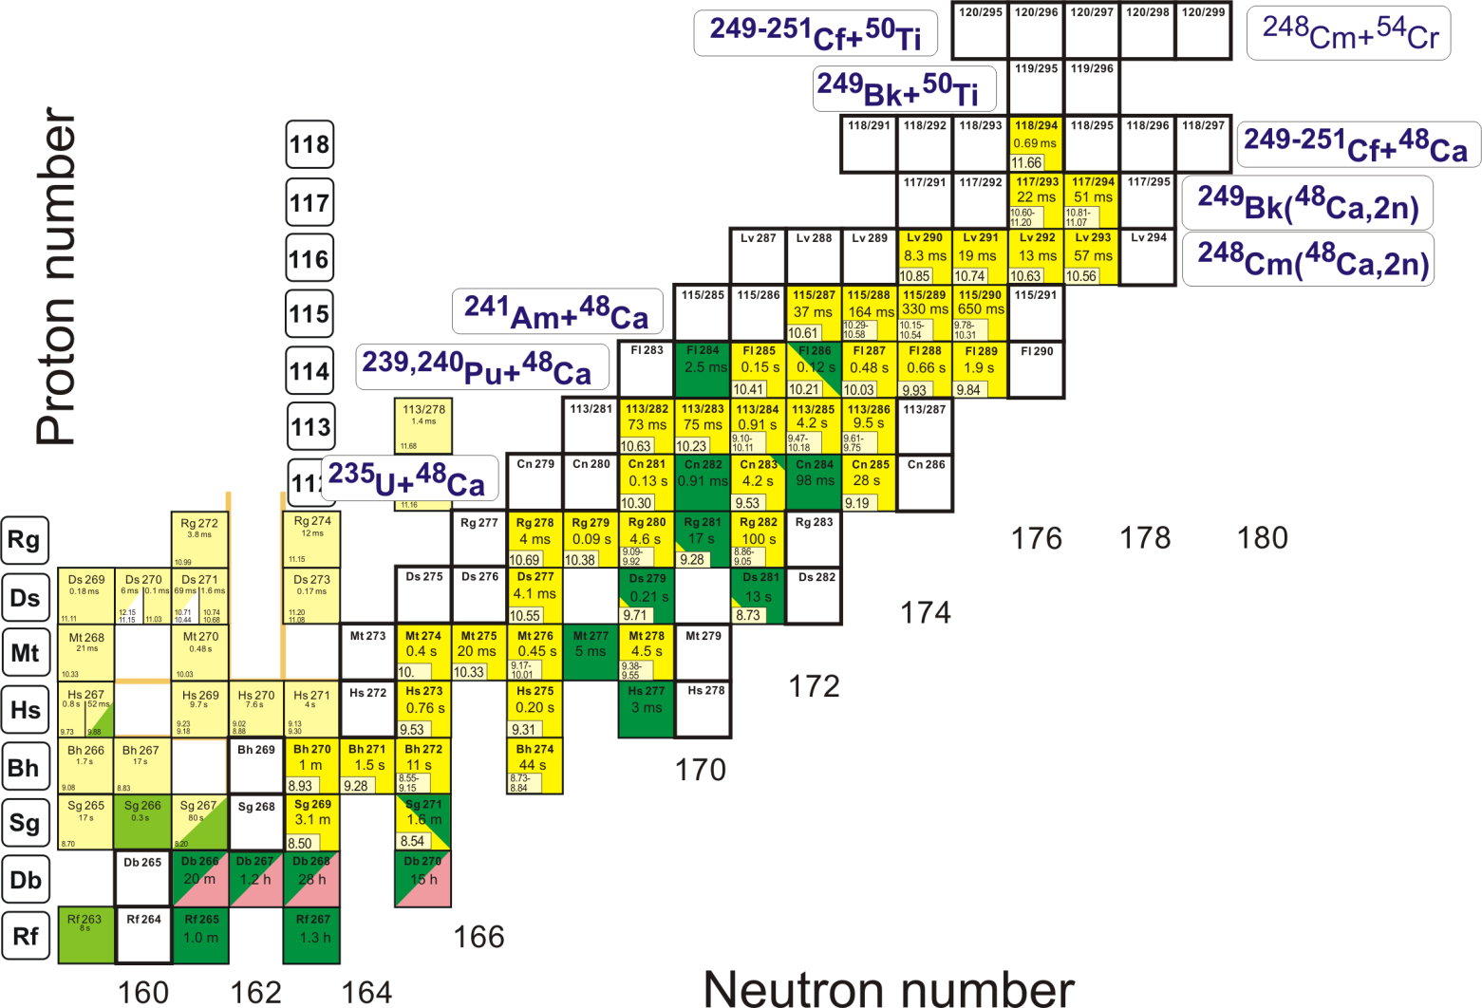
Synthesis of elements 119 and 120
Neutron-deficient/rich nuclei
Reactions (new elements):
²⁴⁹Bk(⁵⁰Ti,xn) ^{299-x}119
²⁴⁹⁻²⁵¹Cf(⁵⁰Ti,xn)^{(299-301)-x}120
²⁴⁸Cm(⁵⁴Cr,xn)^{302-x}120
Reactions (n-deficient):
²⁴¹Am(⁴⁸Ca,xn)^{289-x}Mc
²³⁹Pu(⁴⁸Ca,xn)^{287-x}Fl
²⁴⁰Pu(⁴⁸Ca,xn)^{288-x}Fl
Reactions (n-rich):
²⁴⁹Bk(⁴⁸Ca,2n)²⁹⁵Ts₁₇₈
²⁴⁸Cm(⁴⁸Ca,2n)²⁹⁴Lv₁₇₈
Purposes:
Synthesis of new elements
Test of existing nuclear models
Evaluation of the magnitude of stabilizing effect of the N=184 shell on the properties of superheavy nuclides
Evaluation of fission barriers
Evaluation of the proton magic number

Slide 35
Day-one experiments at SHE Factory
Test experiments I:
Test of functionalities of all the systems of the accelerator and gas-filled separator
⁴⁰Ar+^{nat}Dy and ¹⁸O+²⁰⁸Pb
Test experiments II:
⁴⁸Ca+²⁴²Pu and ⁴⁸Ca+²⁴³Am
Enough material to prepare “big” targets
Well-studied in previous experiments
Relatively large cross sections
⁴⁸Ca+²⁴²Pu
Existing experimental data
⁴⁸Ca+²⁴³Am

Slide 36
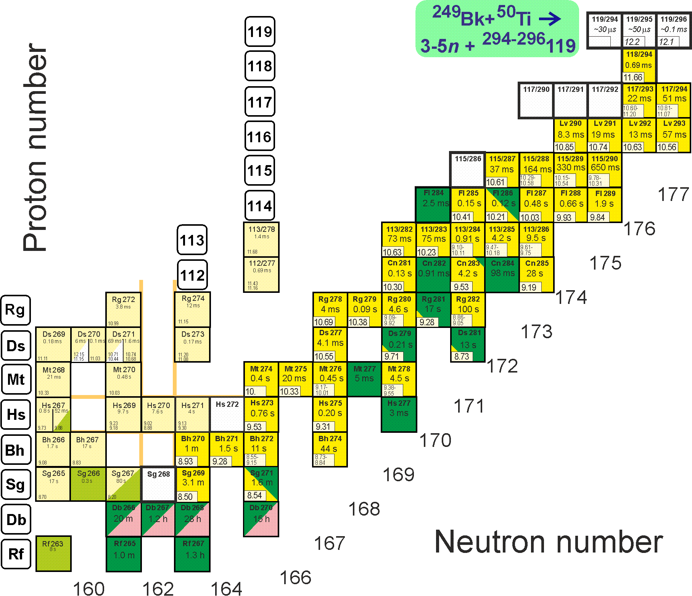
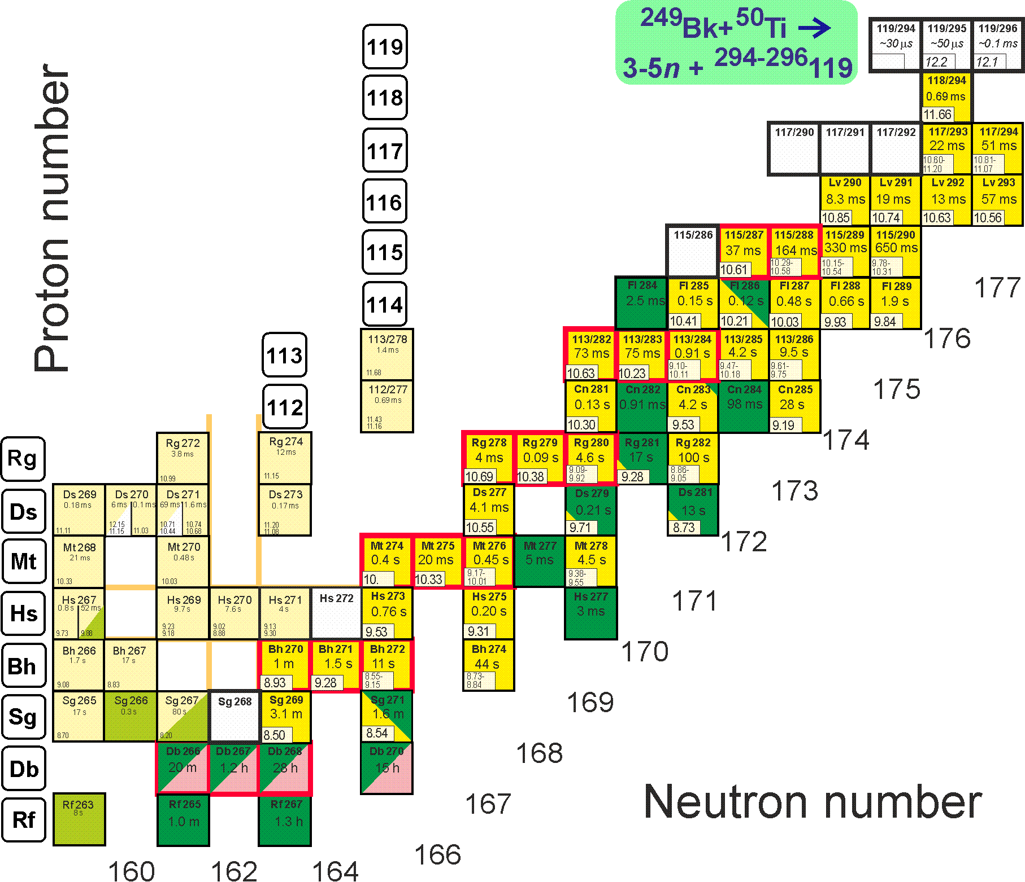
First experiments at SHE Factory
Synthesis of new element 119
²⁴⁹Bk(⁵⁰Ti,3-4n)^{295,296}119
Descendants ^{287,288}Mc, ²⁸²⁻²⁹⁴Nh… are known
s=50 fb, h_{t}=0.3 mg/cm², ε_{coll}=0.6, I_{beam}=3 pmA → ≈1 event per month

Slide 37
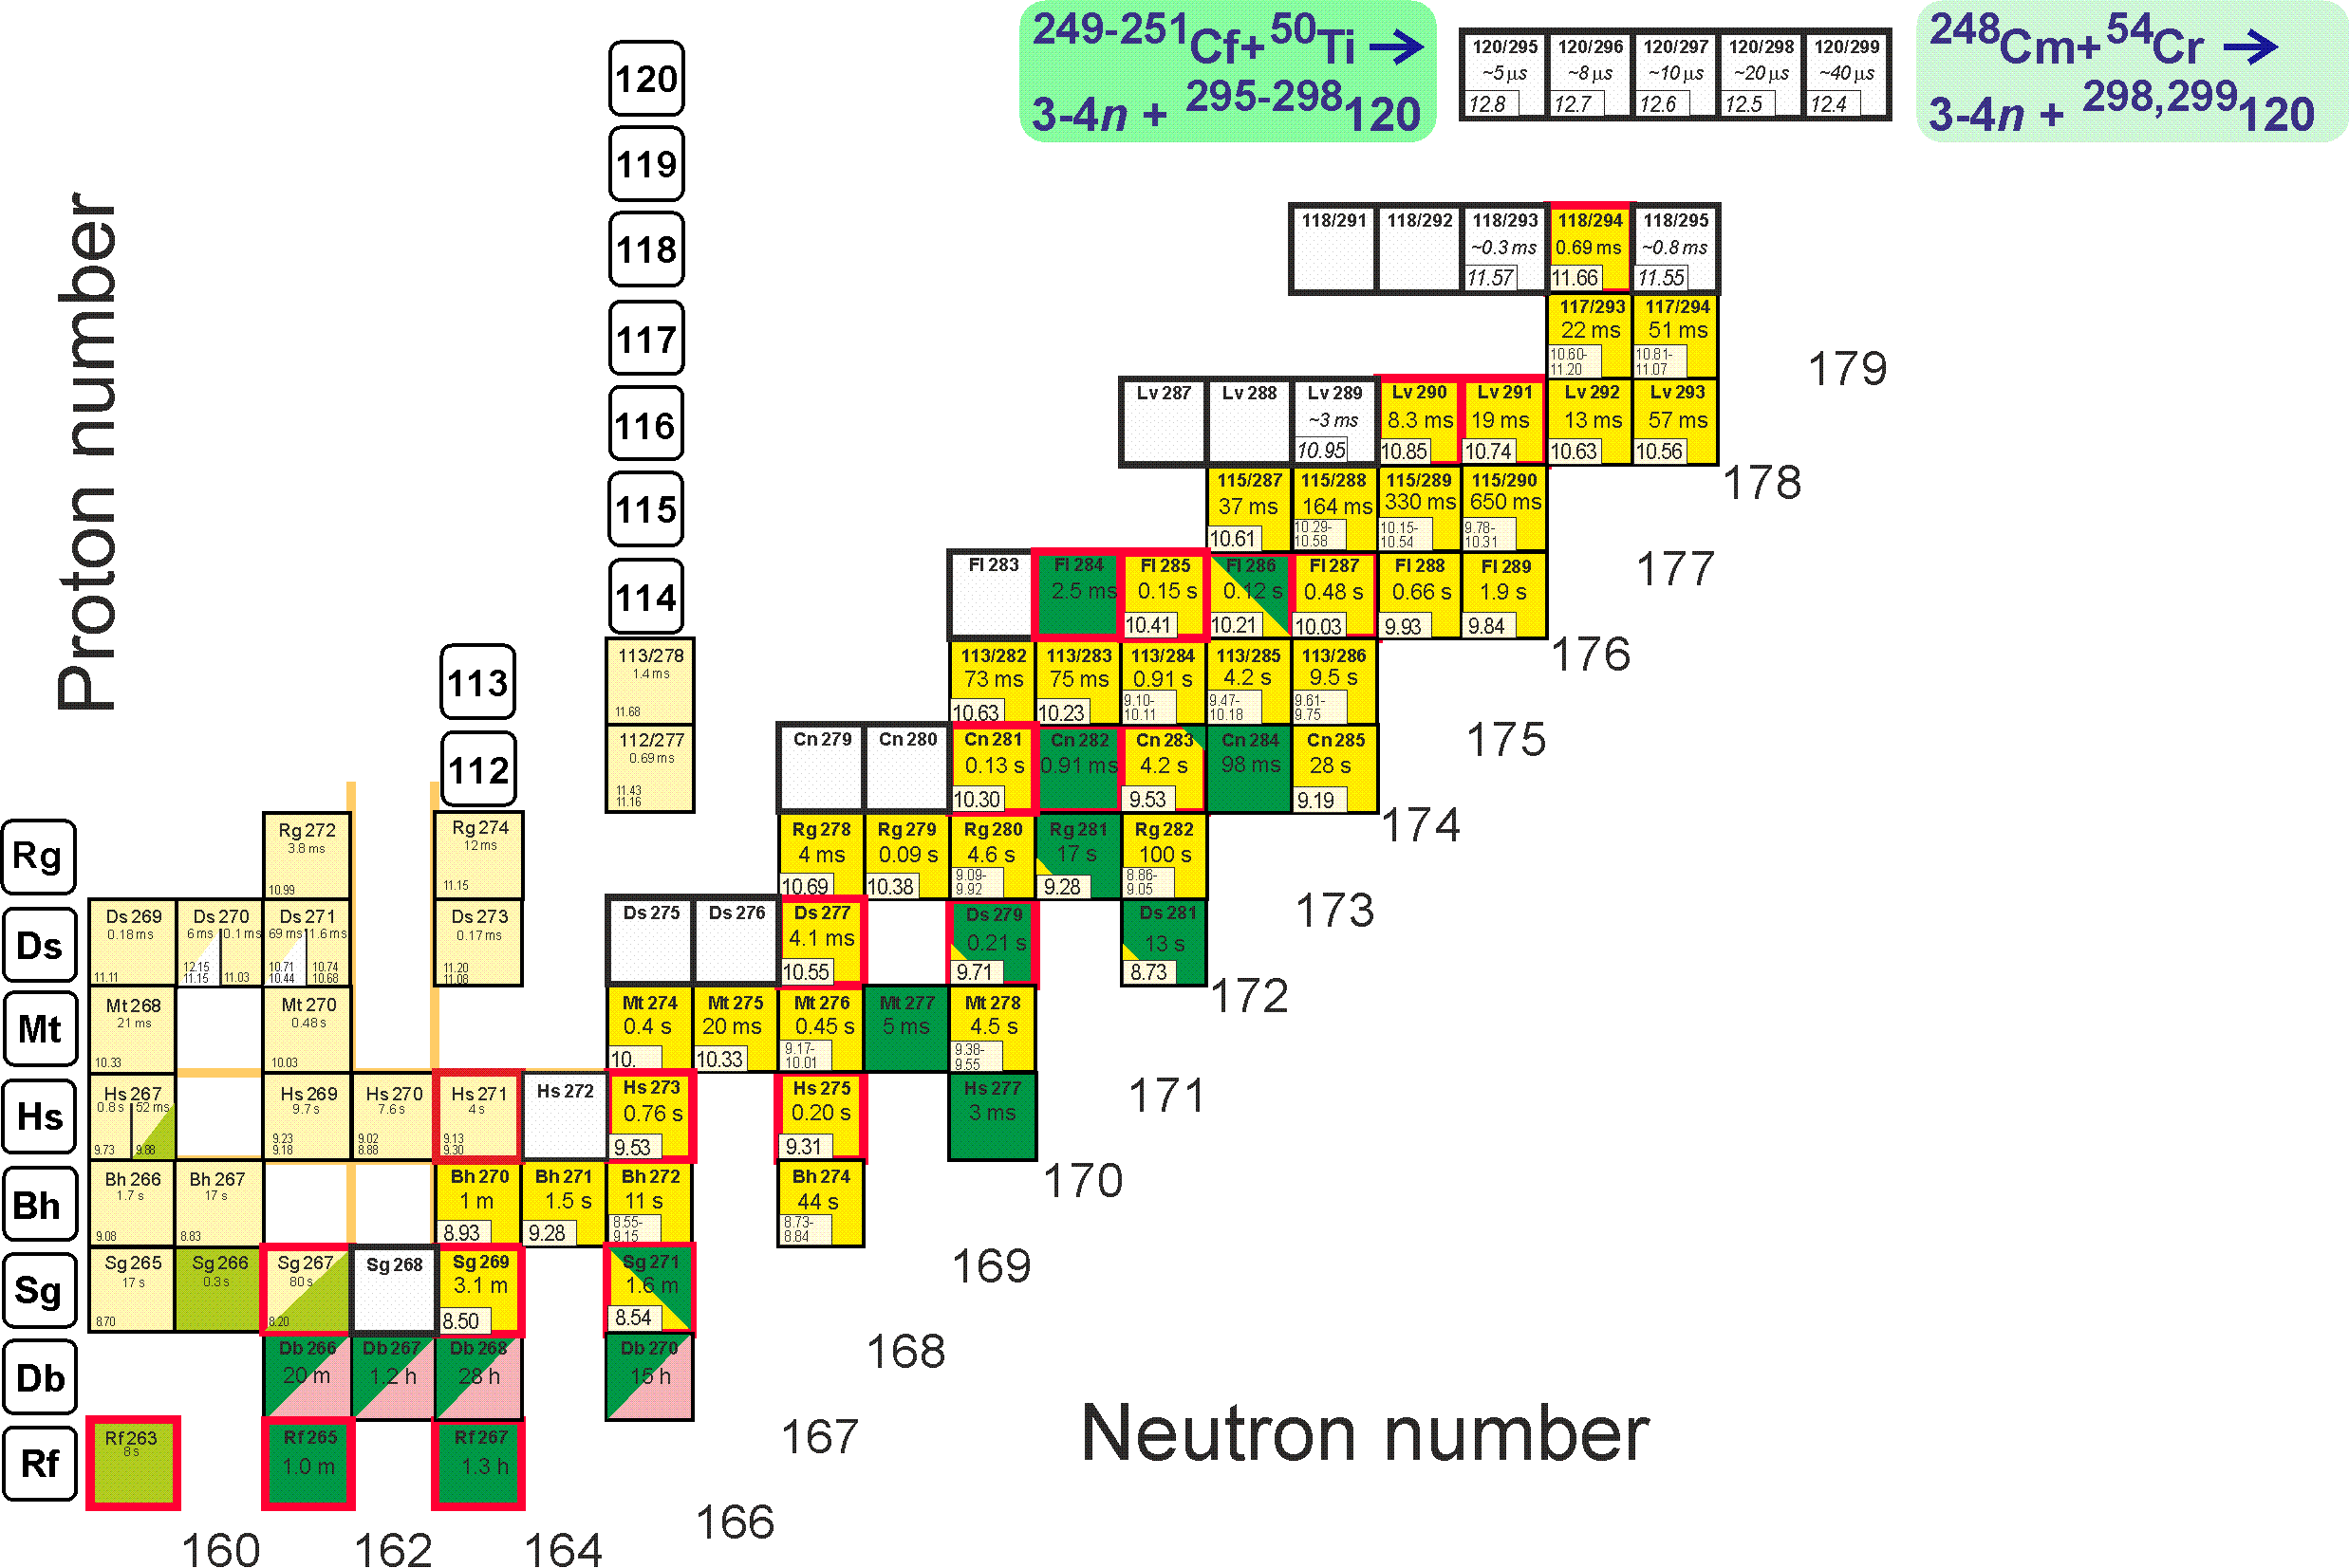
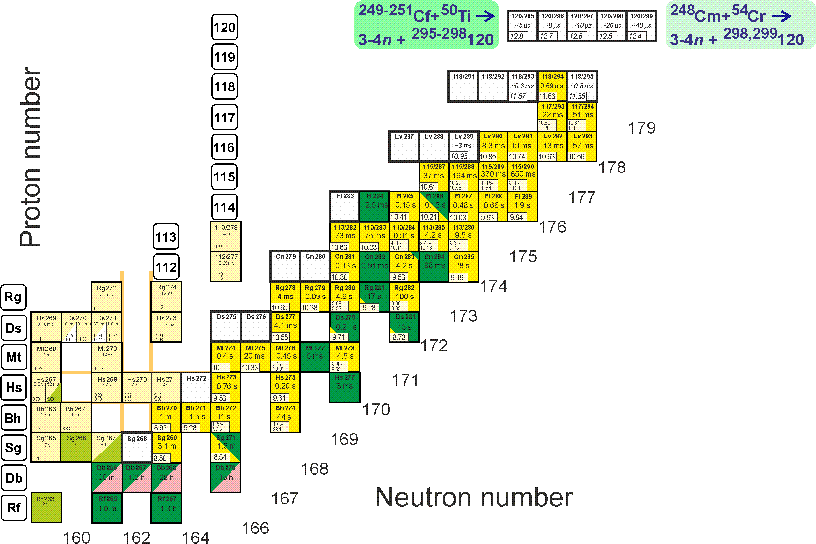
First experiments at SHE Factory
Synthesis of new element 120
²⁴⁹Cf(⁵⁰Ti,3-4n)^{295,296}120
²⁵¹Cf(⁵⁰Ti,3-4n)^{297,298}120
²⁴⁸Cm(⁵⁴Cr,3-4n)^{298,299}120
Descendants ²⁹⁴Og, ^{290,291}Lv, ^{284–286}Fl … are known
s=50 fb, h_{t}=0.3 mg/cm², ε_{coll}=0.6, I_{beam}=3 pmA → ≈1 event per month

Slide 38
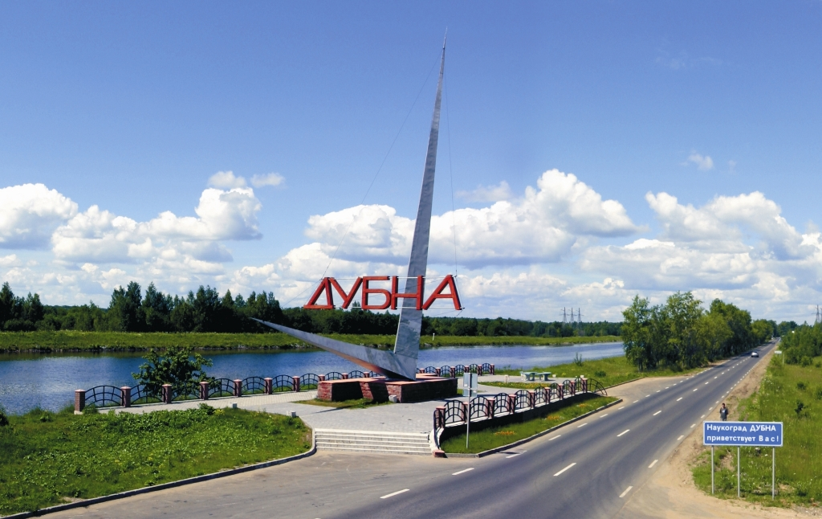

Thank you for your attention!

