Slide 1
Am-241 incineration measurements with activation method in the «QUINTA» neutron field
S. Kilim , E. Strugalska-Gola, M. Szuta, S.I. Tyutyunnikov, O. Dalkhjav, V.I. Stegailov,
I.A. Kryachko, J.H. Khushvaktov, A.G. Shakun, F.B. Sagimbaeva, A.S. Balandin

Slide 2
Some Am-241 introductory data
Radioactive, T_{1/2} = 432.2 y, α-active
Produced in a reactor as a nuclear waste.
Difficult to burn in PWRs. It accumulates.

Slide 3
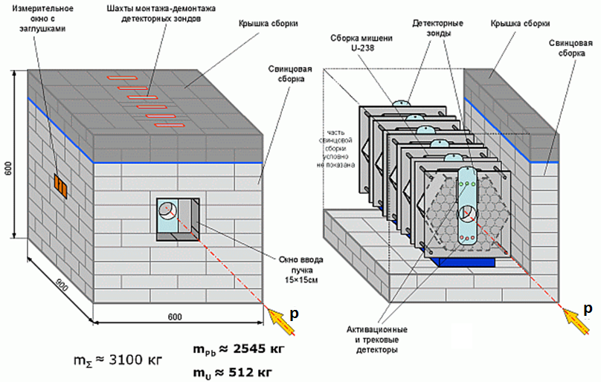
TA QUINTA with lead blanket

Slide 4
Experiment data
Experiment date | 4.12.2015
Experiment place | JINR, Dubna, Russia
QUINTA configuration | 5 sections, lead shield
Accelerator | Phasotron
Beam | 660 MeV protons
Beam integral | 4.5x10¹⁵
Method | Am-241 sample activation, gamma spectra measurement

Slide 5
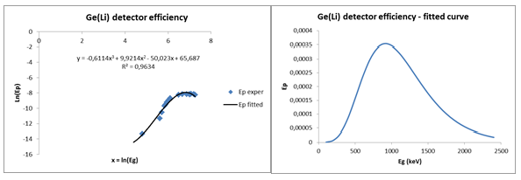
Experimental data work-out details
I_{fγ} – actinide fission rate, per deuteron and per gram
γ – gamma line index
f – reaction index (f = fission)
S_{γ} – gamma peak area
γ_{f} – isotope production yield [%]
m – activation sample mass [g]
ε_{p} – gamma spectrometer efficiency
I_{γ} – gamma line intensity [%]
φ - deuteron beam integral
COI – correction for gamma quanta coincidence
λ_{k} – isotope decay constant
t₊ – cooling time
t_{ir} – irradiation time
t_{real} – real time of measurement
t_{live} – live time of measurement

Slide 6
Basic gamma lines and fission product isotopes identified in Am-241 sample
E-gamma [keV] | Isotope 1 | Isotope 2 | T1/2-1 | T1/2-2 | I-gamma
529.87 | 133I |  | 20.87h |  | 87.00%
641.28 | 142La |  | 91.1 min |  | 47.40%
661.66 | 137Cs |  | 30.05y |  | 85.10%
722.911 | 131I |  | 8.02d |  | 1.77%
743.36 | 97Zr |  | 16.744h |  | 93.00%
847.025 | 134Te | 134I | 94m | 52.5m | 95.40%
884.09 | 134Te | 134I | 94m | 52.5m | 64.90%
1024.3 | 91Sr |  | 9.63h |  | 33.00%
1072.55 | 134Te | 134I | 94m | 52.5m | 14.90%
1131.51 | 135I |  | 6.57h |  | 22.60%
1260.41 | 135I |  | 6.57h |  | 28.70%
1383.93 | 92Sr |  | 2.66h |  | 90.00%
1435.86 | 138Cs |  | 33.41m |  | 76.30%
1455.24 | 134I |  | 52.5m |  | 2.29%

Slide 7
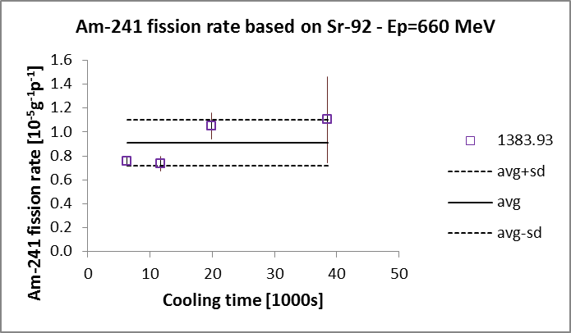
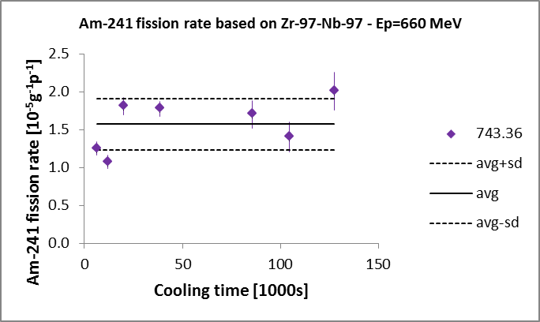
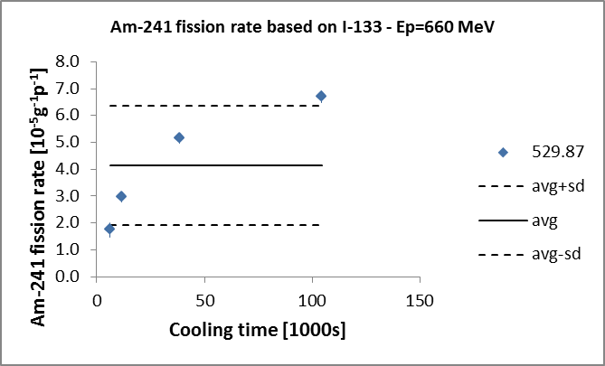
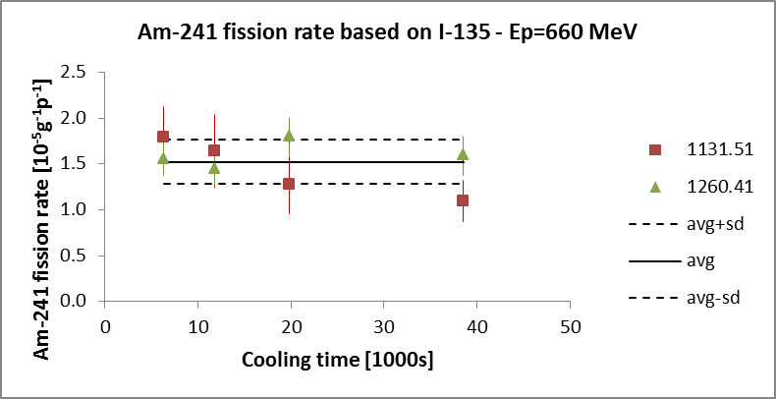
Am-241 FP specific fission rates

Slide 8
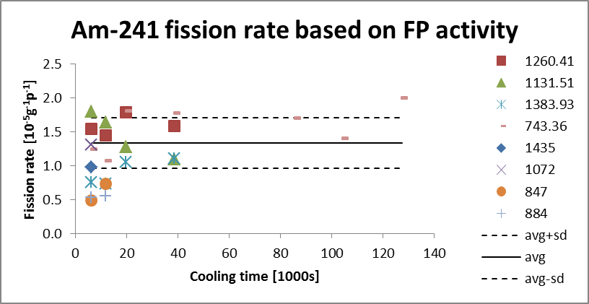
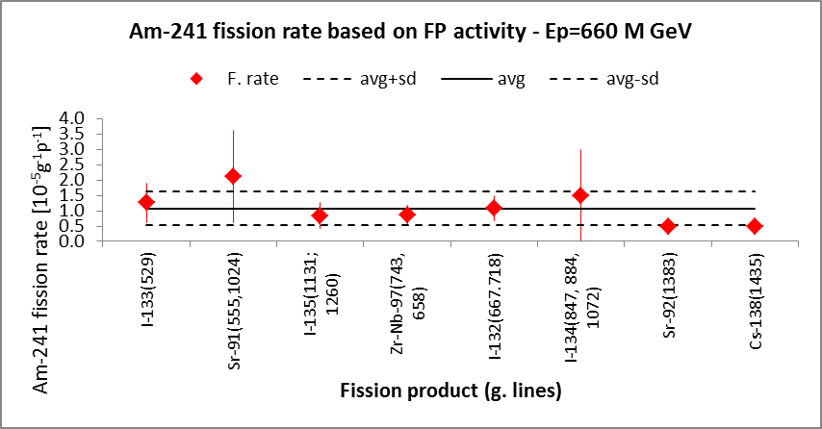
Am-241 fission rate summary based on FP activities
I_{f} = 1.34(37)x10⁻⁵ fissions/g/beam particle

Slide 9
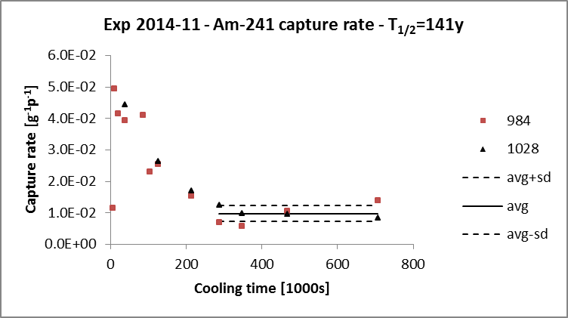
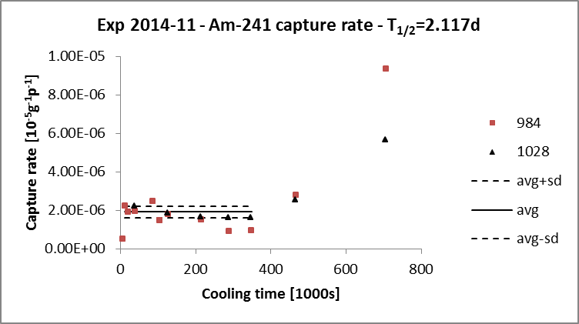
Search for neutron capture product gamma lines
Neutron capture line candidates
923.98 keV
962.77 keV
984.45 keV
1028.54 keV
Surprising effect of correction for cooling time – the lines 984 and 1028 keV stem from more than one reaction.

Slide 10
Search for neutron capture lines in Am-241 – cont.
Am-241 spontaneous α-decay and reaction (n,γ), (n,f), (n,α) channel data.
Comments to the above scheme
Neutron capture products long lived and therefore emitted gammas are of weak intensity.
Spontaneous Am-241 alpha decay emits gammas making high background.
Spontaneous Am-241 alpha decay product (Np-237) cumulates so intensively that after years its neutron capture product overlaps Am-241 neutron capture products.

Slide 11
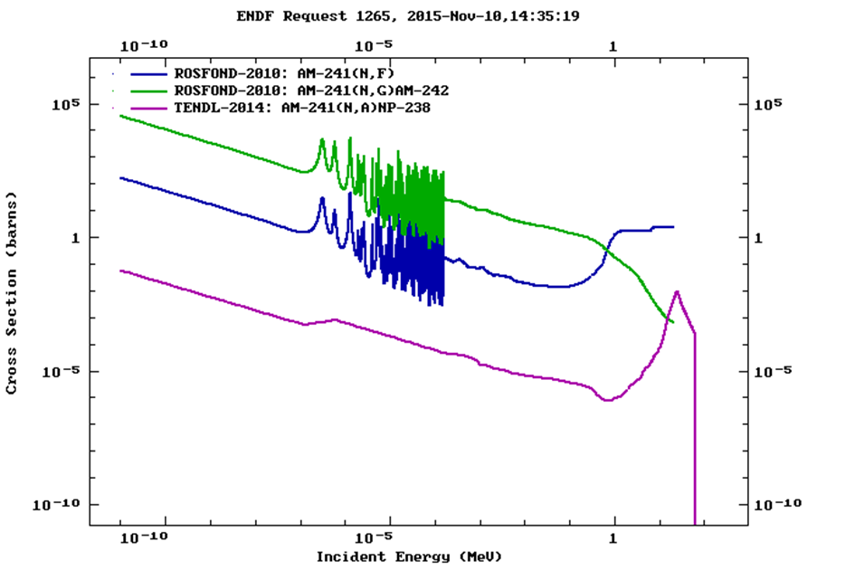
Am-241 cross sections for interaction with neutrons

Slide 12
Conclusions
Am-241 sample was irradiated in spallation neutron field produced in JINR Dubna’s ADS setup QUINTA to determine Am-241 incineration rate with activation method. The incineration goes in two competitive channels, either by fission or neutron capture. A gamma spectrometry method was used then to identify fission products and neutron capture products.
Three fission products were identified and based on them Am-241 fission rate. Am-241 sample activation method is good enough for Am-241 fission rate determination.
Nevertheless the expected lines stemming from neutron captures are either so weak that do not stack above background or are covered by Np-237 neutron capture product lines. To get rid of Np-238 decay lines problem one has to use fresh Am-241 sample or apply completely different method, not the activation one.

