Slide 1



A look at hadronization
via high multiplicity
E. Kokoulina
JINR, Russia & Sukhoy GSTU, Belarus
SEPTEMBER 17-22, 2018 DUBNA

Slide 2
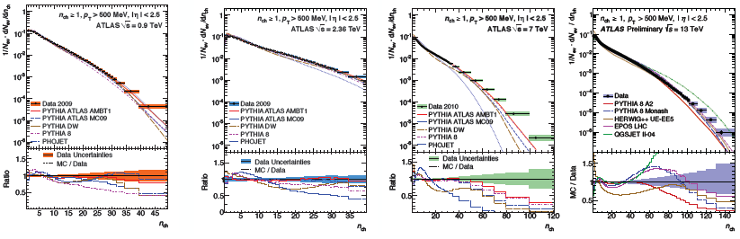
High multiplicity (HM) events
HM events draw considerable attention now. It’s connected with collective behavior of secondary particles in hadron and nuclear interactions (ridges, flows, shock waves etc.). There are lots of problems at the description of multiplicity distribution (MD) at high energy.
ATLAS Coll. A. Morley, 2015

Slide 3
Multi-particle processes
е⁺е⁻ annihilation, three gluonic decay
pp collisions “Thermalization” project
annihilation
number fluctuations of π⁰‘s with increasing of n_{tot}= n_{ch} + n₀ in pp
Soft yield in AA interactions

Slide 4
e⁺e⁻ - annihilation
O.Biebel.
Phys.Rep. 2001
Konishi,U.,V., NP 1979 Giovannini. NP 1979
Multiplicity
Distribution (MD):
Generation Function (GF):
I stage:
qg-cascade
(GF MD)
II stage:
hadronization
Correlated moments:

Slide 5
e⁺e⁻ - annihilation – I stage
I stage qg-cascade is based on pQCD. Elementary processes: 1) (A – probability), 2) ( ) and 3) (B).
Evolutional parameter –
MD in g-jet - Farry:
(GF – G)
MD in q-jet (GF – Q) –
negative binomial distribution (NBD):

Slide 6
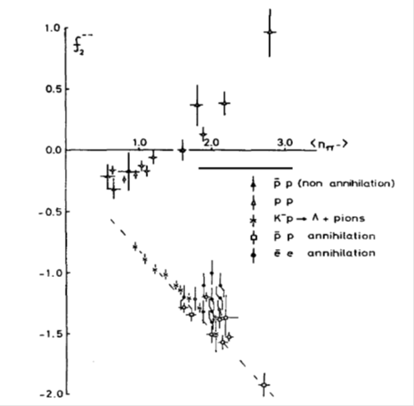
e⁺e⁻ - annihilation- II stage
Poisson: f₂ = 0
NBD:
Experiment testifies to the negative value of f₂ at low energy
We suppose: contribution of hadronization
is predominant in this region. We choose
binomial distribution for its description:
J.G. Rushbrooke, B.R. Webber.
Phys.Rep. 44 (1978) 1

Slide 7
e⁺e⁻ - annihilation
Convolution of two stages
Soft discoloration (GF):
For comparison with data we use (1):

Slide 8
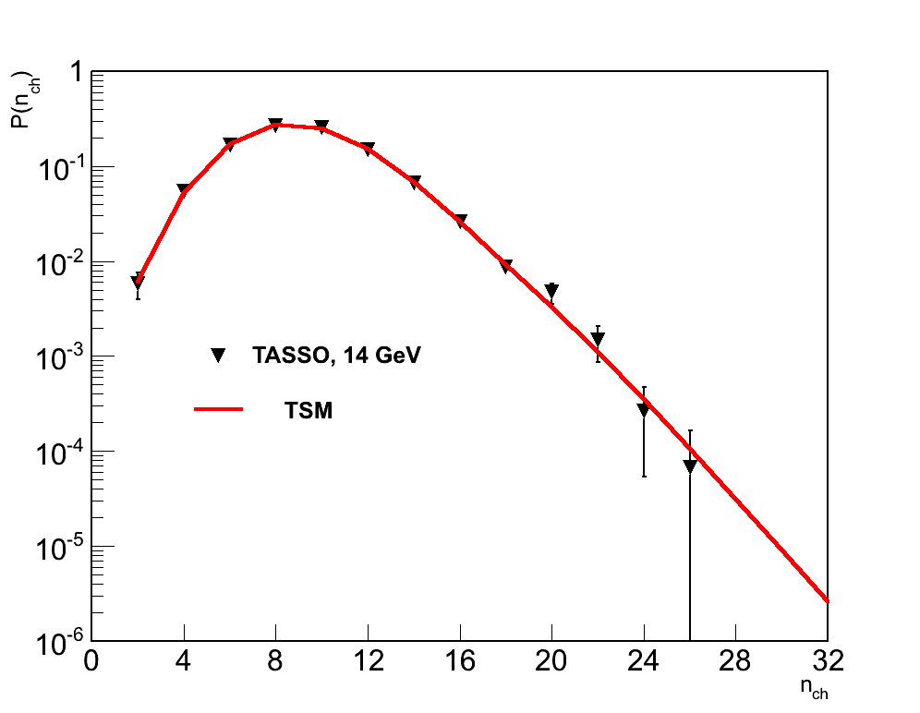
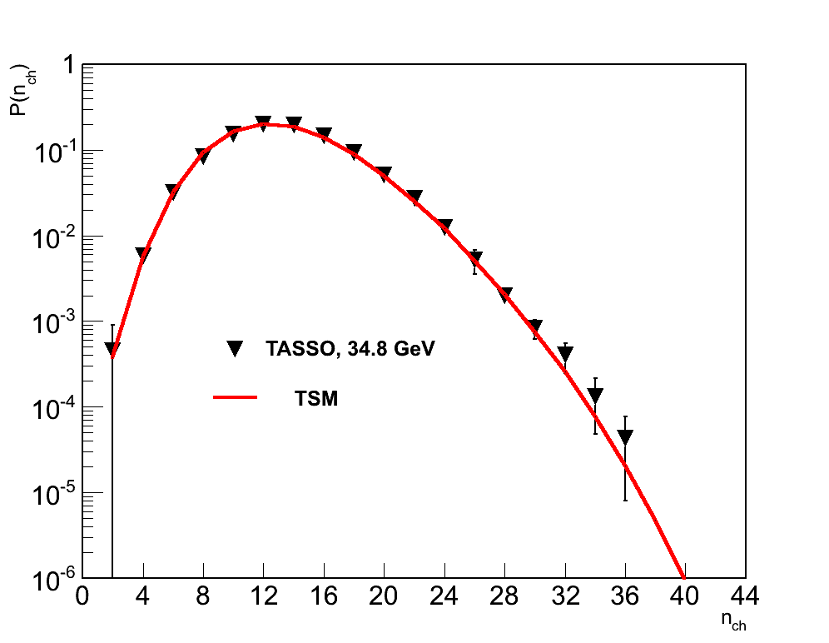
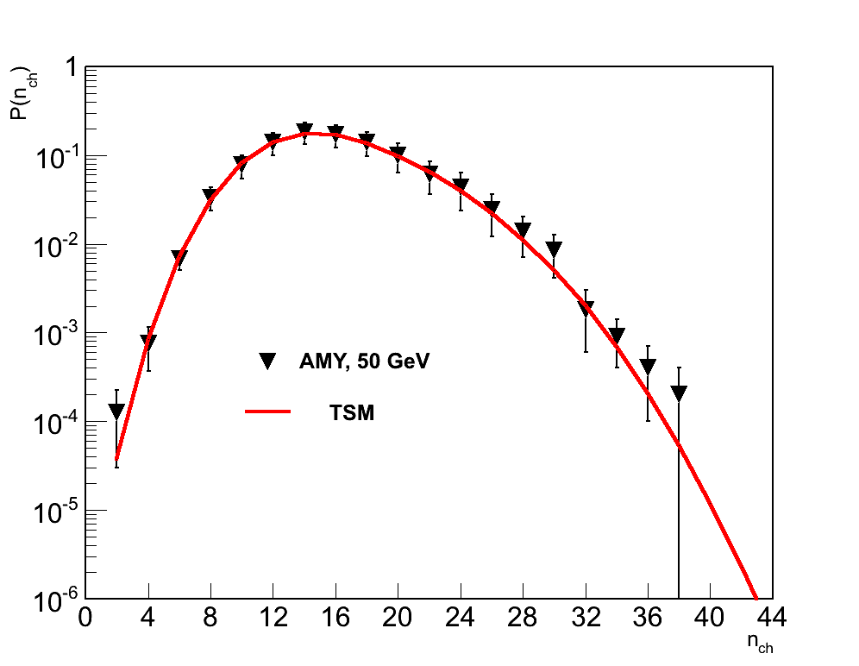
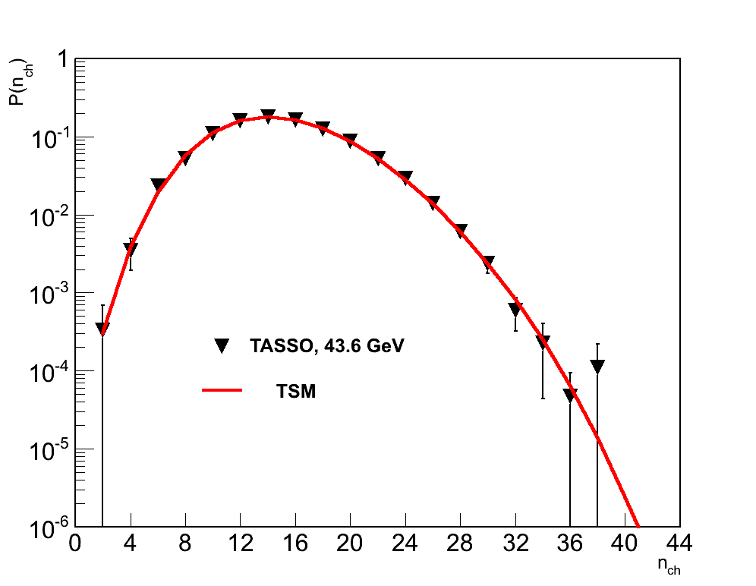
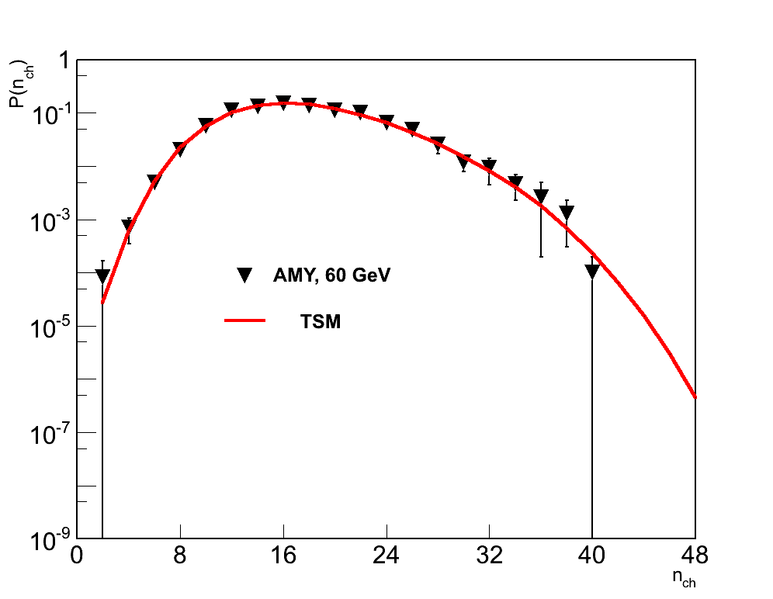
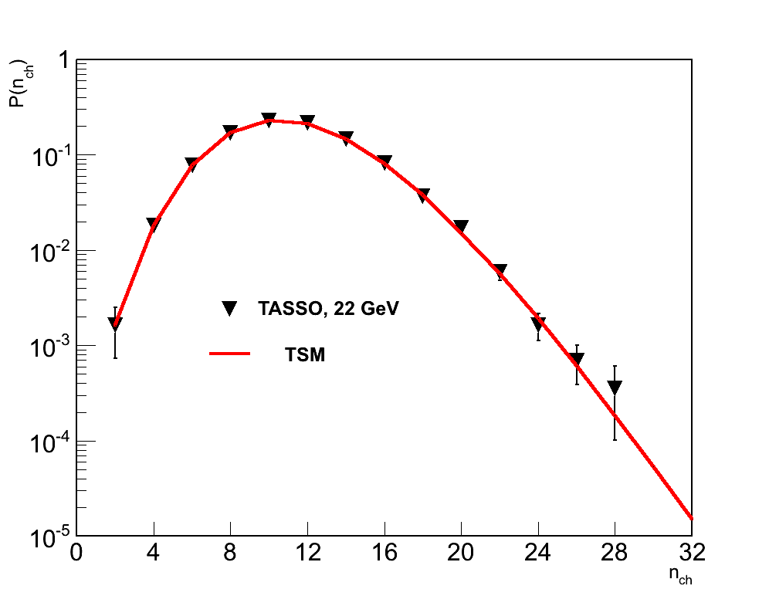
e⁺e⁻ - annihilation. Data & Model

Slide 9
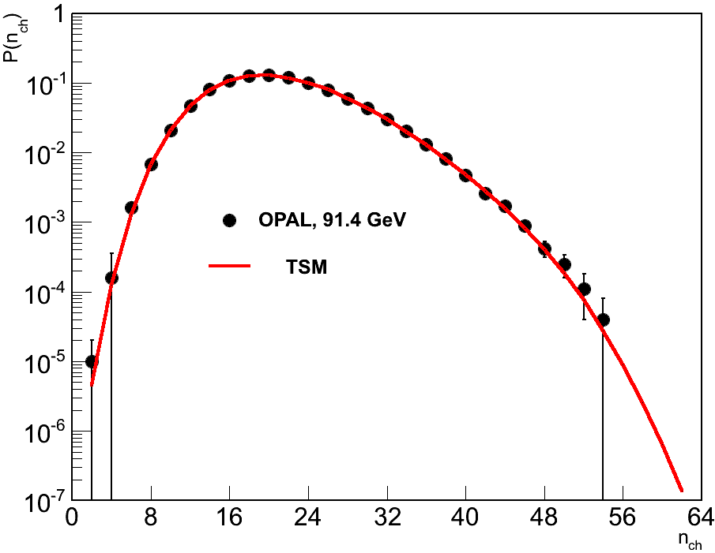
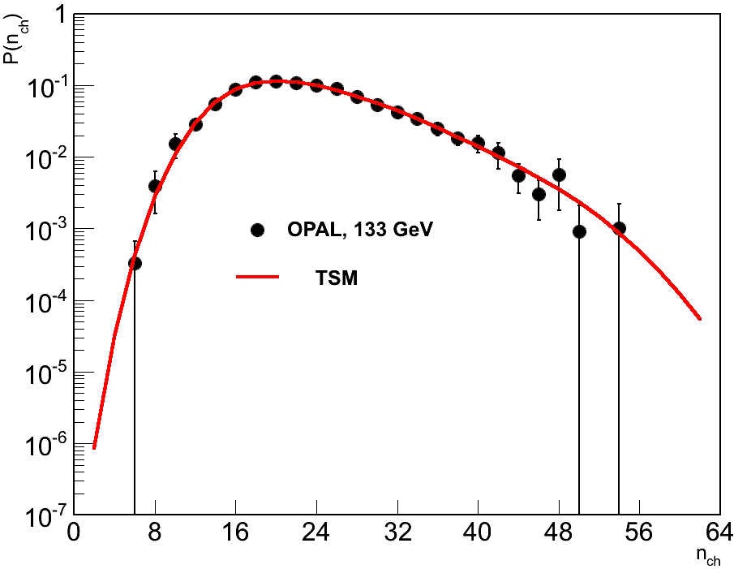
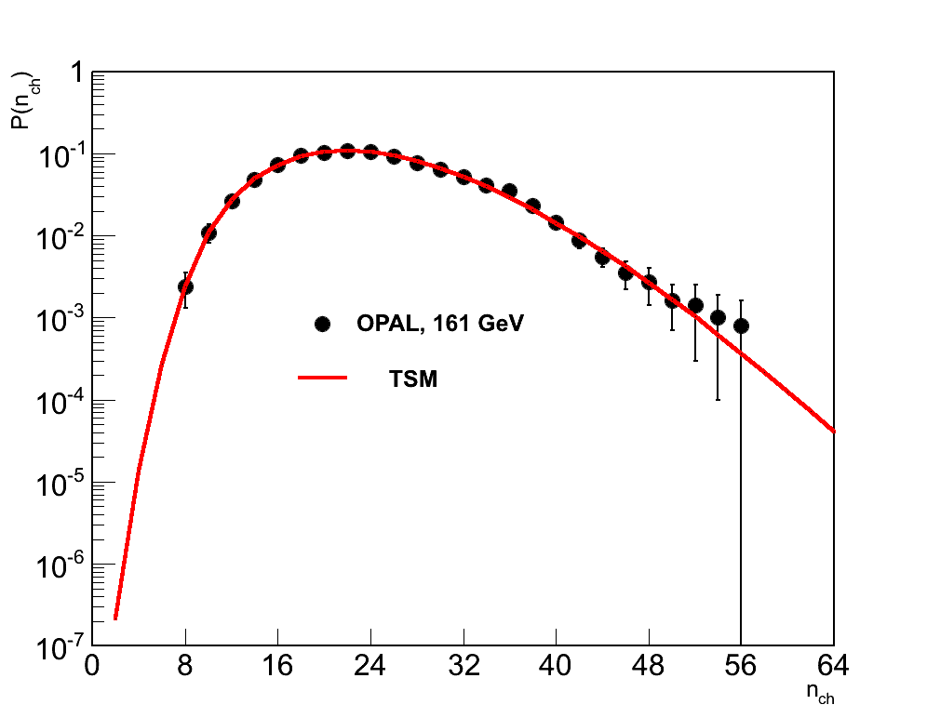
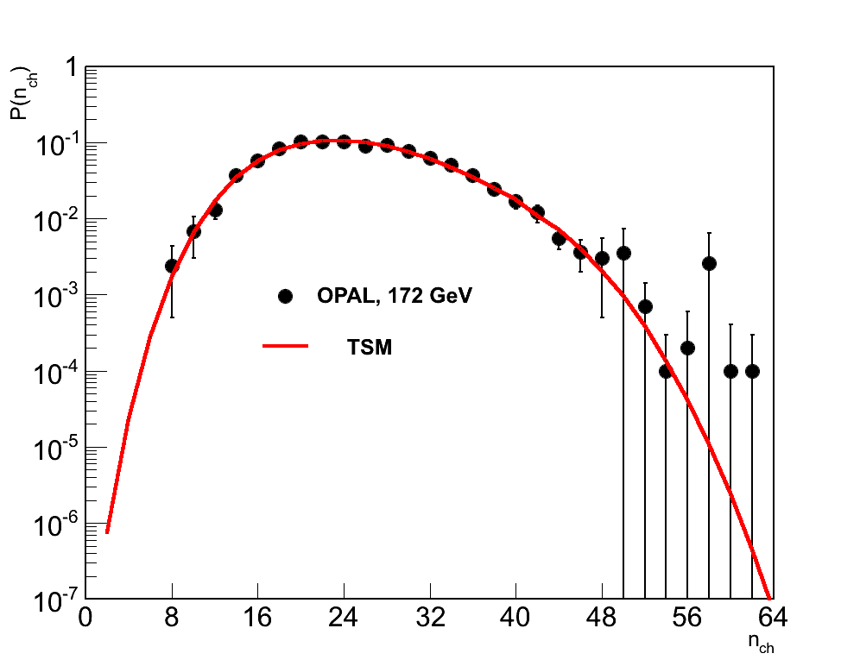
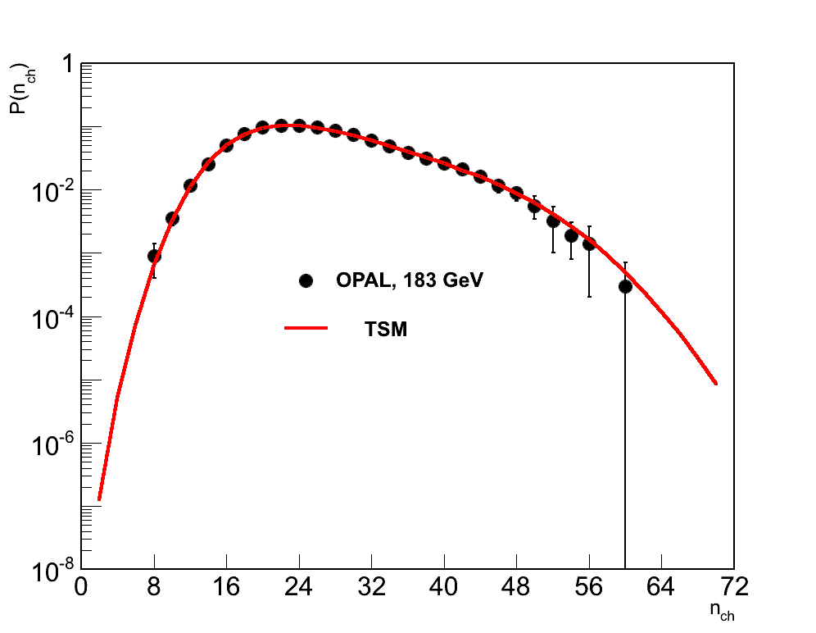
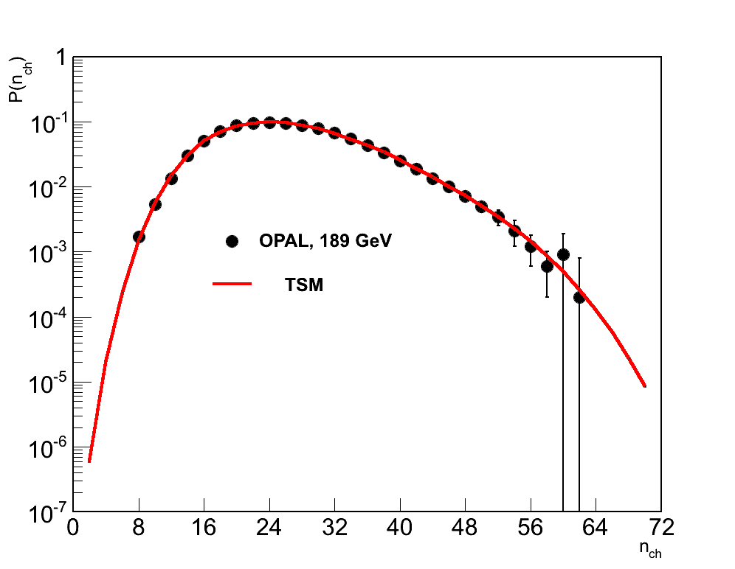
e⁺e⁻ - annihilation. Data & Model

Slide 10
e⁺e⁻ - annihilation
Confirmation: fragmentation mechanism of hadronization
(in vacuum 1 gluon → 1 hadron, LoPHD)

Slide 11
Three-gluon decay of quarkoniums ϒ(9.46), ϒ(10.02)
σ_{in}
Z
MD in g-jet is Farry:
LENA. Z. Phys. C9 (1981)1

Slide 12
HADRON INTERACTIONS (pp)
SVD-2 Collaboration has carried out search for collective phenomena in HM events (n >> ≈ 5) in
at 50 GeV/c proton beams. We suppressed small
multiplicity events and went down on topological cross sections on three orders reaching max n_{ch}=24 pions (at the kinematical limit ~ 59 pions).

Slide 13
HADRON INTERACTIONS
We modified our model to apply it for hadron (pp) interactions where valence quarks & nascent gluons develop branching in accordance to QCD elementary processes.
Convolution of qg-cascade with an analogous e⁺e⁻ scheme of hadronization at the comparison with data leads to considerably smaller values of the hadronization parameters than in е⁺е⁻ annihilation.

Slide 14
HADRON INTERACTIONS (GDM)
Our research has shown: with decreasing of the number of valence quarks, parameters of hadronization start to grow. Only excluding of valence quarks completely (they’re remaining in the leading particles), these parameters become rather more than in е⁺е⁻ annihilation. We call it gluon dominance model (GDM) and such gluons – active. GDM: gluons are sources of secondary. It testifies: change of hadronization mechanism from fragmentation to recombination one.
Fragmentation mechanism
B.Muller. 2004
Recombination
mechanism

Slide 15
pp INTERACTIONS (GDM)
GDM is based on two schemes. 1st. With gluon branching the share of gluons that don’t turn into hadrons ~ 47%. These gluons are remaining in qg-system being sources of increased yield of soft photons (p_{T}< 50 MeV). Their number coincides with Van Hove’s model estimations.
2nd. It’s simpler. Without gluon branching MD is (2):
(2)

Slide 16
pp interactions at 100-800 GeV/c
(2)
р ГэВ/с |  | M_{g} | N |  | Ω | χ²/ndf
102 | 2.75±0.08 | 8 | 3.13±0.56 | 1.64±0.04 | 1.92±0.08 | 2.2/5
205 | 2.82±0.20 | 8 | 4.50±0.10 | 2.02±0.12 | 2.00±0.07 | 2.0/8
300 | 2.94±0.34 | 10 | 4.07±0.86 | 2.22±0.23 | 1.97±0.05 | 9.8/9
405 | 2.70±0.30 | 9 | 4.60±0.24 | 2.66±0.22 | 1.98±0.07 | 16.4/12
800 | 3.41±2.55 | 10 | 20.30±10.40 | 2.41±1.69 | 2.01±0.08 | 10.8/12
At √s =60 GeV (ISR):
We observe an obvious growth of a parameter (the mean number of hadrons formed from a single gluon at its passing of the hadronization stage.

Slide 17
pp interactions at 100-800 GeV/c
102 GeV/c
205 GeV/c
GDM
GDM
300 GeV/c
800 GeV/c
GDM
GDM
NBD

Slide 18
Gluon fission as the source of HM
Kuraev,Bakmaev,E.K.NP (2011) Formation of two gluon jets predominates in the case b) in comparison with the case a). Such behavior can explain ridge structure in AA and pp (HM) events.
a)
b)
Mirabelle and SVD-2 data the topological cross sections, σ_{n ,} for рр collisions at the 50 GeV-proton beam and the GDM description with a g-fission
GDM’s prediction: in pp at 500 TeV <n_{ch}> ~ 50

Slide 19
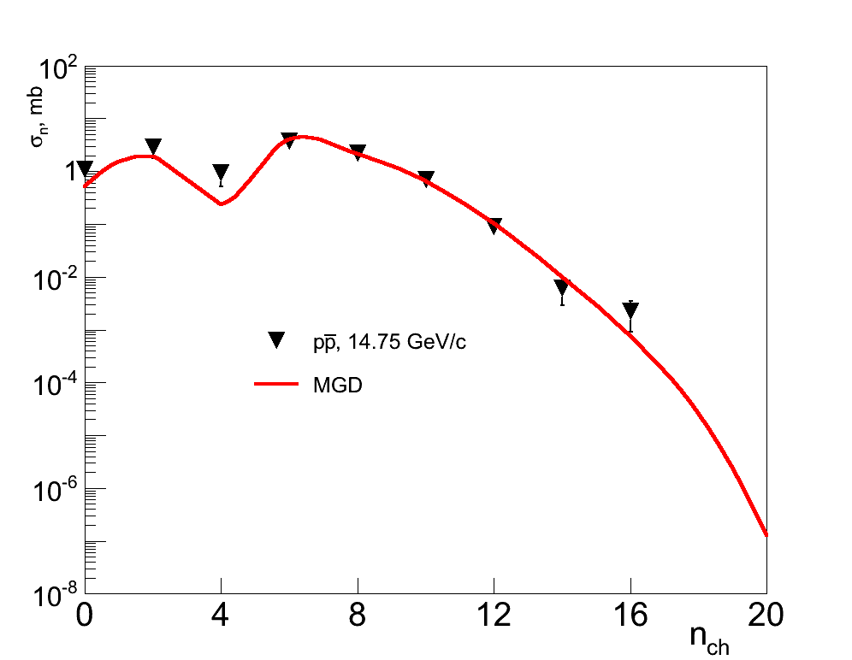
Proton-antiproton annihilation in GDM
<n₋>
J.G. Rushbrooke, B.R. Webber. Phys.Rep. (1978) 1

Slide 20

From Xiangdong Ji, University of Maryland, USA
“Confinement and hadron spectrum” 2018

Slide 21
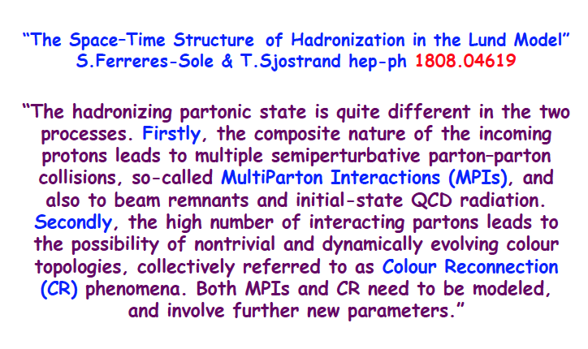

Slide 22
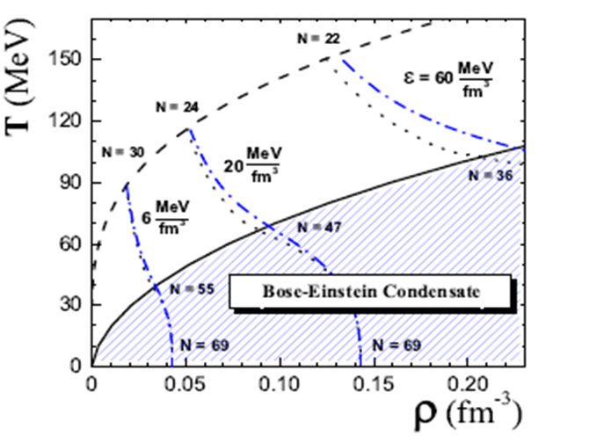
Fluctuations of π⁰’s number in HM
Begun and Gorenstein (Phys.Lett.2007;Phys.Rev., 2008) predicted the Bose-Einstein condensate formation (BEC) in pp interactions at U-70 in HM n_{tot} = n_{ch}+ n₀, in the framework of the ideal pion gas.
Phase diagram of pion gas. Dashed line corresponds to ρ_{π}(μ_{π}=0), solid – BEC line. Dotted lines present states with fix energy densities: ε = 6, 20, 60 MeV/fm³. Numbers (N) – pion multiplicity at μ_{π}=0 and μ_{π}=m_{π} at energy density ε for total energy of the pion system E=9.7 ГэВ.

Slide 23
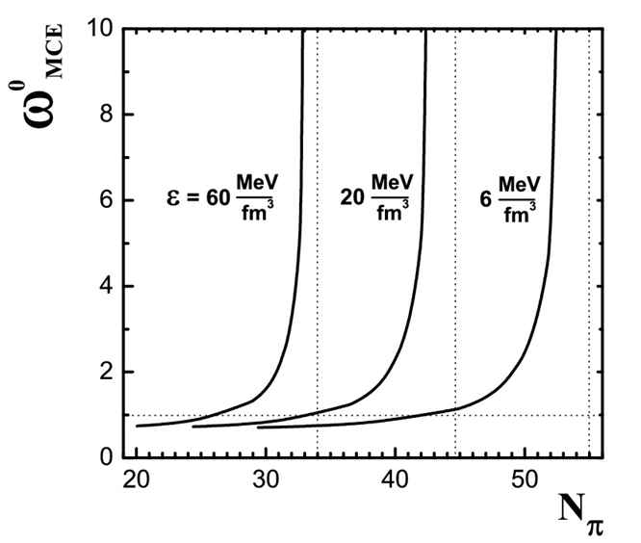
Fluctuations of π⁰’s number in HM
Scaled variance: ω⁰=D/<N₀>, D – variance for MD of π⁰’s, N_{tot} = N_{ch} + N₀– total multiplicity. MC codes and Poisson give ω⁰=1. Authors predict an abrupt & anomalous increase of ω⁰ of neutral and charged pion number fluctuations in HM region at approaching to BEC line in the thermodynamic limit.
With increasing of N, the pion system approaches the conditions of the BEC.
The anomalous increase of the scaled variances of neutral and charged pion number fluctuations is observed. The size of this increase is restricted by the finite size of the pion system.
→ T_{C}(π) >> T_{C}(A).

Slide 24
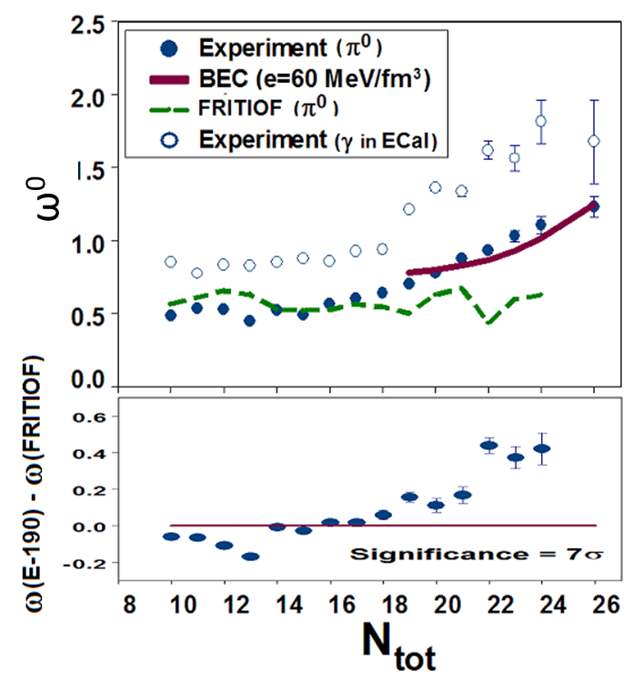
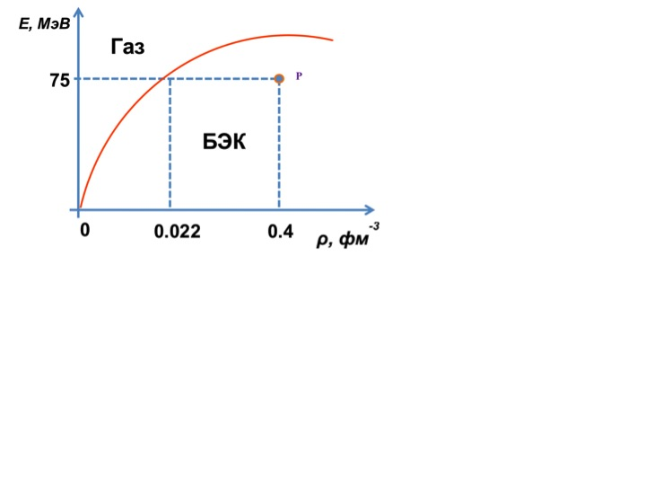
Fluctuations of π⁰’s number in HM
N ~30, r ~1.5 fm, ρ ~0.2 fm⁻³
E_{crit} ~700 MeV, <E_{π}> ~100 MeV <E_{π}> << E_{crit} (red line)
E, MeV
Gas
SVD Collab.,EPJ, 2012; ICHEP 2012
BEC
ρ, fm⁻³

Slide 25
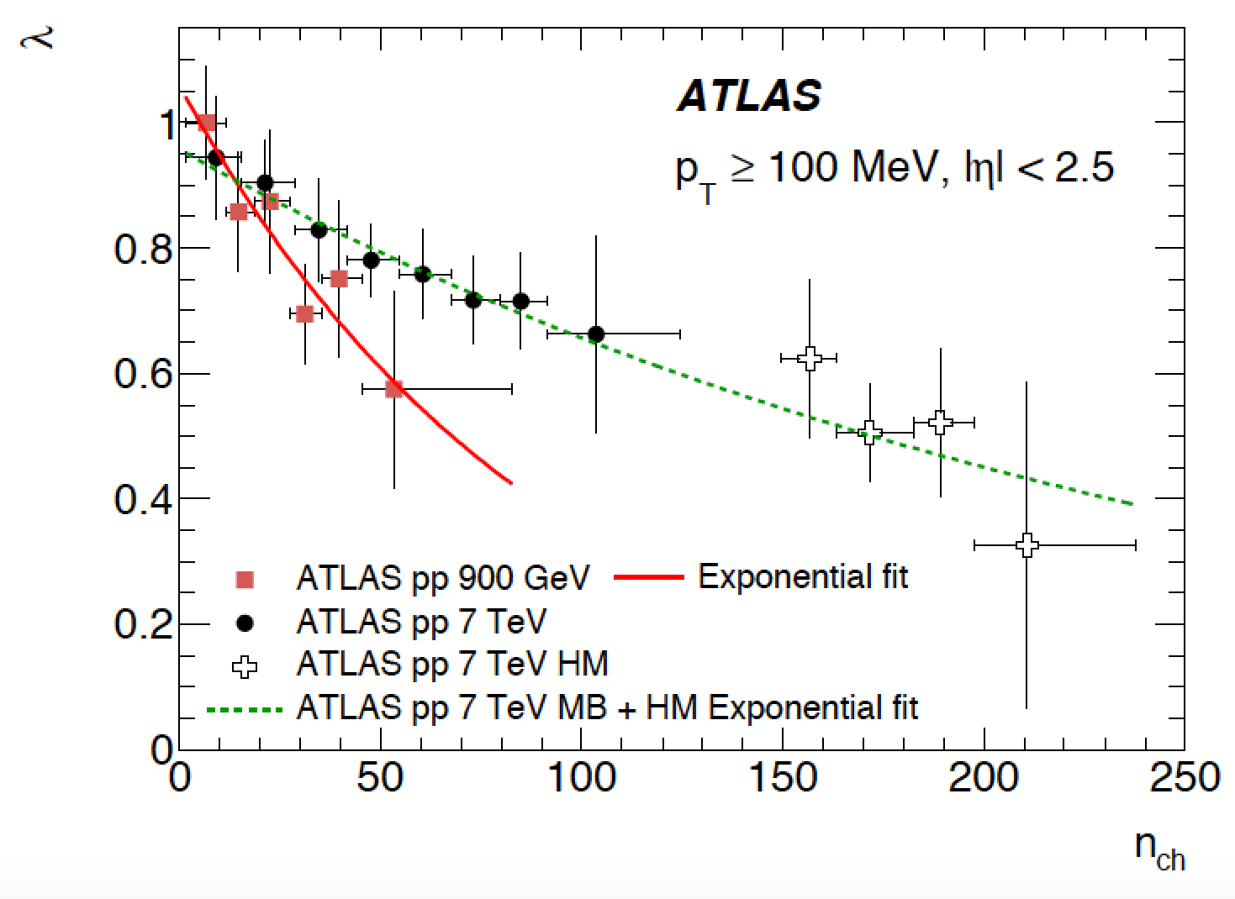
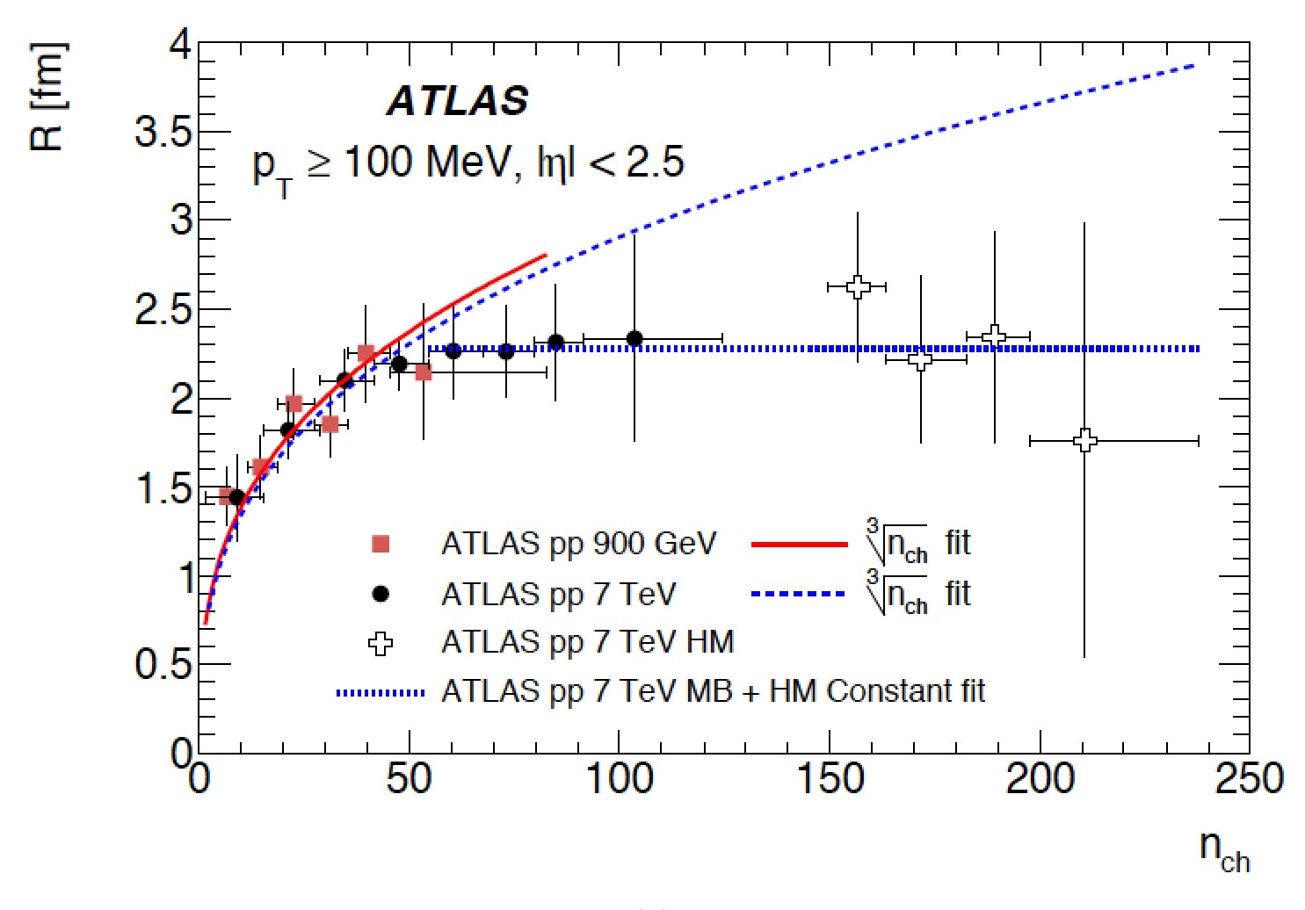
Bose–Einstein correlations in pp collisions
1. Two-particle Bose–Einstein correlations in pp collisions at √s= .9 and 7 TeV measured with the ATLAS detector” Eur.Phys.J. (2015)
2. Chaoticity and coherence in Bose-Einstein condensation and correlations. Cheuk-Yin Wong et al. hep-ph 1501.04530 (BEC)
1.
2. C₂(Q) = ρ(Q)/ρ₀(Q) = C₀ [1 + Ω (λ, QR)](1 + εQ), Q² = (p₁-p₂)², where the effective radius R and λ - incoherence or chaoticity parameter. Scheme for fully coherent emission of identical bosons, λ = 0, while for incoherent (chaotic) emission, λ = 1. That behavior indicates at the approaching to BEC formation (λ = 0).

Slide 26
Soft photon yield in hh & AA interactions
WA91, 2002
DELPHY
2009
SVD-2, 2015

Slide 27

Thank you for attention

