Slide 1

The ideas of A.M. Baldin on overcoming the reductionism principle in relativistic physics.
Anton Baldin
Joint Institute for Nuclear Research, Dubna, Russia
Institute for Advanced Studies "OMEGA", Dubna, Russia

Slide 2



Slide 3
Reductionism
The practice of analyzing and describing a complex phenomenon in terms of its simple or fundamental constituents, especially when this is said to provide a sufficient explanation.

Slide 4
QUANTUM FIELD THEORY AND SYMMETRIES
IN NUCLEAR PHYSICS
A.M.Baldin Particles and Nuclei,Letters No.2[99]-2000
«The problem of describing nuclear processes, like all other physical processes, is solved
on the basis of the construction of the space of defining the parameters linking real physical
objects.
Nuclear physics originates from the discovery of the Mendeleev Periodic Law
in which the parameters: atomic weight A and charge Z, play a fundamental role in the
description of atomic properties. The proton-neutron structure of all the nuclei, including the
synthesized ones, as a function of the parameters A and Z. The creation of quantum mechanics has resulted in the introduction of the quantum parameters of the ground and excited states of atomic nuclei.
Later on, it was found that it was necessary to introduce the concept of non-nucleon degrees of freedom, as well as the concept of quark-gluon or colour degrees of freedom of nuclei.
Then, the idea itself that matter consists of elementary particles has undergone essential changes. However the idea that the primary concept of physics is the concept of space has kept its fundamental importance.
The comparison of the defining parameters space with the mathematical one is the essential point of the construction of mathematical models.»

Slide 5
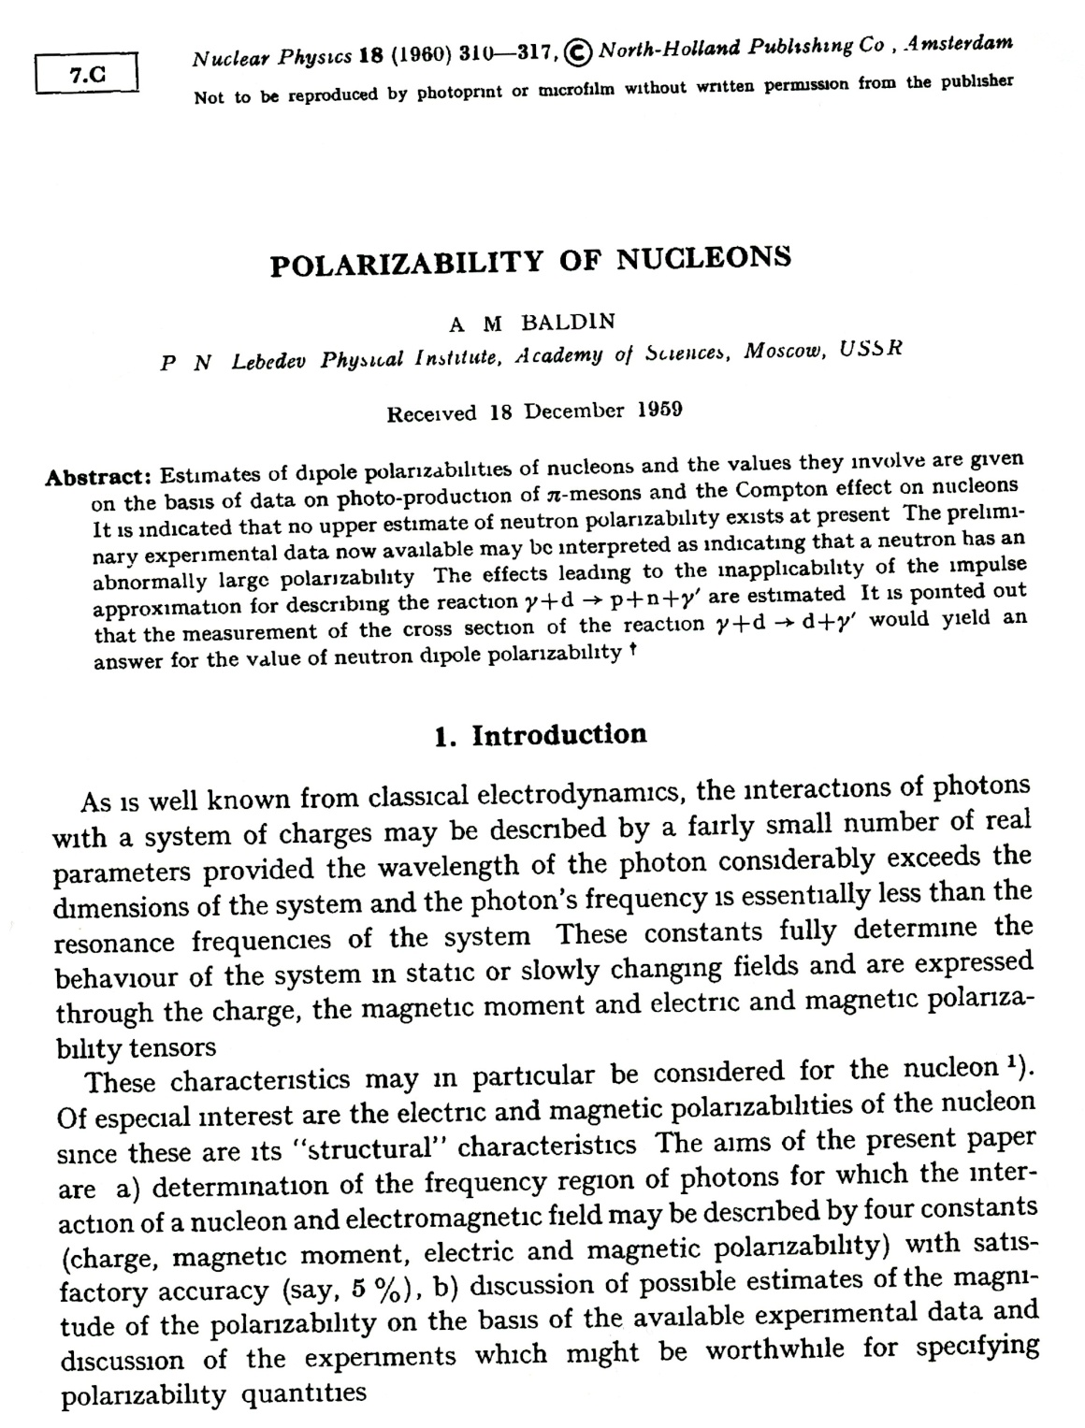
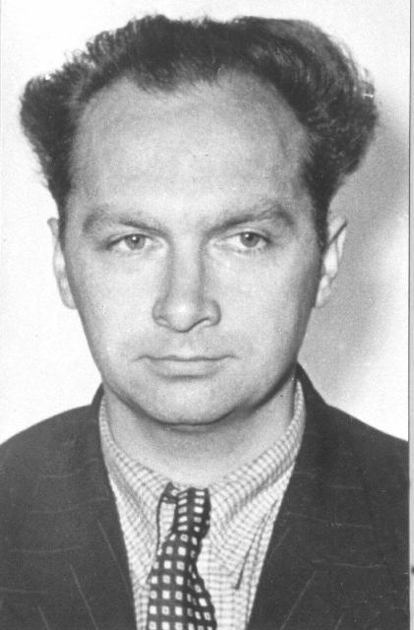
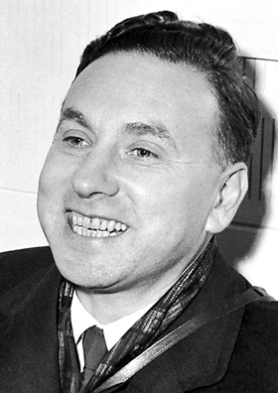
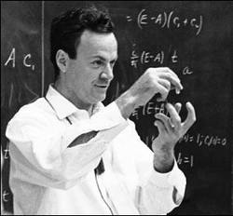
Robert Hofstadter (1961, Nobel Foundationphoto)
"Electron Scattering and Nuclear Structure".
W. McAllister & Robert Hofstadter, "Elastic Scattering of 188 MeV Electrons from Proton and the Alpha Particle," Physical Review, V102, p. 851 (1956).
Richard Feynman
The parton model 1961

Slide 6
Ahiezer A.I., Rekalo M.P., 1979 :
“It should be noted that it was assumed not long ago that an elementary particle cannot have a size and should necessarily be point-like. This opinion was related to the fact that a non-point-like particle was considered as a solid rigid sphere. As, for example, in the well known textbook by Landau and Lifshitz…
In reality, however, the existence of a particle size is not equivalent to its rigidity.”

Slide 7
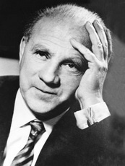
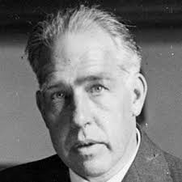
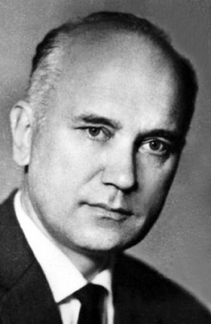
W. Heisenberg:
“We have to remember that what we observe is not nature herself, but nature exposed to our method of questioning.”
“There is a fundamental error in separating the parts from the whole, the mistake of atomizing what should not be atomized. Unity and complementarity constitute reality.”
N. Bohr:
When searching for harmony in life one must never forget that in the drama of existence we are ourselves both actors and spectators. ”
B. Raushenbakh:
d'Alambert told us that Nature does not show us anything but matter and motion. His successors, however, stated that the Universe consists of matter and motion, thus having transformed a reasonable statement into a dubious dogma.

Slide 8
QUANTUM FIELD THEORY AND SYMMETRIES
IN NUCLEAR PHYSICS
A.M.Baldin Particles and Nuclei,Letters No.2[99]-2000
«Complicated real physical situations require simplified descriptions and determinations of the region of validity (measurability) of the introduced concepts. We have to define the region of applicability of the concept "elementary particle". By tradition, the elementary
particles are taken to mean indecomposable structure constituents of matter. This concept
has been formed in a close connection with the idea about the discrete structure of matter at the microscopic level. When constructing models, the elementary particles are thought of as absolutely identical and their ensembles are described by the quantum fields which are just the basis of the mathematical space of a model. However quantum field theory is successfully applied to both particles possessing inherent structure and decomposable objects, for example, helium atoms at low temperatures.»

Slide 9
A.M.Baldin proposed a classification of applicability of the notion “elementary particle” on the basis of the variable b_{ik} introduced by him.

Slide 10
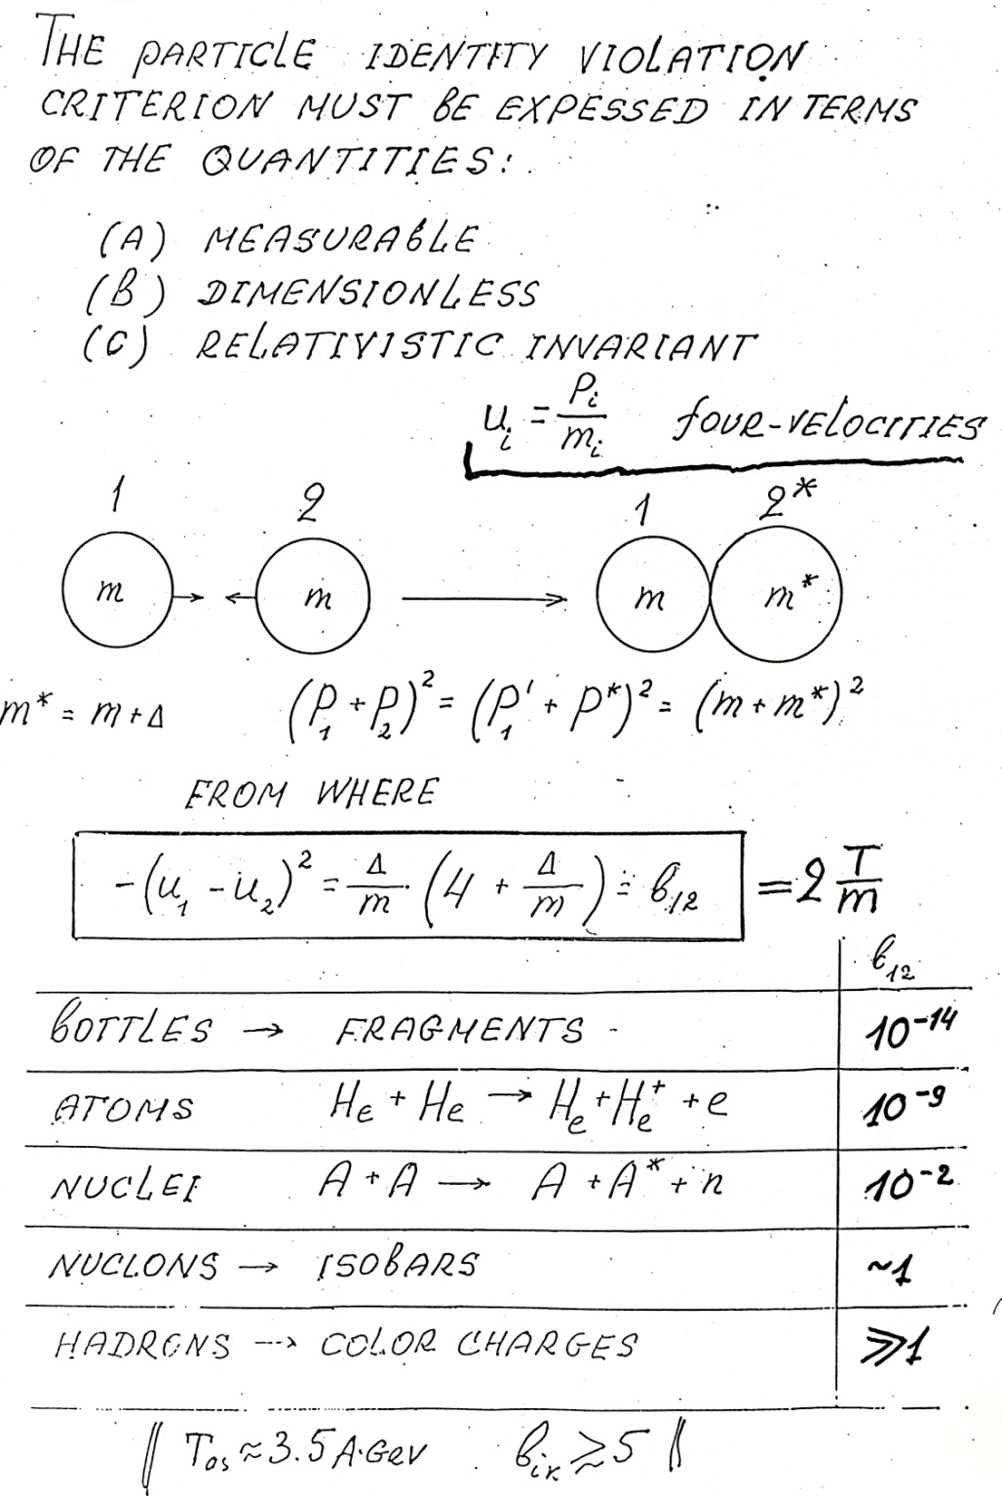

Slide 11
PDG K. Hagiwara et al., Phys. Rev. D 66, 010001 (2002) (http://www-pdg.lbl.gov/)

Slide 12
PDG
K. Hagiwara et al., Phys. Rev. D 66, 010001 (2002) (http://www-pdg.lbl.gov/)

Slide 14
π⁻C (40 GeV)
We consider b_{ik} of all particles in the reaction

Slide 15
u₅
b₄₅
u₄
b₃₅
b₁₄
b₁₃
u₃
u₁
b₁₂
b₂₃
u₂

Slide 16
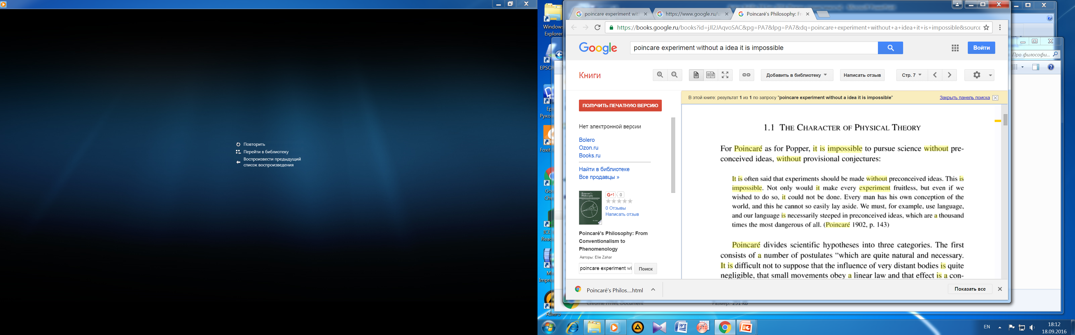

Slide 17
It should be noted that the variable does not form a metric space,
i.e. the relation
is, generally speaking, wrong.
3
α₁
ρ₂₃
ρ₁₃
h
α₃
y
α₂
1
ρ₁₂
2

Slide 18
According to F. Klein, the modern relativity principle in physics amounts to the same thing as the Lorentz group theory, which is isomorphic to the group of isometries of the Lobachevsky space.

Slide 19
3
α₁
ρ₂₃
ρ₁₃
h
α₃
y
α₂
1
ρ₁₂
2
longitudinal rapidity
:
.
,
,
transverse mass :
,
transverse rapidity

Slide 20
3
α₁
ρ₂₃
ρ₁₃
h
α₃
y
α₂
1
ρ₁₂
2
.

Slide 23
3
α
h
ρ
β
2
1

Slide 24
3
α₁
ρ₂₃
ρ₁₃
h
α₃
y
α₂
1
ρ₁₂
2

Slide 25
pC (10 GeV)
Protons, 3 GeV/c
Protons, 16.5 º
Pions, 500 MeV/c
Pions, 16.5 º

Slide 26
π⁻C (40 GeV)
Pions
Pions, spectrum
2Π_{L}-α₁
Pions, 3 GeV/c
Pions, 2.8 º

Slide 27
GeV/c
GeV/c
G
GeV/c
GeV/c
GeV/c

Slide 28
3
α
3
α
h
ρ
h
ρ
β
β
2
1
2
1
Collider
Fixed target
Angle of parallelism

Slide 29
Directed Nuclear Radiation
P+C->pions at 10GeV

Slide 30
Directed Nuclear Radiation
3
α₁
ρ₂₃
ρ₁₃
h
α₃
y
α₂
1
ρ₁₂
2

Slide 31
" The standard model in elementary particle physics claims to be capable of describing electroweak and strong interactions and is a great achievement of experimental and theoretical physics of the second half of the 20th century. However the standard model contains only those defining axioms which concern the lagrangian symmetries, but this is not enough for the description of physical processes. Some additional conditions (hypotheses) are needed : initial and boundary conditions, assumptions about the constants entering the lagrangians (masses, charges and so on ).
It is impossible to deduce nuclear physics, including relativistic nuclear physics, from quantum chromodynamics without using auxiliary hypotheses needed to be checked experimentally. The verification of such hypotheses of a rather general nature is not less important than the verification of quantum chromodynamics. For instance, a detailed probe of the correlation depletion principles and the self-similarirty is a task of paramount importance.
However both the lagrangian properties and the self-similarity are consequences of symmetry. Symmetry was considered by ancient Greek philosophers as a particular case of harmony i.e. the concordance of the parts within the whole.
A.M.Baldin JINR, Dubna,1996

Slide 32
A.M.Baldin
JINR Rapid Comm. №5, 1996
SYMMETRY
OF
SOLUTIONS
SYMMETRY
OF
LAGRANGIANS,
EQUATIONS
SYMMETRY
INVARIANCE
CONSERVATION LAWS
GAUGE
SYMMETRY
QUANTUM NUMBERS
SELECTION RULES
AUTOMODELITY
(SELF-SIMILARITY)
SYMMETRY DICTATES INTERACTION
SIMILITUDE
CDP
RENORMA-LIZATION GROUP
STRONG FORCE
ELECTRO-MAGNETIC FORCE
WEAK FORCE
GRAVITY FORCE
Schematic diagram illustrating the role of symmetry in fundamental physics.

Slide 33
ΣΙΜΜΕΤΡΙΑ
The Greek word “ΣΙΜΜΕΤΡΙΑ” means “commensurability, congruence, proportionality, symmetry”.

Slide 34
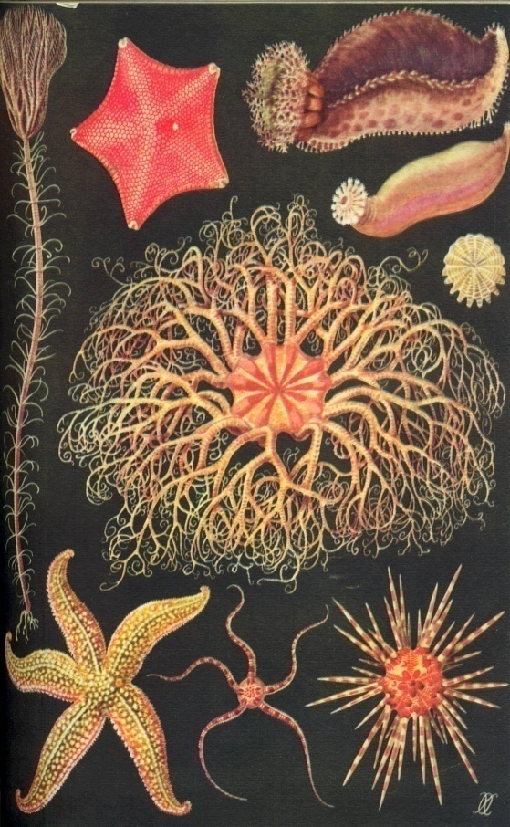
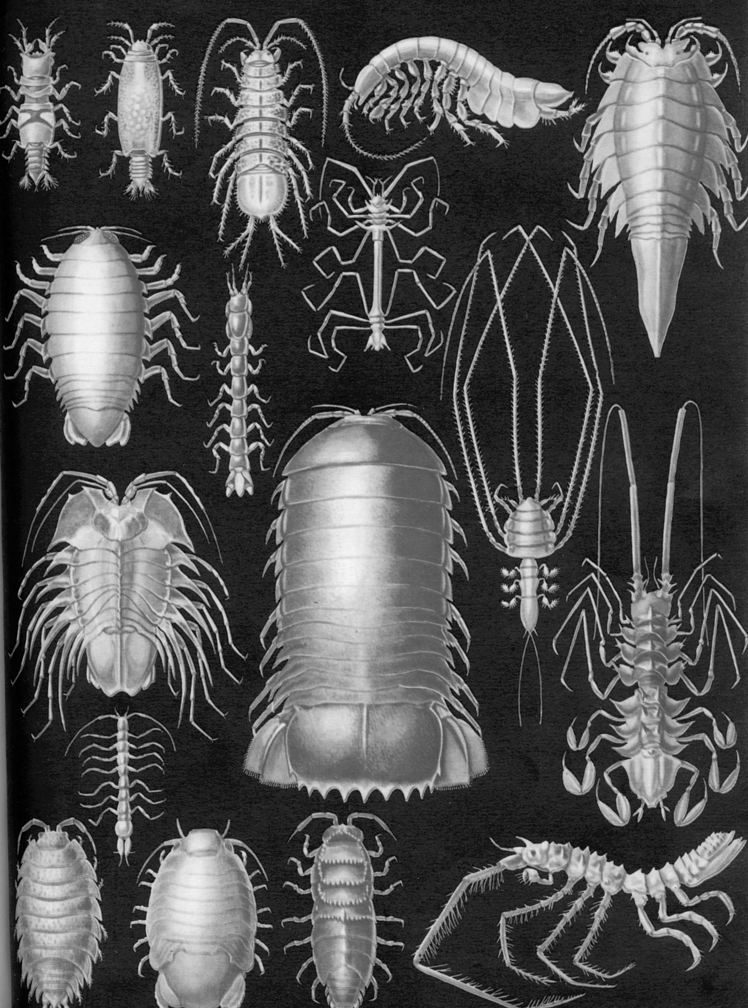
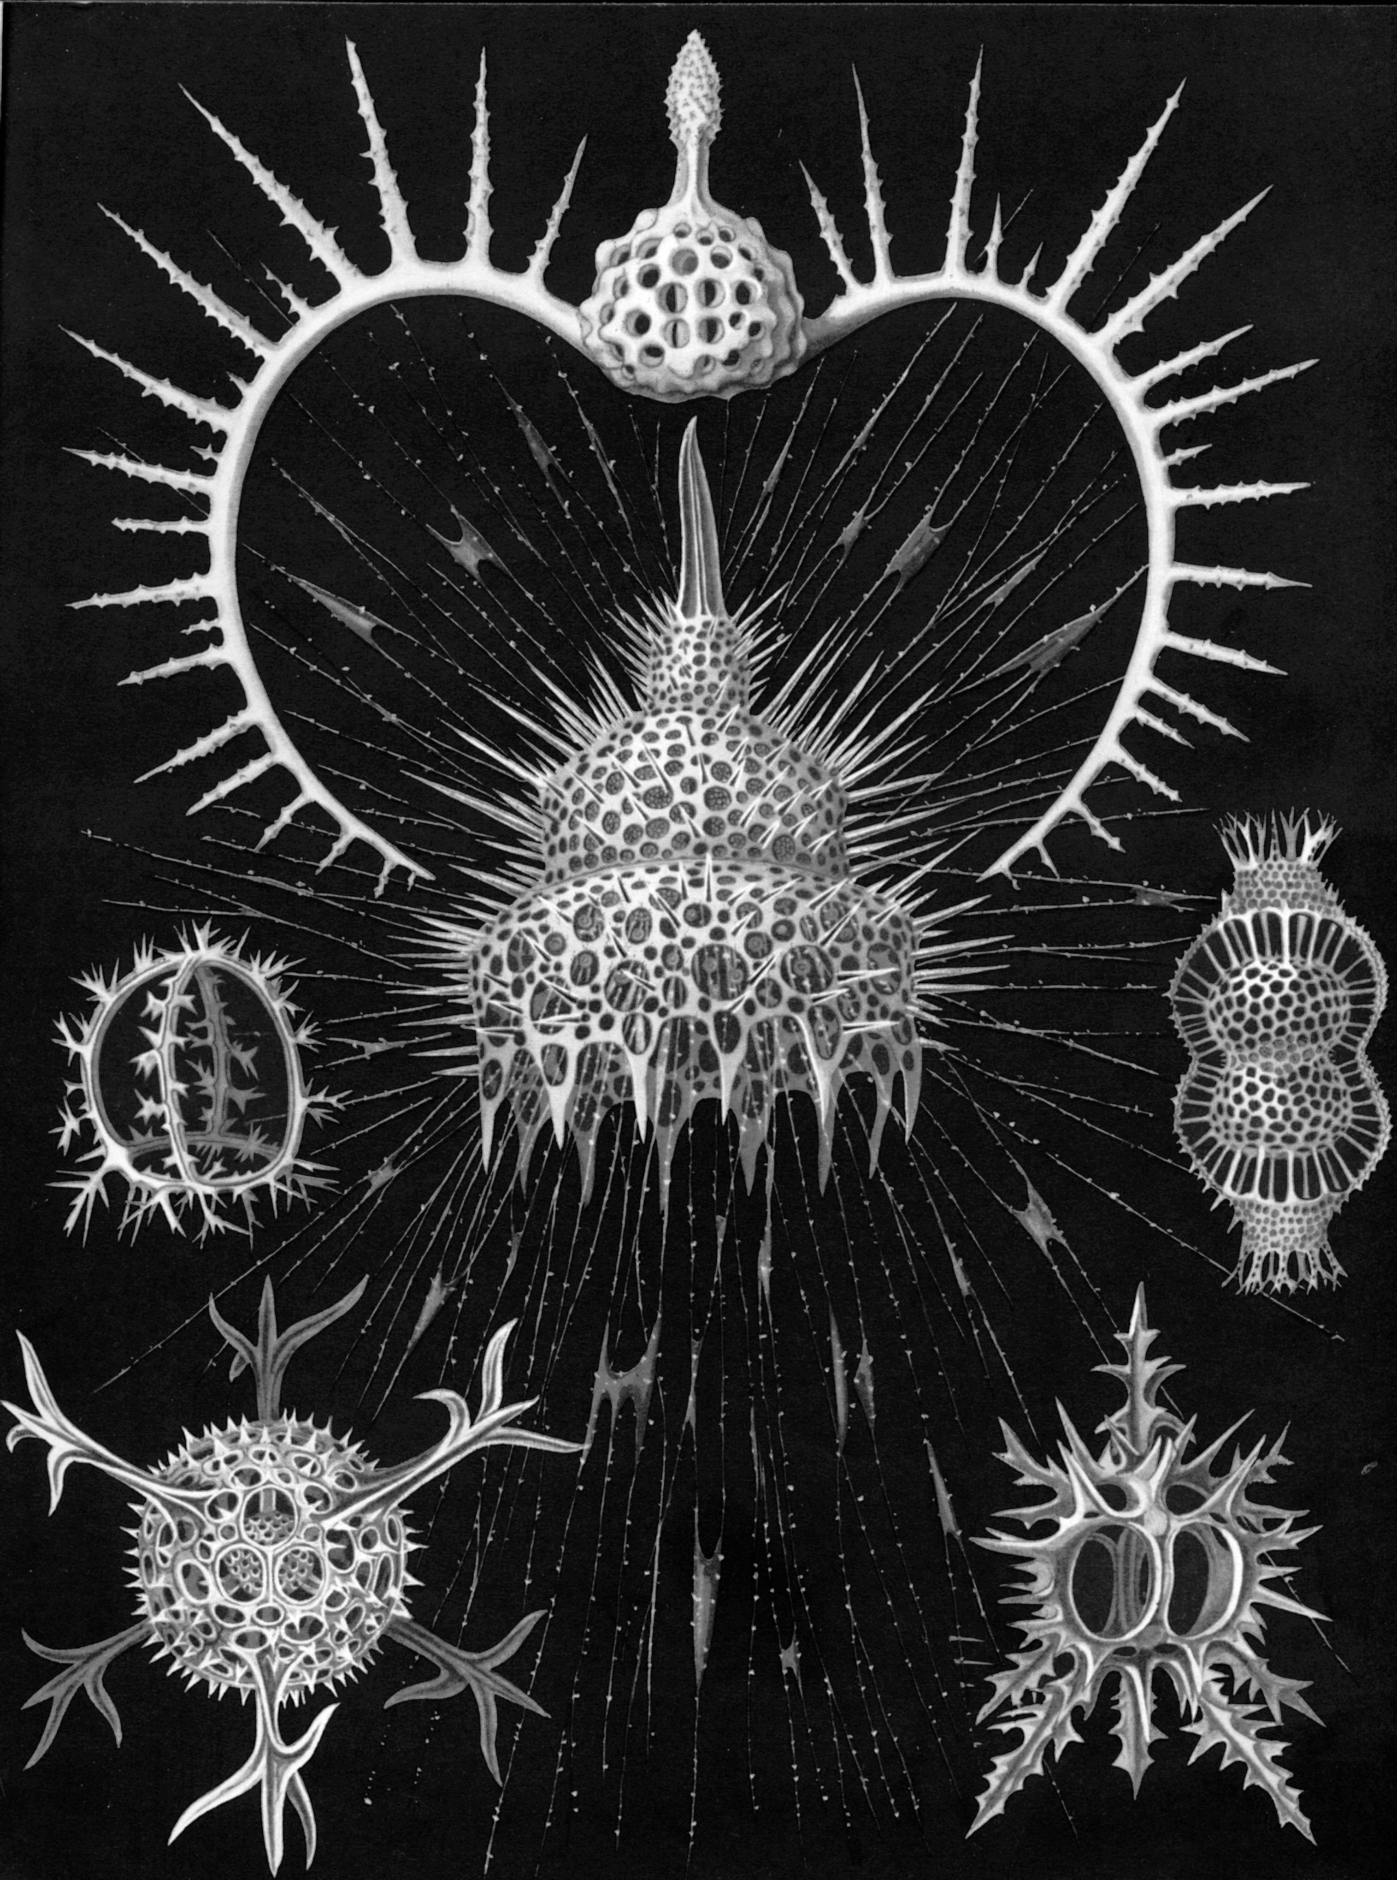
Symmetry in living matter
Echinoderms
Crustaceans
Radiolaria

Slide 35
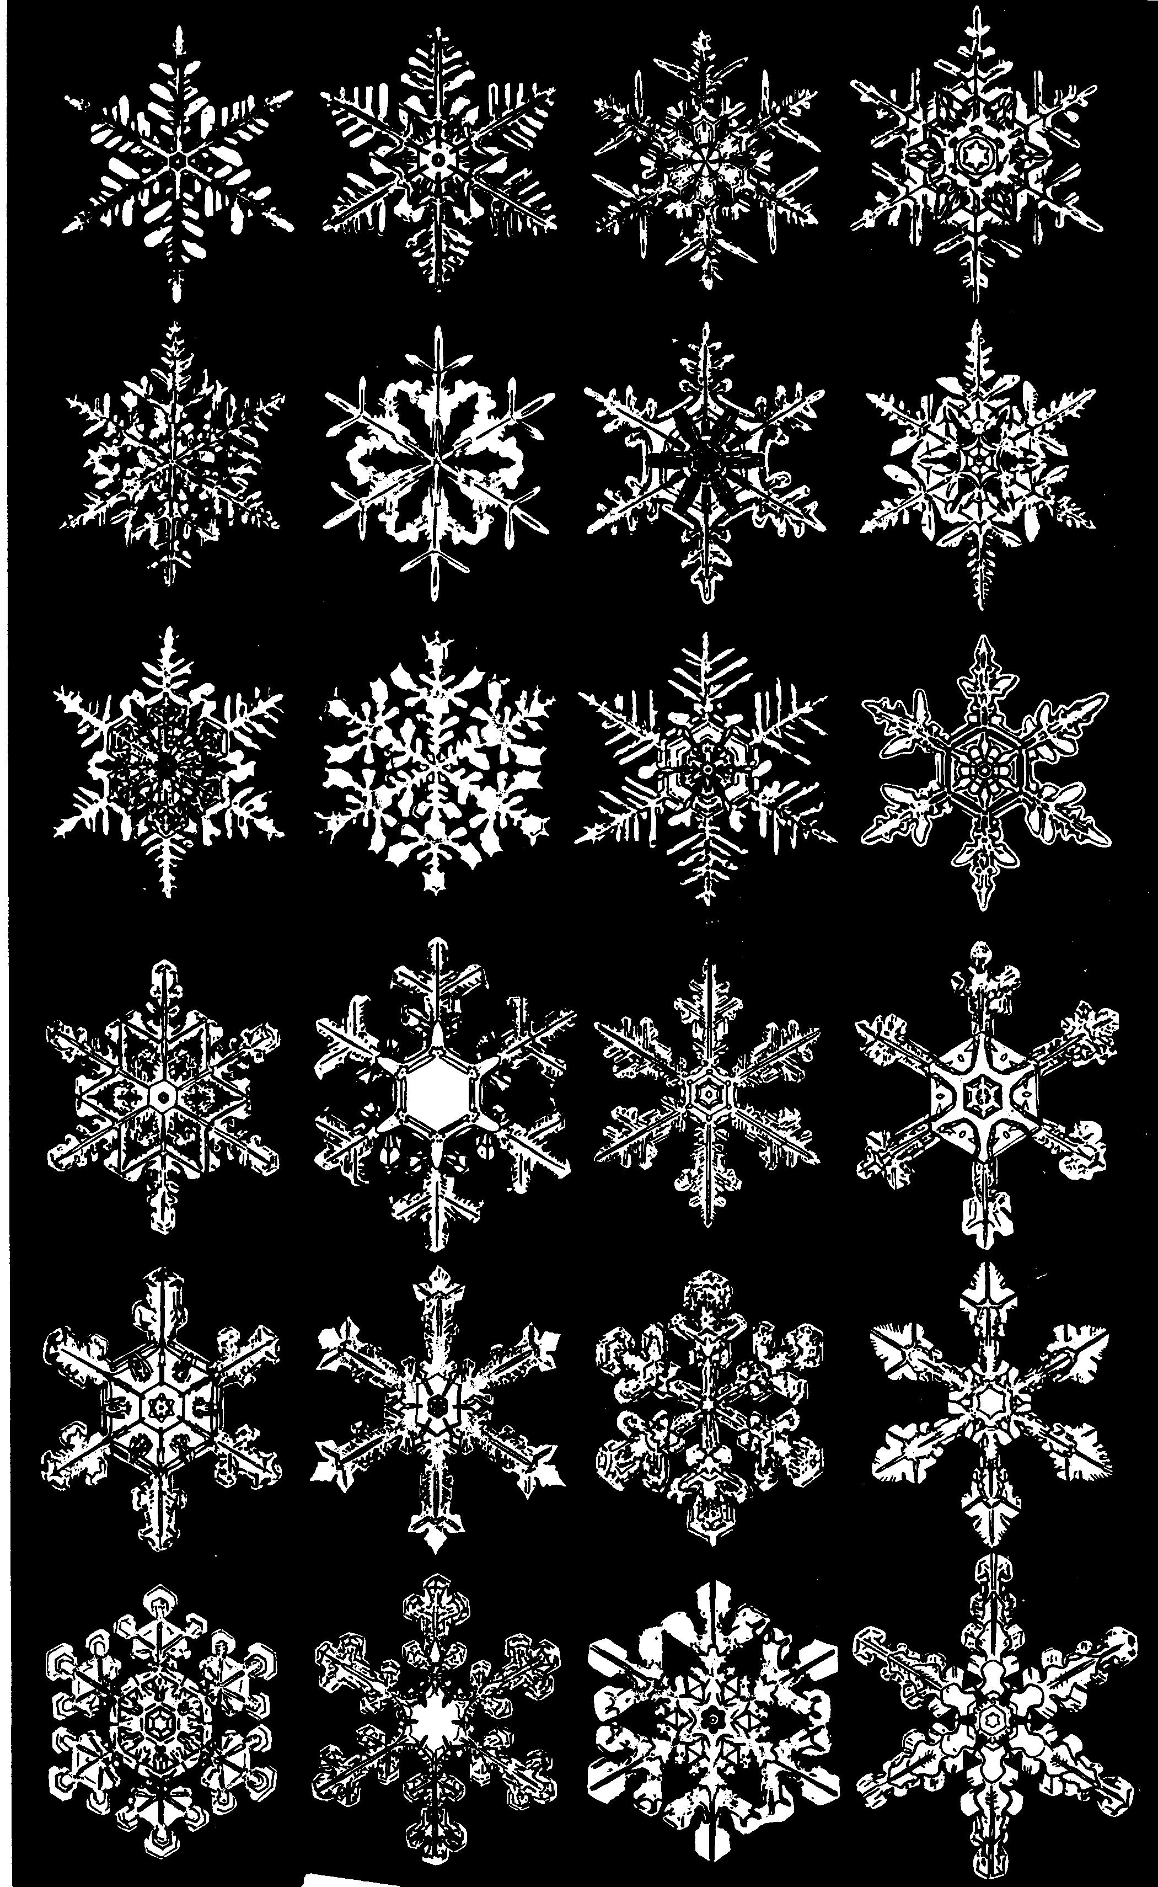
Symmetry in nonliving matter

Slide 36
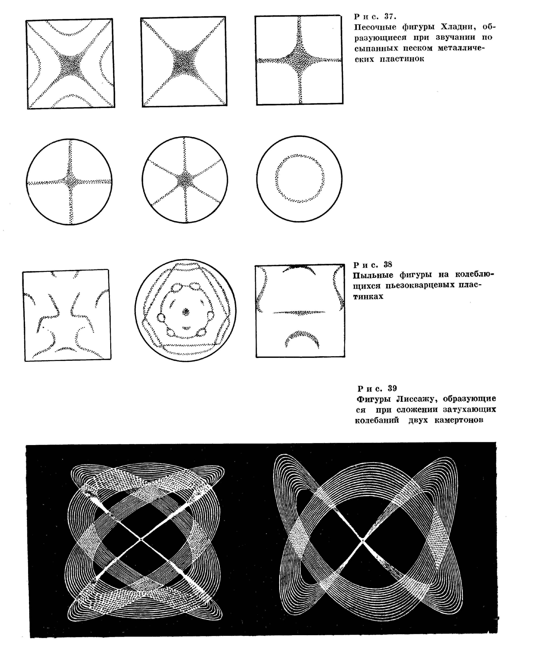
Symmetry in physics phenomena
Chladni figures (acoustics)
Lissajous figures – sum of oscillations of
two damping tuning forks
Dust contours on piezo quartz plates

Slide 37
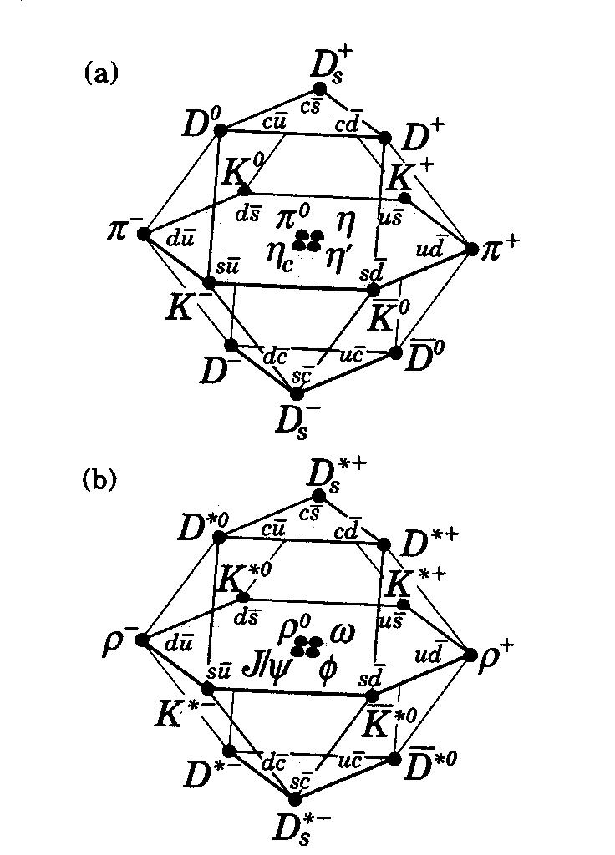
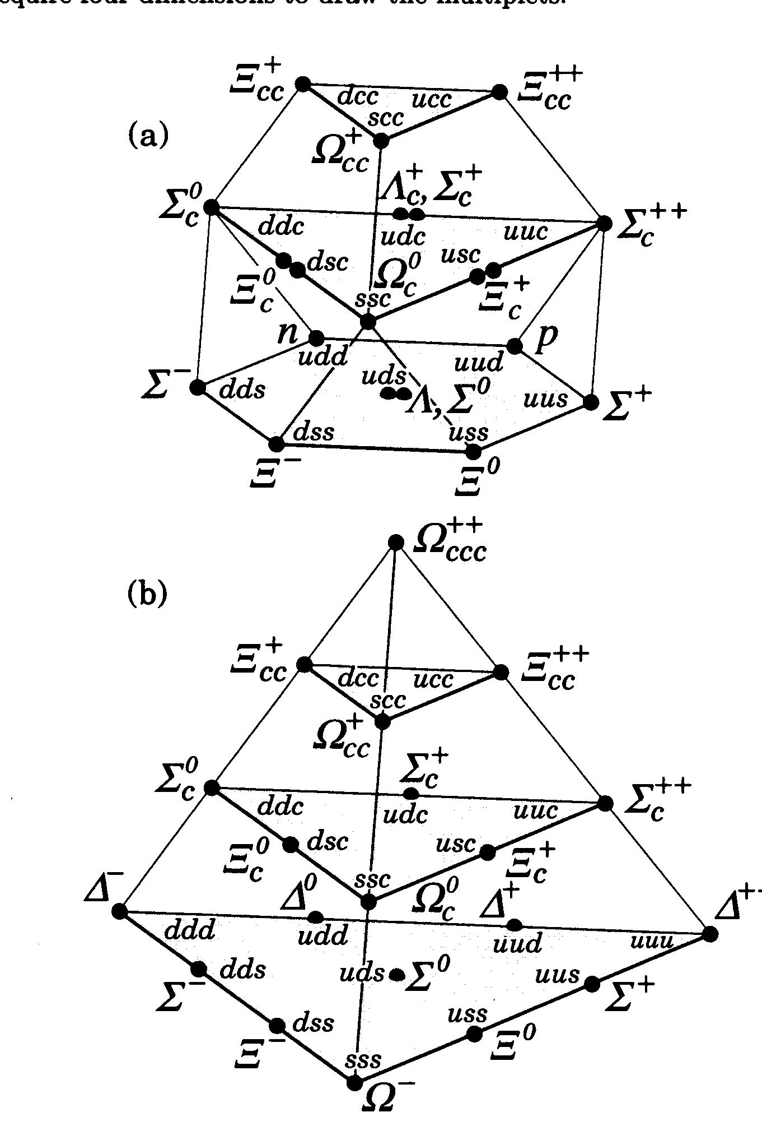
Mesons Baryons

Slide 38
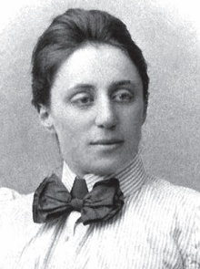
Emmy Noether's first theorem which derives conserved quantities from symmetries
(published exactly 100 years ago, in 1918)
        Noether's first theorem states that every differentiable symmetry of the action of a physical system has a corresponding conservation law.
        The invariance of physical systems with respect to spatial translation (in other words, that the laws of physics do not vary with locations in space) gives the law of conservation of linear momentum.
        The invariance with respect to rotation gives the law of conservation of angular momentum.
        The invariance with respect to time translation gives the law of conservation of energy.

Slide 39
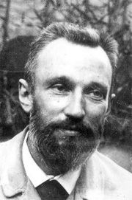
The Curie principle of symmetry:
The causality relation between the symmetry of the cause and that of the effect. The principle is composed of three parts:
If certain causes yield the known effects, the symmetry elements of the causes should be contained in the generated effects.
If the known effects manifest certain dissymmetry (absence of symmetry elements), this latter should be contained in the causes which have generated those effects.
The converse to these two previous propositions is not true, at least in practical: i.e., the effects may have higher symmetry than the causes which generate these effects.

Slide 40
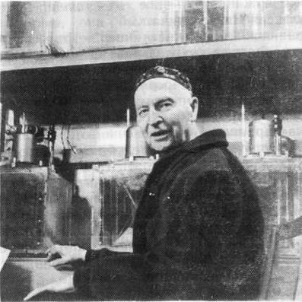
A. V. Shubnikov:
“Whatever interpretation of symmetry we consider, one thing is mandatory: symmetry cannot be considered without its antipode, dissymmetry. Symmetry reflects the aspect of phenomena corresponding to rest, while dissymmetry, the aspect corresponding to motion. The single idea of symmetry – dissymmetry is inexhaustible.”

Slide 41
Self-similarity
Self-similarity is a special symmetry of solutions, when a change in scales of independent variables can be compensated by a self-similarity transformation of other dynamical variables.
The main idea of application of the self-similarity approach in physics (and science in general) is to reduce the number of variables in a physical law.

Slide 42
Bjorken variable – dimensional self-similarity
Historically, self-similarity in elementary particle physics was introduced in relation with the deep inelastic electron scattering on protons, it is the well known Bjorken scaling obtained directly from the conservation laws in the assumption that since the squared momentum of particles participating in the reaction is much lager than the squared mass, the latter can be neglected.
partons
photon
electron
proton

Slide 43
General self-similarity solution for relativistic interacting particles
The relationship between X₁ and X₂ is described by the conservation laws written in the form
Essentially, we are using the correlation depletion principle in the relative four-velocity space which enables us to neglect the relative motion of not detected particles, namely the quantity
in the right-hand side of the above equation.

Slide 44
General self-similarity solution for relativistic interacting particles
In the case of production of antiparticle with mass M₃, the mass M₄ is equal to M₃ as a consequence of conservation of quantum numbers. In studying the production of protons and nuclear fragments
M₄ = −M₃ as far as the minimum value of Π corresponds to the case that no other additional particles are produced. The values of X₁ and X₂ obtained from the minimum Π are used to construct a universal description of the A-dependencies.

Slide 45
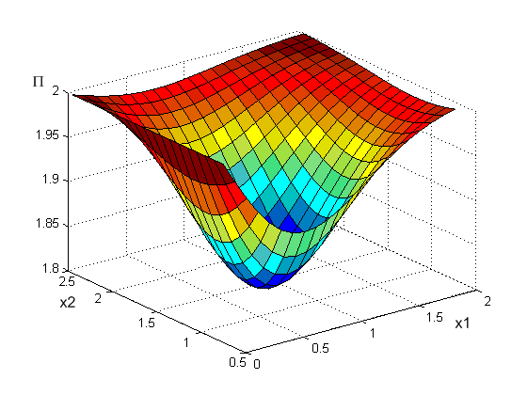
General self-similarity solution for relativistic interacting particles

Slide 46
Cumulative, twice cumulative, and antiparticle production
A.A.Baldin, E.G.Baldina, Selected Papers of (2000-2005) «Symmerties and Integrable Systems» Ed.A.N.Sissakian Dubna JINR, 2006 V.1 p.41-50.
A.A.Baldin et al., JINR Rapid Comm., 3 (92) (1992) 20.
A.A.Baldin, E.G.Baldina, et al., Phys.Part.Nucl., 1 (4/121) (2004), 7.
S.V.Boyarinov, et al. Yad. Fis. , v.57, N8, (1994) ,1452-1461.
O.P.Gavrishchuk et al. Nucl. Phys., A523 (1991) 589.
Jim Carroll Nucl. Phys. A488 (1989) 2192.
A.Shor et al. Phys. Rev. Lett. 62 (1989) 2192.
A.A.Baldin et al. Nucl. Phys., A519 (1990) 407.
A.A.Baldin et al. Rapid Communications JINR, 3-92 (1992) 20.

Slide 47
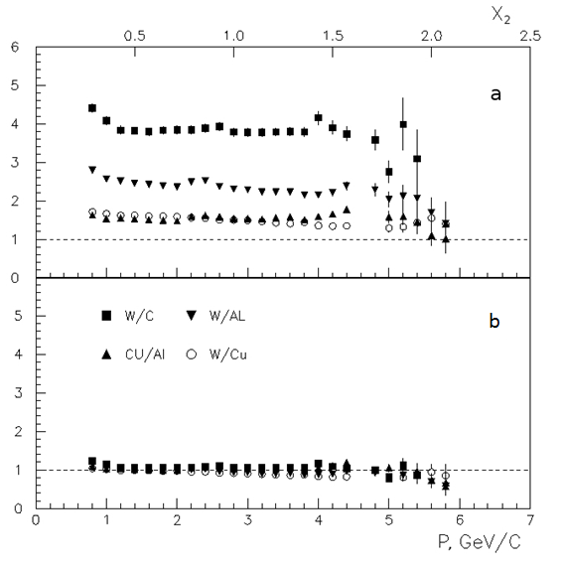
High-PT region
The А-dependence of the form
well describes the dynamic dependence of the cross sections on X2, while it fails to describe a stronger dependence on the mass number of the nucleus observed in this experiment.
Figure. Ratio of cross sections of negative pion production on different nuclei multiplied by inverse А-dependence.
(a) (b)
V. V. Ammosov, et al., Phys. At. Nucl. 76, 1213 (2013).

Slide 48
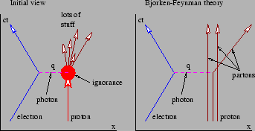
This is the way in which the self-similarity laws following from dimensionality considerations in the region
P² >> M² are extensively applied

Slide 49
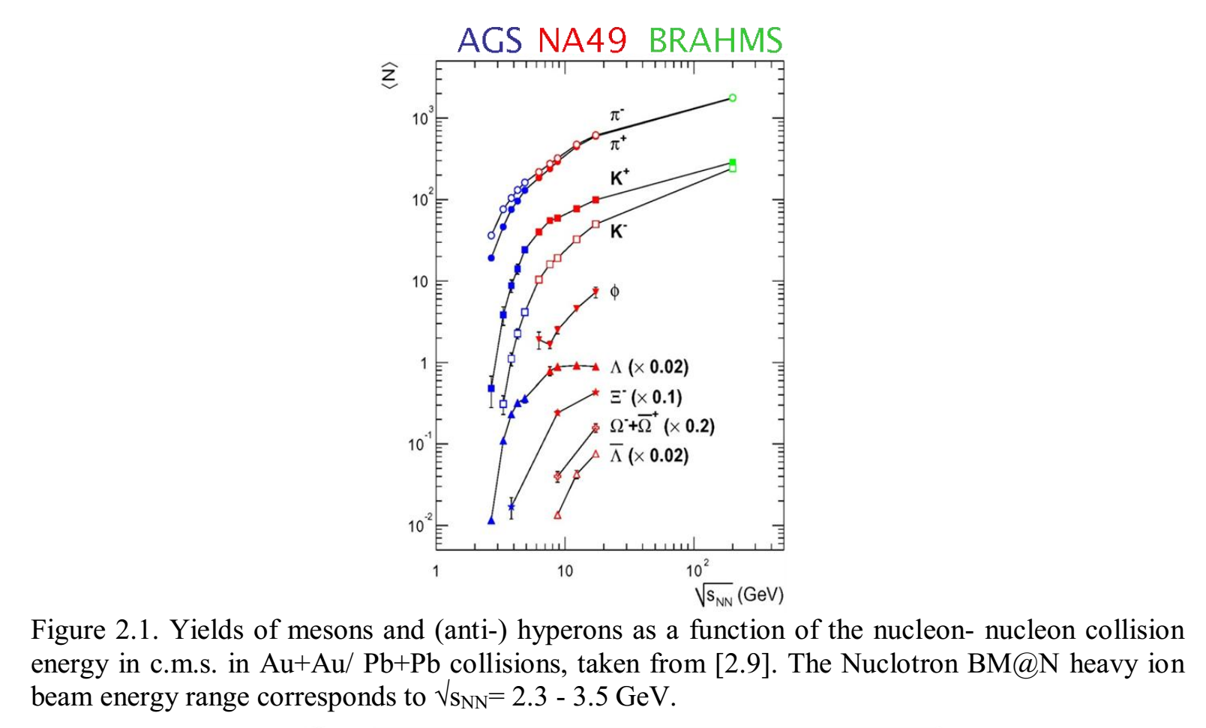

Slide 50
A.M.Baldin, Dokl. Akad. Nauk, 222, №5, 1064 (1975).
α_{ΙΙ1}≈10⁻²

Slide 51
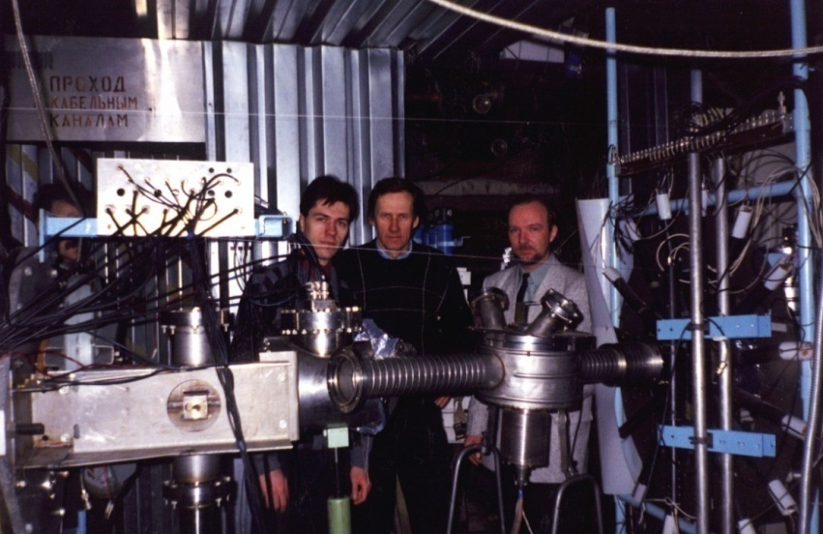
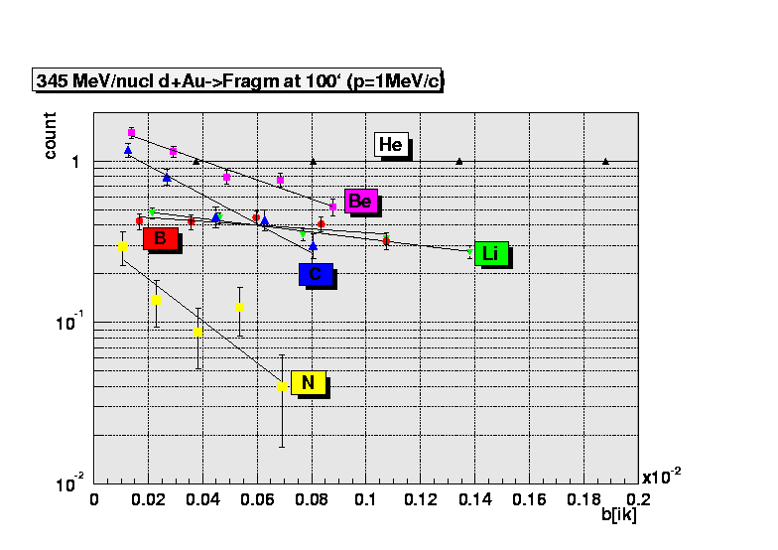
The luminosity in these conditions is 10³³ ÷10³⁵ cm⁻² sec⁻¹.
The processes with cross sections of the order of 10⁻² nb become measurable.
Collaboration MARUSYA
Experiment ITELEF

Slide 52
“The logical form of the theory shall be such that it can be singled out, by means of empirical tests, in a negative sense: it must be possible for an empirical scientific system to be refuted by experience.”
Karl Popper, 1959.

Slide 53
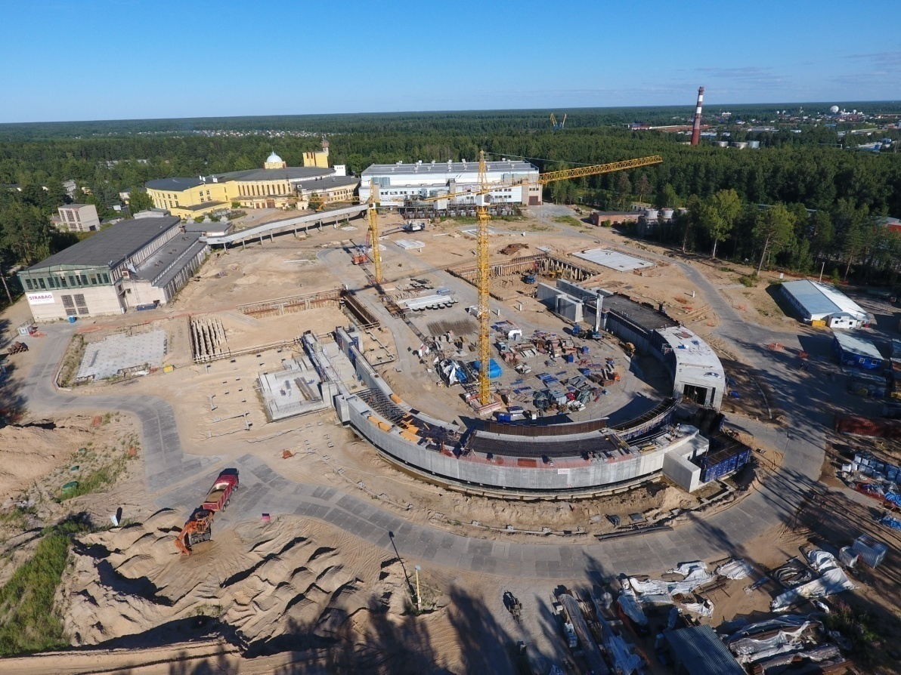

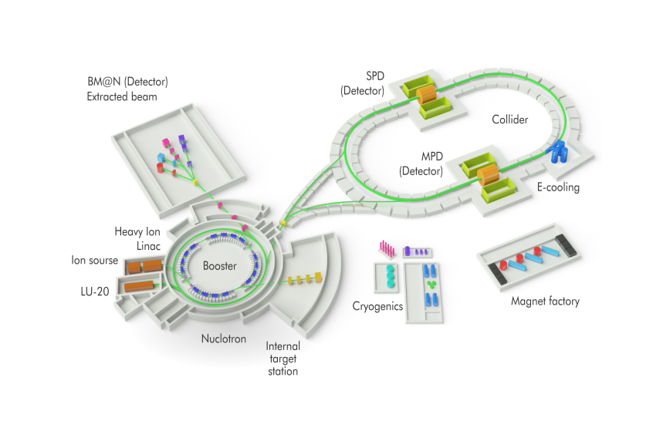
That which was invented and works in the East, does not work in the West.
That which was invented and works in the West, does not work in the East.
All of those work in Russia, but in a different way…
V. Luzanov’s law.

Slide 54
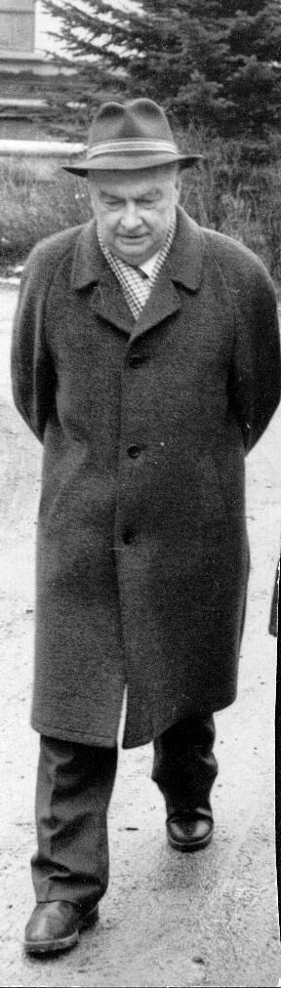
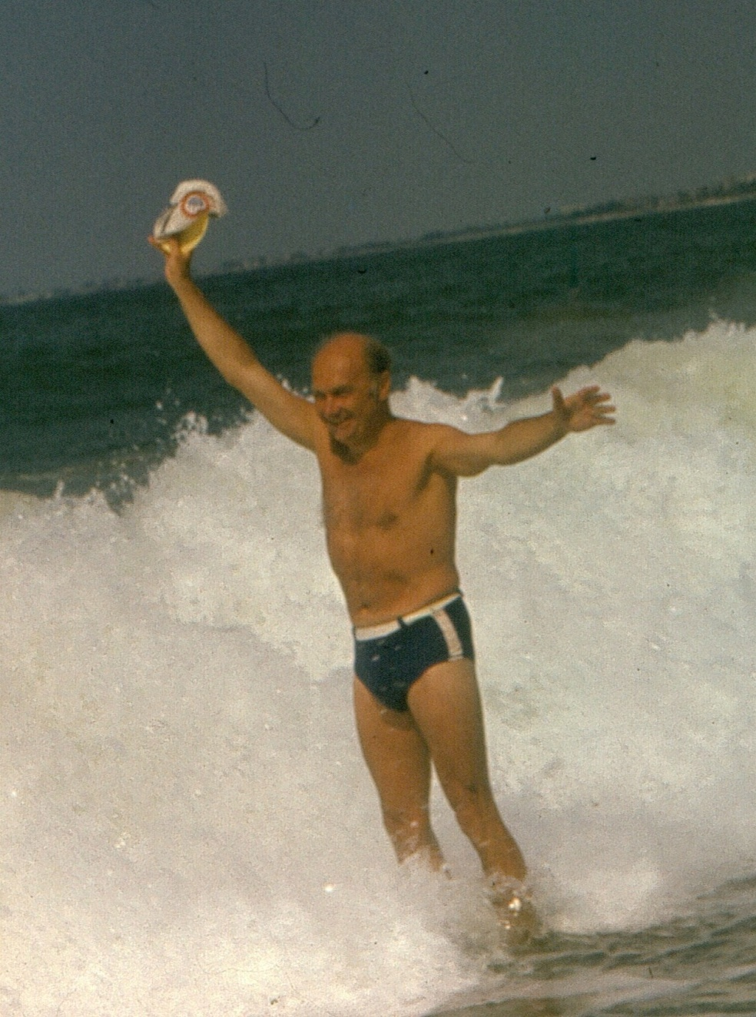
Thank you for your attention!

