Slide 1
CROSS-SECTIONS OF NUCLEAR ISOMERS IN THE INTERACTION OF PROTONS ON THIN THORIUM TARGET
Нolomb Robert
Brno University of Technology
xholom05@stud.feec.vutbr.cz
International Baldin Seminar. Dubna. 2018

Slide 2
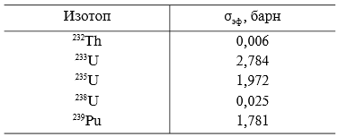
²³⁸U and²³²Th as an alternative for ²³⁵U
Neutron cross-section for isotopes
Natural Uranium:
²³⁸U - 99,2745 %
²³⁵U - 0,72 %
²³⁴U - 0,0055 %
Advantages:
Much more in nature
It is easier to obtain
Disadvantages:
For fission, we need fast neutrons
International Baldin Seminar. Dubna. 2018

Slide 3
The problem of recycling
Burial in continental geological formations
Burial to the bottom of the ocean
Burial in the glacial zone
Removing beyond Earth
Transmutation
International Baldin Seminar. Dubna. 2018

Slide 4
Transmutation
This is the transformation of an isotope of one element into an isotope of another element by one or more nuclear reactions.
International Baldin Seminar. Dubna. 2018

Slide 5
Creation of uranium-thorium-type nuclear power plants controlled by accelerators of high-energy particles (Accelerator Driven Systems - electronuclear systems controlled by a subcritical system accelerator, ADS).
International Baldin Seminar. Dubna. 2018

Slide 6
Energy + Transmutation project
In the mid 90's in the Joint Institute for Nuclear Research (Dubna, Russia) was designed and created the installation "Enehrgy + transmutation" (E + T).
In this project, the study of the generation of neutrons and energy in the lead target and the uranium target on relativistic nuclei is carried out, as well as the transmutation of radioactive waste from nuclear power.
Goal: Investigation of space-energy distribution of neutrons in a system of "lead target + target from natural uranium".
International Baldin Seminar. Dubna. 2018

Slide 7
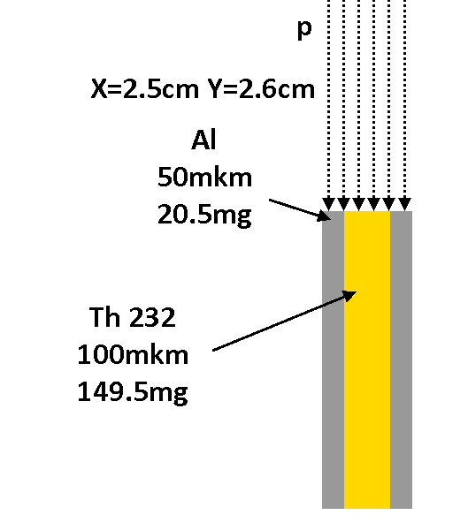
The experiment of irradiation Th232
The energy of protons is -100 and 600 MeV
The current is 0.3 μA.
Thickness of foil Th - 100 microns.
Weight - 149.5mg.
Area - 1.5 cm2.
To determine the integral flux of protons used reaction 27Al + p → 24Na + α
Thickness 27Al - 50 μm
Weight - 20.5, 21 mg.
International Baldin Seminar. Dubna. 2018

Slide 8
The irradiation of the 232Th sample was processed on the internal bundle of protons of the LNP on the JINR Phasotron (Dubna).
International Baldin Seminar. Dubna. 2018

Slide 9
The spectra of the γ-radiation of the 232Th and 27Al foil were measured using a CANBERRA HPGe detector with an efficiency of 18% and a resolution of 1.9 keV on a line of 1332 keV 60Co.
International Baldin Seminar. Dubna. 2018

Slide 10
Processing of gamma spectra
Deimos
A set of scripts
Comparison of the results obtained with data from the Los Alamos National Laboratory (MCNP6) MCNP is a family of programs for modeling ionizing radiation in material systems using the Monte Carlo method. It can simulate the interaction of particles with the substance of the system (scattering, capture, as well as the division of nuclei).
International Baldin Seminar. Dubna. 2018

Slide 11
Software
The software for processing γ-spectra is a set of programs written in the object-oriented programming language Ruby and the program Deimos32.
International Baldin Seminar. Dubna. 2018

Slide 12
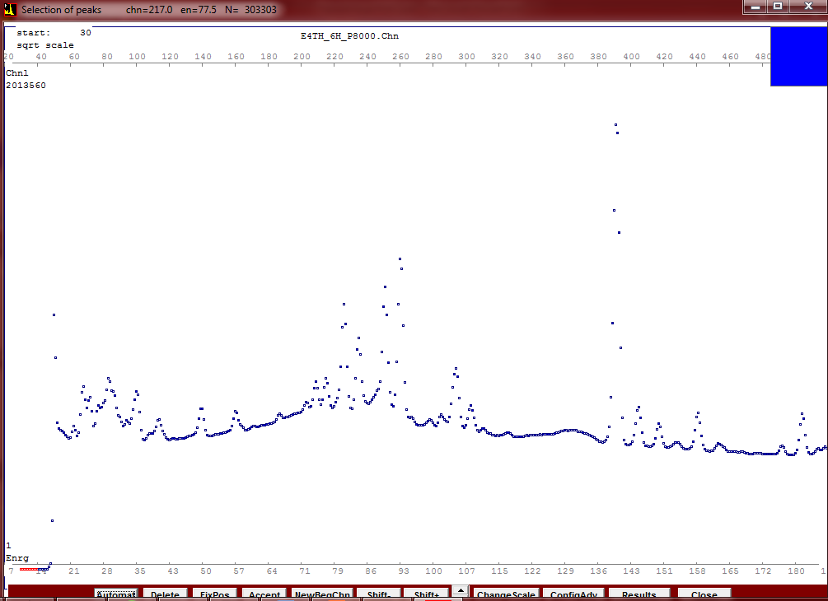
Deimos
Allows to find peaks in the gamma spectra and determine their position and area.
International Baldin Seminar. Dubna. 2018

Slide 13
Programs
Timeconst - creates an input file that is used as a list of important spectrum data
Nonlin64 - correction for non-linearity of the equipment.
Puregam - filters out the background radioactivity.
SepDepe – filters out annihilation peaks.
Effcor - used for the full energy peak efficiency correction.
Attcor - determines the self-absorption correction coefficient.
International Baldin Seminar. Dubna. 2018

Slide 14
MidLit7 - The program reads necessary data for each isotope -gamma line energy, gamma line intensity, isotope’s half-life and identifies the isitope.
TransCs9 - determine the amount initially formed nuclei, reaction rate and cross-section for each detected isotope.
SigmaJ7 - sorting all data into a table.
International Baldin Seminar. Dubna. 2018

Slide 15
International Baldin Seminar. Dubna. 2018

Slide 16
International Baldin Seminar. Dubna. 2018

Slide 17
International Baldin Seminar. Dubna. 2018

Slide 18
International Baldin Seminar. Dubna. 2018

Slide 19
Conclusions
The processing of experimental data on the fragmentation of the ²³²Th nucleus under the influence of protons in the energy of 100 and 600 MeV has been processed.
The cross-sections of fragmentation of the 232Th nucleus have been obtained, depending on the charge and mass number of the reaction fragments .
For 100 MeV proton beam there were identified for 258 gamma lines that belong to 45 nuclides and identified 222 gamma lines that belong to 55 nuclides in the case of 600 MeV proton beam.
For the Al collector 238 gamma lines belonging to 81 nuclides in the case of 100 MeV protons and 330 lines for 119 nuclides in the case of 600 MeV.
The incommensurability of the number of lines for the target and the collector can be explained by the different distribution of fragments by kinetic energy. In the mass and charge spectra there are clearly separated fission and spallation reactions.
International Baldin Seminar. Dubna. 2018

Slide 20
Thank you for attention

