Slide 1




Exotic Hadrons with Heavy Quarks:
Experimental Perspective
Tomasz Skwarnicki
Syracuse University, NY, USA

Slide 2

My connection to Dubna
My mentor during Ph.D. research (Crystal Ball experiment at DESY)
Bogdan Niczyporuk
1936-2017
M. Curie - Sklodowska University, Lublin, 1956-58;
M.S., Moscow University 1962;
Ph.D., Jagiellonian University, Krakow, 1973;
Dr.hab. Institute of Nuclear Physics, Krakow, 1983.
Research physicist, JINR, Dubna, 1963-73;
Adjunct, Institute of Nuclear Physics, Cracow, 1973-83;
Visiting Prof., Stanford University (CA), 1983-88;
Senior physicist, CEBAF (JLab) 1988-2003.

Slide 3
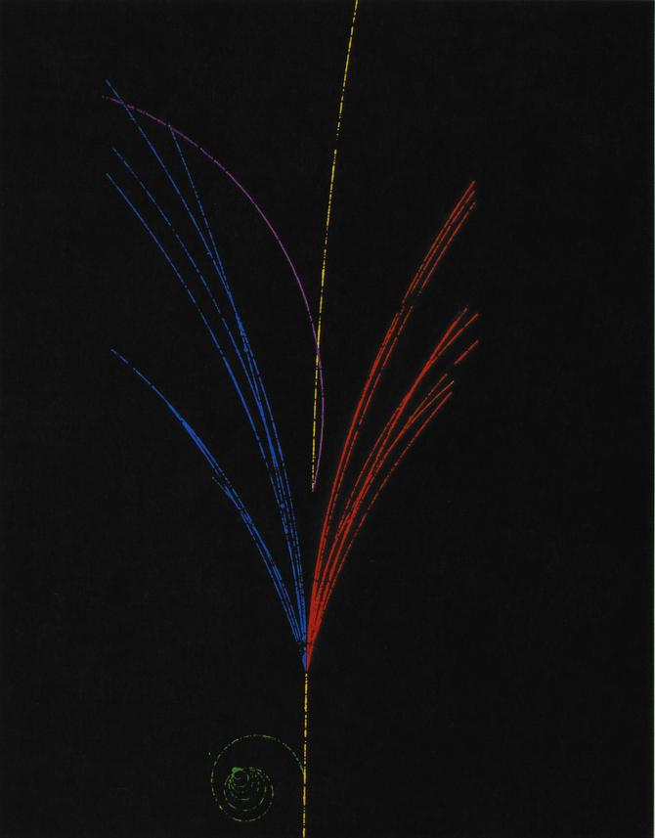



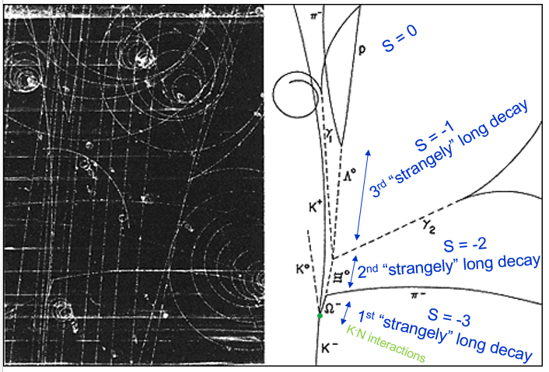
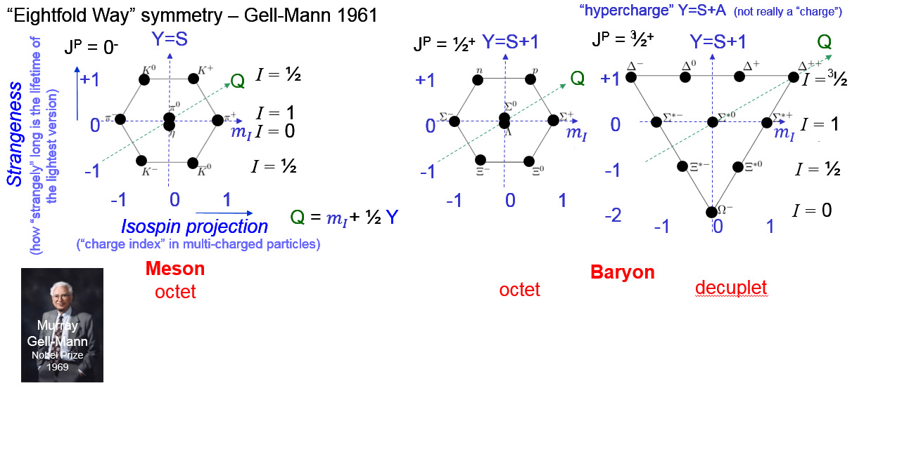
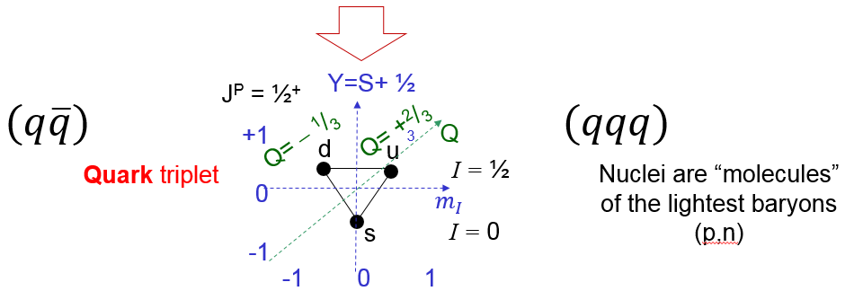

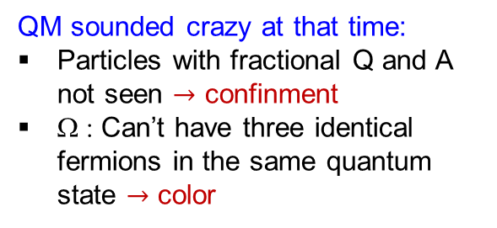
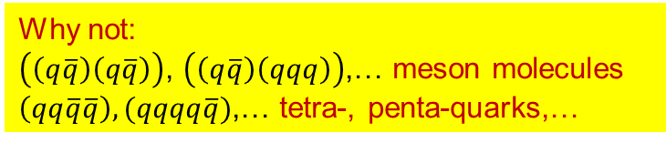

From particle zoo to Quark Model
1950-ies
Strangely long-lived
states gave us clues about the right underlying symmetries:
Quarks and flavor independence of strong interactions
K,Λ,…
N(1440)
a₁
η(1295)
…Ω
b₁
η
Δ(1600)
Δ
Ν(1650)
n
p
ρ
Ω⁻ 1964
π
h₁
η’
QM sounded crazy at that time:
Particles with fractional Q and A not seen $→$ confinment
Ω : Can’t have three identical fermions in the same quantum state $→$ color
Quark Model
Still investigating!
Why not:
$\left(\left(q\overline{q}\right)\left(q\overline{q}\right)\right)$, $\left(\left(q\overline{q}\right)\left(qqq\right)\right)$,… meson molecules
$\left(qq\overline{q}\overline{q}\right),(qqqq\overline{q})$,… tetra-, penta-quarks,…
QCD
(came later)
($\left(qqq\right)\left(qqq\right)…)$

Slide 4
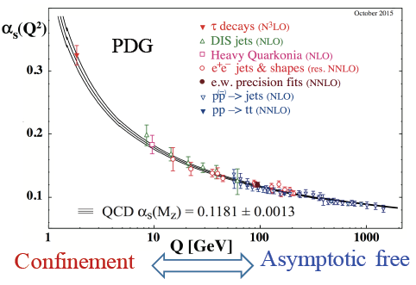

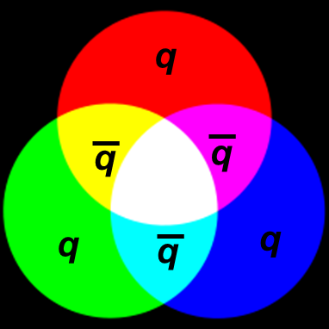
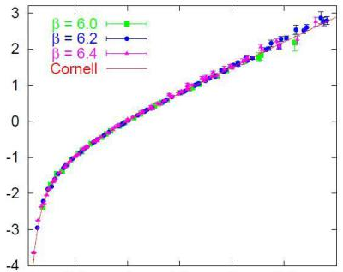
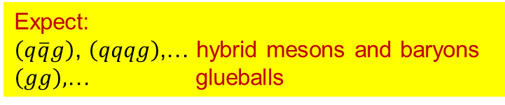
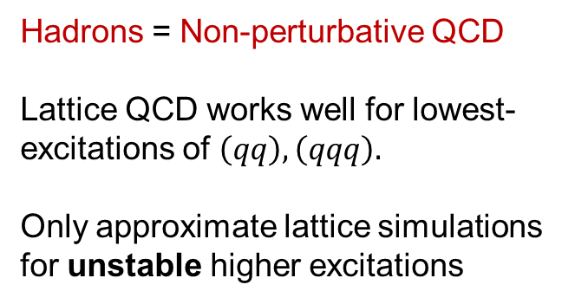


QCD and QCD motivated states
Hadrons = Non-perturbative QCD
Lattice QCD works well for lowest-excitations of $\left(qq\right),\left(qqq\right).$
Only approximate lattice simulations for unstable higher excitations
q=u,d,s,c,b,t
Asymptotic
freedom
Hadron sizes
We have to rely on data and QCD-motivated phenomenology when trying to understand more complex hadronic structures.
SU(3)_{color}
Asymptotic
freedom
Confinement
Gluons $(g)$ with
color-anticolor charge
V~ r
…
A large number of hadronic states expected from radial and angular momentum excitations.
Unlike in QED, large fine and hyperfine structures for lower excitations.
V(r)
We are still looking for these!
V~1/r
Expect:
$\left(q\overline{q}g\right)$, $\left(qqqg\right)$,… hybrid mesons and baryons
$\left(gg\right),$… glueballs
Static qq potential
in Lattice QCD
0.5
1.0
[fm]
$$r$$
1/10
1
1/0.4
1/0.2 [1/GeV]

Slide 5
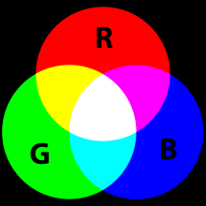
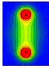
Mesons from quarks & antiquarks in QCD
color octet
color
triplet
color
antitriplet
color
singlet
_
3
8
1
3
quark
antiquark
attractive color force
q
q
(qq) meson
e.g. K⁺
_
Color flux tube stretched between
quark and antiquark
with attractive
potential
s
repulsive color force
quarks will pull apart in any octet configuration
_
u
gluons happen to belong
to the color octet

Slide 6
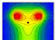
(Colored) diquarks in QCD
color
sextet
(antisymmetric)
color
antitriplet
(symmetric)
color
triplet
color
triplet
_
3
6
3
3
quark
quark
q
q
repulsive color force
quarks will pull apart in any sextet configuration
attractive color force
(perturbatively: half as strong as in the meson)
_
(qq) diquark
Diquark can go in a place of antiquark in a hadron;
antidiquark in place of quark.
Not a particle, just a building block in QCD
s
u

Slide 7
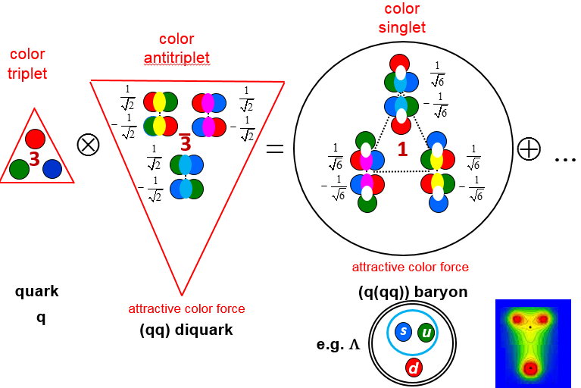
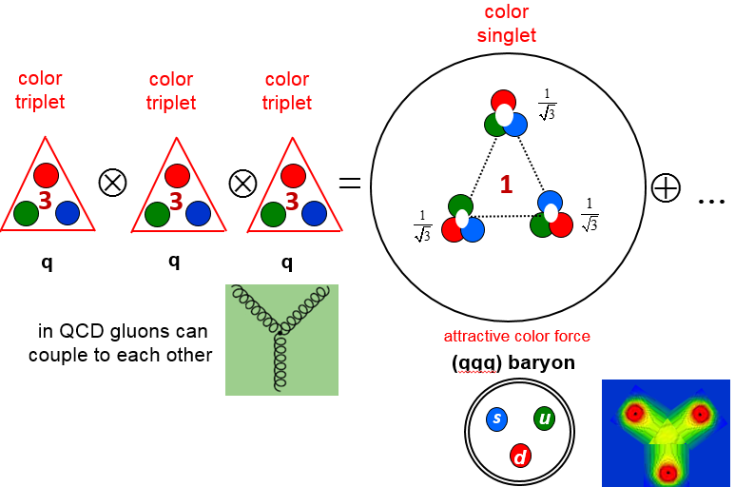
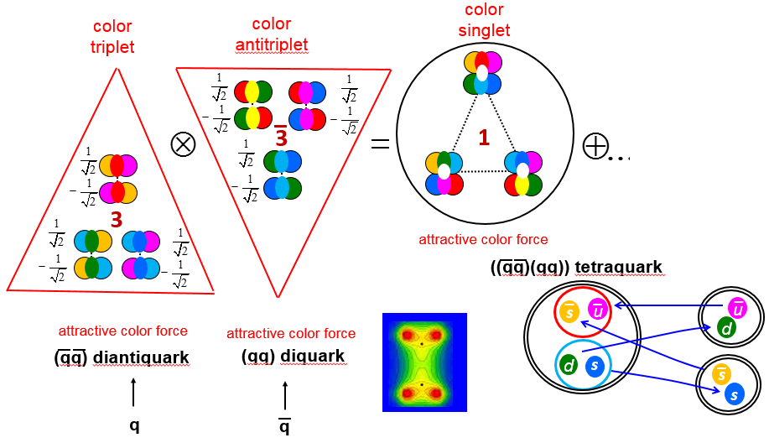
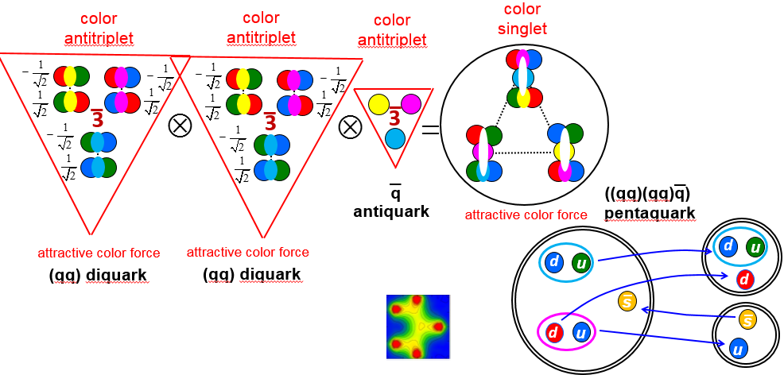
Hadrons from diquarks?
Still an open question!
Role of diquarks in building hadrons?
Light and heavy baryon spectroscopy is sensitive to this question
vs.
Additional motivation for existence of tetra- and penta-quarks.
Does effective mechanism to suppress rapid fall-apart exist?

Slide 8
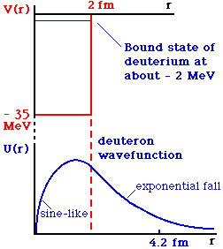
Tetraquarks (pentaquarks) vs meson-meson (meson-baryon) molecules
The same quark content can, in principle, create a meson-meson molecule or a tetraquark
However, mass spectrum from these two types of bindings are very different
((qq)(qq))
tetraquark
(qq)-(qq)
meson-meson molecule
_
_
_
u
u
u
d
_
d
s
u
s
We don’t know if either one exist (“exotic hadron”)
V(r)
Typically expect only one state n=1, L=0.
Fall apart prevented by spatial separation – long-lived states if below threshold.
Mass and J^{P} fairly constrained from the constituents.
…
Very rich mass and J^{P} spectrum expected!
However, states can be undetectable if extremely broad.
r

Slide 9

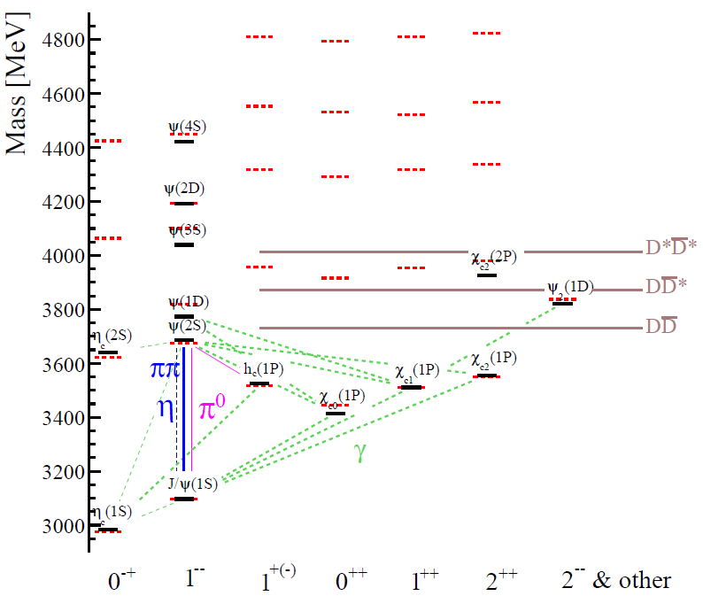
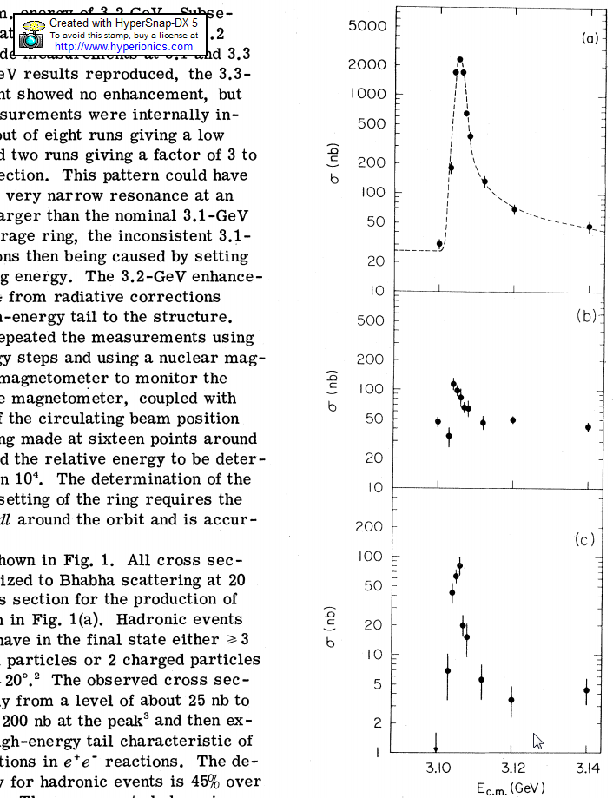
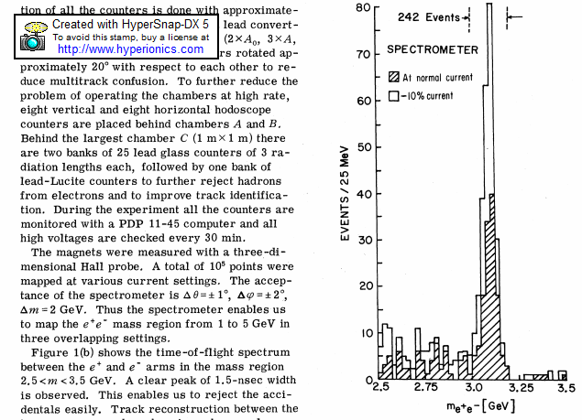

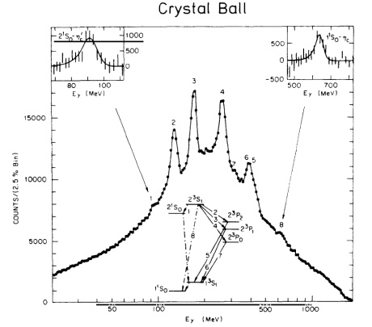
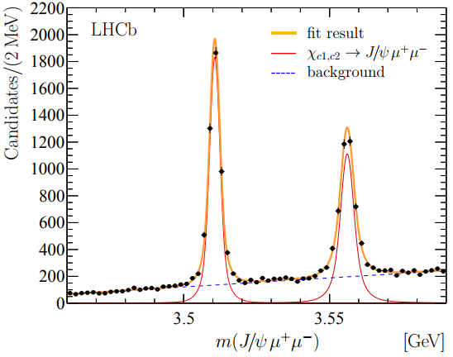
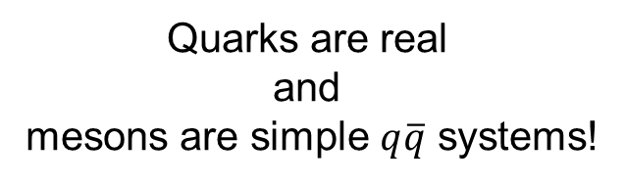
Hadron spectroscopy and heavy flavors
s,c,b
K,D,B
s, c, b
q
K*, ψ’’, ¡’’’
November revolution
of 1974
q, c, b
q
π, D,B
(q=u or d)
q,c,b
wide
e⁺e⁻ → hadrons
Log-scale!
ψ
J
q
pBe
→ e⁺e⁻ X
c,b
q
q
c,b
q
1³S₁
q
q
Long-lived and non-relativistic!
narrow
(at SPEAR)
PRL 119 (2017) 221801
2³S₁→γ 1³P_{2,1,0}
1³P_{2,1,0} →γ1³S₁
Quarks are real
and
mesons are simple $q\overline{q}$ systems!
1³P_{1,2} → μ⁺μ⁻1³S₁
PRD 34 (1986) 711
Eγ [MeV]

Slide 10
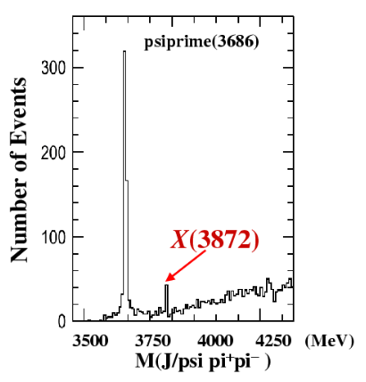






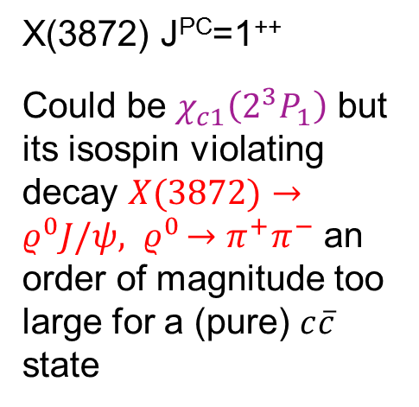
Hadron spectroscopy and heavy flavors
Belle 2003
November revolution
of 1974
e⁺e⁻ → Y(4S) →$B\overline{B}$
$${B→(π}^{+}π^{−}J/ψ)K$$
e⁺e⁻ → hadrons
$$ψ(2S)$$
or ?
Log-scale!
ψ
DD*
J
DD
very narrow
Γ_{X(3872)}
<1.2 MeV
pBe
→ e⁺e⁻ X
X(3872) J^{PC}=1⁺⁺
Could be $χ_{c1}\left(2^{3}P_{1}\right)$ but its isospin violating decay $X(3872)→ρ^{0}J/ψ{{, ρ}^{0}→π}^{+}π^{−}$ an order of magnitude too large for a (pure) $c\overline{c}$ state
$$M(π^{+}π^{−}J/ψ)$$
Quarks are real
and
mesons are simple $q\overline{q}$ systems!
not all mesons are simple!

Slide 11
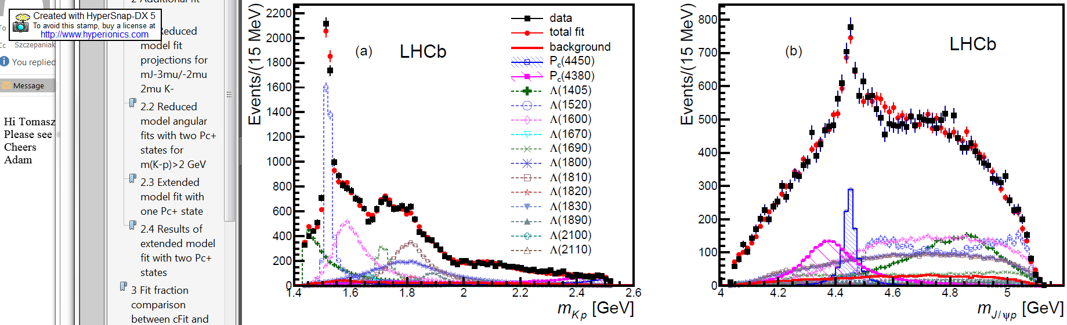




Hadron spectroscopy and heavy flavors
Belle 2003
LHCb 2015
November revolution
of 1974
e⁺e⁻ → Y(4S) →$B\overline{B}$
$pp$ →$Λ_{b}+…$
$${B→(π}^{+}π^{−}J/ψ)K$$
$$Λ_{b}→(p J/ψ)K$$
e⁺e⁻ → hadrons
$$ψ(2S)$$
or ?
Log-scale!
ψ
DD*
J
DD
very narrow
Γ_{X(3872)}
<1.2 MeV
P_{c}(4450)⁺
pBe
→ e⁺e⁻ X
P_{c}(4380)⁺
$$M(π^{+}π^{−}J/ψ)$$
$$M(p J/ψ)$$
Quarks are real
and
mesons are simple $q\overline{q}$ systems!
not all mesons are simple!
neither are all baryons

Slide 12

New particle zoo: charmonium above flavor threshold
Old narrative (before 2003)
predicted
measured
Figures from Olsen,Skwarnicki,Zieminska
Rev.Mod.Phys. 90, 015003 (2018); arXiv:1708.04012
Mesons are $\left(q\overline{q}\right)$ bound states.

Slide 13
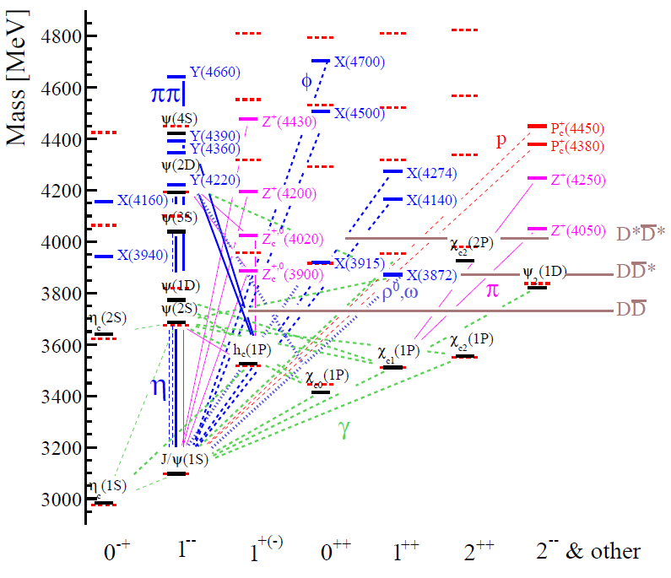












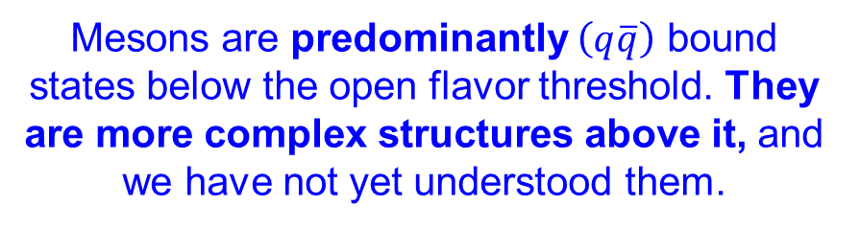
New particle zoo: charmonium above flavor threshold (mostly a freak show)
Old narrative (before 2003)
Above the flavor threshold: More exotic states than $c\overline{c}$ states!
New narrative
predicted
measured
Figures from Olsen,Skwarnicki,Zieminska
Rev.Mod.Phys. 90, 015003 (2018); arXiv:1708.04012
Mesons are predominantly $\left(q\overline{q}\right)$ bound states below the open flavor threshold. They are more complex structures above it, and we have not yet understood them.
Mesons are $\left(q\overline{q}\right)$ bound states.

Slide 14
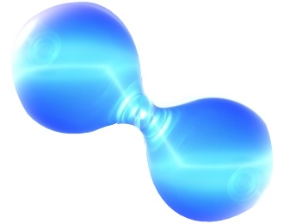
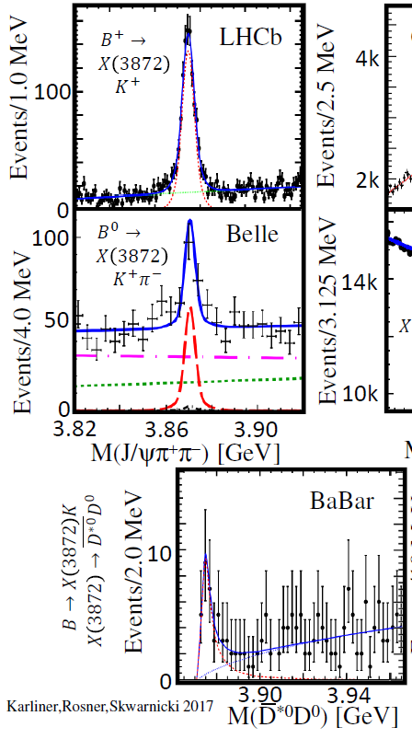
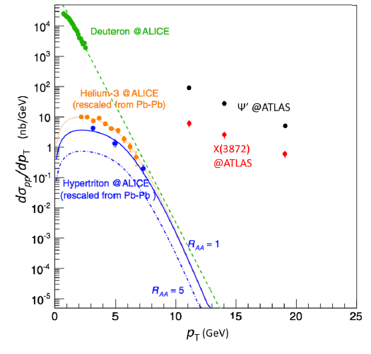
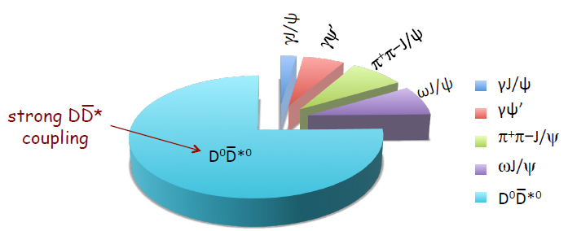
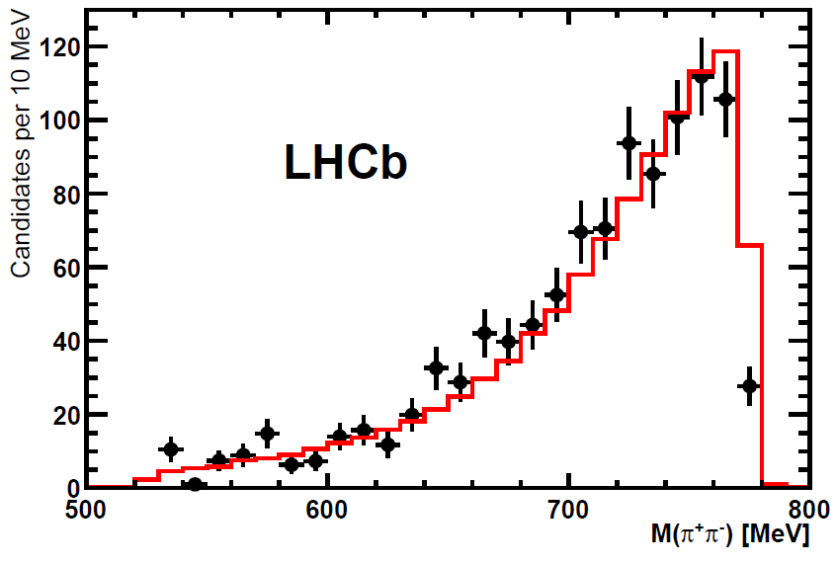




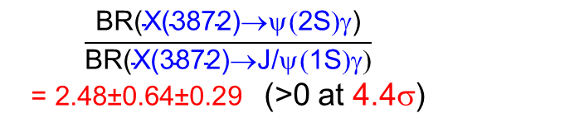





Dual nature of X(3872)
Mass near
threshold
Narrow width
in decays to $c\overline{c}$
D⁰D*⁰
_
_
Charmonium-like prompt
production rates
c
c
u
c
$$c\overline{u}$$
D*⁰
Known decay rates:
Run I
3 fb⁻¹
_
D⁰
$$u\overline{c}$$
i.e. $ρ^{0}J/ψ$
c
u
ALICE, PL,B754,360(2016)
PR,C93,029917(2016)
Enhanced isospin violating decays
$$X\left(3872\right)→ρ^{0}J/ψ$$
$$X\left(3872\right)→ρ^{0}J/ψ$$
ATLAS JHEP01,717(2017)
LHCb-PAPER-2015-015
Huge fall-apart mode from the resonance tail above the $D^{0}\overline{D^{∗0}}$ threshold
Run I
3 fb⁻¹
$$ρ^{0}$$
A.Esposito et al. PRD92, 034028 (2015)
(ATLAS data inserted by S.Olsen)
0⁻1⁻ interacting
in S-wave
compatible
with J^{PC}=1⁺⁺
Charmonium-like pattern
of radiative decays
only small admixture of
$$\frac{\text{BR}\text{(}\text{X}\text{(3872)}\text{®}\text{y}\text{(}\text{2}\text{S}\text{)}\text{g}\text{)}}{\text{BR}\text{(}\text{X}\text{(3872)}\text{®}\text{J}\text{/}\text{y}\text{(}\text{1}\text{S}\text{)}\text{g}\text{)}}$$
= 2.48±0.64±0.29 (>0 at 4.4σ)
$$c\overline{d}$$
LHCb
D* ⁻
$$d\overline{c}$$
molecular
features
unlike a
molecule
LHCb-PAPER-2014-008
D⁺
arXiv:1711.10626

Slide 15
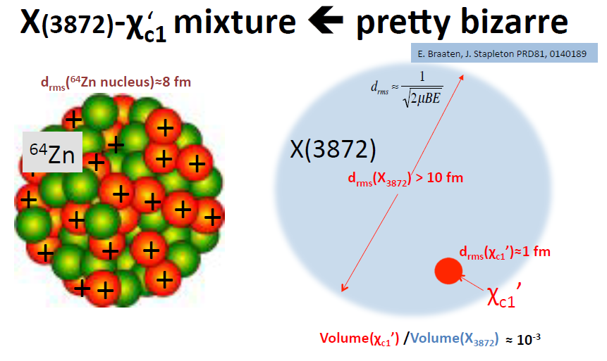
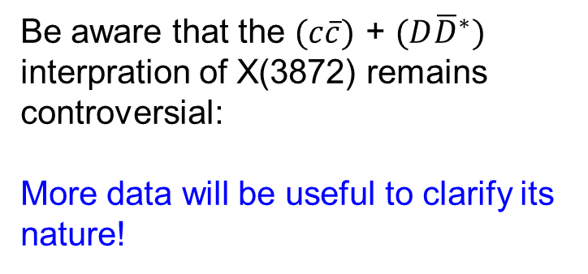
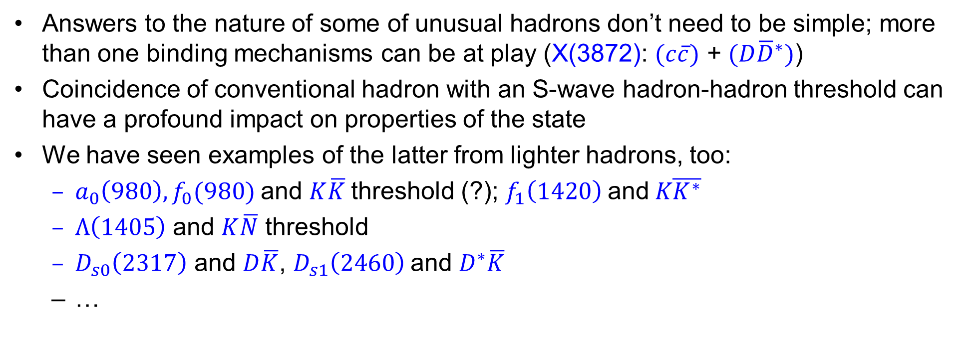

Lessons from X(3872)
Answers to the nature of some of unusual hadrons don’t need to be simple; more than one binding mechanisms can be at play (X(3872): $(c\overline{c})$ + $(D{\overline{D}}^{∗})$)
Coincidence of conventional hadron with an S-wave hadron-hadron threshold can have a profound impact on properties of the state
We have seen examples of the latter from lighter hadrons, too:
  $a_{0}\left(980\right),f_{0}(980)$ and $K\overline{K}$ threshold (?); $f_{1}\left(1420\right) \text{and} K\overline{K^{∗}}$
  $Λ\left(1405\right)$ and $K\overline{N}$ threshold
  $D_{s0}\left(2317\right)$ and $D\overline{K}$, $D_{s1}\left(2460\right)$and $D^{∗}\overline{K}$
  …
Be aware that the $(c\overline{c})$ + $(D{\overline{D}}^{∗})$ interpration of X(3872) remains controversial:
More data will be useful to clarify its nature!
Very weak $D{\overline{D}}^{∗}$ binding
$⟶$very large state

Slide 16
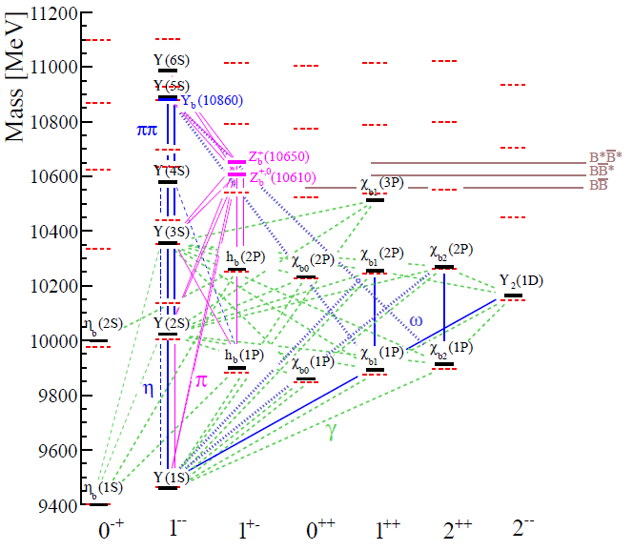
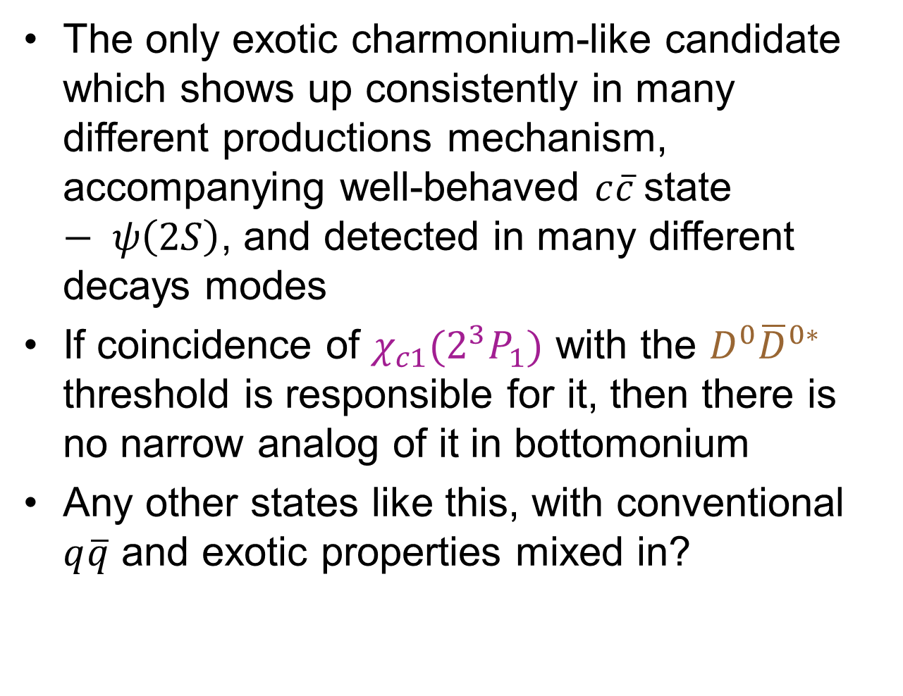


X(3872), so far, is unique!
The only exotic charmonium-like candidate which shows up consistently in many different productions mechanism, accompanying well-behaved $c\overline{c}$state $− ψ\left(2S\right)$, and detected in many different decays modes
If coincidence of $χ_{c1}(2^{3}P_{1})$ with the $D^{0}{\overline{D}}^{0∗}$ threshold is responsible for it, then there is no narrow analog of it in bottomonium
Any other states like this, with conventional $q\overline{q}$ and exotic properties mixed in?
$$χ_{b1}(5P)$$
predicted
$$χ_{b1}(4P)$$
measured

Slide 17
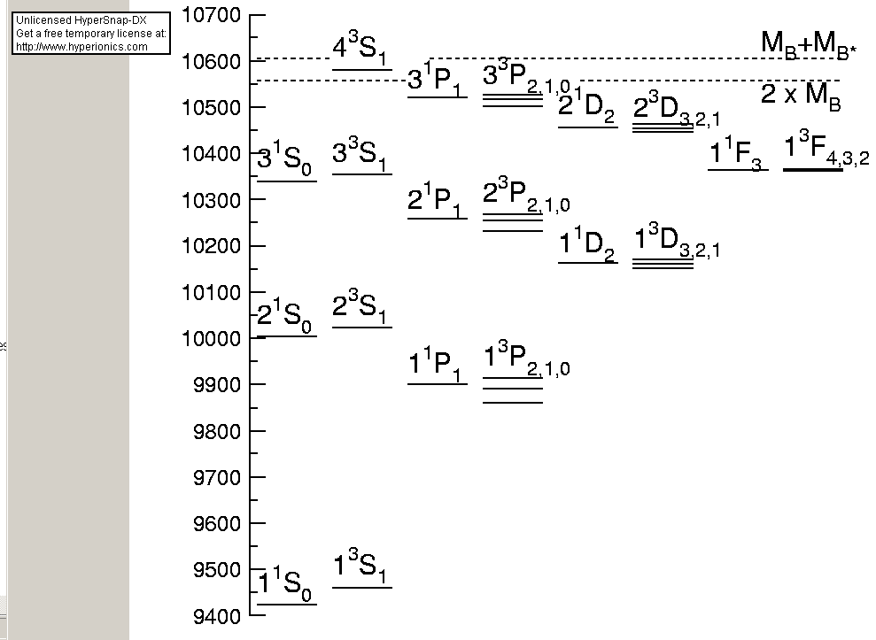
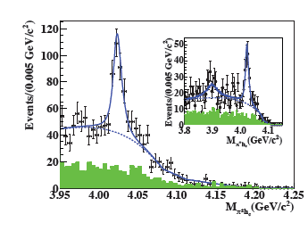
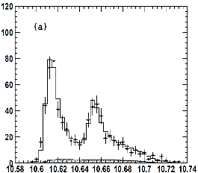
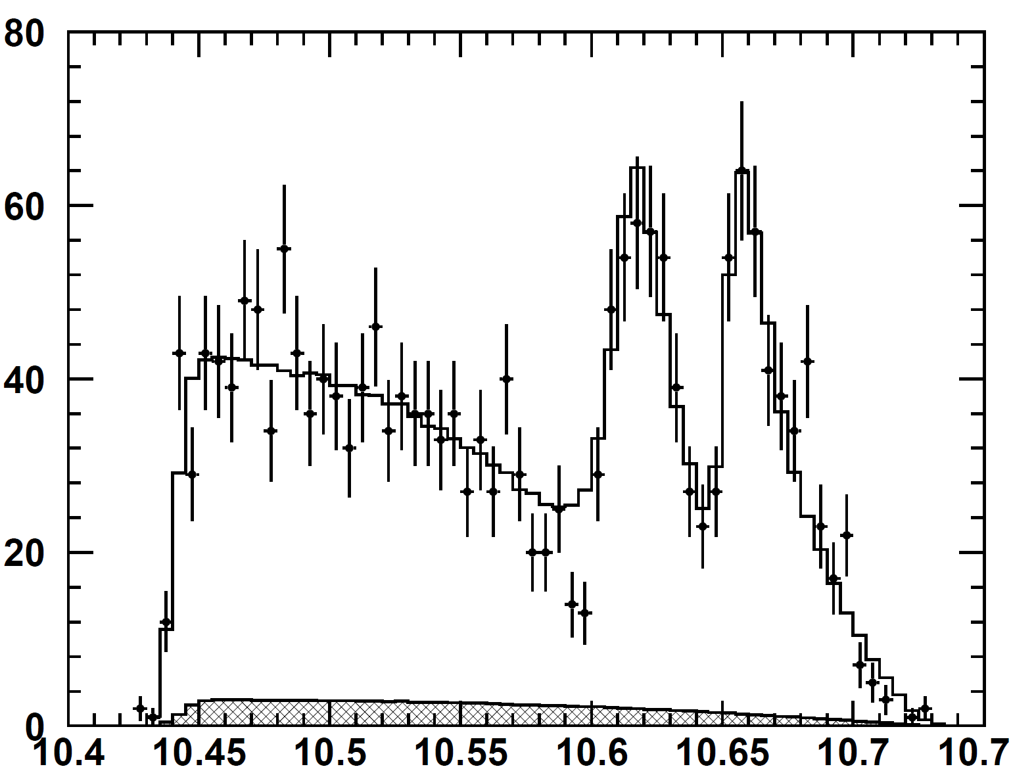
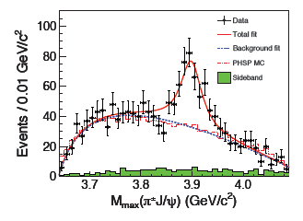

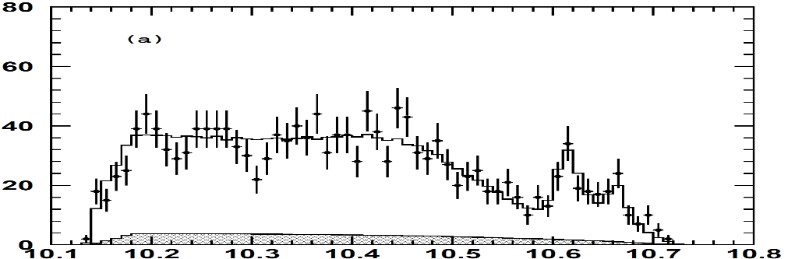
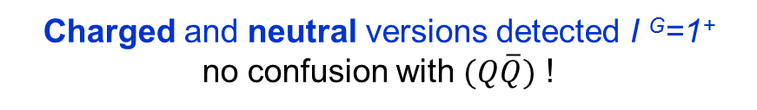
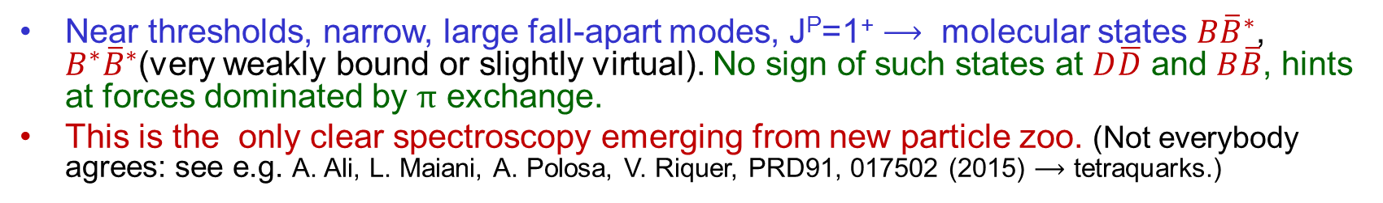
Near-threshold states: Z_{b}^{+,0} and Z_{c}^{+,0} states
5
Mass
MeV
π
Charged and neutral versions detected I ^{G}=1⁺
no confusion with $(Q\overline{Q})$ !
BES-III
Y(4260)
Z_{b}(10650)
B*B*
Z_{c}(4020)
Z_{b}(10610)
BB*
4200
π
π
BB
π
→ϒ (3S)
Z_{c}(4020)
D*D*
Belle
Z_{c}(3900)
π
π
DD*
→ϒ (2S)
3800
2³S₁
π
DD
2¹S₀
1³P_{0,1,2}
1¹P₁
10,650 MeV
10,610 MeV
M(ϒ(nS)π⁺)_{max}
3400
π
→ϒ (1S)
π
1³S₁
BES-III and Belle
1¹S₀
3000
_
_
Near thresholds, narrow, large fall-apart modes, J^{P}=1⁺ $⟶$ molecular states $B{\overline{B}}^{∗}$, $B^{∗}{\overline{B}}^{∗}$(very weakly bound or slightly virtual). No sign of such states at $D\overline{D}$ and $B\overline{B}$, hints at forces dominated by $π$ exchange.
This is the only clear spectroscopy emerging from new particle zoo. (Not everybody agrees: see e.g. A. Ali, L. Maiani, A. Polosa, V. Riquer, PRD91, 017502 (2015) $⟶$ tetraquarks.)
_
_
q
Q
Q
q

Slide 18
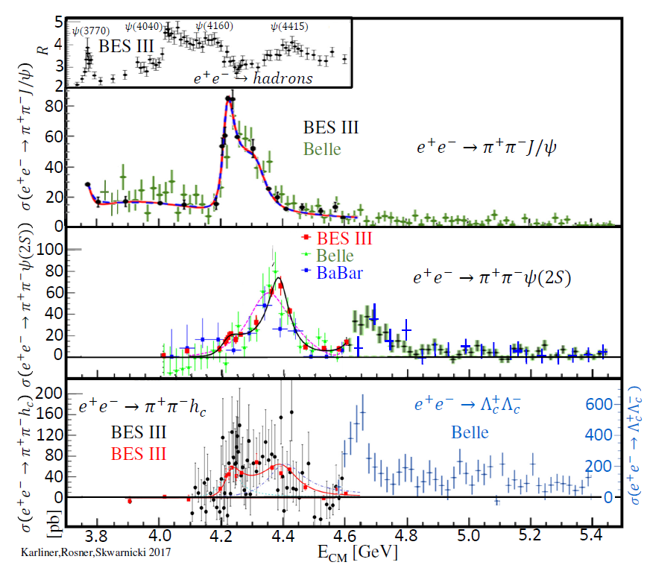









Anomalous charmonium-like vector states
1³D₁
3³S₁
2³D₁
4³S₁
$Y(4220$) and $Y(4320/4360)$ do not align with $c\overline{c}$ states
Γ_{ee} widths suppressed by 10²⁻³
Γ_{ππψ} widths huge
Decays via
$$Y\left(4260\right)→{Z_{c}}^{+(0)}π^{−(0)}$$
$$Y\left(4260\right)$$
$$→Y(4220)$$
$$Y(4320)$$
c
c
Hadron Spectrum Collaboration (LQCD m_{π}=240 MeV)
JHEP 1612, 089 (2016)
_
same?
c
Hybrid-charmonium ?
  Masses not too far from the predicted 1⁻ ⁻ hybrid by the lattice QCD:
    Only one 1⁻ ⁻ hybrid expected in this mass range
    ψ(4020),ψ(4160),ψ(4415) not well reproduced by lattice
  Γ_{ee} suppressed by a spin-flip needed to produce cc in S=0 configuration
  ππψ can proceed via DD** rescattering
  However, expected to decay to DD^{(*)}π, but not observed [CLEO-c PR D80, 072001(2009)]
$$Y(4360)$$
hybrid (n=1,L=0)
$$Y(4660)$$
$$c\overline{c}$$
ψ(4415)
Y(4360)
$Y(4660)$?
Y(4260)
ψ(4160)
Dai et al., PRD96, 116001 (2017)
ψ(4020)
ψ(3770)
F.Close, P.Page PL B628, 215 (2005)
E.Kou, O.Pene, PL B631, 164 (2005)
S-L. Zhu, PL B625, 212 (2005)
P.Guo, A.Szczepaniak G.Galata, A.Vassallo, E.Santopinto PRD78, 056003 (2008) …

Slide 19



Anomalous charmonium-like vector states
_
_
1³D₁
3³S₁
2³D₁
4³S₁
_
_
D₁
q
c
c
q
D
Decays via
$$Y\left(4260\right)→{Z_{c}}^{+(0)}π^{−(0)}$$
$D{\overline{D}}_{1}(2420)$ molecule Q.Wang, C.Hanhart, Q.Zhao, PRL 111 (2013) 132003
$$Y\left(4260\right)$$
$$→Y(4220)$$
$$Y(4320)$$
same?
$$Y(4360)$$
Asymmetric shape: M.Cleven, Q.Wang, F.K. Guo, C. Hanhart, U-G. Meißner, Q. Zhao, PRD90 (2014) 074039
$$Y(4660)$$
_
_
q
c
$Y(4660)$?
q
c
Dai et al., PRD96, 116001 (2017)
Tetraquark (diaquarkonium) L.Maiani, F. Piccinini, A. Polosa, V. Riquer, PR D89, 114010 (2014):
  Tetraquark→tetraquark transitions: Y(4260)→Z_{c}(3900)π, Y(4260)→X(3872)γ (possibly observed by BESIII)
$$D{\overline{D}}_{1}(2420)$$
$Y\left(4220\right)$-60 MeV binding? [ $Y(4360)$ +40 MeV ]

Slide 20

Anomalous charmonium-like vector states
1³D₁
3³S₁
2³D₁
4³S₁
Decays via
$$Y\left(4260\right)→{Z_{c}}^{+(0)}π^{−(0)}$$
$$Y\left(4260\right)$$
$$→Y(4220)$$
$$Y(4320)$$
same?
Y(4660): the same or different state in $e^{+}e^{−}→π^{+}π^{−}ψ\left(2S\right)$ and $e^{+}e^{−}→$(γ) $Λ_{c}^{+}Λ_{c}^{−}$ ?
ψ(5³S₁) or ψ(6³S₁) affected by $\left(Λ_{c}{\overline{Λ}}_{c}\right)?$
tetraquark?
Baryonium ?
$$Y(4360)$$
$$Y(4660)$$
Dai et al., PRD96, 116001 (2017)
$Y(4660)$?
G.C. Rossi, G. Veneziano, NP B123, 507 (1977)!

Slide 21


_
ϒ(5S)
Anomalous behavior of 1⁻⁻ states above open bottom threshold
bb
ϒ(6S)
h_{b}(1P) π⁺π–
However, ϒ(5S), ϒ(6S) → ϒ(1S,2S,3S) π⁺π– widths are 100 larger than ϒ(3S), ϒ(2S) → ϒ(1S) π⁺π–
OZI-rule violation
ϒ(1S) π⁺π–
h_{b}(2P) π⁺π–
ϒ(2S) π⁺π–
Also widths for ϒ(5S), ϒ(6S)
h_{b}(1P), h_{b}(2P) π⁺π–
are comparable, but require heavy quark spin flip
HQSS violation
PRL117,142001(2016)
PRD93,011101(2016)
ϒ(3S) π⁺π–
e⁺e– → ϒ(1S,2S,3S) π⁺π– and h_{b}(1P,2P) π⁺π–
proceed via ϒ(5S), ϒ(6S)
Like in charmonium!
Unlike in charmonium!

Slide 22













Charged charmonium-like states in B decays
(dominated by $K^{∗0}→π^{+}K^{−}$ resonances)
${Z_{c}\left(4200\right)}^{+}$, ${Z_{c}\left(4050\right)}^{+}$, ${Z_{c}\left(4250\right)}^{+}$ await confirmation
$Z_{c}(3900)$⁺ and $Z_{c}\left(4020\right)$⁺
observed in${ e}^{+}e^{−}→π^{−}Z_{c}$⁺, not observed in $B→K Z_{c}$⁺, (and vice versa).
Sensitivity to production mechanism, points to hadron-level interactions.
Breit-Wigner
amplitude
4344
4411
4277 MeV
M_{ψ’π+}= $MZ$
4605
$${Z_{c}\left(4430\right)}^{+}$$
$${Z_{c}\left(4200\right)}^{+}$$
4475
$${Z_{c}\left(4430\right)}^{+}$$
$${Z_{c}\left(4050\right)}^{+}$$
_
4541
$${Z_{c}\left(4250\right)}^{+}$$
No clear explanations.
Too broad to be molecular bound states?
No tetraquark model can accommodate all of them.
Rescattering effects?
Artifacts of complicated amplitude analyses?
J^{P}=1⁺
J^{P}=1⁺
J^{P}=?
$$D\overline{D}(2S)$$
Γ_{Z(4200)}=${370}_{−150}^{+100}$ MeV
Γ_{Z(4430)}=181±31 MeV
Γ_{D(2600)}=104±20 MeV

Slide 23





Many other strange animals with no clear interpretation
LHCb PRL118, 022003 (2017)
PRD95, 012002 (2017)
_
c
c
Thomas Britton, PhD, Syracuse. 2016
https://surface.syr.edu/etd/510/
Comparison with $B→XK, X→J/ψω$
and the strange J^{P} pattern speak against $c\overline{c}$ interpretation
$$B→XK, X→J/ψφ$$
molecules, tetraquarks,
3,4³P_{1,0} $\left(c\overline{c}\right)$ in the mix?
_
_
s
c
(some seen also by CDF,D0,CMS)
S
c
X(4274)
X(4500)
X(4140)
X(4700)
Postdiction by L.Maiani, A.D.Polosa, V. Riquer PRD94, 054026 (2016)
Possibly radially excited 0⁺⁺ tetraquarks. However, only one 1⁺⁺ state with color triplet diquarks.
X(4700)
No η-exchange
0⁺⁺
+69±26 MeV
D_{s0}⁺D_{s0}*⁻
Plenty of other thresholds,
but no matching J^{PC} numbers
_
X(4500)
_
0⁺⁺
_
_
c
s
s
c
F. Stancu, J.Phys. G37, 075017 (2010)
Predicted two 1⁺⁺
tetraquarks in this mass range (S=0,1 diquarks in color triplet and sextet)
1⁺⁺
1⁺⁺
0⁺⁺
0⁺⁺
No π-exchange
forces!
X(4274)
1⁺⁺
X(4140)
1⁺⁺
η-exchange OK
D_{s}⁺D_{s}*⁻
+66±5 MeV

Slide 24
















Many other strange animals with no clear interpretation
Σ_{c}⁺
Tightly-bound penatquark
Molecules
LHCb PRL 115, 072001 (2015)
d
c
u
_
c
Nathan Jurik. PhD Syracuse 2016
https://surface.syr.edu/etd/640/
u
c
D*⁰
_
u
c
$$Λ_{b}^{+}→P_{c}^{+}K, P_{c}^{+}→J/ψp$$
molecules,tetraquarks, triangle anomalies?
No ${\frac{5}{2}}^{±}$ molecules
in this mass range
d
u
Can accommodate ${\frac{5}{2}}^{±}$when at least one diquark in S=1 state
Karliner,Rosner PRL115,
122001(2015) and others
$${\frac{1}{2}}^{−}, {\frac{3}{2}}^{−}$$
Maiani et al PLB749, 289 (2015)
and many others
p χ_{c1}
Σ_{c}⁺D^{*0}
P_{c}(4450)⁺
$${\frac{5}{2}}^{∓}$$
$${\frac{3}{2}}^{∓}$$
$${\frac{1}{2}}^{+}, {\frac{3}{2}}^{+}$$
or
Such mass difference
and the opposite parity
can be explained by
ΔL=1 and ΔS=1
+1±3 MeV
- 10±3 MeV
P_{c}(4380)⁺
$${\frac{3}{2}}^{∓}$$
$${\frac{5}{2}}^{∓}$$
P_{c}(4380)⁺ is too
broad to be a molecule
or
$P_{c}$(4450)
p
$P_{c}$(4380)
p
J^{P} “preferred” rather than definitely
determined
However, where are all the expected other excitations ?
d
u
d
u
J^{P}=?
u
u
_
_
LHCb will have almost 10x
more $Λ_{b}^{+}→J/ψpK$ by Dec.
c
c
c
c
Realistic rescattering mechanisms (cusps, triangle anomalies) have the same J^{P} selection rules as realistic molecular models (must happen in S-wave)
χ_{c1}
J/ψ

Slide 25














Rethinking of light hadron spectroscopy?
Above multiquark-threshold
$$c\overline{c}$$
$$c\overline{c}$$
$$c\overline{c}$$
$$c\overline{c}$$
$$c\overline{c}$$
$$c\overline{c}$$
$$c\overline{c}$$
$$K\overline{N}$$
$$uds$$
$$c\overline{c}$$
πΣ
$$c\overline{c}$$
$$c\overline{c}$$
$$c\overline{c}$$
$$c\overline{c}$$
$$uds$$
States may be “missing” for a good reason
$$c\overline{c}$$
$$c\overline{c}$$
Enormous samples of light hadrons produced in decays of b-hadrons are largely unutilized $→$ opportunity for nuclear and high-energy communities to team up
(25k, we now
have 220k, many other channels…)
If charmonium is such a freak-show zoo above the open flavor threshold, we need to keep an open mind about multiquark or hybrid states altering expectations based on naïve $\left(q\overline{q}\right),\left(qqq\right)$ models. Analyzes of coupled channels, and of many observables are important for probing natures of the observed states.

Slide 26






Plenty of evidence for diquarks in heavy baryons (example)
Spin of charm quark decouples because of its heavy mass: good place to study ss quark pairs:
OZI allowed but rips the diquark apart
s
s
s
s
s
s
s
_
u
$ΞD$
threshold
$$Ξ$$
$$K^{−}$$
q
c
c
narrow
_
u
_
the diquark
survives
s
Ω_{c}^{∗∗ 0}
q
Ω_{c}^{∗∗ 0}
Ω_{c}(3066)
Ω_{c}(3090)
Ω_{c}(3050)
c
c
Ω_{c}(3119)
$$Ξ_{c}^{+}$$
Ω_{c}(3000)
$$D$$
Γ=3.5±0.4 MeV
Γ=8.7±1.3 MeV
Ω_{c}(3188) ?
LHCb PRL 118, 182001 (2017).
Γ<1.2 MeV
Γ<2.6 MeV
wide
Ω_{c}^{∗∗ 0}→ Ξ_{c}⁺K⁻
Γ=4.5±0.7 MeV
Γ=60±19 MeV
(Strong decay)
The narrow states observed by LHCb are likely 1P and 2S
of c-(ss diaquark)
Ξ_{c}⁺ sidebands

Slide 27








Doubly-flavored tetraquarks
tetraquark
c
baryon
Replace the light quark with light anti-diquark in color triplet configuration
d
b
u
c
b
LHCb PRL 119, 112001 (2017)
u
Λ_{c}⁺ → pK⁻π⁺
Part of Run II
1.7 fb⁻¹
The lightest 1⁺ state
0⁺ state
the same toolkit
Distance from EM or strong
decay threshold (MeV)
?
1⁺ state
Stable tetraquark,
will decay weakly
New holy grail of heavy quark spectroscopy
LHCb-PAPER-2017-018
Karliner,Rosner PRD90,094007 (2014)
Luciano Maiani
_
_
Karliner,Rosner PRL 119, 202001 (2017)
See also:
Eighten,Quigg PRL 119, 202002 (2017);
Czarnecki,Leng,Voloshin PL B778, 233 (2018)
Esposito,Papinutto,Pilloni,Polosa, et al PRD88, 054029 (2013); and others
b
b
LHCb $3621±1$
d
u
Ebert,Faustov,Galkin,Martynenko
PRD66, 014008 (2002) $3620 3627$
Consistent results predicted by LQCD:
Francis,Hudspith,Lewis,Maltman PRL 1118,142001 (2017)

Slide 28


Observation of double Y production at LHC
JHEP 05 (2017) 013
First observation of $b\overline{b}+b\overline{b}$ production at LHC. An example, where high luminosity of CMS, and central region coverage, won over lower muon momentum thresholds in forward region at LHCb.
$bb$not in the same hadron yet.
Can look for $(bb)(\overline{b}\overline{b})$ tetraquark in decays to Y(1S)Y(1S) – some predicted it to be narrow.
In stable teraquark need to look for $b→cW$ decay. Look out for observations of $bbq$baryons, as signs of reaching sensitivity to detect $\left(bb\right)\left(\overline{ud}\right).$It will be hard to detect it even at LHCb Phase II upgrade. A better chance to detect $\left(bc\right)\left(\overline{ud}\right)$ if stable or narrow (thousands of $\left(b\overline{c}\right)$ mesons have been already detected at LHC).

Slide 29












SuperKEKB
Past and future: dedicated $c−$quark experiments
Super Tau-Charm Factory (STCF)
Proposed at Beijing and Novosibirsk
$${cm}^{−2}s^{−1}$$
$$\sqrt{s}\sim 10 GeV$$
(energy up to $\sqrt{s}\sim 7 GeV$)
Energy upgrade
to $\sqrt{s}\sim 4.9 GeV$
$$\sqrt{s}\sim 4 GeV$$
BES: highest luminosity $e^{+}e^{−}→c\overline{c}$ experiment near the charm threshold (precision scanning)
PANDA: highest luminosity $p\overline{p}→c\overline{c}$
experiment near the charm threshold
(under construction; physics 2025- )
2020
2030

Slide 30








Past and future: experiments producing b-hadrons
Colliders and bb rates
10⁷
HL-LHC
Decays of b-quark proved to be an excellent source of hadrons containing $c, c\overline{c}$
These experiment see directly produced charm as well
CMS
ATLAS
10⁶
LS3
LS5
Upgraded LHCb
hadron colliders
CMS
LS1
LS2
LS4
10⁵
LHCb
Phase-I
Upgrade
LHCb
Phase-II
Upgrade
LHCb
$$σ_{b\overline{b }}ℒ ε_{geometrical}$$
Tevatron
CDF,D0
bb pairs produced (s⁻¹)
10⁴
(within the angular acceptance)
10³
Belle II
10²
Belle
Good hadron ID, dedicated large-bandwidth triggers,
Enormous rates of b-mesons and b-baryons
10 GeV e⁺e⁻ colliders
10¹
Belle II
BaBar
now
10⁰
2000 2005 2010 2015 2020 2025 2030 2035
$$\int{ℒ dt}$$
CDF 10 fb⁻¹ , D0 8 fb⁻¹
ATLAS
Run I
3 fb⁻¹
25 fb⁻¹
Run II Run III Run IV Run V+VI
5 fb⁻¹ 50 fb⁻¹ 300 fb⁻¹
450 fb⁻¹ 3000 fb⁻¹
Higher luminosities than LHCb.
No hadron ID. Limited triggers.
LHCb
ATLAS,CMS
$$\sqrt{s_{pp}}$$
14 TeV
14 TeV
(27 TeV HE-LHC?)
Good hadron ID, good detection of neutrals.
Good absolute reconstruction efficiencies.
7-8 TeV
13 TeV

Slide 31




Future: photo-production of P_{c} states at JLab
$$γp→J/ψp$$
GlueX preliminary
E12-16-007
CLAS12
will run in Spring 2019

Slide 32

Conclusion
New particle zoo for charmonium above open flavor threshold: more “exotic” than conventional states
  Interplay of conventional states and meson-meson thresholds (molecules?) in X(3872) and in a few lighter hadrons
  Good evidence for meson-meson molecules from the threshold $Z_{b}^{±,0},$ $Z_{c}^{±,0}$
  Many more weird states (including pentaquark candidates) without well-established explanation
Possible implications for light-quark hadron spectroscopy?
No well established states with gluon as a constituent, but experimental efforts continue.
Great prospects for orders of magnitude larger samples from on-going and future projects – expect resolution of existing questions but hopefully also new surprises

