Slide 1
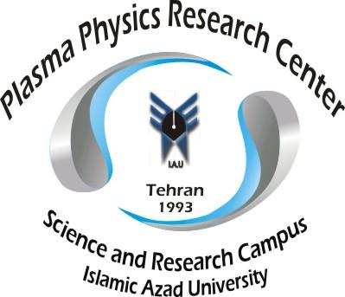
Ion acoustic cnoidal waves in electron-positron-ion plasmas with q-nonextensive electrons and positrons and high relativistic ions
By:
Davoud Dorranian
Forough Farhad Kiaei
Plasma Physics Research Center, Science and Research Branch, I. Azad University, Tehran, Iran

Slide 2
XXIV international Baldin Seminar
Outline
. Introduction
. Basic equations
. Derivation of KdV equation
. Results and discussion
. Conclusion

Slide 3

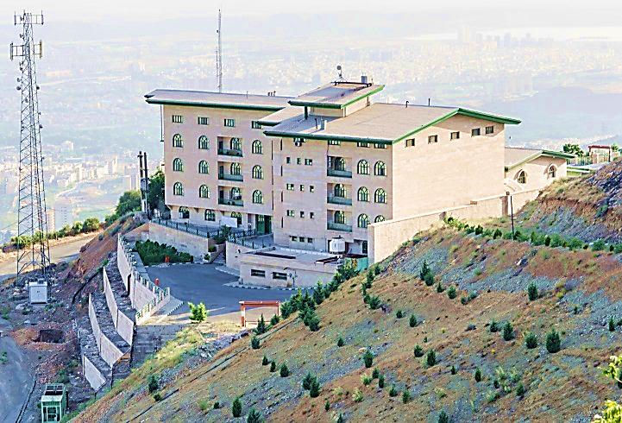
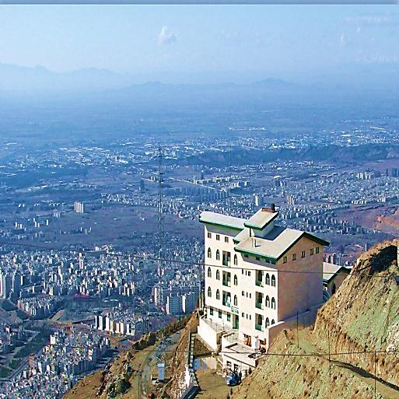
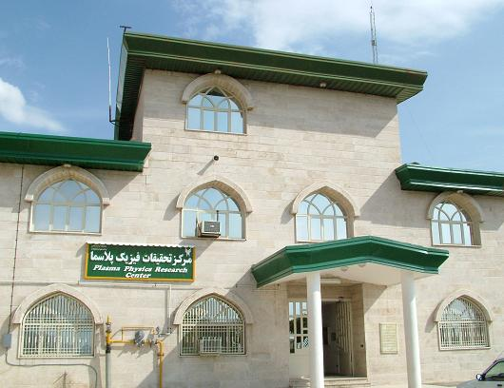

Part 1:
Plasma Physics Research Center

Slide 4
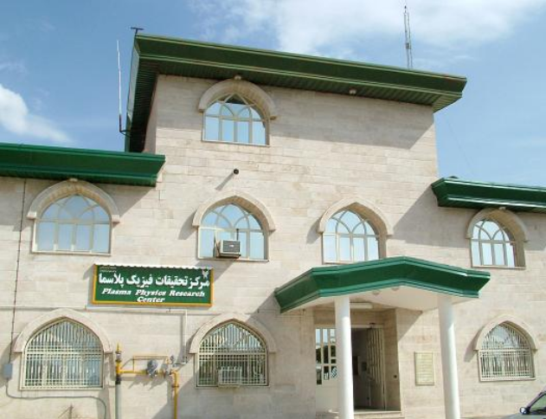
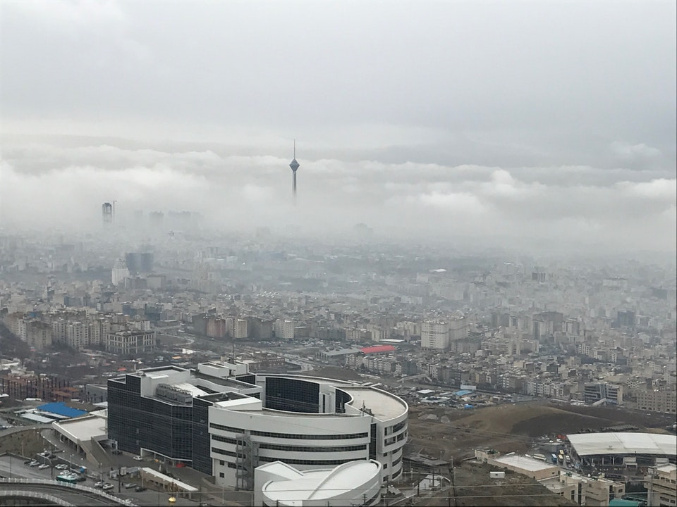
The Department was established by I.A.U Science and research branch in 1993, and includes some of the most advanced facilities of its kind.
Our faculty members specialize in various field of science and technology-Namely Plasma Physics, Laser-Optics, Nano-Technology, Nano-Optoelectronics, Condensed Matter, Solid State Physics and ... .
This department consists of about 74 PhD students, and 500 students that follow bachelor and master degrees in Physics and Engineering Physics (Laser, Plasma and Condensed matter.

Slide 5
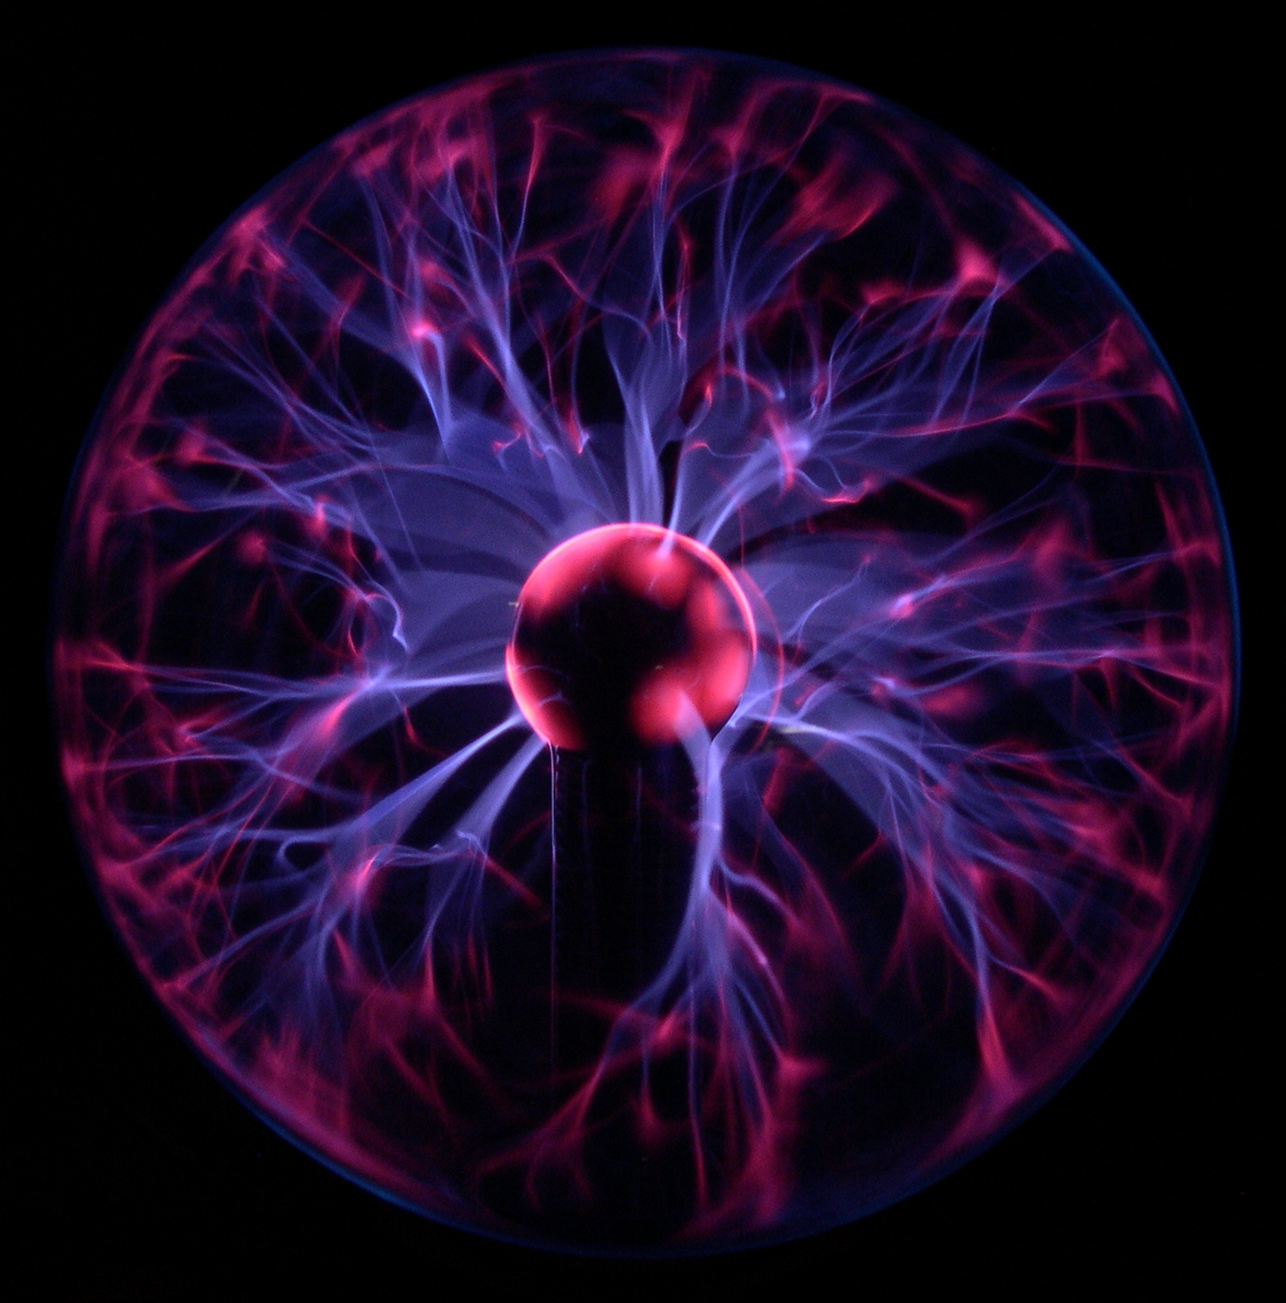
Waste Disposal
Clean Energy
Material Sciences
Medical Sciences

Slide 6
Research at PPRC organized
around following theme:
1. Magnetic Confinement Fusion (Tokamak, Plasma Focus)
2. Inertial Confinement Fusion
3. Laser applications ( Laser medicine, Laser ablation, …)
4. Surface Physics (Thin film structures, ion implantation, ion beam assisted deposition, …)
5. Nanotechnology applications (CVD , TCVD , PECVD , HFCVD , …)
6. Semiconductors
7. Optoelectronics
8. Biophysics and Plasma medicine
9. Plasma application in textile and polymers
10. Thermal Plasma and its application (waste disposal)
…

Slide 7
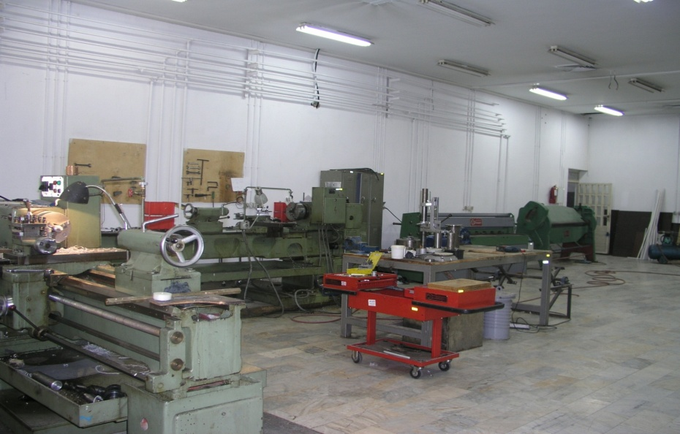
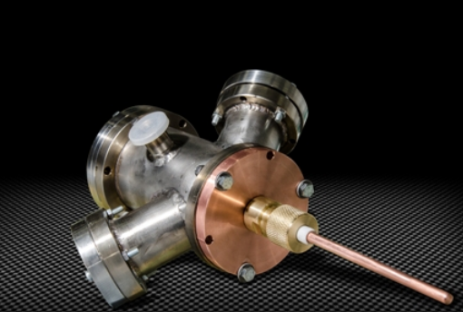
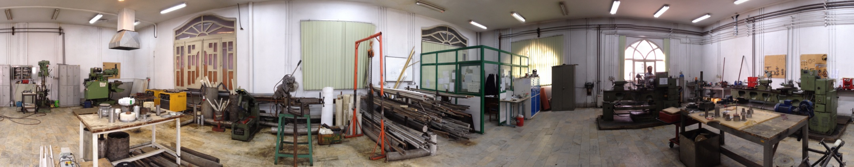
Workshop

Slide 8
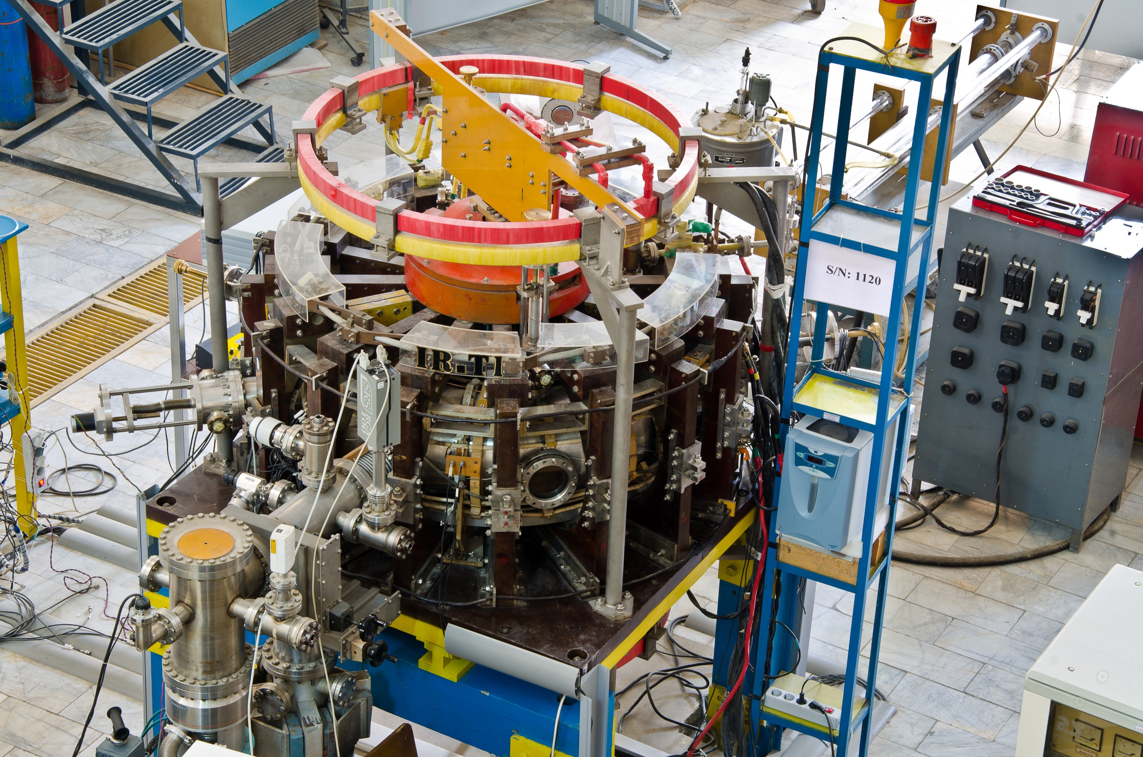
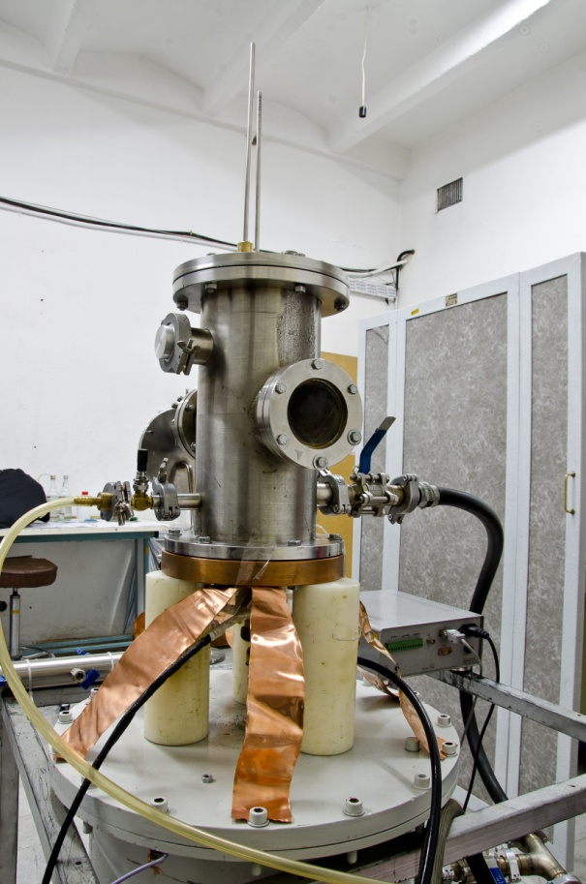
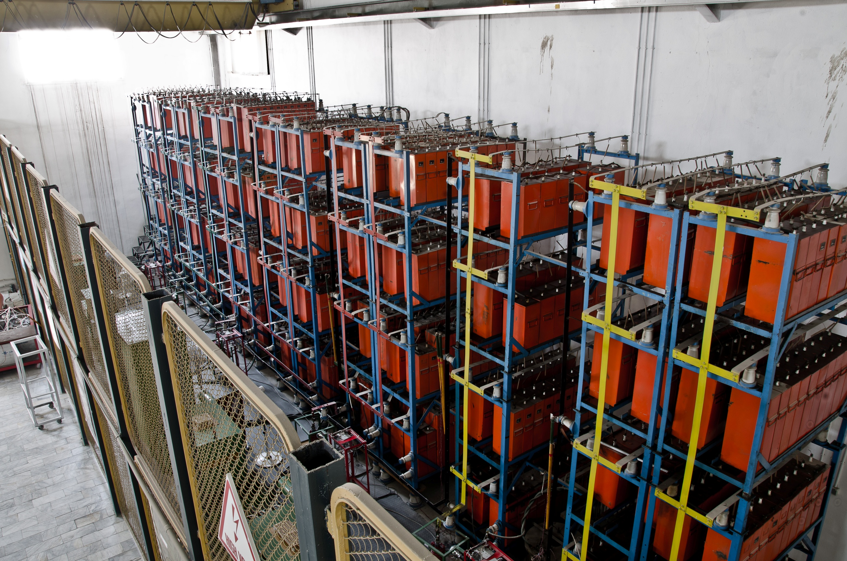
IR-T1 Tokamak
Dense Plasma Focus

Slide 9
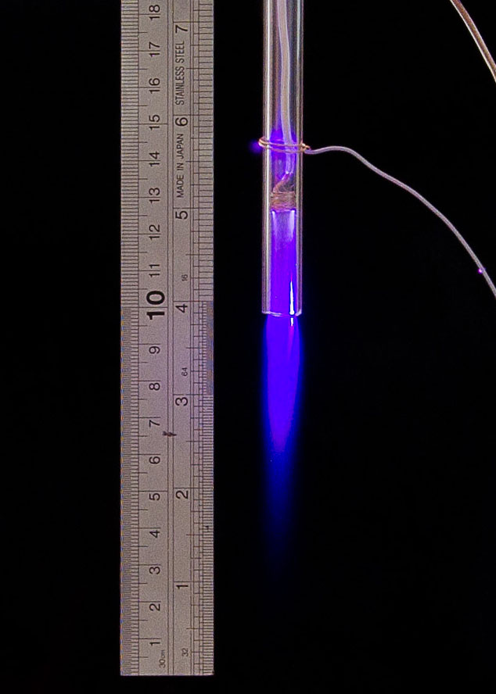
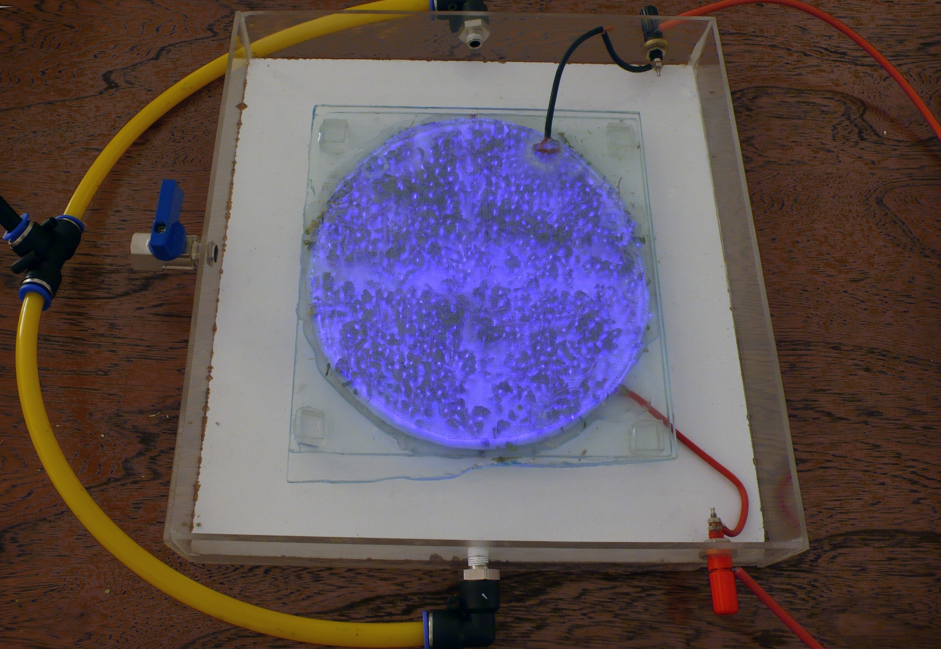
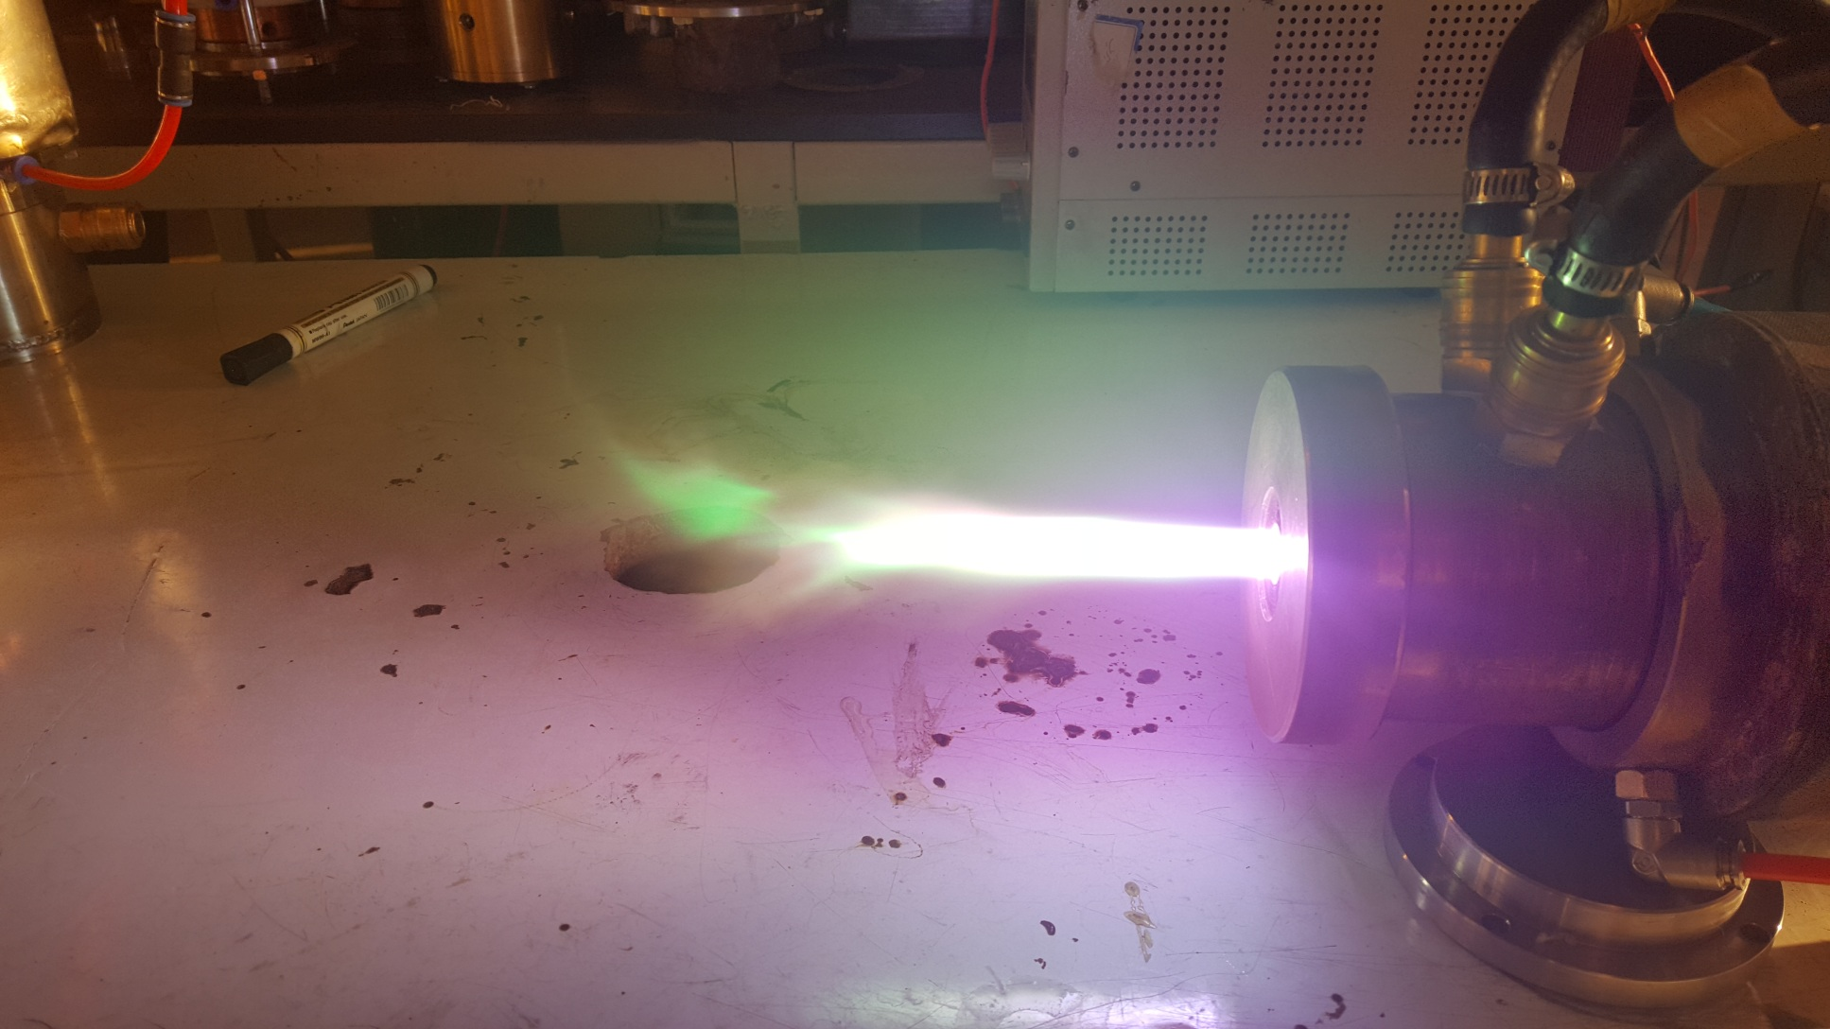
DBD Plasma
Plasma Jet
Plasma Torch

Slide 10
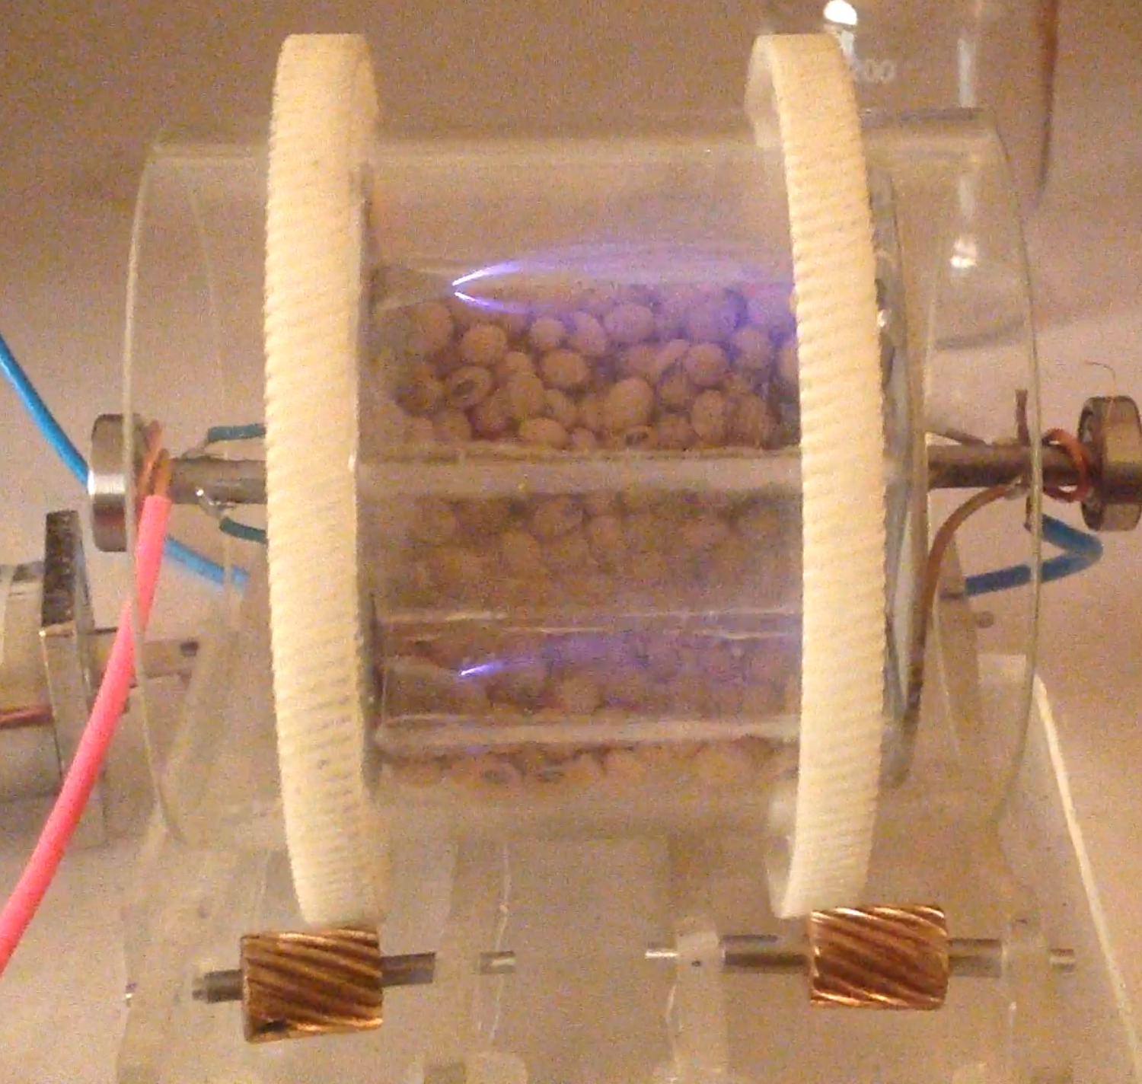
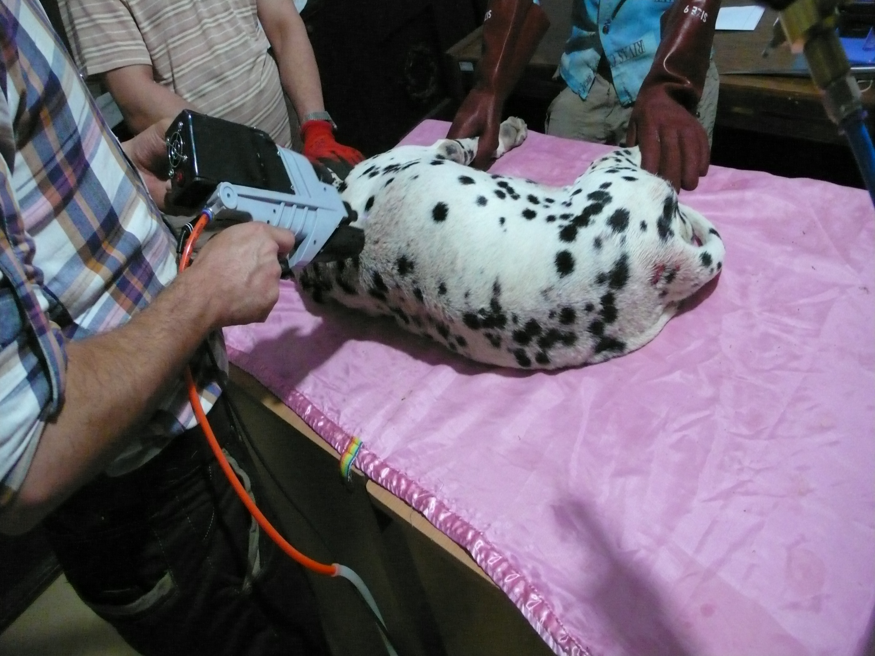
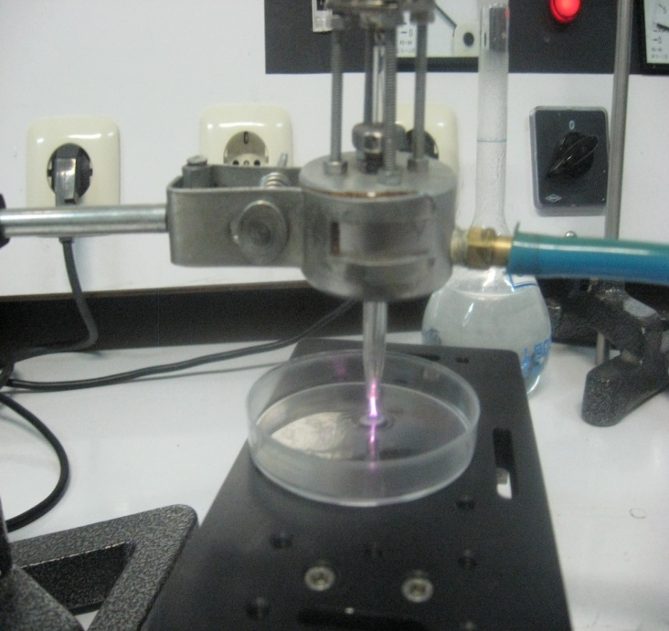
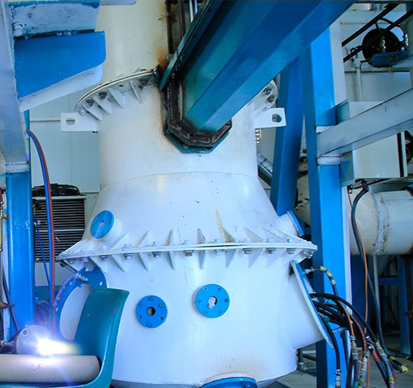
Seed treatment
Bedsore treatment
Antibacterial treatment
Medical waste treatment

Slide 11
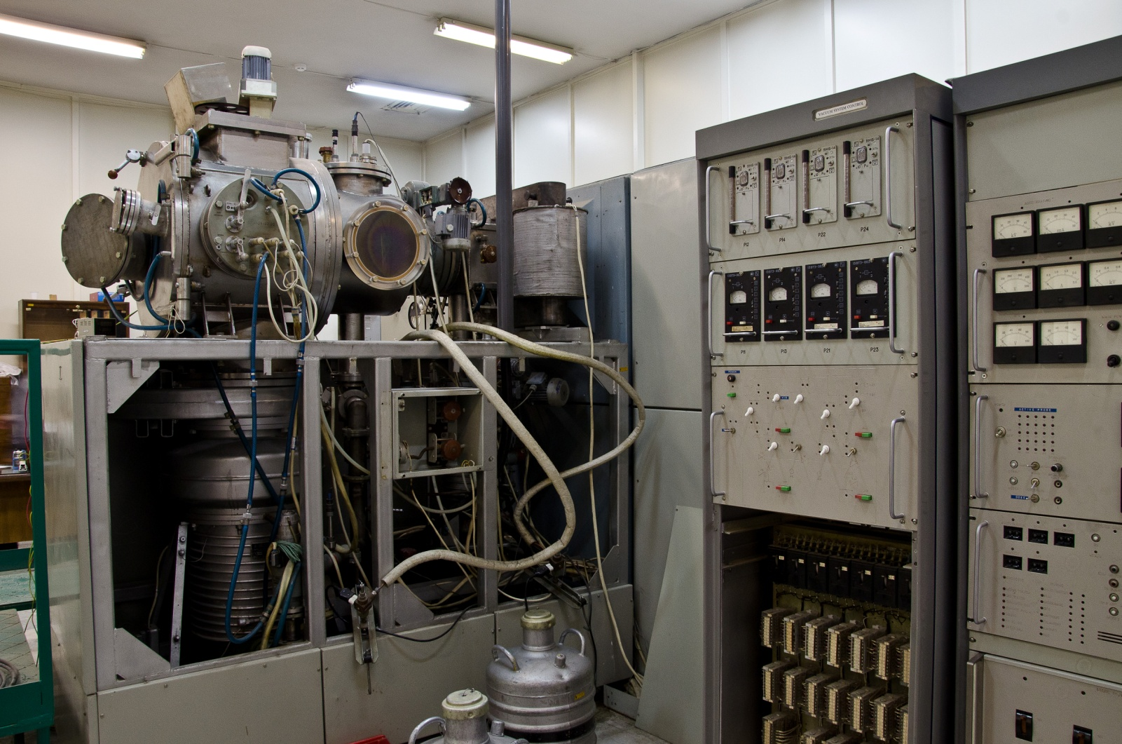
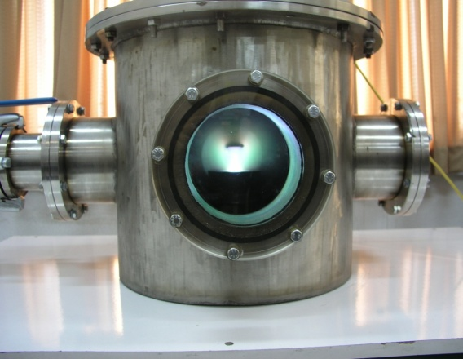
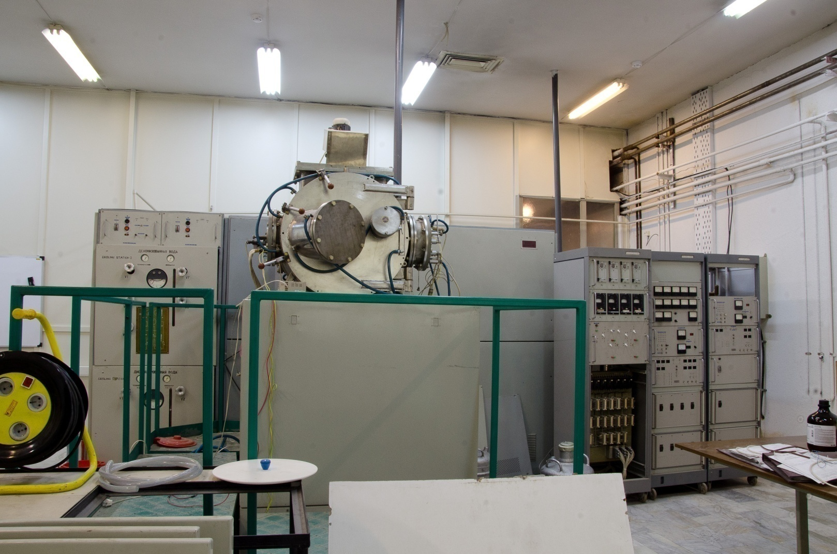
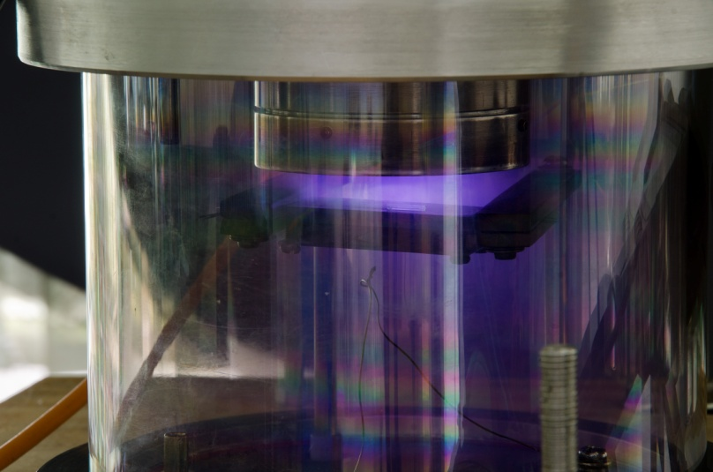
Ion Implantation & Ion Beam
Various Sputtering Systems

Slide 12
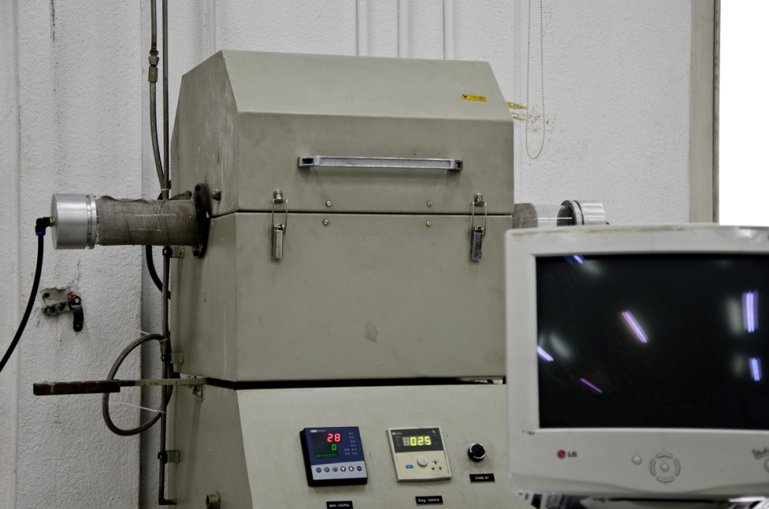
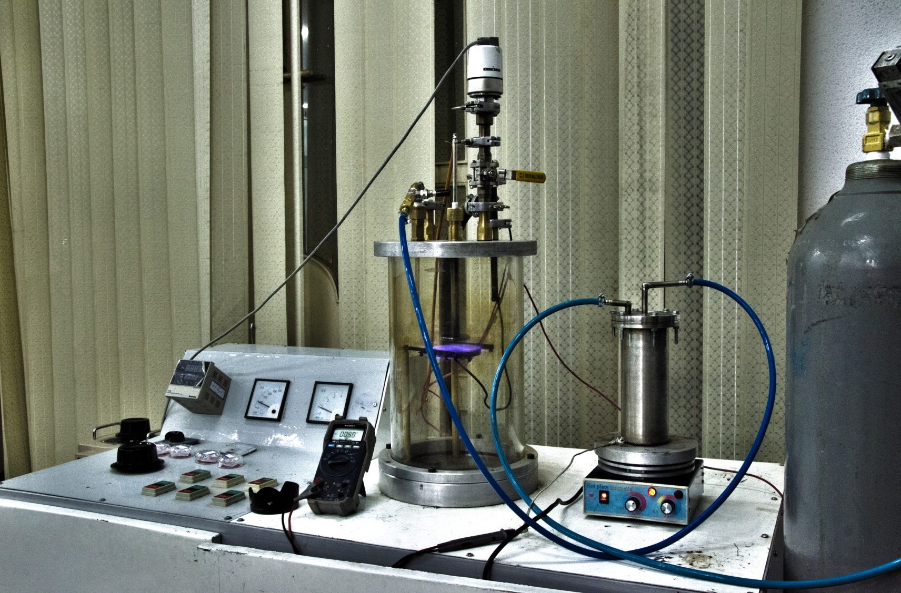
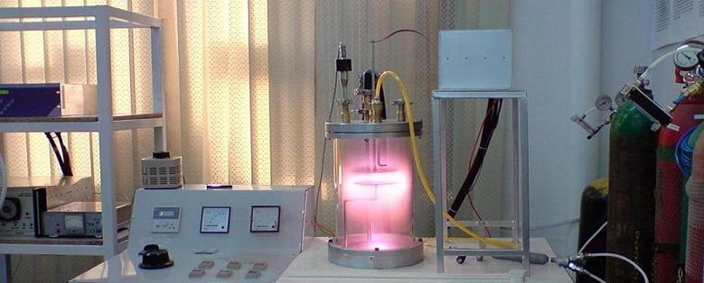
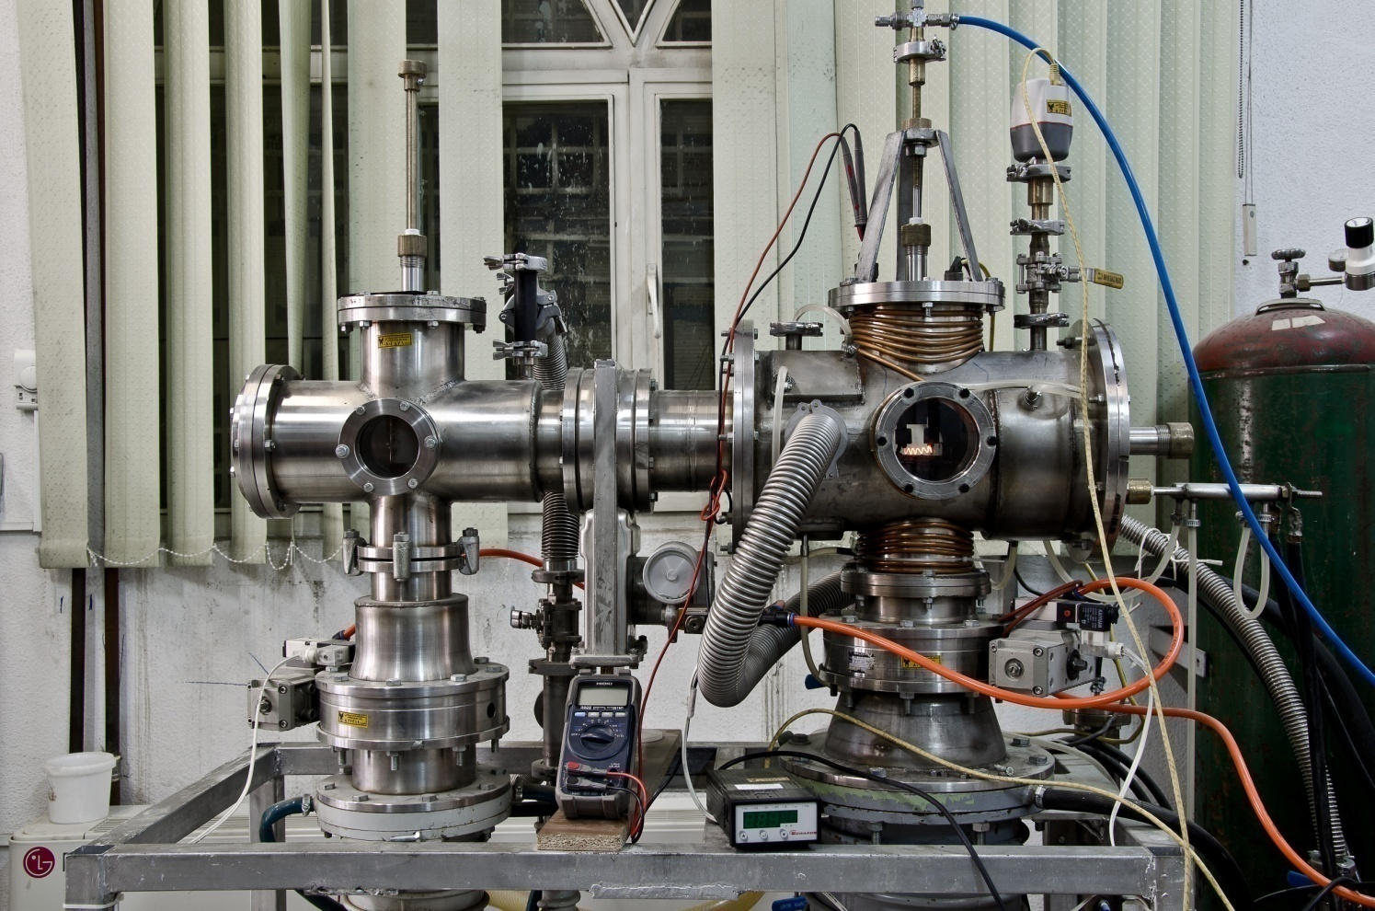
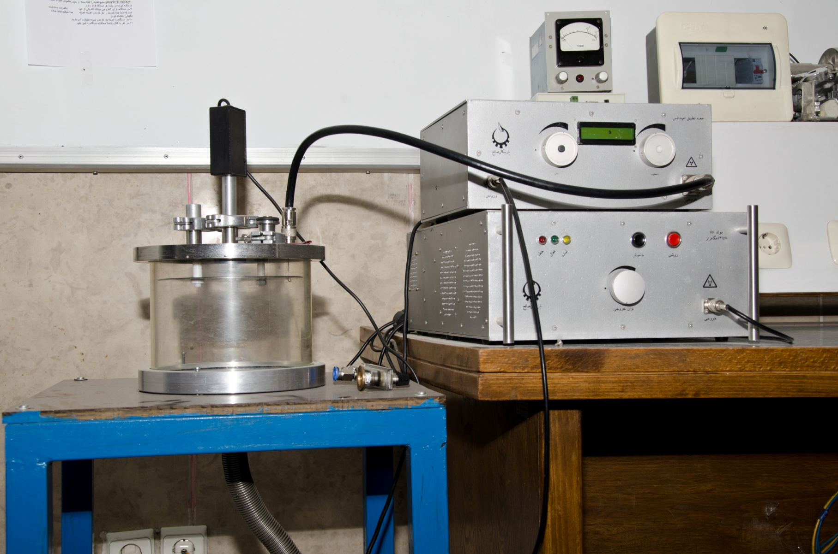
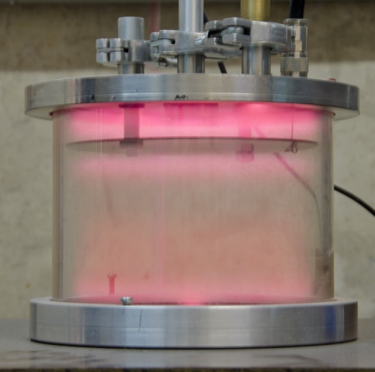
TCVD
PECVD
HFCVD
RF Plasma

Slide 13
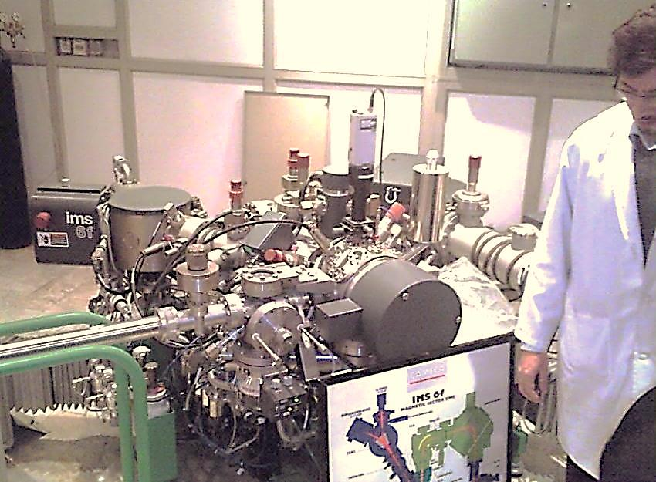
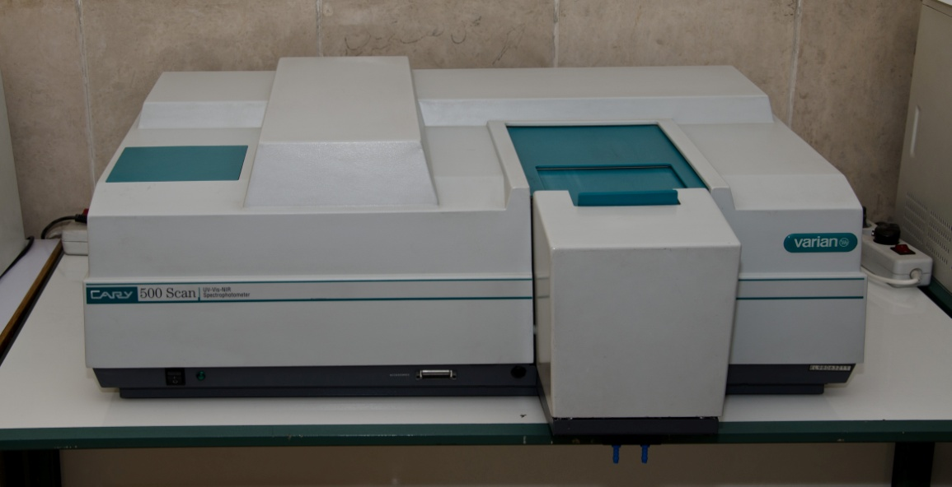
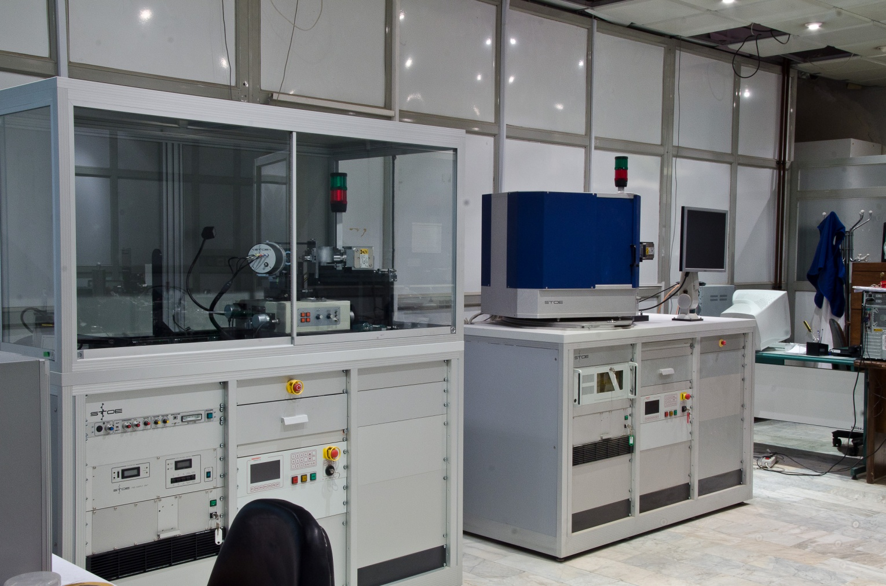
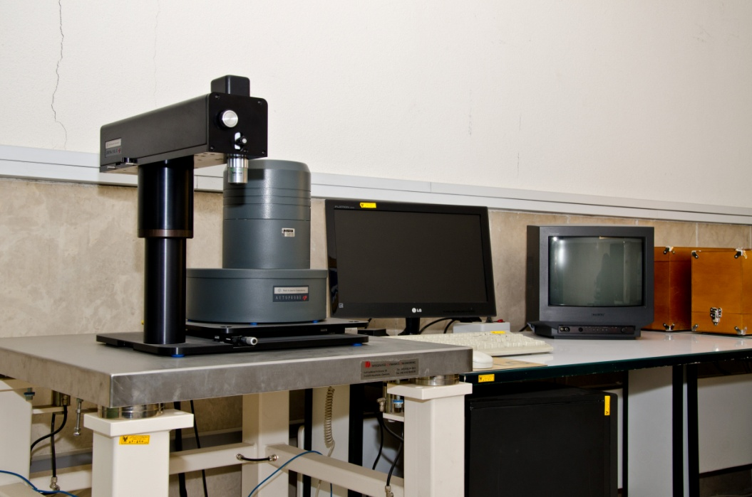
Secondary Ion Mass Spectrometry (SIMS)
UV-Vis-NIR Spectroscope
XRD & SCXRD
SPM-AFM

Slide 14

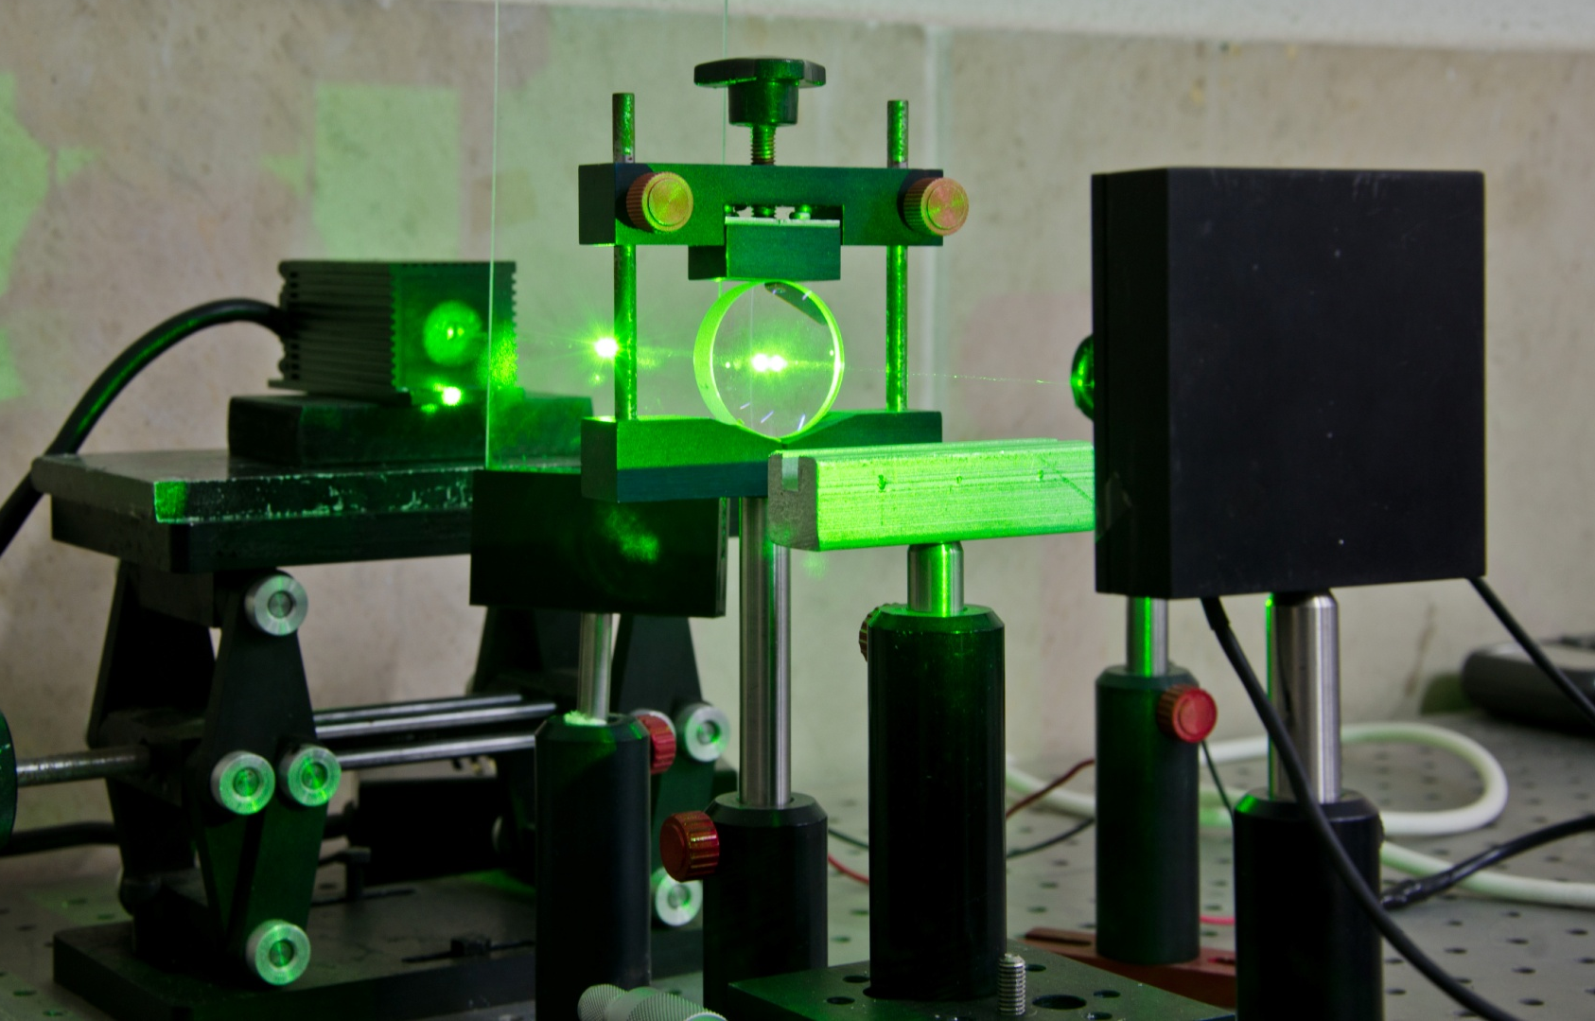
Laser Labs

Slide 15
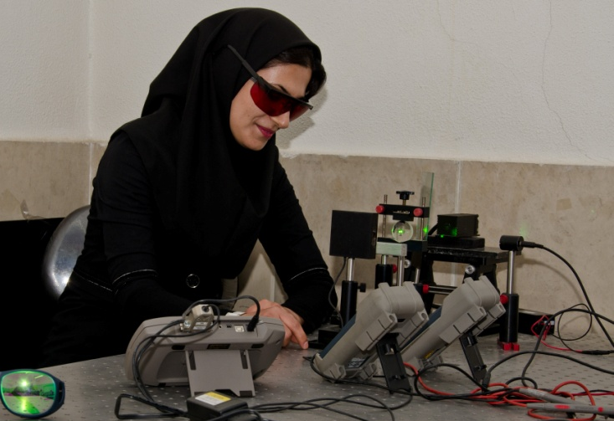
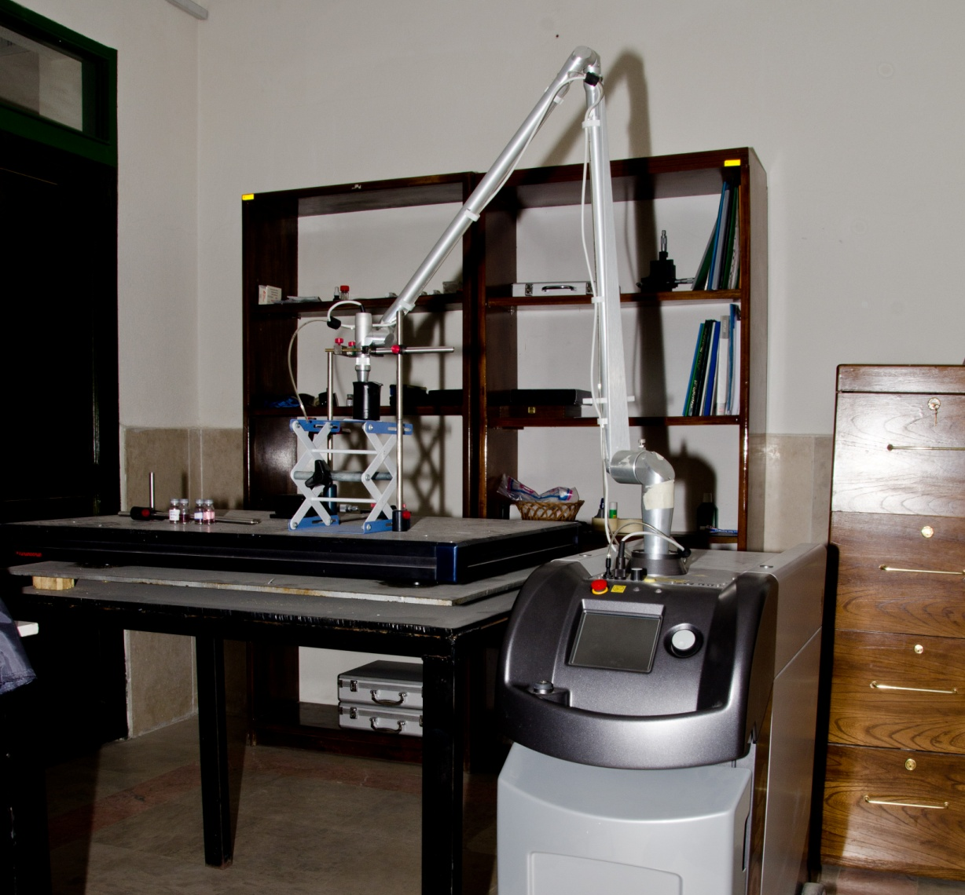
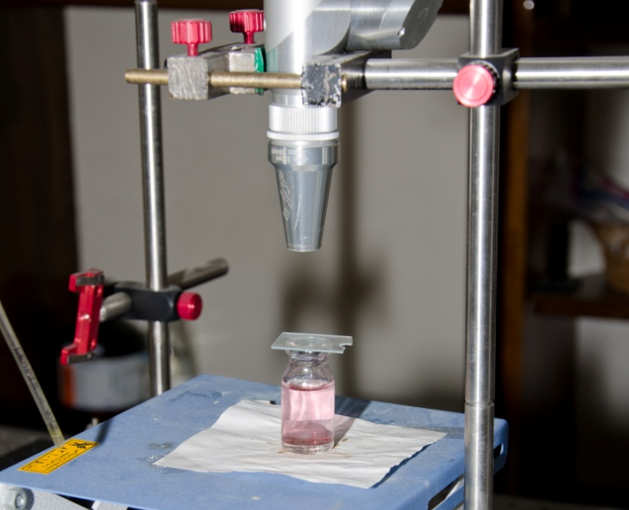
Laser Lab

Slide 16
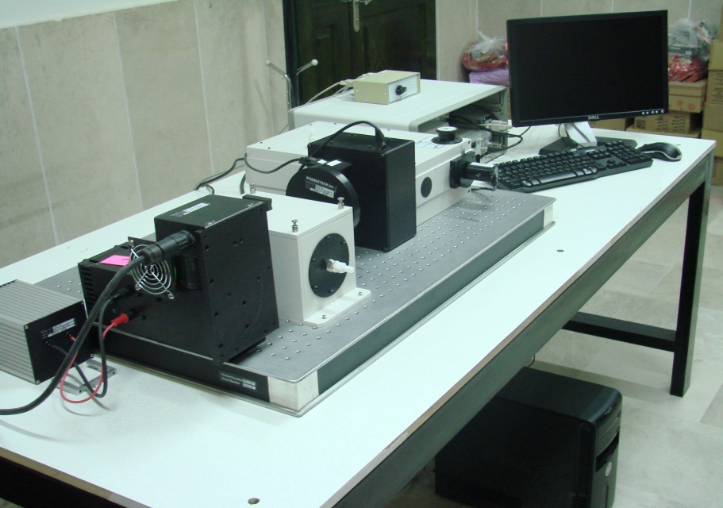
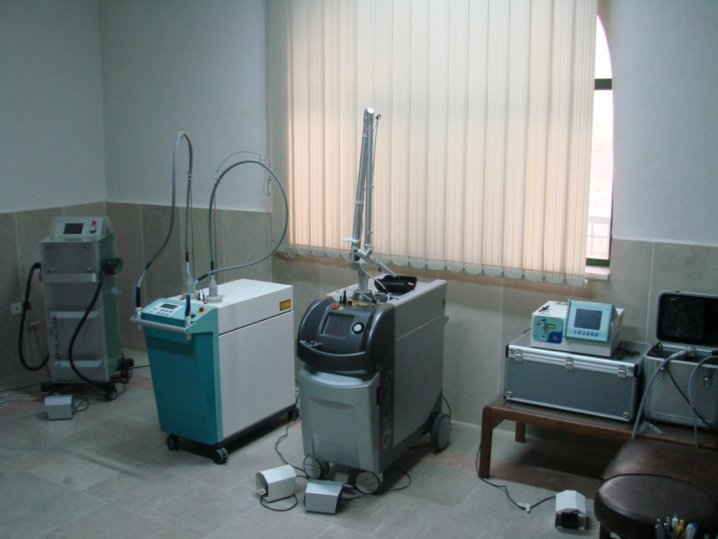
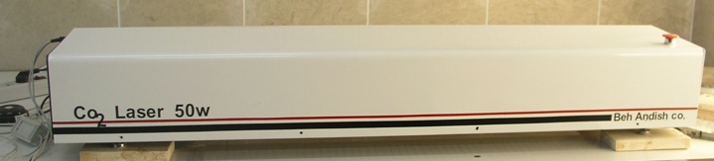
Laser Lab

Slide 17
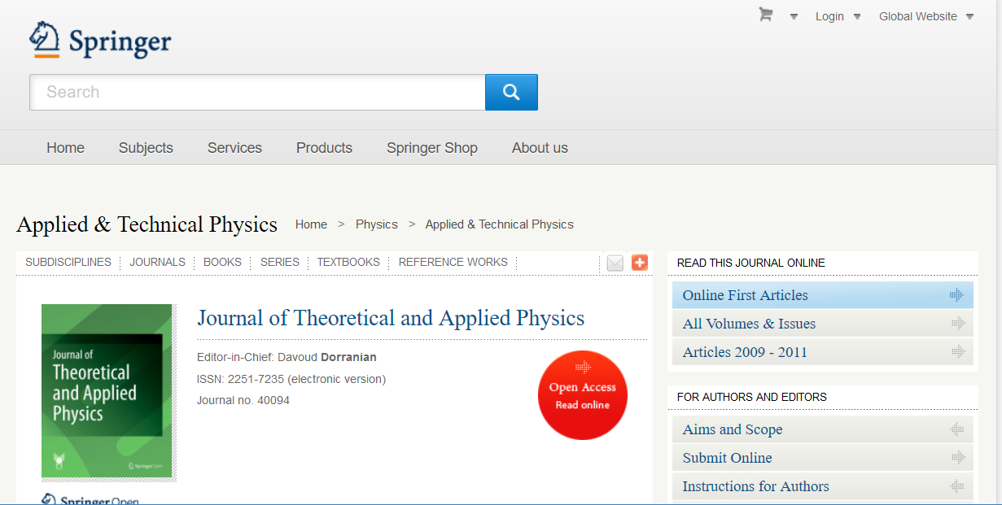

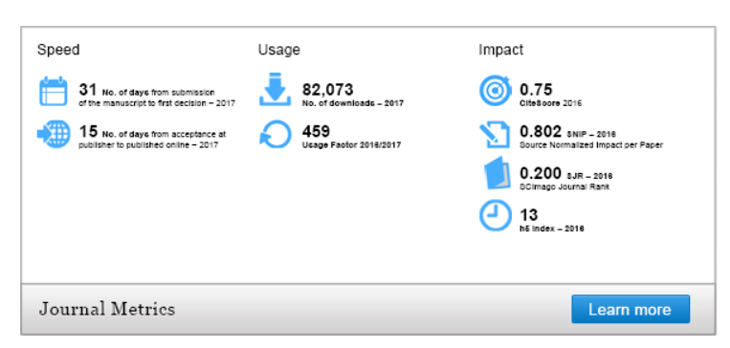

Slide 18
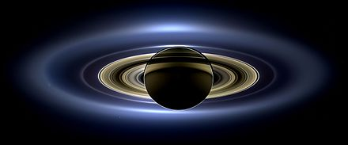
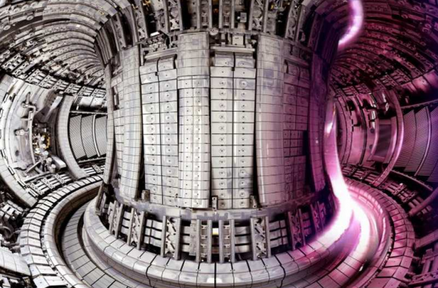
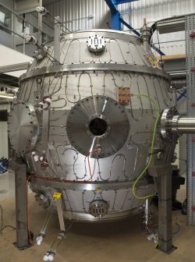
In this work, we study ion acoustic cnoidal waves (IASW) in electron–positron-ion plasma with nonextensive electrons and positrons and high relativistic ions. Our aim in this study is therefore to recognize the effects of plasma nonextensivity and relativity on the IACW.
Applications

Slide 19
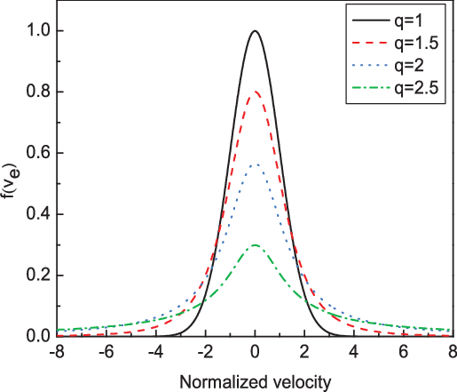
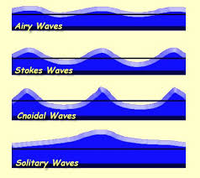
Introduction:
Nonextensive distribution function
For example this normalized density distribution function
Common nonlinear waves in plasmas
Electron+positron+ion plasma
GAS+Energy→ PLASMA
Electric charge conservation
Electron-Ion plasma:
n_{e}+Zn_{i}=0
Electron-Ion-Positron plasma:
n_{e}+Zn_{i}+n_{p}=0
Relativistic effects

Slide 20
2. Basic equations

Slide 21
2. Basic equations
The normalization

Slide 22
2. Derivation of KdV equation
Reductive perturbation method
Dependent variables are expanded :

Slide 23


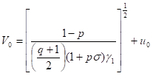



2. Derivation of KdV equation
The set of equations at the
lowest order is;

Slide 24





2. Derivation of KdV equation
The next higher-order
equations are;
After some algebraic manipulations, second order quantities are eliminated and φ₁ is found to satisfy the following KdV equation

Slide 25



2. Derivation of KdV equation
After some algebraic manipulations, second order quantities are eliminated and f₁ is found to satisfy the following KdV equation:
which is the required KdV equation and describes the evolution of the first order perturbed potential . The coefficients and are given by:

Slide 26




2. Derivation of KdV equation
Cnoidal wave solution of KdV equation
The α₀ ،α_{1,} and α₂are the real roots of Sagdeev potential
the amplitude
the wavelength
K(m) is the first kind of complete elliptic integral

Slide 27
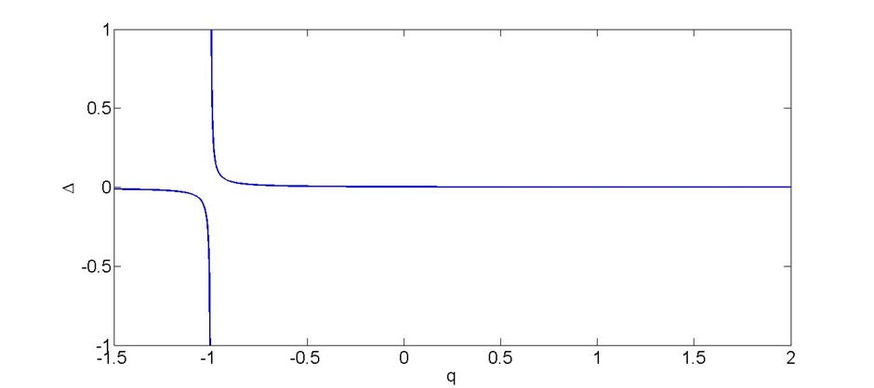
3. Results and discussion
Cnoidal wave may generate and propagate in plasma medium only if Sagdeev potential has three real roots. In this case the domain of real roots should be found from the inequalities Δ= (u/a) ²−ρ₀ (b/a)>0 and0<((α₀−α₁)/(α₀−α₂))^{0.5}<1
The acceptable values for q in which Sagdeev potential has three real roots are shown in Fig. 1
Fig1.Plot of Δ versus q, having σ=0.1, p=0.1,U=0.0075, ζ=0.8 and ρ₀=−0.002
This figure shows that for all values of q> -1 periodic wave (Cnoidal) may be formed

Slide 28

Δ versus ζ=u₀/c is shown in Fig. 2. Ion relativity does not make any effect on the formation of IACW and for all magnitudes of ζ periodic wave may generate and propagate in plasma medium.
Fig2. Plot ofΔ versus ζ , havingσ=0.1, p=0.1,U=0.0075, q=0.1 and ρ₀=−0.002

Slide 29

This figure shows that by increasing plasma nonextensivity the width and depth of the potential well decrease.
Fig3. Plot of V (φ) versus φ for different qs, having σ=0.1, p=0.1, U=0.0075, ζ=0.8 and ρ₀=−0.002

Slide 30

In Fig. 4 the frequency of ion acoustic periodic wave (cnoidal) versus ζ=u₀/c for different qs has been plotted. By increasing q and ζ the frequency of periodic wave (cnoidal) will decrease.
Fig4. Plot of frequency of periodic wave (cnoidal) versus ζ for different qs, having σ=0.1, p=0.1, U=0.0075 and ρ₀=−0.002

Slide 31

By increasing the nonextensiivity of plasma the amplitudeof periodic wave (cnoidal) will decrease. Variation of the amplitude of IACW mainly occurs in the super extensive regime when q<1
Fig5. Plot of amplitude of periodic wave (cnoidal) versus q, havingσ=0.1, p=0.1, U=0.0075, ζ=0.8 and ρ₀=−0.002

Slide 32

By increasing ζ=u₀/c, the amplitude of periodic wave (cnoidal) slightly increased.
Fig6. Plot of amplitude of periodic wave (cnoidal) versus ζ , havingσ=0.1, p=0.1, U=0.0075, q=0.1 and ρ₀=−0.002

Slide 33


Effects of ζ and q on the wave pattern of IACW are presented in Figs. 7 and 8. In any case for all magnitudes of q and ζ, IACW is compressive
Fig8.Plot of the potential of the cnoidal wave φ versus η for different qs,having σ=0.1, p=0.1, U=0.0075, ζ==u₀/c=0.8 and ρ₀=−0.002
Fig7. Plot of the potential of the cnoidal wave φ versus η for different ζs, having σ=0.1, p=0.1, U=0.0075, q=0.1 and ρ₀=−0.002

Slide 34
4. Conclusion
Propagation of IACW in collisionless, unmagnetized high relativistic plasmas with nonextensive electrons and positrons has been studied.
Amplitude of the cnoidal wave and its width has been derived as functions of plasma parameters.
Only positive cnoidals can be generated in the plasma medium.
Amplitude of IACW increases with increasing the relativistic parameter ζ.
Presence of nonextensive electrons decreases the amplitude of IACW.
Width of IACW increases with ζ.

Slide 35

PLASMA
Thank you for your attention

