Slide 1
Determination of geometry of heavy ion collisions with Forward Hadron Calorimeter (FHCal) at MPD
A.Ivashkin, M. Golubeva, F. Guber, S.Morozov, A. Izvestnyy, D. Finogeev
(Institute for Nuclear Research RAS, Moscow)

Slide 2
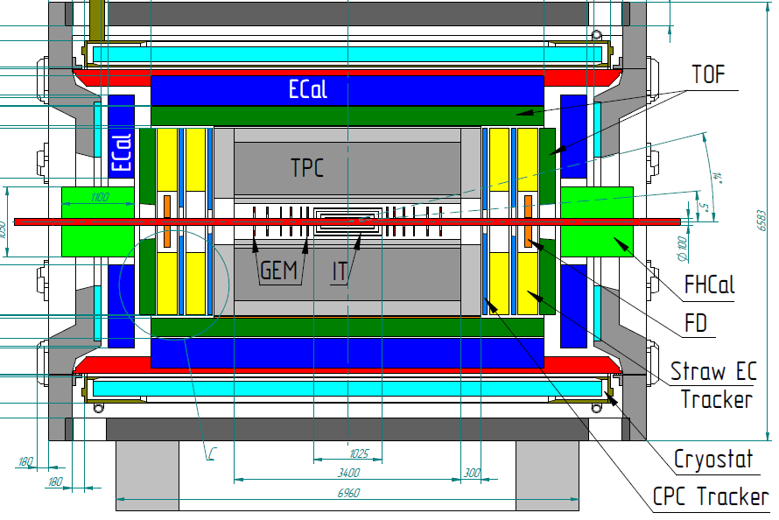
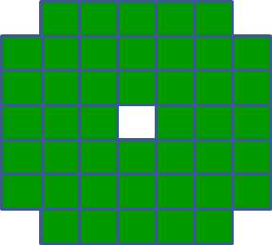
The forward hadron calorimeter in MPD setup
Tasks: detection of spectators to measure the geometry of heavy ion collisions:
The centrality of the collision;
b) The reaction plane orientation.
FHCAL
Two arms of hadron calorimeters at opposite sides in forward regions.
At the distance 3.2 meters from the interaction point.
Available acceptance corresponds to pseudorapidity 2.0<η <5.0
FHCAL consists of 2x44 modules of ~1.1x1.1 m² each part.

Slide 3
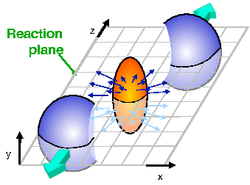
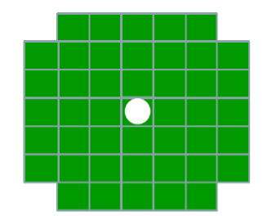
FHCal will detect the spectators to measure the geometry of ion collisions.
Event plane
FHCAL
Spectator spot
FHCal will detect the energy of spectators;
FHCal will detect the space distribution of the spectators.
FHCal will detect the total energy of ALL particles in forward region;
Using the energy and space distribution of spectators one can determine the event plane as an experimental estimate of the reaction plane.

Slide 4
Structure of FHCal – two left/right arms.
Modular Lead/Scintillator sandwich compensating calorimeter. Sampling ratio Pb:Scint=4:1.
Each arm:
44 modules;
Beam hole;
Weight – 9 tons.
Each module:
Transverse size - 15x15cm² ;
Total length - 106 cm.
Interaction length ~4 λ_{int};
Longitudinal segmentation – 7 sections;
1 section ~ 0.56λ_{int};
7 photodetectors/module;
Photodetectors – silicon photomultipliers (SiPM).
Light from scintillator tiles is captured by WLS-fibers and transported to SiPM.

Slide 5
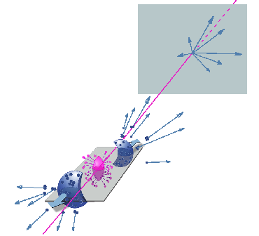
How to reconstruct the event plane with FHCal.
(x_{i} ,y_{i}) – coordinates and E_{i} -energy of i-module.
spectators
Event plane in first FHCal arm.
Event plane in full FHCal.
Event plane in second FHCal arm.
Detection of all types of the spectators (protons, neutrons) for both colliding nuclei would ensure the outstanding angular resolution of the event plane!

Slide 6
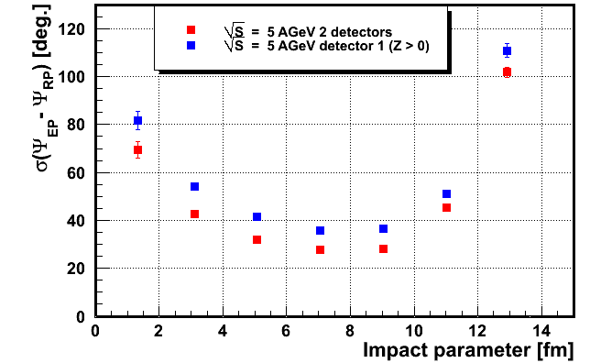
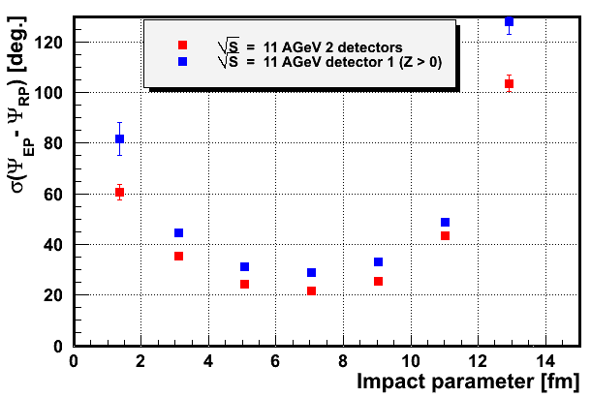
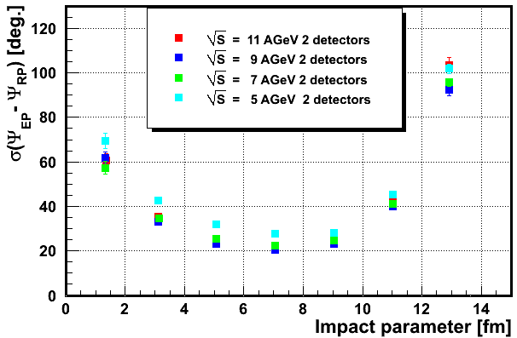
Angular resolution of the reconstructed event plane.
Independent measurements of the spectators in both arms of FHCal improves the resolution for a factor of 1.4.
For the maximum beam energy the angular resolution achieves 20⁰!

Slide 7
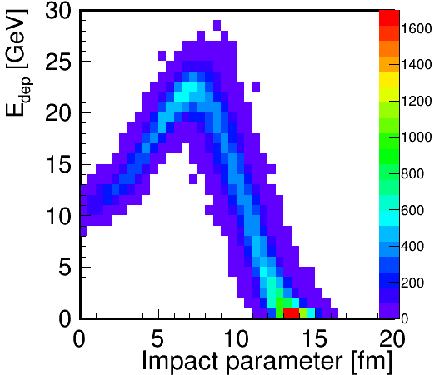
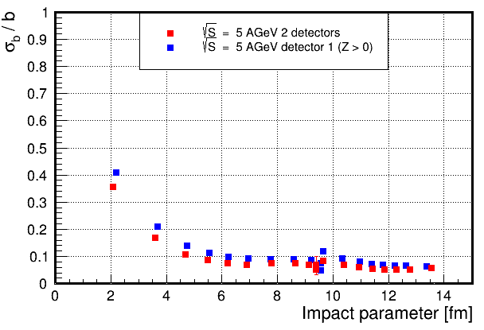
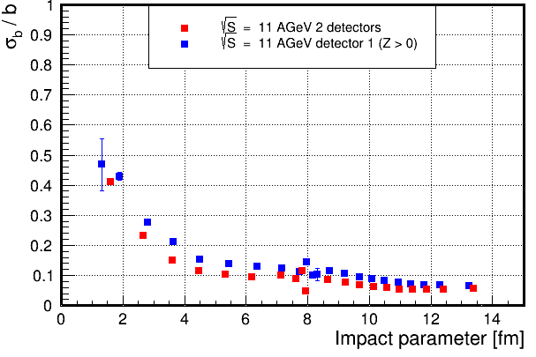
Centrality. Problem with energy depositions in FHCAL.
Effect of beam hole and escape of heavy fragments.
Energy deposition in FHCal isn’t monotonic due to beam hole and can’t resolve the central and peripheral events.
Ambiguity in the centrality measurements might be resolved by using the TPC multiplicity.
It is not good for fluctuations study.
Resolution of impact parameter for different FHCal energy (centrality) bins.
Other approaches are requested!

Slide 8
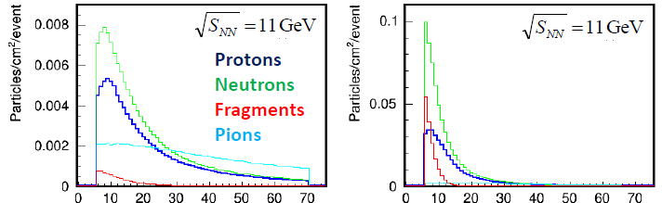
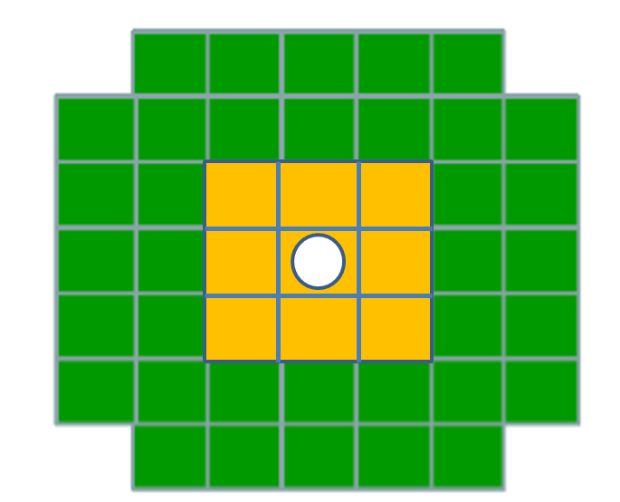
Can FHCal space information be used for the centrality measurement?
Occupancy of particles at front of FHCal
B<6 fm
b>6 fm
R, cm
R, cm
Cone for central events
Cone for peripheral events
Depending on centrality there must be difference in the energy depositions in inner and outer parts of calorimeter.

Slide 9
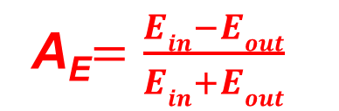
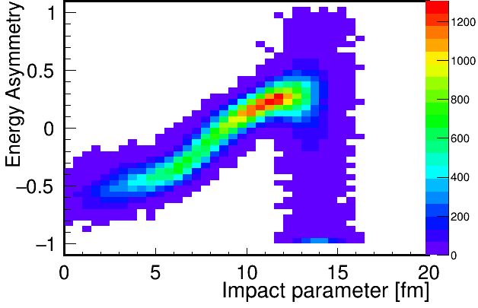
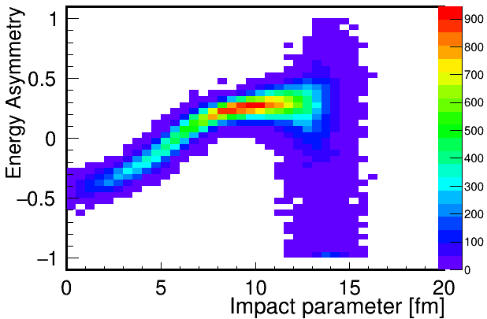
Other FHCal observable for the centrality measurement.
E_{out}
Let’s introduce energy asymmetry:
E_{in}
Dependence of A_{E} on impact parameter.
A_{E} is experimental observable and has clear dependence on centrality. Let’s combine it with energy deposition in FHCal.

Slide 10
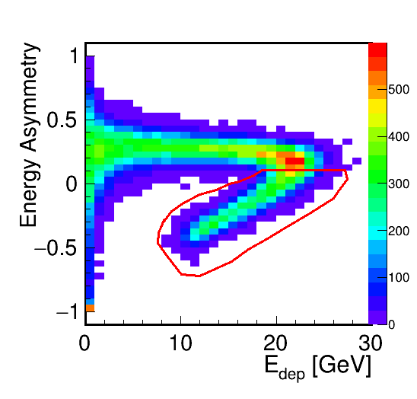
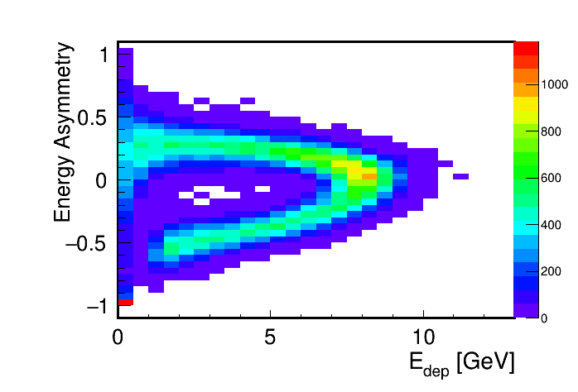
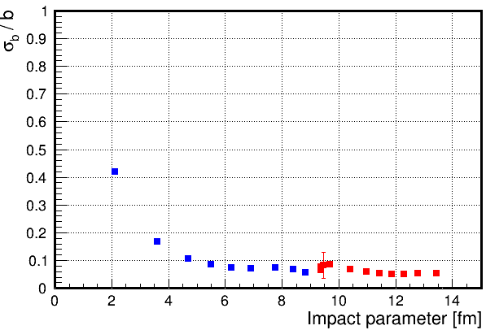
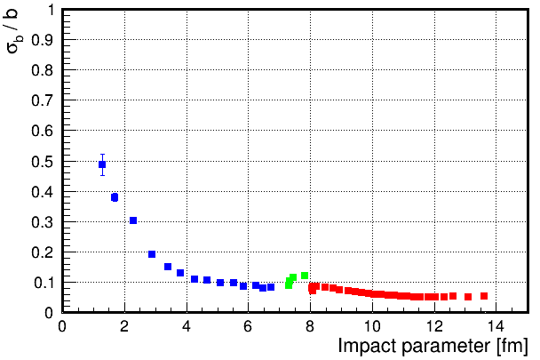
Measurements of centrality with two FHCal observable.
Peripheral events
Peripheral events
0.1
Central events
Central events
Using only FHCal the centrality resolution is below 10% excepting the most central, where the fluctuations of spectator energies dominate.

Slide 11



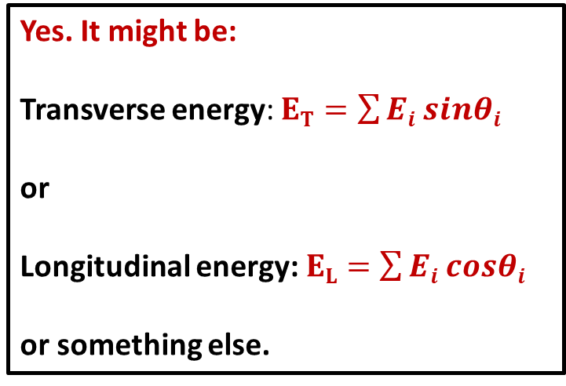
Can we construct new observables in FHCal for the centrality measurement?
Cone for central events
$$Ei$$
Yes. It might be:
Transverse energy: $ET=\sum{Ei sinθi}$
or
Longitudinal energy: $EL=\sum{Ei cosθi}$
or something else.
$$θ$$
$$Ei$$
Cone for peripheral events
E_{T} /E_{L} would depend on centrality as well as on the properties of fireball.
Fine transverse/longitudinal segmentation of FHCal (and NICA energies) allow the construction of new experimental observables.
Can FHCal probe the physics models?

Slide 12
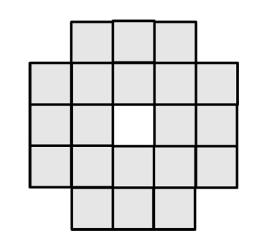
The FHCAL geometry is optimized according to requirements.
First variant:
Extended HCAL of 120 modules with high granularity
Second variant:
Compact ZDC of 20 modules with high granularity.
transverse sizes 10x10 cm²
Interaction length Λ_{i}~20 cm defines both longitudinal and transverse sizes of hadron shower.
Simple, cheap.
Low acceptance,
Poor event plane resolution,
Problem with centrality,
Excessive segmentation.
Final structure
High acceptance,
Nice event plane resolution.
Very expensive,
Complicated,
Excessive segmentation.
transverse sizes 15x15 cm²
FHCAL of 44 modules:
Optimum segmentation, High acceptance,
Nice event plane resolution, Centrality measurement,
Reasonably simple and cheap.
But can other detectors (e.g. Forward Scintillator Wall) be so efficient as FHCal?

Slide 13
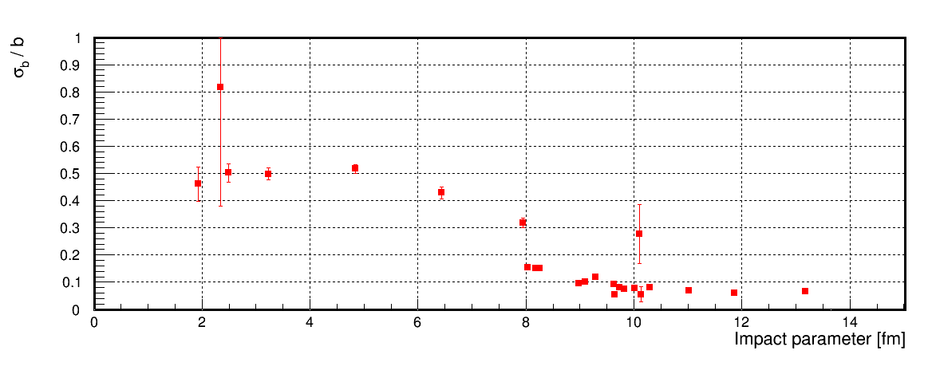
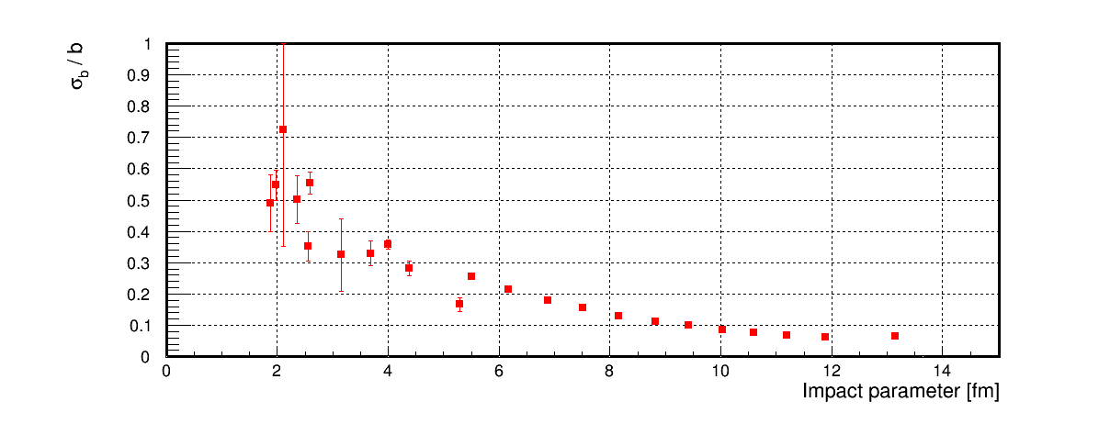
Consideration of Forward Wall for centrality measurements.
FW has outer diameter 140 cm and inner diameter 10 cm.
Each cell of FW equals to 5x5 cm².
About 1200 cells (600 from each side) were considered.
Resolution of impact parameter is a factor of 2-3 worse comparing with FHCal option.

Slide 14
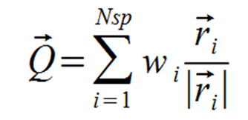
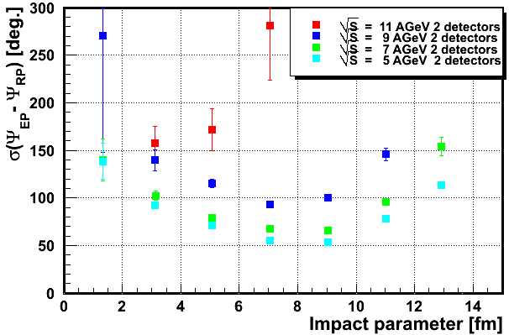
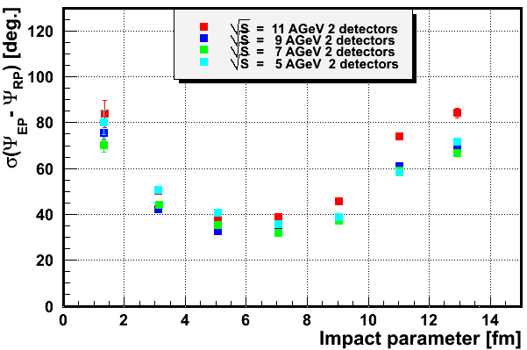
Angular resolution of event plane for FW at different energies.
Weight w_{i} was taken as 1. or as a energy deposition E_{i} in given FW i-cell.
Only charged spectators (protons and fragments)
All charged particles (including pions)
Weight w_{i}=1.
The best resolution of event plane is about 30⁰-40⁰ in case of charged spectators only.
For all charged particles the resolution increases to 50⁰-60⁰ for low energies and is drastically worse at highest energy.
It is a factor of 3 worse comparing to FHCal option.

Slide 15
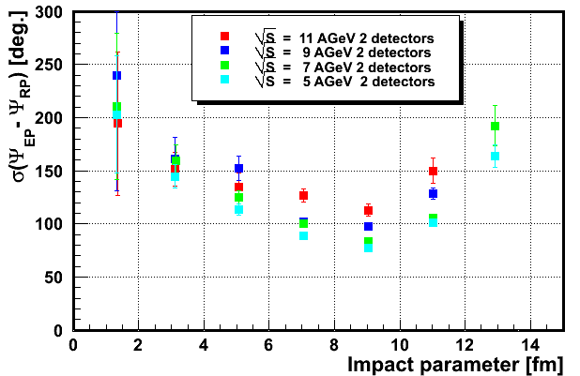
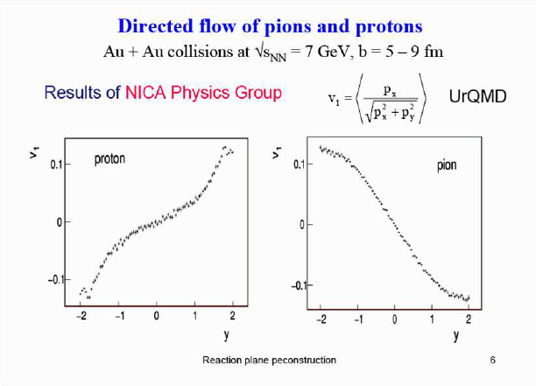
Why pions spoil the event plane resolution?
If weight w_{i}=E_{i} then the resolution for the highest energy is better,
but it is worse for low energies.
The resolution degradation is due to the fact that protons and pions have an opposite signs of v₁ flow.

Slide 16
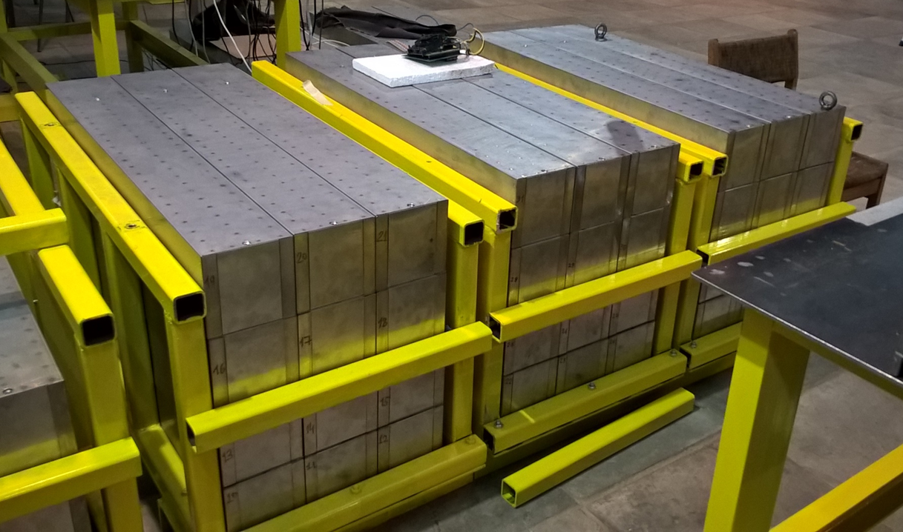
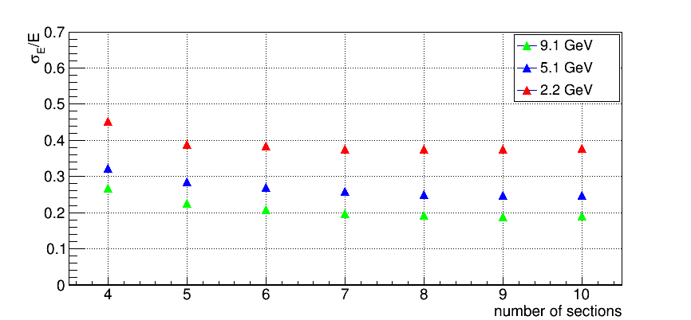
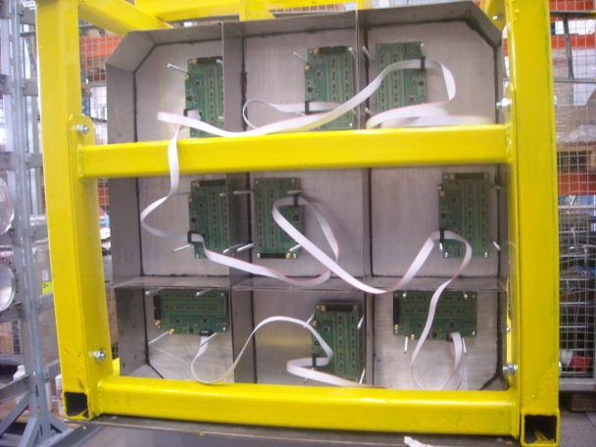
Status of FHCal.
At present, about half of FHCal modules are ready for the tests.
All FHCal modules will be ready in 2019.
Beam tests at NICA energies confirmed the predicted energy resolution and the optimum FHCal module geometry.
7 sections in FHCal modules

Slide 17
Conclusion.
FHCal at MPD is unique tool for the measurements of the geometry of heavy ion collisions.
Due to the detection of all spectator types (protons, neutrons, fragments) of both colliding nuclei the angular resolution of the event plane achieves 20⁰.
The beam hole in FHCal makes a serious problem with the centrality measurements because of the leak of heavy fragments.
The angular (space) distribution of the spectator deposited energy resolves the ambiguity in the energy deposition for central and peripheral events.
New experimental observables might be constructed to improve the centrality measurements.
As additional function, FHCal will be used for the tuning of heavy ion beams at the earliest stage of MPD operation.

Slide 18
Thank you!

Slide 19
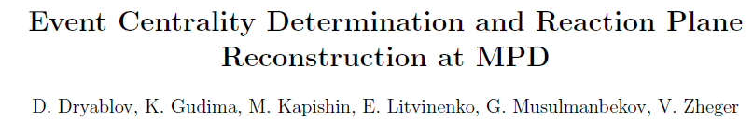
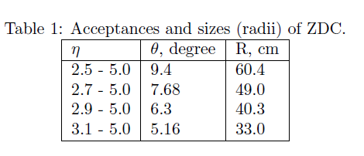
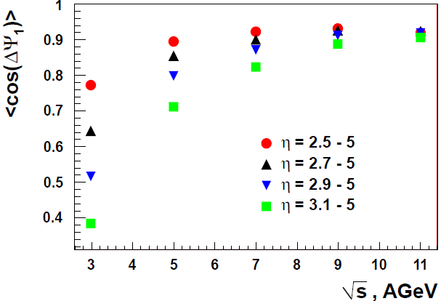
Influence of FHCal acceptance at event pane reconstruction.
Calorimeter with diameter 100-120 cm has an appropriate accuracy in event plane reconstruction in all range of beam energies.

Slide 20
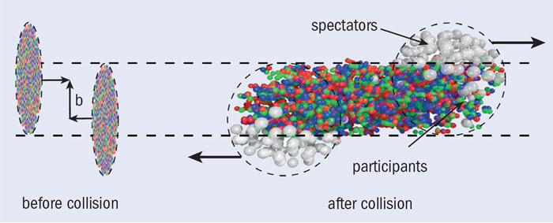
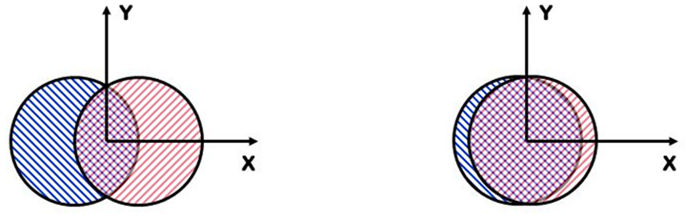
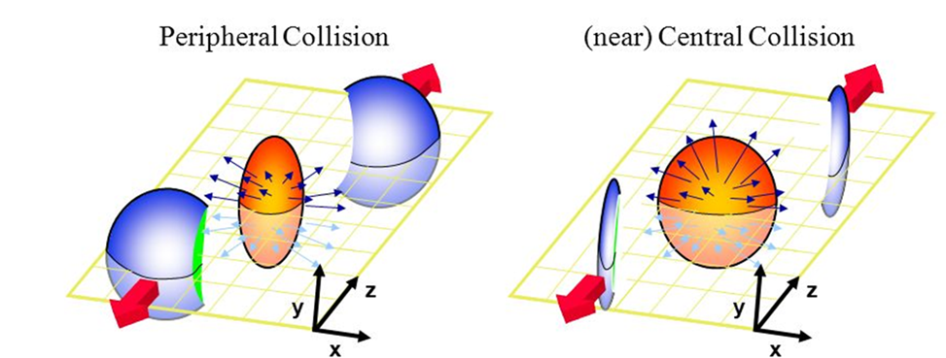
Spectators in centrality and reaction plane measurements.
spectators
Reaction plane:
plane of b and Z (beam).
Spectators are effective tool in the measurements of centrality and the reaction plane of collisions.

Slide 21
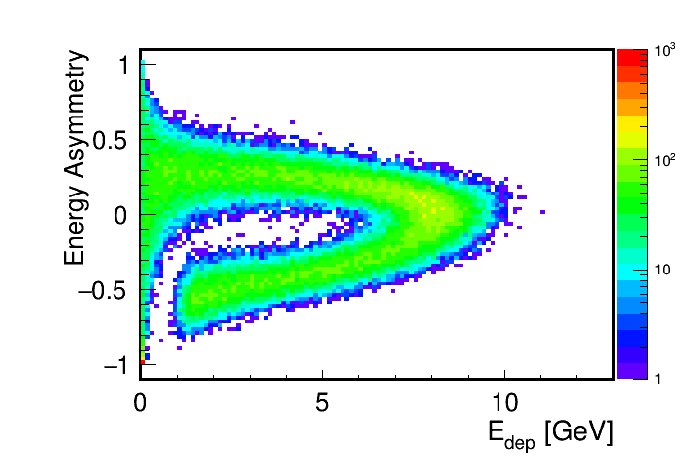
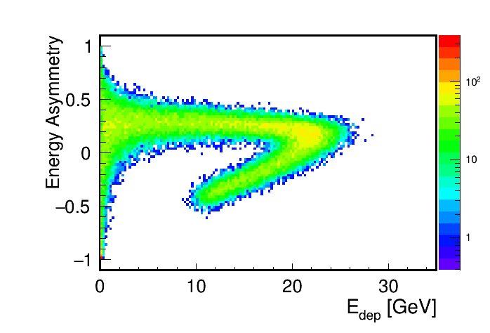

Slide 22
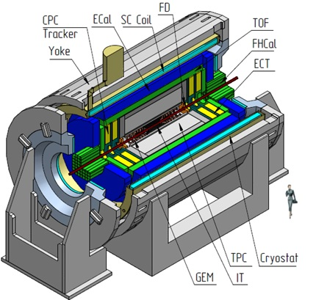
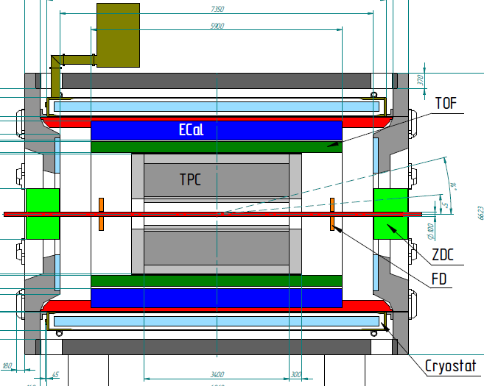
Multi Purpose Detector (MPD).
1st stage
FHCal
ITS
TPC
Notes:
The MPD will be the fist detector operated at the Collider. Main target is …..
The collaboration is permanently growing.

Slide 23
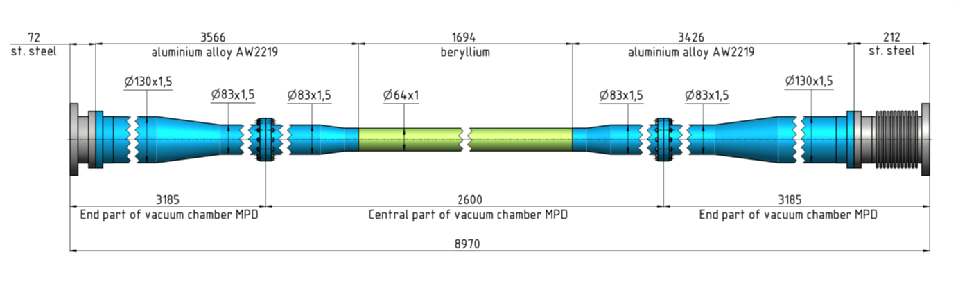
beam pipe

Slide 24
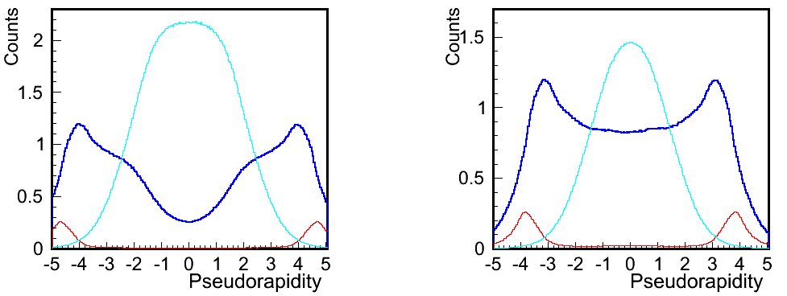
Can be FHCal space information used for the centrality measurement?
Acceptance of FHCAL
Pions
Protons + neutrons
Fragments

