Slide 1
Programme Advisory Committee for Nuclear Physics
47-th meeting
17–18 January 2018
Marek Lewitowicz

Slide 2
Programme
1. Opening of the meeting M. Lewitowicz
2. Implementation of the recommendations of the previous PAC meeting M. Lewitowicz
3. Information on the Resolution of the 120th session of the JINR Scientific Council (September 2017)
and on the decisions of the JINR Committee of Plenipotentiaries (November 2017) M. Itkis
4. Report on the theme "Non-Accelerator Neutrino Physics and Astrophysics" and proposals for their extension:
4.1 Project GERDA (G&M) K. Gusev
4.2 Project SuperNEMO Yu. Shitov
4.3. Project BAIKAL I. Belolaptikov
4.4. Projects conducted at the Kalinin Nuclear Power Plant:
4.4.1. Project DANSS V. Egorov
4.4.2. Project GEMMA-III A. Lubashevsky
4.5. Project EDELWEISS-LT, summary on the theme "Non-Accelerator Neutrino Physics and Astrophysics"
and proposals for their extension E. Yakushev
5. Visit to the Dzhelepov Laboratory of Nuclear Problems
6. Status of the Factory of Superheavy Elements V. Semin,
A. Popeko
7. Commissioning of the ACCULINNA-2 fragment separator A. Fomichev
8. Report on the theme "Theory of Nuclear Structure and Nuclear Reactions" and proposal for a new theme N. Antonenko
9. Scientific reports:
9.1. "Study of vorticity and hyperon polarization in nuclear collisions within the NICA energy range“ V. Toneev
9.2. "Application of multinucleon transfer reactions to the synthesis of neutron-rich nuclei“ A. Karpov
9.3. "Neutron activation analysis of arsenic and mercury content in human remains of the XVI-XVI A. Dmitriev
centuries from the Moscow Kremlin necropolis“
10. General discussion
11. Meeting of the PAC members with the JINR Directorate (closed discussion)
12. Poster presentations by young scientists
13. Presentation of the PAC recommendations

Slide 3
The theme “Non-Accelerator Neutrino Physics and Astrophysics”
The theme is devoted to the studies of rare phenomena associated with the weak interaction by methods of modern nuclear spectroscopy.
Theme “Non-Accelerator Neutrino Physics and Astrophysics” consists of six projects.
Projects:
GERDA (G&M) SuperNEMO projects | search for neutrinoless double-beta decay
DANSS GEMMA-III | experiments with reactor antineutrinos
EDELWEISS-LT | direct search for dark matter particles
BAIKAL-GVD | investigations of high-energy neutrinos from space with the deep-water neutrino telescope at Lake Baikal

Slide 4
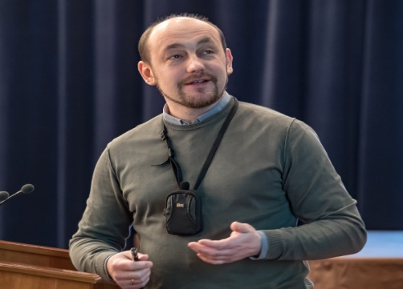
Project GERDA (G&M)
GERDA (G&M) project is dedicated to search for the neutrinoless double-beta decay of ⁷⁶Ge with open Ge-detectors directly immersed in liquid argon.
Konstantin Gusev
Phase-II of the experiment (2015–2021) is being performed by the GERDA collaboration. The most important feature of this phase is the liquid argon instrumentation surrounding the detector array to readout of scintillation light creating an effective active veto system.
The total mass of the ⁷⁶Ge isotope is 38 kg. An unprecedent background level of 0.001 counts/(keV ∙ kg ∙ yr) has been achieved.
The analysis of data collected in 2016–2017 allowed setting a new half-life limit with the world-best sensitivity on the neutrinoless double-beta decay of ⁷⁶Ge > 8.0∙10²⁵ years.
A part of the report was dedicated to the new generation ton-scale ⁷⁶Ge experiment LEGEND, which has been recently started. In this experiment, it is planned to achieve an ultimate sensitivity of 10²⁸ years.

Slide 5
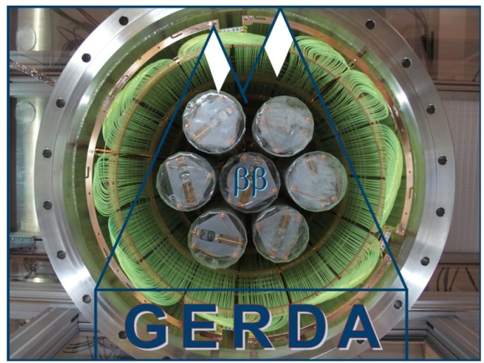
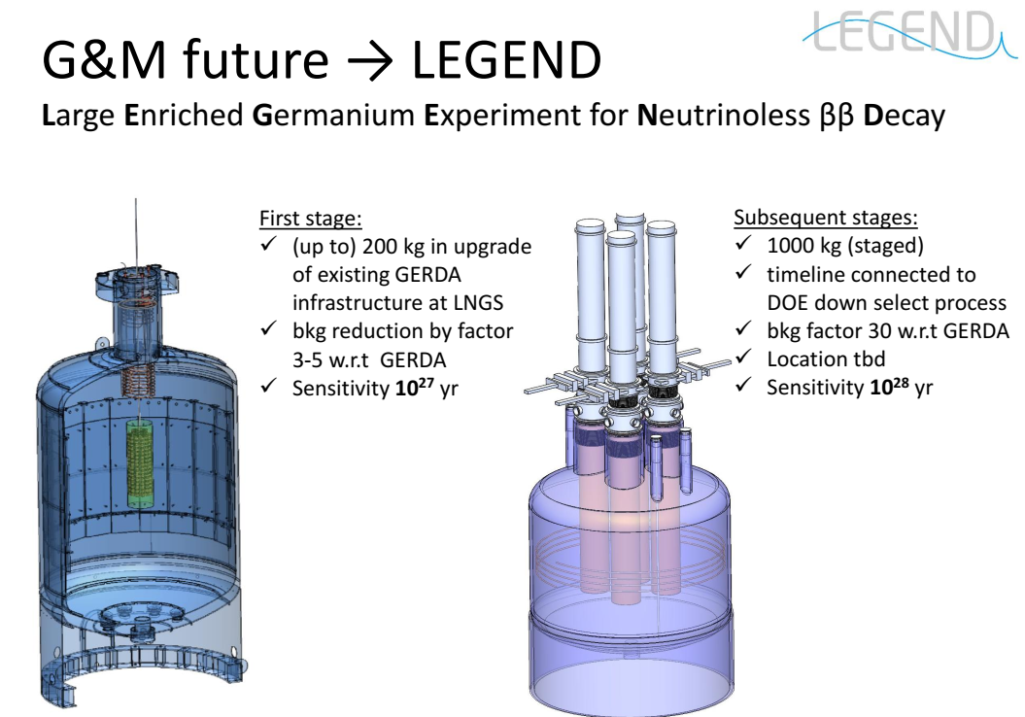
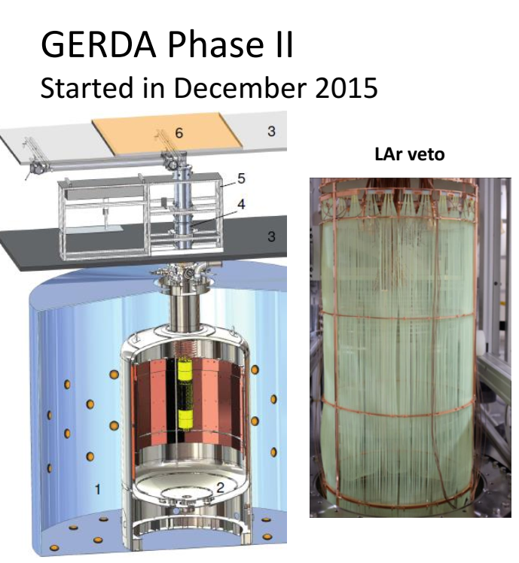
Recommendation:
The PAC recommends continuation of the GERDA project and participation in the LEGEND project in 2019–2021

Slide 6
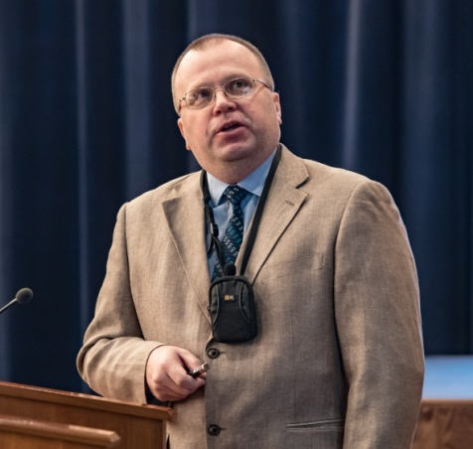
Project SuperNEMO
The long-term successful participation of JINR in the NEMO experiment has led to the fundamental world-level results for the two-neutrino and neutrinoless double-beta decay of enriched isotopes ⁴⁸Ca, ⁸²Se, ⁹⁶Zr, ¹⁰⁰Mo, ¹¹⁶Cd, ¹³⁰Te and ¹⁵⁰Nd (measurements at the NEMO-3 spectrometer).
Yuri Shitov
The new-generation SuperNEMO detector will have a modular design (20 modules) with the ability to simultaneously measure several isotopes at a sensitivity level to the half-life T_{1/2} (2β0ν) ≥ 10²⁶ years.
In the first module of the SuperNEMO (the demonstrator), 7 kg of ⁸²Se are used.
JINR plays a key role in the project, especially in constructing
  the calorimeter,
  the VETO system,
  modeling and data processing programs,
  in developing methods for the purification of isotopes.
  The PAC expresses its confidence that JINR will continue to make a significant contribution to the construction of the SuperNEMO detector and its demonstrator.

Slide 7
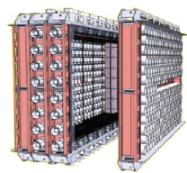
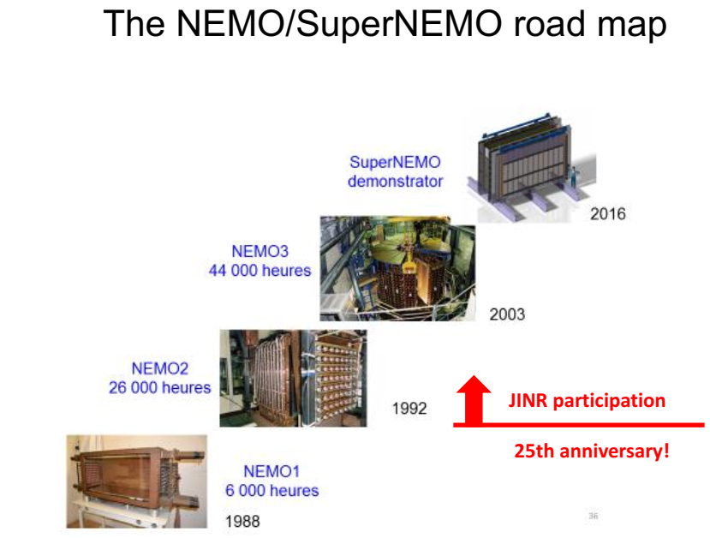
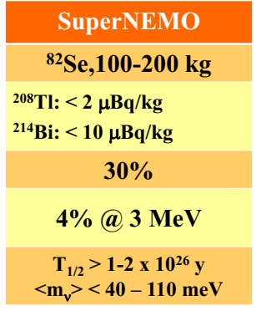
Recommendation.
The PAC recommends continuation of the SuperNEMO project in 2019–2021.

Slide 8
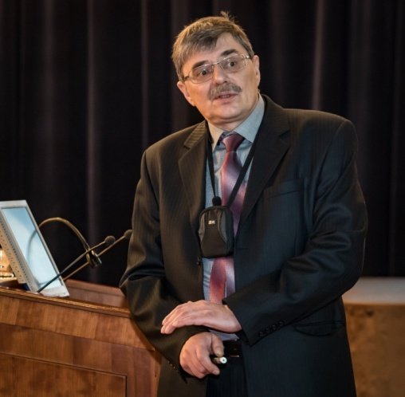
Project BAIKAL
The PAC
  heard a report and proposal for extension of the project of deep-water investigations with the neutrino telescope at Lake Baikal (project BAIKAL)
  underlines the important role played by the BAIKAL project together with the IceCube experiment to study the high-energy neutrino flux from all directions of the sky.
Igor Belolaptikov
The presented second stage of the BAIKAL-GVD gigaton neutrino detector will be a new research infrastructure aimed primarily at studying astrophysical neutrino fluxes.
The first step of BAIKAL-GVD was finished in 2015, when the first demonstration cluster called “Dubna” was accomplished.
During 2016–2017, the BAIKAL collaboration deployed two full-scale clusters with 576 optical modules.
At the end of 2021, the collaboration is planning to put into operation 10 clusters with 2880 optical modules. This will allow about 30 extraterrestrial events with energies above 100 TeV to be accumulated for detailed investigations of “IceCube signal”.

Slide 9

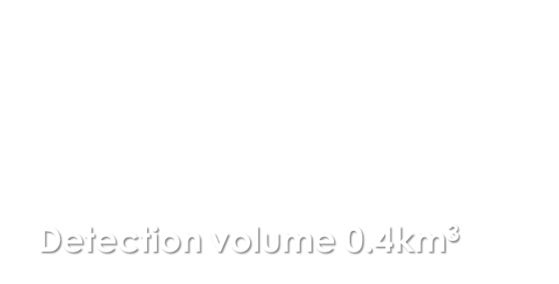


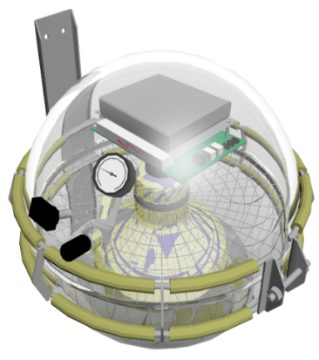
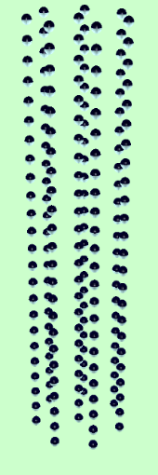
Deployment plan for expedition 2018
April 2017
Taking data
April 2016
Taking data
300 m
~600 m
“Dubna”
Demonstration
Cluster (2015)
~1 km
120 m
Recommendation.
The PAC recommends continuation of the BAIKAL project in 2019–2023 and expects a publication of the first results in due time.

Slide 10
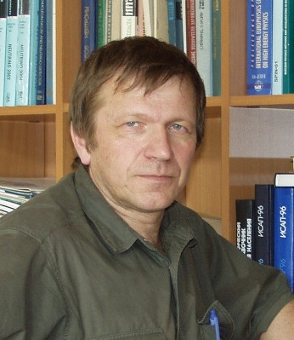
DANSS
The PAC heard a report on the progress of the DANSS experiment with reactor neutrinos performed at the Kalinin Nuclear Power Plant (Kalinin NPP).
The aim of the project:
searching for short-range neutrino oscillation to a sterile state using a relatively compact neutrino detector which does not meet any restrictions against location close to an industrial power reactor.
Vycheslav Egorov
The DANSS spectrometer has been recently assembled, launched and adjusted
The final answer about existence of the so-called “reactor anomaly” is expected to be obtained in 2018.
During 2019–2021, it is planned, first, to widen the range of the DANSS sensitivity for the oscillation parameters and, second, to perform precise measurement of the neutrino energy spectrum as a function of time and fuel composition.
It is also proposed to contribute to a common JINR–NEOS (CUP IBS, Daejeon, Korea)–Neutrino4 (PNPI, Gatchina, Russia) construction of an additional detector near the SM3 research reactor at NIIAR (Dimitrovgrad, Russia) which could measure neutrino spectrum at 5-18 m distances, thus expanding the oscillation parameter region.

Slide 11
Modular structure provides 3d pattern of each IBD event
It is planned to develop and construct two new neutrino detectors S³ (S-cube)
They would be:
  smaller, simpler and cheaper than DANSS;
  have better energy resolution;
  detect about 300-400 IBD events per day each;
The first of them will be constructed by IEAP CTU (Prague) and installed at the Temelín NPP (Czech Republic);
The second one will operate parallel to DANSS at the Kalinin NPP, thus providing more reliable reactor monitoring.
25 Y-Modules
25 X-Modules
2500 independent scintillator strips
Recommendation.
The PAC recommends continuation of the DANSS project in 2019–2021, including JINR’s collaboration with the NEOS and Neutrino4 projects, as well as the development and construction of two small S³ detectors

Slide 12
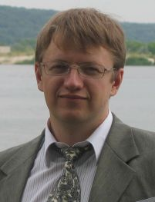
Project GEMMA
The PAC heard a report on the progress of the GEMMA project experiments with reactor neutrinos performed at the Kalinin NPP
The aim of the project:
investigate reactor neutrino properties using high-purity low-threshold germanium detectors.
Alexey Lubashevskiy
the experiments search for the magnetic moment of neutrino (MMN) and coherent elastic neutrino-nucleus scattering (CENNS).
Currently, an experimental set-up is being constructed at the Kalinin NPP.
Within the GEMMA-III project, it is planned to use four new low-threshold detectors (threshold ~ 200 eV) with a total mass of about 5.5 kg.
The experimental set-up will be located under reactor core No.3 at the Kalinin NPP where the distance from the centre of the core is only 10 m leading to an enormous antineutrino flux of > 5⋅10¹³ antineutrino/(cm²⋅s).
After all improvements it is planned to detect about 190 events from CENNS per day, which would allow using this process to study neutrino properties and to monitor the nuclear reactor. It is expected to reach sensitivity to the MMN at a level of 9⋅10⁻¹²μ_{B} after several years of measurements and thus to reach the region of astrophysical interest.

Slide 13
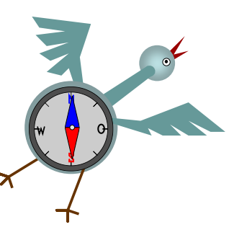
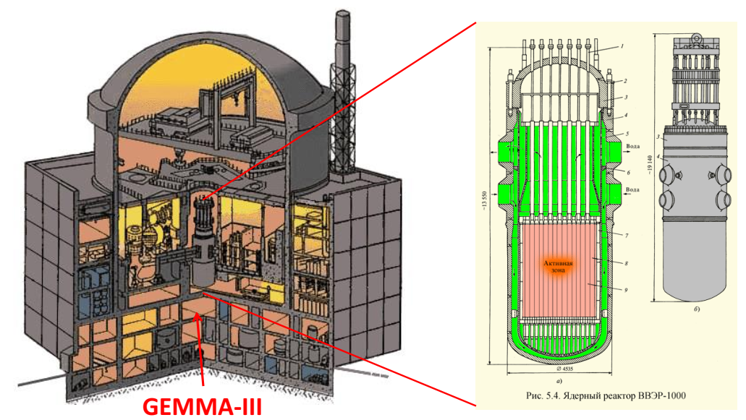
Neutrino source
Recommendation.
The PAC recommends continuation of the GEMMA-III project in 2019–2021.
The leading role of the JINR group in this experiment is highly appreciated.

Slide 14
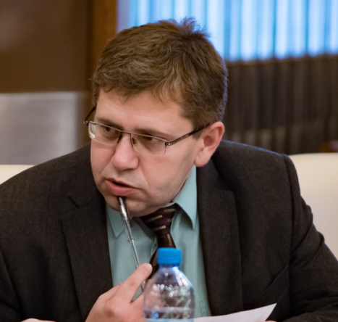
Project EDELWEISS-LT
In the experiment, innovative cryogenic HPGe bolometers installed in a low-background set-up are used for the direct search of weakly interacting massive particles (WIMP) from the galactic halo considered to be the main candidates for the role of dark matter. The main objective of the new phase of the experiment named EDELWEISS-LT is to search for spin-independent scattering on nucleons of the so-called light WIMPs with a mass below 10 GeV/c².
Evgeny Yakushev
The PAC notes with satisfaction that the participation in this project provides JINR an important access to the entire low-background infrastructure of EDELWEISS, including the LSM (Modane Underground Laboratory): one of deepest underground laboratories in the world.
Recommendation.
The PAC recommends continuation of the research programme for the direct search of dark matter particles in the EDELWEISS-LT project in 2019–2021.

Slide 15
Summary on the theme “Non-Accelerator Neutrino Physics and Astrophysics”
The PAC heard a summary presented by Evgeny Yakushev on the implementation of the theme “Non-Accelerator Neutrino Physics and Astrophysics” consisting of the above six projects.
The PAC is pleased to note the world-leading results obtained in all these projects.
The PAC supports the general direction in which the theme is developing, when the participation in highly prestigious international projects provides an access to know-how for the development of home-based neutrino experiments at two basic facilities – the laboratories located at the Kalinin NPP and at Lake Baikal.
General recommendations.
The PAC recommends that support of these experiments be rigorously continued. The PAC is aware about the lack of human resources at JINR for the BAIKAL experiment which can be a problem for a full involvement in the data analysis. It strongly advises to extend international contacts with the KM3NET collaboration to develop common synergies to become part of the ESFRI and APPEC roadmaps.
The PAC recommends that cooperation be supported with deep underground laboratories taking into account the necessity to find the adequate location for both LEGEND and full SuperNEMO detector.
It underlines the necessity to continue the efforts to improve the local infrastructures at JINR and at Lake Baikal.

Slide 16
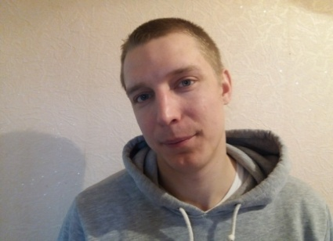
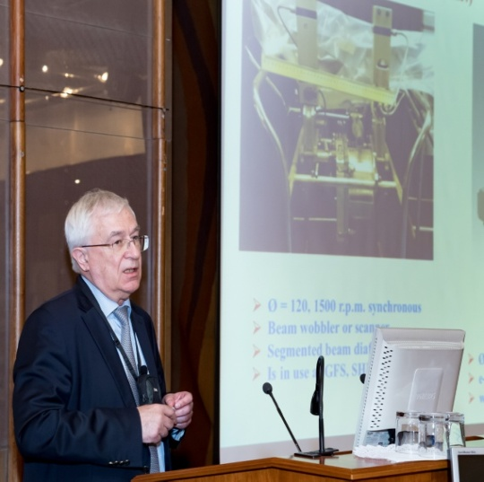
Status of the Factory of Superheavy Elements
The PAC heard a report on the progress of construction of the Factory of Superheavy Elements (SHE) presented by Vasiliy Semin and Andrey Popeko.
▪ The installation work for the DC-280 cyclotron is well advanced and is now planned to end in the first half of 2018.
▪ The start-up and adjustment is to be accomplished by mid 2018.
▪ The commissioning of the DC-280 accelerator should start by September 2018.
▪ The construction of the experimental set-ups including the target system, separators and detection systems has made a very important progress.
▪ In particular, a new gas-filled recoil separator has been manufactured and delivered to Dubna; its assembly is scheduled for January–March 2018.
▪ First test experiments are planned for October–November 2018.
Vasiliy Semin
Andrey Popeko
In addition to the technical work, an important effort of FLNR and JINR concentrates on the licensing process, which has be accomplished to begin experiments on the synthesis and studies of superheavy elements.

Slide 17
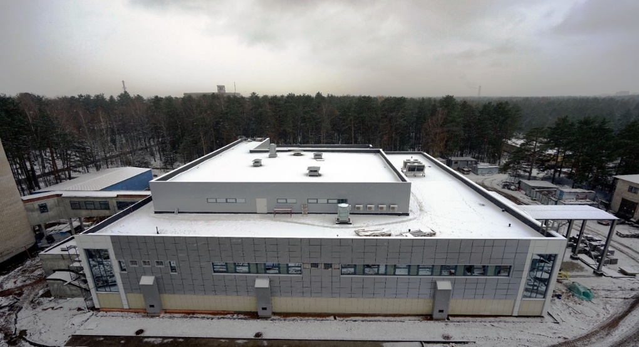
Factory of Superheavy Elements
The PAC would like to congratulate the FLNR team with the well thought-out decisions concerning the continuation of the operation of U-400 for several years in parallel to the operation of experiments at GFS-1. Both experiments, spectroscopy and reaction studies at SHELS and new elements at GFS-1, are complementary.
Recommendations.
In order to meet the deadlines for commissioning and first experiments at the SHE Factory, the PAC recommends that the JINR and FLNR Directorates provide maximum possible resources to accomplish the work for all the systems of the accelerator, the separator, the target and detection units in 2018. The licensing of the facility, which is today on the critical path, should be carefully followed by the management. Following the recommendations taken at the previous meeting, the PAC would like to hear a presentation on the methodology for the quality control for the construction and commissioning of the SHE Factory subsystems at the next PAC meeting.

Slide 18
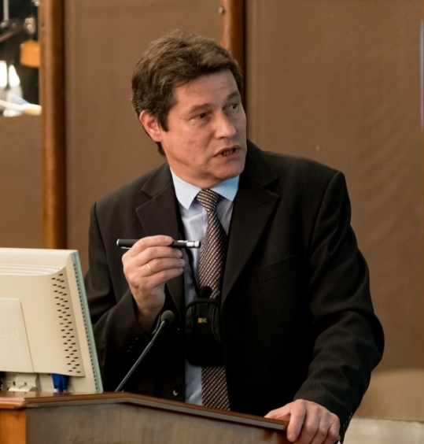
Fragment-separator ACCULINNA-2
ACCULINNA-2 was commissioned at the beam line of the U400M cyclotron.
With the ¹⁵N primary beam, the new fragment separator was tested in 2016 and 2017 to produce various secondary beams of radioactive isotopes.
Intensities of the obtained secondary beams were 25 times higher than those obtained with the previous facility ACCULINNA.
Andrey Fomichev
ACCULINNA-2 becomes the basic facility to study exotic nuclei at the Flerov Laboratory. The first experiments for the new facility are proposed to study ⁷H, ¹³Li, ¹⁷Ne, ²⁶S decaying via the 2p, 2n and 4n emissions
Recommendation.
The PAC fully supports the experimental programme for the year 2018 with the ACCULINNA-2 fragment separator. In the first measurements, a deuterium polyethylene target is planned to be used, and the PAC recommends installation of the gas target system in the ACCULINNA-2 experimental area.

Slide 19
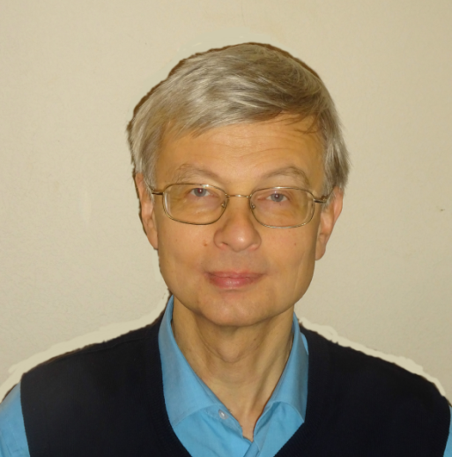
Recommendations on the concluding theme “Theory of Nuclear Structure and Nuclear Reactions” and for a new theme “Theory of Nuclear Systems”
The PAC took note of the report on the concluding theme
“Theory of Nuclear Structure and Nuclear Reactions”
(01-3-1114-2014/2018) and of the proposal for
a new theme entitled “Theory of Nuclear Systems”.
The PAC highly appreciates the results obtained in the main
research directions:
  structure of nuclei far from stability,
  nucleus-nucleus collisions at low energies,
  fusion dynamics,
  few-body systems, Nikolay Antonenko
  nuclear dynamics at relativistic energies,
  properties of hot and dense nuclear matter.
The PAC appreciates that the topics are strongly connected with the main experimental activities occurring in the main facilities at JINR and abroad. The PAC also appreciates the educational activities of BLTP.
Recommendation.
The PAC recommends closure of the theme “Theory of Nuclear Structure and Nuclear Reactions” after its completion in 2018 and approval of the new theme “Theory of Nuclear Systems” for 2019–2023. The PAC also recommends that international cooperation be tightened with other theory groups, in particular with the ECT* centre in Trento (Italy).

Slide 20
Scientific reports
The PAC heard with interest the report “Study of vorticity and hyperon polarization in heavy-ion collisions within the NICA energy range” presented by Vycheslav Toneev.
The PAC heard with great interest the report “Application of multinucleon transfer reactions to the synthesis of neutron-rich nuclei” presented by Alexander Karpov.
  This extended scientific presentation concerned a multinucleon transfer reaction model which has the capabilities to reproduce rather well the existing experimental data, including the experiments performed at JINR by the FLNR teams.
The PAC heard with great interest the report “Neutron activation analysis of arsenic and mercury content in human remains of the XVI-XVII centuries from the Moscow Kremlin necropolis” presented by Andrey Dmitriev.
  The PAC recognizes how the application of this nuclear technique can be so powerful in producing sensitive data as a strong background for historical interpretations. The PAC encourages the team to continue such special work by finalizing the present analysis and applying this method to other cases, for instance in fine arts.

Slide 21
Miscellaneous
E&T project
The PAC notes the large amount of work carried out by the authors of the E&T project to develop methods for studying the main nuclear physics parameters of the uranium assembly “Quinta” (the neutron field, the plutonium production time, the energy yield of the assembly, the transmutation rates of minor actinides) and to prepare the new programme with the uranium massive BURT target. The target has been recently installed at DLNP for irradiation with the Phasotron beam.
Recommendation:
The PAC recommends that the results obtained with the “Quinta” assembly and the future programme with the BURT target be assessed at a dedicated review meeting to be organized by the JINR Directorate.

Slide 22
Poster session
The PAC appreciated the high quality of presentations of new results and proposals by young scientists in the field of nuclear physics research.
The best posters selected are:
  “Sensitive neutron detection method using iodine-containing scintillators” presented by Dmitry Ponomarev
  “Utilization of the (p,4n) reaction potential for the production of medical isotopes with medium-energy protons: radionuclide generator 90Mo→90Nb” presented by Atanaska Marinova.
  “Active background suppression using argon scintillation for the GERDA Phase II and the LEGEND experiment” presented by Egor Shevchik.
The PAC recommended the poster
“Sensitive neutron detection method using iodine-containing scintillators”
for presentation at the session of the Scientific Council in February 2018.

Slide 23
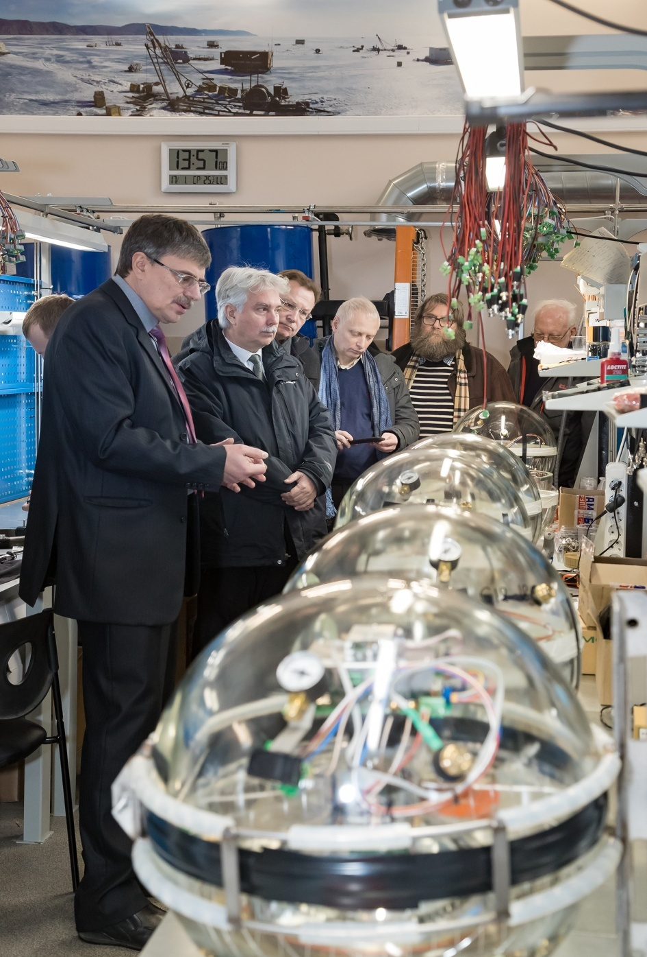
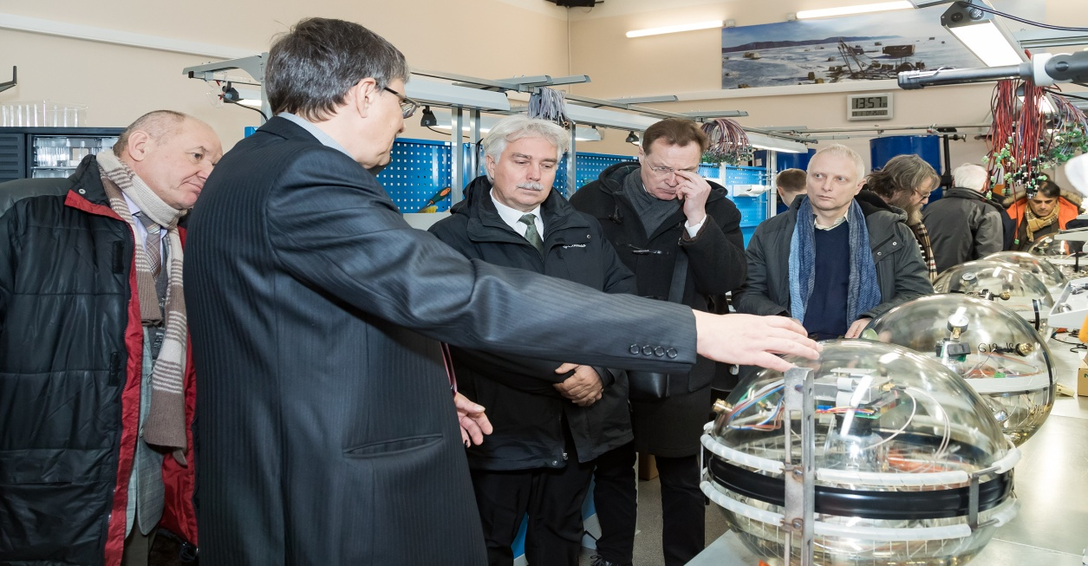
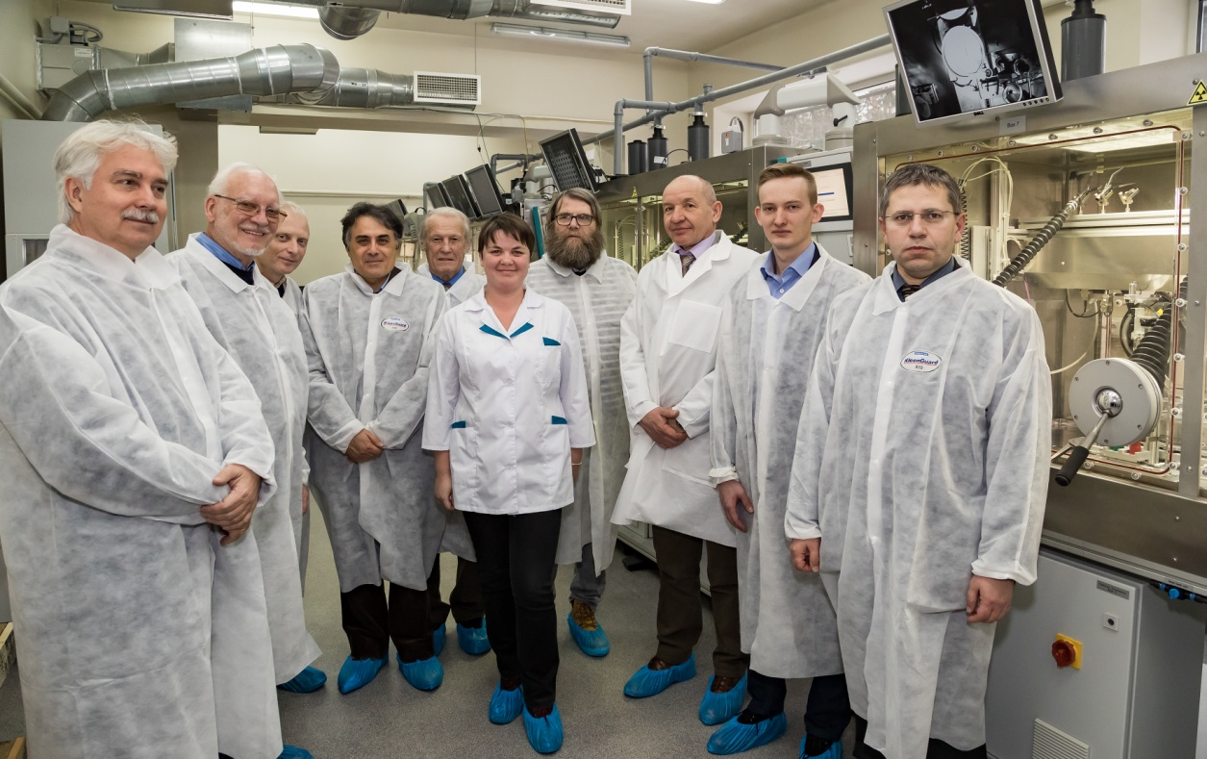
Visit to DLNP
The PAC thanks the Directorate of the Dzhelepov Laboratory of Nuclear Problems for the organization of the visit to this Laboratory.

Slide 24
Next meeting of the PAC
The next meeting of the PAC for Nuclear Physics will be held on
20-21 June 2018.
Its tentative agenda will include:
Reports and recommendations on themes and projects to be completed in 2018;
Consideration of new projects;
Poster presentations of new results and proposals by young scientists in the field of nuclear physics research;
Scientific reports.

Slide 25
THANK YOU FOR YOUR ATTENTION!

Slide 26
so-called “reactor anomaly”
NEOS
“Bump” at ~5 MeV : Daya Bay, Double Chooz, NEOS
Notes:
Before speaking about energy spectra I remind you that in several neutrino experiments (Daya Bay, Double Chooz and NEOS) they see a strange “bump” around 5 MeV which is absent in the models.

